Slide 1
Section 5.4
Inverses of Functions

Slide 2
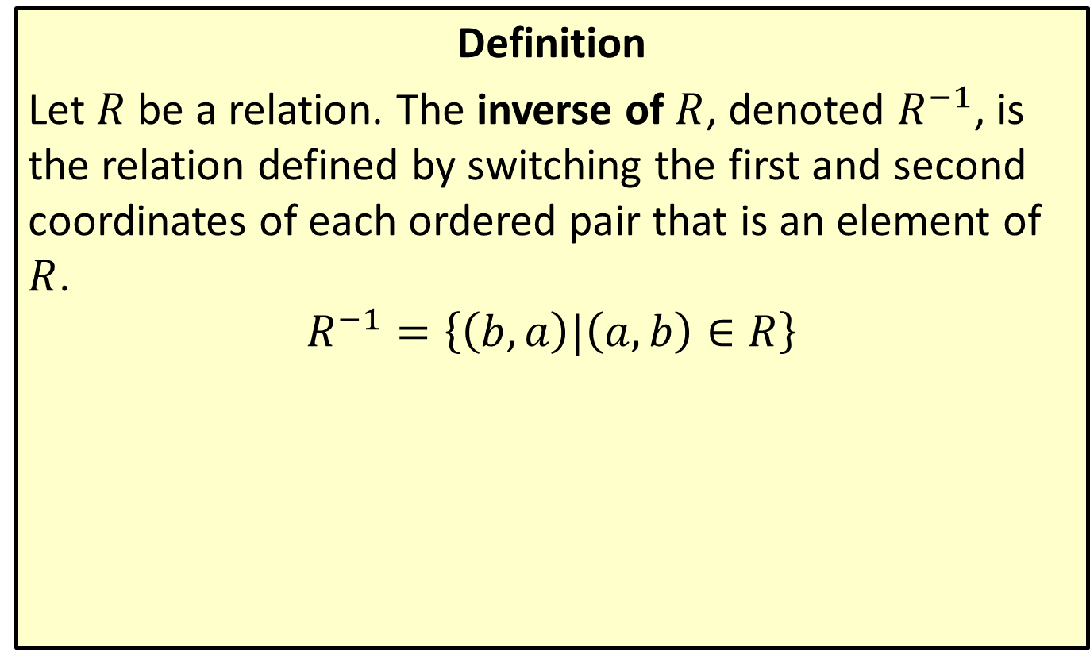
Inverse of a Relation
Definition
Let $R$ be a relation. The inverse of $R$, denoted $R^{−1}$, is the relation defined by switching the first and second coordinates of each ordered pair that is an element of $R$.
$$R^{−1}=\left\{\left(b,a\right)|\left(a,b\right)∈R\right\}$$

Slide 3

Example 1: Finding the Inverse of a Relation
Determine the inverse of each of the following relations. Then graph each relation and its inverse, and determine the domain and range of both.
​$R=\left\{\left(4,−1\right),\left(−3,2\right),\left(0,5\right)\right\}$
​$y=x^{2}$

Slide 4
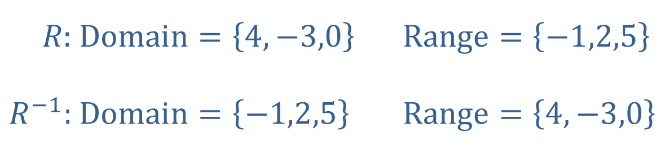
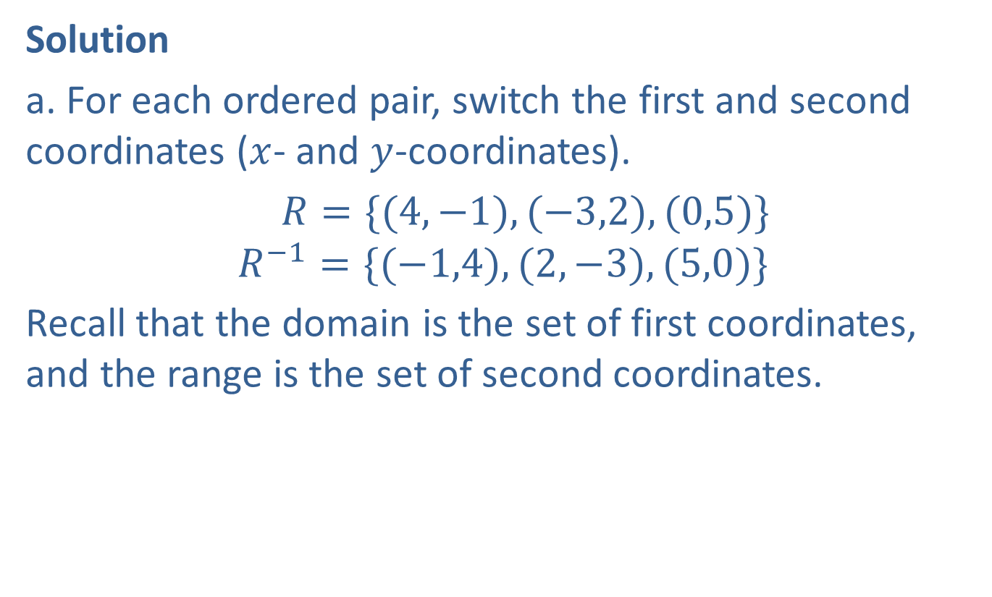
Example 1: Finding the Inverse of a Relation (cont.)
Solution
a. For each ordered pair, switch the first and second coordinates ($x$- and $y$-coordinates).
$R=\{(4,−1),(−3,2),(0,5)\}$
$$R^{−1}=\{(−1,4),(2,−3),(5,0)\}$$
​Recall that the domain is the set of first coordinates, and the range is the set of second coordinates.
​
​
​$R\text{:}$ | ​$\text{Domain}=\left\{4,−3,0\right\}$ | ​$\text{Range}=\left\{−1,2,5\right\}$
​$R^{−1}\text{:}$ | ​$\text{Domain}=\left\{−1,2,5\right\}$ | ​$\text{Range}=\left\{4,−3,0\right\}$

Slide 5

Example 1: Finding the Inverse of a Relation (cont.)
​​The relation $R$ consists of three ordered pairs, and its inverse is simply these three ordered pairs with the coordinates exchanged. Note that the domain of $R$ is the range of $R^{−1}$ and vice versa.

Slide 6
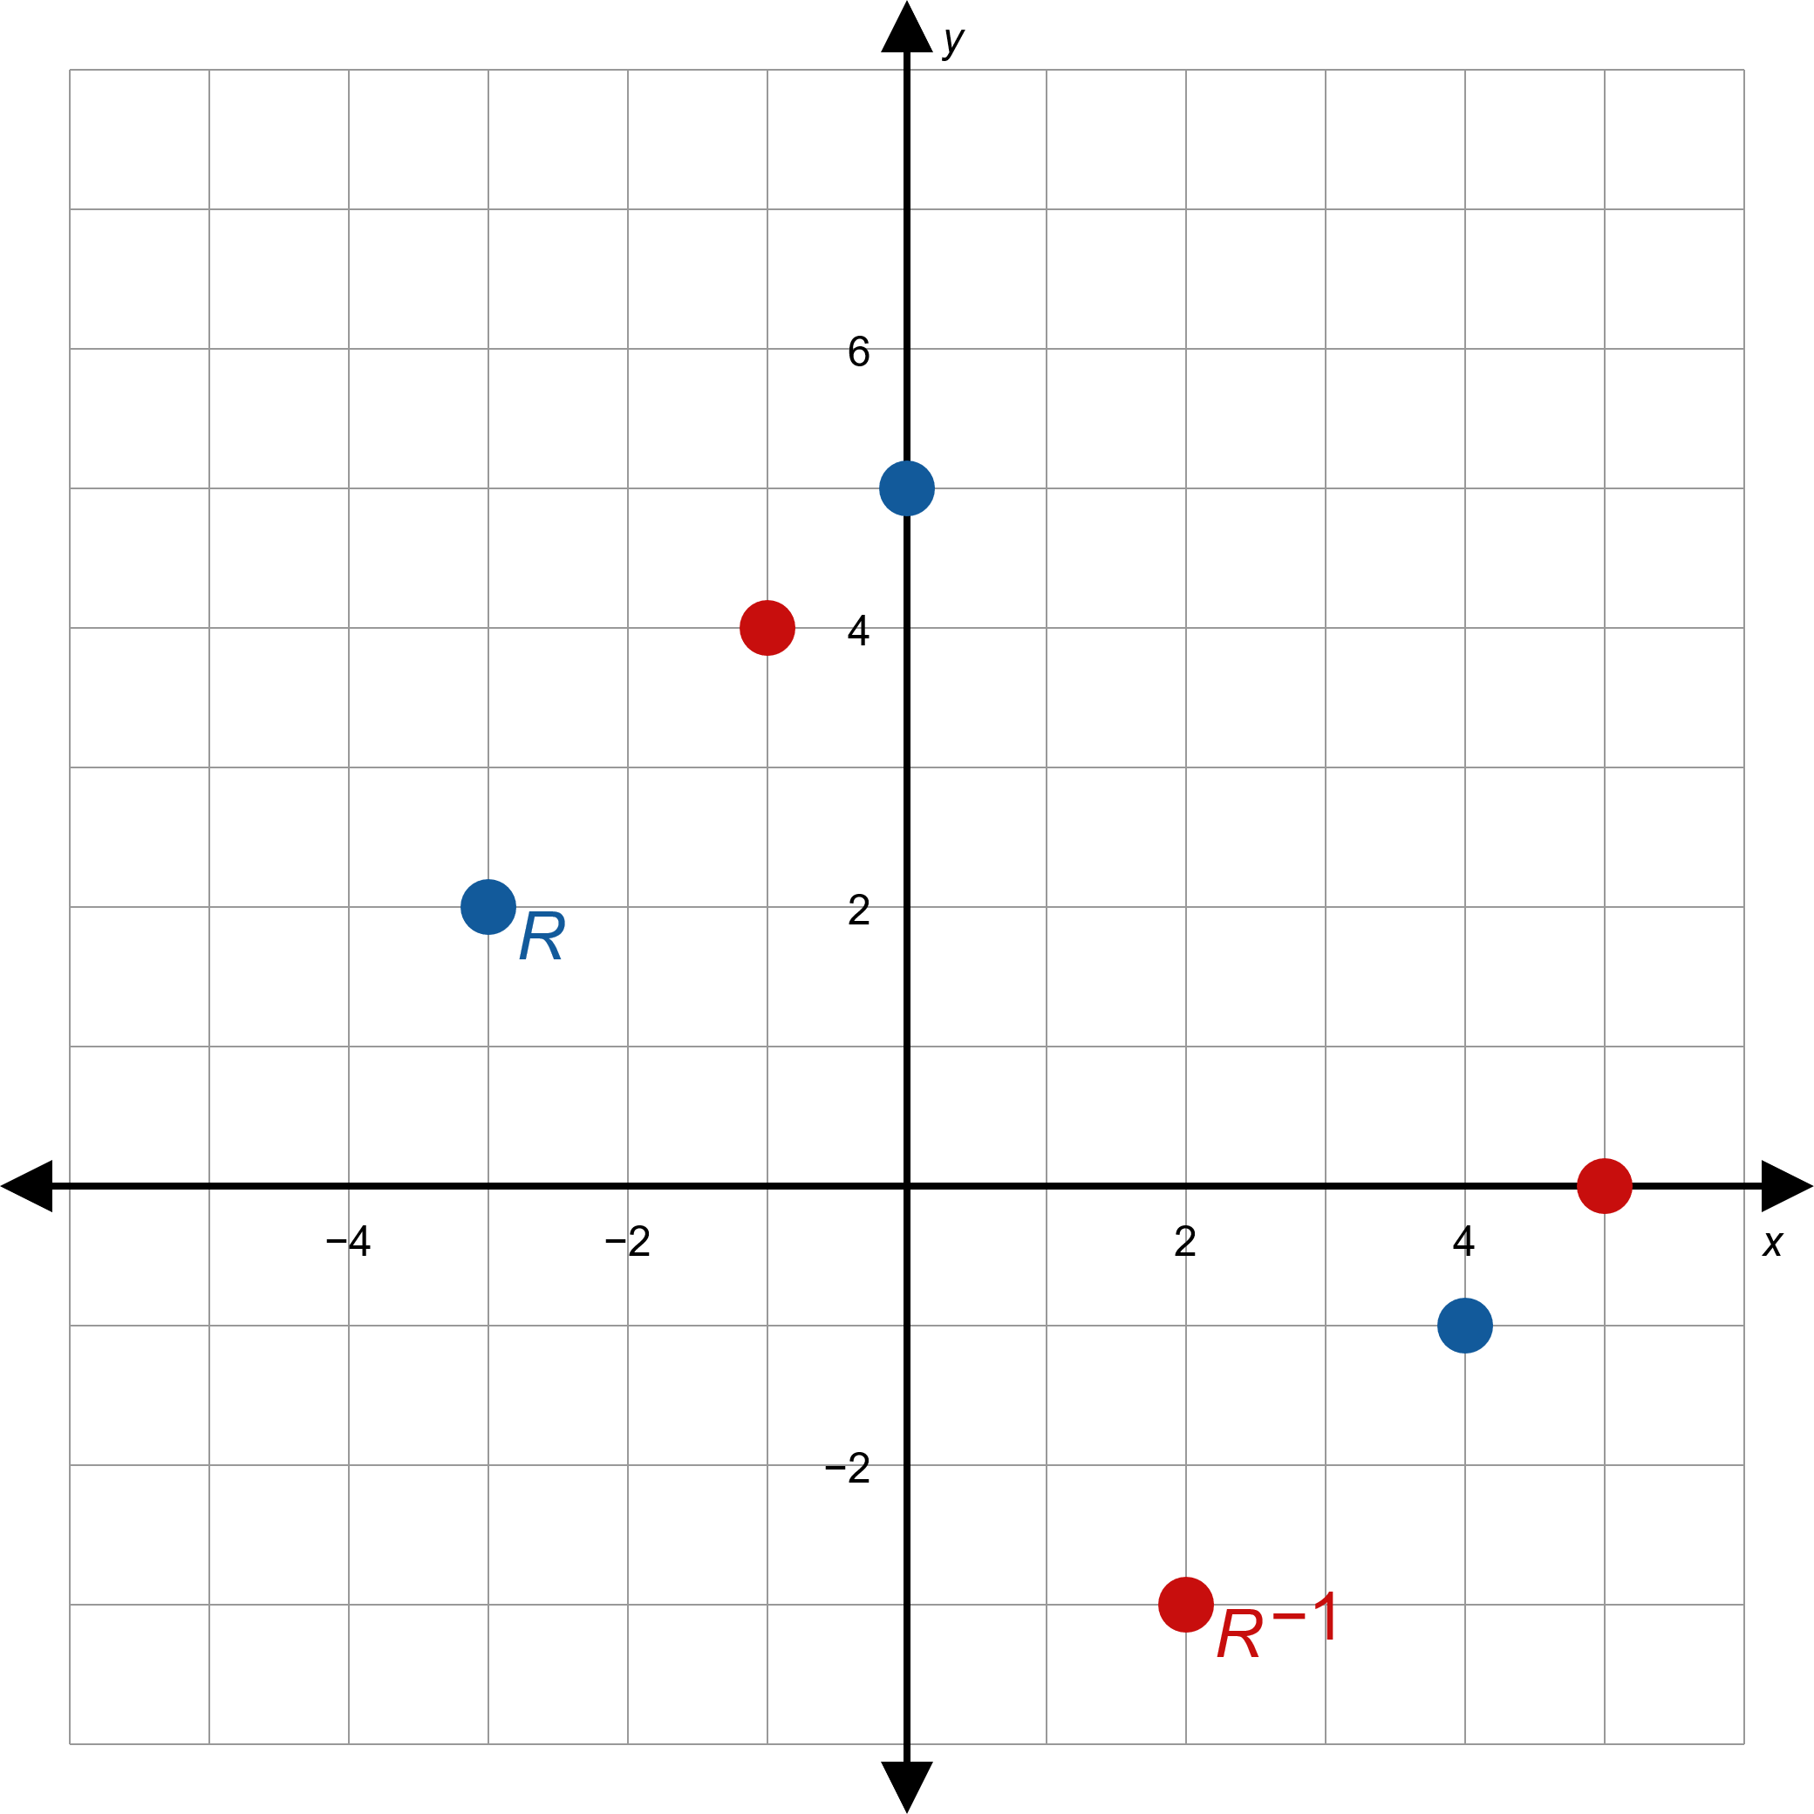
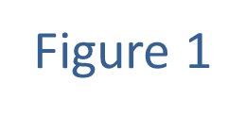
Example 1: Finding the Inverse of a Relation (cont.)

Slide 7
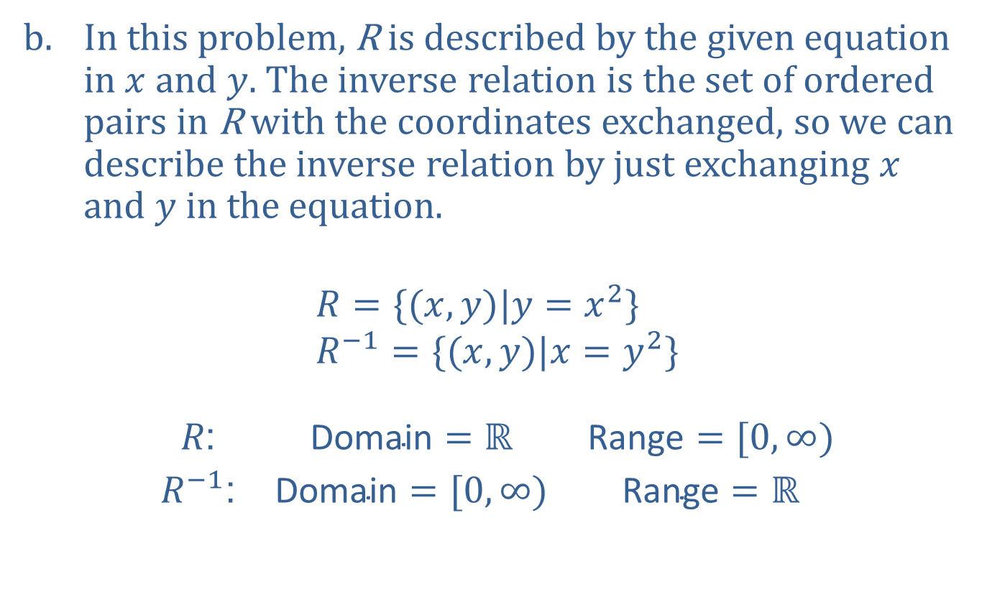
Example 1: Finding the Inverse of a Relation (cont.)
In this problem, R is described by the given equation in $x$ and $y$. The inverse relation is the set of ordered pairs in R with the coordinates exchanged, so we can describe the inverse relation by just exchanging $x$ and $y$ in the equation.
$$R=\{(x,y)|y=x^{2}\} \\ R^{−1}=\{(x,y)|x=y^{2}\}$$
$$\begin{matrix}R\text{:} & \text{Domain}=ℝ & \text{Range}=[0,∞) \\ R^{−1}\text{:} & \text{Domain}=[0,∞) & \text{Range}=ℝ\end{matrix}$$
​

Slide 8
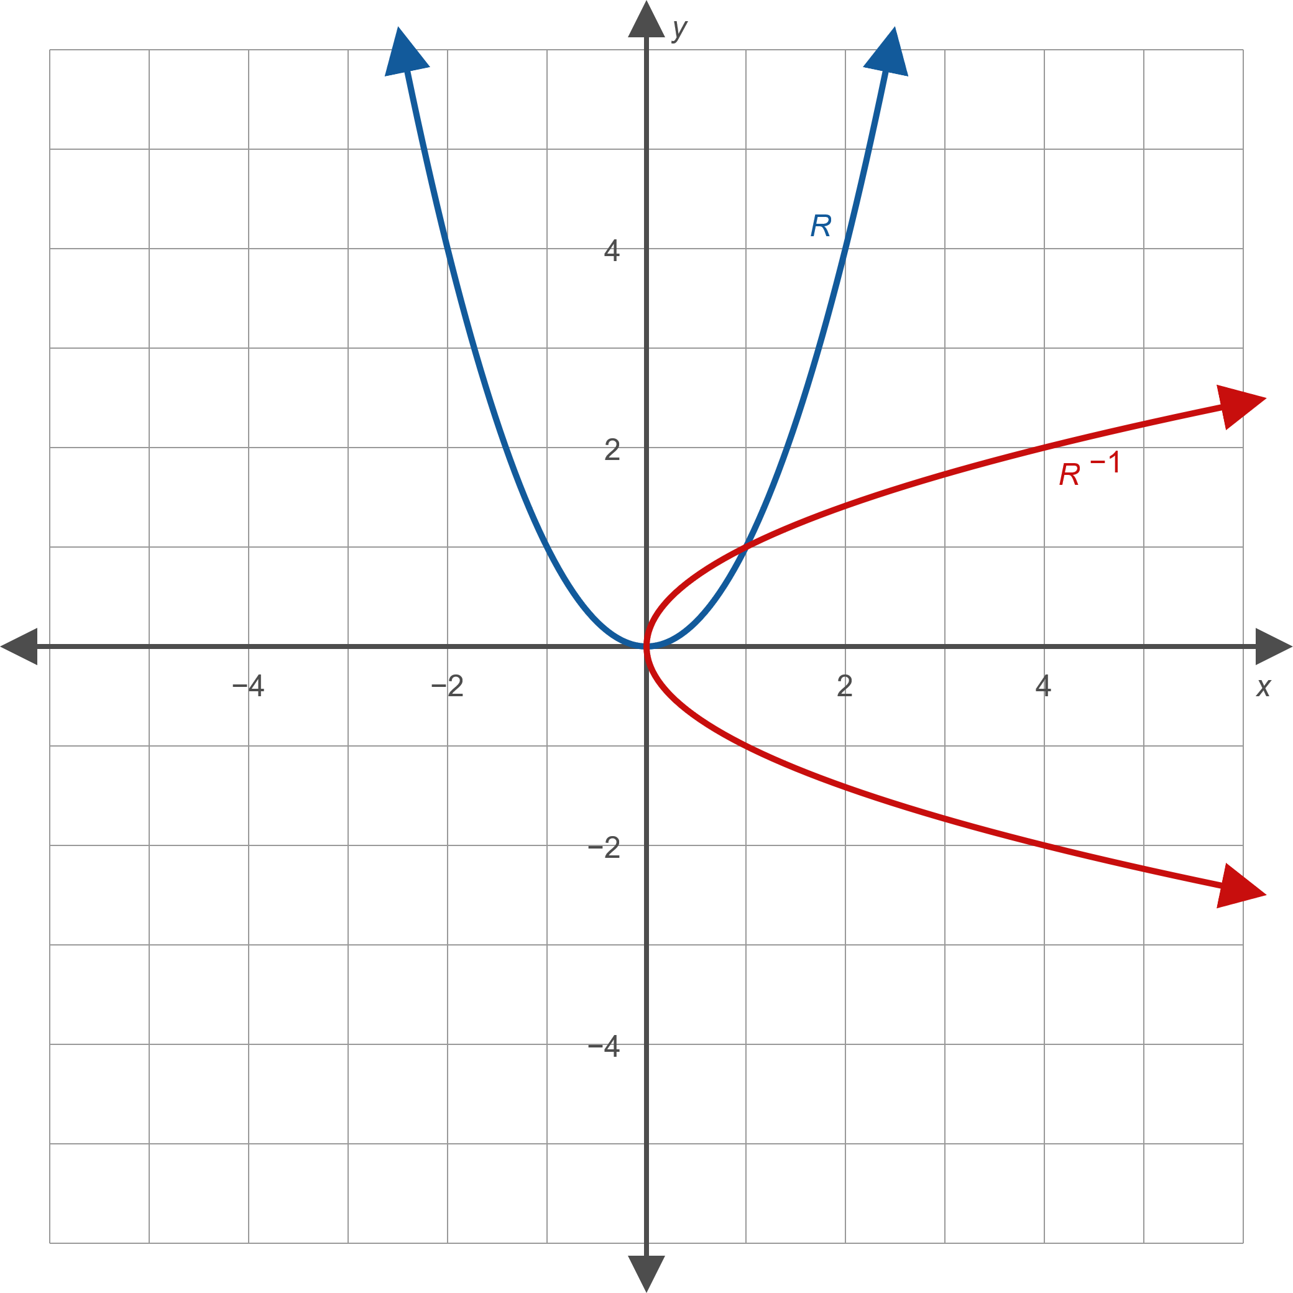
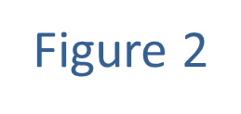
Example 1: Finding the Inverse of a Relation (cont.)

Slide 9
Example 1: Finding the Inverse of a Relation (cont.)
​​Note that the shapes of the graph of the relation and the graph of its inverse are essentially the same.

Slide 10
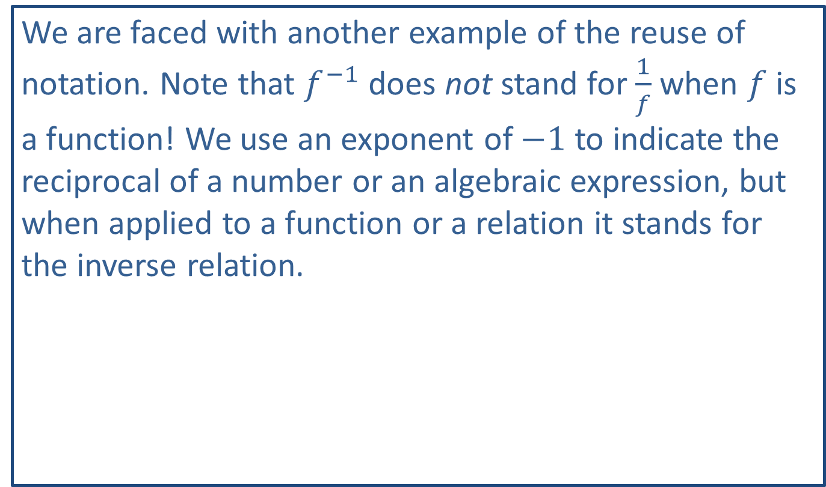
CAUTION!
We are faced with another example of the reuse of notation. Note that $f^{−1}$ does not stand for $\frac{1}{f}$ when $f$ is a function! We use an exponent of $−1$ to indicate the reciprocal of a number or an algebraic expression, but when applied to a function or a relation it stands for the inverse relation.

Slide 11
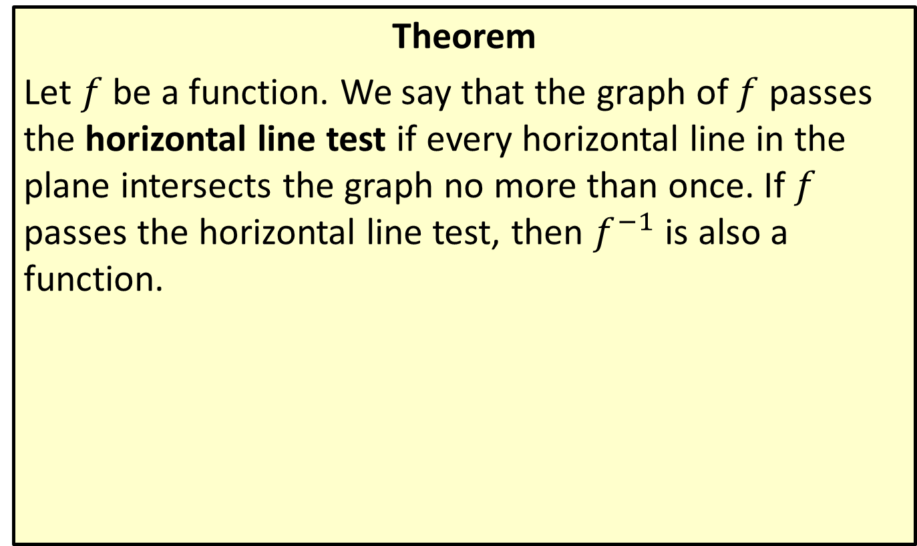
The Horizontal Line Test
Theorem
Let $f$ be a function. We say that the graph of $f$ passes the horizontal line test if every horizontal line in the plane intersects the graph no more than once. If $f$ passes the horizontal line test, then $f^{−1}$ is also a function.

Slide 12
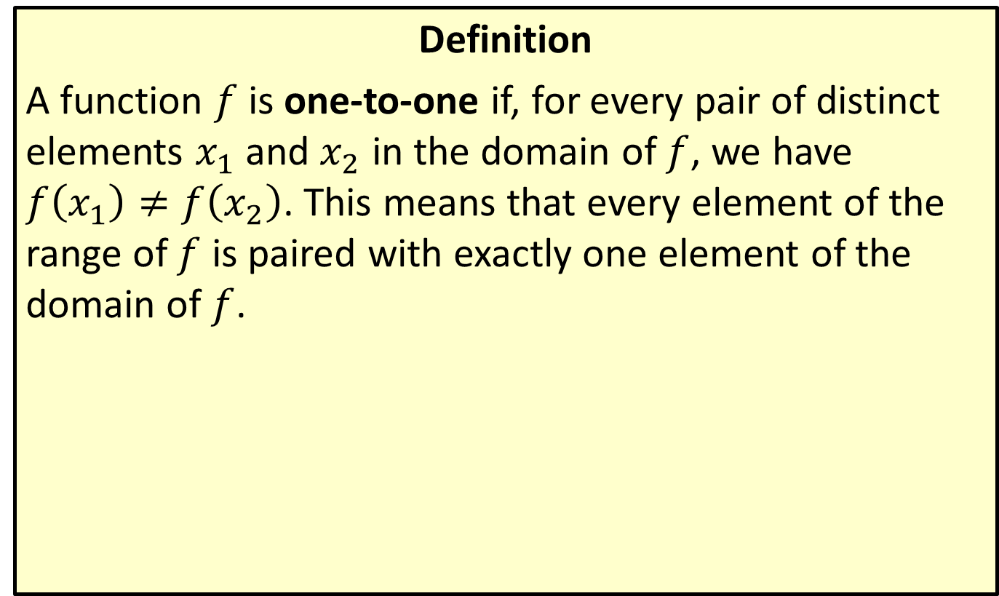
One-to-One Function
Definition
A function $f$ is one-to-one if, for every pair of distinct elements $x_{1}$ and $x_{2}$ in the domain of $f$, we have
$f\left(x_{1}\right)≠f\left(x_{2}\right)$. This means that every element of the range of $f$ is paired with exactly one element of the domain of $f$.

Slide 13

Example 2: Inverse Functions
Determine if the following functions have inverse functions.
​$f\left(x\right)=\left|x\right|$
​$g\left(x\right)={\left(x+2\right)}^{3}$

Slide 14
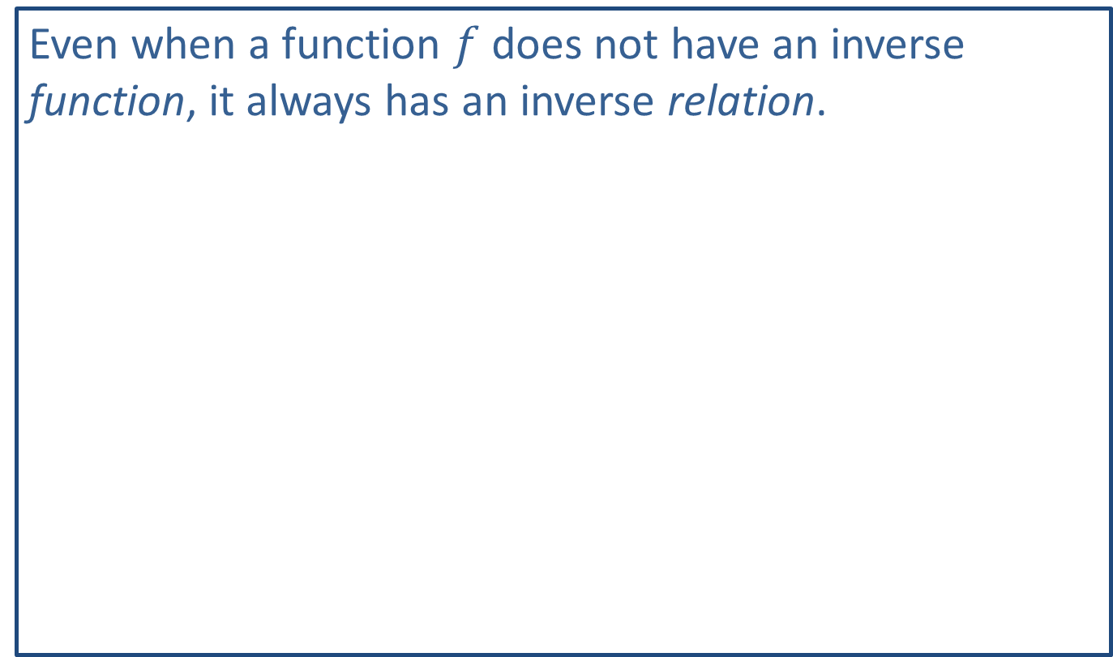
Note:
Even when a function $f$ does not have an inverse function, it always has an inverse relation.

Slide 15
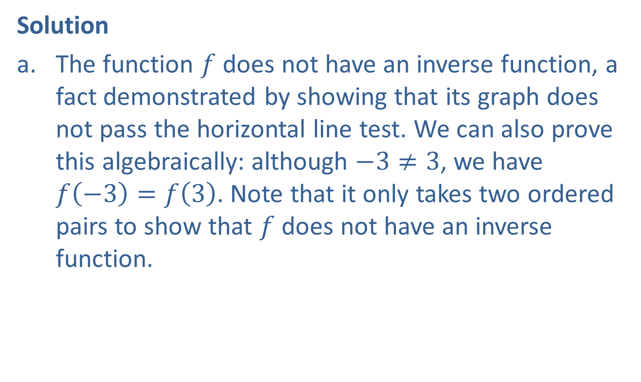
Example 2: Inverse Functions (cont.)
Solution
​The function $f$ does not have an inverse function, a fact demonstrated by showing that its graph does not pass the horizontal line test. We can also prove this algebraically: although $−3≠3$, we have
$f\left(−3\right)=f\left(3\right)$. Note that it only takes two ordered pairs to show that $f$ does not have an inverse function.
​

Slide 16
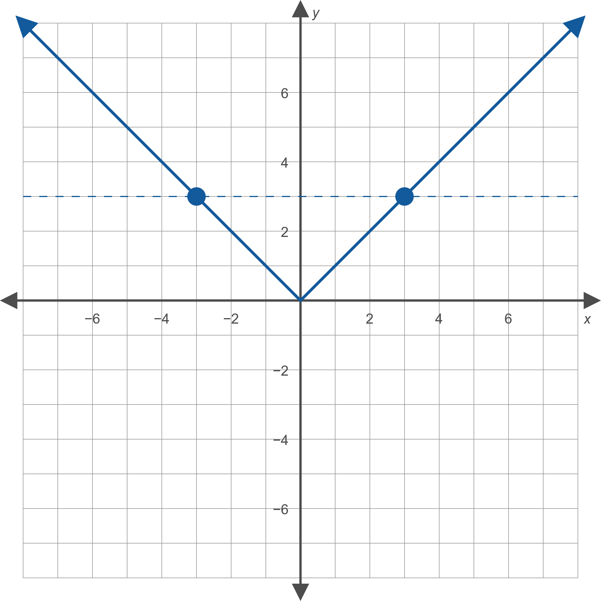
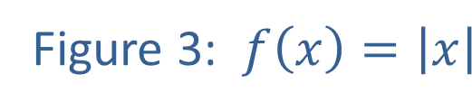
Example 2: Inverse Functions (cont.)

Slide 17

Example 2: Inverse Functions (cont.)
​The graph of $g$ is the standard cubic shape shifted horizontally two units to the left. We can see this graph passes the horizontal line test, so $g$ has an inverse function.
​

Slide 18
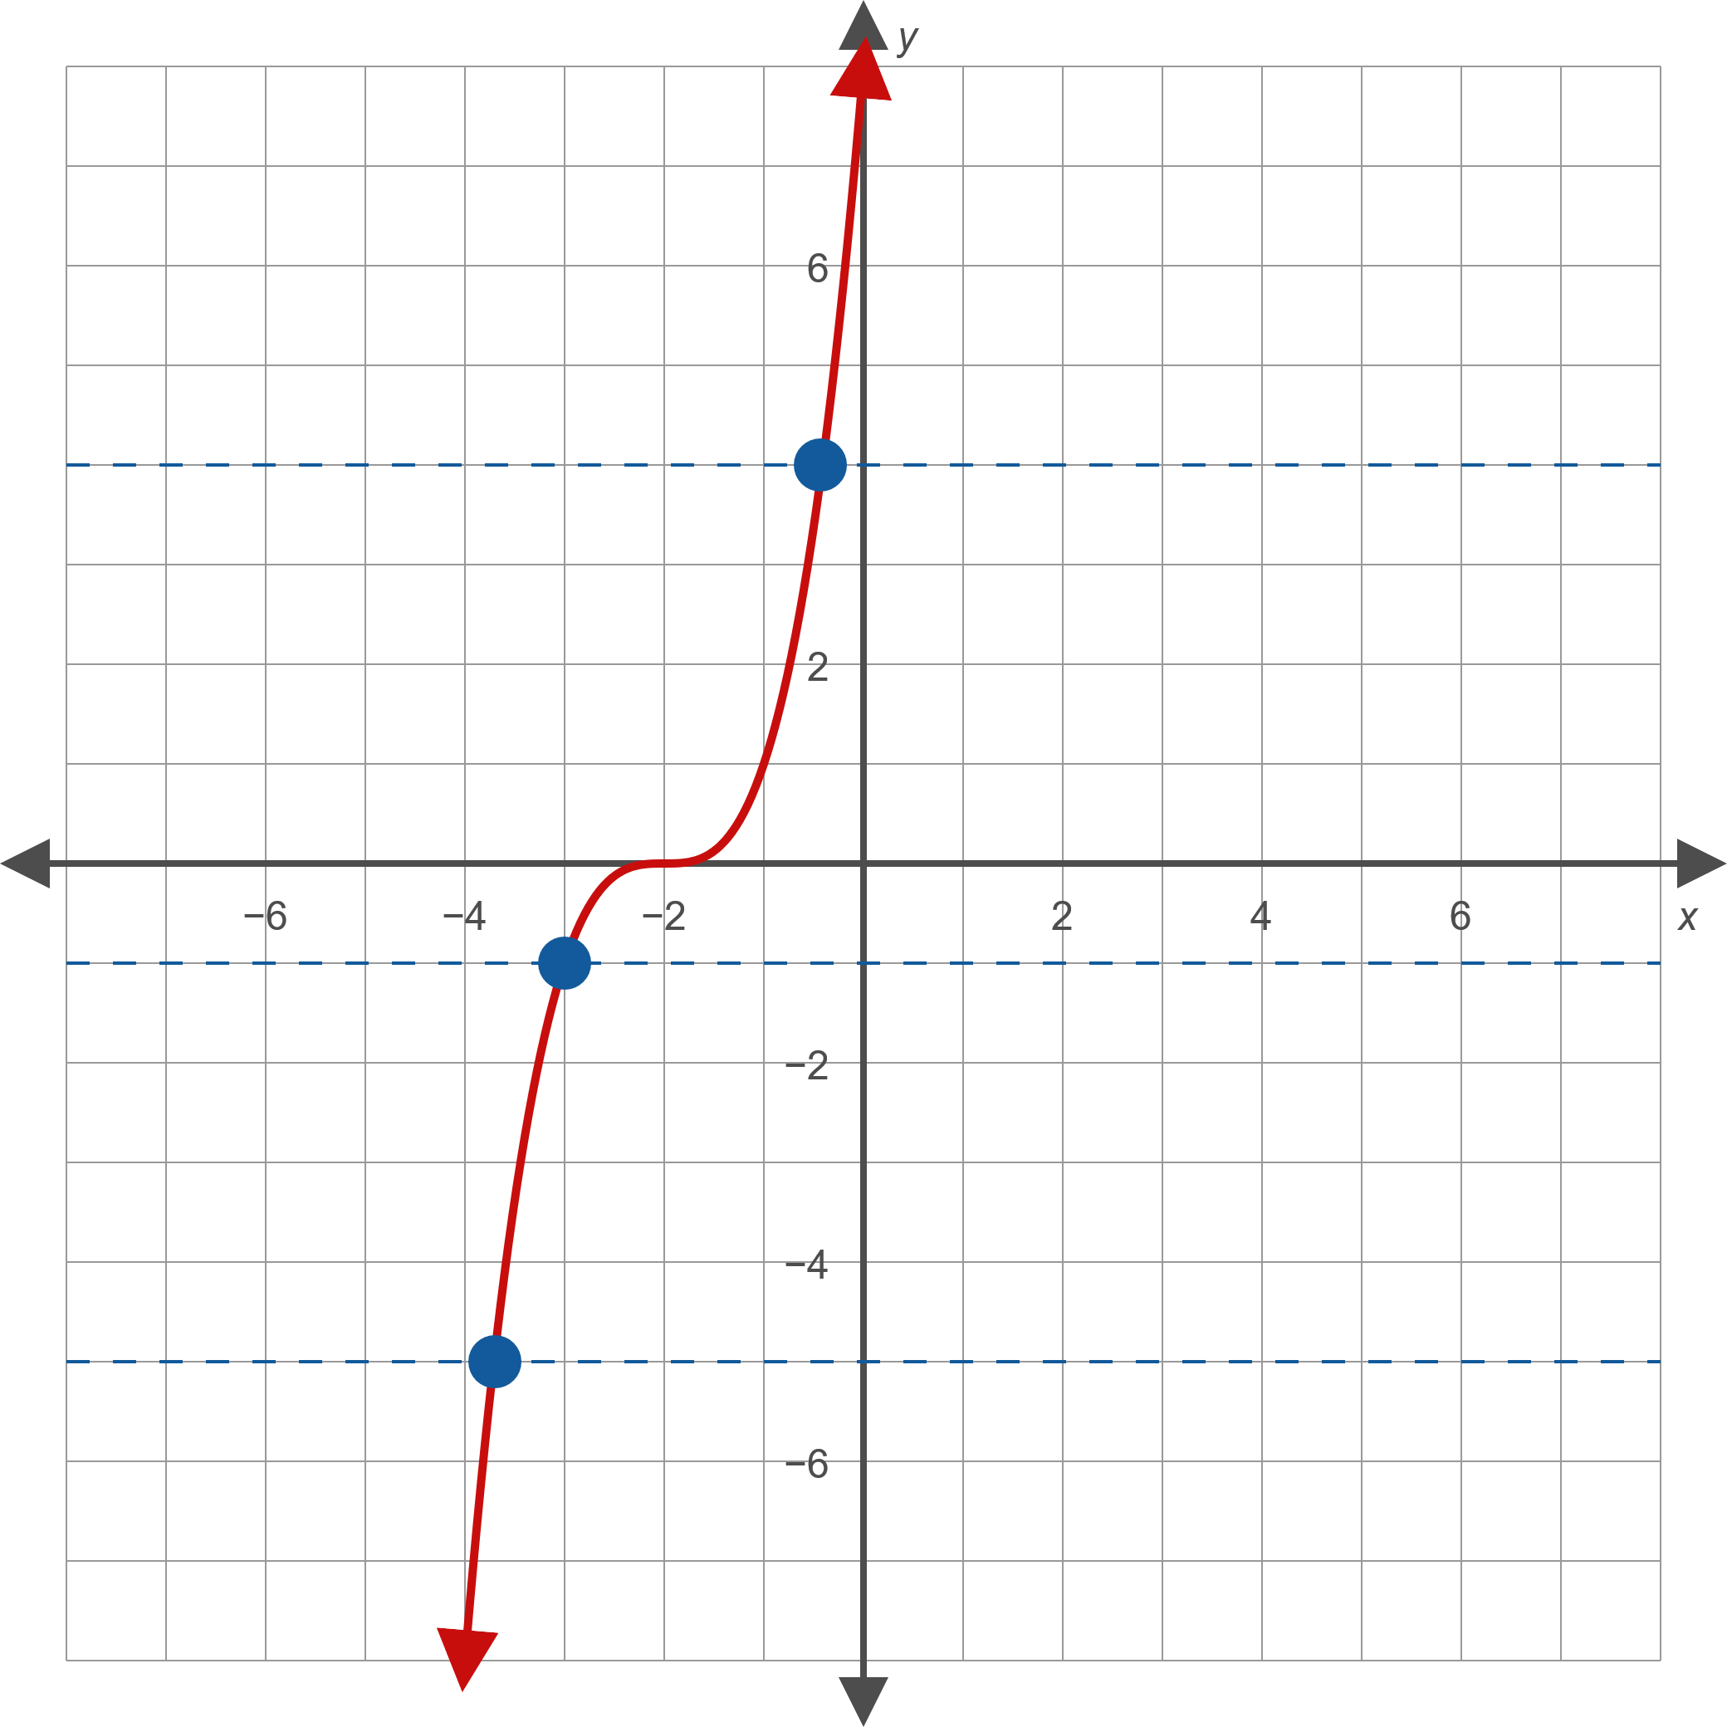
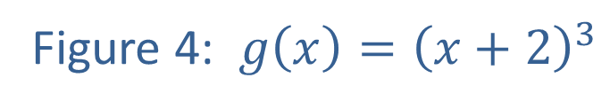
Example 2: Inverse Functions (cont.)

Slide 19

Example 2: Inverse Functions (cont.)
​Algebraically, any two distinct elements of the domain of $g$ lead to different values when substituted into $g$, so $g$ is one-to-one and hence has an inverse function.

Slide 20
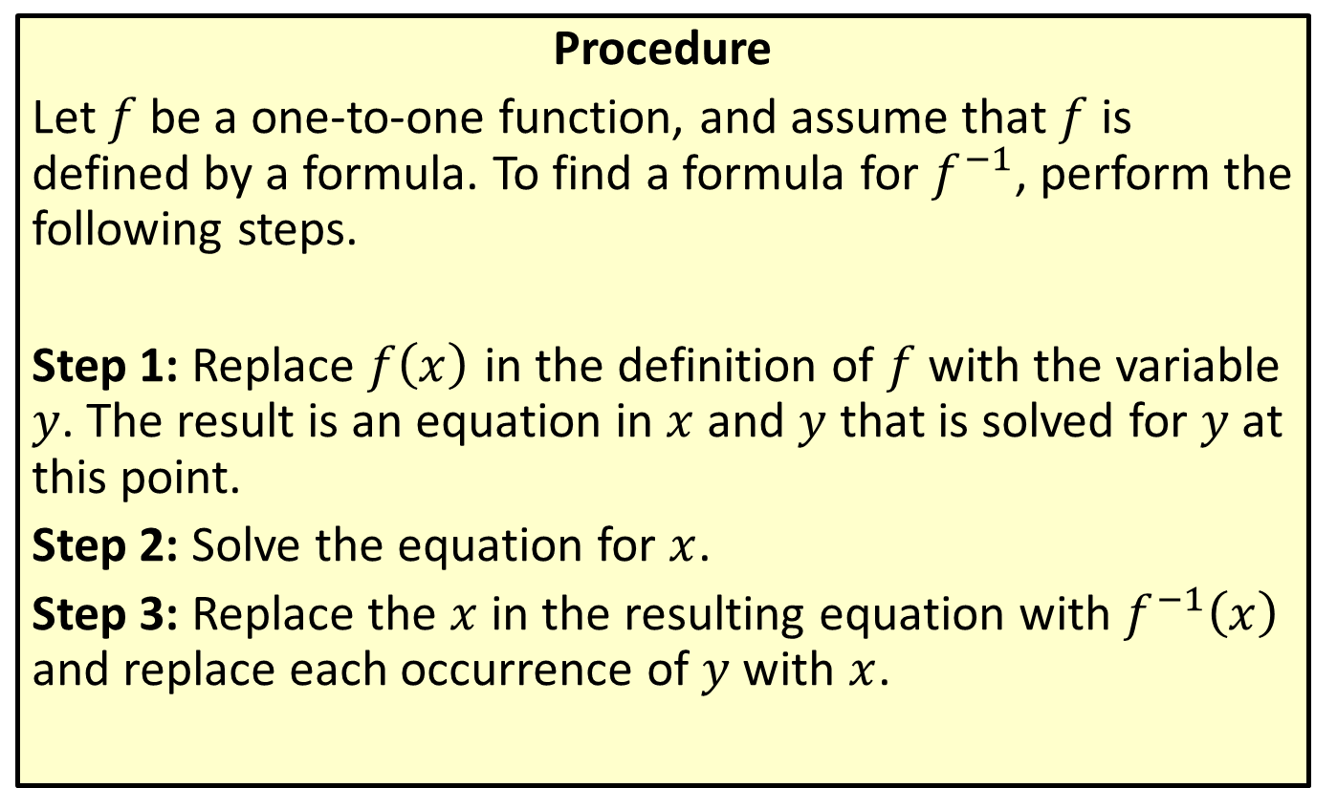
Finding Formulas of Inverse Functions
Procedure
Let $f$ be a one-to-one function, and assume that $f$ is defined by a formula. To find a formula for $f^{−1}$, perform the following steps.
Step 1: Replace $f⁡\left(x\right)$ in the definition of $f$ with the variable $y$. The result is an equation in $x$ and $y$ that is solved for $y$ at this point.
Step 2: Solve the equation for $x$.
Step 3: Replace the $x$ in the resulting equation with $f^{−1}⁡\left(x\right)$ and replace each occurrence of $y$ with $x$.

Slide 21

Example 3: Finding Formulas of Inverse Functions
Find the inverse of each of the following functions.
​$f\left(x\right)={\left(x−1\right)}^{3}+2$
​$g\left(x\right)=\frac{x−3}{2x+1}$

Slide 22
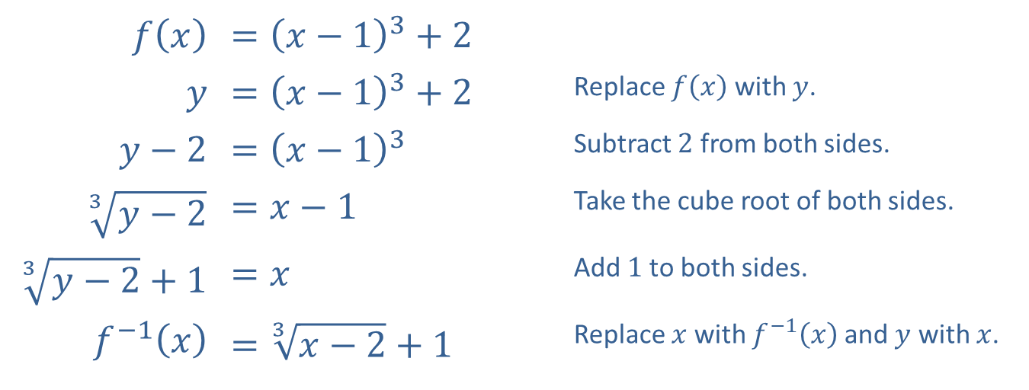
Example 3: Finding Formulas of Inverse Functions (cont.)
Solution
​
​$f⁡\left(x\right)$ | ​$={\left(x−1\right)}^{3}+2$
$$y$$ | ​$={\left(x−1\right)}^{3}+2$ | Replace $f⁡\left(x\right)$ with $y$.
​$y−2$ | ​$={\left(x−1\right)}^{3}$ | Subtract 2 from both sides.
​$\sqrt[3]{y−2}$ | ​$=x−1$ | Take the cube root of both sides.
​$\sqrt[3]{y−2}+1$ | ​$=x$ | Add 1 to both sides.
​$f^{−1}⁡\left(x\right)$ | ​$=\sqrt[3]{x−2}+1$ | Replace $x$ with $f^{−1}⁡\left(x\right)$ and $y$ with $x$.

Slide 23
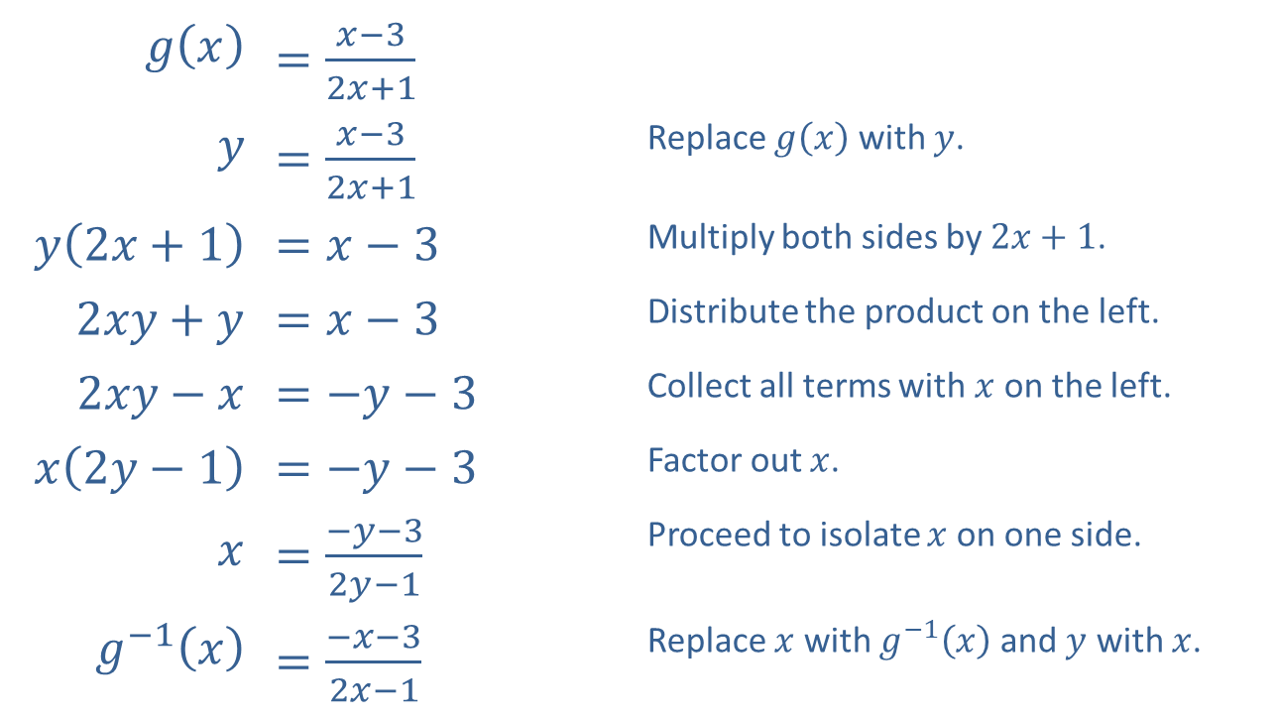
Example 3: Finding Formulas of Inverse Functions (cont.)
​
​$g⁡\left(x\right)$ | ​$=\frac{x−3}{2x+1}$
$$y$$ | ​$=\frac{x−3}{2x+1}$ | Replace $g⁡\left(x\right)$ with $y$.
​$y\left(2x+1\right)$ | ​$=x−3$ | Multiply both sides by $2x+1$.
​$2xy+y$ | ​$=x−3$ | Distribute the product on the left.
​$2xy−x$ | ​$=−y−3$ | Collect all terms with $x$ on the left.
​$x\left(2y−1\right)$ | ​$=−y−3$ | Factor out $x$.
$$x$$ | ​$=\frac{−y−3}{2y−1}$ | Proceed to isolate $x$ on one side.
​$g^{−1}⁡\left(x\right)$ | ​$=\frac{−x−3}{2x−1}$ | Replace $x$ with $g^{−1}⁡\left(x\right)$ and $y$ with $x$.

Slide 24

Example 4: Finding the Inverse of a Restricted-Domain Function
Find two suitable restrictions of the domain so that the function $f⁡\left(x\right)={\left(x+1\right)}^{2}−3$ has an inverse function, then find a formula for the inverse for each restricted function.

Slide 25
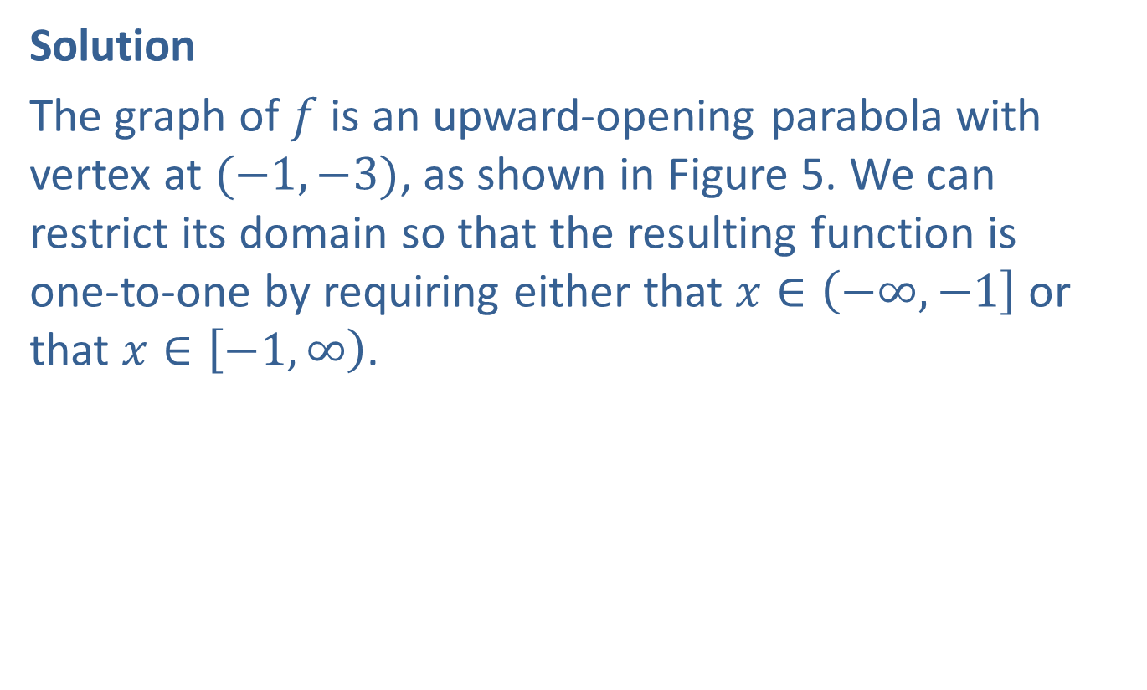
Example 4: Finding the Inverse of a Restricted-Domain Function (cont.)
Solution
The graph of $f$ is an upward-opening parabola with vertex at $(−1,−3)$, as shown in Figure 5. We can restrict its domain so that the resulting function is
one-to-one by requiring either that $x∈\left(−∞,−1\right]$ or that $x∈\left[−1,∞\right)$.

Slide 26
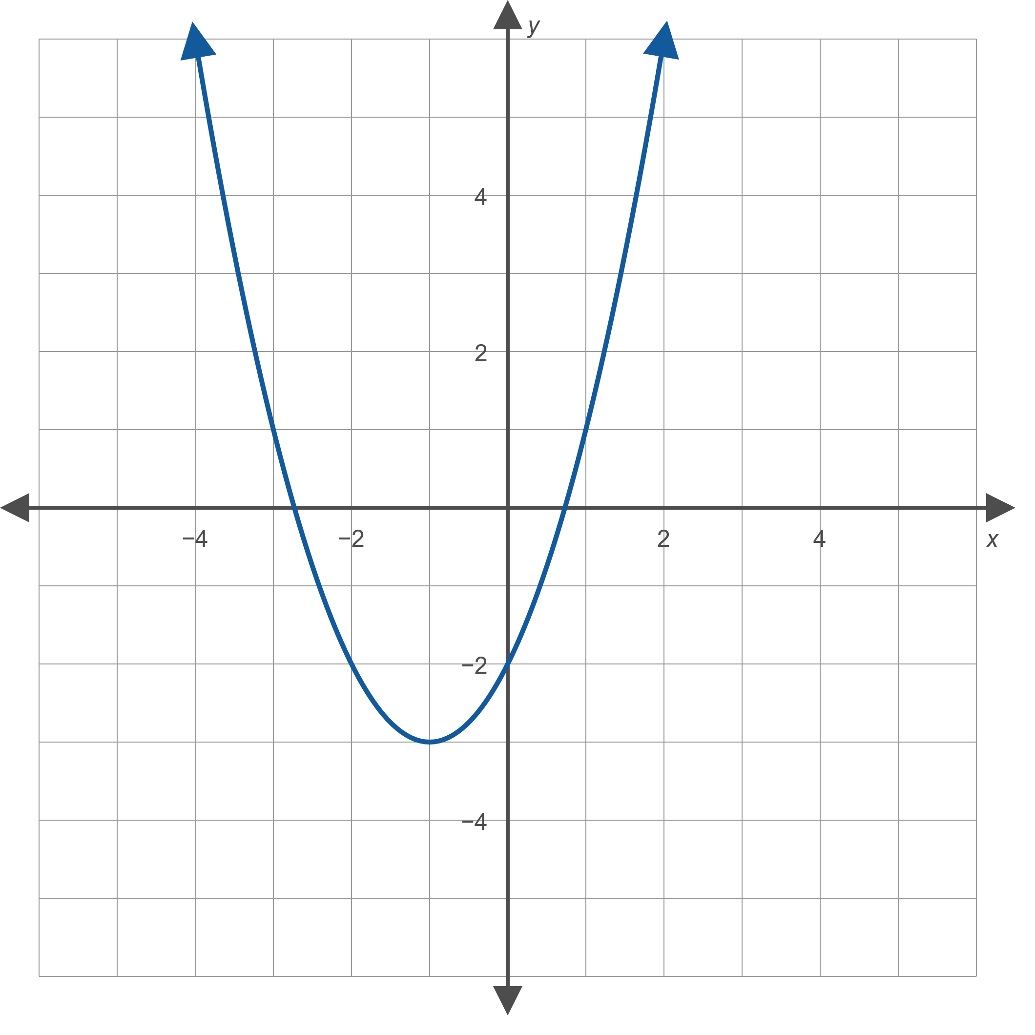
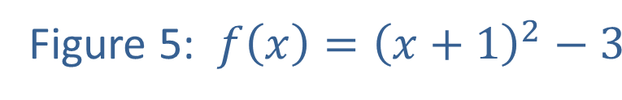
Example 4: Finding the Inverse of a Restricted-Domain Function (cont.)

Slide 27

Example 4: Finding the Inverse of a Restricted-Domain Function (cont.)
Choice 1: If we choose $[−1,∞)$ as the domain of the restricted function, then the expression $x+1$ is guaranteed to be nonnegative. We will use this fact as we work through the procedure to find a formula for the inverse function.

Slide 28
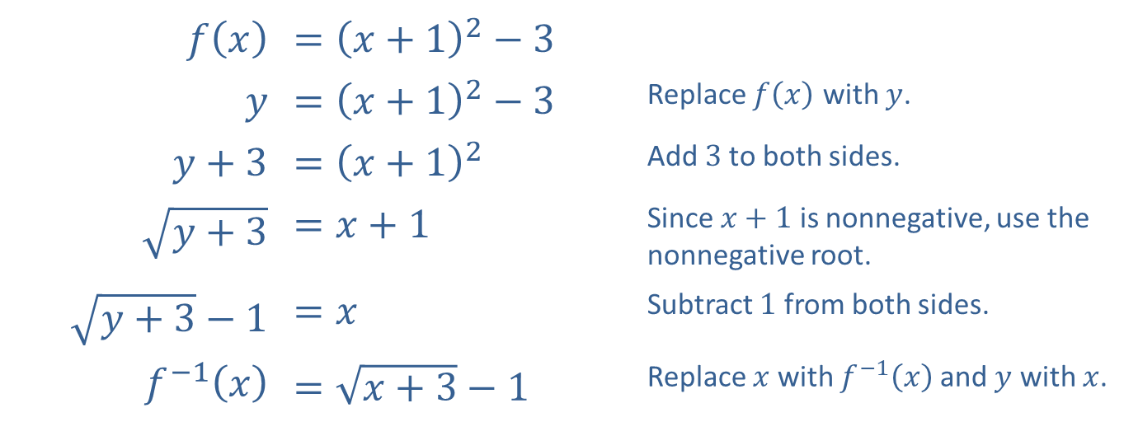
Example 4: Finding the Inverse of a Restricted-Domain Function (cont.)
​$f⁡\left(x\right)$ | ​$={\left(x+1\right)}^{2}−3$
$$y$$ | ​$={\left(x+1\right)}^{2}−3$ | Replace $f⁡\left(x\right)$ with $y$.
​$y+3$ | ​$={\left(x+1\right)}^{2}$ | Add 3 to both sides.
​$\sqrt{y+3}$ | ​$=x+1$ | Since $x+1$ is nonnegative, use the nonnegative root.
​$\sqrt{y+3}−1$ | ​$=x$ | Subtract 1 from both sides.
​$f^{−1}⁡\left(x\right)$ | ​$=\sqrt{x+3}−1$ | Replace $x$ with $f^{−1}⁡\left(x\right)$ and $y$ with $x$.

Slide 29

Example 4: Finding the Inverse of a Restricted-Domain Function (cont.)
Figure 6 shows the graph of the function $f$ restricted to the domain $[−1,∞)$ along with a graph of the function's inverse.

Slide 30
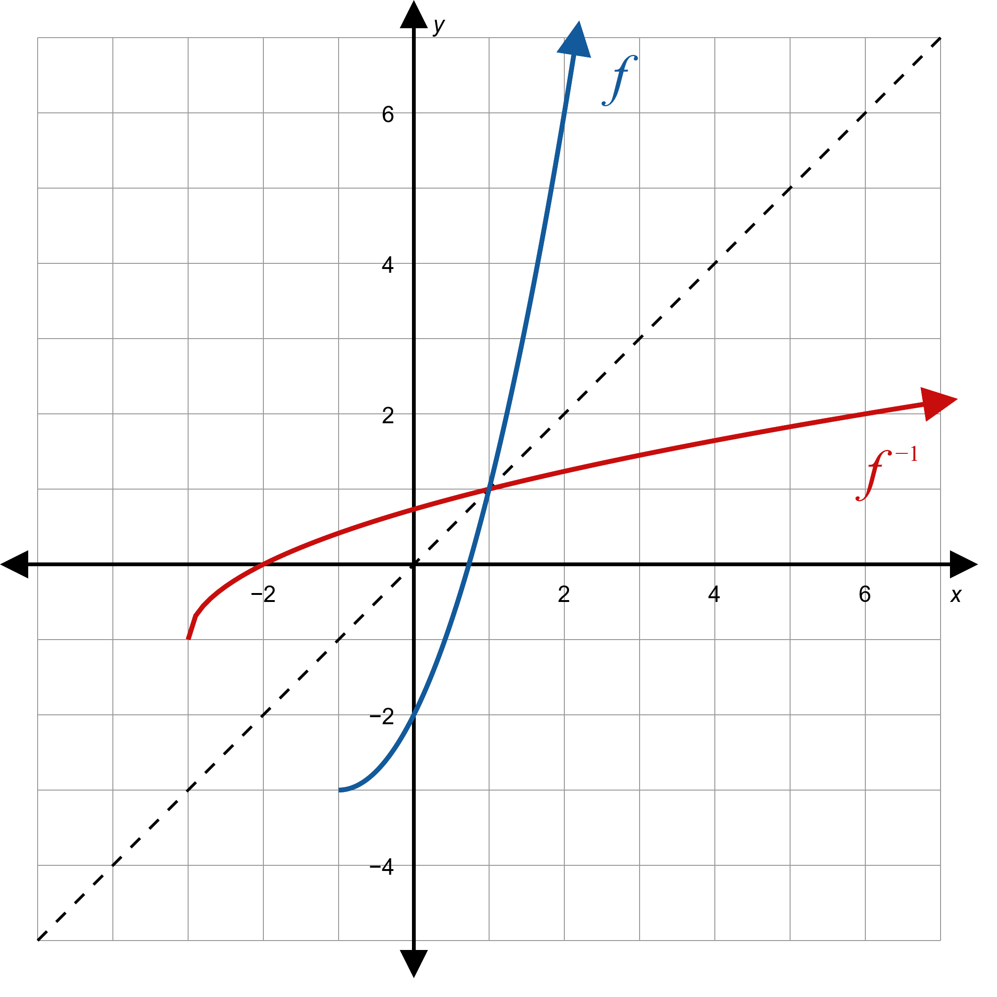
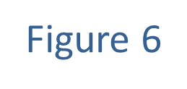
Example 4: Finding the Inverse of a Restricted-Domain Function (cont.)

Slide 31

Example 4: Finding the Inverse of a Restricted-Domain Function (cont.)
Choice 2: If instead we choose $(−∞,−1]$ as the domain of the restricted function, then the expression $x+1$ is guaranteed to be nonpositive. This fact will lead us to choose the other possible root when we take the square root in the following procedure.

Slide 32
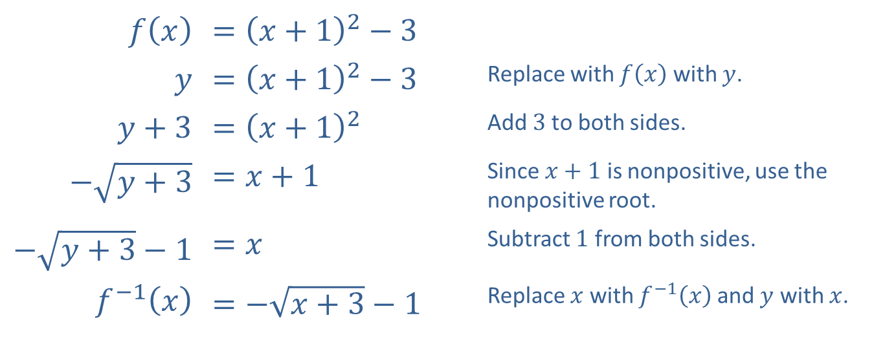
Example 4: Finding the Inverse of a Restricted-Domain Function (cont.)
​$f⁡\left(x\right)$ | ​$={\left(x+1\right)}^{2}−3$
$$y$$ | ​$={\left(x+1\right)}^{2}−3$ | Replace with $f⁡\left(x\right)$ with $y$.
​$y+3$ | ​$={\left(x+1\right)}^{2}$ | Add 3 to both sides.
​$−\sqrt{y+3}$ | ​$=x+1$ | Since $x+1$ is nonpositive, use the nonpositive root.
​$−\sqrt{y+3}−1$ | ​$=x$ | Subtract 1 from both sides.
​$f^{−1}⁡\left(x\right)$ | ​$=−\sqrt{x+3}−1$ | Replace $x$ with $f^{−1}⁡\left(x\right)$ and $y$ with $x$.

Slide 33

Example 4: Finding the Inverse of a Restricted-Domain Function (cont.)
Figure 7 shows the graph of $f$ restricted to this domain, along with the corresponding inverse function.

Slide 34
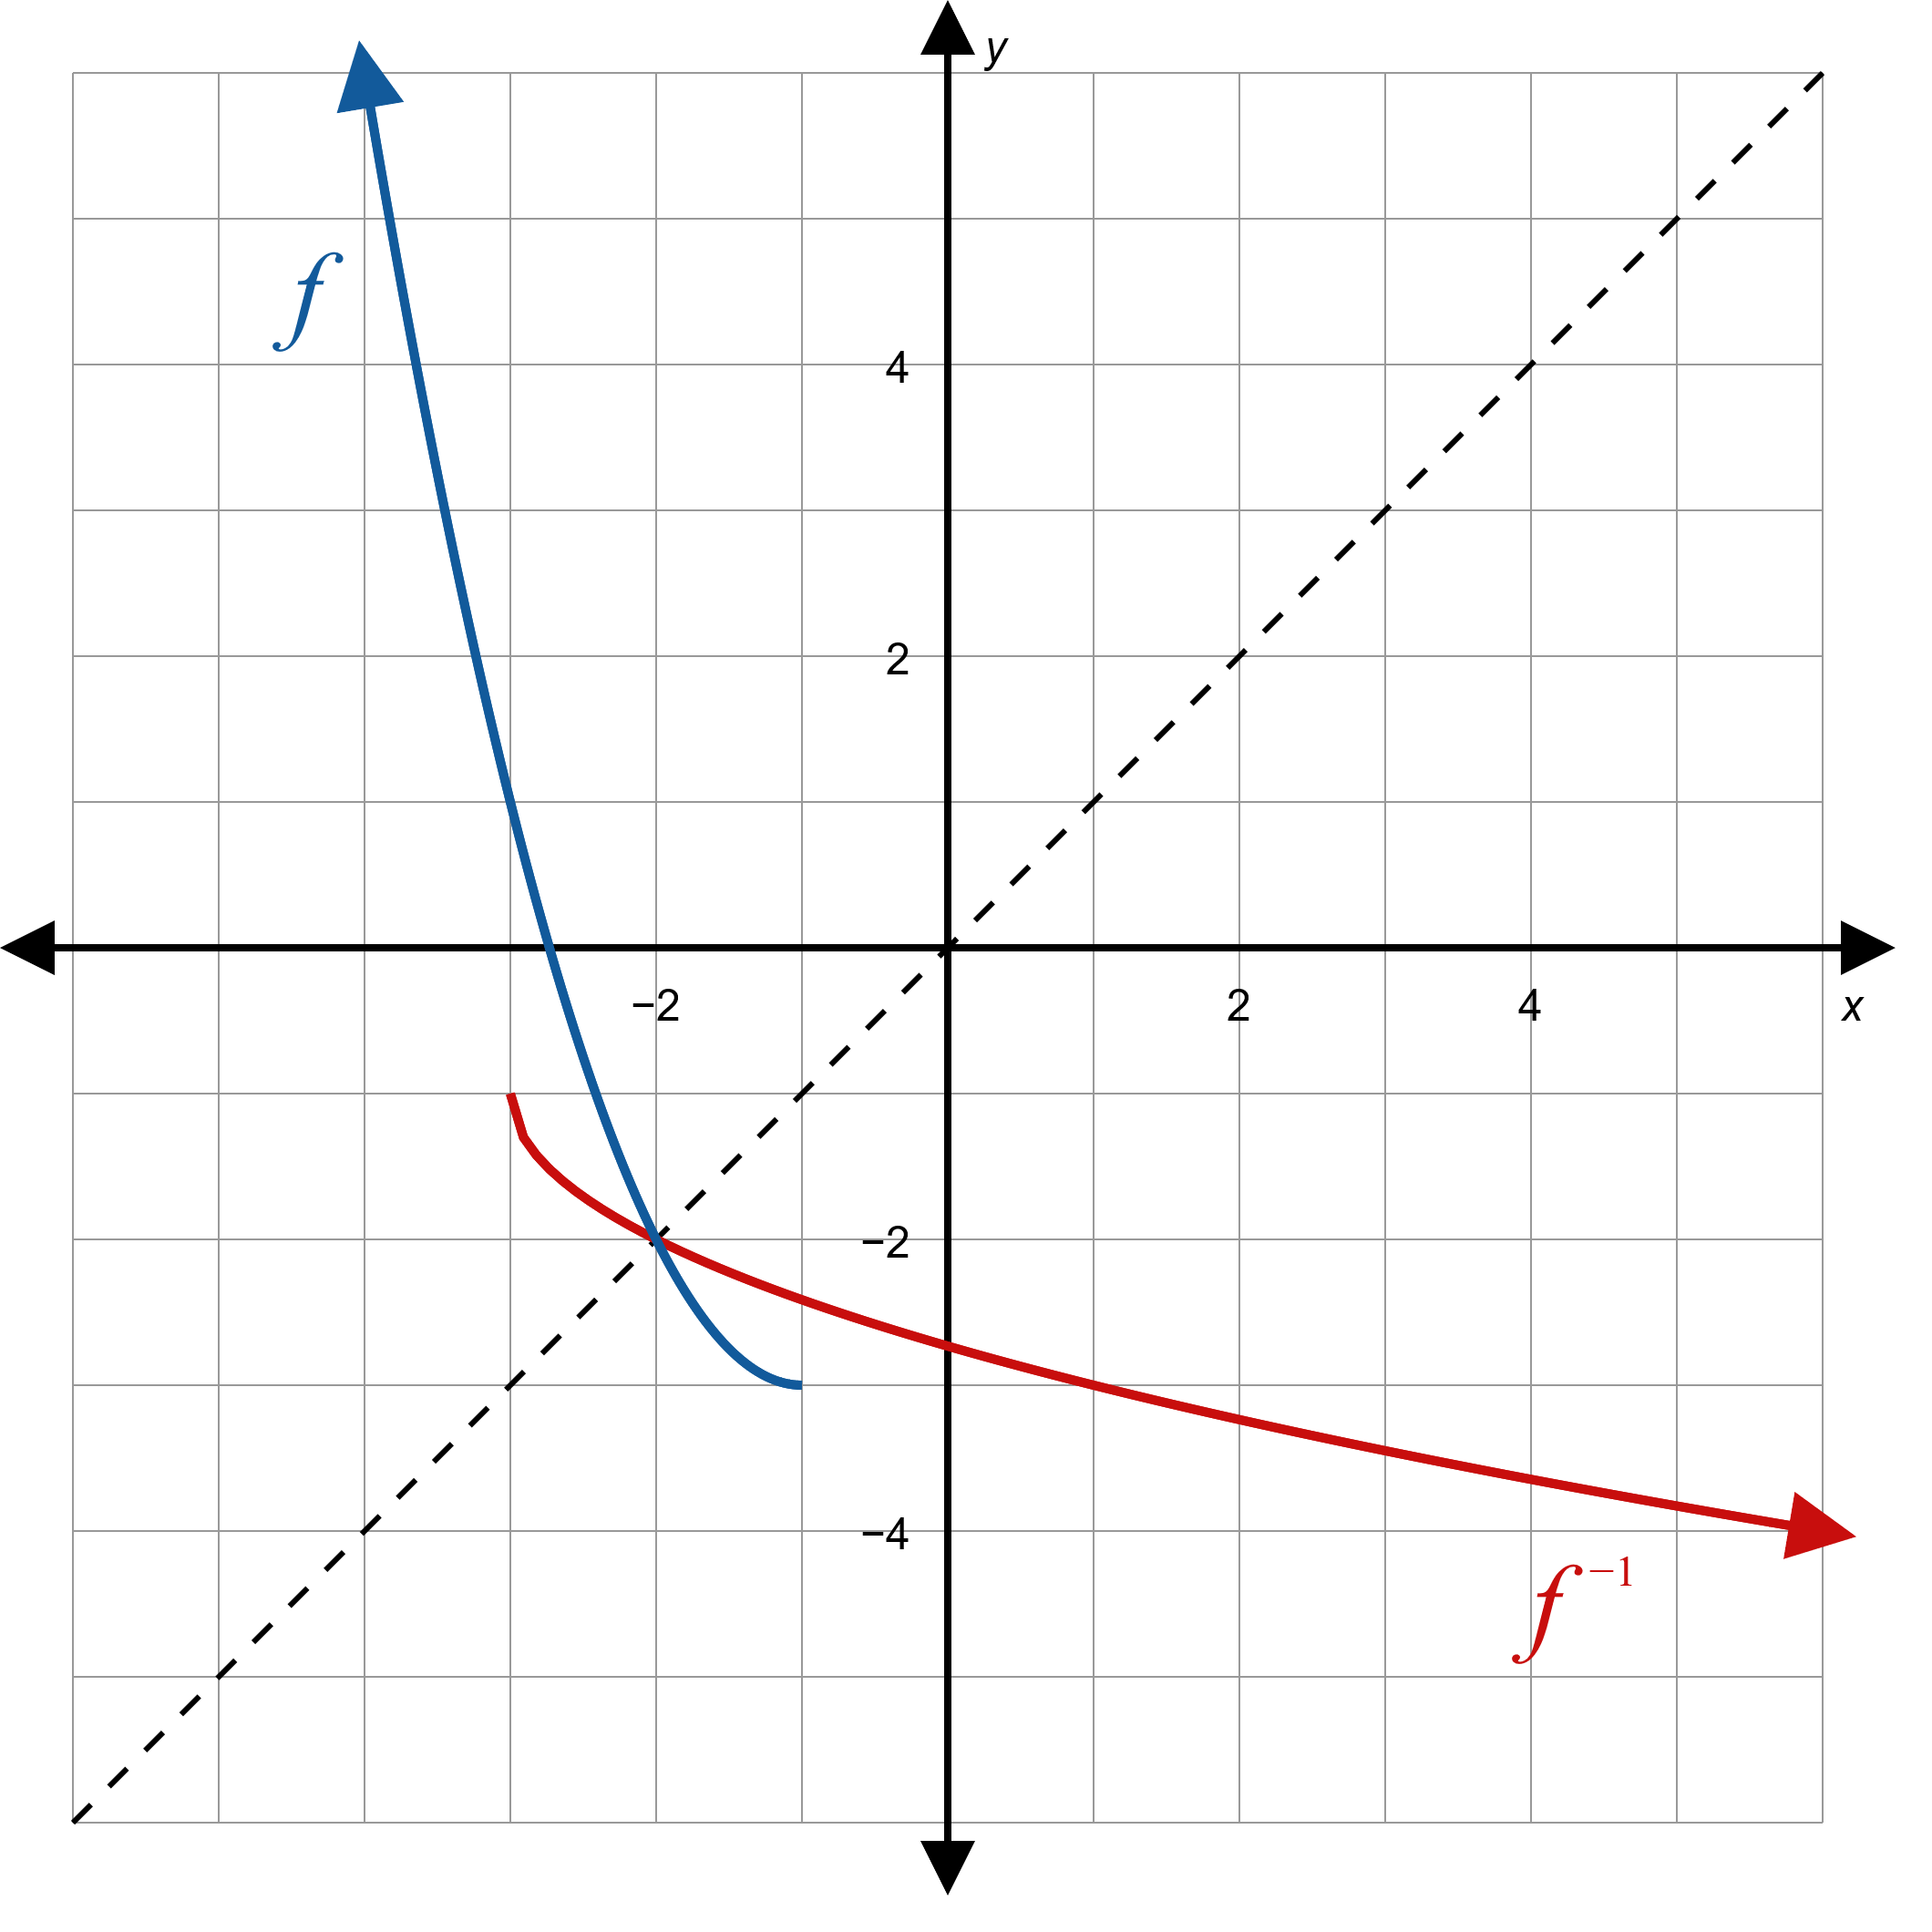
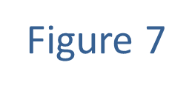
Example 4: Finding the Inverse of a Restricted-Domain Function (cont.)

Slide 35
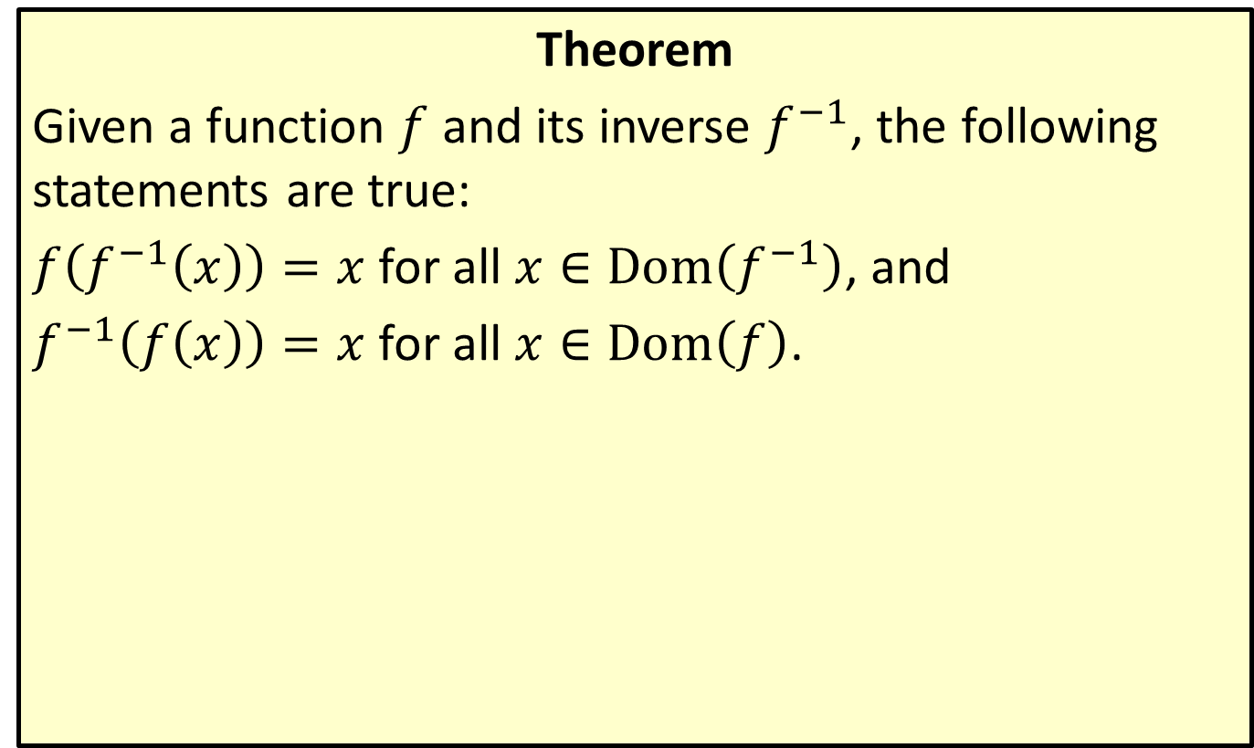
Composition of Functions and Inverses
Theorem
Given a function $f$ and its inverse $f^{−1}$, the following statements are true:
$f\left(f^{−1}\left(x\right)\right)=x$ for all $x∈Dom⁡\left(f^{−1}\right)$, and
$f^{−1}\left(f\left(x\right)\right)=x$ for all $x∈Dom⁡\left(f\right)$.

Slide 36
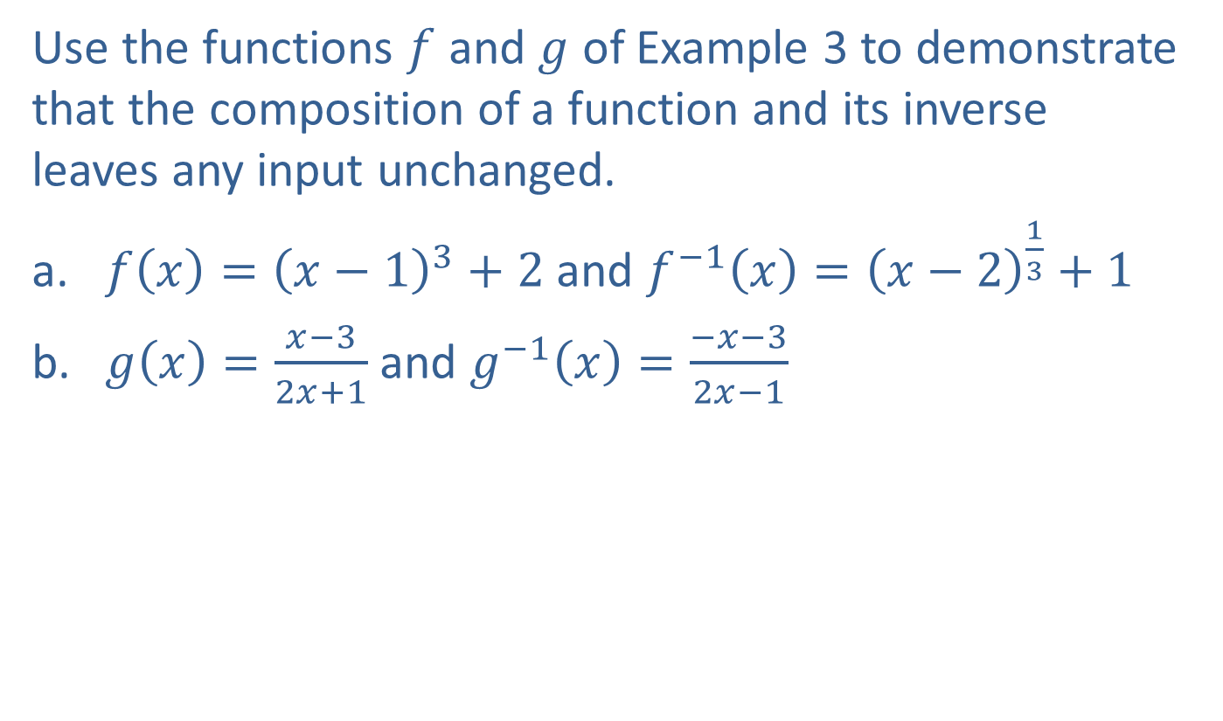
Example 5: Composition of Functions and Inverses
Use the functions $f$ and $g$ of Example 3 to demonstrate that the composition of a function and its inverse leaves any input unchanged.
​$f\left(x\right)={\left(x−1\right)}^{3}+2$ and $f^{−1}\left(x\right)={\left(x−2\right)}^{\frac{1}{3}}+1$
​$g\left(x\right)=\frac{x−3}{2x+1}$ and $g^{−1}\left(x\right)=\frac{−x−3}{2x−1}$

Slide 37
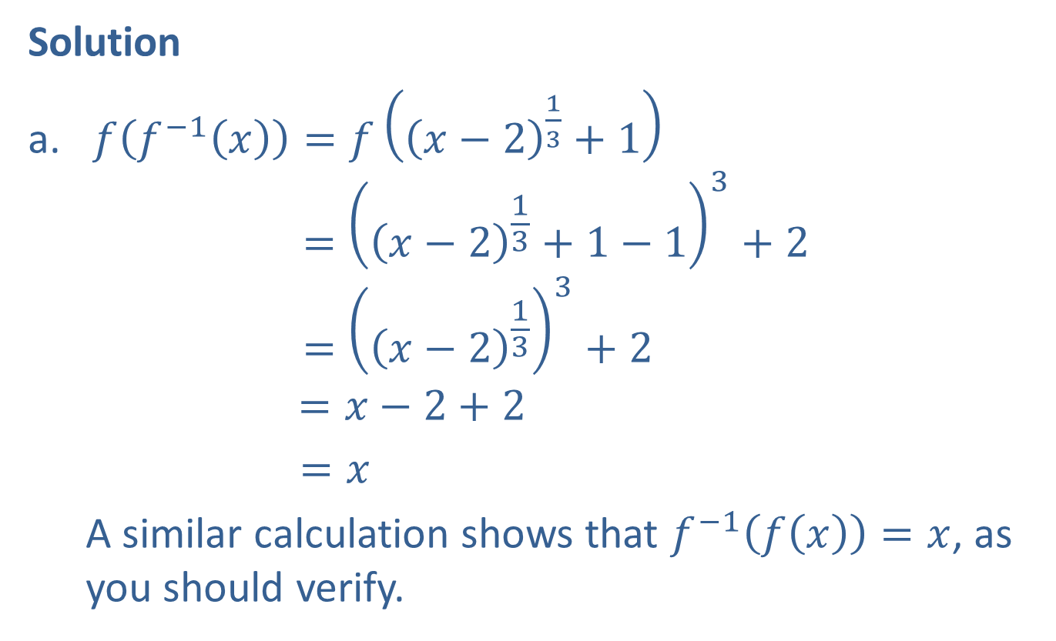
Example 5: Composition of Functions and Inverses (cont.)
Solution
​$f\left(f^{−1}\left(x\right)\right)=f\left({\left(x−2\right)}^{\frac{1}{3}}+1\right)$
$={\left({\left(x−2\right)}^{\frac{1}{3}}+1−1\right)}^{3}+2$
$={\left({\left(x−2\right)}^{\frac{1}{3}}\right)}^{3}+2$
$=x−2+2$
$=x$
  A similar calculation shows that $f^{−1}\left(f\left(x\right)\right)=x$, as you should verify.

Slide 38

Example 5: Composition of Functions and Inverses (cont.)
​$g^{−1}\left(g\left(x\right)\right)=g^{−1}\left(\frac{x−3}{2x+1}\right)$
𝑔−1⁡𝑔𝑥=−𝑥−32𝑥+1−32𝑥−32𝑥+1−1𝑔−1⁡𝑔𝑥=−𝑥−32𝑥+1−32𝑥−32𝑥+1−12𝑥+12𝑥+1𝑔−1⁡𝑔𝑥=−𝑥+3−6𝑥−32𝑥−6−2𝑥−1𝑔−1⁡𝑔𝑥=−7𝑥−7𝑔−1⁡𝑔𝑥=𝑥
​
Similarly, $g\left(g^{−1}\left(x\right)\right)=x$, as you should verify.

