Slide 1
Section 6.1
Polynomial Functions and Polynomial Inequalities

Slide 2
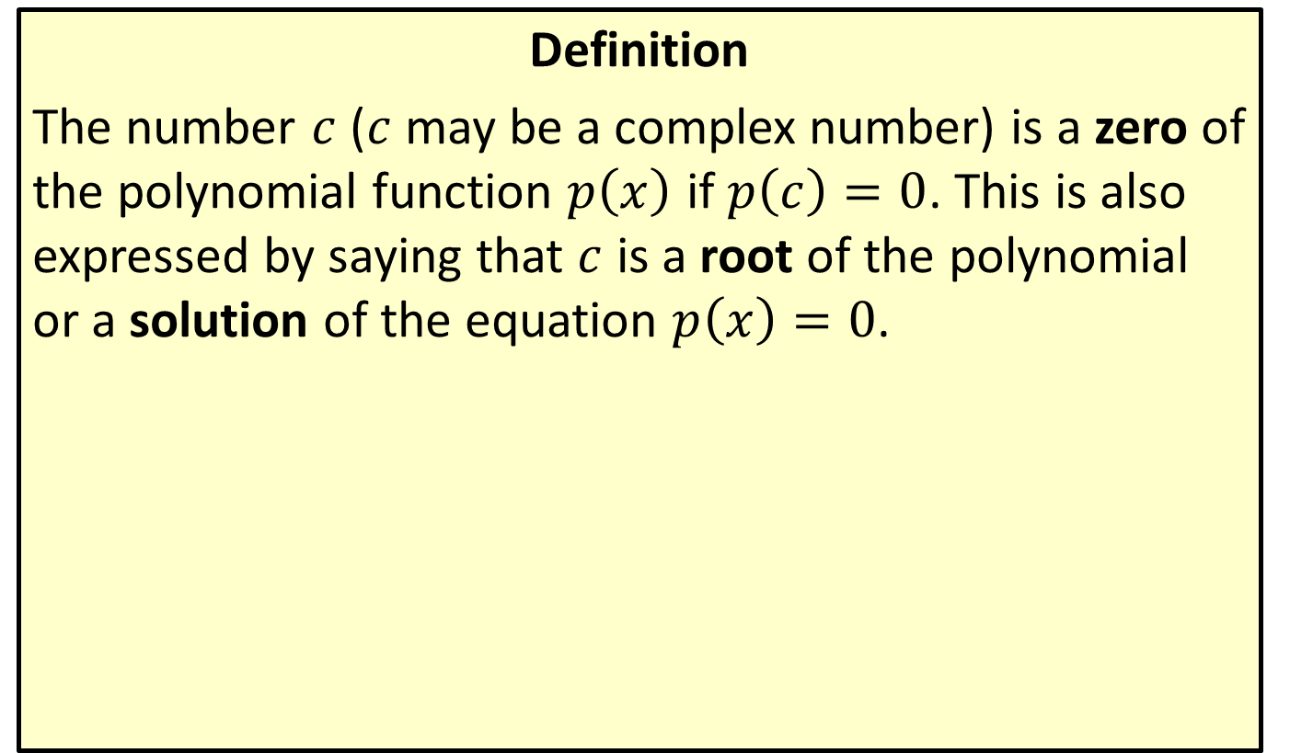
Zeros of a Polynomial
Definition
The number $c$ ($c$ may be a complex number) is a zero of the polynomial function $p⁡\left(x\right)$ if $p\left(c\right)=0$. This is also expressed by saying that $c$ is a root of the polynomial or a solution of the equation $p\left(x\right)=0$.

Slide 3
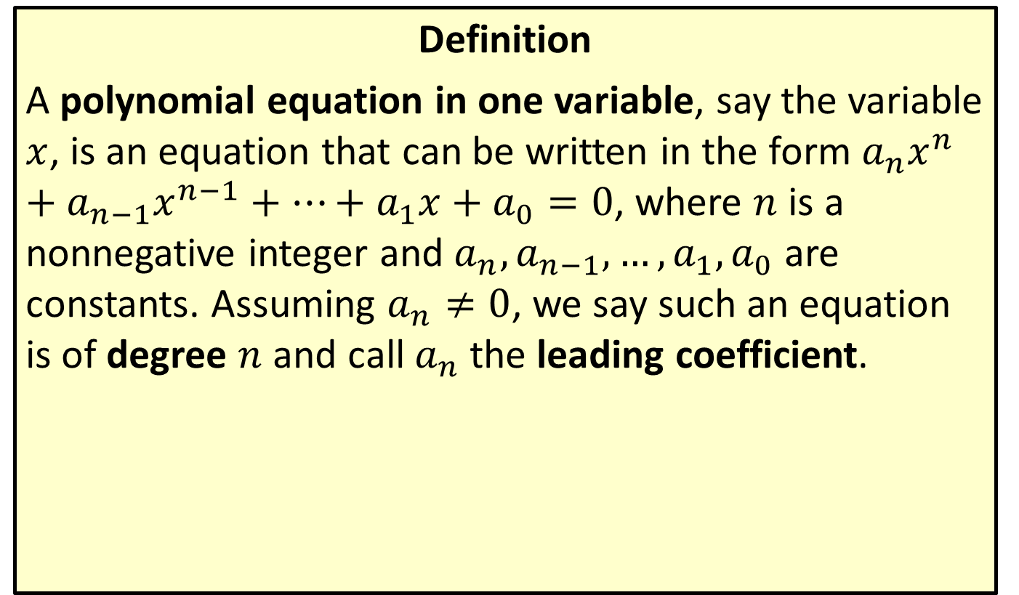
Polynomial Equations
Definition
A polynomial equation in one variable, say the variable $x$, is an equation that can be written in the form $a_{n}x^{n}+a_{n−1}x^{n−1}+…+a_{1}x+a_{0}=0$, where $n$ is a nonnegative integer and $a_{n},a_{n−1},…,a_{1},a_{0}$ are constants. Assuming $a_{n}≠0$, we say such an equation is of degree $n$ and call $a_{n}$ the leading coefficient.

Slide 4
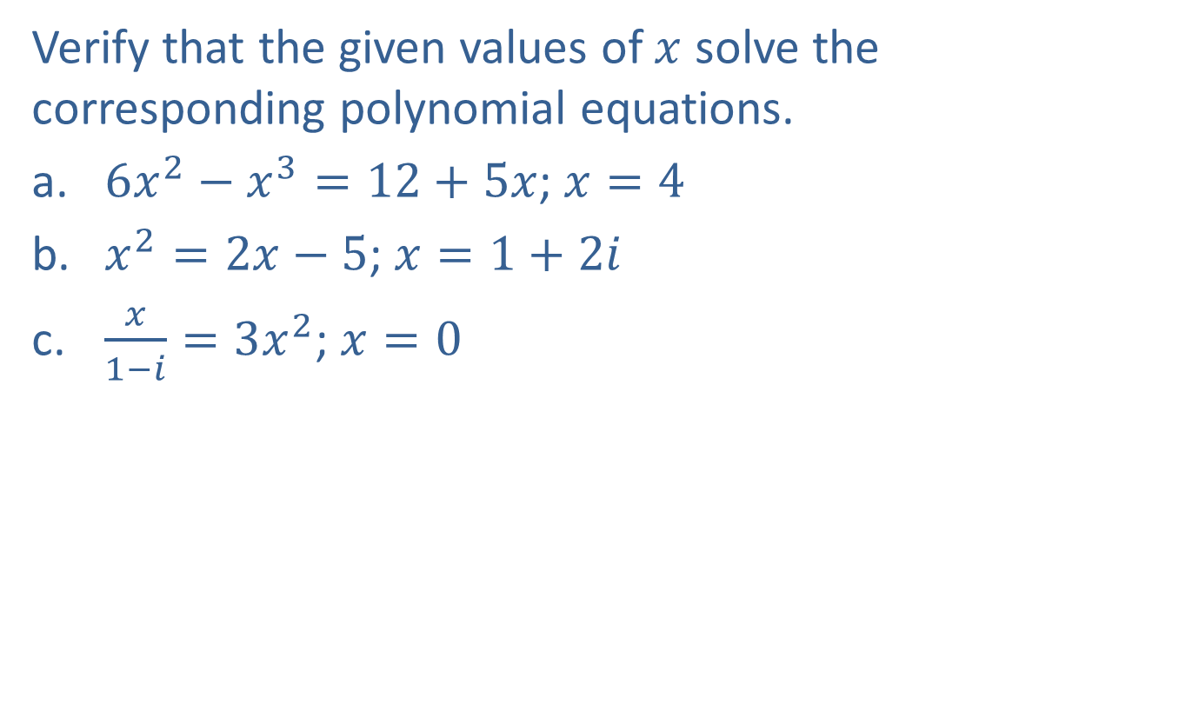
Example 1: Solutions of Polynomial Equations
Verify that the given values of $x$ solve the corresponding polynomial equations.
​$6x^{2}−x^{3}=12+5x$; $x=4$
​$x^{2}=2x−5$; $x=1+2i$
​$\frac{x}{1−i}=3x^{2}$; $x=0$

Slide 5
Note:
When verifying a zero, there is no need to rewrite the equation in the form of the definition.

Slide 6
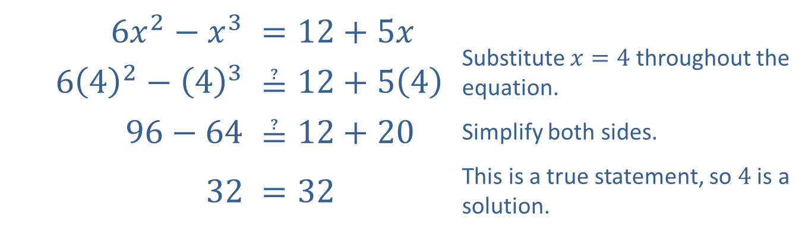
Example 1: Solutions of Polynomial Equations (cont.)
Solution
​
​$6x^{2}−x^{3}$ | ​$=12+5x$ | Substitute $x=4$ throughout the equation.
​$6{\left(4\right)}^{2}−{\left(4\right)}^{3}$ | ​$≟12+5\left(4\right)$
​$96−64$ | ​$≟12+20$ | Simplify both sides.
​32 | ​$=32$ | This is a true statement, so 4 is a solution.

Slide 7
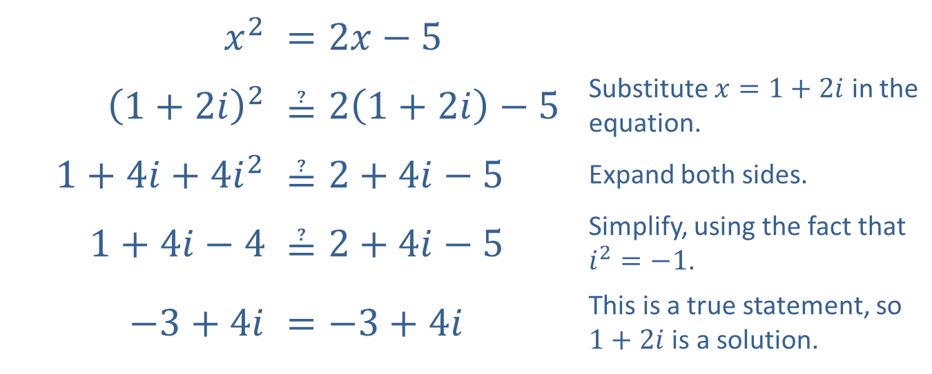
Example 1: Solutions of Polynomial Equations (cont.)
​$x^{2}$ | ​$=2x−5$
​${\left(1+2i\right)}^{2}$ | ​$≟2\left(1+2i\right)−5$ | Substitute $x=1+2i$ in the equation.
​$1+4i+4i^{2}$ | ​$≟2+4i−5$ | Expand both sides.
​$1+4i−4$ | ​$≟2+4i−5$ | Simplify, using the fact that $i^{2}=−1$.
​$−3+4i$ | ​$=−3+4i$ | This is a true statement, so $1+2i$ is a solution.
​

Slide 8
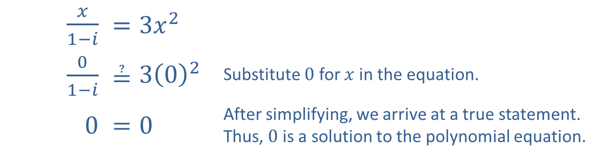
Example 1: Solutions of Polynomial Equations (cont.)
​$\frac{x}{1−i}$ | ​$=3x^{2}$
​$\frac{0}{1−i}$ | ​$≟3{\left(0\right)}^{2}$ | Substitute 0 for $x$ in the equation.
​0 | ​$=0$ | After simplifying, we arrive at a true statement. Thus, 0 is a solution to the polynomial equation.
​

Slide 9
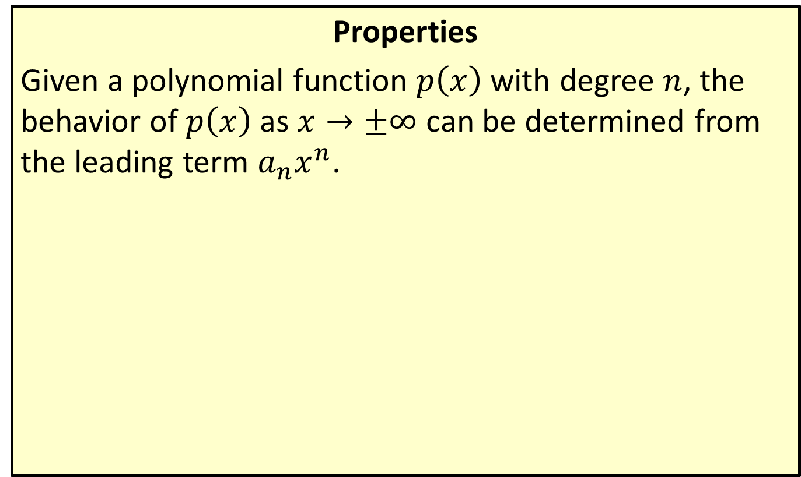

Behavior of Polynomials as $x→±∞$
Properties
Given a polynomial function $p⁡\left(x\right)$ with degree $n$, the behavior of $p⁡\left(x\right)$ as $x→±∞$ can be determined from the leading term $a_{n}x^{n}$.

Slide 10
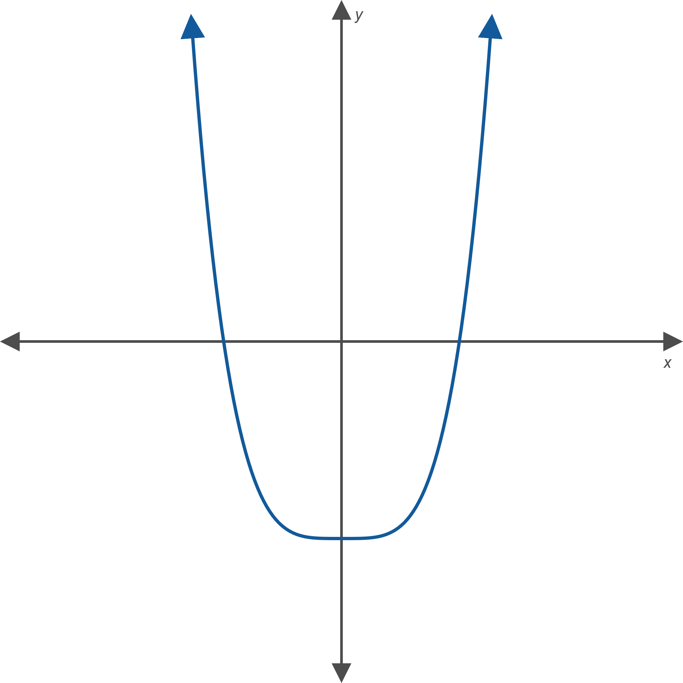
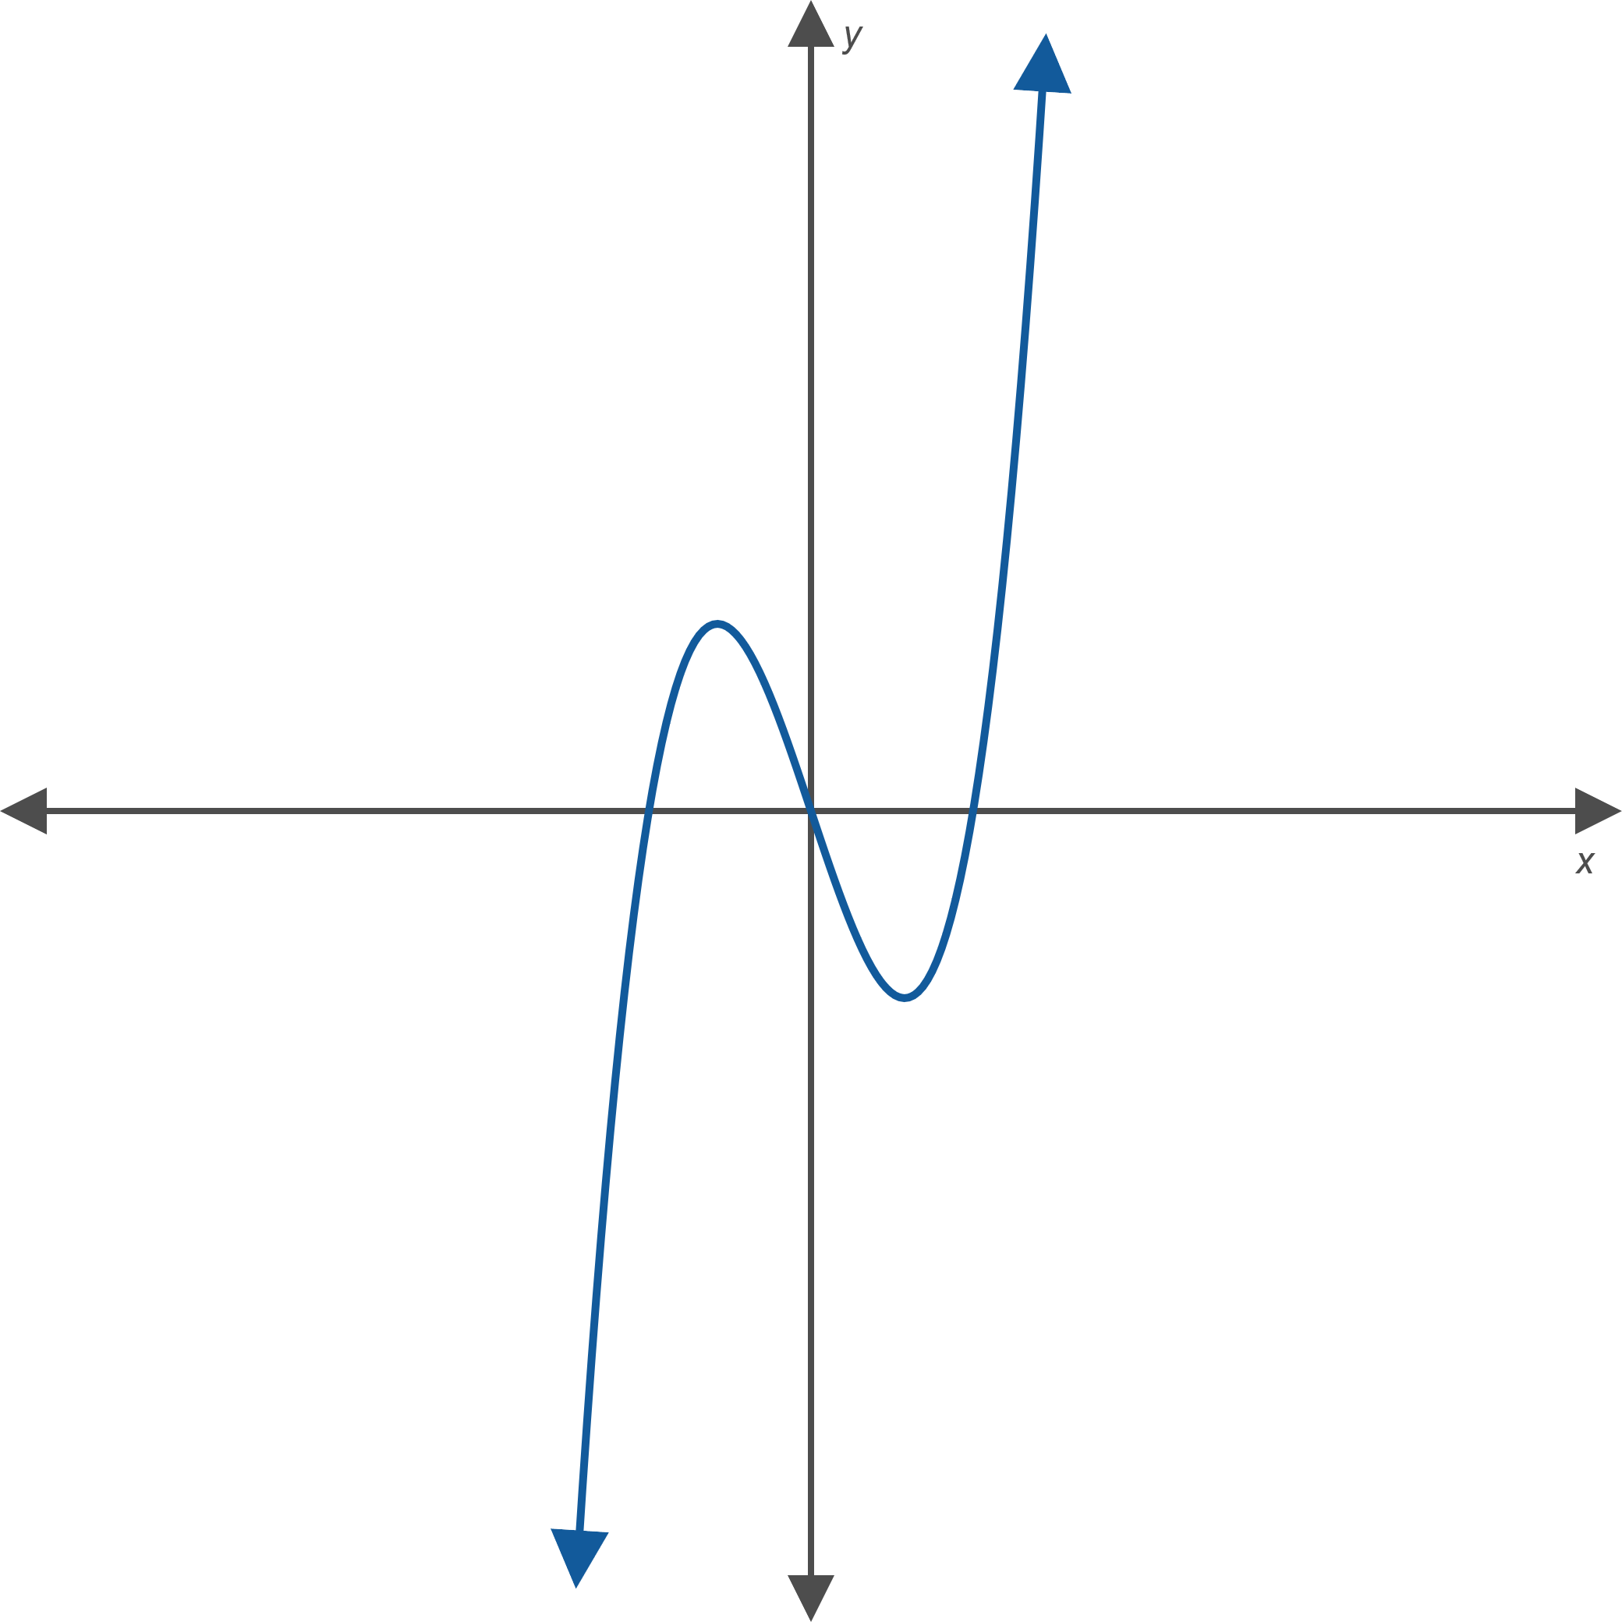
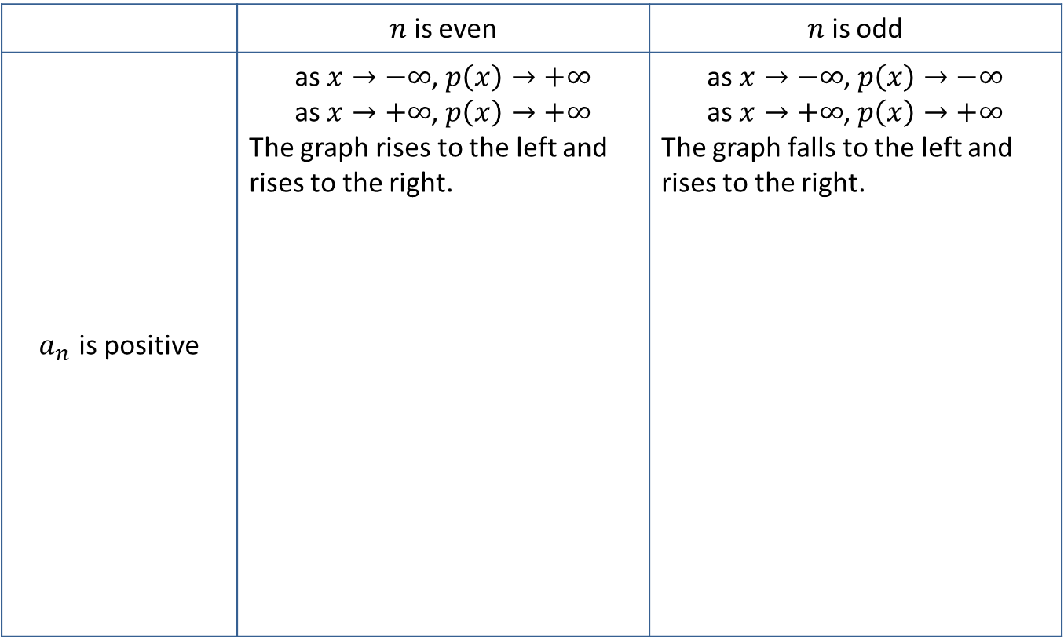

Behavior of Polynomials as $x→±∞$ (cont.)
 | $n$ is even | $n$ is odd
$a_{n}$ is positive | as $x→−∞$, $p\left(x\right)→+∞$ as $x→+∞$, $p\left(x\right)→+∞$ The graph rises to the left and rises to the right. | as $x→−∞$, $p\left(x\right)→−∞$ as $x→+∞$, $p\left(x\right)→+∞$ The graph falls to the left and rises to the right.

Slide 11
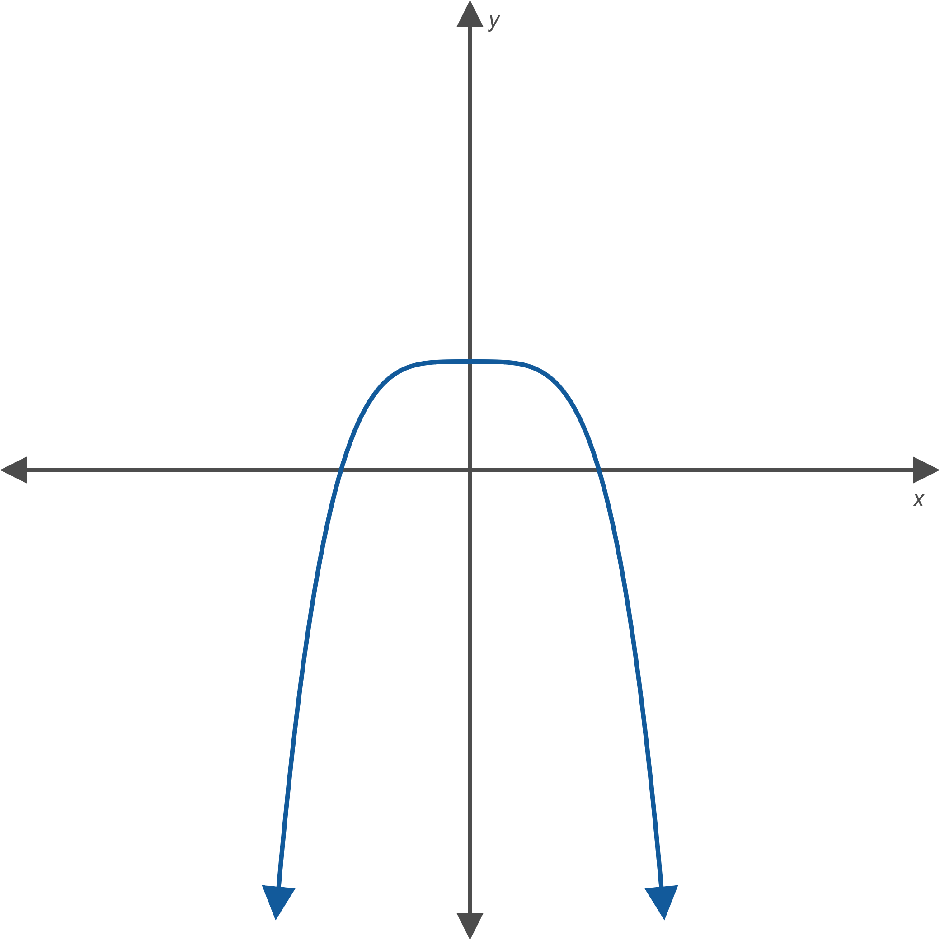
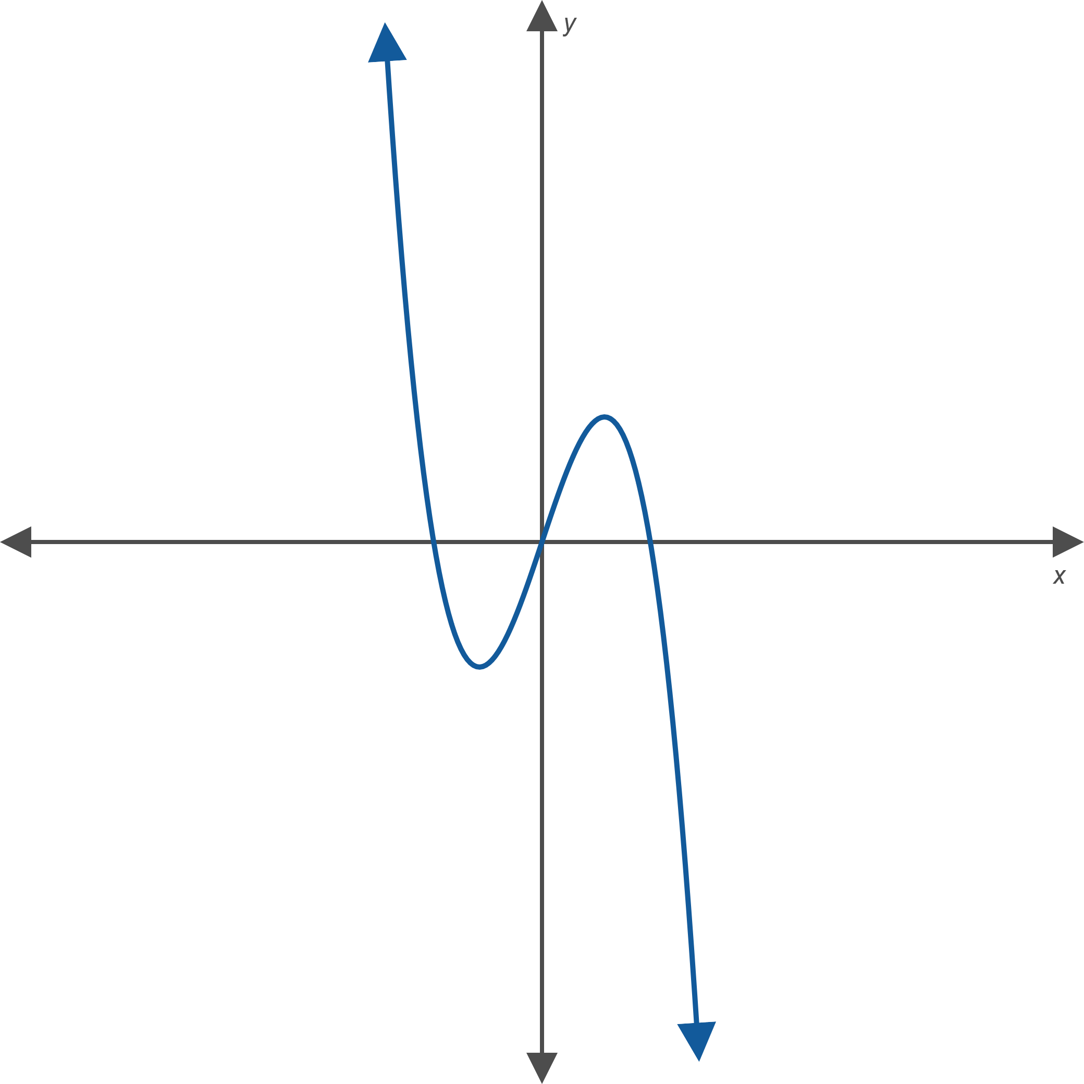

Behavior of Polynomials as $x→±∞$ (cont.)
 | $n$ is even | $n$ is odd
$a_{n}$ is negative | as $x→−∞$, $p\left(x\right)→−∞$ as $x→+∞$, $p\left(x\right)→−∞$ The graph falls to the left and falls to the right. | as $x→−∞$, $p\left(x\right)→+∞$ as $x→+∞$, $p\left(x\right)→−∞$ The graph rises to the left and falls to the right.

Slide 12
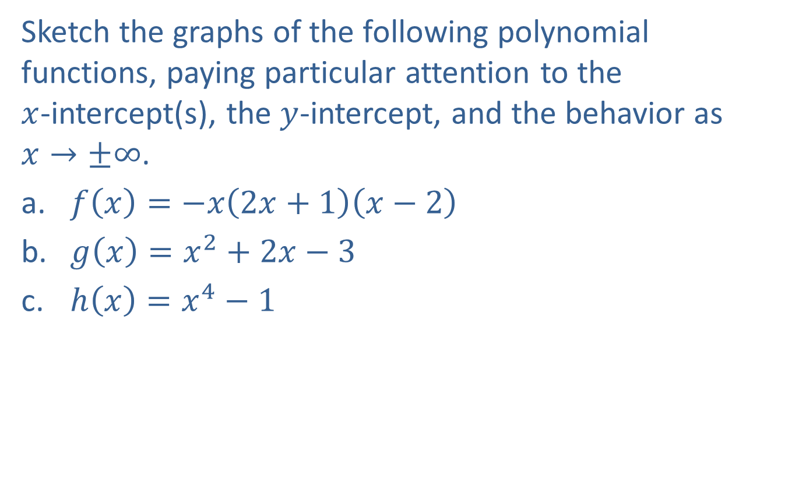
Example 2: Graphing Polynomial Functions
Sketch the graphs of the following polynomial functions, paying particular attention to the
$x$-intercept(s), the $y$-intercept, and the behavior as
$x→±∞$.
​$f\left(x\right)=−x\left(2x+1\right)\left(x−2\right)$
​$g\left(x\right)=x^{2}+2x−3$
​$h\left(x\right)=x^{4}−1$

Slide 13
Note:
As always, plotting additional points will help in sketching an accurate graph.

Slide 14
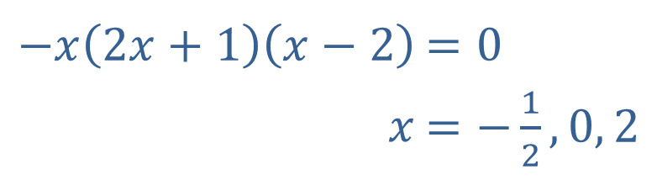
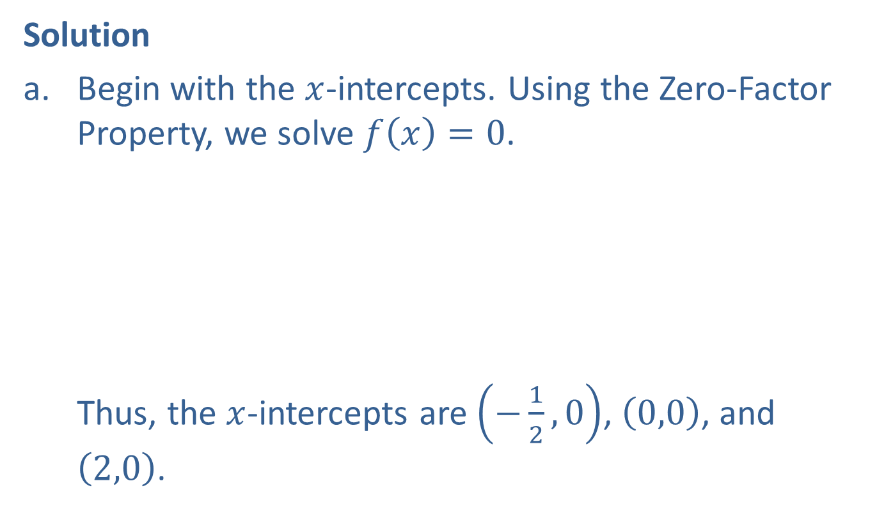
Example 2: Graphing Polynomial Functions (cont.)
Solution
​Begin with the $x$-intercepts. Using the Zero-Factor Property, we solve $f\left(x\right)=0$.
​
Thus, the $x$-intercepts are $\left(−\frac{1}{2},0\right)$, $\left(0,0\right)$, and $\left(2,0\right)$.
​$−x\left(2x+1\right)\left(x−2\right)$ | ​$=0$
​$x$ | ​$=\left.−\frac{1}{2}\right., 0, 2$

Slide 15
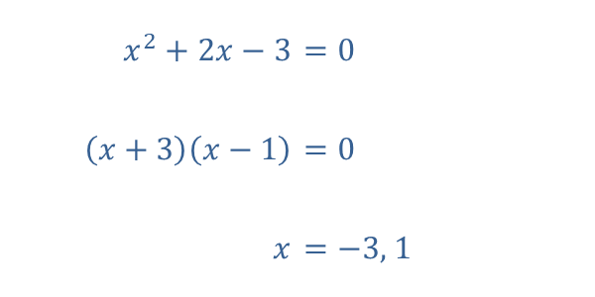
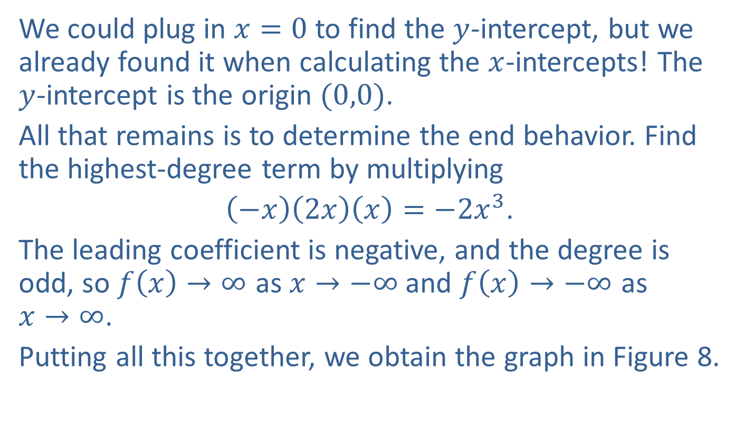
Example 2: Graphing Polynomial Functions (cont.)
​$x^{2}+2x−3$ | ​$=0$
​$\left(x+3\right)\left(x−1\right)$ | ​$=0$
​$x$ | ​$=\left.−3\text{, }1\right.$
We could plug in $x=0$ to find the $y$-intercept, but we already found it when calculating the $x$-intercepts! The
$y$-intercept is the origin $(0,0)$.
All that remains is to determine the end behavior. Find the highest-degree term by multiplying
$\left(−x\right)\left(2x\right)\left(x\right)=−2x^{3}$.
The leading coefficient is negative, and the degree is odd, so $f\left(x\right)→∞$ as $x→−∞$ and $f\left(x\right)→−∞$ as
$x→∞$.
Putting all this together, we obtain the graph in Figure 8. ​

Slide 16
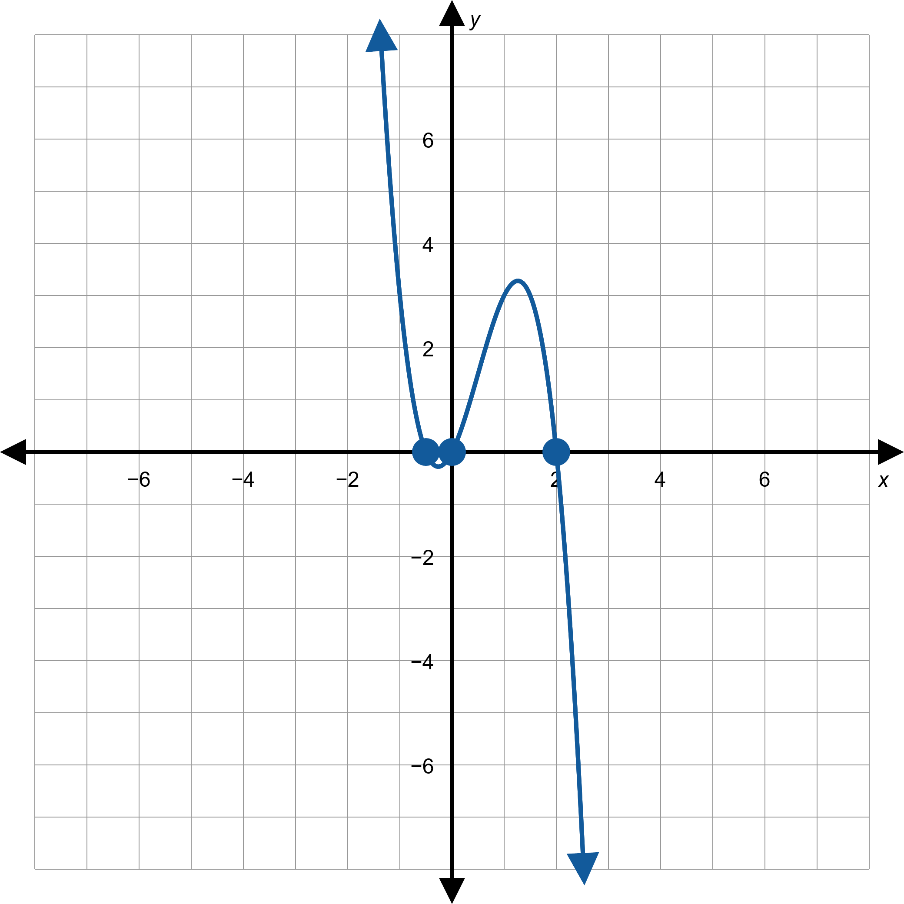
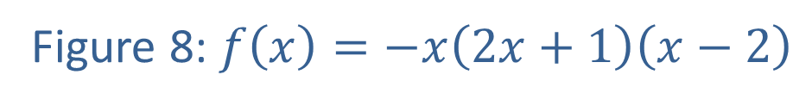
Example 2: Graphing Polynomial Functions (cont.)
Figure 8: $f\left(x\right)=−x\left(2x+1\right)\left(x−2\right)$

Slide 17
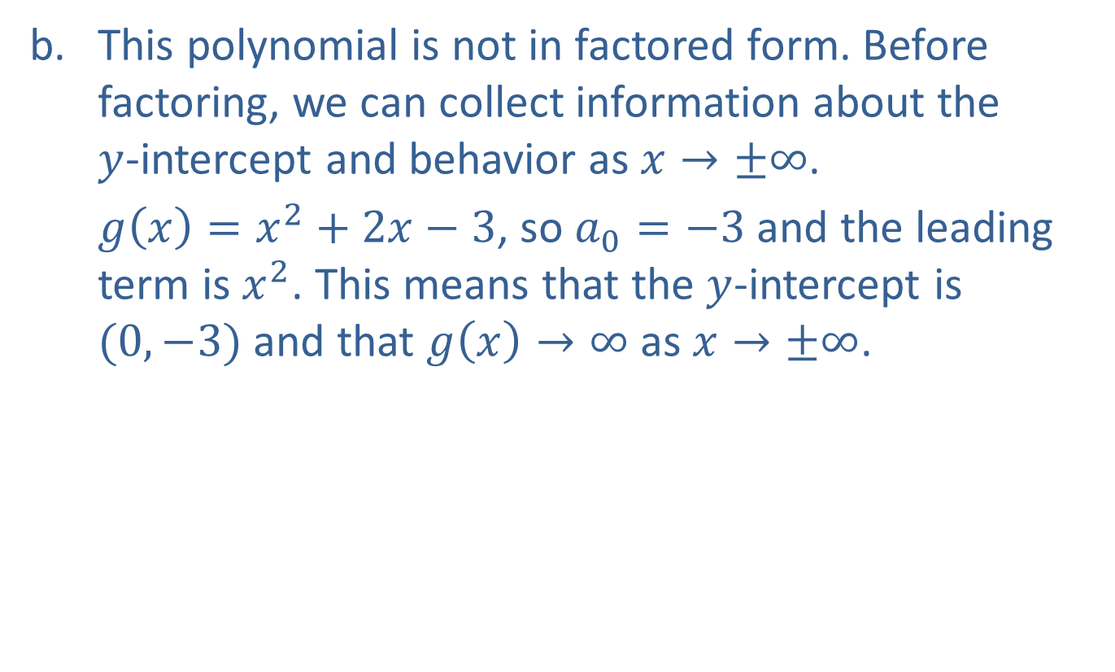
Example 2: Graphing Polynomial Functions (cont.)
​This polynomial is not in factored form. Before factoring, we can collect information about the
$y$-intercept and behavior as $x→±∞$.
​$g\left(x\right)=x^{2}+2x−3$, so $a_{0}=−3$ and the leading term is $x^{2}$. This means that the $y$-intercept is $(0,−3)$ and that $g\left(x\right)→∞$ as $x→±∞$.

Slide 18
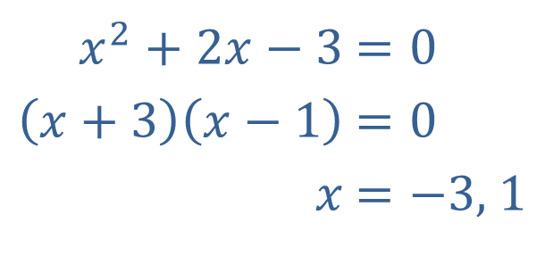

Example 2: Graphing Polynomial Functions (cont.)
​Now, to find the $x$-intercepts, we factor the polynomial.
​Thus, the $x$-intercepts are $(−3,0)$ and $\left(1,0\right)$.
​
​$x^{2}+2x−3$ | ​$=0$
​$\left(x+3\right)\left(x−1\right)$ | ​$=0$
​$x$ | ​$=\left.−3\text{, }1\right.$

Slide 19
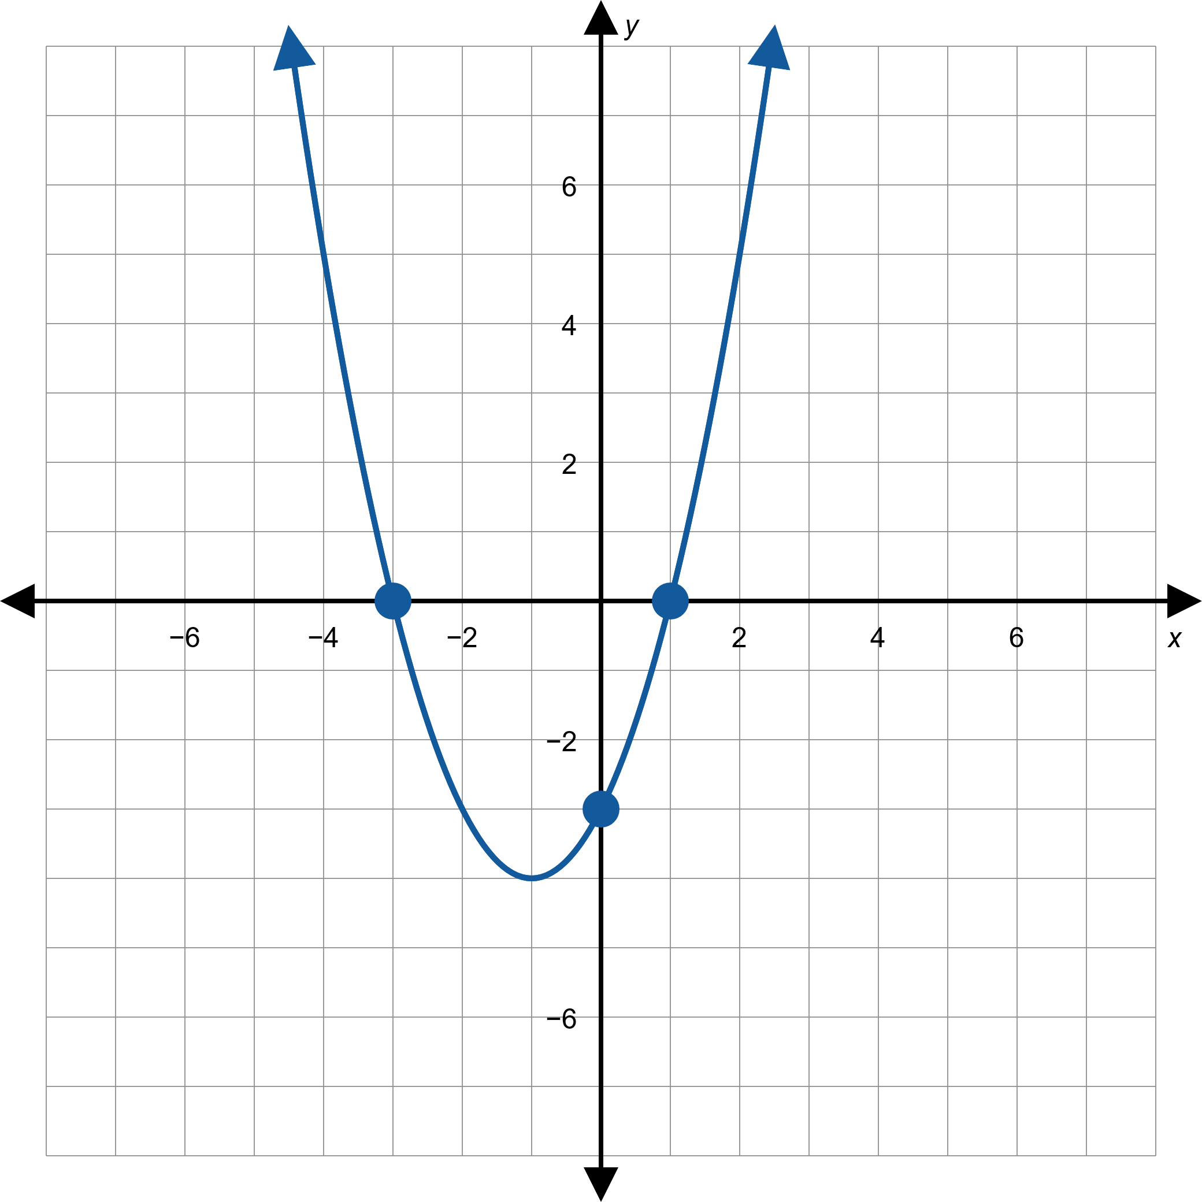
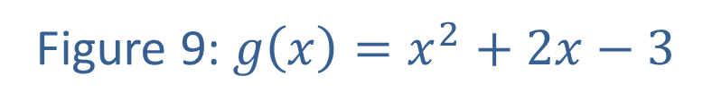
Example 2: Graphing Polynomial Functions (cont.)
Figure 9: $g\left(x\right)=x^{2}+2x−3$

Slide 20

Example 2: Graphing Polynomial Functions (cont.)
As with the previous example, we determine the
$y$-intercept and behavior before factoring.
​$h\left(x\right)=x^{4}−1$, so $a_{0}=−1$ and the leading term is $x^{4}$. This tells us that the $y$-intercept is $(0,−1)$ and that $h\left(x\right)→∞$ as $x→±∞$.

Slide 21
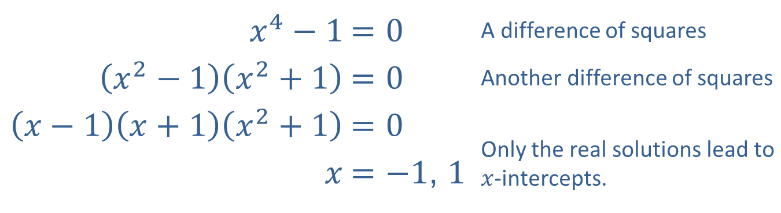

Example 2: Graphing Polynomial Functions (cont.)
​Once again, we factor the polynomial to calculate the $x$-intercepts.
​
Here, the $x$-intercepts are $(−1,0)$ and $\left(1,0\right)$.
​
​$x^{4}−1$ | ​$=0$ | A difference of squares
​$\left(x^{2}−1\right)\left(x^{2}+1\right)$ | ​$=0$ | Another difference of squares
$$\left(x−1\right)\left(x+1\right)\left(x^{2}+1\right)$$ | $$=0$$ | Only the real solutions lead to $x$-intercepts.
​$x$ | ​$=\left.−1\text{, }1\right.$

Slide 22
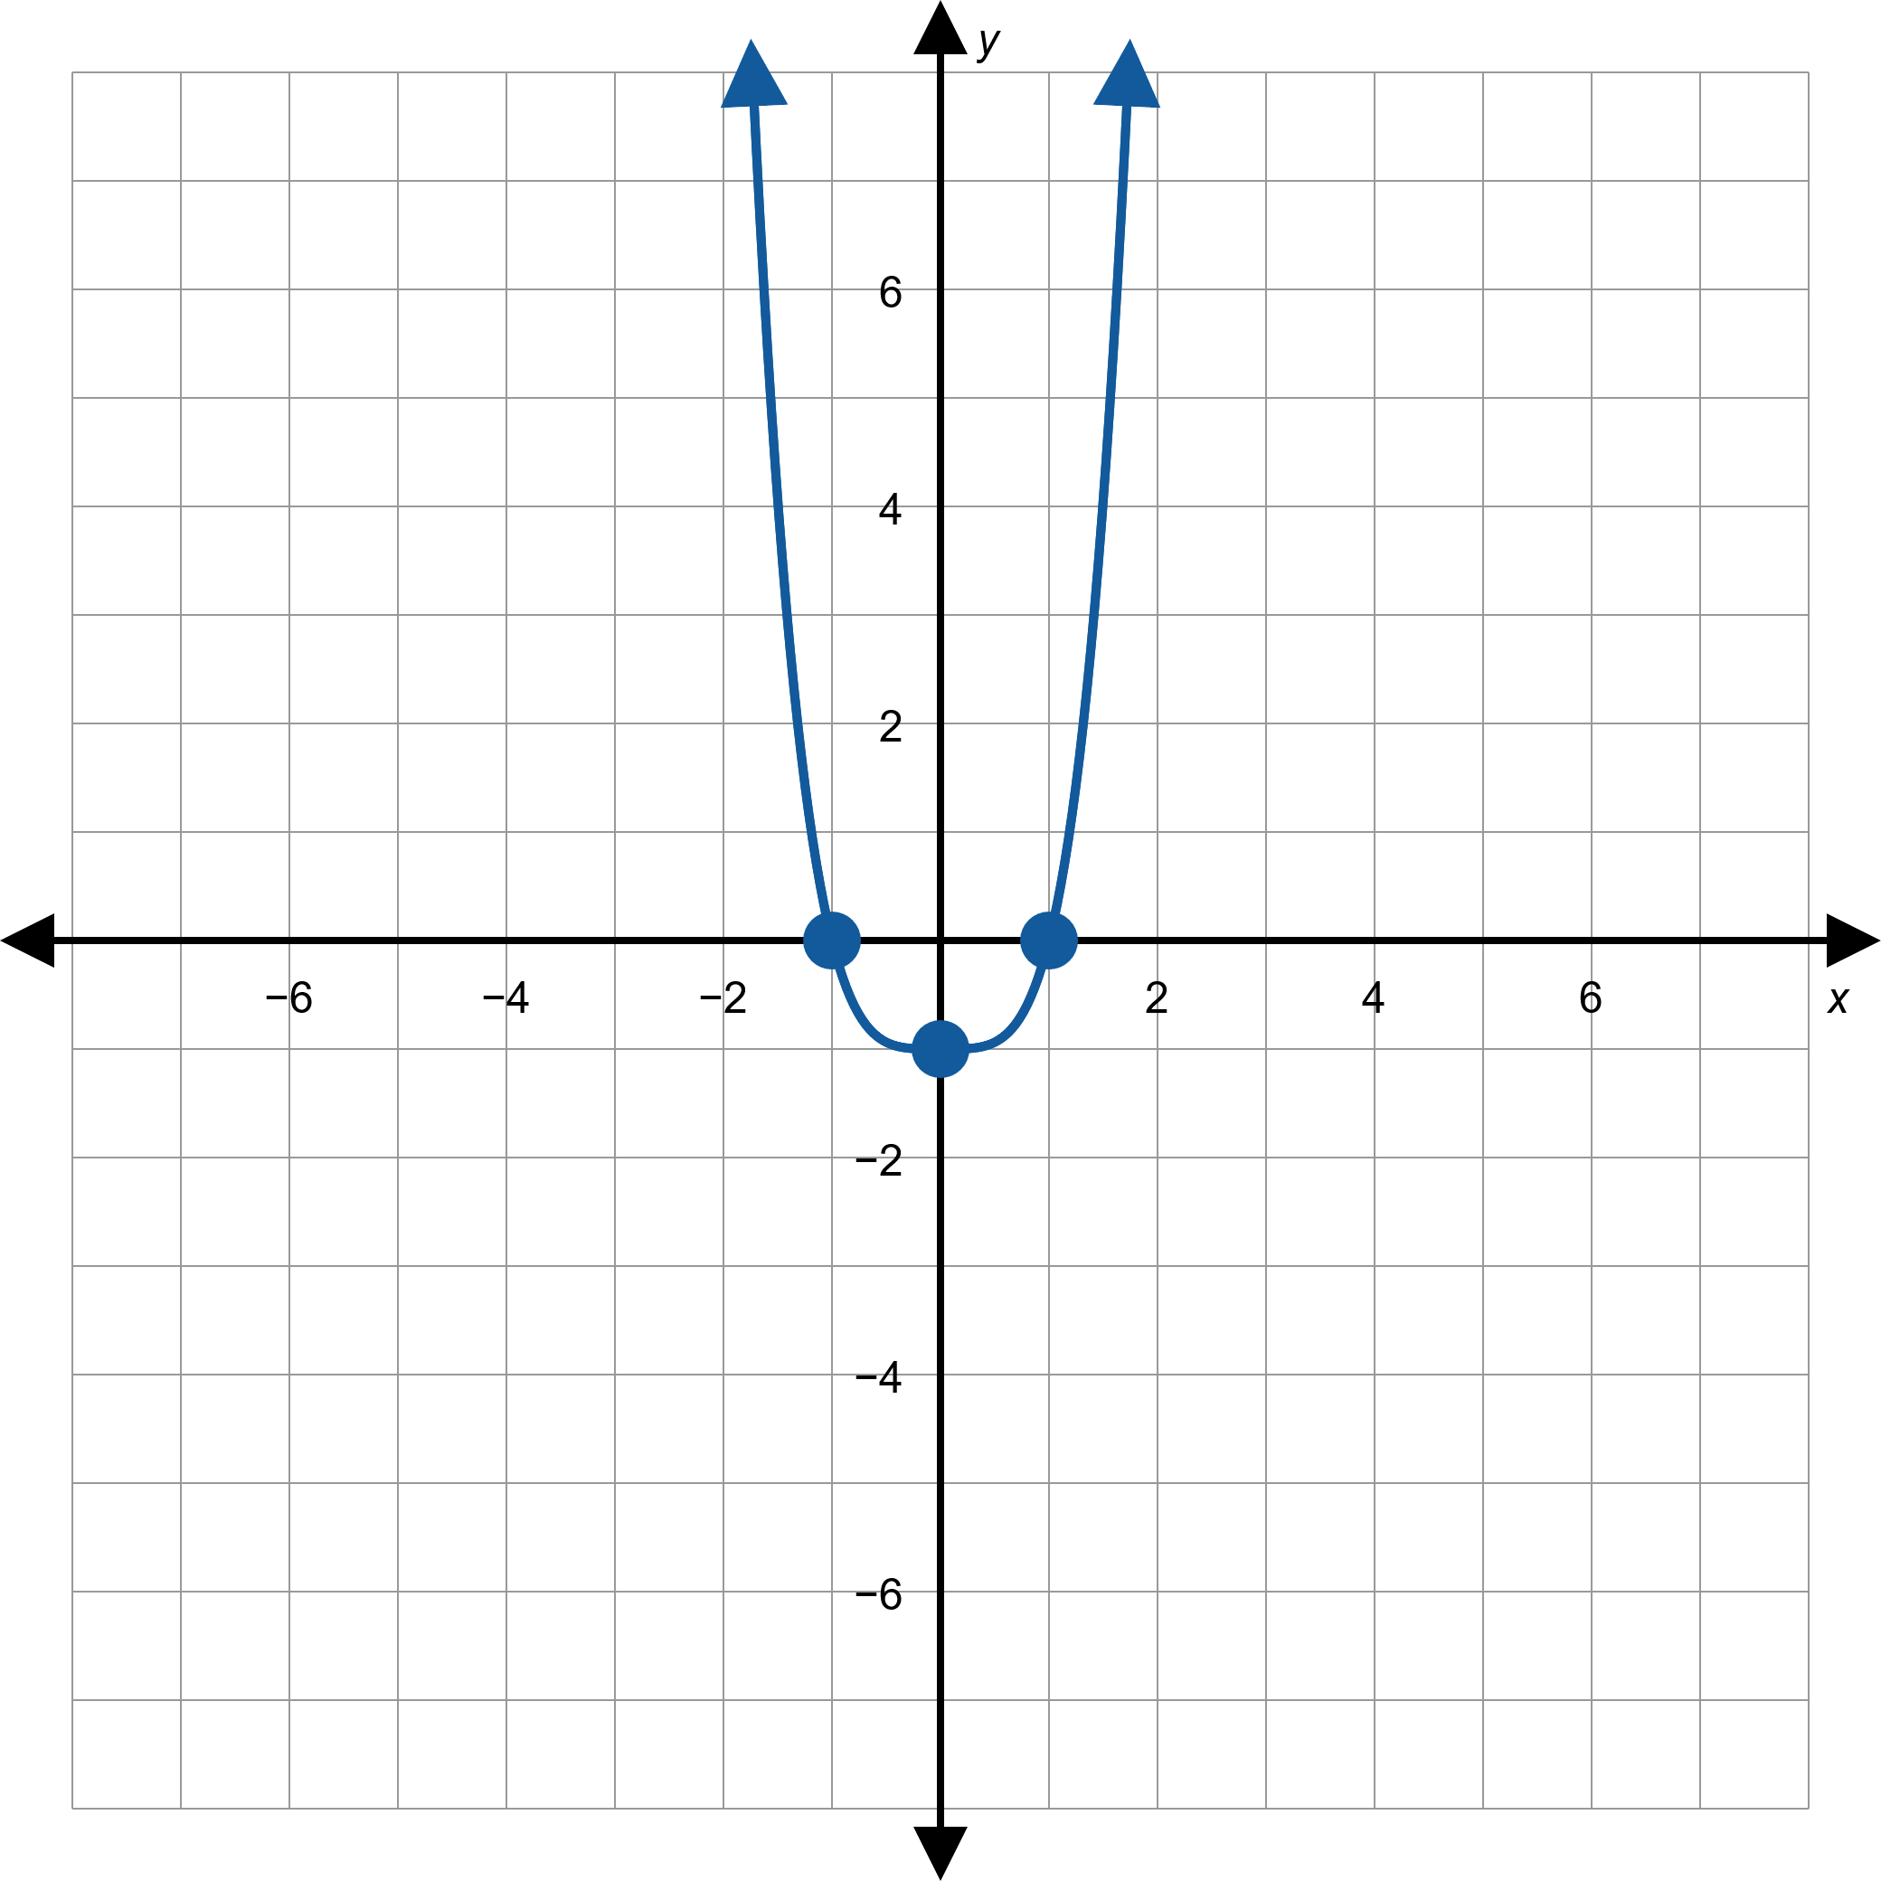
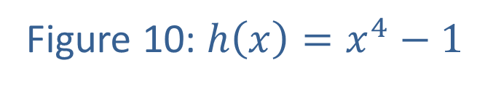
Example 2: Graphing Polynomial Functions (cont.)
Figure 10: $h\left(x\right)=x^{4}−1$

Slide 23
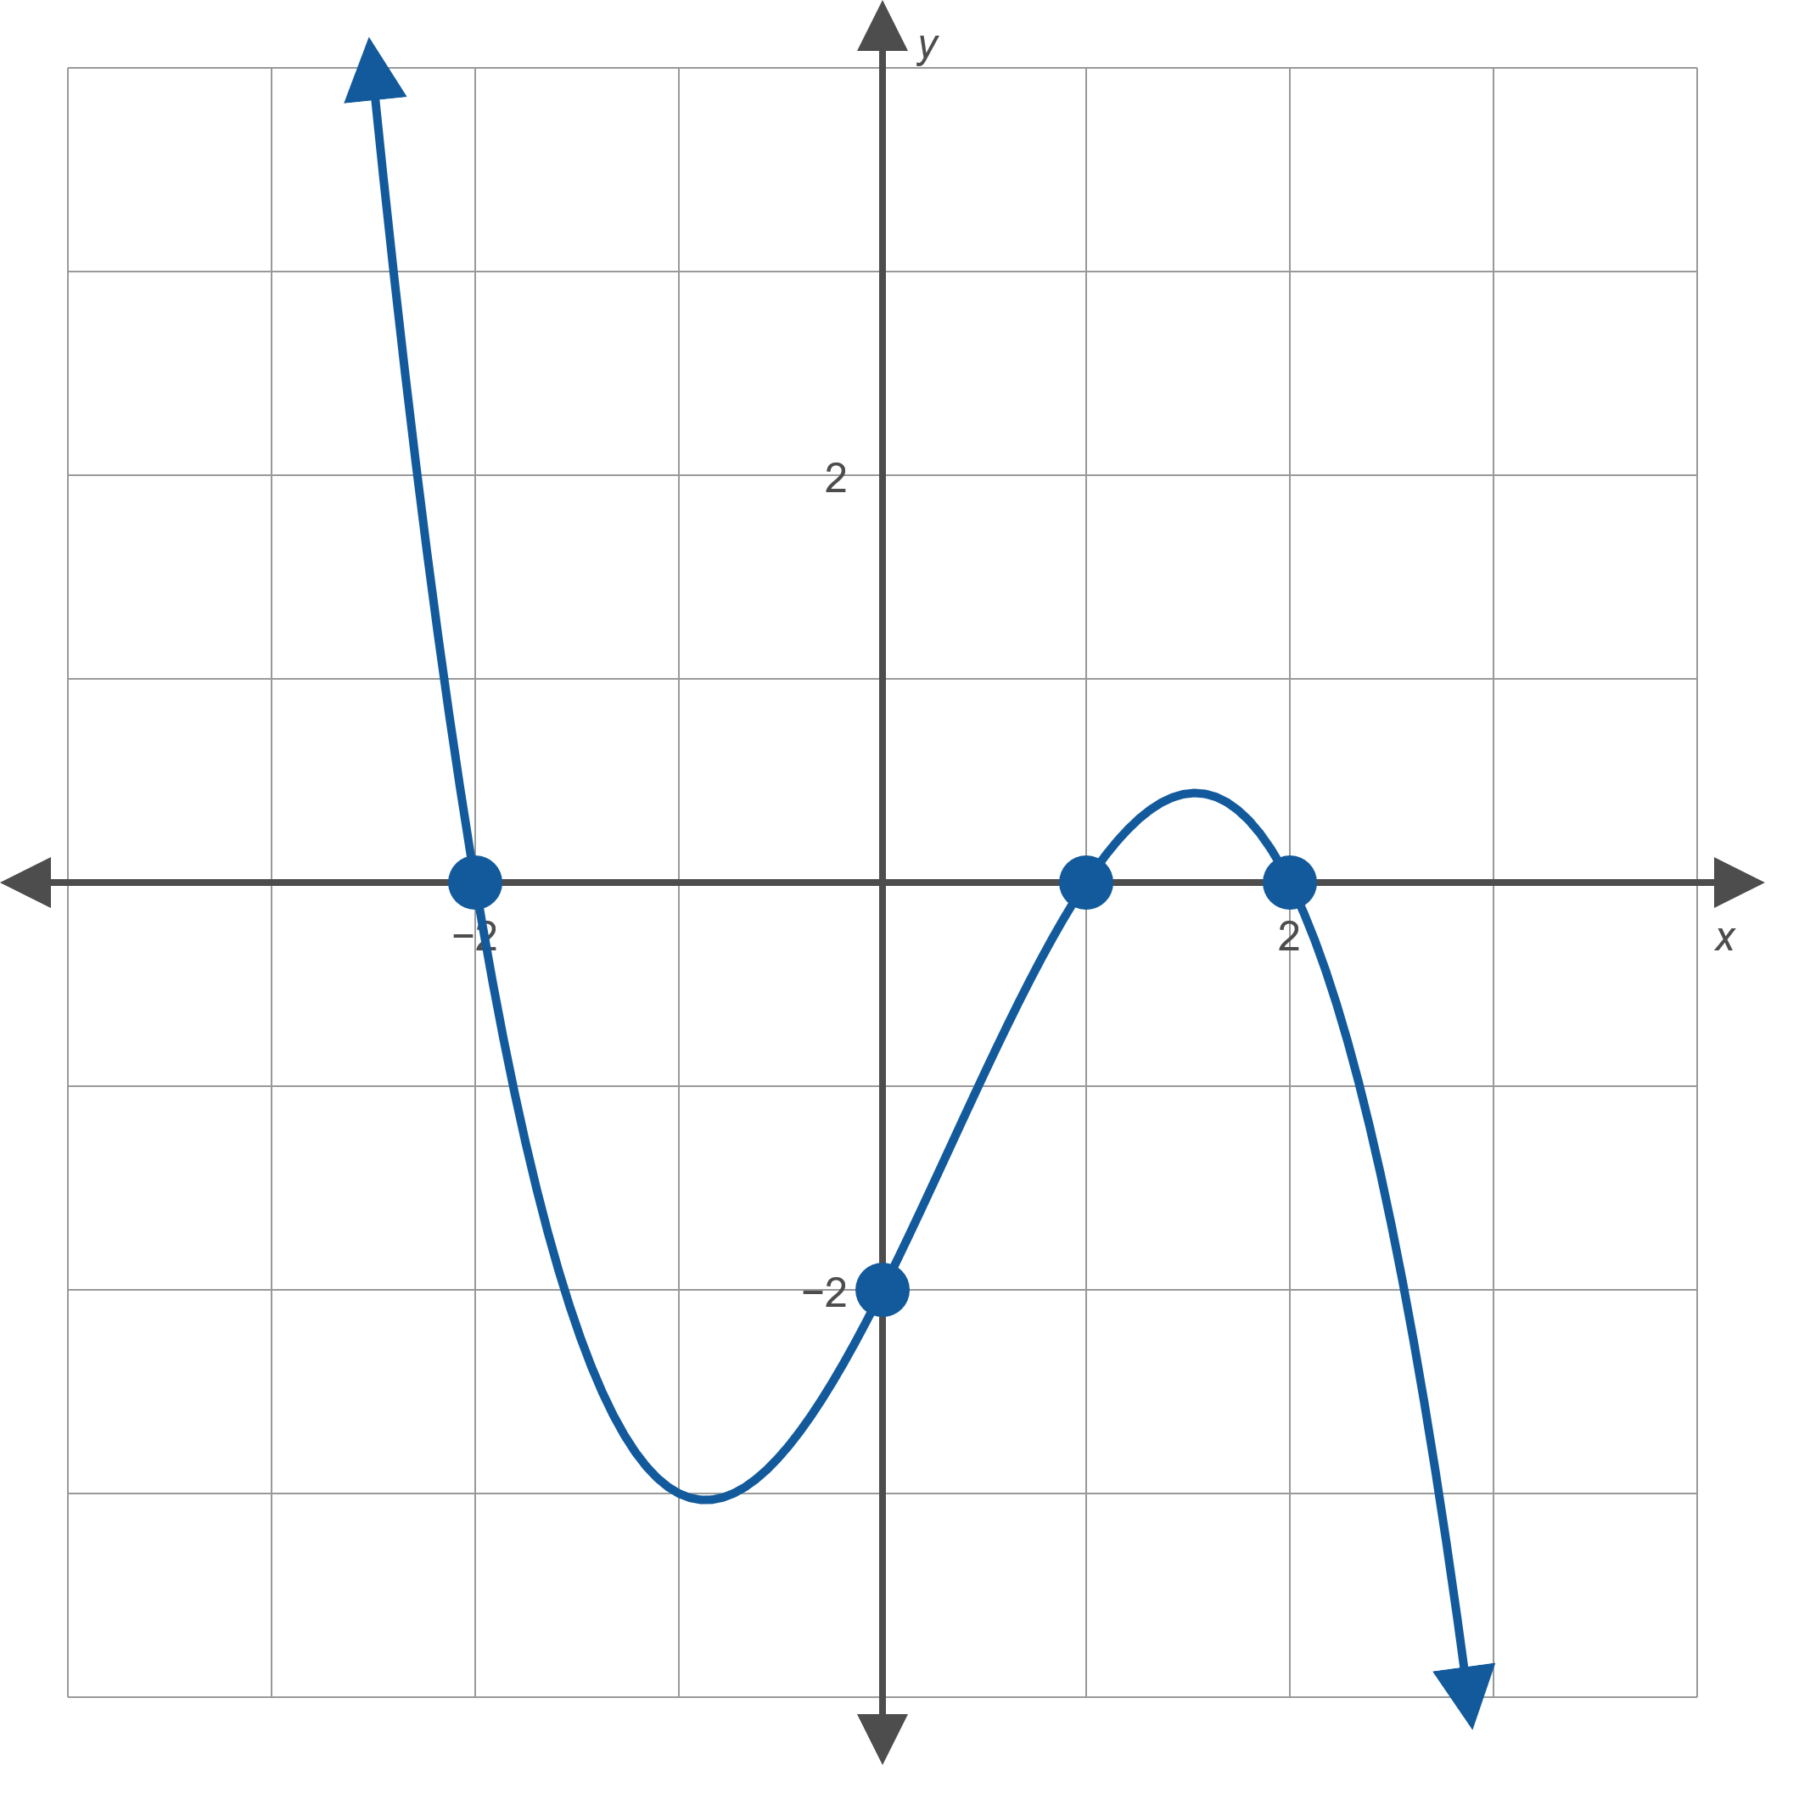
Example 3: Constructing a Polynomial Function from a Graph
Find the polynomial of lowest possible degree that corresponds to the graph in Figure 11.
Figure 11

Slide 24
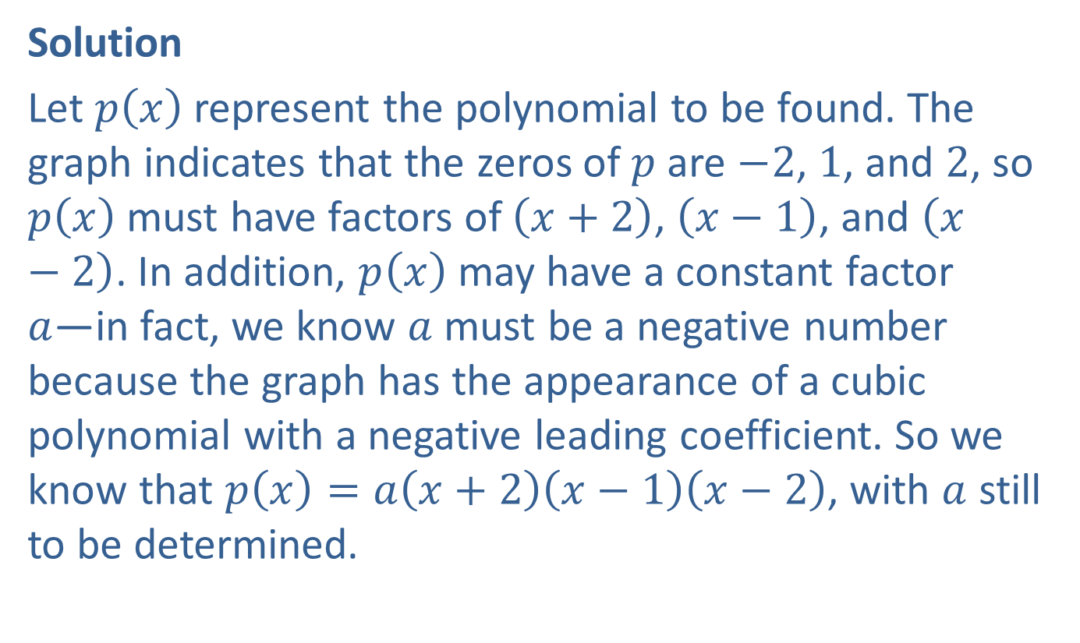
Example 3: Constructing a Polynomial Function from a Graph (cont.)
Solution
Let $p⁡\left(x\right)$ represent the polynomial to be found. The graph indicates that the zeros of $p$ are $−2$, 1, and 2, so $p⁡\left(x\right)$ must have factors of $\left(x+2\right)$, $\left(x−1\right)$, and $\left(x−2\right)$. In addition, $p⁡\left(x\right)$ may have a constant factor
$a$—in fact, we know $a$ must be a negative number because the graph has the appearance of a cubic polynomial with a negative leading coefficient. So we know that $p\left(x\right)=a\left(x+2\right)\left(x−1\right)\left(x−2\right)$, with $a$ still to be determined.

Slide 25
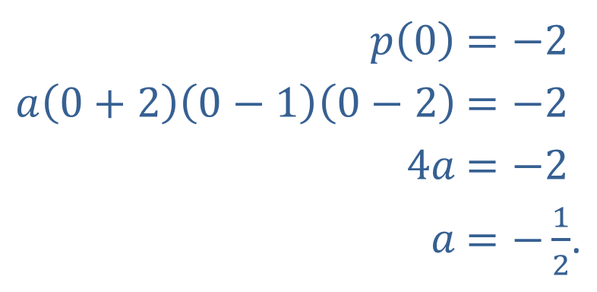

Example 3: Constructing a Polynomial Function from a Graph (cont.)
We can solve for $a$ by noting that the graph has a
$y$-intercept at $(0,−2)$, so
​
Hence, $p\left(x\right)=\left(−\frac{1}{2}\right)\left(x+2\right)\left(x−1\right)\left(x−2\right)$ is the desired polynomial.
​$p⁡\left(0\right)$ | ​$=−2$
​$a\left(0+2\right)\left(0−1\right)\left(0−2\right)$ | ​$=−2$
​$4a$ | ​$=−2$
​$a$ | ​$=−\frac{1}{2}$.

Slide 26
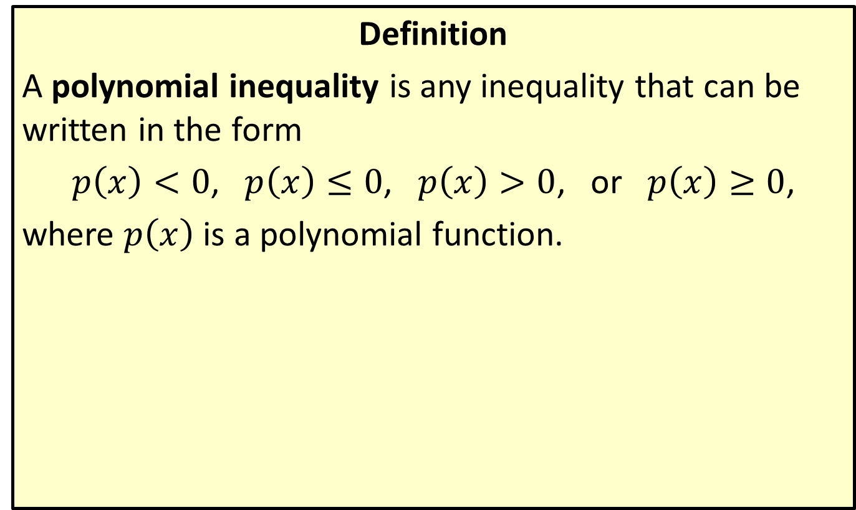
Polynomial Inequalities
Definition
A polynomial inequality is any inequality that can be written in the form
$p\left(x\right)<0$, $p\left(x\right)≤0$, $p\left(x\right)>0$, or $p\left(x\right)≥0$,
where $p⁡\left(x\right)$ is a polynomial function.

Slide 27

Example 4: Solving Polynomial Inequalities Using a Graph
Solve the polynomial inequalities, given the graph of $f\left(x\right)=\left(x+3\right)\left(x+1\right)\left(x−2\right)$ in Figure 12.
​$\left(x+3\right)\left(x+1\right)\left(x−2\right)<0$
​$\left(x+3\right)\left(x+1\right)\left(x−2\right)≥0$

Slide 28
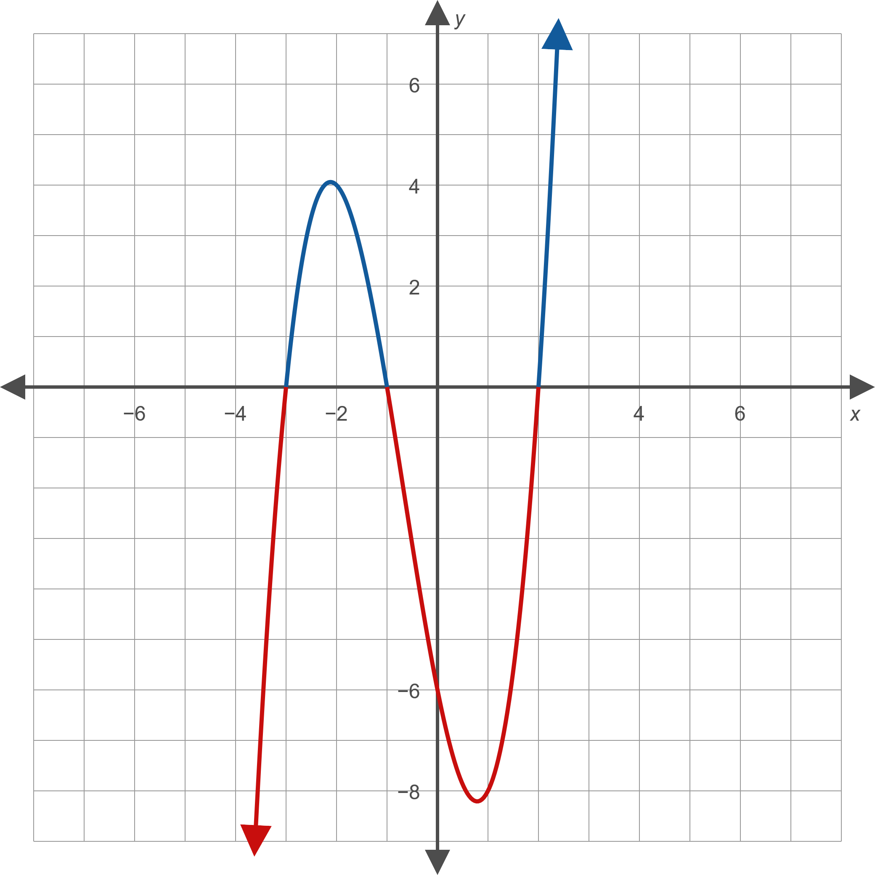
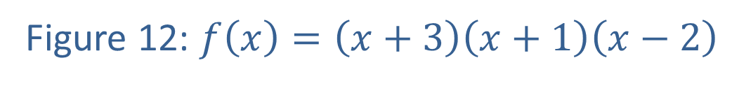
Example 4: Solving Polynomial Inequalities Using a Graph (cont.)
Figure 12: $f\left(x\right)=\left(x+3\right)\left(x+1\right)\left(x−2\right)$

Slide 29
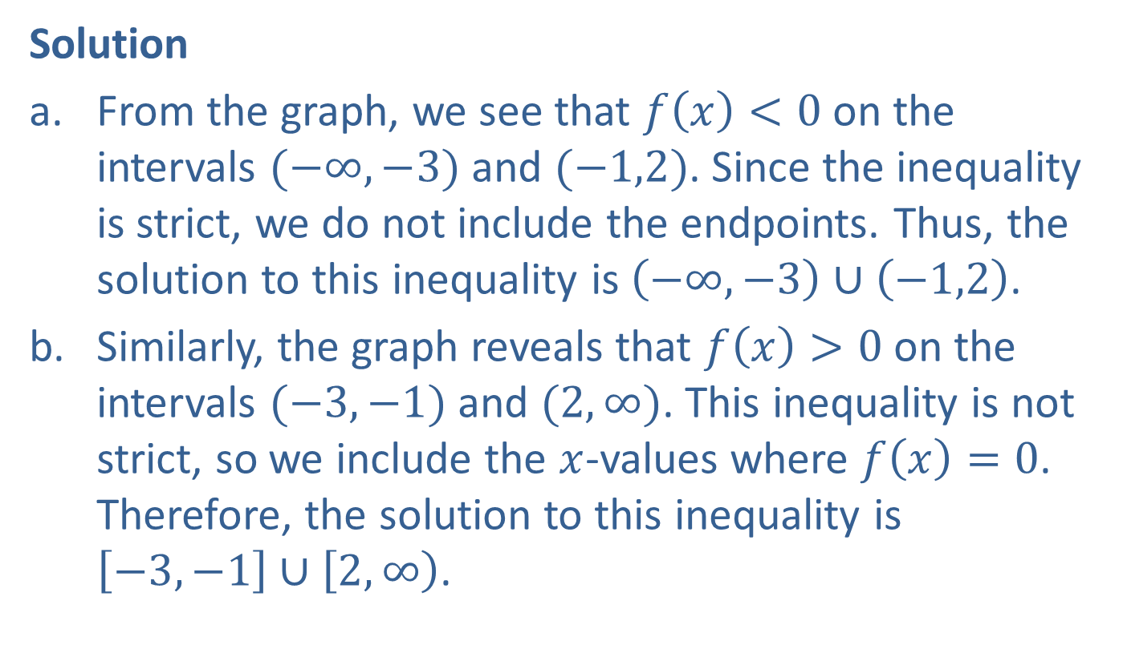
Example 4: Solving Polynomial Inequalities Using a Graph (cont.)
Solution
​From the graph, we see that $f\left(x\right)<0$ on the intervals $(−∞,−3)$ and $(−1,2)$. Since the inequality is strict, we do not include the endpoints. Thus, the solution to this inequality is $\left(−∞,−3\right)∪\left(−1,2\right)$.
​Similarly, the graph reveals that $f\left(x\right)>0$ on the intervals $(−3,−1)$ and $(2,∞)$. This inequality is not strict, so we include the $x$-values where $f\left(x\right)=0$. Therefore, the solution to this inequality is
$\left[−3,−1\right]∪\left[2,∞\right)$.

Slide 30
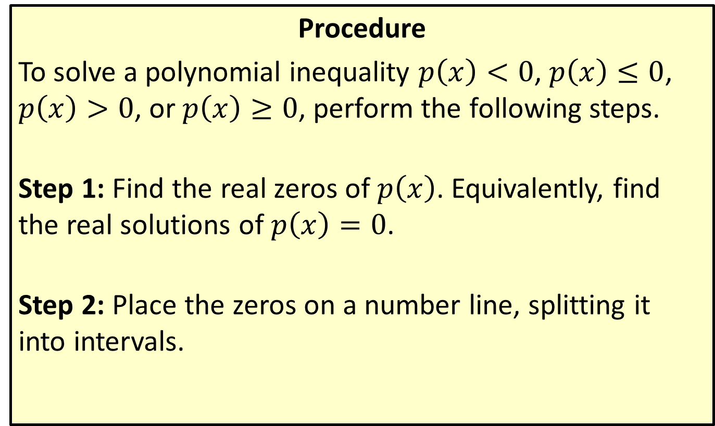
Solving Polynomial Inequalities Using the
Sign-Test Method
Procedure
To solve a polynomial inequality $p\left(x\right)<0$, $p\left(x\right)≤0$, $p\left(x\right)>0$, or $p\left(x\right)≥0$, perform the following steps.
Step 1: Find the real zeros of $p\left(x\right)$. Equivalently, find the real solutions of $p\left(x\right)=0$.
Step 2: Place the zeros on a number line, splitting it into intervals.

Slide 31
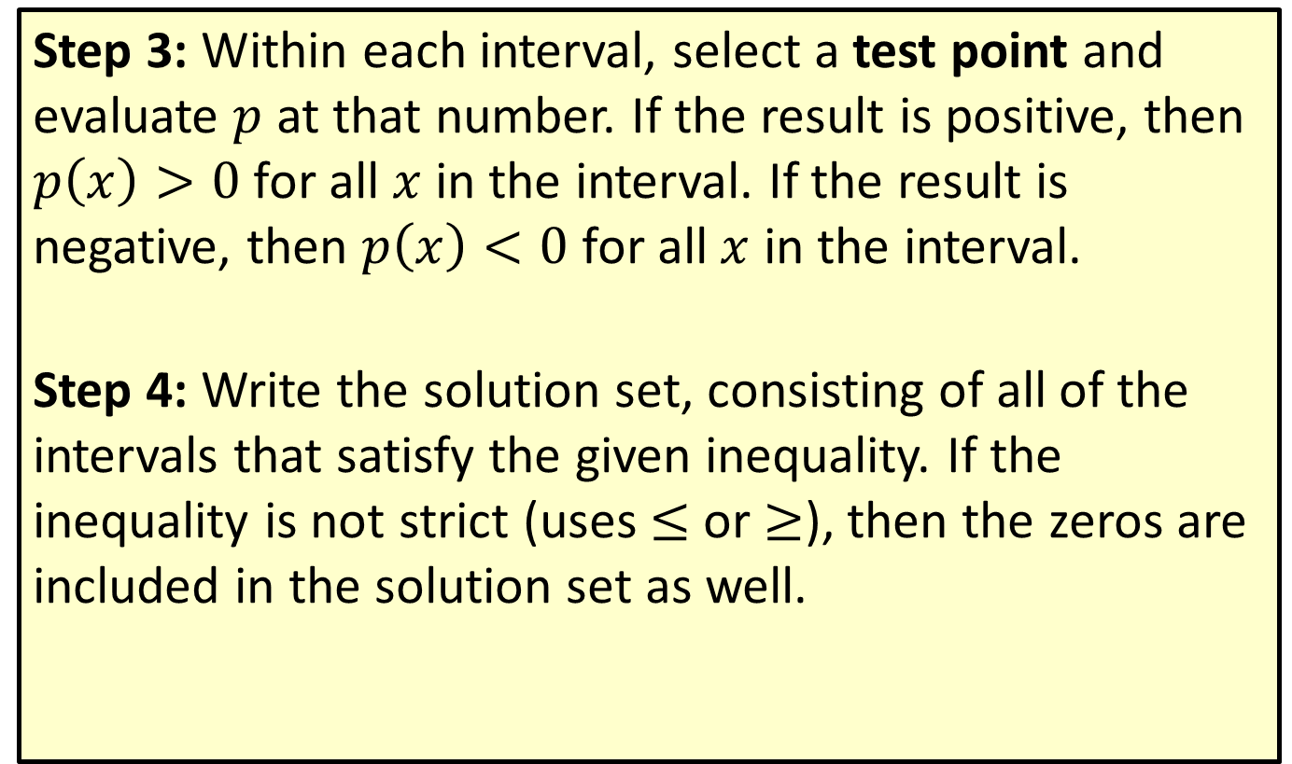
Solving Polynomial Inequalities Using the
Sign-Test Method (cont.)
Step 3: Within each interval, select a test point and evaluate $p$ at that number. If the result is positive, then $p\left(x\right)>0$ for all $x$ in the interval. If the result is negative, then $p\left(x\right)<0$ for all $x$ in the interval.
Step 4: Write the solution set, consisting of all of the intervals that satisfy the given inequality. If the inequality is not strict (uses $≤$ or $≥$), then the zeros are included in the solution set as well.

Slide 32

Example 5: Solving Polynomial Inequalities Using the Sign-Test Method
Solve the polynomial inequality
$\left(x−2\right)\left(x+5\right)\left(x−4\right)>0$.

Slide 33
Note:
When choosing test points, integers (especially 0) are usually easiest to work with.

Slide 34
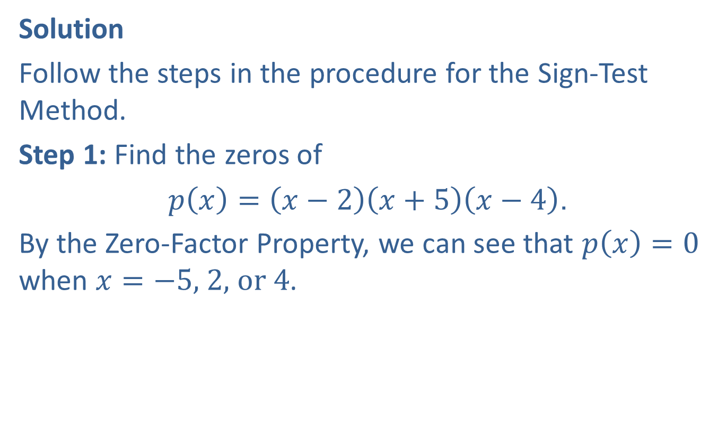
Example 5: Solving Polynomial Inequalities Using the Sign-Test Method (cont.)
Solution
Follow the steps in the procedure for the Sign-Test Method.
Step 1: Find the zeros of
$p\left(x\right)=\left(x−2\right)\left(x+5\right)\left(x−4\right)$.
By the Zero-Factor Property, we can see that $p\left(x\right)=0$ when $x=−5\text{, }2\text{, }\text{or} 4$.

Slide 35
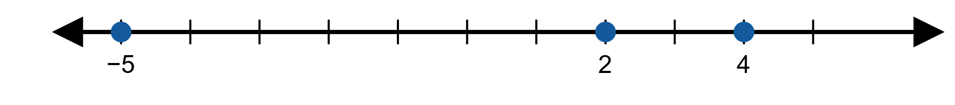
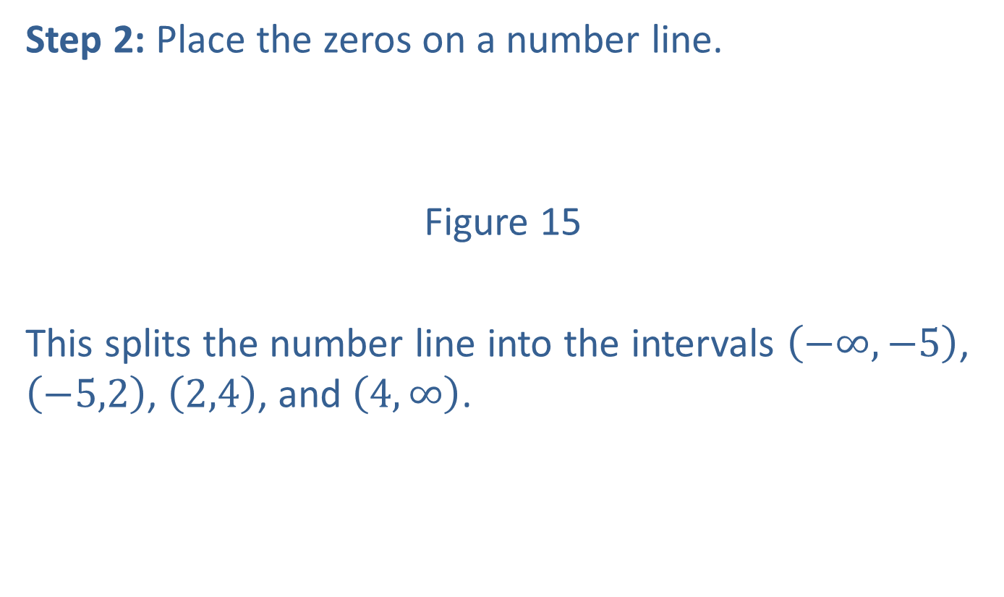
Example 5: Solving Polynomial Inequalities Using the Sign-Test Method (cont.)
Step 2: Place the zeros on a number line.
Figure 15
This splits the number line into the intervals $\left(−∞,−5\right)$, $\left(−5,2\right)$, $\left(2,4\right)$, and $\left(4,∞\right)$.

Slide 36
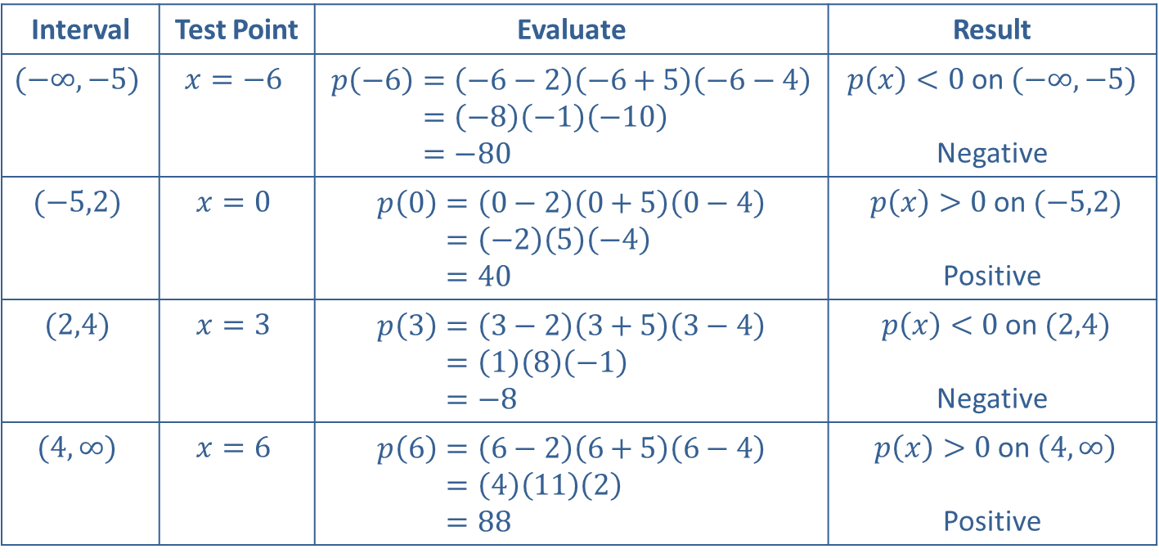

Example 5: Solving Polynomial Inequalities Using the Sign-Test Method (cont.)
Step 3: Evaluate $p\left(x\right)$ for a test point in each interval.
Interval | Test Point | Evaluate | Result
$$(−∞,−5)$$ | $$x=−6$$ | 𝑝−6=−6−2−6+5−6−4𝑝⁡−6=−8−1−10𝑝⁡−6=−80 | $p\left(x\right)<0$ on $(−∞,−5)$ Negative
$$(−5,2)$$ | $$x=0$$ | 𝑝0=0−20+50−4𝑝⁡0=−25−4𝑝⁡0=40 | $p\left(x\right)>0$ on $(−5,2)$ Positive
$$(2,4)$$ | $$x=3$$ | 𝑝3=3−23+53−4𝑝⁡3=18−1𝑝⁡3=−8 | $p\left(x\right)<0$ on $(2,4)$ Negative
$$(4,∞)$$ | $$x=6$$ | 𝑝6=6−26+56−4𝑝⁡6=4112𝑝⁡6=88 | $p\left(x\right)>0$ on $\left(4,∞\right)$ Positive
Table 1

Slide 37
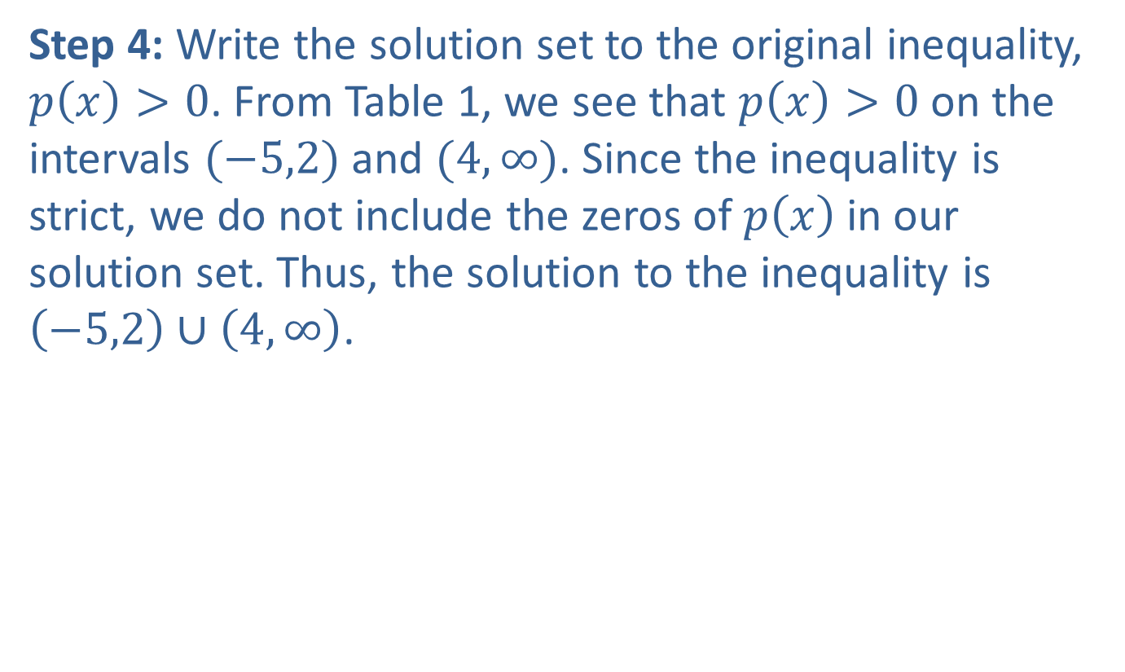
Example 5: Solving Polynomial Inequalities Using the Sign-Test Method (cont.)
Step 4: Write the solution set to the original inequality, $p\left(x\right)>0$. From Table 1, we see that $p\left(x\right)>0$ on the intervals $(−5,2)$ and $(4,∞)$. Since the inequality is strict, we do not include the zeros of $p⁡\left(x\right)$ in our solution set. Thus, the solution to the inequality is $\left(−5,2\right)∪\left(4,∞\right)$.

Slide 38

Example 6: Solving Polynomial Inequalities
Solve the polynomial inequality
$\left(x+2\right){\left(x−1\right)}^{2}\left(x−3\right)≤0$.

Slide 39

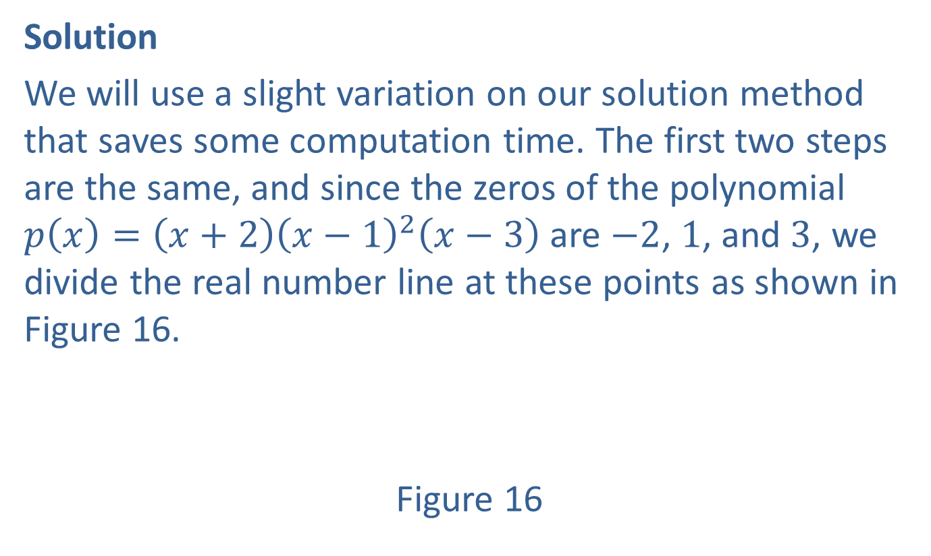
Example 6: Solving Polynomial Inequalities (cont.)
Solution
We will use a slight variation on our solution method that saves some computation time. The first two steps are the same, and since the zeros of the polynomial $p\left(x\right)=\left(x+2\right){\left(x−1\right)}^{2}\left(x−3\right)$ are $−2$, 1, and 3, we divide the real number line at these points as shown in Figure 16.
Figure 16

Slide 40
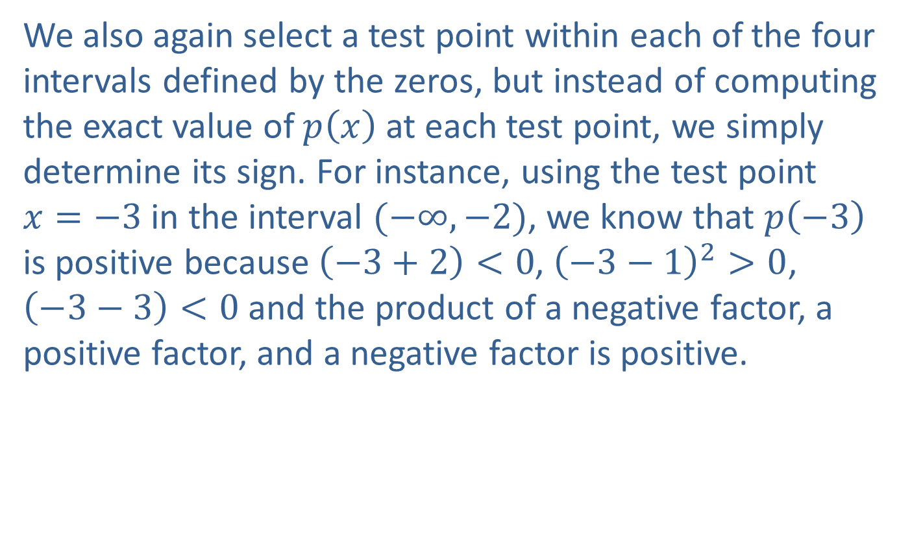
Example 6: Solving Polynomial Inequalities (cont.)
We also again select a test point within each of the four intervals defined by the zeros, but instead of computing the exact value of $p⁡\left(x\right)$ at each test point, we simply determine its sign. For instance, using the test point
$x=−3$ in the interval $(−∞,−2)$, we know that $p⁡\left(−3\right)$ is positive because $\left(−3+2\right)<0$, ${\left(−3−1\right)}^{2}>0$,
$\left(−3−3\right)<0$ and the product of a negative factor, a positive factor, and a negative factor is positive.

Slide 41


Example 6: Solving Polynomial Inequalities (cont.)
In Figure 17, a representative test point for each interval is shown, followed by a string of “+” and “−” signs indicating the sign of each factor of $p⁡\left(x\right)$ at the test point. Finally, the sign of $p⁡\left(x\right)$ overall on the interval is shown.
Figure 17

Slide 42

Example 6: Solving Polynomial Inequalities (cont.)
The last step of the method is to use the sign chart to identify the interval(s) on which $p⁡\left(x\right)≤0$. Since the inequality is not strict and the two intervals on which $p⁡\left(x\right)$ is nonpositive overlap at $x=1$, the solution is $[−2,3]$.

