Slide 1
Section 6.3
Locating Real Zeros of Polynomial Functions

Slide 2
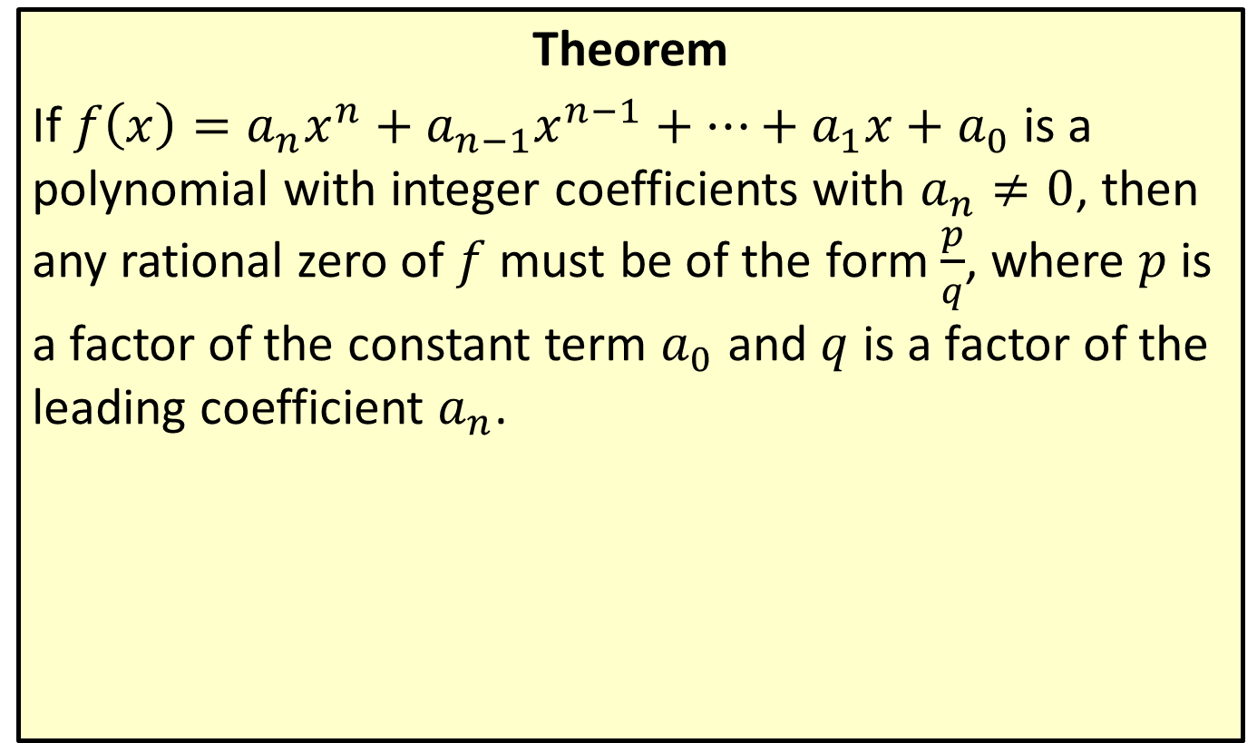
The Rational Zero Theorem
Theorem
If $f\left(x\right)=a_{n}x^{n}+a_{n−1}x^{n−1}+…+a_{1}x+a_{0}$ is a polynomial with integer coefficients with $a_{n}≠0$, then any rational zero of $f$ must be of the form $\frac{p}{q}$, where $p$ is a factor of the constant term $a_{0}$ and $q$ is a factor of the leading coefficient $a_{n}$.

Slide 3
CAUTION!
Before applying the Rational Zero Theorem, we note two things it doesn't do:
​The theorem doesn't necessarily find even a single zero of a polynomial; instead, it identifies a list of rational numbers that could potentially be zeros.
​The theorem says nothing about irrational or complex zeros. If a polynomial has zeros that are either irrational or complex, we must resort to other means to find them.

Slide 4

Example 1: The Rational Zero Theorem
For each of the polynomials that follow, list all of the potential rational zeros. Then write the polynomial in factored form and identify the actual zeros.
​$f\left(x\right)=2x^{3}+5x^{2}−4x−3$
​$g\left(x\right)=27x^{4}−9x^{3}−33x^{2}−x−4$

Slide 5
Note:
After generating the list of possible rational zeros, it's easiest to use synthetic division to check the zeros.

Slide 6
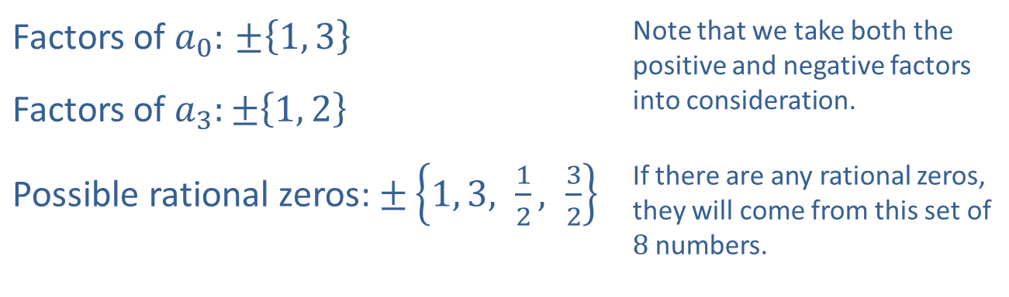

Example 1: The Rational Zero Theorem (cont.)
Solution
​To apply the Rational Zero Theorem, find the factors of $a_{0}$ and $a_{3}$.
​
Factors of $a_{0}:$ $±\left\{1, 3\right\}$ | Note that we take both the positive and negative factors into consideration.
Factors of $a_{3}:±\left\{1, 2\right\}$
Possible rational zeros: $±\left\{1, 3, \frac{1}{2}, \frac{3}{2}\right\}$ | If there are any rational zeros, they will come from this set of 8 numbers.

Slide 7
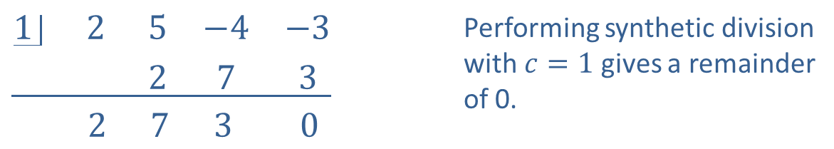
Example 1: The Rational Zero Theorem (cont.)
​Now perform synthetic division on a trial-and-error basis with the potential rational zeros.
​
$$\underline{\begin{matrix}1 & 2 & 5 & −4 & −3 \\ & & 2 & 7 & 3\end{matrix}}$$ $$\begin{matrix} & 2 & 7 & 3 & 0\end{matrix}$$ | Performing synthetic division with $c=1$ gives a remainder of 0.

Slide 8
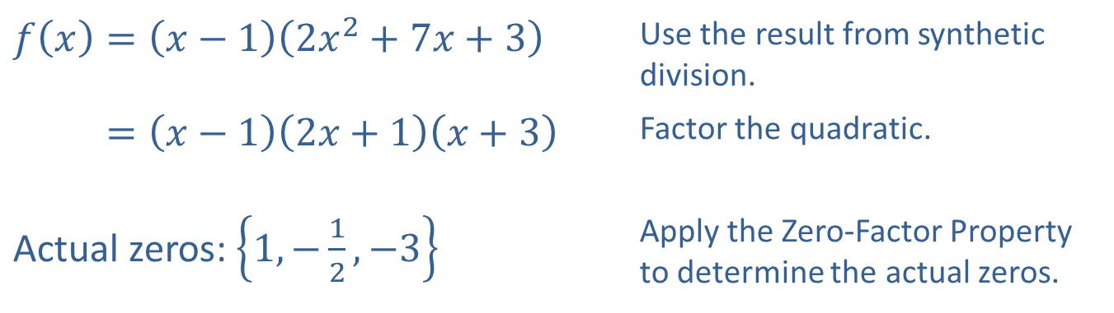

Example 1: The Rational Zero Theorem (cont.)
​Thus, we can factor $f⁡\left(x\right)$ as follows:
​
​$f\left(x\right)=\left(x−1\right)\left(2x^{2}+7x+3\right)$ | Use the result from synthetic division.
​𝑓⁡𝑥=𝑥−12𝑥+1𝑥+3 | Factor the quadratic.
Actual zeros: $\left\{1,−\frac{1}{2},−3\right\}$ | Apply the Zero-Factor Property to determine the actual zeros.

Slide 9
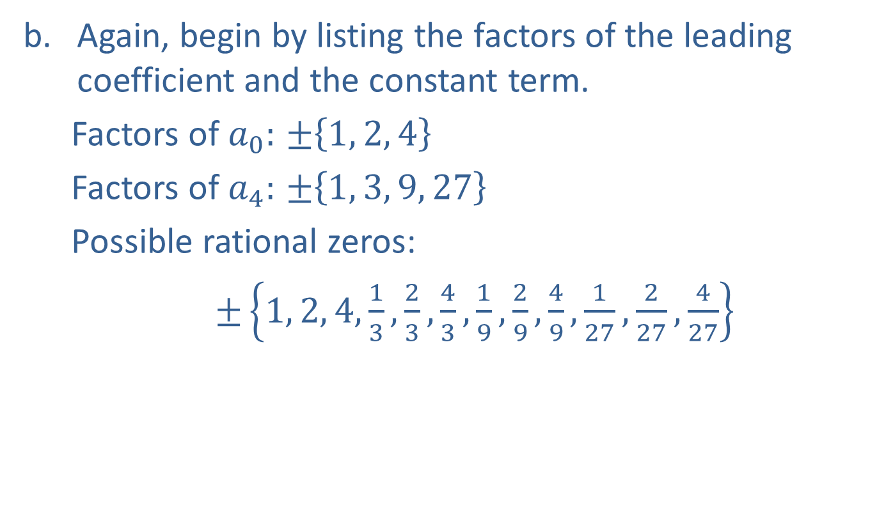
Example 1: The Rational Zero Theorem (cont.)
​Again, begin by listing the factors of the leading coefficient and the constant term.
Factors of $a_{0}:$ $±\left\{1, 2, 4\right\}$
Factors of $a_{4}:$ $±\left\{1, 3, 9, 27\right\}$
Possible rational zeros:
$±\left\{1, 2, 4, \frac{1}{3},\frac{2}{3},\frac{4}{3},\frac{1}{9},\frac{2}{9},\frac{4}{9},\frac{1}{27},\frac{2}{27},\frac{4}{27}\right\}$
​

Slide 10
Example 1: The Rational Zero Theorem (cont.)
​While it may be daunting to consider 24 potential rational zeros, appreciate the fact that the Rational Zero Theorem has eliminated all rational numbers except these 24! Before we begin trial-and-error, consider a few tips for choosing possible zeros.
​Begin with integer values. The synthetic division and resulting quotient will usually be simpler than when trying fractions.

Slide 11
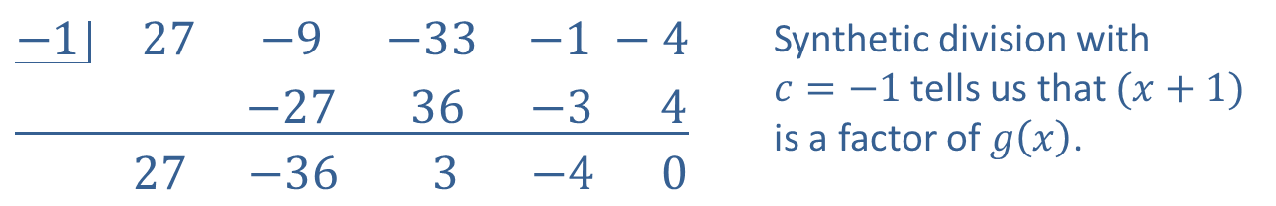
Example 1: The Rational Zero Theorem (cont.)
​Begin with values near 1. This will keep the numbers in calculations smaller, allowing you to test values a bit more quickly.
​
$$\underline{\begin{matrix}−1 & 27 & −9 & −33 & −1 −4 \\ & & −27 & 36 & −3 4\end{matrix}}$$ $\begin{matrix} & 27 & −36 & 3 & −4 0\end{matrix}$ | Synthetic division with $c=−1$ tells us that $(x+1)$ is a factor of $g\left(x\right)$.
​The resulting quotient is still a cubic, so we proceed with synthetic division. It also leads to another consideration when selecting potential zeros.

Slide 12
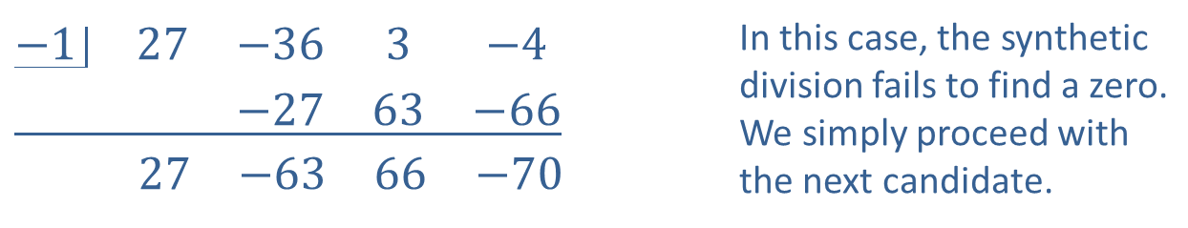

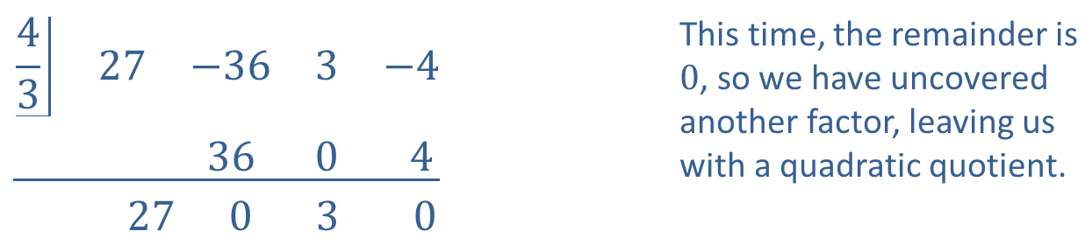
Example 1: The Rational Zero Theorem (cont.)
​If the value $c$ is a zero, do not forget to test $c$ with the quotient, as $\left(x−c\right)$ can appear as a factor multiple times.
​
$$\underline{\begin{matrix}−1 & 27 & −36 & 3 & −4 \\ & & −27 & 63 & −66\end{matrix}}$$ $$\begin{matrix} & 27 & −63 & 66 & −70\end{matrix}$$ | In this case, the synthetic division fails to find a zero. We simply proceed with the next candidate.
$$\underline{\begin{matrix}\frac{4}{3} & 27 & −36 & 3 & −4 \\ & & 36 & 0 & 4\end{matrix}}$$ $$\begin{matrix} & 27 & 0 & 3 & 0\end{matrix}$$ | This time, the remainder is $0$, so we have uncovered another factor, leaving us with a quadratic quotient.

Slide 13
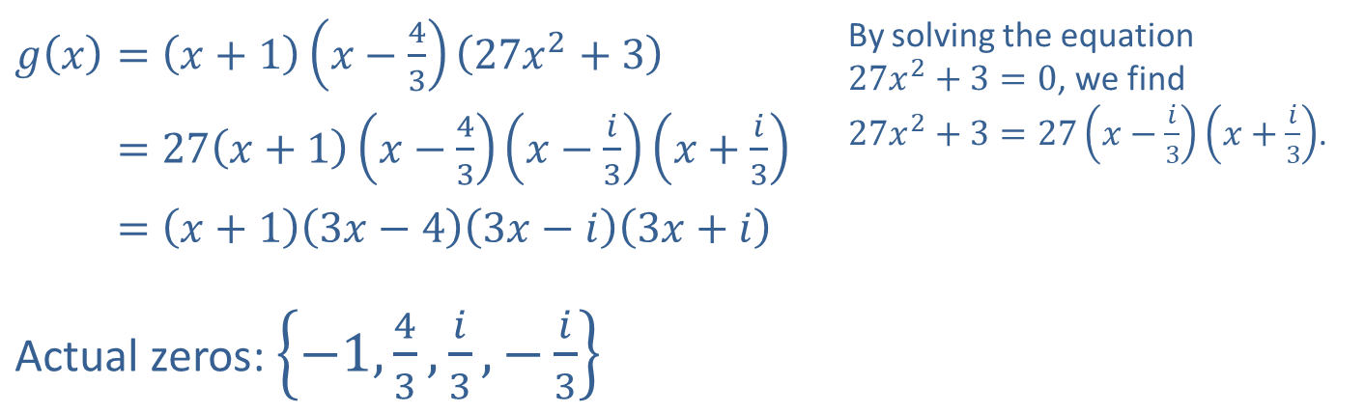
Example 1: The Rational Zero Theorem (cont.)
​We can then write the factorization using the result from synthetic division. The last step in factoring comes from solving a quadratic equation.
​$g\left(x\right)=\left(x+1\right)\left(x−\frac{4}{3}\right)\left(27x^{2}+3\right)$ | By solving the equation $27x^{2}+3=0$, we find $27x^{2}+3=27\left(x−\frac{i}{3}\right)\left(x+\frac{i}{3}\right)$.
​𝑔⁡𝑥=27𝑥+1𝑥−43𝑥−𝑖3𝑥+𝑖3
​𝑔⁡𝑥=𝑥+13𝑥−43𝑥−𝑖3𝑥+𝑖
Actual zeros: $\left\{−1,\frac{4}{3},\frac{i}{3},−\frac{i}{3}\right\}$

Slide 14
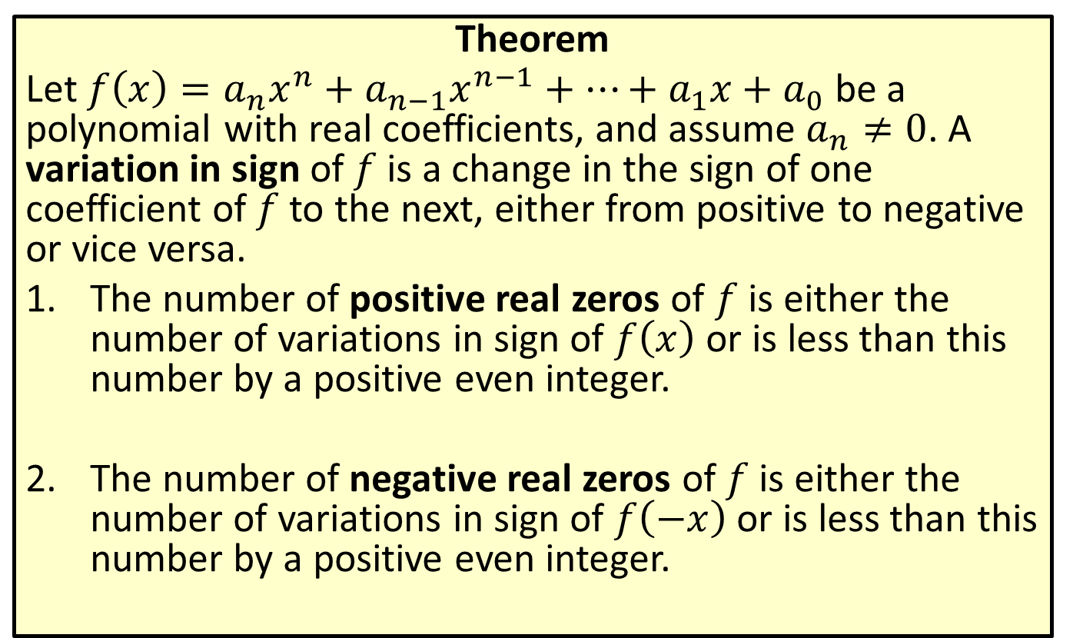
Descartes' Rule of Signs
Theorem
Let $f\left(x\right)=a_{n}x^{n}+a_{n−1}x^{n−1}+…+a_{1}x+a_{0}$ be a polynomial with real coefficients, and assume $a_{n}≠0$. A variation in sign of $f$ is a change in the sign of one coefficient of $f$ to the next, either from positive to negative or vice versa.
​The number of positive real zeros of $f$ is either the number of variations in sign of $f⁡\left(x\right)$ or is less than this number by a positive even integer.
​The number of negative real zeros of $f$ is either the number of variations in sign of $f⁡\left(−x\right)$ or is less than this number by a positive even integer.

Slide 15
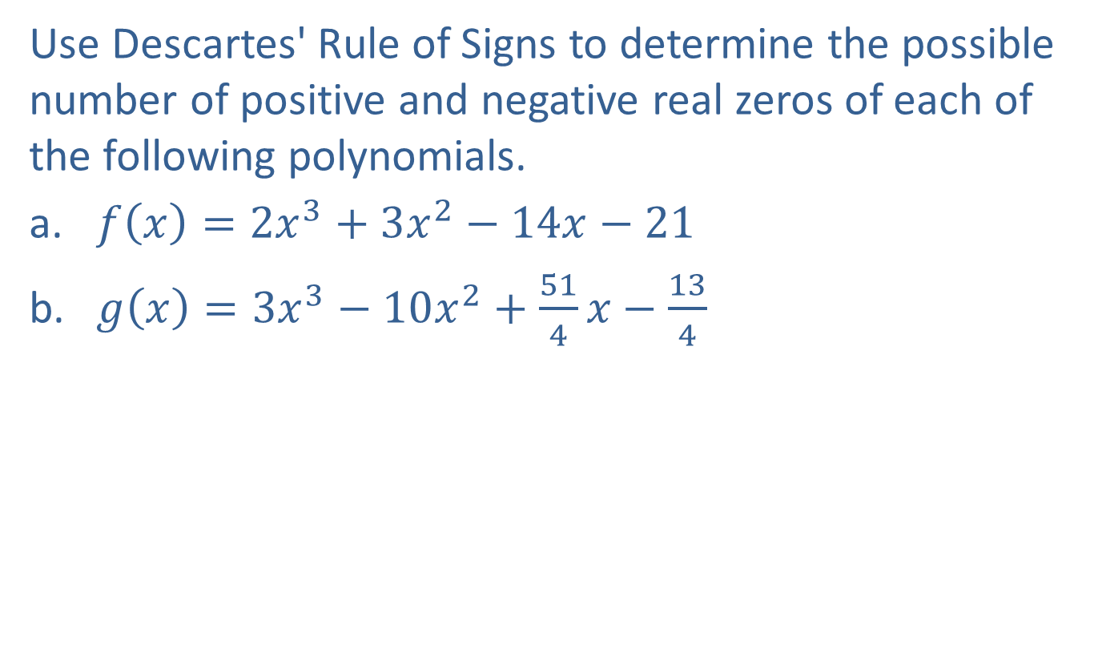
Example 2: Descartes' Rule of Signs
Use Descartes' Rule of Signs to determine the possible number of positive and negative real zeros of each of the following polynomials.
​$f\left(x\right)=2x^{3}+3x^{2}−14x−21$
​$g\left(x\right)=3x^{3}−10x^{2}+\frac{51}{4}x−\frac{13}{4}$

Slide 16

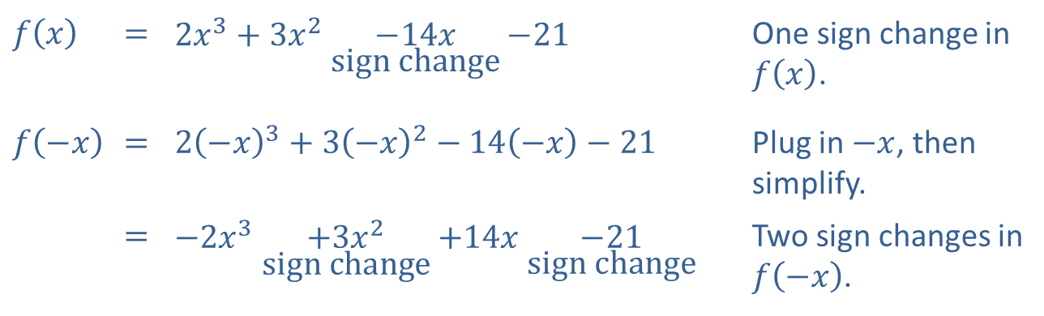
Example 2: Descartes' Rule of Signs (cont.)
Solution
​
​$f⁡\left(x\right)$ | ​= | ​$2x^{3}+3x^{2}\underset{\text{sign} \text{change}}{−14x}−21$ | One sign change in $f⁡\left(x\right)$.
$$f⁡\left(−x\right)$$ | ​= | ​$2{\left(−x\right)}^{3}+3{\left(−x\right)}^{2}−14\left(−x\right)−21$ | Plug in $−x$, then simplify.
 | ​= | ​$−2x^{3}\underset{\text{sign} \text{change}}{+3x^{2}}+14x\underset{\text{sign} \text{change}}{−21}$ | Two sign changes in $f⁡\left(−x\right)$.
​By Descartes' Rule of Signs, there is exactly 1 positive real zero and either 2 or 0 negative real zeros of $f⁡\left(x\right)$.

Slide 17

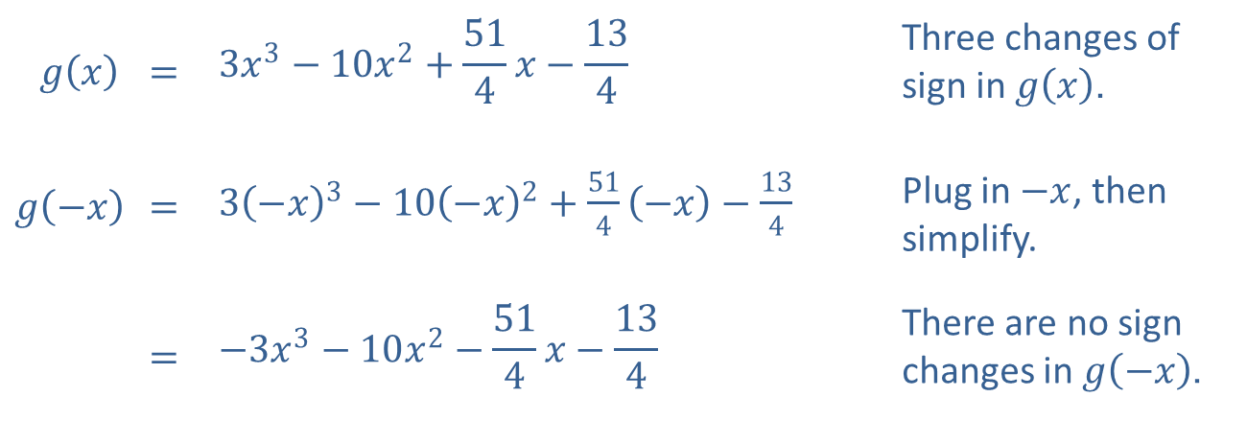
Example 2: Descartes' Rule of Signs (cont.)
​$g\left(x\right)$ | ​= | $$3x^{3}−10x^{2}+\frac{51}{4}x−\frac{13}{4}$$ | Three changes of sign in $g⁡\left(x\right)$.
$$g\left(−x\right)$$ | ​= | ​$3{\left(−x\right)}^{3}−10{\left(−x\right)}^{2}+\frac{51}{4}\left(−x\right)−\frac{13}{4}$ | Plug in $−x$, then simplify.
 | ​= | $$−3x^{3}−10x^{2}−\frac{51}{4}x−\frac{13}{4}$$ | There are no sign changes in $g⁡\left(−x\right)$.
​
​By Descartes' Rule of Signs, there are either 3 or 1 positive real zeros, but no negative real zeros of $g⁡\left(x\right)$.

Slide 18
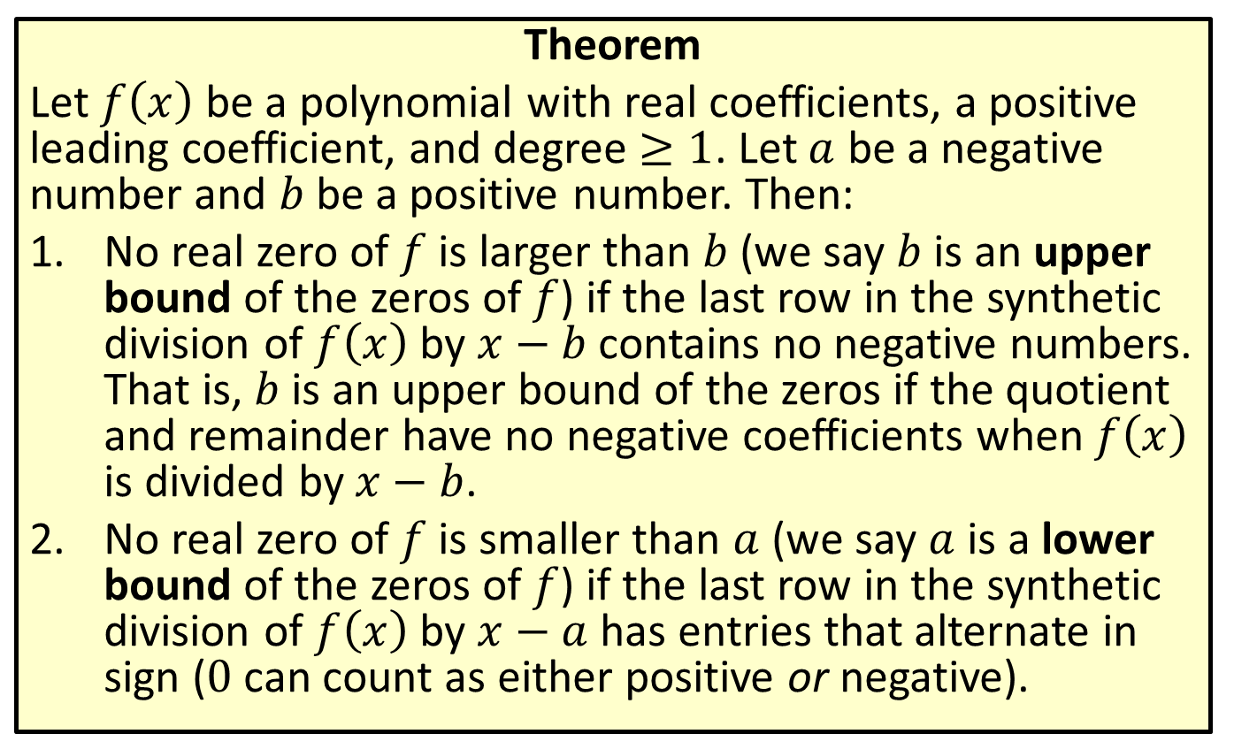
Upper and Lower Bounds of Zeros
Theorem
Let $f⁡\left(x\right)$ be a polynomial with real coefficients, a positive leading coefficient, and degree $≥1$. Let $a$ be a negative number and $b$ be a positive number. Then:
​No real zero of $f$ is larger than $b$ (we say $b$ is an upper bound of the zeros of $f$) if the last row in the synthetic division of $f⁡\left(x\right)$ by $x−b$ contains no negative numbers. That is, $b$ is an upper bound of the zeros if the quotient and remainder have no negative coefficients when $f⁡\left(x\right)$ is divided by $x−b$.
​No real zero of $f$ is smaller than $a$ (we say $a$ is a lower bound of the zeros of $f$) if the last row in the synthetic division of $f⁡\left(x\right)$ by $x−a$ has entries that alternate in sign (0 can count as either positive or negative).

Slide 19

Example 3: Finding Bounds of Real Zeros
Use synthetic division to identify upper and lower bounds of the real zeros of the polynomial $f\left(x\right)=2x^{3}+3x^{2}−14x−21$.

Slide 20
Note:
Finding the smallest upper bound and largest lower bound possible will help us eliminate as many potential zeros as possible.

Slide 21
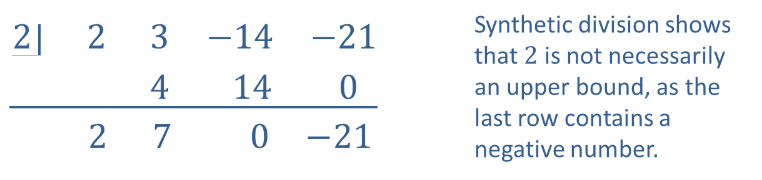
Example 3: Finding Bounds of Real Zeros (cont.)
Solution
Begin by testing any positive number as a potential upper bound.
$$\underline{\begin{matrix}2 & 2 & 3 & −14 & −21 \\ & & 4 & 14 & 0\end{matrix}}$$ $$\begin{matrix} & 2 & 7 & 0 & −21\end{matrix}$$ | Synthetic division shows that $2$ is not necessarily an upper bound, as the last row contains a negative number.

Slide 22
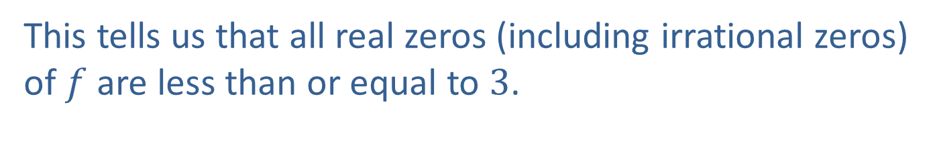
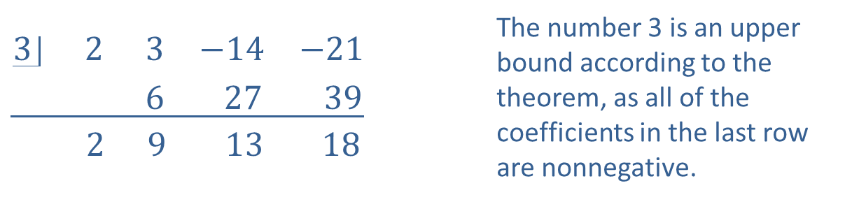
Example 3: Finding Bounds of Real Zeros (cont.)
It is best to begin with a small value, then test progressively larger ones, as this will help in finding the smallest upper bound.
$$\underline{\begin{matrix}3 & 2 & 3 & −14 & −21 \\ & & 6 & 27 & 39\end{matrix}}$$ $$\begin{matrix} & 2 & 9 & 13 & 18\end{matrix}$$ | The number 3 is an upper bound according to the theorem, as all of the coefficients in the last row are nonnegative.
This tells us that all real zeros (including irrational zeros) of $f$ are less than or equal to 3.

Slide 23
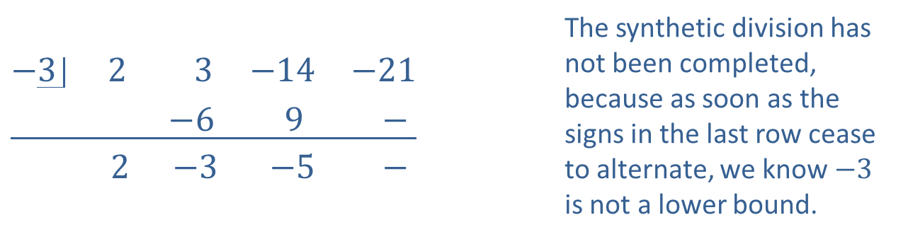
Example 3: Finding Bounds of Real Zeros (cont.)
We continue by testing a value for the lower bound.
$$\underline{\begin{matrix}−3 & 2 & 3 & −14 & −21 \\ & & −6 & 9 & −\end{matrix}}$$ $$\begin{matrix} & 2 & −3 & −5 & −\end{matrix}$$ | The synthetic division has not been completed, because as soon as the signs in the last row cease to alternate, we know $−3$ is not a lower bound.

Slide 24
Note:
Remember that if a 0 appears in the last row, it can be counted as either positive or negative, whichever leads to a sequence of alternating signs.

Slide 25

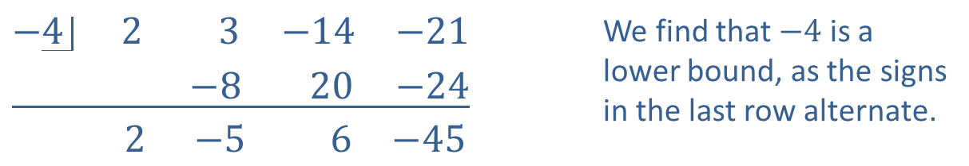
Example 3: Finding Bounds of Real Zeros (cont.)
Move on by testing a lower number.
$$\underline{\begin{matrix}−4 & 2 & 3 & −14 & −21 \\ & & −8 & 20 & −24\end{matrix}}$$ $$\begin{matrix} & 2 & −5 & 6 & −45\end{matrix}$$ | We find that $−4$ is a lower bound, as the signs in the last row alternate.
Thus, we see that $−4$ is a lower bound. Combined with the upper bound, we now know that all real zeros of $f$ lie in the interval $[−4,3]$.

Slide 26

Example 4: Finding the Zeros of a Polynomial
Use the results of Example 3, in conjunction with the Rational Zero Theorem, to find the actual zeros of $f\left(x\right)=2x^{3}+3x^{2}−14x−21$.

Slide 27
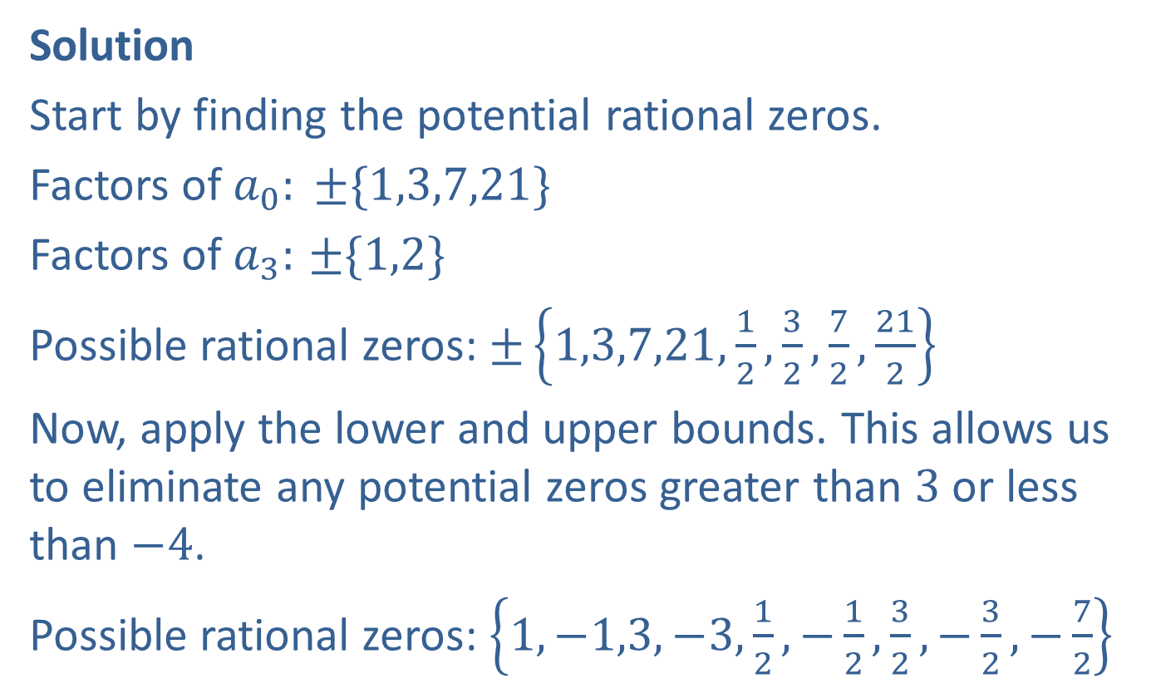
Example 4: Finding the Zeros of a Polynomial (cont.)
Solution
Start by finding the potential rational zeros.
Factors of $a_{0}: ±\{1,3,7,21\}$
Factors of $a_{3}:$ $±\{1,2\}$
Possible rational zeros: $±\left\{1,3,7,21,\frac{1}{2},\frac{3}{2},\frac{7}{2},\frac{21}{2}\right\}$
Now, apply the lower and upper bounds. This allows us to eliminate any potential zeros greater than 3 or less than $−4$.
Possible rational zeros: $\left\{1,−1,3,−3,\frac{1}{2},−\frac{1}{2},\frac{3}{2},−\frac{3}{2},−\frac{7}{2}\right\}$

Slide 28

Example 4: Finding the Zeros of a Polynomial (cont.)
Now, use synthetic division to test potential rational zeros.
$$\underline{\begin{matrix}−\frac{3}{2} & 2 & 3 & −14 & −21 \\ & & −3 & 0 & 21\end{matrix}}$$
$$\begin{matrix} & 2 & 0 & −14 & 0\end{matrix}$$

Slide 29
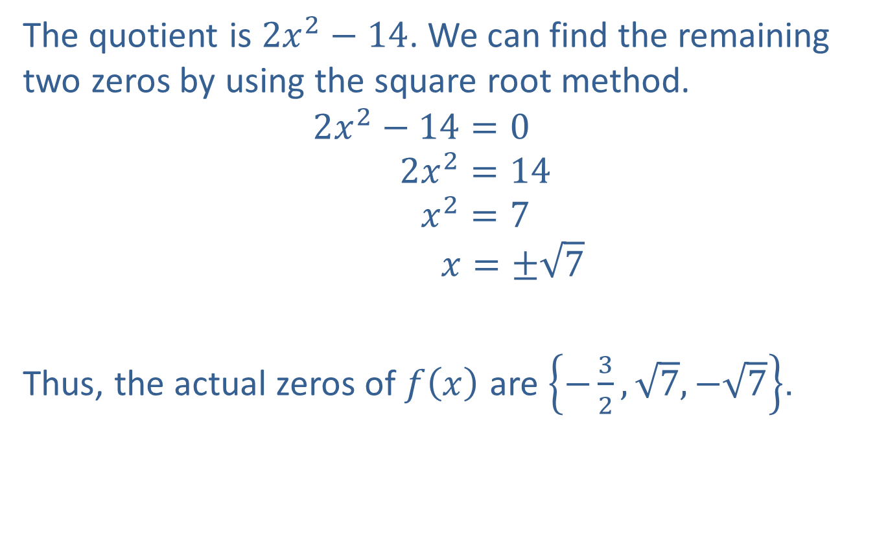
Example 4: Finding the Zeros of a Polynomial (cont.)
The quotient is $2x^{2}−14$. We can find the remaining two zeros by using the square root method.
2𝑥2−14=0 140−2𝑥2=14 44−2𝑥2=7 14−22𝑥=±7
Thus, the actual zeros of $f⁡\left(x\right)$ are $\left\{−\frac{3}{2},\sqrt{7},−\sqrt{7}\right\}$.

Slide 30
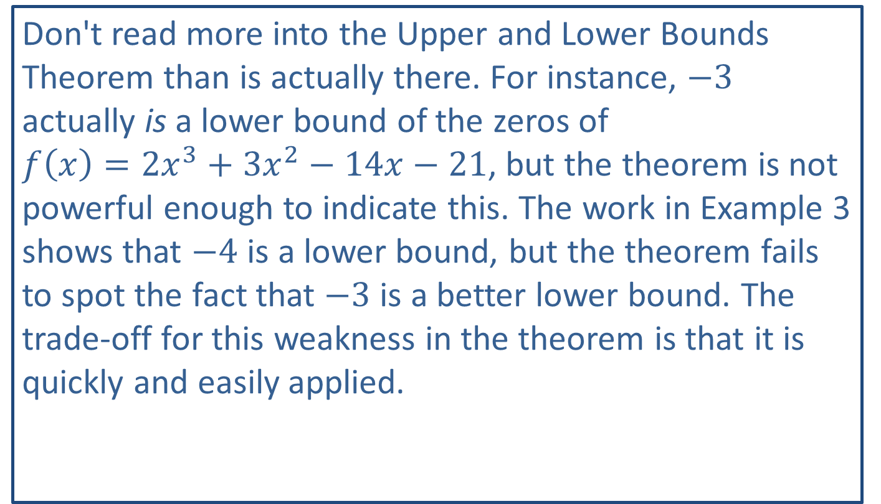
CAUTION!
Don't read more into the Upper and Lower Bounds Theorem than is actually there. For instance, $−3$ actually is a lower bound of the zeros of $f\left(x\right)=2x^{3}+3x^{2}−14x−21$, but the theorem is not powerful enough to indicate this. The work in Example 3 shows that $−4$ is a lower bound, but the theorem fails to spot the fact that $−3$ is a better lower bound. The trade-off for this weakness in the theorem is that it is quickly and easily applied.

Slide 31
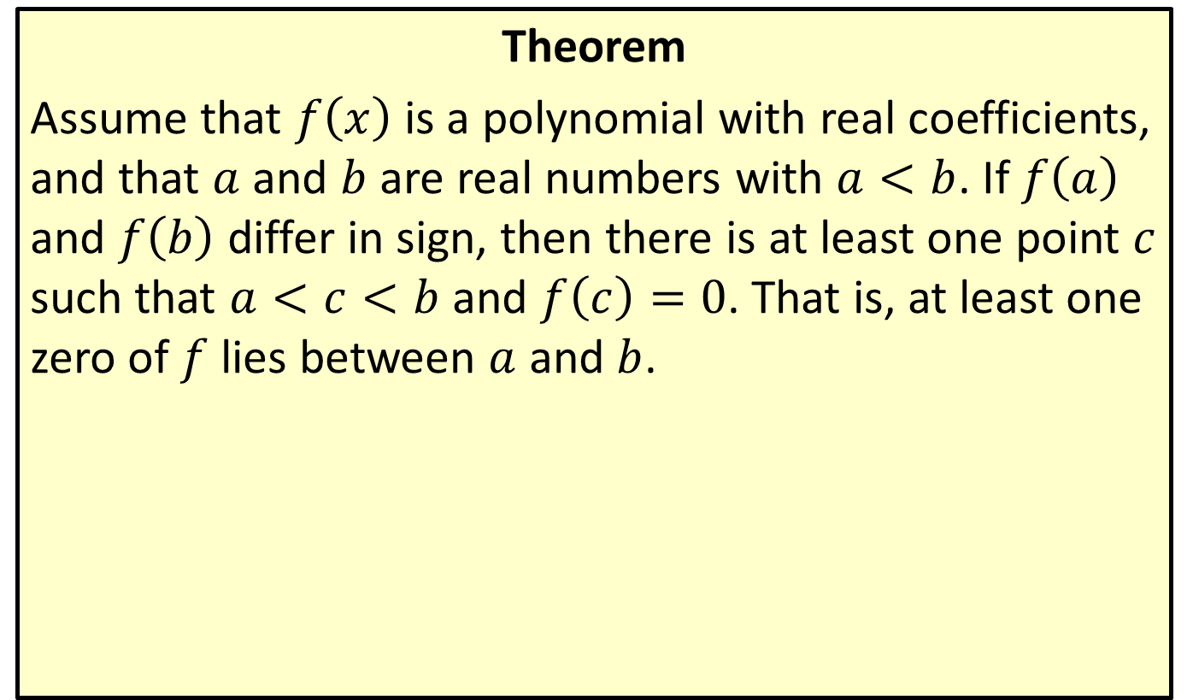
Intermediate Value Theorem
Theorem
Assume that $f⁡\left(x\right)$ is a polynomial with real coefficients, and that $a$ and $b$ are real numbers with $a<b$. If $f⁡\left(a\right)$ and $f⁡\left(b\right)$ differ in sign, then there is at least one point $c$ such that $a<c<b$ and $f\left(c\right)=0$. That is, at least one zero of $f$ lies between $a$ and $b$.

Slide 32
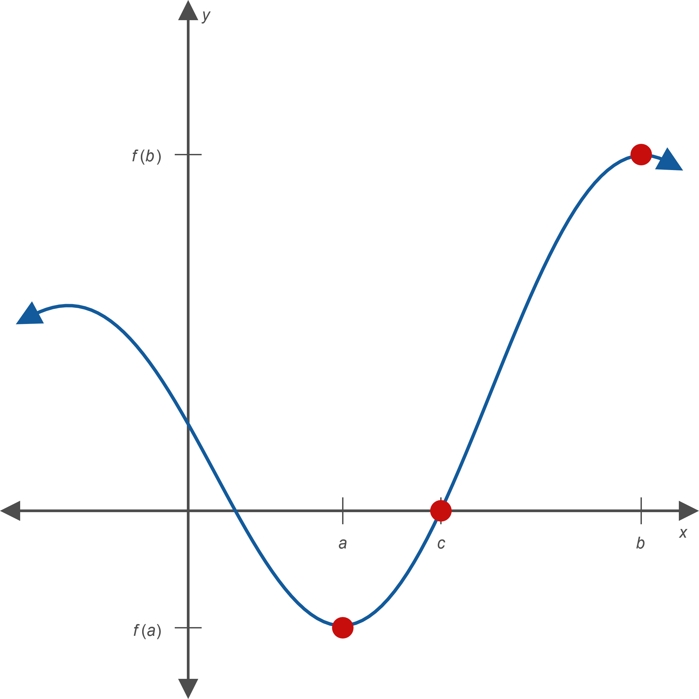
Intermediate Value Theorem (cont.)
Figure 1

Slide 33
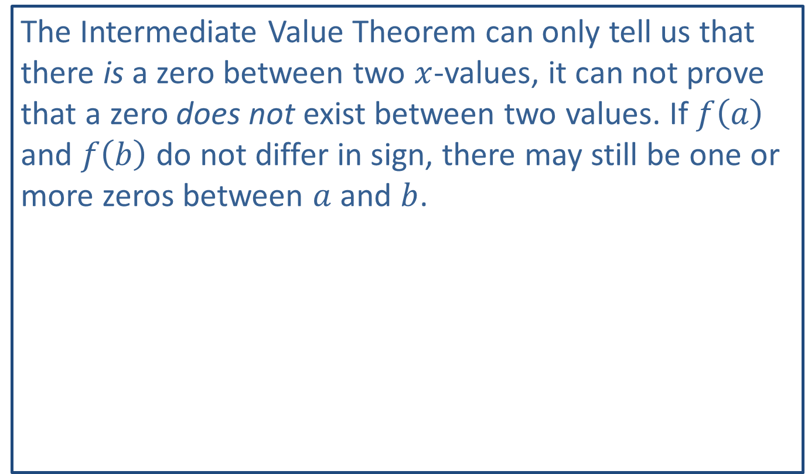
CAUTION!
The Intermediate Value Theorem can only tell us that there is a zero between two $x$-values, it can not prove that a zero does not exist between two values. If $f⁡\left(a\right)$ and $f⁡\left(b\right)$ do not differ in sign, there may still be one or more zeros between $a$ and $b$.

Slide 34

Example 5: Intermediate Value Theorem
​Show that $f\left(x\right)=x^{3}+3x−7$ has a zero between 1 and 2.
​Find an approximation of the zero to the nearest tenth.

Slide 35
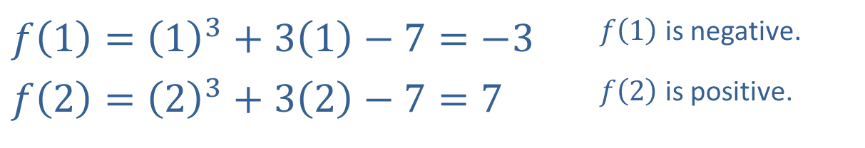


Example 5: Intermediate Value Theorem (cont.)
Solution
​To use Intermediate Value Theorem, we need to calculate $f⁡\left(1\right)$ and $f⁡\left(2\right)$.
​
​$f\left(1\right)={\left(1\right)}^{3}+3\left(1\right)−7=−3$ | ​$f⁡\left(1\right)$ is negative.
​$f\left(2\right)={\left(2\right)}^{3}+3\left(2\right)−7=7$ | ​$f⁡\left(2\right)$ is positive.
​Because $f⁡\left(1\right)$ and $f⁡\left(2\right)$ differ in sign, the Intermediate Value Theorem states that $f$ has a zero between 1 and 2.
​

Slide 36
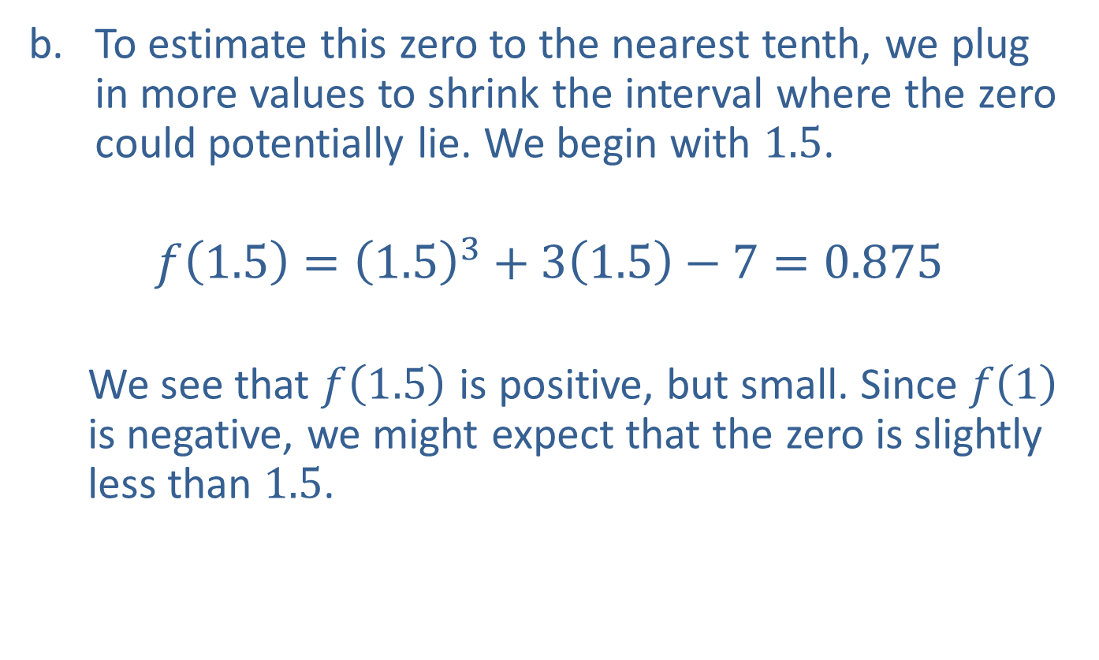
Example 5: Intermediate Value Theorem (cont.)
​To estimate this zero to the nearest tenth, we plug in more values to shrink the interval where the zero could potentially lie. We begin with 1.5.
$$f\left(1.5\right)={\left(1.5\right)}^{3}+3\left(1.5\right)−7=0.875$$
We see that $f⁡\left(1.5\right)$ is positive, but small. Since $f⁡\left(1\right)$ is negative, we might expect that the zero is slightly less than 1.5.
​

Slide 37
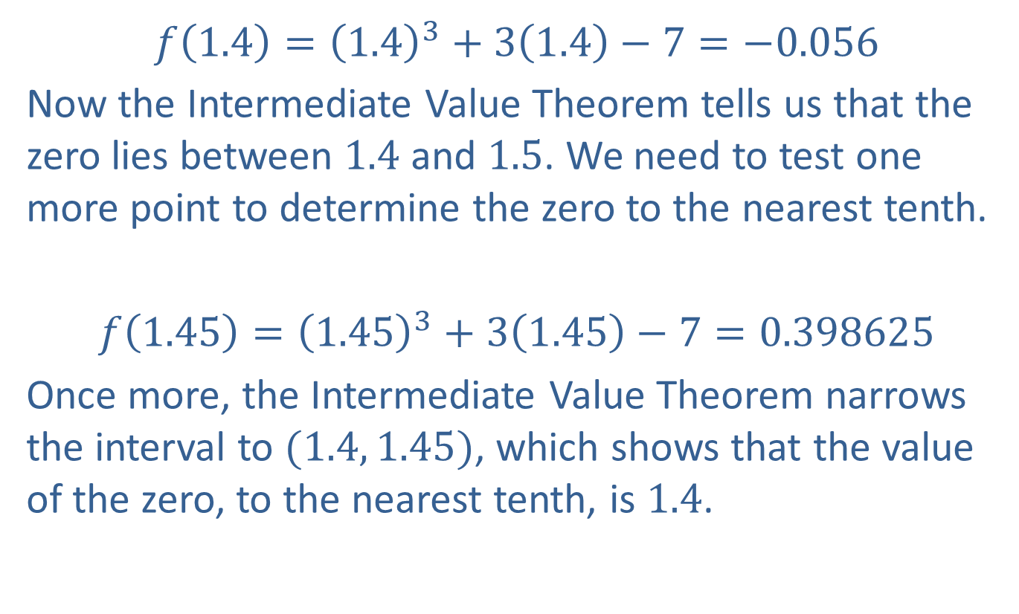
Example 5: Intermediate Value Theorem (cont.)
​​$f\left(1.4\right)={\left(1.4\right)}^{3}+3\left(1.4\right)−7=−0.056$
​Now the Intermediate Value Theorem tells us that the zero lies between 1.4 and 1.5. We need to test one more point to determine the zero to the nearest tenth.
​$f\left(1.45\right)={\left(1.45\right)}^{3}+3\left(1.45\right)−7=0.398625$
​Once more, the Intermediate Value Theorem narrows the interval to $(1.4, 1.45)$, which shows that the value of the zero, to the nearest tenth, is 1.4.

