Slide 1
Section 7.1
Exponential Functions and Their Graphs

Slide 2
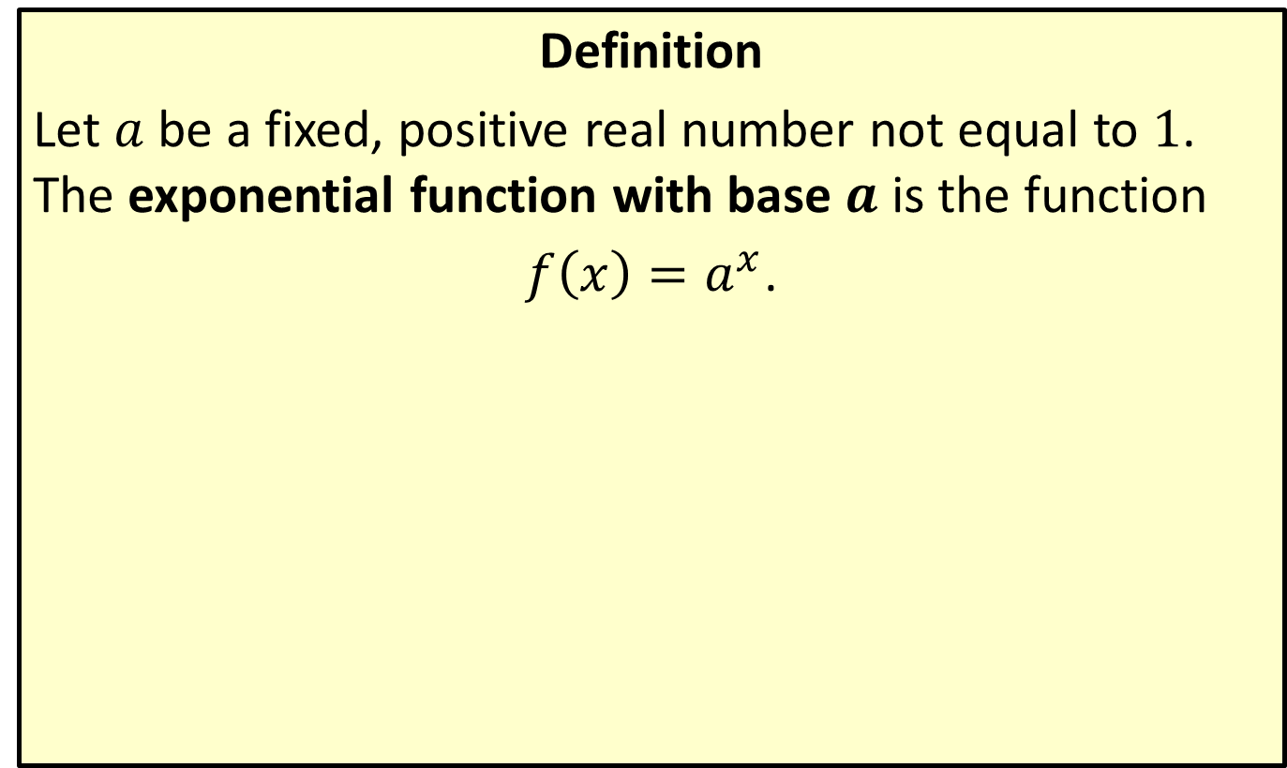
Exponential Functions
Definition
Let $a$ be a fixed, positive real number not equal to 1. The exponential function with base $a$ is the function
$f\left(x\right)=a^{x}$.

Slide 3
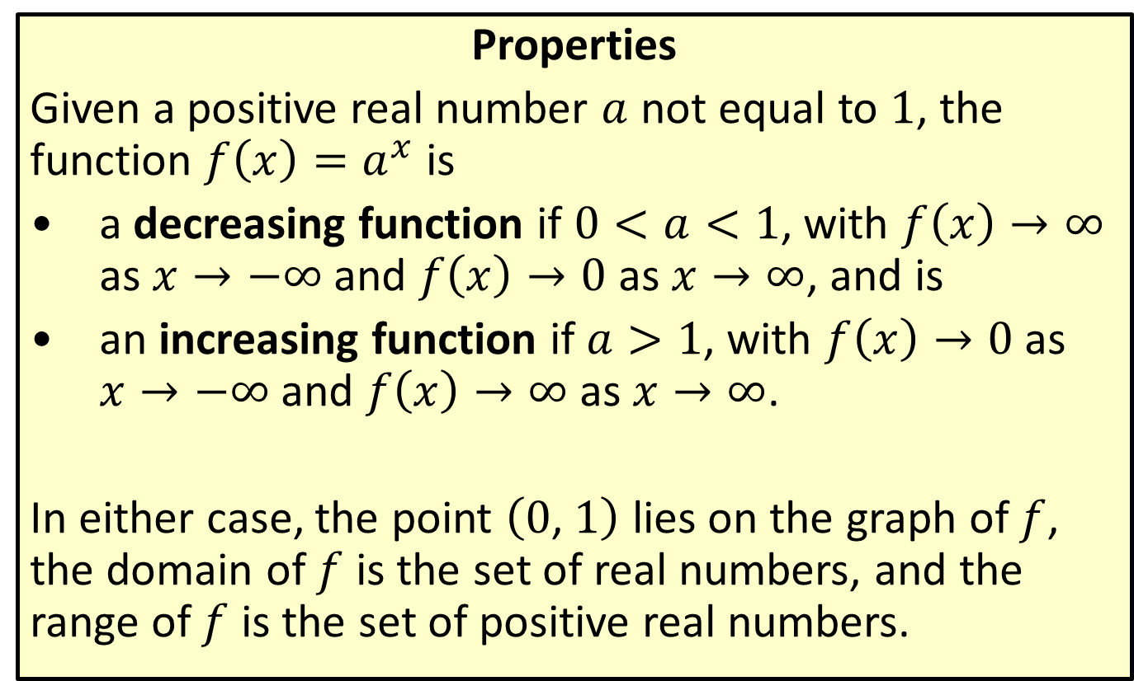
Behavior of Exponential Functions
Properties
Given a positive real number $a$ not equal to 1, the function $f\left(x\right)=a^{x}$ is
​a decreasing function if $0<a<1$, with $f\left(x\right)→∞$ as $x→−∞$ and $f\left(x\right)→0$ as $x→∞$, and is
​an increasing function if $a>1$, with $f\left(x\right)→0$ as $x→−∞$ and $f\left(x\right)→∞$ as $x→∞$.
In either case, the point $\left(0\text{, }1\right)$ lies on the graph of $f$, the domain of $f$ is the set of real numbers, and the range of $f$ is the set of positive real numbers.

Slide 4

Example 1: Graphing Exponential Functions
Sketch the graphs of the following exponential functions.
​$f\left(x\right)=3^{x}$
​$g\left(x\right)={\left(\frac{1}{2}\right)}^{x}$

Slide 5
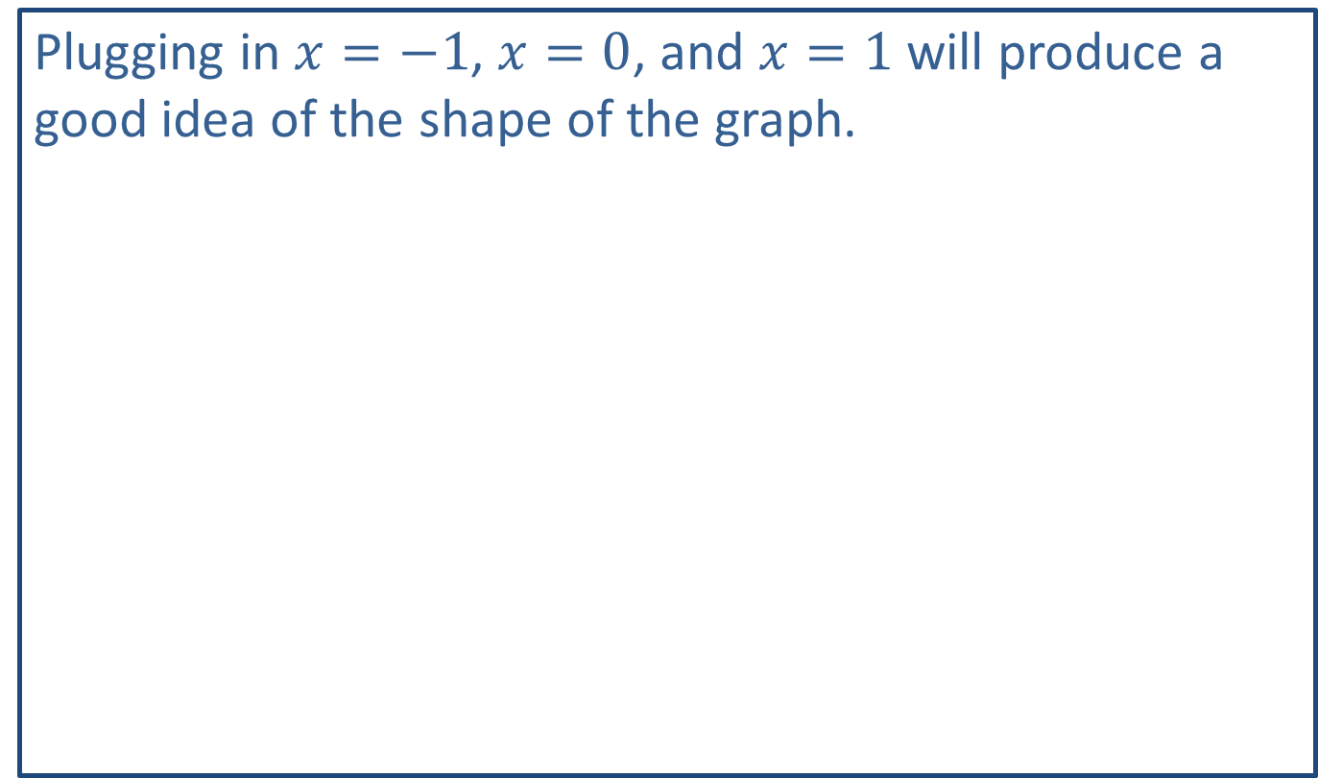
Note:
Plugging in $x=−1$, $x=0$, and $x=1$ will produce a good idea of the shape of the graph.

Slide 6

Example 1: Graphing Exponential Functions (cont.)
Solution
In both cases, we plot 3 points by plugging in $x=−1$, $x=0$, and $x=1$. We then connect the points with a smooth curve.

Slide 7
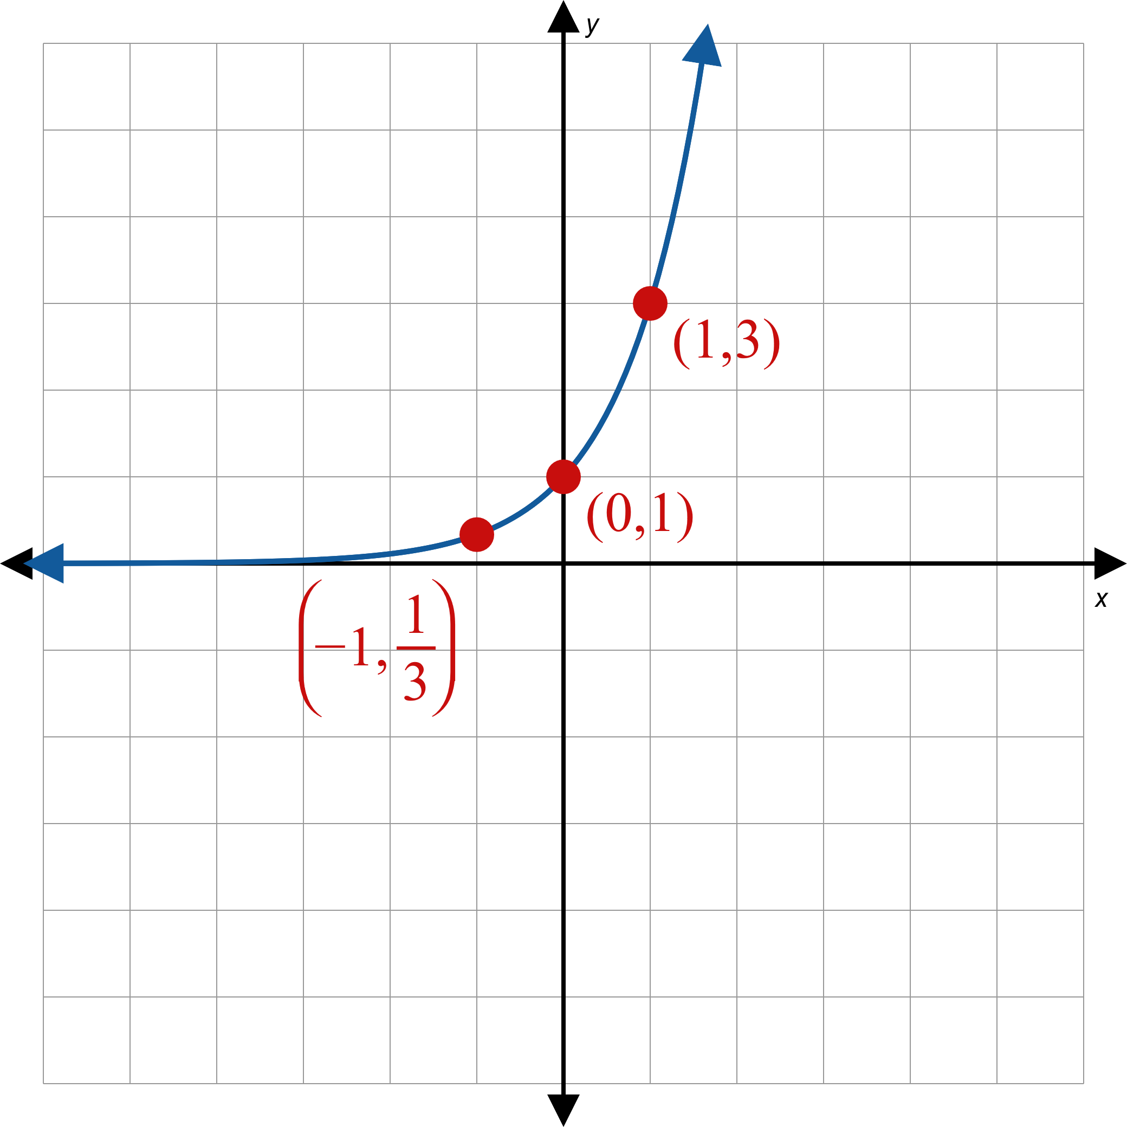
Example 1: Graphing Exponential Functions (cont.)
a.
Figure 2

Slide 8
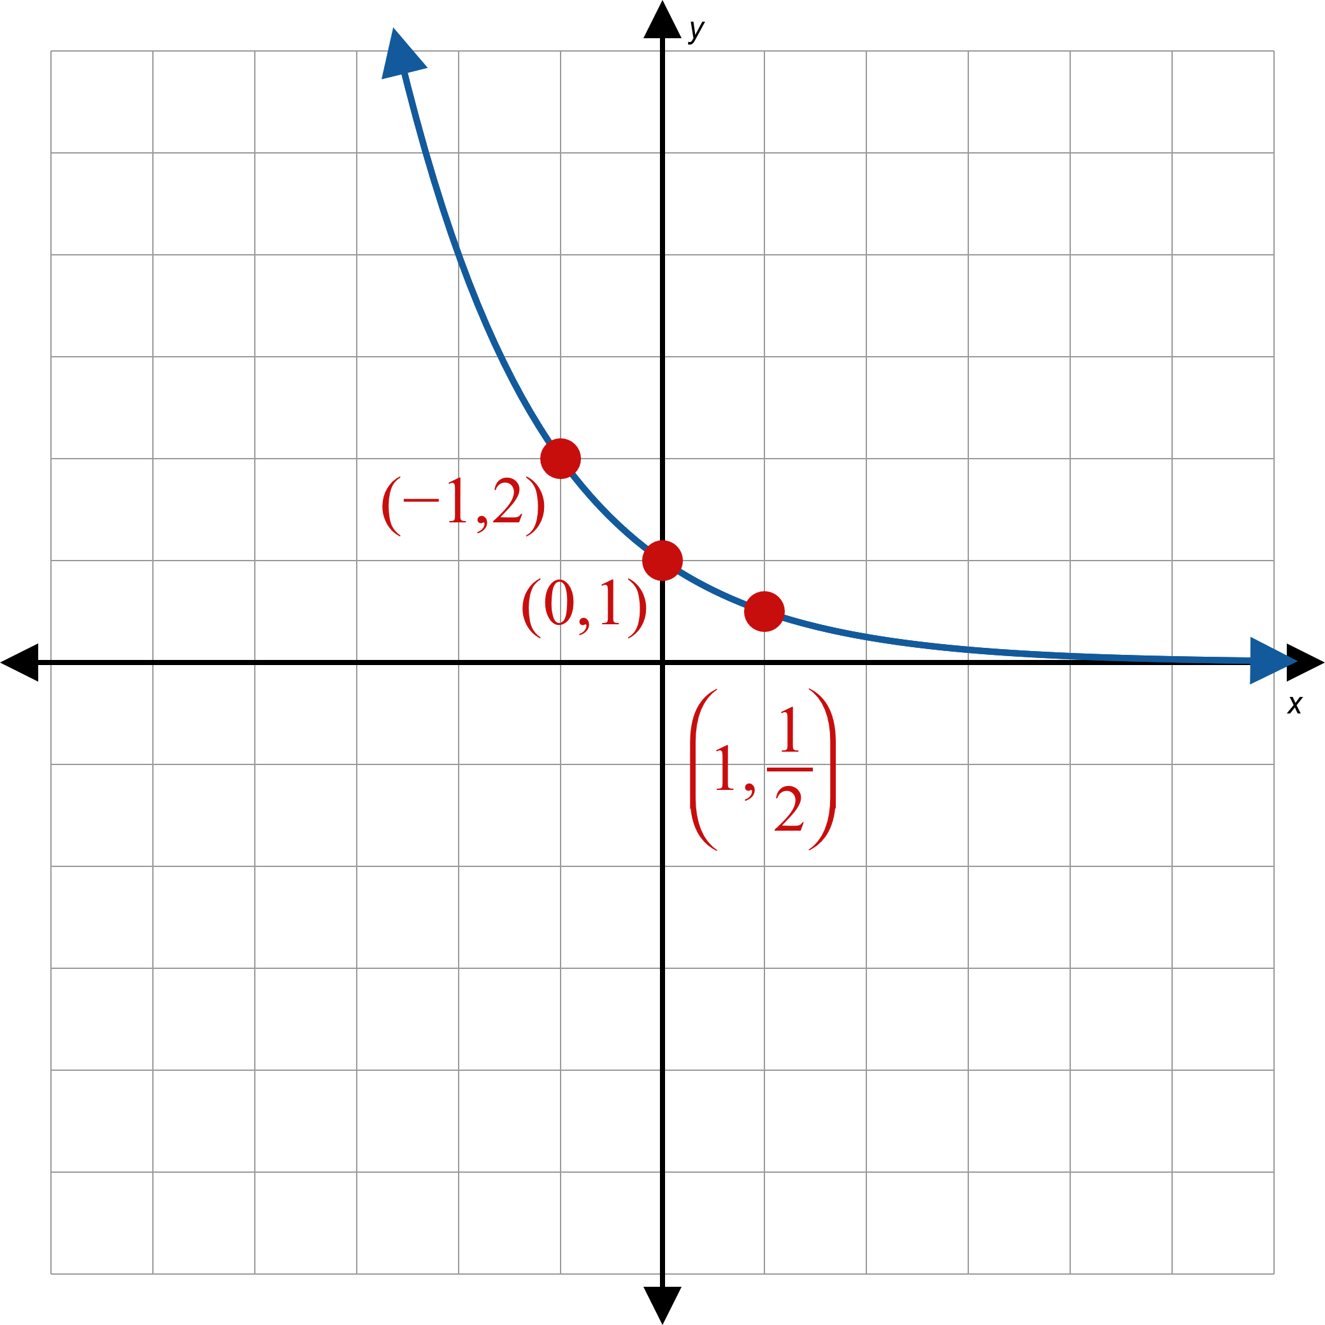
Example 1: Graphing Exponential Functions (cont.)
b.
Figure 3

Slide 9
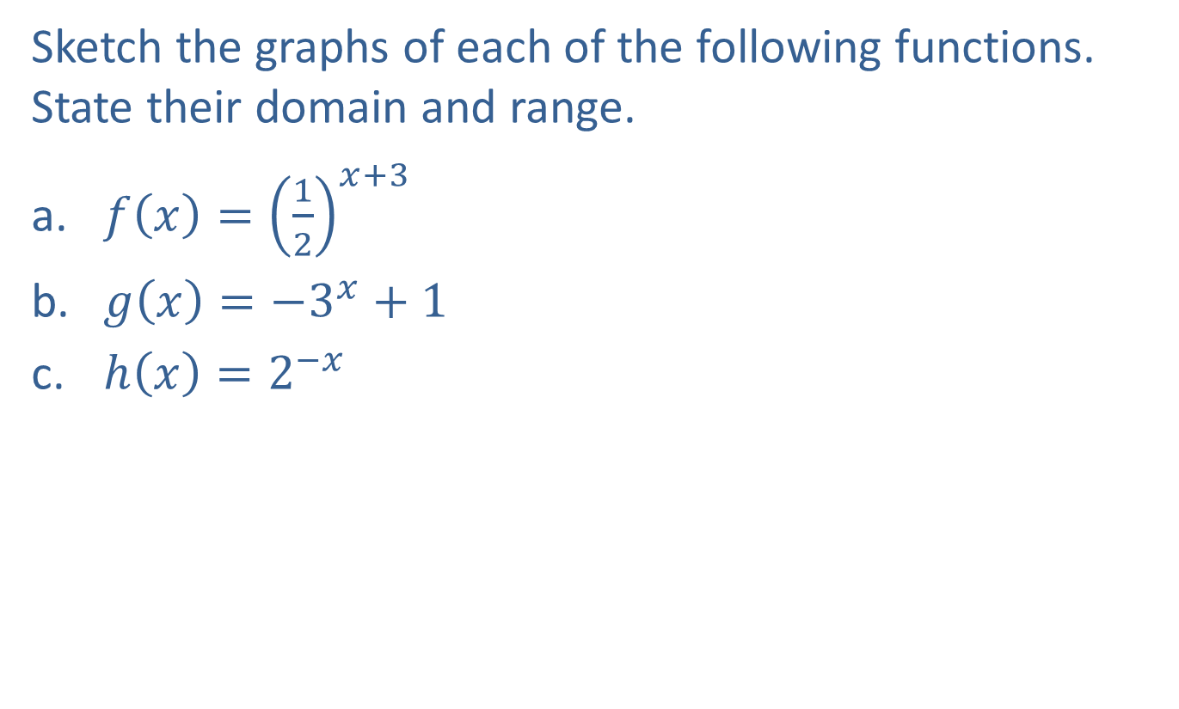
Example 2: Graphing Exponential Functions
Sketch the graphs of each of the following functions. State their domain and range.
​$f\left(x\right)={\left(\frac{1}{2}\right)}^{x+3}$
​$g\left(x\right)=−3^{x}+1$
​$h\left(x\right)=2^{−x}$

Slide 10
Note:
For each example, first graph the base function, then apply any transformations.

Slide 11

Example 2: Graphing Exponential Functions (cont.)
Solution
First, draw the graph of the function ${\left(\frac{1}{2}\right)}^{x}$, as in Example 1b. Then, since $x$ has been replaced by $x+3$, shift the graph to the left by 3 units.

Slide 12
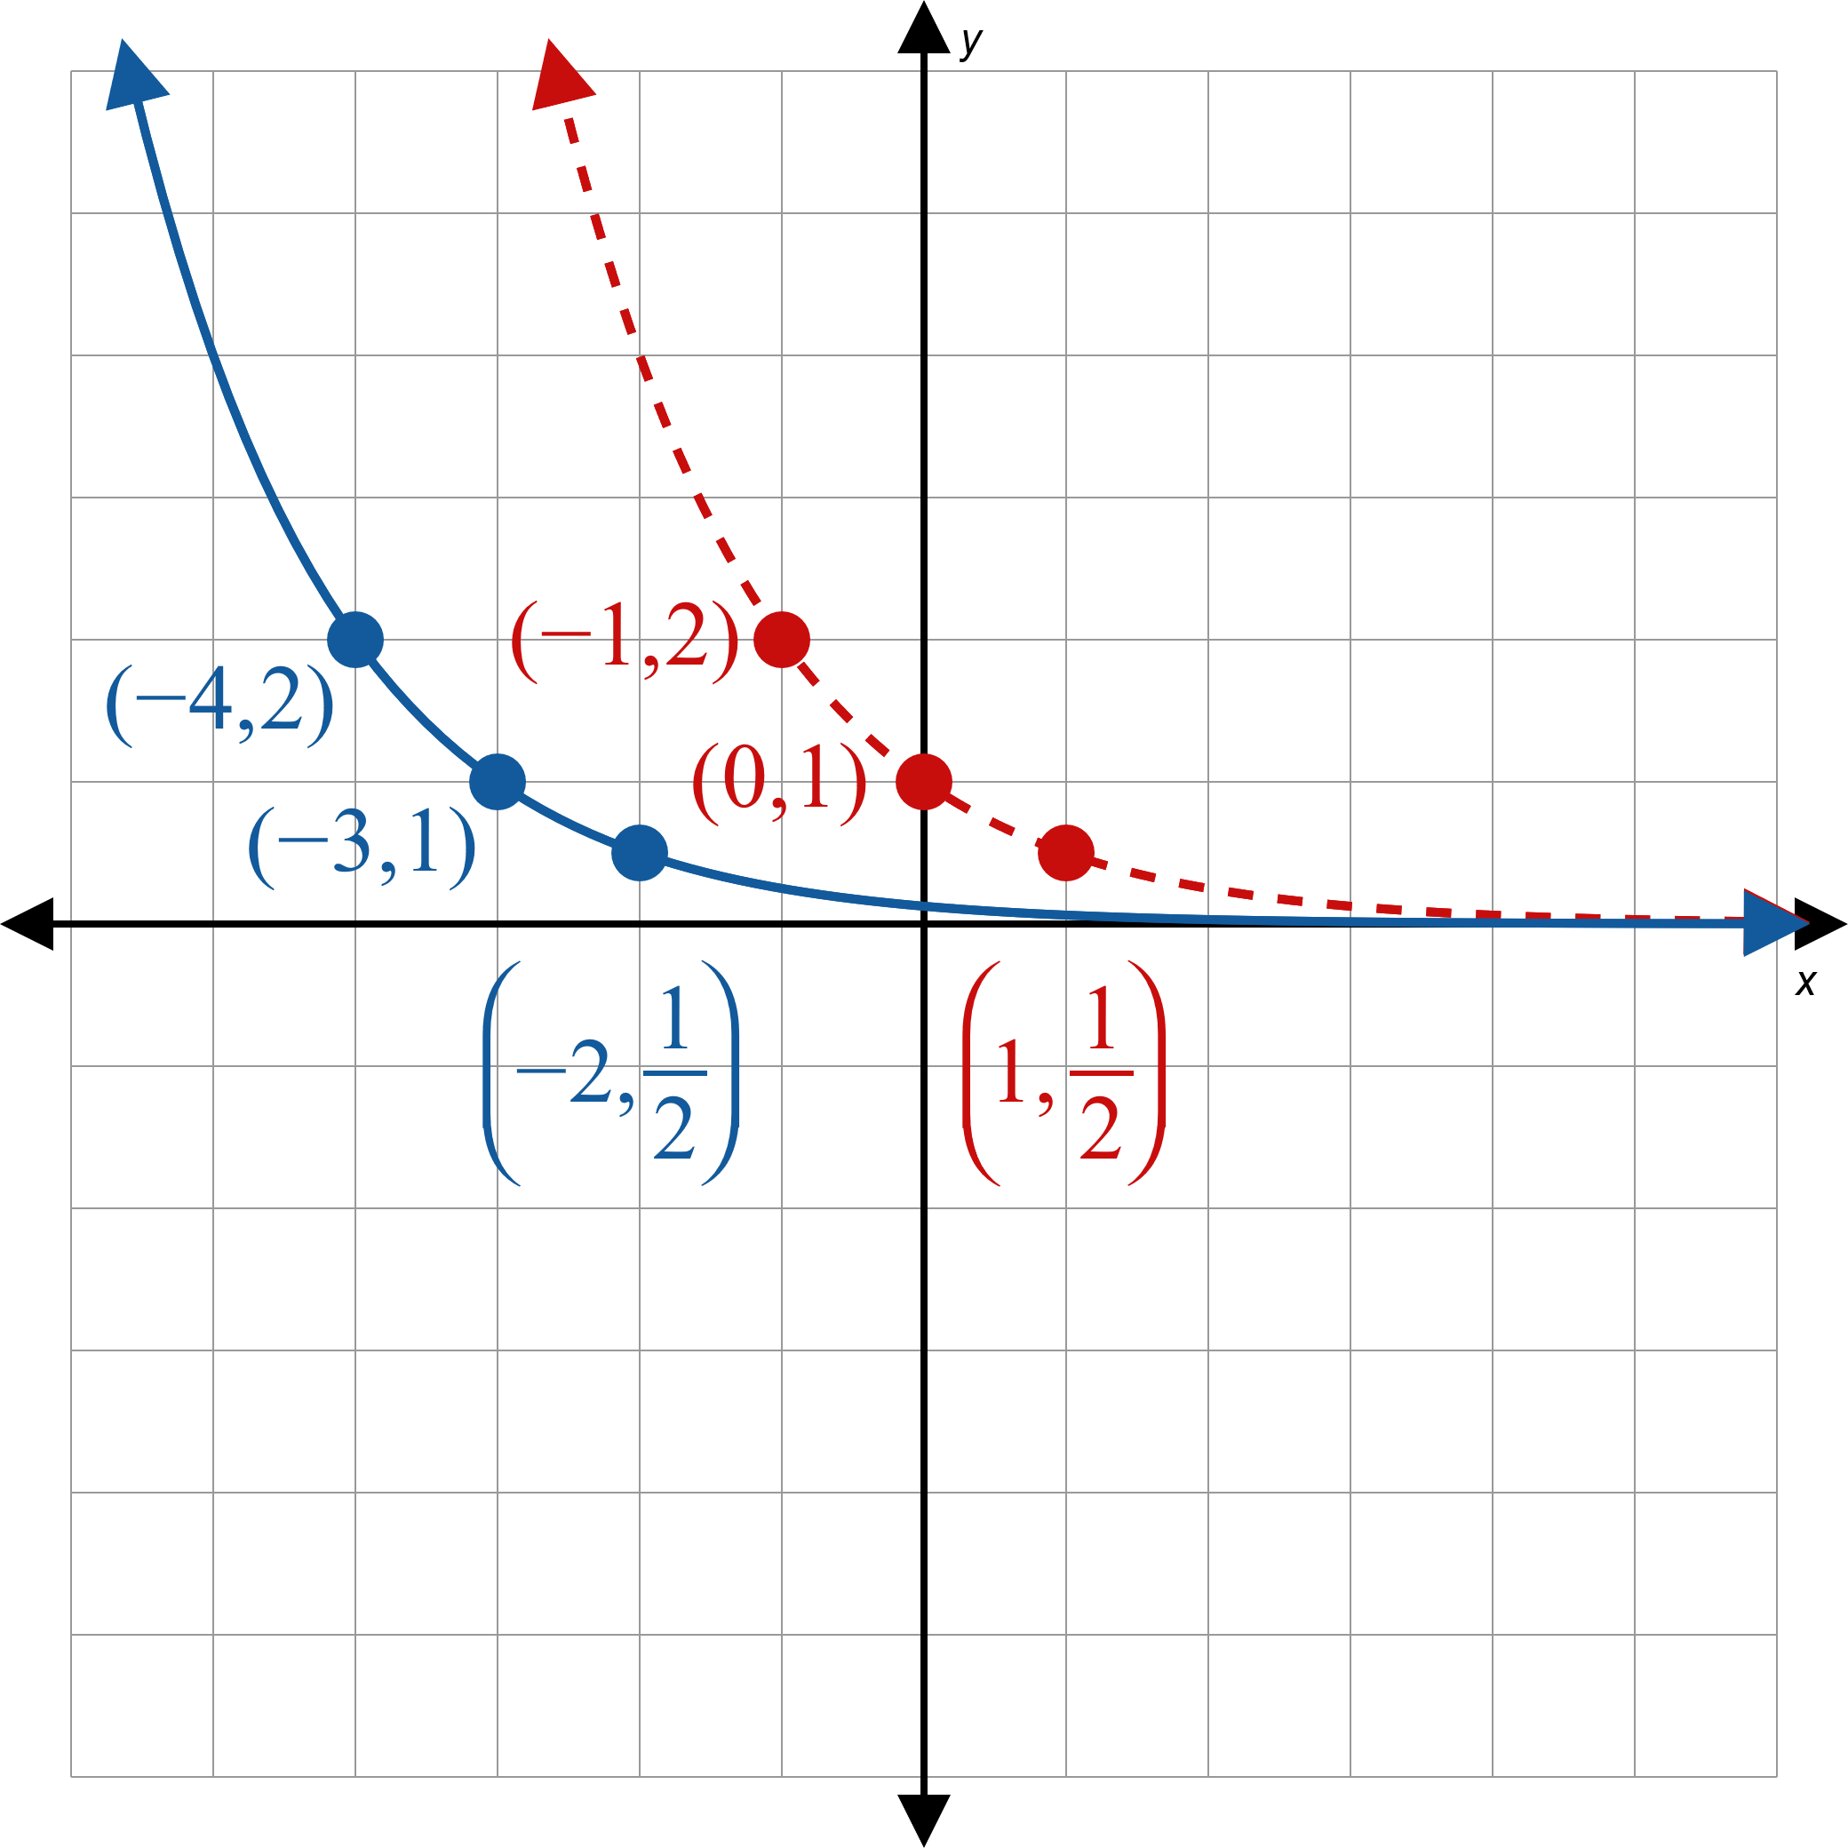
Example 2: Graphing Exponential Functions (cont.)
Figure 4

Slide 13
Example 2: Graphing Exponential Functions (cont.)
Domain $=(−∞, ∞)$, Range $=(0, ∞)$

Slide 14
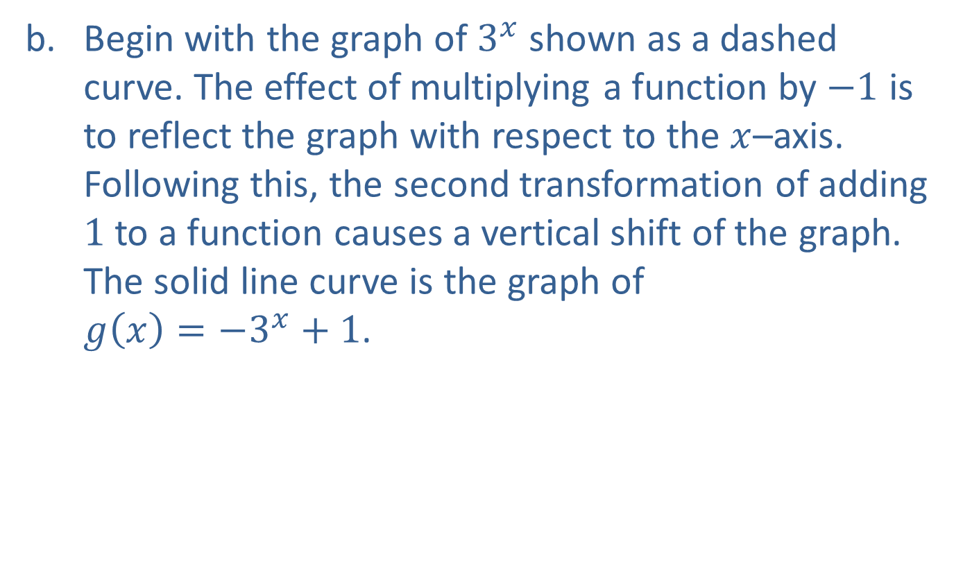
Example 2: Graphing Exponential Functions (cont.)
Begin with the graph of $3^{x}$ shown as a dashed curve. The effect of multiplying a function by $−1$ is to reflect the graph with respect to the $x$–axis. Following this, the second transformation of adding $1$ to a function causes a vertical shift of the graph. The solid line curve is the graph of $g\left(x\right)=−3^{x}+1$.

Slide 15
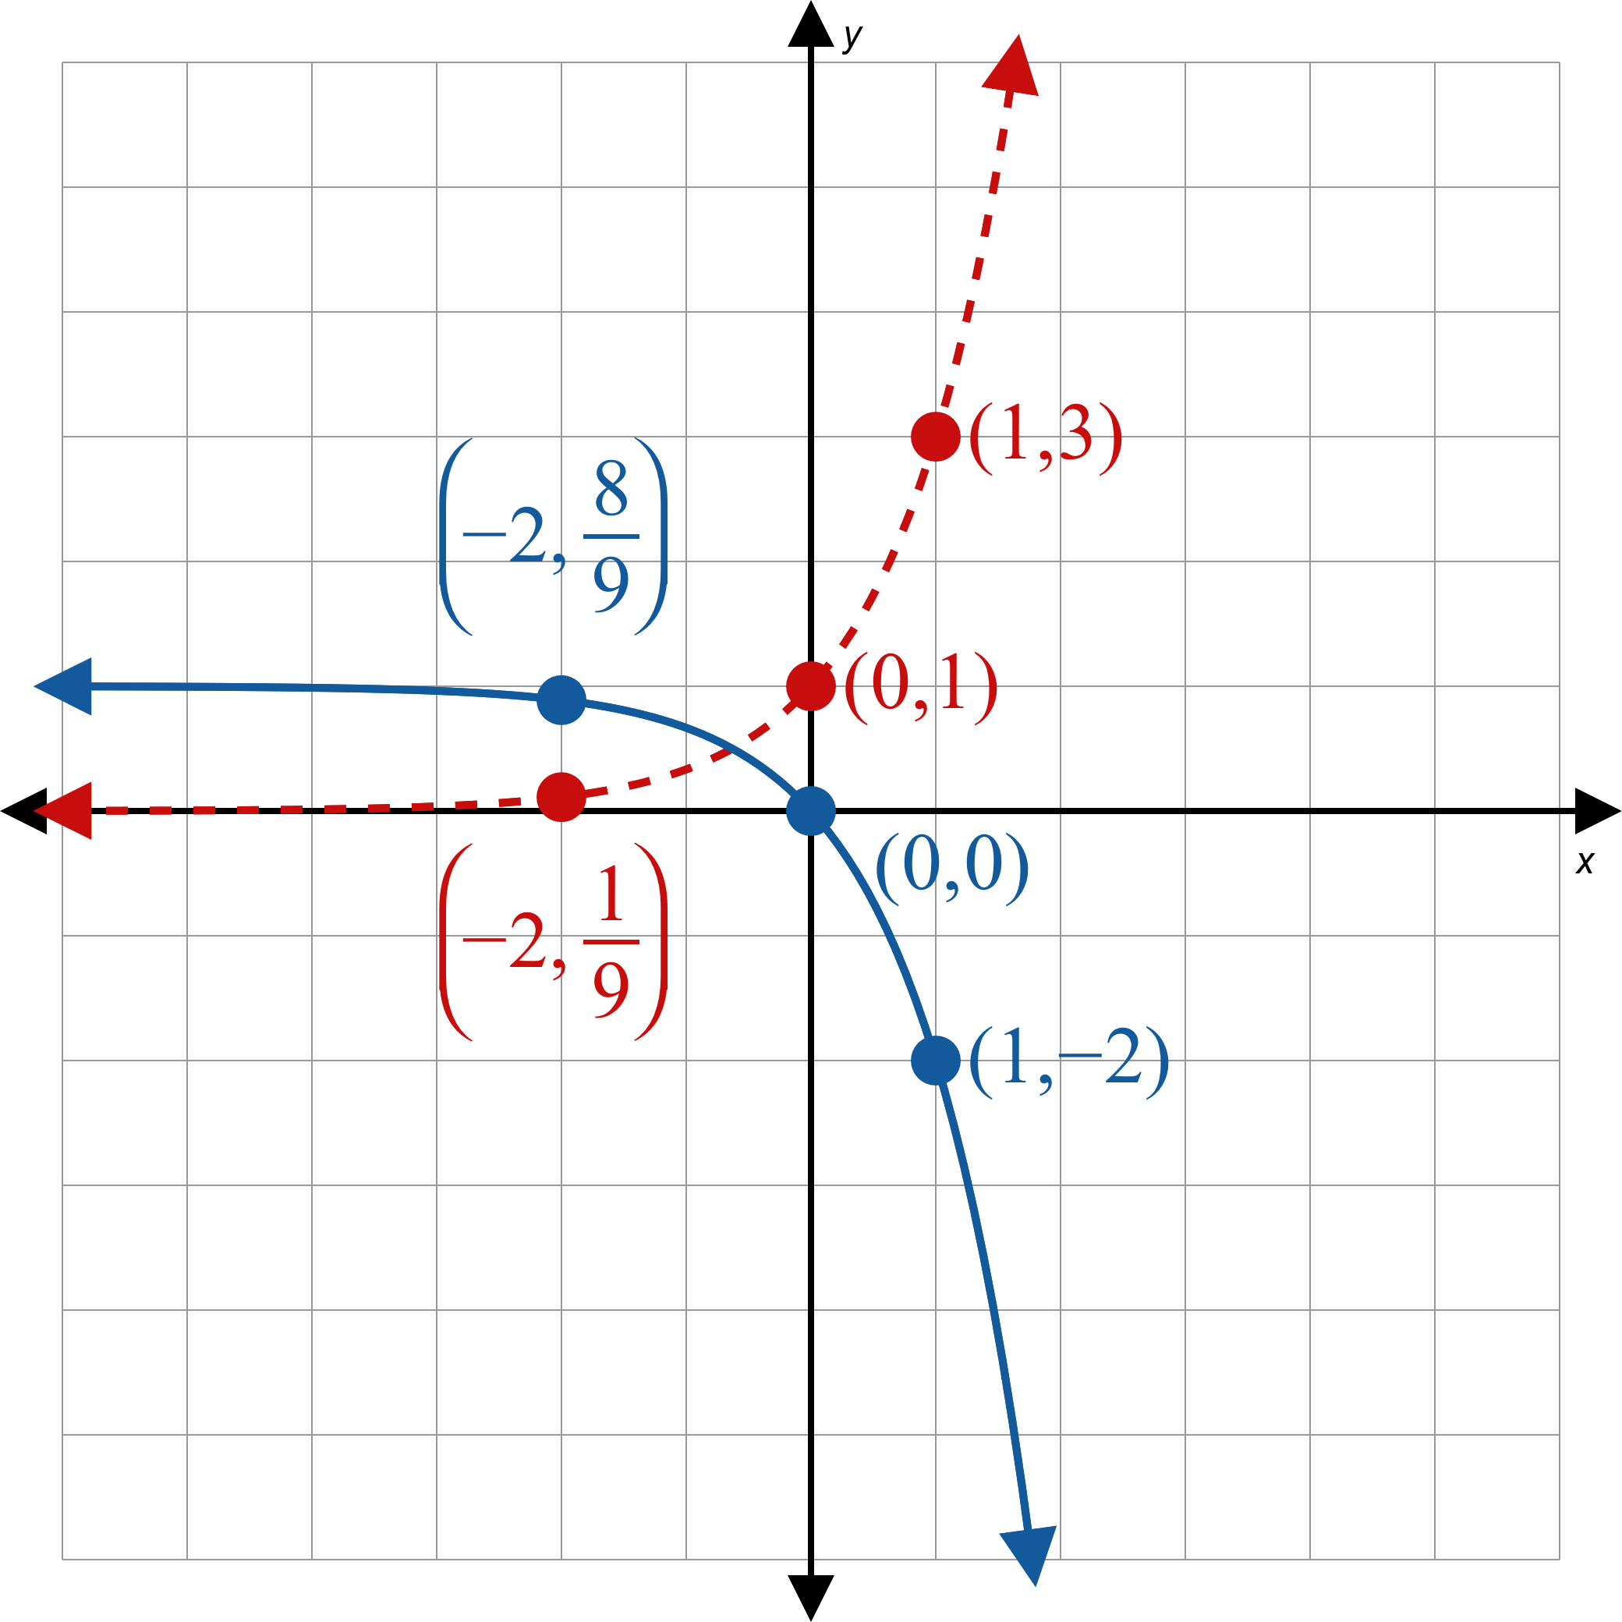
Example 2: Graphing Exponential Functions (cont.)
Figure 5

Slide 16
Example 2: Graphing Exponential Functions (cont.)
Domain $=(−∞, ∞)$, Range $=(−∞, 1)$

Slide 17
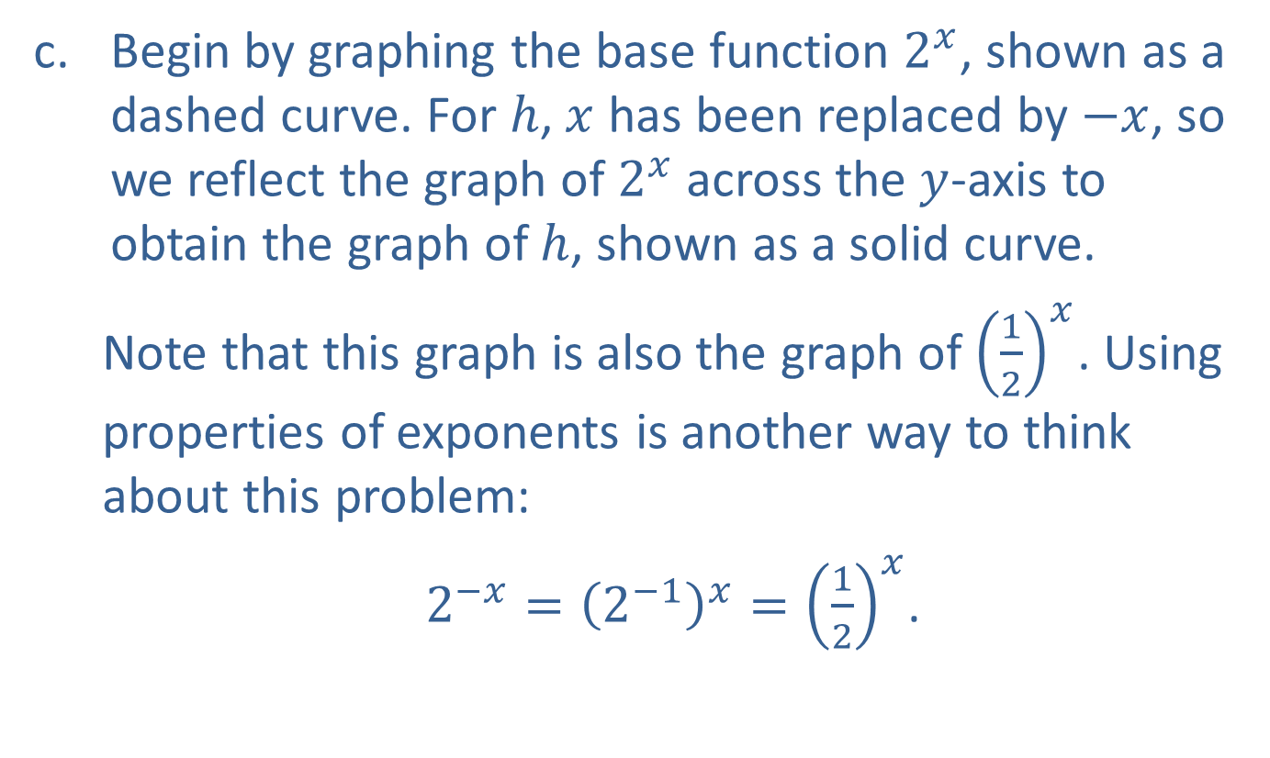
Example 2: Graphing Exponential Functions (cont.)
Begin by graphing the base function $2^{x}$, shown as a dashed curve. For $h$, $x$ has been replaced by $−x$, so we reflect the graph of $2^{x}$ across the $y$-axis to obtain the graph of $h$, shown as a solid curve.
Note that this graph is also the graph of ${\left(\frac{1}{2}\right)}^{x}$. Using properties of exponents is another way to think about this problem:
$2^{−x}={\left(2^{−1}\right)}^{x}={\left(\frac{1}{2}\right)}^{x}$.

Slide 18
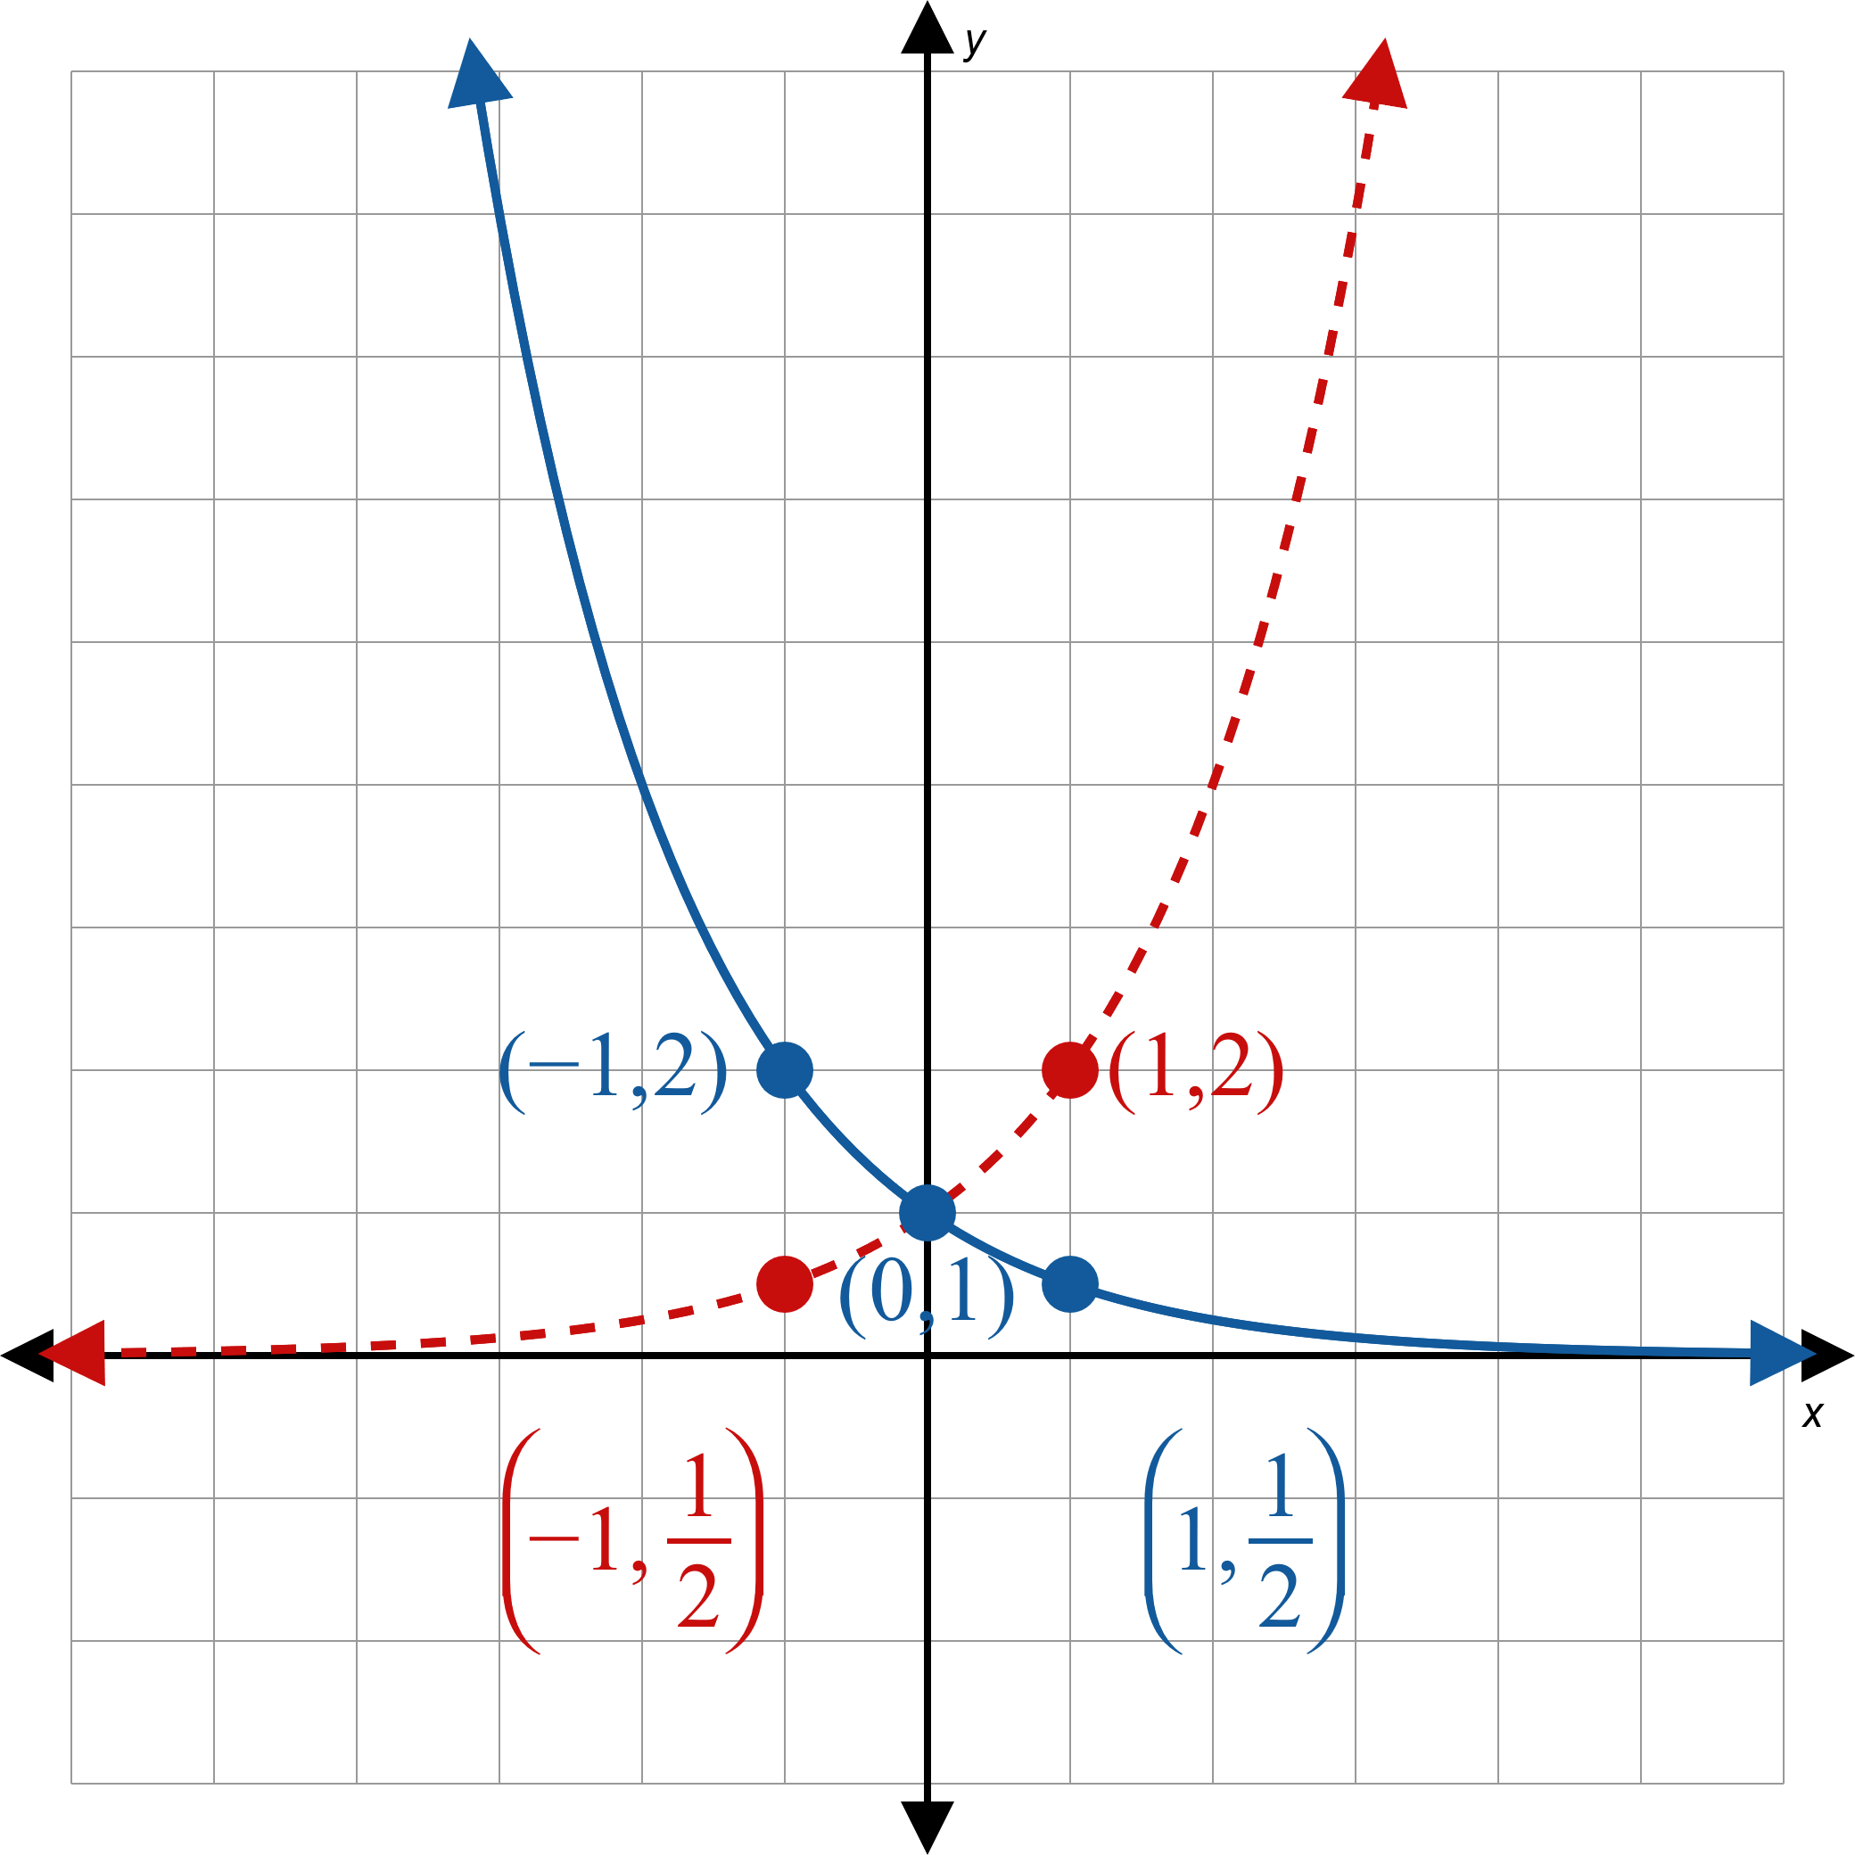
Example 2: Graphing Exponential Functions (cont.)
Figure 6

Slide 19
Example 2: Graphing Exponential Functions (cont.)
Domain $=(−∞, ∞)$, Range $=(0, ∞)$

Slide 20
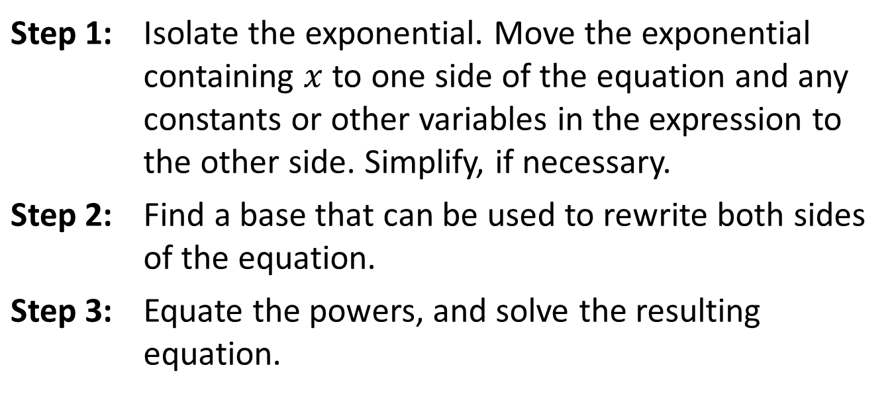
Solving Elementary Exponential Equations
Procedure
To solve an elementary exponential equation perform the following steps.
Step 1: | Isolate the exponential. Move the exponential containing $x$ to one side of the equation and any constants or other variables in the expression to the other side. Simplify, if necessary.
Step 2: | Find a base that can be used to rewrite both sides of the equation.
Step 3: | Equate the powers, and solve the resulting equation.

Slide 21

Example 3: Solving Elementary Exponential Equations
Solve the following exponential equations.
​${25}^{x}−125=0$
​$8^{y−1}=\frac{1}{2}$
​${\left(\frac{2}{3}\right)}^{x}=\frac{9}{4}$

Slide 22
Note:
As always, it is good practice to check your solution in the original equation.

Slide 23
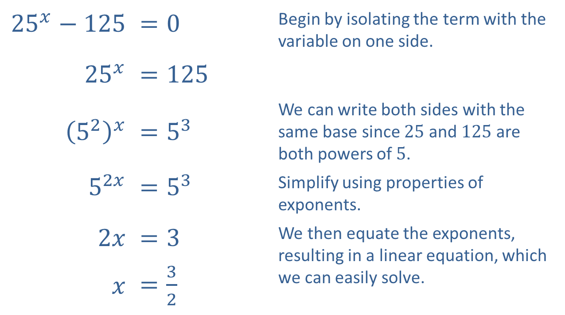
Example 3: Solving Elementary Exponential Equations (cont.)
Solution
​
​${25}^{x}−125$ | ​$=0$ | Begin by isolating the term with the variable on one side.
​${25}^{x}$ | ​$=125$
​${\left(5^{2}\right)}^{x}$ | ​$=5^{3}$ | We can write both sides with the same base since 25 and 125 are both powers of 5.
​$5^{2x}$ | ​$=5^{3}$ | Simplify using properties of exponents.
​$2x$ | ​$=3$ | We then equate the exponents, resulting in a linear equation, which we can easily solve.
$x$ | ​$=\frac{3}{2}$

Slide 24
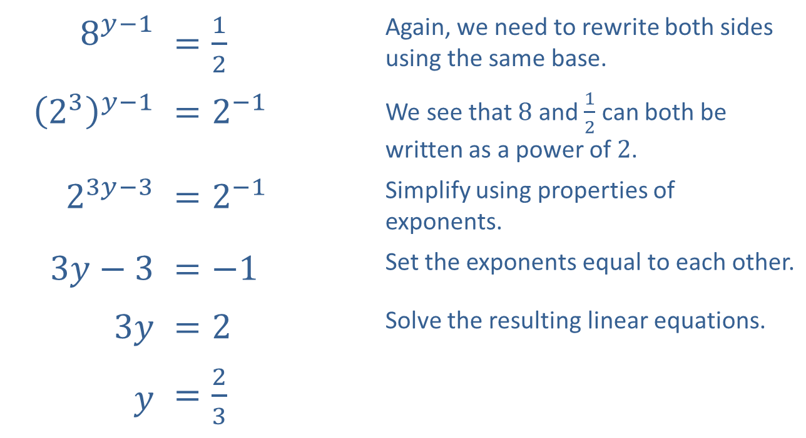
Example 3: Solving Elementary Exponential Equations (cont.)
​
​$8^{y−1}$ | ​$=\frac{1}{2}$ | Again, we need to rewrite both sides using the same base.
​${\left(2^{3}\right)}^{y−1}$ | ​$=2^{−1}$ | We see that 8 and $\frac{1}{2}$ can both be written as a power of 2.
​$2^{3y−3}$ | ​$=2^{−1}$ | Simplify using properties of exponents.
​$3y−3$ | ​$=−1$ | Set the exponents equal to each other.
​$3y$ | ​$=2$ | Solve the resulting linear equations.
$y$ | ​$=\frac{2}{3}$

Slide 25
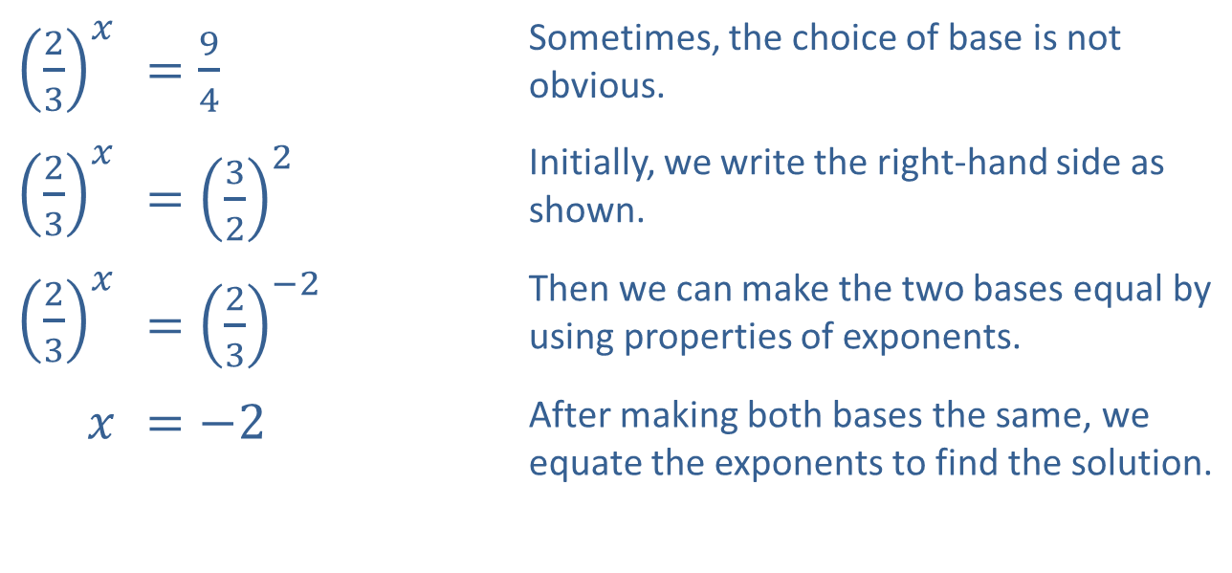
Example 3: Solving Elementary Exponential Equations (cont.)
​${\left(\frac{2}{3}\right)}^{x}$ | ​$=\frac{9}{4}$ | Sometimes, the choice of base is not obvious.
​${\left(\frac{2}{3}\right)}^{x}$ | ​$={\left(\frac{3}{2}\right)}^{2}$ | Initially, we write the right-hand side as shown.
​${\left(\frac{2}{3}\right)}^{x}$ | ​$={\left(\frac{2}{3}\right)}^{−2}$ | Then we can make the two bases equal by using properties of exponents.
$x$ | ​$=−2$ | After making both bases the same, we equate the exponents to find the solution.
​

