Slide 1
Section 7.3
Logarithmic Functions and Their Graphs

Slide 2
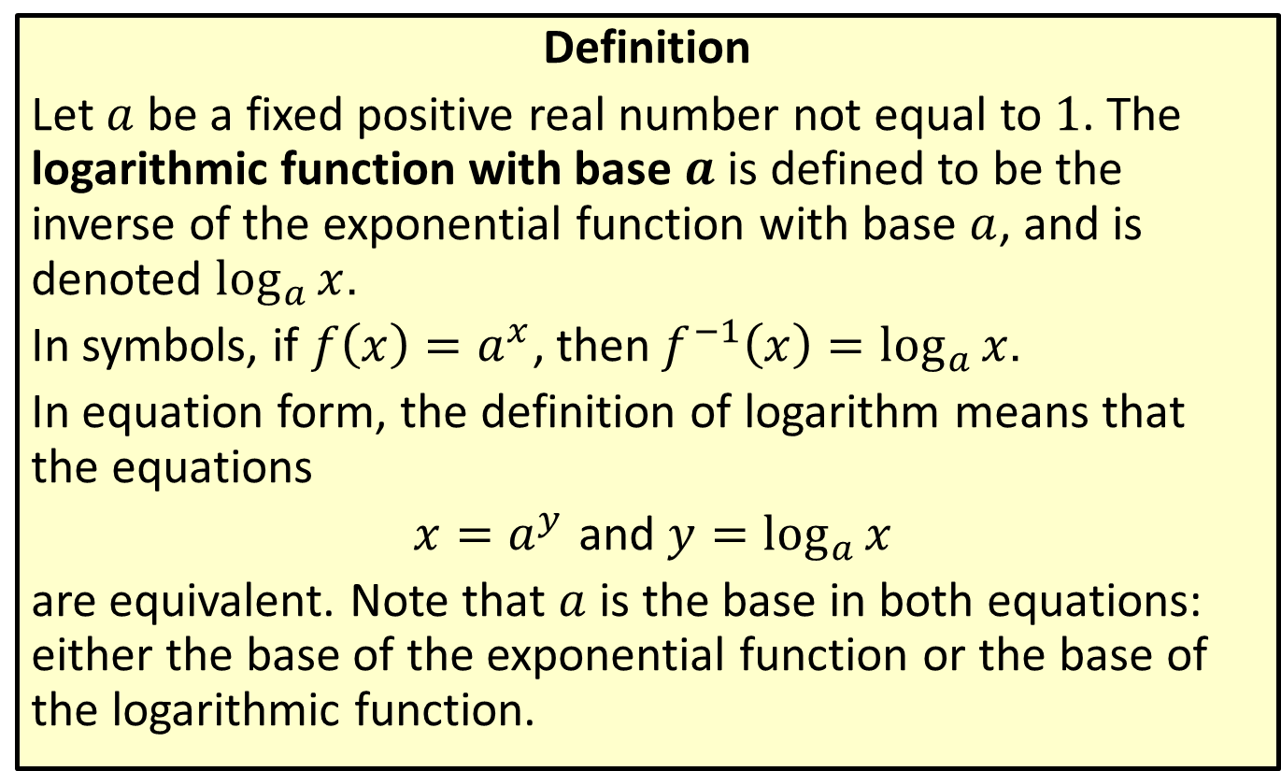
Logarithmic Functions
Definition
Let $a$ be a fixed positive real number not equal to 1. The logarithmic function with base $a$ is defined to be the inverse of the exponential function with base $a$, and is denoted $\log_{a}⁡x$.
In symbols, if $f\left(x\right)=a^{x}$, then$f^{−1}\left(x\right)=\log_{a}{x}$.
In equation form, the definition of logarithm means that the equations
$x=a^{y}$ and $y=\log_{a}{x}$
are equivalent. Note that $a$ is the base in both equations: either the base of the exponential function or the base of the logarithmic function.

Slide 3
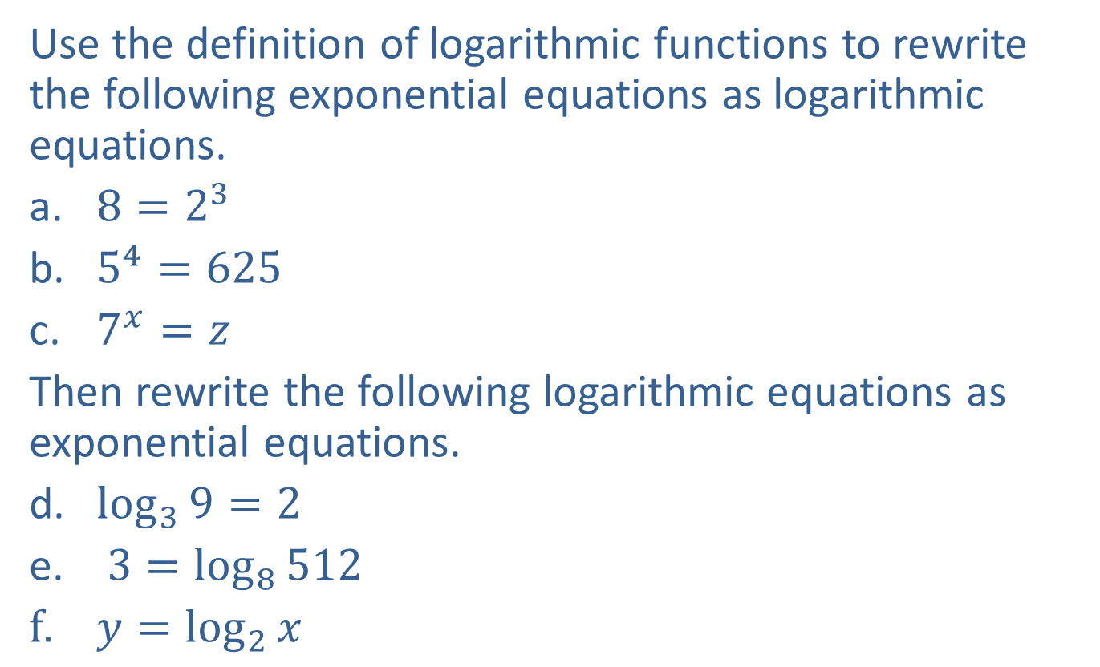
Example 1: Exponential and Logarithmic Equations
Use the definition of logarithmic functions to rewrite the following exponential equations as logarithmic equations.
​$8=2^{3}$
​$5^{4}=625$
​$7^{x}=z$
Then rewrite the following logarithmic equations as exponential equations.
​$\log_{3}{9}=2$
$3=\log_{8}{512}$
$y=\log_{2}{x}$

Slide 4

Example 1: Exponential and Logarithmic Equations (cont.)
Solution
​$3=\log_{2}{8}$
​$4=\log_{5}{625}$
​$x=\log_{7}{z}$
​$3^{2}=9$
​$8^{3}=512$
​$2^{y}=x$
Note that in each case, the base of the exponential equation is the base of the logarithmic equation.

Slide 5
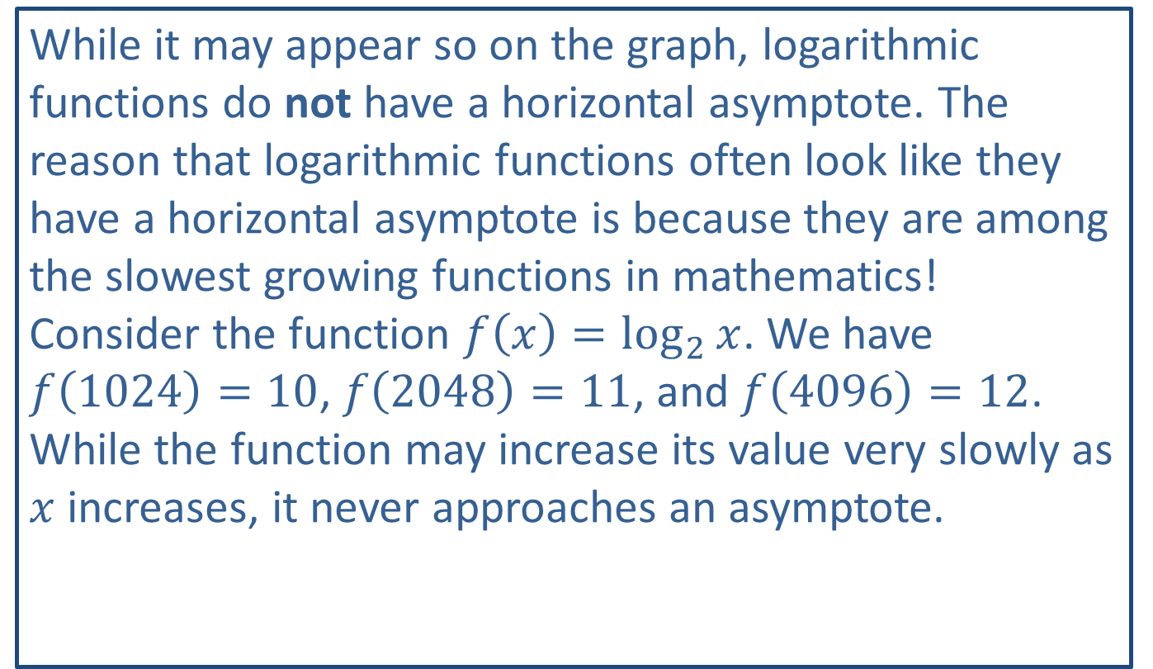
CAUTION!
While it may appear so on the graph, logarithmic functions do not have a horizontal asymptote. The reason that logarithmic functions often look like they have a horizontal asymptote is because they are among the slowest growing functions in mathematics! Consider the function $f⁡\left(x\right)=\log_{2}{x}$. We have $f⁡\left(1024\right)=10$, $f\left(2048\right)=11$, and $f\left(4096\right)=12$. While the function may increase its value very slowly as $x$ increases, it never approaches an asymptote.

Slide 6

Example 2: Graphing Logarithmic Functions
Sketch the graphs of the following logarithmic functions.
​$f\left(x\right)=\log_{3}{x}$
​$g\left(x\right)=\log_{\frac{1}{2}}{x}$

Slide 7
Note:
Once again, plotting a few key points will provide a good idea of the shape of the function.

Slide 8
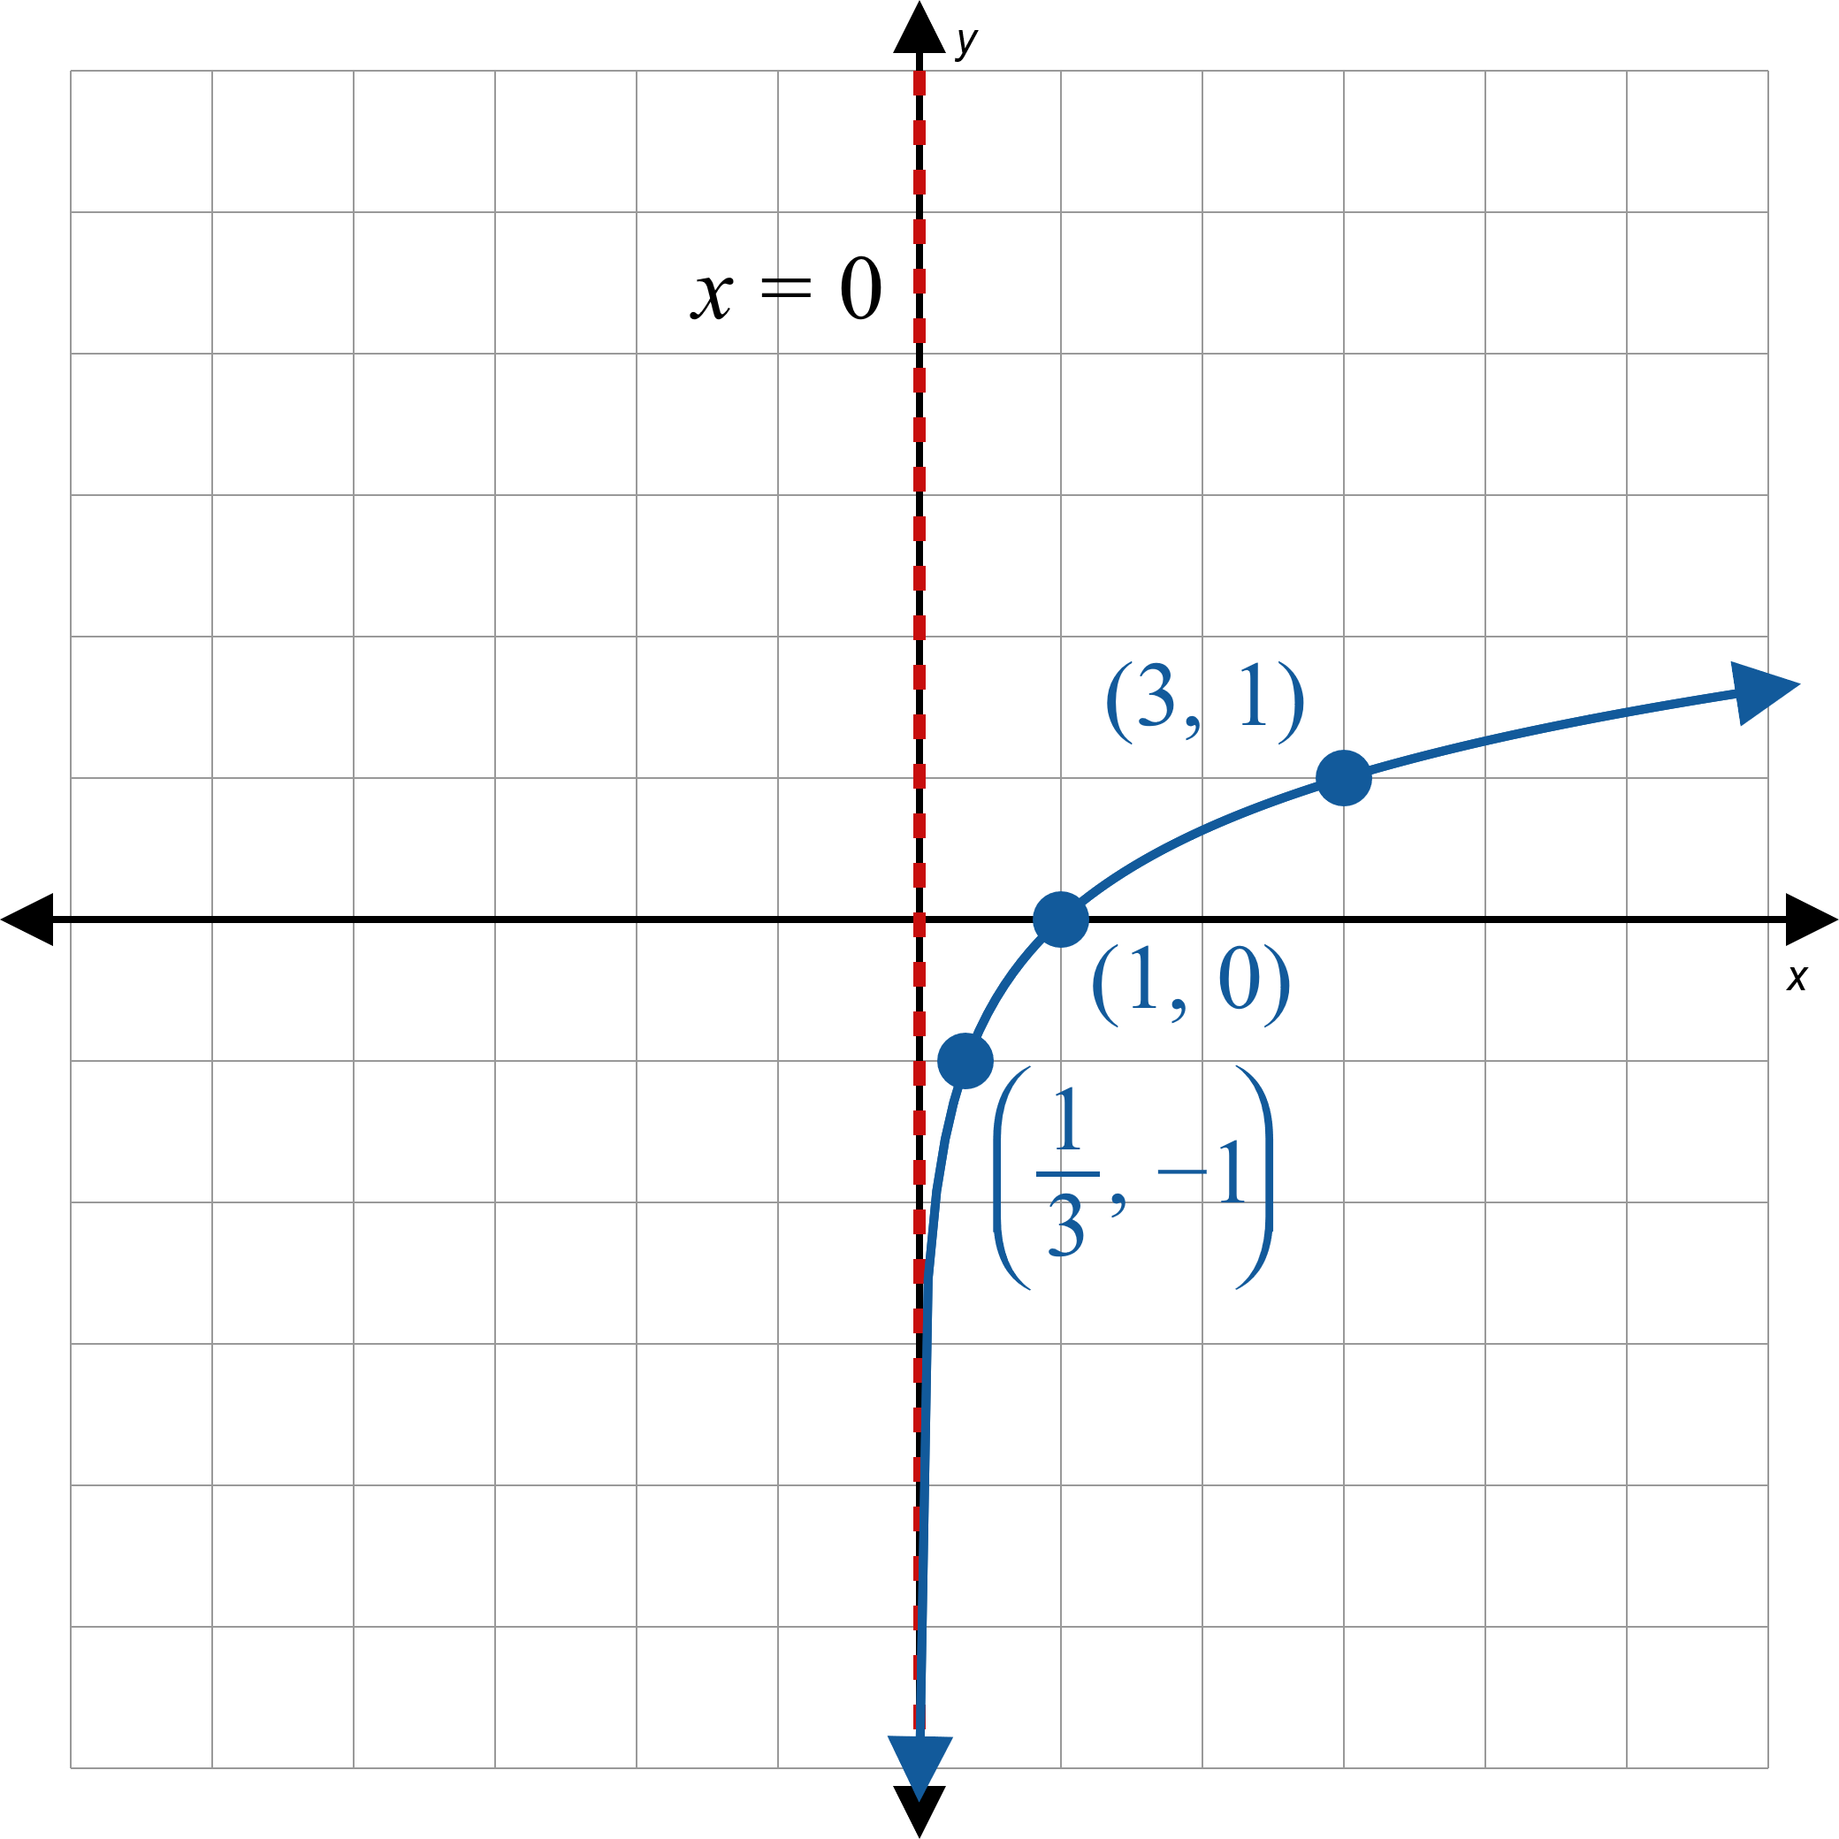
Example 2: Graphing Logarithmic Functions (cont.)
Solution
a.
Figure 2

Slide 9
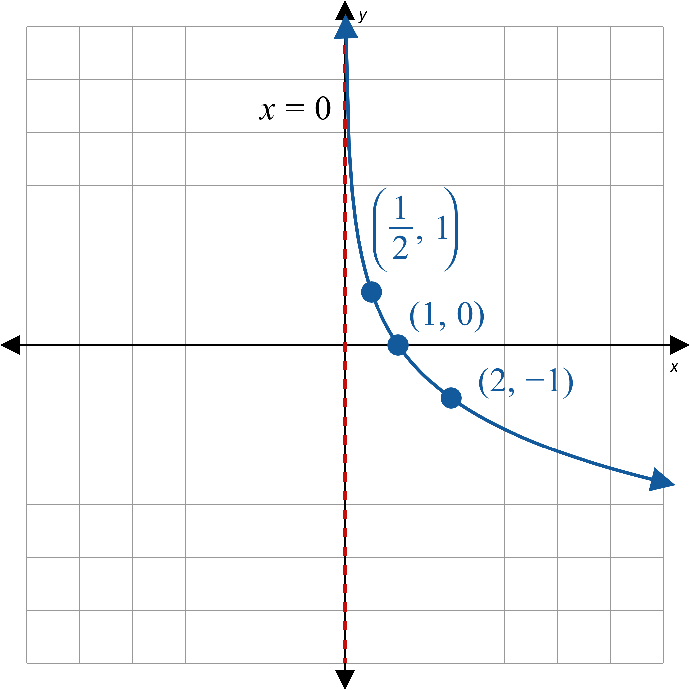
Example 2: Graphing Logarithmic Functions (cont.)
b.
Figure 3

Slide 10
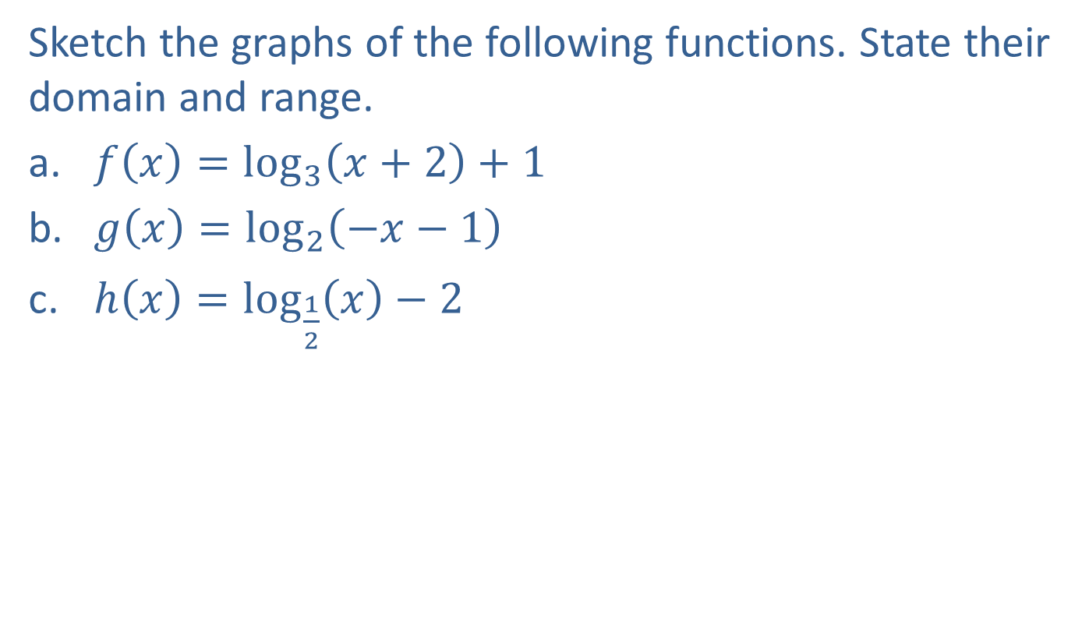
Example 3: Graphing Logarithmic Functions
Sketch the graphs of the following functions. State their domain and range.
​$f\left(x\right)=\log_{3}\left(x+2\right)+1$
​$g\left(x\right)=\log_{2}\left(−x−1\right)$
​$h\left(x\right)=\log_{\frac{1}{2}}⁡\left(x\right)−2$

Slide 11
Note:
Begin by graphing the base function, then apply any transformations.

Slide 12
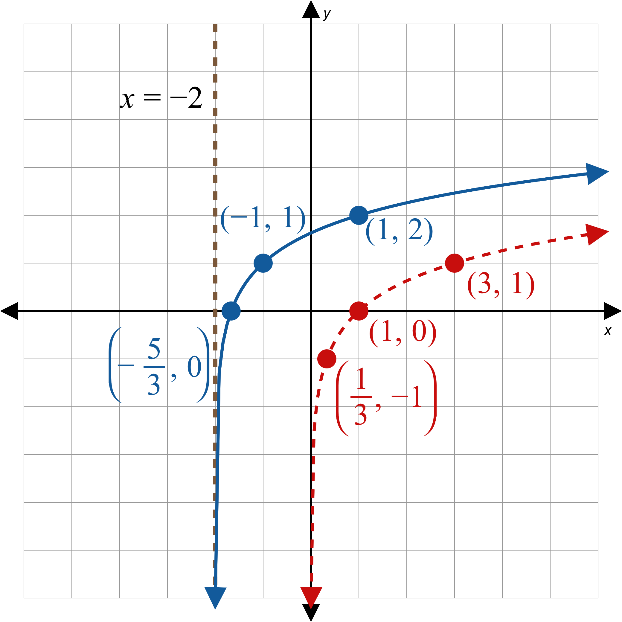


Example 3: Graphing Logarithmic Functions (cont.)
Solution
a.
Begin by graphing the base function, which is $\log_{3}{x}$. This is the dashed curve.
Since $x$ has been replaced by $x+2$, we shift the graph $2$ units to the left.
To find the graph of $f$, we shift the result up $1$ unit, since $1$ has been added to the function. This is the solid curve.
Note that the asymptote has also been shifted to the left.
Figure 4
Domain$=(−2,∞)$, Range $=(−∞,∞)$

Slide 13
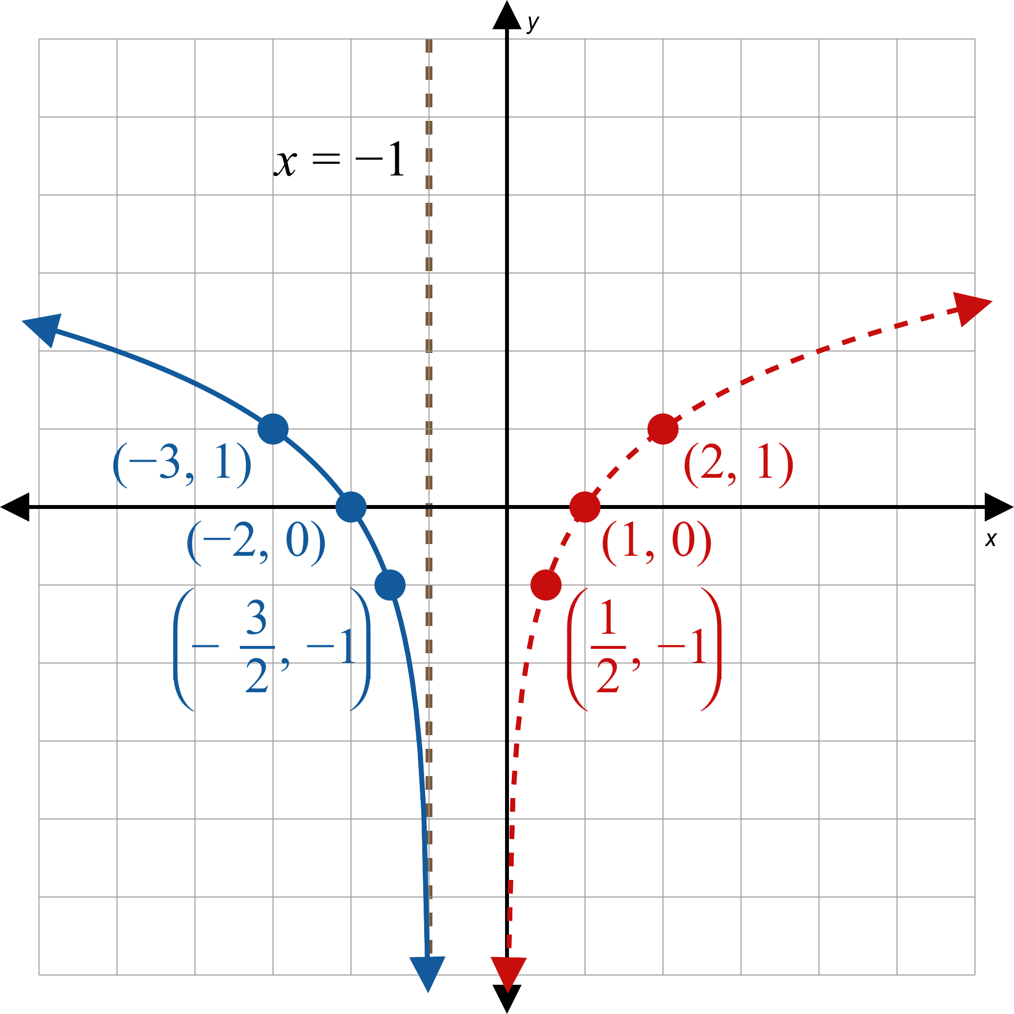


Example 3: Graphing Logarithmic Functions (cont.)
b.
The basic shape of the graph of $g$ is the same as the shape of $y=\log_{2}{x}$, which is the dashed curve.
To obtain $g$ from $\log_{2}{x}$, the variable $x$ is replaced with $x−1$, which shifts the graph $1$ unit to the right, and then $x$ is replaced by $−x$, which reflects the graph with respect to the $y$-axis.
Figure 5
Domain$=(−∞,−1)$, Range $=(−∞,∞)$

Slide 14
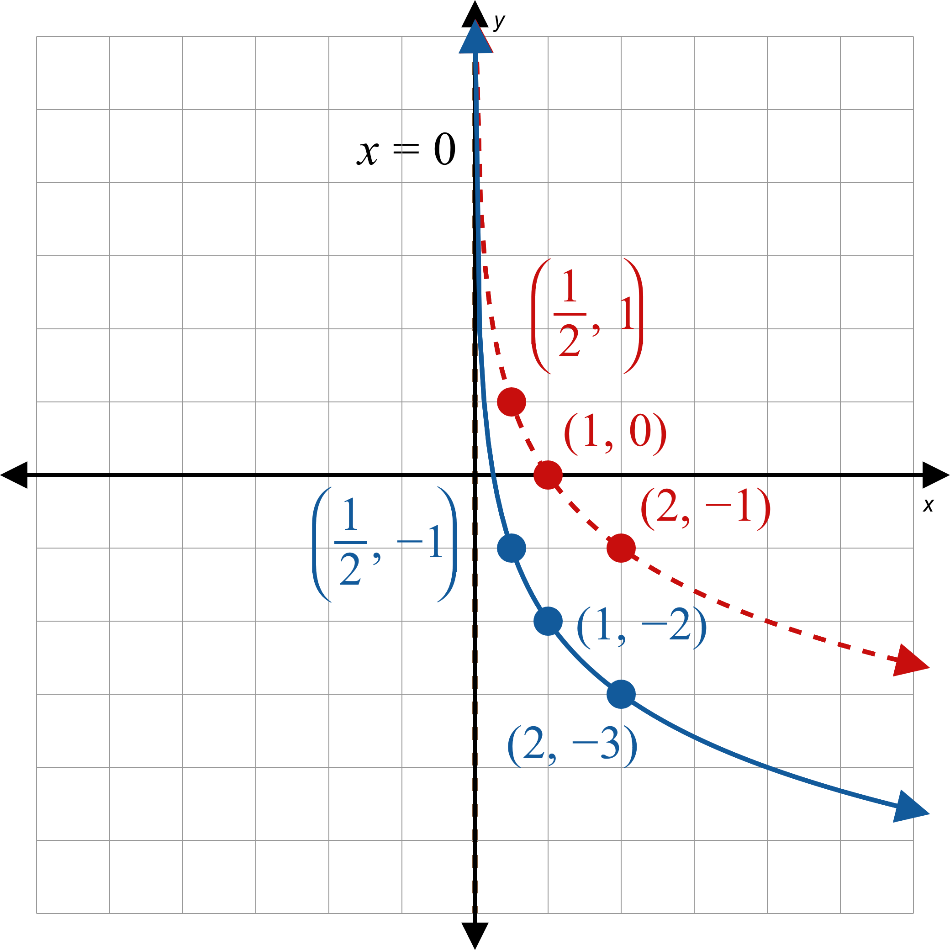

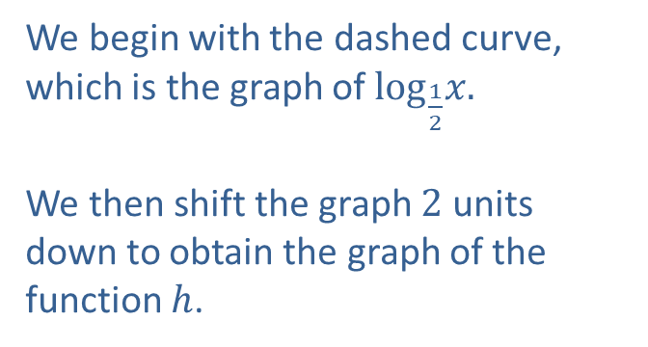
Example 3: Graphing Logarithmic Functions (cont.)
c.
We begin with the dashed curve, which is the graph of $\log_{\frac{1}{2}}x.$
We then shift the graph $2$ units down to obtain the graph of the function $h$.
Figure 6
Domain$=(0,∞)$, Range $=(−∞,∞)$

Slide 15
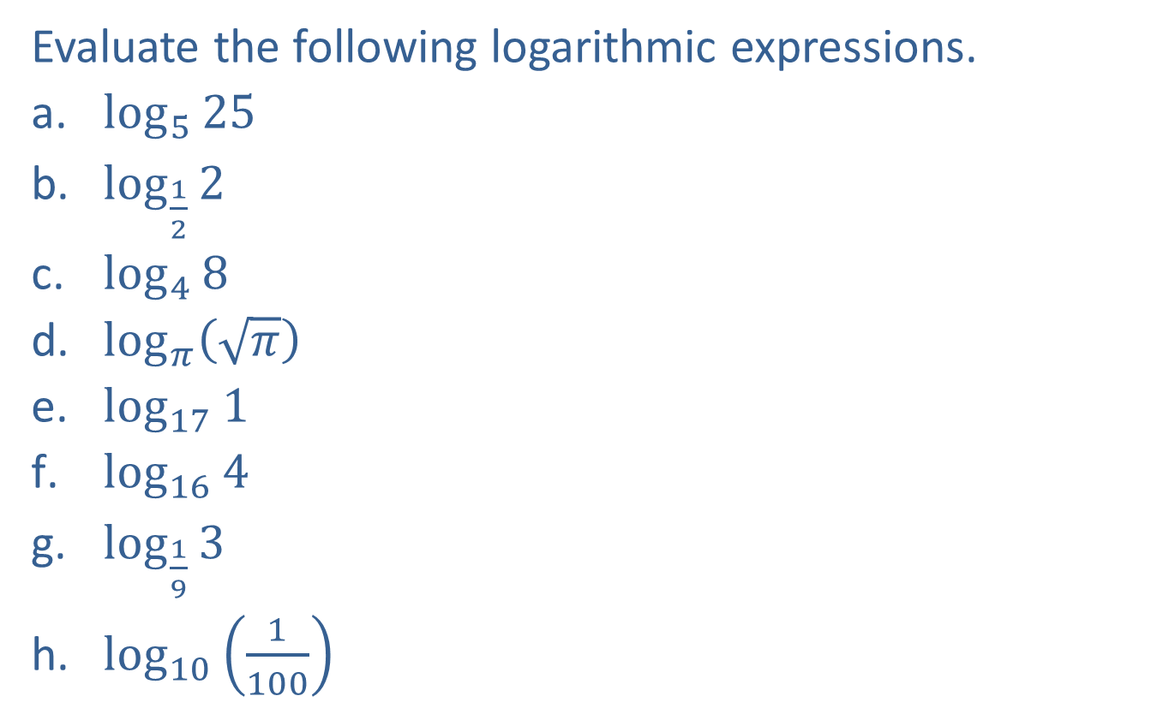
Example 4: Logarithmic Expressions
Evaluate the following logarithmic expressions.
​$\log_{5}⁡25$
​$\log_{\frac{1}{2}}⁡2$
​$\log_{4}{8}$
​$\log_{π}⁡\left(\sqrt{π}\right)$
​$\log_{17}⁡1$
​$\log_{16}⁡4$
​$\log_{\frac{1}{9}}{3}$
​$\log_{10}⁡\left(\frac{1}{100}\right)$

Slide 16
Note:
We write each of the equivalent exponential equations as a reference.

Slide 17
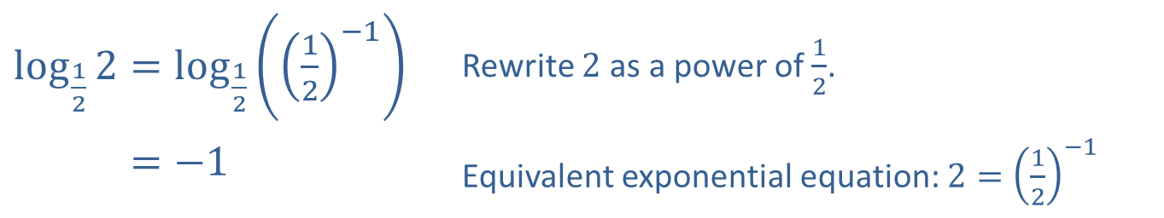
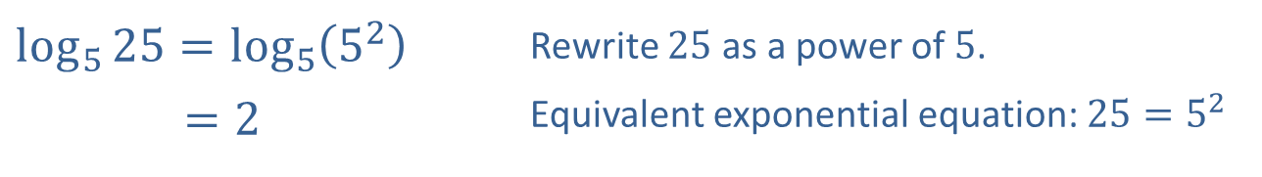
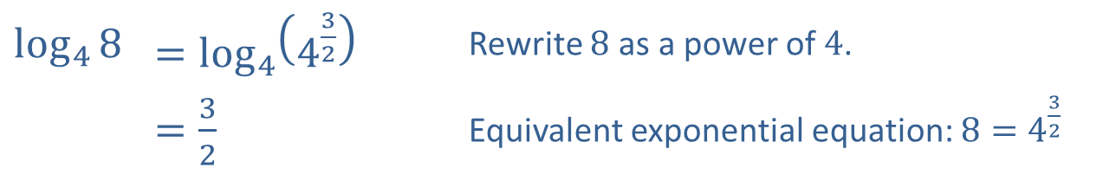
Example 4: Logarithmic Expressions (cont.)
Solution
​
​$\log_{5}{25}=\log_{5}\left(5^{2}\right)$ | Rewrite 25 as a power of 5.
​𝑙𝑜𝑔5⁡25=2 | Equivalent exponential equation: $25=5^{2}$
​$\log_{\frac{1}{2}}{2}=\log_{\frac{1}{2}}\left({\left(\frac{1}{2}\right)}^{−1}\right)$ | Rewrite 2 as a power of $\frac{1}{2}$.
​log12⁡2=−1 | Equivalent exponential equation: $2={\left(\frac{1}{2}\right)}^{−1}$
​
​$\log_{4}⁡8$ | ​$=\log_{4}\left(4^{\frac{3}{2}}\right)$ | Rewrite 8 as a power of 4.
​ | ​$=\frac{3}{2}$ | Equivalent exponential equation: $8=4^{\frac{3}{2}}$
​

Slide 18
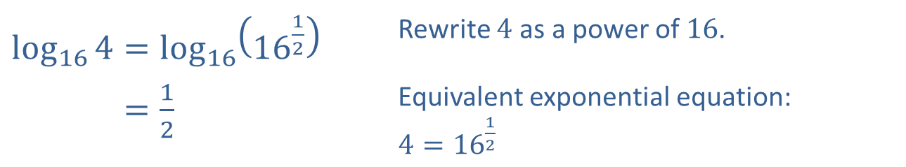
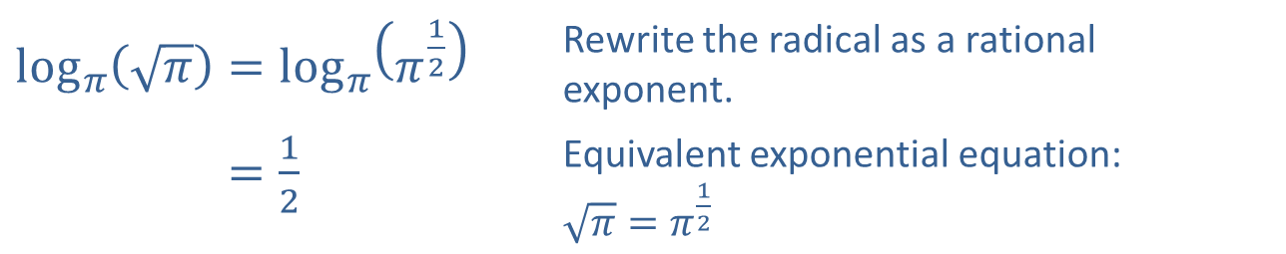
Example 4: Logarithmic Expressions (cont.)
​$\log_{π}\left(\sqrt{π}\right)=\log_{π}\left(π^{\frac{1}{2}}\right)$ | Rewrite the radical as a rational exponent.
​log𝜋⁡𝜋=12 | Equivalent exponential equation: $\sqrt{π}=π^{\frac{1}{2}}$
​
e.​
$$log_{17}1=0$$ | Equivalent exponential equation: $1=17^{0}$
​$\log_{16}{4}=\log_{16}\left({16}^{\frac{1}{2}}\right)$ | Rewrite 4 as a power of 16.
​log16⁡4=12 | Equivalent exponential equation: $4={16}^{\frac{1}{2}}$
f.​

Slide 19
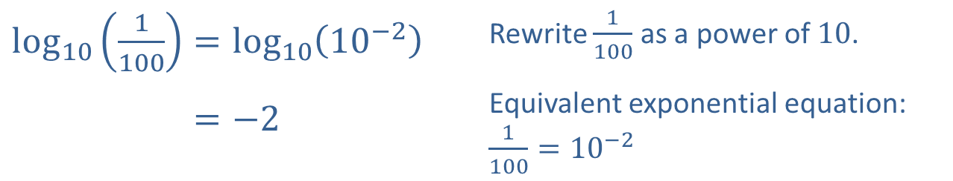
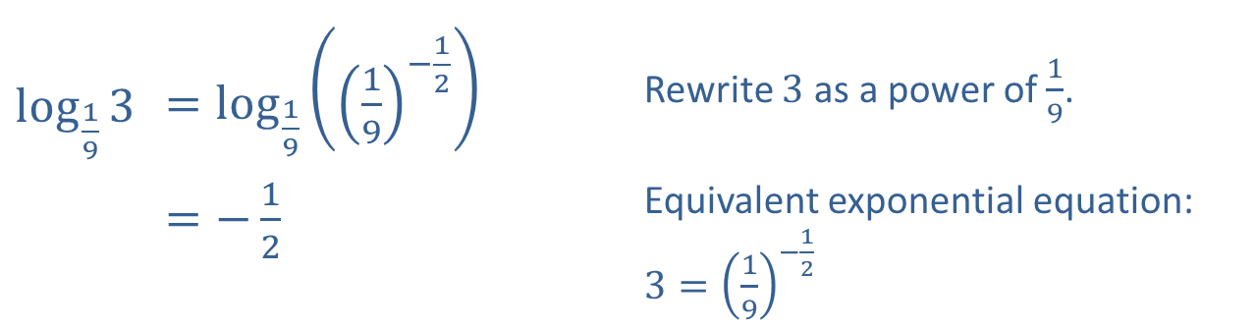
Example 4: Logarithmic Expressions (cont.)
​$\log_{\frac{1}{9}}⁡3$ | ​$=\log_{\frac{1}{9}}\left({\left(\frac{1}{9}\right)}^{−\frac{1}{2}}\right)$ | Rewrite 3 as a power of $\frac{1}{9}$.
 | ​$=−\frac{1}{2}$ | Equivalent exponential equation: $3={\left(\frac{1}{9}\right)}^{−\frac{1}{2}}$
​
​$\log_{10}\left(\frac{1}{100}\right)=\log_{10}\left({10}^{−2}\right)$ | Rewrite $\frac{1}{100}$ as a power of 10.
​log10⁡1100=−2 | Equivalent exponential equation: $\frac{1}{100}={10}^{−2}$
​

Slide 20

Example 5: Solving Logarithmic Equations
Use elementary properties of exponents and logarithms to solve the following equations.
​$\log_{6}\left(2x\right)=−1$
​$3^{\log_{3x}{2}}=2$
​$\log_{2}\left(8^{x}\right)=5$

Slide 21
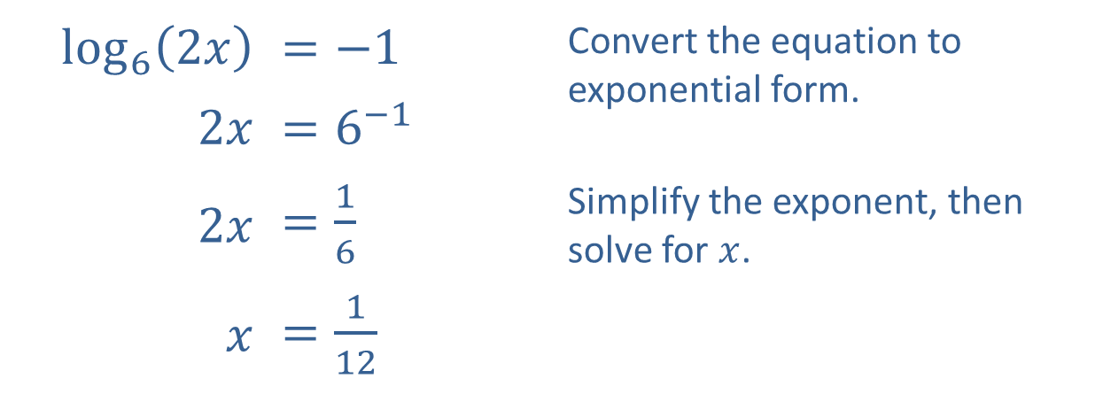
Example 5: Solving Logarithmic Equations (cont.)
Solution
​
​$\log_{6}⁡\left(2x\right)$ | ​$=−1$ | Convert the equation to exponential form.
​$2x$ | ​$=6^{−1}$
​$2x$ | ​$=\frac{1}{6}$ | Simplify the exponent, then solve for $x$.
$x$ | ​$=\frac{1}{12}$

Slide 22
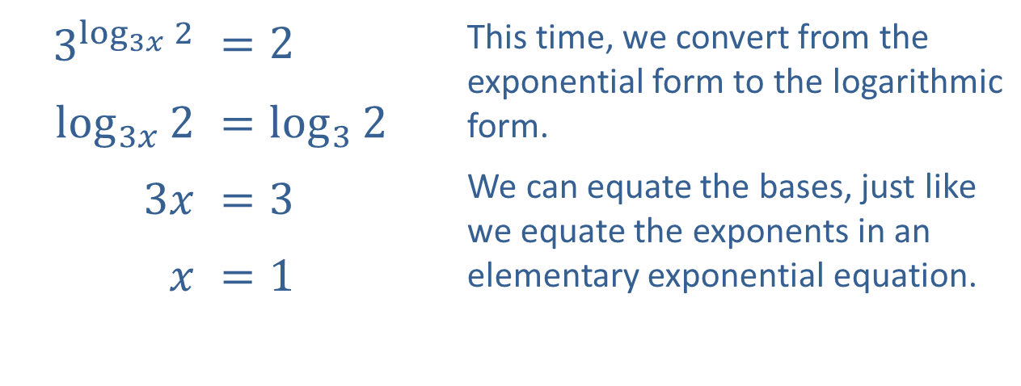
Example 5: Solving Logarithmic Equations (cont.)
​$3^{\log_{3x}{2}}$ | ​$=2$ | This time, we convert from the exponential form to the logarithmic form. We can equate the bases, just like we equate the exponents in an elementary exponential equation.
​$\log_{3x}⁡2$ | ​$=\log_{3}{2}$
​$3x$ | ​$=3$
$x$ | ​$=1$
​

Slide 23
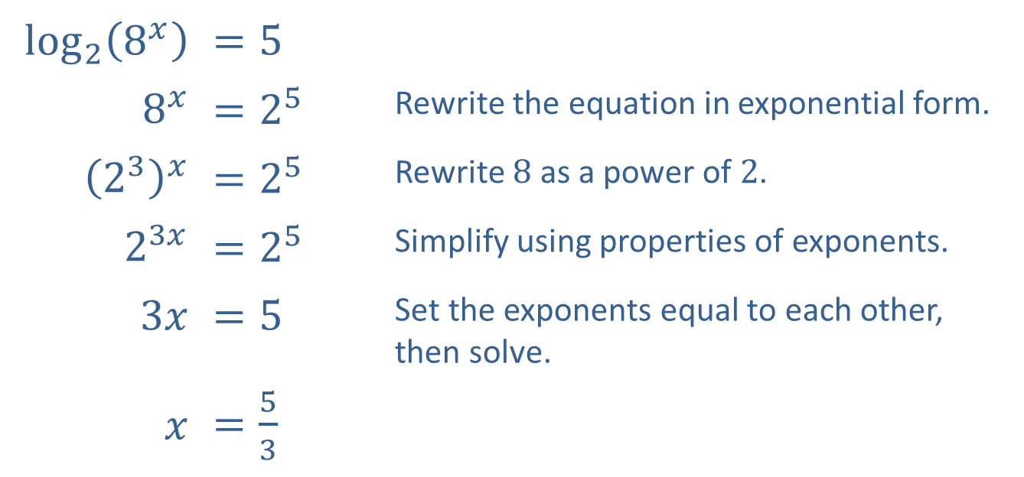
Example 5: Solving Logarithmic Equations (cont.)
​$\log_{2}⁡\left(8^{x}\right)$ | ​$=5$
​$8^{x}$ | ​$=2^{5}$ | Rewrite the equation in exponential form.
​${\left(2^{3}\right)}^{x}$ | ​$=2^{5}$ | Rewrite 8 as a power of 2.
​$2^{3x}$ | ​$=2^{5}$ | Simplify using properties of exponents.
​$3x$ | ​$=5$ | Set the exponents equal to each other, then solve.
$x$ | ​$=\frac{5}{3}$
​

Slide 24
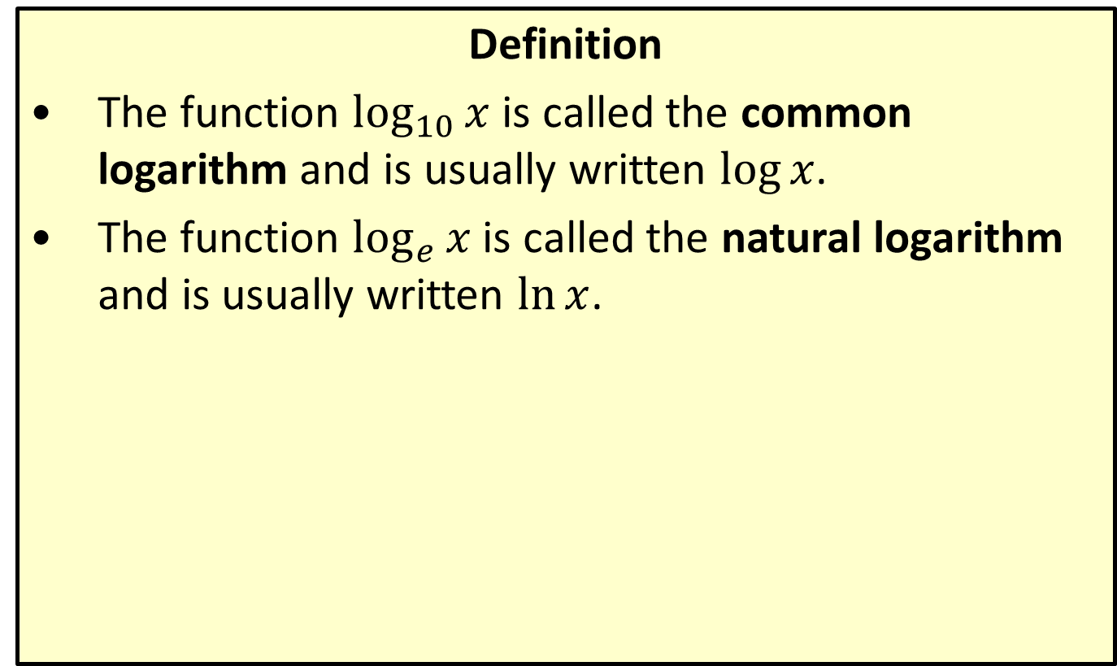
Common and Natural Logarithms
Definition
​The function $\log_{10}⁡x$ is called the common logarithm and is usually written $log⁡x$.
​The function $\log_{e}⁡x$ is called the natural logarithm and is usually written $ln⁡x$.

Slide 25
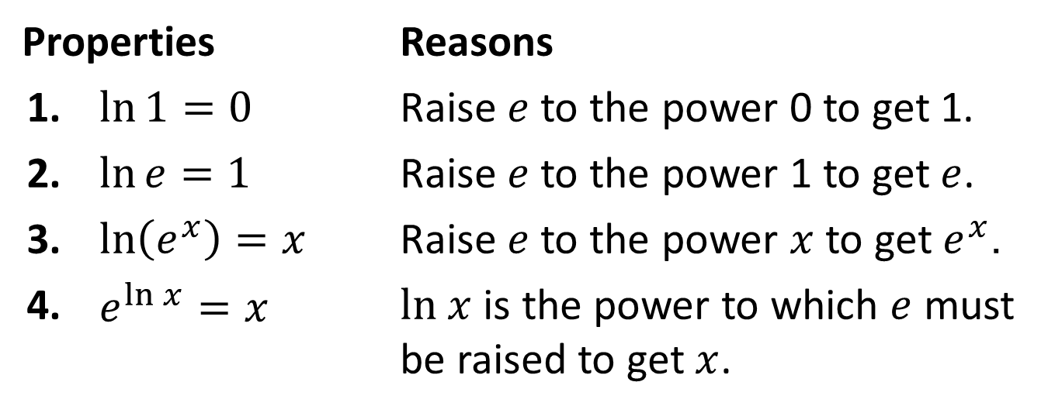

Properties of Natural Logarithms
Properties
$$\ln{x}=y \text{⇔}{ e}^{y}=x$$
Properties |  | Reasons
1. | $\ln{1}=0$ | Raise $e$ to the power 0 to get 1.
2. | $\ln{e}=1$ | Raise $e$ to the power 1 to get $e$.
3. | $\ln\left(e^{x}\right)=x$ | Raise $e$ to the power $x$ to get $e^{x}$.
4. | $e^{\ln{x}}=x$ | $ln x$ is the power to which $e$ must be raised to get $x$.

Slide 26

Example 6: Evaluating Logarithmic Expressions
Evaluate the following logarithmic expressions.
​$ln⁡\left(\sqrt[3]{e}\right)$
​$log⁡1000$
​$ln⁡\left(4.78\right)$
​$log⁡\left(10.5\right)$

Slide 27
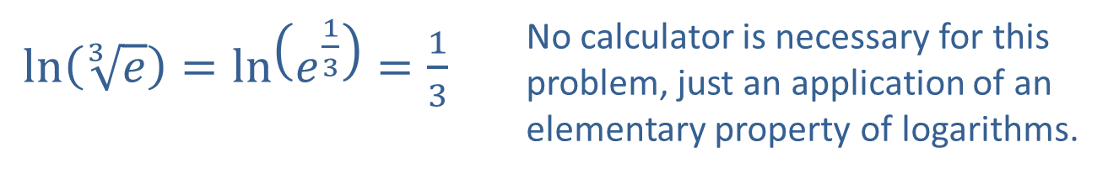
Example 6: Evaluating Logarithmic Expressions (cont.)
Solution
​
$\ln\left(\sqrt[3]{e}\right)=\ln\left(e^{\frac{1}{3}}\right)=\frac{1}{3}$ | No calculator is necessary for this problem, just an application of an elementary property of logarithms.
$\log{1000}=\log\left({10}^{3}\right)=3$ | Again, no calculator is required.
​

Slide 28
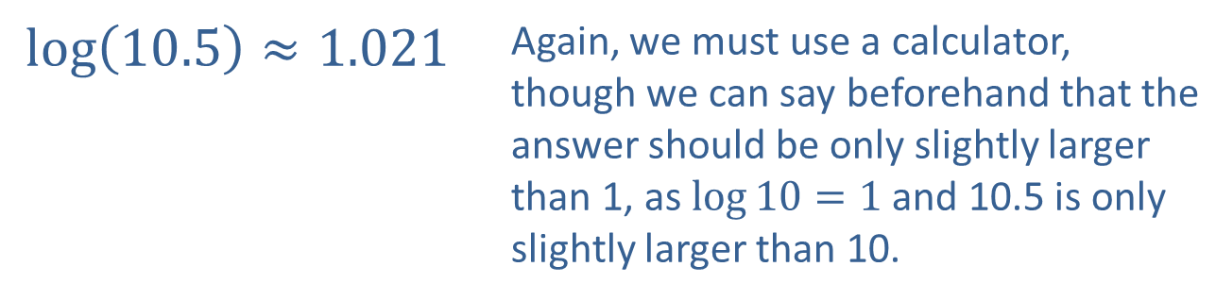
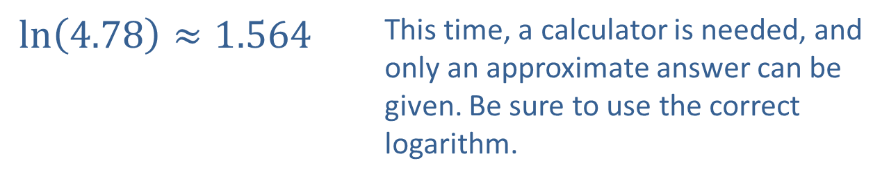
Example 6: Evaluating Logarithmic Expressions (cont.)
$\ln\left(4.78\right)≈1.564$ | This time, a calculator is needed, and only an approximate answer can be given. Be sure to use the correct logarithm.
​
$\log\left(10.5\right)≈1.021$ | Again, we must use a calculator, though we can say beforehand that the answer should be only slightly larger than 1, as $\log{10}=1$ and 10.5 is only slightly larger than 10.
​

