Slide 1
Section 7.4
Logarithmic Properties and Models

Slide 2
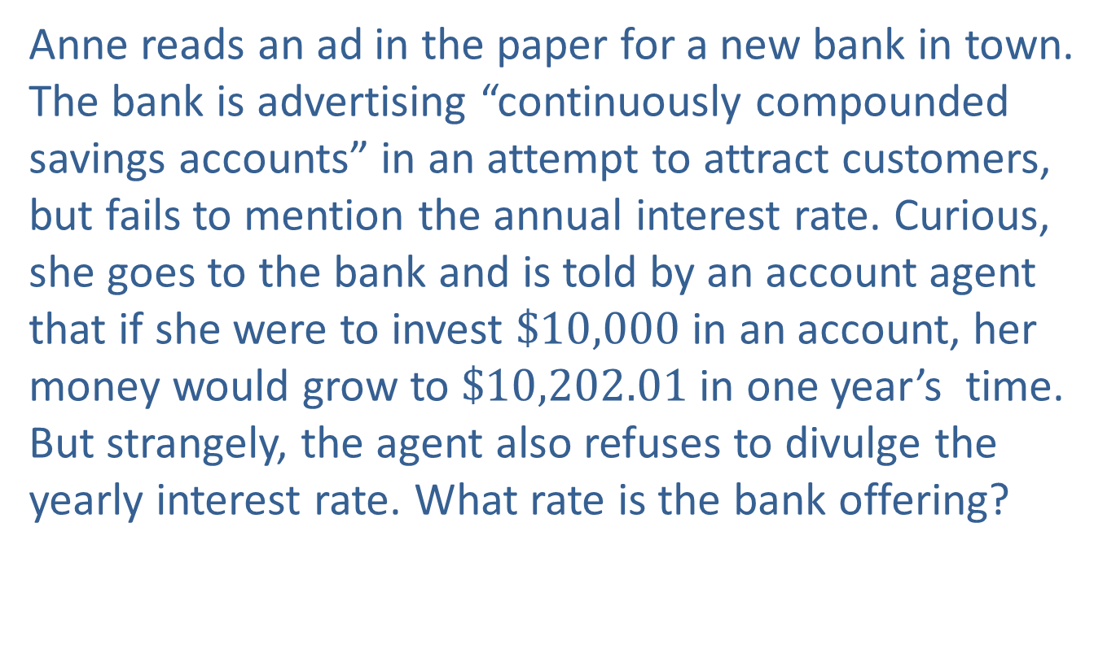
Example 1: Continuously Compounded Interest
Anne reads an ad in the paper for a new bank in town. The bank is advertising “continuously compounded savings accounts” in an attempt to attract customers, but fails to mention the annual interest rate. Curious, she goes to the bank and is told by an account agent that if she were to invest $\$10,000$ in an account, her money would grow to $\$10,202.01$ in one year’s time. But strangely, the agent also refuses to divulge the yearly interest rate. What rate is the bank offering?

Slide 3
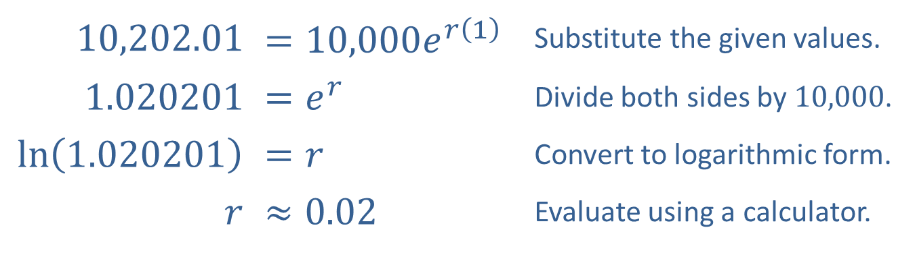

Example 1: Continuously Compounded Interest (cont.)
Solution
We need to solve the equation $A=Pe^{rt}$ for $r$, given that $A=10,202.01$, $P=10,000$, and $t=1$.
Note that we use the natural logarithm since the base of the exponential function is $e$. While we must use a calculator, we can now solve the equation for $r$.
​10,202.01 | ​$=10,000e^{r\left(1\right)}$ | Substitute the given values.
​1.020201 | ​$=e^{r}$ | Divide both sides by 10,000.
​$ln⁡\left(1.020201\right)$ | ​$=r$ | Convert to logarithmic form.
$$r$$ | ​$≈0.02$ | Evaluate using a calculator.

Slide 4

Example 2: Solving Exponential Equations
Solve the equation $2^{x}=9$.

Slide 5
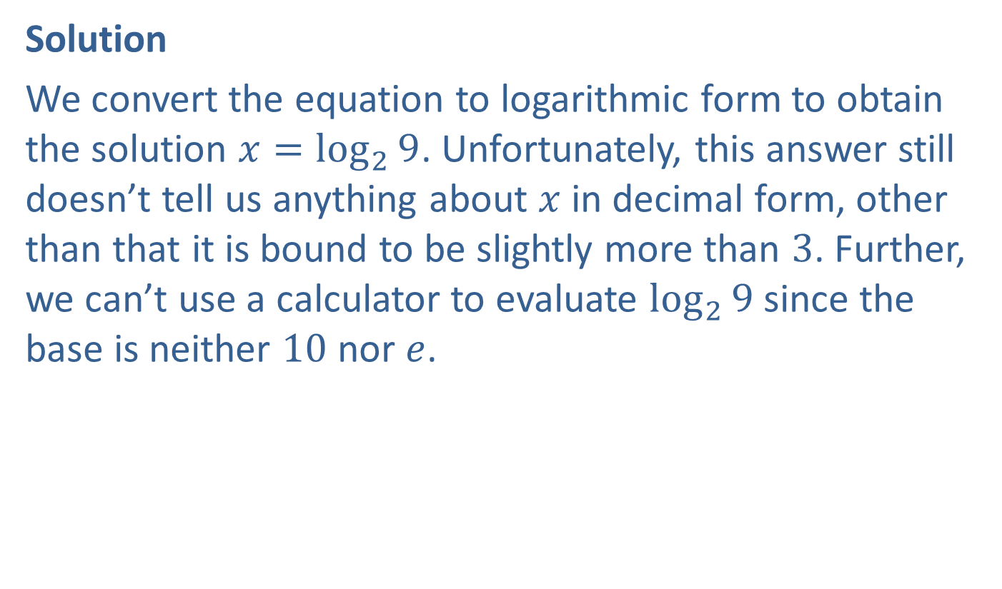
Example 2: Solving Exponential Equations (cont.)
Solution
We convert the equation to logarithmic form to obtain the solution $x=\log_{2}{9}$. Unfortunately, this answer still doesn’t tell us anything about $x$ in decimal form, other than that it is bound to be slightly more than 3. Further, we can’t use a calculator to evaluate $\log_{2}⁡9$ since the base is neither 10 nor $e$.

Slide 6
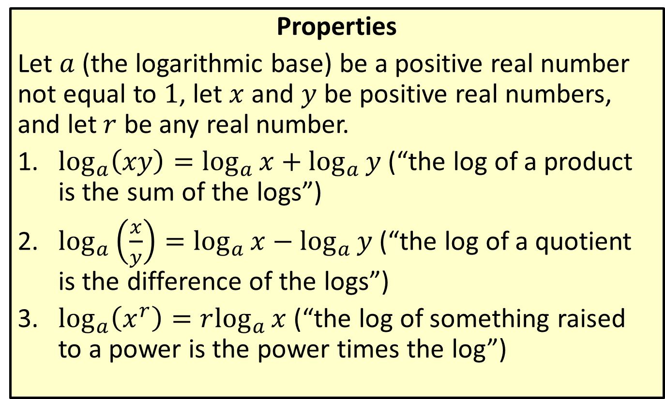
Properties of Logarithms
Properties
Let $a$ (the logarithmic base) be a positive real number not equal to 1, let $x$ and $y$ be positive real numbers, and let $r$ be any real number.
​$\log_{a}\left(xy\right)=\log_{a}{x}+\log_{a}{y}$ (“the log of a product is the sum of the logs”)
​$\log_{a}\left(\frac{x}{y}\right)=\log_{a}{x}−\log_{a}{y}$ (“the log of a quotient is the difference of the logs”)
​$\log_{a}\left(x^{r}\right)=r\log_{a}⁡x$ (“the log of something raised to a power is the power times the log”)

Slide 7
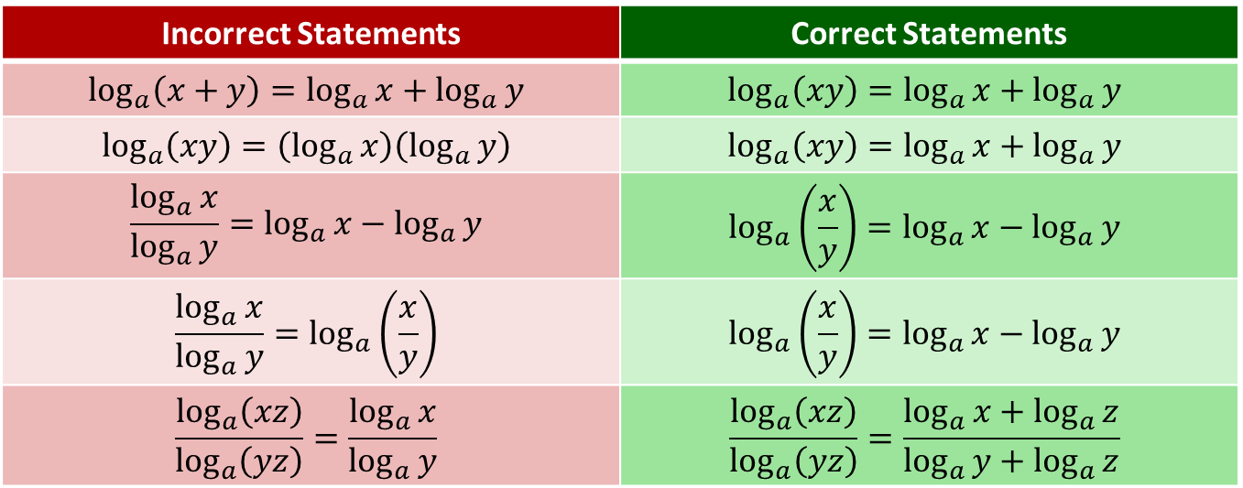
CAUTION!
Errors in working with logarithms often arise from incorrect recall of the logarithmic properties. The comparisons below highlight some common mistakes.
Incorrect Statements | Correct Statements
$$\log_{a}\left(x+y\right)=\log_{a}{x}+\log_{a}{y}$$ | $$\log_{a}\left(xy\right)=\log_{a}{x}+\log_{a}{y}$$
$$\log_{a}\left(xy\right)=\left(\log_{a}{x}\right)\left(\log_{a}{y}\right)$$ | $$\log_{a}\left(xy\right)=\log_{a}{x}+\log_{a}{y}$$
$$\frac{\log_{a}{x}}{\log_{a}{y}}=\log_{a}{x}−\log_{a}{y}$$ | $$\log_{a}\left(\frac{x}{y}\right)=\log_{a}{x}−\log_{a}{y}$$
$$\frac{\log_{a}{x}}{\log_{a}{y}}=\log_{a}\left(\frac{x}{y}\right)$$ | $$\log_{a}\left(\frac{x}{y}\right)=\log_{a}{x}−\log_{a}{y}$$
$$\frac{\log_{a}\left(xz\right)}{\log_{a}\left(yz\right)}=\frac{\log_{a}{x}}{\log_{a}{y}}$$ | $$\frac{\log_{a}\left(xz\right)}{\log_{a}\left(yz\right)}=\frac{\log_{a}{x}+\log_{a}{z}}{\log_{a}{y}+\log_{a}{z}}$$

Slide 8
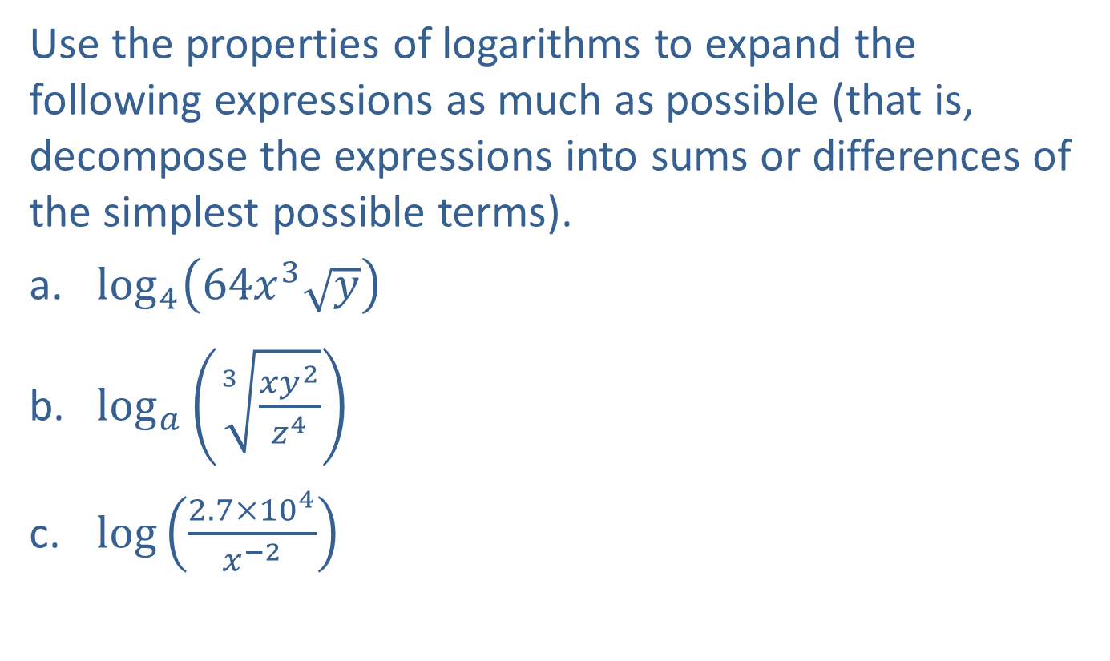
Example 3: Expanding Logarithmic Expressions
Use the properties of logarithms to expand the following expressions as much as possible (that is, decompose the expressions into sums or differences of the simplest possible terms).
​$\log_{4}⁡\left(64x^{3}\sqrt{y}\right)$
​$\log_{a}⁡\left(\sqrt[3]{\frac{xy^{2}}{z^{4}}}\right)$
​$log⁡\left(\frac{2.7×{10}^{4}}{x^{−2}}\right)$

Slide 9
Note:
As long as the base is the same for each term, its value does not affect the use of the properties.

Slide 10
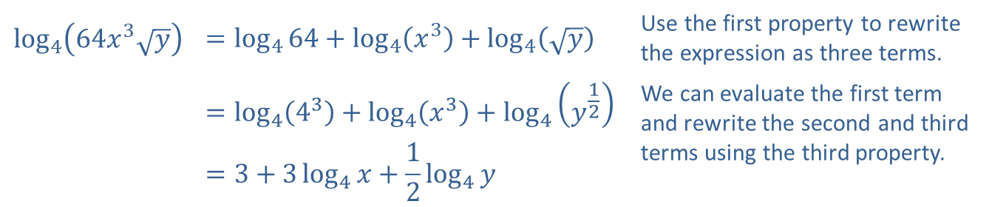
Example 3: Expanding Logarithmic Expressions (cont.)
Solution
​
​$\log_{4}\left(64x^{3}\sqrt{y}\right)$ | $$=\log_{4}{64}+\log_{4}\left(x^{3}\right)+\log_{4}\left(\sqrt{y}\right)$$ | Use the first property to rewrite the expression as three terms.
​ | $$=\log_{4}\left(4^{3}\right)+\log_{4}\left(x^{3}\right)+\log_{4}\left(y^{\frac{1}{2}}\right)$$ | We can evaluate the first term and rewrite the second and third terms using the third property.
​ | $$=3+3\log_{4}{x}+\frac{1}{2}\log_{4}{y}$$

Slide 11
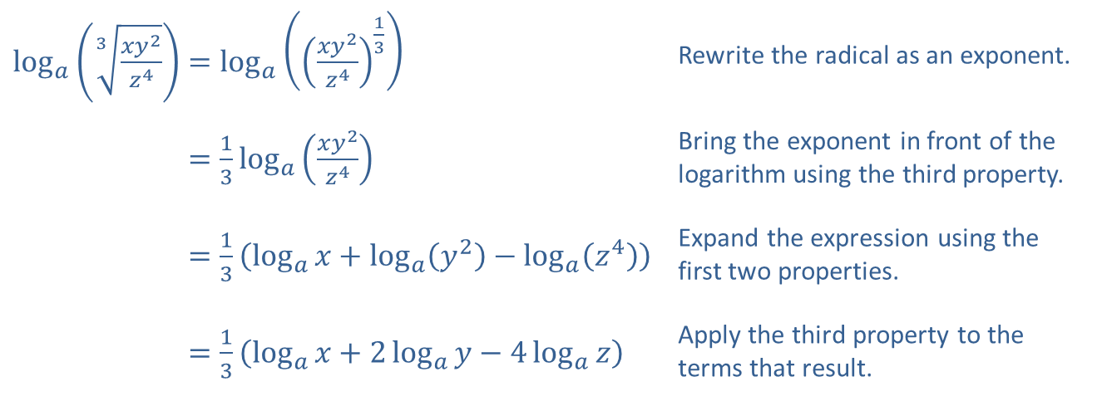
Example 3: Expanding Logarithmic Expressions (cont.)
​$\log_{a}\left(\sqrt[3]{\frac{xy^{2}}{z^{4}}}\right)=\log_{a}\left({\left(\frac{xy^{2}}{z^{4}}\right)}^{\frac{1}{3}}\right)$ | Rewrite the radical as an exponent.
​log𝑎⁡3𝑥𝑦2𝑧4=13log𝑎⁡𝑥𝑦2𝑧4 | Bring the exponent in front of the logarithm using the third property.
​log𝑎⁡3𝑥𝑦2𝑧4=13log𝑎𝑥+log𝑎𝑦2−log𝑎𝑧4 | Expand the expression using the first two properties.
​log𝑎⁡3𝑥𝑦2𝑧4=13log𝑎𝑥+2log𝑎𝑦−4log𝑎𝑧 | Apply the third property to the terms that result.
​

Slide 12
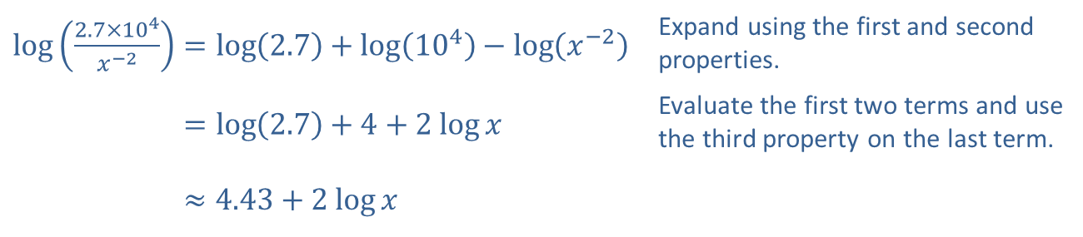
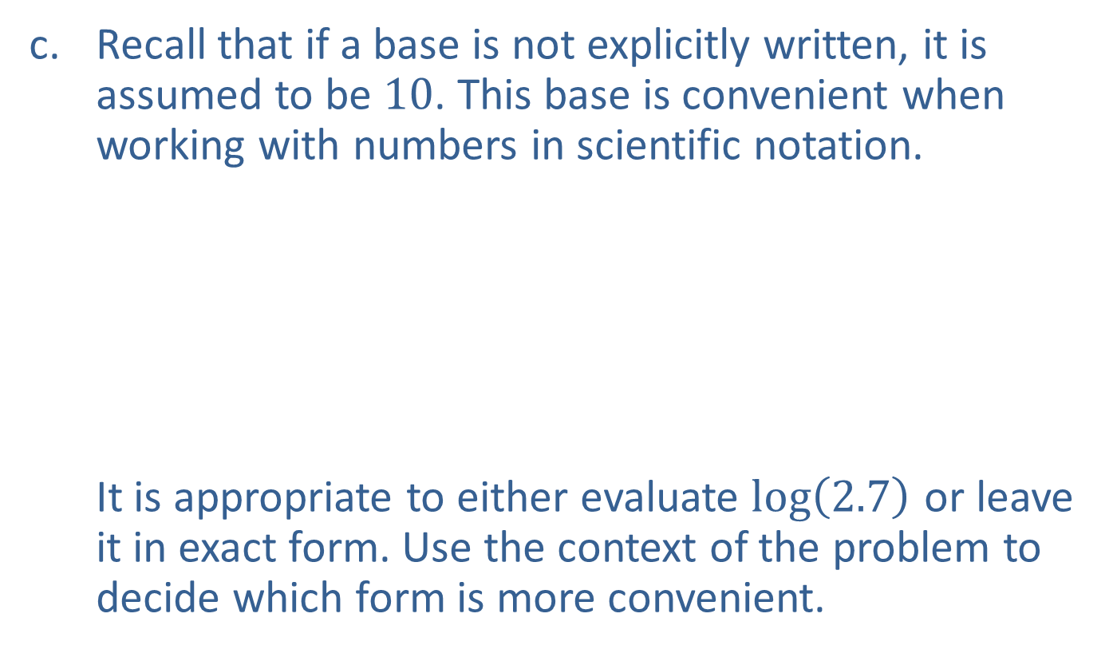
Example 3: Expanding Logarithmic Expressions (cont.)
​Recall that if a base is not explicitly written, it is assumed to be 10. This base is convenient when working with numbers in scientific notation. It is appropriate to either evaluate $log⁡\left(2.7\right)$ or leave it in exact form. Use the context of the problem to decide which form is more convenient.
​$\log\left(\frac{2.7×{10}^{4}}{x^{−2}}\right)=\log\left(2.7\right)+\log\left({10}^{4}\right)−\log\left(x^{−2}\right)$ | Expand using the first and second properties.
​log⁡2.7×104𝑥−2=log2.7+4+2 log⁡𝑥 | Evaluate the first two terms and use the third property on the last term.
​log⁡2.7×104𝑥−2≈4.43+2 log⁡𝑥

Slide 13
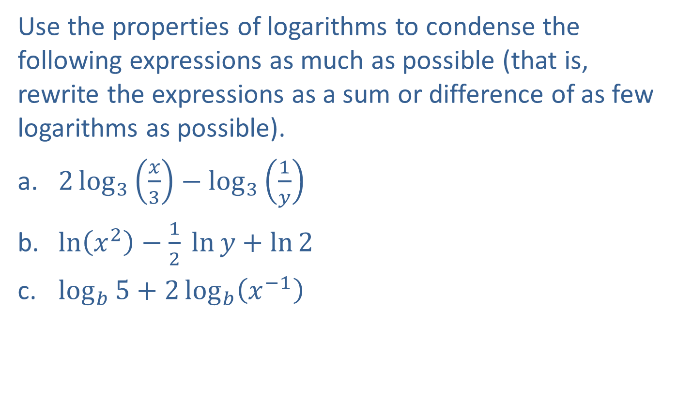
Example 4: Condensing Logarithmic Expressions
Use the properties of logarithms to condense the following expressions as much as possible (that is, rewrite the expressions as a sum or difference of as few logarithms as possible).
​$2\log_{3}\left(\frac{x}{3}\right)−\log_{3}\left(\frac{1}{y}\right)$
​$\ln\left(x^{2}\right)−\frac{1}{2} ln⁡y+\ln{2}$
​$\log_{b}{5}+2\log_{b}\left(x^{−1}\right)$

Slide 14
Note:
Often, there will be multiple orders in which we can apply the properties to find the final result.

Slide 15
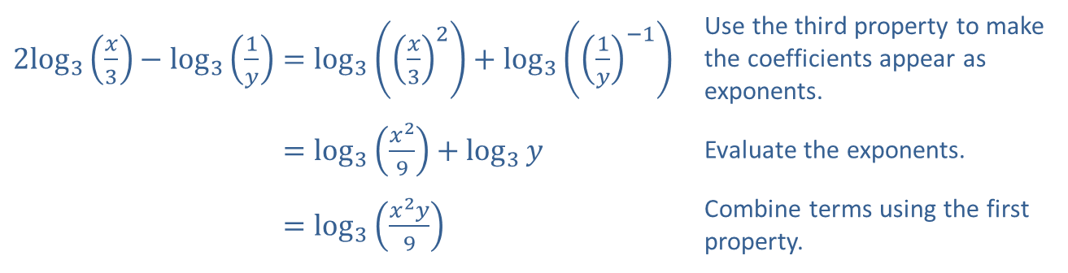
Example 4: Condensing Logarithmic Expressions (cont.)
Solution
​
​$2\log_{3}⁡\left(\frac{x}{3}\right)−\log_{3}\left(\frac{1}{y}\right)=\log_{3}\left({\left(\frac{x}{3}\right)}^{2}\right)+\log_{3}\left({\left(\frac{1}{y}\right)}^{−1}\right)$ | Use the third property to make the coefficients appear as exponents.
​2log3⁡𝑥3−log31𝑦=log3𝑥29+log3𝑦 | Evaluate the exponents.
​2log3⁡𝑥3−log31𝑦=log3𝑥2𝑦9 | Combine terms using the first property.

Slide 16
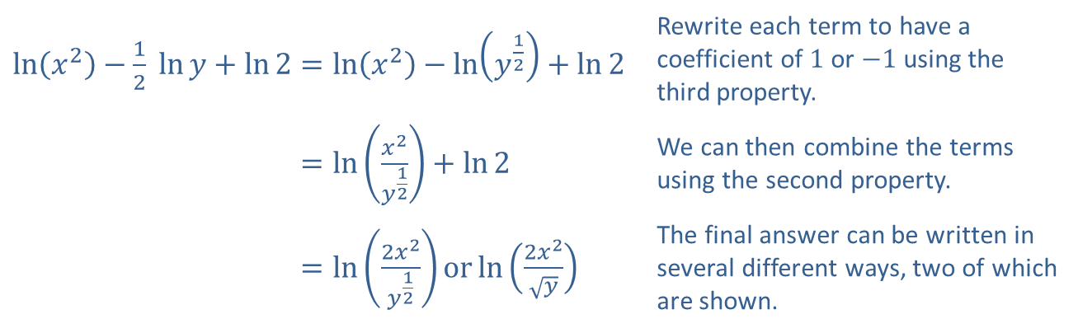
Example 4: Condensing Logarithmic Expressions (cont.)
​$\ln\left(x^{2}\right)−\frac{1}{2} ln⁡y+\ln{2}=\ln\left(x^{2}\right)−\ln\left(y^{\frac{1}{2}}\right)+\ln{2}$ | Rewrite each term to have a coefficient of 1 or $−1$ using the third property.
​ln𝑥2−12 ln⁡𝑦+ln2=ln𝑥2𝑦12+ln2 | We can then combine the terms using the second property.
​ln𝑥2−12 ln⁡𝑦+ln2=ln2𝑥2𝑦12orln2𝑥2𝑦 | The final answer can be written in several different ways, two of which are shown.
​

Slide 17
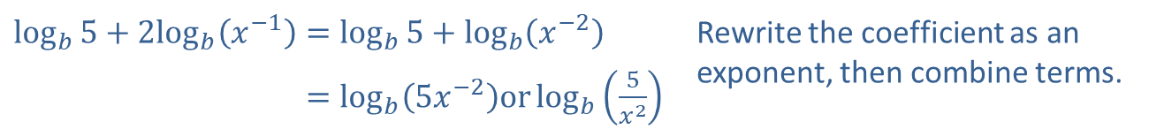
Example 4: Condensing Logarithmic Expressions (cont.)
​
​$\log_{b}{5}+2\log_{b}⁡\left(x^{−1}\right)=\log_{b}{5}+\log_{b}\left(x^{−2}\right)$ | Rewrite the coefficient as an exponent, then combine terms.
​log𝑏5+2log𝑏⁡𝑥−1=log𝑏⁡5𝑥−2orlog𝑏5𝑥2

Slide 18
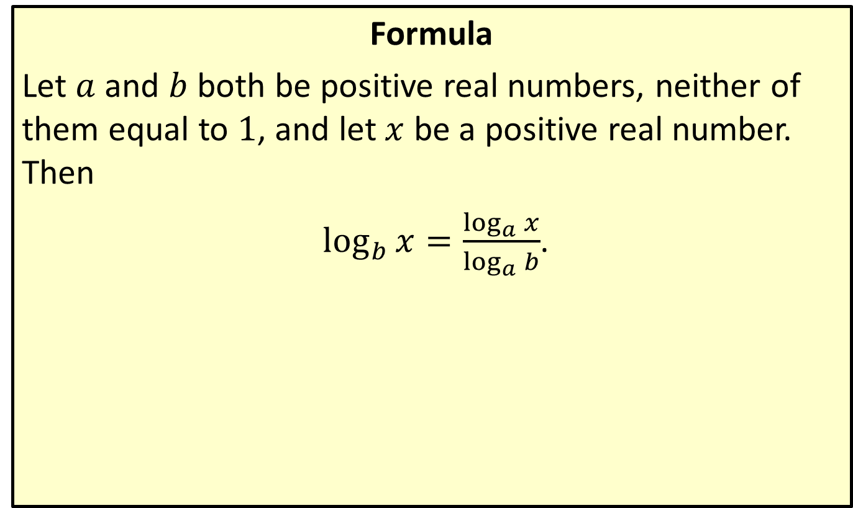
Change of Base Formula
Formula
Let $a$ and $b$ both be positive real numbers, neither of them equal to 1, and let $x$ be a positive real number. Then
$\log_{b}{x}=\frac{\log_{a}{x}}{\log_{a}{b}}$.

Slide 19

Example 5: Change of Base Formula
Evaluate the following logarithmic expressions, using the base of your choice.
​$\log_{7}15$
​$\log_{\frac{1}{2}}⁡3$
​$\log_{π}⁡5$

Slide 20
Note:
Both the common and natural logarithm work in solving these problems.

Slide 21
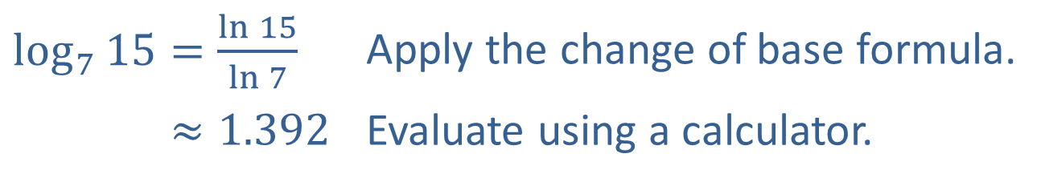
Example 5: Change of Base Formula (cont.)
Solution
​
​$\log_{7}{15}=\frac{\ln{15}}{\ln{7}}$ | Apply the change of base formula.
​log7⁡15≈1.392 | Evaluate using a calculator.

Slide 22
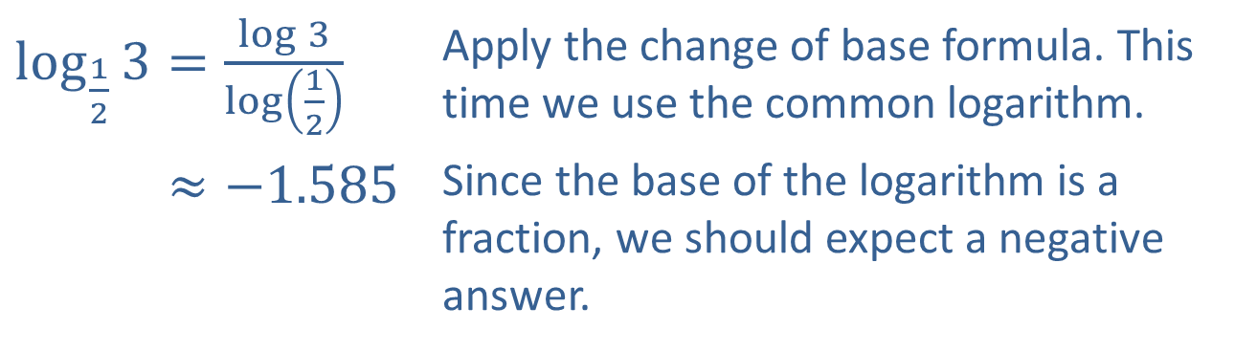
Example 5: Change of Base Formula (cont.)
​$\log_{\frac{1}{2}}{3}=\frac{\log{3}}{\log\left(\frac{1}{2}\right)}$ | Apply the change of base formula. This time we use the common logarithm.
​log12⁡3≈−1.585 | Since the base of the logarithm is a fraction, we should expect a negative answer.
​

Slide 23
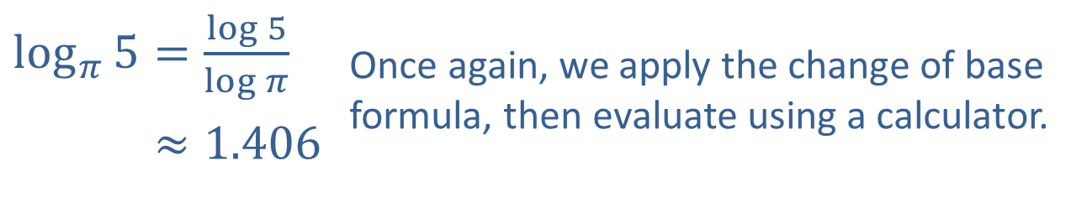
Example 5: Change of Base Formula (cont.)
​$\log_{π}{5}=\frac{\log{5}}{\log{π}}$ | Once again, we apply the change of base formula, then evaluate using a calculator.
​log𝜋⁡5≈1.406
​

Slide 24
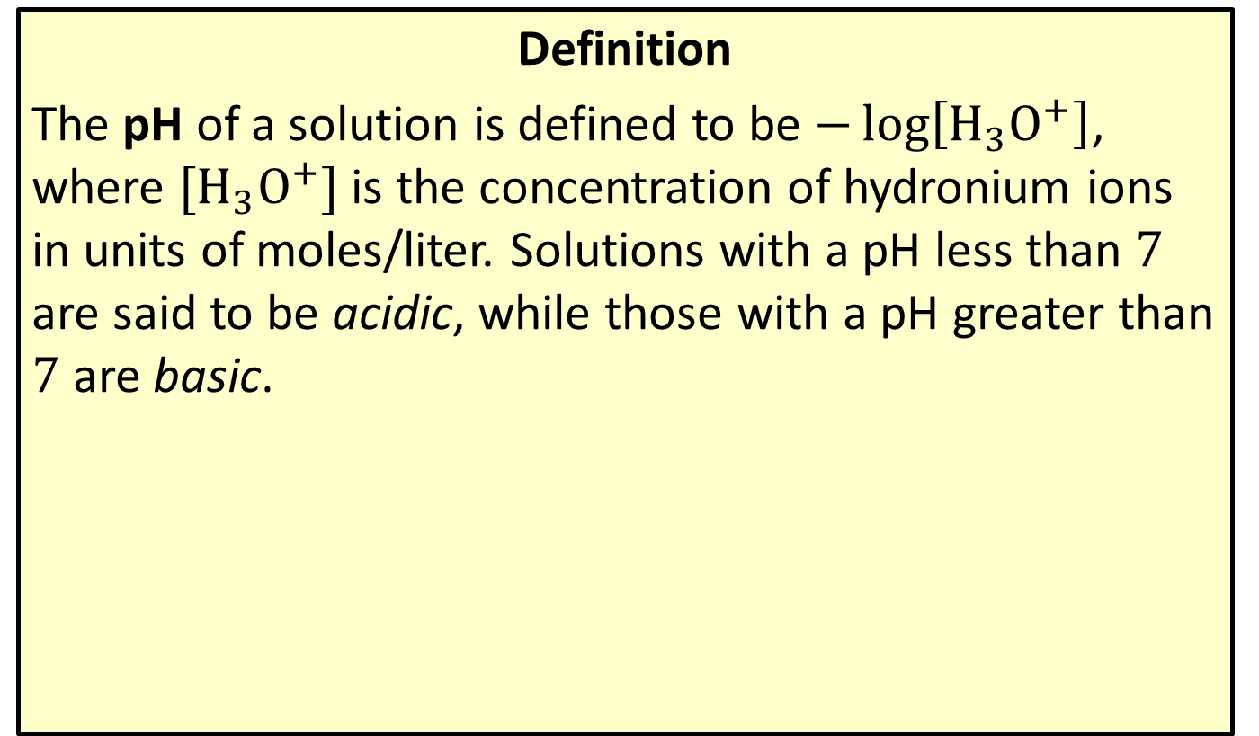
The pH Scale
Definition
The pH of a solution is defined to be $−\log\left[H_{3}O^{+}\right]$, where $[H_{3}O^{+}]$ is the concentration of hydronium ions in units of moles/liter. Solutions with a pH less than 7 are said to be acidic, while those with a pH greater than 7 are basic.

Slide 25
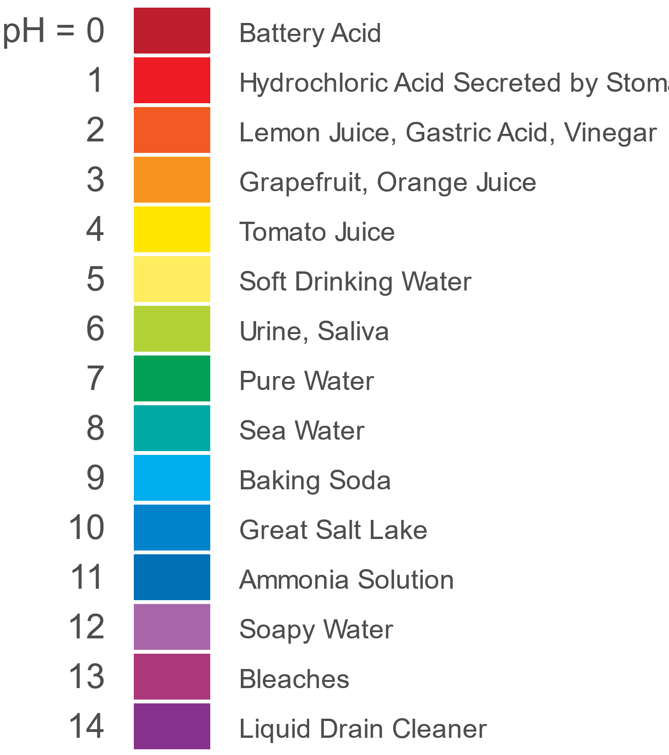
The pH Scale (cont.)
Figure 1: pH of Common Substances

Slide 26

Example 6: The pH Scale
If a sample of orange juice is determined to have a $[H_{3}O^{+}]$ concentration of $1.58×{10}^{−4}$ moles/liter, what is its pH?

Slide 27
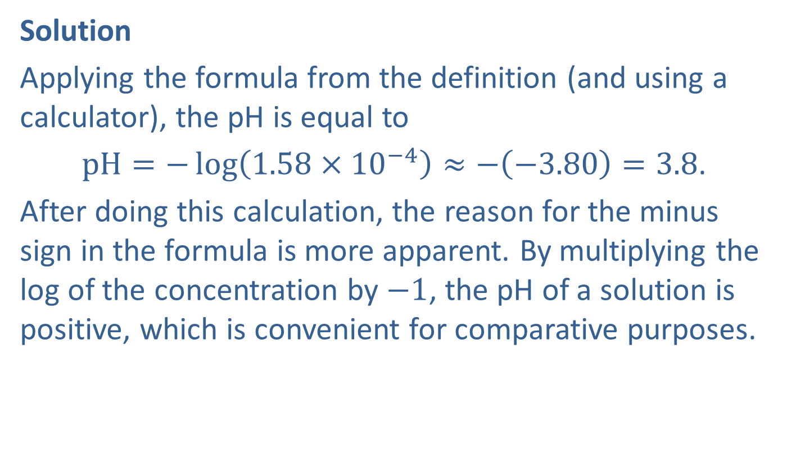
Example 6: The pH Scale (cont.)
Solution
Applying the formula from the definition (and using a calculator), the pH is equal to
$pH=−\log\left(1.58×{10}^{−4}\right)≈−\left(−3.80\right)=3.8$.
After doing this calculation, the reason for the minus sign in the formula is more apparent. By multiplying the log of the concentration by $−1$, the pH of a solution is positive, which is convenient for comparative purposes.

Slide 28
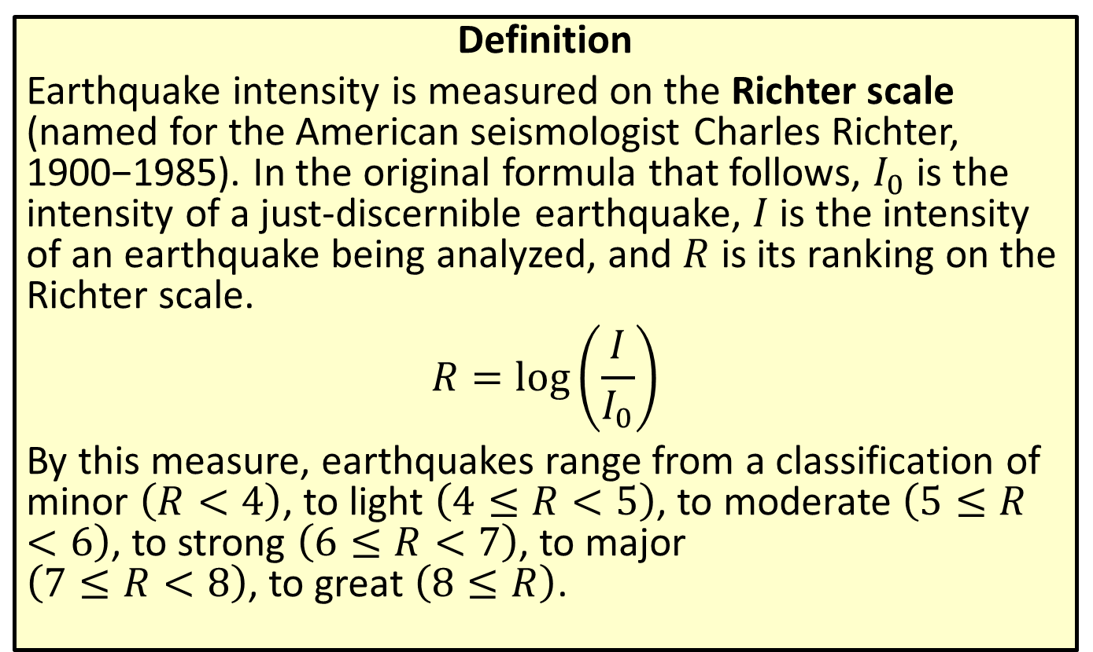
The Richter Scale
Definition
Earthquake intensity is measured on the Richter scale (named for the American seismologist Charles Richter, 1900−1985). In the original formula that follows, $I_{0}$ is the intensity of a just-discernible earthquake, $I$ is the intensity of an earthquake being analyzed, and $R$ is its ranking on the Richter scale.
$$R=\log\left(\frac{I}{I_{0}}\right)$$
By this measure, earthquakes range from a classification of minor $\left(R<4\right)$, to light $\left(4≤R<5\right)$, to moderate $\left(5≤R<6\right)$, to strong $\left(6≤R<7\right)$, to major $\left(7≤R<8\right)$, to great $\left(8≤R\right)$.

Slide 29
Example 7: The Richter Scale
The January 2001 earthquake in the state of Gujarat in India was 7,940,000 times as intense as a 0-level earthquake. What was the Richter ranking of this devastating event?

Slide 30
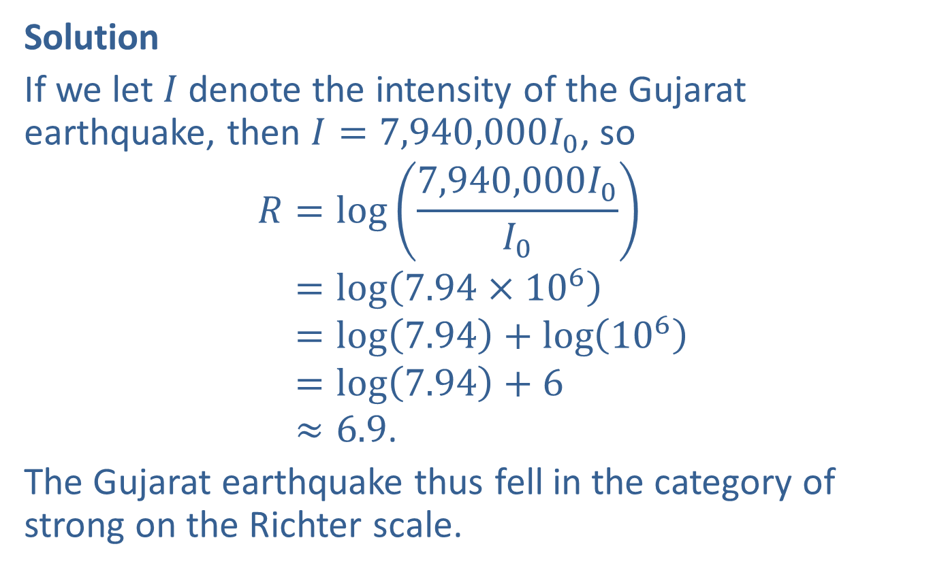
Example 7: The Richter Scale (cont.)
Solution
If we let $I$ denote the intensity of the Gujarat earthquake, then $I=7,940,000I_{0}$, so
𝑅=log7,940,000𝐼0𝐼0𝑅=log7.94×106𝑅=log7.94+log106𝑅=log7.94+6𝑅≈6.9.
The Gujarat earthquake thus fell in the category of strong on the Richter scale.

Slide 31
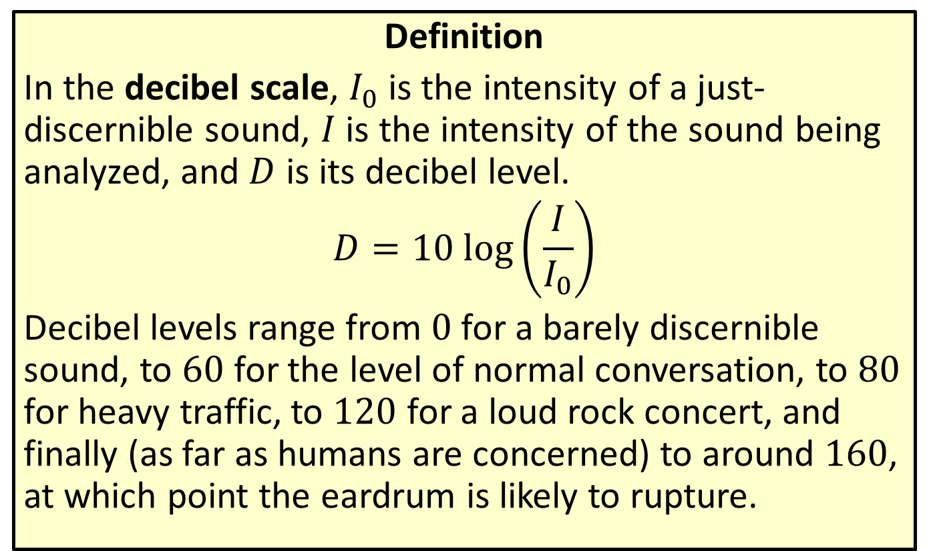
The Decibel Scale
Definition
In the decibel scale, $I_{0}$ is the intensity of a just-discernible sound, $I$ is the intensity of the sound being analyzed, and $D$ is its decibel level.
$$D=10 log⁡\left(\frac{I}{I_{0}}\right)$$
Decibel levels range from 0 for a barely discernible sound, to 60 for the level of normal conversation, to 80 for heavy traffic, to 120 for a loud rock concert, and finally (as far as humans are concerned) to around 160, at which point the eardrum is likely to rupture.

Slide 32

Example 8: The Decibel Scale
Given that $I_{0}={10}^{−12} watts/{meter}^{2}$, what is the decibel level of a jet airliner’s engines at a distance of 45 meters, for which the sound intensity is $50 watts/{meter}^{2}$?

Slide 33
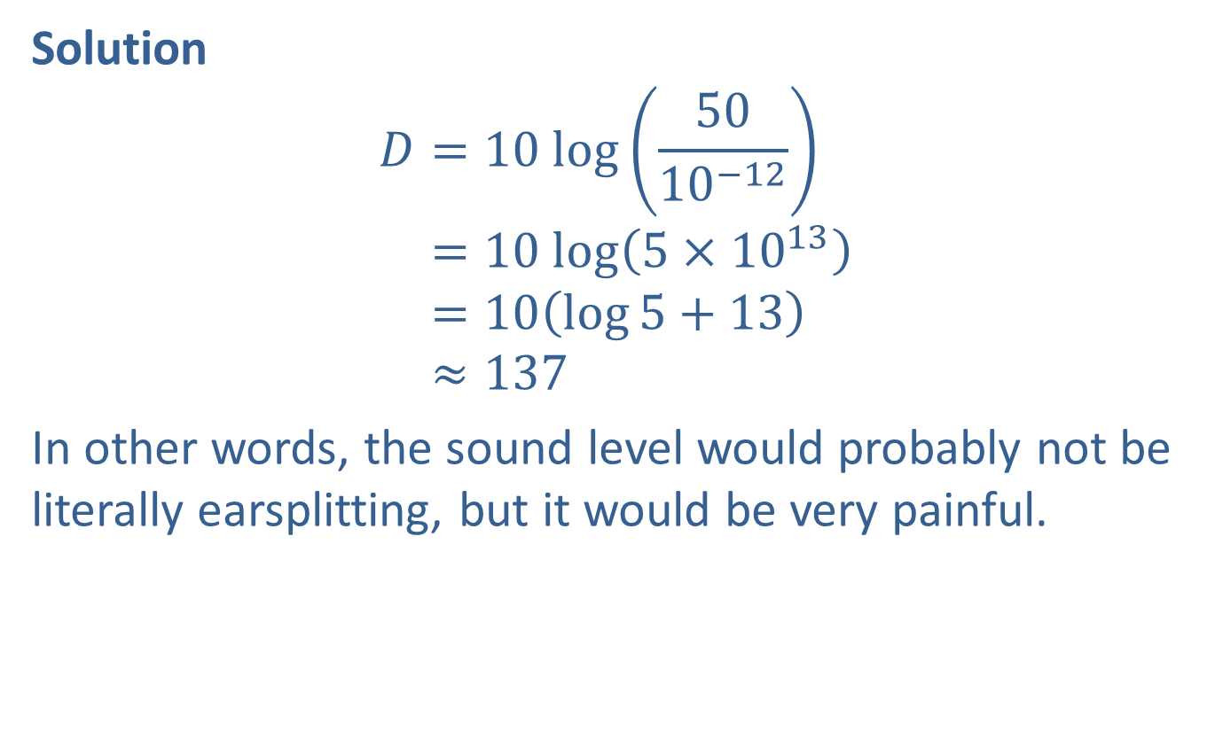
Example 8: The Decibel Scale (cont.)
Solution
𝐷=10 log⁡5010−12𝐷=10 log⁡5×1013𝐷=10log5+13𝐷≈137
In other words, the sound level would probably not be literally earsplitting, but it would be very painful.

Slide 34
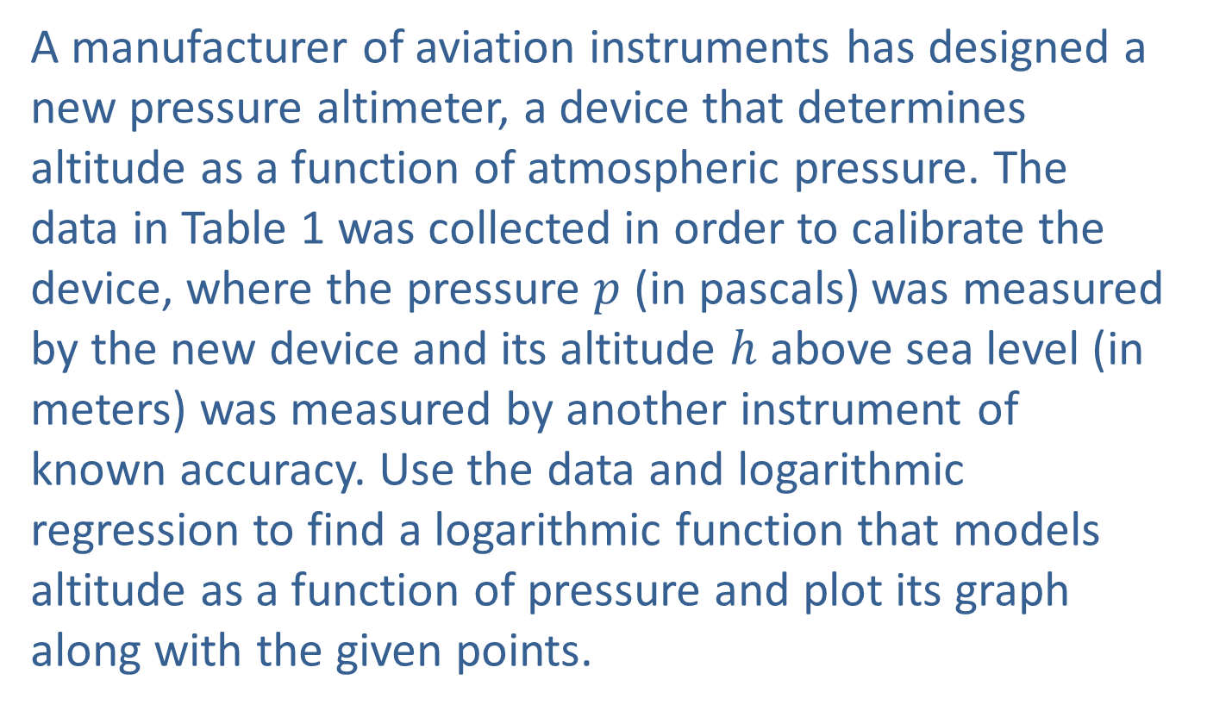
Example 9: Logarithmic Regression
A manufacturer of aviation instruments has designed a new pressure altimeter, a device that determines altitude as a function of atmospheric pressure. The data in Table 1 was collected in order to calibrate the device, where the pressure $p$ (in pascals) was measured by the new device and its altitude $h$ above sea level (in meters) was measured by another instrument of known accuracy. Use the data and logarithmic regression to find a logarithmic function that models altitude as a function of pressure and plot its graph along with the given points.

Slide 35
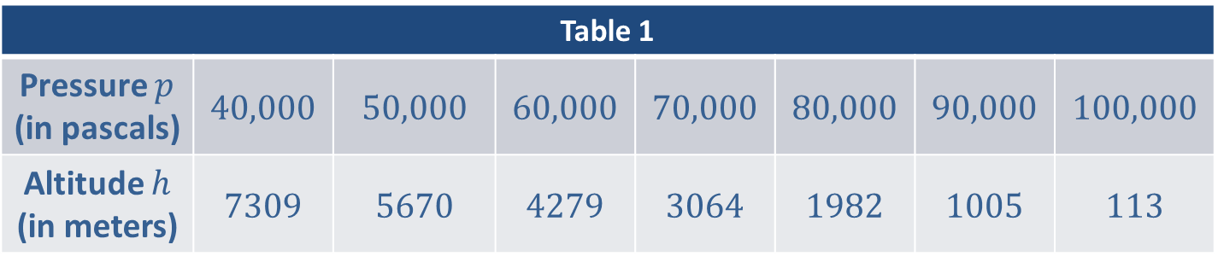
Example 9: Logarithmic Regression (cont.)
Table 1
Pressure $p$ (in pascals) | 40,000 | 50,000 | 60,000 | 70,000 | 80,000 | 90,000 | 100,000
Altitude $h$ (in meters) | 7309 | 5670 | 4279 | 3064 | 1982 | 1005 | 113

Slide 36
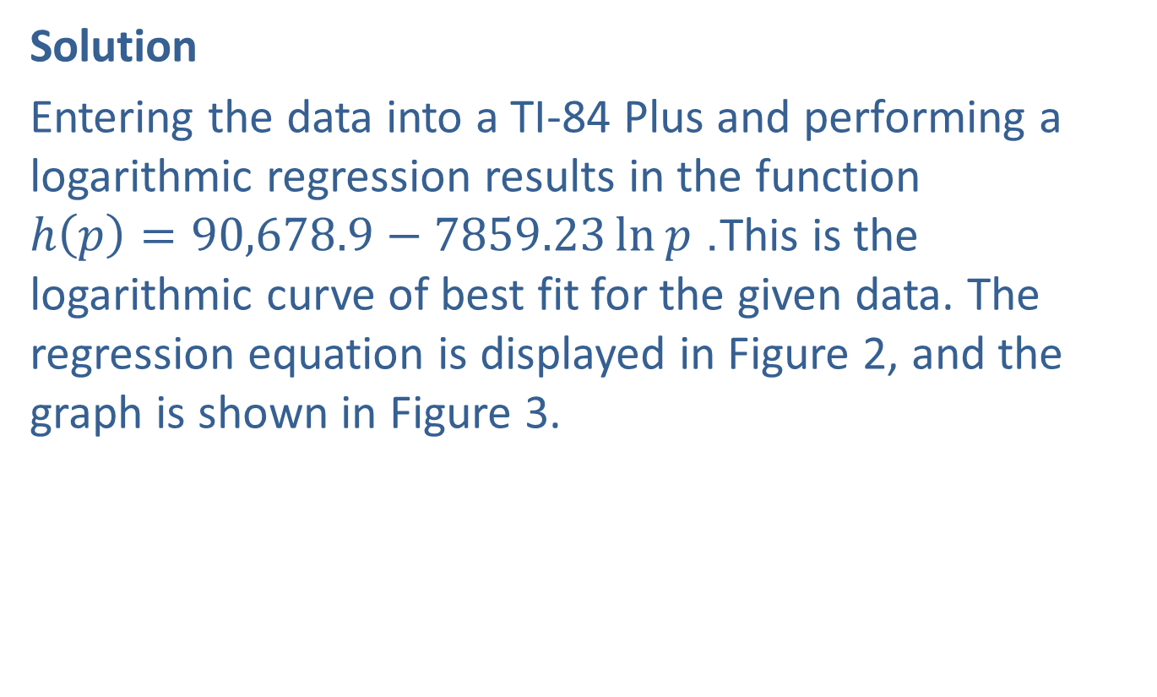
Example 9: Logarithmic Regression (cont.)
Solution
Entering the data into a TI-84 Plus and performing a logarithmic regression results in the function $h\left(p\right)=90,678.9−7859.23\ln{p}$. This is the logarithmic curve of best fit for the given data. The regression equation is displayed in Figure 2, and the graph is shown in Figure 3.

Slide 37
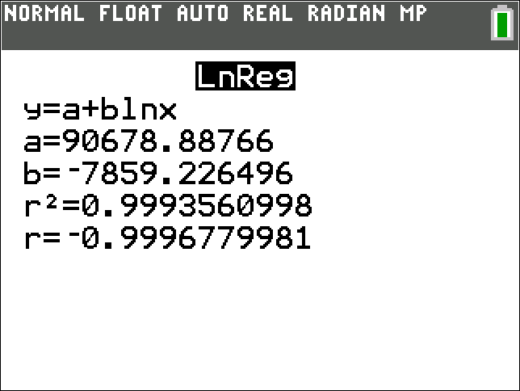
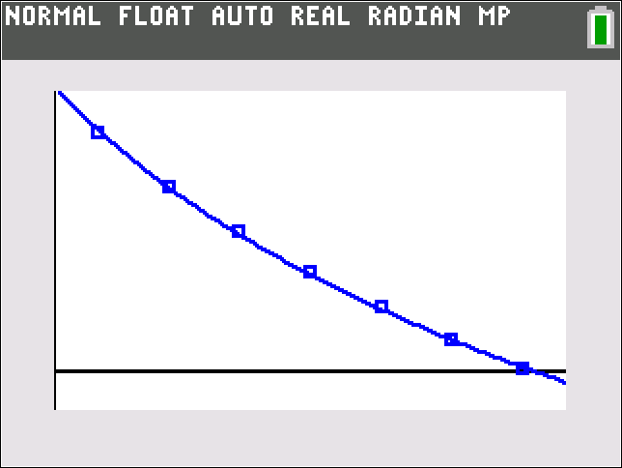
Example 9: Logarithmic Regression (cont.)
Figure 2 Figure 3

