Slide 1
Section 7.5
Exponential and Logarithmic Equations

Slide 2
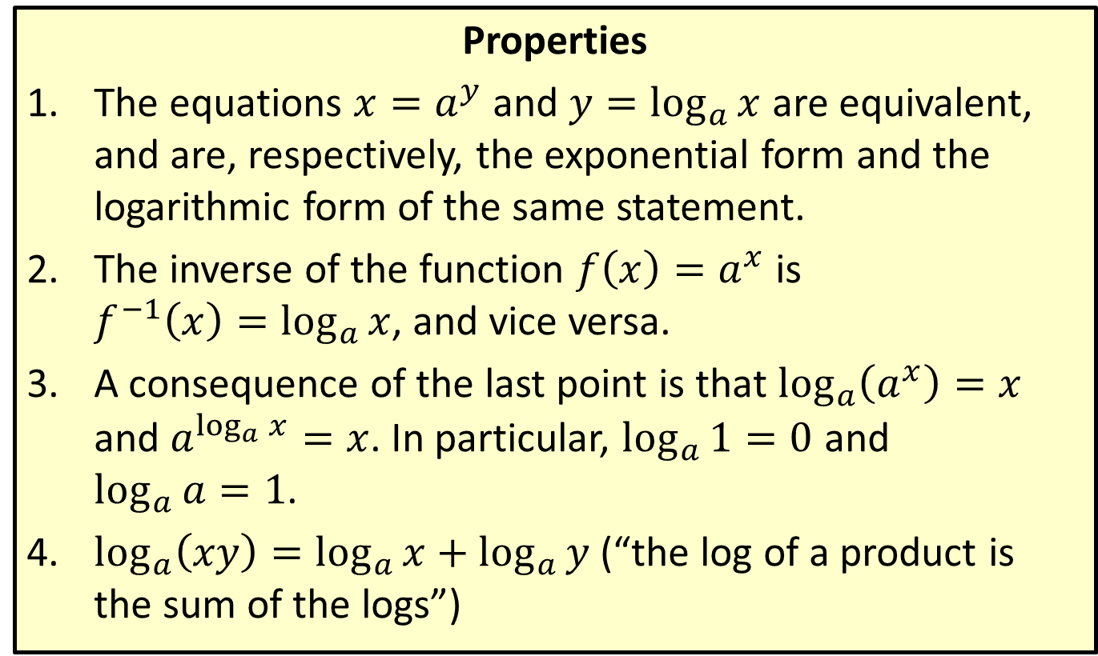
Summary of Logarithmic Properties
Properties
​The equations $x=a^{y}$ and $y=\log_{a}{x}$ are equivalent, and are, respectively, the exponential form and the logarithmic form of the same statement.
​The inverse of the function $f\left(x\right)=a^{x}$ is
$f^{−1}\left(x\right)=\log_{a}{x}$, and vice versa.
​A consequence of the last point is that $\log_{a}\left(a^{x}\right)=x$ and $a^{\log_{a}{x}}=x$. In particular, $\log_{a}{1}=0$ and
$\log_{a}{a}=1$.
​$\log_{a}\left(xy\right)=\log_{a}{x}+\log_{a}{y}$ (“the log of a product is the sum of the logs”)

Slide 3
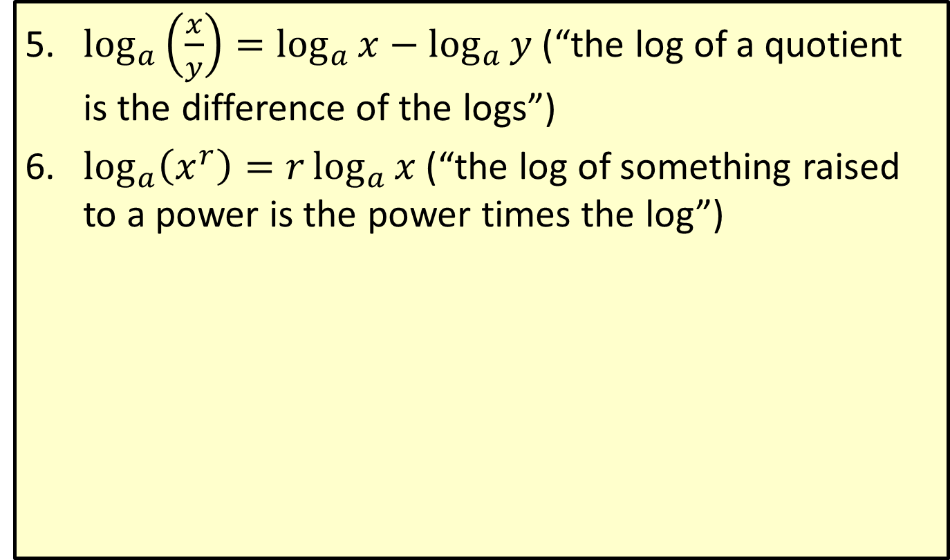
Summary of Logarithmic Properties (cont.)
​$\log_{a}\left(\frac{x}{y}\right)=\log_{a}{x}−\log_{a}{y}$ (“the log of a quotient is the difference of the logs”)
​$\log_{a}\left(x^{r}\right)=r\log_{a}{x}$ (“the log of something raised to a power is the power times the log”)

Slide 4

Example 1: Solving Exponential Equations
Solve the equation $3^{2−5x}=11$. Express the answer exactly and as a decimal approximation.

Slide 5
Note:
This equation is not easily solved in exponential form, since the two sides of the equation do not have the same base.

Slide 6
Example 1: Solving Exponential Equations (cont.)
Solution
There are two ways to convert the equation into logarithmic form. We will explore both, and see that they lead to the same answer.

Slide 7
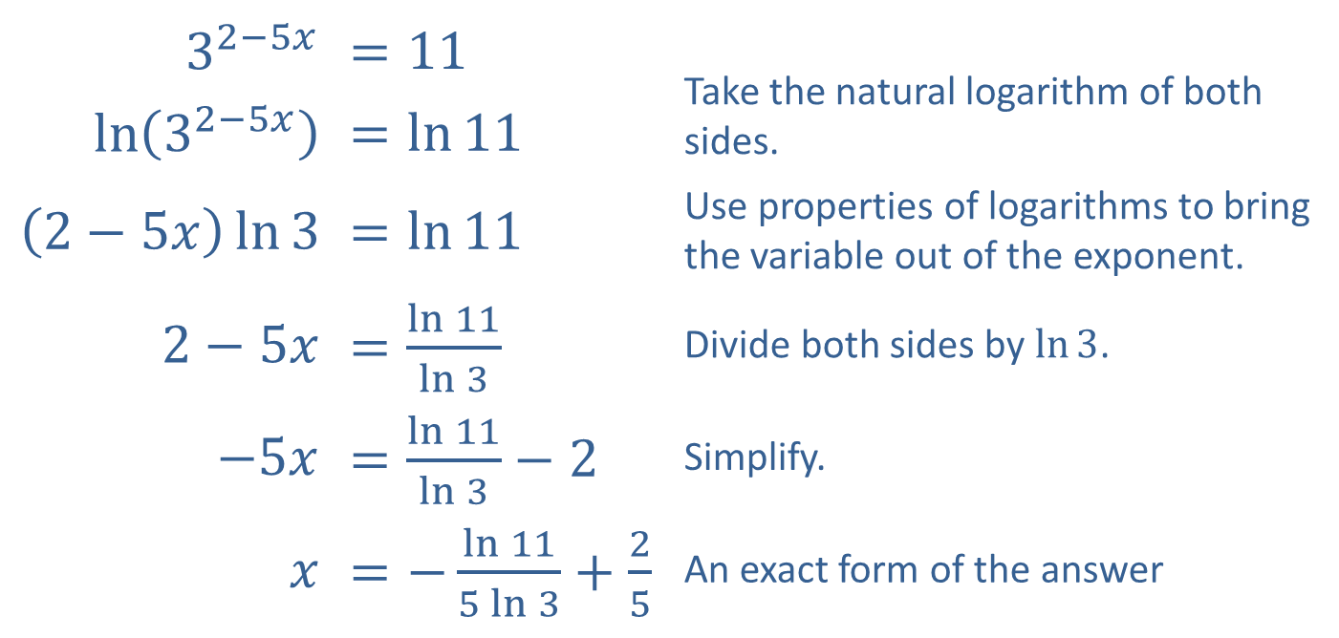
Example 1: Solving Exponential Equations (cont.)
The first method is to take the natural (or common) logarithm of both sides.
​$3^{2−5x}$ | ​$=11$ | Take the natural logarithm of both sides.
​$ln⁡\left(3^{2−5x}\right)$ | ​$=\ln{11}$
​$\left(2−5x\right)\ln{3}$ | ​$=\ln{11}$ | Use properties of logarithms to bring the variable out of the exponent.
​$2−5x$ | ​$=\frac{\ln{11}}{\ln{3}}$ | Divide both sides by $ln⁡3$.
​$−5x$ | ​$=\frac{\ln{11}}{\ln{3}}−2$ | Simplify.
$x$ | ​$=−\frac{\ln{11}}{5\ln{3}}+\frac{2}{5}$ | An exact form of the answer

Slide 8
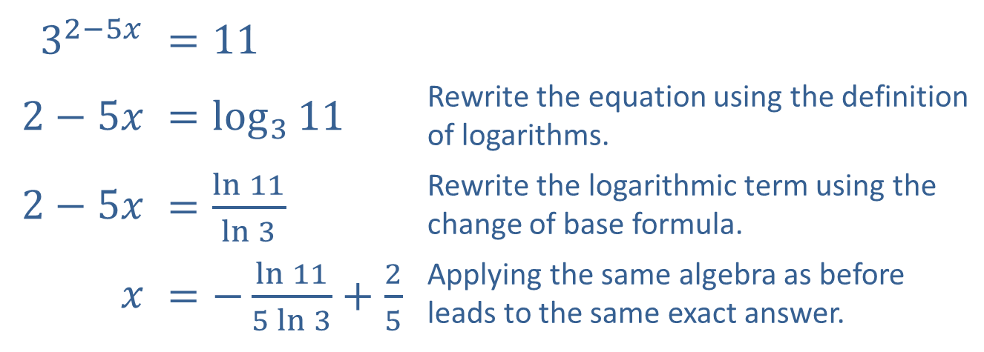
Example 1: Solving Exponential Equations (cont.)
The second method is to rewrite the equation using the definition of logarithms, then apply the change of base formula to work with natural (or common) logarithms.
​$3^{2−5x}$ | ​$=11$
​$2−5x$ | ​$=\log_{3}{11}$ | Rewrite the equation using the definition of logarithms.
​$2−5x$ | ​$=\frac{\ln{11}}{\ln{3}}$ | Rewrite the logarithmic term using the change of base formula.
$x$ | ​$=−\frac{\ln{11}}{5\ln{3}}+\frac{2}{5}$ | Applying the same algebra as before leads to the same exact answer.

Slide 9
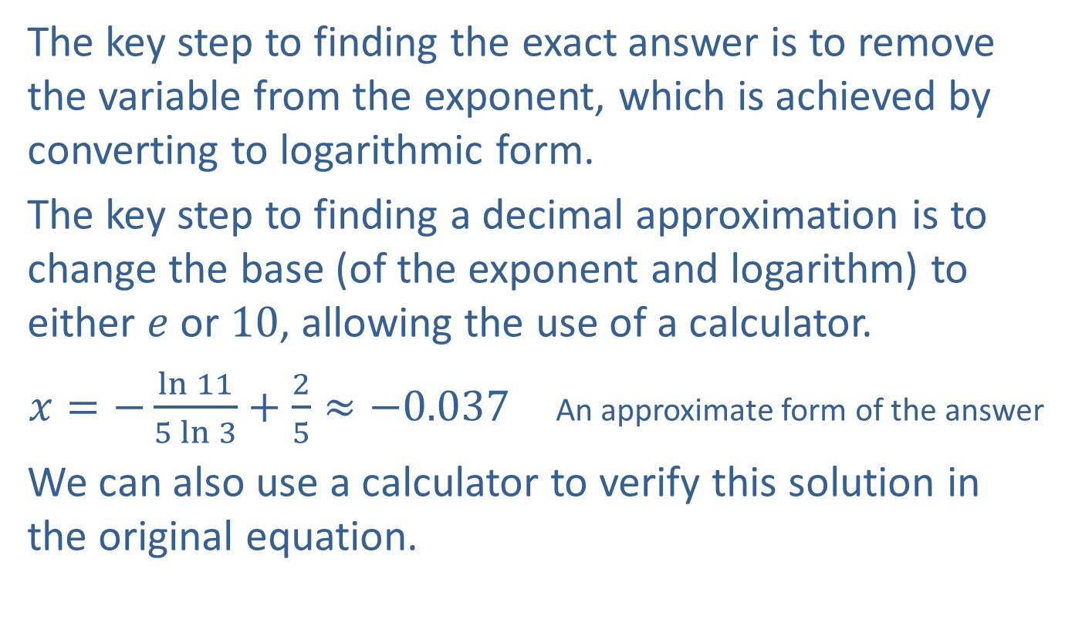
Example 1: Solving Exponential Equations (cont.)
The key step to finding the exact answer is to remove the variable from the exponent, which is achieved by converting to logarithmic form.
The key step to finding a decimal approximation is to change the base (of the exponent and logarithm) to either $e$ or 10, allowing the use of a calculator.
$x=−\frac{\ln{11}}{5\ln{3}}+\frac{2}{5}≈−0.037$ An approximate form of the answer
We can also use a calculator to verify this solution in the original equation.

Slide 10

Example 2: Solving Exponential Equations
Solve the equation $5^{3x−1}=2^{x+3}$. Express the answer exactly and as a decimal approximation.

Slide 11
Example 2: Solving Exponential Equations (cont.)
Solution
As in the first example, taking a logarithm of both sides is the key. We will use the common logarithm this time, but the natural logarithm would work just as well.

Slide 12
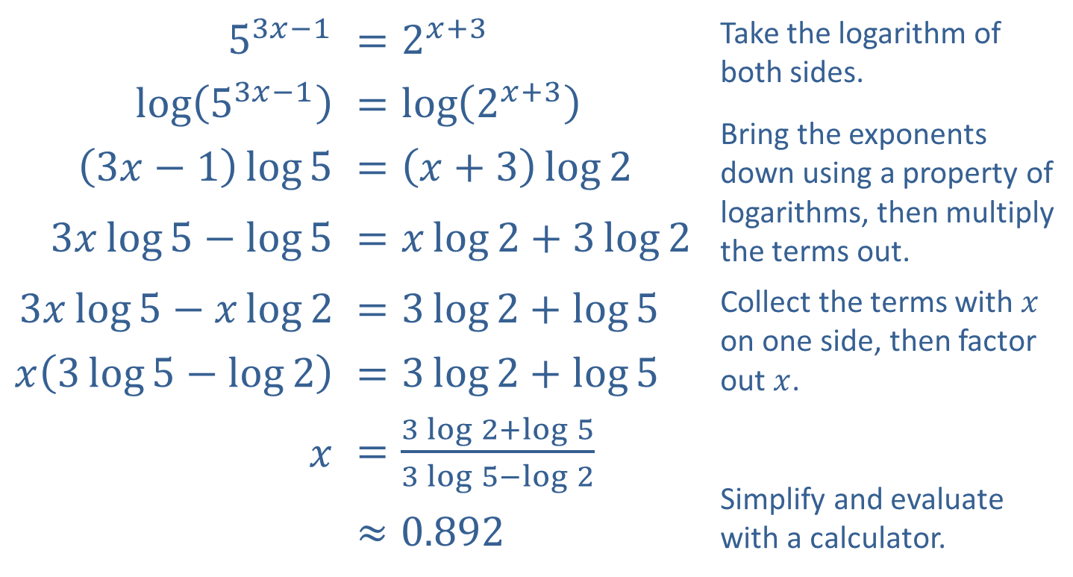
Example 2: Solving Exponential Equations (cont.)
​$5^{3x−1}$ | ​$=2^{x+3}$ | Take the logarithm of both sides. Bring the exponents down using a property of logarithms, then multiply the terms out.
​$log⁡\left(5^{3x−1}\right)$ | ​$=\log\left(2^{x+3}\right)$
​$\left(3x−1\right)\log{5}$ | ​$=\left(x+3\right)\log{2}$
​$3x\log{5}−\log{5}$ | ​$=x\log{2}+3\log{2}$
​$3x\log{5}−x\log{2}$ | ​$=3\log{2}+\log{5}$ | Collect the terms with $x$ on one side, then factor out $x$.
​$x\left(3\log{5}−\log{2}\right)$ | ​$=3\log{2}+\log{5}$
$x$ | ​$=\frac{3\log{2}+\log{5}}{3\log{5}−\log{2}}$ | Simplify and evaluate with a calculator.
 | $$≈0.892$$

Slide 13
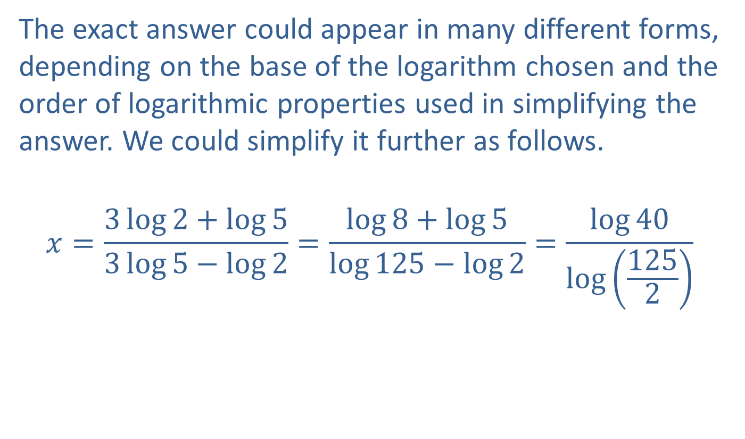
Example 2: Solving Exponential Equations (cont.)
The exact answer could appear in many different forms, depending on the base of the logarithm chosen and the order of logarithmic properties used in simplifying the answer. We could simplify it further as follows.
$$x=\frac{3\log{2}+\log{5}}{3\log{5}−\log{2}}=\frac{\log{8}+\log{5}}{\log{125}−\log{2}}=\frac{\log{40}}{\log\left(\frac{125}{2}\right)}$$

Slide 14

Example 3: Solving Logarithmic Equations
Solve the equation $\log_{7}\left(3x−2\right)=2$.

Slide 15
Note:
Since calculators can evaluate exponents of any base, it often does not matter what the base is when we convert logarithmic equations into their exponential forms.

Slide 16
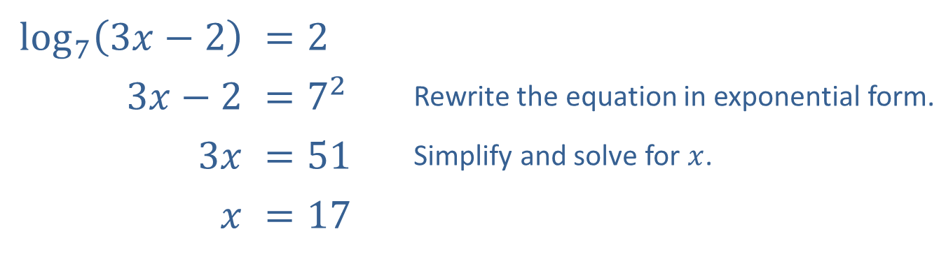
Example 3: Solving Logarithmic Equations (cont.)
Solution
Note that rewriting this equation using the change of base formula does not help, since the variable would still be trapped inside the logarithm. Instead, we use the definition of logarithms to rewrite the equation in exponential form.
​$\log_{7}⁡\left(3x−2\right)$ | ​$=2$
​$3x−2$ | ​$=7^{2}$ | Rewrite the equation in exponential form.
​$3x$ | ​$=51$ | Simplify and solve for $x$.
$x$ | ​$=17$

Slide 17

Example 4: Solving Logarithmic Equations
Solve the equation
$\log_{5}{x}=\log_{5}\left(2x+3\right)−\log_{5}\left(2x−3\right)$.

Slide 18
Note:
We need to check for extraneous solutions when solving logarithmic equations. In particular, remember that logarithms of negative numbers are undefined.

Slide 19
Example 4: Solving Logarithmic Equations (cont.)
Solution
This is an example of a logarithmic equation that is not easily solved in logarithmic form. Once a few properties of logarithms have been utilized, the equation can be rewritten in a very familiar form.

Slide 20
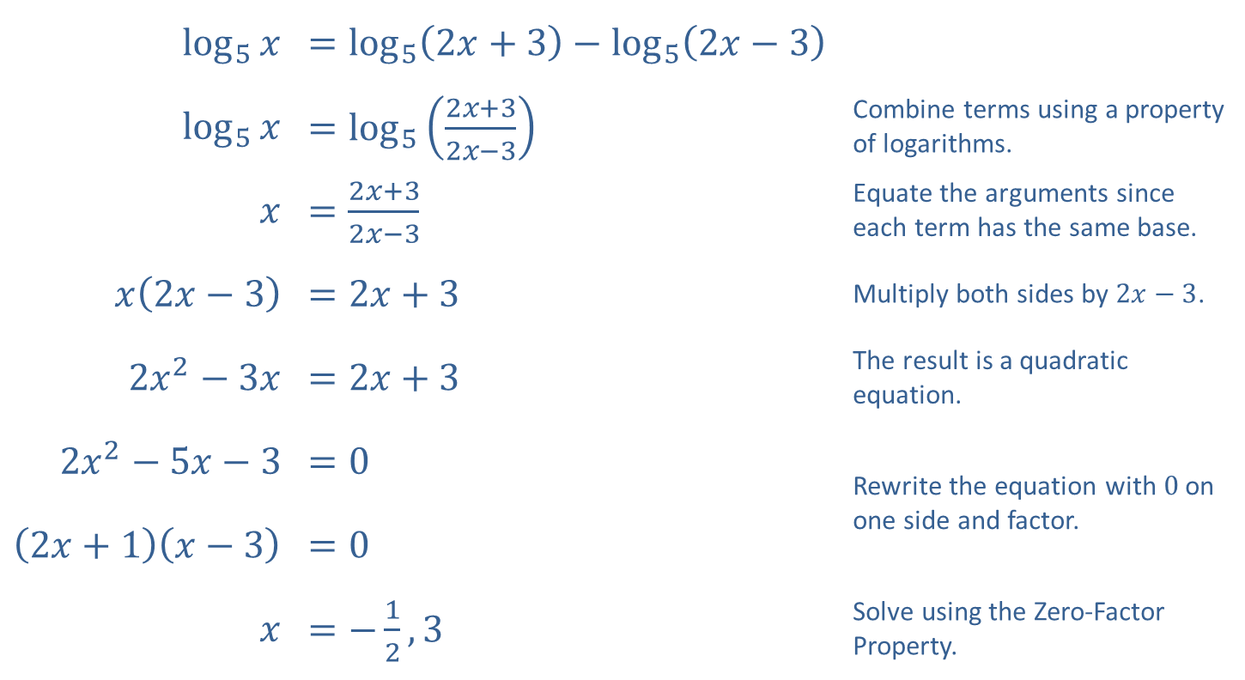
Example 4: Solving Logarithmic Equations (cont.)
​$\log_{5}⁡x$ | ​$=\log_{5}\left(2x+3\right)−\log_{5}\left(2x−3\right)$
​$\log_{5}⁡x$ | ​$=\log_{5}\left(\frac{2x+3}{2x−3}\right)$ | Combine terms using a property of logarithms.
$$x$$ | ​$=\frac{2x+3}{2x−3}$ | Equate the arguments since each term has the same base.
​$x\left(2x−3\right)$ | ​$=2x+3$ | Multiply both sides by $2x−3$.
​$2x^{2}−3x$ | ​$=2x+3$ | The result is a quadratic equation.
​$2x^{2}−5x−3$ | ​$=0$ | Rewrite the equation with $0$ on one side and factor.
​$\left(2x+1\right)\left(x−3\right)$ | ​$=0$
$x$ | ​$=−\frac{1}{2},3$ | Solve using the Zero-Factor Property.

Slide 21
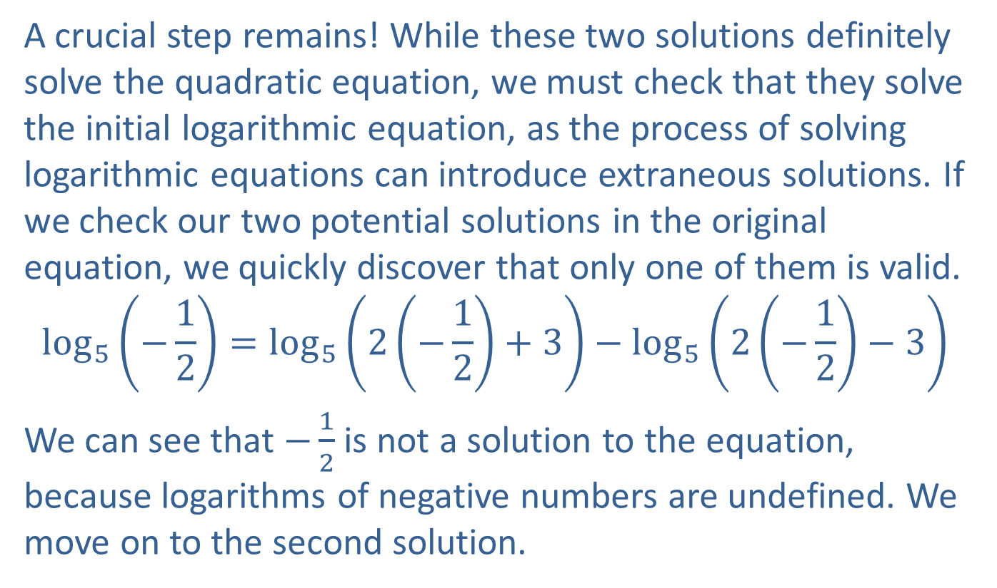
Example 4: Solving Logarithmic Equations (cont.)
A crucial step remains! While these two solutions definitely solve the quadratic equation, we must check that they solve the initial logarithmic equation, as the process of solving logarithmic equations can introduce extraneous solutions. If we check our two potential solutions in the original equation, we quickly discover that only one of them is valid.
$$\log_{5}\left(−\frac{1}{2}\right)=\log_{5}\left(2\left(−\frac{1}{2}\right)+3\right)−\log_{5}\left(2\left(−\frac{1}{2}\right)−3\right)$$
We can see that $−\frac{1}{2}$ is not a solution to the equation, because logarithms of negative numbers are undefined. We move on to the second solution.

Slide 22
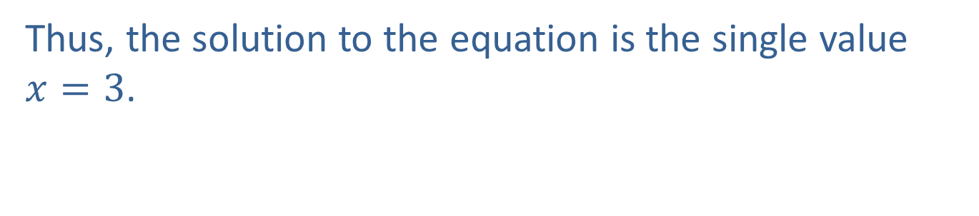
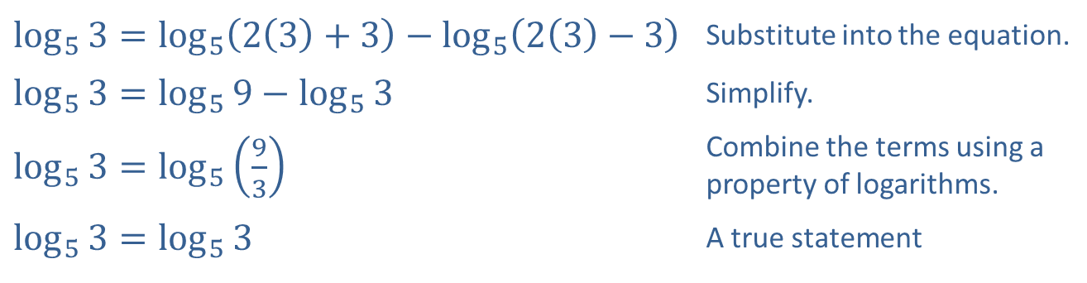
Example 4: Solving Logarithmic Equations (cont.)
​$\log_{5}{3}=\log_{5}\left(2\left(3\right)+3\right)−\log_{5}\left(2\left(3\right)−3\right)$ | Substitute into the equation.
​$\log_{5}{3}=\log_{5}{9}−\log_{5}{3}$ | Simplify.
​$\log_{5}{3}=\log_{5}\left(\frac{9}{3}\right)$ | Combine the terms using a property of logarithms.
​$\log_{5}{3}=\log_{5}{3}$ | A true statement
Thus, the solution to the equation is the single value $x=3$.

Slide 23
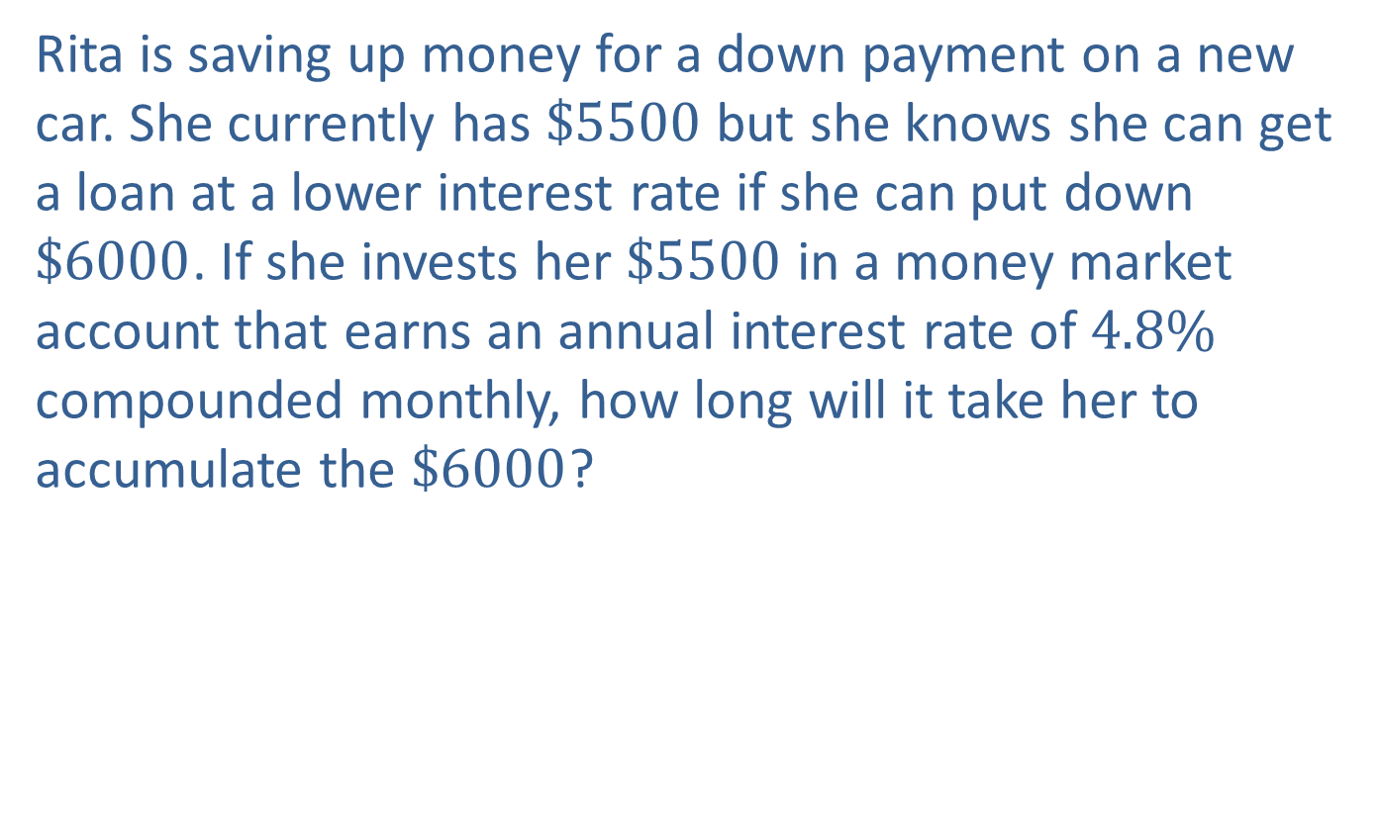
Example 5: Compounding Interest
Rita is saving up money for a down payment on a new car. She currently has $\$5500$ but she knows she can get a loan at a lower interest rate if she can put down $\$6000$. If she invests her $\$5500$ in a money market account that earns an annual interest rate of $4.8\%$ compounded monthly, how long will it take her to accumulate the $\$6000$?

Slide 24
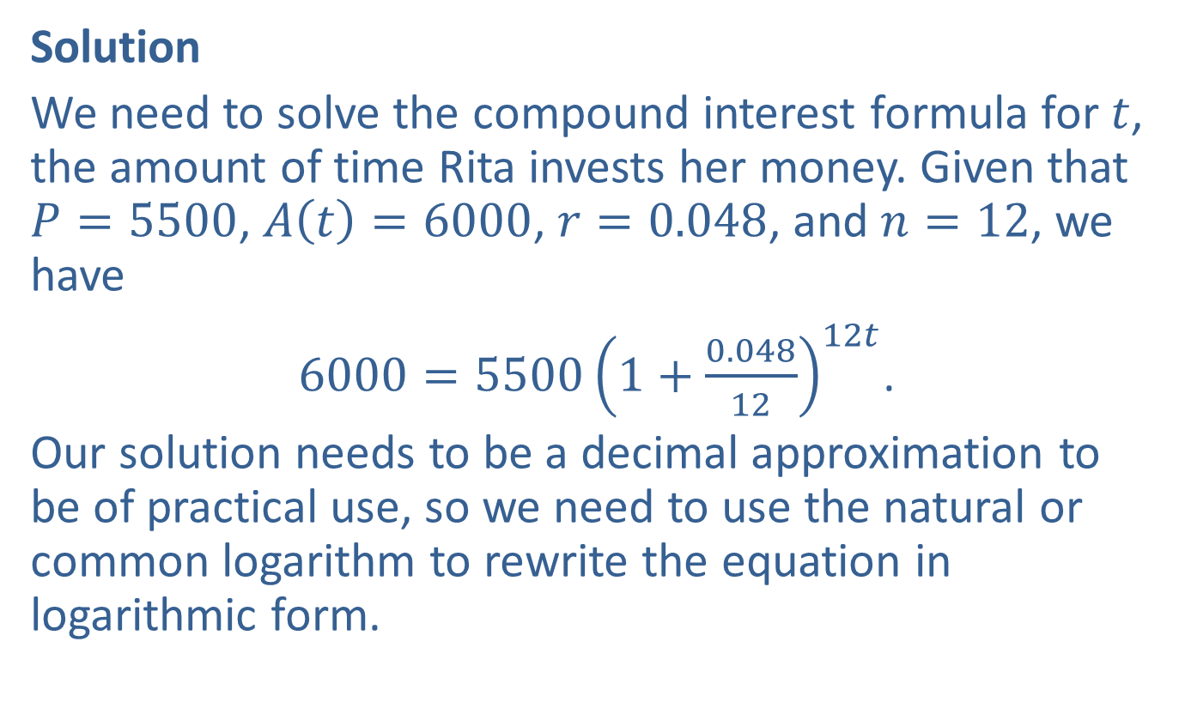
Example 5: Compounding Interest (cont.)
Solution
We need to solve the compound interest formula for $t$, the amount of time Rita invests her money. Given that $P=5500$, $A⁡\left(t\right)=6000$, $r=0.048$, and $n=12$, we have
$6000=5500{\left(1+\frac{0.048}{12}\right)}^{12t}$.
Our solution needs to be a decimal approximation to be of practical use, so we need to use the natural or common logarithm to rewrite the equation in logarithmic form.

Slide 25
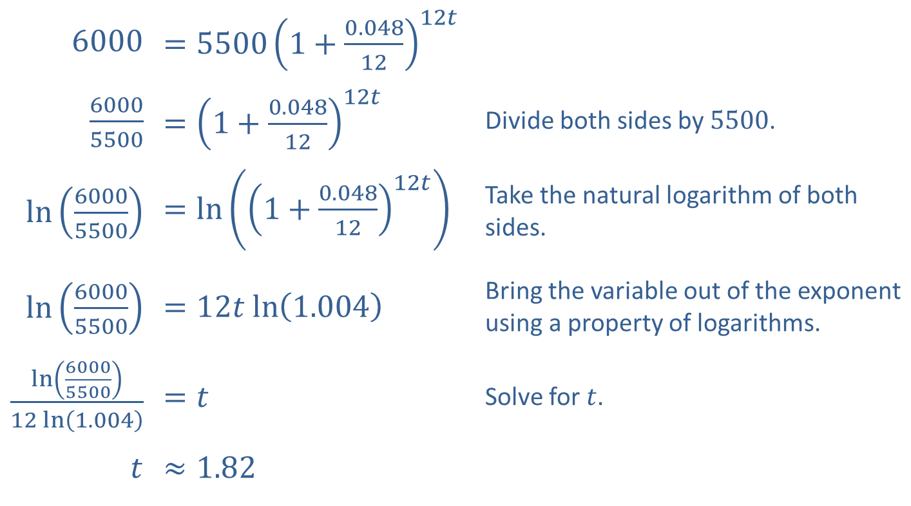
Example 5: Compounding Interest (cont.)
​6000 | ​$=5500{\left(1+\frac{0.048}{12}\right)}^{12t}$
​$\frac{6000}{5500}$ | ​$={\left(1+\frac{0.048}{12}\right)}^{12t}$ | Divide both sides by 5500.
​$ln⁡\left(\frac{6000}{5500}\right)$ | ​$=\ln\left({\left(1+\frac{0.048}{12}\right)}^{12t}\right)$ | Take the natural logarithm of both sides.
​$ln⁡\left(\frac{6000}{5500}\right)$ | ​$=12t ln⁡\left(1.004\right)$ | Bring the variable out of the exponent using a property of logarithms.
​$\frac{\ln\left(\frac{6000}{5500}\right)}{12 ln⁡\left(1.004\right)}$ | ​$=t$ | Solve for $t$.
$t$ | ​$≈1.82$

Slide 26

Example 5: Compounding Interest (cont.)
Since $t$ is measured in years, the solution tells us that it will take a bit less than a year and 10 months for the $\$5500$ to grow to $\$6000$.

Slide 27
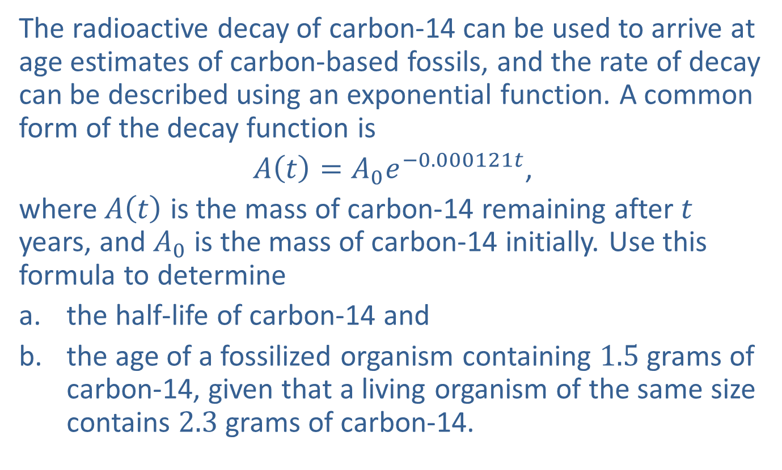
Example 6: Radiocarbon Dating
The radioactive decay of carbon-14 can be used to arrive at age estimates of carbon-based fossils, and the rate of decay can be described using an exponential function. A common form of the decay function is
$A⁡\left(t\right)=A_{0}e^{−0.000121t}$,
where $A⁡\left(t\right)$ is the mass of carbon-14 remaining after $t$ years, and $A_{0}$ is the mass of carbon-14 initially. Use this formula to determine
​the half-life of carbon-14 and
​the age of a fossilized organism containing 1.5 grams of carbon-14, given that a living organism of the same size contains 2.3 grams of carbon-14.

Slide 28

Example 6: Radiocarbon Dating (cont.)
Solution
​We are looking for the value of $t$ for which $A⁡\left(t\right)$ is half of $A_{0}$, or $\frac{A_{0}}{2}$.
​

Slide 29
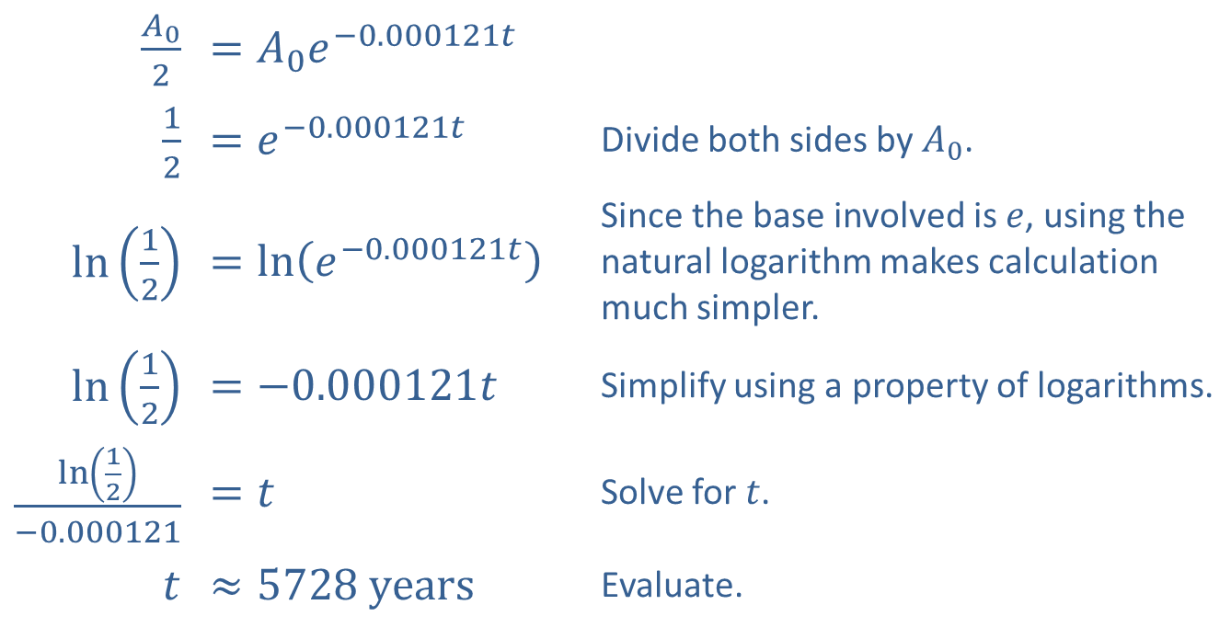
Example 6: Radiocarbon Dating (cont.)
​$\frac{A_{0}}{2}$ | ​$=A_{0}e^{−0.000121t}$
​$\frac{1}{2}$ | ​$=e^{−0.000121t}$ | Divide both sides by $A_{0}$.
​$ln⁡\left(\frac{1}{2}\right)$ | ​$=\ln\left(e^{−0.000121t}\right)$ | Since the base involved is $e$, using the natural logarithm makes calculation much simpler.
​$ln⁡\left(\frac{1}{2}\right)$ | ​$=−0.000121t$ | Simplify using a property of logarithms.
​$\frac{\ln\left(\frac{1}{2}\right)}{−0.000121}$ | ​$=t$ | Solve for $t$.
$t$ | ​$≈5728 years$ | Evaluate.
​Thus, the half-life of carbon-14 is approximately 5728 years.

Slide 30
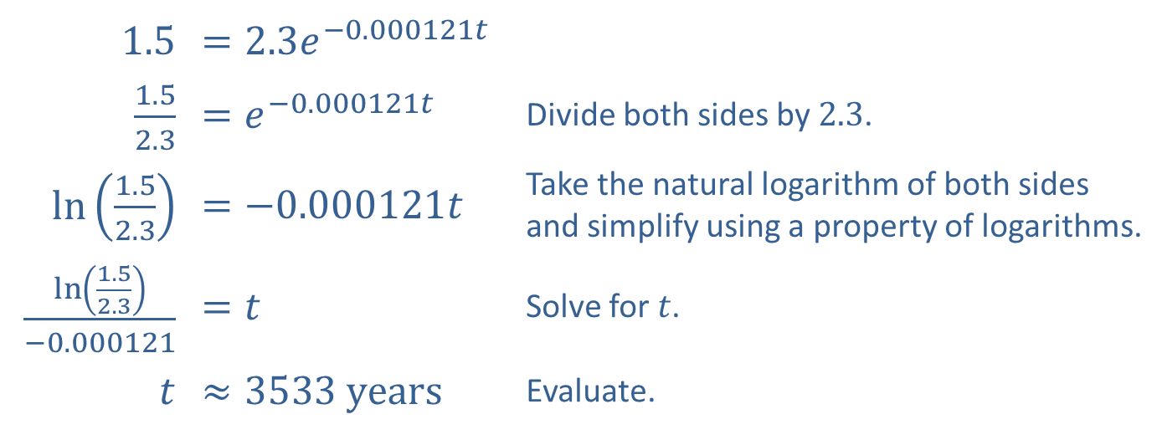

Example 6: Radiocarbon Dating (cont.)
​We plug the given information into the formula and solve for $t$.
​
​1.5 | ​$=2.3e^{−0.000121t}$
​$\frac{1.5}{2.3}$ | ​$=e^{−0.000121t}$ | Divide both sides by 2.3.
​$ln⁡\left(\frac{1.5}{2.3}\right)$ | ​$=−0.000121t$ | Take the natural logarithm of both sides and simplify using a property of logarithms.
​$\frac{\ln\left(\frac{1.5}{2.3}\right)}{−0.000121}$ | ​$=t$ | Solve for $t$.
$t$ | ​$≈3533 years$ | Evaluate.
​According to the radiocarbon dating, the fossil is about 3533 years old.

