Slide 1
Section 8.2
Trigonometric Functions and Right Triangles

Slide 2
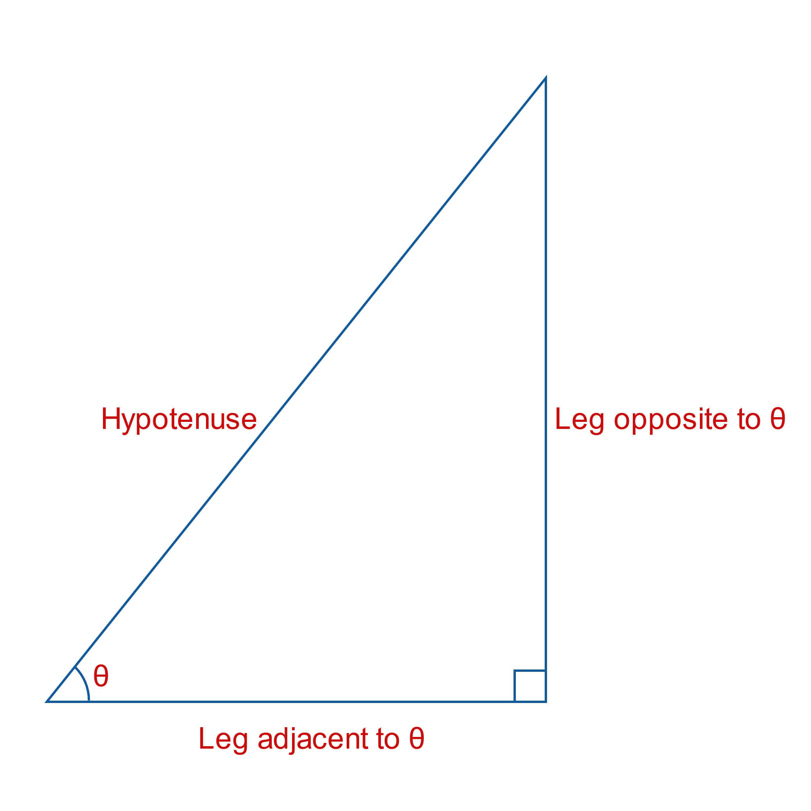


The Trigonometric Functions
To begin, consider a right triangle such as the one shown in Figure 1. We will define six functions which are functions of the angle $θ$. In order to do so, we label the two legs of the triangle as adjacent to and opposite $θ$, as shown. ​

Slide 3
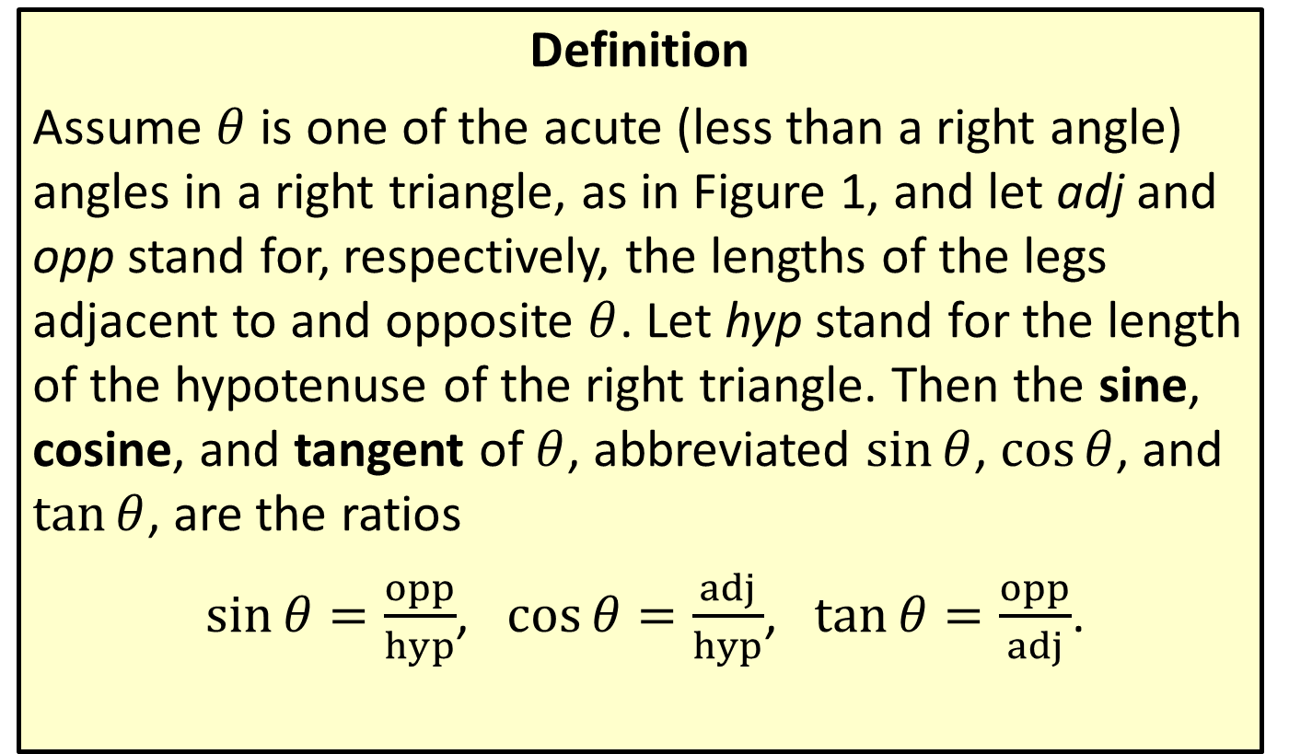
Sine, Cosine, and Tangent
Definition
Assume $θ$ is one of the acute (less than a right angle) angles in a right triangle, as in Figure 1, and let adj and opp stand for, respectively, the lengths of the legs adjacent to and opposite $θ$. Let hyp stand for the length of the hypotenuse of the right triangle. Then the sine, cosine, and tangent of $θ$, abbreviated $sin⁡θ$, $cos⁡θ$, and $tan⁡θ$, are the ratios
$\sin{θ}=\frac{opp}{hyp}$, $\cos{θ}=\frac{adj}{hyp}$, $\tan{θ}=\frac{opp}{adj}$.

Slide 4
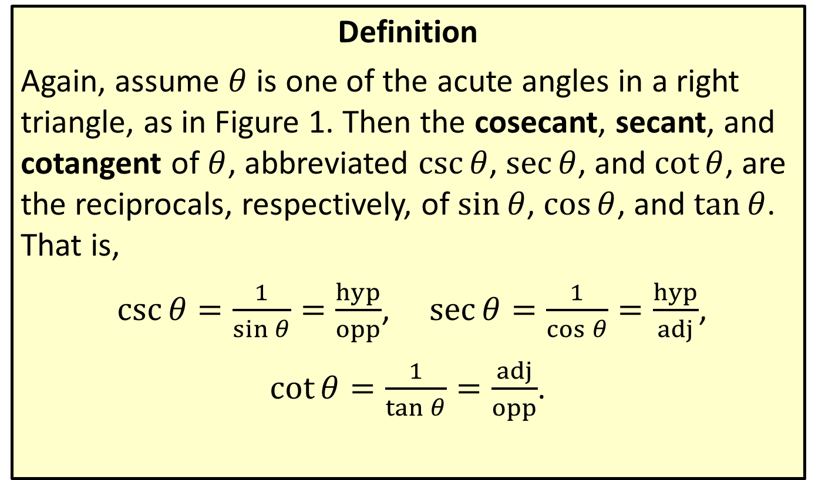
Cosecant, Secant, and Cotangent
Definition
Again, assume $θ$ is one of the acute angles in a right triangle, as in Figure 1. Then the cosecant, secant, and cotangent of $θ$, abbreviated $csc⁡θ$, $sec⁡θ$, and $cot⁡θ$, are the reciprocals, respectively, of $sin⁡θ$, $cos⁡θ$, and $tan⁡θ$. That is,
$\csc{θ}=\frac{1}{\sin{θ}}=\frac{hyp}{opp}$, $\sec{θ}=\frac{1}{\cos{θ}}=\frac{hyp}{adj}$,
$\cot{θ}=\frac{1}{\tan{θ}}=\frac{adj}{opp}$.

Slide 5
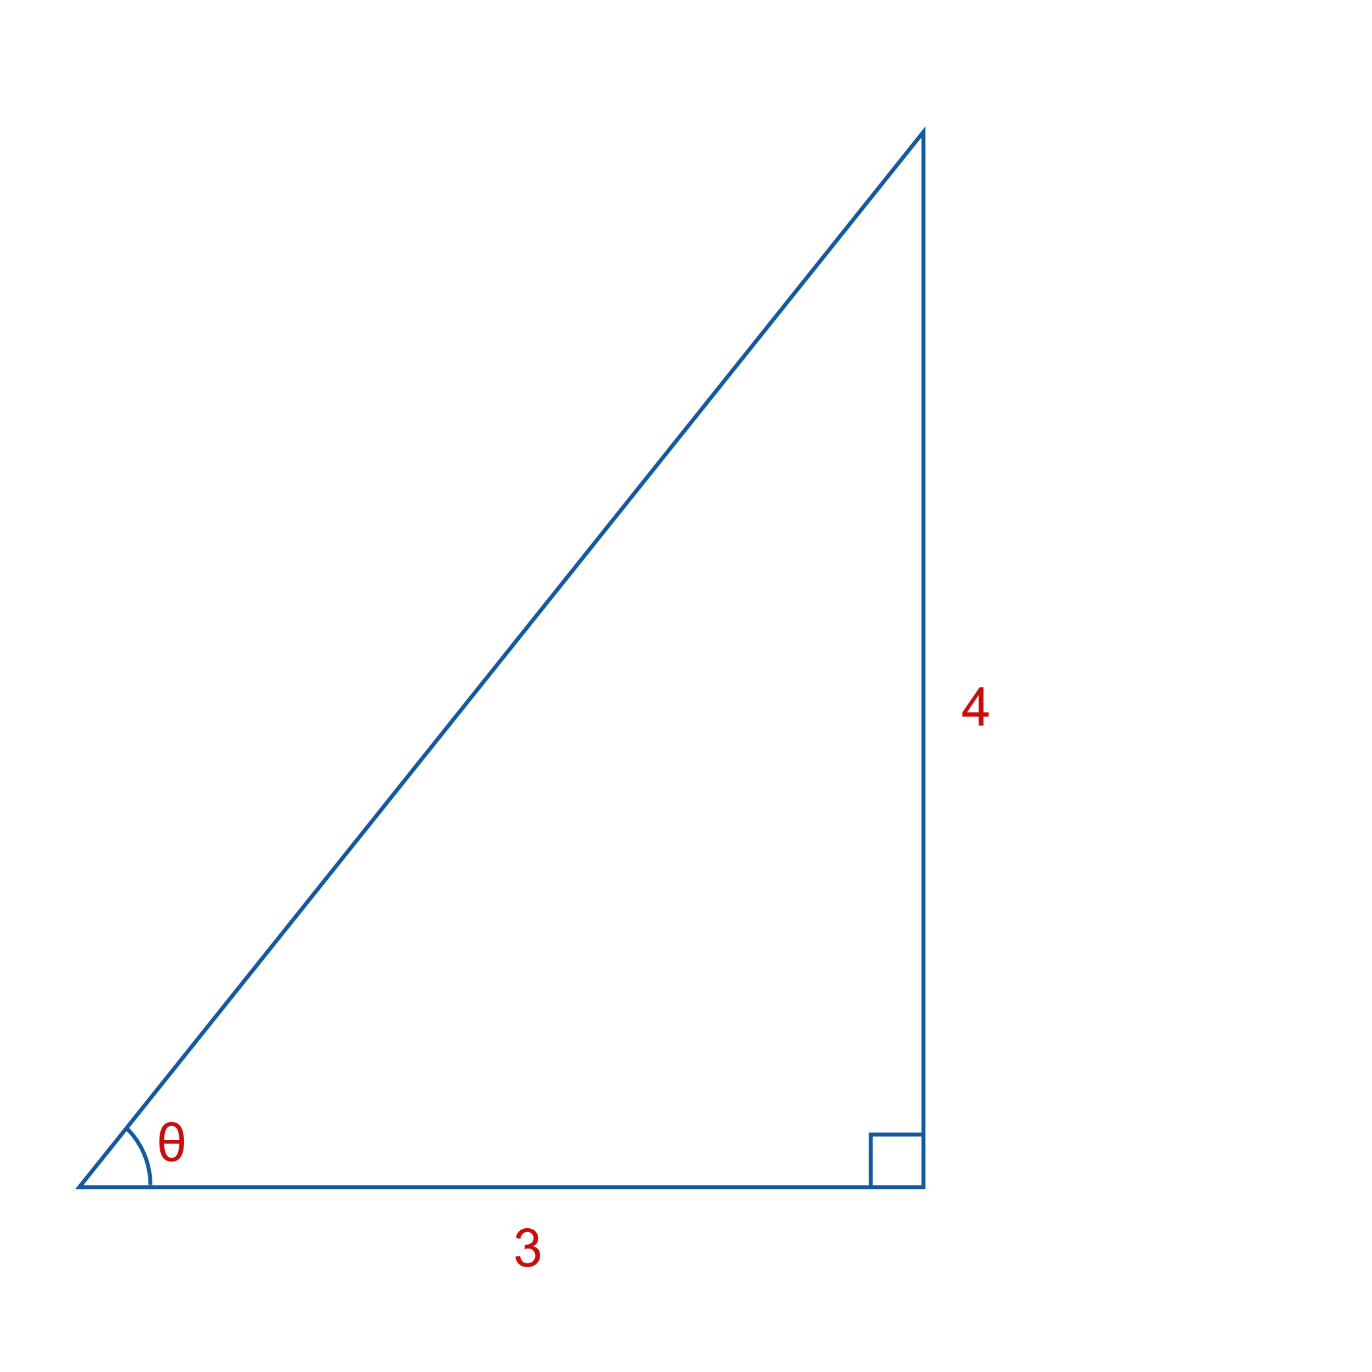
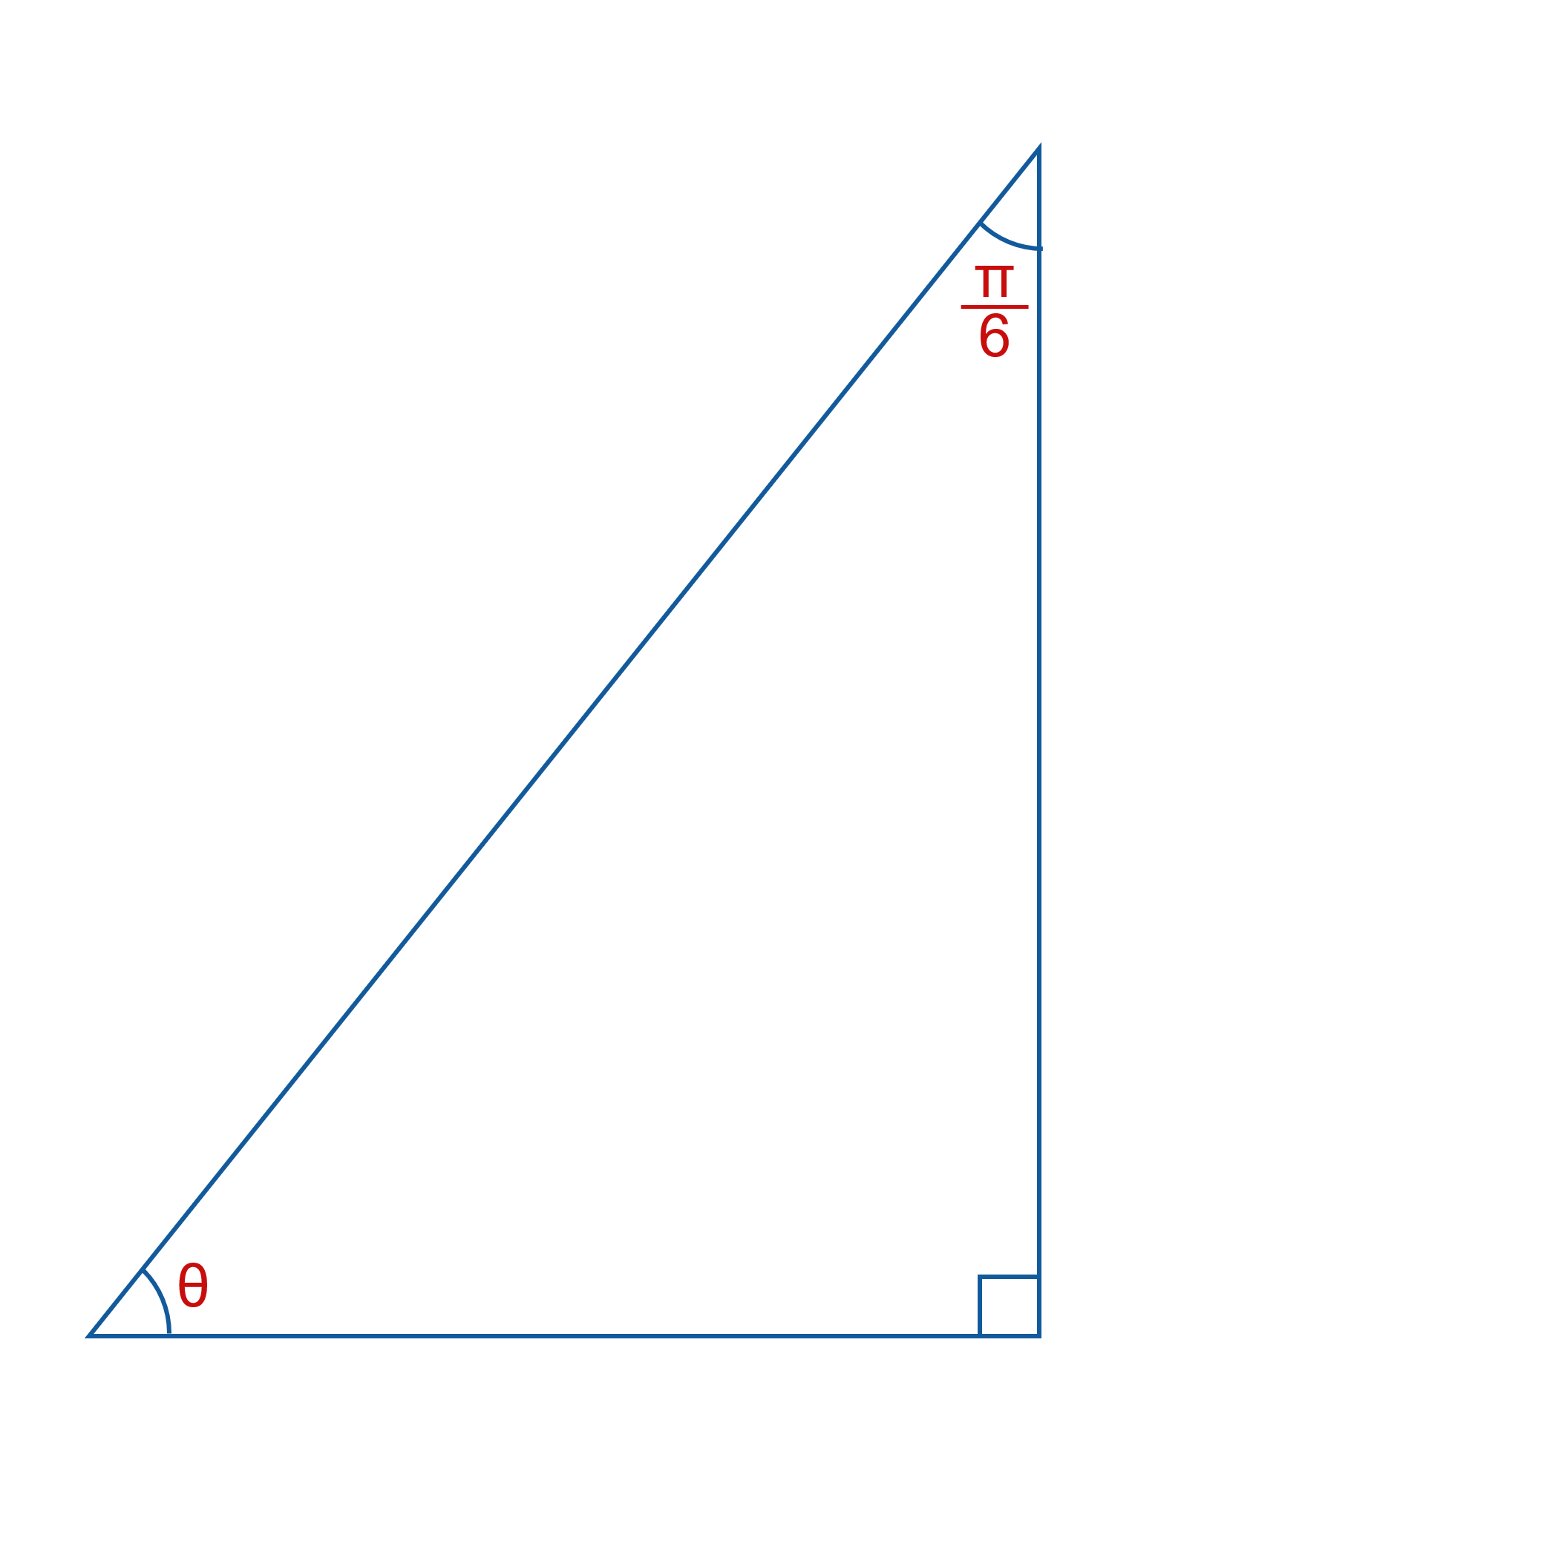

Example 1: Finding the Values of the Six Trigonometric Functions
Use the information contained in these two figures to determine the values of the six trigonometric functions of $θ$.
​ b.

Slide 6
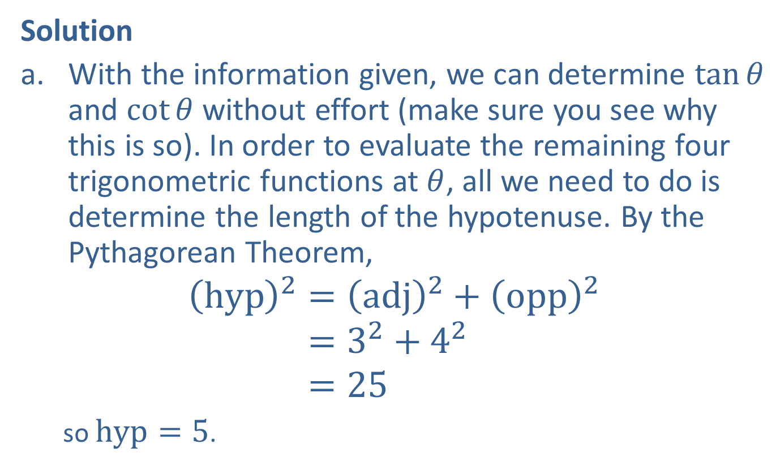
Example 1: Finding the Values of the Six Trigonometric Functions (cont.)
Solution
​With the information given, we can determine $tan⁡θ$ and $cot⁡θ$ without effort (make sure you see why this is so). In order to evaluate the remaining four trigonometric functions at $θ$, all we need to do is determine the length of the hypotenuse. By the Pythagorean Theorem,
hyp2=adj2+opp2hyp2=32+42hyp2=25
so $hyp=5$.

Slide 7

Example 1: Finding the Values of the Six Trigonometric Functions (cont.)
Thus,
​ $\sin{θ}=\frac{opp}{hyp}=\frac{4}{5}$, $\cos{θ}=\frac{adj}{hyp}=\frac{3}{5}$, $\tan{θ}=\frac{opp}{adj}=\frac{4}{3}$
​and
​ $\csc{θ}=\frac{1}{\sin{θ}}=\frac{5}{4}$, $\sec{θ}=\frac{1}{\cos{θ}}=\frac{5}{3}$, $\cot{θ}=\frac{1}{\tan{θ}}=\frac{3}{4}$.

Slide 8
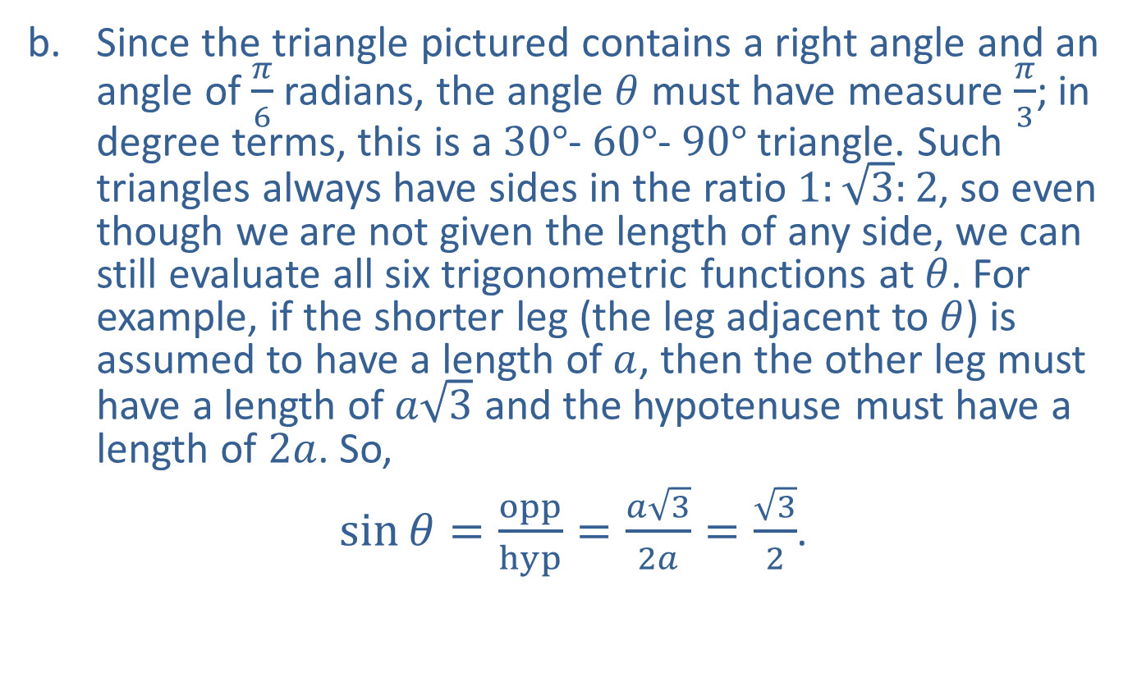
Example 1: Finding the Values of the Six Trigonometric Functions (cont.)
​Since the triangle pictured contains a right angle and an angle of $\frac{π}{6}$ radians, the angle $θ$ must have measure $\frac{π}{3}$; in degree terms, this is a $30°$‐ $60°$‐ $90°$ triangle. Such triangles always have sides in the ratio $1:\sqrt{3}:2$, so even though we are not given the length of any side, we can still evaluate all six trigonometric functions at $θ$. For example, if the shorter leg (the leg adjacent to $θ$) is assumed to have a length of $a$, then the other leg must have a length of $a\sqrt{3}$ and the hypotenuse must have a length of $2a$. So,
​ $\sin{θ}=\frac{opp}{hyp}=\frac{a\sqrt{3}}{2a}=\frac{\sqrt{3}}{2}$.
​

Slide 9

Example 1: Finding the Values of the Six Trigonometric Functions (cont.)
​Similarly,
​ $\cos{θ}=\frac{adj}{hyp}=\frac{1}{2}$,
$\tan{θ}=\frac{opp}{adj}=\sqrt{3}$,
​ $\csc{θ}=\frac{1}{\sin{θ}}=\frac{2}{\sqrt{3}}$,
$\sec{θ}=\frac{1}{\cos{θ}}=2$,
$\cot{θ}=\frac{1}{\tan{θ}}=\frac{1}{\sqrt{3}}$.

Slide 10

Example 2: Evaluating Trigonometric Functions
Evaluate the tangent and secant of $θ=\frac{π}{4}$.

Slide 11
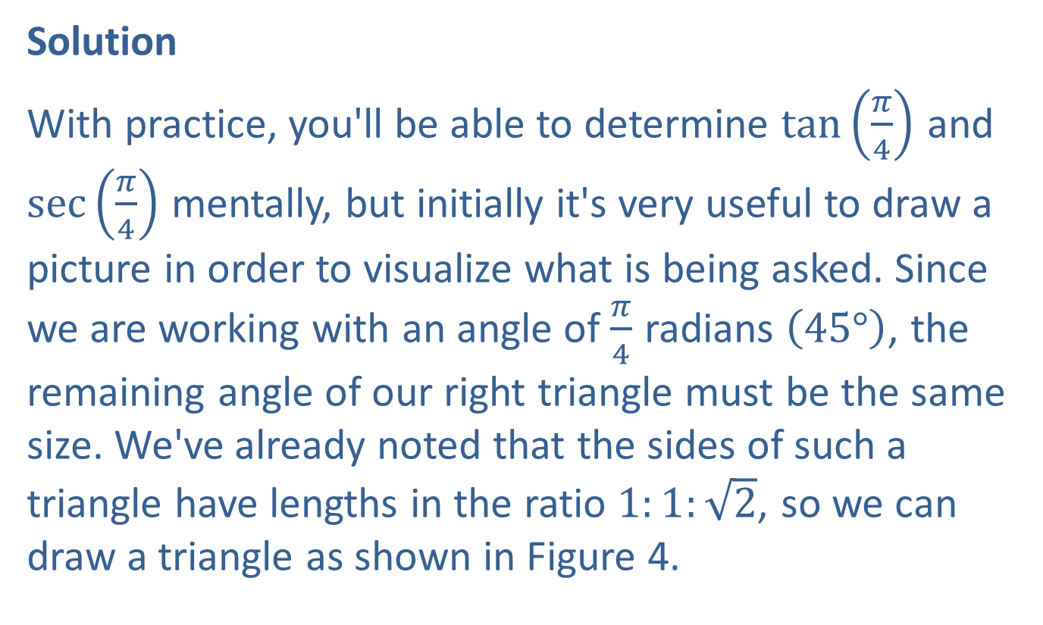
Example 2: Evaluating Trigonometric Functions (cont.)
Solution
With practice, you'll be able to determine $tan⁡\left(\frac{π}{4}\right)$ and $sec⁡\left(\frac{π}{4}\right)$ mentally, but initially it's very useful to draw a picture in order to visualize what is being asked. Since we are working with an angle of $\frac{π}{4}$ radians $\left(45°\right)$, the remaining angle of our right triangle must be the same size. We've already noted that the sides of such a triangle have lengths in the ratio $1:1:\sqrt{2}$, so we can draw a triangle as shown in Figure 4.

Slide 12
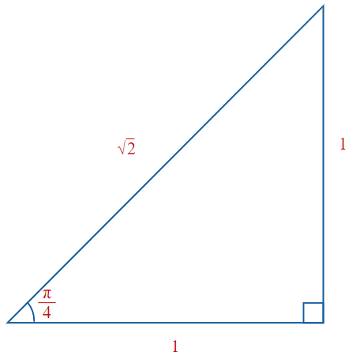

Example 2: Evaluating Trigonometric Functions (cont.)

Slide 13
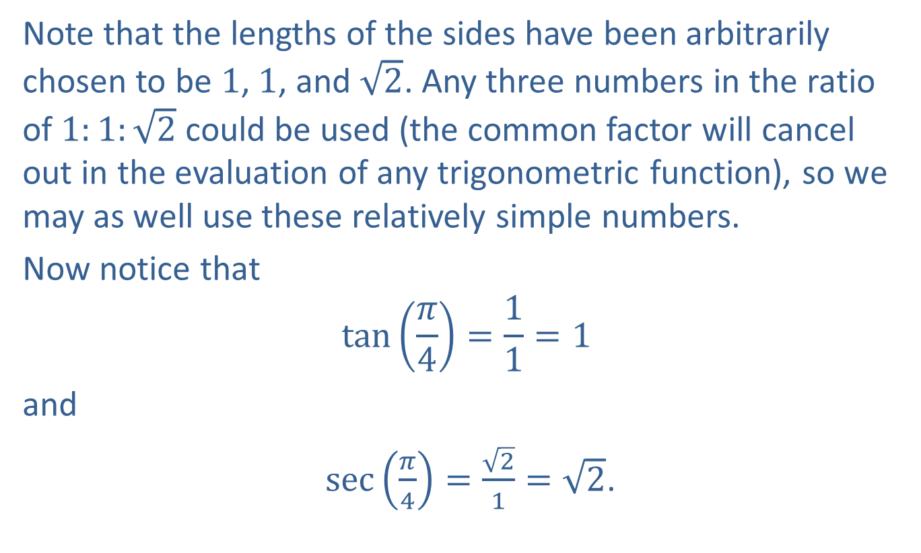
Example 2: Evaluating Trigonometric Functions (cont.)
Note that the lengths of the sides have been arbitrarily chosen to be 1, 1, and $\sqrt{2}$. Any three numbers in the ratio of $1:1:\sqrt{2}$ could be used (the common factor will cancel out in the evaluation of any trigonometric function), so we may as well use these relatively simple numbers.
Now notice that
$$\tan\left(\frac{π}{4}\right)=\frac{1}{1}=1$$
and
$\sec\left(\frac{π}{4}\right)=\frac{\sqrt{2}}{1}=\sqrt{2}$.

Slide 14
CAUTION!
Before using a calculator to evaluate a given trigonometric expression, determine whether the angle in the expression is measured in degrees or radians. Then put the calculator in the appropriate mode prior to the evaluation.

Slide 15

Example 3: Evaluating Trigonometric Functions Using a Calculator
Use a calculator to evaluate the following expressions.
​$sin⁡\left(56.4°\right)$
​$cot⁡\left(\frac{5π}{11}\right)$

Slide 16
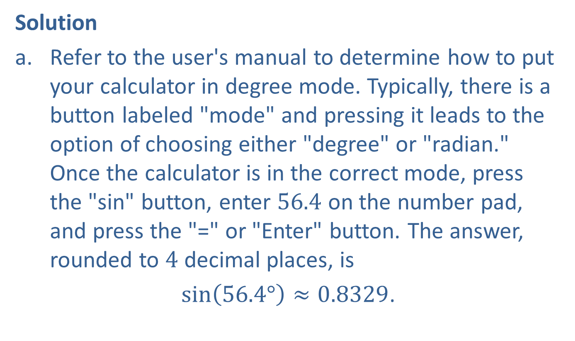
Example 3: Evaluating Trigonometric Functions Using a Calculator (cont.)
Solution
​Refer to the user's manual to determine how to put your calculator in degree mode. Typically, there is a button labeled "mode" and pressing it leads to the option of choosing either "degree" or "radian." Once the calculator is in the correct mode, press the "sin" button, enter 56.4 on the number pad, and press the "=" or "Enter" button. The answer, rounded to 4 decimal places, is
$sin\left(56.4°\right)≈0.8329$.

Slide 17
Example 3: Evaluating Trigonometric Functions Using a Calculator (cont.)
The exact number of digits on your display will depend on the calculator and its current settings. If your display reads −0.1481, your calculator is in the incorrect (radian) mode for this problem.

Slide 18
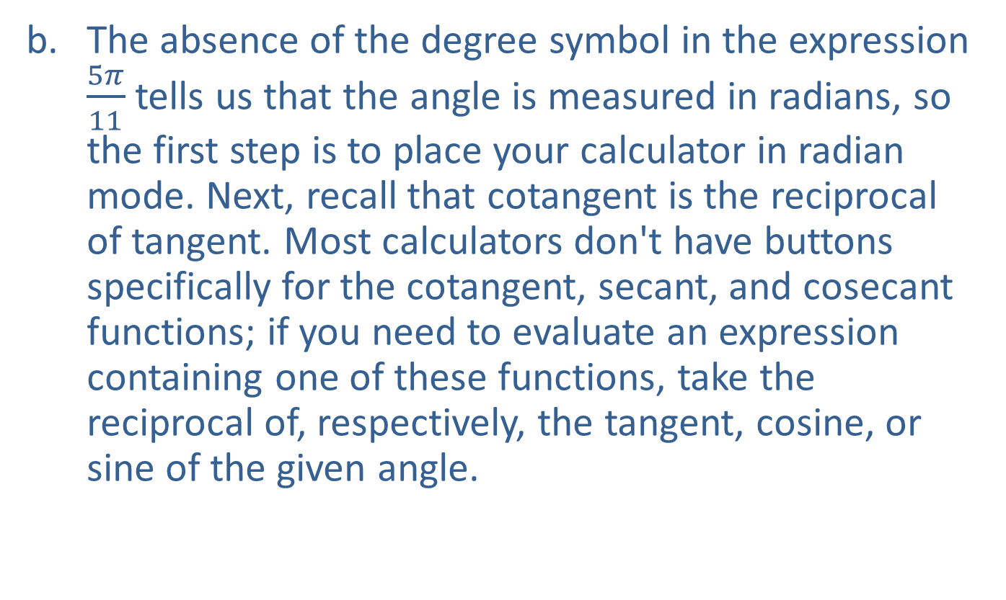
Example 3: Evaluating Trigonometric Functions Using a Calculator (cont.)
​The absence of the degree symbol in the expression $\frac{5π}{11}$ tells us that the angle is measured in radians, so the first step is to place your calculator in radian mode. Next, recall that cotangent is the reciprocal of tangent. Most calculators don't have buttons specifically for the cotangent, secant, and cosecant functions; if you need to evaluate an expression containing one of these functions, take the reciprocal of, respectively, the tangent, cosine, or sine of the given angle.
​

Slide 19

Example 3: Evaluating Trigonometric Functions Using a Calculator (cont.)
​In this case, use your calculator to confirm that
​ $\tan\left(\frac{5π}{11}\right)≈6.9552$,
and therefore
​ $\cot\left(\frac{5π}{11}\right)=\frac{1}{\tan\left(\frac{5π}{11}\right)}≈0.1438$.

Slide 20
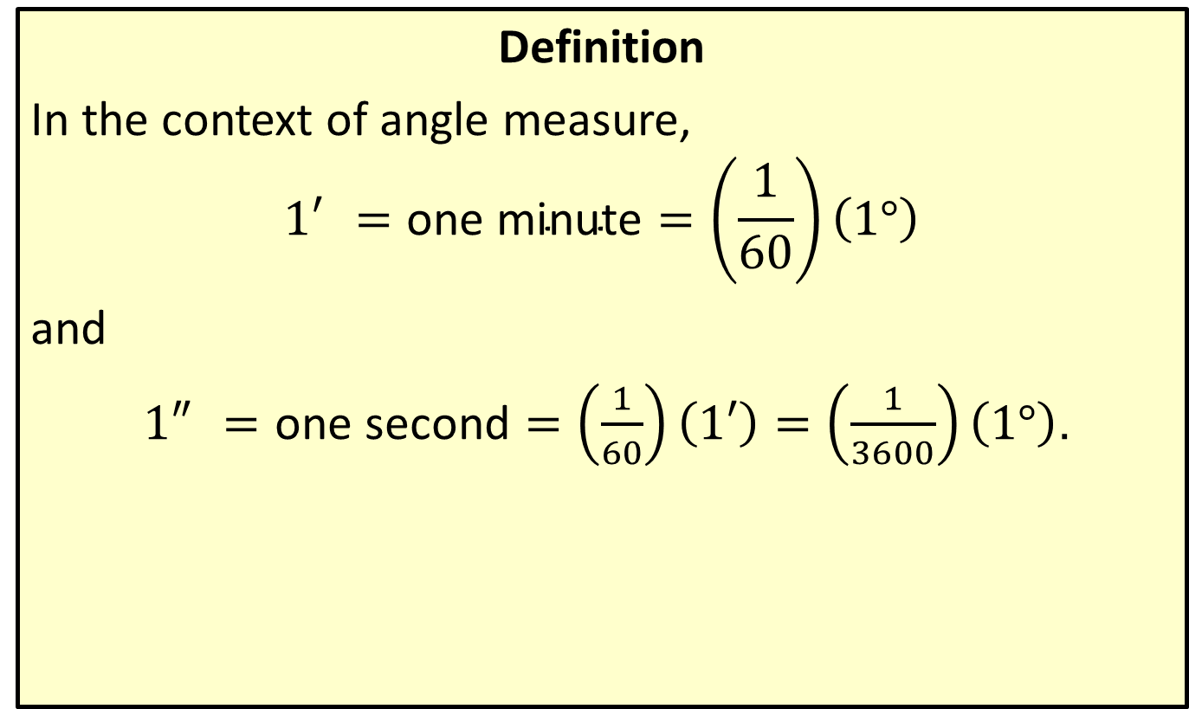
Degree, Minute, Second Notation
Definition
In the context of angle measure,
$${1′}^{ }=\text{one} \text{minute}=\left(\frac{1}{60}\right)\left(1°\right)$$
and
${1″}^{ }=\text{one} \text{second}=\left(\frac{1}{60}\right)\left(1′\right)=\left(\frac{1}{3600}\right)\left(1°\right)$.

Slide 21
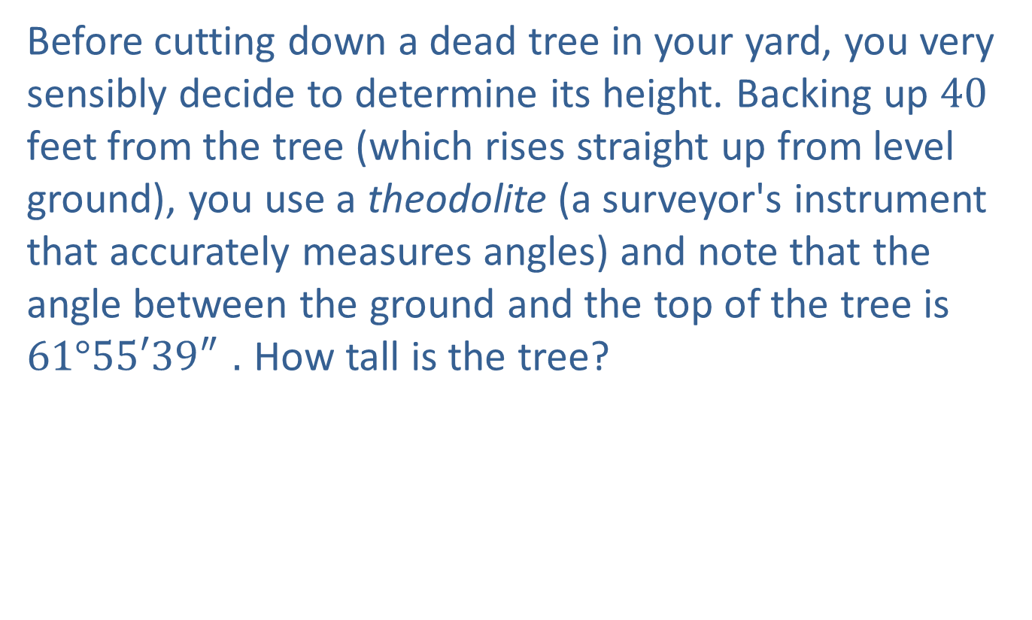
Example 4: Using Trigonometric Functions
Before cutting down a dead tree in your yard, you very sensibly decide to determine its height. Backing up 40 feet from the tree (which rises straight up from level ground), you use a theodolite (a surveyor's instrument that accurately measures angles) and note that the angle between the ground and the top of the tree is $61°{55′39″}^{ }.$ How tall is the tree?

Slide 22
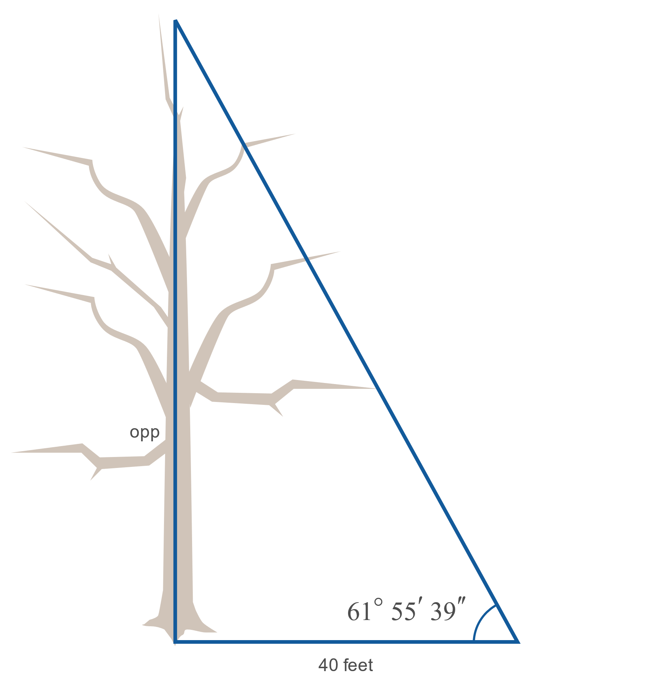

Example 4: Using Trigonometric Functions (cont.)

Slide 23
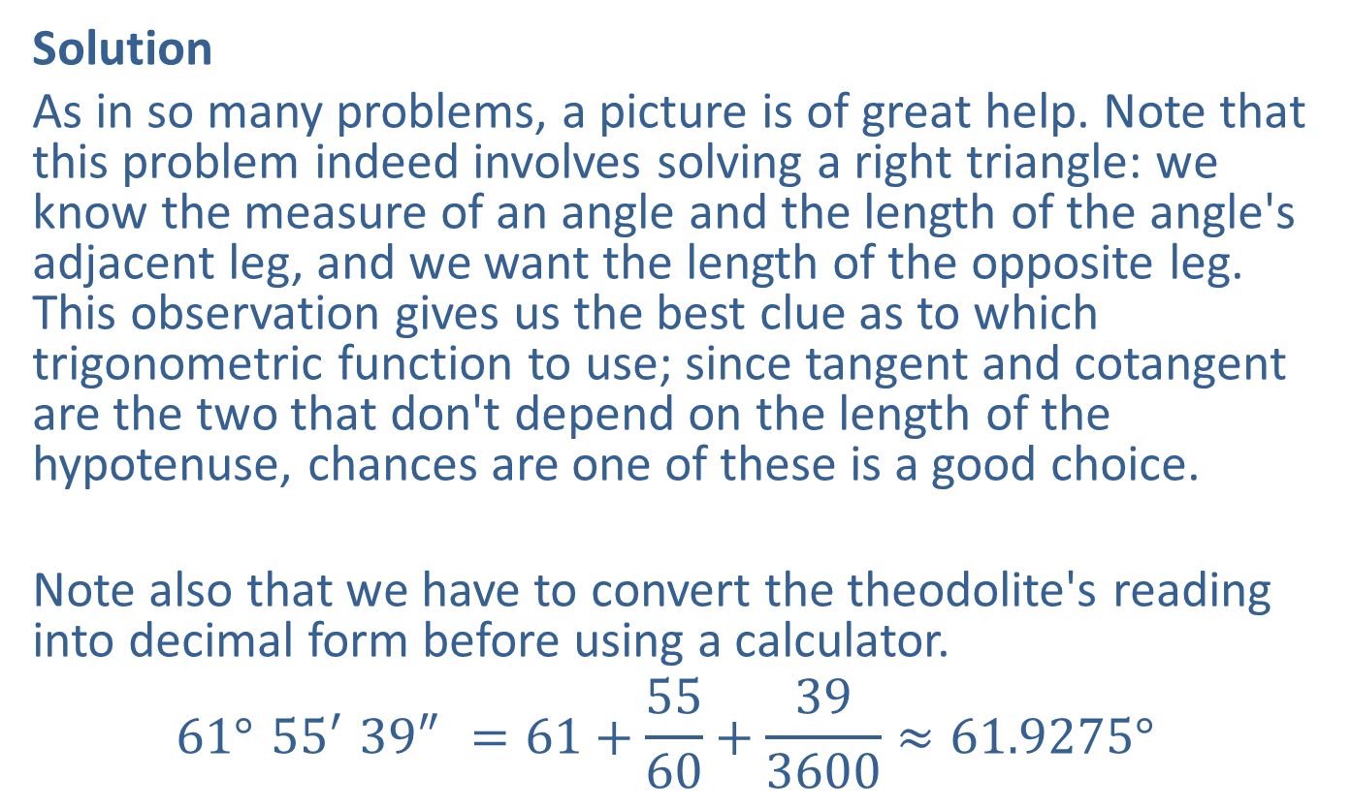
Example 4: Using Trigonometric Functions (cont.)
Solution
As in so many problems, a picture is of great help. Note that this problem indeed involves solving a right triangle: we know the measure of an angle and the length of the angle's adjacent leg, and we want the length of the opposite leg. This observation gives us the best clue as to which trigonometric function to use; since tangent and cotangent are the two that don't depend on the length of the hypotenuse, chances are one of these is a good choice.
Note also that we have to convert the theodolite's reading into decimal form before using a calculator.
$${61°}^{ }{55′}^{ }{39″}^{ }=61+\frac{55}{60}+\frac{39}{3600}≈{61.9275°}^{ }$$

Slide 24
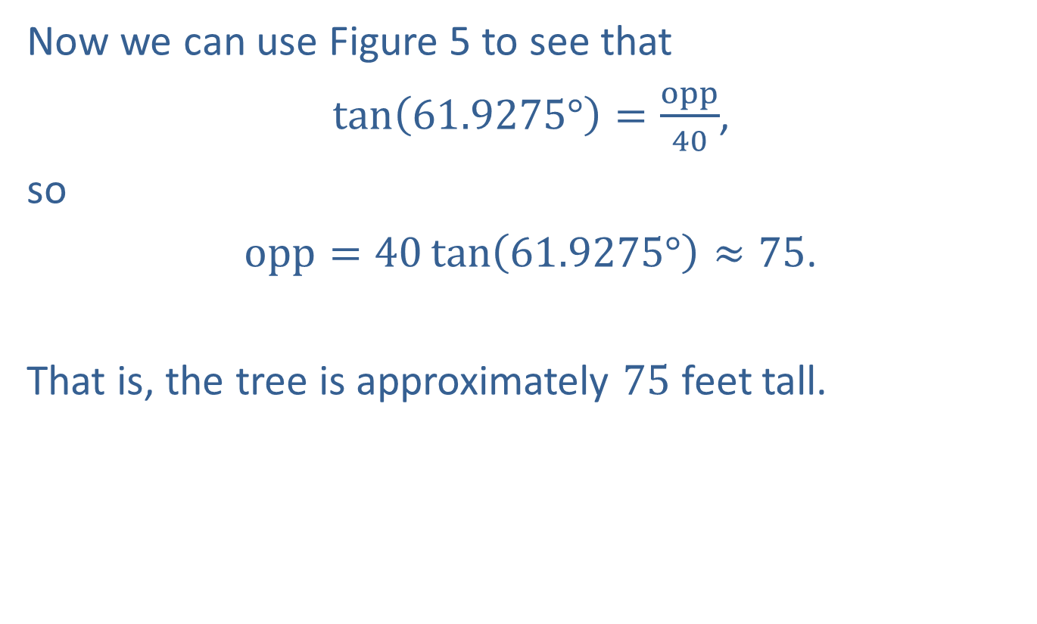
Example 4: Using Trigonometric Functions (cont.)
Now we can use Figure 5 to see that
$\tan\left(61.9275°\right)=\frac{opp}{40}$,
so
$opp=40\tan\left(61.9275°\right)≈75$.
That is, the tree is approximately 75 feet tall.

Slide 25

Example 5: Using Trigonometric Functions
The manufacturer of a certain brand of 16-foot ladder recommends that, when in use, the angle between the ground and the ladder should equal $75°$. What distance should the foot of the ladder be from the base of the wall it is leaning against?

Slide 26
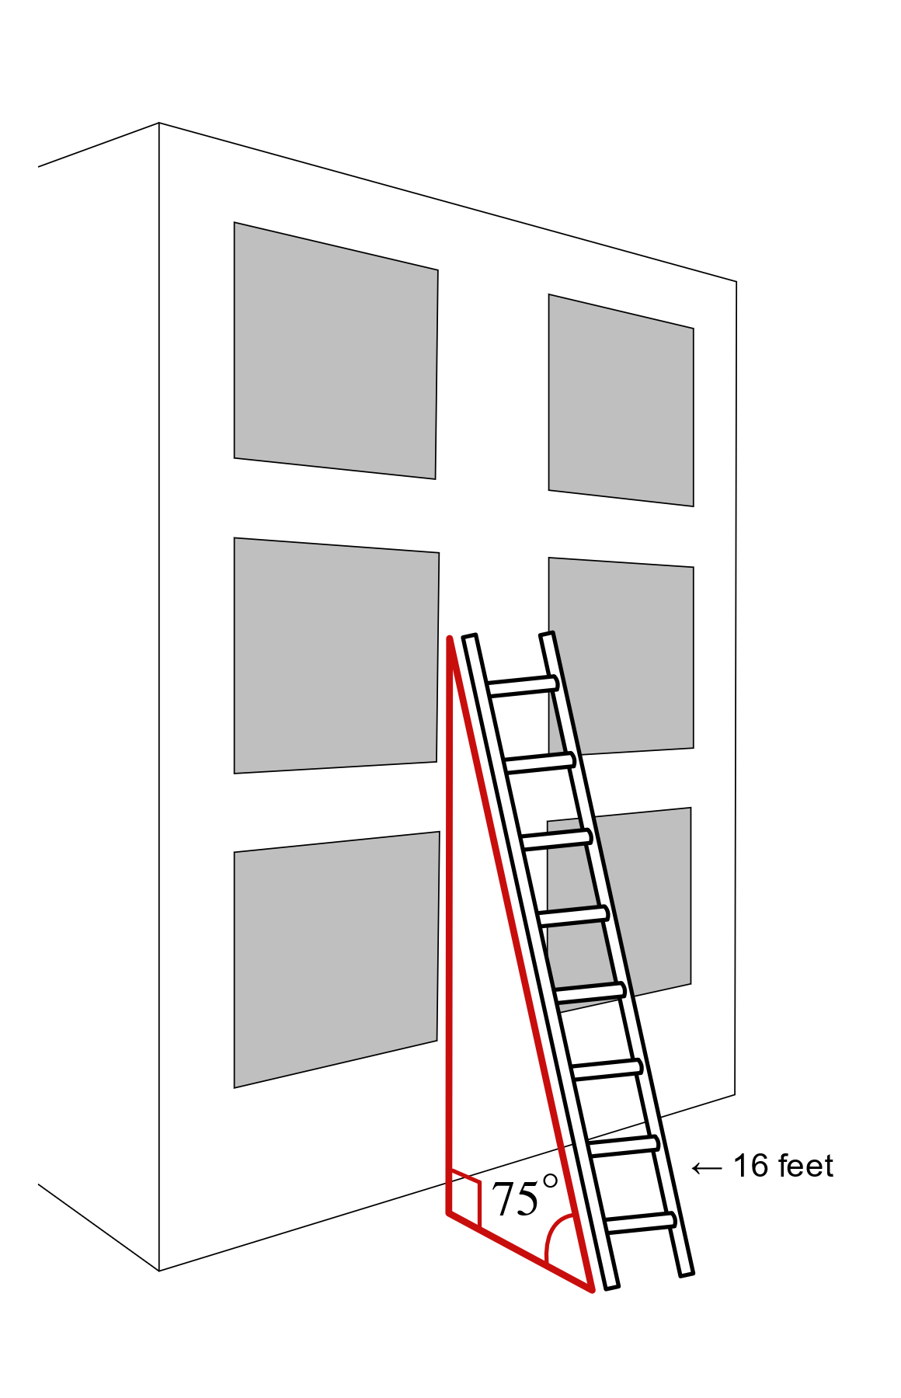

Example 5: Using Trigonometric Functions (cont.)

Slide 27
Example 5: Using Trigonometric Functions (cont.)
Solution
Since we are given information about an angle, its adjacent leg, and the hypotenuse of a right triangle, cosine is the logical trigonometric function to use in solving this problem (equivalently, secant could be used, but calculators are equipped with a "cos" and not a "sec" button so our current technology tends to lead to the use of cosine).

Slide 28
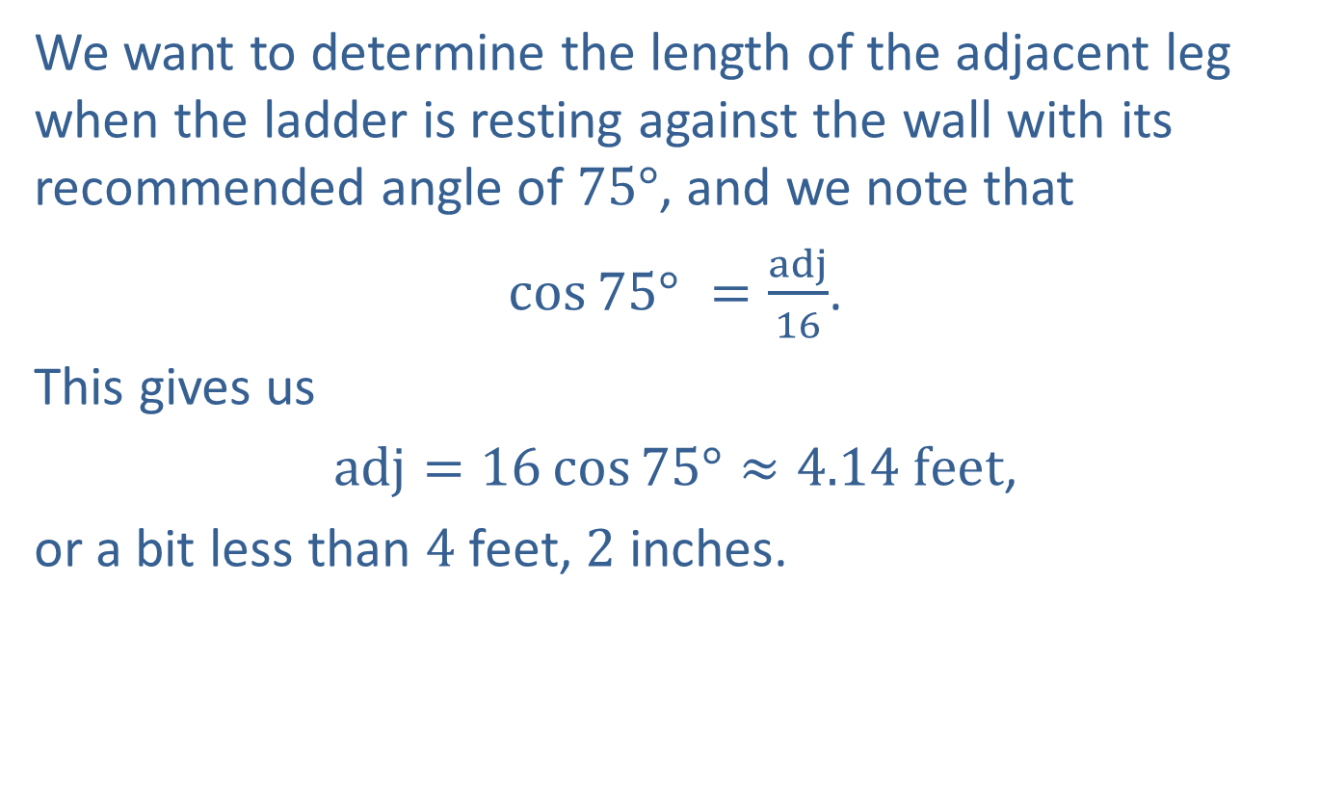
Example 5: Using Trigonometric Functions (cont.)
We want to determine the length of the adjacent leg when the ladder is resting against the wall with its recommended angle of $75°$, and we note that
$\cos{{75°}^{ }}=\frac{adj}{16}$.
This gives us
$adj=16\cos{75°}≈4.14 feet$,
or a bit less than 4 feet, 2 inches.

Slide 29
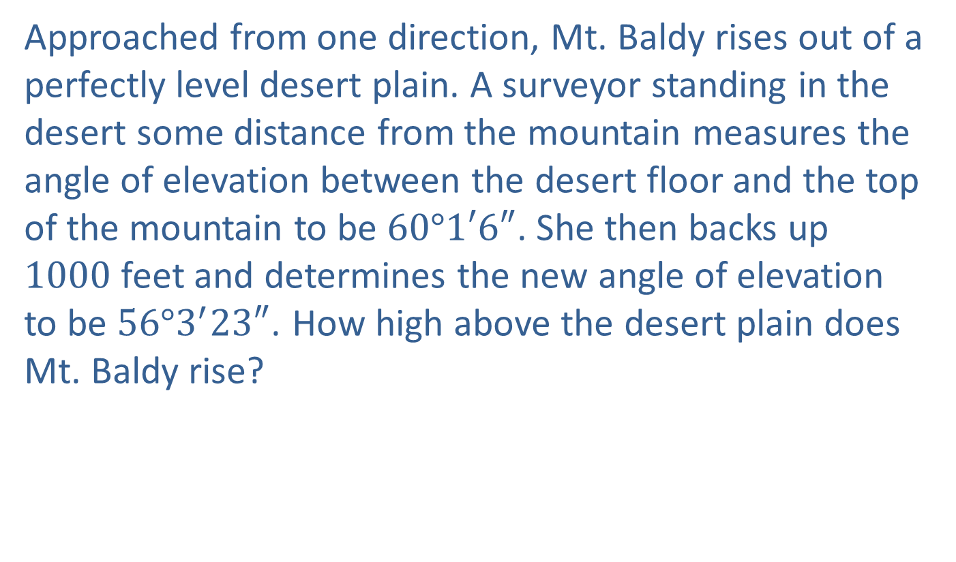
Example 6: Using Trigonometric Functions
Approached from one direction, Mt. Baldy rises out of a perfectly level desert plain. A surveyor standing in the desert some distance from the mountain measures the angle of elevation between the desert floor and the top of the mountain to be $60°1′6″$. She then backs up 1000 feet and determines the new angle of elevation to be $56°3^{′}23″$. How high above the desert plain does Mt. Baldy rise?

Slide 30
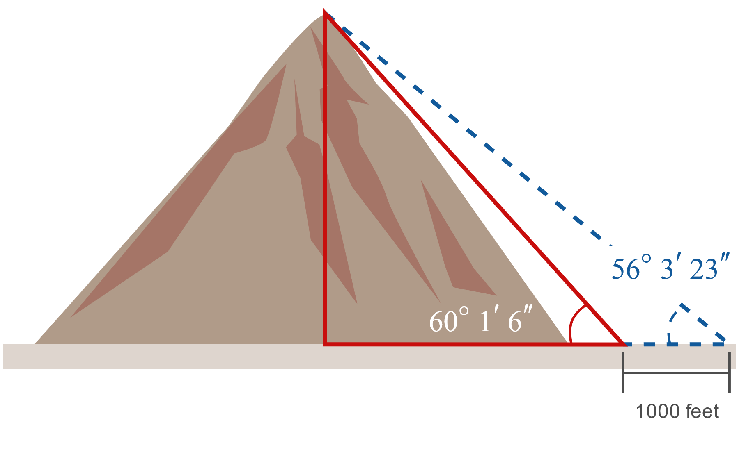

Example 6: Using Trigonometric Functions (cont.)

Slide 31
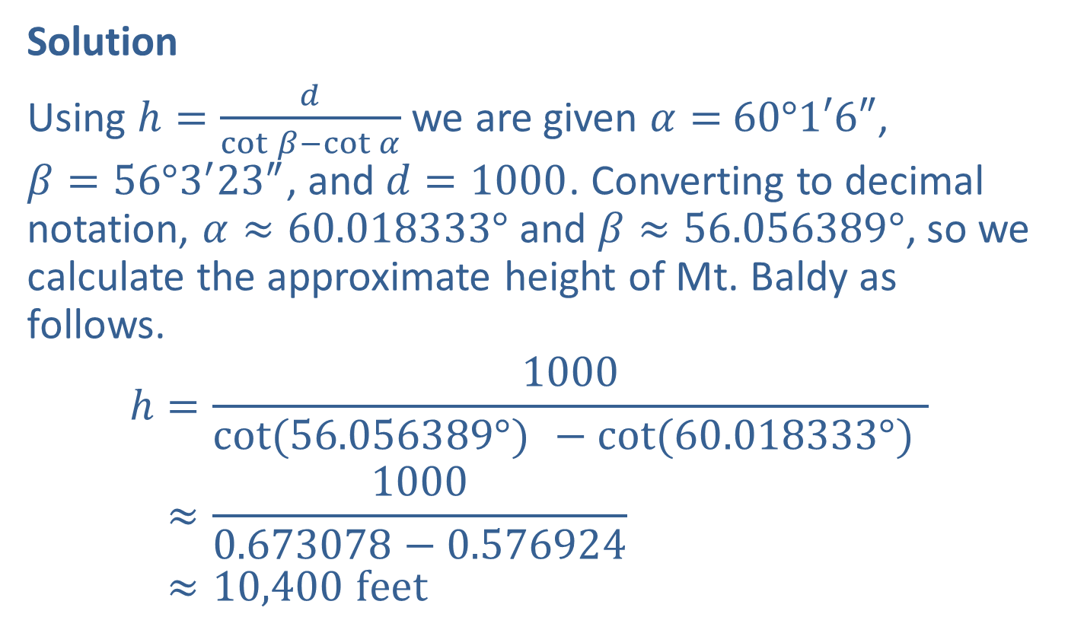
Example 6: Using Trigonometric Functions (cont.)
Solution
Using $h=\frac{d}{\cot{β−\cot{α}}}$ we are given $α=$ $60°1′6″$, $β=56°3^{′}{23}^{″}$, and $d=1000$. Converting to decimal notation, $α≈60.018333°$ and $β≈56.056389°$, so we calculate the approximate height of Mt. Baldy as follows.
h=1000cot(56.056389°) −cot(60.018333°) h≈10000.673078−0.576924h≈10,400 feet

