Slide 1
Section 9.3
Product-Sum Identities

Slide 2
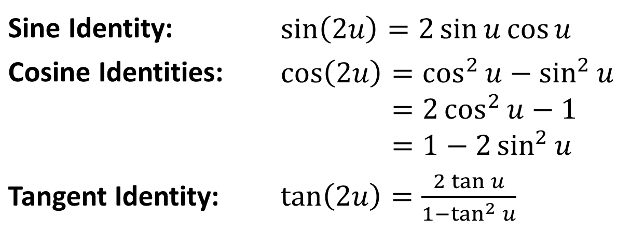
Double-Angle Identities
Identities
Sine Identity: | ​$\sin\left(2u\right)=2\sin{u}\cos{u}$
Cosine Identities: | cos2𝑢=cos2𝑢−sin2𝑢cos⁡2𝑢=2cos2𝑢−1cos⁡2𝑢=1−2sin2𝑢
Tangent Identity: | ​$\tan\left(2u\right)=\frac{2\tan{u}}{1−\tan^{2}{u}}$

Slide 3

Example 1: Using the Double-Angle Identities
Given that $\cos{x}=−\frac{2}{\sqrt{5}}$ and that $sin⁡x$ is positive, determine $cos⁡\left(2x\right)$, $sin⁡\left(2x\right)$, and $tan⁡\left(2x\right)$.

Slide 4

Example 1: Using the Double-Angle Identities (cont.)
Solution
First, note that since $cos⁡x$ is negative and $sin⁡x$ is positive, we know that $x$ lies in quadrant II.

Slide 5
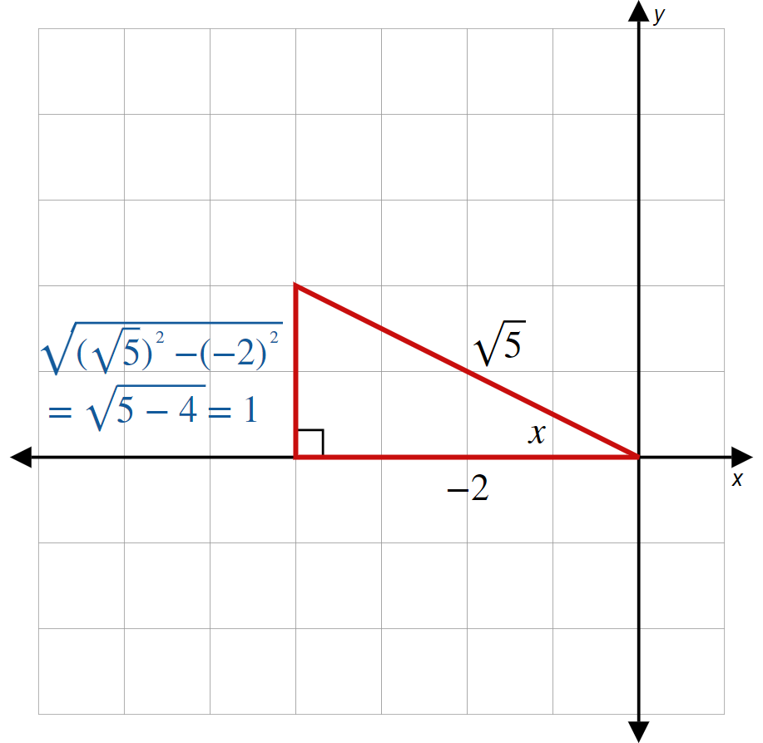
Example 1: Using the Double-Angle Identities (cont.)
Figure 1

Slide 6
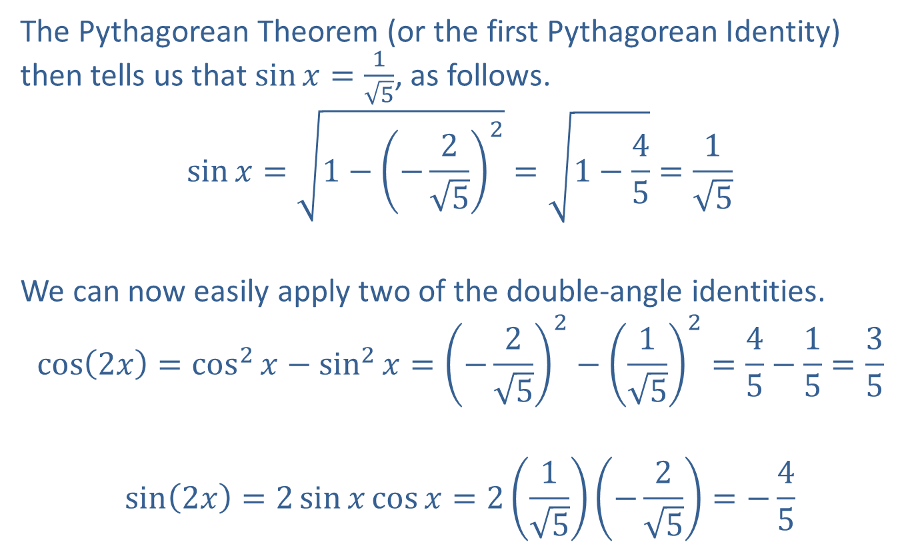
Example 1: Using the Double-Angle Identities (cont.)
The Pythagorean Theorem (or the first Pythagorean Identity) then tells us that $\sin{x}=\frac{1}{\sqrt{5}}$, as follows.
$$\sin{x}=\sqrt{1−{\left(−\frac{2}{\sqrt{5}}\right)}^{2}}=\sqrt{1−\frac{4}{5}}=\frac{1}{\sqrt{5}}$$
We can now easily apply two of the double-angle identities.
$$\cos\left(2x\right)=\cos^{2}{x}−\sin^{2}{x}={\left(−\frac{2}{\sqrt{5}}\right)}^{2}−{\left(\frac{1}{\sqrt{5}}\right)}^{2}=\frac{4}{5}−\frac{1}{5}=\frac{3}{5}$$
$$\sin\left(2x\right)=2\sin{x}\cos{x}=2\left(\frac{1}{\sqrt{5}}\right)\left(−\frac{2}{\sqrt{5}}\right)=−\frac{4}{5}$$

Slide 7
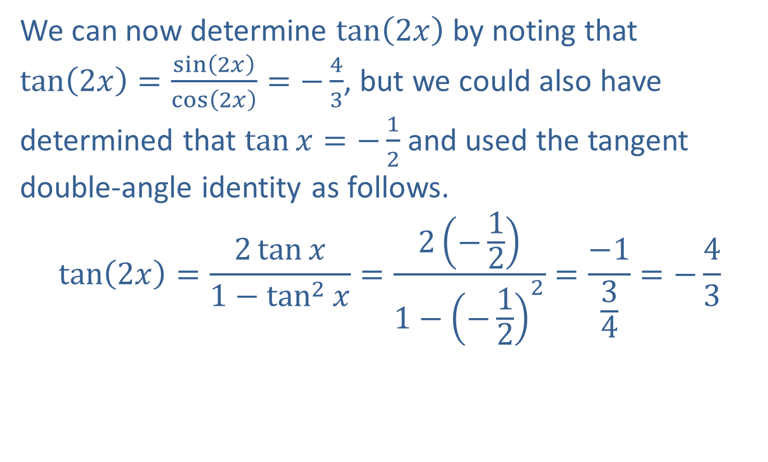
Example 1: Using the Double-Angle Identities (cont.)
We can now determine $tan⁡\left(2x\right)$ by noting that $\tan\left(2x\right)=\frac{\sin\left(2x\right)}{\cos\left(2x\right)}=−\frac{4}{3}$, but we could also have determined that $\tan{x}=−\frac{1}{2}$ and used the tangent double-angle identity as follows.
$$\tan\left(2x\right)=\frac{2\tan{x}}{1−\tan^{2}{x}}=\frac{2\left(−\frac{1}{2}\right)}{1−{\left(−\frac{1}{2}\right)}^{2}}=\frac{−1}{\frac{3}{4}}=−\frac{4}{3}$$

Slide 8

Example 2: Using Trigonometric Identities
Prove that $\sin\left(3x\right)=3\sin{x}−4\sin^{3}{x}$.

Slide 9
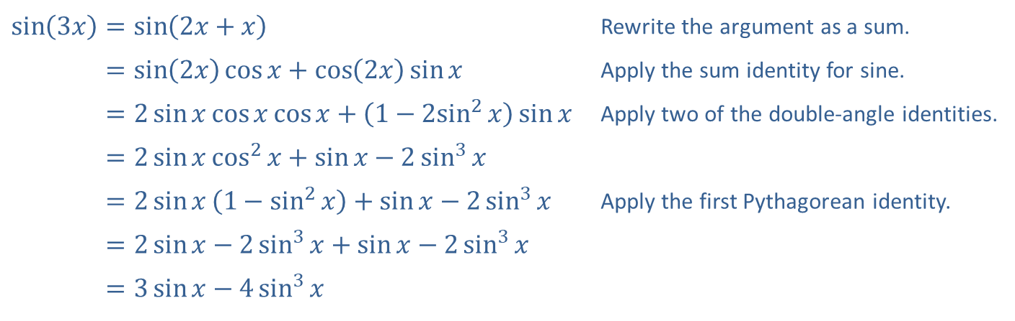
Example 2: Using Trigonometric Identities (cont.)
Solution
​$\sin\left(3x\right)=\sin\left(2x+x\right)$ | Rewrite the argument as a sum.
​sin⁡3𝑥=sin2𝑥cos𝑥+cos2𝑥sin𝑥 | Apply the sum identity for sine.
​sin⁡3𝑥=2sin𝑥cos𝑥cos𝑥+1−2sin2⁡𝑥sin𝑥 | Apply two of the double-angle identities.
​sin⁡3𝑥=2sin𝑥cos2𝑥+sin𝑥−2sin3𝑥
​sin⁡3𝑥=2sin𝑥1−sin2𝑥+sin𝑥−2sin3𝑥 | Apply the first Pythagorean identity.
​sin⁡3𝑥=2sin𝑥−2sin3𝑥+sin𝑥−2sin3𝑥
​sin⁡3𝑥=3sin𝑥−4sin3𝑥

Slide 10
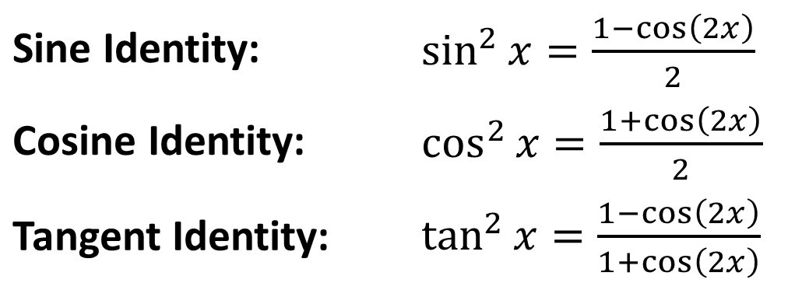
Power-Reducing Identities
Identities
Sine Identity: | ​$\sin^{2}{x}=\frac{1−\cos\left(2x\right)}{2}$
Cosine Identity: | ​$\cos^{2}{x}=\frac{1+\cos\left(2x\right)}{2}$
Tangent Identity: | ​$\tan^{2}{x}=\frac{1−\cos\left(2x\right)}{1+\cos\left(2x\right)}$

Slide 11

Example 3: Using the Power-Reducing Identities
Express $\sin^{5}⁡x$ in terms containing only first powers of sine and cosine.

Slide 12
Example 3: Using the Power-Reducing Identities (cont.)
Solution
The procedure is to break the expression down into pieces to which the power-reducing identities apply, repeating the process if necessary.

Slide 13
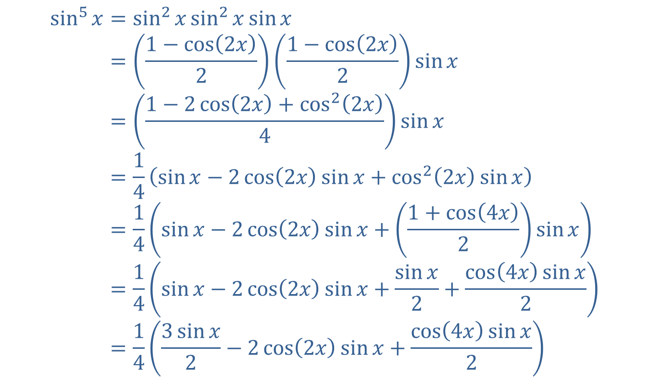
Example 3: Using the Power-Reducing Identities (cont.)
sin5𝑥=sin2𝑥sin2𝑥sin𝑥sin⁡5⁡𝑥=1−cos2𝑥21−cos2𝑥2sin𝑥sin⁡5⁡𝑥=1−2cos2𝑥+cos22𝑥4sin𝑥sin⁡5⁡𝑥=14sin𝑥−2cos2𝑥sin𝑥+cos22𝑥sin𝑥sin⁡5⁡𝑥=14sin𝑥−2cos2𝑥sin𝑥+1+cos4𝑥2sin𝑥sin⁡5⁡𝑥=14sin𝑥−2cos2𝑥sin𝑥+sin𝑥2+cos4𝑥sin𝑥2sin⁡5⁡𝑥=143sin𝑥2−2cos2𝑥sin𝑥+cos4𝑥sin𝑥2

Slide 14
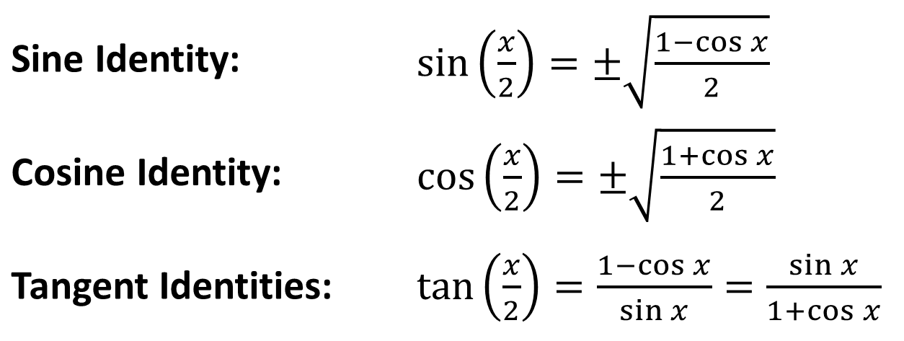
Half-Angle Identities
Identities
Sine Identity: | ​$\sin\left(\frac{x}{2}\right)=±\sqrt{\frac{1−\cos{x}}{2}}$
Cosine Identity: | ​$\cos\left(\frac{x}{2}\right)=±\sqrt{\frac{1+\cos{x}}{2}}$
Tangent Identities: | ​$\tan\left(\frac{x}{2}\right)=\frac{1−\cos{x}}{\sin{x}}=\frac{\sin{x}}{1+\cos{x}}$

Slide 15

Example 4: Using the Half-Angle Identities
Determine the exact values of $sin⁡\left(\frac{π}{8}\right)$, $cos⁡\left(\frac{π}{8}\right)$, and $tan⁡\left(\frac{π}{8}\right)$.

Slide 16
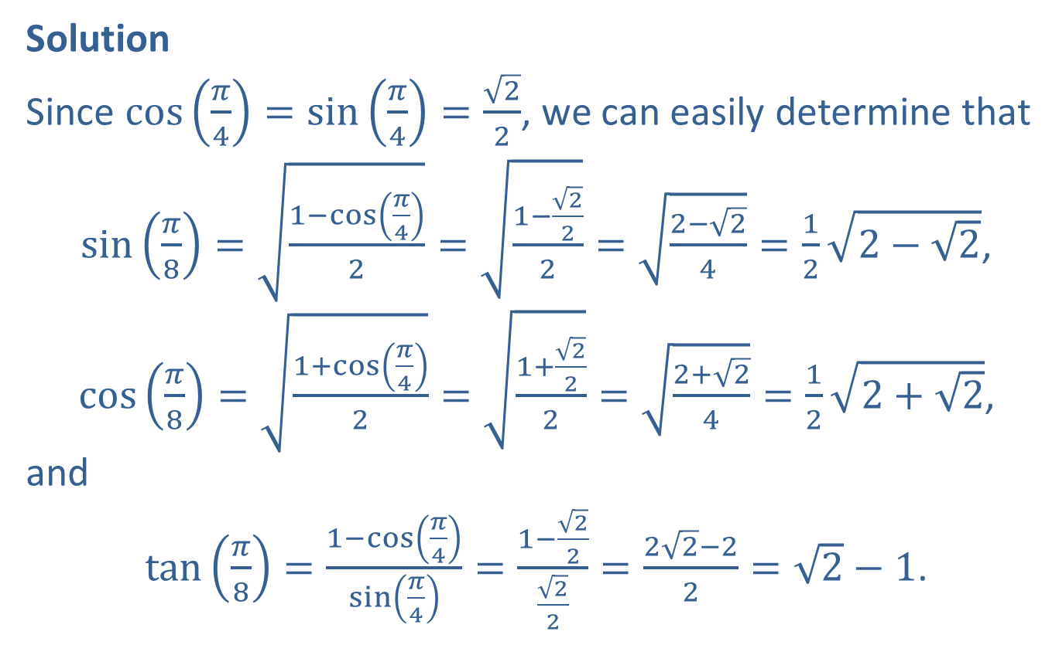
Example 4: Using the Half-Angle Identities (cont.)
Solution
Since $\cos\left(\frac{π}{4}\right)=\sin\left(\frac{π}{4}\right)=\frac{\sqrt{2}}{2}$, we can easily determine that
$\sin\left(\frac{π}{8}\right)=\sqrt{\frac{1−\cos\left(\frac{π}{4}\right)}{2}}=\sqrt{\frac{1−\frac{\sqrt{2}}{2}}{2}}=\sqrt{\frac{2−\sqrt{2}}{4}}=\frac{1}{2}\sqrt{2−\sqrt{2}}$,
$\cos\left(\frac{π}{8}\right)=\sqrt{\frac{1+\cos\left(\frac{π}{4}\right)}{2}}=\sqrt{\frac{1+\frac{\sqrt{2}}{2}}{2}}=\sqrt{\frac{2+\sqrt{2}}{4}}=\frac{1}{2}\sqrt{2+\sqrt{2}}$,
and
$\tan\left(\frac{π}{8}\right)=\frac{1−\cos\left(\frac{π}{4}\right)}{\sin\left(\frac{π}{4}\right)}=\frac{1−\frac{\sqrt{2}}{2}}{\frac{\sqrt{2}}{2}}=\frac{2\sqrt{2}−2}{2}=\sqrt{2}−1$.

Slide 17

Example 4: Using the Half-Angle Identities (cont.)
We could also have used the fact that $\tan{x}=\frac{\sin{x}}{\cos{x}}$ for the last calculation. Verifying that the two seemingly different answers obtained are actually equivalent is left to the reader.

Slide 18

Example 5: Using the Half-Angle Identities for Exact Evaluation
Determine the exact value of ${\cos{105}}^{°}$.

Slide 19
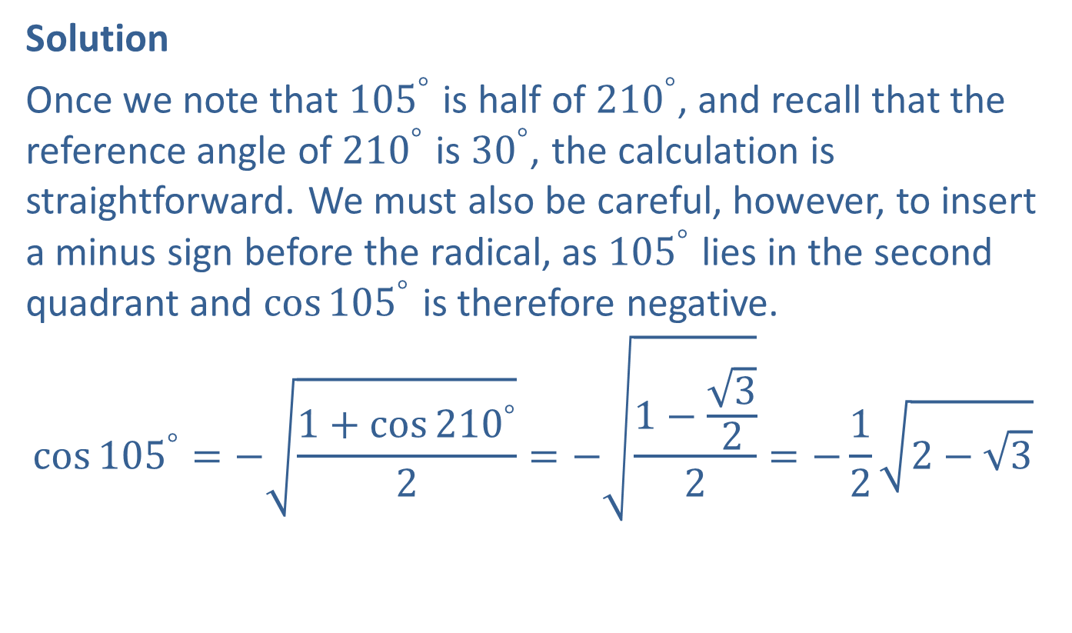
Example 5: Using the Half-Angle Identities for Exact Evaluation (cont.)
Solution
Once we note that ${105}^{°}$ is half of ${210}^{°}$, and recall that the reference angle of ${210}^{°}$ is ${30}^{°}$, the calculation is straightforward. We must also be careful, however, to insert a minus sign before the radical, as ${105}^{°}$ lies in the second quadrant and ${\cos{105}}^{°}$ is therefore negative.
$${\cos{105}}^{°}=−\sqrt{\frac{1+{\cos{210}}^{°}}{2}}=−\sqrt{\frac{1−\frac{\sqrt{3}}{2}}{2}}=−\frac{1}{2}\sqrt{2−\sqrt{3}}$$

Slide 20
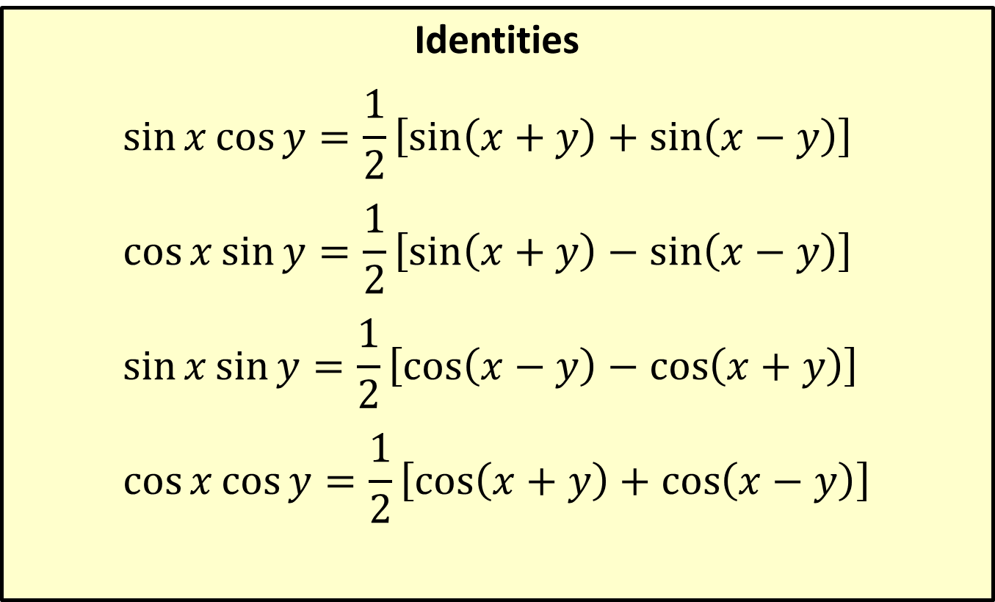
Product-to-Sum Identities
Identities
$$\sin{x}\cos{y}=\frac{1}{2}\left[\sin\left(x+y\right)+\sin\left(x−y\right)\right]$$
$$\cos{x}\sin{y}=\frac{1}{2}\left[\sin\left(x+y\right)−\sin\left(x−y\right)\right]$$
$$\sin{x}\sin{y}=\frac{1}{2}\left[\cos\left(x−y\right)−\cos\left(x+y\right)\right]$$
$$\cos{x}\cos{y}=\frac{1}{2}\left[\cos\left(x+y\right)+\cos\left(x−y\right)\right]$$

Slide 21

Example 6: Using the Product-to-Sum Identities
Express $\sin^{5}⁡x$ in terms containing only first powers of sine.

Slide 22
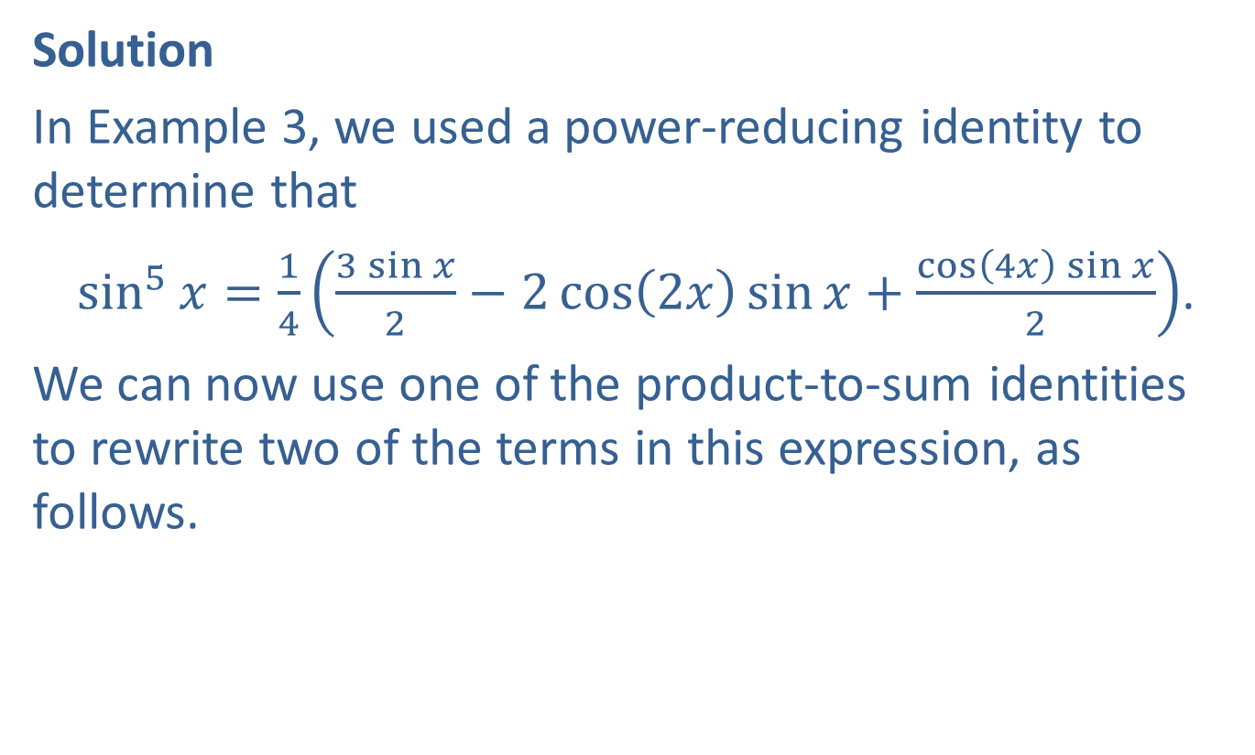
Example 6: Using the Product-to-Sum Identities (cont.)
Solution
In Example 3, we used a power-reducing identity to determine that
$\sin^{5}{x}=\frac{1}{4}\left(\frac{3\sin{x}}{2}−2\cos\left(2x\right)\sin{x}+\frac{\cos\left(4x\right)\sin{x}}{2}\right)$.
We can now use one of the product-to-sum identities to rewrite two of the terms in this expression, as follows.

Slide 23
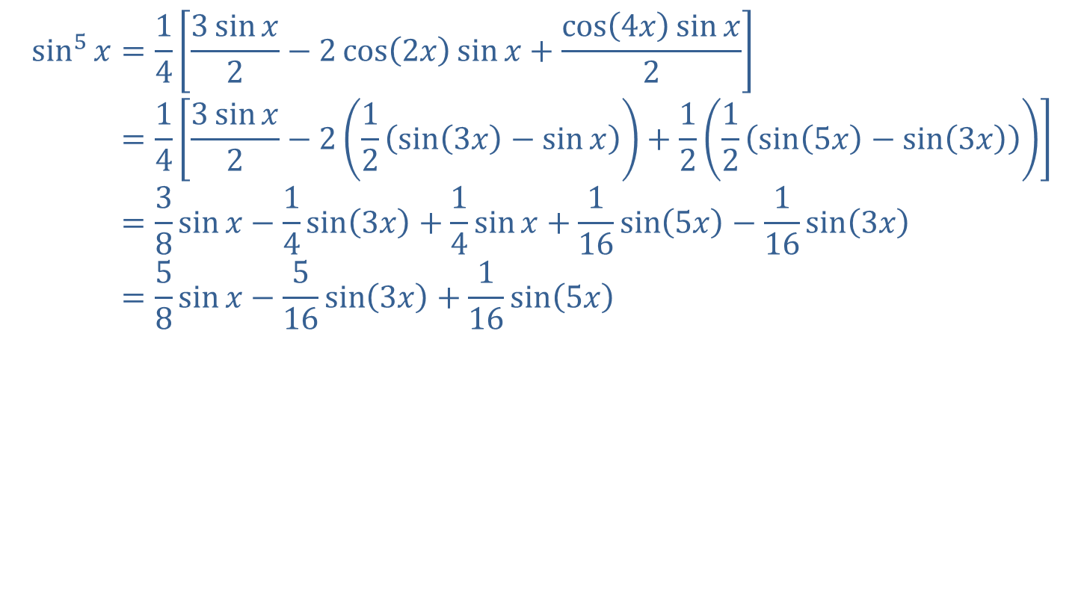
Example 6: Using the Product-to-Sum Identities (cont.)
sin5𝑥=143sin𝑥2−2cos2𝑥sin𝑥+cos4𝑥sin𝑥2sin⁡5⁡𝑥=143sin𝑥2−212sin3𝑥−sin𝑥+1212sin5𝑥−sin3𝑥sin⁡5⁡𝑥=38sin𝑥−14sin3𝑥+14sin𝑥+116sin5𝑥−116sin3𝑥sin⁡5⁡𝑥=58sin𝑥−516sin3𝑥+116sin5𝑥

Slide 24
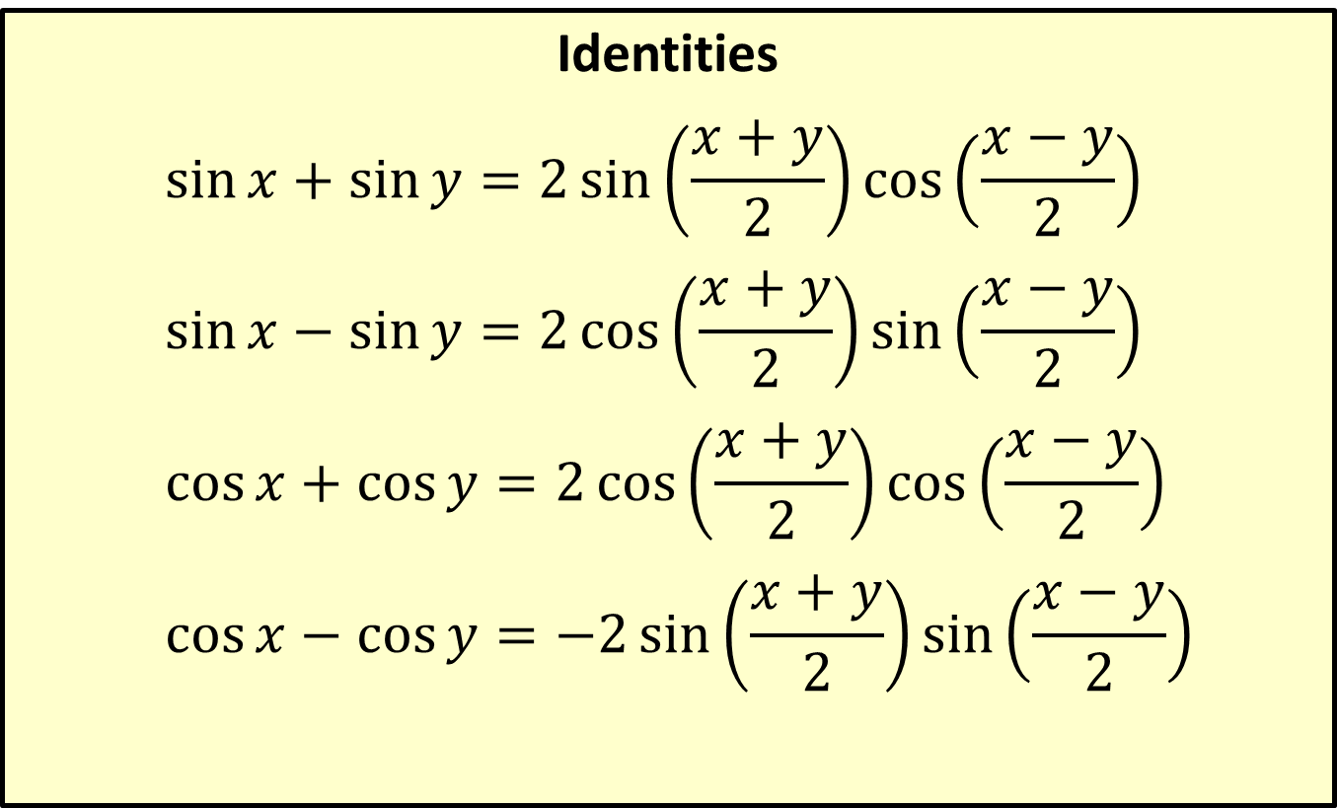
Sum-to-Product Identities
Identities
$$\sin{x}+\sin{y}=2\sin\left(\frac{x+y}{2}\right)\cos\left(\frac{x−y}{2}\right)$$
$$\sin{x}−\sin{y}=2\cos\left(\frac{x+y}{2}\right)\sin\left(\frac{x−y}{2}\right)$$
$$\cos{x}+\cos{y}=2\cos\left(\frac{x+y}{2}\right)\cos\left(\frac{x−y}{2}\right)$$
$$\cos{x}−\cos{y}=−2\sin\left(\frac{x+y}{2}\right)\sin\left(\frac{x−y}{2}\right)$$

Slide 25

Example 7: Using the Sum-to-Product Identities
Verify the identity $\frac{\sin\left(2x\right)+\sin\left(4x\right)}{\cos\left(2x\right)+\cos\left(4x\right)}=\tan\left(3x\right)$.

Slide 26
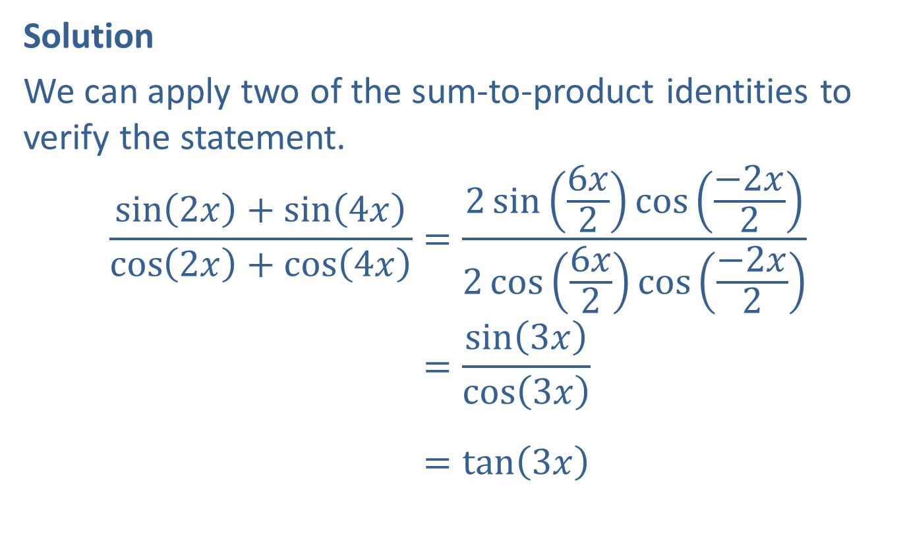
Example 7: Using the Sum-to-Product Identities (cont.)
Solution
We can apply two of the sum-to-product identities to verify the statement.
sin2𝑥+sin4𝑥cos2𝑥+cos4𝑥=2sin6𝑥2cos−2𝑥22cos6𝑥2cos−2𝑥2sin2𝑥𝑥sin4𝑥cos2𝑥+cos4𝑥=sin3𝑥cos3𝑥sin2𝑥𝑥sin4𝑥cos2𝑥+cos4𝑥=tan3𝑥

