Slide 1
Section 1.1
Reading and Writing Whole Numbers

Slide 2
Objectives
Know the values of the places for whole numbers in the decimal system.
Understand the concept of a place value number system.
Know the powers of ten.
Read and write whole numbers in the decimal system.

Slide 3
The Decimal System
Place Value System
The decimal system (or base ten system) is a place value system that depends on three things:
1. The ten digits: 0, 1, 2, 3, 4, 5, 6, 7, 8, 9;
2. The placement of each digit; and
3. The value of each place.

Slide 4
Example 1
954 (standard notation)
954
9 5 4
digits (standard notation)
100 10 1
place values
= 9(100) + 5(10) + 4(1)
= 900 + 50 + 4
(expanded notation)

Slide 5
Example 2
6507 (standard notation)
6 5 0 7
1000 100 10 1
6507
digits (standard notation)
place values
= 6(1000) + 5(100) + 0(10) + 7(1)
= 6000 + 500 + 0 + 7
(expanded notation)
[Note: The 0 is optional.]

Slide 6
Completion Example 3
Complete the expanded notation form of 32,081.
Solution:
32,081 = 30,000 + _______ + ________ + ________ + 1

Slide 7
Completion Example 4
Complete the expanded notation form of 497,500.
Solution:
497,500 = 400,000 + ______ + ______ + ______ + 0 + 0

Slide 8
Reading and Writing Whole Numbers
Whole Numbers
The whole numbers are the counting numbers and the number 0.
𝕎 = {0, 1, 2, 3, 4, 5, 6, 7, 8, 9, 10, 11, 12, 13, 14, 15, ...}

Slide 9
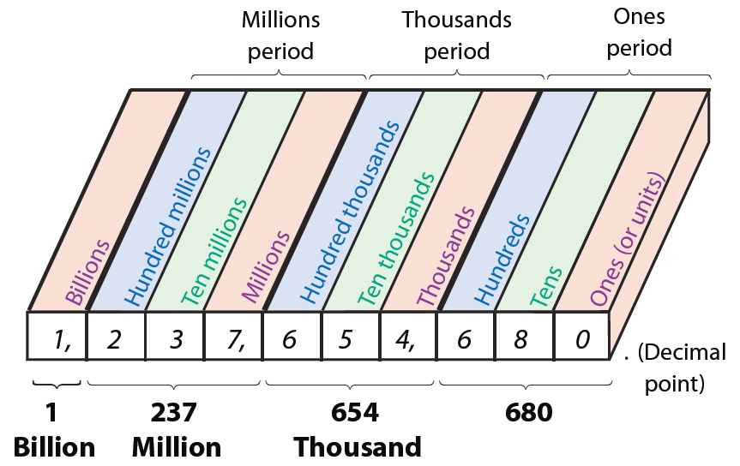
Reading and Writing Whole Numbers
Figure 1.2

Slide 10
Reading and Writing Whole Numbers
Reading and Writing Whole Numbers
You should note the following four things when reading or writing whole numbers:
1. Digits are read in groups of three. (See Figure 1.2.)
2. Commas are used to separate groups of three digits if a number has more than four digits.
3. The word and does not appear in English word equivalents. And is said only when reading a decimal point.

Slide 11
Reading and Writing Whole Numbers
Reading and Writing Whole Numbers (cont.)
4. Hyphens (-) are used to write English words for the two-digit numbers from 21 to 99 except for those that end in 0.

Slide 12
Example 5
653 (standard notation)
600 + 50 + 3 (expanded notation)
six hundred fifty-three (English word equivalent)

Slide 13
Example 6
75,900 (standard notation)
70,000 + 5000 + 900 + 0 + 0 (expanded notation)
seventy-five thousand, nine hundred (English word equivalent)

Slide 14
Completion Example 7
8407
8407 = 8000 + _______ + ________ + ________
eight thousand __________________

Slide 15
Completion Example 8
15,352
15,352 = 10,000 + ______ + ______ + ______ + _____
fifteen thousand,_______________________

Slide 16
Example 9
Write four hundred eighty thousand, five hundred thirty-three in standard notation.
Solution:
480,533

Slide 17
Example 10
Write five hundred seventy-two thousand, six hundred
in standard notation.
Solution:
572,600

Slide 18
Completion Example 11
Write two million, eight hundred thousand, thirty-five in standard notation.
Solution:
2,800, _________

Slide 19
Completion Example 12
Write five million, three hundred fifty thousand in standard notation.
Solution:
5, ______, _______

Slide 20
Practice Problems
1. Write the following numbers in expanded notation and in their English word equivalents.
a. 512 b. 6394
2. Write one hundred eighty thousand, five hundred forty-three in standard notation.

Slide 21
Practice Problem Answers

