Slide 1
Section 1.7
Problem Solving with Whole Numbers

Slide 2
Objectives
Realize that problem solving takes time and that the learning process also involves learning from making mistakes.
Know and understand the Basic Strategy for Solving Word Problems.
Be able to apply this strategy to problems involving Consumer Items, Checking Accounts, and Averages.

Slide 3
Strategy for Solving Word Problems
Note
If you are not exactly sure of what operations to use, at least try something. Even by making errors in technique or judgment you are learning what does not work. If you do nothing, then you learn nothing. Do not be embarrassed by mistakes.

Slide 4
Strategy for Solving Word Problems
Basic Strategy for Solving Word Problems
1. Read each problem carefully until you understand the problem and know what is being asked.
2. Draw any type of figure or diagram that might be helpful and decide what operations are needed.
3. Perform these operations.
4. Mentally check to see if your answer is reasonable and see if you can think of another more efficient or more interesting way to do the same problem.

Slide 5
Example 1: Consumer Items
Bill bought a car for $9000. The salesman added $540 for taxes and $150 for license fees. If Bill made a down payment of $3500 and financed the rest with his credit union, how much did he finance?
Solution
Find the total cost and subtract the down payment.
total cost
down payment
to be financed
total cost

Slide 6
Example 1: Consumer Items (cont.)
Bill financed $6190.
(Mental checking is difficult here. But you might think that if he paid about $10,000 and put down $3500, an answer around $6500 is reasonable.)

Slide 7
Example 2: Checking Accounts
In July, Ms. Smith opened a checking account and deposited $1528. She wrote checks for $132, $425, $196, and $350. What was her balance at the end of July?
Solution
To find the balance, find the sum of the checks and subtract the sum from $1528.

Slide 8
Example 2: Checking Accounts (cont.)
The balance was $425 at the end of July.
(Mentally round each check to the nearest hundred to see if the answer is reasonable.)
balance
total checks

Slide 9
Example 3
Chancellor Sporting Goods recorded its sales for tennis rackets for six months. They found their profits to be: January, $5380; February, $7590; March, $6410; April, $4530; May, $5840; June, $6250. On the next slide is a bar graph of their findings. a. In what month did they have the most sales of tennis rackets? b. What is the average sales per month over the six months?

Slide 10
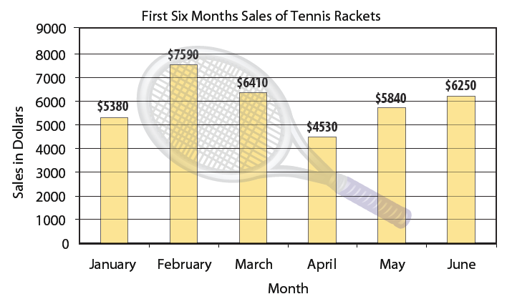
Example 3 (cont.)

Slide 11
Example 3 (cont.)
Solution
a. From the bar graph, we can see that the month with the most sales is February with $7590.
b. The average can be found by finding the sum of the numbers and dividing the sum by the number of numbers.

Slide 12
Example 3 (cont.)
(average)
The sum, 36,000, is divided by 6 because six numbers are being added. The average sales per month over six months is $6,000.

Slide 13
Example 4
Find the average of the three numbers 32, 47, and 23.
Solution
(average)
The sum, 102, is divided by 3 because three numbers are being added.

Slide 14
Example 5
Suppose five people had the following incomes for one year: $23,000; $24,000; $25,000; $26,000; $27,000. Find their average income.
Solution
The average income is $25,000.

Slide 15
Example 6
Suppose five people had the following incomes for one year: $8000; $8000; $8000; $8000; $93,000. Find their average income.
Solution
The average income is $25,000.

Slide 16
Example 7
On an English exam, two students score 95 points, five students score 86 points, one student scores 82 points, one student scores 78 points, and six students score
75 points. What is the mean score of the class?

Slide 17
Example 7 (cont.)
We multiply rather than write down all 15 scores. However, when the five products are added together, we divide the sum by 15 because the sum represents 15 scores.
mean score
The class mean is 82 points.

Slide 18
Practice Problems
1. David bought a new stereo which was originally priced at $120. He had a coupon which gave him $10 off the price of the stereo. He also bought three CDs at $15 apiece. How much did David pay overall for the stereo and CDs?
2. Mr. Morris opened a checking account and deposited $4000 in it. He wrote two checks for $175 each and one for $300. What was his balance after writing these checks?

Slide 19
Practice Problems (cont.)
3. The Lee family spent $238 on groceries in June, $207 in July and $218 in August. What was their average amount spent on groceries per month?

Slide 20
Practice Problem Answers
1. $155
2. $3350
3. $221

