Slide 1
Section 1.8
Geometry: Perimeter and Area

Slide 2
Objectives
Recognize the terms point, line, and plane and know that they are undefined terms.
Know what a polygon is.
Recognize and be able to define the geometric figures triangles, rectangles, and squares.
Understand the concepts of length and perimeter.
Understand the concept of area.

Slide 3

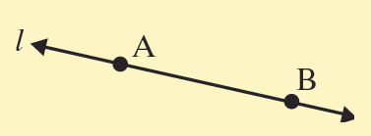

Introduction to Geometry
Undefined Term Representation Discussion
A dot represents a point. Points are labeled with capital letters.
1. Point
point A
A line has no beginning or end. Lines are labeled with small letters or by two points on the line.
2. Line

Slide 4
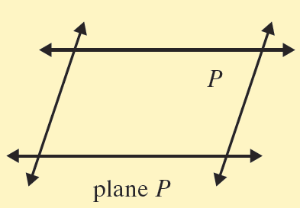
Introduction to Geometry
Undefined Term Representation Discussion
Flat surfaces, such as a table top or wall, represent planes. Planes are labeled with capital letters.
3. Plane

Slide 5
Polygons
Polygon
A polygon is a closed plane figure, with three or more sides, in which each side is a line segment.
(Each point where two sides meet is called a vertex.)
(Note: A closed figure begins and ends at the same point.)

Slide 6
Length and Perimeter
Perimeter
The perimeter, P, of a polygon is the sum of the lengths of its sides.

Slide 7
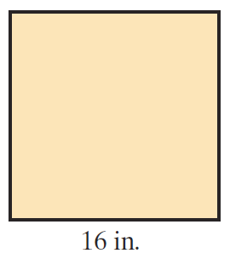
Example 1
Find the perimeter of the square shown.
Solution
Because the figure is a square, each side is 16 in. long. Thus the perimeter can be found as follows:
P
Or, by using the formula, we have
P
= 16 + 16 + 16 + 16
= 64 in.
= 4 ⋅ 16
= 64 in.

Slide 8
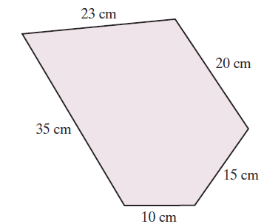
Example 2
Find the perimeter of the polygon shown.
(Note: A 5-sided polygon is called a pentagon.)
Solution
The perimeter of any polygon is found by adding the lengths of the sides. Thus, for this pentagon we have

Slide 9
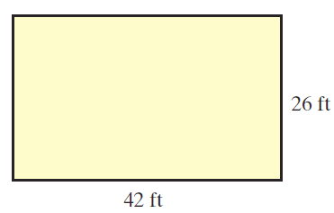
Example 3
Find the perimeter of the rectangle shown.
Solution
The perimeter can be found by adding the lengths of the sides. Thus,
Or, by using the formula we have,

Slide 10
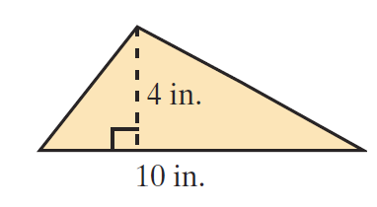
Example 4
Find the area of the triangle shown.
Solution
To find the area of the triangle, multiply the base times the height and divide by 2.

Slide 11
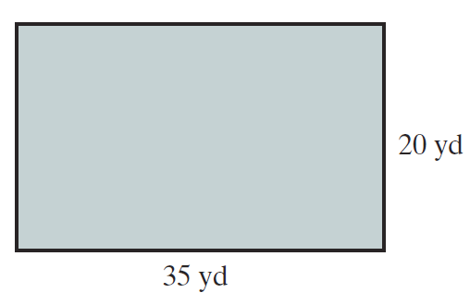
Example 5
Find the area of the rectangle shown.
Solution
To find the area of the rectangle, multiply the length times the width.

Slide 12
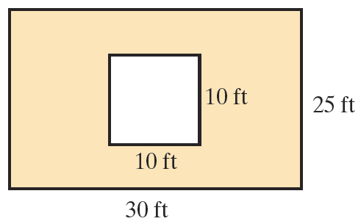
Example 6
A square is inside a rectangle as shown. Find the area of the shaded region.
Solution
To find the area of the shaded region:
First, find the area of the rectangle. Second, find the area of the square.
Third, find the difference of the two areas.
Area of shaded region
= 750 − 100
= 650 ft²

Slide 13
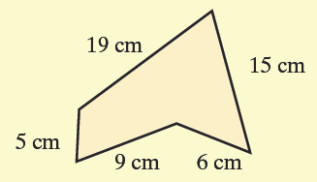
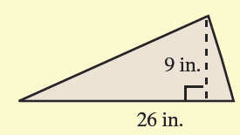
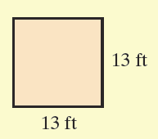
Practice Problems
1. Find the perimeter of the following figure.
2. Find the area of the following figures.
a. b.

Slide 14
Practice Problem Answers
1. 54 cm
2. a. 117 in.² b. 169 ft²

