Slide 1
Section 2.6
Least Common Multiple (LCM) with Applications

Slide 2
Objectives
Understand the meaning of the term least common multiple.
Use prime factorizations to find the least common multiple of a set of numbers.
Recognize the application of the LCM concept in a word problem.

Slide 3
Finding the LCM of a Set of Counting Numbers
Least Common Multiple
The Least Common Multiple (LCM) of a set of counting numbers is the smallest number common to all the sets of multiples of the given numbers.

Slide 4
Finding the LCM of a Set of Counting Numbers
Method I for Finding the LCM
To find the LCM of a set of counting numbers:
1. Find the prime factorization of each number.
2. Find the prime factors that appear in any one of the prime factorizations.
3. Form the product of these primes using each prime the most number of times it appears in any one of the prime factorizations.

Slide 5
Example 1
Find the LCM of 20 and 45.
Solution
a. Prime factorizations:
b. 2, 3, and 5 are the only prime factors.
two 2’s, one 5
two 3’s, one 5

Slide 6
Example 1 (cont.)
c. Most of each factor in any one factorization:
two 2’s (in 20)
two 3’s (in 45)
one 5 (one in 30 and one in 45)
180 is the smallest number divisible by both 20 and 45. (Note also that the LCM, 180, contains all the factors of the numbers 20 and 45.)

Slide 7
Example 2
Find the LCM of 12, 18, and 48.
Solution
a. Prime factorizations:

Slide 8
Example 2 (cont.)
b. The only prime factors that appear are 2 and 3.
c. There are four 2’s in 48 and two 3’s in 18.
Thus the product 2⁴ ⋅ 3² = 144 is the least common multiple.

Slide 9
Example 3
Find the LCM of 27, 30, and 42.
Solution

Slide 10
Completion Example 4
Find the LCM of 36, 24, and 48.
Solution
a. Prime factorizations:
36 = _____________
24 = _____________
48 = _____________
b. _____ and _____ are the only prime factors.
2 ⋅ 2 ⋅ 3 ⋅ 3
2 ⋅ 2 ⋅ 2 ⋅ 3
2 ⋅ 2 ⋅ 2 ⋅ 2 ⋅ 3
2
3

Slide 11
Completion Example 4 (cont.)
c. Most of each factor in any one factorization:
__________ (in 48)
__________ (in 36)
LCM = ______________ = _______ = 144
_______ is the smallest number divisible by all the numbers 36, 24, and 48.
4 2’s
2 3’s
2 ⋅ 2 ⋅ 2 ⋅ 2 ⋅ 3 ⋅ 3
2⁴ ⋅ 3²
144

Slide 12
Finding the LCM of a Set of Counting Numbers
Method II for Finding the LCM
To find the LCM of a set of counting numbers:
1. Write the numbers horizontally and find a prime number that will divide into more than one number, if possible.
2. Divide by that prime and write the quotients beneath the dividends. Rewrite any numbers not divided beneath themselves.

Slide 13
Finding the LCM of a Set of Counting Numbers
Method II for Finding the LCM (cont.)
3. Continue the process until no two numbers have a common prime divisor.
4. The LCM is the product of all the prime divisors and the last set of quotients.

Slide 14
Example 5
Find the LCM of 20, 25, 18, and 6.
Solution

Slide 15
Example 6
Find the LCM of 15, 49, and 35.
Solution

Slide 16
Example 7
Find the LCM for 27, 30, and 42, and tell how many times each number divides into the LCM.
Solution

Slide 17
Example 7
1890
= 2 ⋅ 3 ⋅ 3 ⋅ 3 ⋅ 5 ⋅ 7
= (3 ⋅ 3 ⋅ 3) ⋅ (2 ⋅ 5 ⋅ 7)
= 27 ⋅ 70
1890
= 2 ⋅ 3 ⋅ 3 ⋅ 3 ⋅ 5 ⋅ 7
= (2 ⋅ 3 ⋅ 5) ⋅ (3 ⋅ 3 ⋅ 7)
= 30 ⋅ 63

Slide 18
Example 7 (cont.)
So 27 divides into 1890 70 times;
30 divides into 1890 63 times;
42 divides into 1890 45 times.
1890
= 2 ⋅ 3 ⋅ 3 ⋅ 3 ⋅ 5 ⋅ 7
= (2 ⋅ 3 ⋅ 7) ⋅ (3 ⋅ 3 ⋅ 5)
= 42 ⋅ 45

Slide 19
Example 8
Find the LCM for 12, 18, and 66, and tell how many times each number divides into the LCM.
Solution

Slide 20
Example 8
396
= 2 ⋅ 2 ⋅ 3 ⋅ 3 ⋅ 11
= (2 ⋅ 2 ⋅ 3) ⋅ (3 ⋅ 11)
= 12 ⋅ 33
396
= 2 ⋅ 2 ⋅ 3 ⋅ 3 ⋅ 11
= (2 ⋅ 3 ⋅ 3) ⋅ (2 ⋅ 11)
= 18 ⋅ 22

Slide 21
Example 8 (cont.)
396
= 2 ⋅ 2 ⋅ 3 ⋅ 3 ⋅ 11
= (2 ⋅ 3 ⋅ 11) ⋅ (2 ⋅ 3)
So 12 divides into 396 33 times;
18 divides into 396 22 times;
66 divides into 396 6 times.
= 66 ⋅ 6

Slide 22
Completion Example 9
a. Find the LCM of 30, 50, and 63.
b. State the number of times each number divides into the LCM.
Solution
a.
2 ⋅ 3 ⋅ 5
2 ⋅ 3 ⋅ 3 ⋅ 5 ⋅ 5 ⋅ 7
2 ⋅ 5 ⋅ 5
2 ⋅ 3² ⋅ 5² ⋅ 7
3 ⋅ 3 ⋅ 7

Slide 23
Completion Example 9 (cont.)
b.
3150 = ______________ = (2 ⋅ 3 ⋅ 5) ⋅ (________)
= 105 ⋅ ______
3150 = ______________ = (2 ⋅ 5 ⋅ 5) ⋅ (________)
= 63 ⋅ ______
3150 = ______________ = (3 ⋅ 3 ⋅ 7) ⋅ (________)
= 50 ⋅ ______
2 ⋅ 3 ⋅ 3 ⋅ 5 ⋅ 5 ⋅ 7
3 ⋅ 5 ⋅ 7
30
2 ⋅ 3 ⋅ 3 ⋅ 5 ⋅ 5 ⋅ 7
3 ⋅ 3 ⋅ 7
50
2 ⋅ 3 ⋅ 3 ⋅ 5 ⋅ 5 ⋅ 7
2 ⋅ 5 ⋅ 5
63

Slide 24
Example 10: An Application
Suppose three weather satellites − A, B, and C − are orbiting the earth. Satellite A takes 18 hours, B takes 14 hours, and C takes 10 hours. If they are directly above each other now, as shown in part (a) of the figure on the next slide, in how many hours will they again be directly above each other in the positions shown in part (a) of the figure?

Slide 25
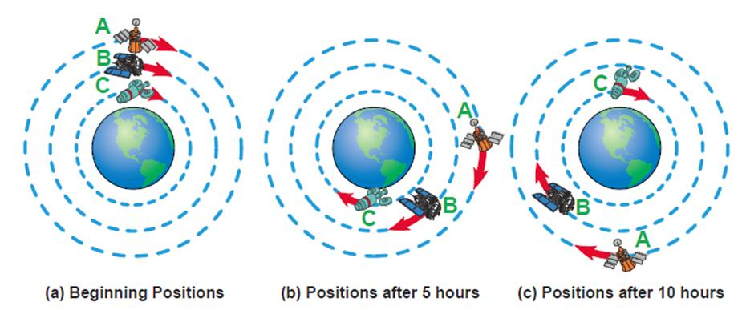
Example 10: An Application (cont.)
Solution
Note that when the three satellites are in this position again, each one will have made some number of complete orbits.

Slide 26
Example 10: An Application (cont.)
Since satellite A takes 18 hours to make one complete orbit of the earth, our solution must be a multiple of 18. Similarly, our solution must also be a multiple of 14 and a multiple of 10 to account for the complete orbits of satellites B and C.
The LCM of 18, 14, and 10 will tell us the next time satellites A, B, and C will all complete an orbit at the same time.

Slide 27
Example 10: An Application (cont.)
Thus the satellites will not align again for 630 hours (or 26 days and 6 hours).
Note:
Satellite A will have made 35 orbits, since 630 = 18 ⋅ 35.
Satellite B will have made 45 orbits, since 630 = 14 ⋅ 45.
Satellite C will have made 63 orbits, since 630 = 10 ⋅ 63.

Slide 28
Completion Example 11
The problem stated in Mathematics at Work! at the beginning of this chapter is similar to Example 10. Only the orbiting times of the satellites are different. Redraw the figures from Example 10 here. In how many hours will they again be directly above each other in the positions shown in the first figure? How many orbits will each satellite have completed at that time?

Slide 29
Completion Example 11 (cont.)
Solution
They will be in the original position in _____ hours.
Satellite A will have made _____ orbits.
Satellite B will have made _____ orbits.
Satellite C will have made _____ orbits.
72
3
4
6

Slide 30
Practice Problems
Find the LCM for each of the following sets of numbers.
1. 30, 40, 50
2. 28, 70
3. 168, 140

Slide 31
Practice Problem Answers
1. 600
2. 140
3. 840

