Slide 1
Section 3.1
Basic Multiplication and Changing to Higher Terms

Slide 2
Objectives
Know the terms numerator and denominator.
Learn two meanings of fractions: to indicate equal parts of a whole and to indicate division.
Understand why no denominator can be 0.
Learn how to multiply fractions.
Determine what to multiply by in order to build a fraction to higher terms.

Slide 3
Introduction to Fractions (or Rational Numbers)
Rational Numbers
A rational number is a number that can be written in
the fraction form where a is a whole number and b is
a nonzero whole number.
Note: The numerator a can be 0, but the denominator b cannot be 0.
numerator
denominator

Slide 4
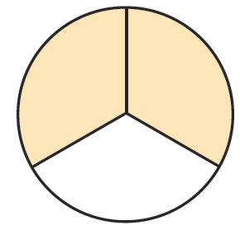
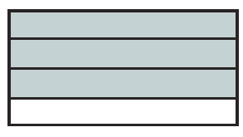
Example 1
a.
In the circle, 2 of the 3 equal
parts are shaded. Thus of the
circle is shaded and is not shaded.
In the rectangle, 3 of the 4 equal parts are shaded. Thus of
the rectangle is shaded and is not shaded.
b.

Slide 5
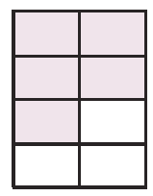
Example 1 (cont.)
c.
In the rectangle, 5 of the 8 equal parts
are shaded. Thus of the rectangle is
shaded and is not shaded.

Slide 6
Introduction to Fractions (or Rational Numbers)
Fractions
A fraction is a proper fraction if the numerator is less than the denominator.
A fraction is an improper fraction if the numerator is equal to or greater than the denominator.

Slide 7
Introduction to Fractions (or Rational Numbers)
Fractions can be used in two basic ways
1. To indicate equal parts of a whole.
2. To indicate division. (The numerator is to be divided by the denominator.)

Slide 8
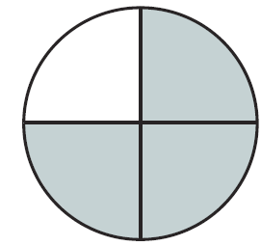
Example 2
indicates 3 of 4 equal parts.

Slide 9
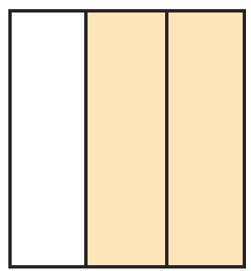
Example 3
indicates 2 of 3 equal parts.

Slide 10
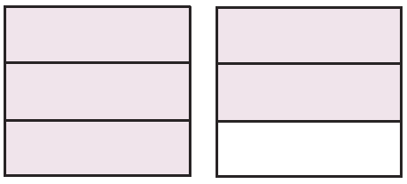
Example 4
indicates 5 of 3 equal parts (more than a whole).

Slide 11
Introduction to Fractions (or Rational Numbers)
Division by 0 is Undefined
Consider Then we must have But this
is impossible because Therefore,
is undefined.

Slide 12
Introduction to Fractions (or Rational Numbers)
Division by 0 is Undefined (cont.)
is Undefined
Next, consider Then we must have
But is true for any value of and in arithmetic, an operation such as division cannot give
more than one answer. So we agree that is undefined.
Thus is undefined for any value of a.

Slide 13
Example 5

Slide 14
Example 6

Slide 15
Multiplying Fractions
To Multiply Fractions
1. Multiply the numerators.
2. Multiply the denominators.

Slide 16
Multiplying Fractions
Special Note about Fractions
We know that any whole number a can be considered
as a fraction with denominator 1; that is
Similarly, any fraction can be considered to be the product of a whole number and a fraction; that is,

Slide 17
Multiplying Fractions
Special Note about Fractions (cont.)
This idea will be helpful throughout the text in understanding how various forms of whole numbers, fractions, mixed numbers, and decimal numbers are related. For example,

Slide 18
Example 7
Find the product of
Solution
This product can be illustrated graphically. We can think
of the multiplication as finding

Slide 19
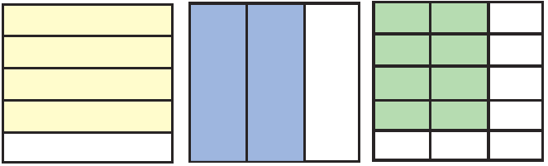
Example 7 (cont.)

Slide 20
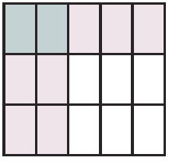
Example 8
Find the product of illustrate the product as in
Example 7 by shading parts of a square.
Solution

Slide 21
Completion Example 9
Find the following products.

Slide 22
Multiplying Fractions
Commutative Property of Multiplication
If are fractions, then

Slide 23
Multiplying Fractions
Associative Property of Multiplication
If are fractions, then

Slide 24
Example 10
Illustrates the commutative
property of multiplication.

Slide 25
Example 11
Illustrates the associative
property of multiplication.

Slide 26
Changing Fractions to Higher Terms
Multiplicative Identity
The number 1 is called the multiplicative identity, and
for any fraction

Slide 27
Changing Fractions to Higher Terms
To Change a Fraction to Higher Terms
Multiply the numerator and denominator by the same nonzero whole number.

Slide 28
Example 12
Suppose we want to find a fraction equal to with a denominator of 28.
We know 4 ⋅ 7 = 28,

Slide 29
Example 13
Suppose we want to find a fraction equal to with a denominator of 30.
Since 10 ⋅ 3 = 30,

Slide 30
Example 14
Suppose we want to find a fraction equal to with a denominator of 32.
Since 8 ⋅ 4 = 32,

Slide 31
Example 15
Since 8 ⋅ 5 = 40,

Slide 32
Completion Example 16
Find a fraction with denominator 35 equal to
21

Slide 33
Completion Example 17
Find a fraction with denominator 28 equal to
42

Slide 34
Example 18
In a certain voting district, of the eligible voters are
actually registered to vote. Of these registered voters, are independents (have no party affiliation). What fraction of the eligible voters are registered independents?

Slide 35
Example 18 (cont.)
Thus of the eligible voters are registered as
independents.
Solution
Since the independents are a fraction of the eligible voters, we multiply:

Slide 36
Practice Problems
Find the products.

Slide 37
Practice Problem Answers

