Slide 1
Section 4.3
Addition with Mixed Numbers

Slide 2
Objectives
Know how to add mixed numbers when the fraction parts have the same denominator.
Know how to add mixed numbers when the fraction parts have different denominators.
Be able to write the sum of mixed numbers in the form of a mixed number with the fraction part less than 1.

Slide 3
Addition with Mixed Numbers
To Add Mixed Numbers
1. Add the fraction parts.
2. Add the whole numbers.
3. Write the sum as a mixed number so that the fraction part is less than 1. (If the sum of the fraction parts is more than 1, rewrite it as a mixed number and add it to the sum of the whole numbers.)

Slide 4
Example 1
Find the sum:
Solution
We can write each number as a sum and then use the commutative and associative properties of addition to treat the whole numbers and fraction parts separately.

Slide 5
Example 1 (cont.)

Slide 6
Example 2
Solution

Slide 7
Example 2 (cont.)
Or, vertically,

Slide 8
Example 3
Add the mixed numbers:
Solution
Fraction part is greater than 1.
Change it to a mixed number.

Slide 9
Example 4
A triangle has sides measuring meters, meters,
and meters.
a. Find the perimeter of (total distance around) the triangle.
b. Find the area of the triangle if the height of the
triangle is meters and the base is meters.

Slide 10
Example 4 (cont.)
Solution
a. We find the perimeter by adding the lengths of the three sides.

Slide 11
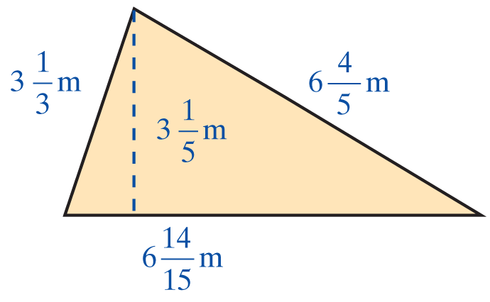
Example 4 (cont.)
The perimeter is meters.

Slide 12
Example 4 (cont.)
b. Let the meters and the meters.
To find the area of the triangle, multiply the base times the height and divide by 2.

Slide 13
Example 4 (cont.)
Thus the area of the triangle is square meters.

Slide 14
Practice Problems
Find the indicated sums. Write the answer as a mixed number.
1. 2. 3.
4. 5.

Slide 15
Practice Problem Answers
1. 2.
3. 4.
5.

