Slide 1
Section 5.1
Introduction to Decimal Numbers

Slide 2
Objectives
Learn to read and write decimal numbers.
Know the importance of and in reading and writing decimal numbers.
Understand that th at the end of a word indicates a fraction.
Know how to round a decimal number to an indicated place of accuracy.

Slide 3
Introduction to Decimal Numbers
Reading and Writing Decimal Numbers
1. Read (or write) the whole number.
2. Read (or write) the word and in place of the decimal point when written between two digits.
3. Read (or write) the fraction part as a whole number with the name of the place of the last digit on the right.

Slide 4
Example 1
Write the mixed number in decimal notation and in words.
Solution
And indicates the decimal point; the digit 6 is in the tenths position.
in decimal notation
in words

Slide 5
Example 2
Write the mixed number decimal notation and in words.
Solution
And indicates the decimal point; the digit 8 is in the thousandths position.
5
3 9 8
in decimal notation
in words

Slide 6
Example 3
Write the mixed number in decimal notation and in words.
Solution
And indicates the decimal point; the digit 5 is in the ten-thousandths position.
Two 0’s must be inserted as placeholders.
in decimal notation
in words

Slide 7
Introduction to Decimal Numbers
Special Notes
1. The letters th at the end of a word indicate a fraction part (a part to the right of the decimal point).
six hundred = 600
six hundredths = 0.06
2. The hyphen (-) indicates one word.
four hundred thousand = 400,000
four hundred-thousandths = 0.00004

Slide 8
Example 4
Write seventeen thousandths in decimal notation.
Solution
0. 0 1 7
0 is inserted as placeholder
The digit 7 is in the thousandths position.

Slide 9
Example 5
Write six hundred and five thousandths in decimal notation.
Solution
6 0 0 . 0 0 5
Two 0’s are inserted as placeholders.
The digit 5 is in the thousandths position.

Slide 10
Example 6
Write six hundred five thousandths in decimal notation.
Solution
0.605

Slide 11
Introduction to Decimal Numbers
Note
As a safety measure when writing a check, the amount is written in number form and in word form to avoid problems of spelling and poor penmanship. If there is a discrepancy between the number and the written form, the bank will honor the written form. (See Example 7.)

Slide 12
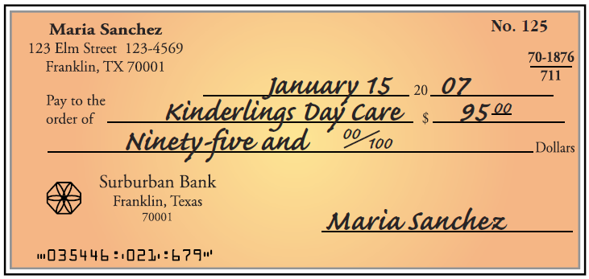
Example 7
When writing a check, the written form of the amount is written on the line next to “Dollars” in decimal notation. This check is written for $95.

Slide 13
Rounding Decimal Numbers
Rules for Rounding Decimal Numbers
(to the right of the decimal point)
1. If the digit to the right of the given place value is less than 5: leave the digit in the given place as is and drop the remaining digits.
2. If the digit to the right of the given place value is 5 or more: increase the digit in the given place value by 1 and drop the remaining digits.

Slide 14
Rounding Decimal Numbers
Rules for Rounding Decimal Numbers
(to the right of the decimal point) (cont.)
(Important Reminder: In rounding whole numbers, digits to the left of the decimal point that are dropped must be replaced by 0’s.)

Slide 15
Example 8
Round 6.749 to the nearest tenth.
Solution
a. 6 . 7 4 9
b. Because 4 is less than 5, leave 7 as it is and drop 4 and 9.
c. Thus, 6.749 rounds to 6.7 (to the nearest tenth).
7 is in the tenths position.
The next digit is 4.

Slide 16
Example 9
Round 13.73962 to the nearest thousandth.
Solution
a. 1 3 . 7 3 9 6 2
9 is in the thousandths position. The next digit is 6.
b. Because 6 is greater than 5, increase 9 by 1 and drop 6 and 2.

Slide 17
Example 9 (cont.)
c. Thus, 13.73962 rounds to 13.740 (to the nearest thousandth).
(Note carefully that increasing 9 by 1 gives 10 and this affects the digit 3 as well. Think of 39 becoming 40.)

Slide 18
Completion Example 10
Round 8.00241 to the nearest ten-thousandth.
Solution
a. The digit in the ten-thousandths position is _____.
b. The next digit to the right is _____.
c. Because _____ is less than 5, leave _____ as it is and drop the _____.
d. Thus, 8.00241 rounds to __________ (to the nearest _____________ ).
4
1
1
4
1
8.0024
ten-thousandth

Slide 19
Completion Example 11
Round 7361 to the nearest hundred.
Solution
a. The decimal point is understood to be to the right of _____.
b. The digit in the hundreds position is _____.
c. The next digit to the right is _____.
d. Because _____ is more than 5, increase _____ by 1 and replace ____ and ____ with 0’s.
e. Thus, 7361 rounds to ________ (to the nearest hundred).
1
3
6
6
3
6
1
7400

Slide 20
Practice Problems
1. Write 20.7 in words.
2. Write 18.051 in words.
3. Write in decimal notation.
4. Write eight hundred and three tenths in decimal notation.
Round as indicated.
5. 572.3 (to the nearest ten)
6. 6.749 (to the nearest tenth)

Slide 21
Practice Problems (cont.)
7. 7558 (to the nearest thousand)
8. 0.07961 (to the nearest thousandth)
9. A penny dated anytime from 1959 through 1982 had an original weight of 3.11 grams. A penny dated 1983 or later had an original weight of 2.5 grams. Write the numbers representing weights in words.

Slide 22
Practice Problem Answers
1. twenty and seven tenths
2. eighteen and fifty-one thousandths
3. 4.06
4. 800.3
5. 570
6. 6.7
7. 8000
8. 0.080
9. three and eleven hundredths; two and five tenths

