Slide 1
Section 5.5
Decimals and Fractions

Slide 2
Objectives
Know how to change decimal numbers to fraction form and/or mixed number form.
Know how to change fractions and mixed numbers to decimal form.
Recognize both terminating and non-terminating decimals.
Understand that working with decimals and fractions in the same problem may involve rounded numbers and approximate answers.

Slide 3
Changing from Decimals to Fractions
Changing from Decimals to Fractions
A finite (or terminating) decimal number can be written in fraction form by writing a fraction with the following:
1. A numerator that consists of the whole number formed by all the digits of the decimal number, and
2. A denominator that is the power of ten that names the position of the rightmost digit.

Slide 4
Example 1
hundredths

Slide 5
Example 2
hundredths

Slide 6
Example 3
thousandths

Slide 7
Example 4
thousandths

Slide 8
Example 5
or, as a mixed number,
tenths

Slide 9
Example 6
or, as a mixed number,
hundredths

Slide 10
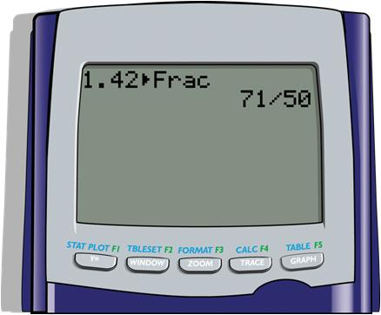


Example 6 (cont.)
To use the TI-84 Plus calculator to change a decimal to a fraction, follow the steps given below.
Step 1: Enter 1.42.
Step 2: Press .
Step 3: Press .
To the right is the display after
pressing enter.

Slide 11
Changing from Fractions to Decimals
Changing from Fractions to Decimals
We have seen that fractions indicate parts of a whole and that fractions indicate division. To change a fraction to decimal form, we use the meaning that the numerator is to be divided by the denominator.
1. If the remainder is 0, the decimal is said to be terminating.
2. If the remainder is not 0, the decimal is said to be non-terminating.

Slide 12
Example 7

Slide 13
Example 8

Slide 14
Example 9

Slide 15
Example 10
The 3 will repeat without end.
Continuing to divide will give a remainder of 1 each time.
The three dots mean “and so on” or to continue without stopping.

Slide 16
Example 11
The 3 will repeat without end.
Continuing to divide will give a remainder of 4 each time

Slide 17
Example 12
The six digits will repeat in the same pattern without end.
The remainder will repeat in sequence 1, 3, 2, 6, 4, 5, 1, and so on. Therefore, the digits in the quotient will also repeat in sequence.

Slide 18
Example 13

Slide 19
Example 14

Slide 20
Operating with Both Fractions and Decimals
Note
In some cases changing the all of the fractions to decimal form may involve rounding the decimal form of a number and settling for an approximate answer. To have a more accurate answer, we may need to change the decimals to fraction form and then perform the operations.

Slide 21
Example 15
Find the sum in decimal form.
Solution

Slide 22
Example 16
Determine whether is larger than 0.18 by changing
to decimal form and then comparing the two
numbers. Find the difference.
Solution
Divide first.

Slide 23
Example 16 (cont.)

Slide 24
Example 16 (cont.)
Now subtract.
Thus is larger than 0.18 and their difference is
0.0075.
difference

Slide 25
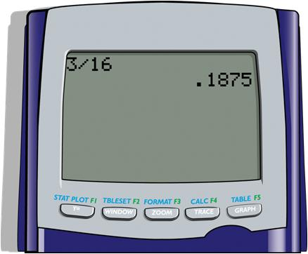
Example 16 (cont.)
To use the TI-84 Plus calculator to change to a
decimal, enter the fraction in the calculator and press
. The display will be as follows:

Slide 26
Practice Problems
Convert the following to fraction form.
1. 0.475 2. 2.9
3. 0.003 4. 1.17
Convert the following to decimal form. Write repeating decimals using bar notation.

Slide 27
Practice Problem Answers

