Slide 1
Section 5.6
Square Roots and the Pythagorean Theorem

Slide 2
Objectives
Memorize the squares of the whole numbers from 1 to 20.
Understand the terms square root, radical sign, radicand, and radical.
Memorize the perfect square whole numbers from 1 to 400.
Know how to use a calculator to find square roots.
Understand the terms right triangle, hypotenuse, and leg.
Know and be able to use the Pythagorean Theorem.

Slide 3
Example 1
Use your memory of the results in Tables 5.2 and 5.3 to answer the following
Solution

Slide 4




Example 2
Use a calculator to find accurate to four decimal places.
Solution
Step 1: Press the key.
Step 2: Press the key (the radical symbol is above the x² key).
Step 3: Enter the number 2.
Step 4: Press the right parenthesis key .
Step 5: Press .

Slide 5
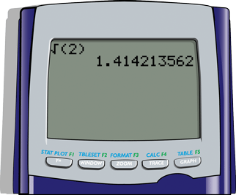
Example 2 (cont.)
The window will appear as follows with the result.
(Note: The right parenthesis is optional. The calculator will give the result with or without the right parenthesis.)
The display shows 1.414213562.
Thus accurate to four places.

Slide 6

Example 3
Find accurate to four decimal places.
Solution
Following the steps as in Example 2 gives:
The display shows 4.242640687.
Thus accurate to four places.

Slide 7
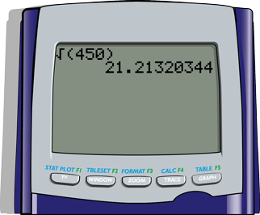
Example 4
Find accurate to four decimal places.
Solution
Following the steps as in Example 2 gives:
The display shows 21.21320344.
Thus accurate to four places.

Slide 8
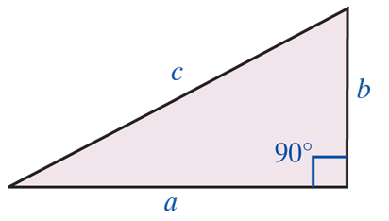
The Pythagorean Theorem
The Pythagorean Theorem
In a right triangle, the square of the hypotenuse is equal to the sum of the squares of the two legs:

Slide 9
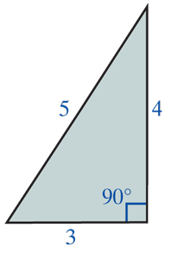
Example 5
Show that a triangle with sides of 3 inches, 4 inches, and 5 inches must be a right triangle.
Solution
If the triangle is a right triangle, then its three sides must satisfy the property stated in the
Pythagorean Theorem: c² = a² + b². Or, in
this case, 5² = 3² + 4². Since 25 = 9 + 16 is
a true statement, the triangle is a right
triangle.

Slide 10
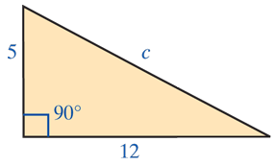
Example 6
Find the length of the hypotenuse of a right triangle with legs of length 12 cm and 5 cm.
Solution
Let c = the length of the hypotenuse.
Now, by the Pythagorean Theorem,
The length of the hypotenuse is 13 centimeters.

Slide 11
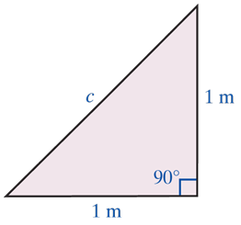
Example 7
Find the length of the hypotenuse of a right triangle in which both legs have a length of 1 meter.
Solution
The length of the hypotenuse is meters (or about 1.41 meters).

Slide 12
Example 8
A guy wire is attached to the top of a telephone pole and anchored to the ground 10 feet from the base of the pole. If the pole is 20 feet high, what is the length of the guy wire?
Solution
Let x = the length of the guy wire.
Then, by the Pythagorean Theorem,

Slide 13
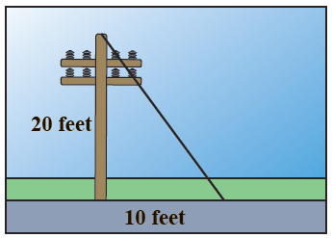
Example 8 (cont.)
The guy wire is about 22.36 feet long.

Slide 14
Practice Problems
Find the following values using your memory of
Tables 5.2 and 5.3.
Use a calculator to find the following accurate to four decimal places.

Slide 15
Practice Problems (cont.)
Determine whether triangles with the following side lengths are right triangles.

Slide 16
Practice Problem Answers
1. 18 2. 64
3. 361 4. 11
5. 9.4340 6. 4.1231
7. No 8. Yes

