Slide 1
Section 6.5
Geometry: Angles and Triangles

Slide 2
Objectives
Know the definition of a ray and an angle.
Learn how to classify an angle by its measure as acute, right, obtuse, or straight.
Know the meanings of the terms complementary angles and supplementary angles.
Learn how to classify a triangle by its sides: scalene, isosceles, or equilateral.
Learn how to classify a triangle by its angles: acute, right, or obtuse.

Slide 3
Objectives (cont.)
Know the following two important statements about any triangle:
a. The sum of the measures of the angles is 180°.
b. The sum of the lengths of any two sides must be greater than the length of the third side.
Know that in similar triangles:
a. Corresponding angles have the same measure.
b. Corresponding sides are proportional.

Slide 4
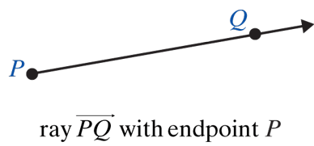
Measuring Angles
Ray and Angle
Term Definition Illustration
Ray
A ray consists of a point (called the endpoint) and all the points on a line on one side of that point.

Slide 5
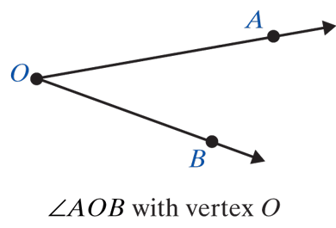
Measuring Angles
Ray and Angle (cont.)
Term Definition Illustration
Angle
An angle consists of two rays with a common endpoint (called a vertex).

Slide 6
Measuring Angles
Labeling Angles
Three common ways of labeling angles (Figure on next slide) are:
1. Using three capital letters with the vertex as the middle letter.
2. Using single numbers such as 1, 2, 3.
3. Using the single capital letter at the vertex when the meaning is clear.

Slide 7
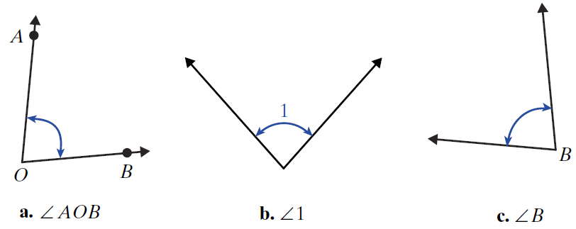
Measuring Angles
Three ways of labeling angles

Slide 8
Classifying Angles
Note
We will use the two inequality symbols
< (read “is less than”)
> (read “is greater than”)
to indicate the relative sizes of the measures of angles.

Slide 9
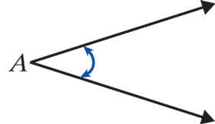
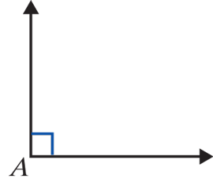
Classifying Angles
Angles Classified by Measure
Name Measure Illustration
1. Acute
∠A is an acute angle.
2. Right
∠A is a right angle.

Slide 10
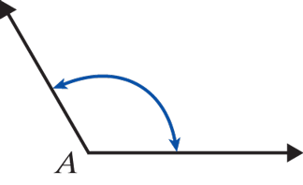

Classifying Angles
Angles Classified by Measure (cont.)
Name Measure Illustration
3. Obtuse
∠A is an obtuse angle.
The rays are in opposite directions. ∠A is a straight angle.
4. Straight

Slide 11
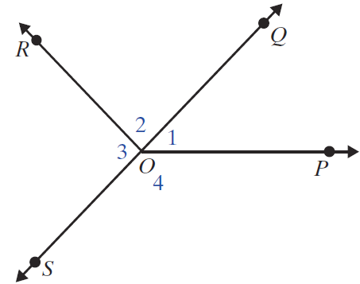
Example 1
Use a protractor to check the measures of the angles.
Solution

Slide 12
Example 2
Tell whether each of the following angles is acute, right, obtuse, or straight.
Solution

Slide 13
Classifying Angles
Two Angles are
1. Complementary if the sum of their measures is 90°.
2. Supplementary if the sum of their measures is 180°.
3. Equal if they have the same measure.

Slide 14
Example 3
In the figure shown on the next slide,
a. ∠1 and ∠2 are complementary since
m∠1 + m∠2 = 90°;
b. ∠COD and ∠COA are supplementary since
m∠COD + m∠COA = 70° + 110° = 180°;
c. ∠AOD is a straight angle since m∠AOD = 180°;
d. ∠BOA and ∠BOD are supplementary; and in this case m∠BOD = 90°.

Slide 15
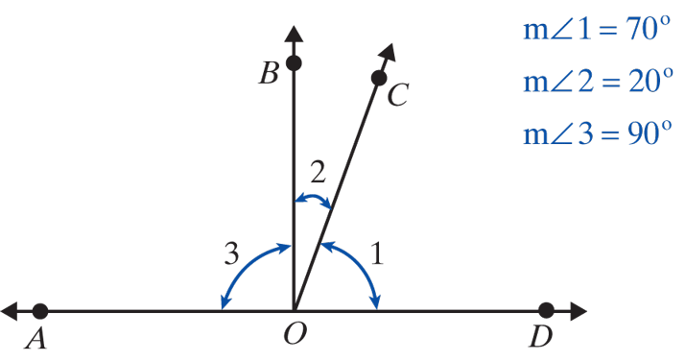
Example 3 (cont.)

Slide 16
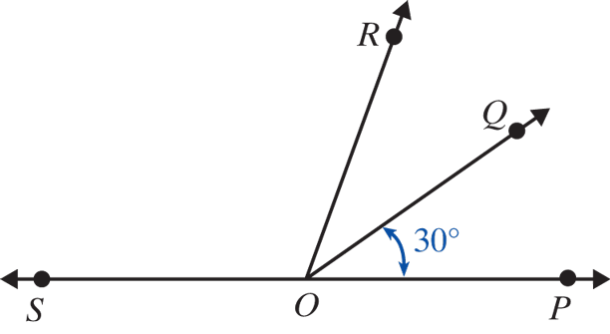
Example 4
In the figure below, is a straight line and
m∠QOP = 30°. Find the measures of
a. ∠QOS and b. ∠SOP.
c. Are any pairs supplementary?

Slide 17
Example 4
Solution
a. m∠QOS = 150°.
b. m∠SOP = 180°.
c. Yes, ∠QOP and ∠QOS are supplementary and ∠ROP and ∠ROS are supplementary.

Slide 18
Classifying Triangles
Special Note
The line segment with endpoints A and B is indicated by placing a bar over the letters, as in The length of the segment is indicated by writing only the letters, as in AB.

Slide 19
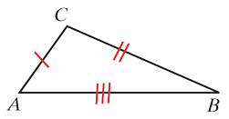
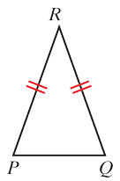
Classifying Triangles
Triangles Classified by Sides
Name Property Example
1. Scalene
No two sides are equal.
ΔABC is scalene since no two sides are equal.
2. Isosceles
At least two sides are
equal.
ΔPQR is isosceles since PR = QR.

Slide 20
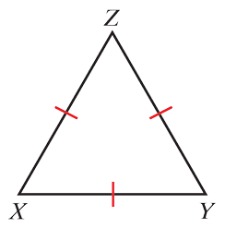
Classifying Triangles
Triangles Classified by Sides (cont.)
Name Property Example
3. Equilateral
All three sides are equal.
ΔXYZ is equilateral since XY = XZ = YZ.

Slide 21
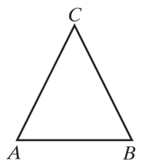
Classifying Triangles
Triangles Classified by Angles
Name Property Example
1. Acute
All three angles are acute.
∠A, ∠B, ∠C and are all acute so ΔABC is acute.

Slide 22
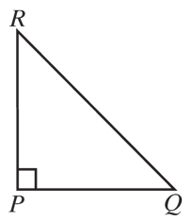
Classifying Triangles
Triangles Classified by Angles (cont.)
Name Property Example
2. Right
One angle is a right angle.
m∠P = 90° so ΔPQR is a right triangle.

Slide 23
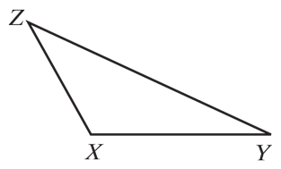
Classifying Triangles
Triangles Classified by Angles (cont.)
Name Property Example
3. Obtuse
One angle is obtuse.
∠X is obtuse so ΔXYZ is an obtuse triangle.

Slide 24
Classifying Triangles
Two Important Statements about any Triangle
1. The sum of the measures of the angles is 180°.
2. The sum of the lengths of any two sides must be greater than the length of the third side.

Slide 25
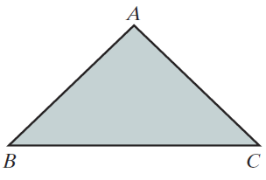
Example 5
In ΔABC below, AB = AC. What kind of triangle is ΔABC?
Solution
ΔABC is isosceles because two sides are equal.

Slide 26
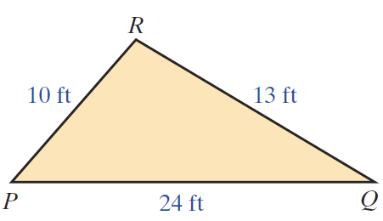
Example 6
Suppose the lengths of the sides of ΔPQR are as shown in the figure below. Is this possible?

Slide 27
Example 6 (cont.)
Solution
This is not possible because PR + QR = 10 ft + 13 ft = 23 ft and PQ = 24 ft, which is longer than the sum of the other two sides. In a triangle, the sum of the lengths of any two sides must be greater than the length of the third side.

Slide 28
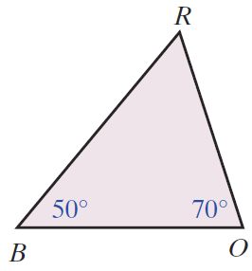
Example 7
In ΔBOR below, m∠B = 50° and m∠O = 70°.
a. What is m∠R?
b. What kind of triangle is ΔBOR?
c. Which side is opposite ∠R?
d. Which sides include ∠R?
e. Is ΔBOR a right triangle?
Why or why not?

Slide 29
Example 7 (cont.)
Solution
a. The sum of the measures of the angles must be 180°.
b. ΔBOR is an acute triangle since all the angles are acute. Also, ΔBOR is scalene because no two sides are equal.
c. is opposite ∠R.

Slide 30
Example 7 (cont.)
d. include ∠R.
e. ΔBOR is not a right triangle because none of the angles is a right angle.

Slide 31
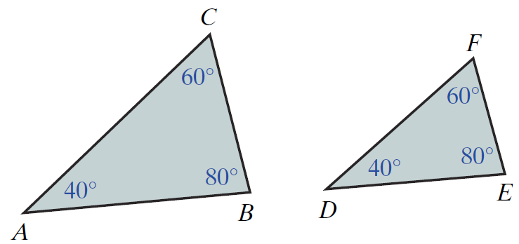
Similar Triangles
Two Triangles are Similar If
1. The corresponding angles have the same measure. (We say that the corresponding angles are equal.)
2. The corresponding sides are proportional. (See the figure below.)

Slide 32
Similar Triangles
Note
The notation for similar triangles indicates the respective correspondences of angles and sides by the order in which the vertices of each triangle are identified. For example, we could have written
ΔBCA ∼ ΔEFD or ΔCAB ∼ ΔFDE. Be sure to follow this pattern when indicating similar triangles.

Slide 33
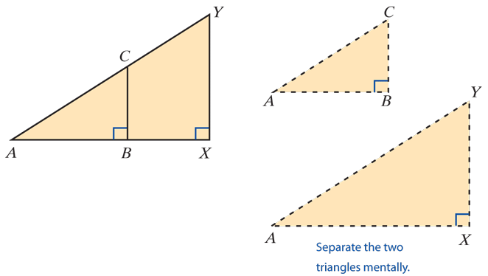
Example 8
Given the two triangles ΔABC and ΔAXY with
m∠ABC = m∠AXY = 90°, as shown in the figure, determine whether or not ΔABC ∼ ΔAXY.

Slide 34
Example 8 (cont.)
Solution
We can show that the corresponding angles are equal as follows:
m∠CAB = m∠YAX because they are the same angle.
m∠CBA = m∠YXA because both are right angles (90°).
m∠BCA = m∠XYA because the sum of the measures of the angles in each triangle must be 180°.
Therefore, the corresponding angles are equal, and the triangles are similar.

Slide 35
Example 9
Refer to the figure used in Example 8.
If AB = 4 centimeters, BX = 2 centimeters, and
BC = 3 centimeters, find XY.
Solution
From Example 8 we know that the two triangles are similar: therefore, their corresponding sides are proportional. Since are corresponding sides (they are opposite equal angles) and are corresponding sides (they are opposite equal angles), the following proportion is true:

Slide 36
Example 9 (cont.)
But, AX = AB + BX = 4 + 2 = 6 cm.
Thus,

Slide 37
Practice Problems
Identify each given angle as acute, right, obtuse, or straight.
Determine whether it is possible for a triangle to have the following side lengths. If such a triangle exists, classify it as scalene, isosceles, or equilateral.

Slide 38
Practice Problem Answers
1. acute
2. obtuse
3. straight
4. acute
5. does not exist
6. isosceles

