Slide 1
Section 8.2
Compound Interest

Slide 2
Objectives
Understand the concept of compound interest.
Find interest compounded periodically with repeated calculations.
Find compound interest using the formula

Slide 3
Understanding Compound Interest
To Calculate Compound Interest
Step 1: Using the formula for simple interest, I = P × r × t, calculate the simple interest where
and n is the number of periods per year for compounding. For example,

Slide 4
Understanding Compound Interest
To Calculate Compound Interest (cont.)

Slide 5
Understanding Compound Interest
To Calculate Compound Interest (cont.)
Step 2: Add this interest to the principal to create a new value for the principal.
Step 3: Repeat steps 1 and 2 however many times the interest is to be compounded.

Slide 6
Understanding Compound Interest
Note
For the purpose of calculations, we will use 360 days in one year (30 days a month).

Slide 7
Example 1
If an account is compounded annually (once a year) at 10%, how much interest will a principal of $1200 earn in three years?
Solution
Because the compounding is done annually, use
in the formula I = P × r × t. Also, since the
compounding is for three years, calculate the interest three times with a new principal (the old principal plus interest) each time.

Slide 8
Example 1 (cont.)
a. First year: the principal is P = $1200.
I = 1200 × 0.10 × 1
= $120.00 interest for the first year
b. Second year: the principal is
P = $1200 + $120 = $1320.
I = 1320 × 0.10 × 1
= $132.00 interest for the second year

Slide 9
Example 1 (cont.)
c. Third year: the principal is
P = $1320 + $132 = $1452.
I = 1452 × 0.10 × 1
= $145.20 interest for the third year
The total interest earned in three years will be

Slide 10
Example 2
If a principal of $5000 is compounded monthly (12 times a year) at 6%, what will be the balance in the account at the end of four months?
Solution
Because the compounding is monthly, use
in the formula I = P × r × t. Also, since the compounding is for four months, calculate the interest four times with a new principal (the old principal plus interest) each time.

Slide 11
Example 2 (cont.)
a. First month: the principal is P = $5000.
b. Second month: the principal is
P = $5000.00 + $25.00 = $5025.00.

Slide 12
Example 2 (cont.)
c. Third month: the principal is
P = $5025.00 + $25.13 = $5050.13.
d. Fourth month: the principal is
P = $5050.13 + $25.25 = $5075.38.

Slide 13
Example 2 (cont.)
The balance in the account at the end of four months will be
And the total interest earned will be
$5075.38 + $25.38
= $5100.76.
$5100.76 – $5000
= $100.76.

Slide 14
Example 3
Find the interest earned on $5000 if simple interest is calculated for a period of 4 months at 6%. What is the difference between this amount and the interest earned by compounding monthly (as shown in
Example 2)?
Solution
For simple interest we use the formula I = P × r × t just
once with

Slide 15
Example 3 (cont.)
This gives
Thus the interest earned would be $100 and the difference in compound interest and simple interest for the four months would be
$100.76 − $100.00
= $0.76.

Slide 16
Compound Interest Formula
Compound Interest Formula
When interest is compounded, the total amount, A, accumulated (including principal and interest) is given by the formula
where
P = the principal
r = the annual interest rate (in decimal or fraction form)

Slide 17
Compound Interest Formula
Compound Interest Formula (cont.)
t = the length of time in years
n = the number of compounding periods in one year

Slide 18
Example 4
Christopher invests $5000 at 6% compounded monthly. What will be the amount in his account in 10 years?
Solution
P = $5000, r = 6% = 0.06, n = 12 times per year,
t = 10 years
Substituting into the formula gives

Slide 19
Example 4 (cont.)
To use the TI-84 calculator, enter all of the numbers just as you see them in the formula. You can enter the exponent as 120 or enter it as the product of 12 times 10. If you enter the exponent as a product, it must be in parentheses as (12 * 10).

Slide 20

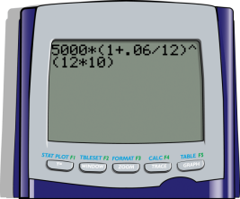
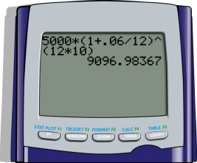
Example 4 (cont.)
Step 1: Enter the numbers and parentheses so that the display appears as follows:
Step 2: Press .
The display should now read:
The amount in Christopher’s account after 10 years is $9096.98.

Slide 21
Example 5
Maria’s grandmother was so pleased when she was born that she put $10,000 in a savings account at 8% to be compounded daily for 20 years. Maria is to have the money for college when she is 20 years old. How much money would be in Maria’s college fund when she is 20?
Solution
P = $10,000, r = 8% = 0.08, n = 360 times per year,
t = 20 years

Slide 22
Example 5 (cont.)
Substituting into the formula gives
To use the TI-84 calculator, enter all of the numbers just as you see them in the formula. You can enter the exponent as 7200 or enter it as the product of 360 times 20. If you enter the exponent as a product, it must be in parentheses as (360 * 20).

Slide 23
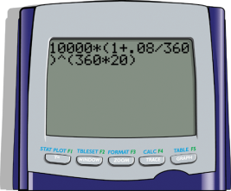
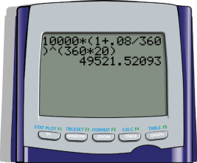
Example 5 (cont.)
Step 1: Enter the numbers and parentheses so that the display appears as follows:
Step 2: Press .
The display should now read:
We find the amount in Maria’s college fund in 20 years is $49,521.52. (Thanks Grandma!)

Slide 24
Practice Problems
1. You deposit $800 at 7% to be compounded monthly and withdraw the money 2 months later. How much interest will you earn?
2. You deposit $2500 at 6% to be compounded monthly. How much will the account be worth in one year?

Slide 25
Practice Problems
3. You deposit $1500 at 4% to be compounded semi-annually. How much interest will you earn in 3 years?
4. You deposit $500 at 5% to be compounded daily. How much will the account be worth in 6 months?

Slide 26
Practice Problem Answers
1. $9.36
2. $2654.19
3. $189.24
4. $512.66

