Slide 1
Section 8.3
Balancing a Checking Account

Slide 2
Objectives
Become familiar with the information in a bank statement.
Learn how to keep a checkbook register current.
Know how to balance a checking account.

Slide 3
Balancing a Checking Account
The bank or the savings and loan company sends you a statement of your checking account each month. This statement contains a record of:
1. The beginning balance;
2. A list of all checks paid by the bank;
3. A list of deposits you made;
4. Any interest paid to you (some checking accounts do pay interest);
5. Any service charge by the bank; and
6. The closing balance.

Slide 4
Balancing a Checking Account
Your checkbook register contains a record of:
1. All the checks you have written;
2. All the deposits you have made; and
3. The current balance.

Slide 5
Balancing a Checking Account
Your current balance may not agree with the closing balance on the bank statement because:
1. You have not recorded the interest.
2. You have not recorded the service charge.
3. The bank does not have a record of all the checks you have written. (Several checks will be outstanding because they have not been received yet for payment by the bank by the date given on the bank statement.)

Slide 6
Balancing a Checking Account
To Balance your Checking Account
(sometimes called reconciling the bank statement with your checkbook register):
1. Go through your checkbook register and the bank statement and put a check mark (√ ) by each check paid and deposit recorded on the bank statement.
2. In your checkbook register:
a. Add any interest paid to your current balance.
b. Subtract any service charge from this balance.
This number is your true balance.

Slide 7
Balancing a Checking Account
To Balance your Checking Account (cont.)
3. Find the total of all the outstanding checks (no √ mark) in your checkbook register (checks not yet received by the bank).

Slide 8
Balancing a Checking Account
To Balance your Checking Account (cont.)
4. On the reconciliation sheet:
a. Enter the balance from the bank statement.
b. Add any deposits you have made that are not recorded (no √ mark) on the bank statement.
c. Subtract the total of your outstanding checks (found in Step 3). This number should agree with your true balance. Now your checking account is balanced.

Slide 9
Balancing a Checking Account
If Your Checking Account Does Not Balance
1. Go over your arithmetic in the balancing procedure.
2. Go over your arithmetic check by check in your checkbook register.
3. Make an appointment with bank personnel to find the reasons for any other errors.

Slide 10
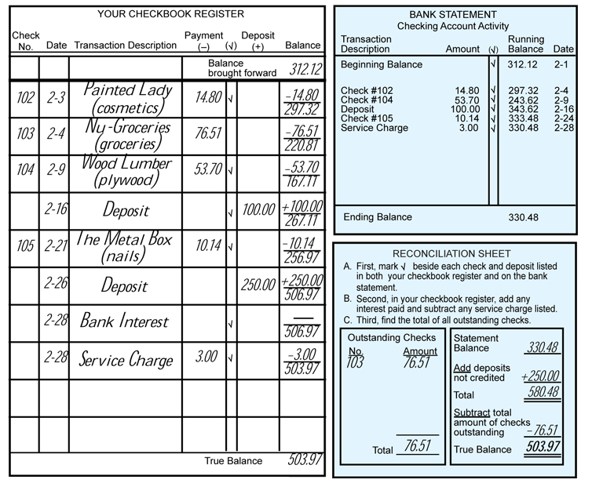
Example 1

Slide 11
Example 1 (cont.)
After adding deposits not credited to the statement balance and subtracting the total amount of outstanding checks, the true balance is $503.97.

Slide 12
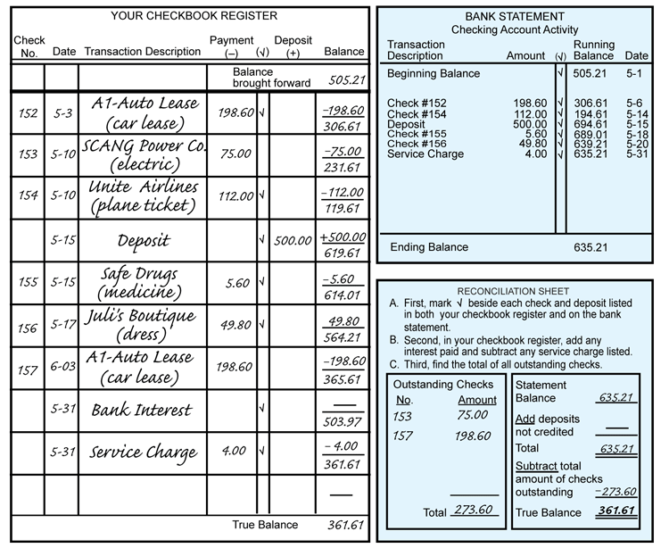
Example 2

Slide 13
Example 2 (cont.)
After adding deposits not credited to the statement balance and subtracting the total amount of outstanding checks, the true balance is $361.61.

Slide 14
Practice Problems
1. You begin with a balance of $575.14, write checks for $100, $75, and $150.50; and deposit $250. What is your balance?
2. You open a new account with a deposit of $600. You write checks for $120.50, $320.05, and $100.10; then you deposit $250 and $350. What is your balance?

Slide 15
Practice Problems (cont.)
3. You begin with a balance of $250.34, deposit $450, and write checks for $200, $35.87, and $75.50. What is your balance?
4. Your beginning balance is $4.14. You make two deposits of $350 each; then you write checks for $235.12, $75.16, and $129.98. What is your balance?

Slide 16
Practice Problem Answers
1. $499.64
2. $659.35
3. $388.97
4. $263.88

