Slide 1
Section 8.6
Reading Graphs

Slide 2
Objectives
Learn how to read data and calculate information from the following types of graphs: bar graphs, circle graphs, line graphs, and histograms.

Slide 3
Introduction to Graphs
The Purpose of the Four Types of Graphs
1. Bar Graphs: to emphasize comparative amounts.
2. Circle Graphs: to help in understanding percents or parts of a whole.
3. Line Graphs: to indicate tendencies or trends over a period of time.
4. Histograms: to indicate data in classes (a range or interval of numbers).

Slide 4
Example 1
Bar Graph
Figure 8.1 shows a bar graph. Note that the scale on the left and the data on the bottom (months) are clearly labeled and the graph itself has a title. The following questions can be easily answered by looking at Figure 8.1.

Slide 5
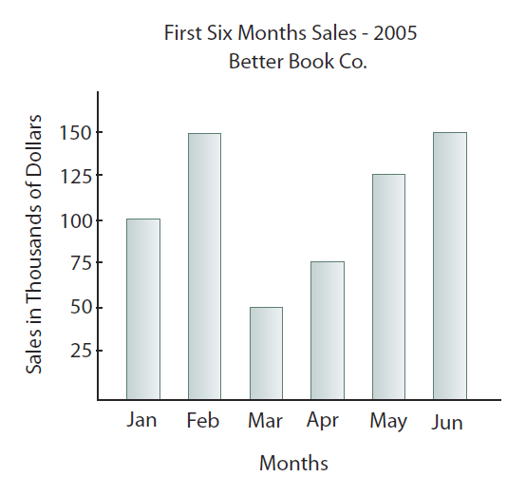
Example 1 (cont.)
Figure 8.1: Bar graph

Slide 6
Example 1 (cont.)
$100,000
a. What were the sales in January?
b. During what month were sales lowest?
c. During what month were sales highest?
d. What were the sales during each of the highest sales months?
e. What were the sales in April?
March
February
and June
$150,000
$75,000

Slide 7
Example 1 (cont.)
The following questions will take some calculations after reading the graphs.
f. What was the amount of decrease in sales between February and March?

Slide 8
Example 1 (cont.)
g. What was the percent of decrease?

Slide 9
Example 2
Circle Graph
Figure 8.2 shows percents budgeted for various items in a home for one year. Suppose a person has an annual income of $15,000. Using Figure 8.2, calculate how much will be allocated to each item indicated in the graph.

Slide 10
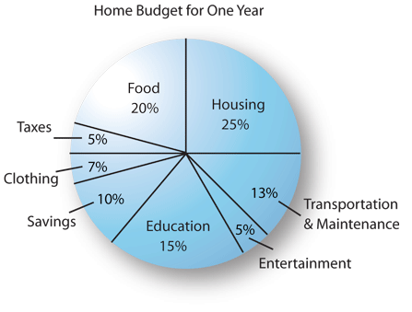
Example 2 (cont.)
Figure 8.2: Circle Graph

Slide 11
Example 2 (cont.)
Solution
Item Amount
Housing: 0.25 × $15,000 = $3750.00
Food: 0.20 × $15,000 = 3000.00
Taxes: 0.05 × $15,000 = 750.00
Clothing: 0.07 × $15,000 = 1050.00
Savings: 0.10 × $15,000 = 1500.00
Education: 0.15 × $15,000 = 2250.00
Entertainment: 0.05 × $15,000 = 750.00

Slide 12
Example 2 (cont.)
Transportation
& Maintenance: 0.13 × $ 15,000 = 1950.00
What is the total of all amounts?
$15,000.00

Slide 13
Example 3
Line Graph
Figure 8.3, on the next slide, is a line graph that shows the relationships between daily high and low temperatures. You can see that temperatures tended to rise during the week but fell sharply on Saturday.
What was the lowest high temperature?
On what day did this occur?
What was the highest low temperature?
On what day did this occur?
66°
Sunday
70°
Friday

Slide 14
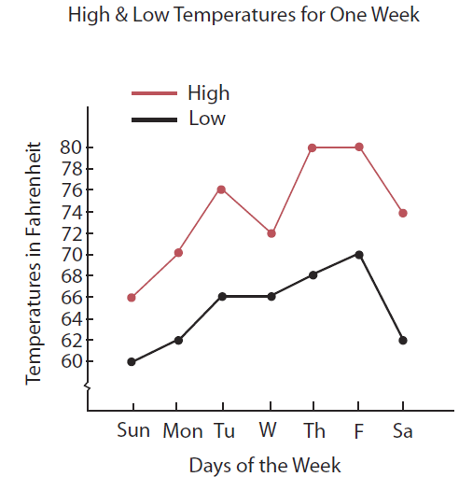
Example 3 (cont.)
Find the average difference
between the daily high and
low temperatures for the
week shown.
Figure 8.3: Line graph

Slide 15
Example 3 (cont.)
Solution
First, find the differences; then average these differences.
Sunday: 66 – 60 = 6°
Monday: 70 – 62 = 8°
Tuesday: 76 – 66 = 10°
Wednesday: 72 – 66 = 6°
Thursday: 80 – 68 = 12°
Friday: 80 – 70 = 10°
Saturday: 74 – 62 = 12°
average difference
64°
total of differences

Slide 16
Introduction to Graphs
Terms Related to Histograms
Class: a range (or interval) of numbers that contain data items.
Lower class limit: the smallest whole number that belongs to a class.
Upper class limit: the largest whole number that belongs to a class.
Class boundaries: numbers that are halfway between the upper limit of one class and the lower limit of the next class.

Slide 17
Introduction to Graphs
Terms Related to Histograms (cont.)
Class width: the difference between the class boundaries of a class (the width of each bar).
Frequency: the number of data items in a class.

Slide 18
Example 4
Histogram
Figure 8.4 shows a histogram that summarizes the scores of 50 students on an English placement test. Answer the following questions by referring to the graph.
a. How many classes are represented?
b. What are the class limits of the first class?
c. What are the class boundaries of the second class?
6
201 and 250
250.5 and 300.5

Slide 19
Example 4 (cont.)
50
d. What is the width of each class?
e. Which class has the greatest frequency?
f. What is this frequency?
g. What percentage of the scores are between 200.5
and 250.5?
h. What percentage of the scores are above 400?
second class
16

Slide 20
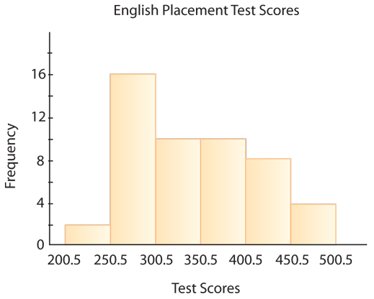
Example 4 (cont.)
Figure 8.4: Histogram

Slide 21
Practice Problems
1. Using the bar graph in Example 1, what was the amount of increase in sales between March and April?
2. Using the circle graph in Example 2, if the person’s income increases to $30,000 and the percentage spent on each item does not change, what is the amount spent on entertainment over the year?

Slide 22
Practice Problems (cont.)
3. Using the line graph in Example 3, find the minimum difference between the high and low temperatures of a single day in the week shown.
4. Using the histogram in Example 4, what is the frequency of the class with the least frequency?

Slide 23
Practice Problem Answers
1. $25,000
2. $1500
3. 6°
4. 2

