Slide 1
Section 9.7
Problem Solving

Slide 2
Objectives
Be able to solve number problems by using equations.
Be able to solve problems involving geometric concepts by using equations.

Slide 3
Solving Number Problems
Basic Steps for Solving Number Problems
1. Read the problem carefully at least twice. Look for key words and phrases that can be translated into algebraic expressions.
2. Assign a variable as the unknown quantity and form an equation using the expressions you translated.
3. Solve the equation.
4. Look back over the problem and check that the answer is reasonable.

Slide 4
Example 1
Four less than twice a number is equal to 20. Find the number.
Solution
Step 1: Let n = the unknown number.
Step 2: Translate “four less than twice a number” to
_______
Step 3: Form the equation: _________

Slide 5
Example 1 (cont.)
Step 4: Solve the equation:
Check:
The number is 12.

Slide 6
Completion Example 2
A number is increased by 45 and the result is 30. What is the number?
Solution
Step 1: Let x = the unknown number.
Step 2: Translate “a number is increased by 45” to
______________.
Step 3: Form the equation: _________________.
x + 45
x + 45 = 30

Slide 7
Completion Example 2 (cont.)
Step 4: Solve the equation:
x + 45
30
45
45
0
−15
−15
Check:
−15
30
−15
So _______ is the correct number.

Slide 8
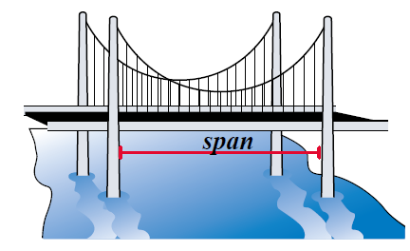
Example 3
A span of a suspension bridge is the distance between its supports. The longest span on the Tacoma Narrows bridge in Washington State is 2800 feet. This is 40 feet more than twice the longest span of the Triboro bridge in New York City. What is the longest span of the Triboro bridge?

Slide 9
Example 3 (cont.)
Solution
Step 1: Let x = the length of the longest span of the Triboro bridge.
Step 2: Translate “40 feet more than twice the longest span of the Triboro bridge” to
Step 3: Form the equation:
Step 4: Solve the equation:

Slide 10
Example 3 (cont.)
The longest span of the Triboro bridge is 1380 feet. (The student should check this result in the original equation.)

Slide 11
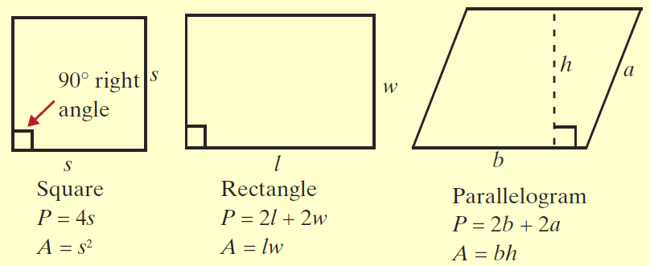
Solving Geometry Problems
Table 9.1 Formulas for Finding Perimeter and Area of Six Geometric Figures

Slide 12
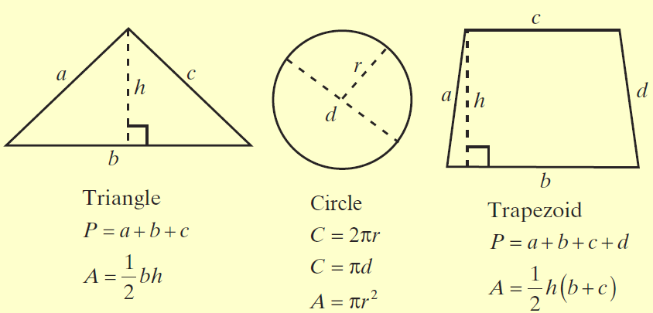
Solving Geometry Problems
Table 9.1 Formulas for Finding Perimeter and Area of Six Geometric Figures (cont.)

Slide 13
Solving Geometry Problems
Table 9.1 Formulas for Finding Perimeter and Area of Six Geometric Figures (cont.)
Note: The Greek letter π is the symbol used for the constant number 3.1415926535…. This constant is an infinite decimal with no pattern to its digits. For our purposes, we will use π = 3.14, but you should be aware that 3.14 is only an approximation for π.

Slide 14
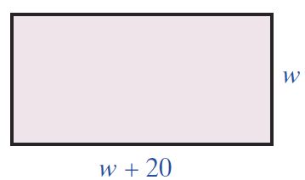
Example 4
A rectangular swimming pool has a perimeter of
160 meters and a length that is 20 meters more than its width. Find its width and length.
Solution
w = the width
w + 20 = the length
Substituting into the formula gives the equation to be solved:

Slide 15
Example 4 (cont.)
The width of the pool is 30 meters, and the length is
w + 20 = 50 meters.

Slide 16
Example 5
Suppose that the area of a triangle is 45 square feet. If the base is 10 feet long, what is the height of the triangle?
Solution
The formula for the area of a triangle is
In this problem we know that A = 45 and b = 10. Substitution gives the equation

Slide 17
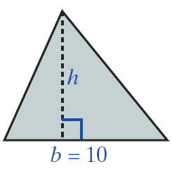
Example 5 (cont.)
Now we want to solve this equation for h.
The height of the triangle is 9 feet.

Slide 18
Practice Problems
1. Eight less than four times a number is equal to 20. Find the number.
2. Thirteen more than five times a number is equal to 28. Find the number.
3. If the product of a number and 8 is decreased by 16, the result is 32. Find the number.
4. A rectangle has a perimeter of 120 meters and a length that is 10 meters more than its width. Find its width and length.

Slide 19
Practice Problem Answers
1. 7
2. 3
3. 6
4. width is 25 m and length is 35 m

