Slide 1
Section A.1
Constructing Samples

Slide 2
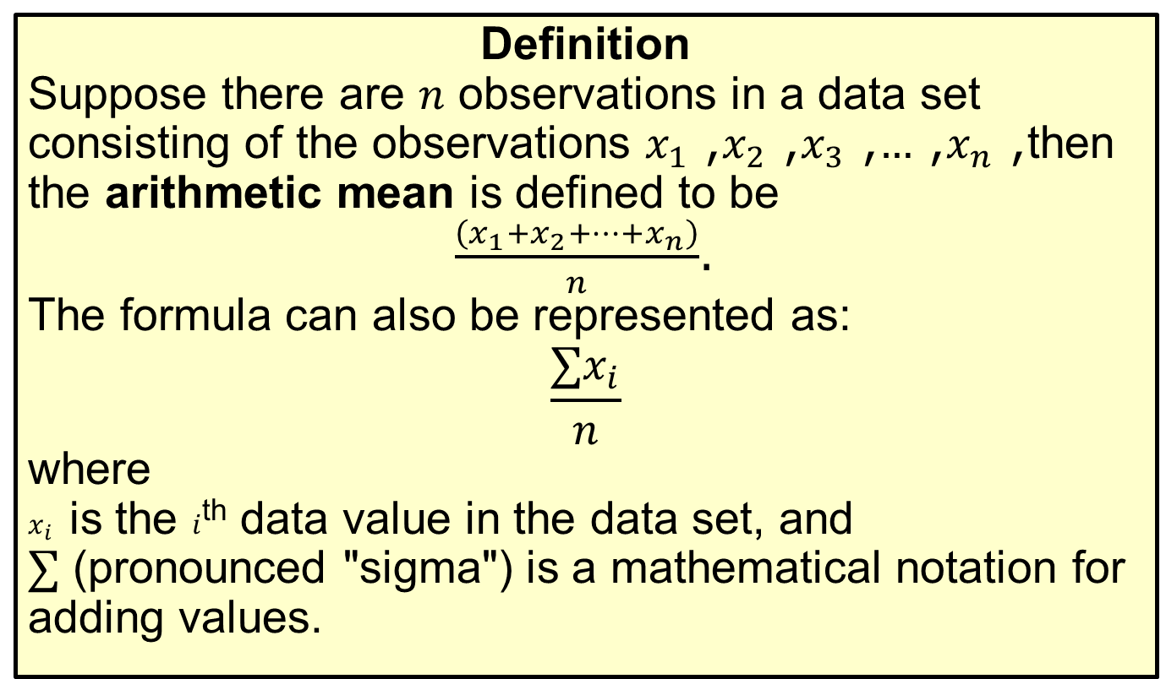
Mean
Definition
Suppose there are $n$ observations in a data set consisting of the observations $x_{1}$, $x_{2}$, $x_{3}$, …, $x_{n}$, then the arithmetic mean is defined to be
$\frac{\left(x_{1}+x_{2}+…+x_{n}\right)}{n}$.
The formula can also be represented as:
$$\frac{∑x_{i}}{n}$$
where
$x_{i}$ is the $i$^{th} data value in the data set, and
∑ (pronounced "sigma") is a mathematical notation for adding values.

Slide 3
Example A1.1: Construct a Sample
Construct a sample of 4 measurements whose mean is 10.

Slide 4
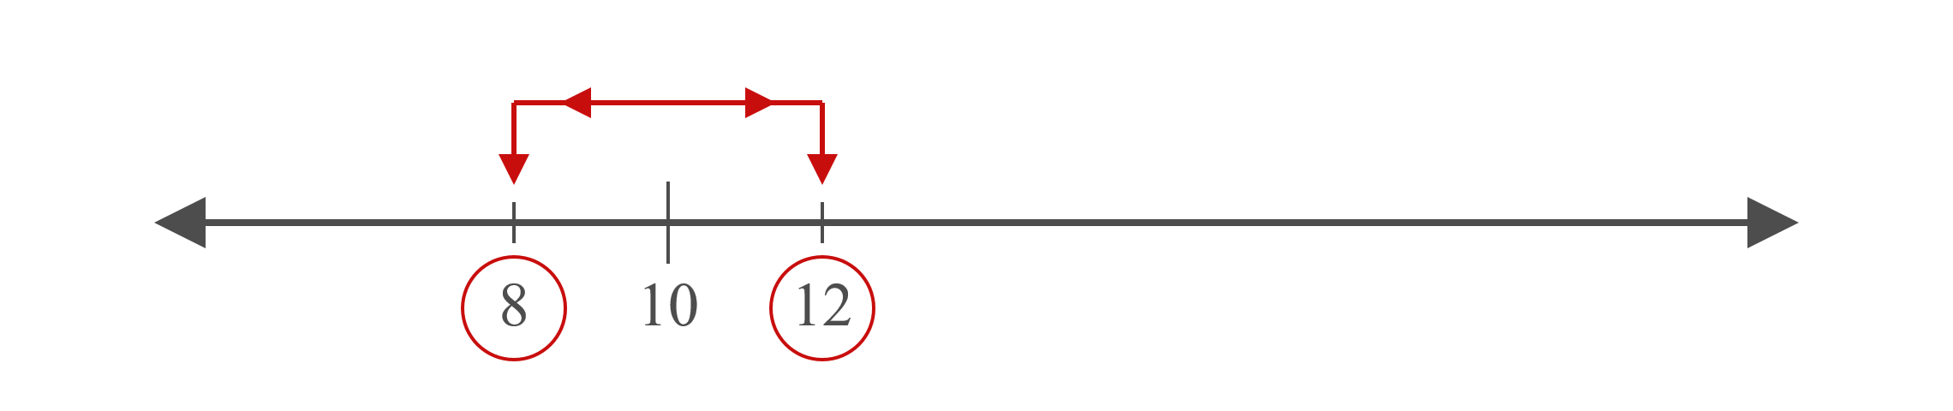
Example A1.1: Construct a Sample (cont.)
Solution
Choose two points that are equidistant from the mean.

Slide 5
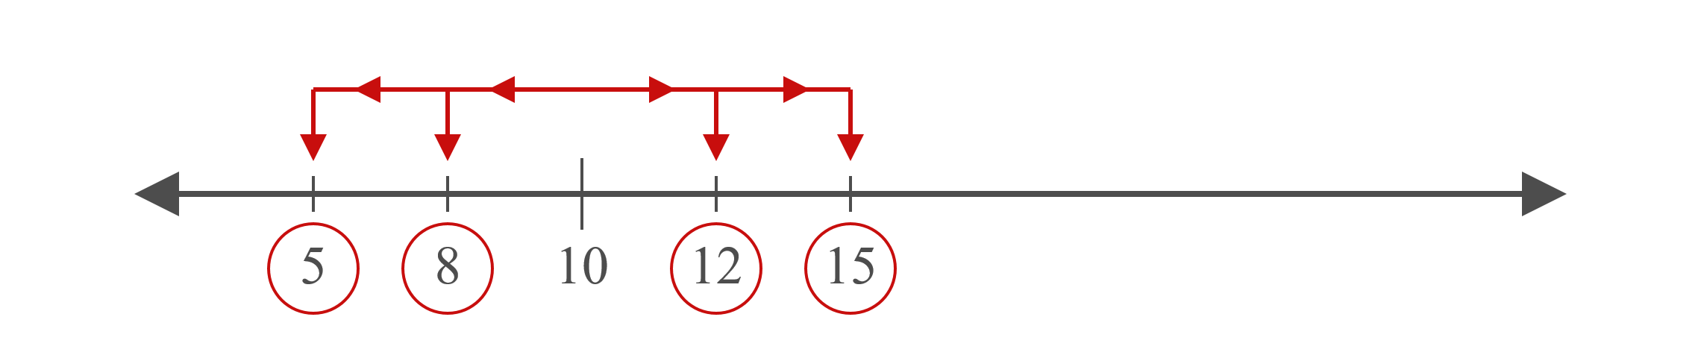
Example A1.1: Construct a Sample (cont.)
Again, choose two more points that are equidistant from the mean.

Slide 6
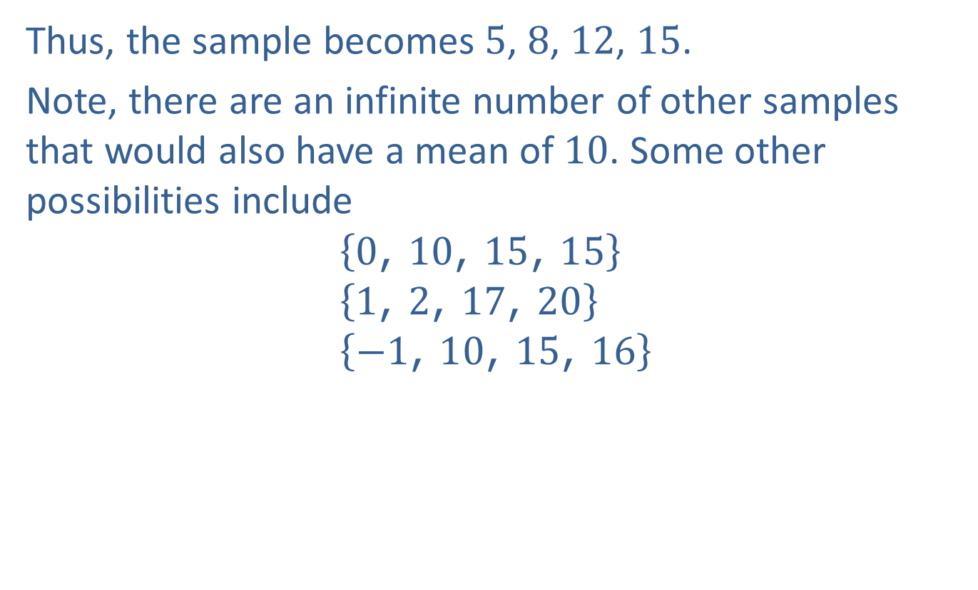
Example A1.1: Construct a Sample (cont.)
Thus, the sample becomes 5, 8, 12, 15.
Note, there are an infinite number of other samples that would also have a mean of 10. Some other possibilities include
$$\left\{0\text{, }10\text{, }15\text{, }15\right\} \\ \left\{1\text{, }2\text{, }17\text{, }20\right\} \\ \left\{−1\text{, }10\text{, }15\text{, }16\right\}$$

Slide 7
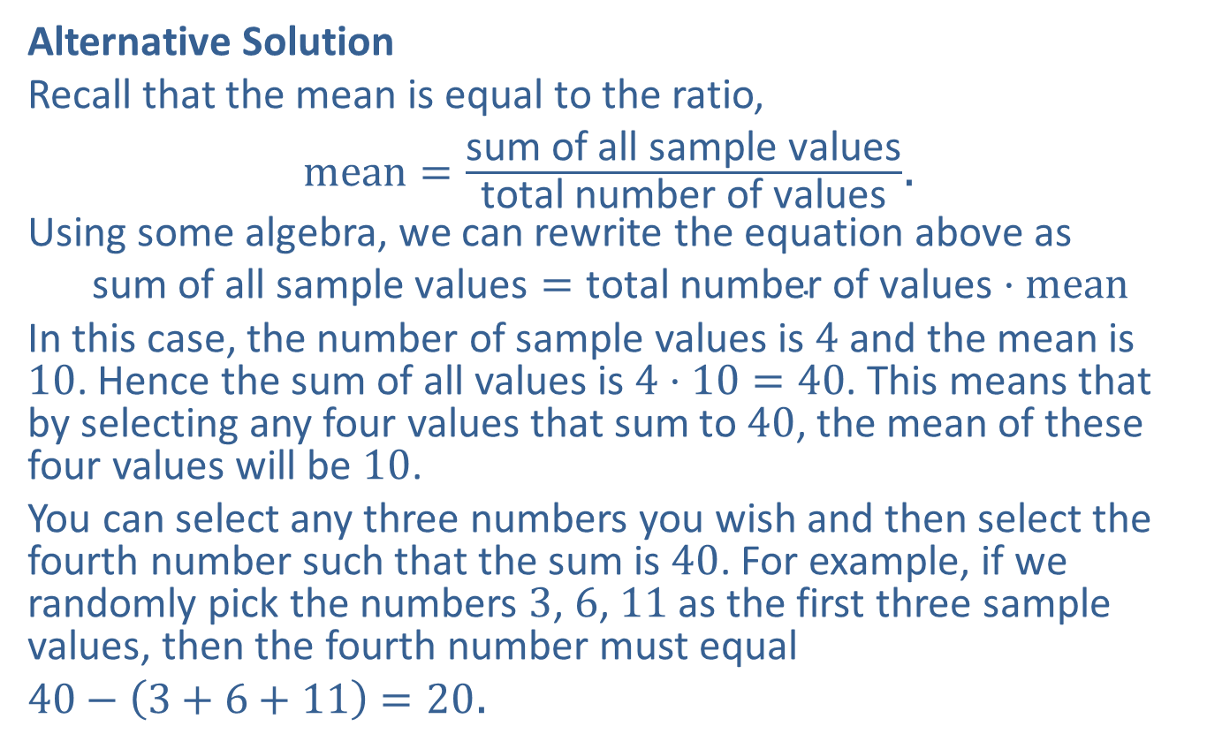
Example A1.1: Construct a Sample (cont.)
Alternative Solution
Recall that the mean is equal to the ratio,
$mean=\frac{\text{sum} \text{of} \text{all} \text{sample} \text{values}}{\text{total} \text{number} \text{of} \text{values}}$.
Using some algebra, we can rewrite the equation above as
$$\text{sum} \text{of} \text{all} \text{sample} \text{values}=\text{total} \text{number} \text{of} \text{values}⋅mean$$
In this case, the number of sample values is 4 and the mean is 10. Hence the sum of all values is $4⋅10=40$. This means that by selecting any four values that sum to 40, the mean of these four values will be 10.
You can select any three numbers you wish and then select the fourth number such that the sum is 40. For example, if we randomly pick the numbers 3, 6, 11 as the first three sample values, then the fourth number must equal
$40−\left(3+6+11\right)=20$.

Slide 8
Median
Definition
The median of a set of observations is the data value in the middle of an ordered array. The same number of data values is on either side of the median value.
If the number of data values is an even number, then the median is the mean of the middle two numbers.

Slide 9
Example A1.2: Construct a Sample
Construct a sample of 4 measurements whose median is 8.

Slide 10

Example A1.2: Construct a Sample (cont.)
Solution
Choose two points that are equidistant from the median, 8.

Slide 11
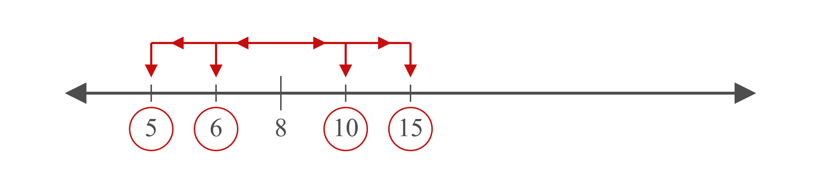
Example A1.2: Construct a Sample (cont.)
Choose two points on either side of the median. It does not matter if the two points are equidistant from the median.

Slide 12
Example A1.2: Construct a Sample (cont.)
Thus, the sample becomes 5, 6, 10, 15.

Slide 13
Note
If the number of sample values is odd, then choose the first value to be the desired median. For example, if the number of sample values is 5 and the desired median is 11, then choose the first sample value to be 11. Then choose two more sample values on either side of the existing value and proceed further.

Slide 14
Range
Definition
The range is the difference between the largest and the smallest data values.

Slide 15
Mode
Definition
The mode of a data set is the most frequently occurring value.
If all of the data values occur only once, or they each occur an equal number of times, the data set is considered to have no mode.
If only one value occurs the most, then the data set is said to be unimodal.
If exactly two values occur equally often, then the data set is said to be bimodal.
If more than two values occur equally often, the data set is multimodal.

Slide 16
Example A1.3: Construct a Bimodal Sample
Construct a bimodal sample of 5 measurements whose range is 6.

Slide 17
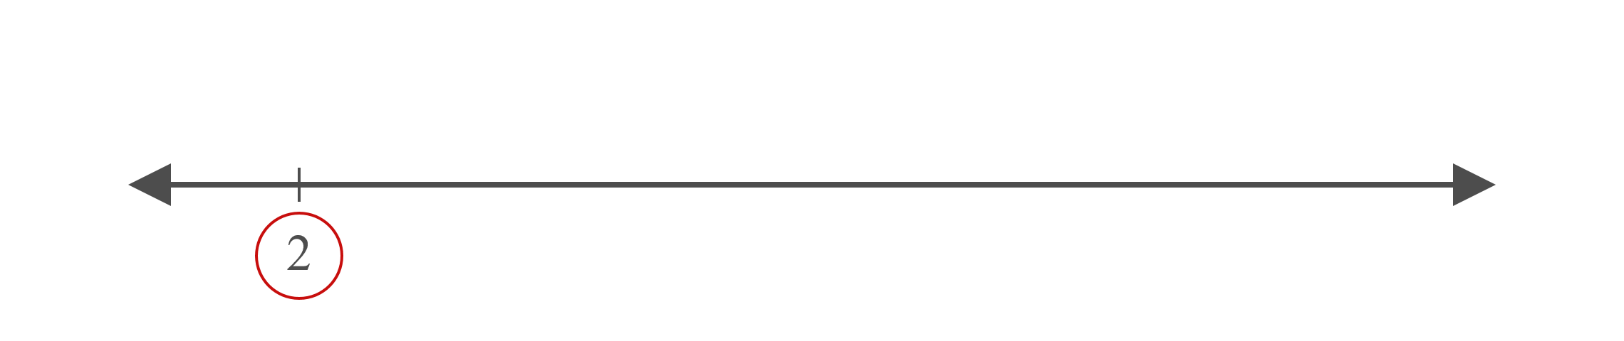
Example A1.3: Construct a Bimodal Sample (cont.)
Solution
First, choose a point.

Slide 18
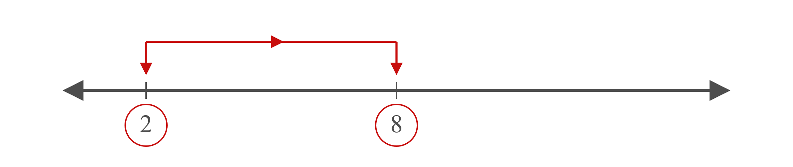
Example A1.3: Construct a Bimodal Sample (cont.)
Then choose a point which is at a distance equal to the range from the first point.

Slide 19
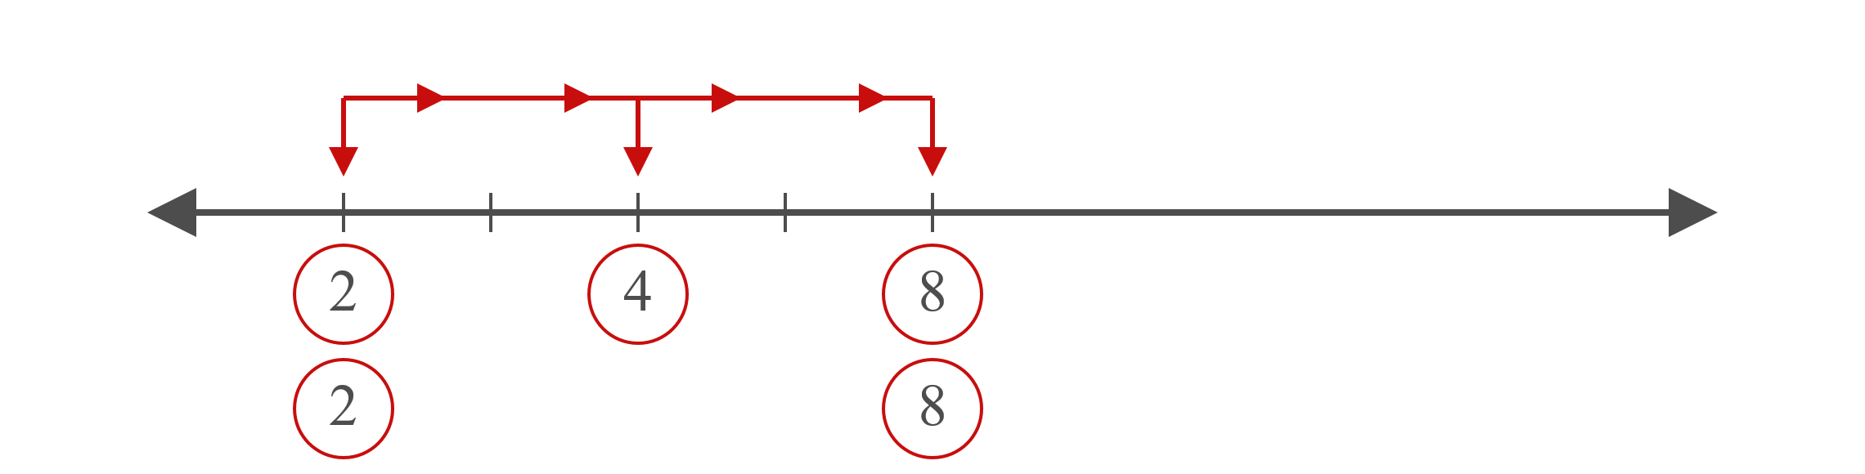
Example A1.3: Construct a Bimodal Sample (cont.)
Choose the remaining sample values in between these two values. Since the sample is bimodal, choose the values such that two sample values are tied for the most frequent value.

Slide 20
Example A1.3: Construct a Bimodal Sample (cont.)
Thus, the sample becomes 2, 2, 4, 8, 8.

Slide 21
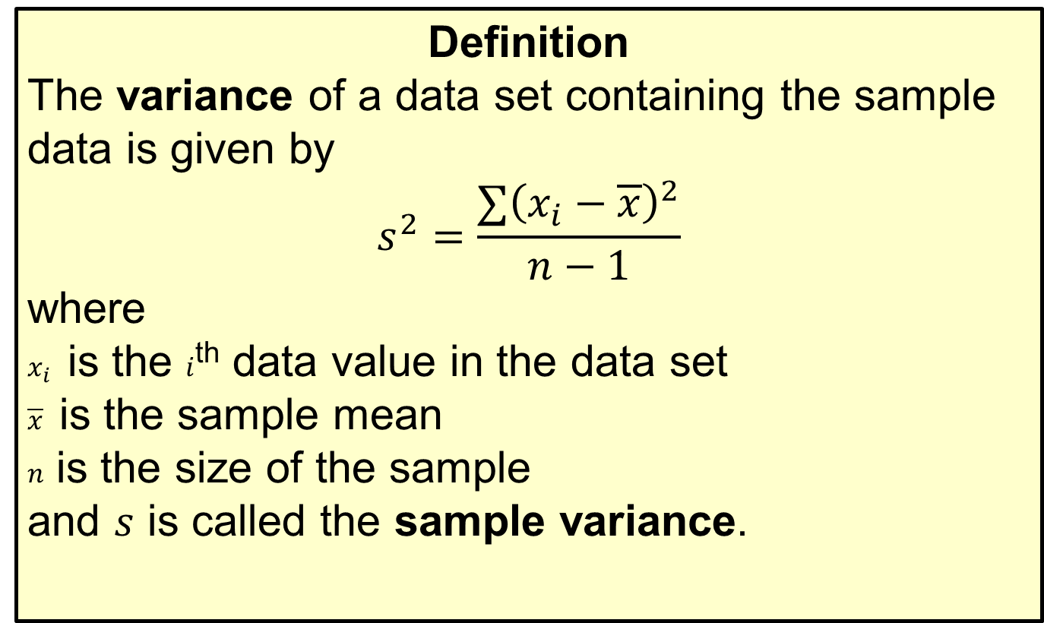
Variance
Definition
The variance of a data set containing the sample data is given by
$$s^{2}=\frac{∑{\left(x_{i}−\overline{x}\right)}^{2}}{n−1}$$
where
$x_{i}$ is the $i$^{th} data value in the data set
$\overline{x}$ is the sample mean
$n$ is the size of the sample
and $s$ is called the sample variance.

Slide 22

Example A1.4: Adding a Sample Value
Given the following sample: $\left\{4\text{, }6\text{, }7\text{, }9\right\}$, add one more sample value that will make the mean equal to 15.

Slide 23
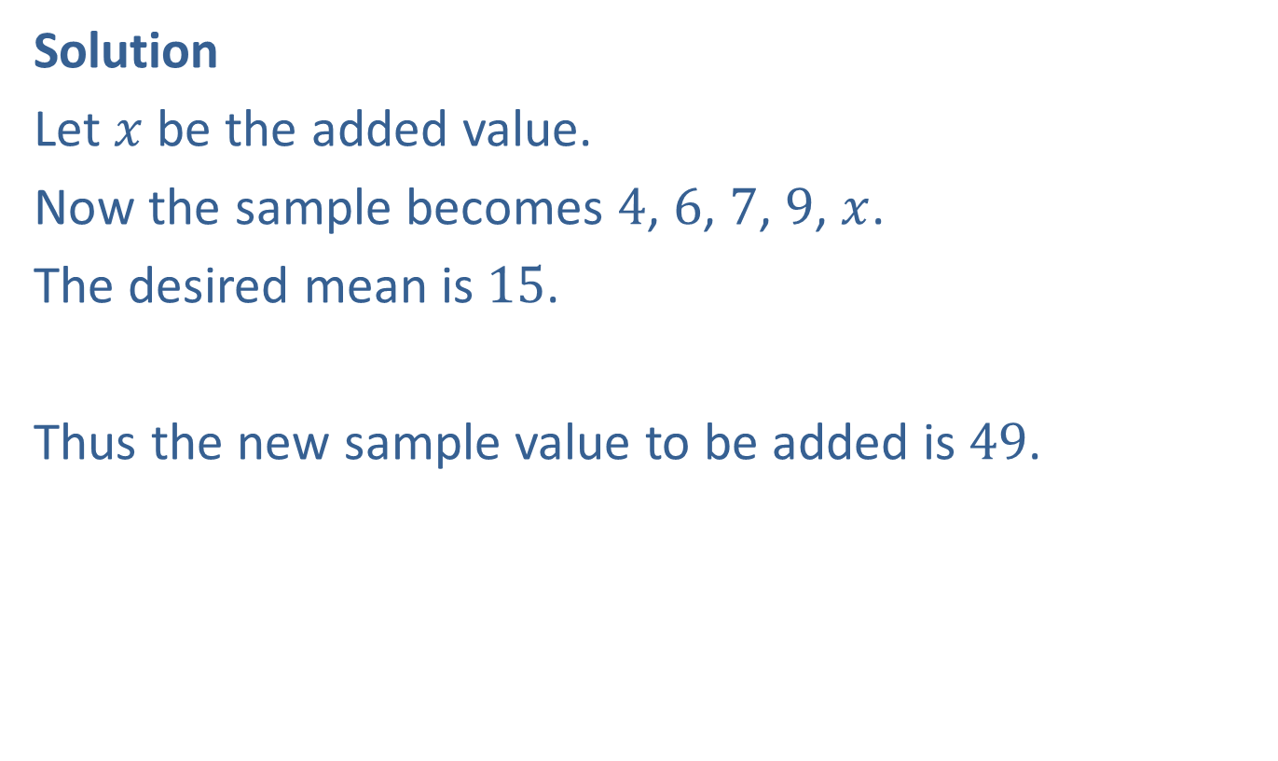
Example A1.4: Adding a Sample Value (cont.)
Solution
Let $x$ be the added value.
Now the sample becomes 4, 6, 7, 9, $x$.
The desired mean is 15.
​
Thus the new sample value to be added is 49.

Slide 24

Example A1.5: Adding a Sample Value
Given the following sample: $\left\{3,5,6,10\right\}$, add one more sample value that will not change the mean nor the range.

Slide 25
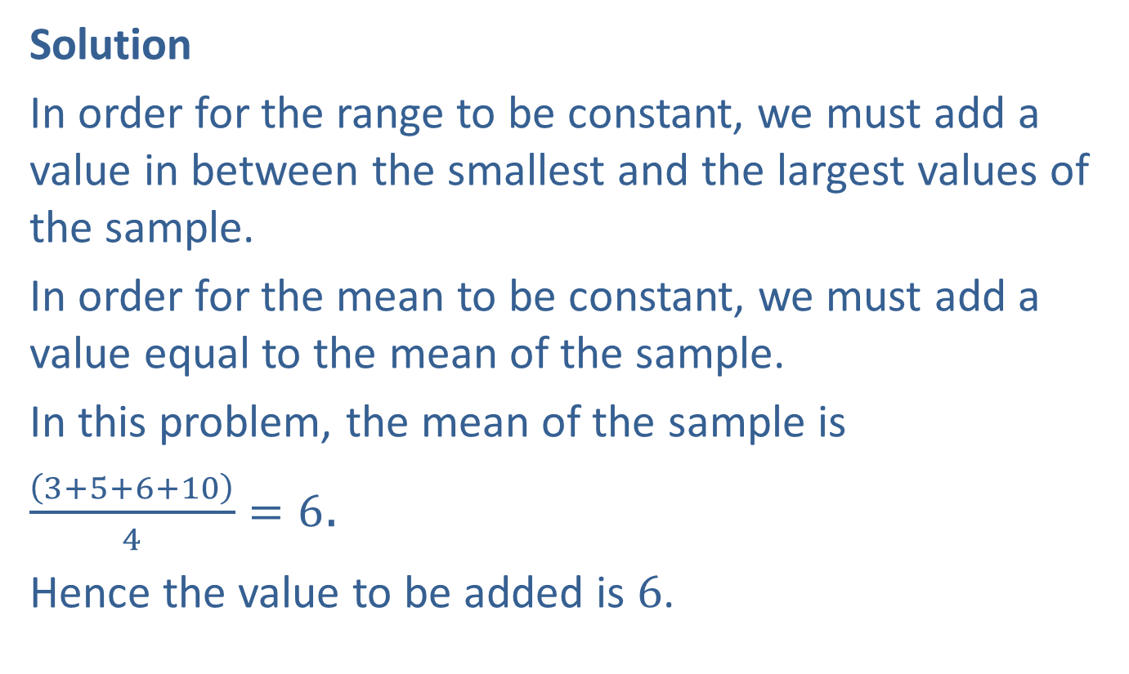
Example A1.5: Adding a Sample Value (cont.)
Solution
In order for the range to be constant, we must add a value in between the smallest and the largest values of the sample.
In order for the mean to be constant, we must add a value equal to the mean of the sample.
In this problem, the mean of the sample is
$\frac{\left(3+5+6+10\right)}{4}=6$.
Hence the value to be added is 6.

Slide 26

Example A1.6: Adding a Sample Value
Given the following sample: $\left\{4\text{, }7\text{, }9\text{, }12\text{, }13\right\}$, add one more sample value that will not change the mean nor the variance.

Slide 27
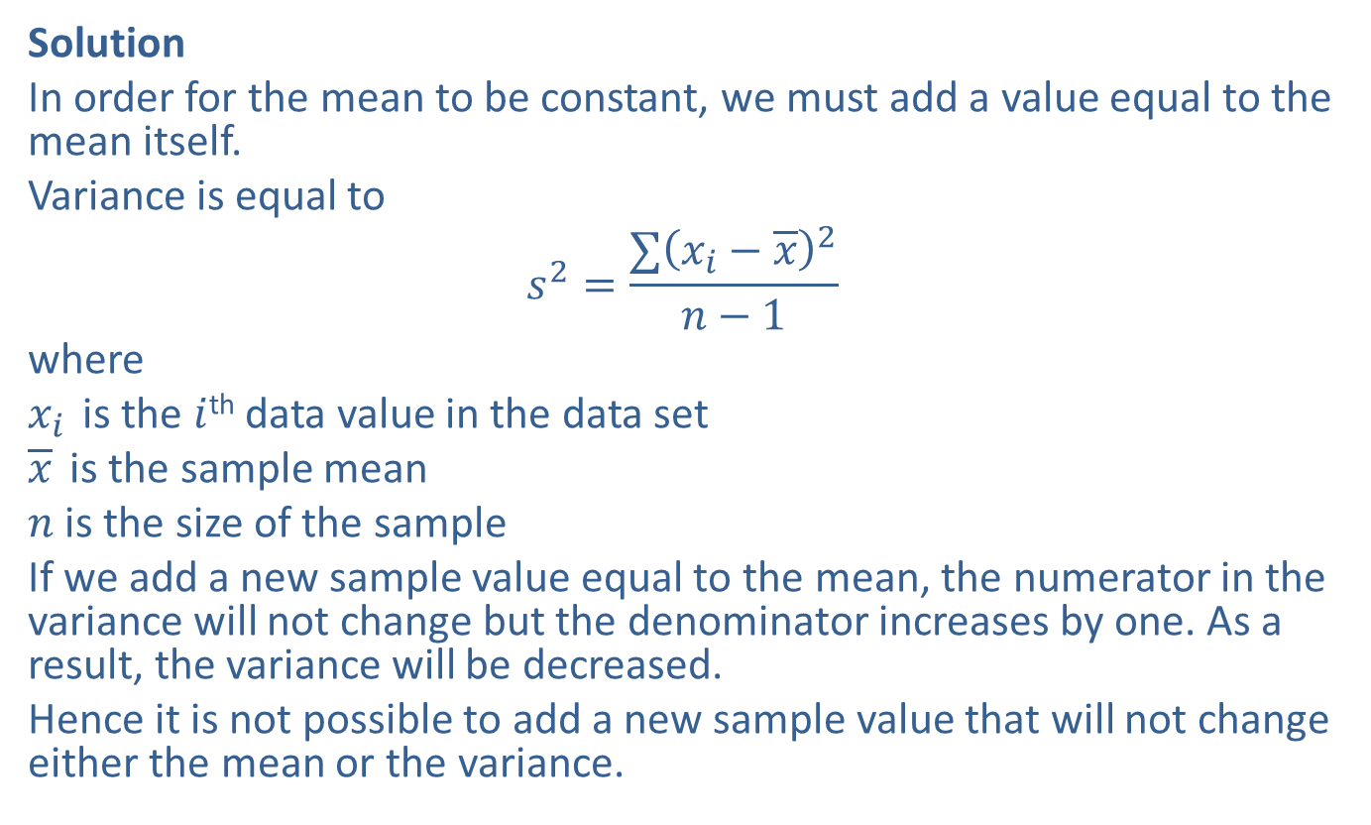
Example A1.6: Adding a Sample Value (cont.)
Solution
In order for the mean to be constant, we must add a value equal to the mean itself.
Variance is equal to
$$s^{2}=\frac{∑{\left(x_{i}−\overline{x}\right)}^{2}}{n−1}$$
where
$x_{i}$ is the $i$^{th} data value in the data set
$\overline{x}$ is the sample mean
$n$ is the size of the sample
If we add a new sample value equal to the mean, the numerator in the variance will not change but the denominator increases by one. As a result, the variance will be decreased.
Hence it is not possible to add a new sample value that will not change either the mean or the variance.

Slide 28

Example A1.7: Construct a Sample
Construct a sample of 6 measurements whose mean is larger than $\frac{2}{3}$ of the measurements.

Slide 29
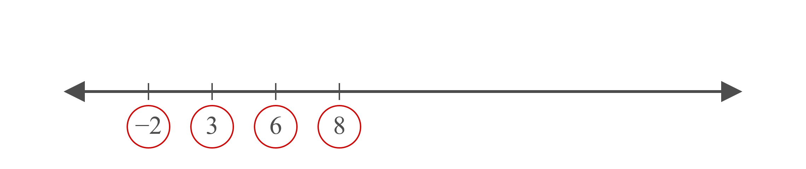
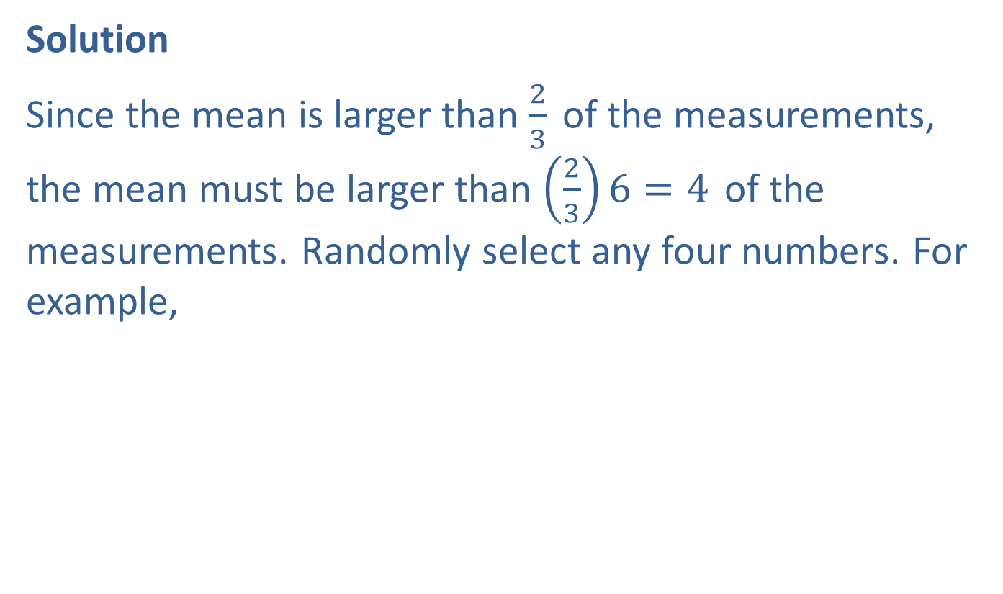
Example A1.7: Construct a Sample (cont.)
Solution
Since the mean is larger than $\frac{2}{3}$ of the measurements, the mean must be larger than $\left(\frac{2}{3}\right)6=4$ of the measurements. Randomly select any four numbers. For example,

Slide 30
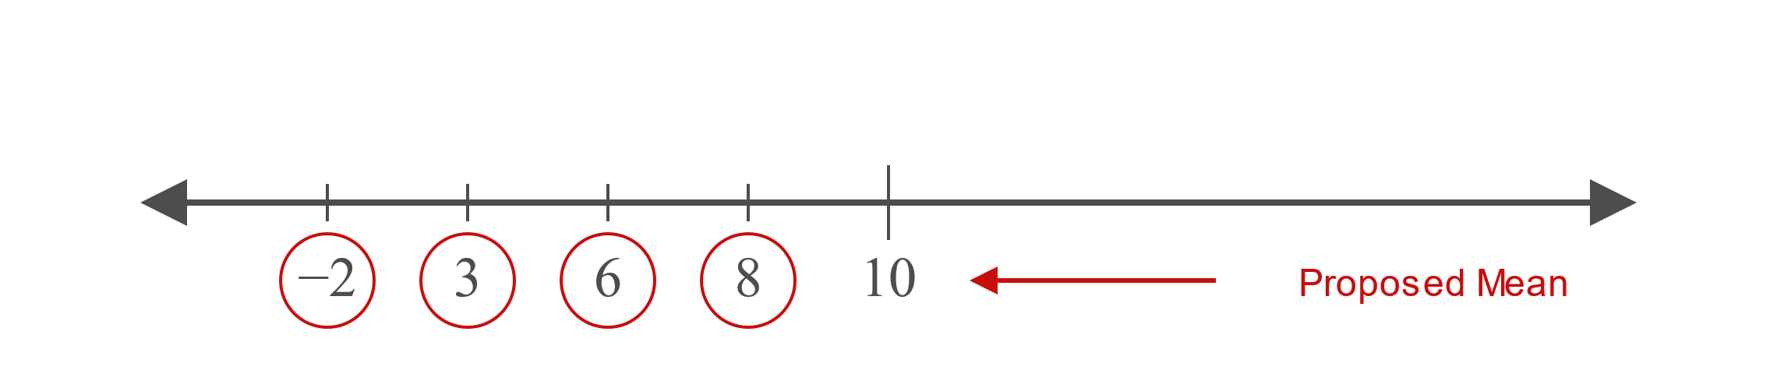
Example A1.7: Construct a Sample (cont.)
Now select a value for the mean which is larger than any of these numbers.

Slide 31
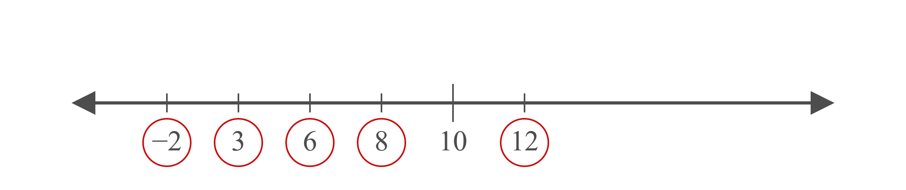
Example A1.7: Construct a Sample (cont.)
Now select one number larger than 10, say 12. Thus the sample now looks like this:

Slide 32
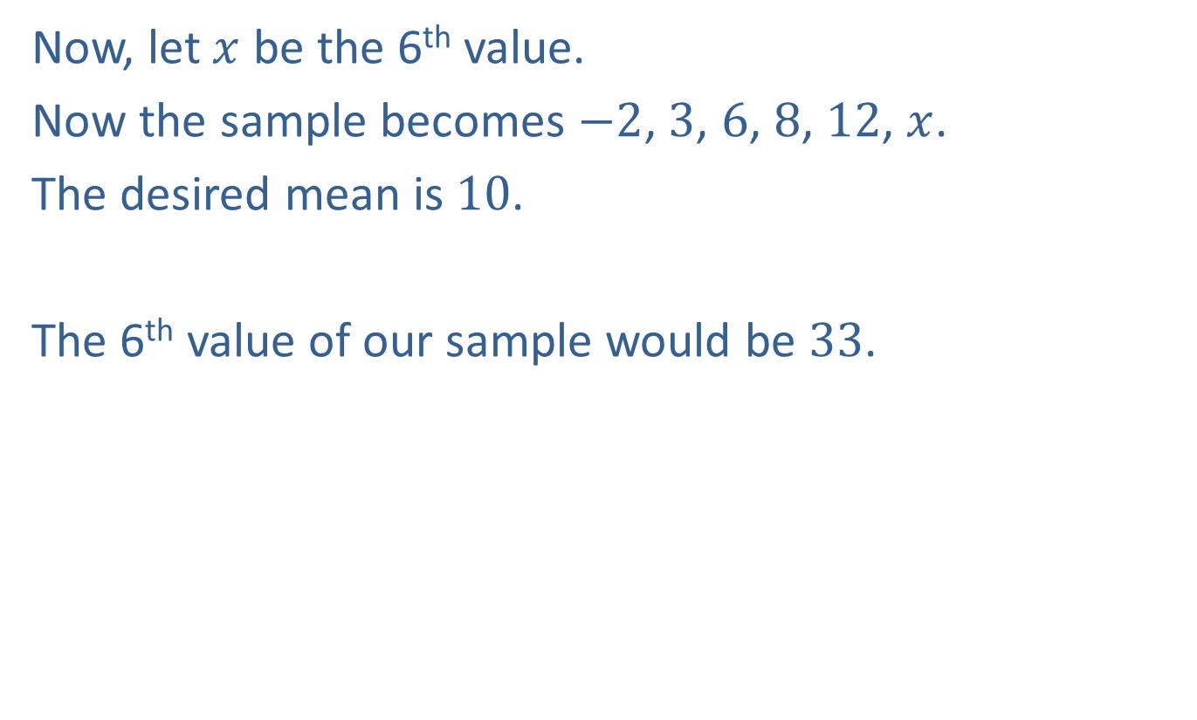
Example A1.7: Construct a Sample (cont.)
Now, let $x$ be the 6th value.
Now the sample becomes $−2$, 3, 6, 8, 12, $x$.
The desired mean is 10.
​
The 6th value of our sample would be 33.

Slide 33
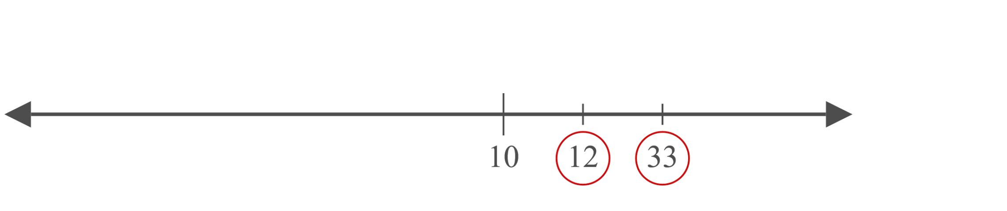
Example A1.7: Construct a Sample (cont.)

Slide 34

Example A1.7: Construct a Sample (cont.)
Thus the sample becomes $−2$, 3, 6, 8, 12, 33.

