Slide 1
Section A.2
Games of Chance

Slide 2
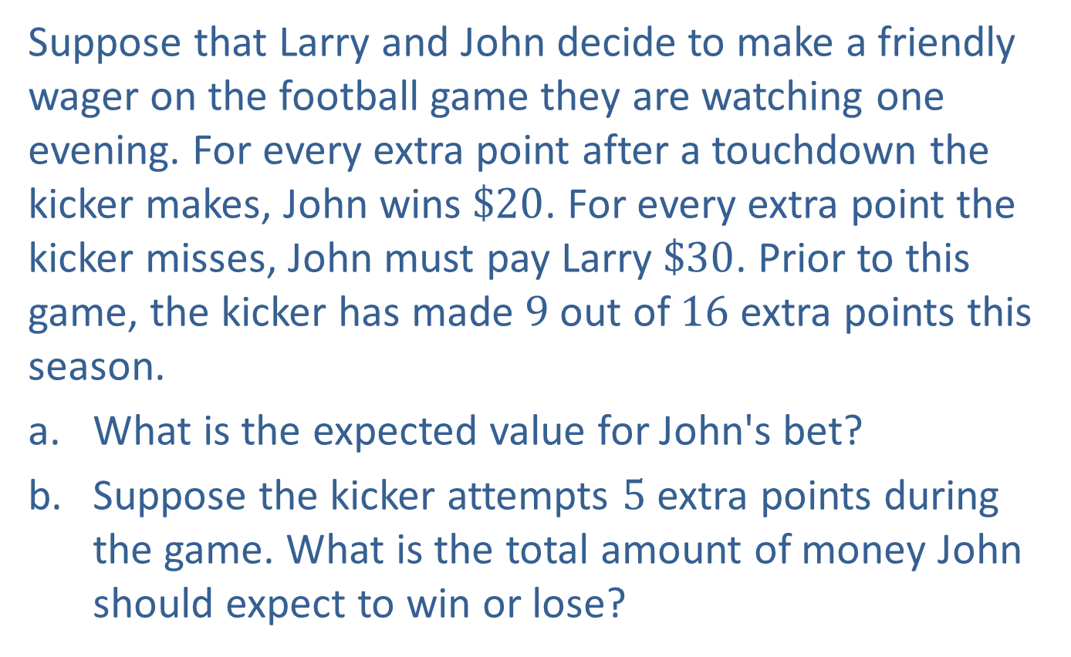
Example A2.1: Expected Value
Suppose that Larry and John decide to make a friendly wager on the football game they are watching one evening. For every extra point after a touchdown the kicker makes, John wins $\$20$. For every extra point the kicker misses, John must pay Larry $\$30$. Prior to this game, the kicker has made 9 out of 16 extra points this season.
​What is the expected value for John's bet?
​Suppose the kicker attempts 5 extra points during the game. What is the total amount of money John should expect to win or lose?

Slide 3
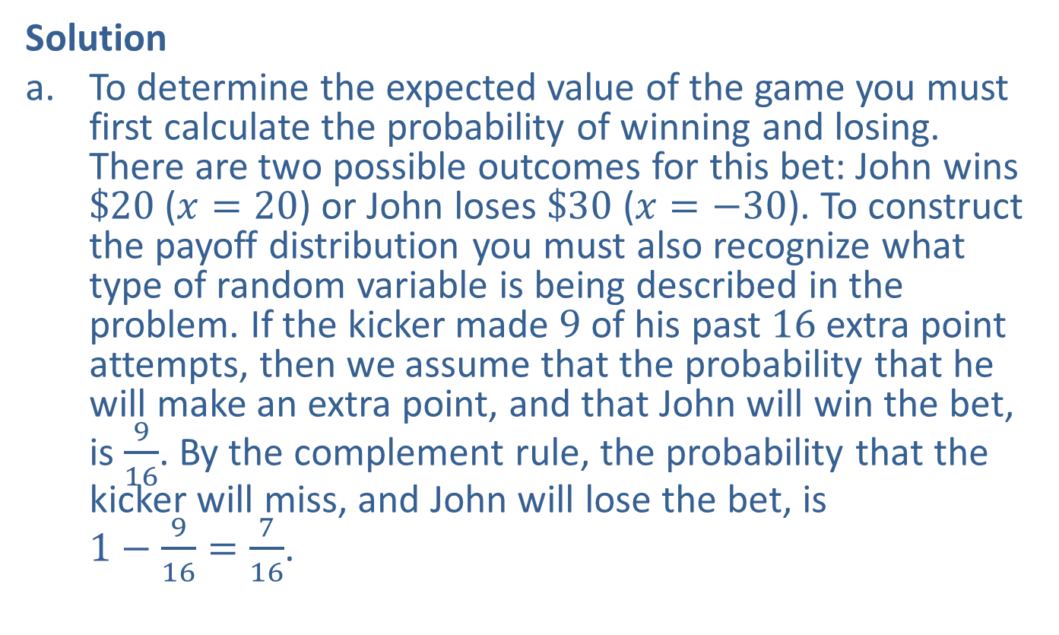
Example A2.1: Expected Value (cont.)
Solution
​To determine the expected value of the game you must first calculate the probability of winning and losing. There are two possible outcomes for this bet: John wins $\$20$ ($x=20$) or John loses $\$30$ ($x=−30$). To construct the payoff distribution you must also recognize what type of random variable is being described in the problem. If the kicker made 9 of his past 16 extra point attempts, then we assume that the probability that he will make an extra point, and that John will win the bet, is $\frac{9}{16}$. By the complement rule, the probability that the kicker will miss, and John will lose the bet, is $1−\frac{9}{16}=\frac{7}{16}$.

Slide 4
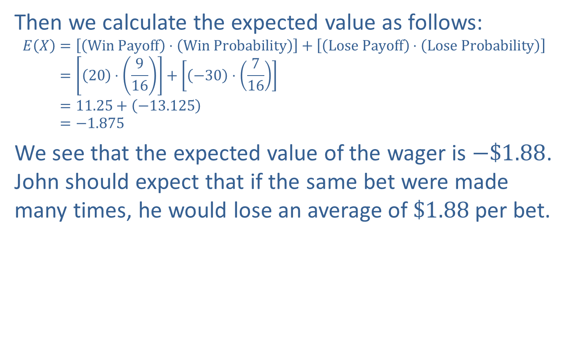
Example A2.1: Expected Value (cont.)
​Then we calculate the expected value as follows:
𝐸𝑋=Win Payoff⋅Win Probability+Lose Payoff⋅Lose Probability𝐸⁡𝑋=20⋅916+−30⋅716𝐸⁡𝑋=11.25+−13.125𝐸⁡𝑋=−1.875
​We see that the expected value of the wager is $−\$1.88$. John should expect that if the same bet were made many times, he would lose an average of $\$1.88$ per bet.

Slide 5
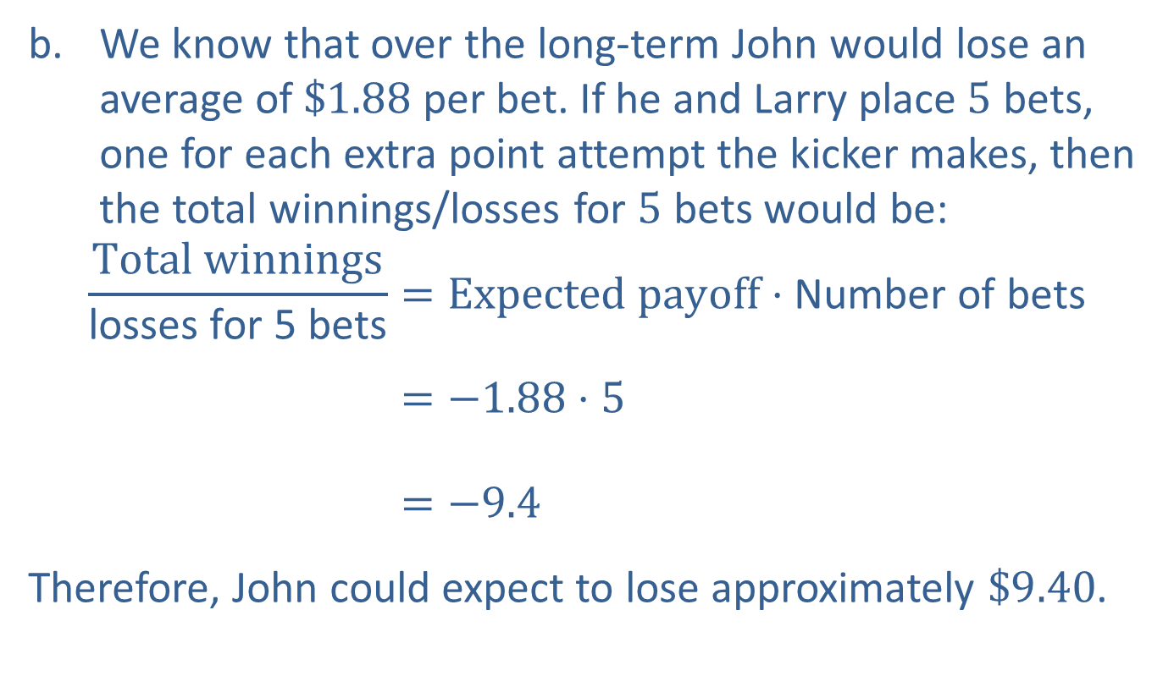
Example A2.1: Expected Value (cont.)
​We know that over the long-term John would lose an average of $\$1.88$ per bet. If he and Larry place 5 bets, one for each extra point attempt the kicker makes, then the total winnings/losses for 5 bets would be:
Total winningslosses for 5 bets=Expected payoff⋅Number of betsTotal winningslosses for 5 bets=−1.88⋅5Total winningslosses for 5 bets=−9.4
​Therefore, John could expect to lose approximately $\$9.40$.

Slide 6
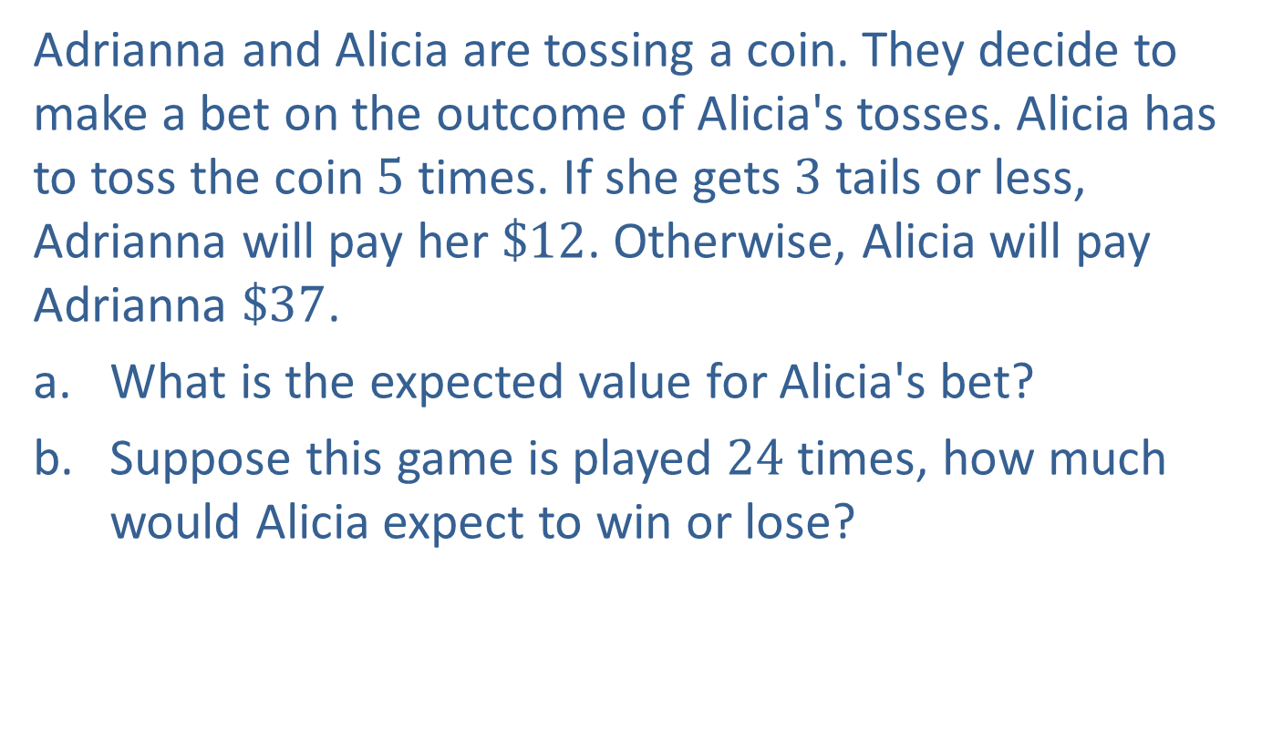
Example A2.2: Expected Value
Adrianna and Alicia are tossing a coin. They decide to make a bet on the outcome of Alicia's tosses. Alicia has to toss the coin 5 times. If she gets 3 tails or less, Adrianna will pay her $\$12$. Otherwise, Alicia will pay Adrianna $\$37$.
​What is the expected value for Alicia's bet?
​Suppose this game is played 24 times, how much would Alicia expect to win or lose?

Slide 7
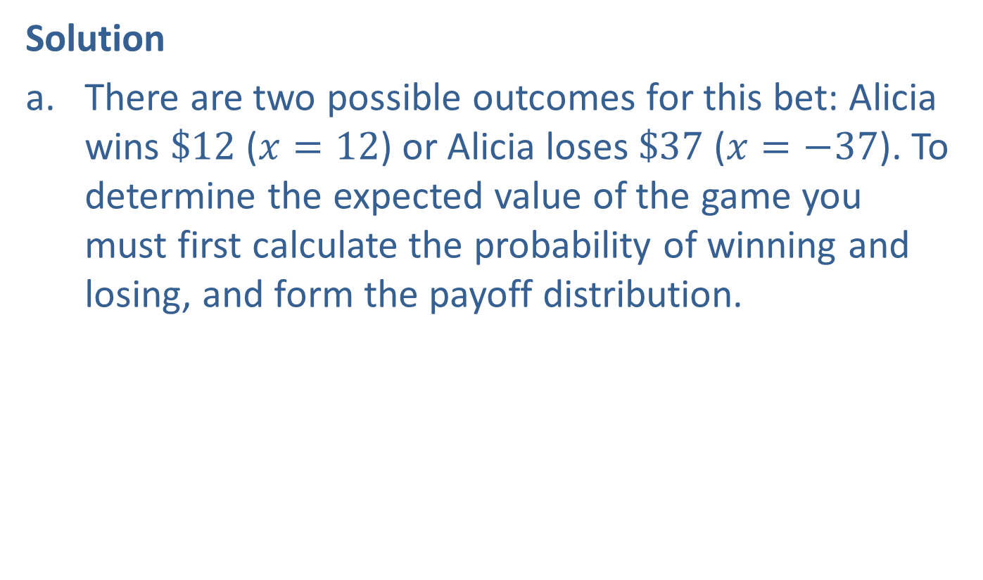
Example A2.2: Expected Value (cont.)
Solution
​There are two possible outcomes for this bet: Alicia wins $\$12$ ($x=12$) or Alicia loses $\$37$ ($x=−37$). To determine the expected value of the game you must first calculate the probability of winning and losing, and form the payoff distribution.
​
​

Slide 8
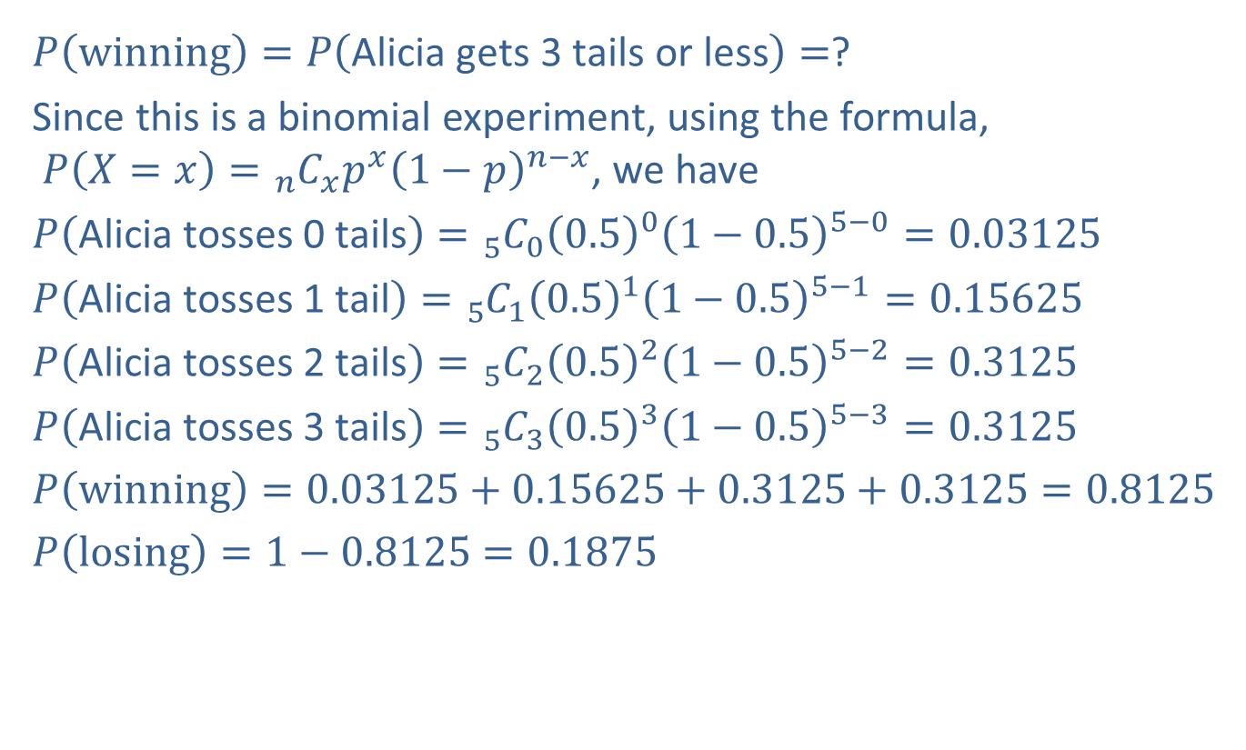
Example A2.2: Expected Value (cont.)
​$P\left(winning\right)=P\left(\text{Alicia} \text{gets}\text{ 3 }\text{tails} \text{or} \text{less}\right)=$?
​Since this is a binomial experiment, using the formula, $P\left(X=x\right)={}_{n}^{ }{C_{x}}p^{x}{\left(1−p\right)}^{n−x}$, we have
​$P\left(\text{Alicia} \text{tosses}\text{ 0 }\text{tails}\right)={}_{5}^{ }{C_{0}}{\left(0.5\right)}^{0}{\left(1−0.5\right)}^{5−0}=0.03125$
​$P\left(\text{Alicia} \text{tosses}\text{ 1 }\text{tail}\right)={}_{5}^{ }{C_{1}}{\left(0.5\right)}^{1}{\left(1−0.5\right)}^{5−1}=0.15625$
​$P\left(\text{Alicia} \text{tosses}\text{ 2 }\text{tails}\right)={}_{5}^{ }{C_{2}}{\left(0.5\right)}^{2}{\left(1−0.5\right)}^{5−2}=0.3125$
​$P\left(\text{Alicia} \text{tosses}\text{ 3 }\text{tails}\right)={}_{5}^{ }{C_{3}}{\left(0.5\right)}^{3}{\left(1−0.5\right)}^{5−3}=0.3125$
​$P\left(winning\right)=0.03125+0.15625+0.3125+0.3125=0.8125$
​$P\left(losing\right)=1−0.8125=0.1875$

Slide 9

Example A2.2: Expected Value (cont.)
​Then we calculate the expected value as follows:
𝐸𝑋=Win Payoff⋅Win Probability+Lose Payoff⋅Lose Probability𝐸⁡𝑋=12⋅0.8125+−37⋅0.1875𝐸⁡𝑋=9.75+−6.9375𝐸⁡𝑋=2.8125
​We see that the expected value of the wager is $\$2.81$.

Slide 10

Example A2.2: Expected Value (cont.)
b.
Total winnings/losses for 24 games=Expected payoff⋅Number of betsTotal winnings/losses for 24 games=2.81⋅24Total winnings/losses for 24 games=67.44
​Therefore, Alicia could expect to win approximately $\$67.44$.

Slide 11
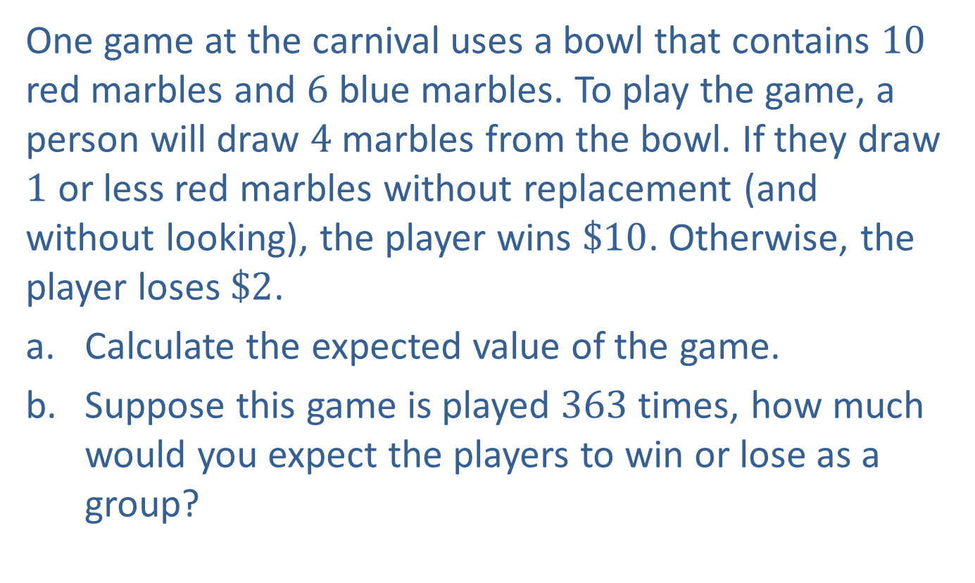
Example A2.3: Expected Value
One game at the carnival uses a bowl that contains 10 red marbles and 6 blue marbles. To play the game, a person will draw 4 marbles from the bowl. If they draw 1 or less red marbles without replacement (and without looking), the player wins $\$10$. Otherwise, the player loses $\$2$.
​Calculate the expected value of the game.
​Suppose this game is played 363 times, how much would you expect the players to win or lose as a group?

Slide 12
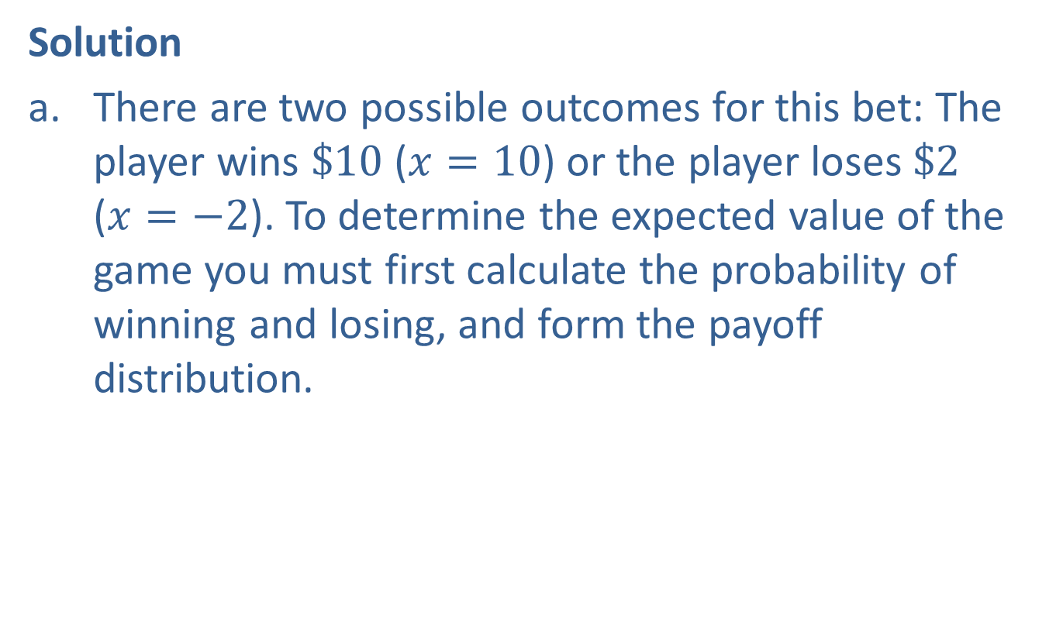
Example A2.3: Expected Value (cont.)
Solution
​There are two possible outcomes for this bet: The player wins $\$10$ ($x=10$) or the player loses $\$2$ ($x=−2$). To determine the expected value of the game you must first calculate the probability of winning and losing, and form the payoff distribution.
​

Slide 13
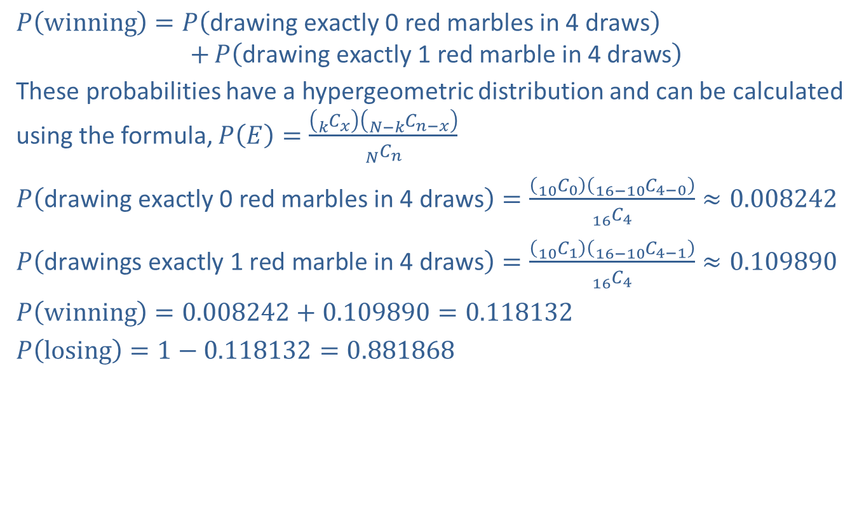
Example A2.3: Expected Value (cont.)
​$P\left(winning\right)=P\left(\text{drawing} \text{exactly} \text{0 }\text{red} \text{marbles} \text{in} \text{4 }\text{draws}\right)$
$$+P\left(\text{drawing} \text{exactly} \text{1 }\text{red} \text{marble} \text{in} \text{4 }\text{draws}\right)$$
​These probabilities have a hypergeometric distribution and can be calculated using the formula, $P\left(E\right)=\frac{\left({}_{k}^{ }{C_{x}}\right)\left({}_{N−k}^{ }{C_{n−x}}\right)}{{}_{N}^{ }{C_{n}}}$
​$P\left(\text{drawing} \text{exactly} \text{0 }\text{red} \text{marbles} \text{in} \text{4 }\text{draws}\right)=\frac{\left({}_{10}^{ }{C_{0}}\right)\left({}_{16−10}^{ }{C_{4−0}}\right)}{{}_{16}^{ }{C_{4}}}≈0.008242$
​$P\left(\text{drawings} \text{exactly} \text{1 }\text{red} \text{marble} \text{in} \text{4 }\text{draws}\right)=\frac{\left({}_{10}^{ }{C_{1}}\right)\left({}_{16−10}^{ }{C_{4−1}}\right)}{{}_{16}^{ }{C_{4}}}≈0.109890$
​$P\left(winning\right)=0.008242+0.109890=0.118132$
​$P\left(losing\right)=1−0.118132=0.881868$
​

Slide 14

Example A2.3: Expected Value (cont.)
​Then we calculate the expected value as follows:
𝐸𝑋=Win Payoff⋅Win Probability+Lose Payoff⋅Lose Probability𝐸⁡𝑋=10⋅0.118132+−2⋅0.881868𝐸⁡𝑋=1.18132+−1.763736𝐸⁡𝑋≈−0.582
​We see that the expected value of the wager is $−\$0.58$.

Slide 15

Example A2.3: Expected Value (cont.)
b.
Total winnings/losses for 363 games=Expected payoff⋅Number of betsTotal winnings/losses for 363 games=−0.58⋅363Total winnings/losses for 363 games=−210.54
​Therefore, the players could expect to lose approximately $\$210.54$.

