Slide 1
Section A.6
Statistical Process Control

Slide 2
Control Chart
Definition
A control chart for a process consists of values plotted over time used as a graphical display to detect unusual variation in a process.
A Control Chart consists of three horizontal lines:
​A Center Line that represents the average value of the quality characteristic corresponding to the in-control state.
​An upper bound called the Upper Control Limit (UCL)
​A lower bound called the Lower Control Limit (LCL)

Slide 3
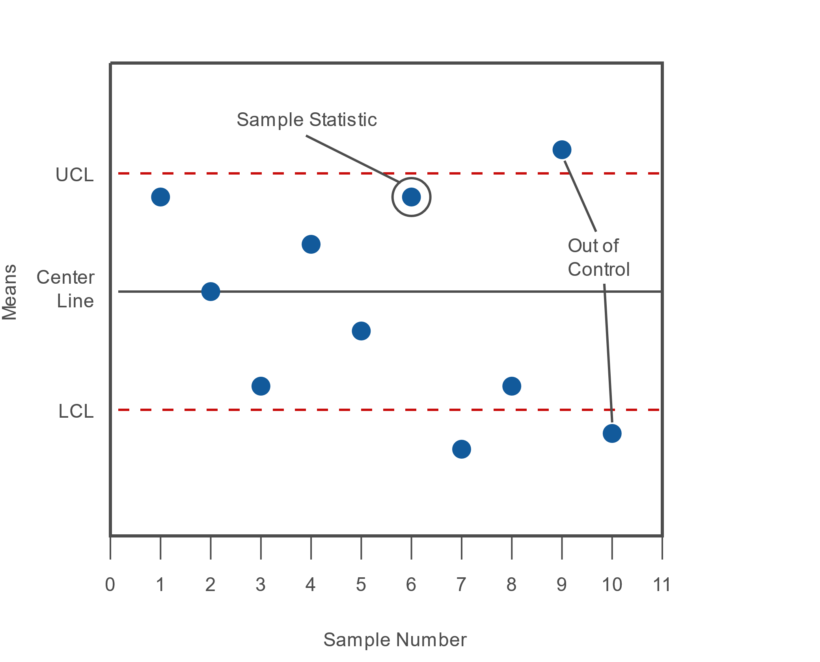
Control Chart (cont.)
Figure A6.1

Slide 4
Control Chart (cont.)
Each point on the chart represents a sample statistic which has been calculated for the sample taken at a particular time period. The sample statistic will vary depending on the type of the control chart which is being used. If the sample statistic falls above the UCL or below the LCL, this signals unusual variation in the process and the process is deemed to be "Out of Control."

Slide 5
The Highway Control Chart
When you are driving a car and you stay in your lane, you could say that you are operating the car "in control." The white lines that define your lane are similar to the UCL and LCL. The car would be expected to move around within the lane, which would be normal process variation. Veering outside your lane might have assignable causes such as cell phone usage, children fighting in the back seat, or any number of other distractions.

Slide 6
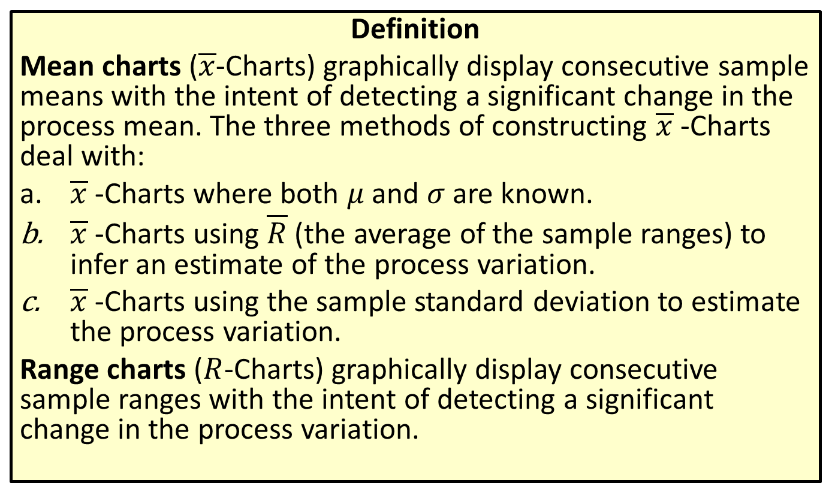
Control Charts for Continuous Variables
Definition
Mean charts ($\overline{x}$-Charts) graphically display consecutive sample means with the intent of detecting a significant change in the process mean. The three methods of constructing $\overline{x}$-Charts deal with:
​$\overline{x}$-Charts where both $μ$ and $σ$ are known.
$\overline{x}$​-Charts using $\overline{R}$ (the average of the sample ranges) to infer an estimate of the process variation.
$\overline{x}$​-Charts using the sample standard deviation to estimate the process variation.
Range charts ($R$-Charts) graphically display consecutive sample ranges with the intent of detecting a significant change in the process variation.

Slide 7
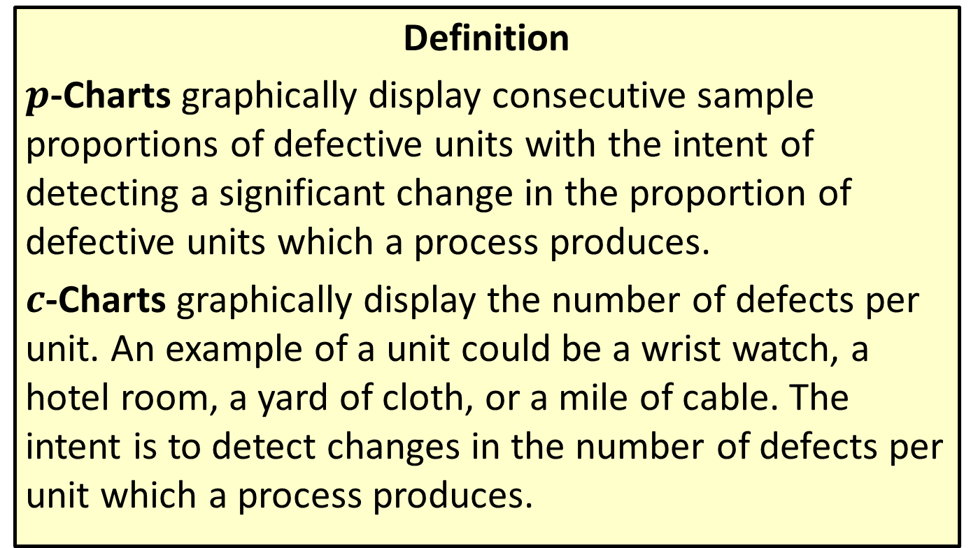
Control Charts for Attributes
Definition
$p$-Charts graphically display consecutive sample proportions of defective units with the intent of detecting a significant change in the proportion of defective units which a process produces.
$c$-Charts graphically display the number of defects per unit. An example of a unit could be a wrist watch, a hotel room, a yard of cloth, or a mile of cable. The intent is to detect changes in the number of defects per unit which a process produces.

Slide 8
Note
If the same number of units are sampled at each time period (which, in general, they should be), the Center Line can also be calculated by finding the proportion of defective units in each sample and then averaging the sample proportions.

Slide 9
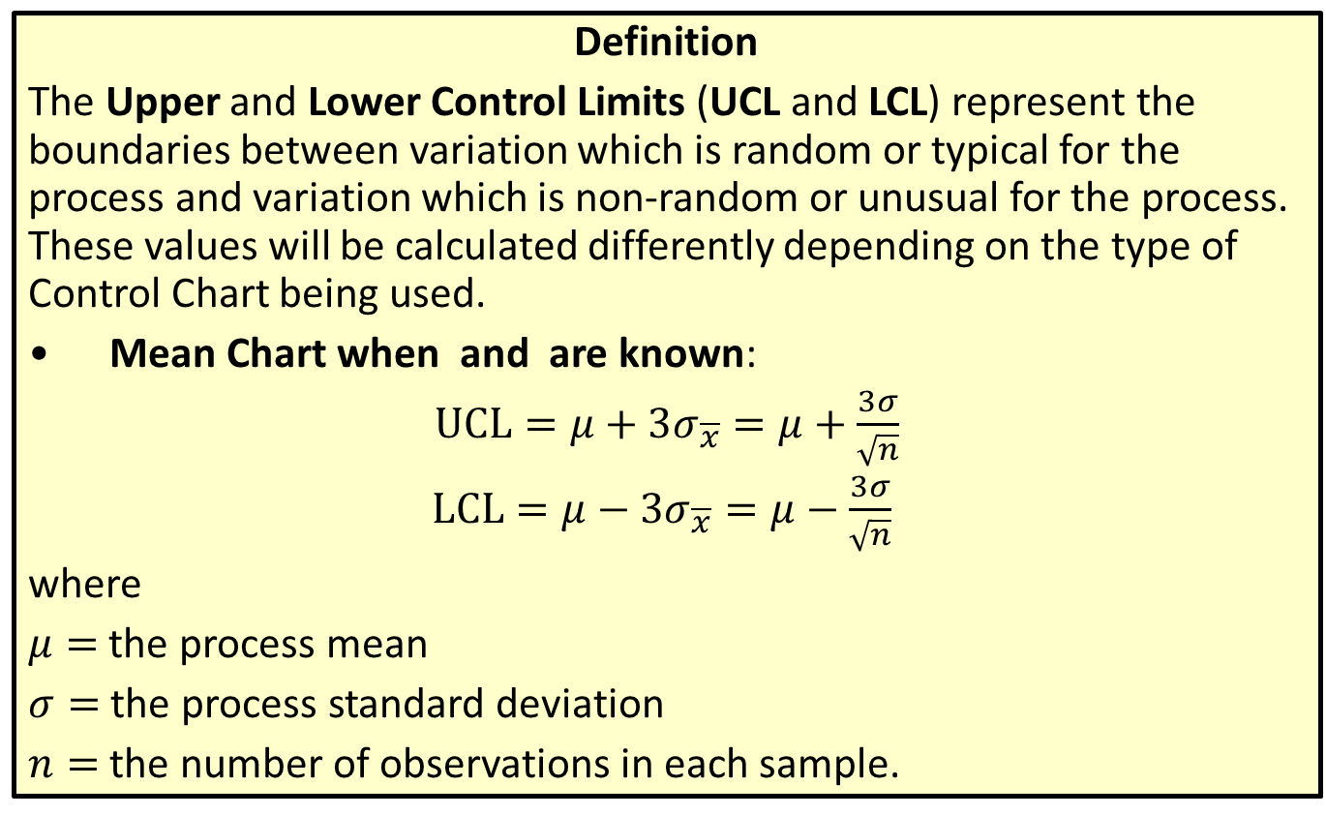
Upper and Lower Control Limits
Definition
The Upper and Lower Control Limits (UCL and LCL) represent the boundaries between variation which is random or typical for the process and variation which is non-random or unusual for the process. These values will be calculated differently depending on the type of Control Chart being used.
​Mean Chart when and are known:
$UCL=μ+3σ_{\overline{x}}=μ+\frac{3σ}{\sqrt{n}}$​
$LCL=μ−3σ_{\overline{x}}=μ−\frac{3σ}{\sqrt{n}}$ ​
​where
​$μ=$ the process mean
​$σ=$ the process standard deviation
​$n=$ the number of observations in each sample.

Slide 10
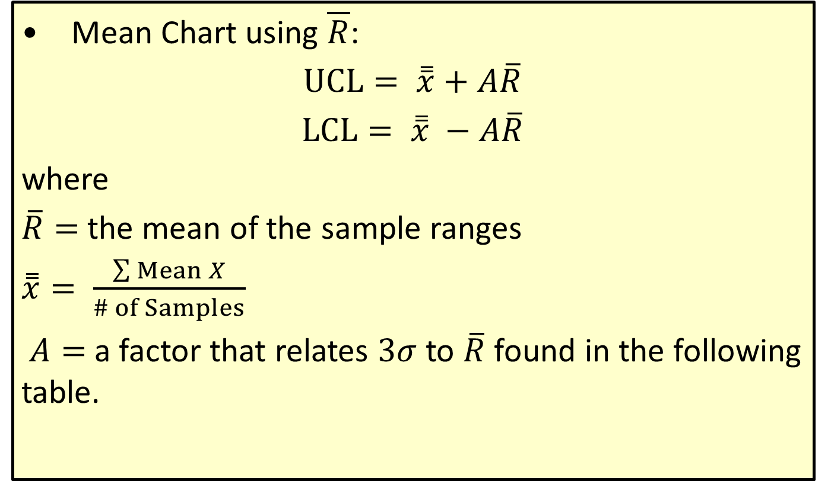
Upper and Lower Control Limits (cont.)
​Mean Chart using $\overline{R}$:
$UCL= \overset{̿}{x}+A\overline{R}$​
​$LCL= \overset{̿}{x} −A\overline{R}$
​where
​$\overline{R}=$the mean of the sample ranges
​$\overset{̿}{x}= \frac{\sum{Mean X}}{\# of Samples}$
​ $A=$a factor that relates $3σ$ to $\overline{R}$ found in the following table.

Slide 11
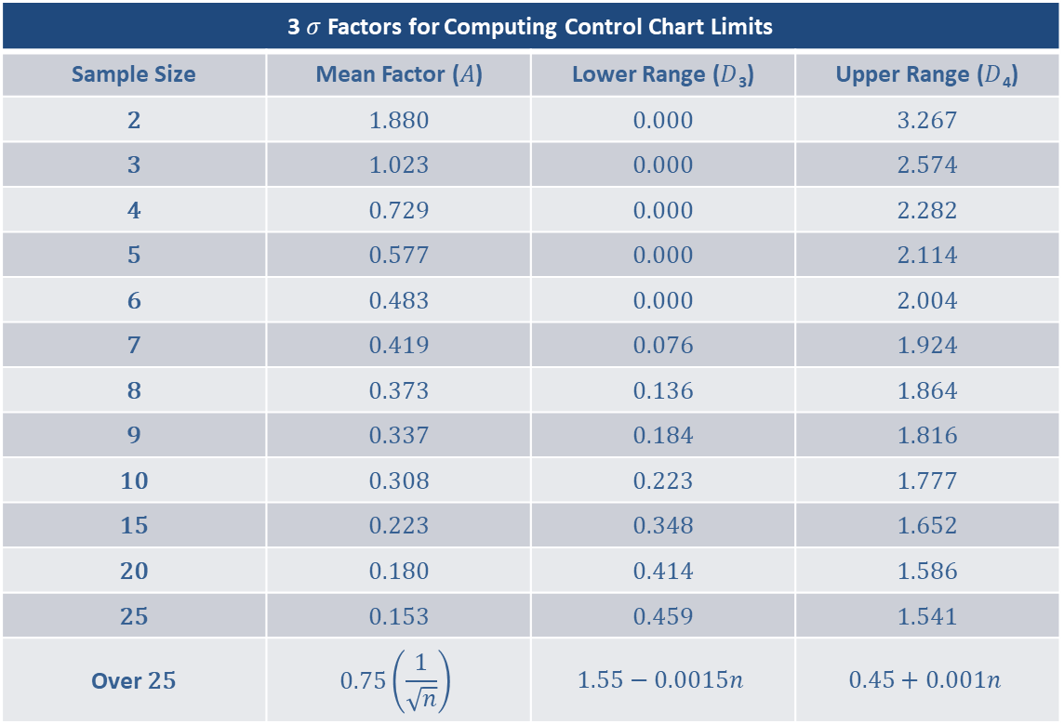
Upper and Lower Control Limits (cont.)
3 Factors for Computing Control Chart Limits
Sample Size | Mean Factor () | Lower Range (₃) | Upper Range (₄)
2 | 1.880 | 0.000 | 3.267
3 | 1.023 | 0.000 | 2.574
4 | 0.729 | 0.000 | 2.282
5 | 0.577 | 0.000 | 2.114
6 | 0.483 | 0.000 | 2.004
7 | 0.419 | 0.076 | 1.924
8 | 0.373 | 0.136 | 1.864
9 | 0.337 | 0.184 | 1.816
10 | 0.308 | 0.223 | 1.777
15 | 0.223 | 0.348 | 1.652
20 | 0.180 | 0.414 | 1.586
25 | 0.153 | 0.459 | 1.541
Over 25
Sample Size
2 | 1.880 | 0.000 | 3.267
3 | 1.023 | 0.000 | 2.574
4 | 0.729 | 0.000 | 2.282
5 | 0.577 | 0.000 | 2.114
6 | 0.483 | 0.000 | 2.004
7 | 0.419 | 0.076 | 1.924
8 | 0.373 | 0.136 | 1.864
9 | 0.337 | 0.184 | 1.816
10 | 0.308 | 0.223 | 1.777
15 | 0.223 | 0.348 | 1.652
20 | 0.180 | 0.414 | 1.586
25 | 0.153 | 0.459 | 1.541
Over 25

Slide 12
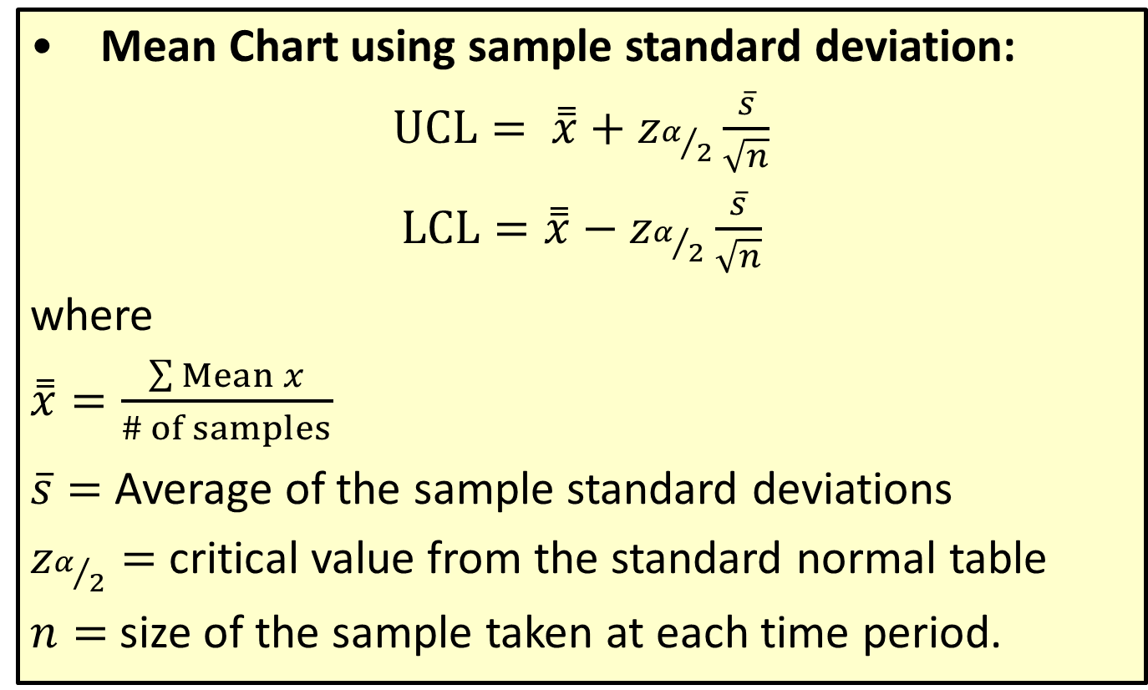
Upper and Lower Control Limits (cont.)
​Mean Chart using sample standard deviation:
$UCL= \overset{̿}{x}+z_{α/2}\frac{\overline{s}}{\sqrt{n}}$​
​$LCL=\overset{̿}{x}−z_{α/2}\frac{\overline{s}}{\sqrt{n}}$
​where
​$\overset{̿}{x}=\frac{\sum{Mean x}}{\# of samples}$
​$\overline{s}=$ Average of the sample standard deviations
​$z_{α/2}=$ critical value from the standard normal table
​$n=$ size of the sample taken at each time period.

Slide 13
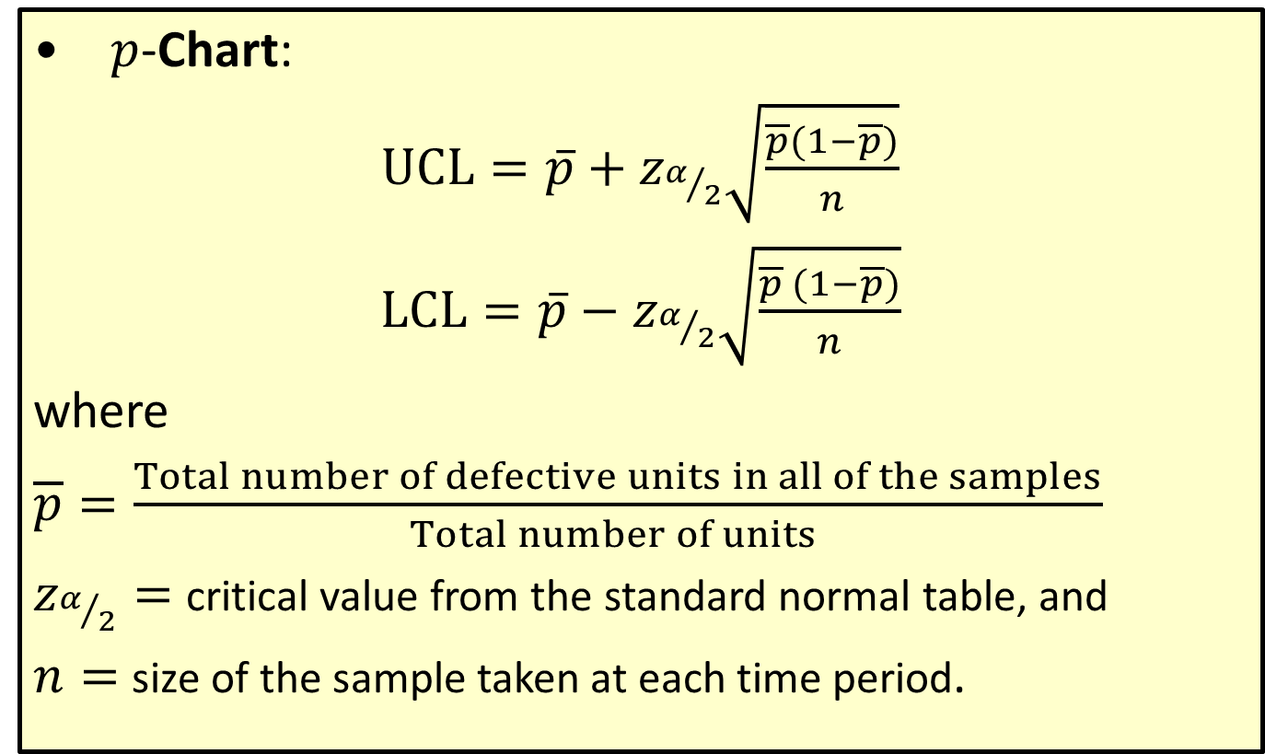
Upper and Lower Control Limits (cont.)
$p$​-Chart:
$UCL=\overline{p}+z_{α/2}\sqrt{\frac{\overline{p}(1−\overline{p})}{n}}$​
​$LCL=\overline{p}−z_{α/2}\sqrt{\frac{\overline{p} (1−\overline{p})}{n}}$
​where
$\overline{p}=\frac{Total number of defective units in all of the samples}{Total number of units }$​
$z_{α/2}=$​ critical value from the standard normal table, and
$n=$ size of the sample taken at each time period​.

Slide 14
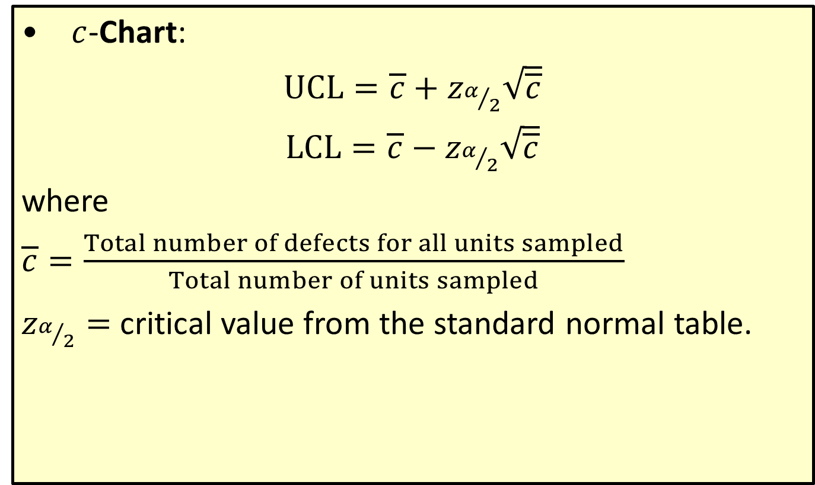
Upper and Lower Control Limits (cont.)
$c$​-Chart:
$UCL=\overline{c}+z_{α/2}\sqrt{\overline{c}}$​
​$LCL=$ $\overline{c}−z_{α/2}\sqrt{\overline{c}}$
​where
​$\overline{c}=\frac{Total number of defects for all units sampled}{Total number of units sampled}$
​$z_{α/2}=$ critical value from the standard normal table.

Slide 15
Note
The wider the control limits the less likely we are to make a Type I Error. However, we do not want to make the control limits too wide, because then we are more likely to conclude that the process is "In Control" when it is not (i.e., make a Type II Error).

Slide 16
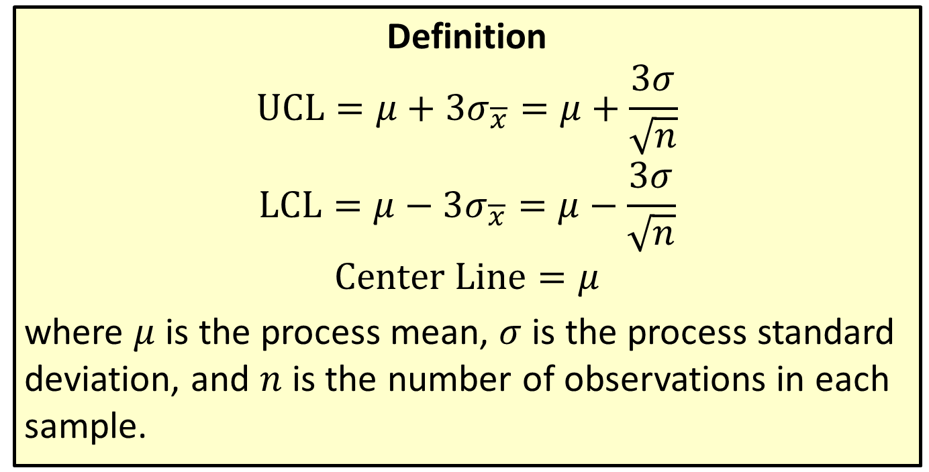

$3σ$ Control Limits for $\overline{x}$ When Standard Values of the Process Mean and Standard Deviation Are Known
Definition
$$UCL=μ+3σ_{\overline{x}}=μ+\frac{3σ}{\sqrt{n}}$$
$$LCL=μ−3σ_{\overline{x}}=μ−\frac{3σ}{\sqrt{n}}$$
$$Center Line=μ$$
where $μ$ is the process mean, $σ$ is the process standard deviation, and $n$ is the number of observations in each sample.

Slide 17
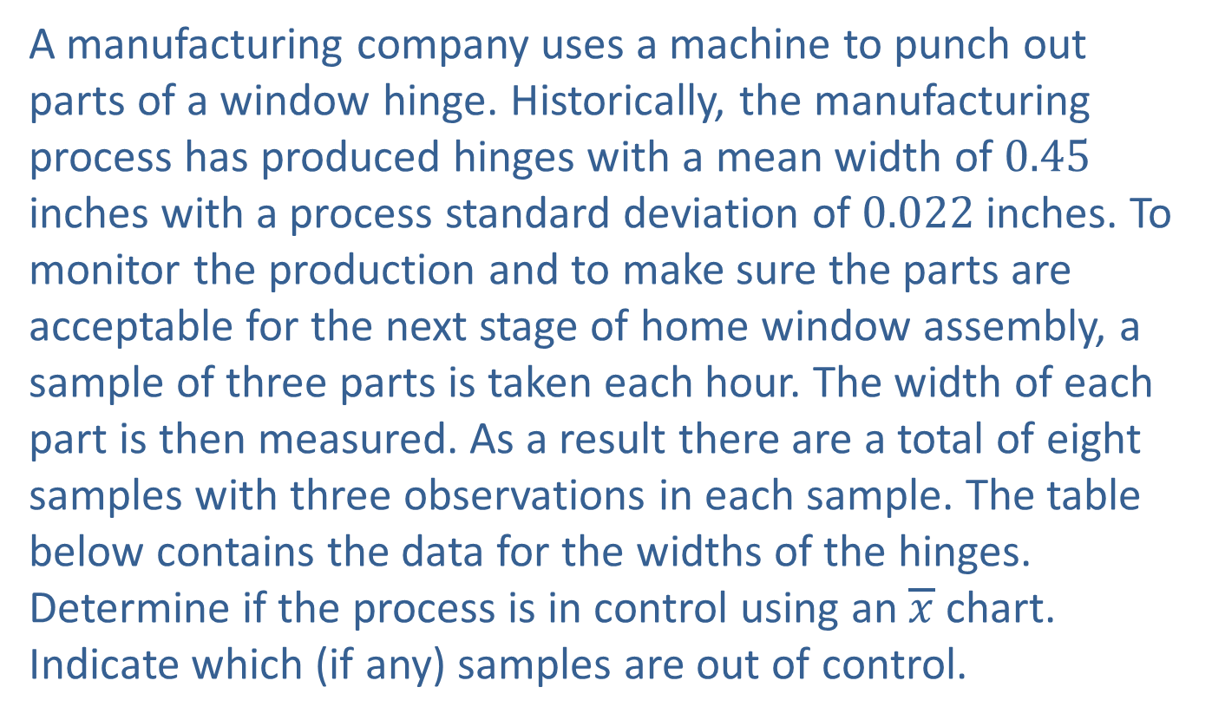
Example A6.1
A manufacturing company uses a machine to punch out parts of a window hinge. Historically, the manufacturing process has produced hinges with a mean width of 0.45 inches with a process standard deviation of 0.022 inches. To monitor the production and to make sure the parts are acceptable for the next stage of home window assembly, a sample of three parts is taken each hour. The width of each part is then measured. As a result there are a total of eight samples with three observations in each sample. The table below contains the data for the widths of the hinges. Determine if the process is in control using an $\overline{x}$ chart. Indicate which (if any) samples are out of control.

Slide 18
Example A6.1 (cont.)
Sampling Data for Window Hinges (Inches)
Sample Number | Observation 1 | Observation 2 | Observation 3
1 | 0.42 | 0.48 | 0.46
2 | 0.44 | 0.48 | 0.45
3 | 0.44 | 0.45 | 0.41
4 | 0.47 | 0.42 | 0.46
5 | 0.53 | 0.43 | 0.42
6 | 0.47 | 0.42 | 0.45
7 | 0.44 | 0.47 | 0.50
8 | 0.48 | 0.43 | 0.44

Slide 19
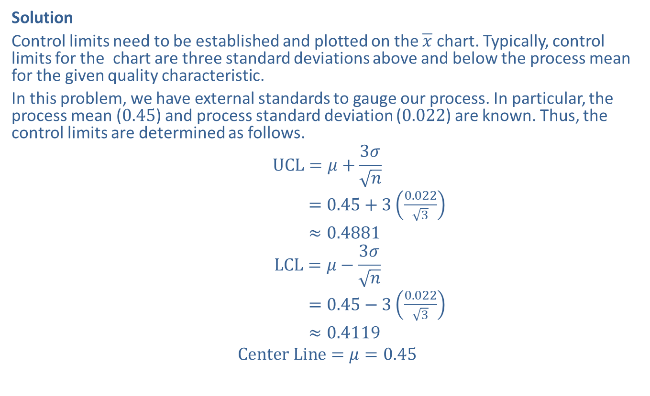
Example A6.1 (cont.)
Solution
Control limits need to be established and plotted on the $\overline{x}$ chart. Typically, control limits for the chart are three standard deviations above and below the process mean for the given quality characteristic.
In this problem, we have external standards to gauge our process. In particular, the process mean (0.45) and process standard deviation (0.022) are known. Thus, the control limits are determined as follows.
$$UCL=μ+\frac{3σ}{\sqrt{n}}$$
$=0.45+3\left(\frac{0.022}{\sqrt{3}}\right)$
$≈0.4881$
$$LCL=μ−\frac{3σ}{\sqrt{n}}$$
$=0.45−3\left(\frac{0.022}{\sqrt{3}}\right)$
$≈0.4119$
$$Center Line=μ=0.45$$

Slide 20
Example A6.1 (cont.)
Sampling Data for Window Hinges (Inches) with Sample Mean
Sample | Observation 1 | Observation 2 | Observation 3 | Sample Mean
1 | 0.42 | 0.48 | 0.46 | 0.453
2 | 0.44 | 0.48 | 0.45 | 0.457
3 | 0.44 | 0.45 | 0.41 | 0.433
4 | 0.47 | 0.42 | 0.46 | 0.450
5 | 0.53 | 0.43 | 0.42 | 0.460
6 | 0.47 | 0.42 | 0.45 | 0.447
7 | 0.44 | 0.47 | 0.50 | 0.470
8 | 0.48 | 0.43 | 0.44 | 0.450

Slide 21
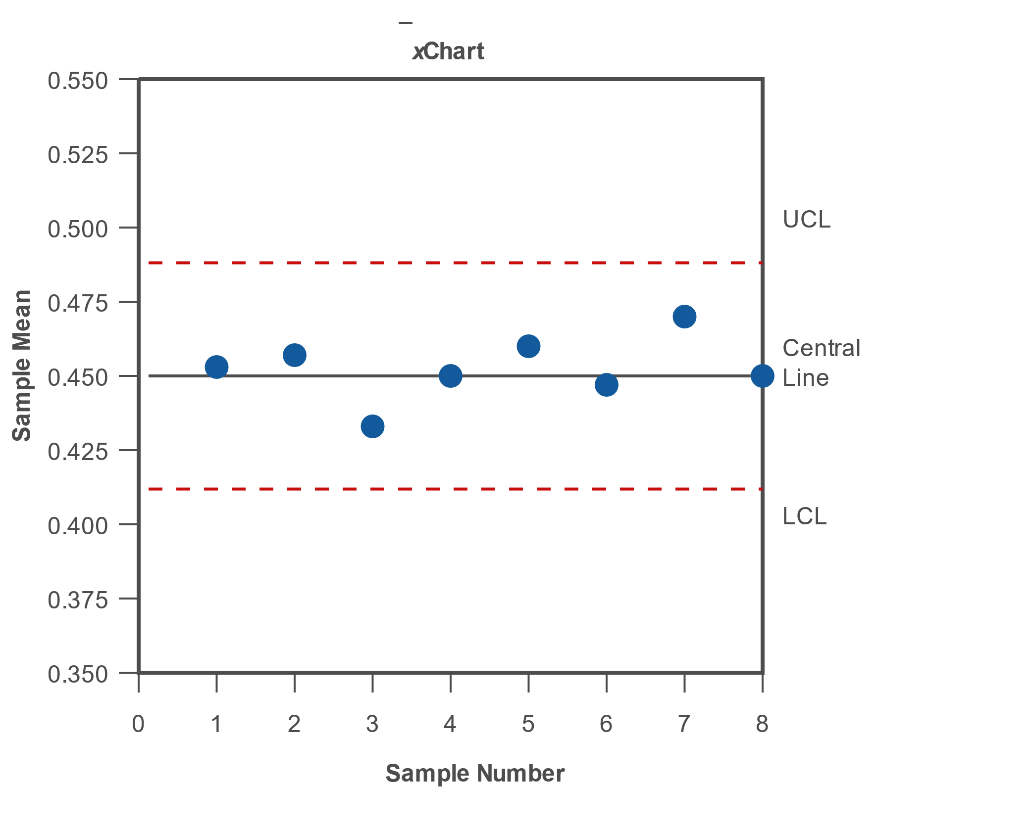
Example A6.1 (cont.)

Slide 22
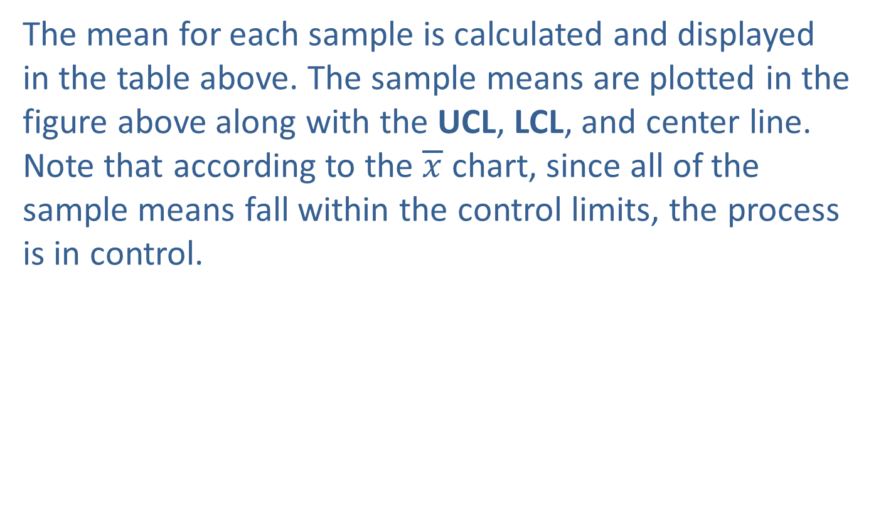
Example A6.1 (cont.)
The mean for each sample is calculated and displayed in the table above. The sample means are plotted in the figure above along with the UCL, LCL, and center line. Note that according to the $\overline{x}$ chart, since all of the sample means fall within the control limits, the process is in control.

Slide 23
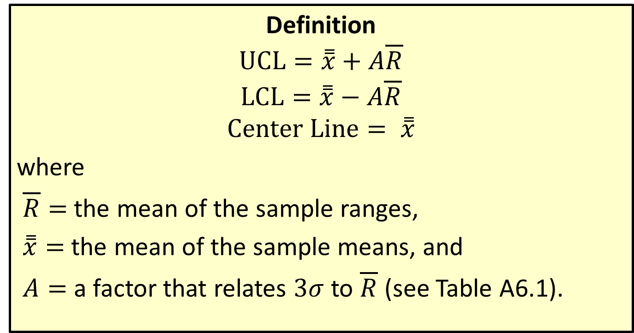

$3σ$ Control Limits for $\overline{x}$ When Standard Values of the Process Mean and Standard Deviation Are Unknown
Definition
$$UCL=\overset{̿}{x}+A\overline{R}$$
$$LCL=\overset{̿}{x}−A\overline{R}$$
$$Center Line= \overset{̿}{x}$$
where
$\overline{R}=$the mean of the sample ranges,
$\overset{̿}{x}=$the mean of the sample means, and
$A=$ a factor that relates $3σ$ to $\overline{R}$ (see Table A6.1).

Slide 24

Example A6.2
Using the window hinge data (reproduced below) and assuming that we do not know the mean or standard deviation of the process, construct the $\overline{x}$ chart for this process.

Slide 25
Example A6.2 (cont.)
Sampling Data for Window Hinges (Inches)
Sample Number | Observation 1 | Observation 2 | Observation 3
1 | 0.42 | 0.48 | 0.46
2 | 0.44 | 0.48 | 0.45
3 | 0.44 | 0.45 | 0.41
4 | 0.47 | 0.42 | 0.46
5 | 0.53 | 0.43 | 0.42
6 | 0.47 | 0.42 | 0.45
7 | 0.44 | 0.47 | 0.50
8 | 0.48 | 0.43 | 0.44

Slide 26
Example A6.2 (cont.)
Solution
In this example, we do not know the process standard deviation. However, we are going to use another measure of variation, the sample range, to compute the UCL and LCL. Since we do not know the true process mean, we are going to estimate that mean with , the mean of the sample means.
Before calculating the control limits for the chart, we need to perform some preliminary calculations. We need to calculate the mean and range for each sample. That is, the ^{th} sample mean and range are calculated as follows.
Note that is the number of observations in each sample.
The mean and range for each sample are presented in the following table.

Slide 27
Example A6.2 (cont.)
Sampling Data for Window Hinges (Inches) with Mean and Range
Sample Number | Observation 1 | Observation 2 | Observation 3 | Mean | Range
1 | 0.42 | 0.48 | 0.46 | 0.453 | 0.06
2 | 0.44 | 0.48 | 0.45 | 0.457 | 0.04
3 | 0.44 | 0.45 | 0.41 | 0.433 | 0.04
4 | 0.47 | 0.42 | 0.46 | 0.450 | 0.05
5 | 0.53 | 0.43 | 0.42 | 0.460 | 0.11
6 | 0.47 | 0.42 | 0.45 | 0.447 | 0.05
7 | 0.44 | 0.47 | 0.50 | 0.470 | 0.06
8 | 0.48 | 0.43 | 0.44 | 0.450 | 0.05

Slide 28
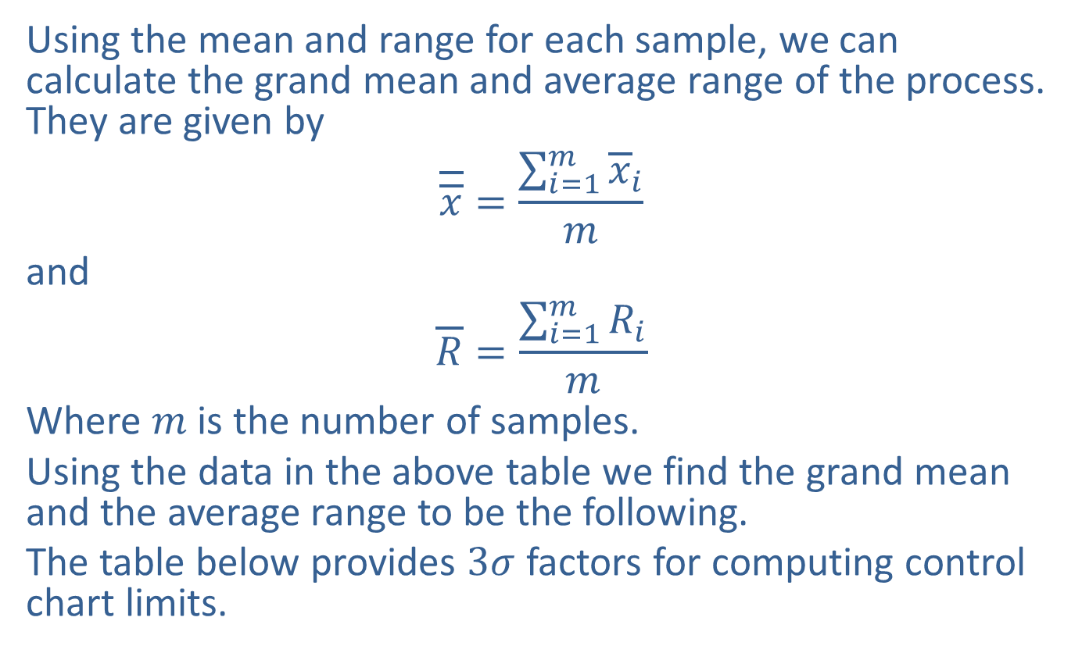
Example A6.2 (cont.)
Using the mean and range for each sample, we can calculate the grand mean and average range of the process. They are given by
$$\overline{\overline{x}}=\frac{\sum_{i=1}^{m}{{\overline{x}}_{i}}}{m}$$
and
$$\overline{R}=\frac{\sum_{i=1}^{m}{R_{i}}}{m}$$
Where $m$ is the number of samples.
Using the data in the above table we find the grand mean and the average range to be the following.
The table below provides $3σ$ factors for computing control chart limits.

Slide 29
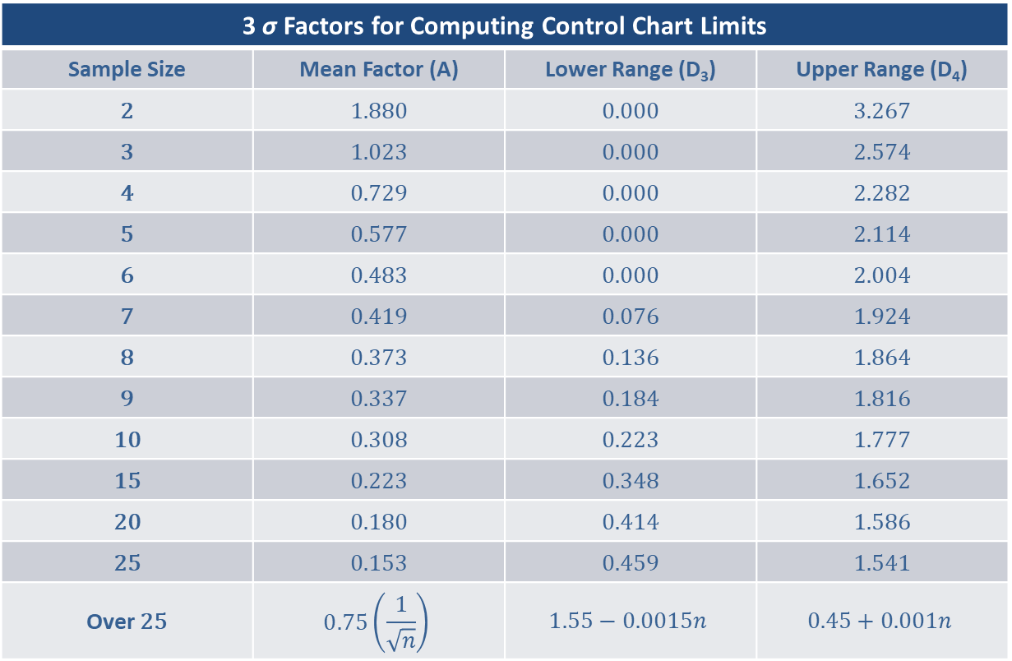
Example A6.2 (cont.)
3 σ Factors for Computing Control Chart Limits
Sample Size | Mean Factor (A) | Lower Range (D₃) | Upper Range (D₄)
2 | 1.880 | 0.000 | 3.267
3 | 1.023 | 0.000 | 2.574
4 | 0.729 | 0.000 | 2.282
5 | 0.577 | 0.000 | 2.114
6 | 0.483 | 0.000 | 2.004
7 | 0.419 | 0.076 | 1.924
8 | 0.373 | 0.136 | 1.864
9 | 0.337 | 0.184 | 1.816
10 | 0.308 | 0.223 | 1.777
15 | 0.223 | 0.348 | 1.652
20 | 0.180 | 0.414 | 1.586
25 | 0.153 | 0.459 | 1.541
Over 25
3 σ Factors for Computing Control Chart Limits
Sample Size | Mean Factor (A) | Lower Range (D₃) | Upper Range (D₄)
2 | 1.880 | 0.000 | 3.267
3 | 1.023 | 0.000 | 2.574
4 | 0.729 | 0.000 | 2.282
5 | 0.577 | 0.000 | 2.114
6 | 0.483 | 0.000 | 2.004
7 | 0.419 | 0.076 | 1.924
8 | 0.373 | 0.136 | 1.864
9 | 0.337 | 0.184 | 1.816
10 | 0.308 | 0.223 | 1.777
15 | 0.223 | 0.348 | 1.652
20 | 0.180 | 0.414 | 1.586
25 | 0.153 | 0.459 | 1.541
Over 25

Slide 30
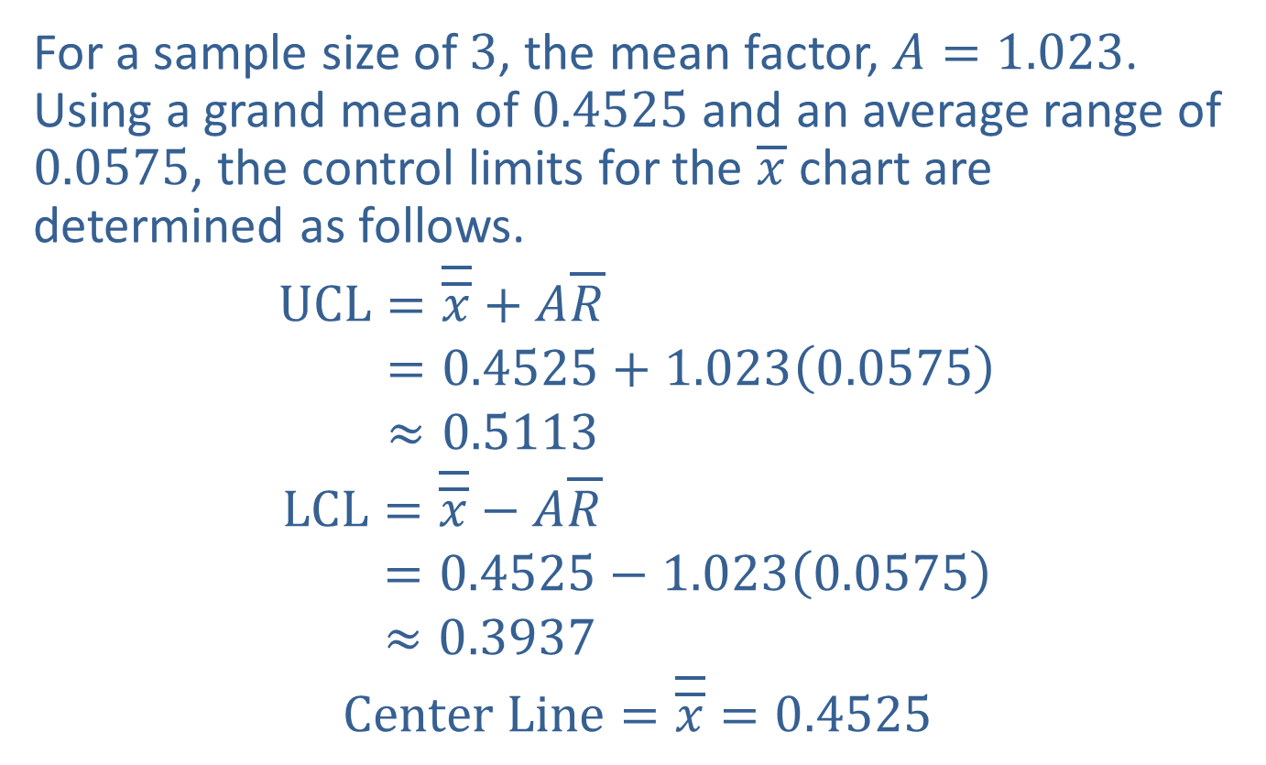
Example A6.2 (cont.)
For a sample size of 3, the mean factor, $A=1.023$. Using a grand mean of 0.4525 and an average range of 0.0575, the control limits for the $\overline{x}$ chart are determined as follows.
UCL=𝑥+𝐴𝑅UCL=0.4525+1.0230.0575UCL≈0.5113
LCL=𝑥−𝐴𝑅LCL=0.4525−1.0230.0575LCL≈0.3937
$$Center Line=\overline{\overline{x}}=0.4525$$

Slide 31
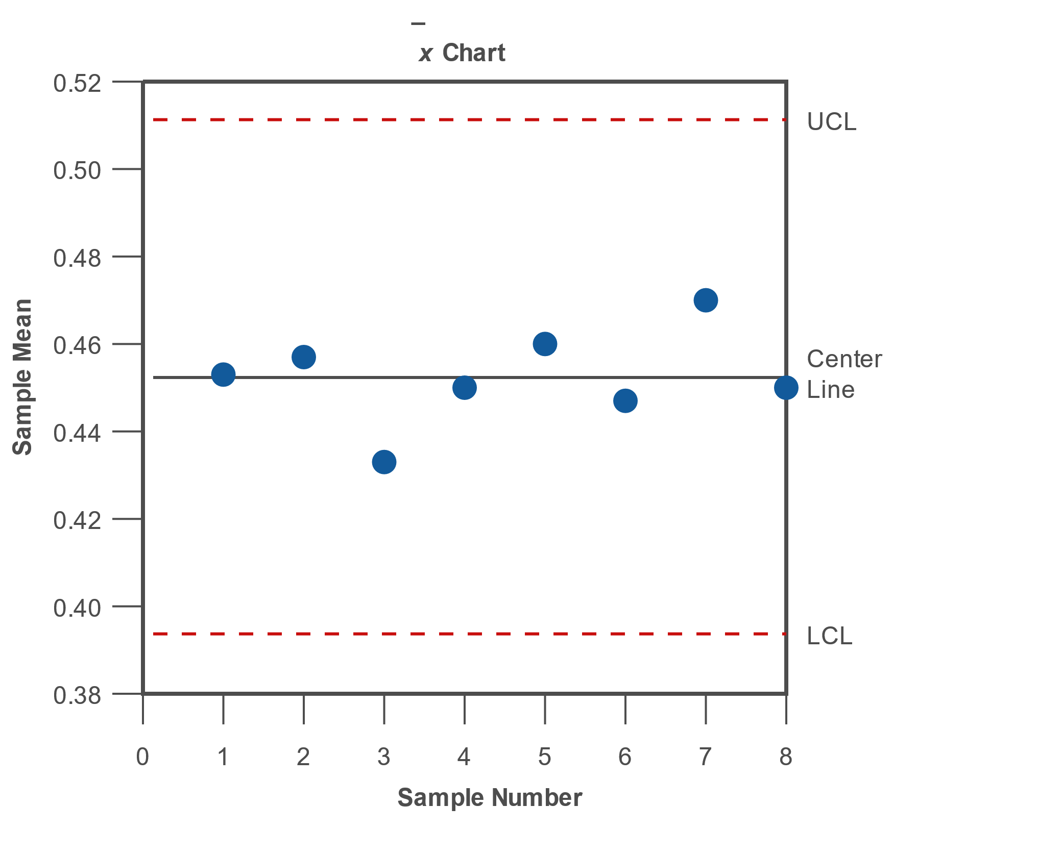
Example A6.2 (cont.)

Slide 32

Example A6.2 (cont.)
Examining the $\overline{x}$ chart, one can see that the process mean is within the control limits. That is, each of the sample means fall within the control limits of the $\overline{x}$ chart, indicating that the process is in control.

Slide 33
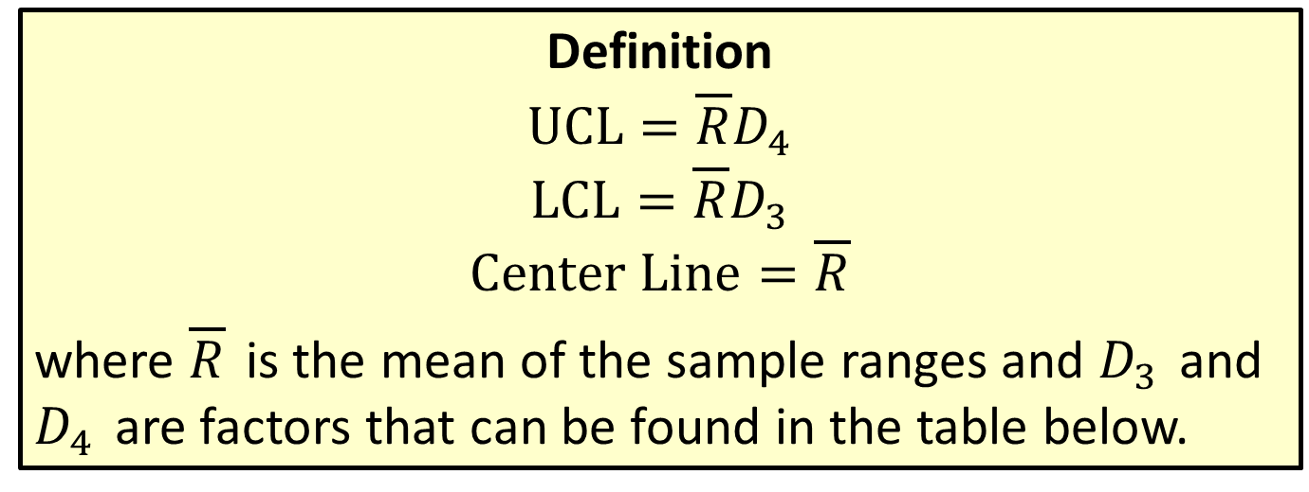

3 $σ$ Control Chart for the Process Range
Definition
$$UCL=\overline{R}D_{4}$$
$$LCL=\overline{R}D_{3}$$
$$Center Line=\overline{R}$$
where $\overline{R}$ is the mean of the sample ranges and $D_{3}$ and $D_{4}$ are factors that can be found in the table below.

Slide 34

Example A6.3
Using the window hinge data (reproduced below) and assuming that we do not know the mean or standard deviation of the process, construct the $R$ chart for this process.

Slide 35
Example A6.3 (cont.)
Sampling Data for Window Hinges (Inches)
Sample Number | Observation 1 | Observation 2 | Observation 3
1 | 0.42 | 0.48 | 0.46
2 | 0.44 | 0.48 | 0.45
3 | 0.44 | 0.45 | 0.41
4 | 0.47 | 0.42 | 0.46
5 | 0.53 | 0.43 | 0.42
6 | 0.47 | 0.42 | 0.45
7 | 0.44 | 0.47 | 0.50
8 | 0.48 | 0.43 | 0.44

Slide 36
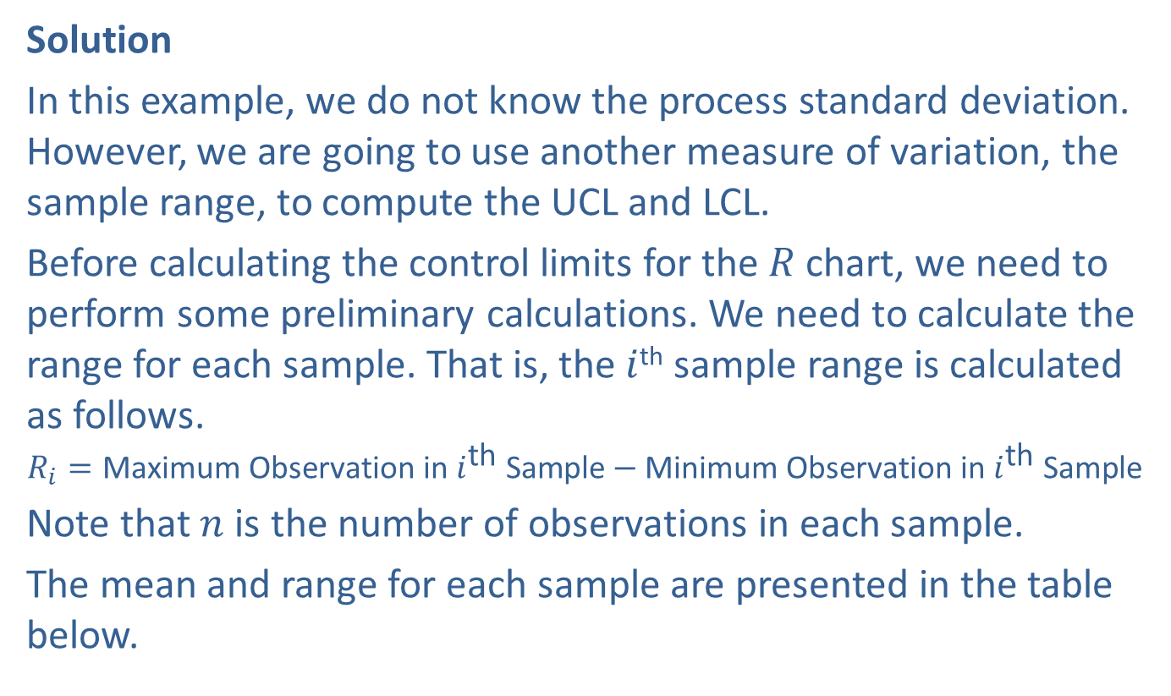
Example A6.3 (cont.)
Solution
In this example, we do not know the process standard deviation. However, we are going to use another measure of variation, the sample range, to compute the UCL and LCL.
Before calculating the control limits for the $R$ chart, we need to perform some preliminary calculations. We need to calculate the range for each sample. That is, the $i$^{th} sample range is calculated as follows.
$$R_{i}=\text{Maximum} \text{Observation} \text{in} i^{\text{th}} \text{Sample}−\text{Minimum} \text{Observation} \text{in} i^{\text{th}} \text{Sample}$$
Note that $n$ is the number of observations in each sample.
The mean and range for each sample are presented in the table below.

Slide 37
Example A6.3 (cont.)
Sampling Data for Window Hinges (Inches) with Mean and Range
Sample Number | Observation 1 | Observation 2 | Observation 3 | Mean | Range
1 | 0.42 | 0.48 | 0.46 | 0.453 | 0.06
2 | 0.44 | 0.48 | 0.45 | 0.457 | 0.04
3 | 0.44 | 0.45 | 0.41 | 0.433 | 0.04
4 | 0.47 | 0.42 | 0.46 | 0.450 | 0.05
5 | 0.53 | 0.43 | 0.42 | 0.460 | 0.11
6 | 0.47 | 0.42 | 0.45 | 0.447 | 0.05
7 | 0.44 | 0.47 | 0.50 | 0.470 | 0.06
8 | 0.48 | 0.43 | 0.44 | 0.450 | 0.05

Slide 38
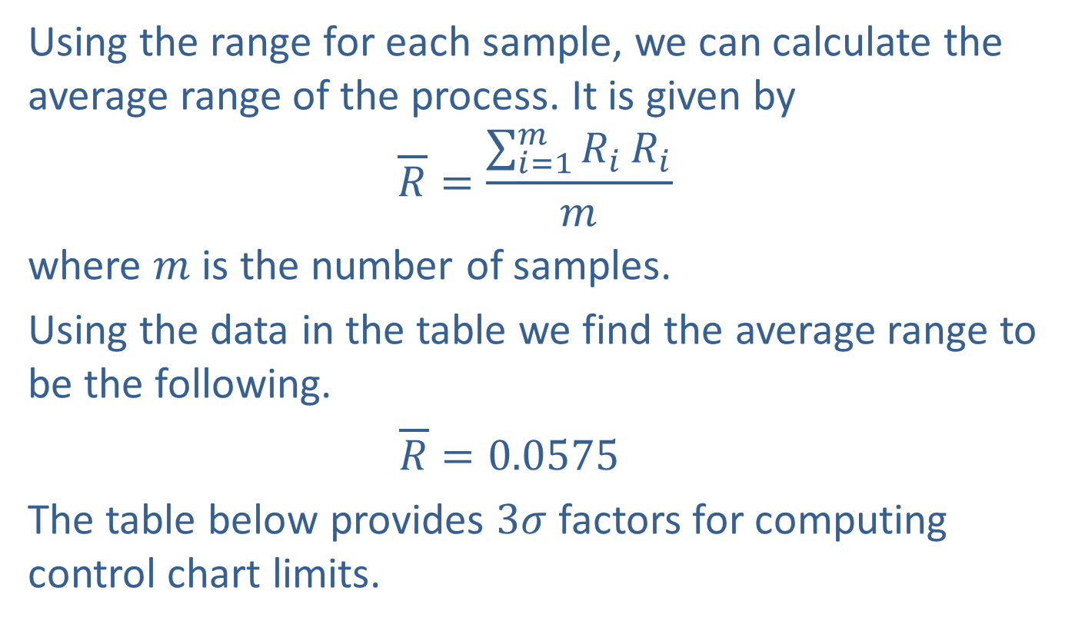
Example A6.3 (cont.)
Using the range for each sample, we can calculate the average range of the process. It is given by
$$\overline{R}=\frac{\sum_{i=1}^{m}{R_{i}}R_{i}}{m}$$
where $m$ is the number of samples.
Using the data in the table we find the average range to be the following.
$\overline{R}=0.0575$
The table below provides $3σ$ factors for computing control chart limits.

Slide 39
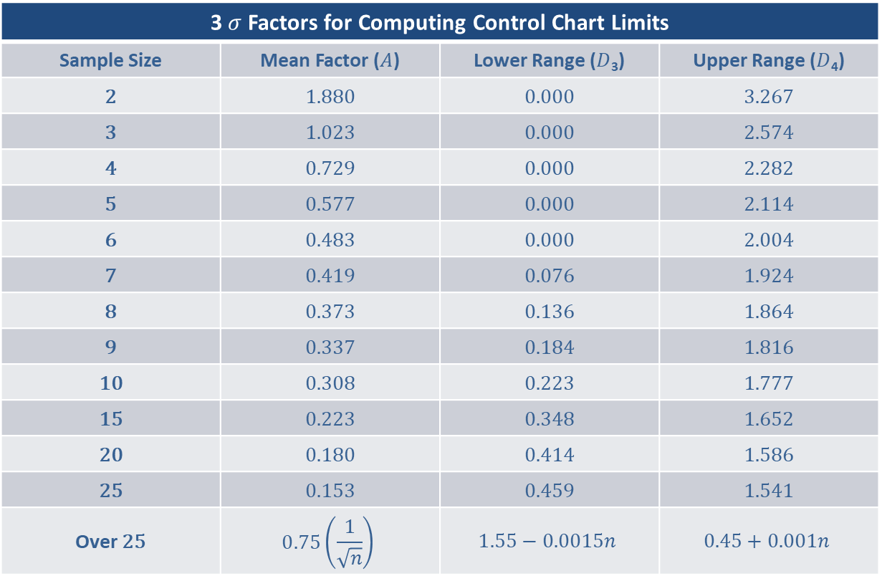
Example A6.3 (cont.)
3 Factors for Computing Control Chart Limits
Sample Size | Mean Factor () | Lower Range (₃) | Upper Range (₄)
2 | 1.880 | 0.000 | 3.267
3 | 1.023 | 0.000 | 2.574
4 | 0.729 | 0.000 | 2.282
5 | 0.577 | 0.000 | 2.114
6 | 0.483 | 0.000 | 2.004
7 | 0.419 | 0.076 | 1.924
8 | 0.373 | 0.136 | 1.864
9 | 0.337 | 0.184 | 1.816
10 | 0.308 | 0.223 | 1.777
15 | 0.223 | 0.348 | 1.652
20 | 0.180 | 0.414 | 1.586
25 | 0.153 | 0.459 | 1.541
Over 25
Sample Size
2 | 1.880 | 0.000 | 3.267
3 | 1.023 | 0.000 | 2.574
4 | 0.729 | 0.000 | 2.282
5 | 0.577 | 0.000 | 2.114
6 | 0.483 | 0.000 | 2.004
7 | 0.419 | 0.076 | 1.924
8 | 0.373 | 0.136 | 1.864
9 | 0.337 | 0.184 | 1.816
10 | 0.308 | 0.223 | 1.777
15 | 0.223 | 0.348 | 1.652
20 | 0.180 | 0.414 | 1.586
25 | 0.153 | 0.459 | 1.541
Over 25

Slide 40
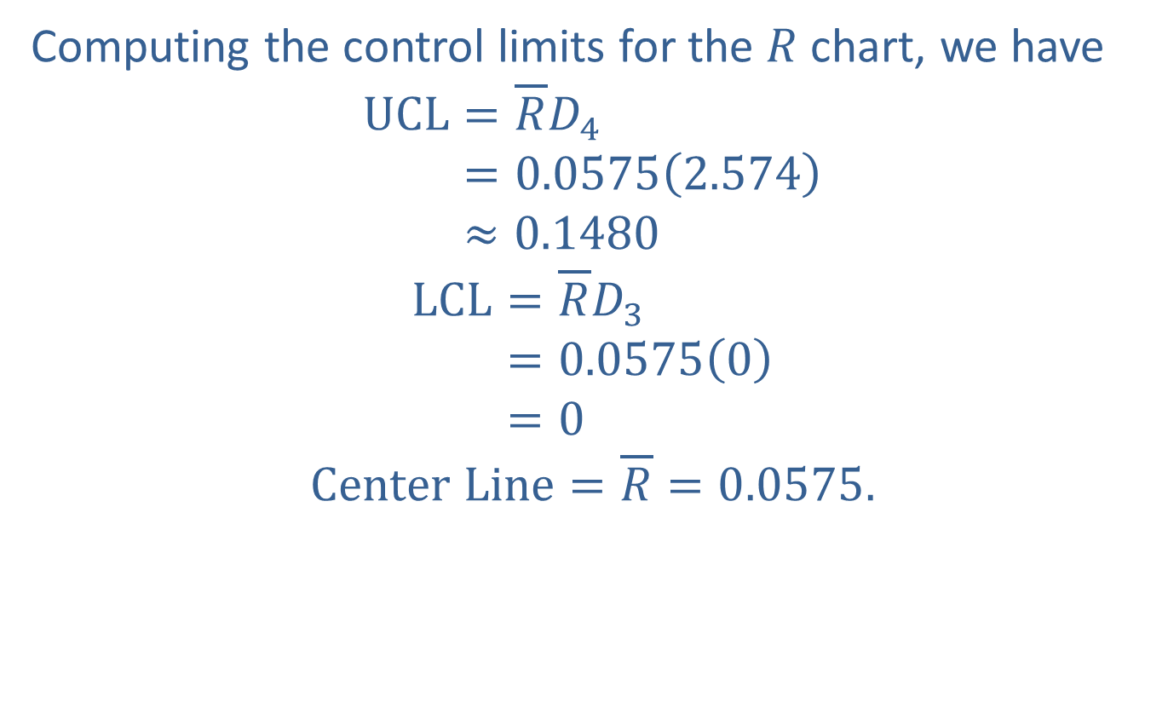
Example A6.3 (cont.)
Computing the control limits for the $R$ chart, we have
UCL=𝑅𝐷4UCL=0.05752.574UCL≈0.1480
LCL=𝑅𝐷3LCL=0.05750LCL=0
$$Center Line=\overline{R}=0.0575.$$

Slide 41
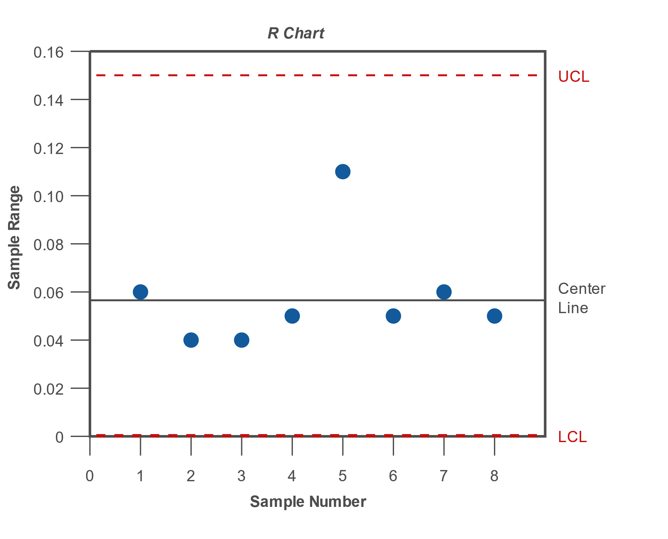
Example A6.3 (cont.)

Slide 42

Example A6.3 (cont.)
Examining the $R$ chart, one can see that the variability is within the control limits. That is, the sample ranges fall within the control limits of the $R$ chart, indicating that the process is in control.

Slide 43
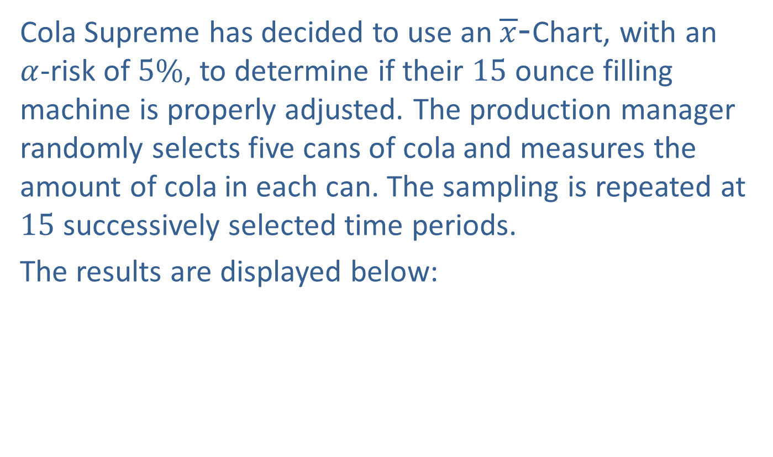

Example A6.4: Mean Charts Using $s$
Cola Supreme has decided to use an $\overline{x}$-Chart, with an $α$-risk of $5\%$, to determine if their 15 ounce filling machine is properly adjusted. The production manager randomly selects five cans of cola and measures the amount of cola in each can. The sampling is repeated at 15 successively selected time periods.
The results are displayed below:

Slide 44
Example A6.4: Mean Charts Using $s$
Sample Results
Sample Number | Obs. 1 | Obs. 2 | Obs. 3 | Obs. 4 | Obs. 5 | Sample Mean | Sample Standard Deviation
1 | 15.00 | 14.97 | 15.01 | 15.00 | 15.04 | 15.0040 | 0.0251
2 | 14.96 | 14.98 | 14.97 | 15.00 | 14.98 | 14.9780 | 0.0148
3 | 14.98 | 14.95 | 15.02 | 14.96 | 14.98 | 14.9780 | 0.0268
4 | 15.03 | 14.98 | 14.99 | 15.00 | 15.03 | 15.0060 | 0.0230
5 | 15.01 | 14.98 | 15.04 | 14.99 | 15.05 | 15.0140 | 0.0305
6 | 14.99 | 15.01 | 15.02 | 14.98 | 15.00 | 15.0000 | 0.0158
7 | 15.03 | 15.00 | 15.04 | 14.96 | 14.97 | 15.0000 | 0.0354
8 | 15.00 | 15.00 | 15.02 | 15.00 | 15.04 | 15.0120 | 0.0179
9 | 15.00 | 15.03 | 15.01 | 14.95 | 15.01 | 15.0000 | 0.0300
10 | 14.97 | 15.01 | 14.98 | 14.96 | 15.03 | 14.9900 | 0.0292
11 | 15.05 | 15.03 | 15.00 | 14.98 | 14.96 | 15.0040 | 0.0365
12 | 15.01 | 15.00 | 14.97 | 14.96 | 14.99 | 14.9860 | 0.0207
13 | 15.02 | 14.98 | 14.97 | 14.99 | 15.03 | 14.9980 | 0.0259
14 | 14.99 | 14.99 | 14.97 | 15.00 | 14.99 | 14.9880 | 0.0110
15 | 14.95 | 15.00 | 14.95 | 15.03 | 14.96 | 14.9780 | 0.0356

Slide 45

Example A6.4: Mean Charts Using $s$ (cont.)
​What is the Center Line of the control chart?
​What are the Upper and Lower Control Limits?
​If the given samples are taken at the next time periods, determine if each process is "In Control" or "Out of Control"?
​

Slide 46
Example A6.4: Mean Charts Using $s$ (cont.)
Sample Number | Obs. 1 | Obs. 2 | Obs. 3 | Obs. 4 | Obs. 5 | Sample Mean
16 | 14.99 | 14.98 | 14.97 | 14.98 | 14.96 | 14.976
17 | 15.10 | 14.99 | 15.09 | 15.07 | 15.09 | 15.068
18 | 14.90 | 14.99 | 14.95 | 14.96 | 15.00 | 14.960

Slide 47
Example A6.4: Mean Charts Using $s$ (cont.)
​Based on the control limits established, what is the probability that the production manager will conclude that the process is "Out of Control," when the process is actually "In Control"?

Slide 48
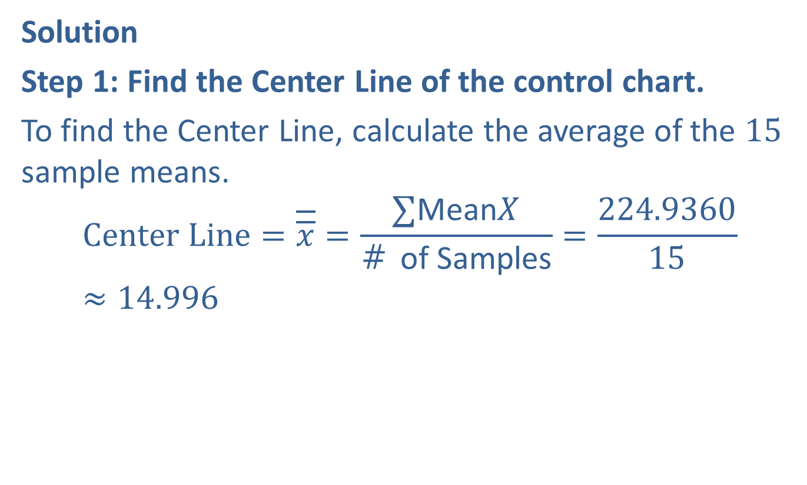
Example A6.4: Mean Charts Using $s$ (cont.)
Solution
Step 1: Find the Center Line of the control chart.
To find the Center Line, calculate the average of the 15 sample means.
$$Center Line=\overline{\overline{x}}=\frac{∑\text{Mean}X}{\text{\# }\text{of} \text{Samples}}=\frac{224.9360}{15}≈14.996$$

Slide 49
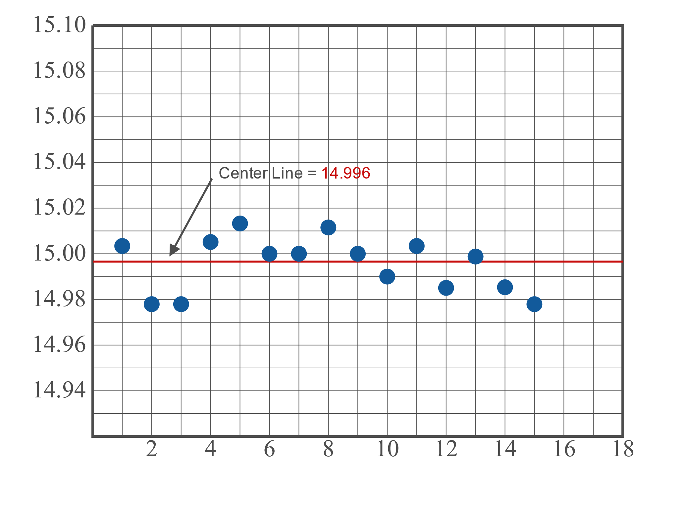
Example A6.4: Mean Charts Using $s$ (cont.)

Slide 50
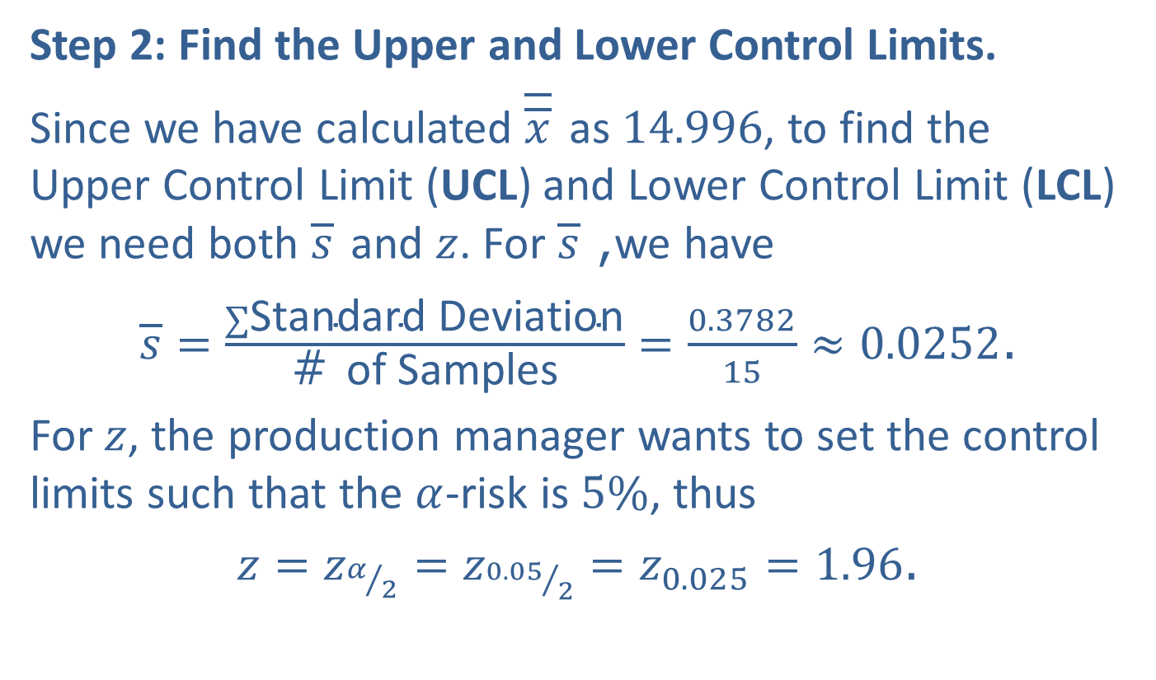
Example A6.4: Mean Charts Using $s$ (cont.)
Step 2: Find the Upper and Lower Control Limits.
Since we have calculated $\overline{\overline{x}}$ as 14.996, to find the Upper Control Limit (UCL) and Lower Control Limit (LCL) we need both $\overline{s}$ and $z$. For $\overline{s}$, we have
$\overline{s}=\frac{∑\text{Standard} \text{Deviation}}{\text{\# }\text{of} \text{Samples}}=\frac{0.3782}{15}≈0.0252$.
For $z$, the production manager wants to set the control limits such that the $α$-risk is $5\%$, thus
$z=z_{α/2}=z_{{0.05}/2}=z_{0.025}=1.96$.

Slide 51
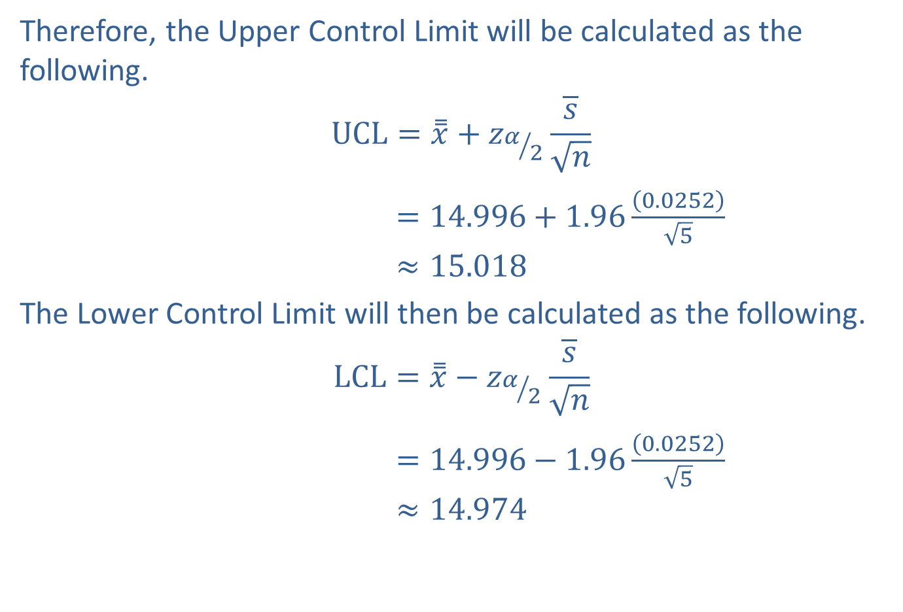

Example A6.4: Mean Charts Using $s$ (cont.)
Therefore, the Upper Control Limit will be calculated as the following.
$$UCL=\overset{̿}{x}+z_{α/2}\frac{\overline{s}}{\sqrt{n}}$$
$=14.996+1.96\frac{\left(0.0252\right)}{\sqrt{5}}$
$$≈15.018$$
The Lower Control Limit will then be calculated as the following.
$$LCL=\overset{̿}{x}−z_{α/2}\frac{\overline{s}}{\sqrt{n}}$$
$=14.996−1.96\frac{\left(0.0252\right)}{\sqrt{5}}$
$$≈14.974$$

Slide 52
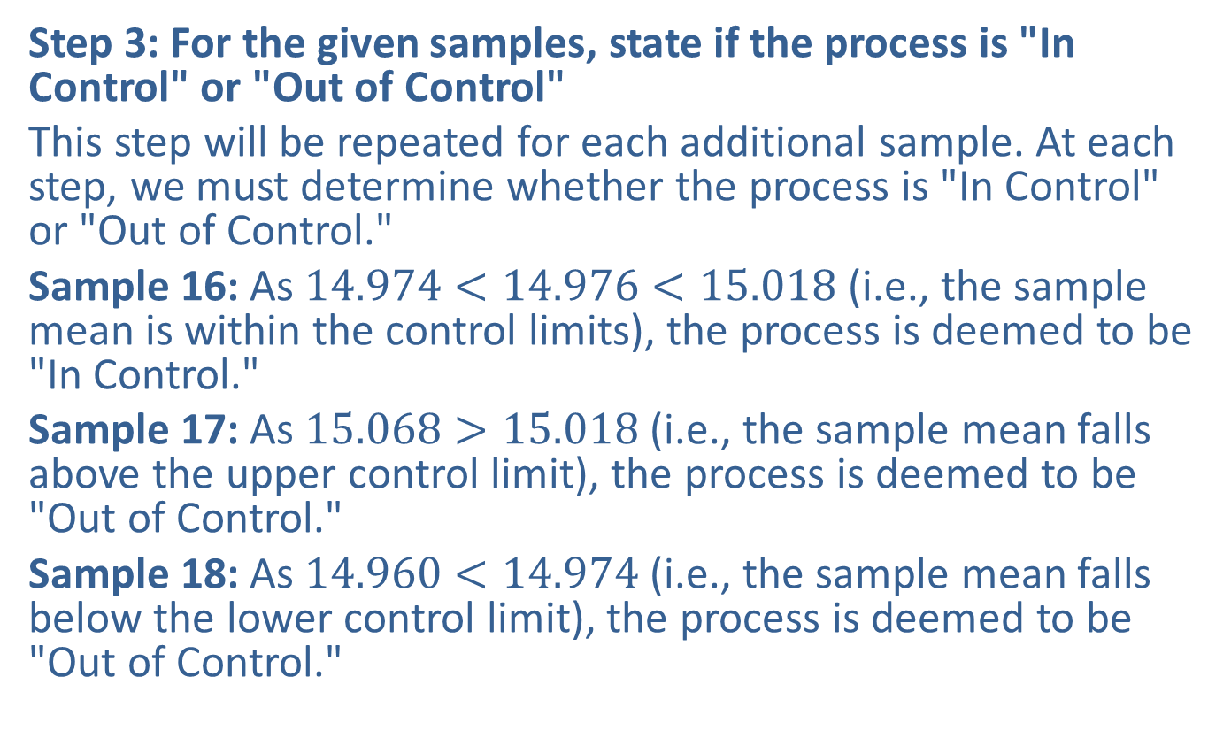
Example A6.4: Mean Charts Using $s$ (cont.)
Step 3: For the given samples, state if the process is "In Control" or "Out of Control"
This step will be repeated for each additional sample. At each step, we must determine whether the process is "In Control" or "Out of Control."
Sample 16: As $14.974<14.976<15.018$ (i.e., the sample mean is within the control limits), the process is deemed to be "In Control."
Sample 17: As $15.068>15.018$ (i.e., the sample mean falls above the upper control limit), the process is deemed to be "Out of Control."
Sample 18: As $14.960<14.974$ (i.e., the sample mean falls below the lower control limit), the process is deemed to be "Out of Control."

Slide 53
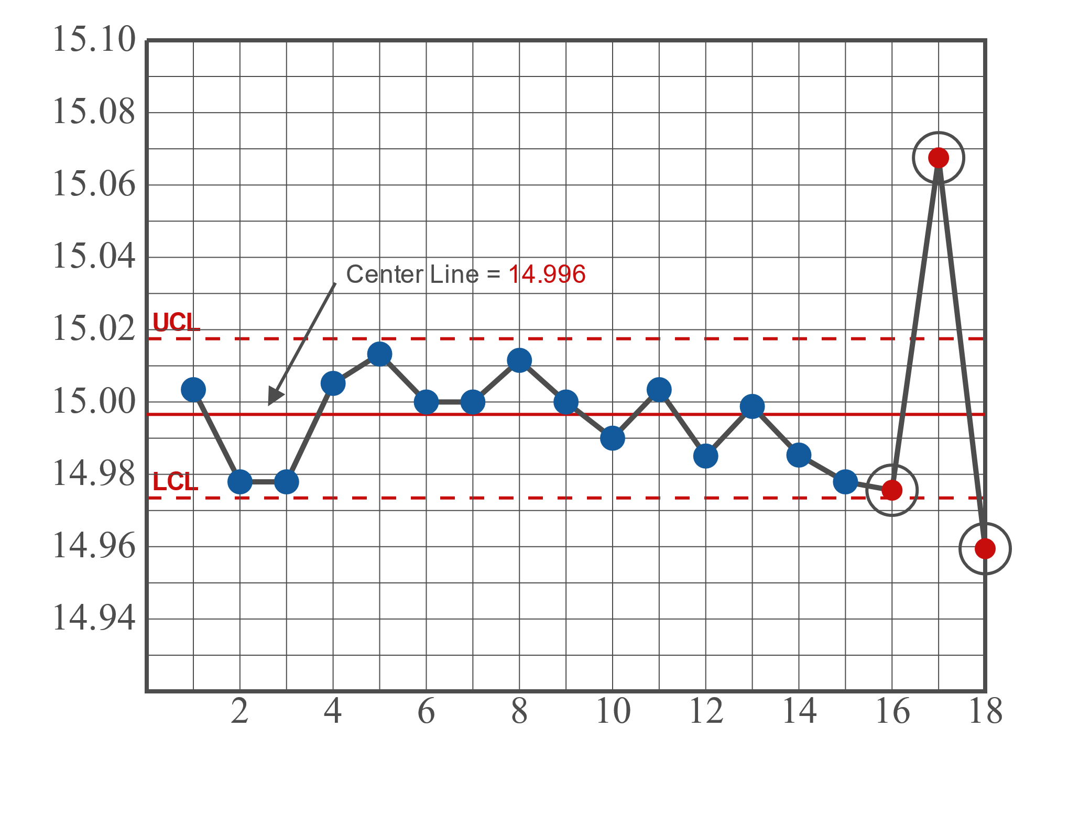
Example A6.4: Mean Charts Using $s$ (cont.)

Slide 54
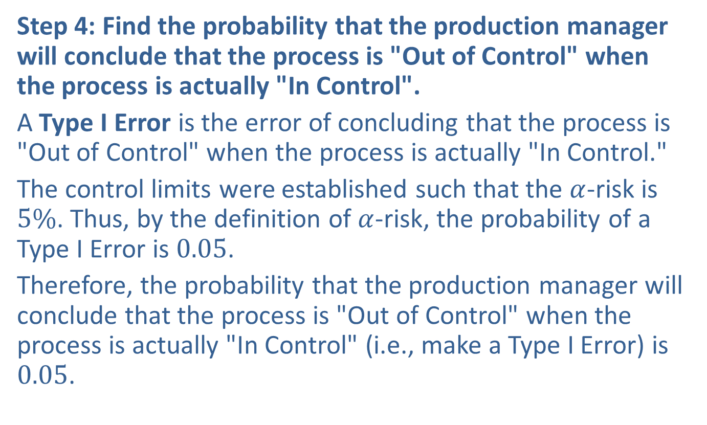
Example A6.4: Mean Charts Using $s$ (cont.)
Step 4: Find the probability that the production manager will conclude that the process is "Out of Control" when the process is actually "In Control".
A Type I Error is the error of concluding that the process is "Out of Control" when the process is actually "In Control."
The control limits were established such that the $α$-risk is $5\%$. Thus, by the definition of $α$-risk, the probability of a Type I Error is 0.05.
Therefore, the probability that the production manager will conclude that the process is "Out of Control" when the process is actually "In Control" (i.e., make a Type I Error) is 0.05.

Slide 55
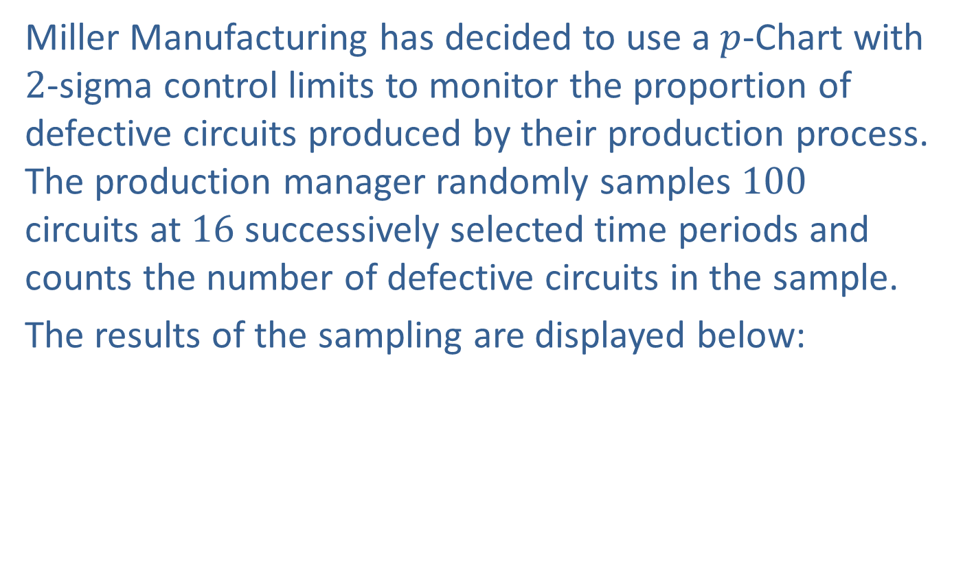

Example A6.5: $p$-Charts
Miller Manufacturing has decided to use a $p$-Chart with 2-sigma control limits to monitor the proportion of defective circuits produced by their production process. The production manager randomly samples 100 circuits at 16 successively selected time periods and counts the number of defective circuits in the sample.
The results of the sampling are displayed below:

Slide 56
Example A6.5: $p$-Charts
Sample Data
Sample Number | # of Defects
1 | 15
2 | 10
3 | 10
4 | 11
5 | 10
6 | 9
7 | 14
8 | 11
9 | 11
10 | 14
11 | 13
12 | 14
13 | 14
14 | 10
15 | 13
16 | 13

Slide 57

Example A6.5: $p$-Charts (cont.)
​What is the Center Line of the control chart?
​What are the Upper and Lower Control Limits?
​During the next three time periods, 100 curcuits are sampled in each period. In the first time period 4 defective circuits are detected, 16 are detected in the second, and 12 are detected in the third. Determine if each process is "In Control" or "Out of Control"?
​Based on the control limits established, what is the probability that the production manager will conclude that the process is "Out of Control," when the process is actually "In Control"?

Slide 58
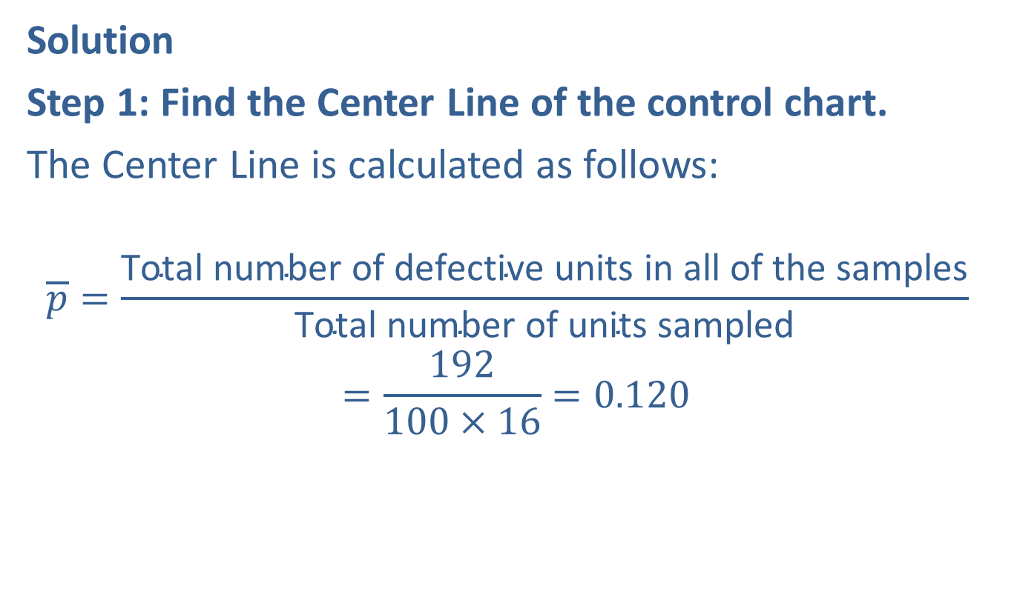
Example A6.5: $p$-Charts (cont.)
Solution
Step 1: Find the Center Line of the control chart.
The Center Line is calculated as follows:
$$\overline{p}=\frac{\text{Total} \text{number} \text{of} \text{defective} \text{units} \text{in} \text{all} \text{of} \text{the} \text{samples}}{\text{Total} \text{number} \text{of} \text{units} \text{sampled}}$$
$$=\frac{192}{100×16}=0.120$$

Slide 59
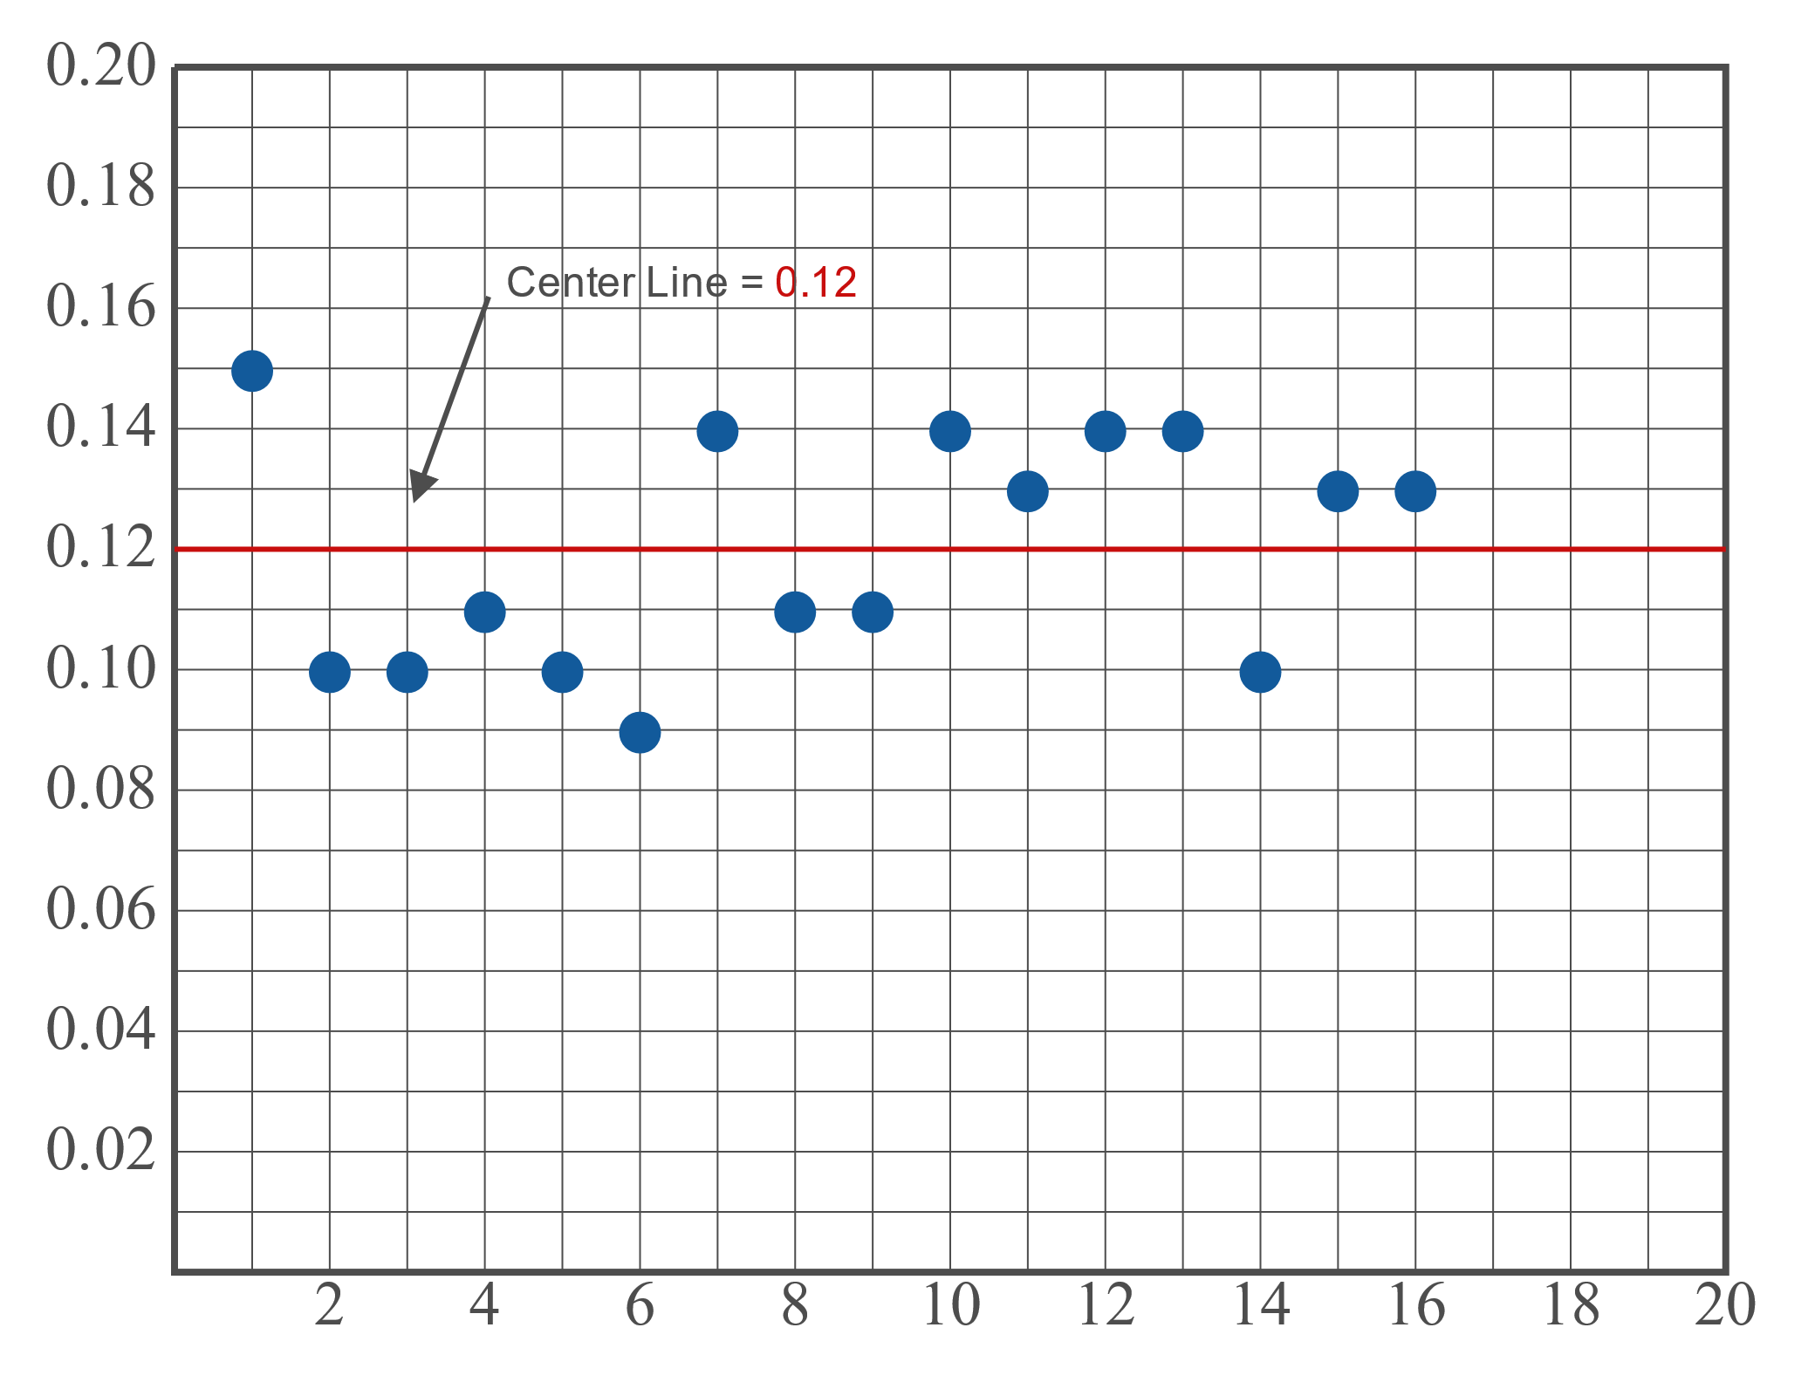
Example A6.5: $p$-Charts (cont.)

Slide 60
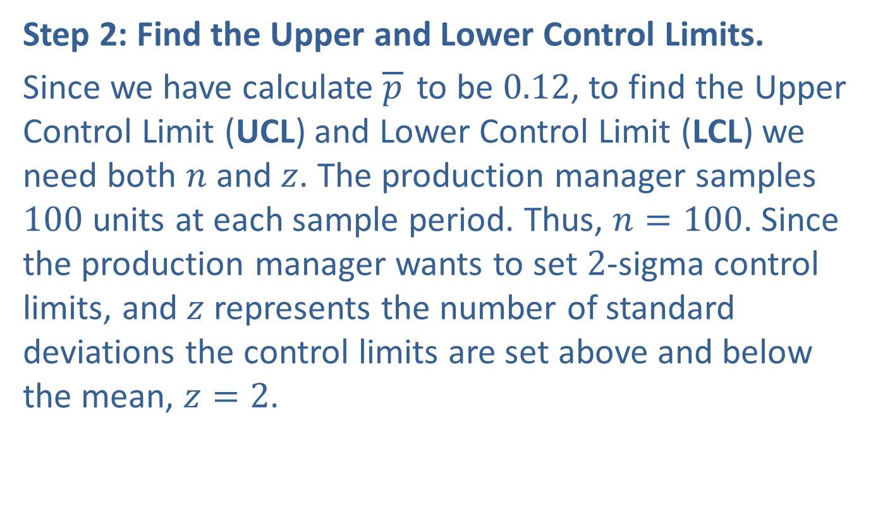
Example A6.5: $p$-Charts (cont.)
Step 2: Find the Upper and Lower Control Limits.
Since we have calculate $\overline{p}$ to be 0.12, to find the Upper Control Limit (UCL) and Lower Control Limit (LCL) we need both $n$ and $z$. The production manager samples 100 units at each sample period. Thus, $n=100$. Since the production manager wants to set 2-sigma control limits, and $z$ represents the number of standard deviations the control limits are set above and below the mean, $z=2$.

Slide 61
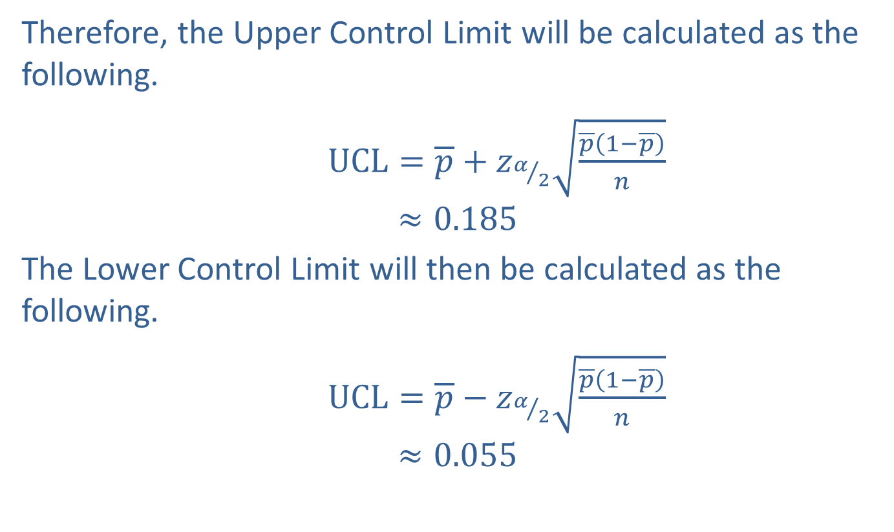

Example A6.5: $p$-Charts (cont.)
Therefore, the Upper Control Limit will be calculated as the following.
$UCL=\overline{p}+z_{α/2}\sqrt{\frac{\overline{p}\left(1−\overline{p}\right)}{n}}$
$$≈0.185$$
The Lower Control Limit will then be calculated as the following.
$UCL=\overline{p}−z_{α/2}\sqrt{\frac{\overline{p}\left(1−\overline{p}\right)}{n}}$
$$≈0.055$$

Slide 62
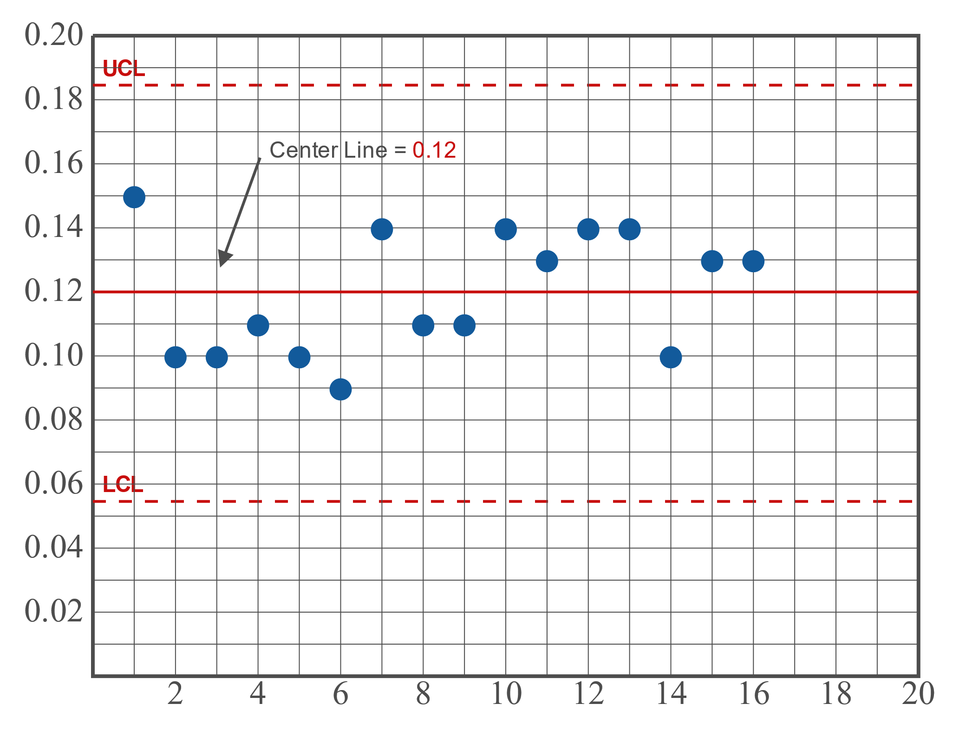
Example A6.5: $p$-Charts (cont.)

Slide 63
Example A6.5: $p$-Charts (cont.)
Step 3: For the given samples, state if the process is "In Control" or "Out of Control"
This step will be repeated for each additional sample. At each step, we must determine whether the process is "In Control" or "Out of Control."
Sample 17: Since 0.04 falls below the Lower Control Limit, the process is deemed to be "Out of Control."
Sample 18: Since 0.16 falls between the Upper and Lower Control Limits, the process is deemed to be "In Control."
Sample 19: Since 0.12 falls between the Upper and Lower Control Limits, the process is deemed to be "In Control."

Slide 64
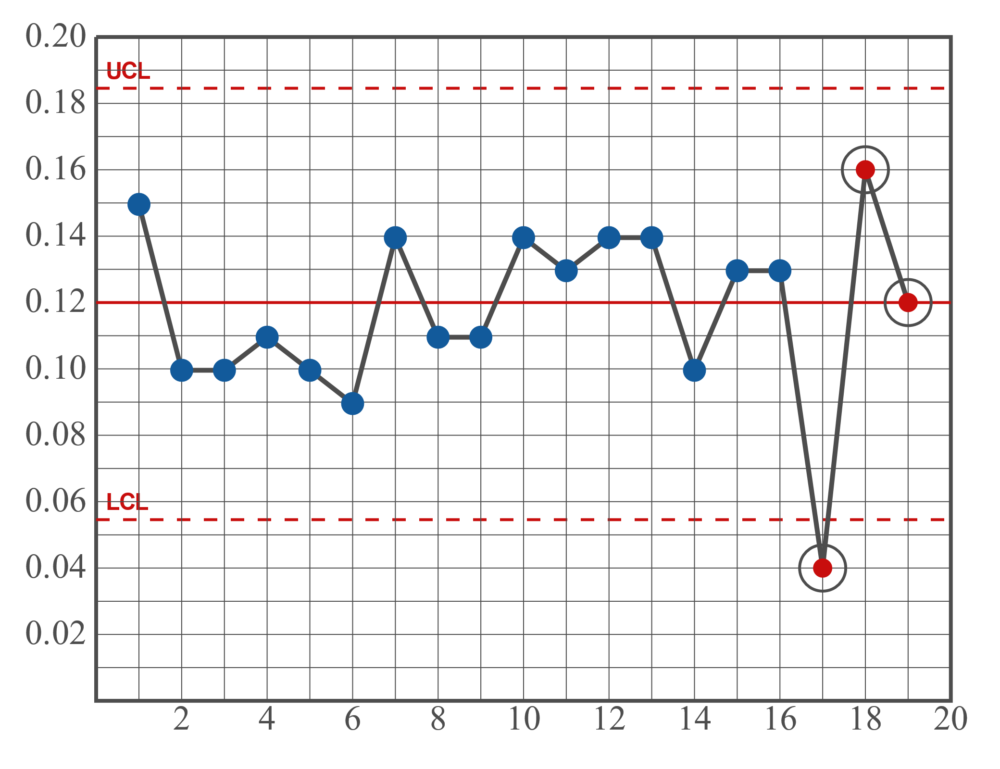
Example A6.5: $p$-Charts (cont.)

Slide 65
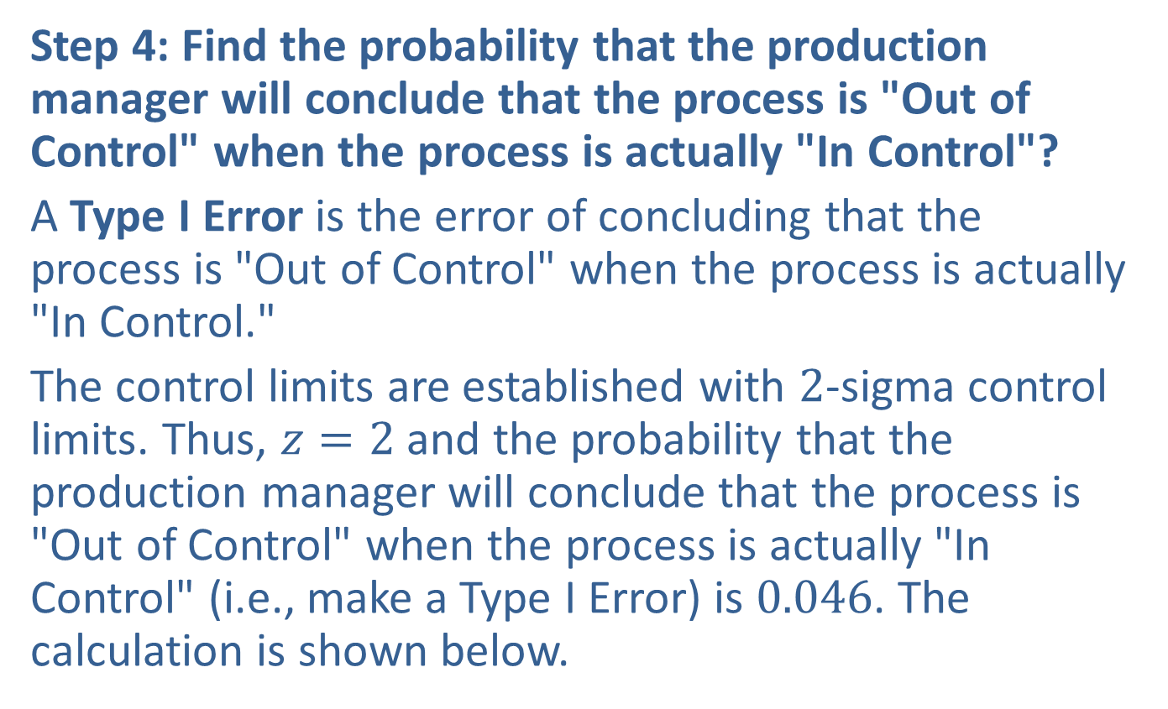
Example A6.5: $p$-Charts (cont.)
Step 4: Find the probability that the production manager will conclude that the process is "Out of Control" when the process is actually "In Control"?
A Type I Error is the error of concluding that the process is "Out of Control" when the process is actually "In Control."
The control limits are established with 2-sigma control limits. Thus, $z=2$ and the probability that the production manager will conclude that the process is "Out of Control" when the process is actually "In Control" (i.e., make a Type I Error) is 0.046. The calculation is shown below.

Slide 66
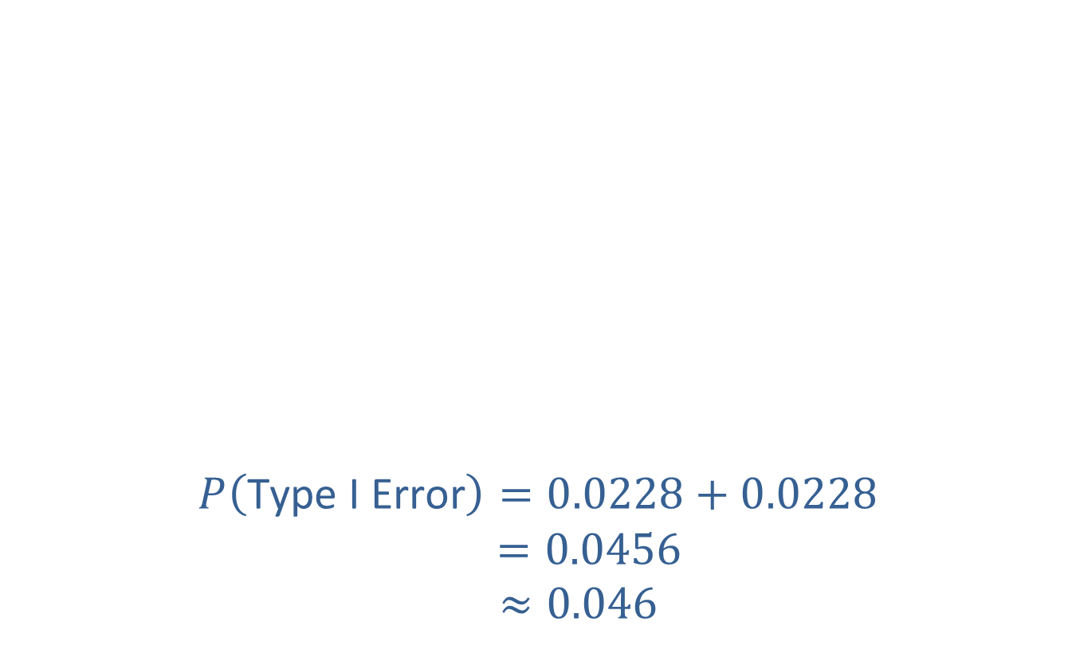
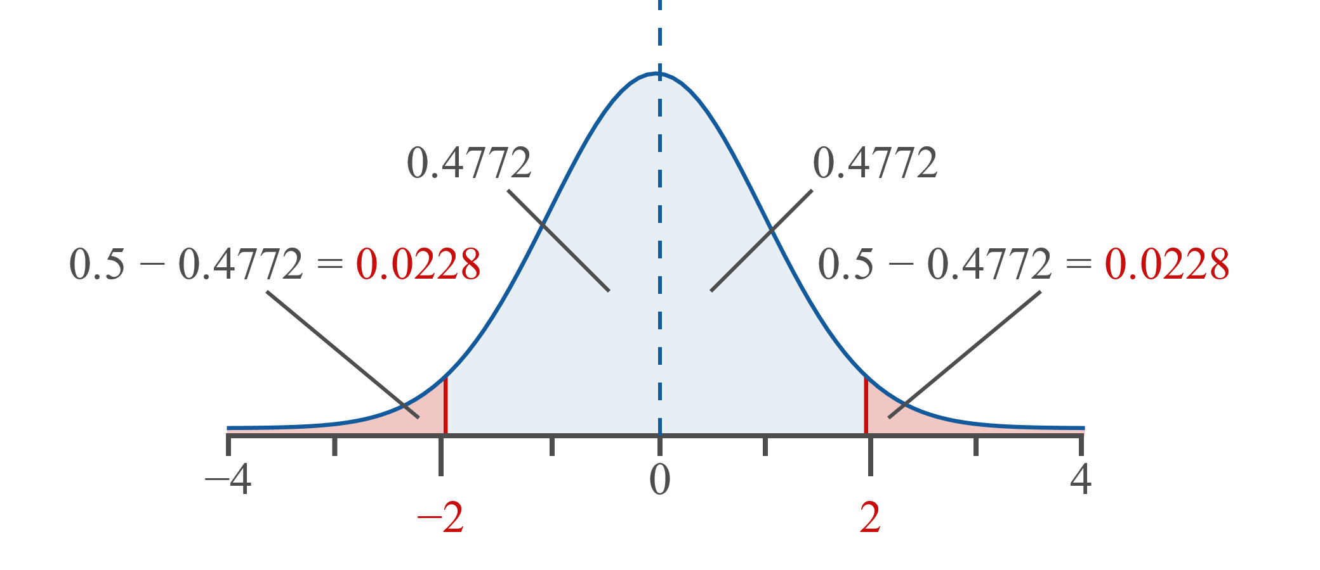
Example A6.5: $p$-Charts (cont.)

Slide 67
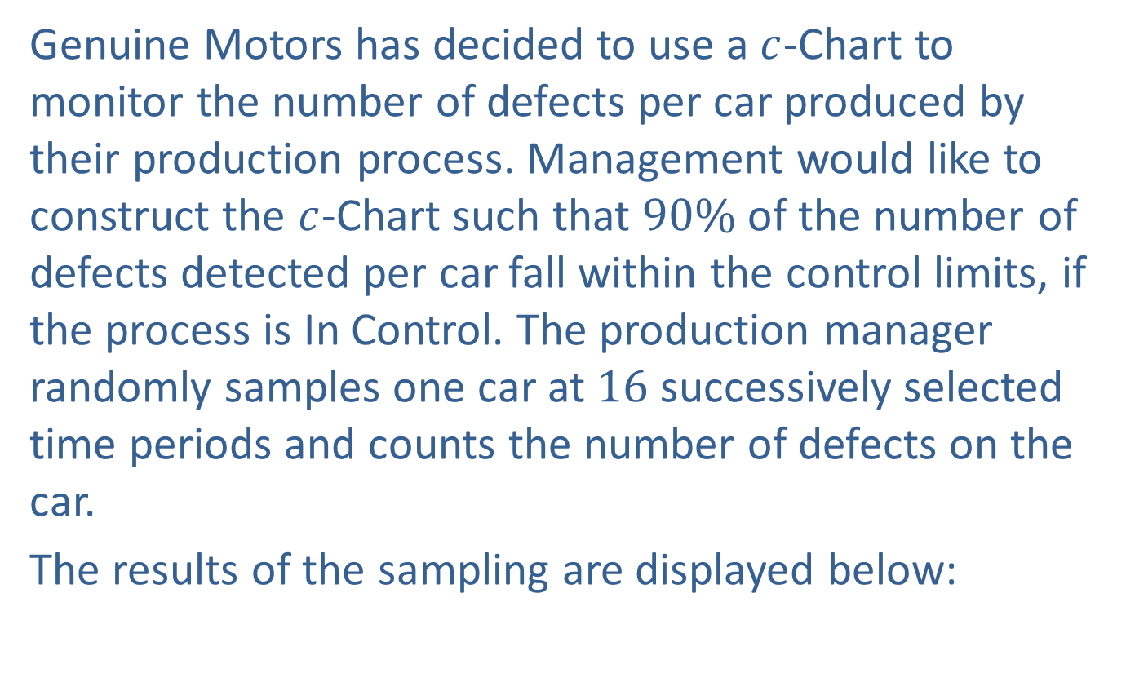

Example A6.6: $c$-Charts
Genuine Motors has decided to use a $c$-Chart to monitor the number of defects per car produced by their production process. Management would like to construct the $c$-Chart such that $90\%$ of the number of defects detected per car fall within the control limits, if the process is In Control. The production manager randomly samples one car at 16 successively selected time periods and counts the number of defects on the car.
The results of the sampling are displayed below:

Slide 68
Example A6.6: $c$-Charts
Sample Data
Sample Number | # of Defects
1 | 15
2 | 10
3 | 10
4 | 11
5 | 10
6 | 9
7 | 14
8 | 11
9 | 11
10 | 14
11 | 13
12 | 14
13 | 14
14 | 10
15 | 13
16 | 13

Slide 69
Example A6.6: $c$-Charts
​What is the Center Line of the control chart?
​What are the Upper and Lower Control Limits?
​During the next three time periods, 4 defects are detected on the first selected car, 16 defects are detected on the second, and 12 are detected on the third. Determine if each process is "In Control" or "Out of Control"?
​Based on the control limits established, what is the probability that the production manager will conclude that the process is "Out of Control," when the process is actually "In Control"?

Slide 70
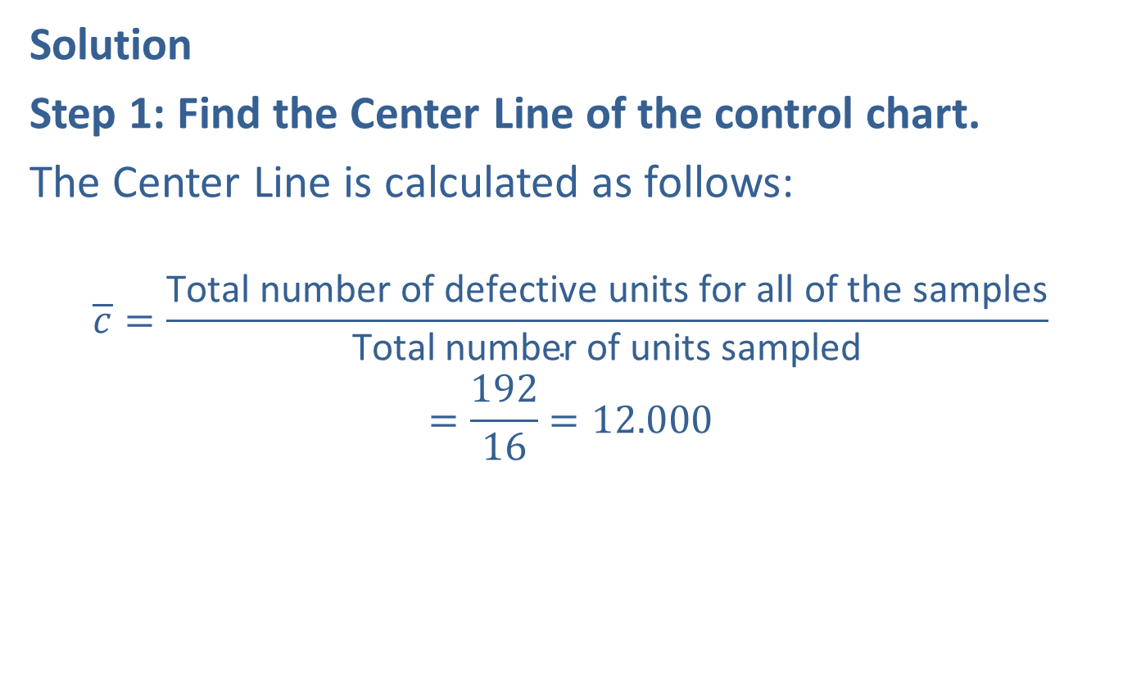
Example A6.6: $c$-Charts
Solution
Step 1: Find the Center Line of the control chart.
The Center Line is calculated as follows:
$$\overline{c}=\frac{\text{Total} \text{number} \text{of} \text{defective} \text{units} \text{for} \text{all} \text{of} \text{the} \text{samples}}{\text{Total} \text{number} \text{of} \text{units} \text{sampled}}$$
$$=\frac{192}{16}=12.000$$

Slide 71
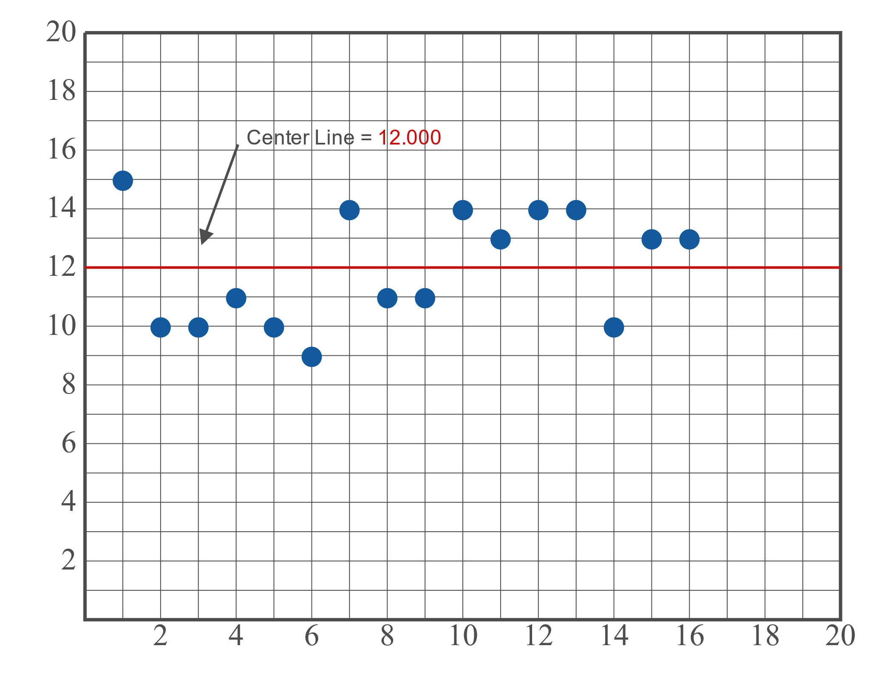

Example A6.6: $c$-Charts (cont.)

Slide 72
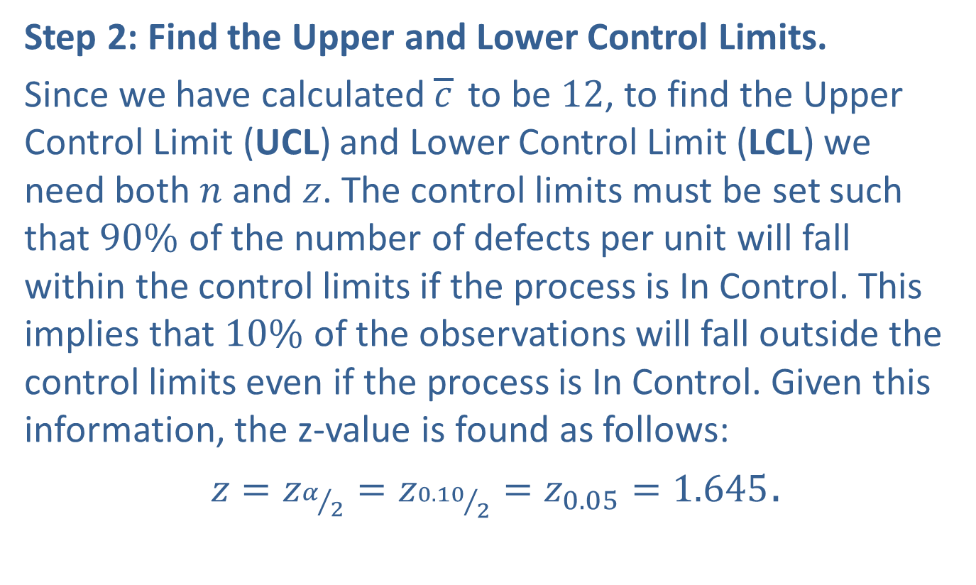
Example A6.6: $c$-Charts (cont.)
Step 2: Find the Upper and Lower Control Limits.
Since we have calculated $\overline{c}$ to be 12, to find the Upper Control Limit (UCL) and Lower Control Limit (LCL) we need both $n$ and $z$. The control limits must be set such that $90\%$ of the number of defects per unit will fall within the control limits if the process is In Control. This implies that $10\%$ of the observations will fall outside the control limits even if the process is In Control. Given this information, the z-value is found as follows:
$z=z_{α/2}=z_{{0.10}/2}=z_{0.05}=1.645$.

Slide 73


Example A6.6: $c$-Charts (cont.)
Therefore, the Upper Control Limit will be calculated as the following.
$$UCL=\overline{c}+z_{α/2}\sqrt{\overline{c}}$$
$=12+1.645\sqrt{12}$
$≈17.698$
The Lower Control Limit will then be calculated as the following.
$$LCL=\overline{c}−z_{α/2}\sqrt{\overline{c}}$$
$=12−1.645\sqrt{12}$
$$≈6.302$$

Slide 74

Example A6.6: $c$-Charts (cont.)

Slide 75
Example A6.6: $c$-Charts (cont.)
Step 3: For the given samples, state if the process is "In Control" or "Out of Control"
This step will be repeated for each additional sample. At each step, we must determine whether the process is "In Control" or "Out of Control."
Sample 17: Since 4 falls below the Lower Control Limit, the process is deemed to be "Out of Control."
Sample 18: Since 16 falls between the Upper and Lower Control Limits, the process is deemed to be "In Control."
Sample 19: Since 12 falls between the Upper and Lower Control Limits, the process is deemed to be "In Control."

Slide 76

Example A6.6: $c$-Charts (cont.)

Slide 77
Example A6.6: $c$-Charts (cont.)
Step 3: For the given samples, state if the process is "In Control" or "Out of Control"
This step will be repeated for each additional sample. At each step, we must determine whether the process is "In Control" or "Out of Control."
Sample 17: Since 4 falls below the Lower Control Limit, the process is deemed to be "Out of Control."
Sample 18: Since 16 falls between the Upper and Lower Control Limits, the process is deemed to be "In Control."
Sample 19: Since 12 falls between the Upper and Lower Control Limits, the process is deemed to be "In Control."

