Slide 1
Section A.7
Choosing the Correct Statistic for Estimating a Population Mean

Slide 2
Point Estimate
Definition
A point estimate is a single number estimate of a population parameter.

Slide 3
Example A7.1: Best Point Estimate
Find the best point estimate for the population mean of GPA s for seniors in high school. The following is a simple random sample taken from these GPAs.
GPA Values
2.5 | 1.6 | 2.8 | 3.4 | 4.0 | 3.8
2.6 | 1.6 | 1.8 | 2.0 | 3.2 | 2.5
2.7 | 1.7 | 1.9 | 2.1 | 3.1 | 3.0
3.6 | 3.5 | 2.8 | 2.9 | 2.7 | 1.9
1.5 | 1.4 | 2.0 | 2.3 | 3.1 | 2.7

Slide 4
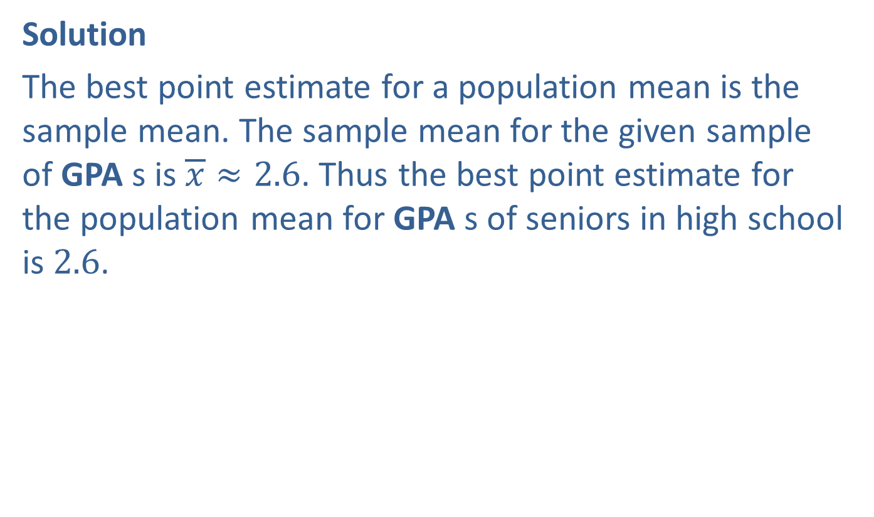
Example A7.1: Best Point Estimate (cont.)
Solution
The best point estimate for a population mean is the sample mean. The sample mean for the given sample of GPA s is $\overline{x}≈2.6$. Thus the best point estimate for the population mean for GPA s of seniors in high school is 2.6.

Slide 5
Interval Estimate, Level Of Confidence & Confidence Interval
Definition
An interval estimate is a range of possible values for the population parameter.
The level of confidence is the degree of certainty that the interval estimate contains the population parameter.
A confidence interval is an interval estimate associated with a certain level of confidence.

Slide 6
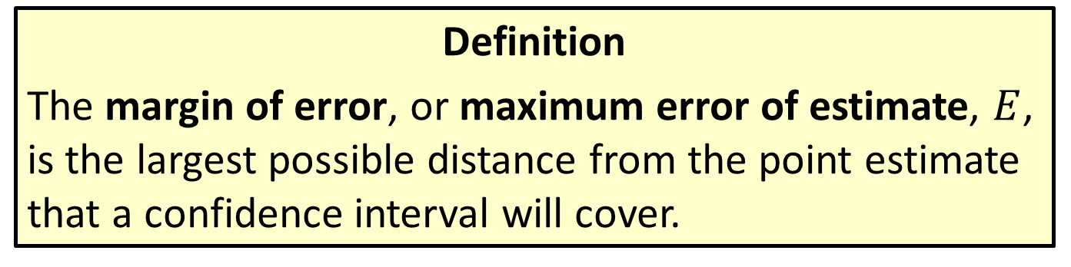
Margin Of Error
Definition
The margin of error, or maximum error of estimate, $E$, is the largest possible distance from the point estimate that a confidence interval will cover.

Slide 7

Definition: Confidence Interval for a Population Mean
Definition
$\overline{x}−E<μ<\overline{x}+E$ or $(\overline{x}−E,\overline{x}+E)$

Slide 8
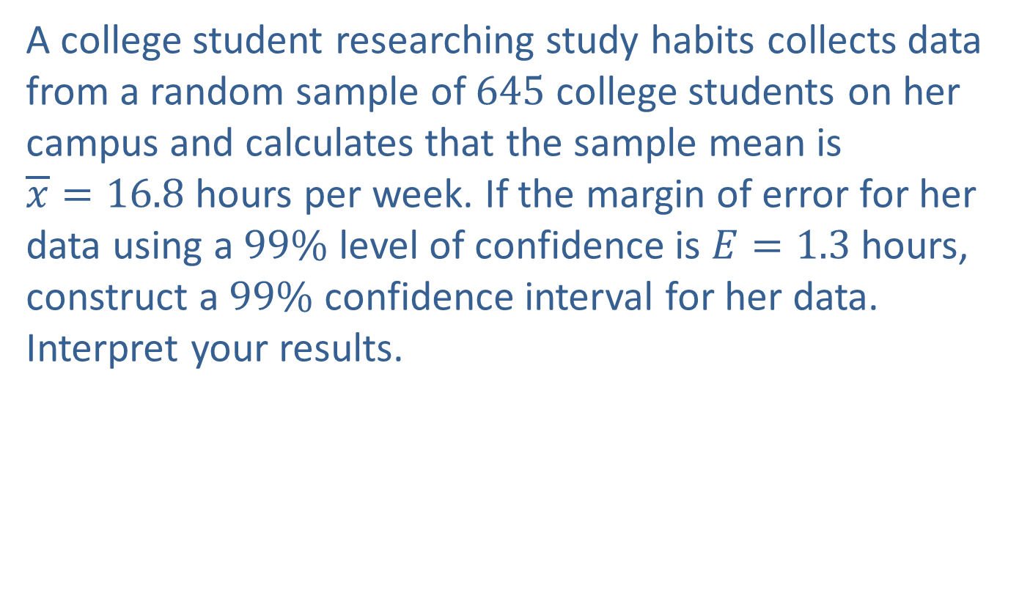
Example A7.2: Confidence Intervals
A college student researching study habits collects data from a random sample of 645 college students on her campus and calculates that the sample mean is
$\overline{x}=16.8$ hours per week. If the margin of error for her data using a $99\%$ level of confidence is $E=1.3$ hours, construct a $99\%$ confidence interval for her data. Interpret your results.

Slide 9
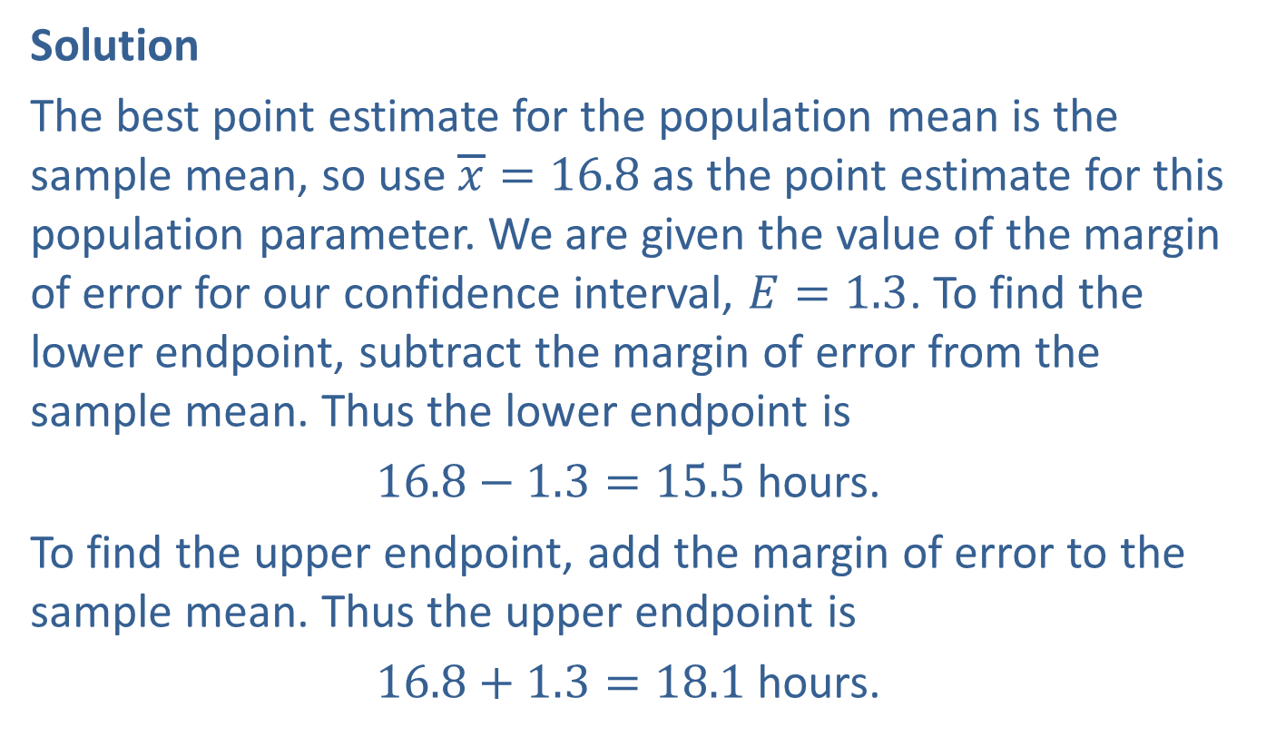
Example A7.2: Confidence Intervals (cont.)
Solution
The best point estimate for the population mean is the sample mean, so use $\overline{x}=16.8$ as the point estimate for this population parameter. We are given the value of the margin of error for our confidence interval, $E=1.3$. To find the lower endpoint, subtract the margin of error from the sample mean. Thus the lower endpoint is
$16.8−1.3=15.5$ hours.
To find the upper endpoint, add the margin of error to the sample mean. Thus the upper endpoint is
$16.8+1.3=18.1$ hours.

Slide 10
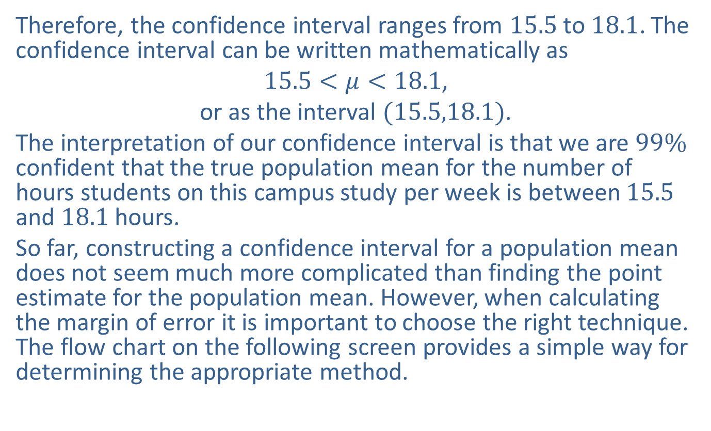
Example A7.2: Confidence Intervals (cont.)
Therefore, the confidence interval ranges from 15.5 to 18.1. The confidence interval can be written mathematically as
$15.5<μ<18.1$,
or as the interval $(15.5,18.1)$.
The interpretation of our confidence interval is that we are $99\%$ confident that the true population mean for the number of hours students on this campus study per week is between 15.5 and 18.1 hours.
So far, constructing a confidence interval for a population mean does not seem much more complicated than finding the point estimate for the population mean. However, when calculating the margin of error it is important to choose the right technique. The flow chart on the following screen provides a simple way for determining the appropriate method.

Slide 11
Example A7.3: Determining the Appropriate Method
An amusement company wants to estimate the average amount that each state fair visitor spends on tickets, games, and food. They choose, at random, 78 state fair visitors one afternoon and ask each to record the amount of money spent that afternoon before leaving the fair. If the distribution of the population is normal and the population standard deviation is known to be 2.5, which technique should be used to calculate a confidence interval for this population mean?

Slide 12
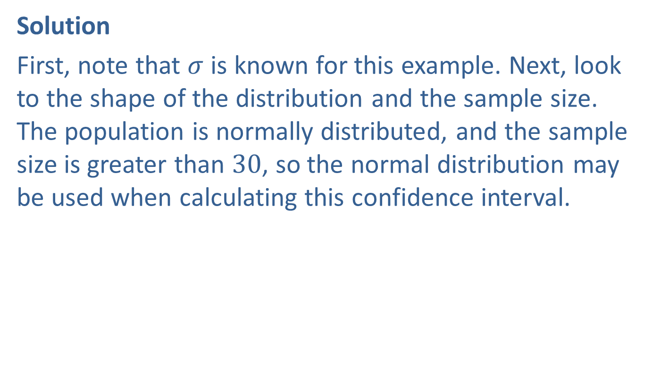
Example A7.3: Determining the Appropriate Method (cont.)
Solution
First, note that $σ$ is known for this example. Next, look to the shape of the distribution and the sample size. The population is normally distributed, and the sample size is greater than 30, so the normal distribution may be used when calculating this confidence interval.

Slide 13
Example A7.4: Determining the Appropriate Method
The managers of the new women's clothing store at the local mall wish to estimate the number of times that women shop for clothes in a month. They plan to survey 20 women locally. From previous studies, they believe that the population has a uniform distribution with an unknown standard deviation. Which technique should be used to calculate a confidence interval for this population mean?

Slide 14
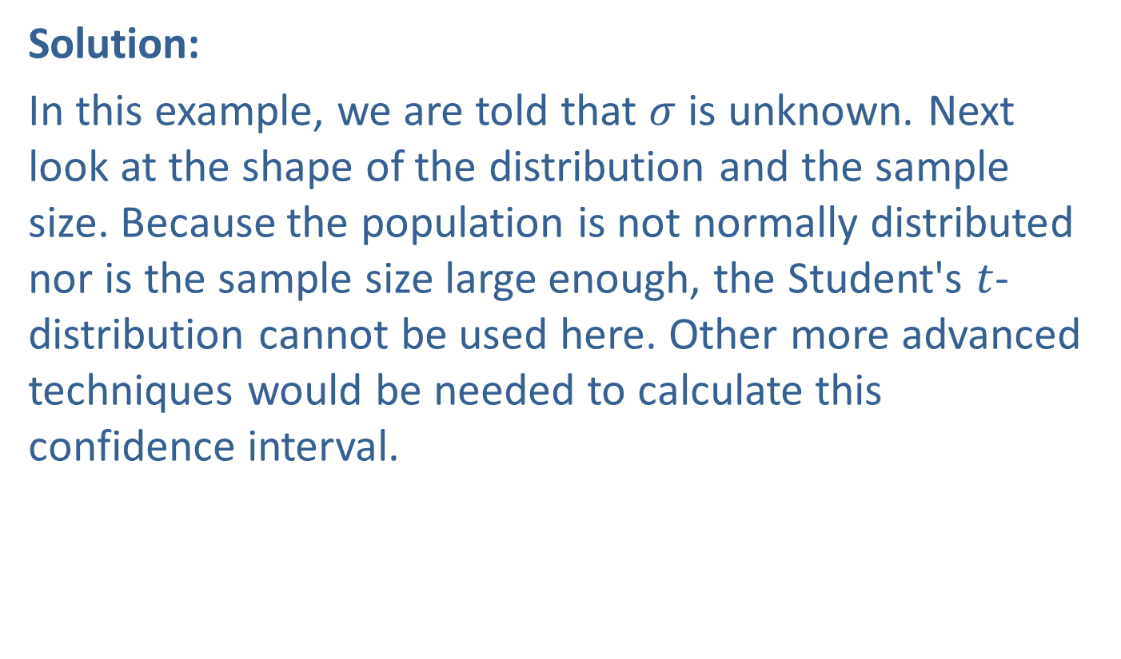
Example A7.4: Determining the Appropriate Method (cont.)
Solution:
In this example, we are told that $σ$ is unknown. Next look at the shape of the distribution and the sample size. Because the population is not normally distributed nor is the sample size large enough, the Student's $t$-distribution cannot be used here. Other more advanced techniques would be needed to calculate this confidence interval.

