Slide 1
Section 10.1
Fundamentals of Hypothesis Testing

Slide 2
Procedure: Performing a Hypothesis Test
​State the null and alternative hypothesis.
​Determine which distribution to use for the test statistic, and state the level of significance.
​Gather data and calculate the necessary sample statistics.
​Draw a conclusion and interpret the decision.

Slide 3
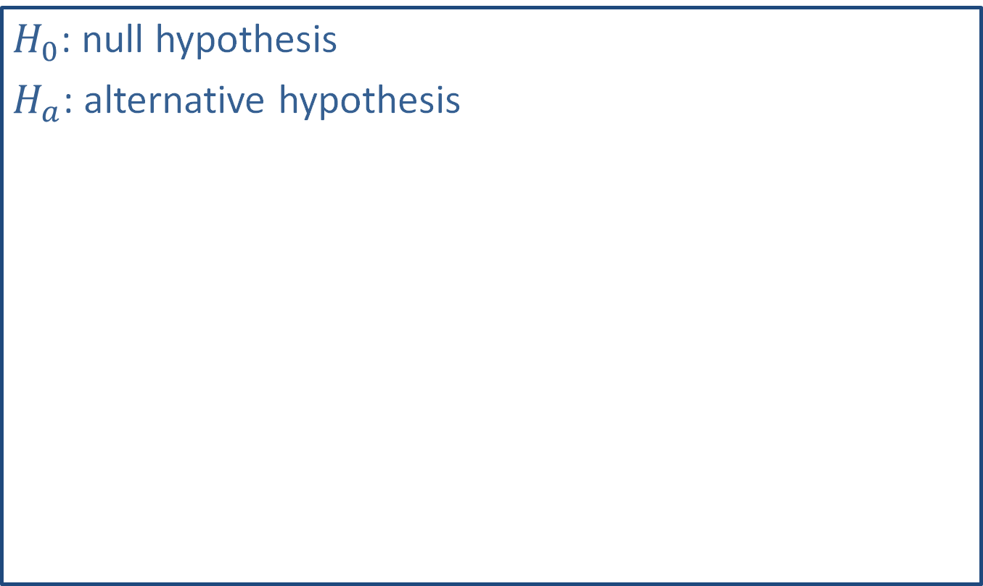
Math Symbols
$H_{0}$: null hypothesis
$H_{a}$: alternative hypothesis

Slide 4
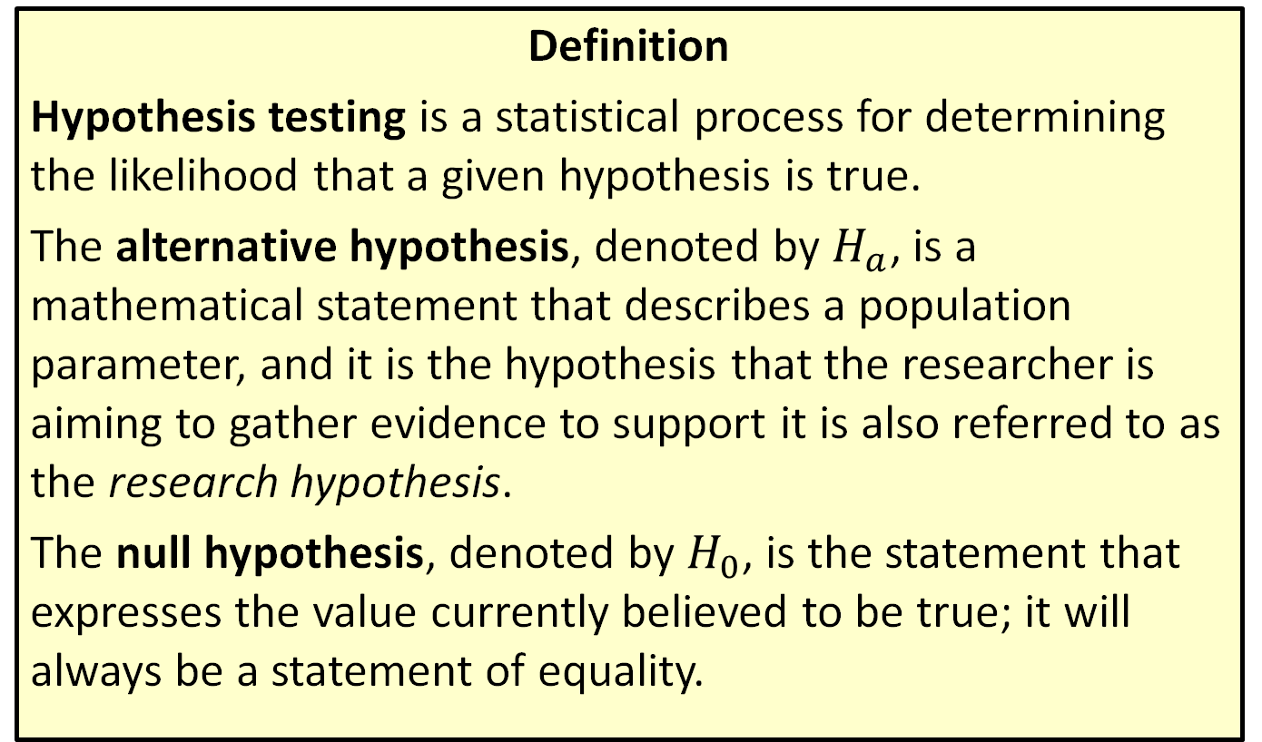
Hypothesis Testing, Alternative Hypothesis & Null Hypothesis
Definition
Hypothesis testing is a statistical process for determining the likelihood that a given hypothesis is true.
The alternative hypothesis, denoted by $H_{a}$, is a mathematical statement that describes a population parameter, and it is the hypothesis that the researcher is aiming to gather evidence to support it is also referred to as the research hypothesis.
The null hypothesis, denoted by $H_{0}$, is the statement that expresses the value currently believed to be true; it will always be a statement of equality.

Slide 5
Example 10.1.1: Determining the Null and Alternative Hypotheses
Determine the null and alternative hypotheses for the following scenario.
At Northwest Mississippi Community College, syllabi for online classes state that students should expect to spend 10 hours per week completing coursework for each three-credit-hour class. The director of eLearning for the community college is concerned that students are being required to spend more than 10 hours per week doing work for each three-credit course.

Slide 6
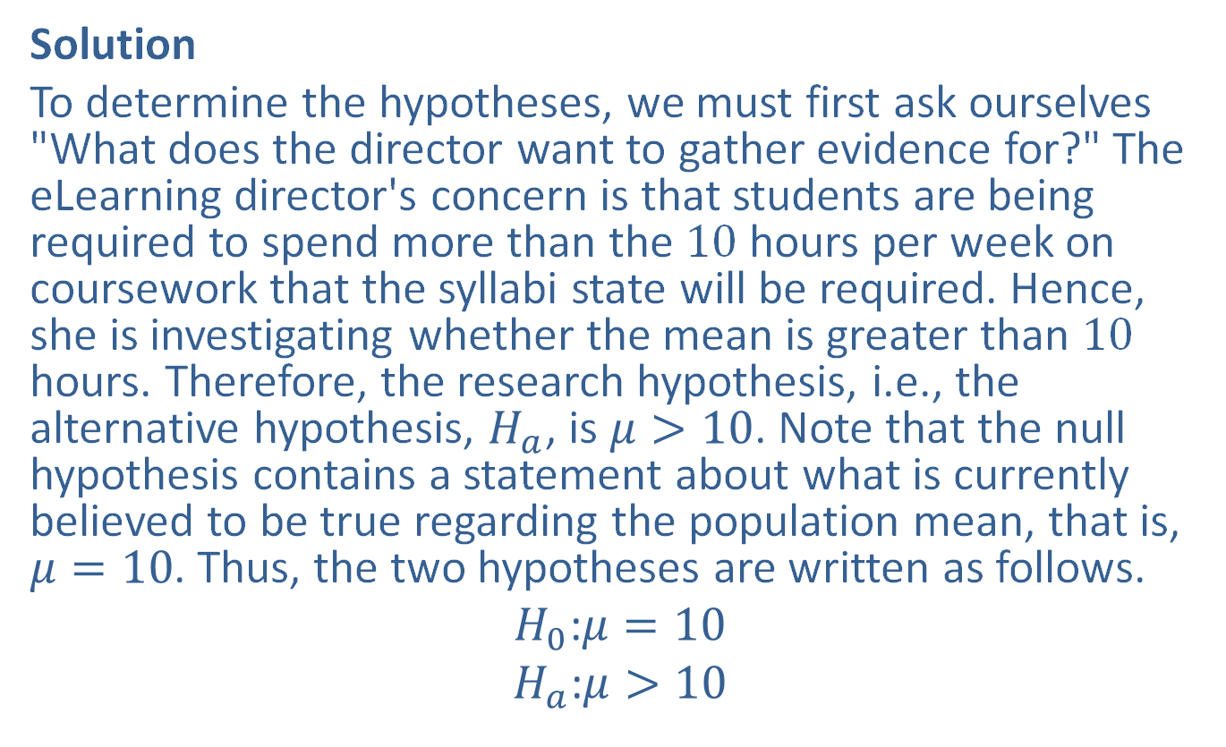
Example 10.1.1: Determining the Null and Alternative Hypotheses (cont.)
Solution
To determine the hypotheses, we must first ask ourselves "What does the director want to gather evidence for?" The eLearning director's concern is that students are being required to spend more than the 10 hours per week on coursework that the syllabi state will be required. Hence, she is investigating whether the mean is greater than 10 hours. Therefore, the research hypothesis, i.e., the alternative hypothesis, $H_{a}$, is $μ>10$. Note that the null hypothesis contains a statement about what is currently believed to be true regarding the population mean, that is, $μ=10$. Thus, the two hypotheses are written as follows.
$$H_{0}\text{:}μ=10$$
$$H_{a}\text{:}μ>10$$

Slide 7
Example 10.1.2: Determining the Null and Alternative Hypotheses
Determine the null and alternative hypotheses for the following scenario.
After learning that Peter Colat of Switzerland could hold his breath for 19 minutes and 21 seconds underwater, a group of students decided to conduct their science fair project around the amount of time an average adult can hold their breath. Part of the group found research to suggest that adults can hold their breath for 30.0 seconds when submerged in lukewarm water. The other half of the group found evidence to suggest that the mean time is different if the water temperature is colder. The group would like to test this claim about adults holding their breath in cold water.

Slide 8
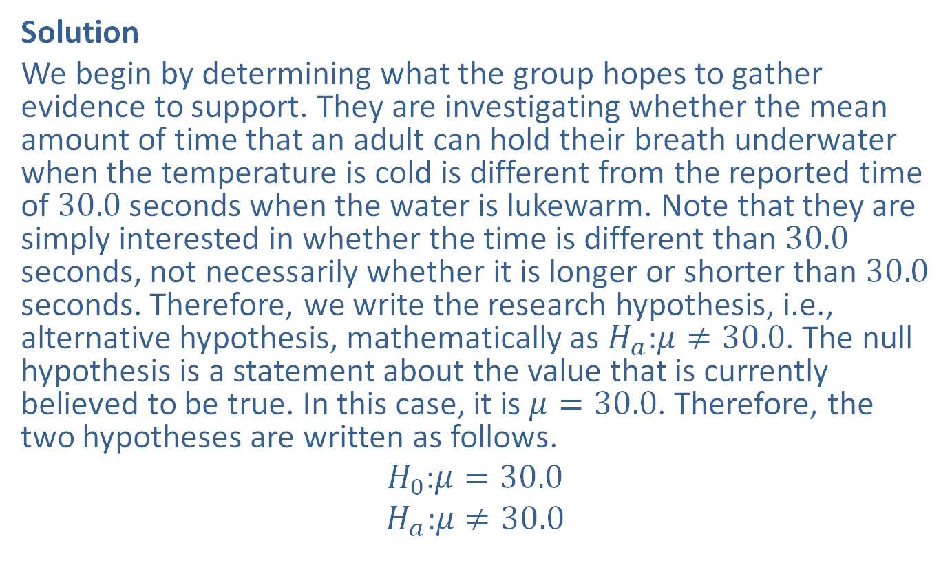
Example 10.1.2: Determining the Null and Alternative Hypotheses (cont.)
Solution
We begin by determining what the group hopes to gather evidence to support. They are investigating whether the mean amount of time that an adult can hold their breath underwater when the temperature is cold is different from the reported time of 30.0 seconds when the water is lukewarm. Note that they are simply interested in whether the time is different than 30.0 seconds, not necessarily whether it is longer or shorter than 30.0 seconds. Therefore, we write the research hypothesis, i.e., alternative hypothesis, mathematically as $H_{a}\text{:}μ≠30.0$. The null hypothesis is a statement about the value that is currently believed to be true. In this case, it is $μ=30.0$. Therefore, the two hypotheses are written as follows.
$$H_{0}\text{:}μ=30.0$$
$$H_{a}\text{:}μ≠30.0$$

Slide 9
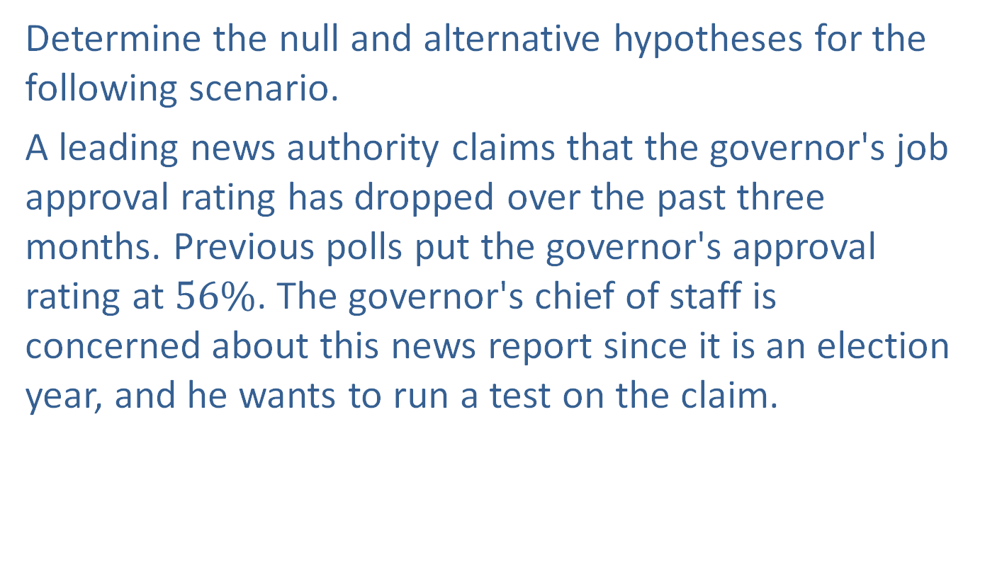
Example 10.1.3: Determining the Null and Alternative Hypotheses
Determine the null and alternative hypotheses for the following scenario.
A leading news authority claims that the governor's job approval rating has dropped over the past three months. Previous polls put the governor's approval rating at $56\%$. The governor's chief of staff is concerned about this news report since it is an election year, and he wants to run a test on the claim.

Slide 10
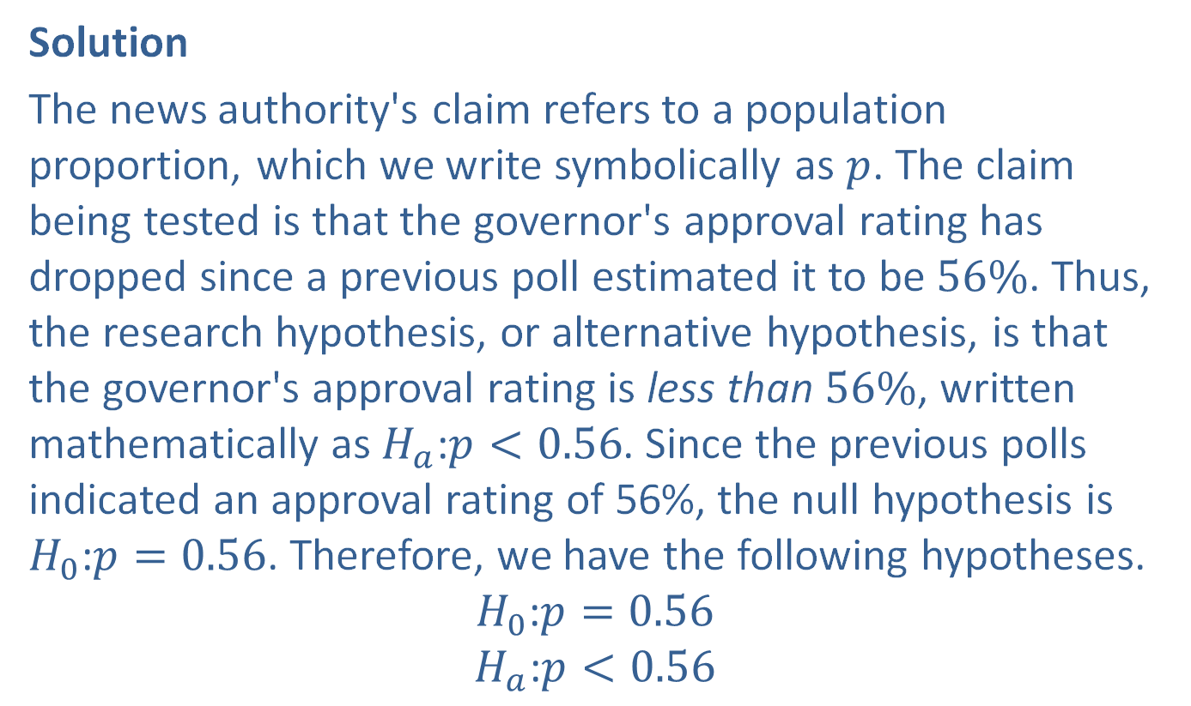
Example 10.1.3: Determining the Null and Alternative Hypotheses (cont.)
Solution
The news authority's claim refers to a population proportion, which we write symbolically as $p$. The claim being tested is that the governor's approval rating has dropped since a previous poll estimated it to be $56\%$. Thus, the research hypothesis, or alternative hypothesis, is that the governor's approval rating is less than $56\%$, written mathematically as $H_{a}\text{:}p<0.56$. Since the previous polls indicated an approval rating of 56%, the null hypothesis is $H_{0}\text{:}p=0.56$. Therefore, we have the following hypotheses.
$$H_{0}\text{:}p=0.56$$
$$H_{a}\text{:}p<0.56$$

Slide 11
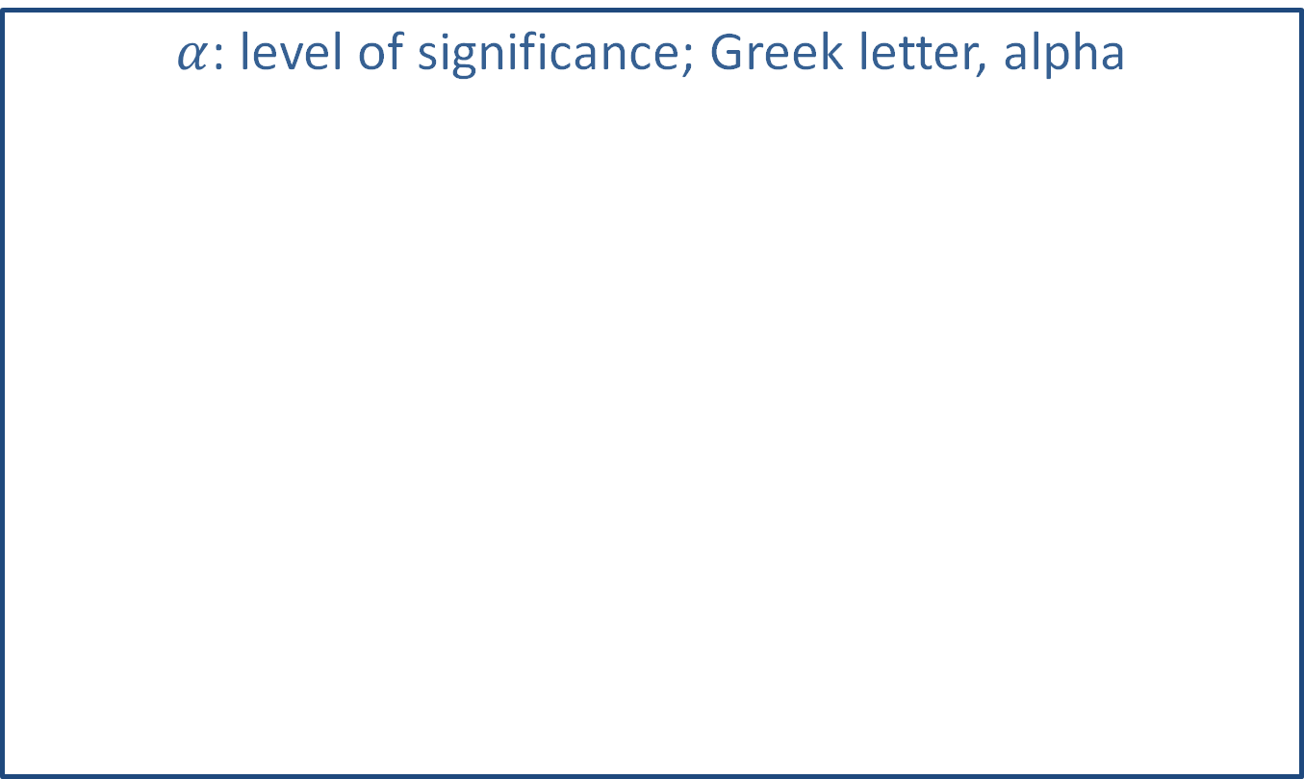
Math Symbols
$α$: level of significance; Greek letter, alpha

Slide 12
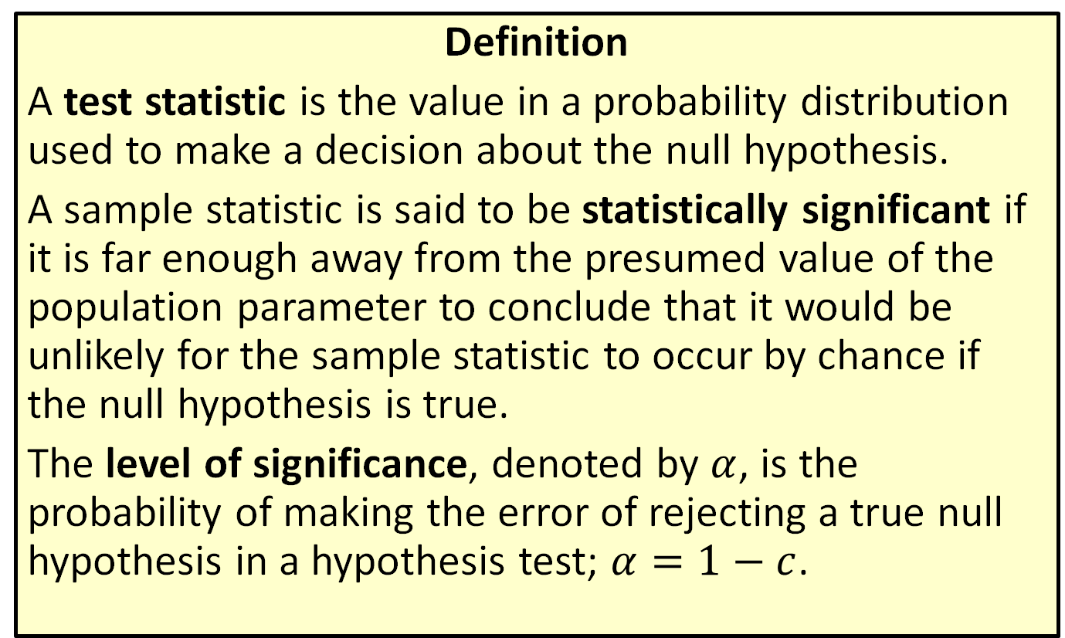
Test Statistic, Statistically Significant & Level Of Significance
Definition
A test statistic is the value in a probability distribution used to make a decision about the null hypothesis.
A sample statistic is said to be statistically significant if it is far enough away from the presumed value of the population parameter to conclude that it would be unlikely for the sample statistic to occur by chance if the null hypothesis is true.
The level of significance, denoted by $α$, is the probability of making the error of rejecting a true null hypothesis in a hypothesis test; $α=1−c$.

Slide 13
Memory Booster
Throughout a hypothesis test, the null hypothesis is assumed to be true.

Slide 14
Properties: Conclusions for a Hypothesis Test
​Reject the null hypothesis.
​Fail to reject the null hypothesis.

Slide 15
Memory Booster
No matter what the conclusion of a hypothesis test is, neither hypothesis has been proven to be true.

Slide 16
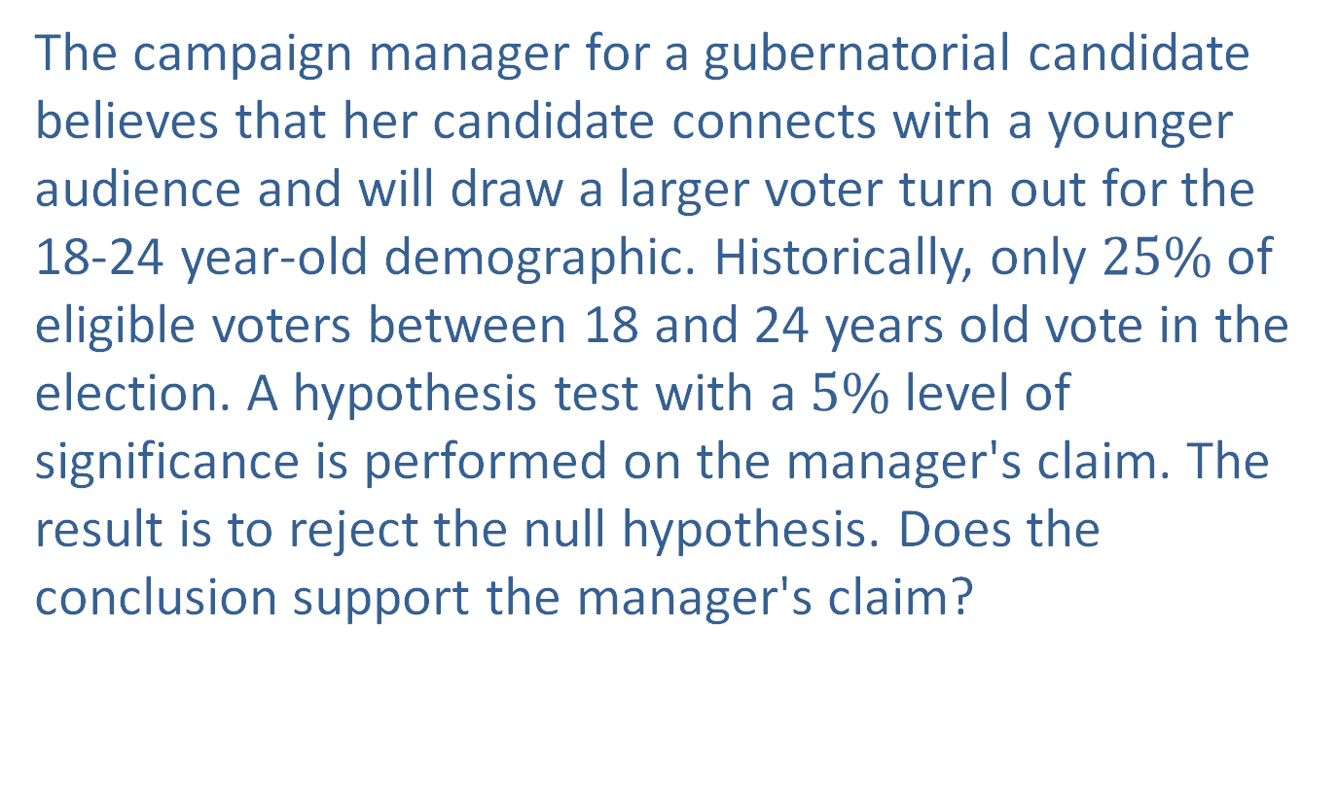
Example 10.1.4: Interpreting the Conclusion to a Hypothesis Test
The campaign manager for a gubernatorial candidate believes that her candidate connects with a younger audience and will draw a larger voter turn out for the 18-24 year-old demographic. Historically, only $25\%$ of eligible voters between 18 and 24 years old vote in the election. A hypothesis test with a $5\%$ level of significance is performed on the manager's claim. The result is to reject the null hypothesis. Does the conclusion support the manager's claim?

Slide 17
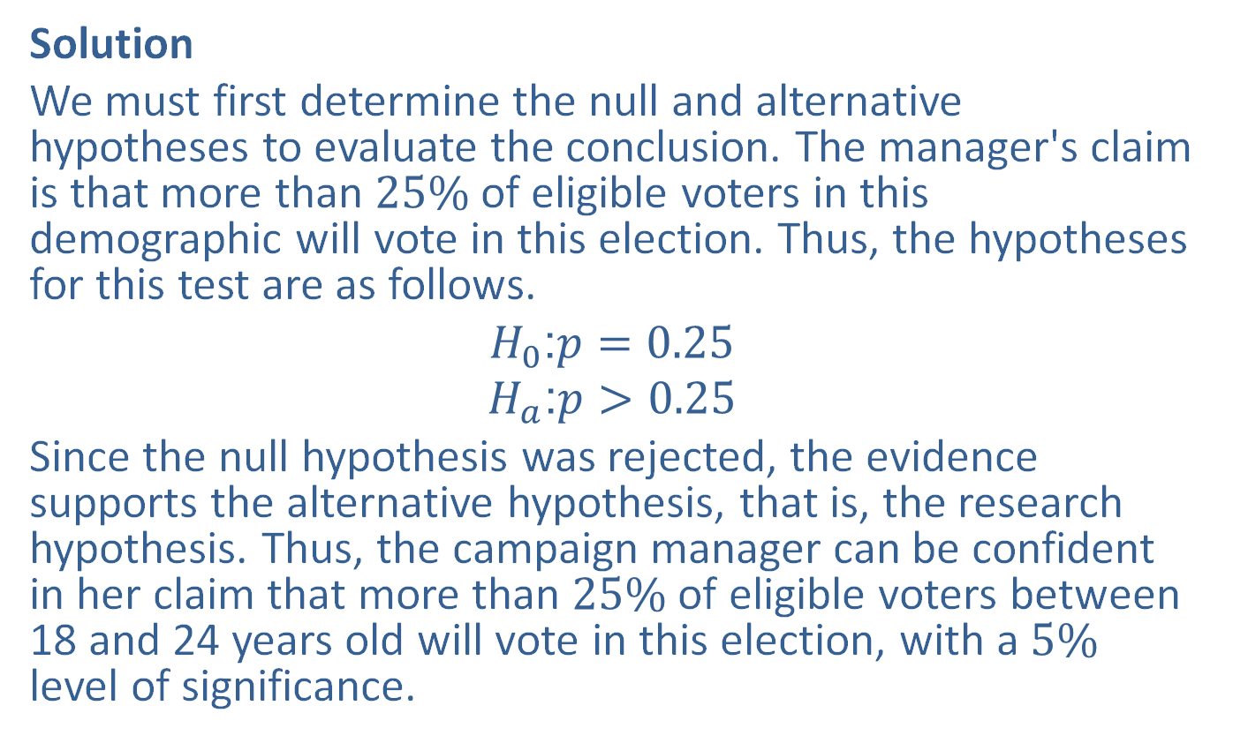
Example 10.1.4: Interpreting the Conclusion to a Hypothesis Test (cont.)
Solution
We must first determine the null and alternative hypotheses to evaluate the conclusion. The manager's claim is that more than $25\%$ of eligible voters in this demographic will vote in this election. Thus, the hypotheses for this test are as follows.
$$H_{0}\text{:}p=0.25$$
$$H_{a}\text{:}p>0.25$$
Since the null hypothesis was rejected, the evidence supports the alternative hypothesis, that is, the research hypothesis. Thus, the campaign manager can be confident in her claim that more than $25\%$ of eligible voters between 18 and 24 years old will vote in this election, with a $5\%$ level of significance.

Slide 18
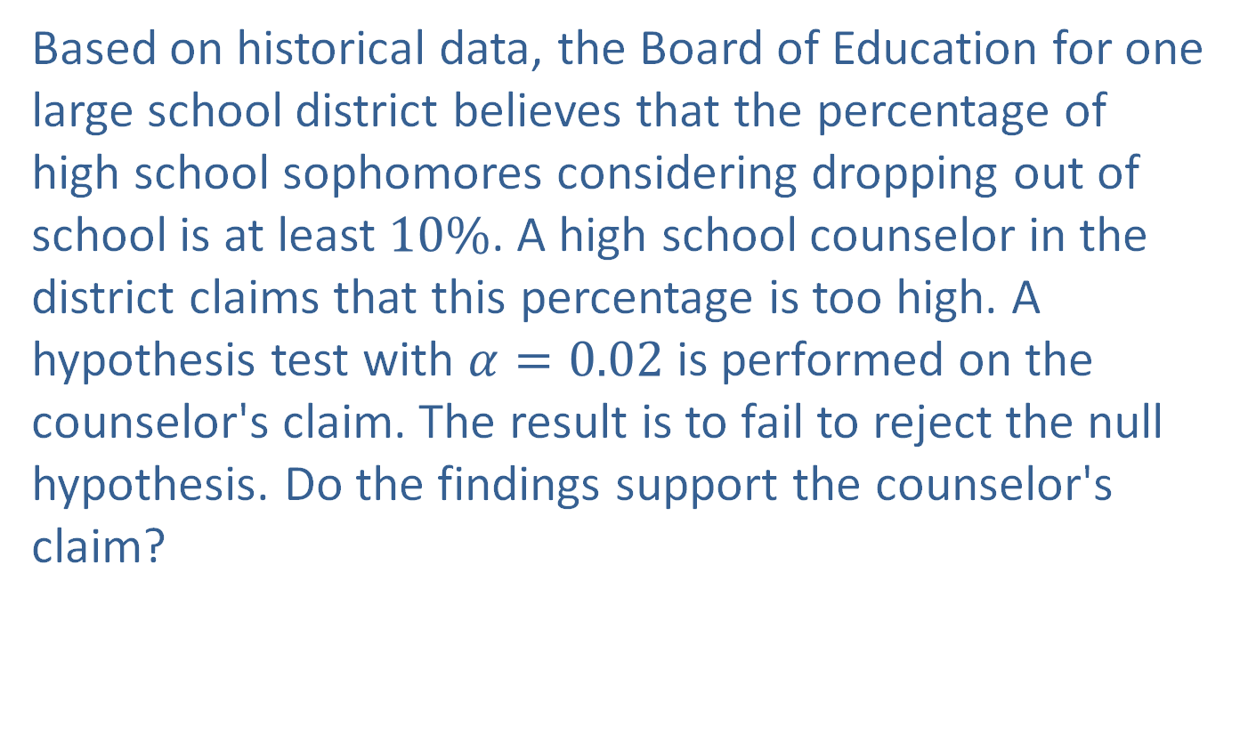
Example 10.1.5: Interpreting the Conclusion to a Hypothesis Test
Based on historical data, the Board of Education for one large school district believes that the percentage of high school sophomores considering dropping out of school is at least $10\%$. A high school counselor in the district claims that this percentage is too high. A hypothesis test with $α=0.02$ is performed on the counselor's claim. The result is to fail to reject the null hypothesis. Do the findings support the counselor's claim?

Slide 19
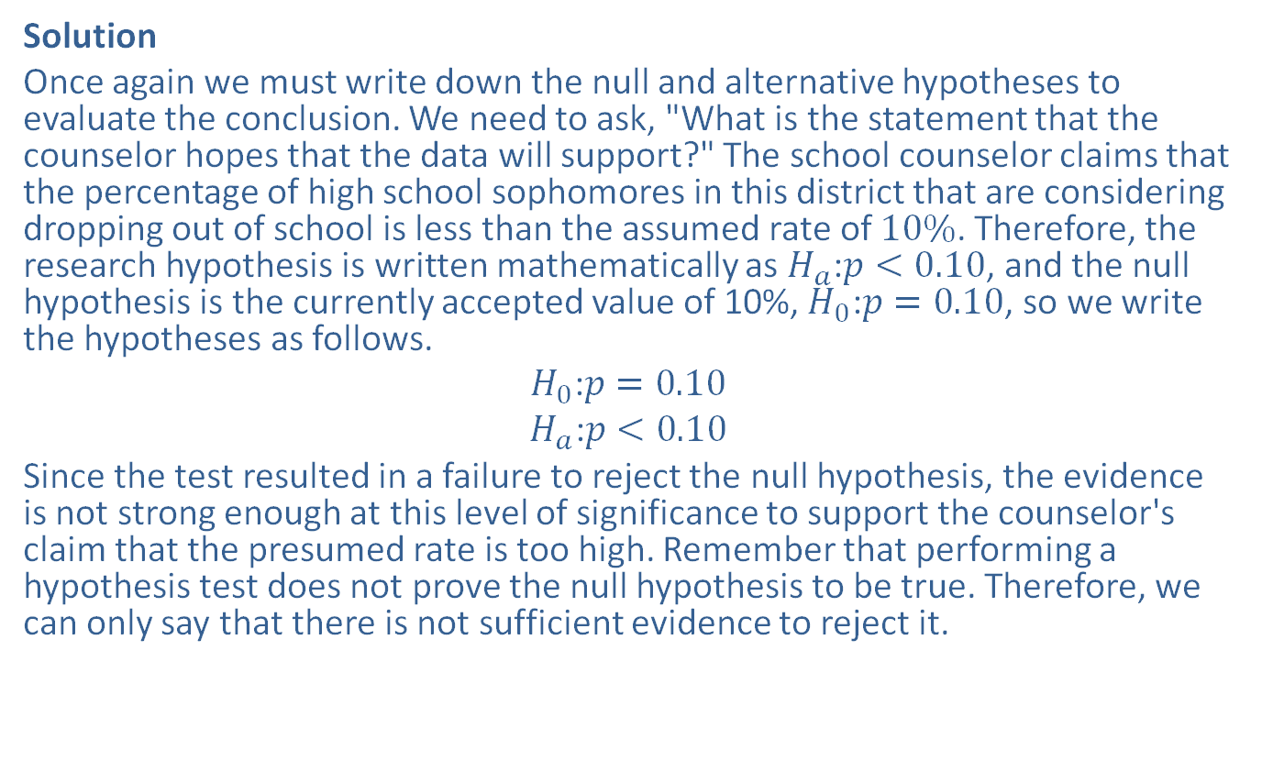
Example 10.1.5: Interpreting the Conclusion to a Hypothesis Test (cont.)
Solution
Once again we must write down the null and alternative hypotheses to evaluate the conclusion. We need to ask, "What is the statement that the counselor hopes that the data will support?" The school counselor claims that the percentage of high school sophomores in this district that are considering dropping out of school is less than the assumed rate of $10\%$. Therefore, the research hypothesis is written mathematically as $H_{a}\text{:}p<0.10$, and the null hypothesis is the currently accepted value of 10%, $H_{0}\text{:}p=0.10$, so we write the hypotheses as follows.
$$H_{0}\text{:}p=0.10$$
$$H_{a}\text{:}p<0.10$$
Since the test resulted in a failure to reject the null hypothesis, the evidence is not strong enough at this level of significance to support the counselor's claim that the presumed rate is too high. Remember that performing a hypothesis test does not prove the null hypothesis to be true. Therefore, we can only say that there is not sufficient evidence to reject it.

Slide 20
Types of Errors in Hypothesis Testing
If we fail to reject the null hypothesis, then we cannot say that the null hypothesis is supported. We can only say that the evidence does not support the alternative
hypothesis.
It is important to remember that no matter what the conclusion is, neither hypothesis has been proven.

Slide 21
Types of Errors in Hypothesis Testing
When performing a hypothesis test there are two types of errors possible:
rejecting a true null hypothesis, or
failing to reject a false null hypothesis.

Slide 22
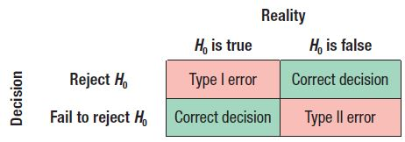
Types of Errors in Hypothesis Testing
We call rejecting a true null hypothesis a Type I error and failing to reject a false null hypothesis is called a Type II error.

Slide 23
Types of Errors in Hypothesis Testing
The decision criteria used in a hypothesis test are usually based on the idea of minimizing the chance of committing a Type I error.
The probability of committing a Type I error, in other words the probability of rejecting a true null hypothesis, is called the level of significance, which we denote with the Greek letter, α.
This is the same level of significance that is used to draw the conclusions in hypothesis tests.

Slide 24
Types of Errors in Hypothesis Testing
The smaller the level of significance, the more evidence required to reject the null hypothesis. The most common practice in academic research is to use a level of significance of 0.05, if one is stated at all.
Many times research studies do not provide a value for the level of significance, but simply state the probability that the results obtained would occur by chance under the assumption that the null hypothesis is true. Therefore, readers can determine for themselves whether the null hypothesis should be rejected.

Slide 25
Types of Errors in Hypothesis Testing
Technically, we can choose the level of significance, α, to be any value we wish. So why wouldn’t we choose the level of significance to be as low as possible?
The answer lies in the inverse relationship between the probability of making a Type I error and the probability of making a Type II error. The probability of making a Type II error is represented by the Greek letter “beta,” β . The smaller the probability of making a Type I error, the larger the probability of making a Type II error will be.

Slide 26
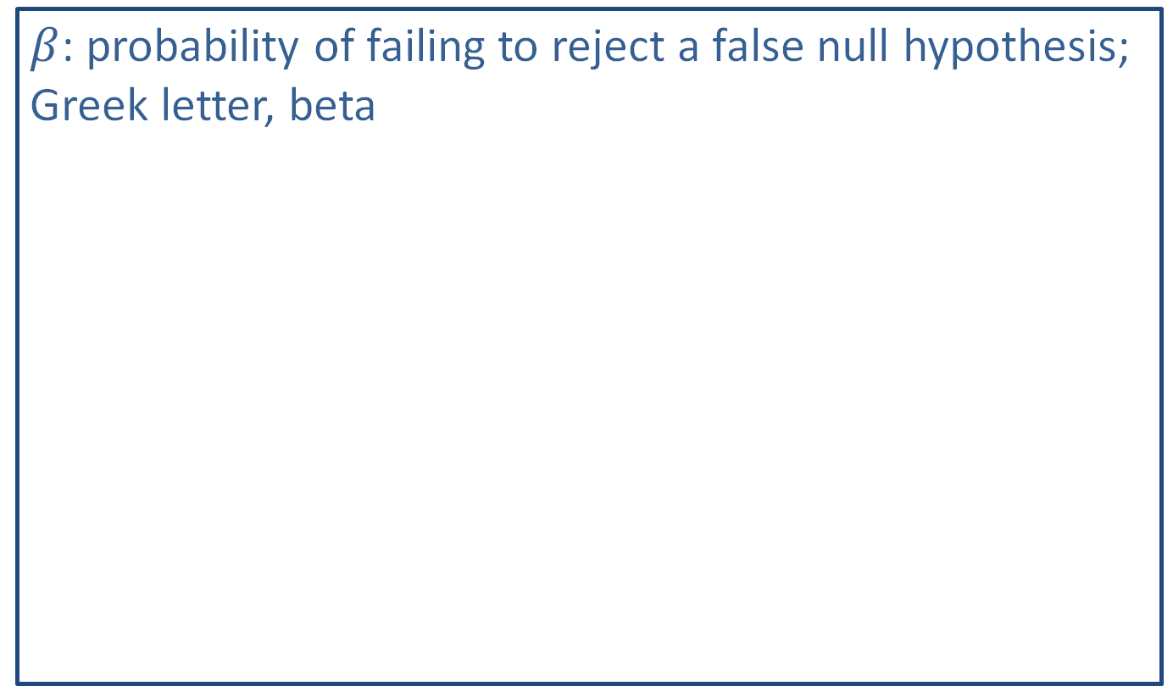
Math Symbols
$β$: probability of failing to reject a false null hypothesis; Greek letter, beta

Slide 27
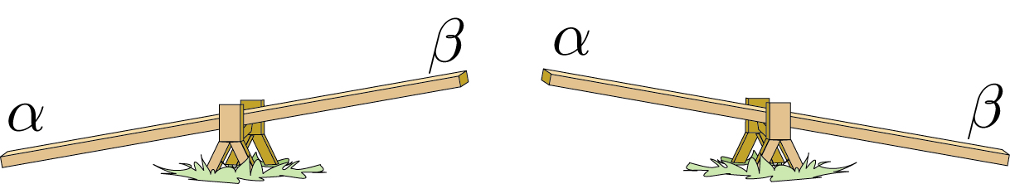
Types of Errors in Hypothesis Testing
Thus, you must choose a level of significance small enough to control the risk of a Type I error while not making it too small, which would increase the chance of making a Type II error. The figure below shows the inverse relationship of α and β.

Slide 28
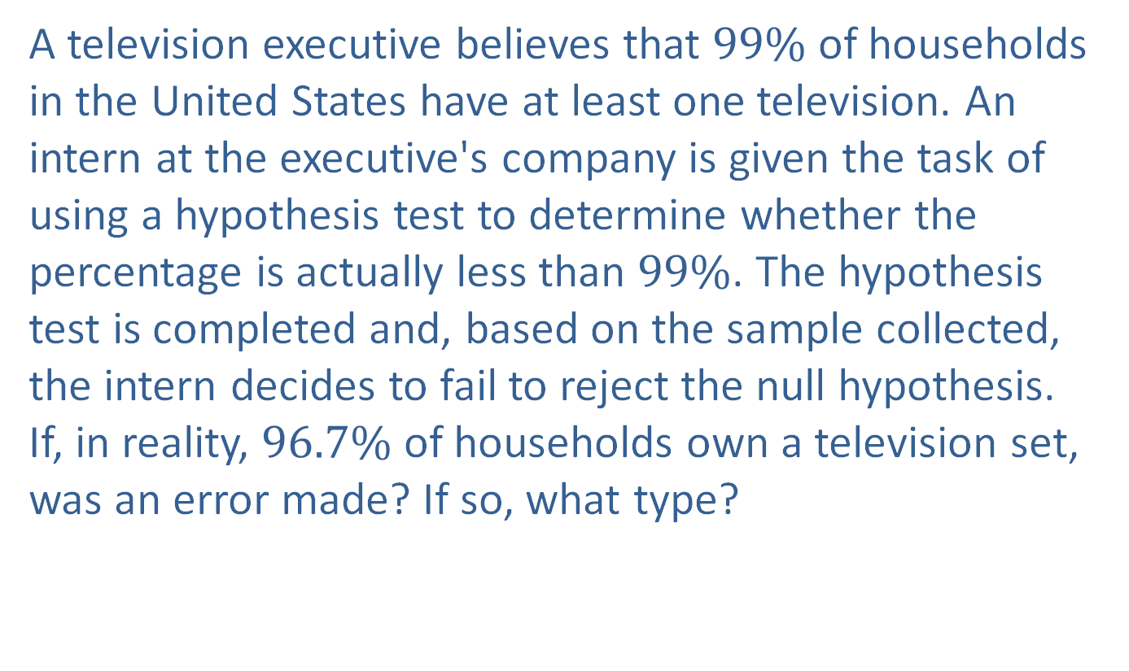
Example 10.1.6: Determining the Type of Error
A television executive believes that $99\%$ of households in the United States have at least one television. An intern at the executive's company is given the task of using a hypothesis test to determine whether the percentage is actually less than $99\%$. The hypothesis test is completed and, based on the sample collected, the intern decides to fail to reject the null hypothesis. If, in reality, $96.7\%$ of households own a television set, was an error made? If so, what type?

Slide 29
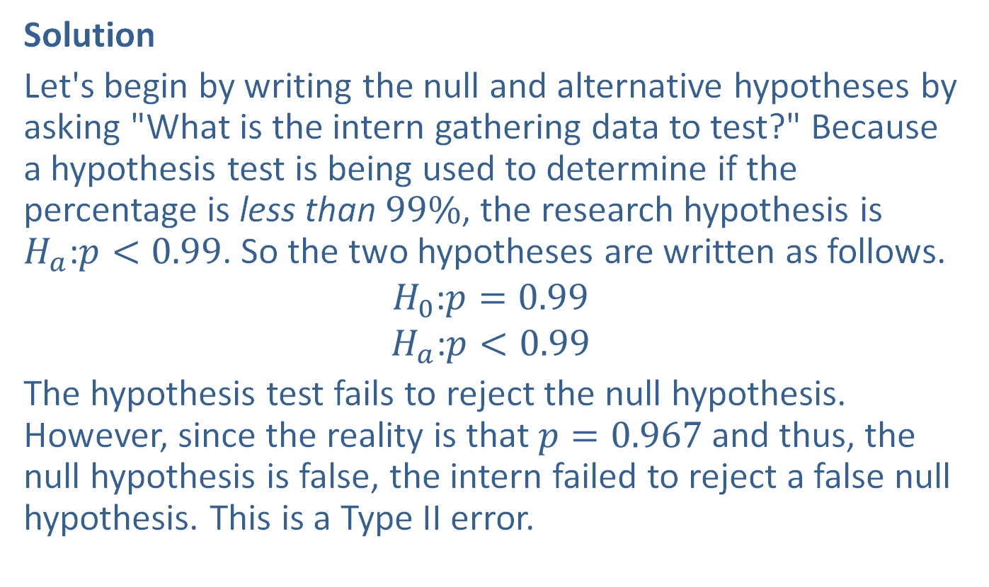
Example 10.1.6: Determining the Type of Error (cont.)
Solution
Let's begin by writing the null and alternative hypotheses by asking "What is the intern gathering data to test?" Because a hypothesis test is being used to determine if the percentage is less than $99\%$, the research hypothesis is $H_{a}\text{:}p<0.99$. So the two hypotheses are written as follows.
$$H_{0}\text{:}p=0.99$$
$$H_{a}\text{:}p<0.99$$
The hypothesis test fails to reject the null hypothesis. However, since the reality is that $p=0.967$ and thus, the null hypothesis is false, the intern failed to reject a false null hypothesis. This is a Type II error.

Slide 30
Example 10.1.7: Determining the Type of Error
Insurance companies commonly use 1000 miles as the mean number of miles a car is driven per month. One insurance company claims that, due to our more mobile society, the mean is more than 1000 miles per month. The insurance company tests its claim with a hypothesis test and decides to reject the null hypothesis. Assume that in reality, the mean number of miles a car is driven per month is 1250 miles. Was an error made? If so, what type?

Slide 31
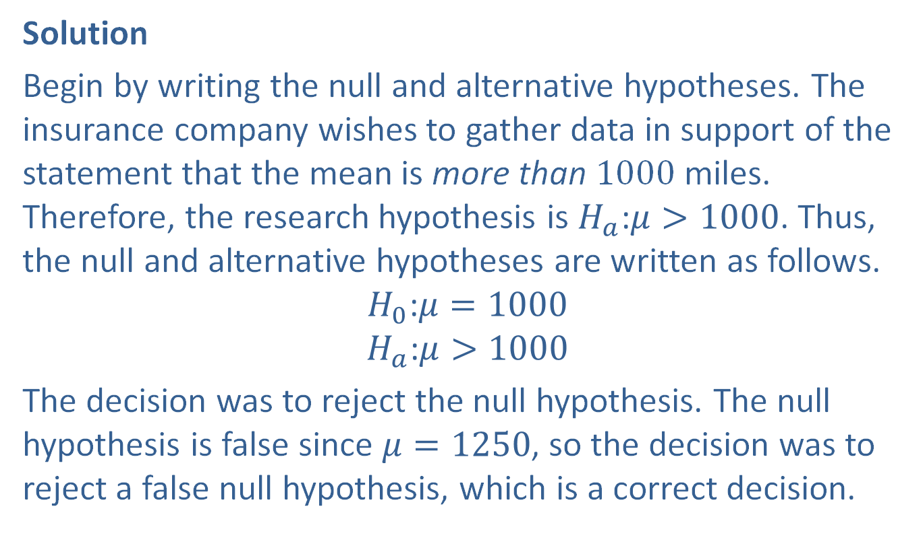
Example 10.1.7: Determining the Type of Error (cont.)
Solution
Begin by writing the null and alternative hypotheses. The insurance company wishes to gather data in support of the statement that the mean is more than 1000 miles. Therefore, the research hypothesis is $H_{a}\text{:}μ>1000$. Thus, the null and alternative hypotheses are written as follows.
$$H_{0}\text{:}μ=1000$$
$$H_{a}\text{:}μ>1000$$
The decision was to reject the null hypothesis. The null hypothesis is false since $μ=1250$, so the decision was to reject a false null hypothesis, which is a correct decision.

Slide 32
Example 10.1.8: Determining the Type of Error
A study regarding the effects of television viewing on children reports that children watch a mean of 4.0 hours of television per night. Kiko believes the mean number of hours that children in her neighborhood watch television per night is not 4.0. She performs a hypothesis test and rejects the null hypothesis. Assume that in reality, children in her neighborhood do watch a mean of 4.0 hours of television per night. Did she make an error? If so, what type?

Slide 33
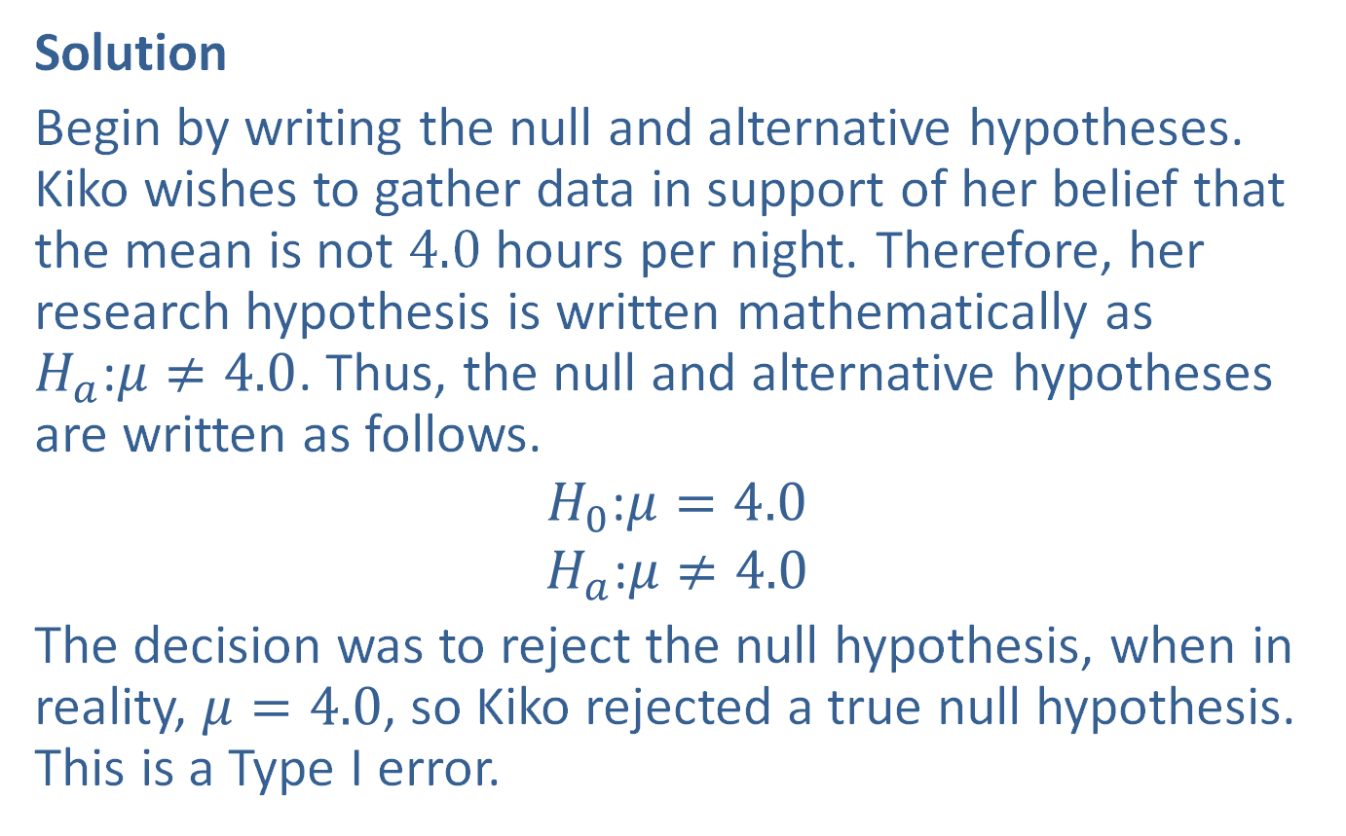
Example 10.1.8: Determining the Type of Error (cont.)
Solution
Begin by writing the null and alternative hypotheses. Kiko wishes to gather data in support of her belief that the mean is not 4.0 hours per night. Therefore, her research hypothesis is written mathematically as $H_{a}\text{:}μ≠4.0$. Thus, the null and alternative hypotheses are written as follows.
$$H_{0}\text{:}μ=4.0$$
$$H_{a}\text{:}μ≠4.0$$
The decision was to reject the null hypothesis, when in reality, $μ=4.0$, so Kiko rejected a true null hypothesis. This is a Type I error.

Slide 34
Memory Booster
We would usually have no basis for determining if a Type I error or a Type II error has been made because population parameters are usually unknown.

