Slide 1
Section 10.2
Hypothesis Testing for Population Means (Sigma Known)

Slide 2
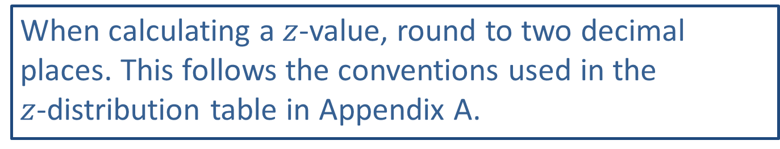
Rounding Rule:
When calculating a $z$-value, round to two decimal places. This follows the conventions used in the $z$-distribution table in Appendix A.

Slide 3
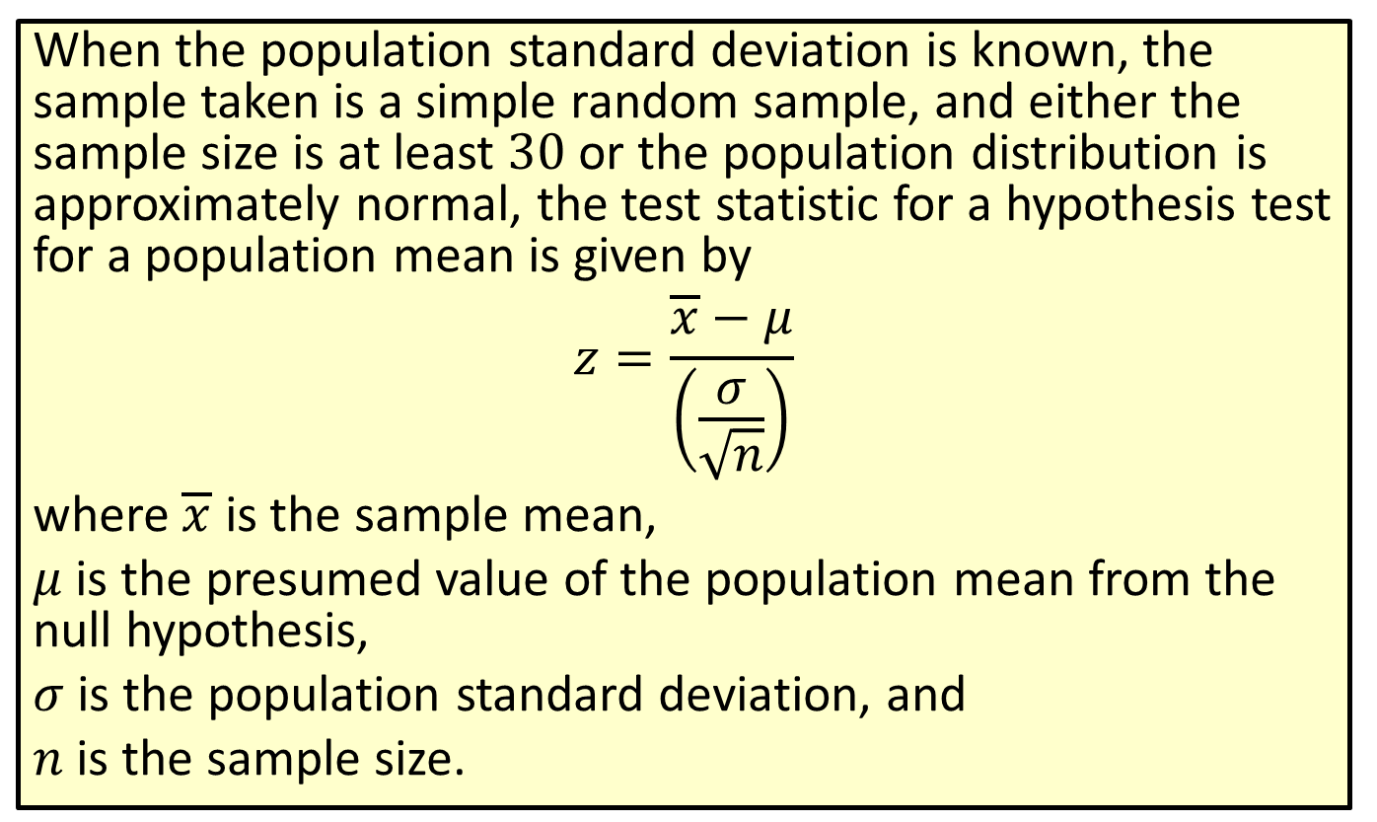

Formula: Test Statistic for a Hypothesis Test for a Population Mean ($σ$ Known)
When the population standard deviation is known, the sample taken is a simple random sample, and either the sample size is at least 30 or the population distribution is approximately normal, the test statistic for a hypothesis test for a population mean is given by
$$z=\frac{\overline{x}−μ}{\left(\frac{σ}{\sqrt{n}}\right)}$$
where $\overline{x}$ is the sample mean,
$μ$ is the presumed value of the population mean from the null hypothesis,
$σ$ is the population standard deviation, and
$n$ is the sample size.

Slide 4
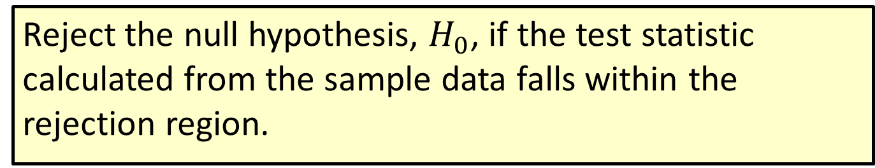
Procedure: Decision Rule for Rejection Regions
Reject the null hypothesis, $H_{0}$, if the test statistic calculated from the sample data falls within the rejection region.

Slide 5
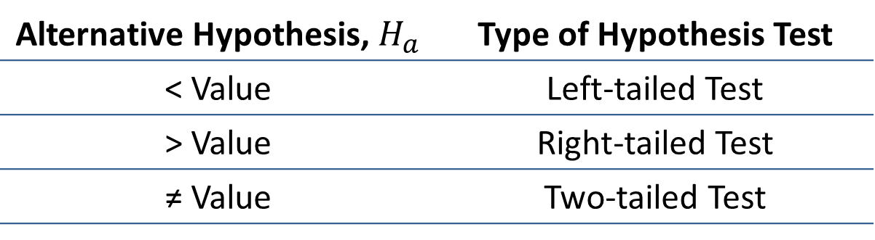
Definition
Definition
The three types of hypothesis tests are defined by the symbol given in the alternative hypothesis as follows.
Alternative Hypothesis, $H_{a}$ | Type of Hypothesis Test
< Value | Left-tailed Test
> Value | Right-tailed Test
≠ Value | Two-tailed Test

Slide 6
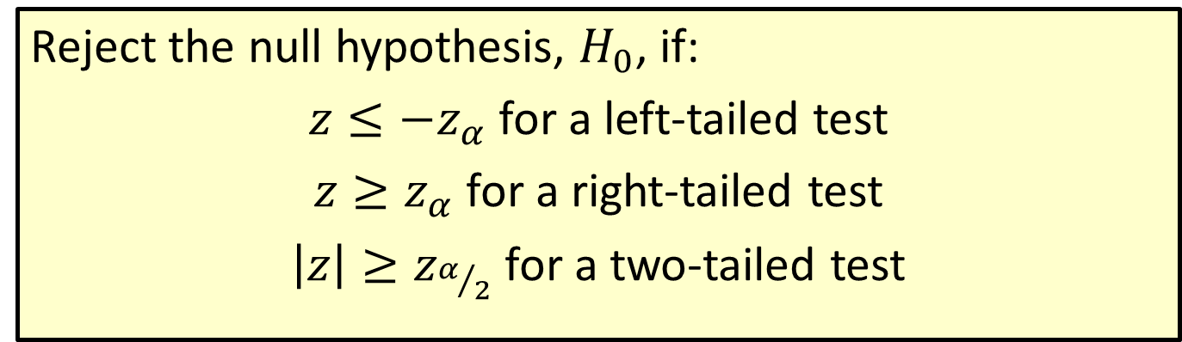

Procedure: Rejection Regions for Hypothesis Tests for Population Means ($σ$ Known)
Reject the null hypothesis, $H_{0}$, if:
$z≤−z_{α}$ for a left-tailed test
$z≥z_{α}$ for a right-tailed test
$\left|z\right|≥z_{α/2}$ for a two-tailed test

Slide 7
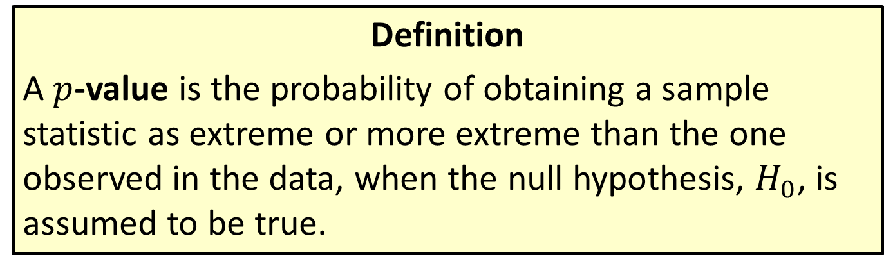

$p$-Value
Definition
A $p$-value is the probability of obtaining a sample statistic as extreme or more extreme than the one observed in the data, when the null hypothesis, $H_{0}$, is assumed to be true.

Slide 8
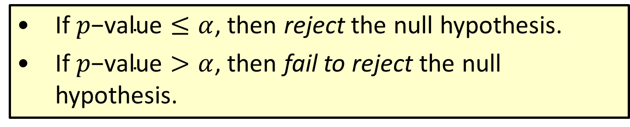

Procedure: Conclusions Using $p$-Values
​If $p\text{−}\text{value}≤α$, then reject the null hypothesis.
​If $p\text{−}\text{value}>α$, then fail to reject the null hypothesis.

Slide 9
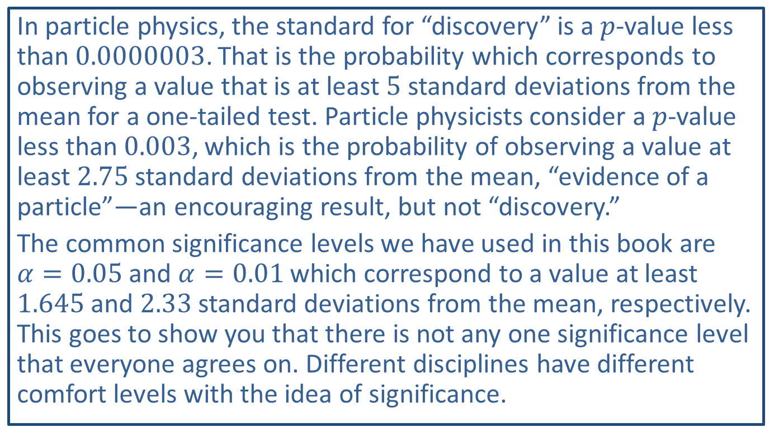

Different $p$-Values for Different Folks
In particle physics, the standard for “discovery” is a $p$-value less than 0.0000003. That is the probability which corresponds to observing a value that is at least 5 standard deviations from the mean for a one-tailed test. Particle physicists consider a $p$-value less than 0.003, which is the probability of observing a value at least 2.75 standard deviations from the mean, “evidence of a particle”—an encouraging result, but not “discovery.”
The common significance levels we have used in this book are $α=0.05$ and $α=0.01$ which correspond to a value at least 1.645 and 2.33 standard deviations from the mean, respectively. This goes to show you that there is not any one significance level that everyone agrees on. Different disciplines have different comfort levels with the idea of significance.

Slide 10
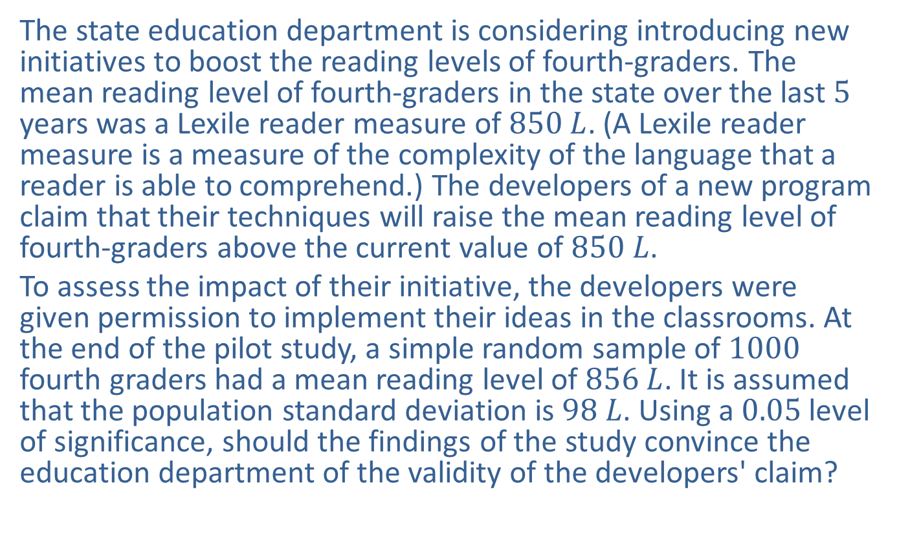

Example 10.2.1: Hypothesis Test for a Population Mean (Right-Tailed, $σ$ Known)
The state education department is considering introducing new initiatives to boost the reading levels of fourth-graders. The mean reading level of fourth-graders in the state over the last 5 years was a Lexile reader measure of $850 L$. (A Lexile reader measure is a measure of the complexity of the language that a reader is able to comprehend.) The developers of a new program claim that their techniques will raise the mean reading level of fourth-graders above the current value of $850 L$.
To assess the impact of their initiative, the developers were given permission to implement their ideas in the classrooms. At the end of the pilot study, a simple random sample of 1000 fourth graders had a mean reading level of $856 L$. It is assumed that the population standard deviation is $98 L$. Using a 0.05 level of significance, should the findings of the study convince the education department of the validity of the developers' claim?

Slide 11
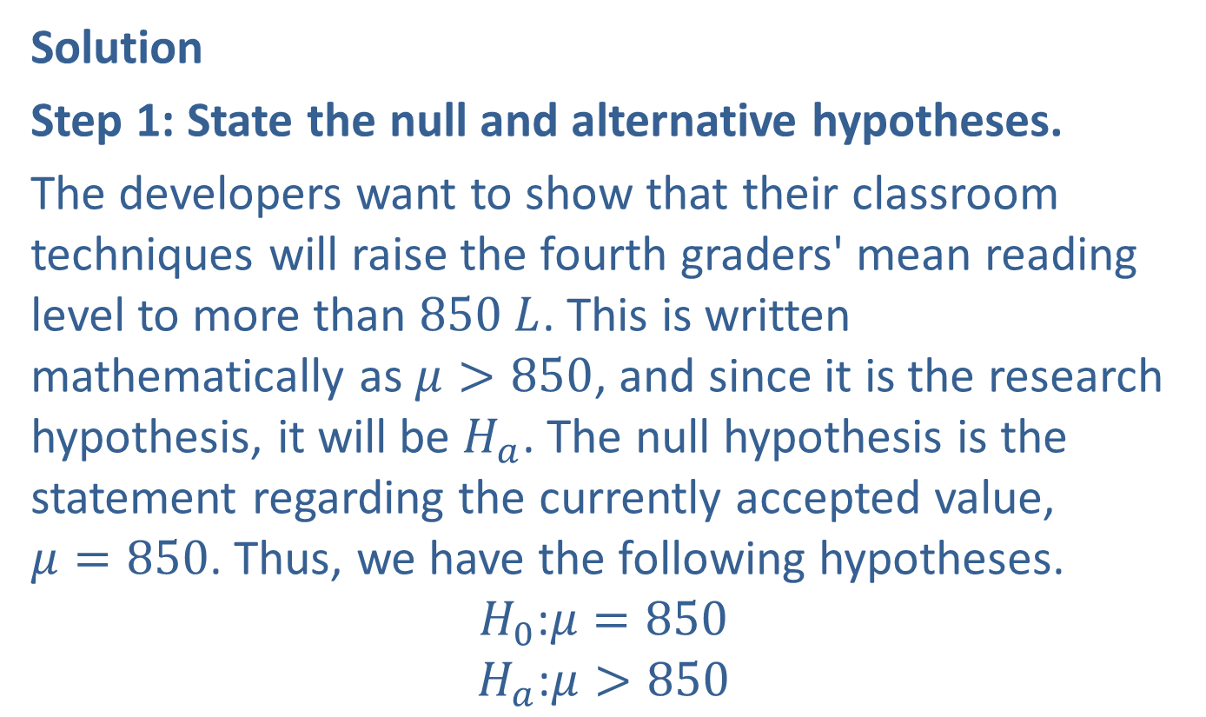

Example 10.2.1: Hypothesis Test for a Population Mean (Right-Tailed, $σ$ Known) (cont.)
Solution
Step 1: State the null and alternative hypotheses.
The developers want to show that their classroom techniques will raise the fourth graders' mean reading level to more than $850 L$. This is written mathematically as $μ>850$, and since it is the research hypothesis, it will be $H_{a}$. The null hypothesis is the statement regarding the currently accepted value, $μ=850$. Thus, we have the following hypotheses.
$$H_{0}\text{:}μ=850$$
$$H_{a}\text{:}μ>850$$

Slide 12
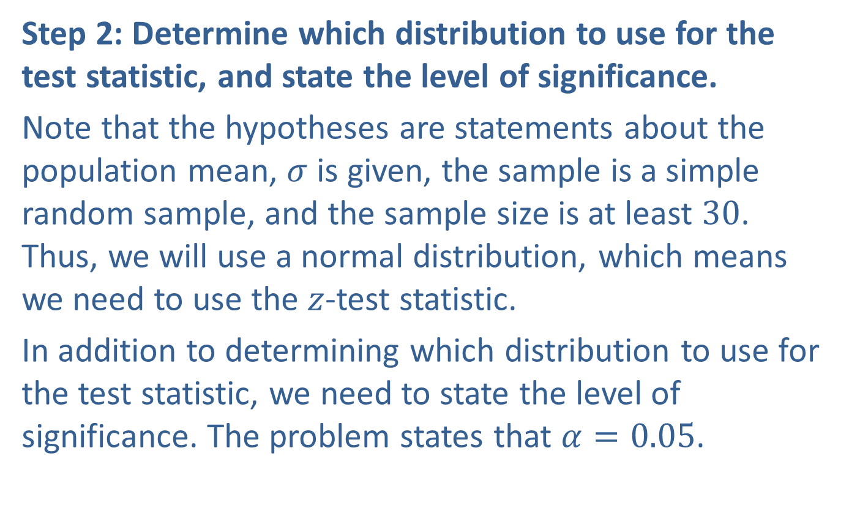
Example 10.2.1: Hypothesis Test for a Population Mean (Right-Tailed, $σ$ Known) (cont.)
Step 2: Determine which distribution to use for the test statistic, and state the level of significance.
Note that the hypotheses are statements about the population mean, $σ$ is given, the sample is a simple random sample, and the sample size is at least 30. Thus, we will use a normal distribution, which means we need to use the $z$-test statistic.
In addition to determining which distribution to use for the test statistic, we need to state the level of significance. The problem states that $α=0.05$.

Slide 13
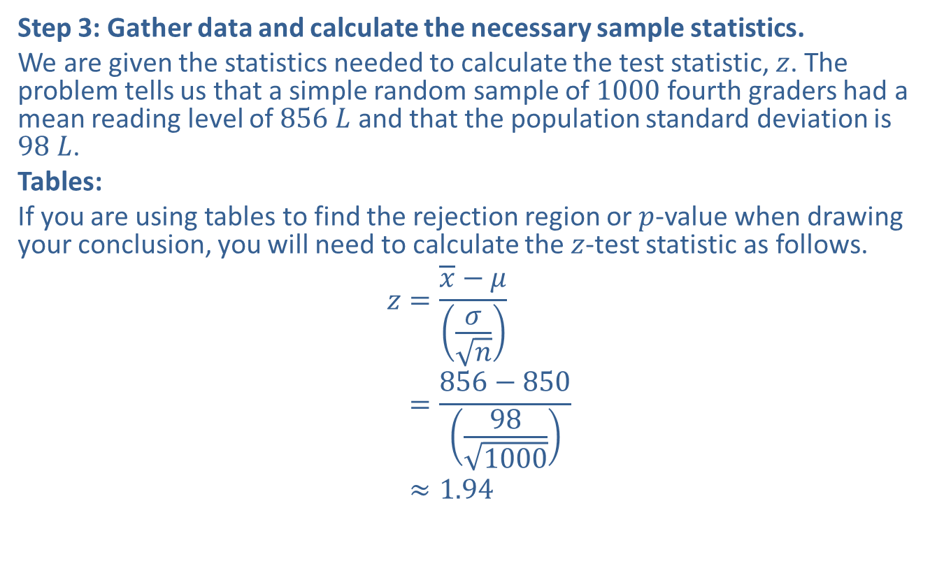
Example 10.2.1: Hypothesis Test for a Population Mean (Right-Tailed, $σ$ Known) (cont.)
Step 3: Gather data and calculate the necessary sample statistics.
We are given the statistics needed to calculate the test statistic, $z$. The problem tells us that a simple random sample of 1000 fourth graders had a mean reading level of $856 L$ and that the population standard deviation is $98 L$.
Tables:
If you are using tables to find the rejection region or $p$-value when drawing your conclusion, you will need to calculate the $z$-test statistic as follows.
𝑧=𝑥−𝜇𝜎𝑛𝑧=856−850981000𝑧≈1.94

Slide 14
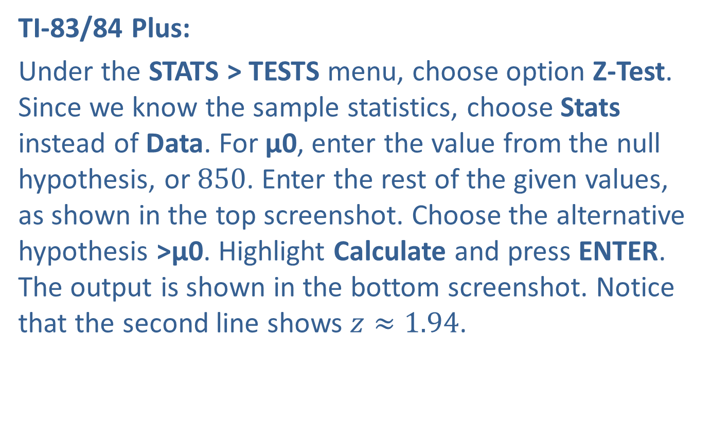
Example 10.2.1: Hypothesis Test for a Population Mean (Right-Tailed, $σ$ Known) (cont.)
TI-83/84 Plus:
Under the STATS > TESTS menu, choose option Z-Test. Since we know the sample statistics, choose Stats instead of Data. For μ0, enter the value from the null hypothesis, or 850. Enter the rest of the given values, as shown in the top screenshot. Choose the alternative hypothesis >μ0. Highlight Calculate and press ENTER. The output is shown in the bottom screenshot. Notice that the second line shows $z≈1.94$.

Slide 15
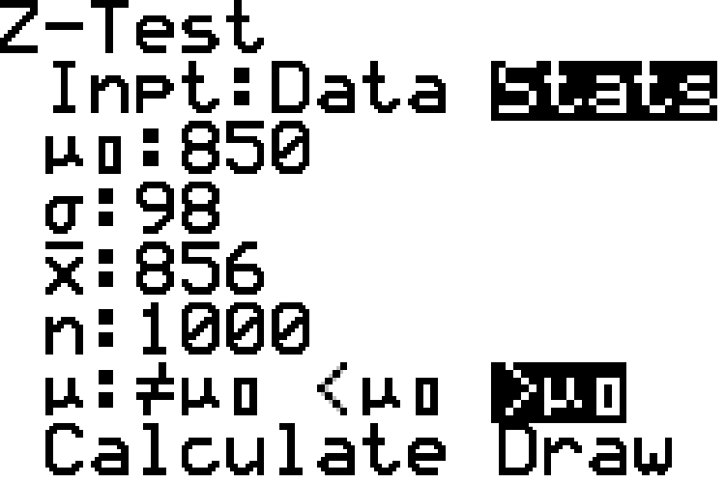
Example 10.2.1: Hypothesis Test for a Population Mean (Right-Tailed, $σ$ Known) (cont.)

Slide 16
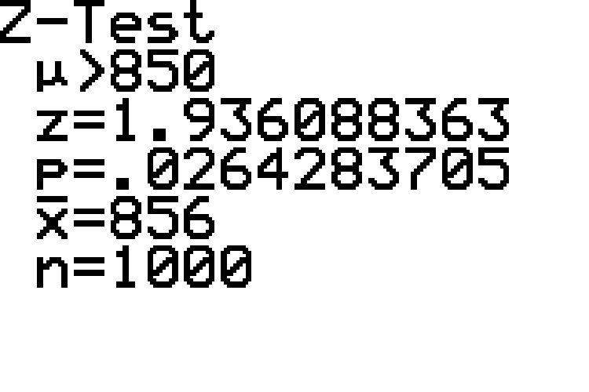
Example 10.2.1: Hypothesis Test for a Population Mean (Right-Tailed, $σ$ Known) (cont.)

Slide 17
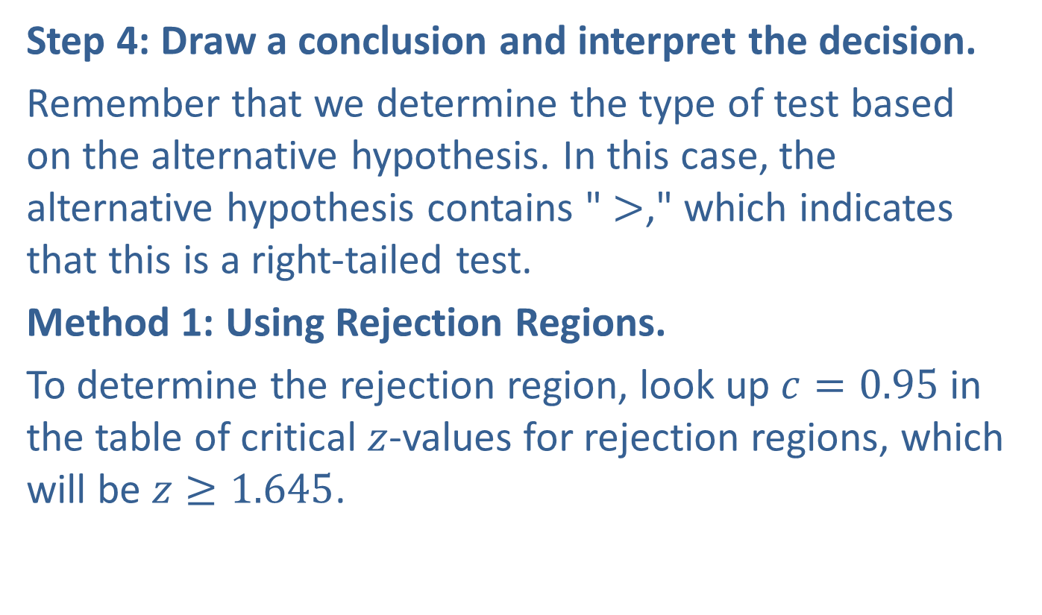
Example 10.2.1: Hypothesis Test for a Population Mean (Right-Tailed, $σ$ Known) (cont.)
Step 4: Draw a conclusion and interpret the decision.
Remember that we determine the type of test based on the alternative hypothesis. In this case, the alternative hypothesis contains " $>$," which indicates that this is a right-tailed test.
Method 1: Using Rejection Regions.
To determine the rejection region, look up $c=0.95$ in the table of critical $z$-values for rejection regions, which will be $z≥1.645$.

Slide 18
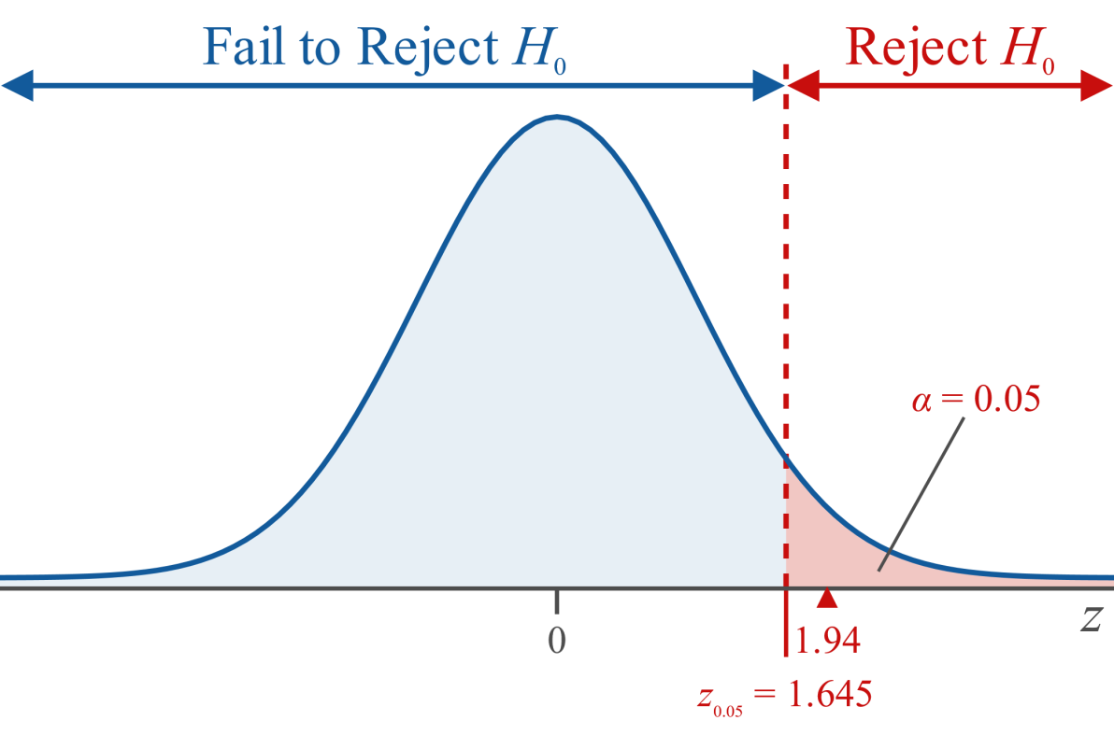
Example 10.2.1: Hypothesis Test for a Population Mean (Right-Tailed, $σ$ Known) (cont.)

Slide 19
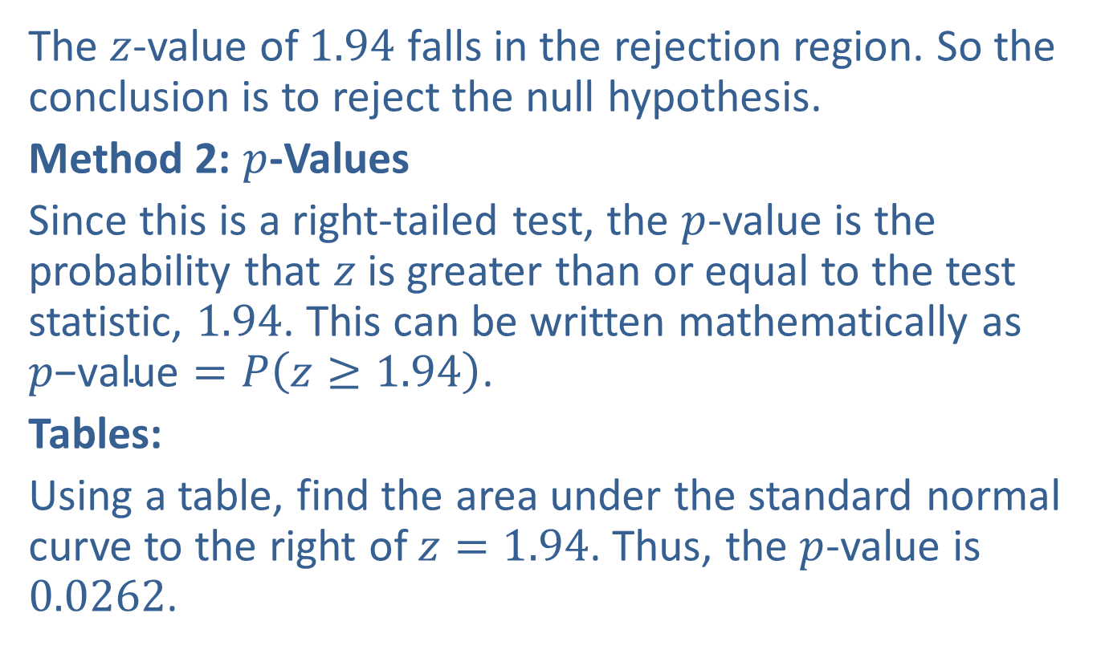
Example 10.2.1: Hypothesis Test for a Population Mean (Right-Tailed, $σ$ Known) (cont.)
The $z$-value of 1.94 falls in the rejection region. So the conclusion is to reject the null hypothesis.
Method 2: $p$-Values
Since this is a right-tailed test, the $p$-value is the probability that $z$ is greater than or equal to the test statistic, 1.94. This can be written mathematically as $p\text{−}\text{value}=P\left(z≥1.94\right)$.
Tables:
Using a table, find the area under the standard normal curve to the right of $z=1.94$. Thus, the $p$-value is 0.0262.

Slide 20
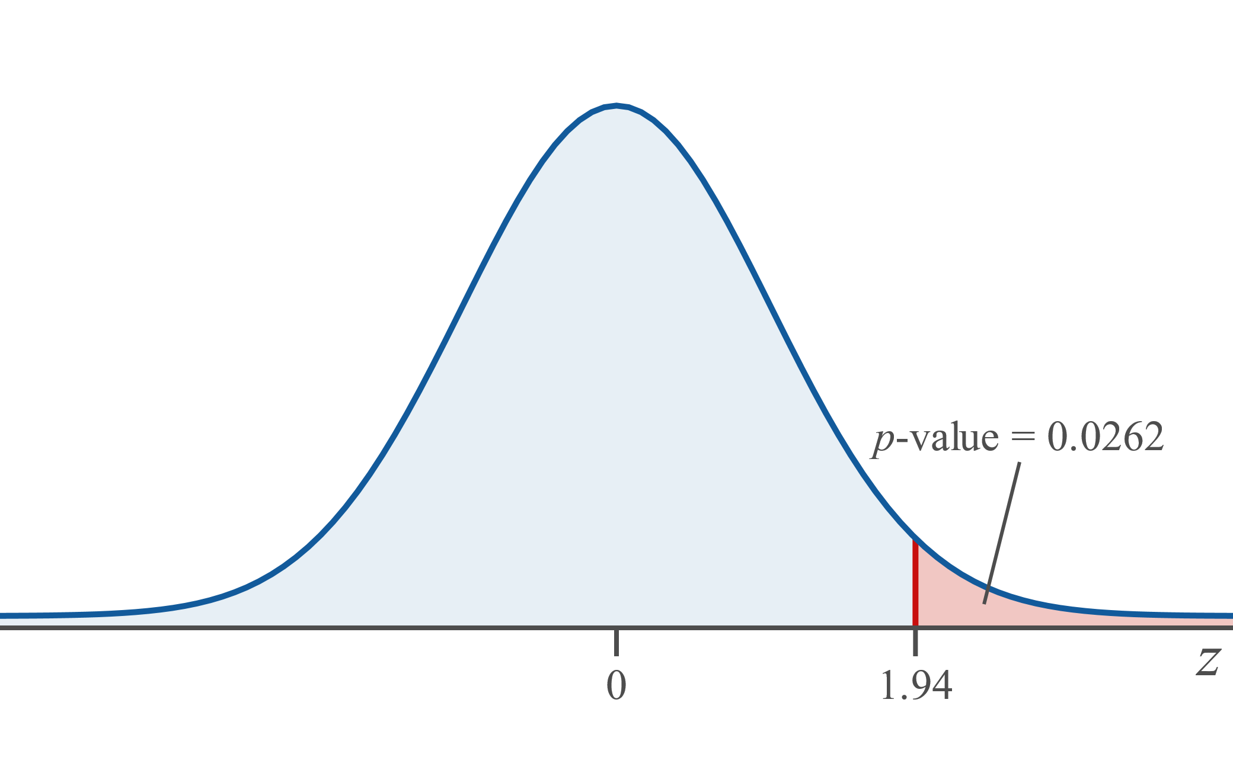
Example 10.2.1: Hypothesis Test for a Population Mean (Right-Tailed, $σ$ Known) (cont.)

Slide 21
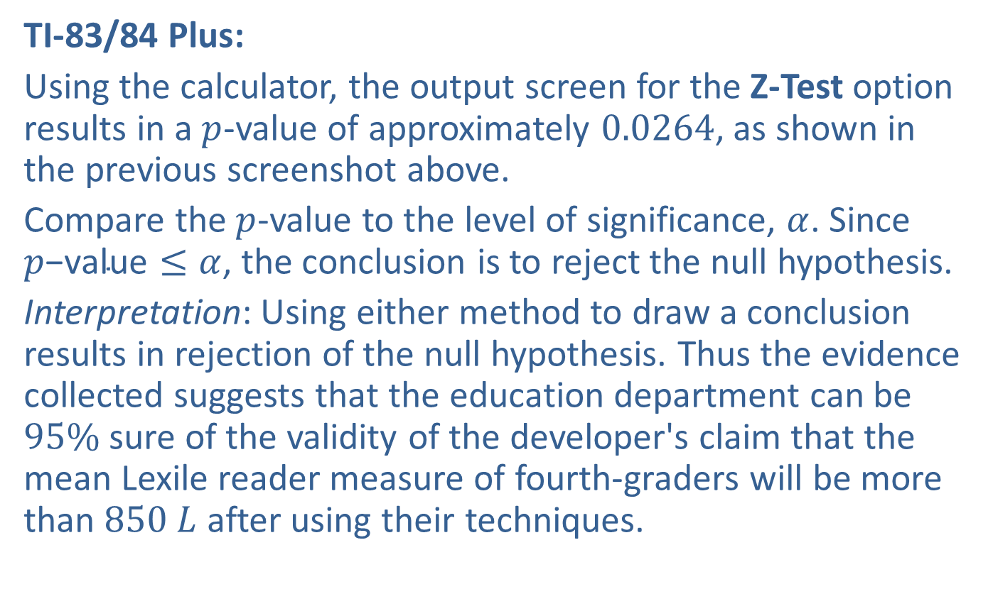
Example 10.2.1: Hypothesis Test for a Population Mean (Right-Tailed, $σ$ Known) (cont.)
TI-83/84 Plus:
Using the calculator, the output screen for the Z-Test option results in a $p$-value of approximately 0.0264, as shown in the previous screenshot above.
Compare the $p$-value to the level of significance, $α$. Since $p\text{−}\text{value}≤α$, the conclusion is to reject the null hypothesis.
Interpretation: Using either method to draw a conclusion results in rejection of the null hypothesis. Thus the evidence collected suggests that the education department can be $95\%$ sure of the validity of the developer's claim that the mean Lexile reader measure of fourth-graders will be more than $850 L$ after using their techniques.

Slide 22
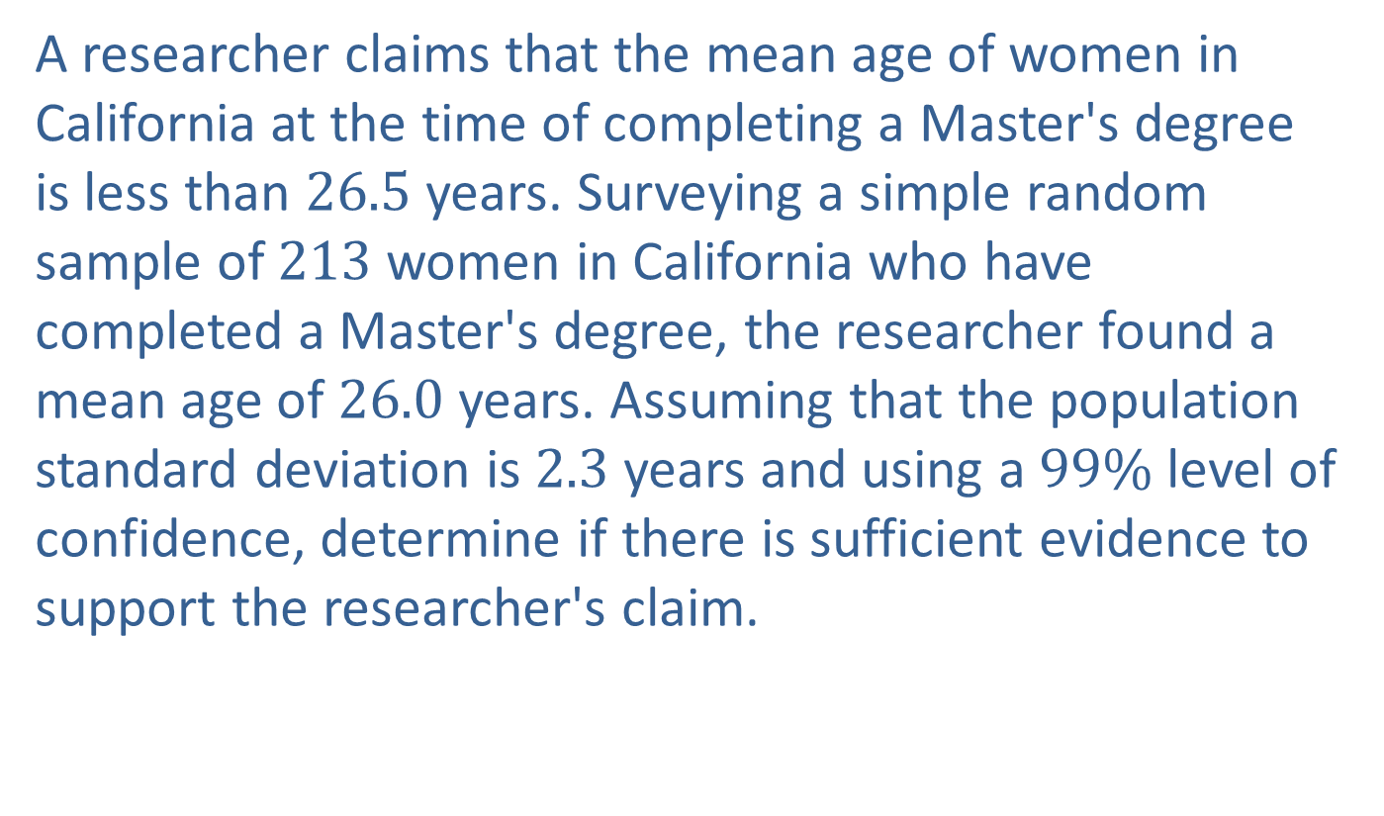

Example 10.2.2: Hypothesis Test for a Population Mean (Left-Tailed, $σ$ Known)
A researcher claims that the mean age of women in California at the time of completing a Master's degree is less than 26.5 years. Surveying a simple random sample of 213 women in California who have completed a Master's degree, the researcher found a mean age of 26.0 years. Assuming that the population standard deviation is 2.3 years and using a $99\%$ level of confidence, determine if there is sufficient evidence to support the researcher's claim.

Slide 23
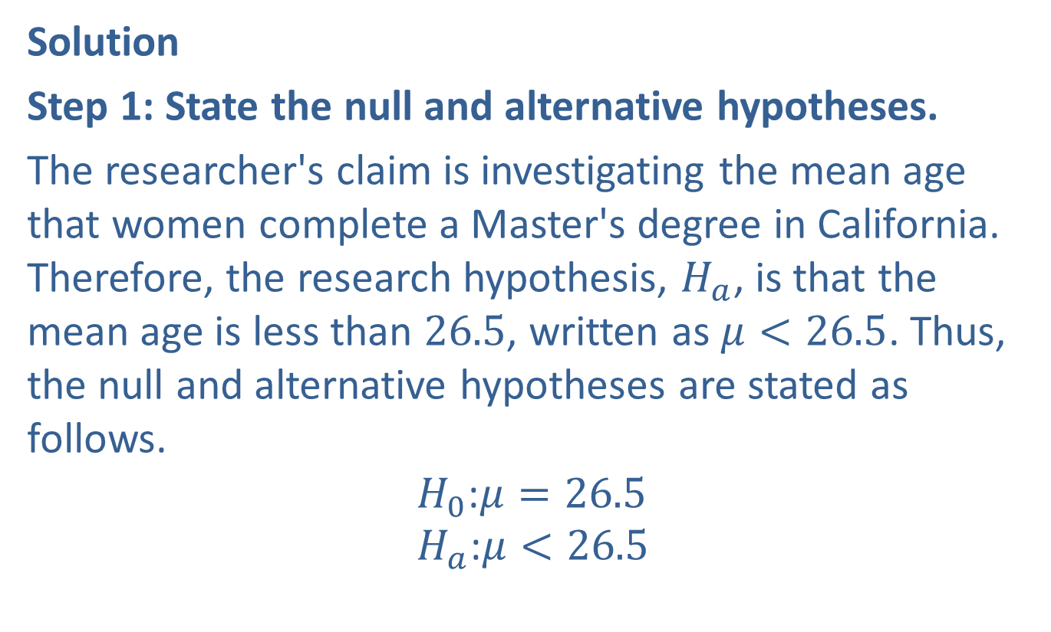

Example 10.2.2: Hypothesis Test for a Population Mean (Left-Tailed, $σ$ Known) (cont.)
Solution
Step 1: State the null and alternative hypotheses.
The researcher's claim is investigating the mean age that women complete a Master's degree in California. Therefore, the research hypothesis, $H_{a}$, is that the mean age is less than 26.5, written as $μ<26.5$. Thus, the null and alternative hypotheses are stated as follows.
$$H_{0}\text{:}μ=26.5 \\ H_{a}\text{:}μ<26.5$$

Slide 24
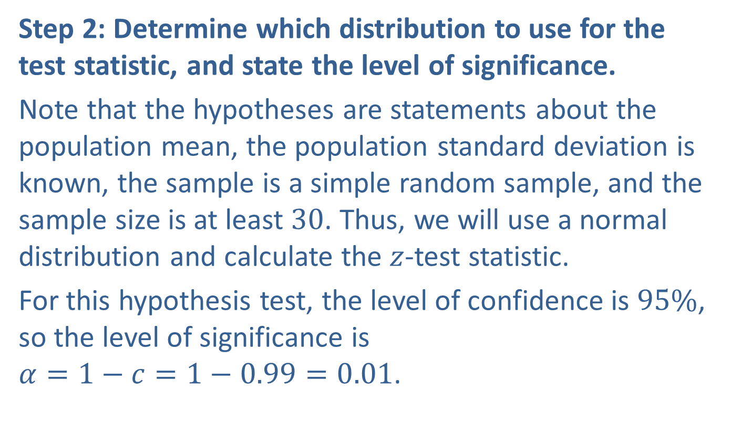
Example 10.2.2: Hypothesis Test for a Population Mean (Left-Tailed, $σ$ Known) (cont.)
Step 2: Determine which distribution to use for the test statistic, and state the level of significance.
Note that the hypotheses are statements about the population mean, the population standard deviation is known, the sample is a simple random sample, and the sample size is at least 30. Thus, we will use a normal distribution and calculate the $z$-test statistic.
For this hypothesis test, the level of confidence is $95\%$, so the level of significance is $α=1−c=1−0.99=0.01$.

Slide 25
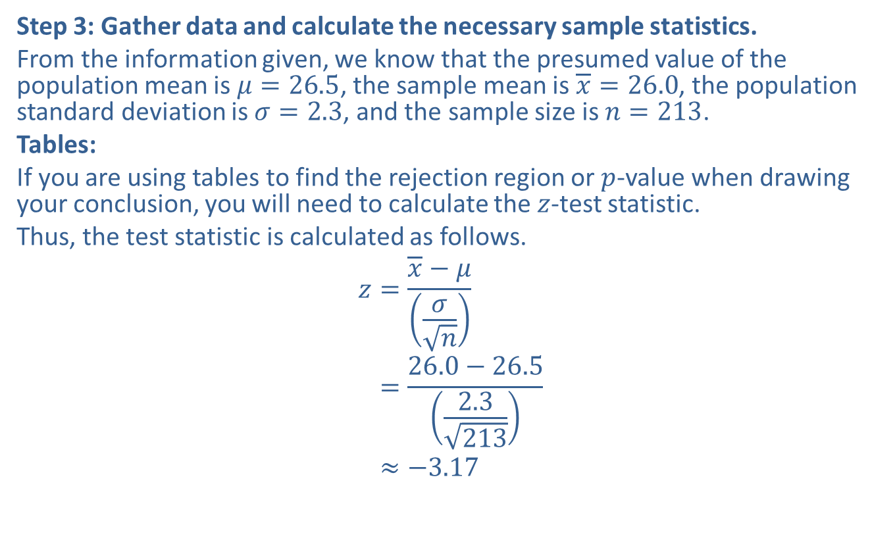
Example 10.2.2: Hypothesis Test for a Population Mean (Left-Tailed, $σ$ Known) (cont.)
Step 3: Gather data and calculate the necessary sample statistics.
From the information given, we know that the presumed value of the population mean is $μ=26.5$, the sample mean is $\overline{x}=26.0$, the population standard deviation is $σ=2.3$, and the sample size is $n=213$.
Tables:
If you are using tables to find the rejection region or $p$-value when drawing your conclusion, you will need to calculate the $z$-test statistic.
Thus, the test statistic is calculated as follows.
𝑧=𝑥−𝜇𝜎𝑛𝑧=26.0−26.52.3213𝑧≈−3.17

Slide 26
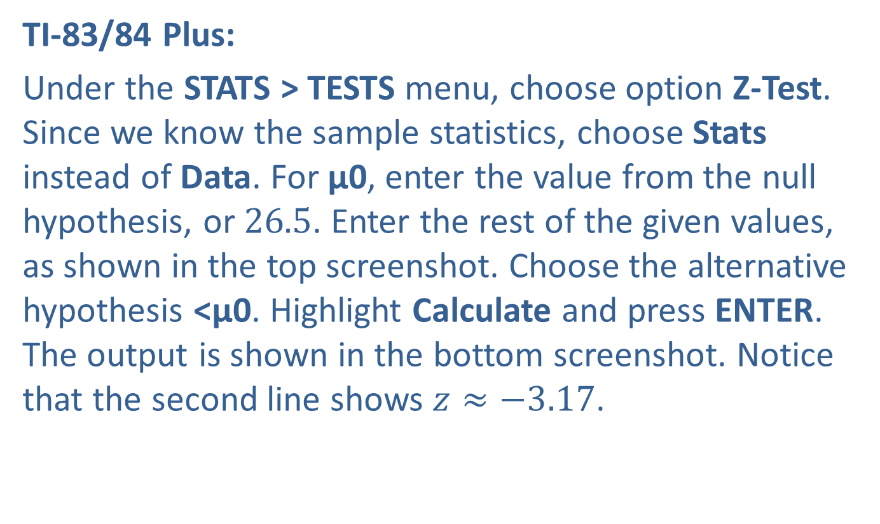
Example 10.2.2: Hypothesis Test for a Population Mean (Left-Tailed, $σ$ Known) (cont.)
TI-83/84 Plus:
Under the STATS > TESTS menu, choose option Z-Test. Since we know the sample statistics, choose Stats instead of Data. For μ0, enter the value from the null hypothesis, or 26.5. Enter the rest of the given values, as shown in the top screenshot. Choose the alternative hypothesis <μ0. Highlight Calculate and press ENTER. The output is shown in the bottom screenshot. Notice that the second line shows $z≈−3.17$.

Slide 27
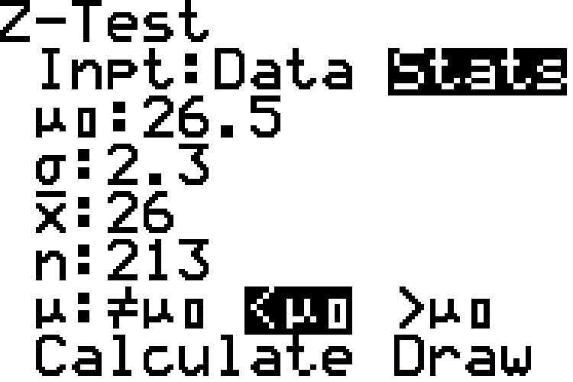
Example 10.2.2: Hypothesis Test for a Population Mean (Left-Tailed, $σ$ Known) (cont.)

Slide 28
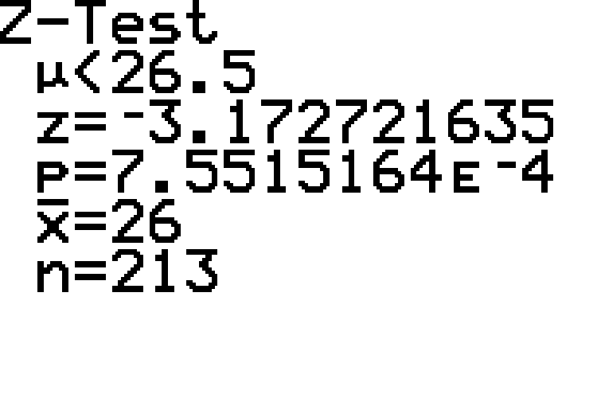
Example 10.2.2: Hypothesis Test for a Population Mean (Left-Tailed, $σ$ Known) (cont.)

Slide 29
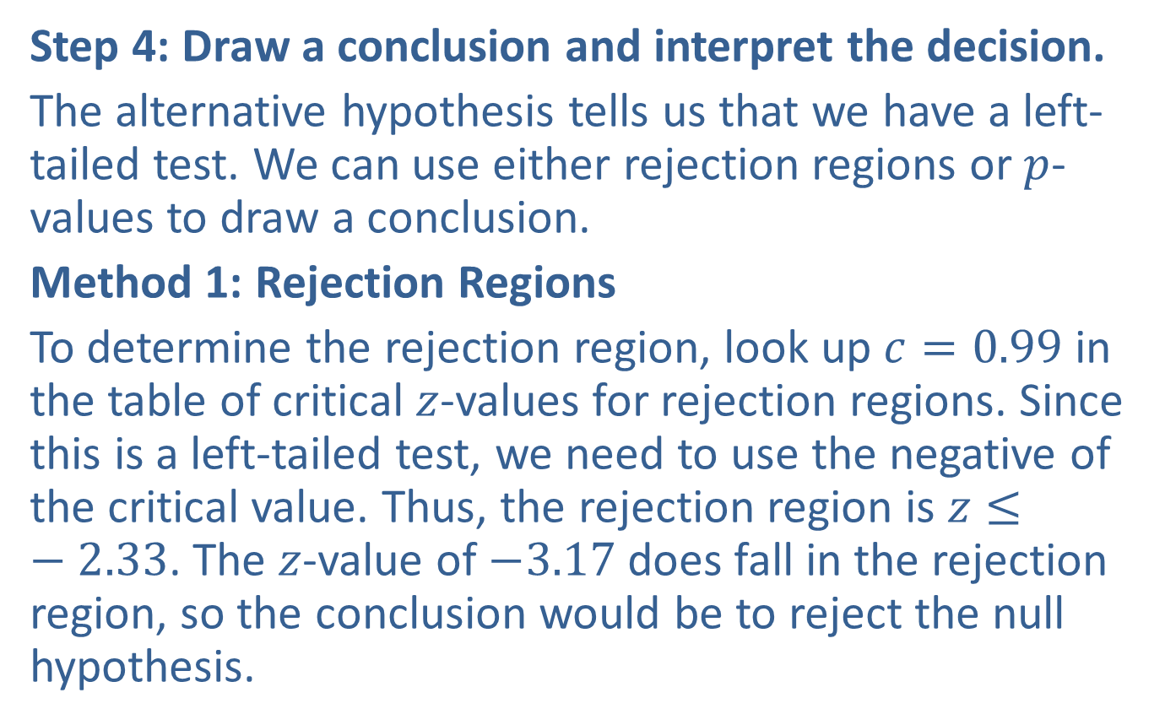
Example 10.2.2: Hypothesis Test for a Population Mean (Left-Tailed, $σ$ Known) (cont.)
Step 4: Draw a conclusion and interpret the decision.
The alternative hypothesis tells us that we have a left-tailed test. We can use either rejection regions or $p$-values to draw a conclusion.
Method 1: Rejection Regions
To determine the rejection region, look up $c=0.99$ in the table of critical $z$-values for rejection regions. Since this is a left-tailed test, we need to use the negative of the critical value. Thus, the rejection region is $z≤−2.33$. The $z$-value of $−3.17$ does fall in the rejection region, so the conclusion would be to reject the null hypothesis.

Slide 30
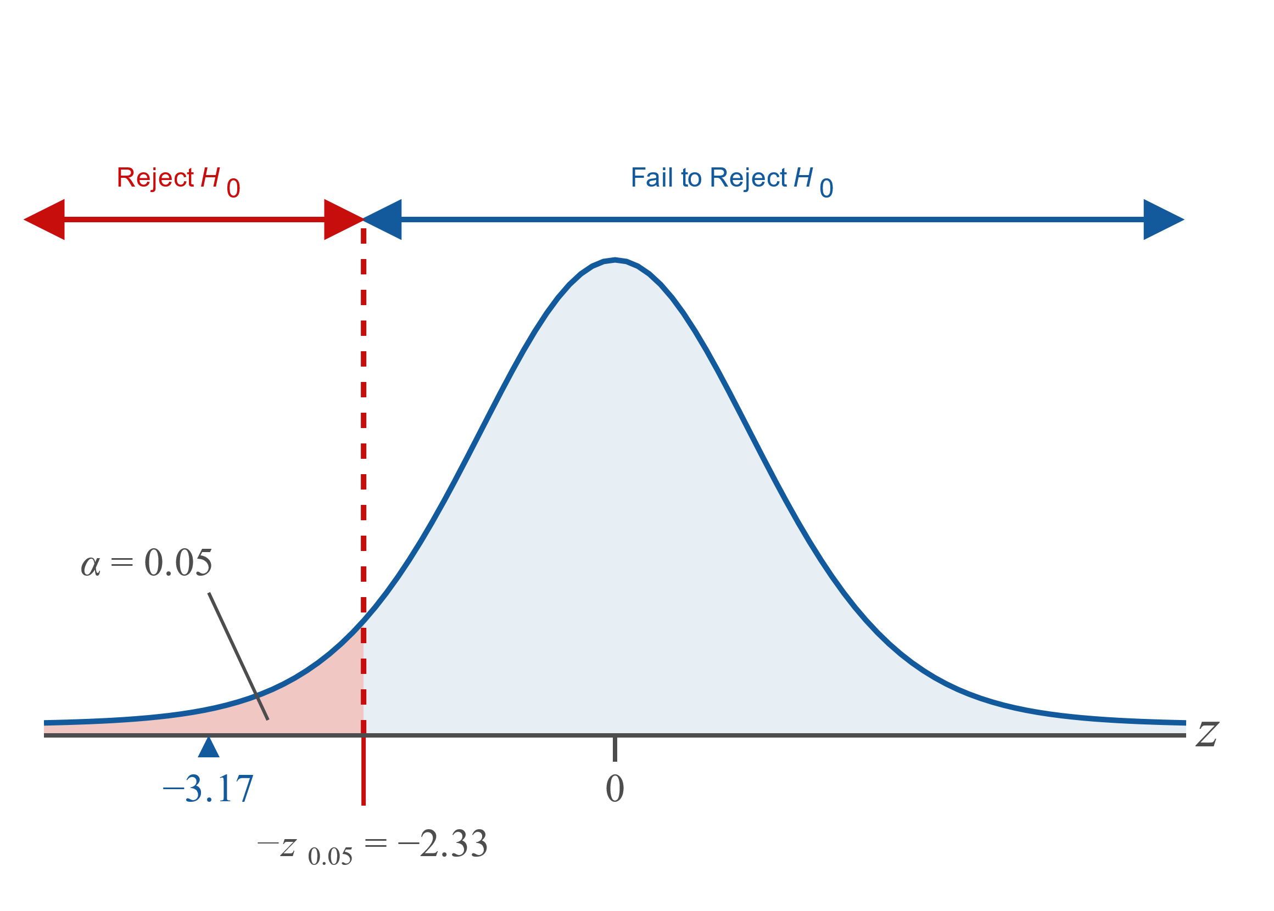
Example 10.2.2: Hypothesis Test for a Population Mean (Left-Tailed, $σ$ Known) (cont.)

Slide 31
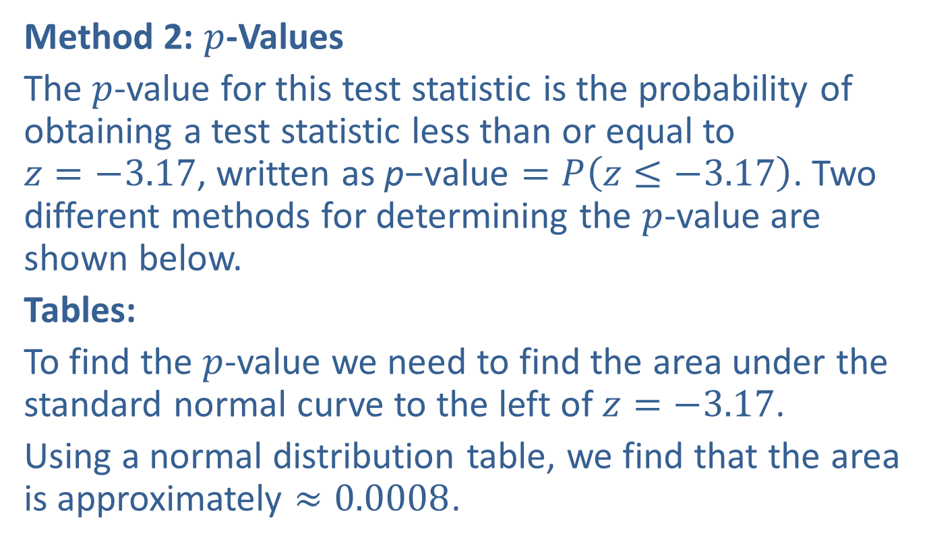
Example 10.2.2: Hypothesis Test for a Population Mean (Left-Tailed, $σ$ Known) (cont.)
Method 2: $p$-Values
The $p$-value for this test statistic is the probability of obtaining a test statistic less than or equal to $z=−3.17$, written as p$\text{−}\text{value}=P\left(z≤−3.17\right)$. Two different methods for determining the $p$-value are shown below.
Tables:
To find the $p$-value we need to find the area under the standard normal curve to the left of $z=−3.17$.
Using a normal distribution table, we find that the area is approximately $≈0.0008$.

Slide 32
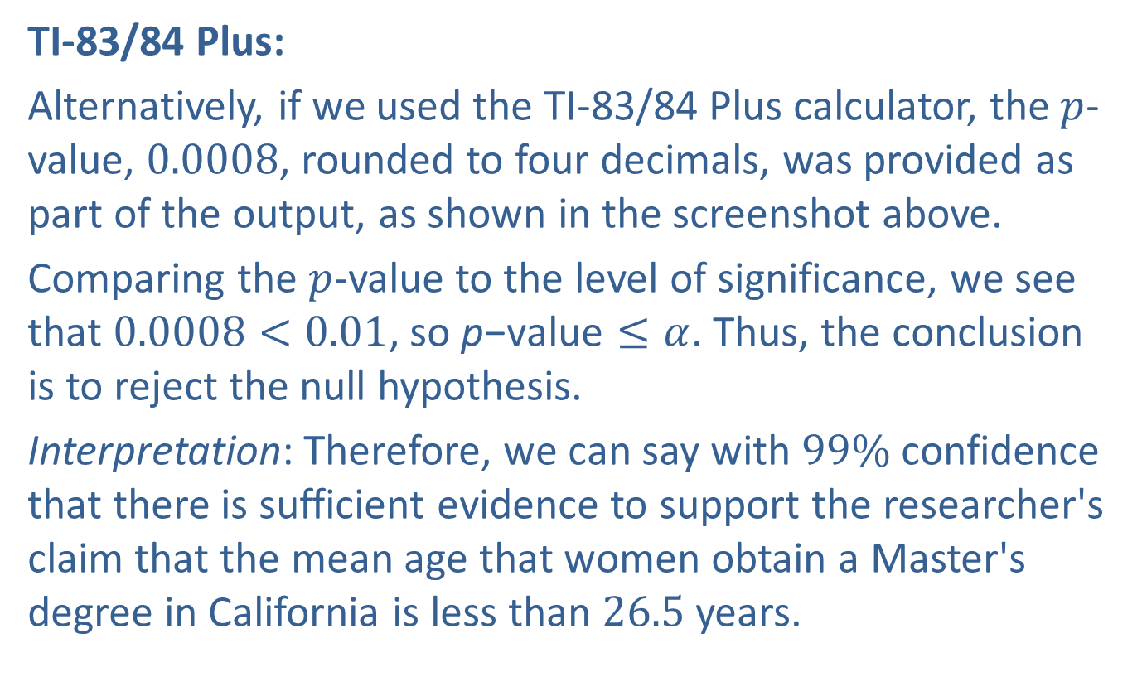
Example 10.2.2: Hypothesis Test for a Population Mean (Left-Tailed, $σ$ Known) (cont.)
TI-83/84 Plus:
Alternatively, if we used the TI-83/84 Plus calculator, the $p$-value, 0.0008, rounded to four decimals, was provided as part of the output, as shown in the screenshot above.
Comparing the $p$-value to the level of significance, we see that $0.0008<0.01$, so p$\text{−}\text{value}≤α$. Thus, the conclusion is to reject the null hypothesis.
Interpretation: Therefore, we can say with $99\%$ confidence that there is sufficient evidence to support the researcher's claim that the mean age that women obtain a Master's degree in California is less than 26.5 years.

Slide 33
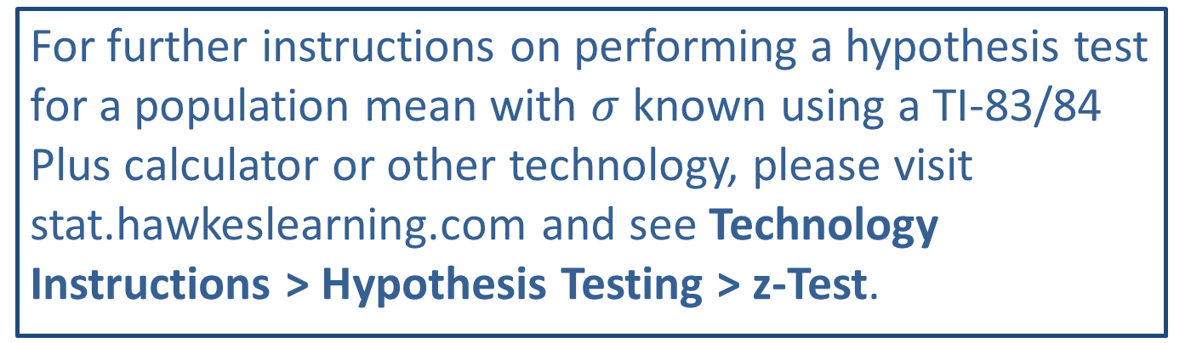
Technology
For further instructions on performing a hypothesis test for a population mean with $σ$ known using a TI-83/84 Plus calculator or other technology, please visit stat.hawkeslearning.com and see Technology Instructions > Hypothesis Testing > z-Test.

Slide 34
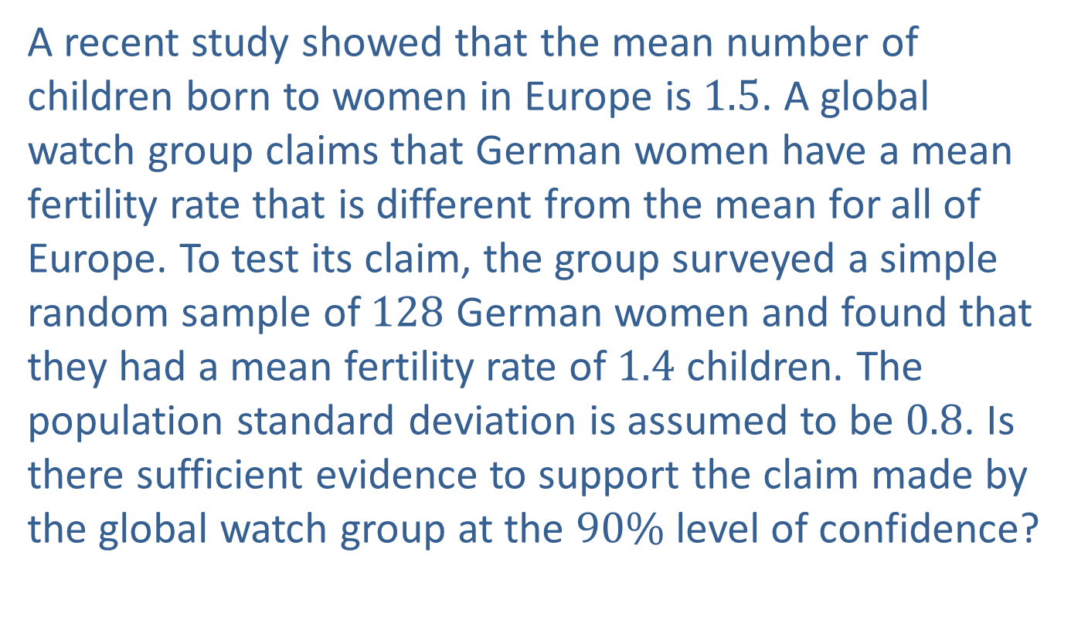

Example 10.2.3: Hypothesis Test for a Population Mean (Two-Tailed, $σ$ Known)
A recent study showed that the mean number of children born to women in Europe is 1.5. A global watch group claims that German women have a mean fertility rate that is different from the mean for all of Europe. To test its claim, the group surveyed a simple random sample of 128 German women and found that they had a mean fertility rate of 1.4 children. The population standard deviation is assumed to be 0.8. Is there sufficient evidence to support the claim made by the global watch group at the $90\%$ level of confidence?

Slide 35
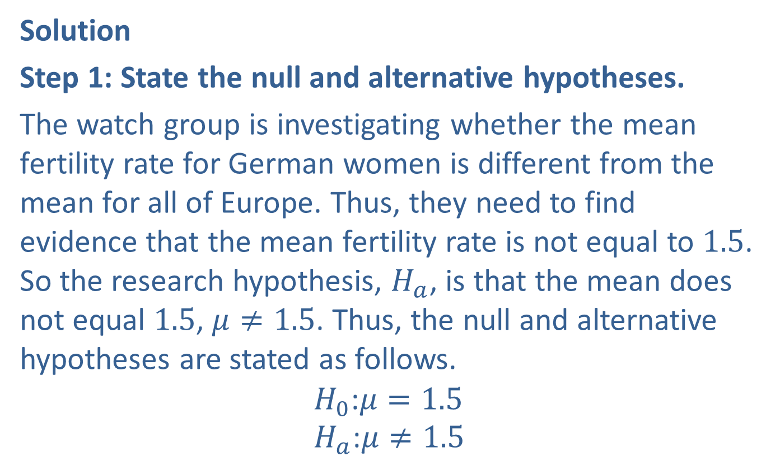

Example 10.2.3: Hypothesis Test for a Population Mean (Two-Tailed, $σ$ Known) (cont.)
Solution
Step 1: State the null and alternative hypotheses.
The watch group is investigating whether the mean fertility rate for German women is different from the mean for all of Europe. Thus, they need to find evidence that the mean fertility rate is not equal to 1.5. So the research hypothesis, $H_{a}$, is that the mean does not equal 1.5, $μ≠1.5$. Thus, the null and alternative hypotheses are stated as follows.
$$H_{0}\text{:}μ=1.5 \\ H_{a}\text{:}μ≠1.5$$

Slide 36
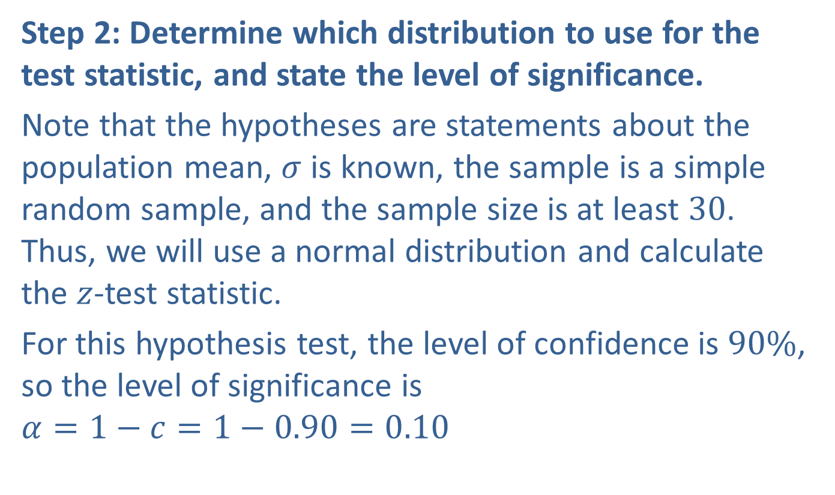
Example 10.2.3: Hypothesis Test for a Population Mean (Two-Tailed, $σ$ Known) (cont.)
Step 2: Determine which distribution to use for the test statistic, and state the level of significance.
Note that the hypotheses are statements about the population mean, $σ$ is known, the sample is a simple random sample, and the sample size is at least 30. Thus, we will use a normal distribution and calculate the $z$-test statistic.
For this hypothesis test, the level of confidence is $90\%$, so the level of significance is
$$α=1−c=1−0.90=0.10$$

Slide 37
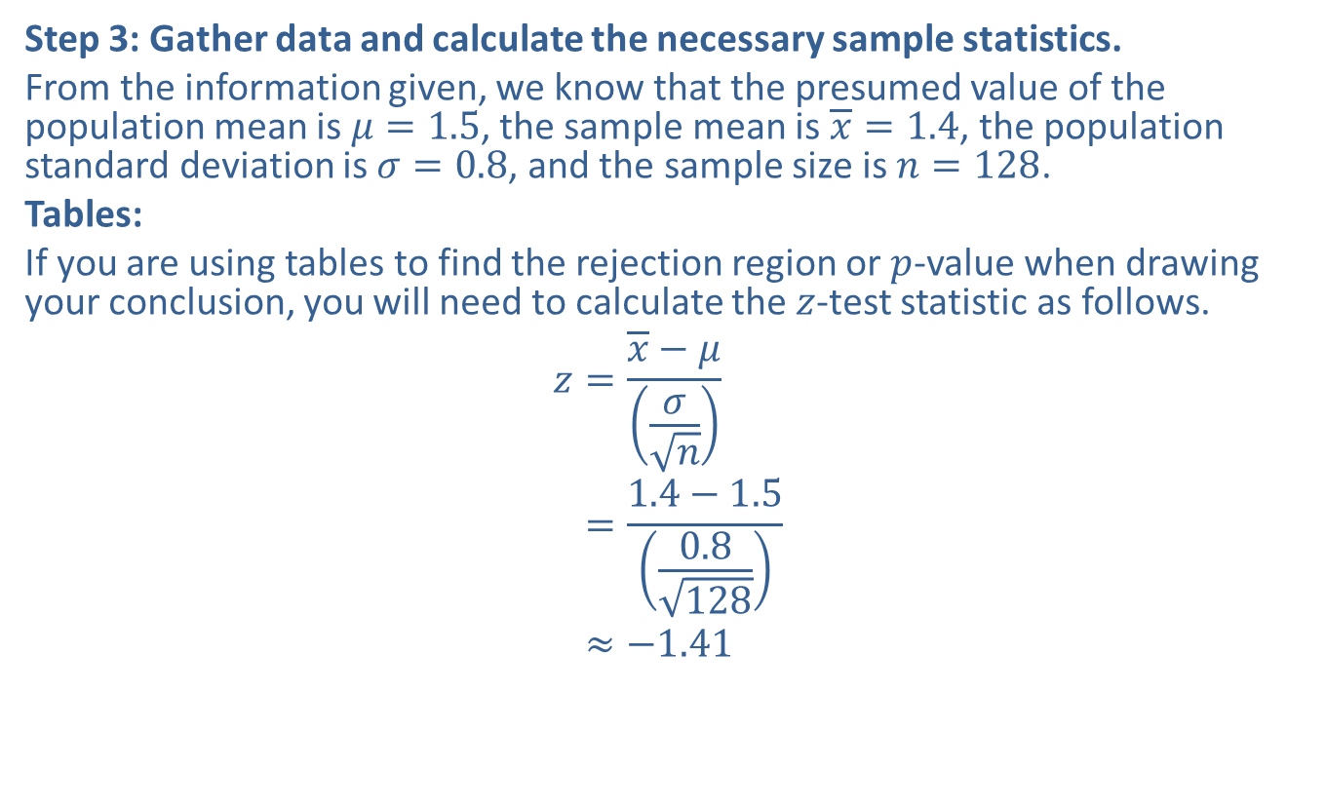
Example 10.2.3: Hypothesis Test for a Population Mean (Two-Tailed, $σ$ Known) (cont.)
Step 3: Gather data and calculate the necessary sample statistics.
From the information given, we know that the presumed value of the population mean is $μ=1.5$, the sample mean is $\overline{x}=1.4$, the population standard deviation is $σ=0.8$, and the sample size is $n=128$.
Tables:
If you are using tables to find the rejection region or $p$-value when drawing your conclusion, you will need to calculate the $z$-test statistic as follows.
𝑧=𝑥−𝜇𝜎𝑛𝑧=1.4−1.50.8128𝑧≈−1.41

Slide 38
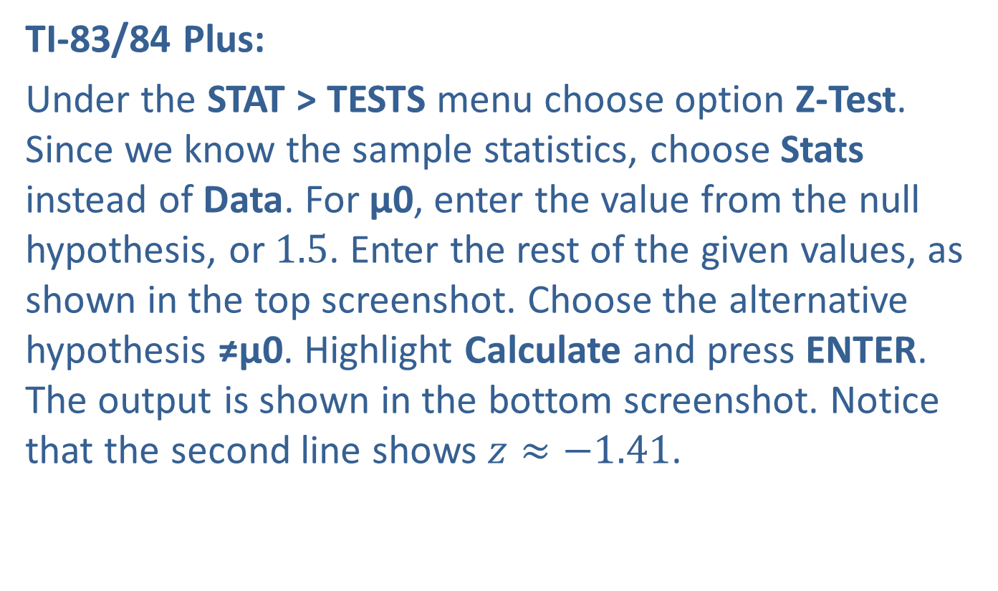
Example 10.2.3: Hypothesis Test for a Population Mean (Two-Tailed, $σ$ Known) (cont.)
TI-83/84 Plus:
Under the STAT > TESTS menu choose option Z-Test. Since we know the sample statistics, choose Stats instead of Data. For μ0, enter the value from the null hypothesis, or 1.5. Enter the rest of the given values, as shown in the top screenshot. Choose the alternative hypothesis ≠μ0. Highlight Calculate and press ENTER. The output is shown in the bottom screenshot. Notice that the second line shows $z≈−1.41$.

Slide 39
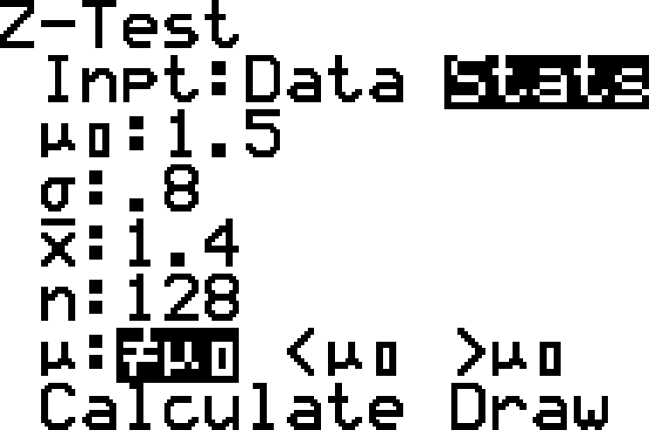
Example 10.2.3: Hypothesis Test for a Population Mean (Two-Tailed, $σ$ Known) (cont.)

Slide 40
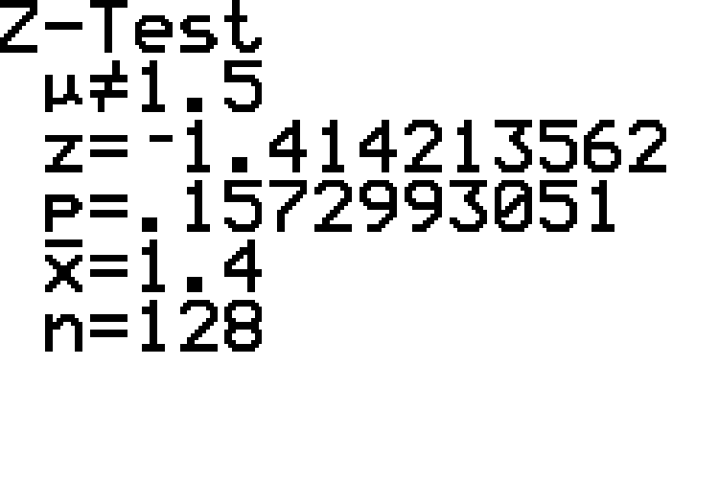
Example 10.2.3: Hypothesis Test for a Population Mean (Two-Tailed, $σ$ Known) (cont.)

Slide 41
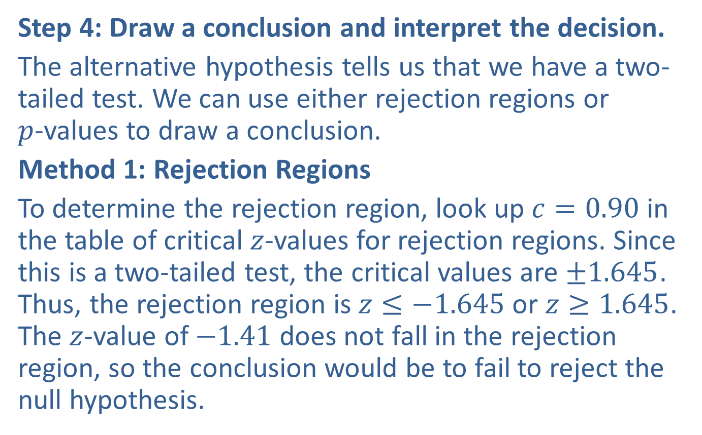
Example 10.2.3: Hypothesis Test for a Population Mean (Two-Tailed, $σ$ Known) (cont.)
Step 4: Draw a conclusion and interpret the decision.
The alternative hypothesis tells us that we have a two-tailed test. We can use either rejection regions or $p$-values to draw a conclusion.
Method 1: Rejection Regions
To determine the rejection region, look up $c=0.90$ in the table of critical $z$-values for rejection regions. Since this is a two-tailed test, the critical values are $±1.645$. Thus, the rejection region is $z≤−1.645$ or $z≥1.645$. The $z$-value of $−1.41$ does not fall in the rejection region, so the conclusion would be to fail to reject the null hypothesis.

Slide 42
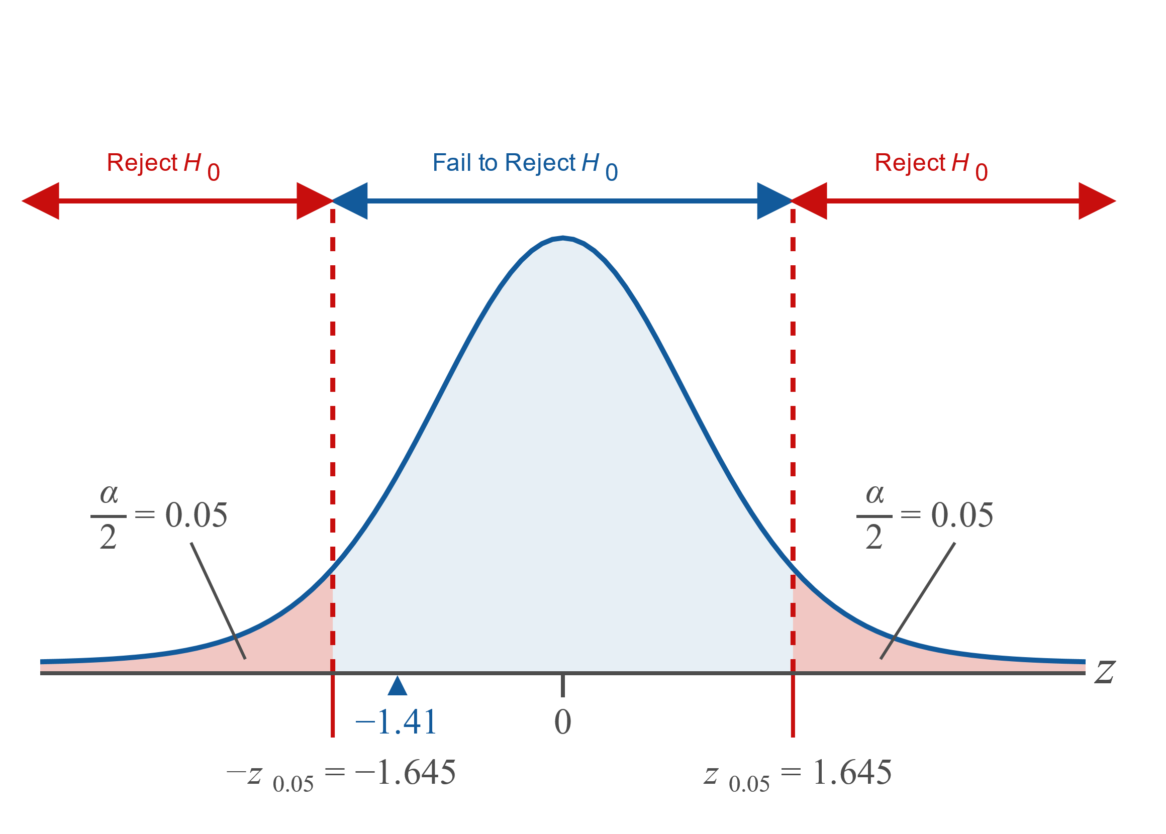
Example 10.2.3: Hypothesis Test for a Population Mean (Two-Tailed, $σ$ Known) (cont.)

Slide 43
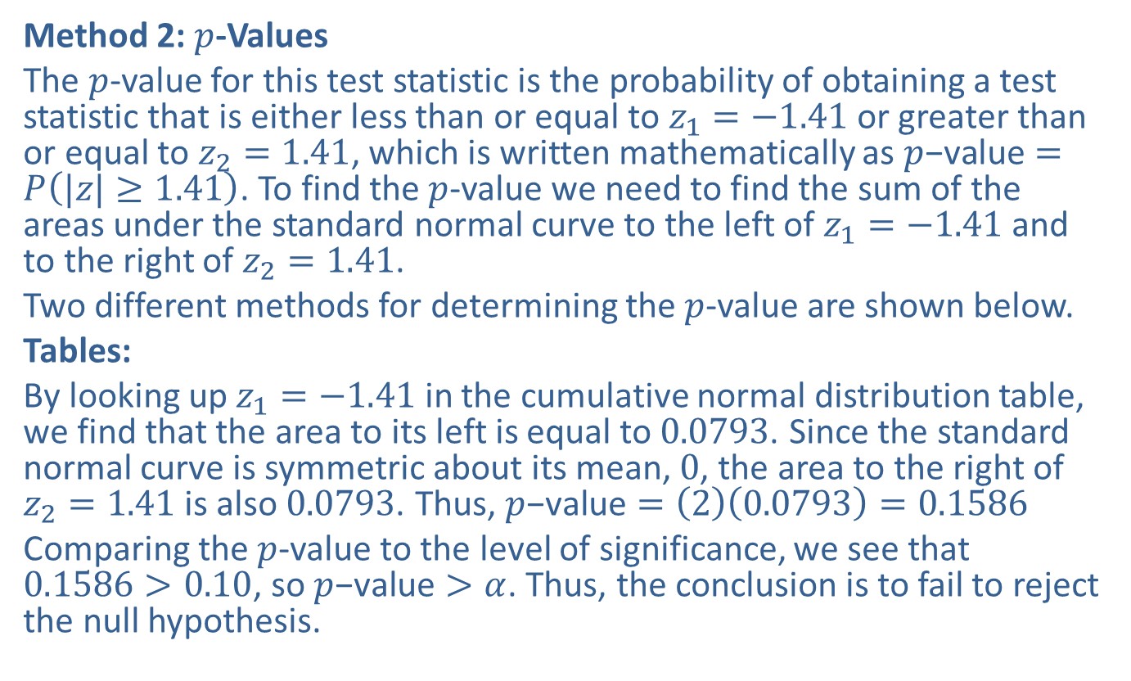
Example 10.2.3: Hypothesis Test for a Population Mean (Two-Tailed, $σ$ Known) (cont.)
Method 2: $p$-Values
The $p$-value for this test statistic is the probability of obtaining a test statistic that is either less than or equal to $z_{1}=−1.41$ or greater than or equal to $z_{2}=1.41$, which is written mathematically as $p\text{−}\text{value}=P\left(|z|≥1.41\right)$. To find the $p$-value we need to find the sum of the areas under the standard normal curve to the left of $z_{1}=−1.41$ and to the right of $z_{2}=1.41$.
Two different methods for determining the $p$-value are shown below.
Tables:
By looking up $z_{1}=−1.41$ in the cumulative normal distribution table, we find that the area to its left is equal to 0.0793. Since the standard normal curve is symmetric about its mean, 0, the area to the right of $z_{2}=1.41$ is also 0.0793. Thus, $p\text{−}\text{value}=\left(2\right)\left(0.0793\right)=0.1586$
Comparing the $p$-value to the level of significance, we see that $0.1586>0.10$, so $p\text{−}\text{value}>α$. Thus, the conclusion is to fail to reject the null hypothesis.

Slide 44
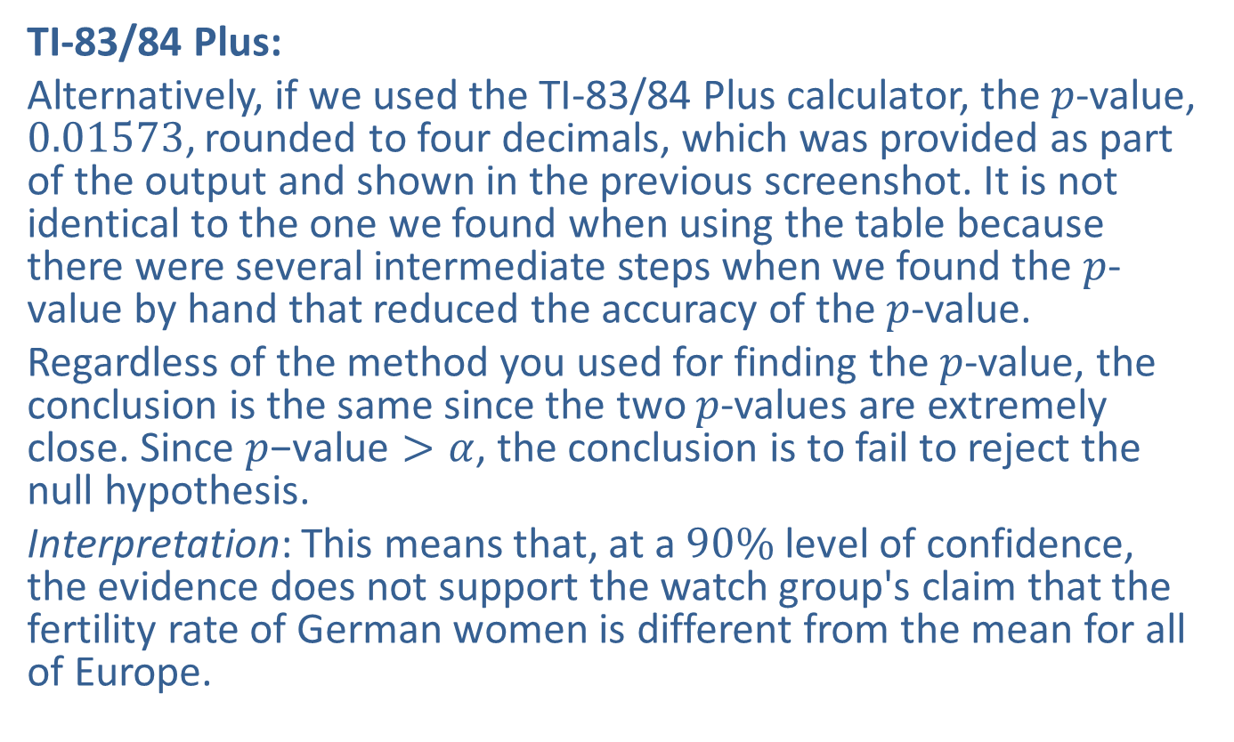
Example 10.2.3: Hypothesis Test for a Population Mean (Two-Tailed, $σ$ Known) (cont.)
TI-83/84 Plus:
Alternatively, if we used the TI-83/84 Plus calculator, the $p$-value, 0.01573, rounded to four decimals, which was provided as part of the output and shown in the previous screenshot. It is not identical to the one we found when using the table because there were several intermediate steps when we found the $p$-value by hand that reduced the accuracy of the $p$-value.
Regardless of the method you used for finding the $p$-value, the conclusion is the same since the two $p$-values are extremely close. Since $p\text{−}\text{value}>α$, the conclusion is to fail to reject the null hypothesis.
Interpretation: This means that, at a $90\%$ level of confidence, the evidence does not support the watch group's claim that the fertility rate of German women is different from the mean for all of Europe.

