Slide 1
Section 10.3
Hypothesis Testing for Population Means (Sigma Unknown)

Slide 2
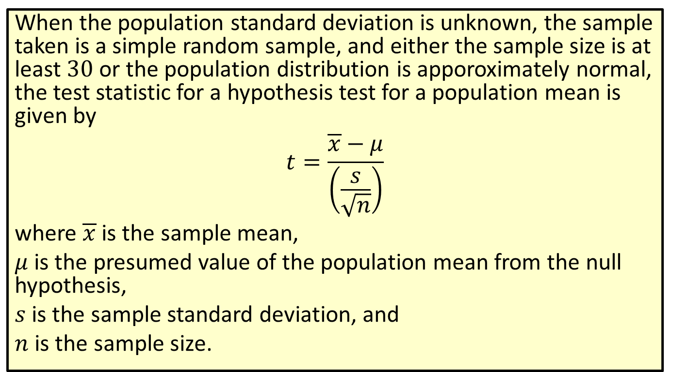

Formula: Test Statistic for a Hypothesis Test for a Population Mean ($σ$ Unknown)
When the population standard deviation is unknown, the sample taken is a simple random sample, and either the sample size is at least 30 or the population distribution is apporoximately normal, the test statistic for a hypothesis test for a population mean is given by
$$t=\frac{\overline{x}−μ}{\left(\frac{s}{\sqrt{n}}\right)}$$
where $\overline{x}$ is the sample mean,
$μ$ is the presumed value of the population mean from the null hypothesis,
$s$ is the sample standard deviation, and
$n$ is the sample size.

Slide 3
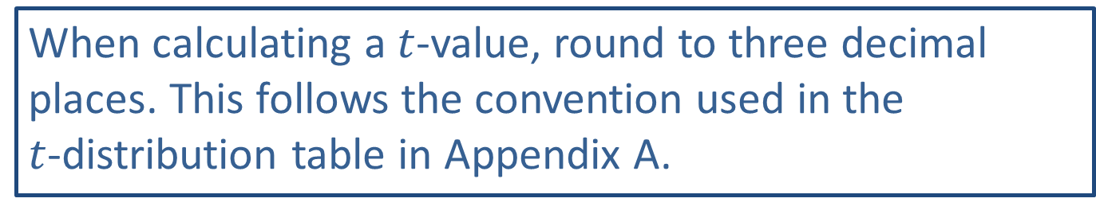
Rounding Rule
When calculating a $t$-value, round to three decimal places. This follows the convention used in the $t$-distribution table in Appendix A.

Slide 4
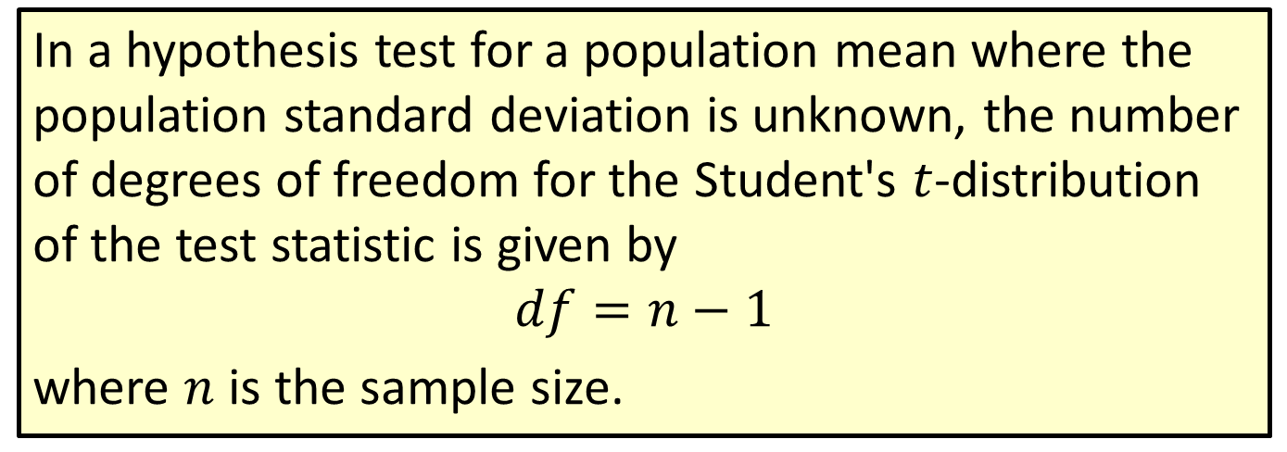

Formula: Degrees of Freedom for $t$ in a Hypothesis Test for a Population Mean ($σ$ Unknown)
In a hypothesis test for a population mean where the population standard deviation is unknown, the number of degrees of freedom for the Student's $t$-distribution of the test statistic is given by
$$df=n−1$$
where $n$ is the sample size.

Slide 5
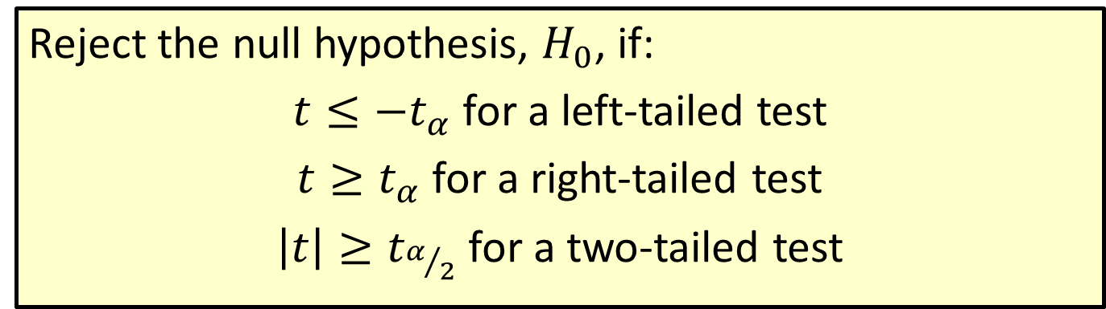

Procedure: Rejection Regions for Hypothesis Tests for Population Means ($σ$ Unknown)
Reject the null hypothesis, $H_{0}$, if:
$t≤−t_{α}$ for a left-tailed test
$t≥t_{α}$ for a right-tailed test
$\left|t\right|≥t_{α/2}$ for a two-tailed test

Slide 6


Example 10.3.1: Finding the Critical $t$-value for a Right-Tailed Hypothesis Test
Find the critical $t$-value that corresponds with 14 degrees of freedom at the 0.025 level of significance for a right-tailed hypothesis test.

Slide 7


Example 10.3.1: Finding the Critical $t$-value for a Right-Tailed Hypothesis Test (cont.)
Solution
Scanning through the table, we see that the row for 14 degrees of freedom and column for a one-tailed area of $α=0.025$ intersect at a critical $t$-value of 2.145. Hence, $t_{α}=t_{0.025}=2.145$.

Slide 8
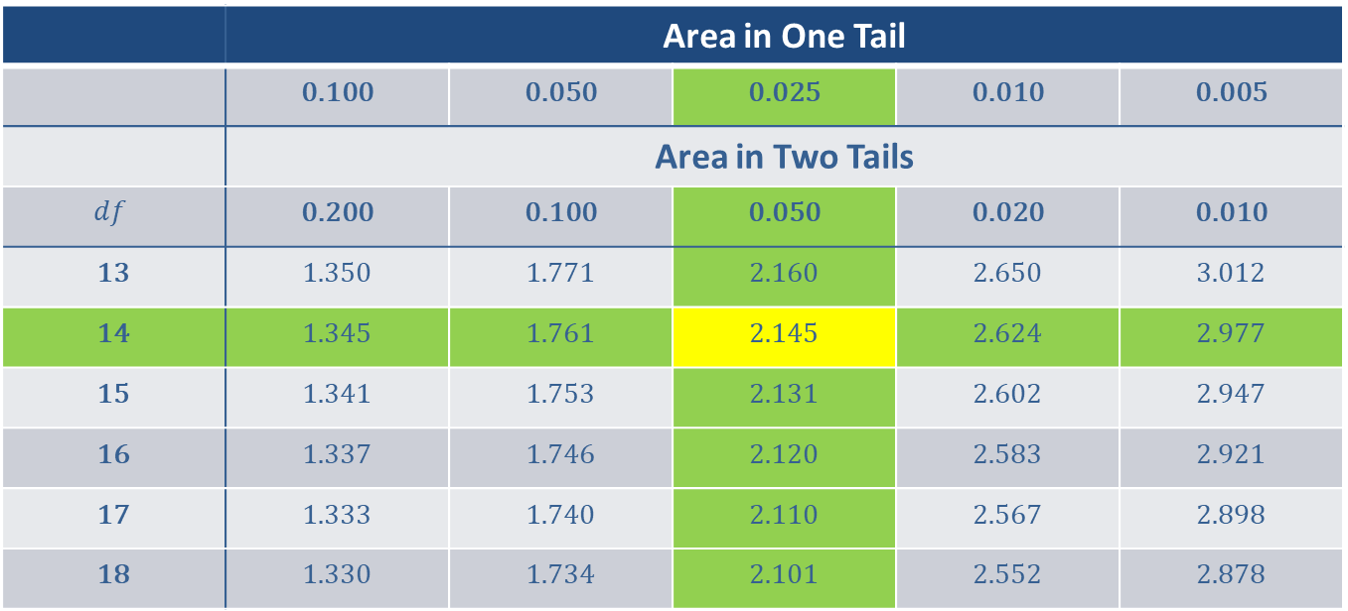
Example 10.3.1: Finding the Critical $t$-value for a Right-Tailed Hypothesis Test (cont.)
 | Area in One Tail
 | 0.100 | 0.050 | 0.025 | 0.010 | 0.005
 | Area in Two Tails
$$df$$ | 0.200 | 0.100 | 0.050 | 0.020 | 0.010
13 | 1.350 | 1.771 | 2.160 | 2.650 | 3.012
14 | 1.345 | 1.761 | 2.145 | 2.624 | 2.977
15 | 1.341 | 1.753 | 2.131 | 2.602 | 2.947
16 | 1.337 | 1.746 | 2.120 | 2.583 | 2.921
17 | 1.333 | 1.740 | 2.110 | 2.567 | 2.898
18 | 1.330 | 1.734 | 2.101 | 2.552 | 2.878

Slide 9
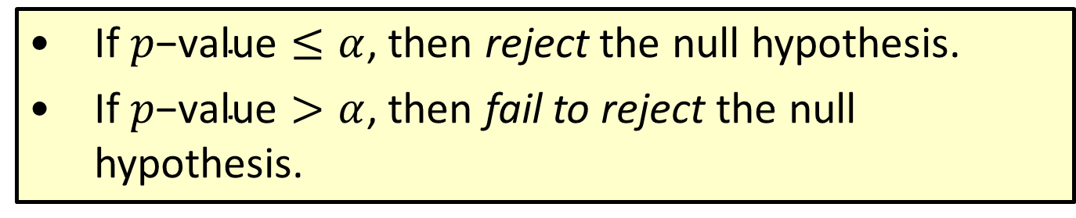

Procedure: Conclusions Using $p$-Values
​If $p\text{−}\text{value}≤α$, then reject the null hypothesis.
​If $p\text{−}\text{value}>α$, then fail to reject the null hypothesis.

Slide 10
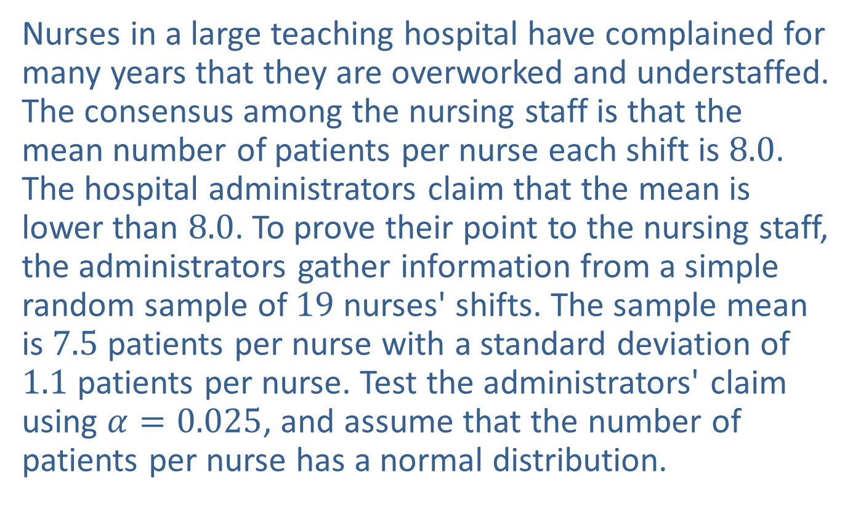
Example 10.3.2: Hypothesis Test for a Population Mean (Left-Tailed, σ Unknown)
Nurses in a large teaching hospital have complained for many years that they are overworked and understaffed. The consensus among the nursing staff is that the mean number of patients per nurse each shift is 8.0. The hospital administrators claim that the mean is lower than 8.0. To prove their point to the nursing staff, the administrators gather information from a simple random sample of 19 nurses' shifts. The sample mean is 7.5 patients per nurse with a standard deviation of 1.1 patients per nurse. Test the administrators' claim using $α=0.025$, and assume that the number of patients per nurse has a normal distribution.

Slide 11
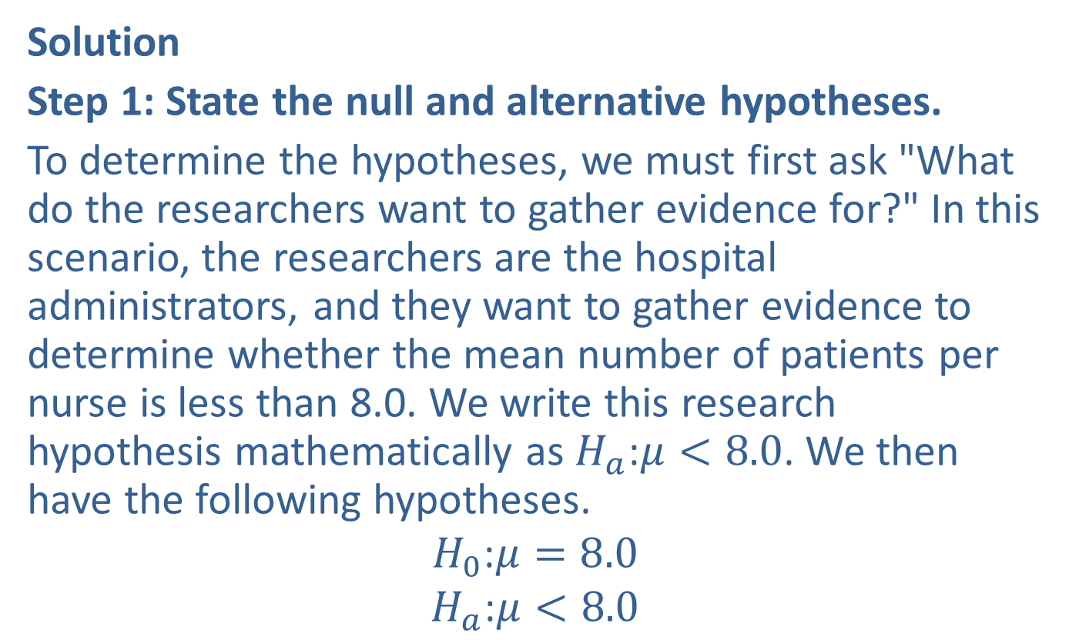
Example 10.3.2: Hypothesis Test for a Population Mean (Left-Tailed, σ Unknown) (cont.)
Solution
Step 1: State the null and alternative hypotheses.
To determine the hypotheses, we must first ask "What do the researchers want to gather evidence for?" In this scenario, the researchers are the hospital administrators, and they want to gather evidence to determine whether the mean number of patients per nurse is less than 8.0. We write this research hypothesis mathematically as $H_{a}\text{:}μ<8.0$. We then have the following hypotheses.
$$H_{0}\text{:}μ=8.0$$
$$H_{a}\text{:}μ<8.0$$

Slide 12
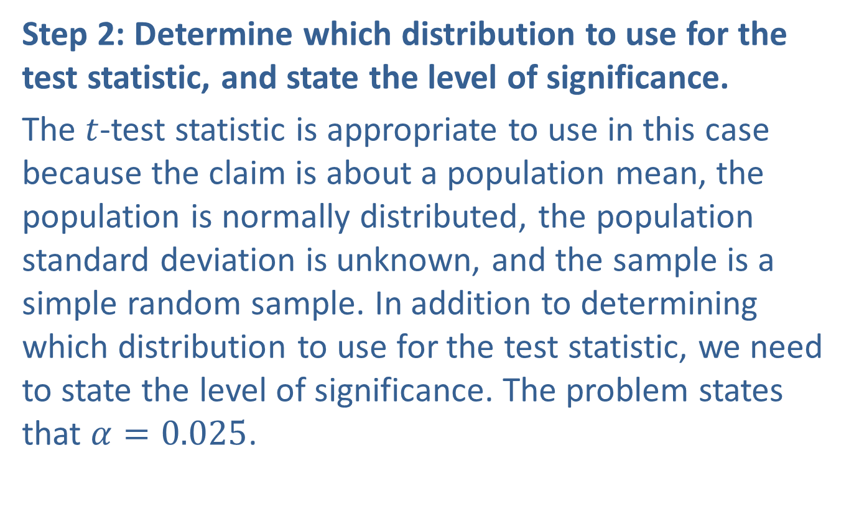
Example 10.3.2: Hypothesis Test for a Population Mean (Left-Tailed, σ Unknown) (cont.)
Step 2: Determine which distribution to use for the test statistic, and state the level of significance.
The $t$-test statistic is appropriate to use in this case because the claim is about a population mean, the population is normally distributed, the population standard deviation is unknown, and the sample is a simple random sample. In addition to determining which distribution to use for the test statistic, we need to state the level of significance. The problem states that $α=0.025$.

Slide 13
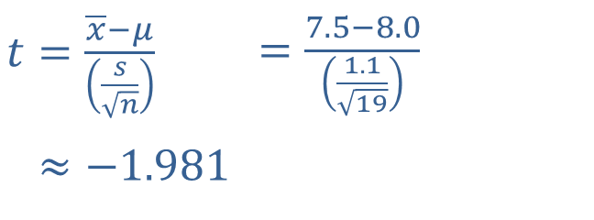
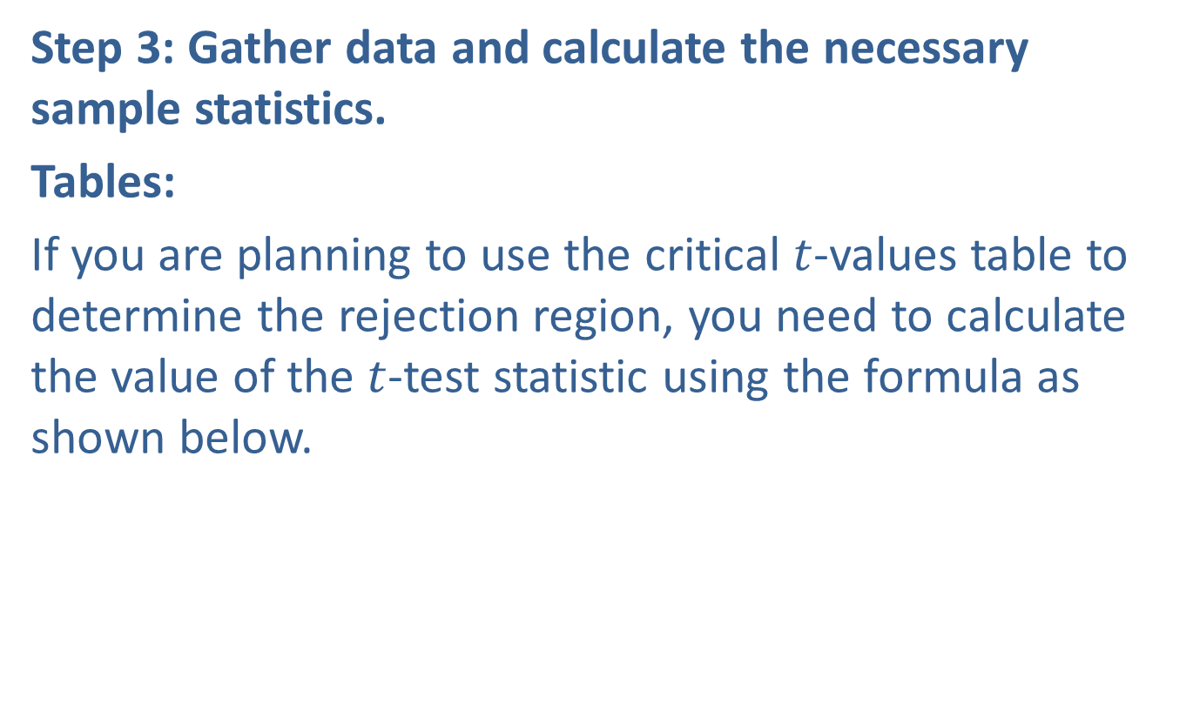
Example 10.3.2: Hypothesis Test for a Population Mean (Left-Tailed, σ Unknown) (cont.)
Step 3: Gather data and calculate the necessary sample statistics.
Tables:
If you are planning to use the critical $t$-values table to determine the rejection region, you need to calculate the value of the $t$-test statistic using the formula as shown below.
​
​$t=\frac{\overline{x}−μ}{\left(\frac{s}{\sqrt{n}}\right)}$ | ​$=\frac{7.5−8.0}{\left(\frac{1.1}{\sqrt{19}}\right)}$
​𝑡≈−1.981 | ​

Slide 14
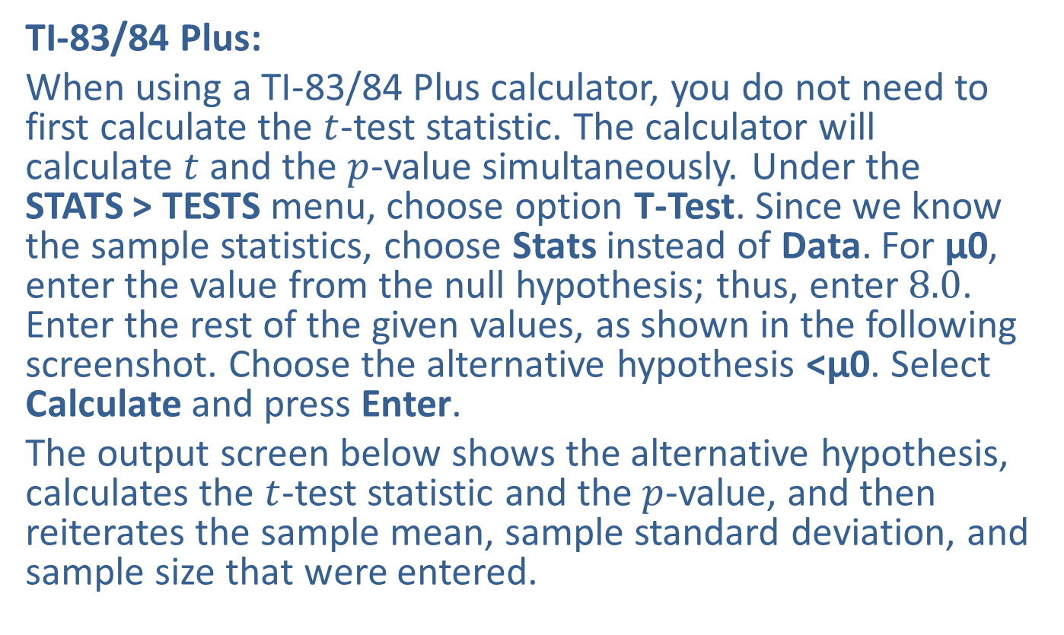
Example 10.3.2: Hypothesis Test for a Population Mean (Left-Tailed, σ Unknown) (cont.)
TI-83/84 Plus:
When using a TI-83/84 Plus calculator, you do not need to first calculate the $t$-test statistic. The calculator will calculate $t$ and the $p$-value simultaneously. Under the STATS > TESTS menu, choose option T-Test. Since we know the sample statistics, choose Stats instead of Data. For μ0, enter the value from the null hypothesis; thus, enter 8.0. Enter the rest of the given values, as shown in the following screenshot. Choose the alternative hypothesis <μ0. Select Calculate and press Enter.
The output screen below shows the alternative hypothesis, calculates the $t$-test statistic and the $p$-value, and then reiterates the sample mean, sample standard deviation, and sample size that were entered.

Slide 15
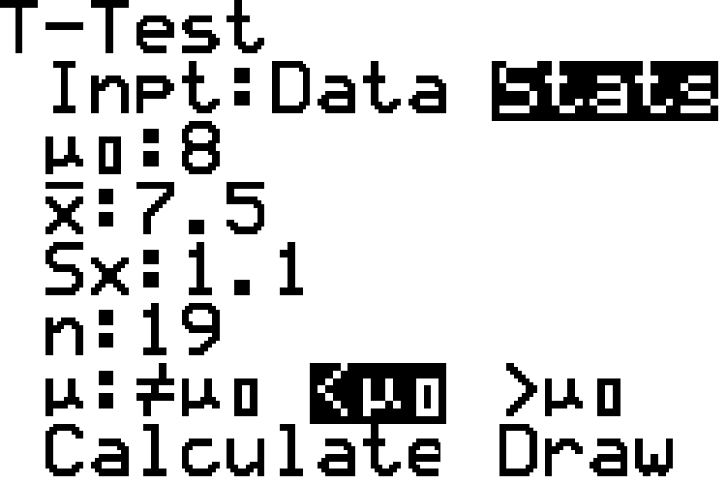
Example 10.3.2: Hypothesis Test for a Population Mean (Left-Tailed, σ Unknown) (cont.)

Slide 16
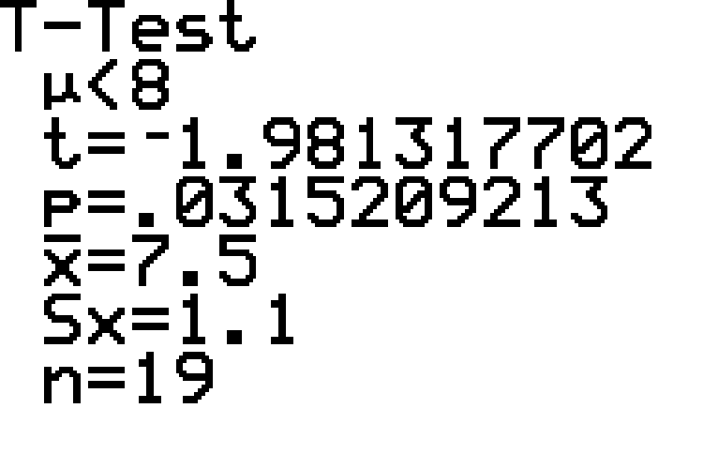
Example 10.3.2: Hypothesis Test for a Population Mean (Left-Tailed, σ Unknown) (cont.)

Slide 17
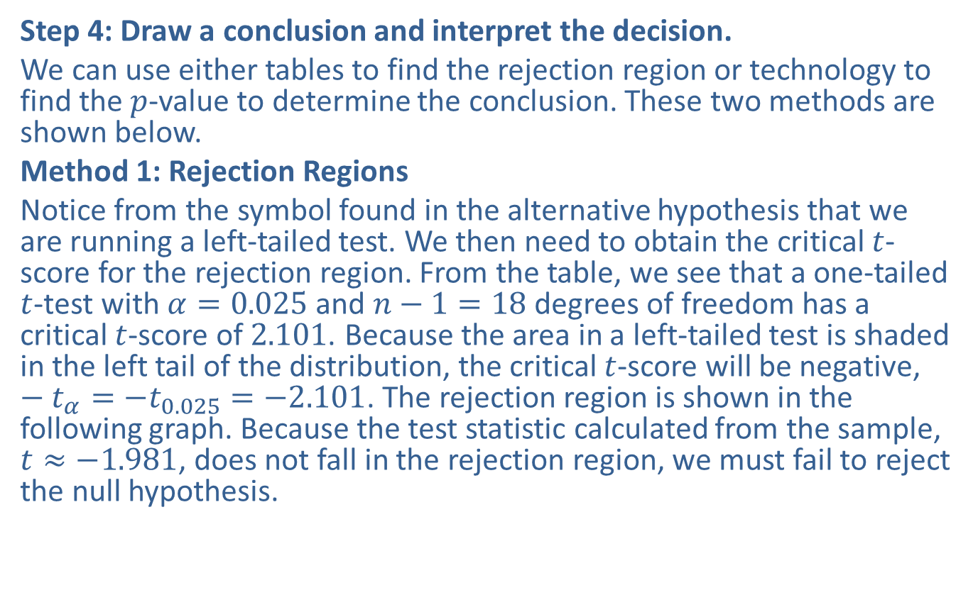
Example 10.3.2: Hypothesis Test for a Population Mean (Left-Tailed, σ Unknown) (cont.)
Step 4: Draw a conclusion and interpret the decision.
We can use either tables to find the rejection region or technology to find the $p$-value to determine the conclusion. These two methods are shown below.
Method 1: Rejection Regions
Notice from the symbol found in the alternative hypothesis that we are running a left-tailed test. We then need to obtain the critical $t$-score for the rejection region. From the table, we see that a one-tailed $t$-test with $α=0.025$ and $n−1=18$ degrees of freedom has a critical $t$-score of 2.101. Because the area in a left-tailed test is shaded in the left tail of the distribution, the critical $t$-score will be negative, $−t_{α}=−t_{0.025}=−2.101$. The rejection region is shown in the following graph. Because the test statistic calculated from the sample, $t≈−1.981$, does not fall in the rejection region, we must fail to reject the null hypothesis.

Slide 18
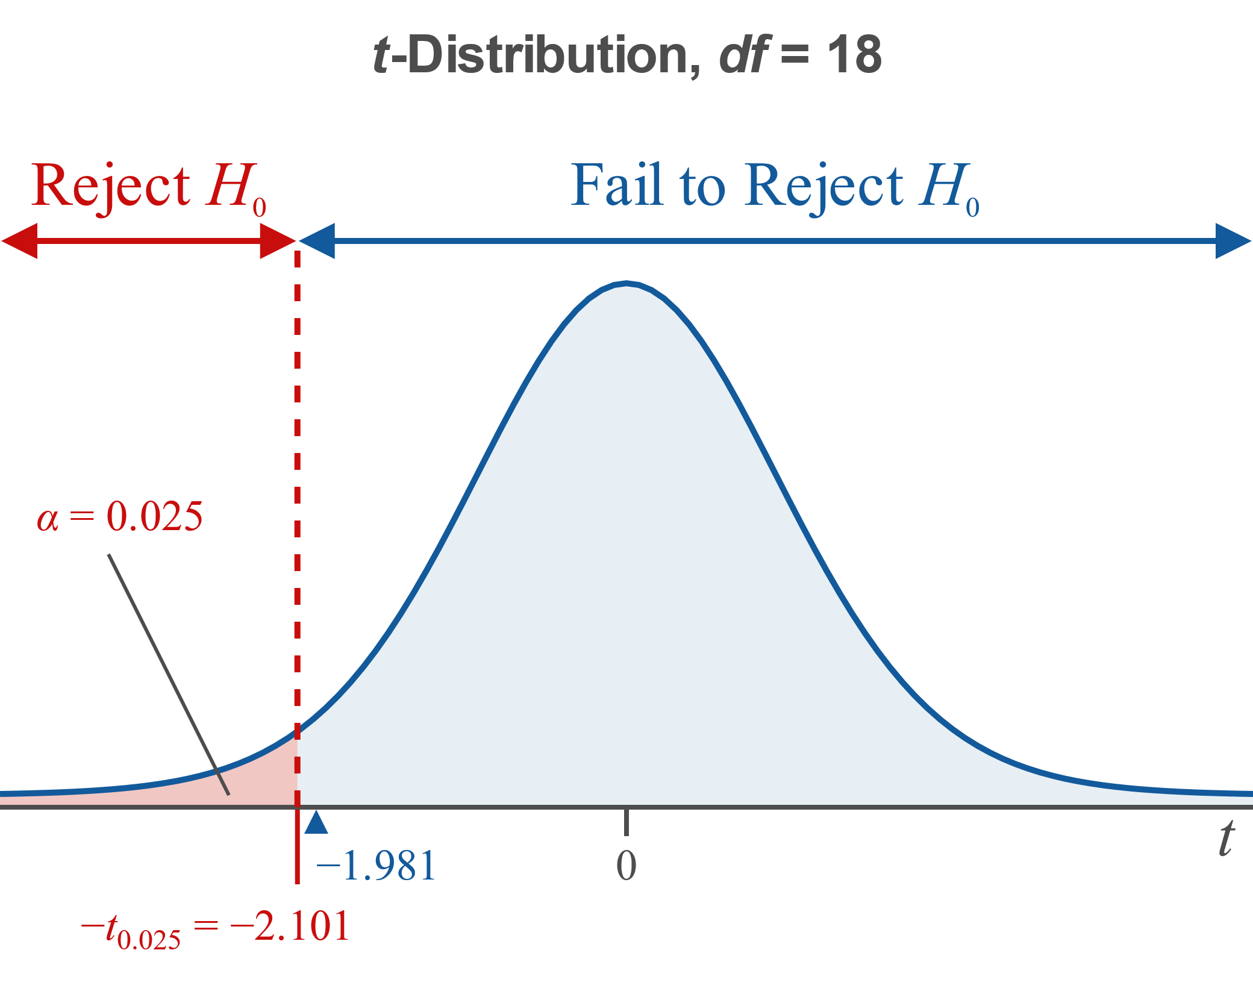
Example 10.3.2: Hypothesis Test for a Population Mean (Left-Tailed, σ Unknown) (cont.)

Slide 19
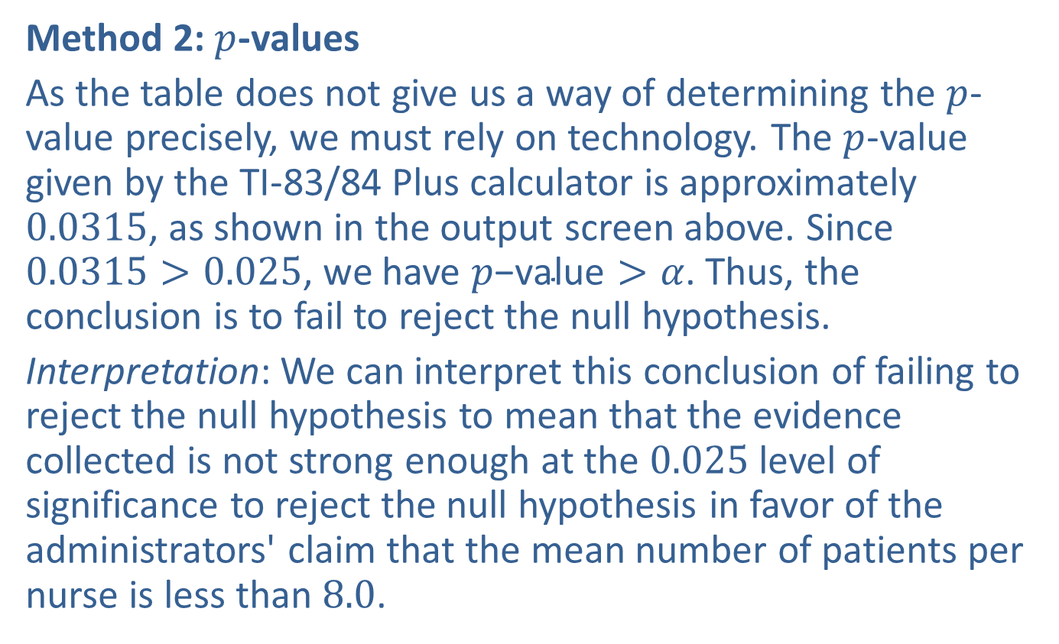
Example 10.3.2: Hypothesis Test for a Population Mean (Left-Tailed, σ Unknown) (cont.)
Method 2: $p$-values
As the table does not give us a way of determining the $p$-value precisely, we must rely on technology. The $p$-value given by the TI-83/84 Plus calculator is approximately 0.0315, as shown in the output screen above. Since $0.0315>0.025$, we have $p\text{−}\text{value}>α$. Thus, the conclusion is to fail to reject the null hypothesis.
Interpretation: We can interpret this conclusion of failing to reject the null hypothesis to mean that the evidence collected is not strong enough at the 0.025 level of significance to reject the null hypothesis in favor of the administrators' claim that the mean number of patients per nurse is less than 8.0.

Slide 20
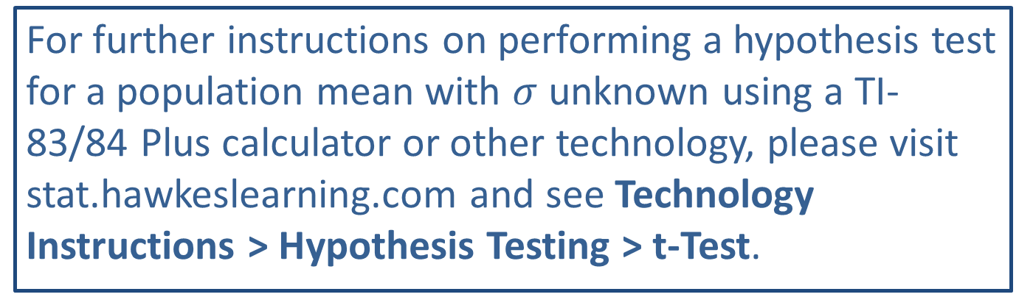
Technology
For further instructions on performing a hypothesis test for a population mean with $σ$ unknown using a TI-83/84 Plus calculator or other technology, please visit stat.hawkeslearning.com and see Technology Instructions > Hypothesis Testing > t-Test.

Slide 21
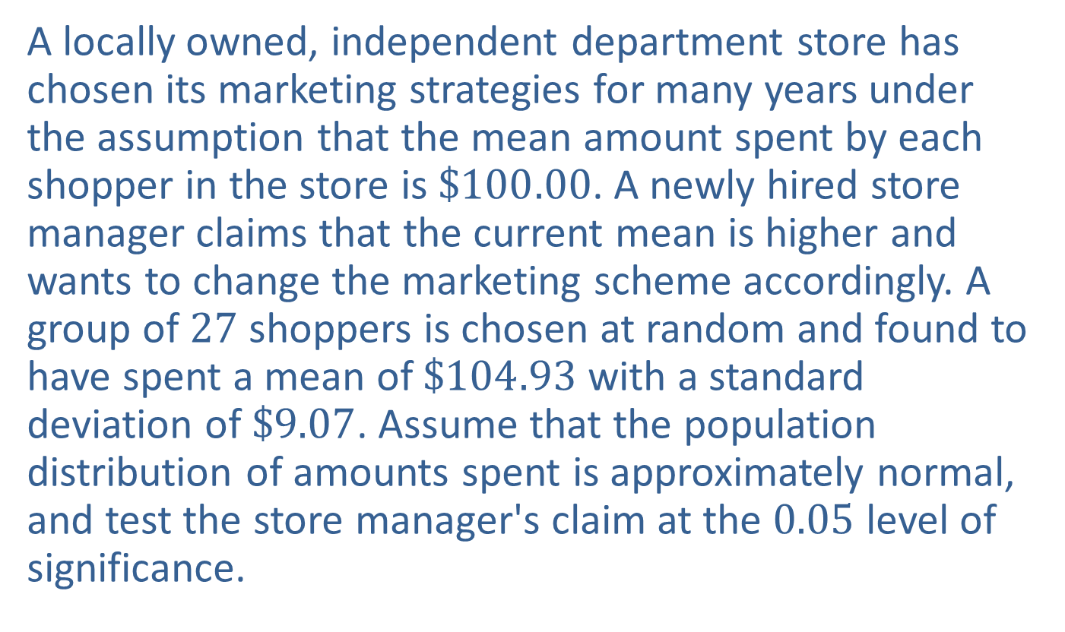

Example 10.3.3: Hypothesis Test for a Population Mean (Right-Tailed, $σ$ Unknown)
A locally owned, independent department store has chosen its marketing strategies for many years under the assumption that the mean amount spent by each shopper in the store is $\$100.00$. A newly hired store manager claims that the current mean is higher and wants to change the marketing scheme accordingly. A group of 27 shoppers is chosen at random and found to have spent a mean of $\$104.93$ with a standard deviation of $\$9.07$. Assume that the population distribution of amounts spent is approximately normal, and test the store manager's claim at the 0.05 level of significance.

Slide 22
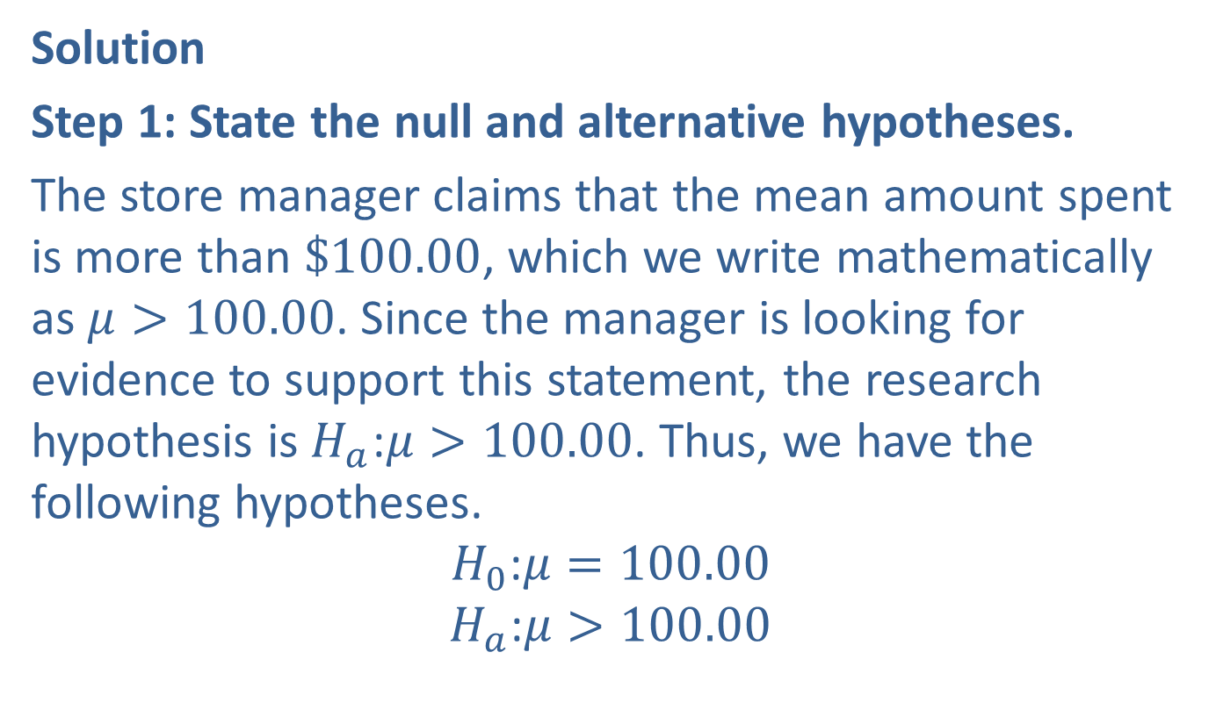

Example 10.3.3: Hypothesis Test for a Population Mean (Right-Tailed, $σ$ Unknown) (cont.)
Solution
Step 1: State the null and alternative hypotheses.
The store manager claims that the mean amount spent is more than $\$100.00$, which we write mathematically as $μ>100.00$. Since the manager is looking for evidence to support this statement, the research hypothesis is $H_{a}\text{:}μ>100.00$. Thus, we have the following hypotheses.
$$H_{0}\text{:}μ=100.00$$
$$H_{a}\text{:}μ>100.00$$

Slide 23
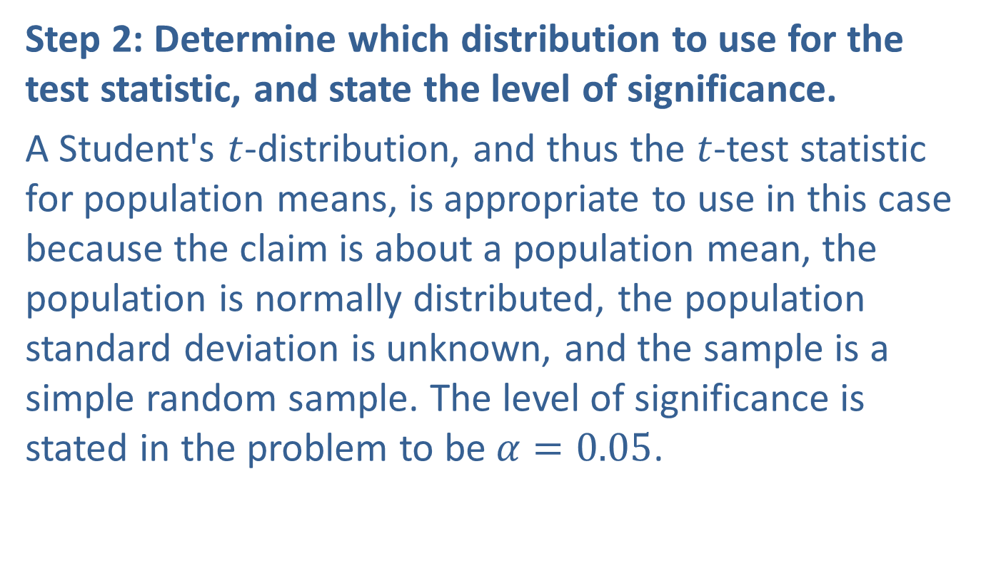
Example 10.3.3: Hypothesis Test for a Population Mean (Right-Tailed, $σ$ Unknown) (cont.)
Step 2: Determine which distribution to use for the test statistic, and state the level of significance.
A Student's $t$-distribution, and thus the $t$-test statistic for population means, is appropriate to use in this case because the claim is about a population mean, the population is normally distributed, the population standard deviation is unknown, and the sample is a simple random sample. The level of significance is stated in the problem to be $α=0.05$.

Slide 24
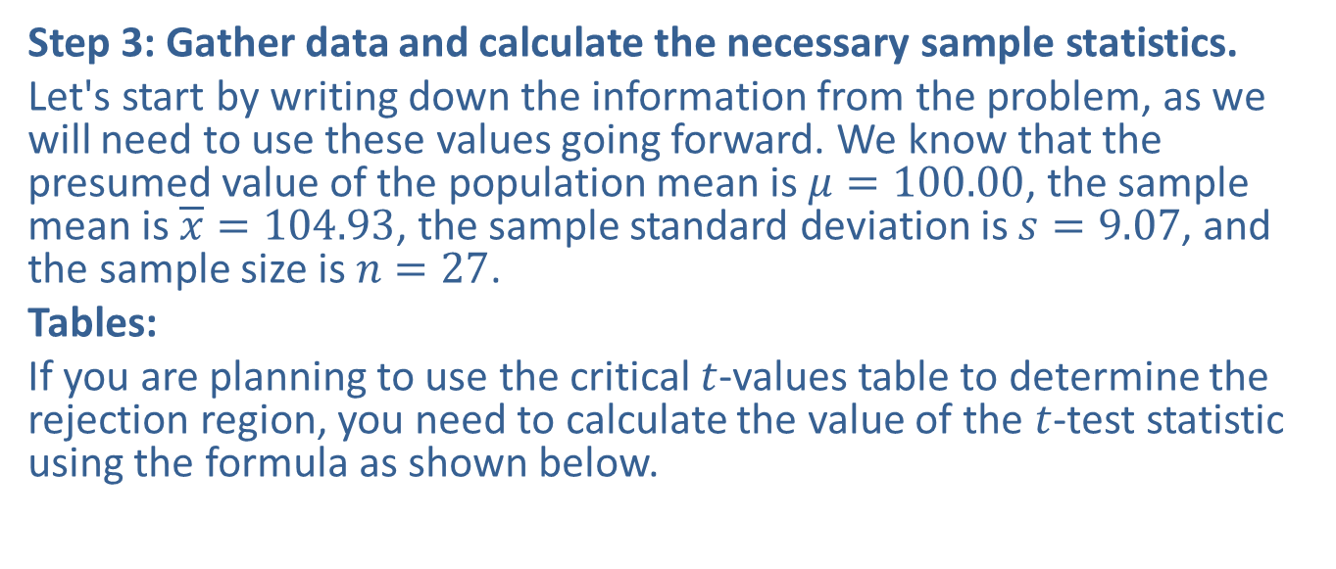
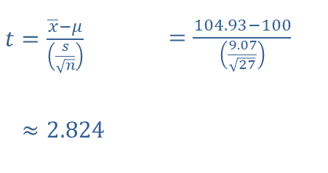
Example 10.3.3: Hypothesis Test for a Population Mean (Right-Tailed, $σ$ Unknown) (cont.)
Step 3: Gather data and calculate the necessary sample statistics.
Let's start by writing down the information from the problem, as we will need to use these values going forward. We know that the presumed value of the population mean is $μ=100.00$, the sample mean is $\overline{x}=104.93$, the sample standard deviation is $s=9.07$, and the sample size is $n=27$.
Tables:
If you are planning to use the critical $t$-values table to determine the rejection region, you need to calculate the value of the $t$-test statistic using the formula as shown below.
​
​$t=\frac{\overline{x}−μ}{\left(\frac{s}{\sqrt{n}}\right)}$ | ​$=\frac{104.93−100}{\left(\frac{9.07}{\sqrt{27}}\right)}$
​𝑡≈2.824 | ​

Slide 25
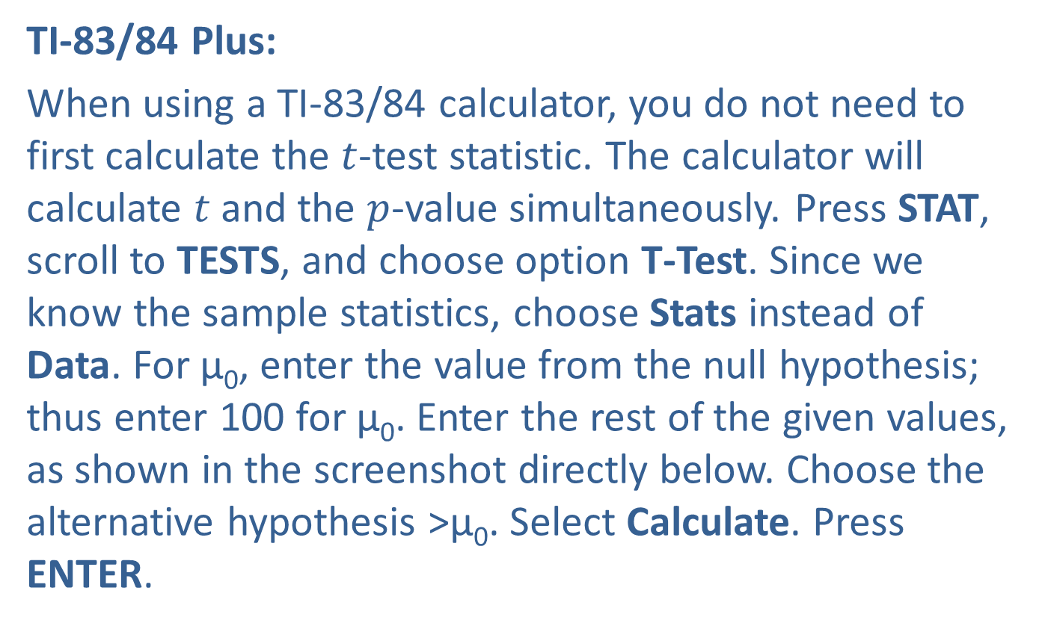
Example 10.3.3: Hypothesis Test for a Population Mean (Right-Tailed, $σ$ Unknown) (cont.)
TI-83/84 Plus:
When using a TI-83/84 calculator, you do not need to first calculate the $t$-test statistic. The calculator will calculate $t$ and the $p$-value simultaneously. Press STAT, scroll to TESTS, and choose option T-Test. Since we know the sample statistics, choose Stats instead of Data. For μ₀, enter the value from the null hypothesis; thus enter 100 for μ₀. Enter the rest of the given values, as shown in the screenshot directly below. Choose the alternative hypothesis >μ₀. Select Calculate. Press ENTER.

Slide 26
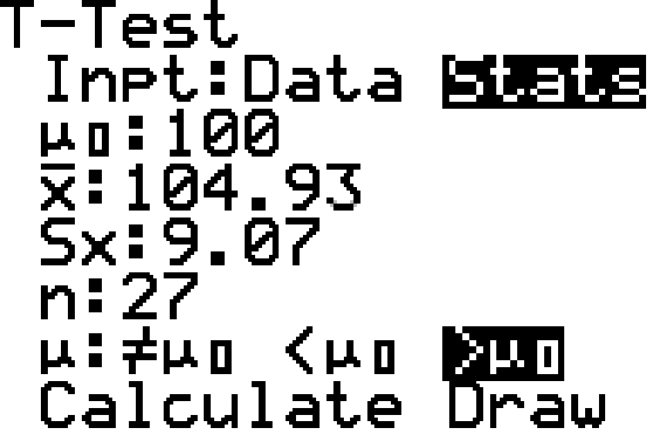
Example 10.3.3: Hypothesis Test for a Population Mean (Right-Tailed, $σ$ Unknown) (cont.)

Slide 27
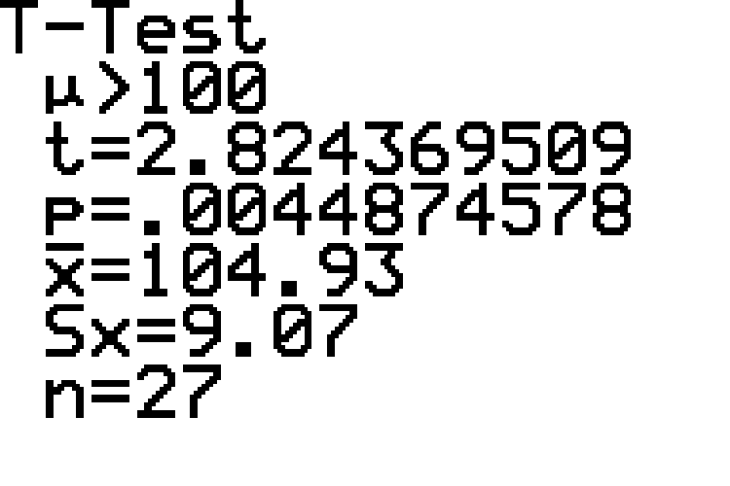
Example 10.3.3: Hypothesis Test for a Population Mean (Right-Tailed, $σ$ Unknown) (cont.)

Slide 28

Example 10.3.3: Hypothesis Test for a Population Mean (Right-Tailed, $σ$ Unknown) (cont.)
The calculator output above shows the alternative hypothesis, calculates the $t$-test statistic and the $p$-value, and then reiterates the sample mean, sample standard deviation, and sample size that were entered.

Slide 29
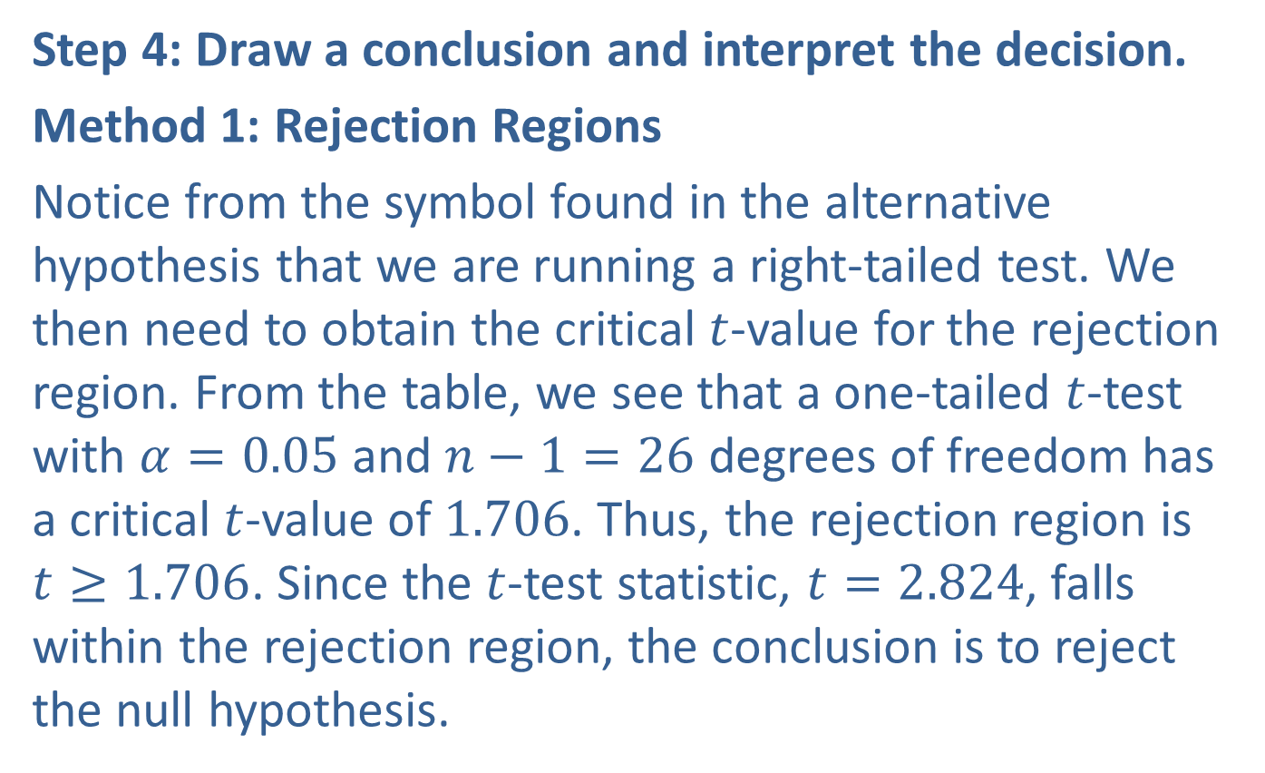
Example 10.3.3: Hypothesis Test for a Population Mean (Right-Tailed, $σ$ Unknown) (cont.)
Step 4: Draw a conclusion and interpret the decision.
Method 1: Rejection Regions
Notice from the symbol found in the alternative hypothesis that we are running a right-tailed test. We then need to obtain the critical $t$-value for the rejection region. From the table, we see that a one-tailed $t$-test with $α=0.05$ and $n−1=26$ degrees of freedom has a critical $t$-value of 1.706. Thus, the rejection region is $t≥1.706$. Since the $t$-test statistic, $t=2.824$, falls within the rejection region, the conclusion is to reject the null hypothesis.

Slide 30
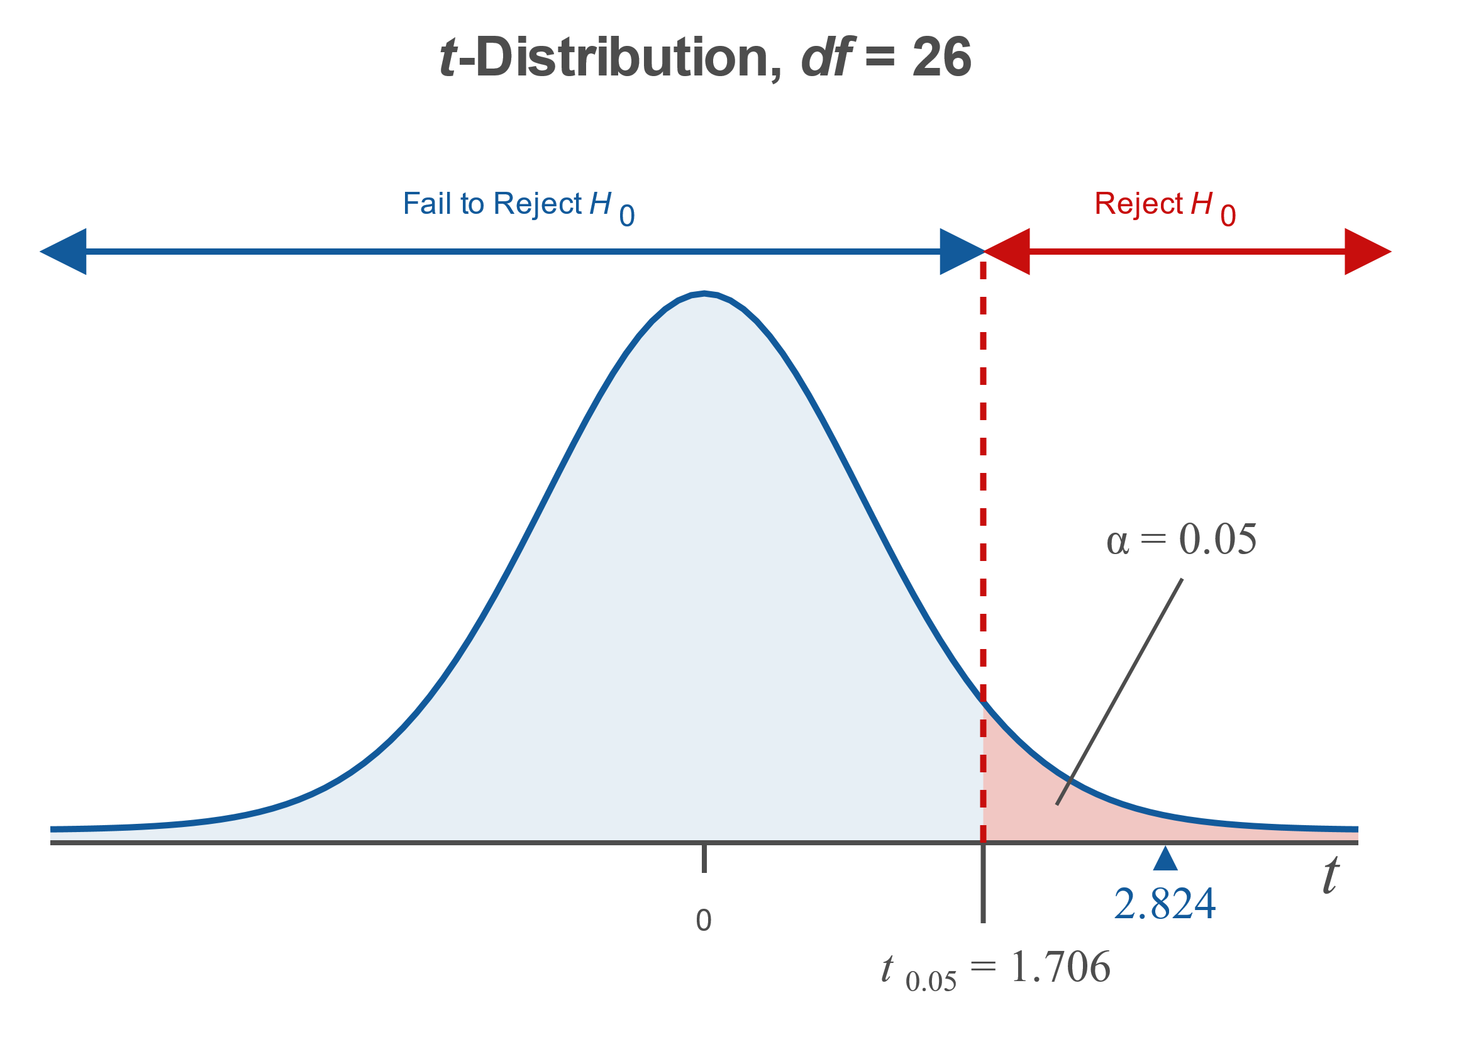
Example 10.3.3: Hypothesis Test for a Population Mean (Right-Tailed, $σ$ Unknown) (cont.)

Slide 31
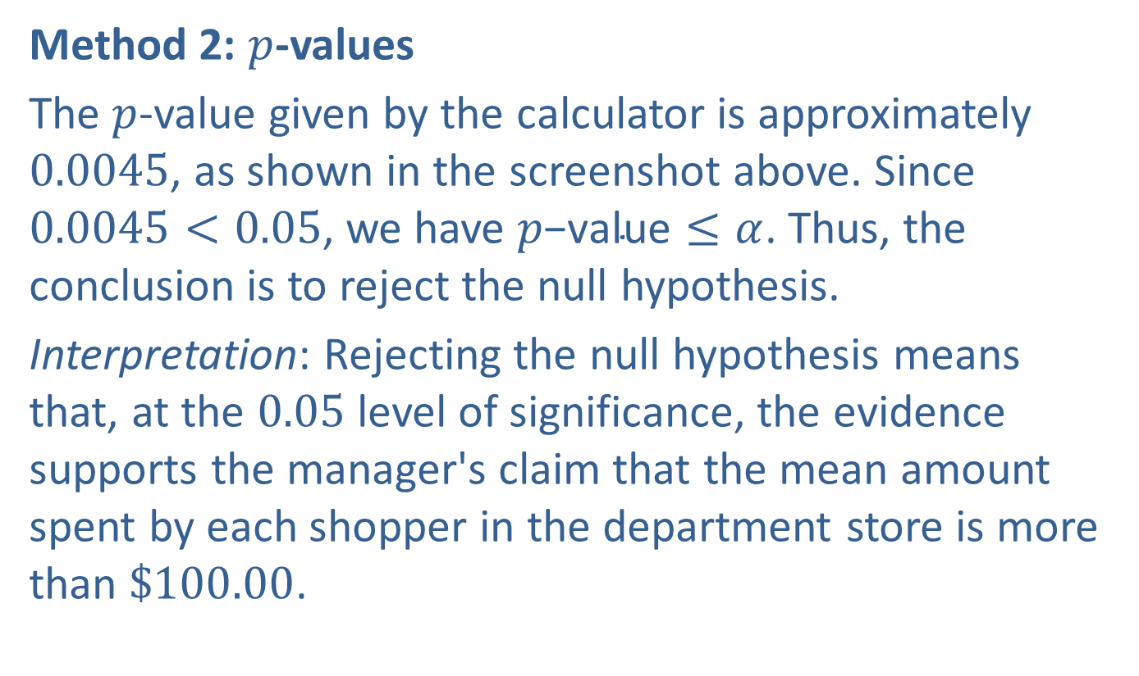
Example 10.3.3: Hypothesis Test for a Population Mean (Right-Tailed, $σ$ Unknown) (cont.)
Method 2: $p$-values
The $p$-value given by the calculator is approximately 0.0045, as shown in the screenshot above. Since $0.0045<0.05$, we have $p\text{−}\text{value}≤α$. Thus, the conclusion is to reject the null hypothesis.
Interpretation: Rejecting the null hypothesis means that, at the 0.05 level of significance, the evidence supports the manager's claim that the mean amount spent by each shopper in the department store is more than $\$100.00$.

Slide 32
Technology
For further instructions on performing a hypothesis test for a population mean with $σ$ unknown using a TI-83/84 Plus calculator or other technology, please visit stat.hawkeslearning.com and see Technology Instructions > Hypothesis Testing > t-Test.

Slide 33

Example 10.3.4: Hypothesis Test for a Population Mean (Two-Tailed, $σ$ Unknown)
The meat-packing department of a grocery store chain packs ground beef in two-pound portions. Supervisors are concerned that their machine is no longer packaging the beef to the required specifications. To test the claim that the mean weight of ground beef portions is not 2.00 pounds, the supervisors calculate the mean weight for a simple random sample of 20 packages of beef. The sample mean is 2.10 pounds with a standard deviation of 0.33 pounds. Is there sufficient evidence at the 0.01 level of significance to show that the machine is not working properly? Assume that the weights are normally distributed.

Slide 34
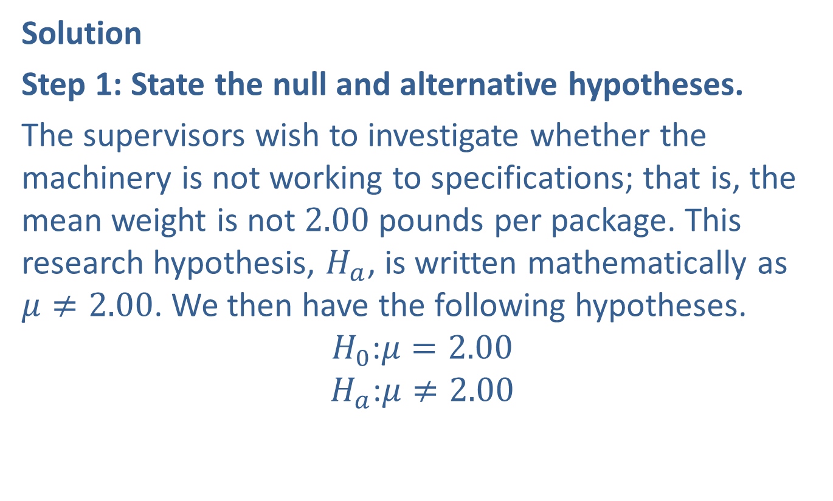

Example 10.3.4: Hypothesis Test for a Population Mean (Two-Tailed, $σ$ Unknown) (cont.)
Solution
Step 1: State the null and alternative hypotheses.
The supervisors wish to investigate whether the machinery is not working to specifications; that is, the mean weight is not 2.00 pounds per package. This research hypothesis, $H_{a}$, is written mathematically as $μ≠2.00$. We then have the following hypotheses.
$$H_{0}\text{:}μ=2.00$$
$$H_{a}\text{:}μ≠2.00$$

Slide 35
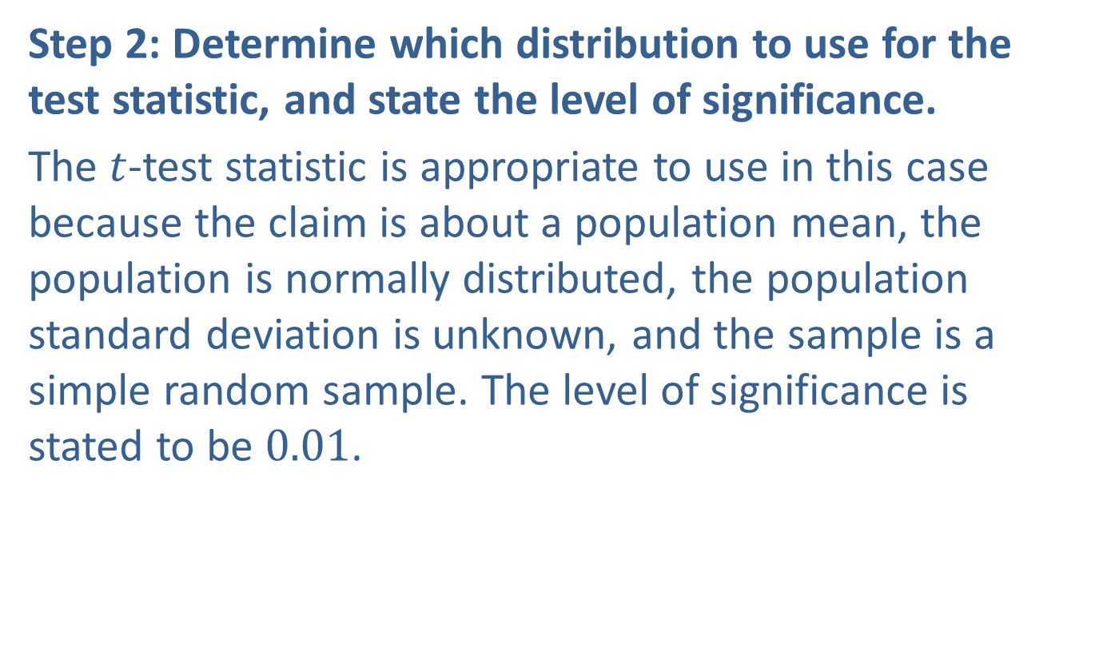
Example 10.3.4: Hypothesis Test for a Population Mean (Two-Tailed, $σ$ Unknown) (cont.)
Step 2: Determine which distribution to use for the test statistic, and state the level of significance.
The $t$-test statistic is appropriate to use in this case because the claim is about a population mean, the population is normally distributed, the population standard deviation is unknown, and the sample is a simple random sample. The level of significance is stated to be 0.01.

Slide 36
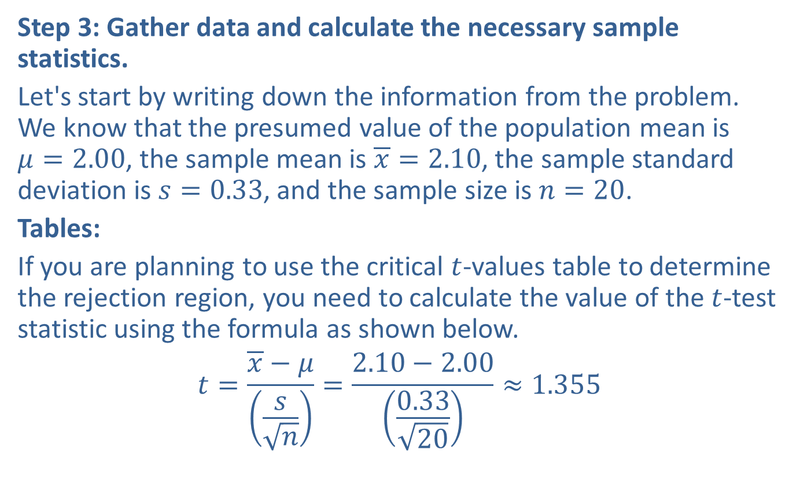
Example 10.3.4: Hypothesis Test for a Population Mean (Two-Tailed, $σ$ Unknown) (cont.)
Step 3: Gather data and calculate the necessary sample statistics.
Let's start by writing down the information from the problem. We know that the presumed value of the population mean is $μ=2.00$, the sample mean is $\overline{x}=2.10$, the sample standard deviation is $s=0.33$, and the sample size is $n=20$.
Tables:
If you are planning to use the critical $t$-values table to determine the rejection region, you need to calculate the value of the $t$-test statistic using the formula as shown below.
$$t=\frac{\overline{x}−μ}{\left(\frac{s}{\sqrt{n}}\right)}=\frac{2.10−2.00}{\left(\frac{0.33}{\sqrt{20}}\right)}≈1.355$$

Slide 37
Example 10.3.4: Hypothesis Test for a Population Mean (Two-Tailed, $σ$ Unknown) (cont.)
TI-83/84 Plus:
Press STAT, scroll to TESTS, and choose option T-Test. Since we know the sample statistics, choose Stats instead of Data. For μ₀, enter the value from the null hypothesis; thus enter 2 for μ₀.
Enter the rest of the given values, as shown in the screenshot directly below. Choose the alternative hypothesis ≠μ₀. Select Calculate. Press ENTER.

Slide 38
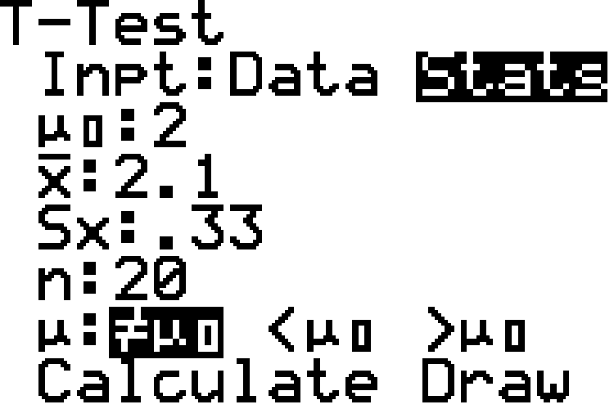
Example 10.3.4: Hypothesis Test for a Population Mean (Two-Tailed, $σ$ Unknown) (cont.)

Slide 39
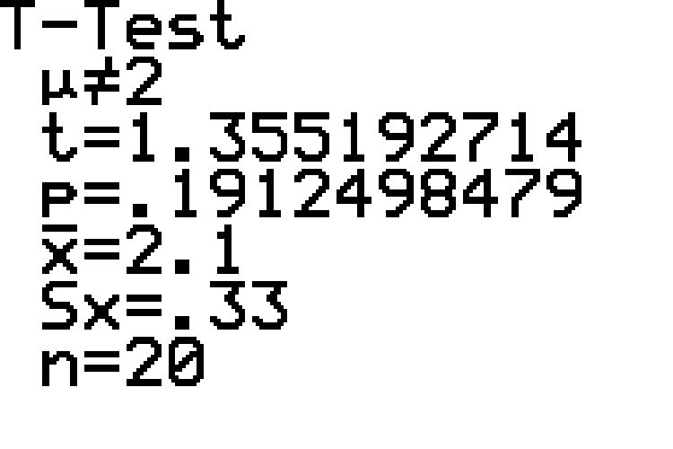
Example 10.3.4: Hypothesis Test for a Population Mean (Two-Tailed, $σ$ Unknown) (cont.)

Slide 40

Example 10.3.4: Hypothesis Test for a Population Mean (Two-Tailed, $σ$ Unknown) (cont.)
The output screen, shown in the bottom screenshot, shows the alternative hypothesis, calculates the $t$-test statistic and the $p$-value, and then reiterates the sample mean, sample standard deviation, and sample size that were entered.

Slide 41
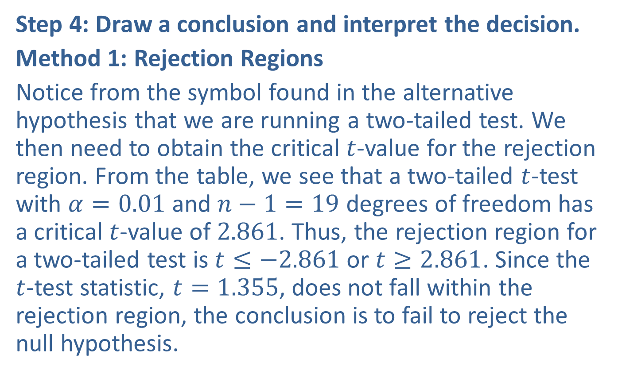
Example 10.3.4: Hypothesis Test for a Population Mean (Two-Tailed, $σ$ Unknown) (cont.)
Step 4: Draw a conclusion and interpret the decision.
Method 1: Rejection Regions
Notice from the symbol found in the alternative hypothesis that we are running a two-tailed test. We then need to obtain the critical $t$-value for the rejection region. From the table, we see that a two-tailed $t$-test with $α=0.01$ and $n−1=19$ degrees of freedom has a critical $t$-value of 2.861. Thus, the rejection region for a two-tailed test is $t≤−2.861$ or $t≥2.861$. Since the $t$-test statistic, $t=1.355$, does not fall within the rejection region, the conclusion is to fail to reject the null hypothesis.

Slide 42
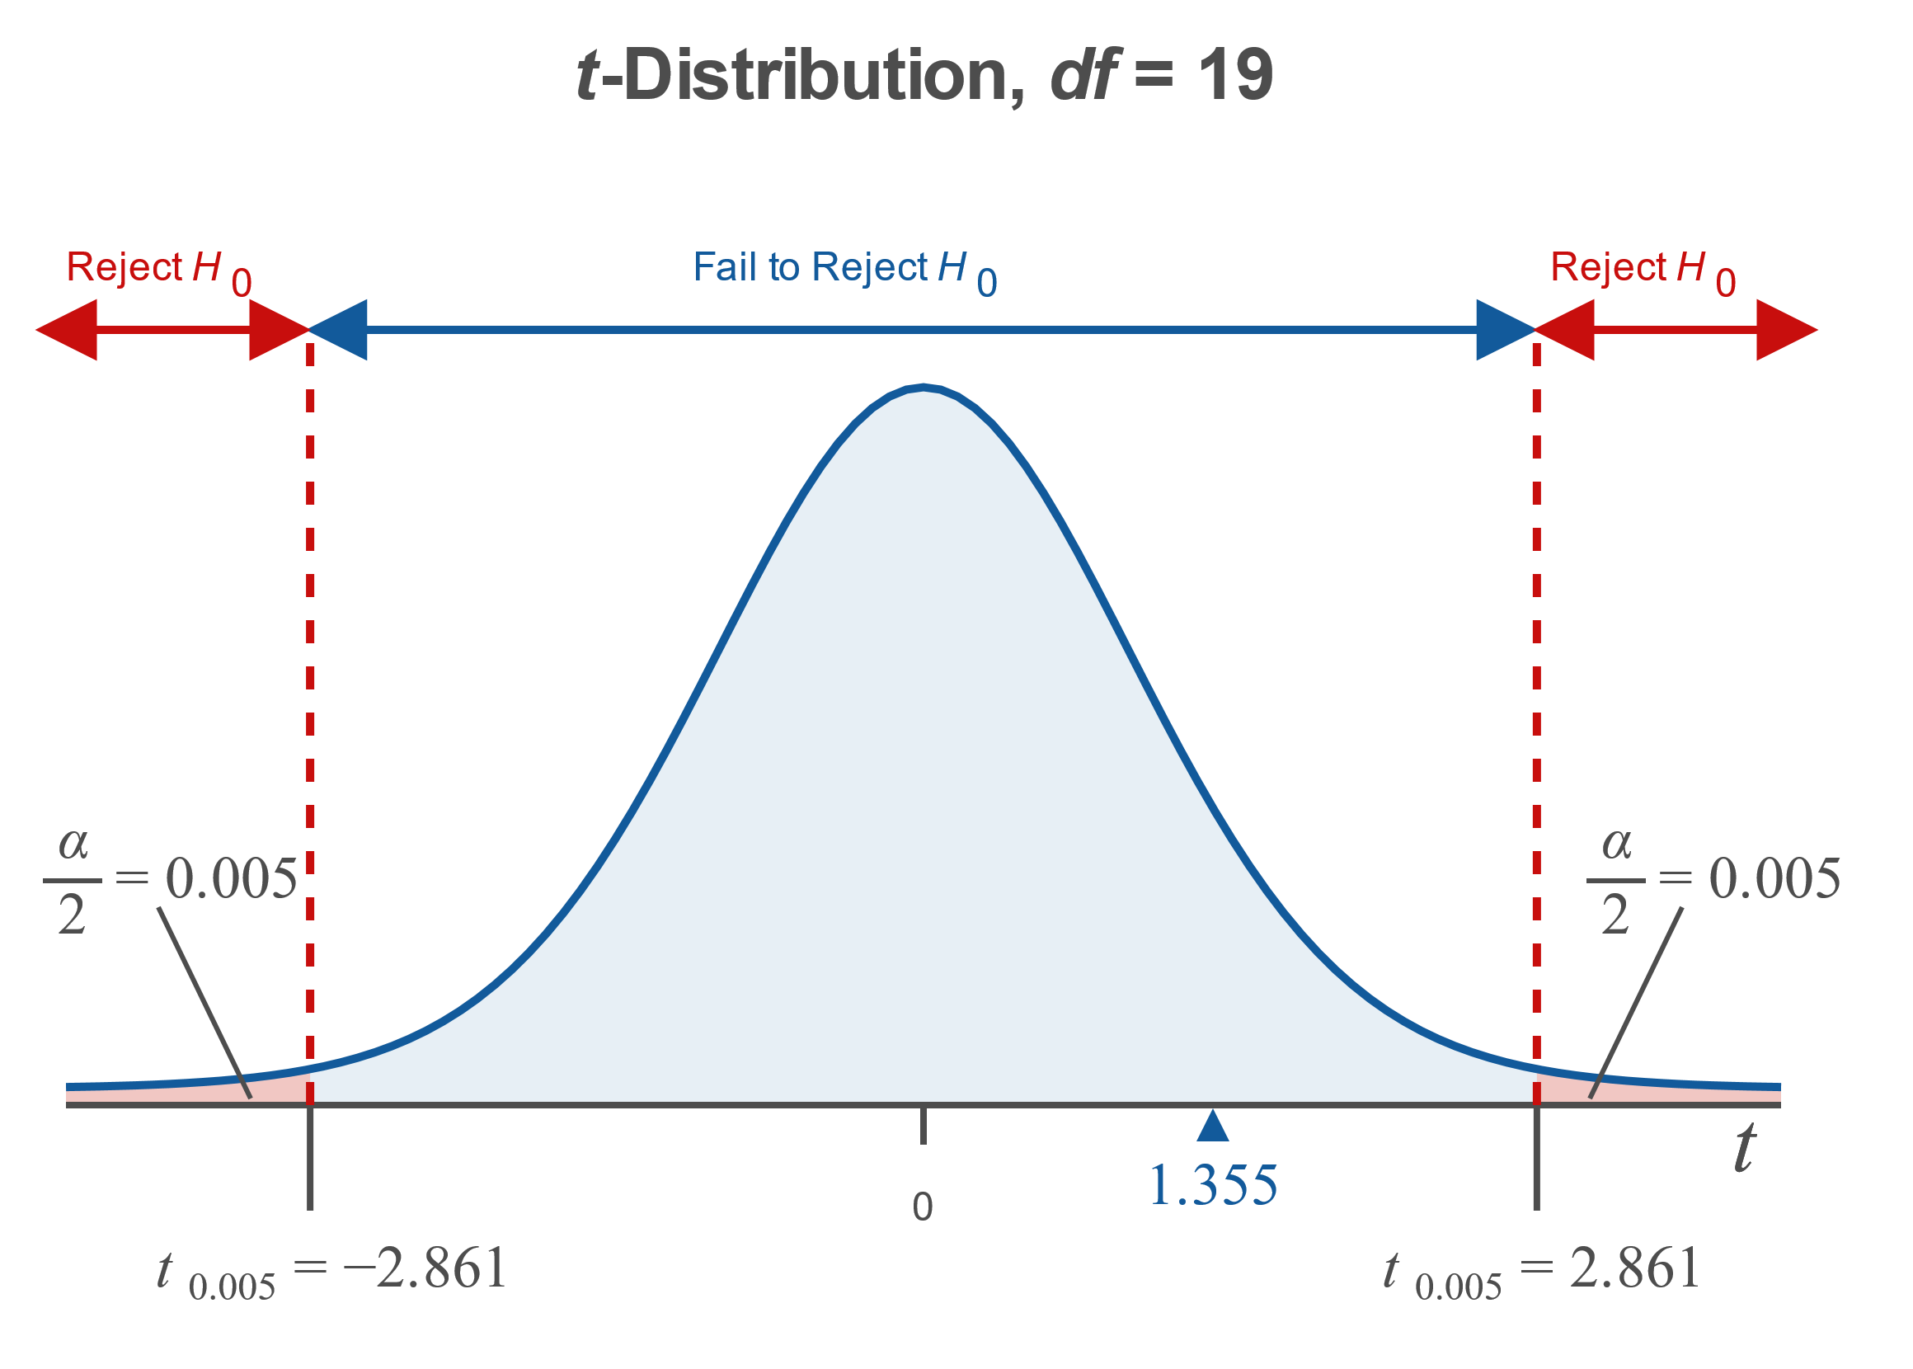
Example 10.3.4: Hypothesis Test for a Population Mean (Two-Tailed, $σ$ Unknown) (cont.)

Slide 43
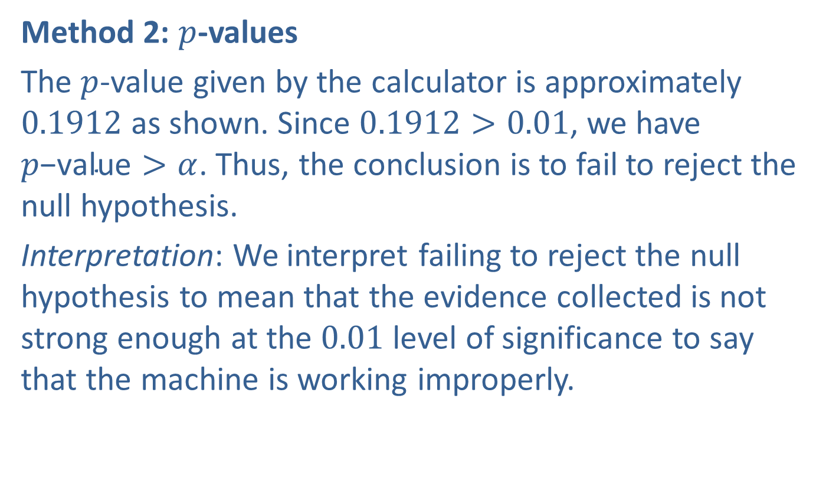
Example 10.3.4: Hypothesis Test for a Population Mean (Two-Tailed, $σ$ Unknown) (cont.)
Method 2: $p$-values
The $p$-value given by the calculator is approximately 0.1912 as shown. Since $0.1912>0.01$, we have $p\text{−}\text{value}>α$. Thus, the conclusion is to fail to reject the null hypothesis.
Interpretation: We interpret failing to reject the null hypothesis to mean that the evidence collected is not strong enough at the 0.01 level of significance to say that the machine is working improperly.

Slide 44
Technology
For further instructions on performing a hypothesis test for a population mean with $σ$ unknown using a TI-83/84 Plus calculator or other technology, please visit stat.hawkeslearning.com and see Technology Instructions > Hypothesis Testing > t-Test.

