Slide 1
Section 10.4
Hypothesis Testing for Population Proportions

Slide 2
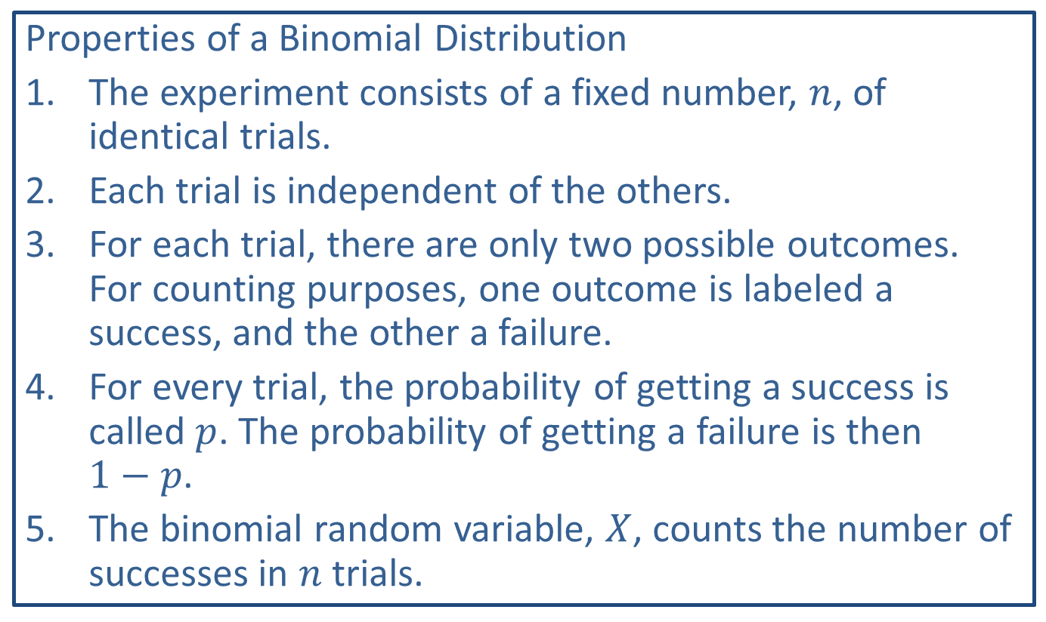
Memory Booster
Properties of a Binomial Distribution
​The experiment consists of a fixed number, $n$, of identical trials.
​Each trial is independent of the others.
​For each trial, there are only two possible outcomes. For counting purposes, one outcome is labeled a success, and the other a failure.
​For every trial, the probability of getting a success is called $p$. The probability of getting a failure is then $1−p$.
​The binomial random variable, $X$, counts the number of successes in $n$ trials.

Slide 3
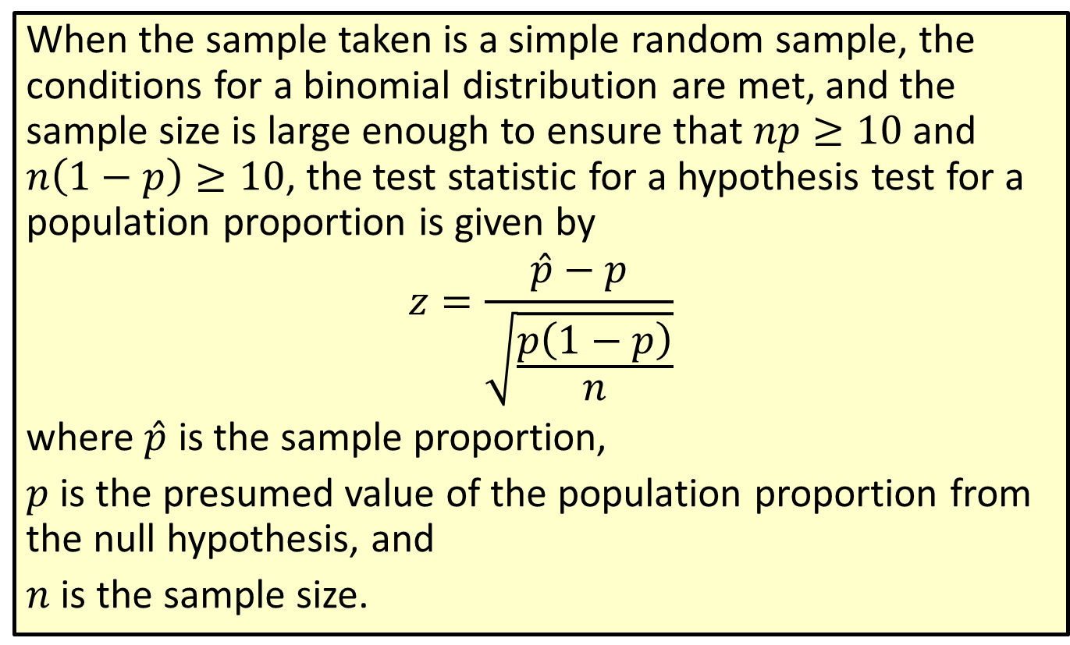
Formula: Test Statistic for a Hypothesis Test for a Population Proportion
When the sample taken is a simple random sample, the conditions for a binomial distribution are met, and the sample size is large enough to ensure that $np≥10$ and $n\left(1−p\right)≥10$, the test statistic for a hypothesis test for a population proportion is given by
$$z=\frac{\hat{p}−p}{\sqrt{\frac{p\left(1−p\right)}{n}}}$$
where $\hat{p}$ is the sample proportion,
$p$ is the presumed value of the population proportion from the null hypothesis, and
$n$ is the sample size.

Slide 4
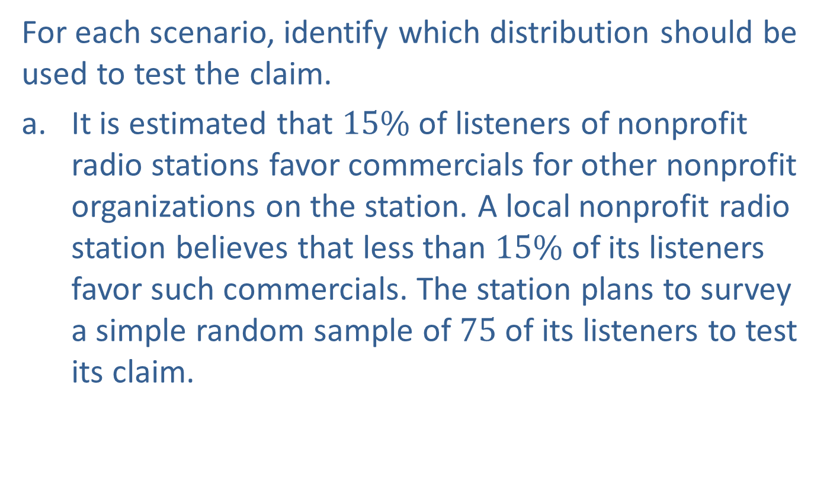
Example 10.4.1: Determining Which Distribution to Use for the Test Statistic in a Hypothesis Test
For each scenario, identify which distribution should be used to test the claim.
​It is estimated that $15\%$ of listeners of nonprofit radio stations favor commercials for other nonprofit organizations on the station. A local nonprofit radio station believes that less than $15\%$ of its listeners favor such commercials. The station plans to survey a simple random sample of 75 of its listeners to test its claim.

Slide 5
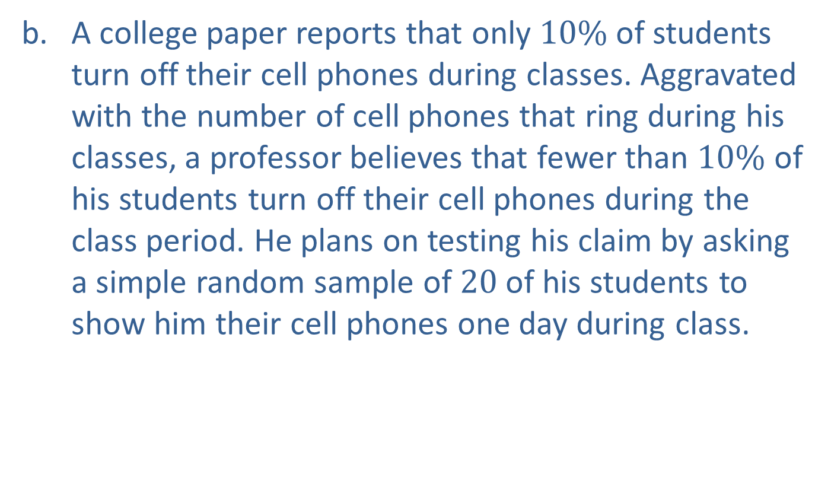
Example 10.4.1: Determining Which Distribution to Use for the Test Statistic in a Hypothesis Test (cont.)
​A college paper reports that only $10\%$ of students turn off their cell phones during classes. Aggravated with the number of cell phones that ring during his classes, a professor believes that fewer than $10\%$ of his students turn off their cell phones during the class period. He plans on testing his claim by asking a simple random sample of 20 of his students to show him their cell phones one day during class.

Slide 6
Example 10.4.1: Determining Which Distribution to Use for the Test Statistic in a Hypothesis Test (cont.)
​The mean amount of rainfall in the southern part of Texas during the month of September is commonly believed to be 3.02 inches. A meteorologist claims that the amount of rainfall this September has been higher than normal. He tests his claim by measuring the amounts of rainfall in a simple random sample of 12 locations across the region. Assume that the population standard deviation is unknown and the population distribution is approximately normal.

Slide 7
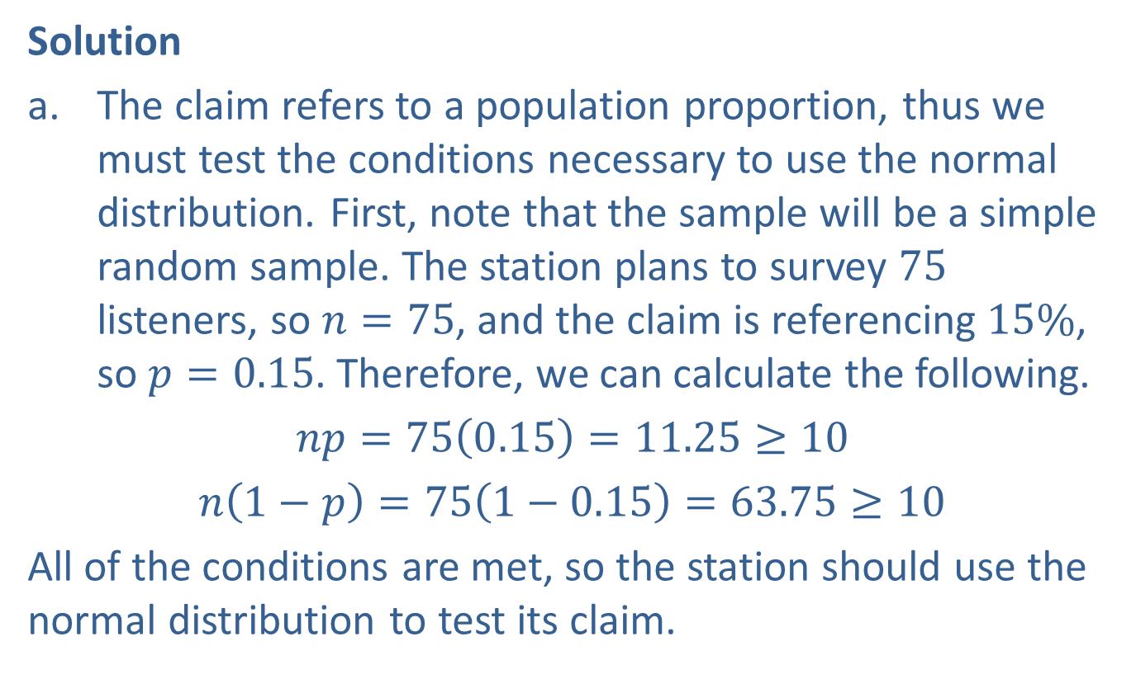
Example 10.4.1: Determining Which Distribution to Use for the Test Statistic in a Hypothesis Test (cont.)
Solution
​The claim refers to a population proportion, thus we must test the conditions necessary to use the normal distribution. First, note that the sample will be a simple random sample. The station plans to survey 75 listeners, so $n=75$, and the claim is referencing $15\%$, so $p=0.15$. Therefore, we can calculate the following.
​$np=75\left(0.15\right)=11.25≥10$
​$n\left(1−p\right)=75\left(1−0.15\right)=63.75≥10$
​All of the conditions are met, so the station should use the normal distribution to test its claim.

Slide 8
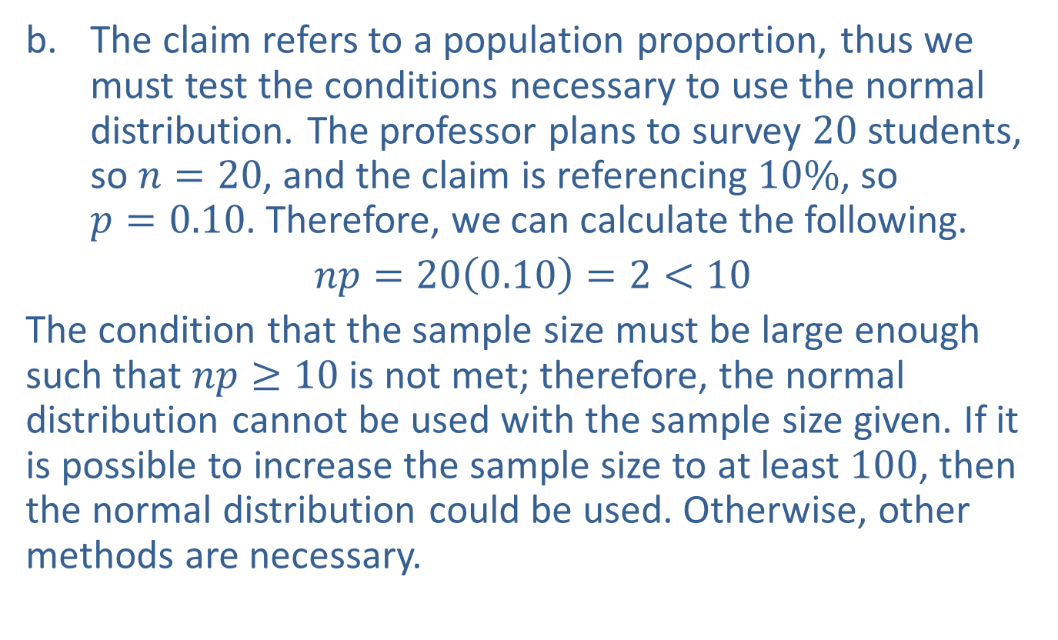
Example 10.4.1: Determining Which Distribution to Use for the Test Statistic in a Hypothesis Test (cont.)
​The claim refers to a population proportion, thus we must test the conditions necessary to use the normal distribution. The professor plans to survey 20 students, so $n=20$, and the claim is referencing $10\%$, so $p=0.10$. Therefore, we can calculate the following.
​$np=20\left(0.10\right)=2<10$
​The condition that the sample size must be large enough such that $np≥10$ is not met; therefore, the normal distribution cannot be used with the sample size given. If it is possible to increase the sample size to at least 100, then the normal distribution could be used. Otherwise, other methods are necessary.

Slide 9
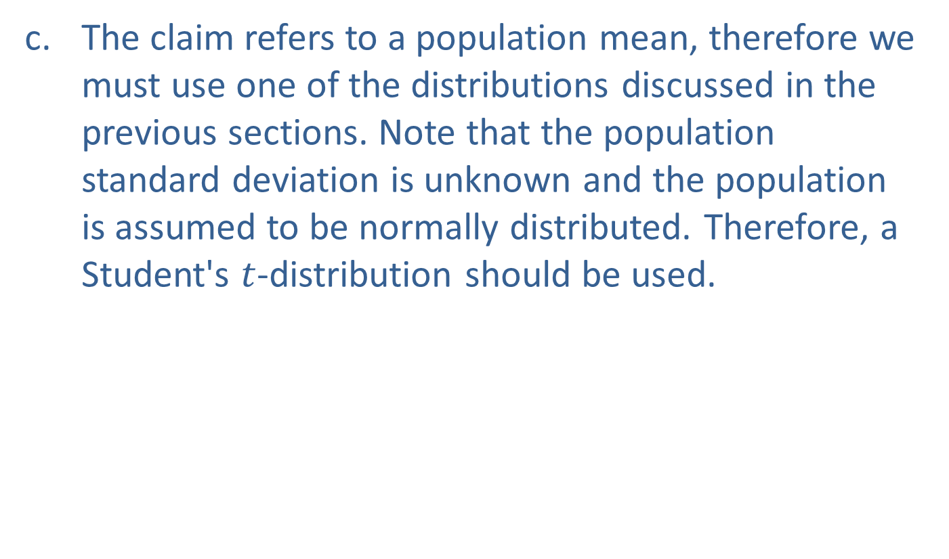
Example 10.4.1: Determining Which Distribution to Use for the Test Statistic in a Hypothesis Test (cont.)
​The claim refers to a population mean, therefore we must use one of the distributions discussed in the previous sections. Note that the population standard deviation is unknown and the population is assumed to be normally distributed. Therefore, a Student's $t$-distribution should be used.

Slide 10
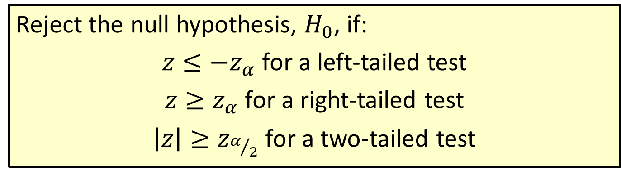
Procedure: Rejection Region for Hypothesis Tests for Population Proportions
Reject the null hypothesis, $H_{0}$, if:
$z≤−z_{α}$ for a left-tailed test
$z≥z_{α}$ for a right-tailed test
$\left|z\right|≥z_{α/2}$ for a two-tailed test

Slide 11
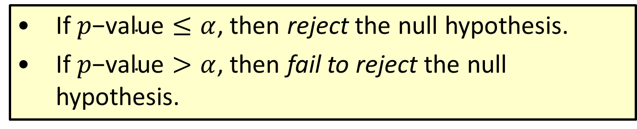

Procedure: Conclusions Using $p$-Values
​If $p\text{−}\text{value}≤α$, then reject the null hypothesis.
​If $p\text{−}\text{value}>α$, then fail to reject the null hypothesis.

Slide 12
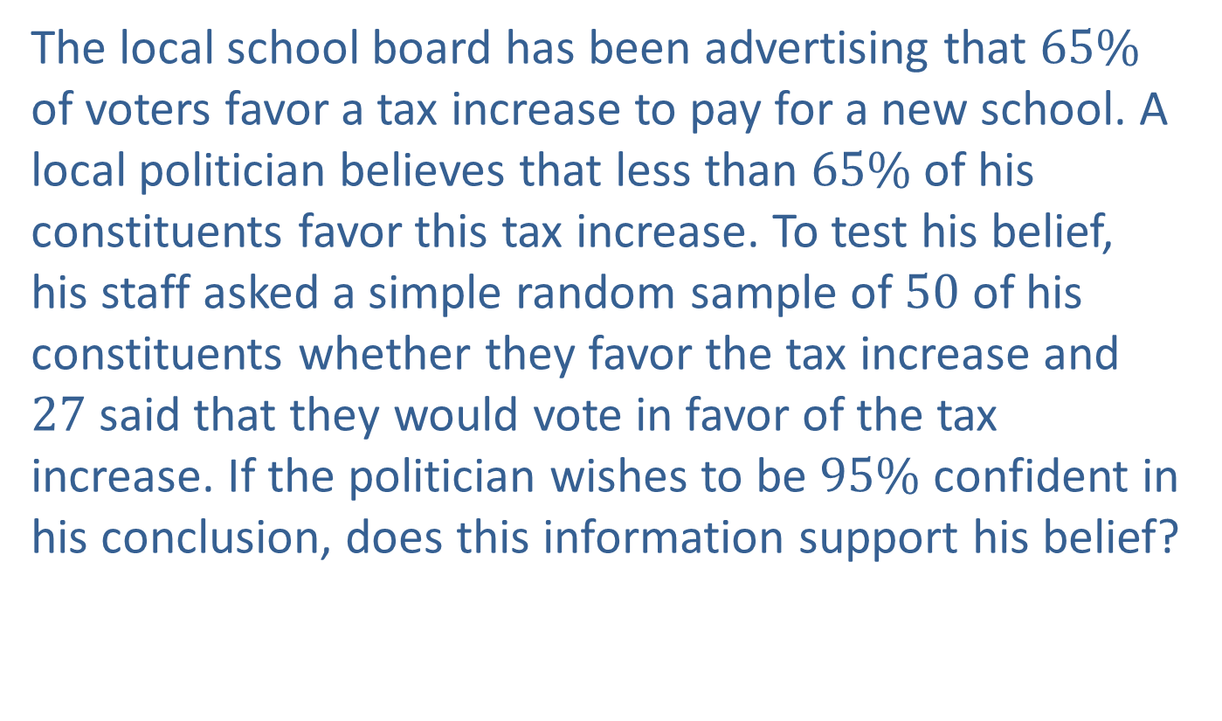
Example 10.4.2: Hypothesis Test for a Population Proportion (Left-Tailed)
The local school board has been advertising that $65\%$ of voters favor a tax increase to pay for a new school. A local politician believes that less than $65\%$ of his constituents favor this tax increase. To test his belief, his staff asked a simple random sample of 50 of his constituents whether they favor the tax increase and 27 said that they would vote in favor of the tax increase. If the politician wishes to be $95\%$ confident in his conclusion, does this information support his belief?

Slide 13
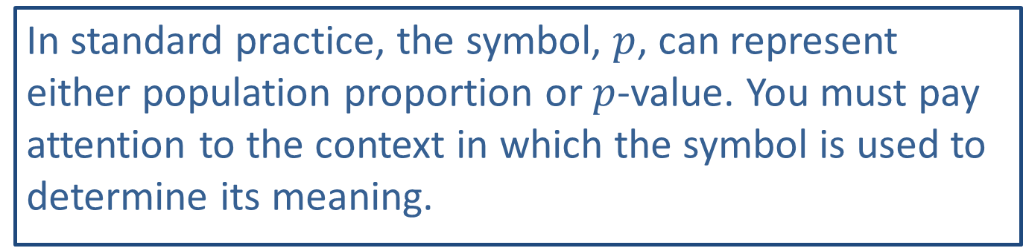
Caution
In standard practice, the symbol, $p$, can represent either population proportion or $p$-value. You must pay attention to the context in which the symbol is used to determine its meaning.

Slide 14
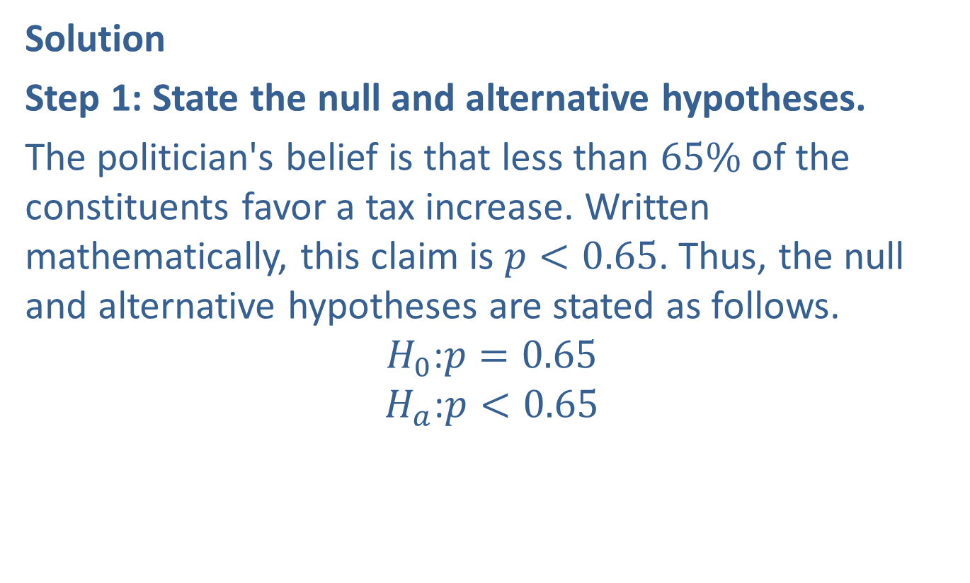
Example 10.4.2: Hypothesis Test for a Population Proportion (Left-Tailed) (cont.)
Solution
Step 1: State the null and alternative hypotheses.
The politician's belief is that less than $65\%$ of the constituents favor a tax increase. Written mathematically, this claim is $p<0.65$. Thus, the null and alternative hypotheses are stated as follows.
$$H_{0}\text{:}p=0.65$$
$$H_{a}\text{:}p<0.65$$

Slide 15
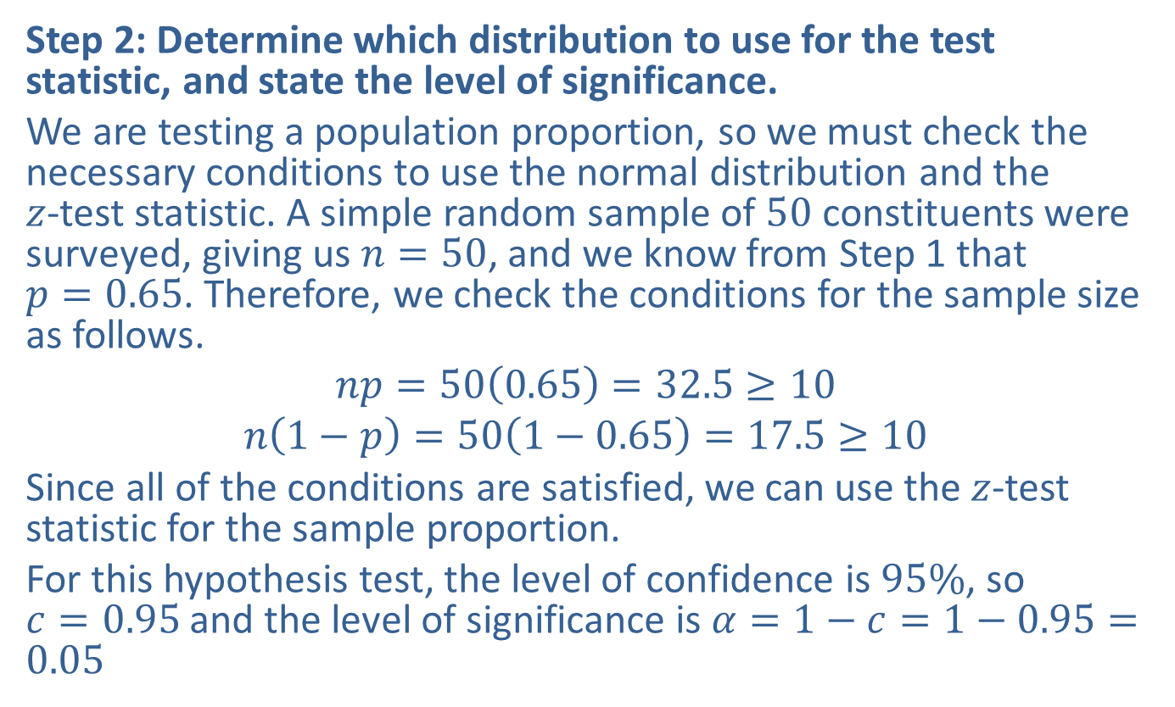
Example 10.4.2: Hypothesis Test for a Population Proportion (Left-Tailed) (cont.)
Step 2: Determine which distribution to use for the test statistic, and state the level of significance.
We are testing a population proportion, so we must check the necessary conditions to use the normal distribution and the $z$-test statistic. A simple random sample of 50 constituents were surveyed, giving us $n=50$, and we know from Step 1 that $p=0.65$. Therefore, we check the conditions for the sample size as follows.
$$np=50\left(0.65\right)=32.5≥10$$
$$n\left(1−p\right)=50\left(1−0.65\right)=17.5≥10$$
Since all of the conditions are satisfied, we can use the $z$-test statistic for the sample proportion.
For this hypothesis test, the level of confidence is $95\%$, so $c=0.95$ and the level of significance is $α=1−c=1−0.95=0.05$

Slide 16
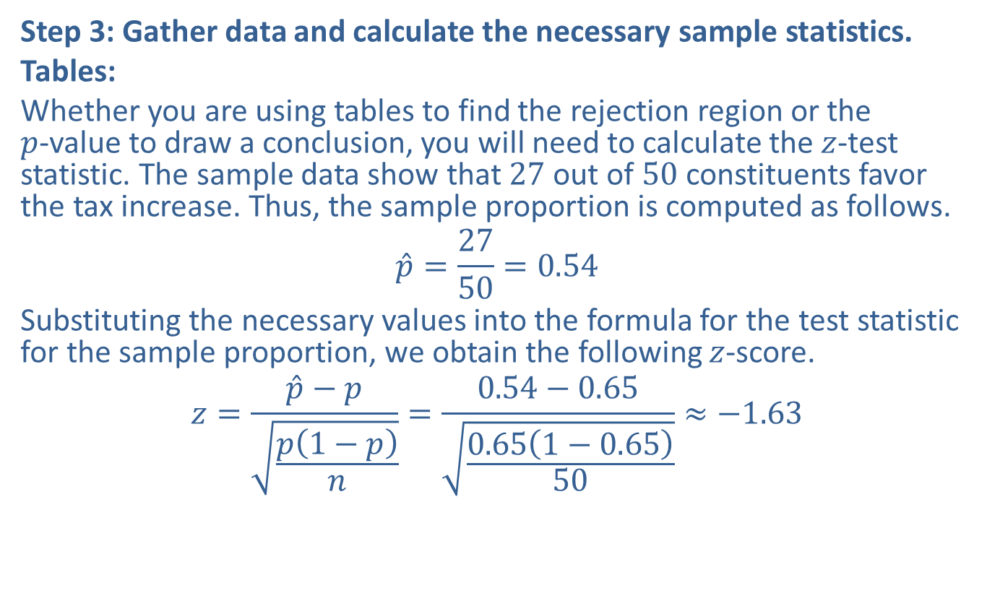
Example 10.4.2: Hypothesis Test for a Population Proportion (Left-Tailed) (cont.)
Step 3: Gather data and calculate the necessary sample statistics.
Tables:
Whether you are using tables to find the rejection region or the $p$-value to draw a conclusion, you will need to calculate the $z$-test statistic. The sample data show that 27 out of 50 constituents favor the tax increase. Thus, the sample proportion is computed as follows.
$$\hat{p}=\frac{27}{50}=0.54$$
Substituting the necessary values into the formula for the test statistic for the sample proportion, we obtain the following $z$-score.
$$z=\frac{\hat{p}−p}{\sqrt{\frac{p\left(1−p\right)}{n}}}=\frac{0.54−0.65}{\sqrt{\frac{0.65\left(1−0.65\right)}{50}}}≈−1.63$$

Slide 17
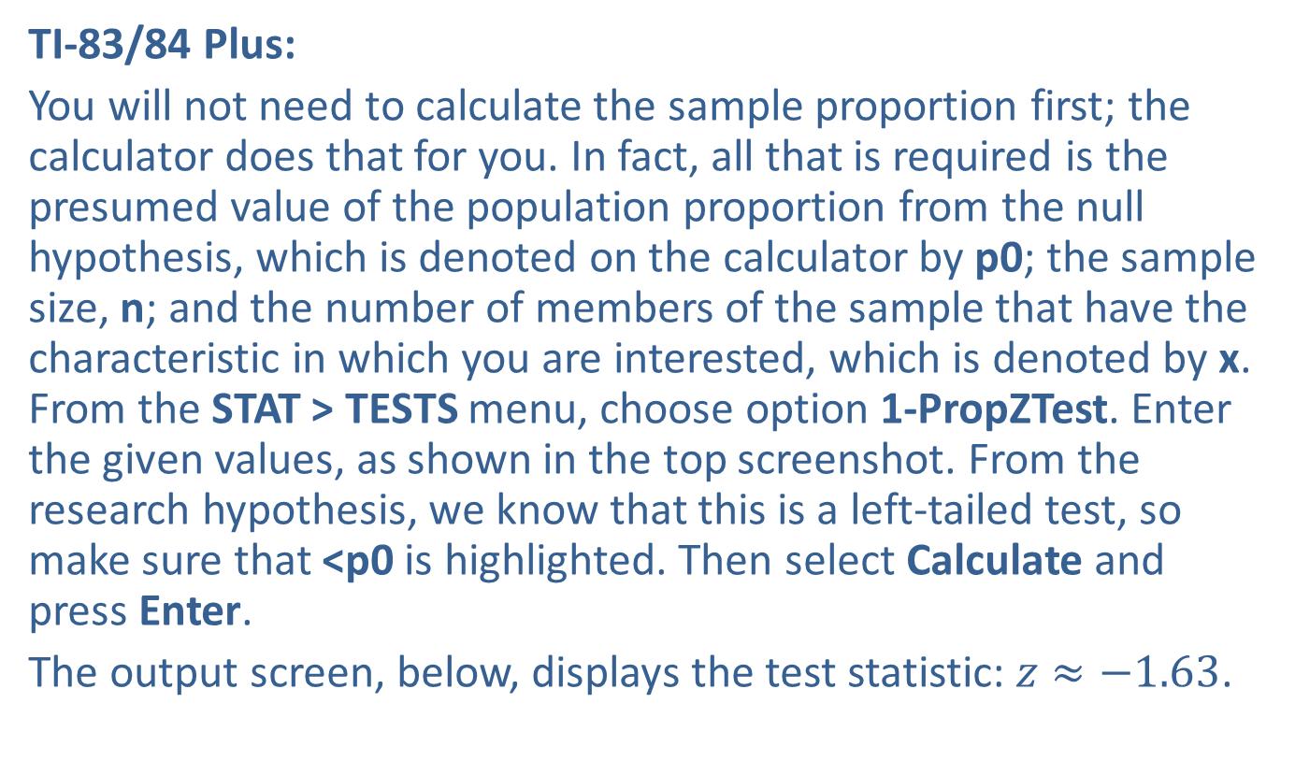
Example 10.4.2: Hypothesis Test for a Population Proportion (Left-Tailed) (cont.)
TI-83/84 Plus:
You will not need to calculate the sample proportion first; the calculator does that for you. In fact, all that is required is the presumed value of the population proportion from the null hypothesis, which is denoted on the calculator by p0; the sample size, n; and the number of members of the sample that have the characteristic in which you are interested, which is denoted by x. From the STAT > TESTS menu, choose option 1-PropZTest. Enter the given values, as shown in the top screenshot. From the research hypothesis, we know that this is a left-tailed test, so make sure that <p0 is highlighted. Then select Calculate and press Enter.
The output screen, below, displays the test statistic: $z≈−1.63$.

Slide 18
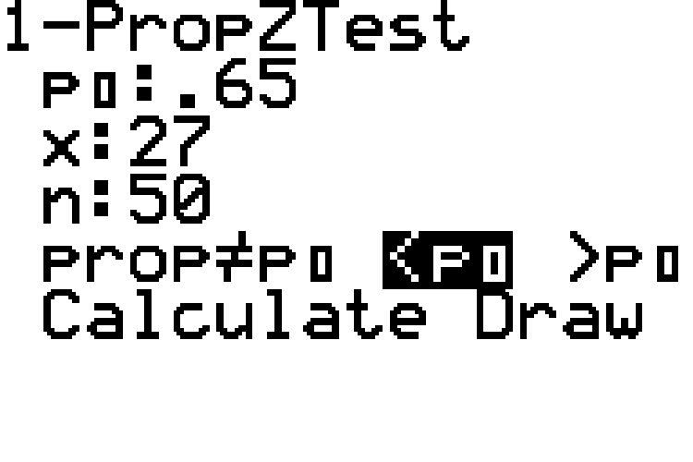
Example 10.4.2: Hypothesis Test for a Population Proportion (Left-Tailed) (cont.)

Slide 19
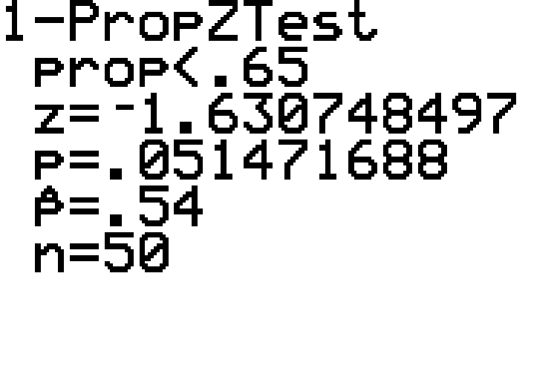
Example 10.4.2: Hypothesis Test for a Population Proportion (Left-Tailed) (cont.)

Slide 20
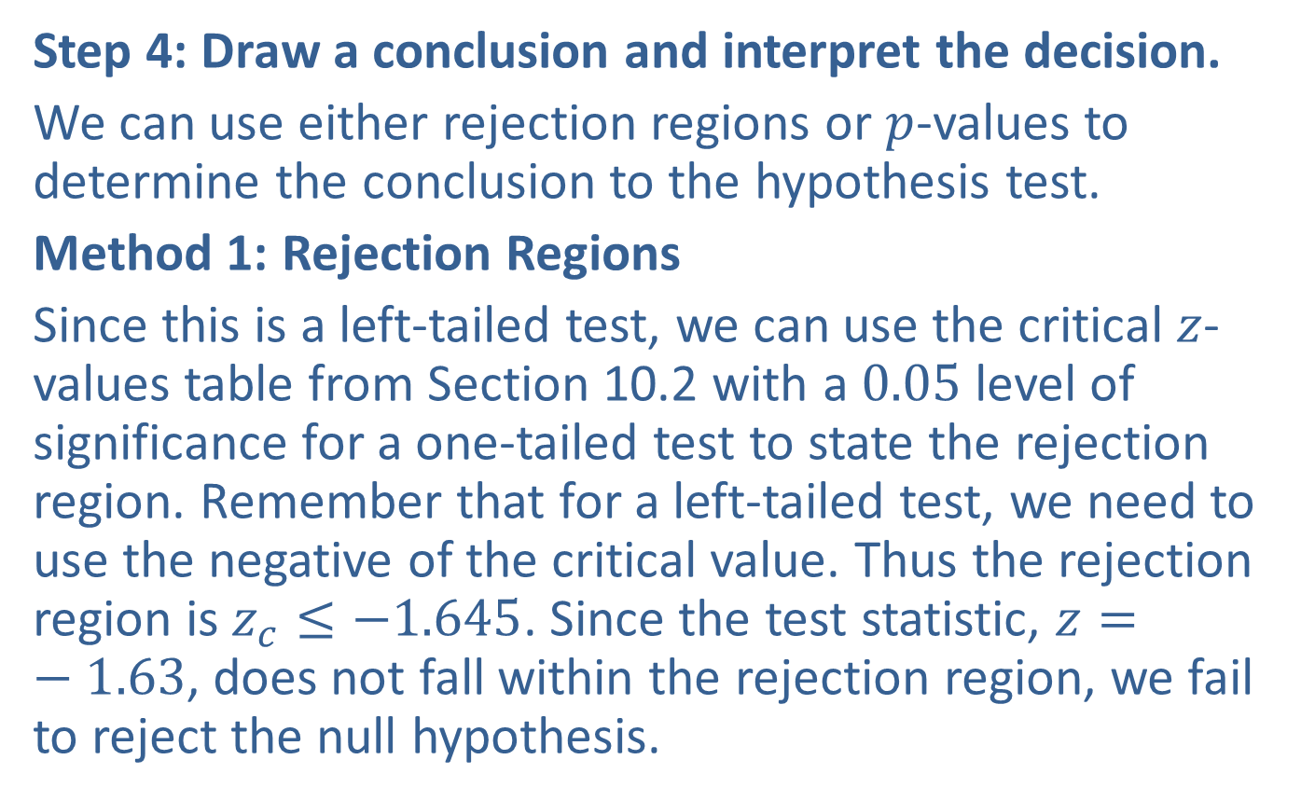
Example 10.4.2: Hypothesis Test for a Population Proportion (Left-Tailed) (cont.)
Step 4: Draw a conclusion and interpret the decision.
We can use either rejection regions or $p$-values to determine the conclusion to the hypothesis test.
Method 1: Rejection Regions
Since this is a left-tailed test, we can use the critical $z$-values table from Section 10.2 with a 0.05 level of significance for a one-tailed test to state the rejection region. Remember that for a left-tailed test, we need to use the negative of the critical value. Thus the rejection region is $z_{c}≤−1.645$. Since the test statistic, $z=−1.63$, does not fall within the rejection region, we fail to reject the null hypothesis.

Slide 21
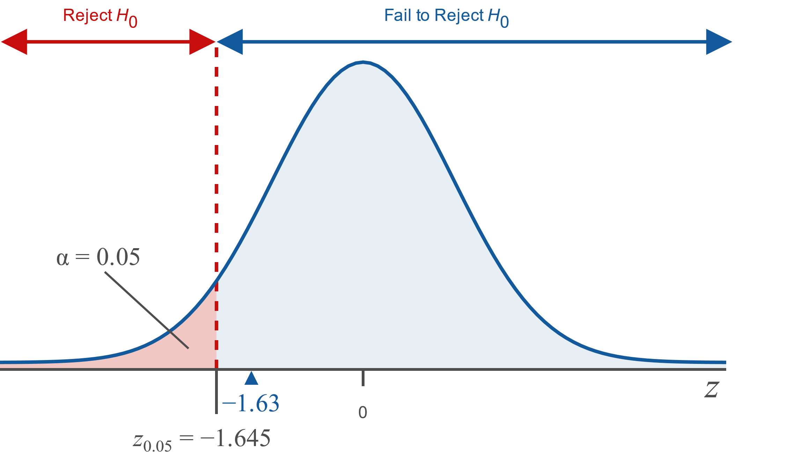
Example 10.4.2: Hypothesis Test for a Population Proportion (Left-Tailed) (cont.)

Slide 22
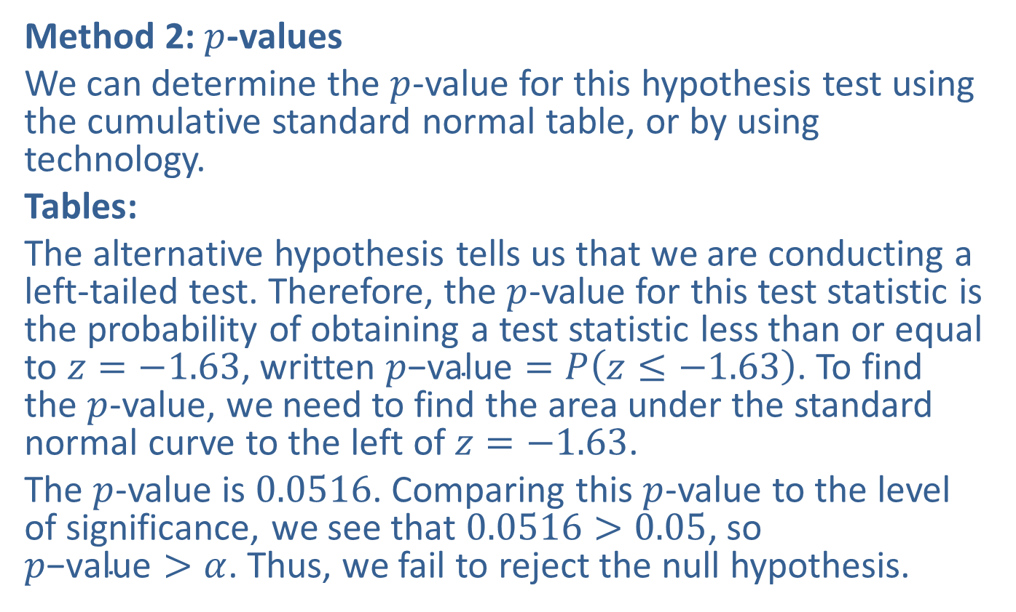
Example 10.4.2: Hypothesis Test for a Population Proportion (Left-Tailed) (cont.)
Method 2: $p$-values
We can determine the $p$-value for this hypothesis test using the cumulative standard normal table, or by using technology.
Tables:
The alternative hypothesis tells us that we are conducting a left-tailed test. Therefore, the $p$-value for this test statistic is the probability of obtaining a test statistic less than or equal to $z=−1.63$, written $p\text{−}\text{value}=P\left(z≤−1.63\right)$. To find the $p$-value, we need to find the area under the standard normal curve to the left of $z=−1.63$.
The $p$-value is 0.0516. Comparing this $p$-value to the level of significance, we see that $0.0516>0.05$, so $p\text{−}\text{value}>α$. Thus, we fail to reject the null hypothesis.

Slide 23
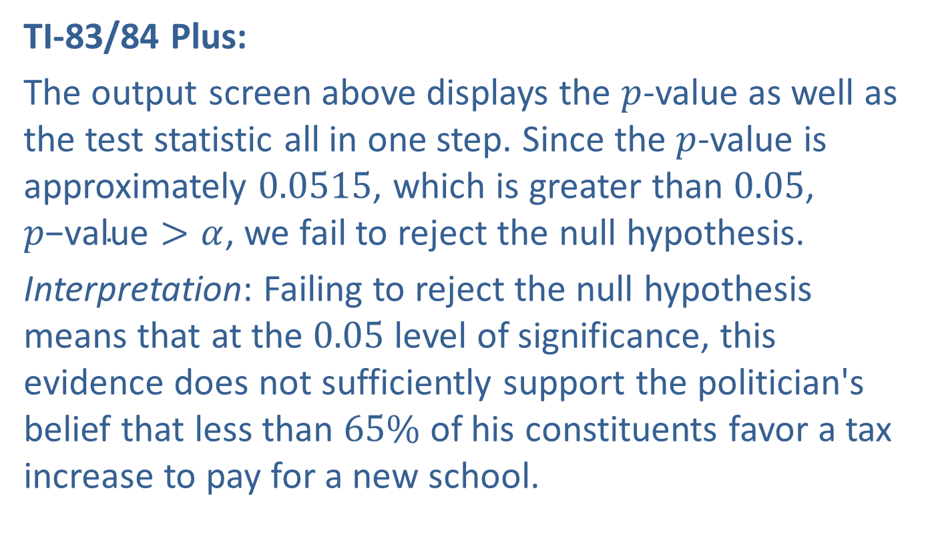
Example 10.4.2: Hypothesis Test for a Population Proportion (Left-Tailed) (cont.)
TI-83/84 Plus:
The output screen above displays the $p$-value as well as the test statistic all in one step. Since the $p$-value is approximately 0.0515, which is greater than 0.05, $p\text{−}\text{value}>α$, we fail to reject the null hypothesis.
Interpretation: Failing to reject the null hypothesis means that at the 0.05 level of significance, this evidence does not sufficiently support the politician's belief that less than $65\%$ of his constituents favor a tax increase to pay for a new school.

Slide 24
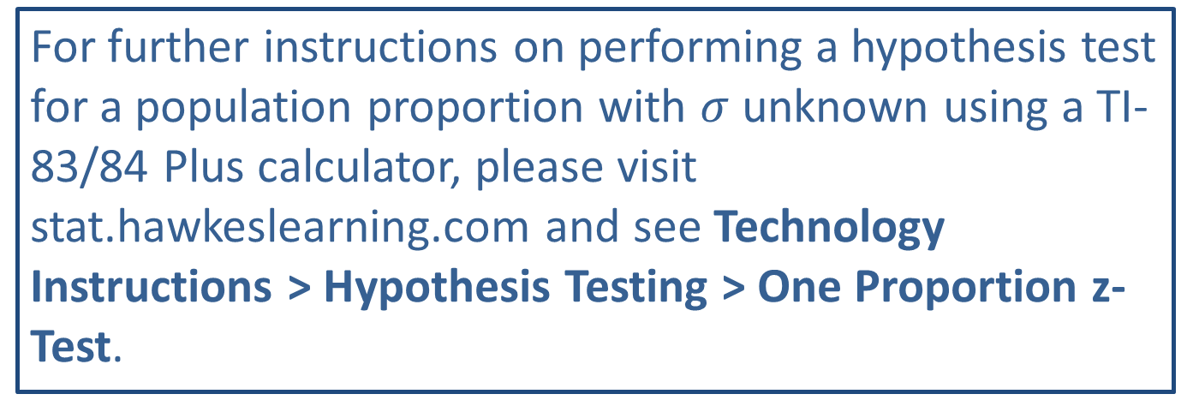
Technology
For further instructions on performing a hypothesis test for a population proportion with $σ$ unknown using a TI-83/84 Plus calculator, please visit stat.hawkeslearning.com and see Technology Instructions > Hypothesis Testing > One Proportion z-Test.

Slide 25
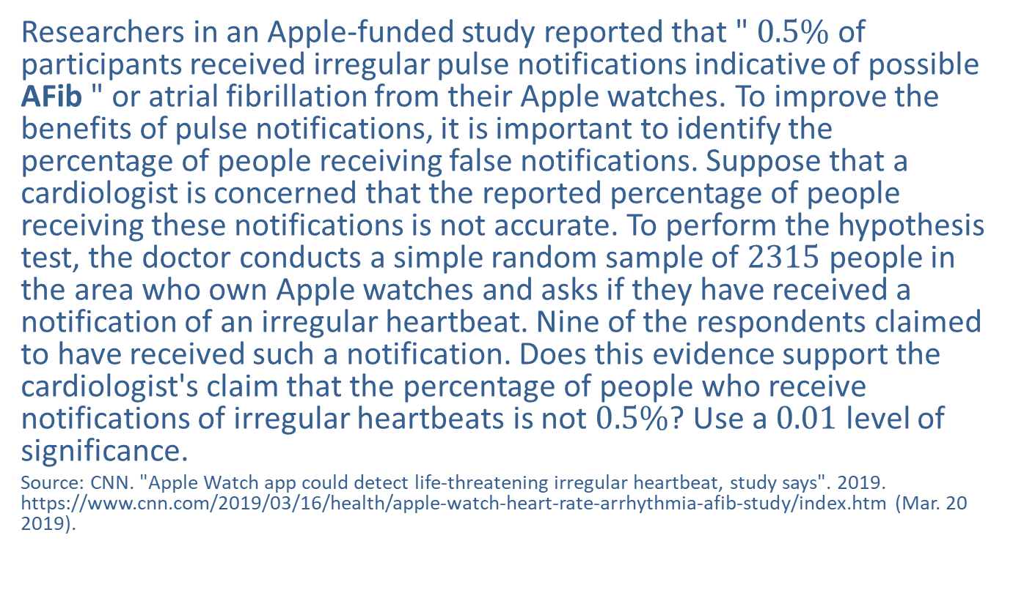
Example 10.4.3: Hypothesis Test for a Population Proportion (Two-Tailed)
Researchers in an Apple-funded study reported that " $0.5\%$ of participants received irregular pulse notifications indicative of possible AFib " or atrial fibrillation from their Apple watches. To improve the benefits of pulse notifications, it is important to identify the percentage of people receiving false notifications. Suppose that a cardiologist is concerned that the reported percentage of people receiving these notifications is not accurate. To perform the hypothesis test, the doctor conducts a simple random sample of 2315 people in the area who own Apple watches and asks if they have received a notification of an irregular heartbeat. Nine of the respondents claimed to have received such a notification. Does this evidence support the cardiologist's claim that the percentage of people who receive notifications of irregular heartbeats is not $0.5\%$? Use a 0.01 level of significance.
Source: CNN. "Apple Watch app could detect life-threatening irregular heartbeat, study says". 2019. https://www.cnn.com/2019/03/16/health/apple-watch-heart-rate-arrhythmia-afib-study/index.htm (Mar. 20 2019).

Slide 26
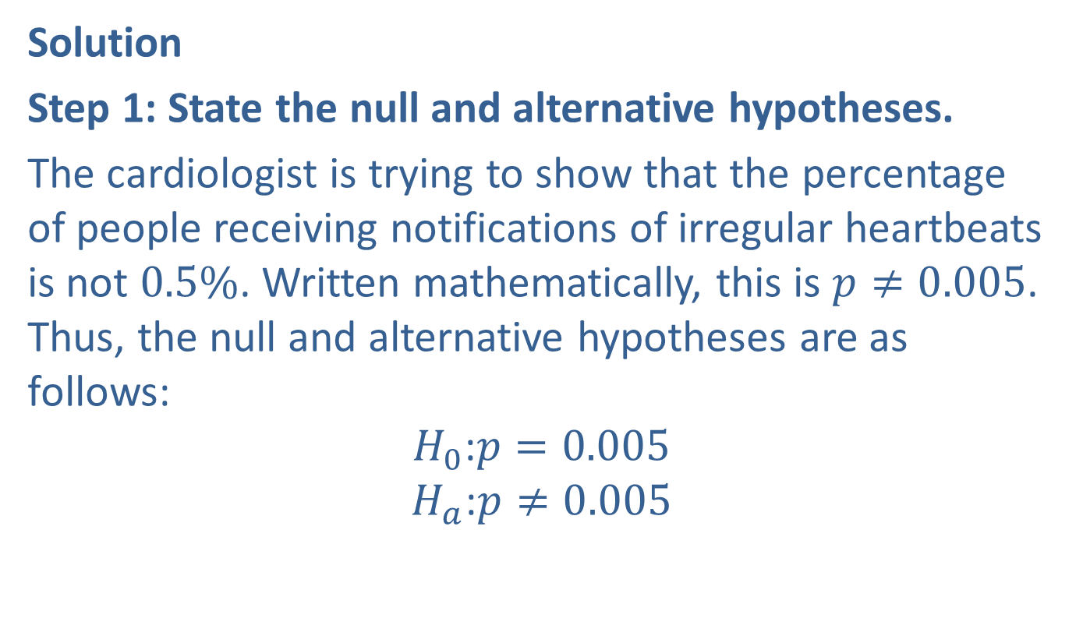
Example 10.4.3: Hypothesis Test for a Population Proportion (Two-Tailed) (cont.)
Solution
Step 1: State the null and alternative hypotheses.
The cardiologist is trying to show that the percentage of people receiving notifications of irregular heartbeats is not $0.5\%$. Written mathematically, this is $p≠0.005$. Thus, the null and alternative hypotheses are as follows:
$$H_{0}\text{:}p=0.005$$
$$H_{a}\text{:}p≠0.005$$

Slide 27
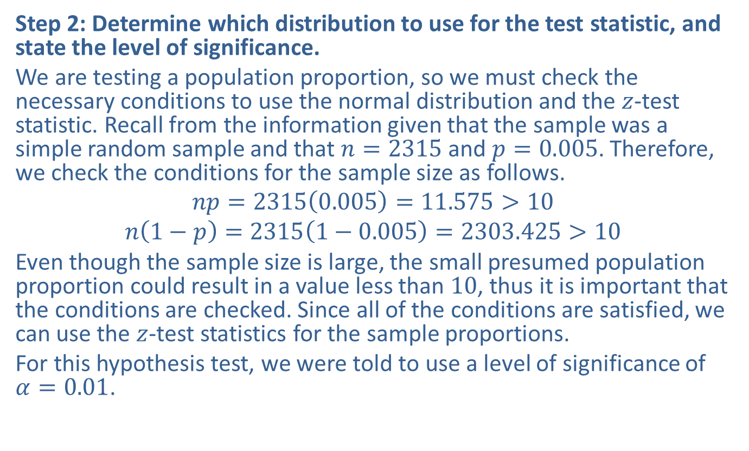
Example 10.4.3: Hypothesis Test for a Population Proportion (Two-Tailed) (cont.)
Step 2: Determine which distribution to use for the test statistic, and state the level of significance.
We are testing a population proportion, so we must check the necessary conditions to use the normal distribution and the $z$-test statistic. Recall from the information given that the sample was a simple random sample and that $n=2315$ and $p=0.005$. Therefore, we check the conditions for the sample size as follows.
$$np=2315\left(0.005\right)=11.575>10$$
$$n\left(1−p\right)=2315\left(1−0.005\right)=2303.425>10$$
Even though the sample size is large, the small presumed population proportion could result in a value less than 10, thus it is important that the conditions are checked. Since all of the conditions are satisfied, we can use the $z$-test statistics for the sample proportions.
For this hypothesis test, we were told to use a level of significance of $α=0.01$.

Slide 28
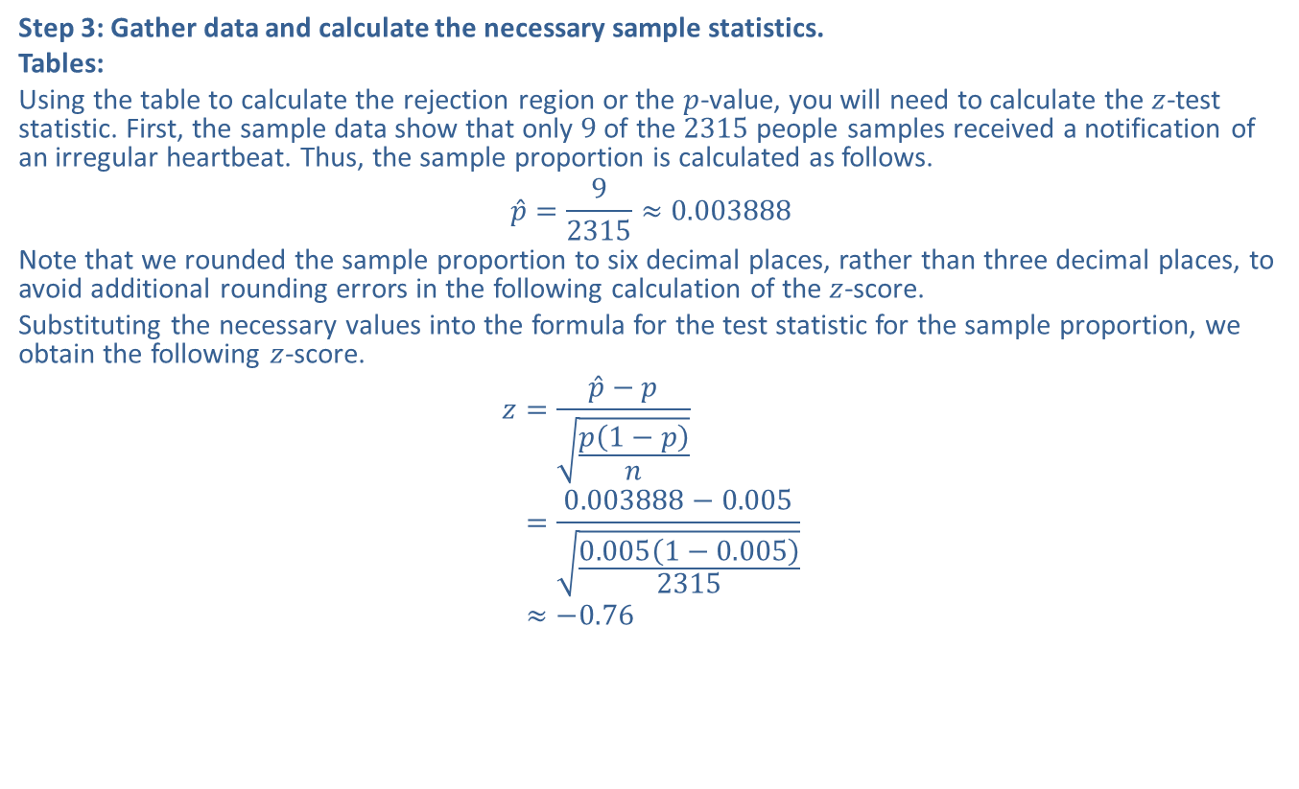
Example 10.4.3: Hypothesis Test for a Population Proportion (Two-Tailed) (cont.)
Step 3: Gather data and calculate the necessary sample statistics.
Tables:
Using the table to calculate the rejection region or the $p$-value, you will need to calculate the $z$-test statistic. First, the sample data show that only 9 of the 2315 people samples received a notification of an irregular heartbeat. Thus, the sample proportion is calculated as follows.
$$\hat{p}=\frac{9}{2315}≈0.003888$$
Note that we rounded the sample proportion to six decimal places, rather than three decimal places, to avoid additional rounding errors in the following calculation of the $z$-score.
Substituting the necessary values into the formula for the test statistic for the sample proportion, we obtain the following $z$-score.
𝑧=𝑝−𝑝𝑝1−𝑝𝑛𝑧=0.003888−0.0050.0051−0.0052315𝑧≈−0.76

Slide 29
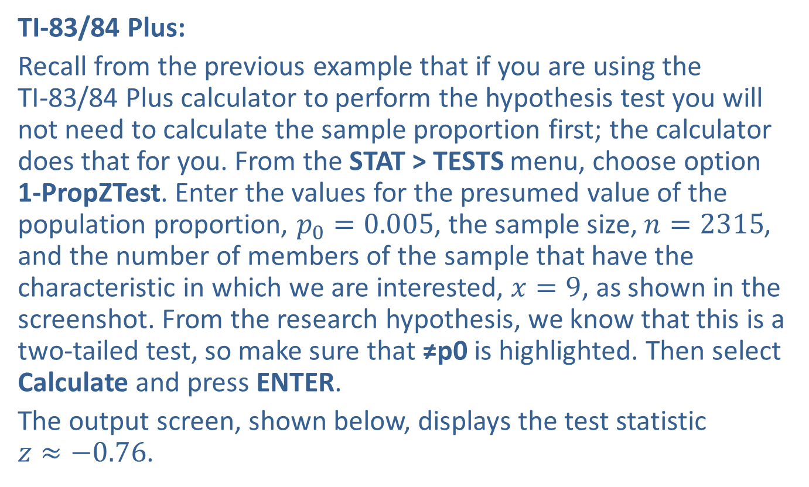
Example 10.4.3: Hypothesis Test for a Population Proportion (Two-Tailed) (cont.)
TI-83/84 Plus:
Recall from the previous example that if you are using the TI-83/84 Plus calculator to perform the hypothesis test you will not need to calculate the sample proportion first; the calculator does that for you. From the STAT > TESTS menu, choose option 1-PropZTest. Enter the values for the presumed value of the population proportion, $p_{0}=0.005$, the sample size, $n=2315$, and the number of members of the sample that have the characteristic in which we are interested, $x=9$, as shown in the screenshot. From the research hypothesis, we know that this is a two-tailed test, so make sure that ≠p0 is highlighted. Then select Calculate and press ENTER.
The output screen, shown below, displays the test statistic $z≈−0.76$.

Slide 30
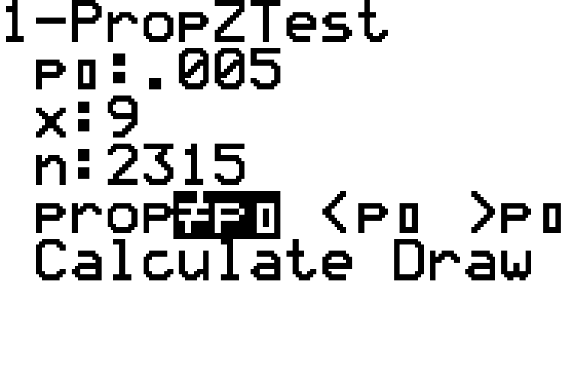
Example 10.4.3: Hypothesis Test for a Population Proportion (Two-Tailed) (cont.)

Slide 31
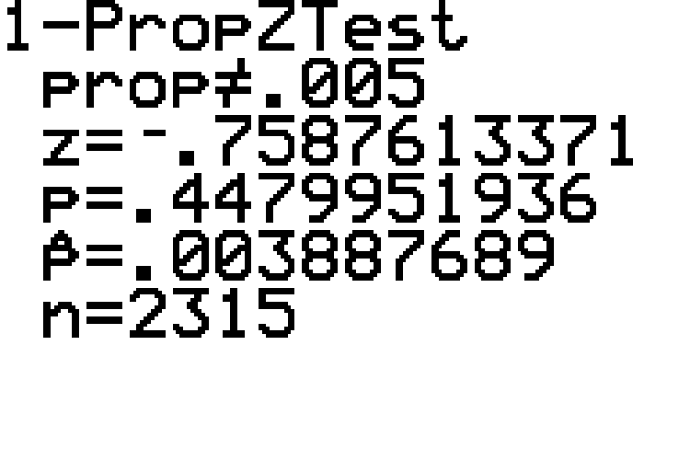
Example 10.4.3: Hypothesis Test for a Population Proportion (Two-Tailed) (cont.)

Slide 32
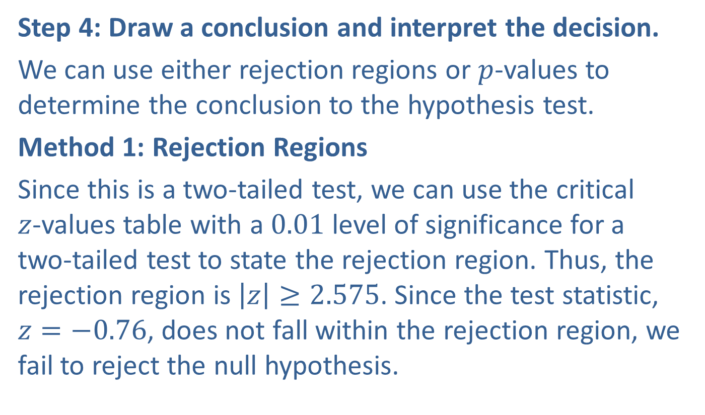
Example 10.4.3: Hypothesis Test for a Population Proportion (Two-Tailed) (cont.)
Step 4: Draw a conclusion and interpret the decision.
We can use either rejection regions or $p$-values to determine the conclusion to the hypothesis test.
Method 1: Rejection Regions
Since this is a two-tailed test, we can use the critical $z$-values table with a 0.01 level of significance for a two-tailed test to state the rejection region. Thus, the rejection region is $\left|z\right|≥2.575$. Since the test statistic, $z=−0.76$, does not fall within the rejection region, we fail to reject the null hypothesis.

Slide 33
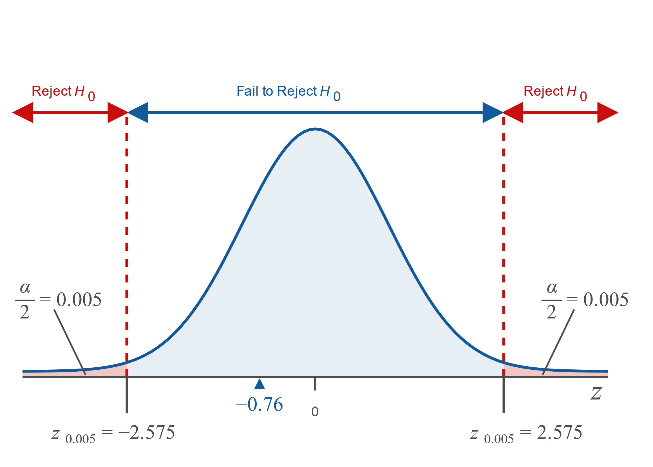
Example 10.4.3: Hypothesis Test for a Population Proportion (Two-Tailed) (cont.)

Slide 34
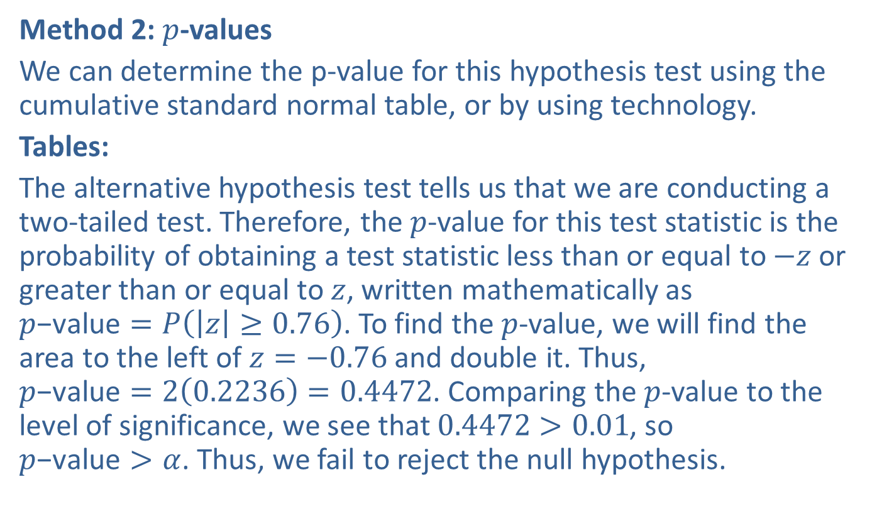
Example 10.4.3: Hypothesis Test for a Population Proportion (Two-Tailed) (cont.)
Method 2: $p$-values
We can determine the p-value for this hypothesis test using the cumulative standard normal table, or by using technology.
Tables:
The alternative hypothesis test tells us that we are conducting a two-tailed test. Therefore, the $p$-value for this test statistic is the probability of obtaining a test statistic less than or equal to $−z$ or greater than or equal to $z$, written mathematically as $p\text{−}\text{value}=P\left(\left|z\right|≥0.76\right)$. To find the $p$-value, we will find the area to the left of $z=−0.76$ and double it. Thus, $p\text{−}\text{value}=2\left(0.2236\right)=0.4472$. Comparing the $p$-value to the level of significance, we see that $0.4472>0.01$, so $p\text{−}\text{value}>α$. Thus, we fail to reject the null hypothesis.

Slide 35
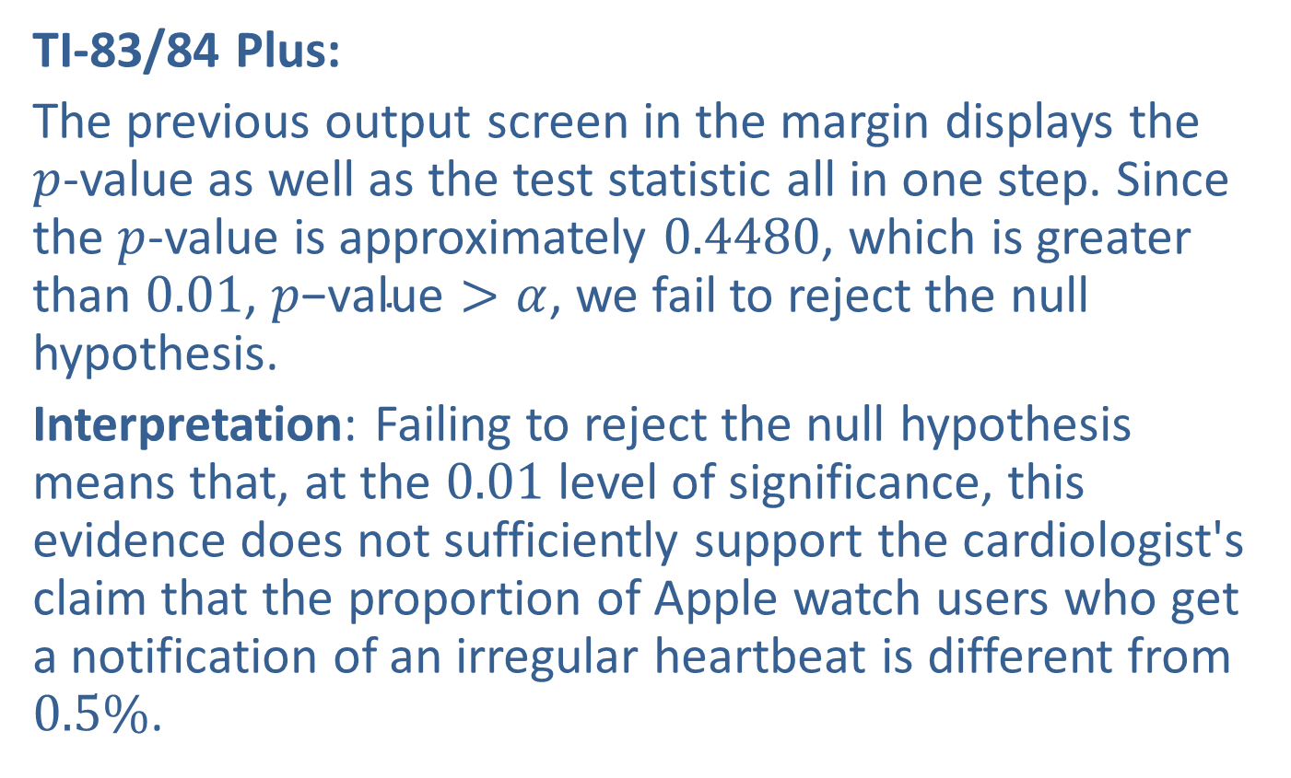
Example 10.4.3: Hypothesis Test for a Population Proportion (Two-Tailed) (cont.)
TI-83/84 Plus:
The previous output screen in the margin displays the $p$-value as well as the test statistic all in one step. Since the $p$-value is approximately 0.4480, which is greater than 0.01, $p\text{−}\text{value}>α$, we fail to reject the null hypothesis.
Interpretation: Failing to reject the null hypothesis means that, at the 0.01 level of significance, this evidence does not sufficiently support the cardiologist's claim that the proportion of Apple watch users who get a notification of an irregular heartbeat is different from $0.5\%$.

Slide 36
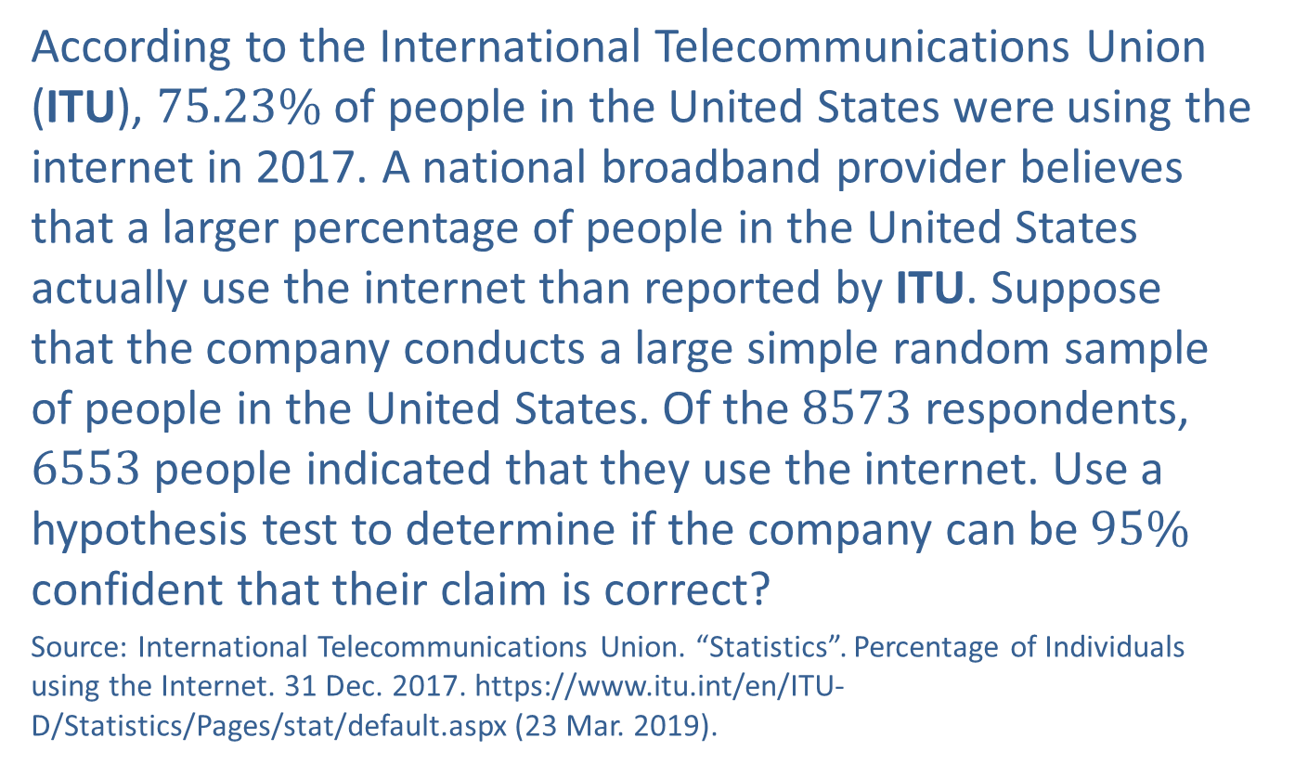
Example 10.4.4: Hypothesis Test for a Population Proportion (Right-Tailed)
According to the International Telecommunications Union (ITU), $75.23\%$ of people in the United States were using the internet in 2017. A national broadband provider believes that a larger percentage of people in the United States actually use the internet than reported by ITU. Suppose that the company conducts a large simple random sample of people in the United States. Of the 8573 respondents, 6553 people indicated that they use the internet. Use a hypothesis test to determine if the company can be $95\%$ confident that their claim is correct?
Source: International Telecommunications Union. “Statistics”. Percentage of Individuals using the Internet. 31 Dec. 2017. https://www.itu.int/en/ITU-D/Statistics/Pages/stat/default.aspx (23 Mar. 2019).

Slide 37
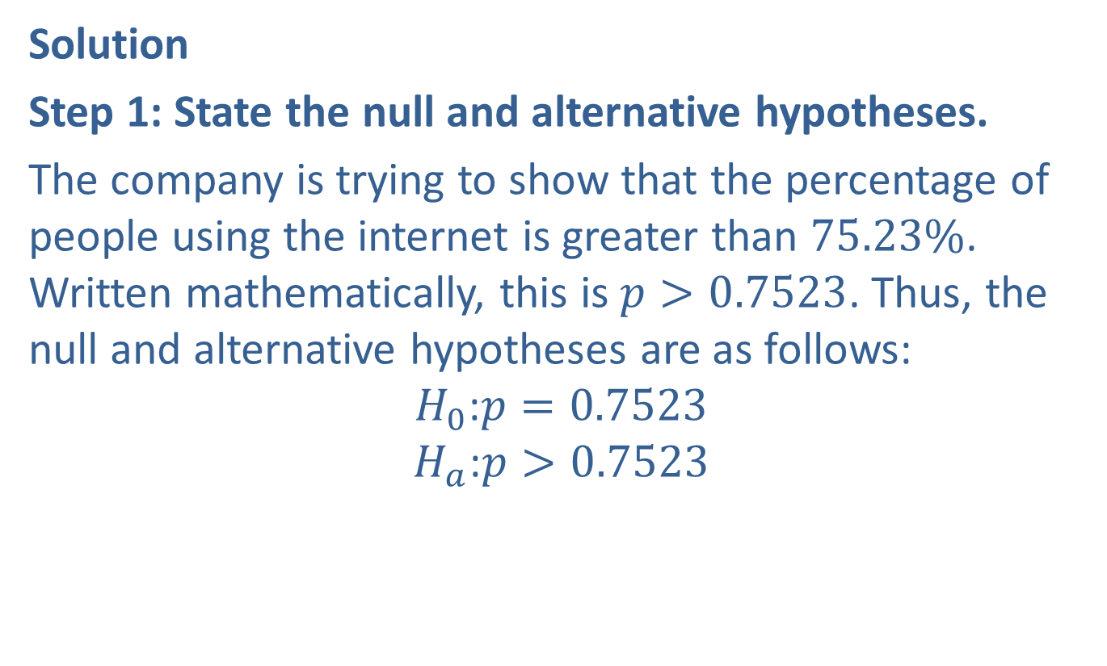
Example 10.4.4: Hypothesis Test for a Population Proportion (Right-Tailed) (cont.)
Solution
Step 1: State the null and alternative hypotheses.
The company is trying to show that the percentage of people using the internet is greater than $75.23\%$. Written mathematically, this is $p>0.7523$. Thus, the null and alternative hypotheses are as follows:
$$H_{0}\text{:}p=0.7523$$
$$H_{a}\text{:}p>0.7523$$

Slide 38
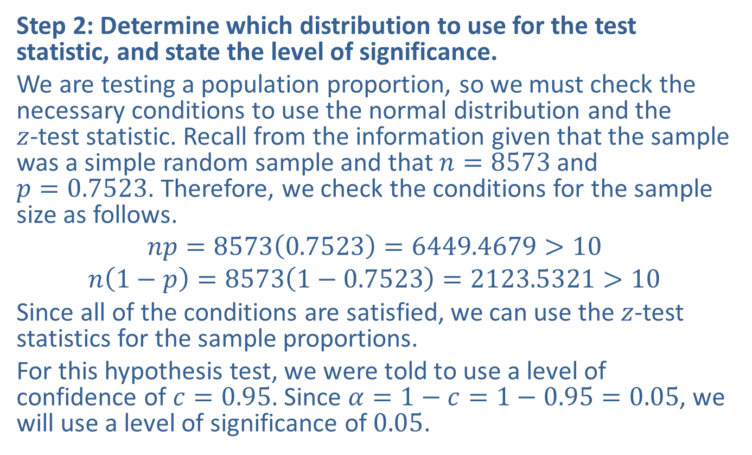
Example 10.4.4: Hypothesis Test for a Population Proportion (Right-Tailed) (cont.)
Step 2: Determine which distribution to use for the test statistic, and state the level of significance.
We are testing a population proportion, so we must check the necessary conditions to use the normal distribution and the $z$-test statistic. Recall from the information given that the sample was a simple random sample and that $n=8573$ and $p=0.7523$. Therefore, we check the conditions for the sample size as follows.
$$np=8573\left(0.7523\right)=6449.4679>10$$
$$n\left(1−p\right)=8573\left(1−0.7523\right)=2123.5321>10$$
Since all of the conditions are satisfied, we can use the $z$-test statistics for the sample proportions.
For this hypothesis test, we were told to use a level of confidence of $c=0.95$. Since $α=1−c=1−0.95=0.05$, we will use a level of significance of 0.05.

Slide 39
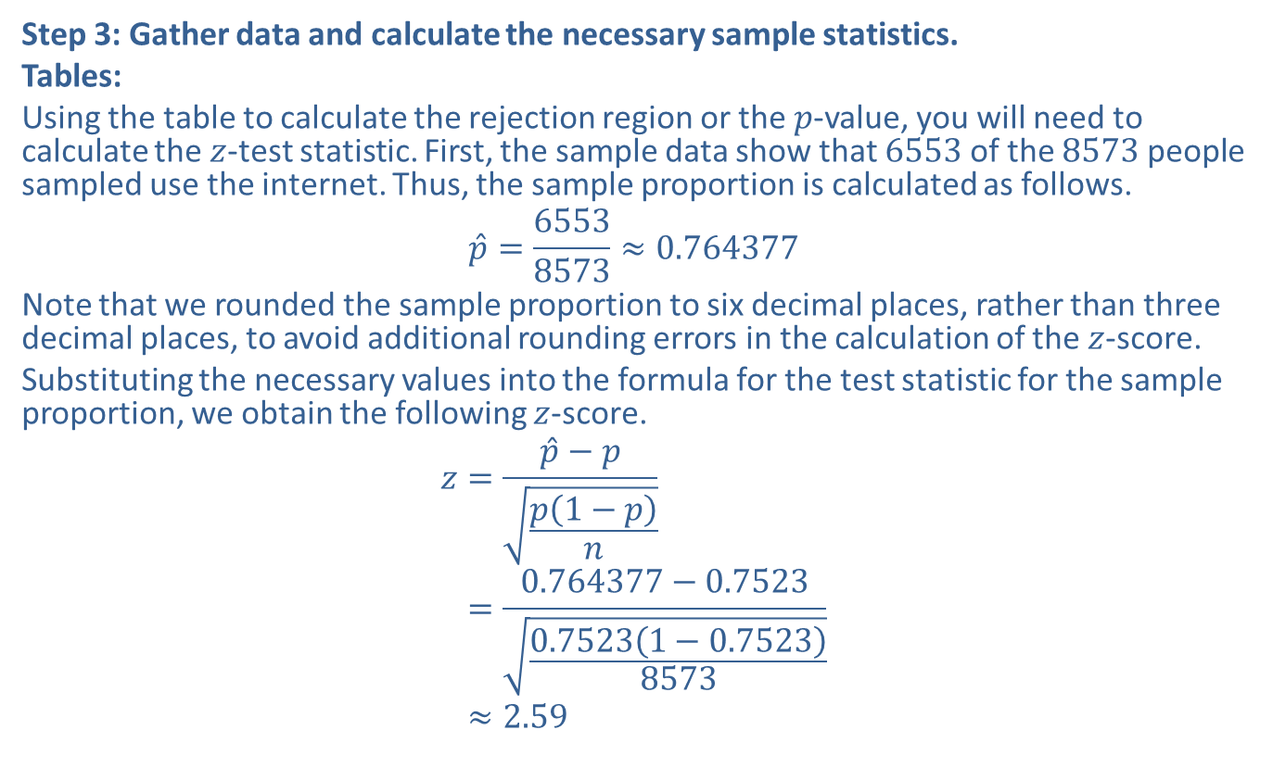
Example 10.4.4: Hypothesis Test for a Population Proportion (Right-Tailed) (cont.)
Step 3: Gather data and calculate the necessary sample statistics.
Tables:
Using the table to calculate the rejection region or the $p$-value, you will need to calculate the $z$-test statistic. First, the sample data show that 6553 of the 8573 people sampled use the internet. Thus, the sample proportion is calculated as follows.
$$\hat{p}=\frac{6553}{8573}≈0.764377$$
Note that we rounded the sample proportion to six decimal places, rather than three decimal places, to avoid additional rounding errors in the calculation of the $z$-score.
Substituting the necessary values into the formula for the test statistic for the sample proportion, we obtain the following $z$-score.
𝑧=𝑝−𝑝𝑝1−𝑝𝑛𝑧=0.764377−0.75230.75231−0.75238573𝑧≈2.59

Slide 40
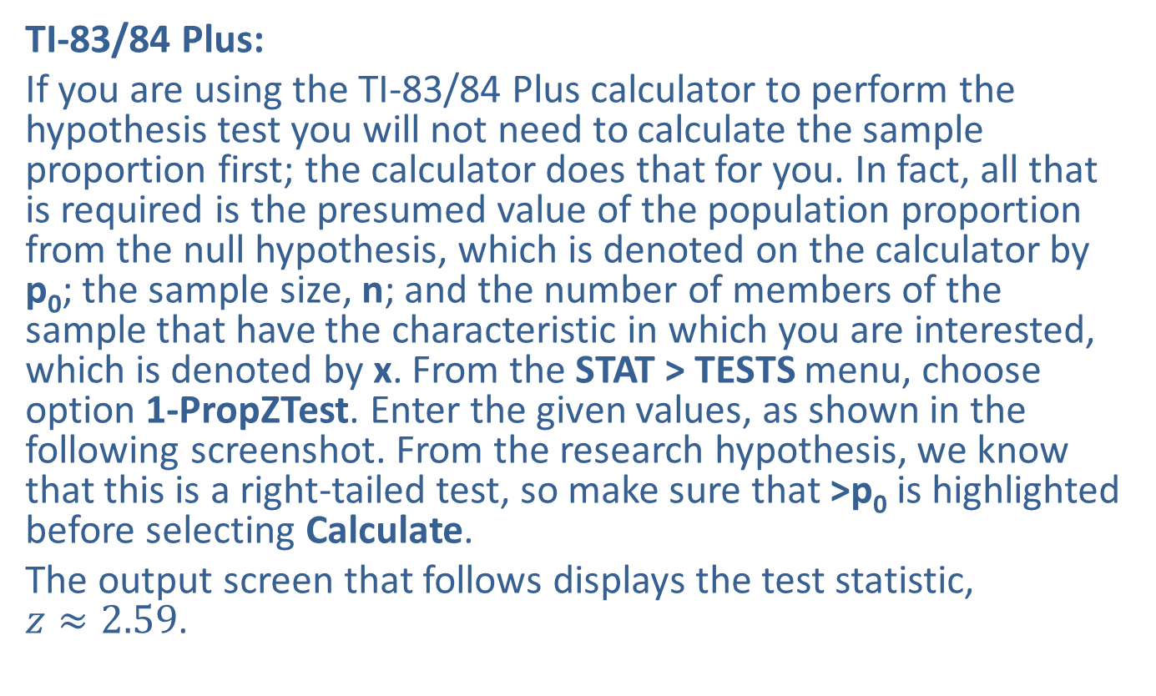
Example 10.4.4: Hypothesis Test for a Population Proportion (Right-Tailed) (cont.)
TI-83/84 Plus:
If you are using the TI-83/84 Plus calculator to perform the hypothesis test you will not need to calculate the sample proportion first; the calculator does that for you. In fact, all that is required is the presumed value of the population proportion from the null hypothesis, which is denoted on the calculator by p₀; the sample size, n; and the number of members of the sample that have the characteristic in which you are interested, which is denoted by x. From the STAT > TESTS menu, choose option 1-PropZTest. Enter the given values, as shown in the following screenshot. From the research hypothesis, we know that this is a right-tailed test, so make sure that >p₀ is highlighted before selecting Calculate.
The output screen that follows displays the test statistic, $z≈2.59$.

Slide 41
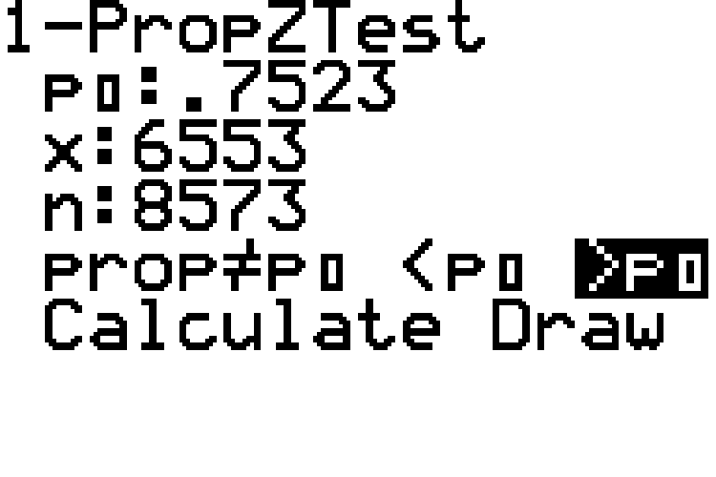
Example 10.4.4: Hypothesis Test for a Population Proportion (Right-Tailed) (cont.)

Slide 42
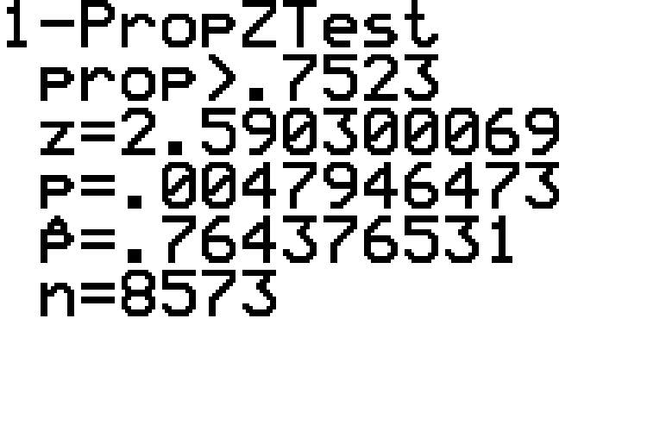
Example 10.4.4: Hypothesis Test for a Population Proportion (Right-Tailed) (cont.)

Slide 43
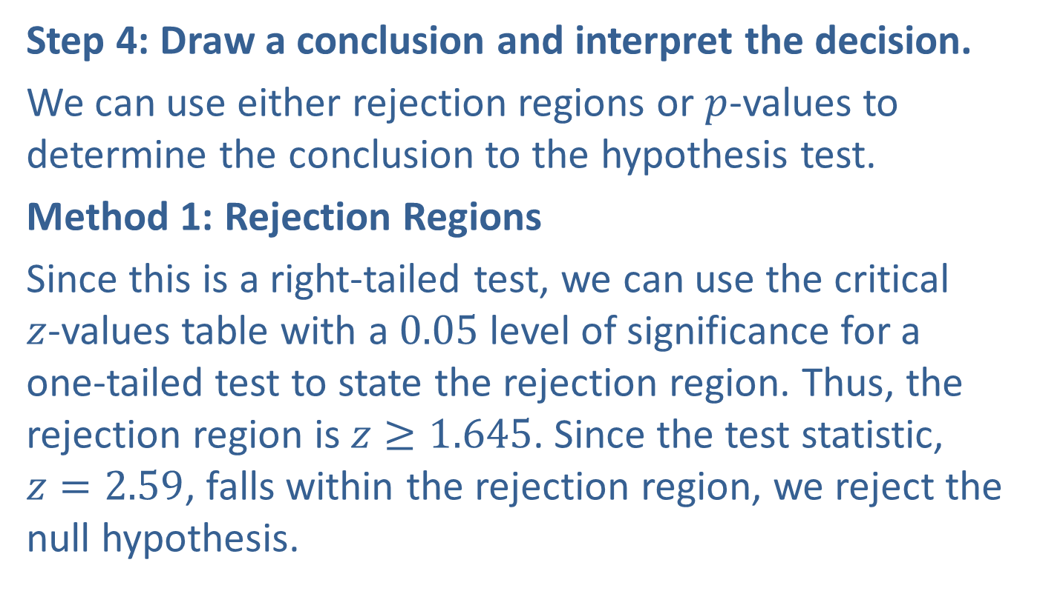
Example 10.4.4: Hypothesis Test for a Population Proportion (Right-Tailed) (cont.)
Step 4: Draw a conclusion and interpret the decision.
We can use either rejection regions or $p$-values to determine the conclusion to the hypothesis test.
Method 1: Rejection Regions
Since this is a right-tailed test, we can use the critical $z$-values table with a 0.05 level of significance for a one-tailed test to state the rejection region. Thus, the rejection region is $z≥1.645$. Since the test statistic, $z=2.59$, falls within the rejection region, we reject the null hypothesis.

Slide 44
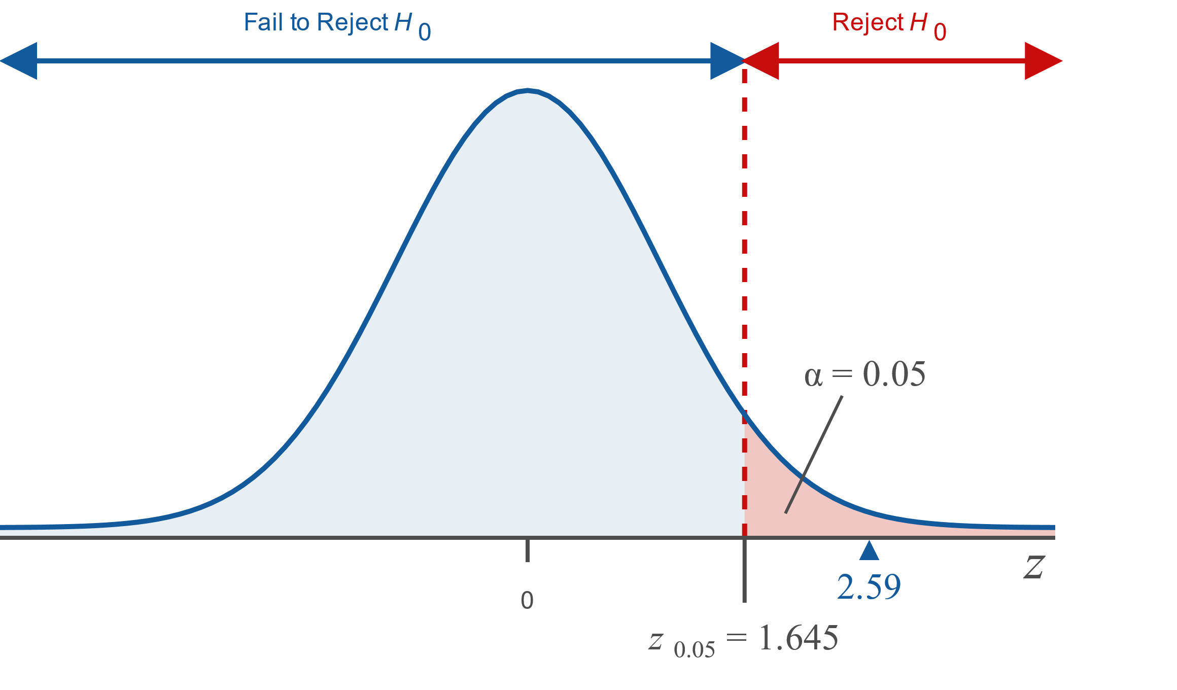
Example 10.4.4: Hypothesis Test for a Population Proportion (Right-Tailed) (cont.)

Slide 45
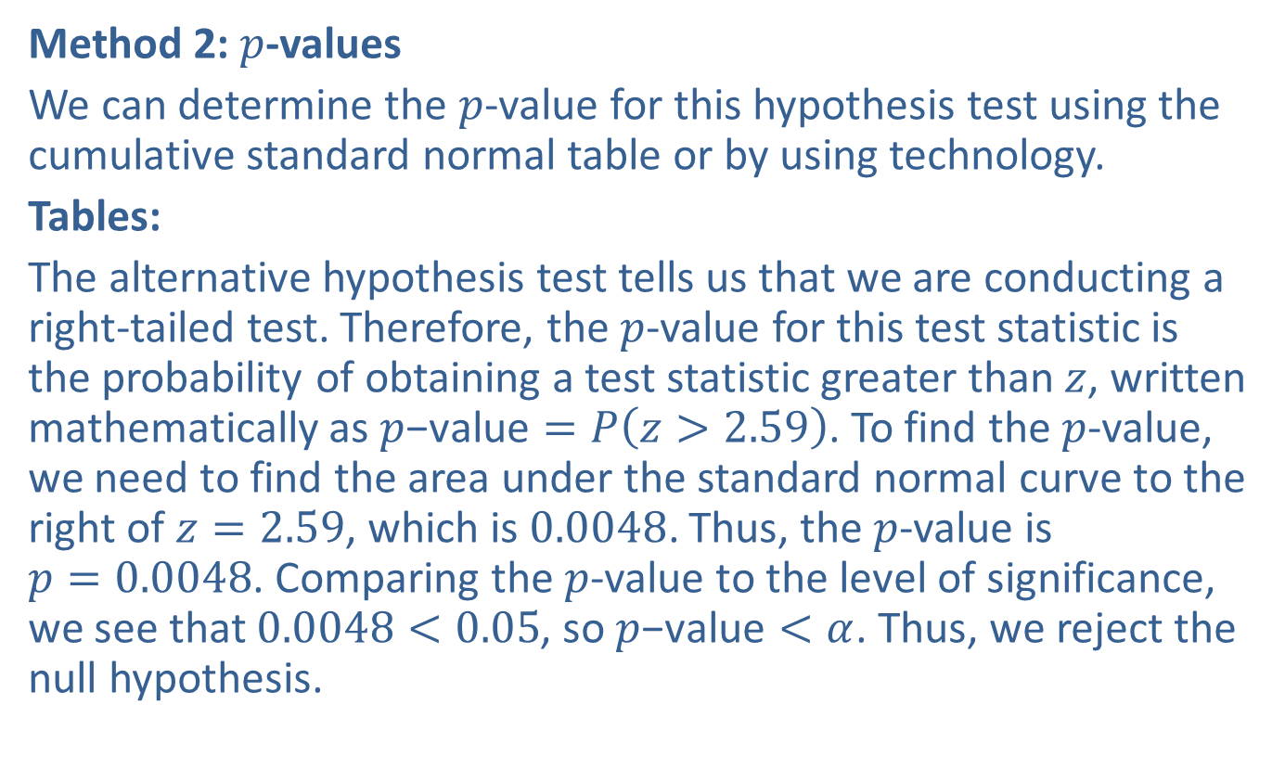
Example 10.4.4: Hypothesis Test for a Population Proportion (Right-Tailed) (cont.)
Method 2: $p$-values
We can determine the $p$-value for this hypothesis test using the cumulative standard normal table or by using technology.
Tables:
The alternative hypothesis test tells us that we are conducting a right-tailed test. Therefore, the $p$-value for this test statistic is the probability of obtaining a test statistic greater than $z$, written mathematically as $p\text{−}\text{value}=P\left(z>2.59\right)$. To find the $p$-value, we need to find the area under the standard normal curve to the right of $z=2.59$, which is 0.0048. Thus, the $p$-value is $p=0.0048$. Comparing the $p$-value to the level of significance, we see that $0.0048<0.05$, so $p\text{−}\text{value}<α$. Thus, we reject the null hypothesis.

Slide 46
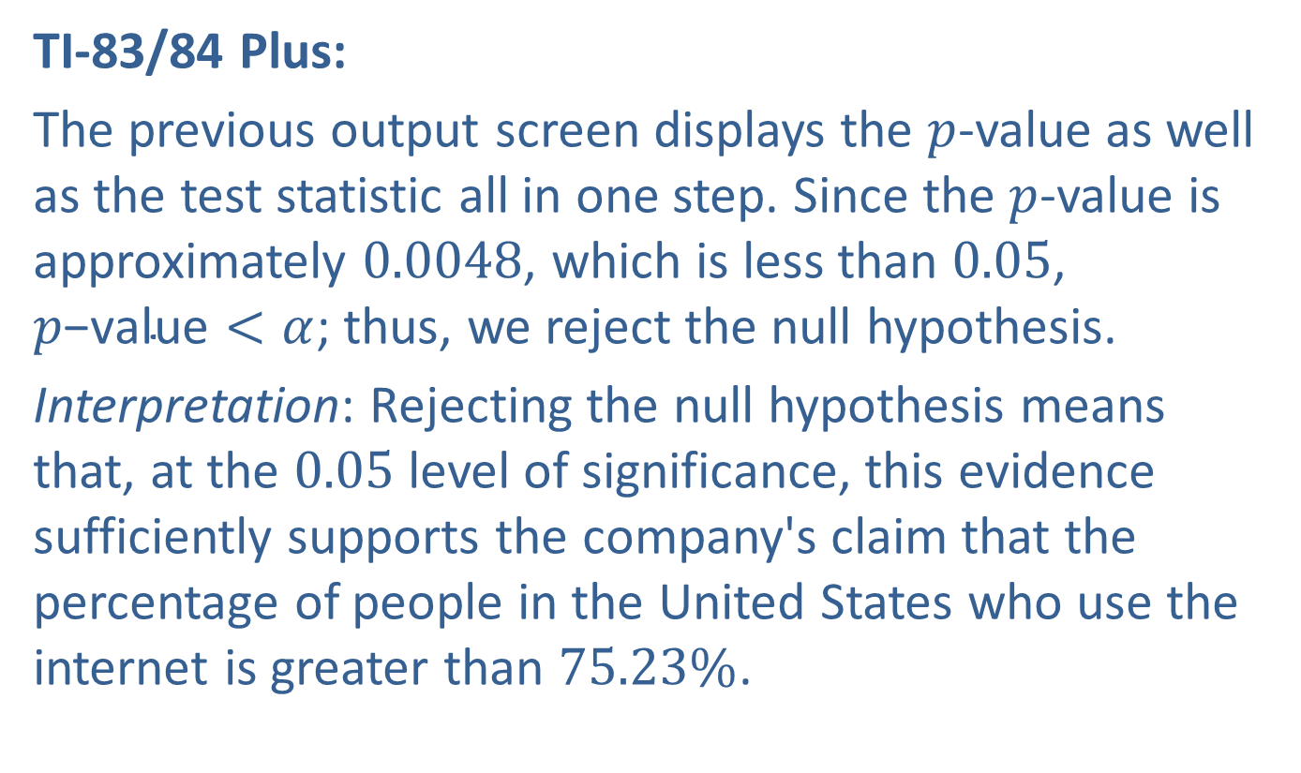
Example 10.4.4: Hypothesis Test for a Population Proportion (Right-Tailed) (cont.)
TI-83/84 Plus:
The previous output screen displays the $p$-value as well as the test statistic all in one step. Since the $p$-value is approximately 0.0048, which is less than 0.05, $p\text{−}\text{value}<α$; thus, we reject the null hypothesis.
Interpretation: Rejecting the null hypothesis means that, at the 0.05 level of significance, this evidence sufficiently supports the company's claim that the percentage of people in the United States who use the internet is greater than $75.23\%$.

