Slide 1
Section 10.5
Hypothesis Testing for Population Variances

Slide 2

Caution
Read each example and exercise carefully. Some describe hypothesis tests for variance, $σ^{2}$, while others involve standard deviation, $σ$.

Slide 3
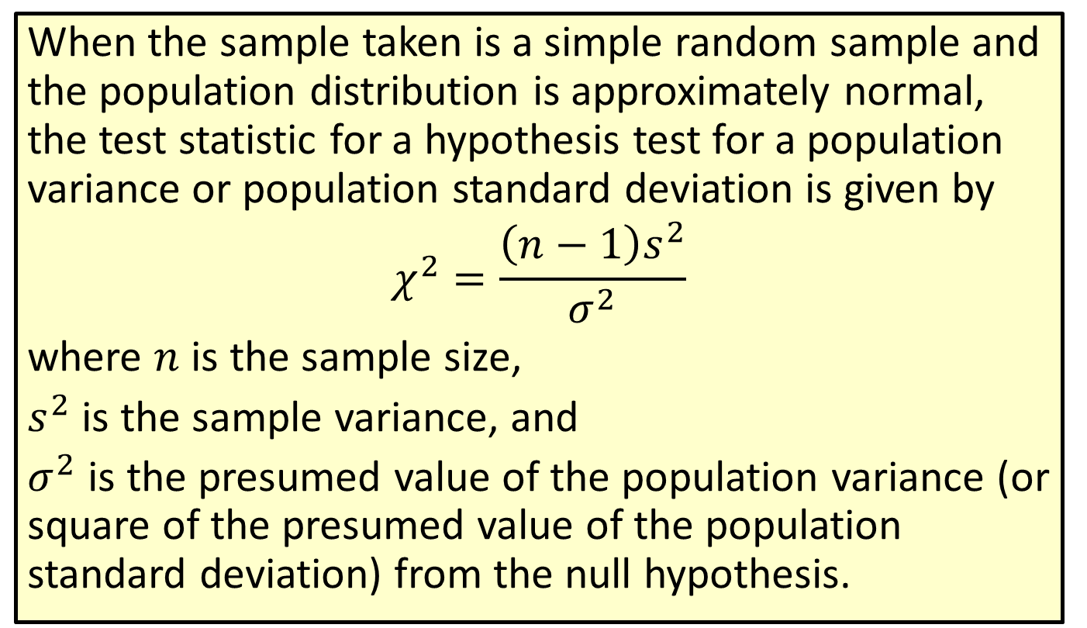
Formula: Test Statistic for a Hypothesis Test for a Population Variance or Population Standard Deviation
When the sample taken is a simple random sample and the population distribution is approximately normal, the test statistic for a hypothesis test for a population variance or population standard deviation is given by
$$χ^{2}=\frac{\left(n−1\right)s^{2}}{σ^{2}}$$
where $n$ is the sample size,
$s^{2}$ is the sample variance, and
$σ^{2}$ is the presumed value of the population variance (or square of the presumed value of the population standard deviation) from the null hypothesis.

Slide 4
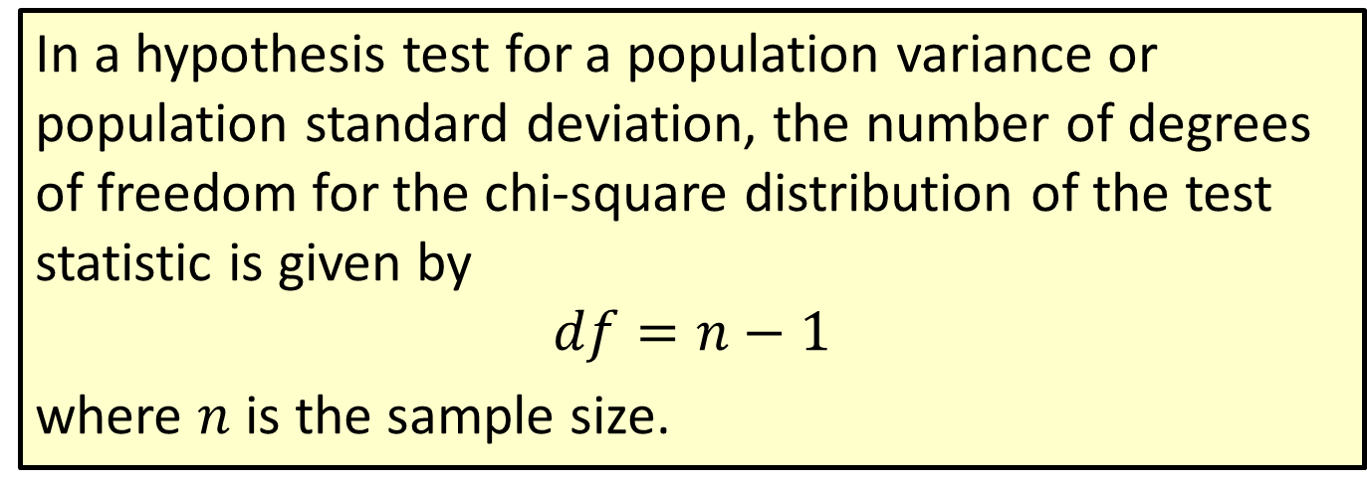
Formula: Degrees of Freedom for a Hypothesis Test for a Population Variance or Population Standard Deviation
In a hypothesis test for a population variance or population standard deviation, the number of degrees of freedom for the chi-square distribution of the test statistic is given by
$$df=n−1$$
where $n$ is the sample size.

Slide 5
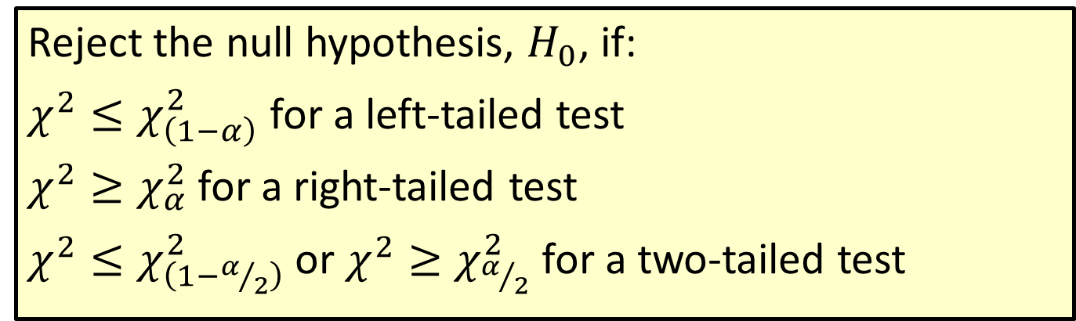
Procedure: Rejection Regions for Hypothesis Tests for Population Variances and Standard Deviations
Reject the null hypothesis, $H_{0}$, if:
$χ^{2}≤χ_{\left(1−α\right)}^{2}$ for a left-tailed test
$χ^{2}≥χ_{α}^{2}$ for a right-tailed test
$χ^{2}≤χ_{\left(1−α/2\right)}^{2}$ or $χ^{2}≥χ_{α/2}^{2}$ for a two-tailed test

Slide 6
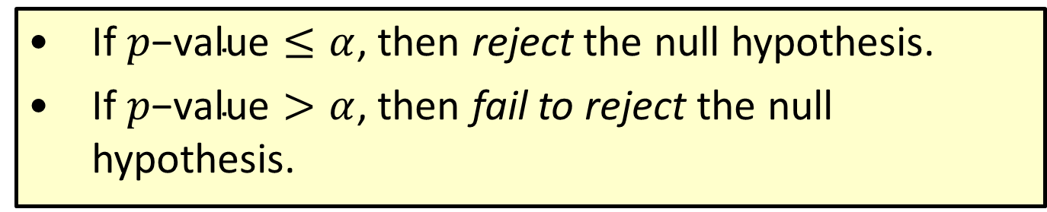

Procedure: Conclusions Using $p$-Values for $χ^{2}$-distribution
​If $p\text{−}\text{value}≤α$, then reject the null hypothesis.
​If $p\text{−}\text{value}>α$, then fail to reject the null hypothesis.

Slide 7
Technology
The p-value for a right-tailed hypothesis test for a population variance can be found at stat.hawkeslearning.com by navigating to Technology Instructions > Chi-Square Distribution > Right Tailed Probability (cdf). Likewise, for a left-tailed test, navigate to Technology Instructions > Chi-Square Distribution > Left Tailed Probability (cdf).

Slide 8
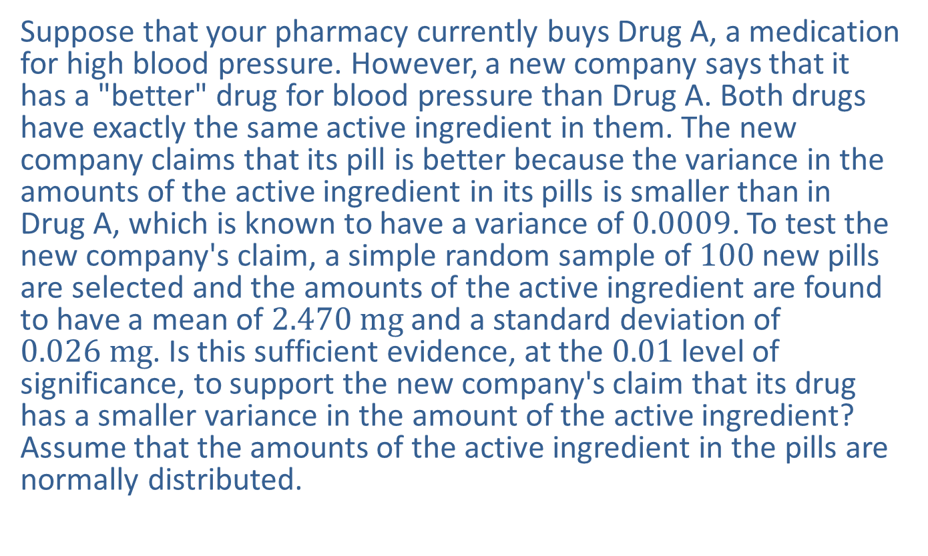
Example 10.5.1: Hypothesis Test for a Population Variance (Left-Tailed)
Suppose that your pharmacy currently buys Drug A, a medication for high blood pressure. However, a new company says that it has a "better" drug for blood pressure than Drug A. Both drugs have exactly the same active ingredient in them. The new company claims that its pill is better because the variance in the amounts of the active ingredient in its pills is smaller than in Drug A, which is known to have a variance of 0.0009. To test the new company's claim, a simple random sample of 100 new pills are selected and the amounts of the active ingredient are found to have a mean of $2.470 mg$ and a standard deviation of $0.026 mg$. Is this sufficient evidence, at the 0.01 level of significance, to support the new company's claim that its drug has a smaller variance in the amount of the active ingredient? Assume that the amounts of the active ingredient in the pills are normally distributed.

Slide 9
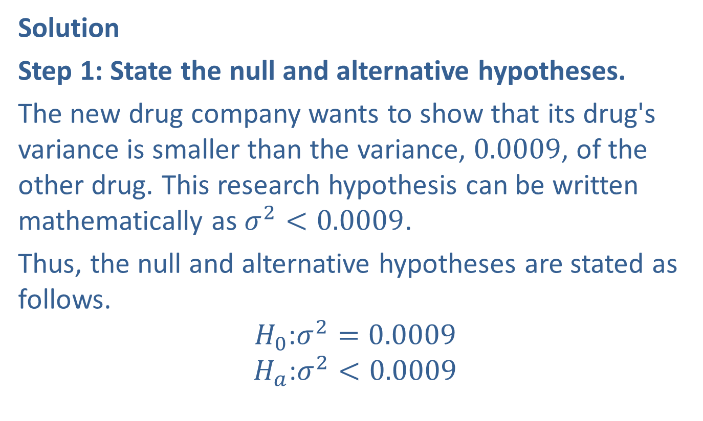
Example 10.5.1: Hypothesis Test for a Population Variance (Left-Tailed) (cont.)
Solution
Step 1: State the null and alternative hypotheses.
The new drug company wants to show that its drug's variance is smaller than the variance, 0.0009, of the other drug. This research hypothesis can be written mathematically as $σ^{2}<0.0009$.
Thus, the null and alternative hypotheses are stated as follows.
$$H_{0}\text{:}σ^{2}=0.0009$$
$$H_{a}\text{:}σ^{2}<0.0009$$

Slide 10
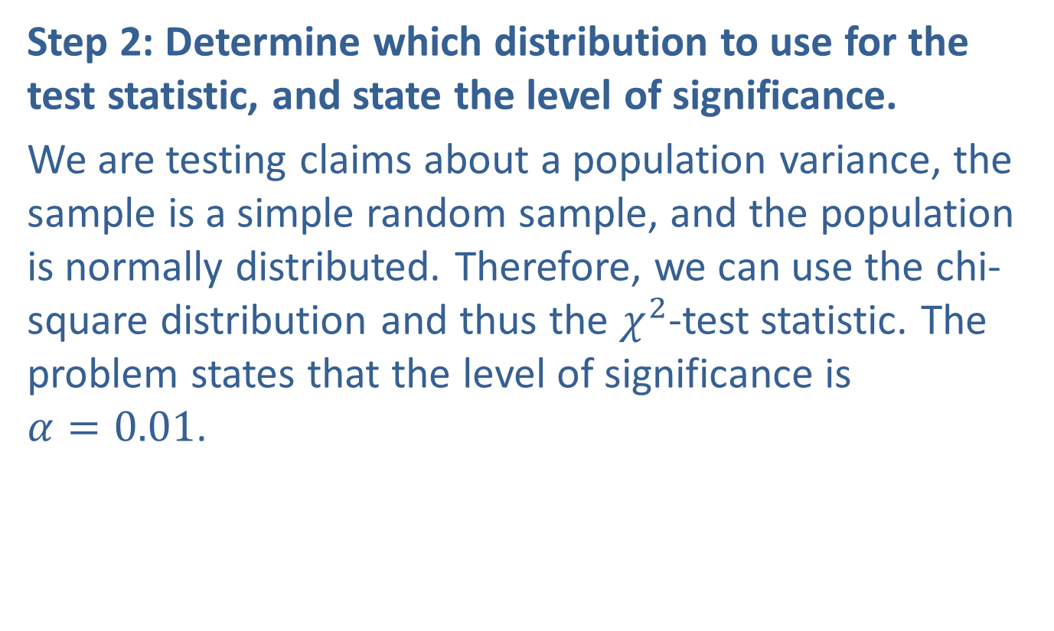
Example 10.5.1: Hypothesis Test for a Population Variance (Left-Tailed) (cont.)
Step 2: Determine which distribution to use for the test statistic, and state the level of significance.
We are testing claims about a population variance, the sample is a simple random sample, and the population is normally distributed. Therefore, we can use the chi-square distribution and thus the $χ^{2}$-test statistic. The problem states that the level of significance is $α=0.01$.

Slide 11
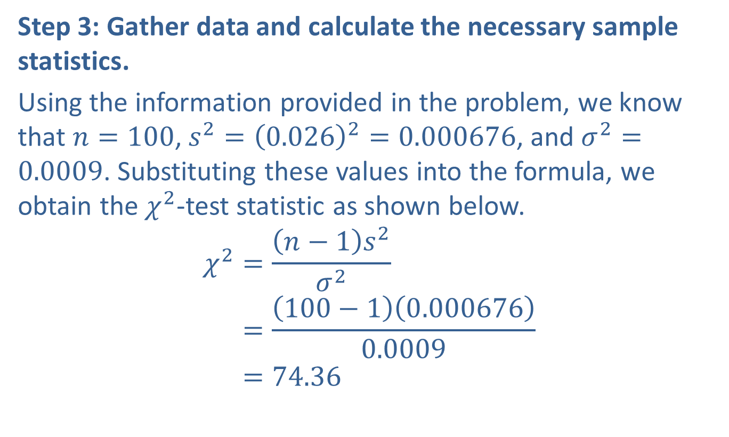
Example 10.5.1: Hypothesis Test for a Population Variance (Left-Tailed) (cont.)
Step 3: Gather data and calculate the necessary sample statistics.
Using the information provided in the problem, we know that $n=100$, $s^{2}={\left(0.026\right)}^{2}=0.000676$, and $σ^{2}=0.0009$. Substituting these values into the formula, we obtain the $χ^{2}$-test statistic as shown below.
𝜒2=𝑛−1𝑠2𝜎2𝜒2=100−10.0006760.0009𝜒2=74.36

Slide 12
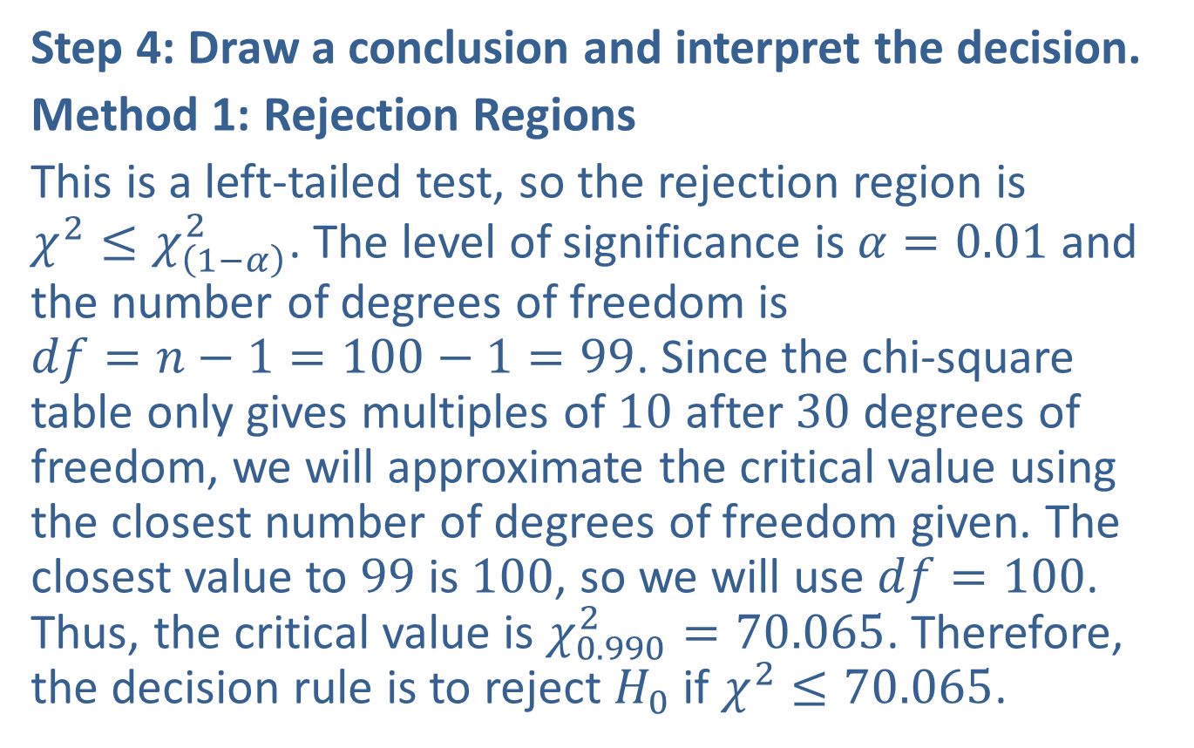
Example 10.5.1: Hypothesis Test for a Population Variance (Left-Tailed) (cont.)
Step 4: Draw a conclusion and interpret the decision.
Method 1: Rejection Regions
This is a left-tailed test, so the rejection region is $χ^{2}≤χ_{\left(1−α\right)}^{2}$. The level of significance is $α=0.01$ and the number of degrees of freedom is $df=n−1=100−1=99$. Since the chi-square table only gives multiples of 10 after 30 degrees of freedom, we will approximate the critical value using the closest number of degrees of freedom given. The closest value to 99 is 100, so we will use $df=100$. Thus, the critical value is $χ_{0.990}^{2}=70.065$. Therefore, the decision rule is to reject $H_{0}$ if $χ^{2}≤70.065$.

Slide 13
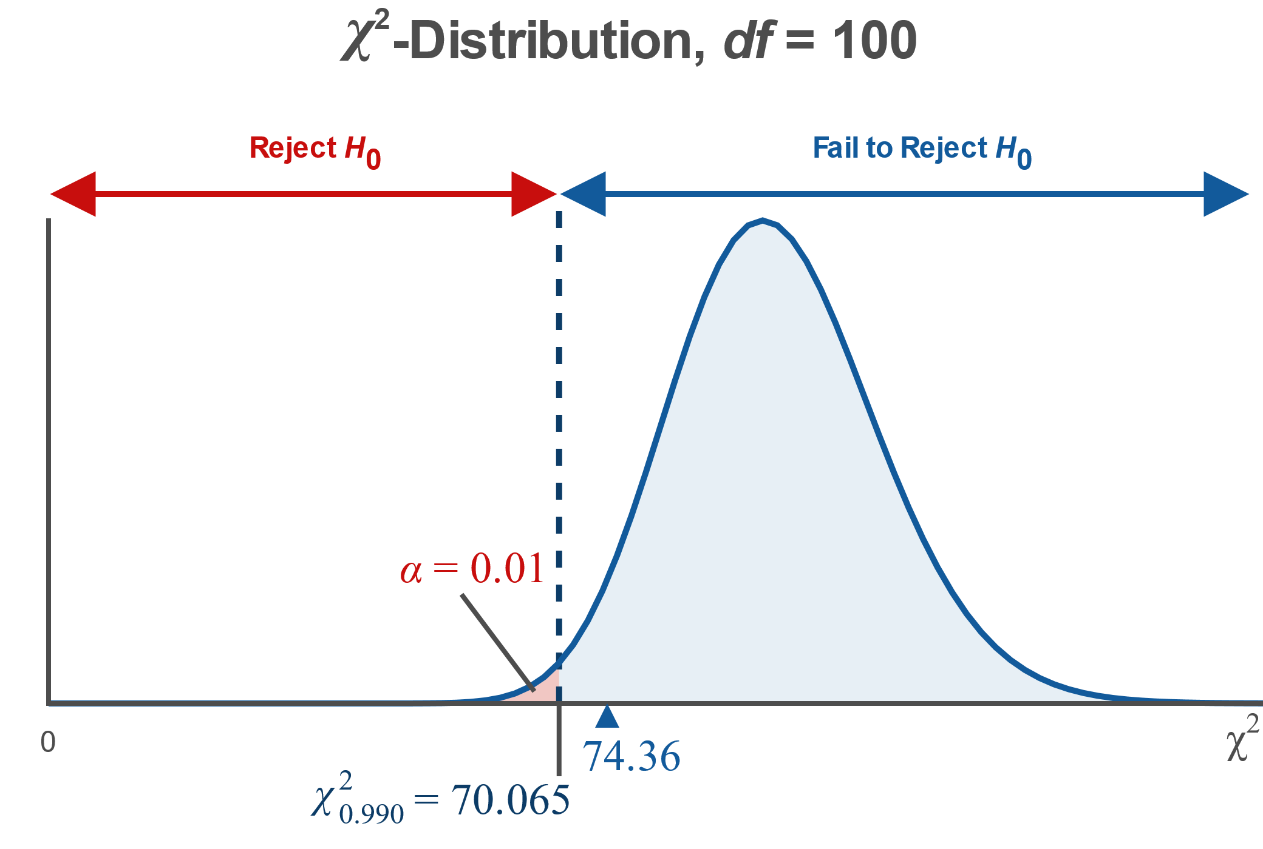
Example 10.5.1: Hypothesis Test for a Population Variance (Left-Tailed) (cont.)

Slide 14
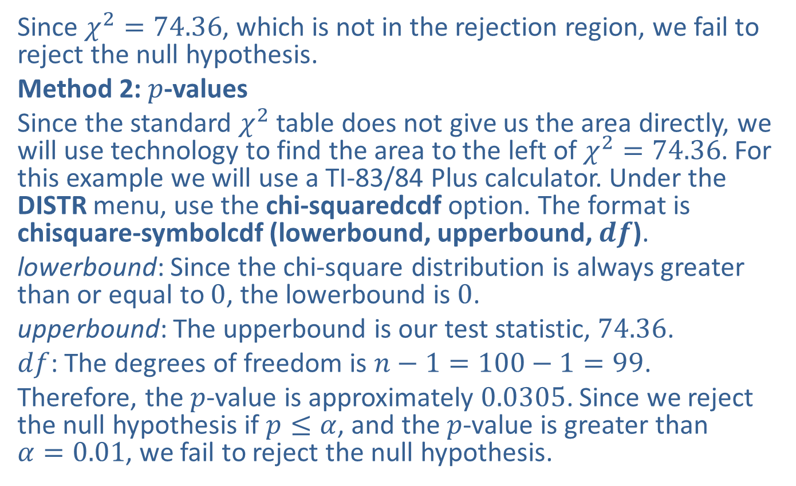
Example 10.5.1: Hypothesis Test for a Population Variance (Left-Tailed) (cont.)
Since $χ^{2}=74.36$, which is not in the rejection region, we fail to reject the null hypothesis.
Method 2: $p$-values
Since the standard $χ^{2}$ table does not give us the area directly, we will use technology to find the area to the left of $χ^{2}=74.36$. For this example we will use a TI-83/84 Plus calculator. Under the DISTR menu, use the chi-squaredcdf option. The format is chisquare-symbolcdf (lowerbound, upperbound, $df$).
lowerbound: Since the chi-square distribution is always greater than or equal to 0, the lowerbound is 0.
upperbound: The upperbound is our test statistic, 74.36.
$df$: The degrees of freedom is $n−1=100−1=99$.
Therefore, the $p$-value is approximately 0.0305. Since we reject the null hypothesis if $p≤α$, and the $p$-value is greater than $α=0.01$, we fail to reject the null hypothesis.

Slide 15
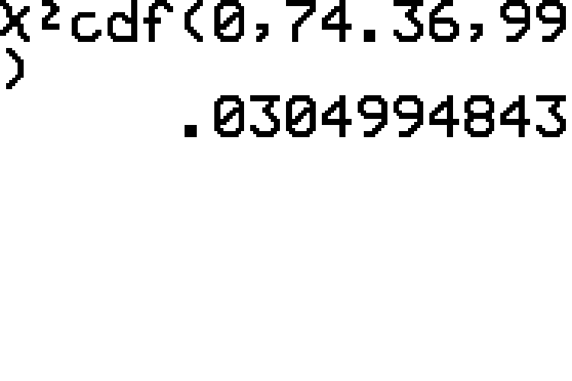
Example 10.5.1: Hypothesis Test for a Population Variance (Left-Tailed) (cont.)

Slide 16
Example 10.5.1: Hypothesis Test for a Population Variance (Left-Tailed) (cont.)
Interpretation: Failing to reject the null hypothesis means that there is not sufficient evidence at the 0.01 level of significance to support the new drug company's claim that the variance in the amount of the active ingredient in its drug is less than 0.0009.

Slide 17
Example 10.5.2: Hypothesis Test for a Population Standard Deviation (Right-Tailed)
A manufacturer of golf balls requires that the weights of its golf balls have a standard deviation that does not exceed 0.08 ounces. One of the quality control inspectors says that the machines need to be recalibrated because he believes the standard deviation of the weights of the golf balls is more than 0.08 ounces. To test the machines, he selects a simple random sample of 30 golf balls off the assembly line and finds that they have a mean weight of 1.6200 ounces and a standard deviation of 0.0804 ounces. Does this evidence support the need to recalibrate the machines, at the 0.05 level of significance? Assume that the weights of the golf balls are normally distributed.

Slide 18
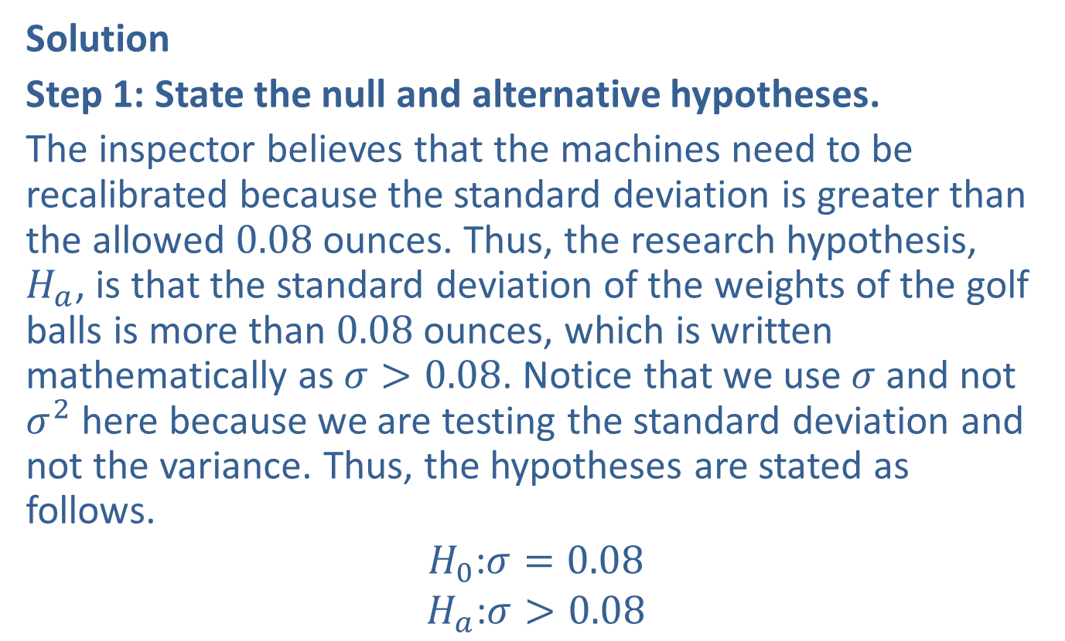
Example 10.5.2: Hypothesis Test for a Population Standard Deviation (Right-Tailed) (cont.)
Solution
Step 1: State the null and alternative hypotheses.
The inspector believes that the machines need to be recalibrated because the standard deviation is greater than the allowed 0.08 ounces. Thus, the research hypothesis, $H_{a}$, is that the standard deviation of the weights of the golf balls is more than 0.08 ounces, which is written mathematically as $σ>0.08$. Notice that we use $σ$ and not $σ^{2}$ here because we are testing the standard deviation and not the variance. Thus, the hypotheses are stated as follows.
$$H_{0}\text{:}σ=0.08$$
$$H_{a}\text{:}σ>0.08$$

Slide 19
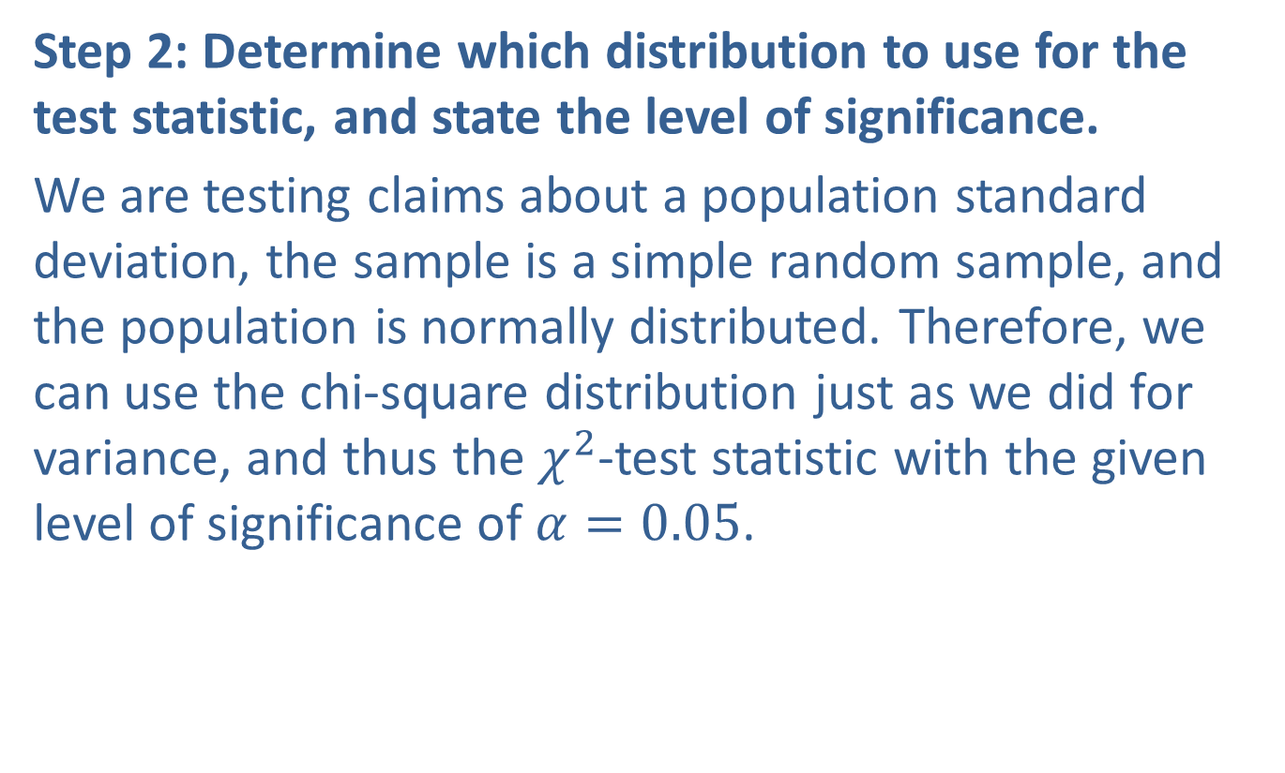
Example 10.5.2: Hypothesis Test for a Population Standard Deviation (Right-Tailed) (cont.)
Step 2: Determine which distribution to use for the test statistic, and state the level of significance.
We are testing claims about a population standard deviation, the sample is a simple random sample, and the population is normally distributed. Therefore, we can use the chi-square distribution just as we did for variance, and thus the $χ^{2}$-test statistic with the given level of significance of $α=0.05$.

Slide 20
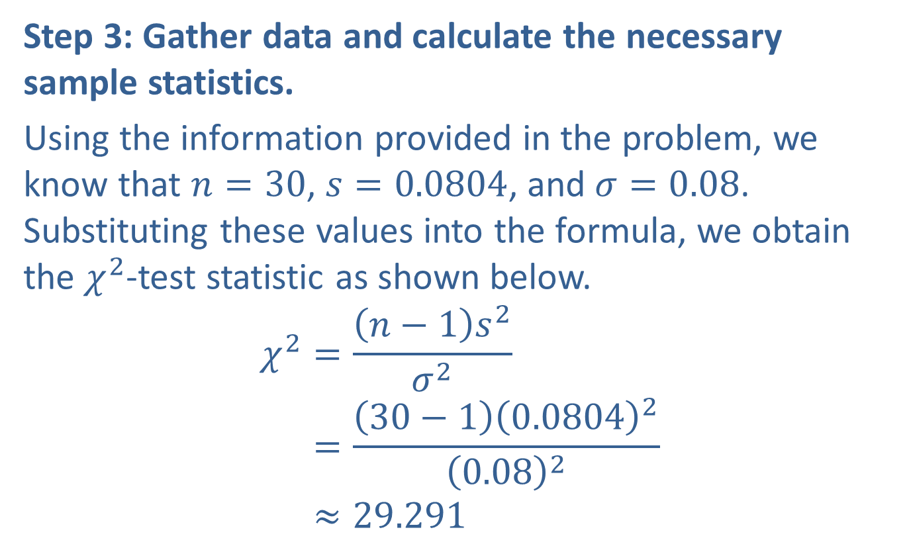
Example 10.5.2: Hypothesis Test for a Population Standard Deviation (Right-Tailed) (cont.)
Step 3: Gather data and calculate the necessary sample statistics.
Using the information provided in the problem, we know that $n=30$, $s=0.0804$, and $σ=0.08$. Substituting these values into the formula, we obtain the $χ^{2}$-test statistic as shown below.
𝜒2=𝑛−1𝑠2𝜎2𝜒2=30−10.080420.082𝜒2≈29.291

Slide 21
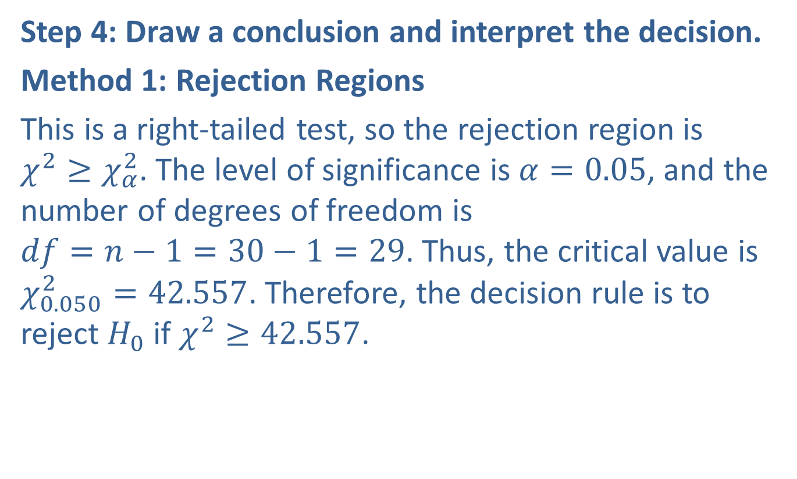
Example 10.5.2: Hypothesis Test for a Population Standard Deviation (Right-Tailed) (cont.)
Step 4: Draw a conclusion and interpret the decision.
Method 1: Rejection Regions
This is a right-tailed test, so the rejection region is $χ^{2}≥χ_{α}^{2}$. The level of significance is $α=0.05$, and the number of degrees of freedom is $df=n−1=30−1=29$. Thus, the critical value is $χ_{0.050}^{2}=42.557$. Therefore, the decision rule is to reject $H_{0}$ if $χ^{2}≥42.557$.

Slide 22
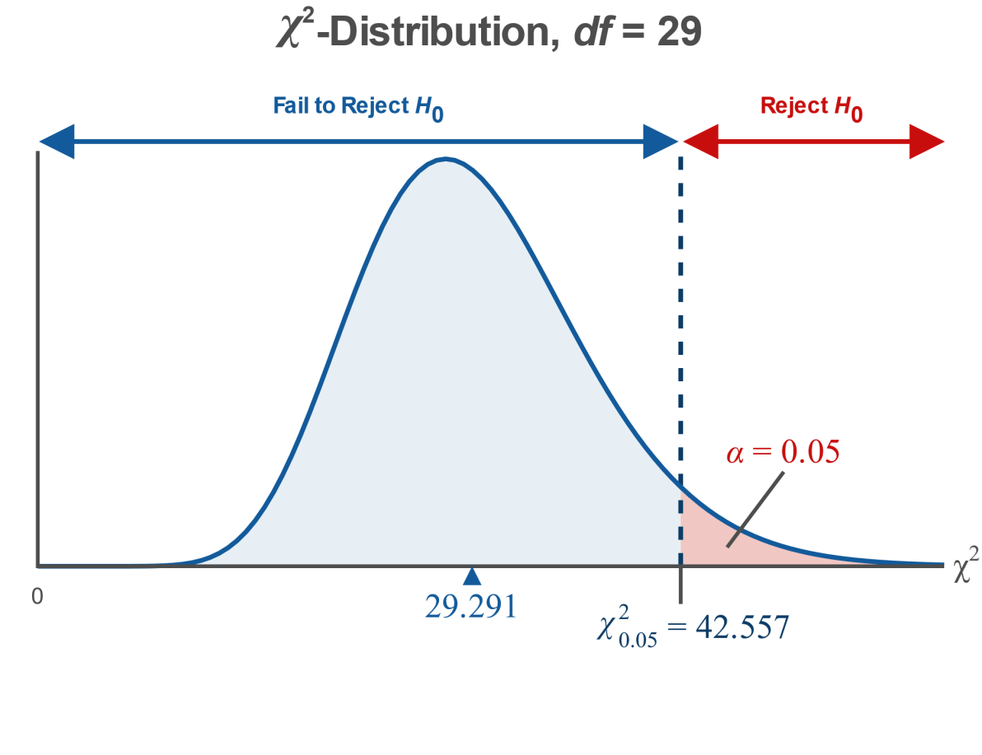
Example 10.5.2: Hypothesis Test for a Population Standard Deviation (Right-Tailed) (cont.)

Slide 23
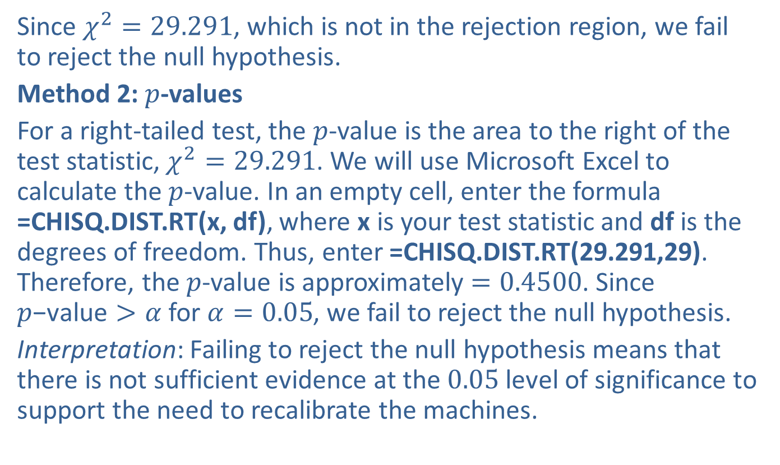
Example 10.5.2: Hypothesis Test for a Population Standard Deviation (Right-Tailed) (cont.)
Since $χ^{2}=29.291$, which is not in the rejection region, we fail to reject the null hypothesis.
Method 2: $p$-values
For a right-tailed test, the $p$-value is the area to the right of the test statistic, $χ^{2}=29.291$. We will use Microsoft Excel to calculate the $p$-value. In an empty cell, enter the formula =CHISQ.DIST.RT(x, df), where x is your test statistic and df is the degrees of freedom. Thus, enter =CHISQ.DIST.RT(29.291,29). Therefore, the $p$-value is approximately $=0.4500$. Since $p\text{−}\text{value}>α$ for $α=0.05$, we fail to reject the null hypothesis.
Interpretation: Failing to reject the null hypothesis means that there is not sufficient evidence at the 0.05 level of significance to support the need to recalibrate the machines.

Slide 24
Example 10.5.3: Hypothesis Test for a Population Variance (Two-Tailed)
A tree farmer would like to know how much variance there is in the heights of two-year-old trees on the farm. It is generally accepted by botanists that after two years of growth, the heights of this variety of tree, measured in feet, should have a variance of 16. The farmer claims that after two years of growth, the variance in the heights of the trees is not 16. A simple random sample of 40 two-year-old trees on the farm finds that their heights have a standard deviation of 3.2 feet. Does this evidence, at the 0.10 level of significance, support the farmer's claim? Assume that the heights of the trees are normally distributed.

Slide 25
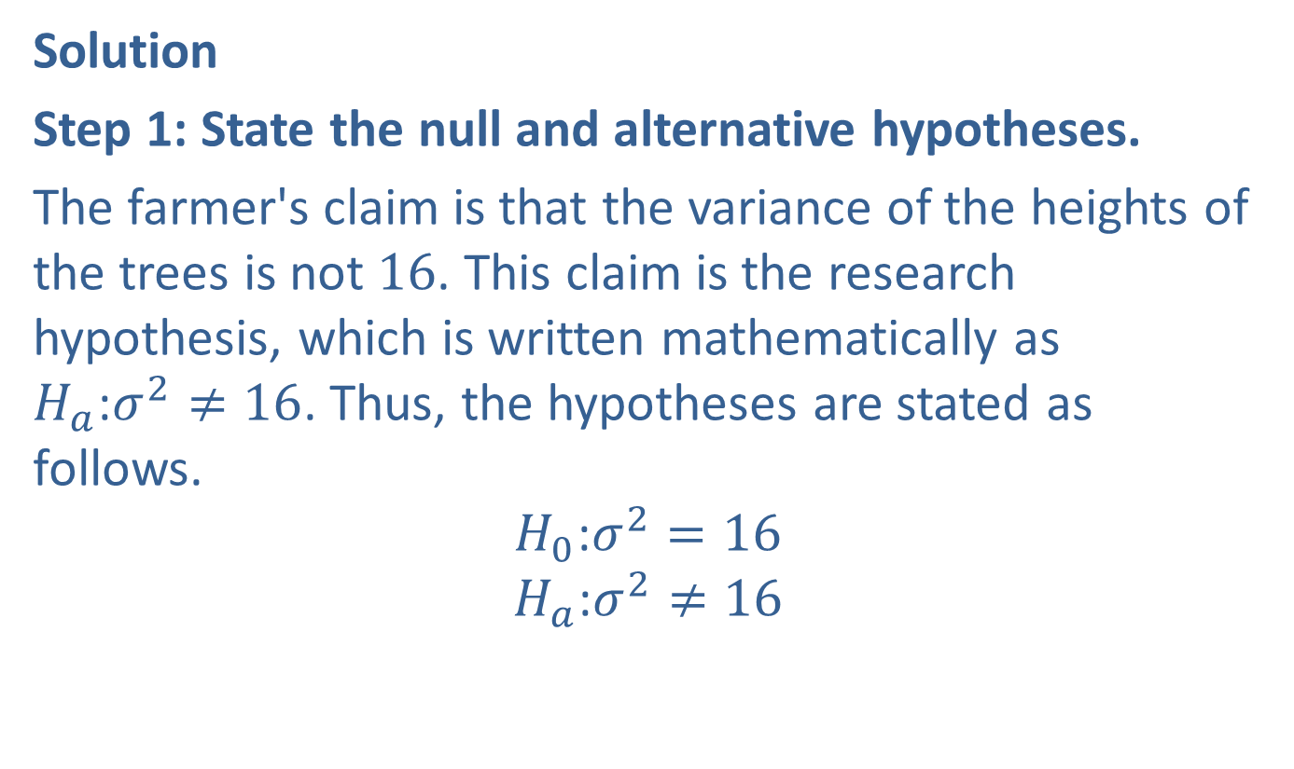
Example 10.5.3: Hypothesis Test for a Population Variance (Two-Tailed) (cont.)
Solution
Step 1: State the null and alternative hypotheses.
The farmer's claim is that the variance of the heights of the trees is not 16. This claim is the research hypothesis, which is written mathematically as $H_{a}\text{:}σ^{2}≠16$. Thus, the hypotheses are stated as follows.
$$H_{0}\text{:}σ^{2}=16$$
$$H_{a}\text{:}σ^{2}≠16$$

Slide 26
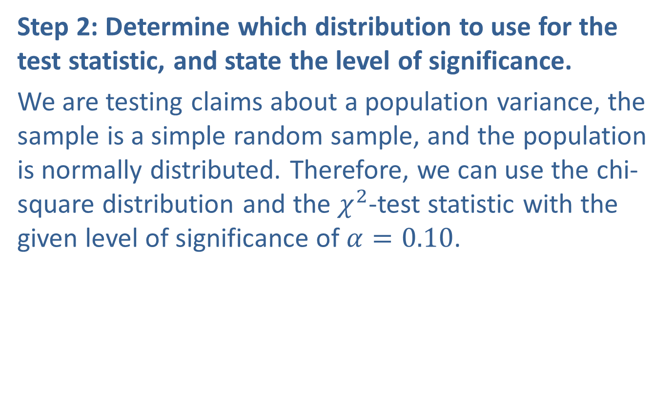
Example 10.5.3: Hypothesis Test for a Population Variance (Two-Tailed) (cont.)
Step 2: Determine which distribution to use for the test statistic, and state the level of significance.
We are testing claims about a population variance, the sample is a simple random sample, and the population is normally distributed. Therefore, we can use the chi-square distribution and the $χ^{2}$-test statistic with the given level of significance of $α=0.10$.

Slide 27
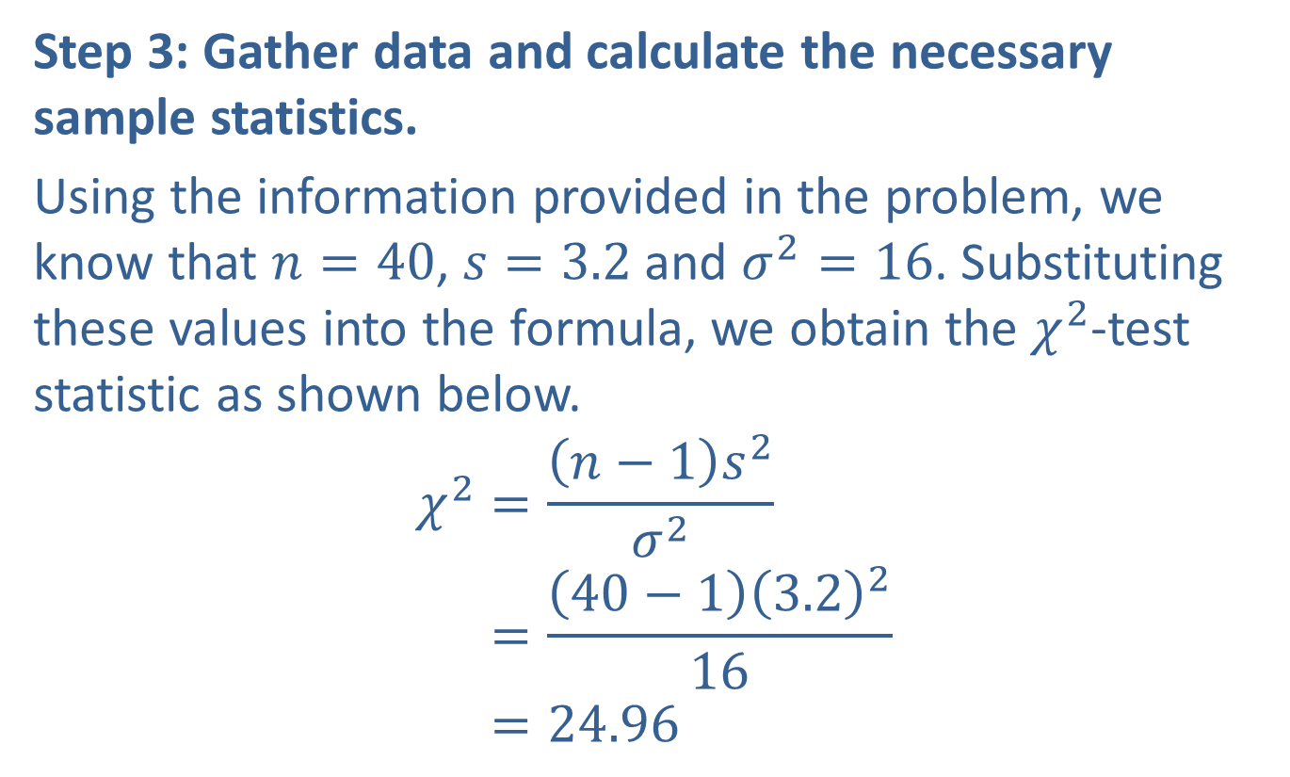
Example 10.5.3: Hypothesis Test for a Population Variance (Two-Tailed) (cont.)
Step 3: Gather data and calculate the necessary sample statistics.
Using the information provided in the problem, we know that $n=40$, $s=3.2$ and $σ^{2}=16$. Substituting these values into the formula, we obtain the $χ^{2}$-test statistic as shown below.
𝜒2=𝑛−1𝑠2𝜎2𝜒2=40−13.2216𝜒2=24.96

Slide 28
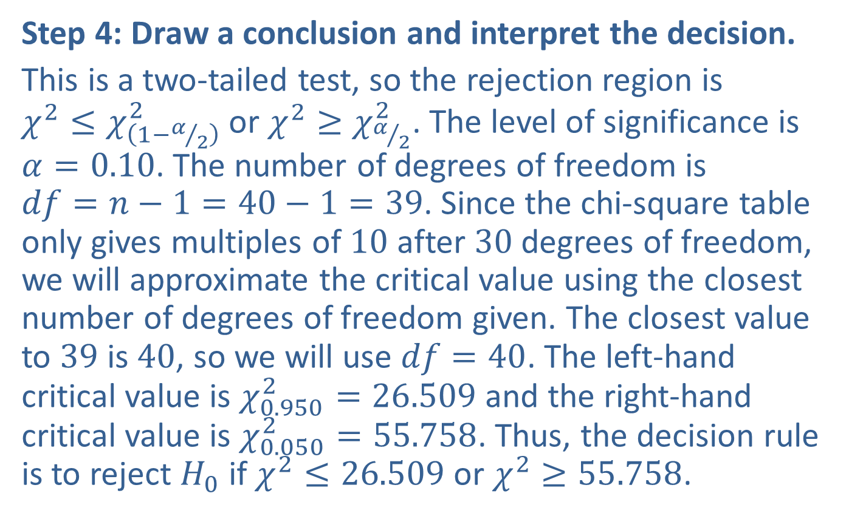
Example 10.5.3: Hypothesis Test for a Population Variance (Two-Tailed) (cont.)
Step 4: Draw a conclusion and interpret the decision.
This is a two-tailed test, so the rejection region is $χ^{2}≤χ_{\left(1−α/2\right)}^{2}$ or $χ^{2}≥χ_{α/2}^{2}$. The level of significance is $α=0.10$. The number of degrees of freedom is $df=n−1=40−1=39$. Since the chi-square table only gives multiples of 10 after 30 degrees of freedom, we will approximate the critical value using the closest number of degrees of freedom given. The closest value to 39 is 40, so we will use $df=40$. The left-hand critical value is $χ_{0.950}^{2}=26.509$ and the right-hand critical value is $χ_{0.050}^{2}=55.758$. Thus, the decision rule is to reject $H_{0}$ if $χ^{2}≤26.509$ or $χ^{2}≥55.758$.

Slide 29
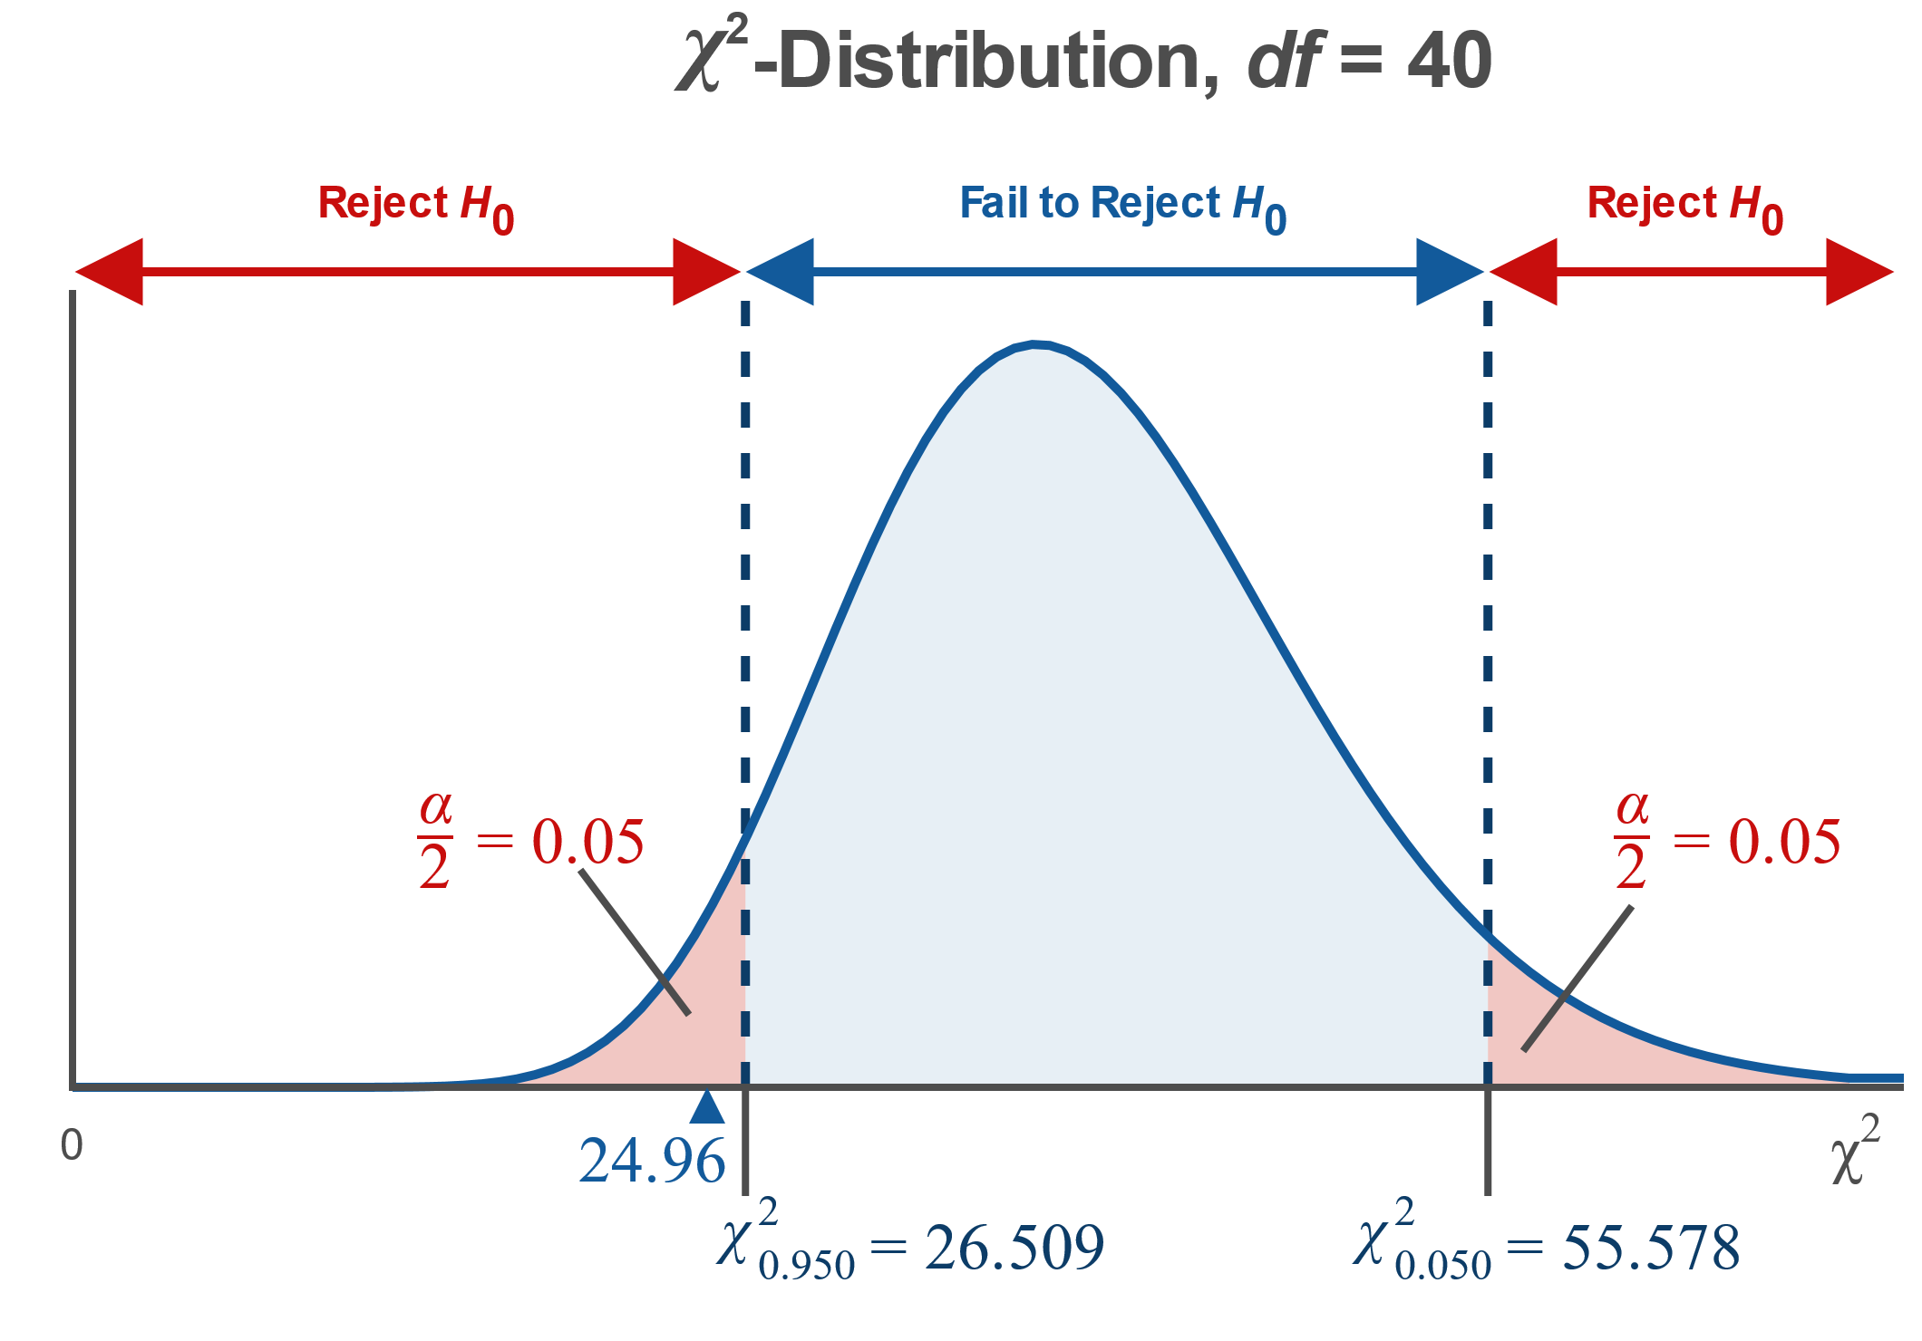
Example 10.5.3: Hypothesis Test for a Population Variance (Two-Tailed) (cont.)

Slide 30
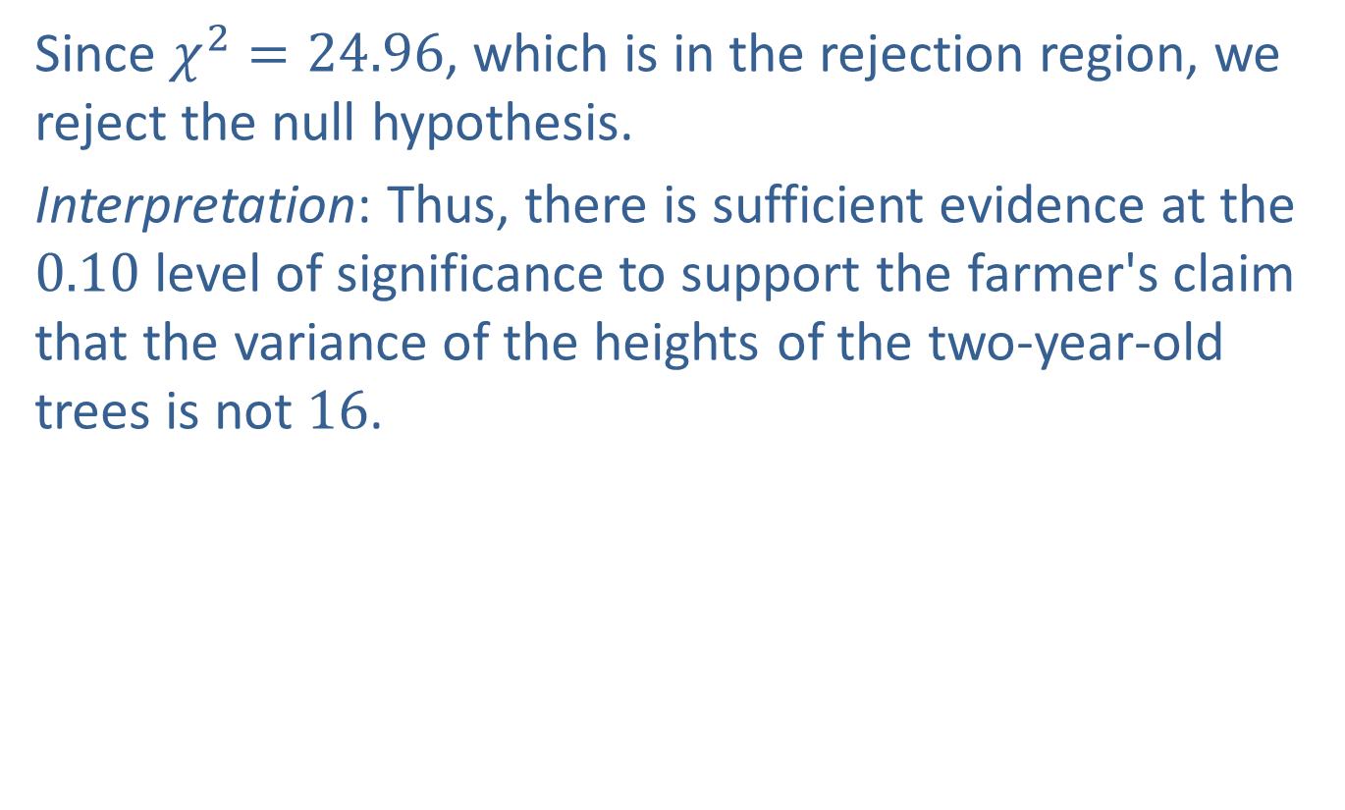
Example 10.5.3: Hypothesis Test for a Population Variance (Two-Tailed) (cont.)
Since $χ^{2}=24.96$, which is in the rejection region, we reject the null hypothesis.
Interpretation: Thus, there is sufficient evidence at the 0.10 level of significance to support the farmer's claim that the variance of the heights of the two-year-old trees is not 16.

