Slide 1
Section 10.6
Chi-Square Test for Goodness of Fit

Slide 2
Multinomial Experiment
Definition
A multinomial experiment is a probability experiment consisting of a fixed number of identical independent trials. The outcome of each trial can be classified into exactly one of several different categories where the probabilities of each category remain constant for each trial.

Slide 3
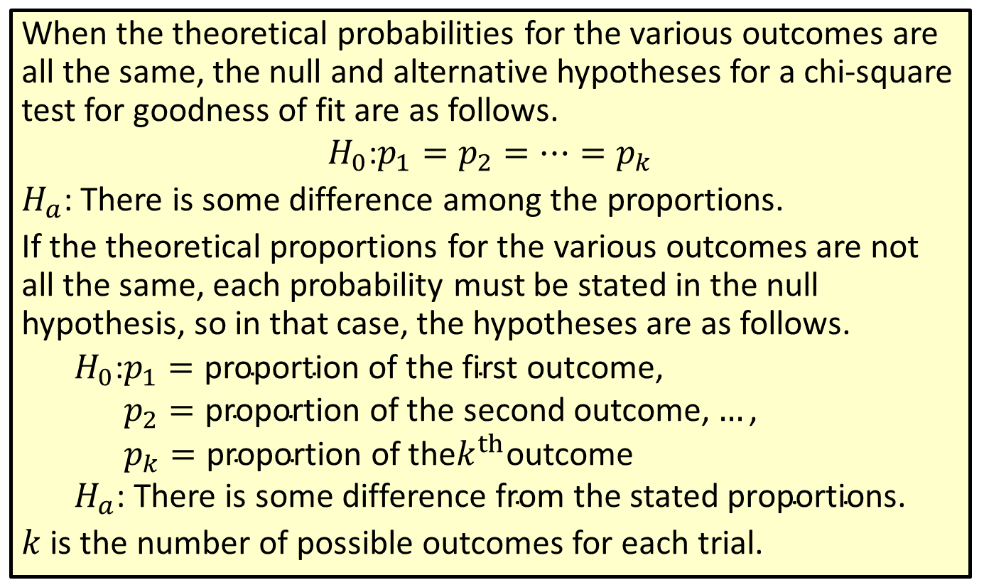
Procedure: Null and Alternative Hypotheses for a Chi-Square Test for Goodness of Fit
When the theoretical probabilities for the various outcomes are all the same, the null and alternative hypotheses for a chi-square test for goodness of fit are as follows.
$$H_{0}\text{:}p_{1}=p_{2}=…=p_{k}$$
$H_{a}$: There is some difference among the proportions.
If the theoretical proportions for the various outcomes are not all the same, each probability must be stated in the null hypothesis, so in that case, the hypotheses are as follows.
𝐻0:𝑝1=proportion of the first outcome,𝐻0:𝑝2=proportion of the second outcome,…,𝐻0:𝑝𝑘=proportion of the𝑘thoutcome𝐻𝑎: There is some difference from the stated proportions.
$k$ is the number of possible outcomes for each trial.

Slide 4
Memory Booster
$$E_{i}=np_{i}$$

Slide 5
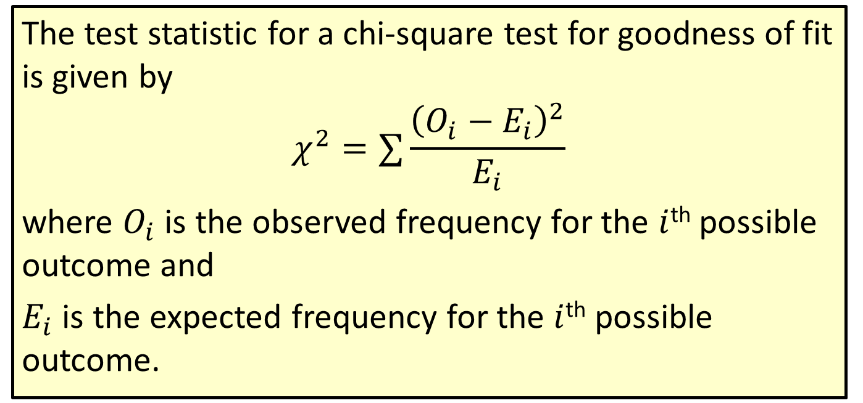
Formula: Test Statistic for a Chi-Square Test for Goodness of Fit
The test statistic for a chi-square test for goodness of fit is given by
$$χ^{2}=∑\frac{{\left(O_{i}−E_{i}\right)}^{2}}{E_{i}}$$
where $O_{i}$ is the observed frequency for the $i$^{th} possible outcome and
$E_{i}$ is the expected frequency for the $i$^{th} possible outcome.

Slide 6
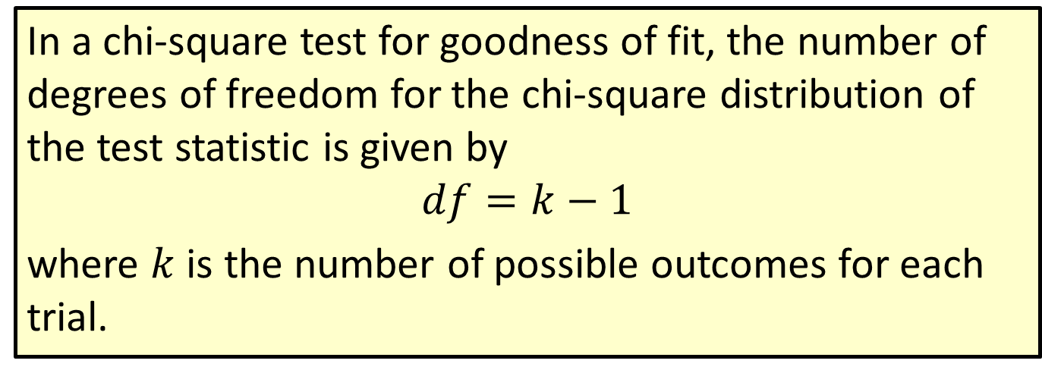
Formula: Degrees of Freedom in a Chi-Square Test for Goodness of Fit
In a chi-square test for goodness of fit, the number of degrees of freedom for the chi-square distribution of the test statistic is given by
$$df=k−1$$
where $k$ is the number of possible outcomes for each trial.

Slide 7
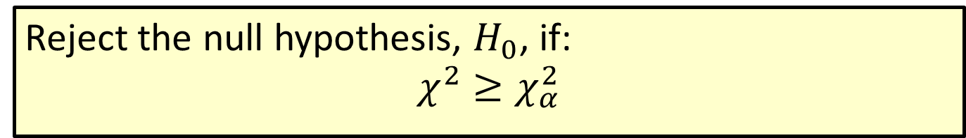
Procedure: Rejection Region for a Chi-Square Test for Goodness of Fit
Reject the null hypothesis, $H_{0}$, if:
$$χ^{2}≥χ_{α}^{2}$$

Slide 8
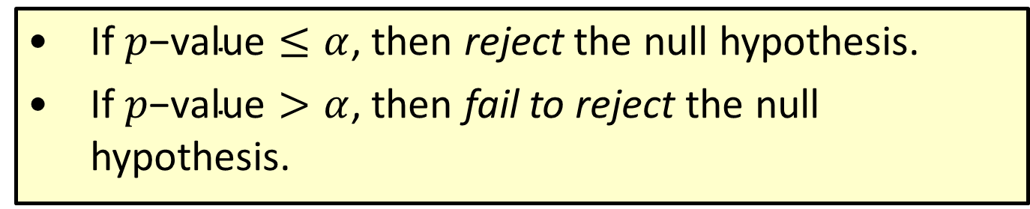

Procedure: Conclusions Using $p$-Values
​If $p\text{−}\text{value}≤α$, then reject the null hypothesis.
​If $p\text{−}\text{value}>α$, then fail to reject the null hypothesis.

Slide 9
Example 10.6.1: Chi-Square Test for Goodness of Fit
A local bank wants to evaluate the usage of its ATM. Currently, the bank manager assumes that the ATM is used consistently throughout the week, including weekends. She decides to use statistical inference with a 0.10 level of significance to test a customer's claim that the ATM is much busier on some days of the week than it is on other days. During a randomly selected week, the bank recorded the number of times the ATM was used on each day. The results are listed in the following table.

Slide 10
Example 10.6.1: Chi-Square Test for Goodness of Fit (cont.)
ATM Usage
Day of the Week | Number of Times Used
Monday | 38
Tuesday | 33
Wednesday | 41
Thursday | 25
Friday | 22
Saturday | 38
Sunday | 45

Slide 11
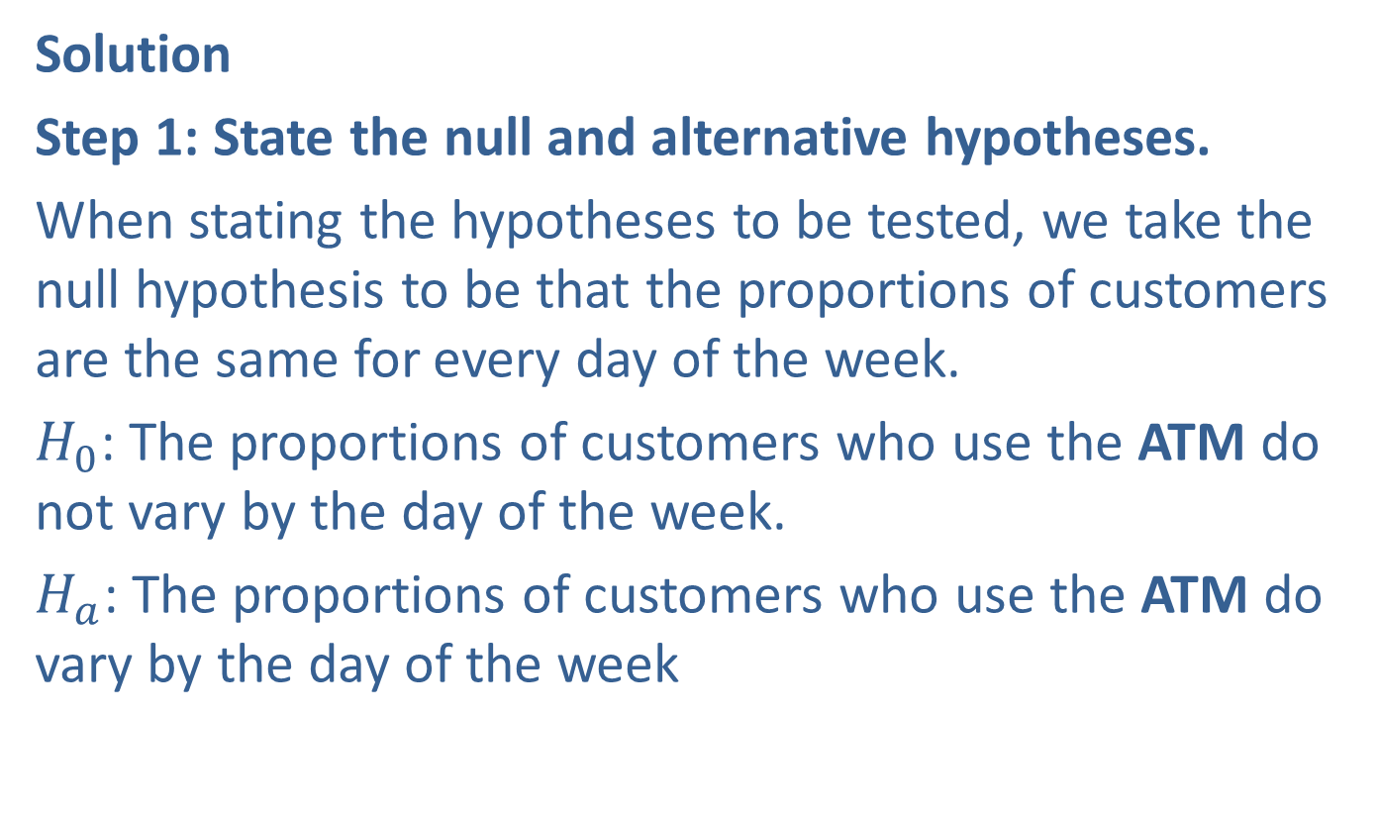
Example 10.6.1: Chi-Square Test for Goodness of Fit (cont.)
Solution
Step 1: State the null and alternative hypotheses.
When stating the hypotheses to be tested, we take the null hypothesis to be that the proportions of customers are the same for every day of the week.
$H_{0}$: The proportions of customers who use the ATM do not vary by the day of the week.
$H_{a}$: The proportions of customers who use the ATM do vary by the day of the week

Slide 12

Example 10.6.1: Chi-Square Test for Goodness of Fit (cont.)
Mathematically, we can write the null and alternative hypotheses as follows.
$$H_{0}\text{:}p_{1}=p_{2}=p_{3}=p_{4}=p_{5}=p_{6}=p_{7}$$
$H_{a}$: There is some difference among the proportions.

Slide 13
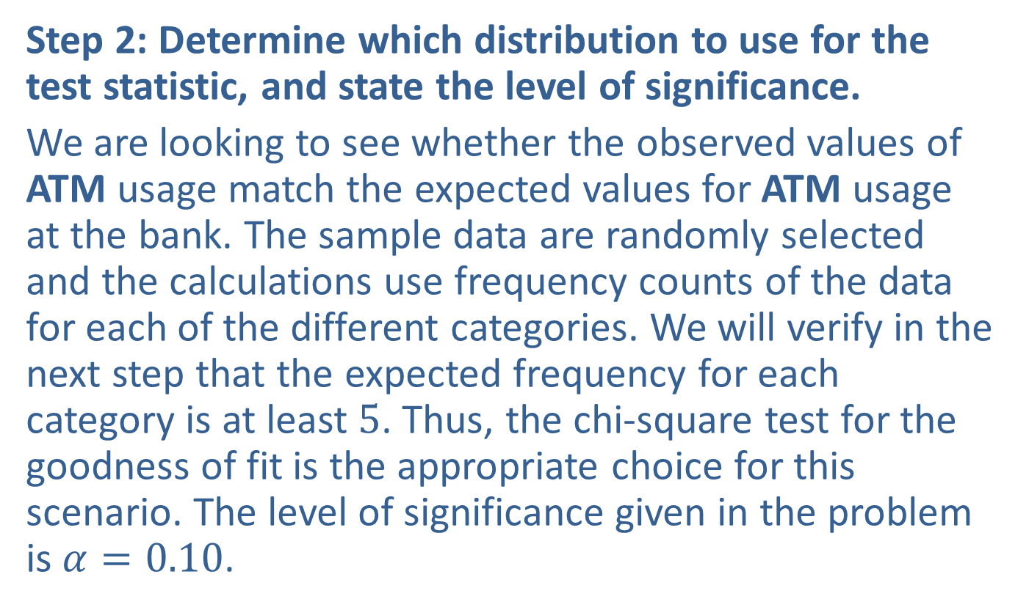
Example 10.6.1: Chi-Square Test for Goodness of Fit (cont.)
Step 2: Determine which distribution to use for the test statistic, and state the level of significance.
We are looking to see whether the observed values of ATM usage match the expected values for ATM usage at the bank. The sample data are randomly selected and the calculations use frequency counts of the data for each of the different categories. We will verify in the next step that the expected frequency for each category is at least 5. Thus, the chi-square test for the goodness of fit is the appropriate choice for this scenario. The level of significance given in the problem is $α=0.10$.

Slide 14
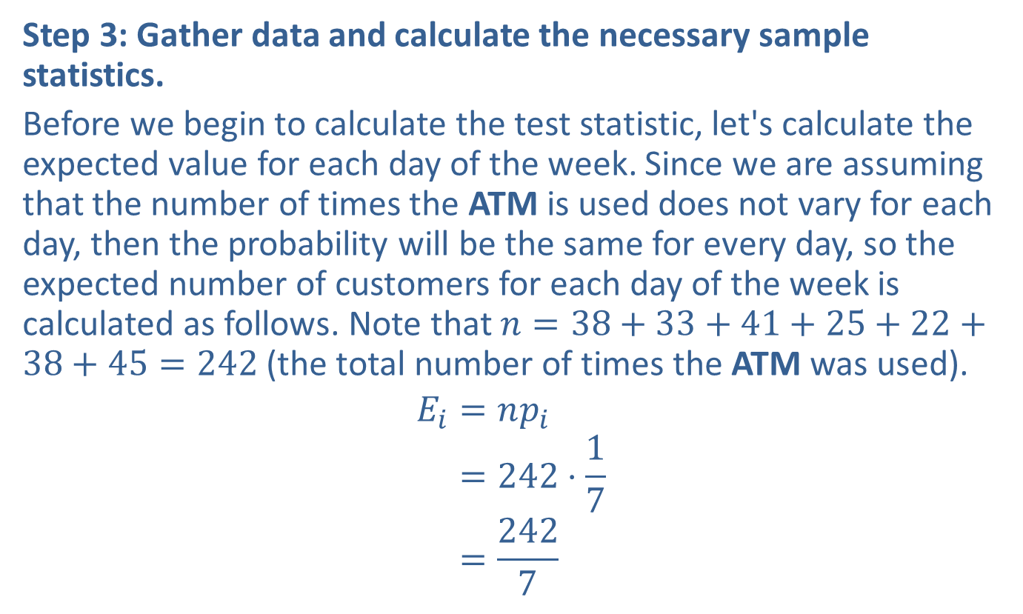
Example 10.6.1: Chi-Square Test for Goodness of Fit (cont.)
Step 3: Gather data and calculate the necessary sample statistics.
Before we begin to calculate the test statistic, let's calculate the expected value for each day of the week. Since we are assuming that the number of times the ATM is used does not vary for each day, then the probability will be the same for every day, so the expected number of customers for each day of the week is calculated as follows. Note that $n=38+33+41+25+22+38+45=242$ (the total number of times the ATM was used).
𝐸𝑖=𝑛𝑝𝑖𝐸𝑖=242⋅17𝐸𝑖=2427

Slide 15
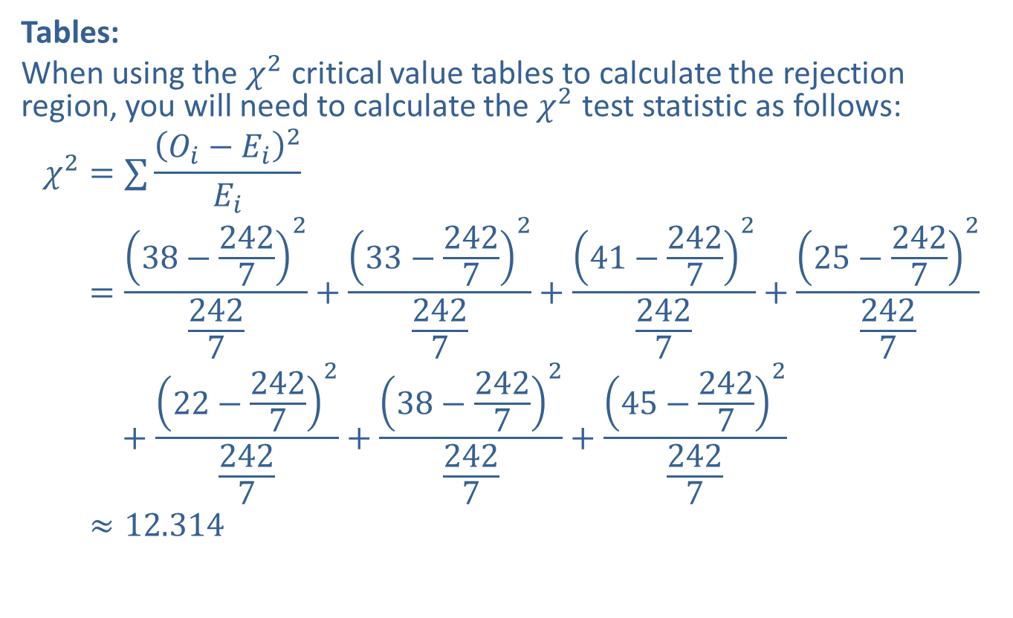
Example 10.6.1: Chi-Square Test for Goodness of Fit (cont.)
Tables:
When using the $χ^{2}$ critical value tables to calculate the rejection region, you will need to calculate the $χ^{2}$ test statistic as follows:
𝜒2=∑𝑂𝑖−𝐸𝑖2𝐸𝑖𝜒2=38−242722427+33−242722427+41−242722427+25−242722427𝜒2=+22−242722427+38−242722427+45−242722427𝜒2≈12.314

Slide 16
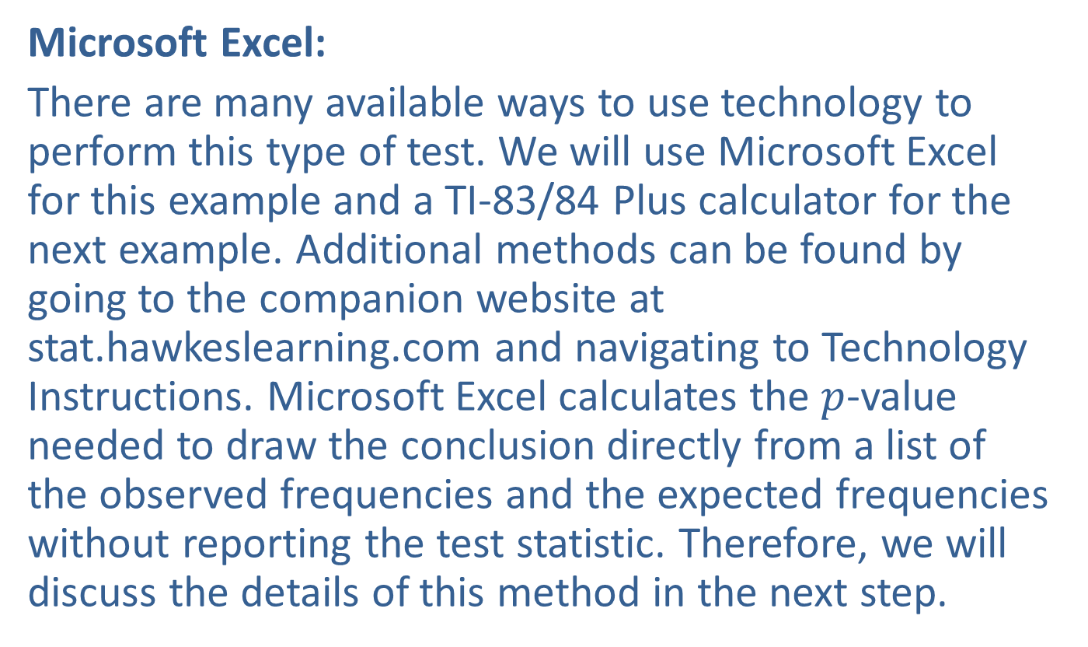
Example 10.6.1: Chi-Square Test for Goodness of Fit (cont.)
Microsoft Excel:
There are many available ways to use technology to perform this type of test. We will use Microsoft Excel for this example and a TI-83/84 Plus calculator for the next example. Additional methods can be found by going to the companion website at stat.hawkeslearning.com and navigating to Technology Instructions. Microsoft Excel calculates the $p$-value needed to draw the conclusion directly from a list of the observed frequencies and the expected frequencies without reporting the test statistic. Therefore, we will discuss the details of this method in the next step.

Slide 17
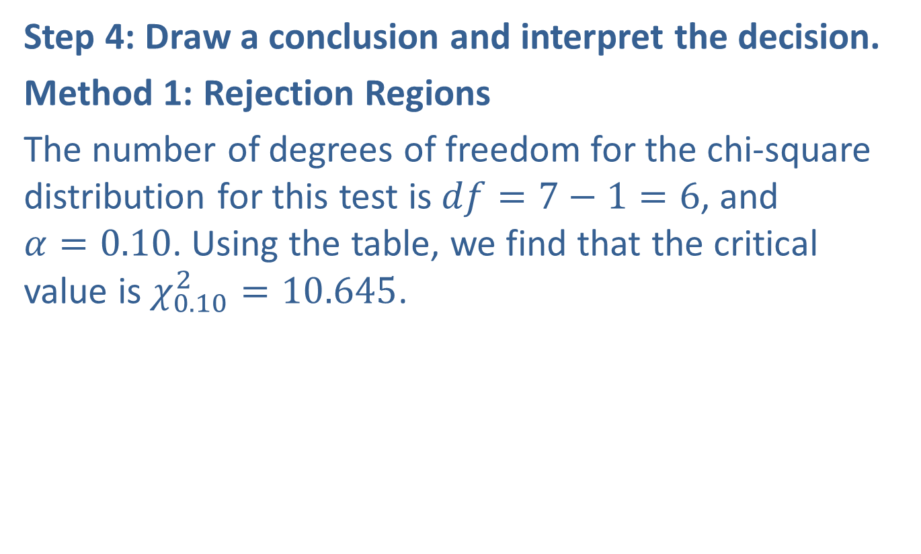
Example 10.6.1: Chi-Square Test for Goodness of Fit (cont.)
Step 4: Draw a conclusion and interpret the decision.
Method 1: Rejection Regions
The number of degrees of freedom for the chi-square distribution for this test is $df=7−1=6$, and $α=0.10$. Using the table, we find that the critical value is $χ_{0.10}^{2}=10.645$.

Slide 18
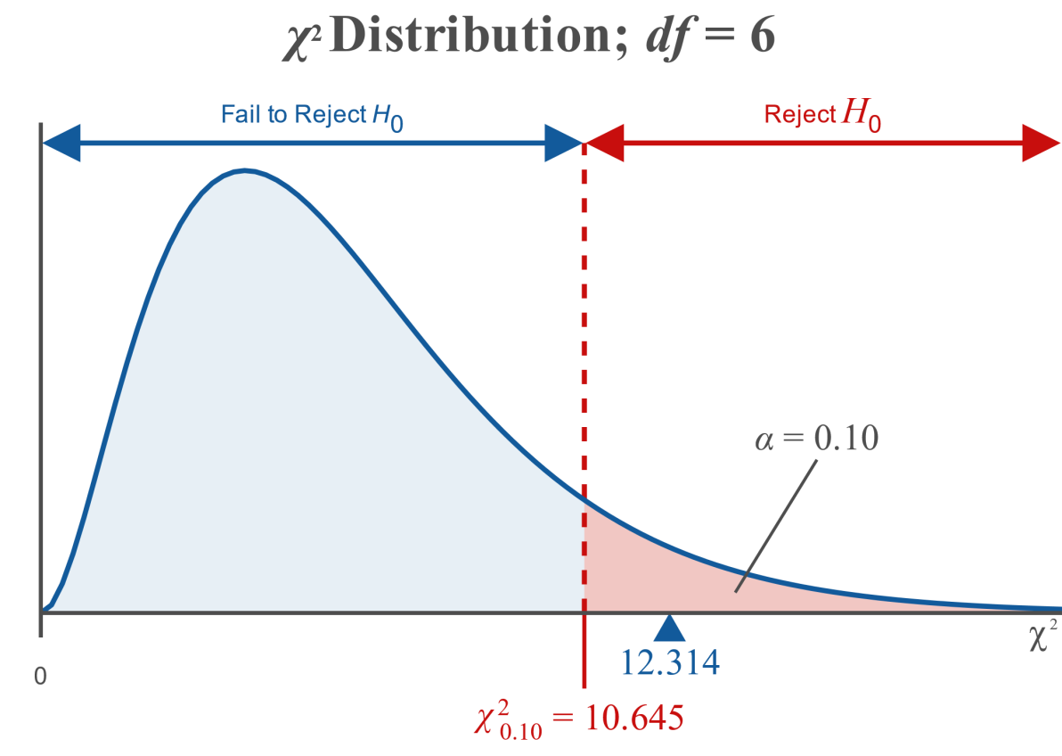
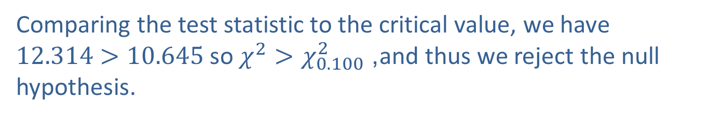
Example 10.6.1: Chi-Square Test for Goodness of Fit (cont.)
Comparing the test statistic to the critical value, we have $12.314>10.645$ so $χ^{2}>χ_{0.100}^{2}$, and thus we reject the null hypothesis.

Slide 19
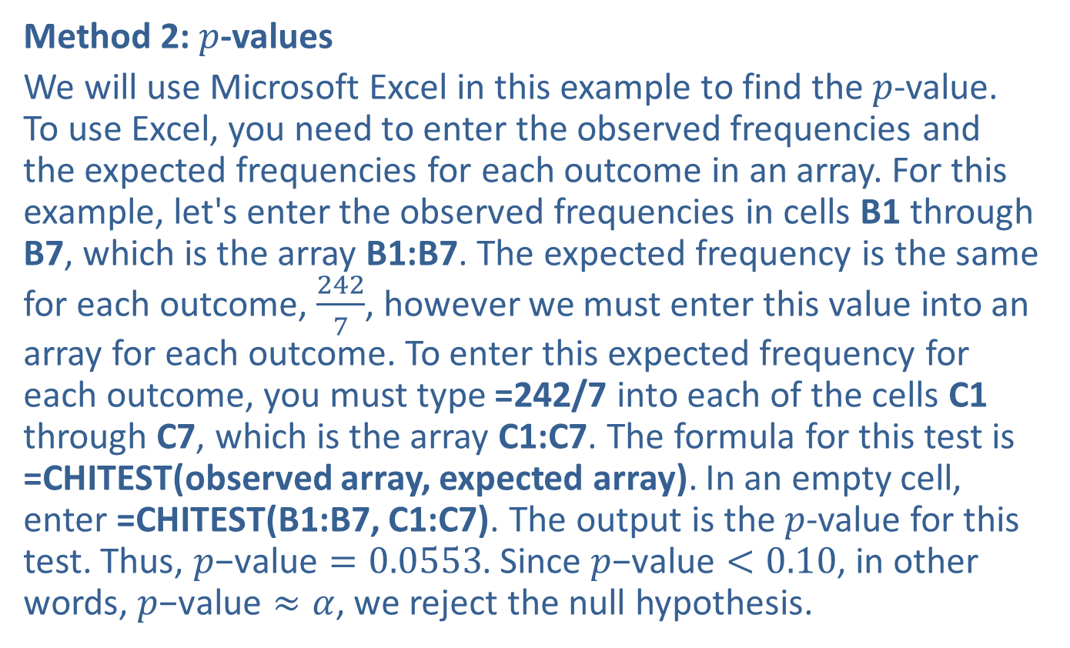
Example 10.6.1: Chi-Square Test for Goodness of Fit (cont.)
Method 2: $p$-values
We will use Microsoft Excel in this example to find the $p$-value. To use Excel, you need to enter the observed frequencies and the expected frequencies for each outcome in an array. For this example, let's enter the observed frequencies in cells B1 through B7, which is the array B1:B7. The expected frequency is the same for each outcome, $\frac{242}{7}$, however we must enter this value into an array for each outcome. To enter this expected frequency for each outcome, you must type =242/7 into each of the cells C1 through C7, which is the array C1:C7. The formula for this test is =CHITEST(observed array, expected array). In an empty cell, enter =CHITEST(B1:B7, C1:C7). The output is the $p$-value for this test. Thus, $p\text{−}\text{value}=0.0553$. Since $p\text{−}\text{value}<0.10$, in other words, $p\text{−}\text{value}≈α$, we reject the null hypothesis.

Slide 20
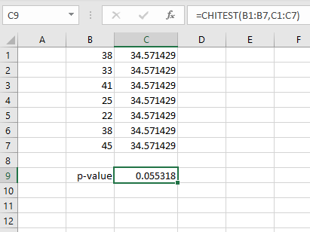
Example 10.6.1: Chi-Square Test for Goodness of Fit (cont.)

Slide 21
Example 10.6.1: Chi-Square Test for Goodness of Fit (cont.)
Interpretation: At the 0.10 level of significance, there is sufficient evidence to support the customer's claim that the ATM is used significantly more on certain days of the week. Note, however, that the test does not tell us which days of the week it is used more. We might be able to guess which days from the data; however, the test gives no indication of which day the ATM is used more than any other.

Slide 22
Technology
For instructions on how to perform a chi-square goodness of fit test please visit stat.hawkeslearning.com and navigate to Technology Instructions > Chi-Square Distribution > Test for Goodness of Fit.

Slide 23
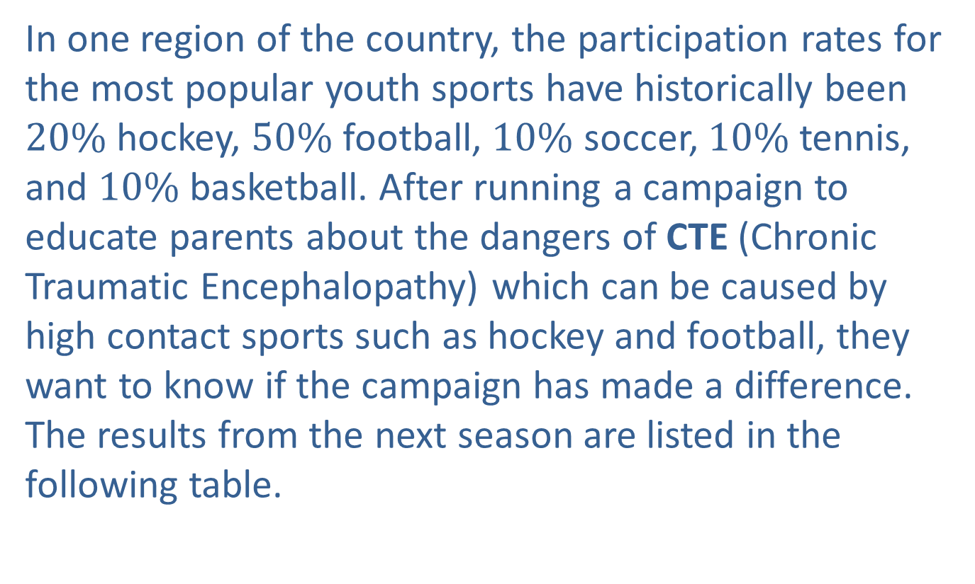
Example 10.6.2: Chi-Square Test for Goodness of Fit
In one region of the country, the participation rates for the most popular youth sports have historically been $20\%$ hockey, $50\%$ football, $10\%$ soccer, $10\%$ tennis, and $10\%$ basketball. After running a campaign to educate parents about the dangers of CTE (Chronic Traumatic Encephalopathy) which can be caused by high contact sports such as hockey and football, they want to know if the campaign has made a difference. The results from the next season are listed in the following table.

Slide 24
Example 10.6.2: Chi-Square Test for Goodness of Fit (cont.)
Youth Sports Participation
Sport | Number Participating
Hockey | 251
Football | 630
Soccer | 115
Tennis | 141
Basketball | 121

Slide 25
Example 10.6.2: Chi-Square Test for Goodness of Fit (cont.)
Is there sufficient evidence at the 0.05 level of significance to say that the educational campaign has made any difference in the proportions of children playing the most popular sports?

Slide 26
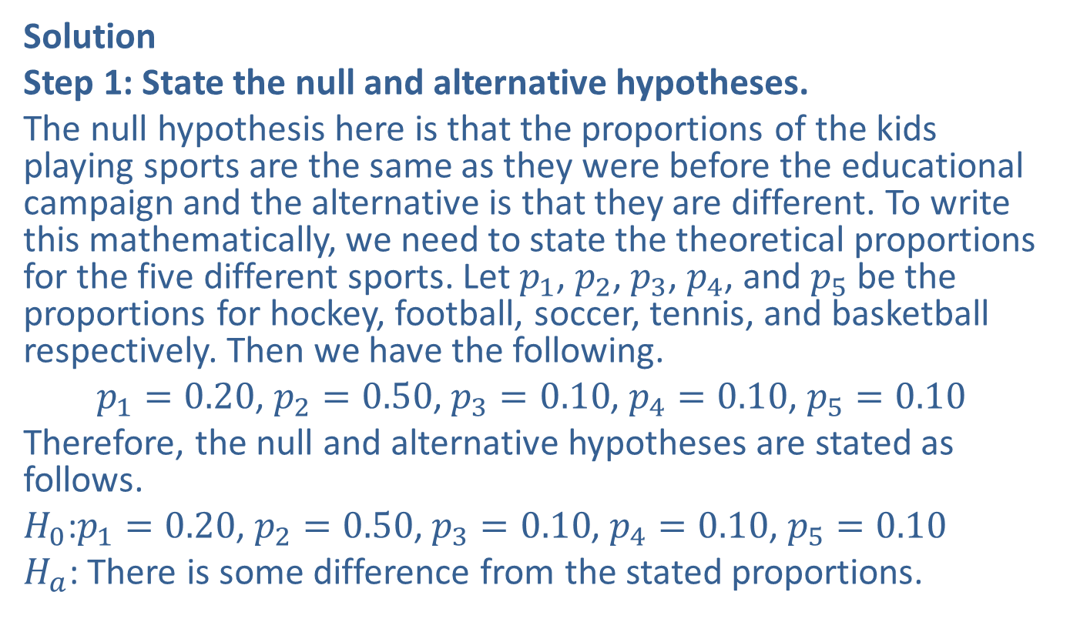
Example 10.6.2: Chi-Square Test for Goodness of Fit (cont.)
Solution
Step 1: State the null and alternative hypotheses.
The null hypothesis here is that the proportions of the kids playing sports are the same as they were before the educational campaign and the alternative is that they are different. To write this mathematically, we need to state the theoretical proportions for the five different sports. Let $p_{1}$, $p_{2}$, $p_{3}$, $p_{4}$, and $p_{5}$ be the proportions for hockey, football, soccer, tennis, and basketball respectively. Then we have the following.
$p_{1}=0.20$, $p_{2}=0.50$, $p_{3}=0.10$, $p_{4}=0.10$, $p_{5}=0.10$
Therefore, the null and alternative hypotheses are stated as follows.
$H_{0}\text{:}p_{1}=0.20$, $p_{2}=0.50$, $p_{3}=0.10$, $p_{4}=0.10$, $p_{5}=0.10$
$H_{a}$: There is some difference from the stated proportions.

Slide 27
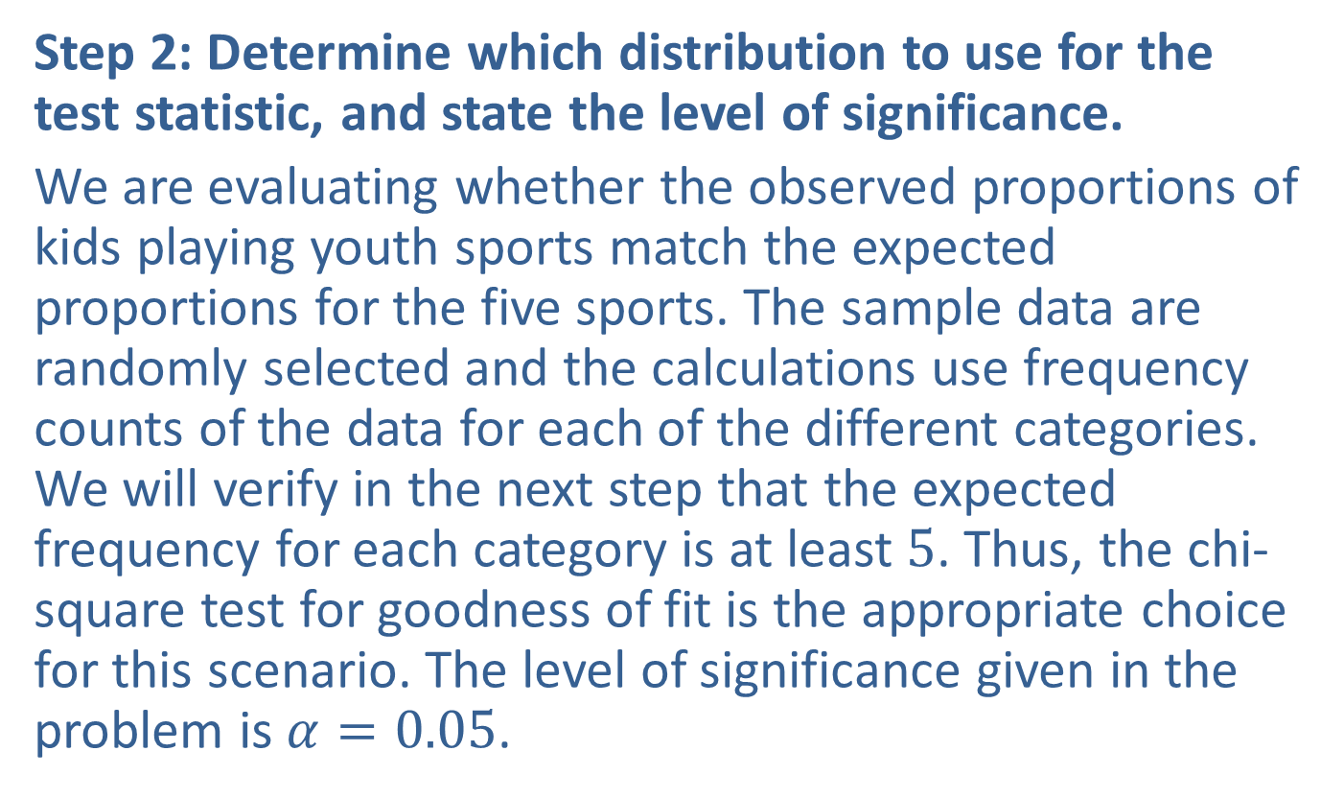
Example 10.6.2: Chi-Square Test for Goodness of Fit (cont.)
Step 2: Determine which distribution to use for the test statistic, and state the level of significance.
We are evaluating whether the observed proportions of kids playing youth sports match the expected proportions for the five sports. The sample data are randomly selected and the calculations use frequency counts of the data for each of the different categories. We will verify in the next step that the expected frequency for each category is at least 5. Thus, the chi-square test for goodness of fit is the appropriate choice for this scenario. The level of significance given in the problem is $α=0.05$.

Slide 28
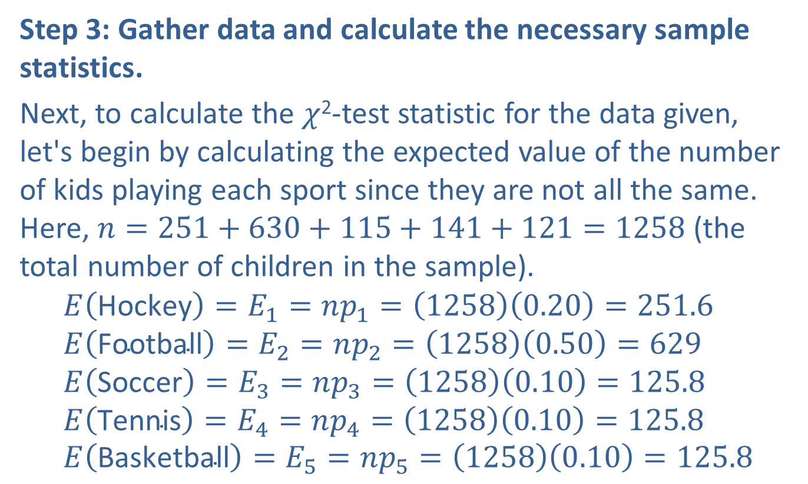
Example 10.6.2: Chi-Square Test for Goodness of Fit (cont.)
Step 3: Gather data and calculate the necessary sample statistics.
Next, to calculate the $χ$²-test statistic for the data given, let's begin by calculating the expected value of the number of kids playing each sport since they are not all the same. Here, $n=251+630+115+141+121=1258$ (the total number of children in the sample).
$$E\left(\text{Hockey}\right)=E_{1}=np_{1}=\left(1258\right)\left(0.20\right)=251.6 \\ E\left(\text{Football}\right)=E_{2}=np_{2}=\left(1258\right)\left(0.50\right)=629 \\ E\left(\text{Soccer}\right)=E_{3}=np_{3}=\left(1258\right)\left(0.10\right)=125.8 \\ E\left(\text{Tennis}\right)=E_{4}=np_{4}=\left(1258\right)\left(0.10\right)=125.8 \\ E\left(\text{Basketball}\right)=E_{5}=np_{5}=\left(1258\right)\left(0.10\right)=125.8$$

Slide 29
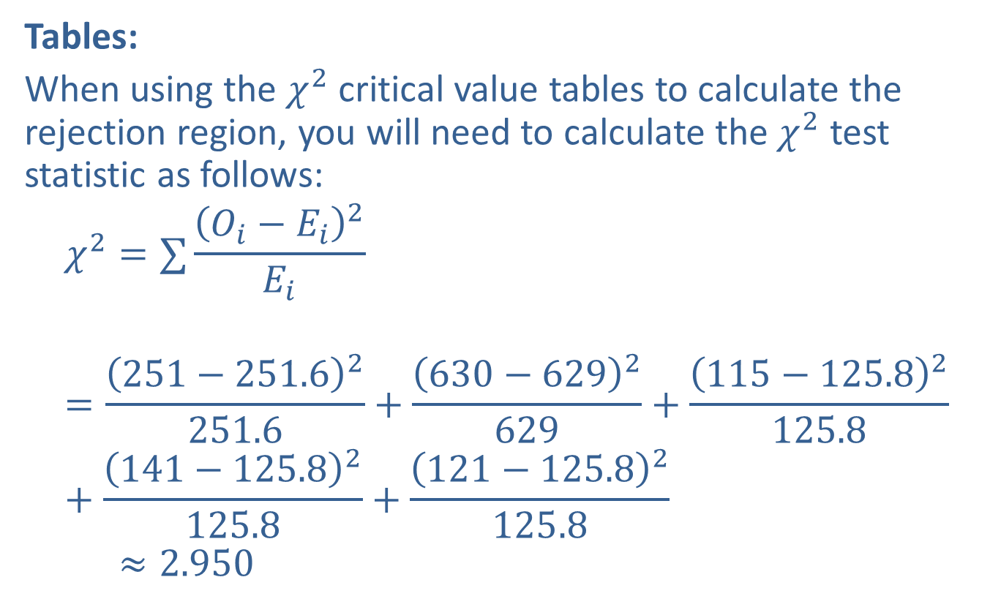
Example 10.6.2: Chi-Square Test for Goodness of Fit (cont.)
Tables:
When using the $χ^{2}$ critical value tables to calculate the rejection region, you will need to calculate the $χ^{2}$ test statistic as follows:
𝜒2=∑𝑂𝑖−𝐸𝑖2𝐸𝑖𝜒2=251−251.62251.6+630−6292629+115−125.82125.8+141−125.82125.8+121−125.82125.8𝜒2≈2.950

Slide 30
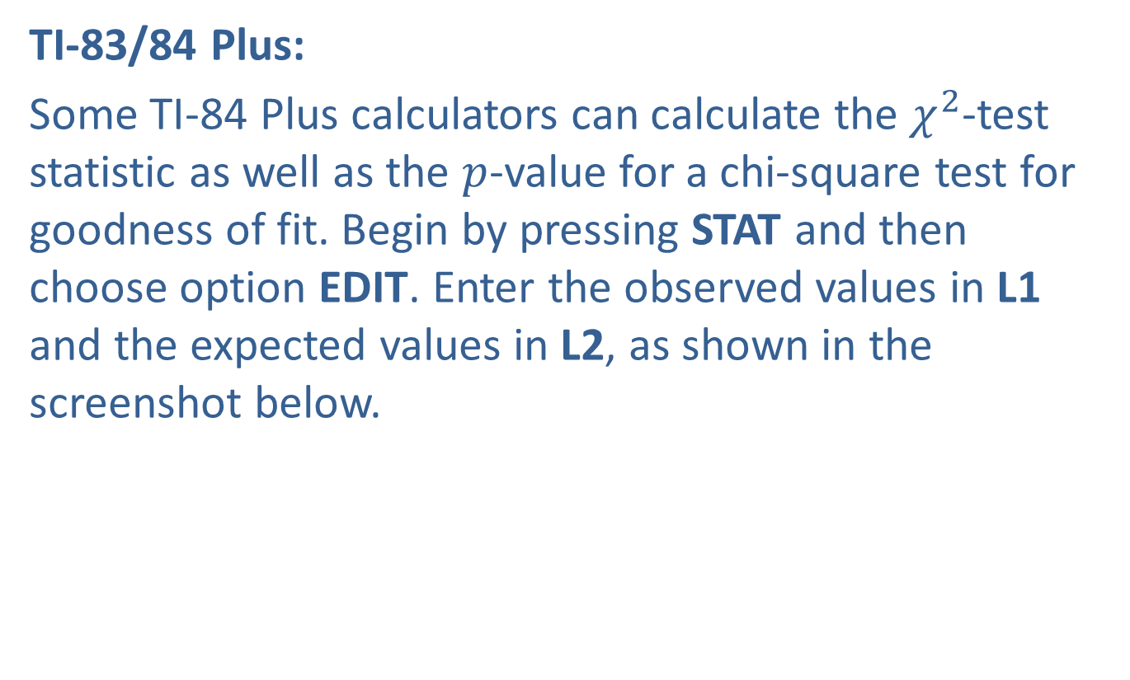
Example 10.6.2: Chi-Square Test for Goodness of Fit (cont.)
TI-83/84 Plus:
Some TI-84 Plus calculators can calculate the $χ^{2}$-test statistic as well as the $p$-value for a chi-square test for goodness of fit. Begin by pressing STAT and then choose option EDIT. Enter the observed values in L1 and the expected values in L2, as shown in the screenshot below.

Slide 31
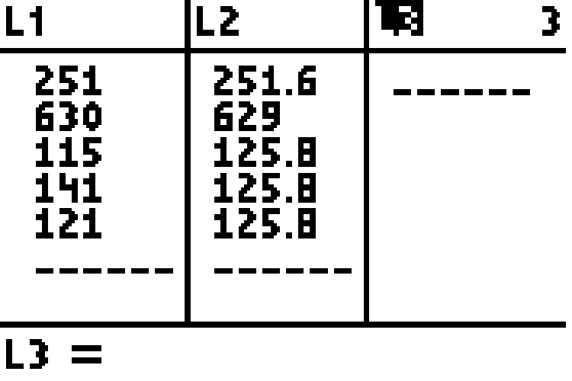
Example 10.6.2: Chi-Square Test for Goodness of Fit (cont.)

Slide 32
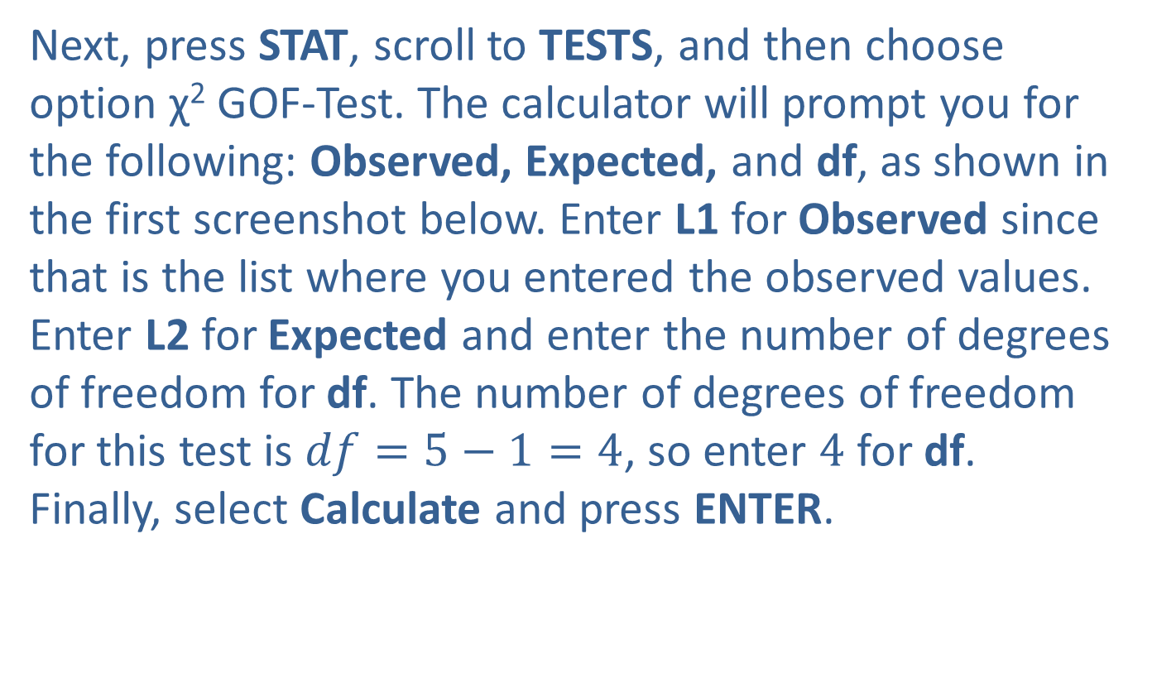
Example 10.6.2: Chi-Square Test for Goodness of Fit (cont.)
Next, press STAT, scroll to TESTS, and then choose option χ² GOF-Test. The calculator will prompt you for the following: Observed, Expected, and df, as shown in the first screenshot below. Enter L1 for Observed since that is the list where you entered the observed values. Enter L2 for Expected and enter the number of degrees of freedom for df. The number of degrees of freedom for this test is $df=5−1=4$, so enter 4 for df. Finally, select Calculate and press ENTER.

Slide 33
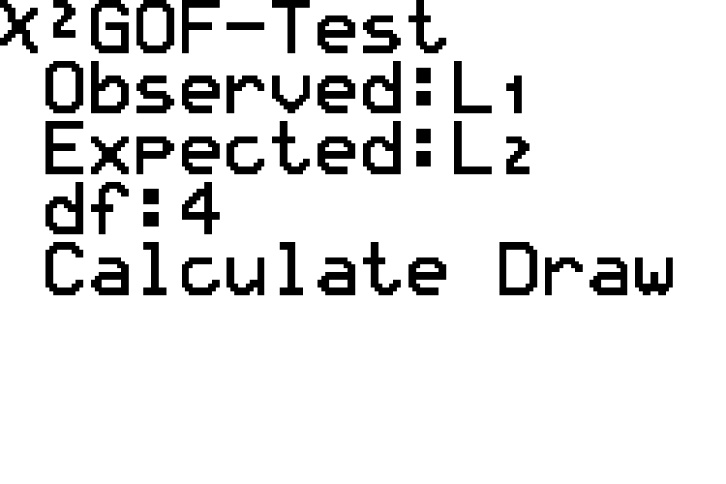
Example 10.6.2: Chi-Square Test for Goodness of Fit (cont.)

Slide 34
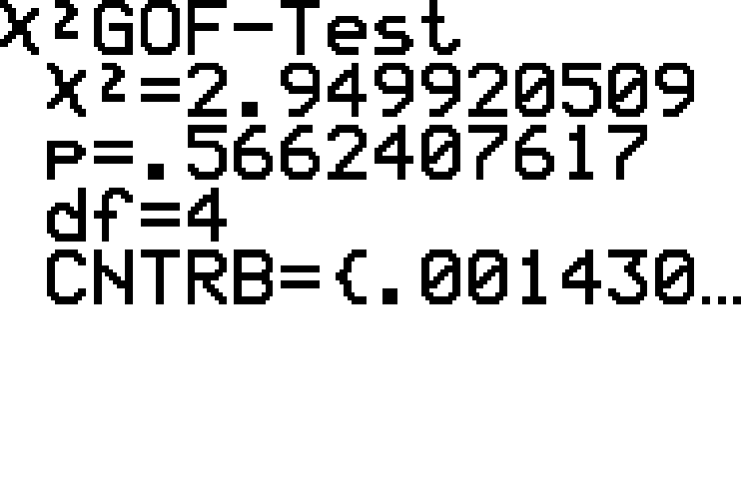
Example 10.6.2: Chi-Square Test for Goodness of Fit (cont.)

Slide 35

Example 10.6.2: Chi-Square Test for Goodness of Fit (cont.)
The output screen displays the $χ$²-test statistic and the $p$-value, and reiterates the number of degrees of freedom that was entered.

Slide 36
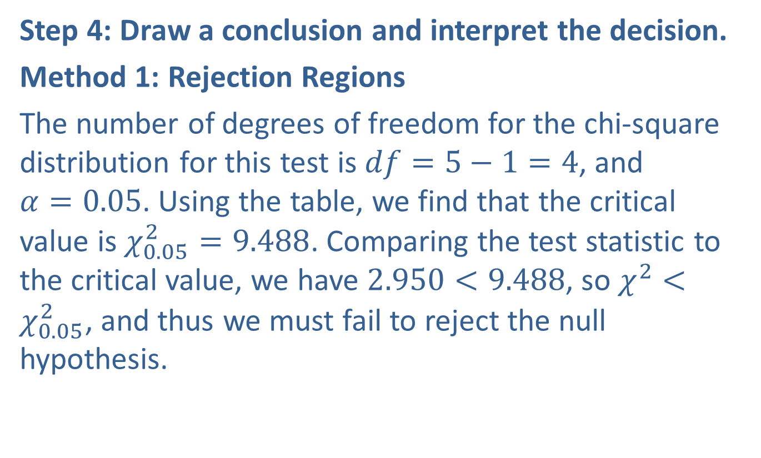
Example 10.6.2: Chi-Square Test for Goodness of Fit (cont.)
Step 4: Draw a conclusion and interpret the decision.
Method 1: Rejection Regions
The number of degrees of freedom for the chi‑square distribution for this test is $df=5−1=4$, and $α=0.05$. Using the table, we find that the critical value is $χ_{0.05}^{2}=9.488$. Comparing the test statistic to the critical value, we have $2.950<9.488$, so $χ^{2}<χ_{0.05}^{2}$, and thus we must fail to reject the null hypothesis.

Slide 37
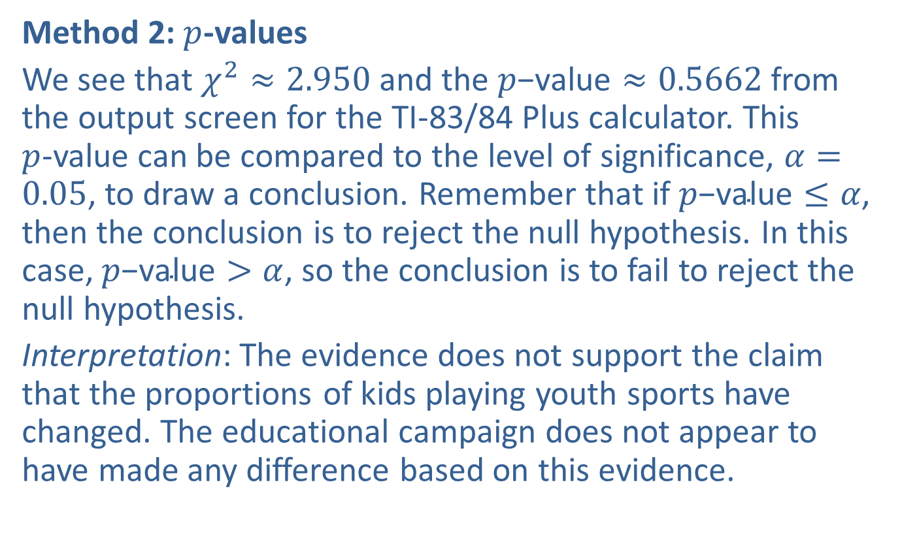
Example 10.6.2: Chi-Square Test for Goodness of Fit (cont.)
Method 2: $p$-values
We see that $χ^{2}≈2.950$ and the $p\text{−}\text{value}≈0.5662$ from the output screen for the TI-83/84 Plus calculator. This $p$-value can be compared to the level of significance, $α=0.05$, to draw a conclusion. Remember that if $p\text{−}\text{value}≤α$, then the conclusion is to reject the null hypothesis. In this case, $p\text{−}\text{value}>α$, so the conclusion is to fail to reject the null hypothesis.
Interpretation: The evidence does not support the claim that the proportions of kids playing youth sports have changed. The educational campaign does not appear to have made any difference based on this evidence.

Slide 38
Technology
For further instructions on performing a chi-square test for goodness of fit with a TI-83/84 Plus calculator or other technology, please visit stat.hawkeslearning.com and see Technology Instructions > Chi-Square Distribution > Test for Goodness of Fit.

