Slide 1
Section 10.7
Chi-Square Test for Association

Slide 2
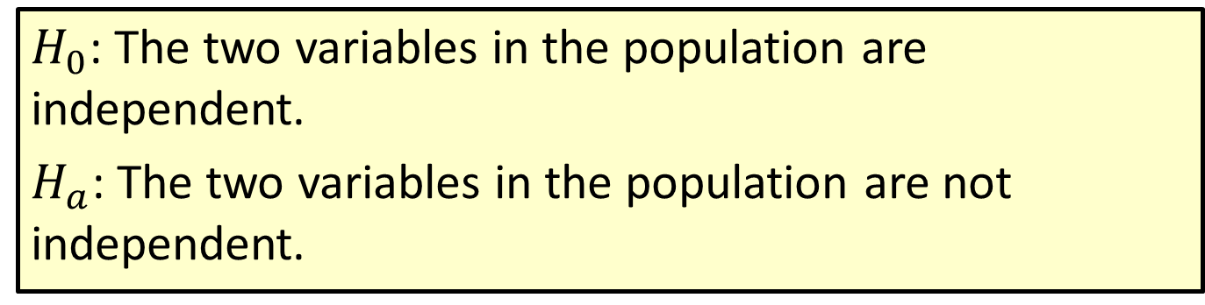
Procedure: Null and Alternative Hypotheses for a Chi-Square Test for Association
$H_{0}$: The two variables in the population are independent.
$H_{a}$: The two variables in the population are not independent.

Slide 3
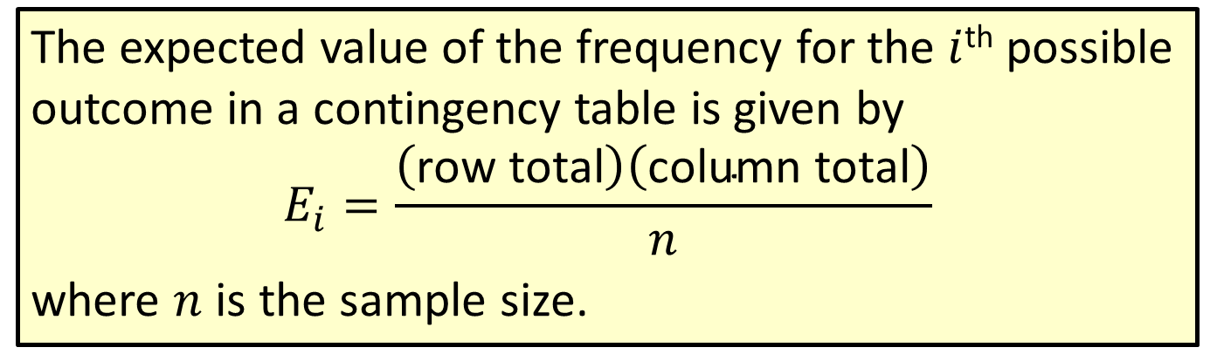
Formula: Expected Value of a Frequency in a Contingency Table
The expected value of the frequency for the $i$^{th} possible outcome in a contingency table is given by
$$E_{i}=\frac{\left(\text{row} \text{total}\right)\left(\text{column} \text{total}\right)}{n}$$
where $n$ is the sample size.

Slide 4
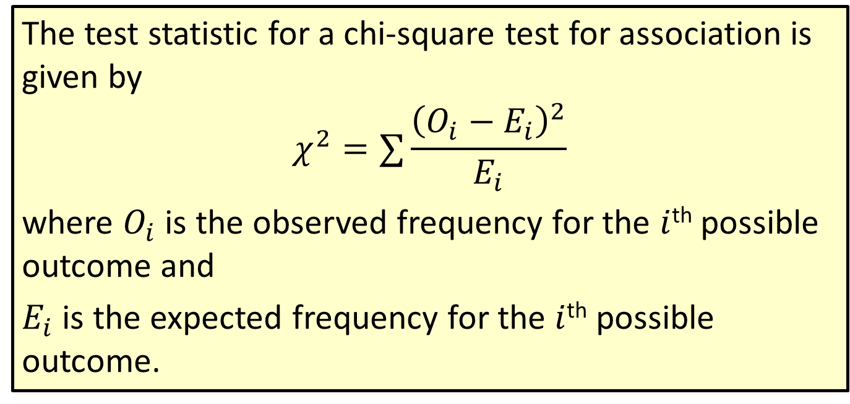
Formula: Test Statistic for a Chi-Square Test for Association
The test statistic for a chi-square test for association is given by
$$χ^{2}=∑\frac{{\left(O_{i}−E_{i}\right)}^{2}}{E_{i}}$$
where $O_{i}$ is the observed frequency for the $i$^{th} possible outcome and
$E_{i}$ is the expected frequency for the $i$^{th} possible outcome.

Slide 5
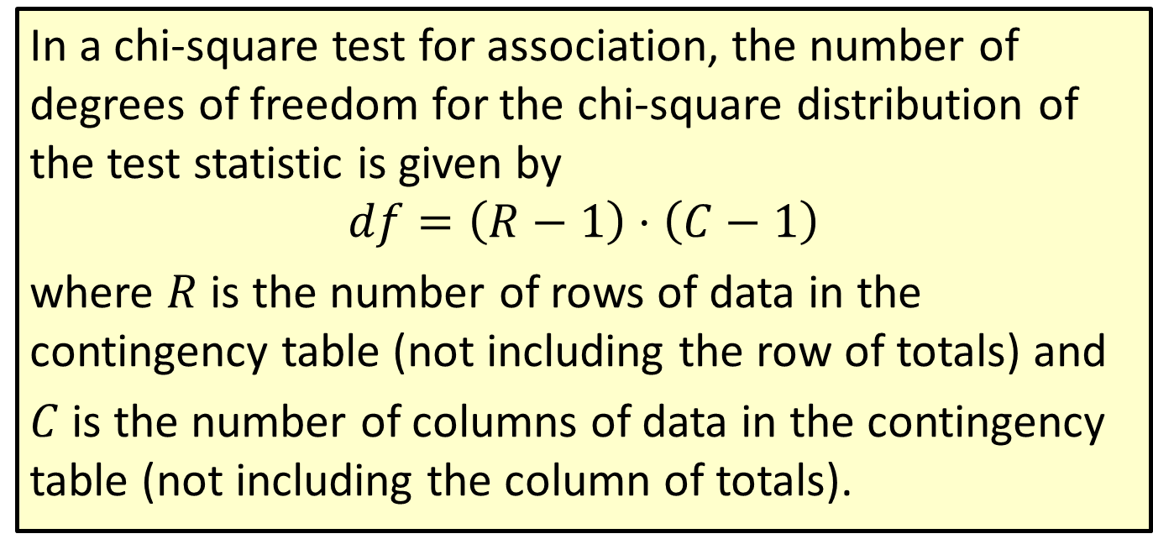
Formula: Degrees of Freedom in a Chi-Square Test for Association
In a chi-square test for association, the number of degrees of freedom for the chi-square distribution of the test statistic is given by
$$df=\left(R−1\right)⋅\left(C−1\right)$$
where $R$ is the number of rows of data in the contingency table (not including the row of totals) and
$C$ is the number of columns of data in the contingency table (not including the column of totals).

Slide 6

Procedure: Rejection Region for Chi-Square Tests for Association
Reject the null hypothesis, $H_{0}\text{, }\text{if}\text{:}$
$χ^{2}≥χ_{α}^{2}$.

Slide 7
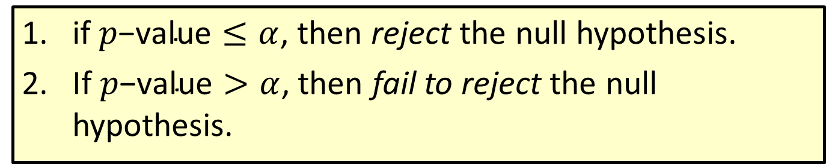
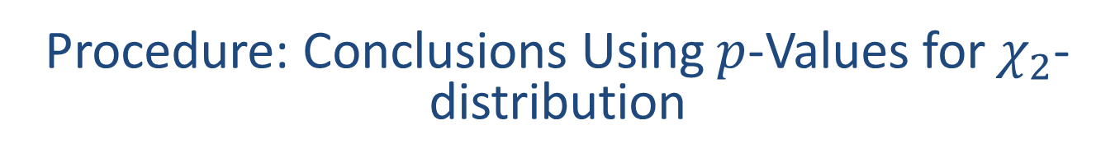
Procedure: Conclusions Using $p$-Values for $χ_{2}$-distribution
​if $p\text{−}\text{value}≤α$, then reject the null hypothesis.
​If $p\text{−}\text{value}>α$, then fail to reject the null hypothesis.

Slide 8
Example 10.7.1: Performing a Chi-Square Test for Association
Suppose that the following data were collected in a poll of 13,660 randomly selected voters during a gubernatorial election campaign. The voters were asked if they lived in a rural or urban area of the state, as well as if they voted for the Republican, Democratic, or Independent candidate.

Slide 9
Example 10.7.1: Performing a Chi-Square Test for Association (cont.)
Observed Sample of 13,660 Voters
 | Republican | Democrat | Independent | Total
Rural | 3455 | 2764 | 65 | 6284
Urban | 3541 | 3762 | 73 | 7376
Total | 6996 | 6526 | 138 | 13,660

Slide 10
Example 10.7.1: Performing a Chi-Square Test for Association (cont.)
Is there evidence at the 0.05 level to say that residential location and party choice were related for this election?

Slide 11
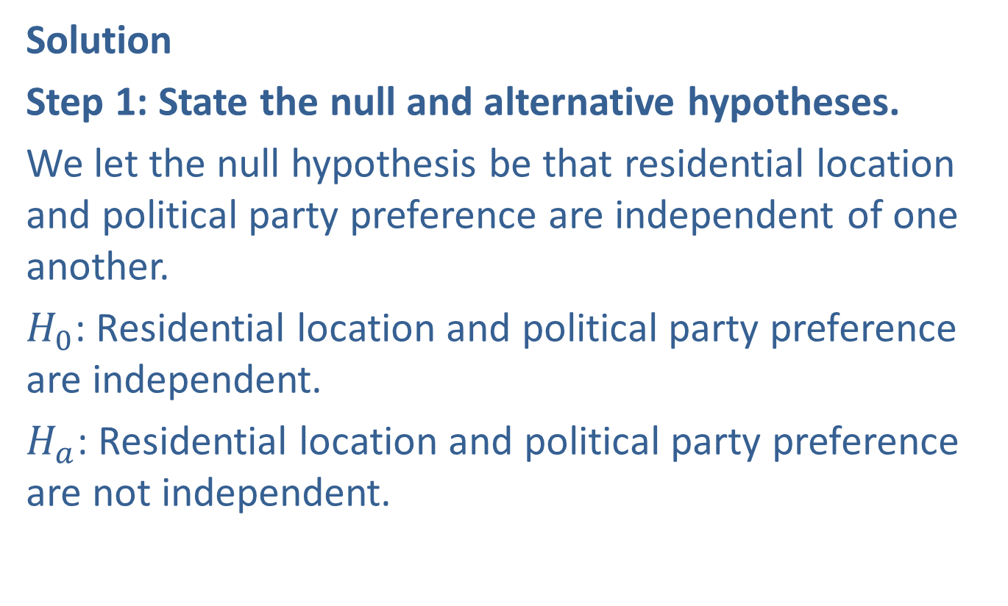
Example 10.7.1: Performing a Chi-Square Test for Association (cont.)
Solution
Step 1: State the null and alternative hypotheses.
We let the null hypothesis be that residential location and political party preference are independent of one another.
$H_{0}$: Residential location and political party preference are independent.
$H_{a}$: Residential location and political party preference are not independent.

Slide 12
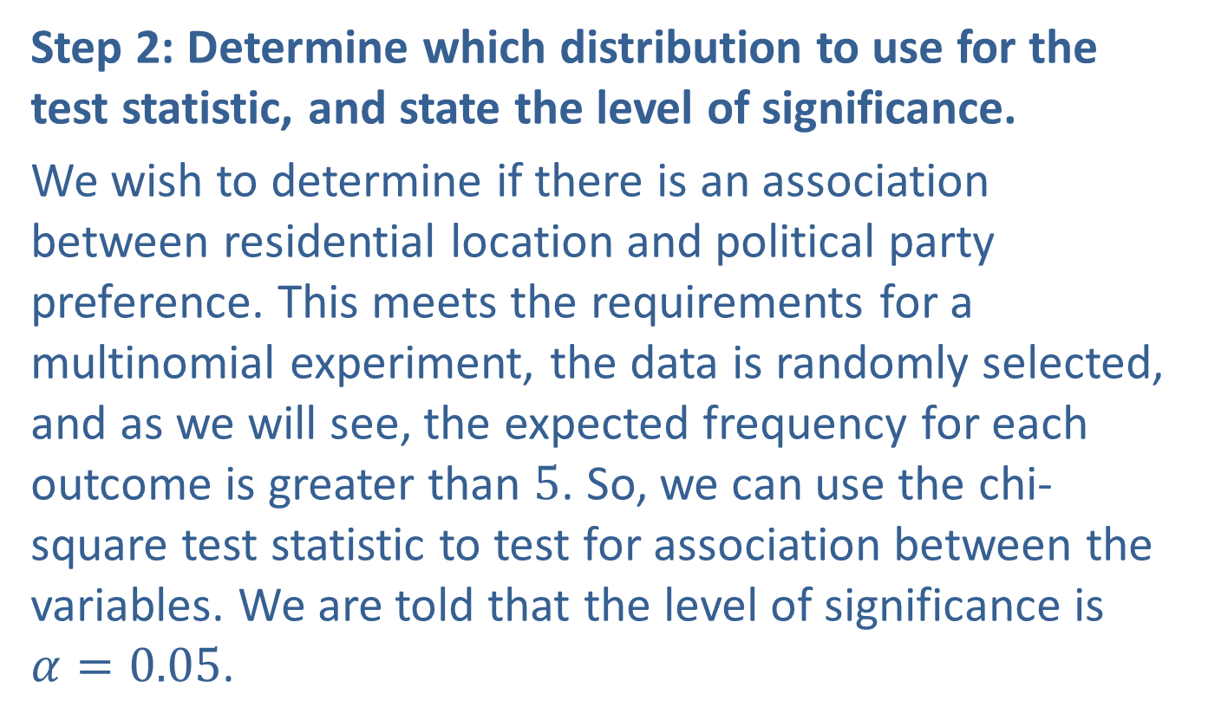
Example 10.7.1: Performing a Chi-Square Test for Association (cont.)
Step 2: Determine which distribution to use for the test statistic, and state the level of significance.
We wish to determine if there is an association between residential location and political party preference. This meets the requirements for a multinomial experiment, the data is randomly selected, and as we will see, the expected frequency for each outcome is greater than 5. So, we can use the chi-square test statistic to test for association between the variables. We are told that the level of significance is $α=0.05$.

Slide 13
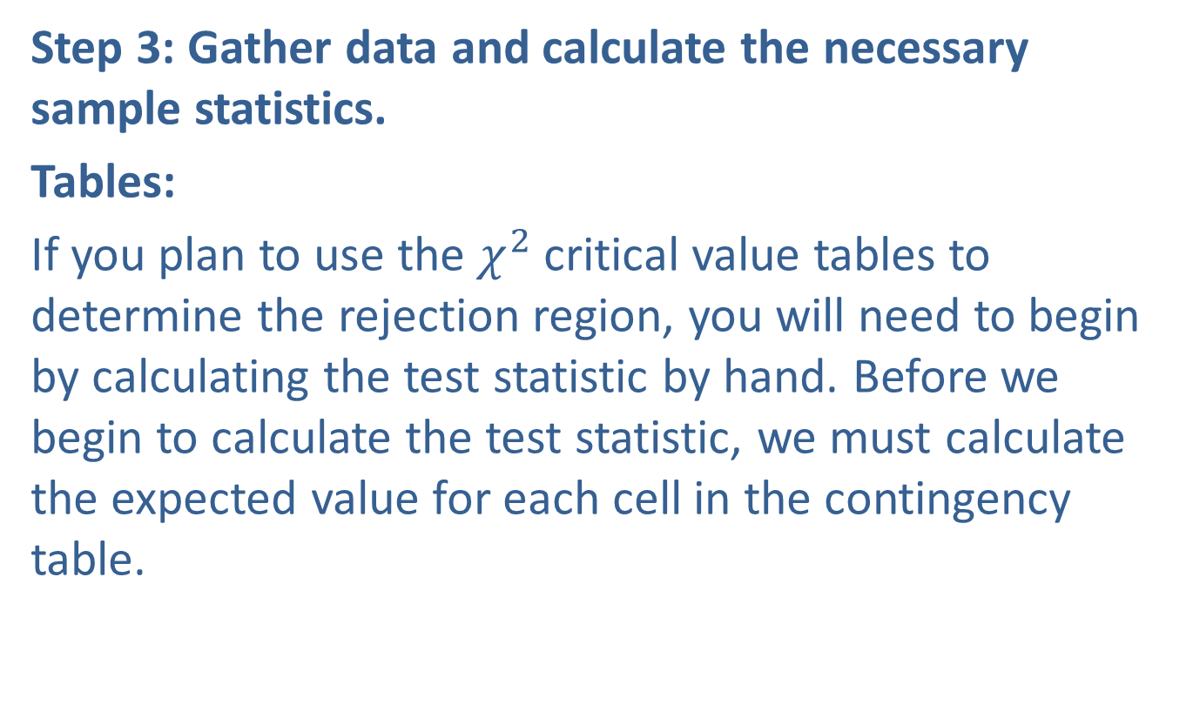
Example 10.7.1: Performing a Chi-Square Test for Association (cont.)
Step 3: Gather data and calculate the necessary sample statistics.
Tables:
If you plan to use the $χ^{2}$ critical value tables to determine the rejection region, you will need to begin by calculating the test statistic by hand. Before we begin to calculate the test statistic, we must calculate the expected value for each cell in the contingency table.

Slide 14
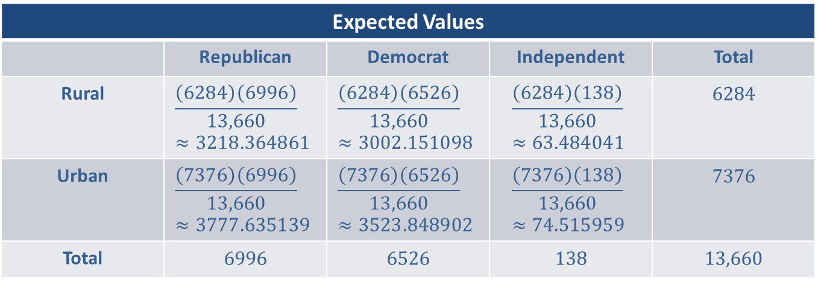
Example 10.7.1: Performing a Chi-Square Test for Association (cont.)
Expected Values
 | Republican | Democrat | Independent | Total
Rural | $$\frac{\left(6284\right)\left(6996\right)}{13,660}≈3218.364861$$ | $$\frac{\left(6284\right)\left(6526\right)}{13,660}≈3002.151098$$ | $$\frac{\left(6284\right)\left(138\right)}{13,660}≈63.484041$$ | 6284
Urban | $$\frac{\left(7376\right)\left(6996\right)}{13,660}≈3777.635139$$ | $$\frac{\left(7376\right)\left(6526\right)}{13,660}≈3523.848902$$ | $$\frac{\left(7376\right)\left(138\right)}{13,660}≈74.515959$$ | 7376
Total | 6996 | 6526 | 138 | 13,660

Slide 15
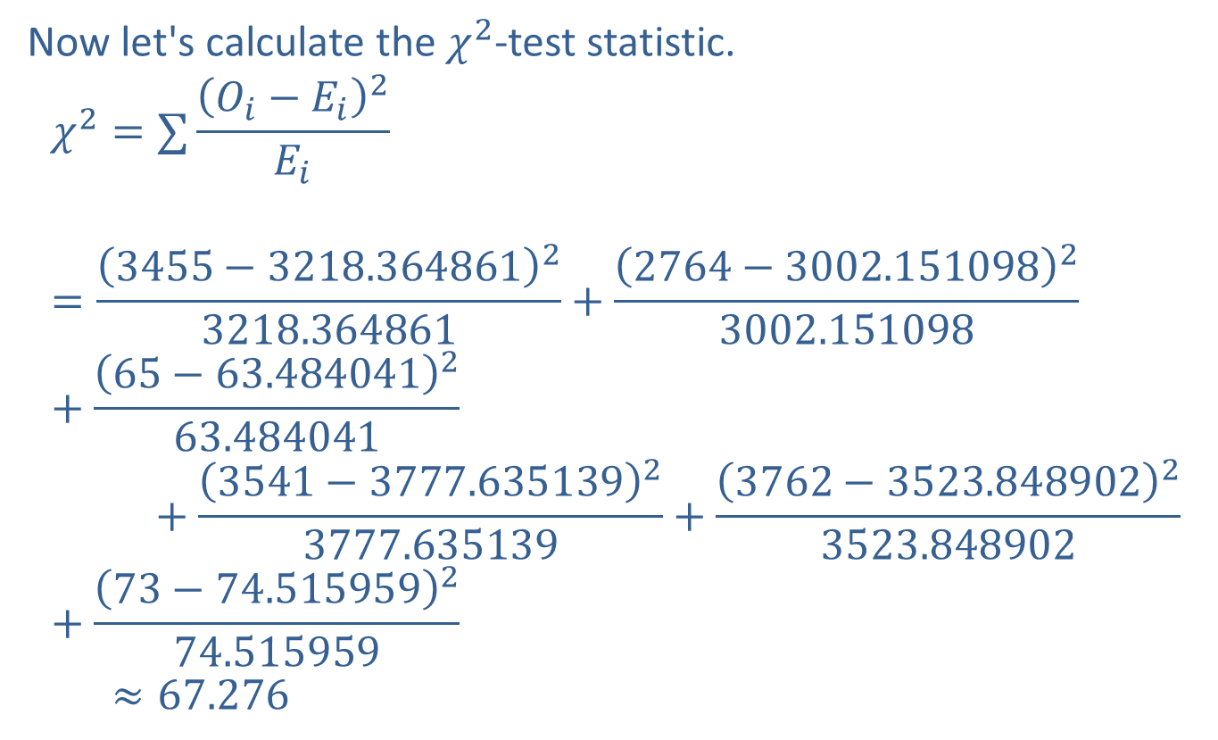
Example 10.7.1: Performing a Chi-Square Test for Association (cont.)
Now let's calculate the $χ^{2}$-test statistic.
𝜒2=∑𝑂𝑖−𝐸𝑖2𝐸𝑖𝜒2=3455−3218.36486123218.364861+2764−3002.15109823002.151098+65−63.484041263.484041𝜒2=+3541−3777.63513923777.635139+3762−3523.84890223523.848902+73−74.515959274.515959𝜒2≈67.276

Slide 16
Memory Booster:
Remember to round intermediate calculations to at least six decimal places.

Slide 17
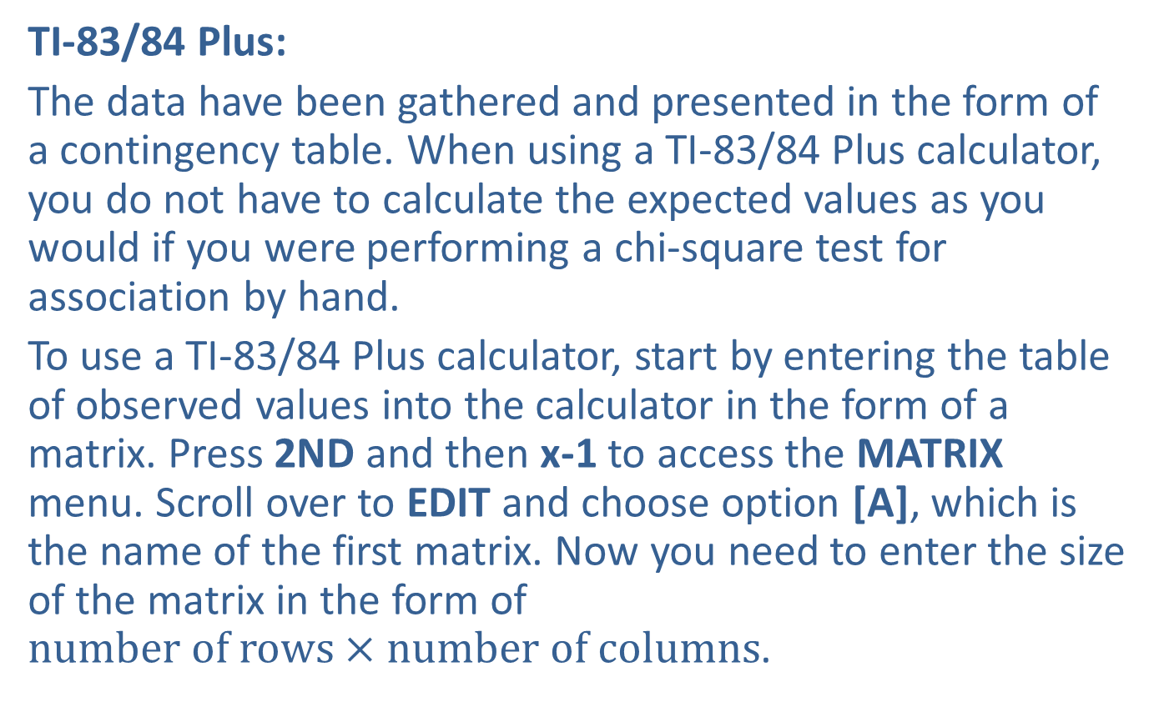
Example 10.7.1: Performing a Chi-Square Test for Association (cont.)
TI-83/84 Plus:
The data have been gathered and presented in the form of a contingency table. When using a TI-83/84 Plus calculator, you do not have to calculate the expected values as you would if you were performing a chi-square test for association by hand.
To use a TI-83/84 Plus calculator, start by entering the table of observed values into the calculator in the form of a matrix. Press 2ND and then x-1 to access the MATRIX menu. Scroll over to EDIT and choose option [A], which is the name of the first matrix. Now you need to enter the size of the matrix in the form of $number of rows×number of columns$.

Slide 18
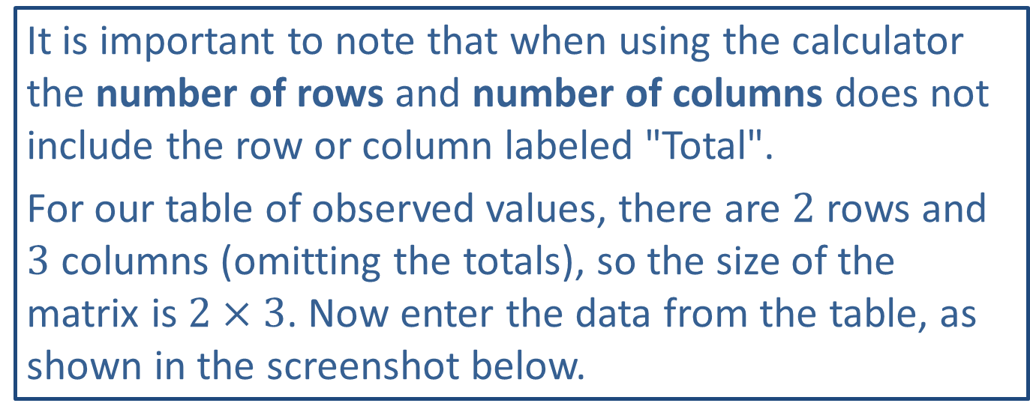
Technology
It is important to note that when using the calculator the number of rows and number of columns does not include the row or column labeled "Total".
For our table of observed values, there are 2 rows and 3 columns (omitting the totals), so the size of the matrix is $2×3$. Now enter the data from the table, as shown in the screenshot below.

Slide 19
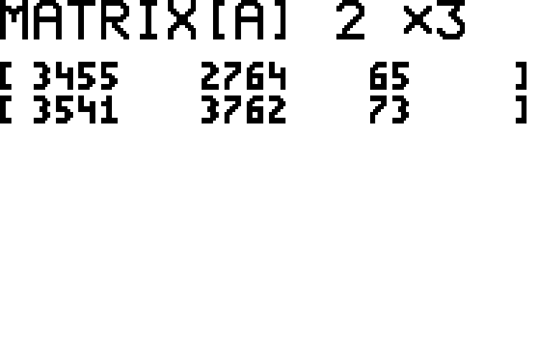
Example 10.7.1: Performing a Chi-Square Test for Association (cont.)

Slide 20
Example 10.7.1: Performing a Chi-Square Test for Association (cont.)
Next press STAT and scroll to TESTS. Choose option C:χ²-Test. We must then enter the name of the matrix containing the observed values and the name of the matrix where we want the expected values to be calculated. The TI-83/84 Plus calculates the expected values for the given matrix of observed values, and stores them in the matrix that you specify.
If the names of the matrices you wish to use are not the ones indicated, press 2ND and then x^-1 to access the MATRIX menu. Then choose the name of the matrix needed. The default options of [A] for Observed and [B] for Expected are correct for our example. To run the test, scroll down to select Calculate.

Slide 21
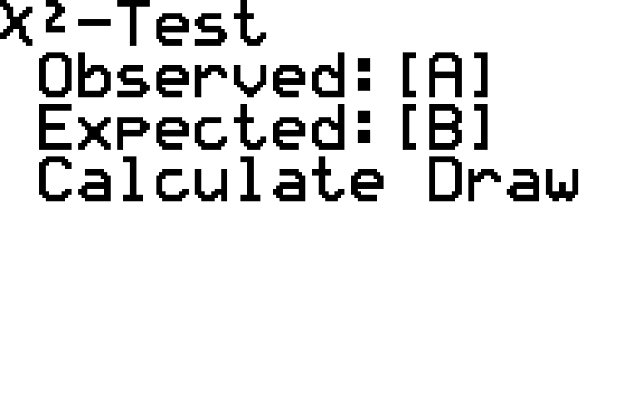
Example 10.7.1: Performing a Chi-Square Test for Association (cont.)

Slide 22
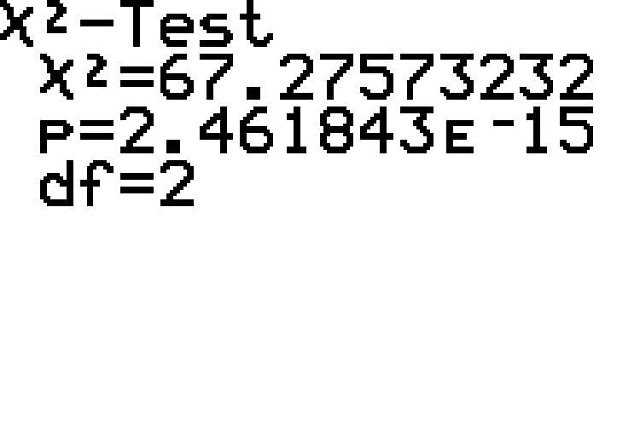
Example 10.7.1: Performing a Chi-Square Test for Association (cont.)

Slide 23
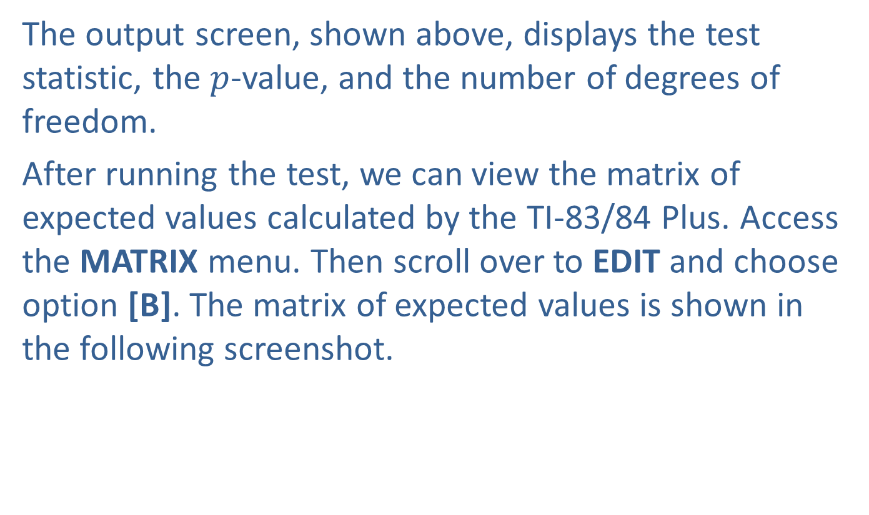
Example 10.7.1: Performing a Chi-Square Test for Association (cont.)
The output screen, shown above, displays the test statistic, the $p$-value, and the number of degrees of freedom.
After running the test, we can view the matrix of expected values calculated by the TI-83/84 Plus. Access the MATRIX menu. Then scroll over to EDIT and choose option [B]. The matrix of expected values is shown in the following screenshot.

Slide 24
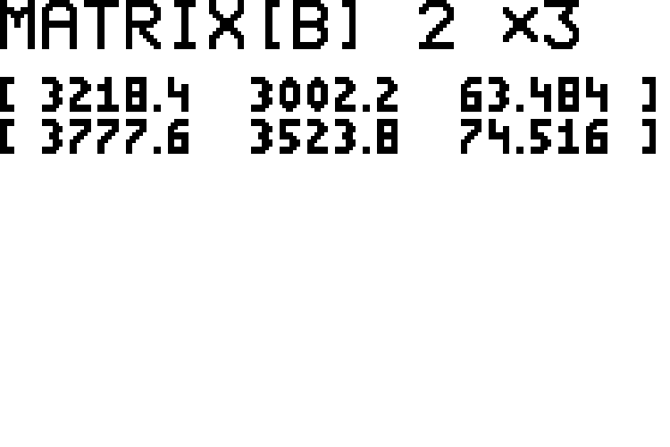
Example 10.7.1: Performing a Chi-Square Test for Association (cont.)

Slide 25
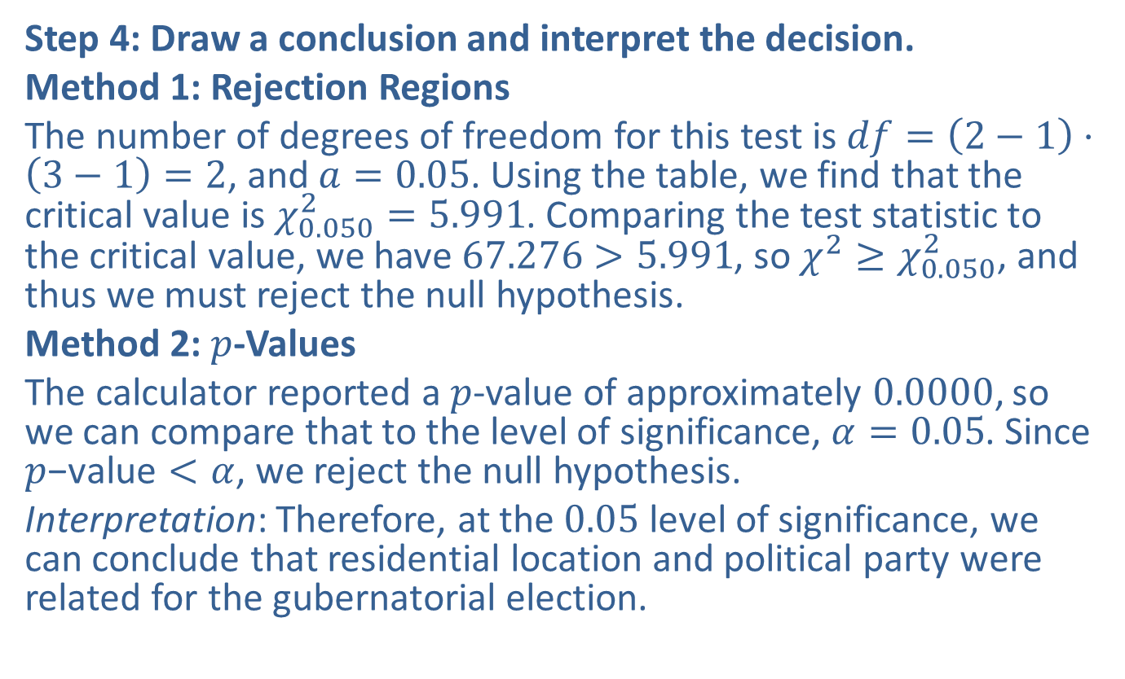
Example 10.7.1: Performing a Chi-Square Test for Association (cont.)
Step 4: Draw a conclusion and interpret the decision.
Method 1: Rejection Regions
The number of degrees of freedom for this test is $df=\left(2−1\right)⋅\left(3−1\right)=2$, and $a=0.05$. Using the table, we find that the critical value is $χ_{0.050}^{2}=5.991$. Comparing the test statistic to the critical value, we have $67.276>5.991$, so $χ^{2}≥χ_{0.050}^{2}$, and thus we must reject the null hypothesis.
Method 2: $p$-Values
The calculator reported a $p$-value of approximately 0.0000, so we can compare that to the level of significance, $α=0.05$. Since $p\text{−}\text{value}<α$, we reject the null hypothesis.
Interpretation: Therefore, at the 0.05 level of significance, we can conclude that residential location and political party were related for the gubernatorial election.

Slide 26
Technology
For further instructions on performing a chi-square test for goodness of fit with a TI-83/84 Plus calculator or other technology, please visit stat.hawkeslearning.com and see Technology Instructions > Chi-Square Distribution > Test for Association.

Slide 27
Example 10.7.2: Performing a Chi-Square Test for Association
A local hairdresser is curious about whether there is a relationship between hair color and the combination of gender and marital status among his clients. He collects data from a random sample of his clients and records the data in the following contingency table.

Slide 28
Example 10.7.2: Performing a Chi-Square Test for Association (cont.)
Observed Sample of 232 Clients
 | Blonde | Brown | Red | Black | Total
Single Women | 18 | 19 | 8 | 14 | 59
Married Women | 20 | 18 | 9 | 17 | 64
Single Men | 13 | 22 | 4 | 16 | 55
Married Men | 12 | 24 | 3 | 15 | 54
Total | 63 | 83 | 24 | 62 | 232

Slide 29
Example 10.7.2: Performing a Chi-Square Test for Association (cont.)
Based on these data, is there enough evidence at the 0.10 level of significance to say that there is a relationship between a person's hair color and the combination of gender and marital status for this hairdresser's clients?

Slide 30
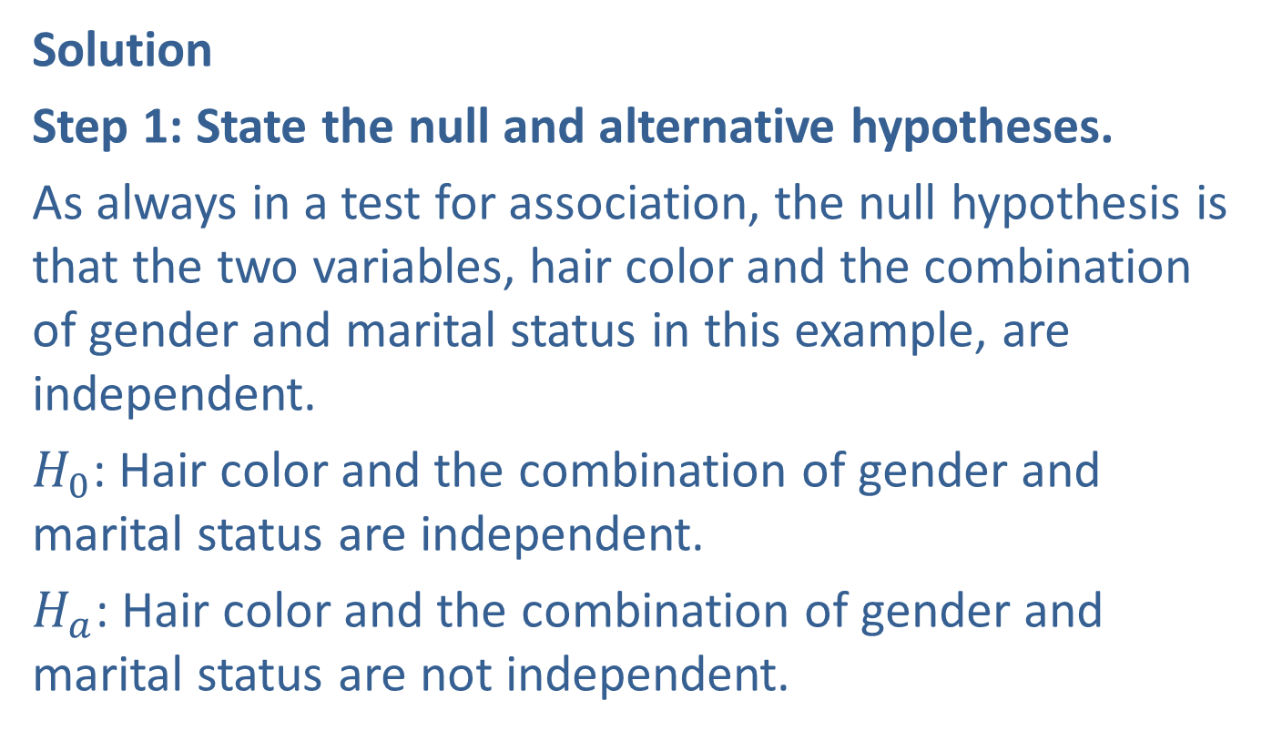
Example 10.7.2: Performing a Chi-Square Test for Association (cont.)
Solution
Step 1: State the null and alternative hypotheses.
As always in a test for association, the null hypothesis is that the two variables, hair color and the combination of gender and marital status in this example, are independent.
$H_{0}$: Hair color and the combination of gender and marital status are independent.
$H_{a}$: Hair color and the combination of gender and marital status are not independent.

Slide 31
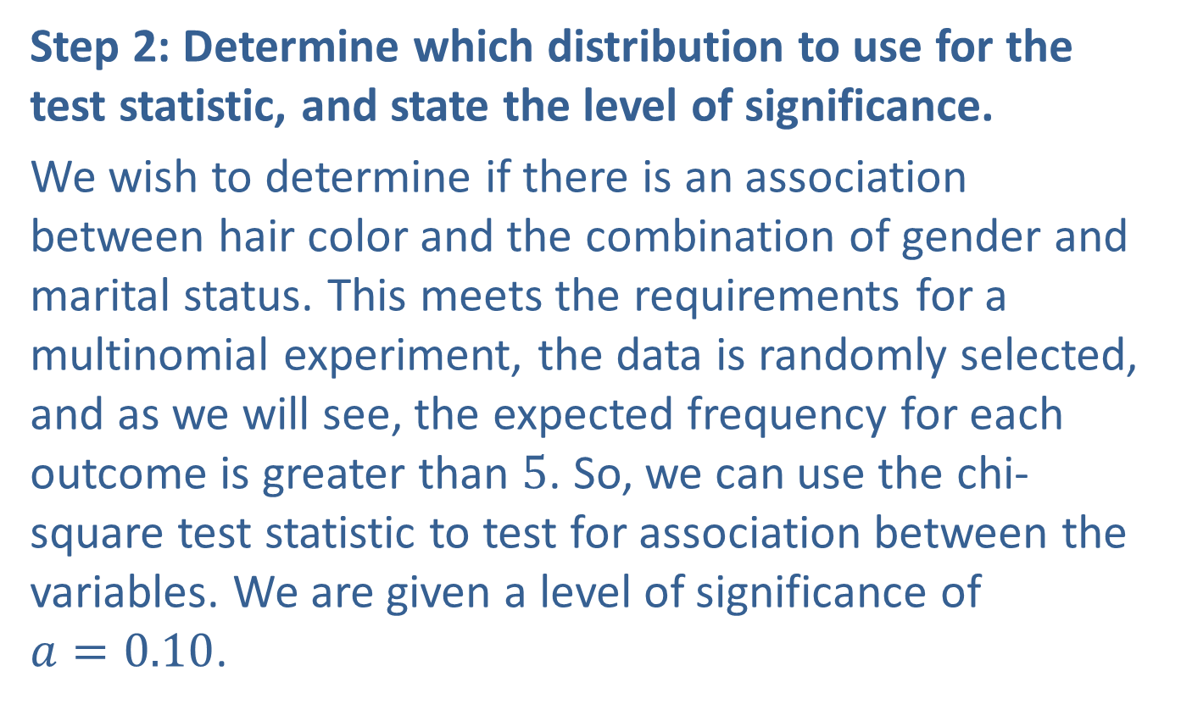
Example 10.7.2: Performing a Chi-Square Test for Association (cont.)
Step 2: Determine which distribution to use for the test statistic, and state the level of significance.
We wish to determine if there is an association between hair color and the combination of gender and marital status. This meets the requirements for a multinomial experiment, the data is randomly selected, and as we will see, the expected frequency for each outcome is greater than 5. So, we can use the chi-square test statistic to test for association between the variables. We are given a level of significance of $a=0.10$.

Slide 32
Example 10.7.2: Performing a Chi-Square Test for Association (cont.)
Step 3: Gather data and calculate the necessary sample statistics.
Tables:
If you plan to use the $χ^{2}$ critical value tables to determine the rejection region, you will need to begin by calculating the test statistic by hand. Before we begin to calculate the test statistic, we must calculate the expected value for each cell in the contingency table.

Slide 33
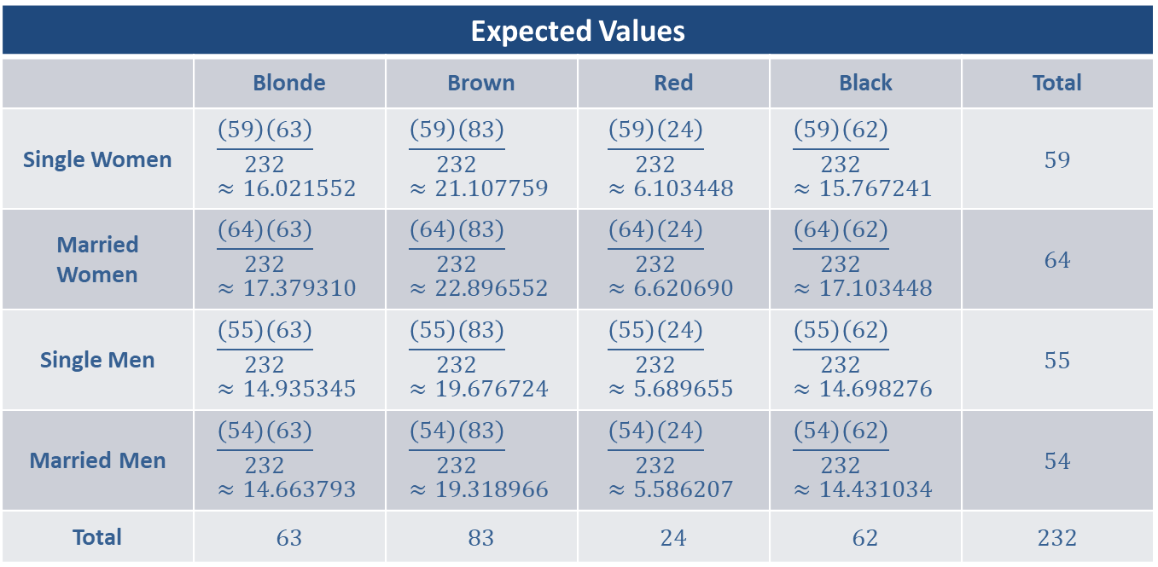
Example 10.7.2: Performing a Chi-Square Test for Association (cont.)
Expected Values
 | Blonde | Brown | Red | Black | Total
Single Women | $$\frac{\left(59\right)\left(63\right)}{232}≈16.021552$$ | $$\frac{\left(59\right)\left(83\right)}{232}≈21.107759$$ | $$\frac{\left(59\right)\left(24\right)}{232}≈6.103448$$ | $$\frac{\left(59\right)\left(62\right)}{232}≈15.767241$$ | 59
Married Women | $$\frac{\left(64\right)\left(63\right)}{232}≈17.379310$$ | $$\frac{\left(64\right)\left(83\right)}{232}≈22.896552$$ | $$\frac{\left(64\right)\left(24\right)}{232}≈6.620690$$ | $$\frac{\left(64\right)\left(62\right)}{232}≈17.103448$$ | 64
Single Men | $$\frac{\left(55\right)\left(63\right)}{232}≈14.935345$$ | $$\frac{\left(55\right)\left(83\right)}{232}≈19.676724$$ | $$\frac{\left(55\right)\left(24\right)}{232}≈5.689655$$ | $$\frac{\left(55\right)\left(62\right)}{232}≈14.698276$$ | 55
Married Men | $$\frac{\left(54\right)\left(63\right)}{232}≈14.663793$$ | $$\frac{\left(54\right)\left(83\right)}{232}≈19.318966$$ | $$\frac{\left(54\right)\left(24\right)}{232}≈5.586207$$ | $$\frac{\left(54\right)\left(62\right)}{232}≈14.431034$$ | 54
Total | 63 | 83 | 24 | 62 | 232

Slide 34

Memory Booster:
The expected value for each cell in a contingency table is given by $\frac{\text{(}\text{row} \text{total}\text{)(}\text{column} \text{total}\text{)}}{n}$.

Slide 35
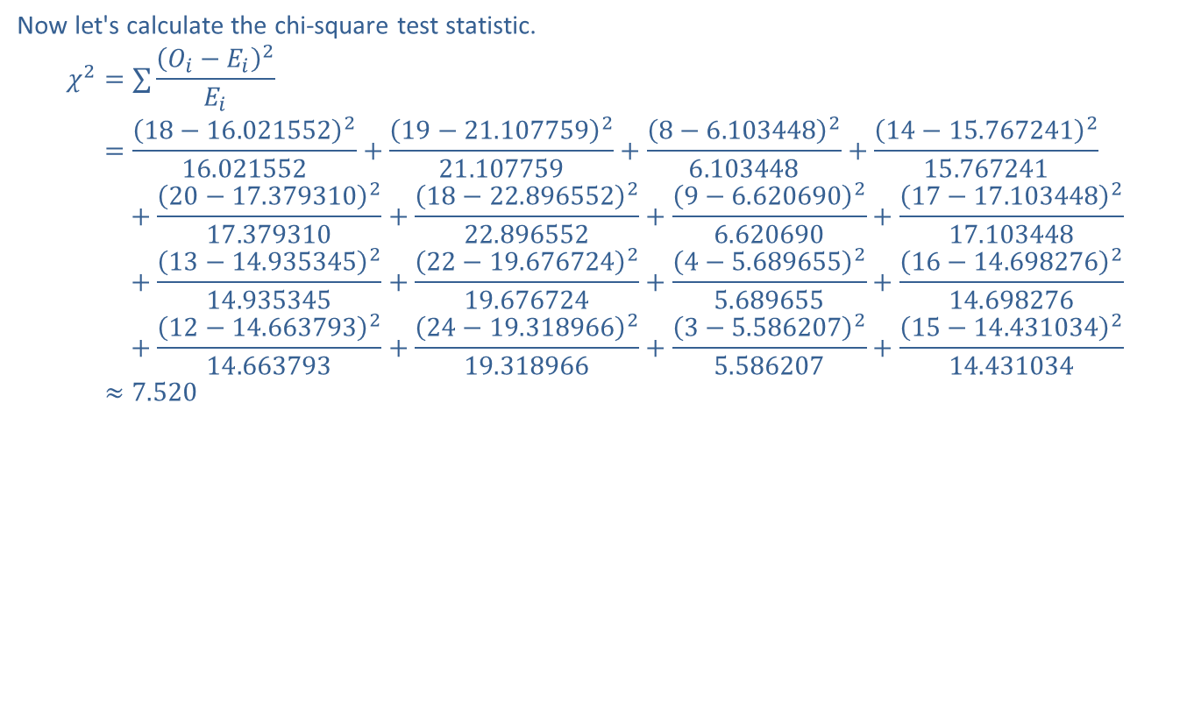
Example 10.7.2: Performing a Chi-Square Test for Association (cont.)
Now let's calculate the chi-square test statistic.
𝜒2=∑𝑂𝑖−𝐸𝑖2𝐸𝑖𝜒2=18−16.021552216.021552+19−21.107759221.107759+8−6.10344826.103448+14−15.767241215.767241𝜒2=+20−17.379310217.379310+18−22.896552222.896552+9−6.62069026.620690+17−17.103448217.103448𝜒2=+13−14.935345214.935345+22−19.676724219.676724+4−5.68965525.689655+16−14.698276214.698276𝜒2=+12−14.663793214.663793+24−19.318966219.318966+3−5.58620725.586207+15−14.431034214.431034𝜒2≈7.520

Slide 36
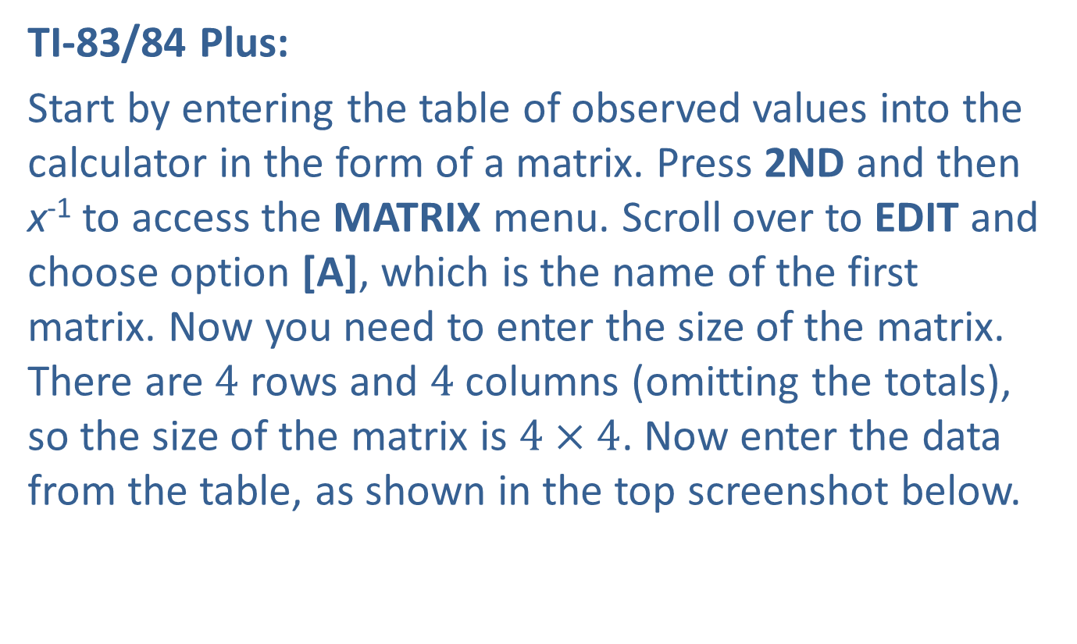
Example 10.7.2: Performing a Chi-Square Test for Association (cont.)
TI-83/84 Plus:
Start by entering the table of observed values into the calculator in the form of a matrix. Press 2ND and then x⁻¹ to access the MATRIX menu. Scroll over to EDIT and choose option [A], which is the name of the first matrix. Now you need to enter the size of the matrix. There are 4 rows and 4 columns (omitting the totals), so the size of the matrix is $4×4$. Now enter the data from the table, as shown in the top screenshot below.

Slide 37
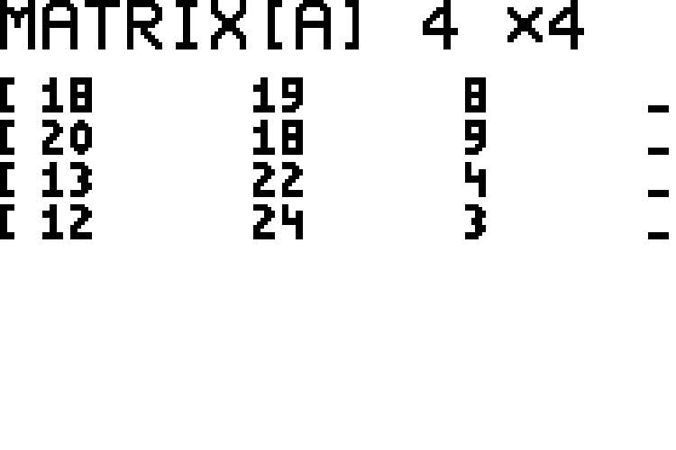
Example 10.7.2: Performing a Chi-Square Test for Association (cont.)

Slide 38
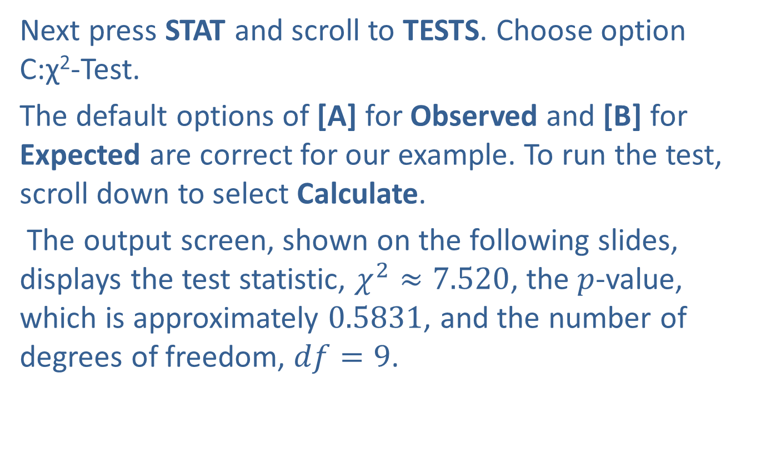
Example 10.7.2: Performing a Chi-Square Test for Association (cont.)
Next press STAT and scroll to TESTS. Choose option C:χ²-Test.
The default options of [A] for Observed and [B] for Expected are correct for our example. To run the test, scroll down to select Calculate.
The output screen, shown on the following slides, displays the test statistic, $χ^{2}≈7.520$, the $p$-value, which is approximately 0.5831, and the number of degrees of freedom, $df=9$.

Slide 39
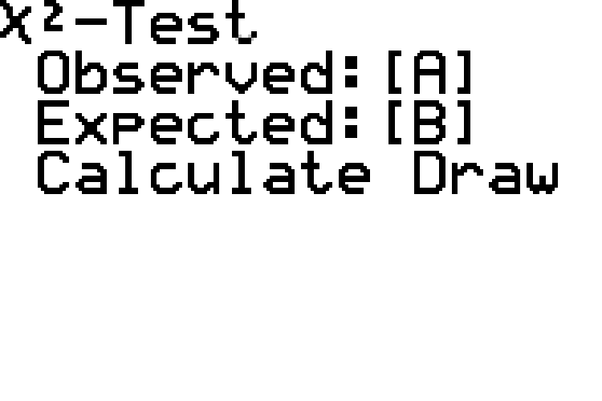
Example 10.7.2: Performing a Chi-Square Test for Association (cont.)

Slide 40
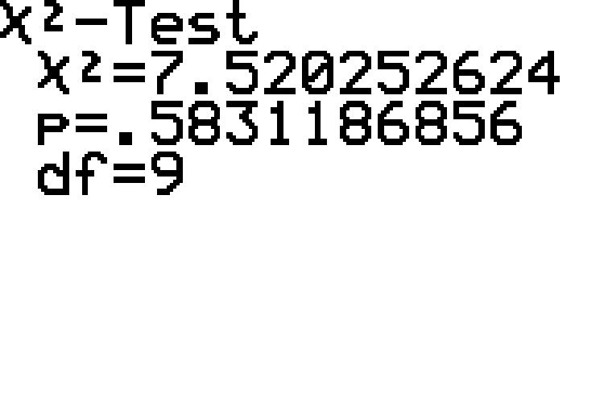
Example 10.7.2: Performing a Chi-Square Test for Association (cont.)

Slide 41
Example 10.7.2: Performing a Chi-Square Test for Association (cont.)
After running the test, we can view the matrix of expected values calculated by the TI-83/84 Plus. Press 2ND and then x⁻¹ to access the MATRIX menu. Then scroll over to EDIT and choose option [B]. The matrix of expected values is shown in the screenshot below.

Slide 42
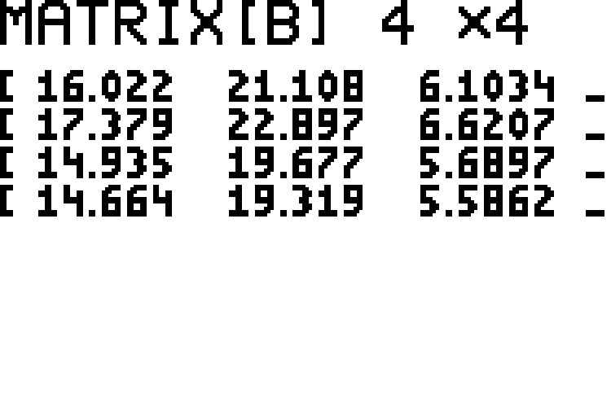
Example 10.7.2: Performing a Chi-Square Test for Association (cont.)

Slide 43
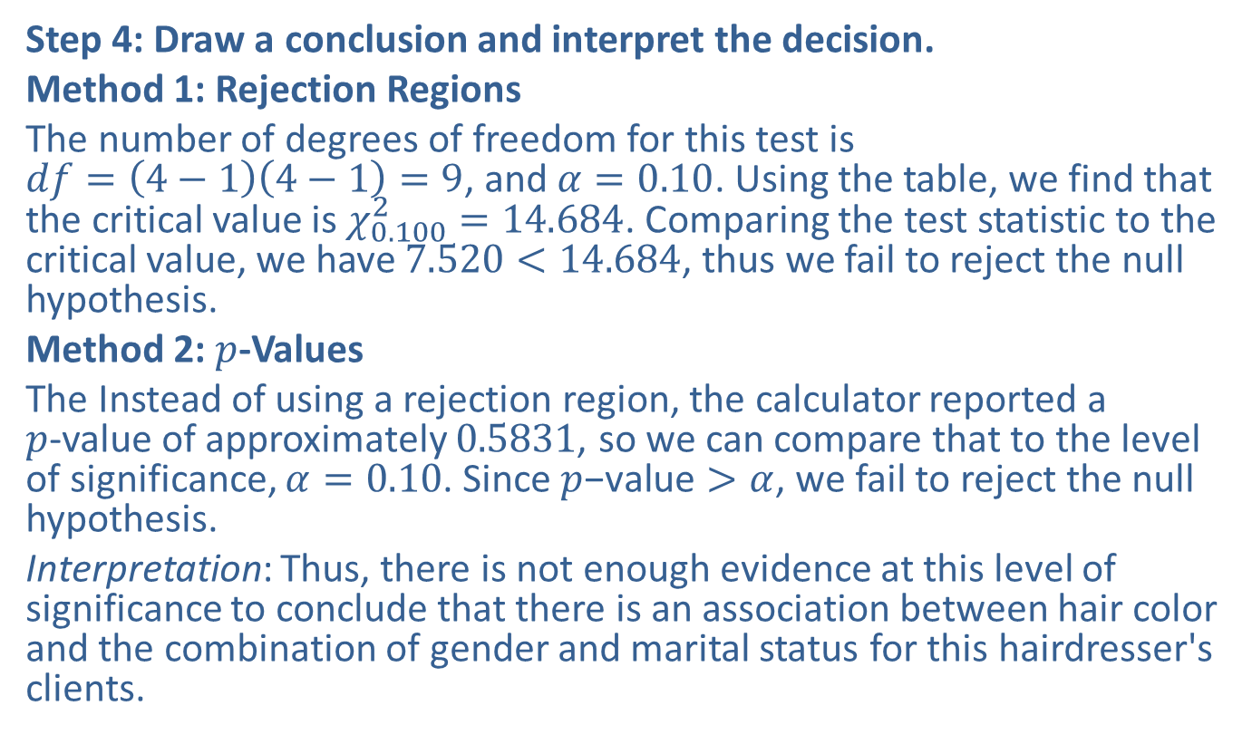
Example 10.7.2: Performing a Chi-Square Test for Association (cont.)
Step 4: Draw a conclusion and interpret the decision.
Method 1: Rejection Regions
The number of degrees of freedom for this test is $df=\left(4−1\right)\left(4−1\right)=9$, and $α=0.10$. Using the table, we find that the critical value is $χ_{0.100}^{2}=14.684$. Comparing the test statistic to the critical value, we have $7.520<14.684$, thus we fail to reject the null hypothesis.
Method 2: $p$-Values
The Instead of using a rejection region, the calculator reported a $p$-value of approximately 0.5831, so we can compare that to the level of significance, $α=0.10$. Since $p\text{−}\text{value}>α$, we fail to reject the null hypothesis.
Interpretation: Thus, there is not enough evidence at this level of significance to conclude that there is an association between hair color and the combination of gender and marital status for this hairdresser's clients.

