Slide 1
Section 11.1
Hypothesis Testing: Two Population Means (Sigma Known, Independent Samples)

Slide 2
Procedure: Performing a Hypothesis Test
​State the null and alternative hypotheses.
​Determine which distribution to use for the test statistic, and state the level of significance.
​Gather data and calculate the necessary sample statistics.
​Draw a conclusion and interpret the decision.

Slide 3
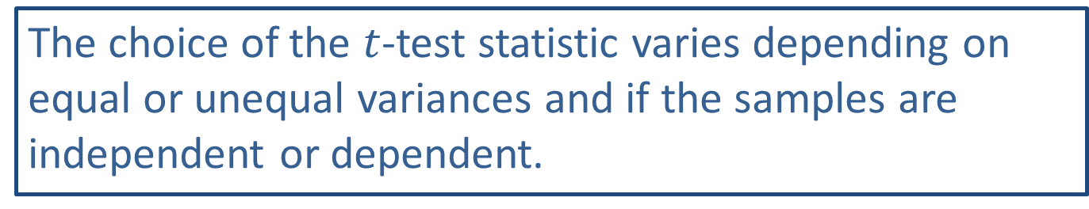
Side Note
The choice of the $t$-test statistic varies depending on equal or unequal variances and if the samples are independent or dependent.

Slide 4
Properties: Conclusions for a Hypothesis Test
Reject the null hypothesis.
Fail to reject the null hypothesis.

Slide 5
Memory Booster:
Two samples are said to be independent if the data from the first sample are not connected to the data from the second sample.

Slide 6
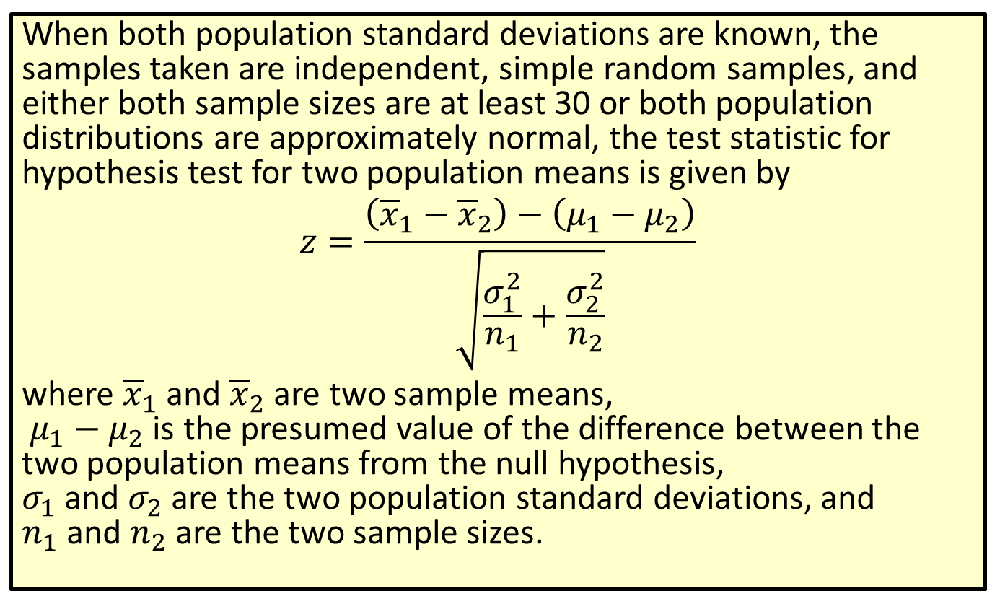
Formula: Test Statistic for a Hypothesis Test for Two Population Means (σ Known, Independent Samples)
When both population standard deviations are known, the samples taken are independent, simple random samples, and either both sample sizes are at least 30 or both population distributions are approximately normal, the test statistic for hypothesis test for two population means is given by
$$z=\frac{\left({\overline{x}}_{1}−{\overline{x}}_{2}\right)−\left(μ_{1}−μ_{2}\right)}{\sqrt{\frac{σ_{1}^{2}}{n_{1}}+\frac{σ_{2}^{2}}{n_{2}}}}$$
where ${\overline{x}}_{1}$ and ${\overline{x}}_{2}$ are two sample means,
$μ_{1}−μ_{2}$ is the presumed value of the difference between the two population means from the null hypothesis,
$σ_{1}$ and $σ_{2}$ are the two population standard deviations, and
$n_{1}$ and $n_{2}$ are the two sample sizes.

Slide 7
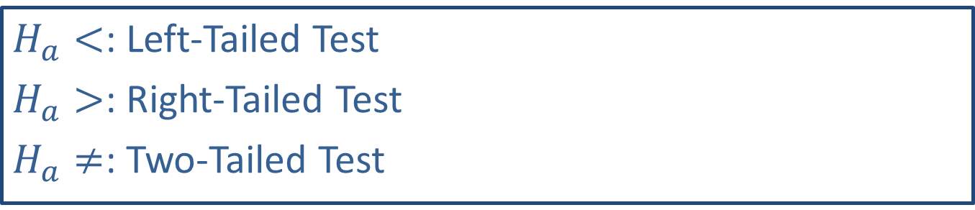
Memory Booster:
$H_{a}<$: Left-Tailed Test
$H_{a}>$: Right-Tailed Test
$H_{a}≠$: Two-Tailed Test

Slide 8
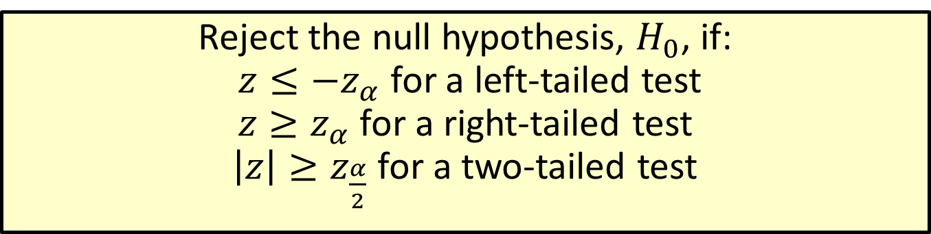
Procedure: Rejection Regions for Hypothesis Tests for Population Means (σ Known, Independent Samples)
Reject the null hypothesis, $H_{0}$, if:
$z≤−z_{α}$ for a left-tailed test
$z≥z_{α}$ for a right-tailed test
$\left|z\right|≥z_{\frac{α}{2}}$ for a two-tailed test

Slide 9
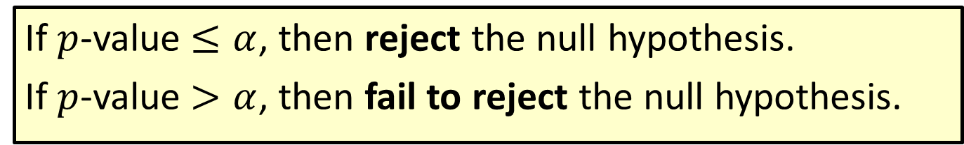

Procedure: Conclusions Using $p$-Values
If $p$-value $≤α$, then reject the null hypothesis.
If $p$-value $>α$, then fail to reject the null hypothesis.

Slide 10
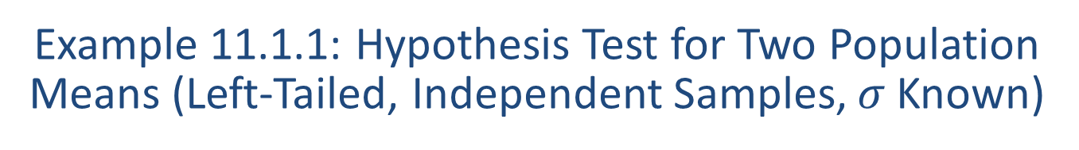
Example 11.1.1: Hypothesis Test for Two Population Means (Left-Tailed, Independent Samples, $σ$ Known)
A university researcher is interested in a new instructional method of English for university freshmen whose scores require them to complete remedial work. He is comparing the traditional two-semester instruction against the new one-semester co-requisite instruction. He wants to test the claim that students who are in the traditional English remediation sequence score lower on the departmental final exam in English Composition I than their counterparts in the new single semester co-requisite English class. Ninety-three randomly selected students were chosen for the study. Of this group, 41 students were randomly chosen from the group who took the traditional remediation English classes. This group scored a mean of 66.47 on the departmental final exam. The other 52 students were randomly chosen from the new one semester co-requisite English classes and scored a mean of 69.43 on the final exam. Assume that the population standard deviation for students in the traditional English class is known to be 8.05 and the population standard deviation for students in the new co-requisite English class is known to be 9.22. Test the claim using a 0.10 level of significance.

Slide 11
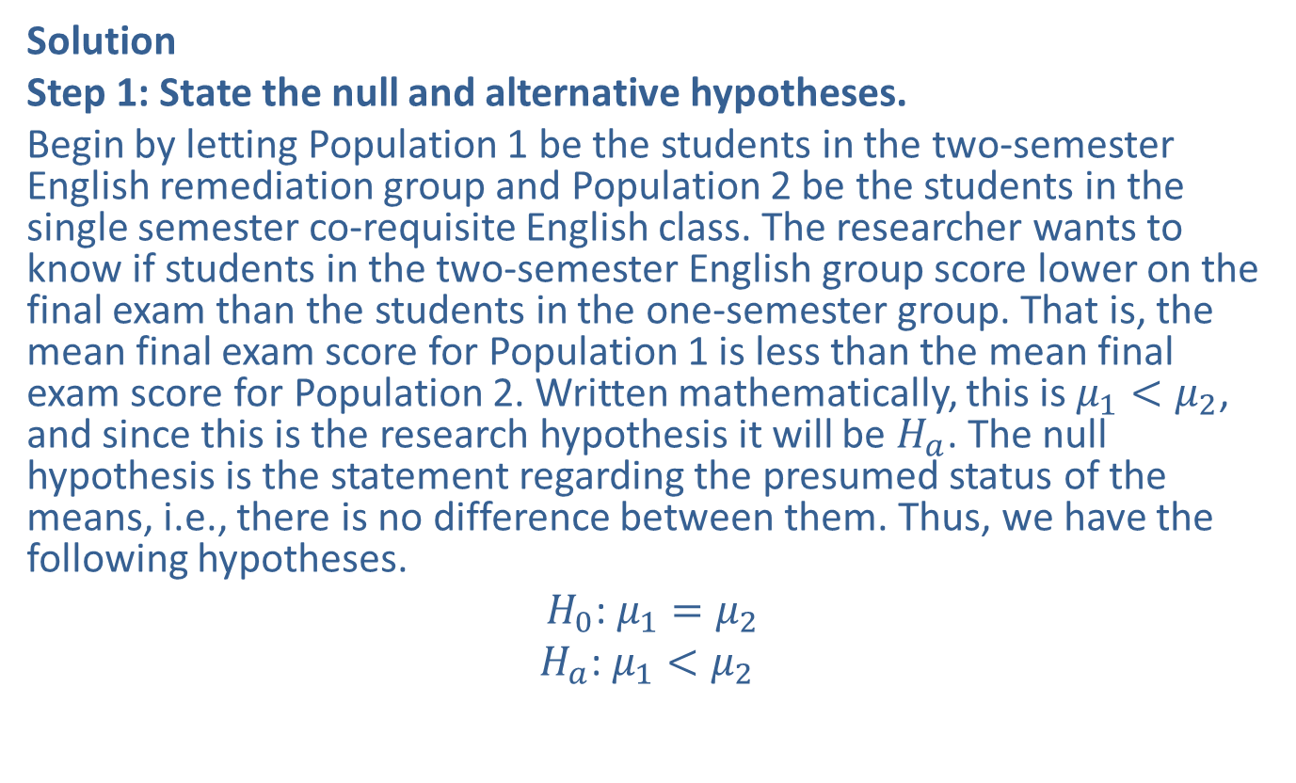
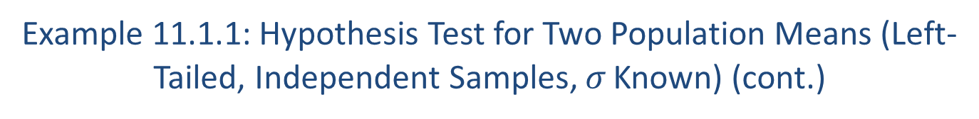
Example 11.1.1: Hypothesis Test for Two Population Means (Left-Tailed, Independent Samples, $σ$ Known) (cont.)
Solution
Step 1: State the null and alternative hypotheses.
Begin by letting Population 1 be the students in the two-semester English remediation group and Population 2 be the students in the single semester co-requisite English class. The researcher wants to know if students in the two-semester English group score lower on the final exam than the students in the one-semester group. That is, the mean final exam score for Population 1 is less than the mean final exam score for Population 2. Written mathematically, this is $μ_{1}<μ_{2}$, and since this is the research hypothesis it will be $H_{a}$. The null hypothesis is the statement regarding the presumed status of the means, i.e., there is no difference between them. Thus, we have the following hypotheses.
$H_{0}$: $μ_{1}=μ_{2}$
$H_{a}$: $μ_{1}<μ_{2}$

Slide 12
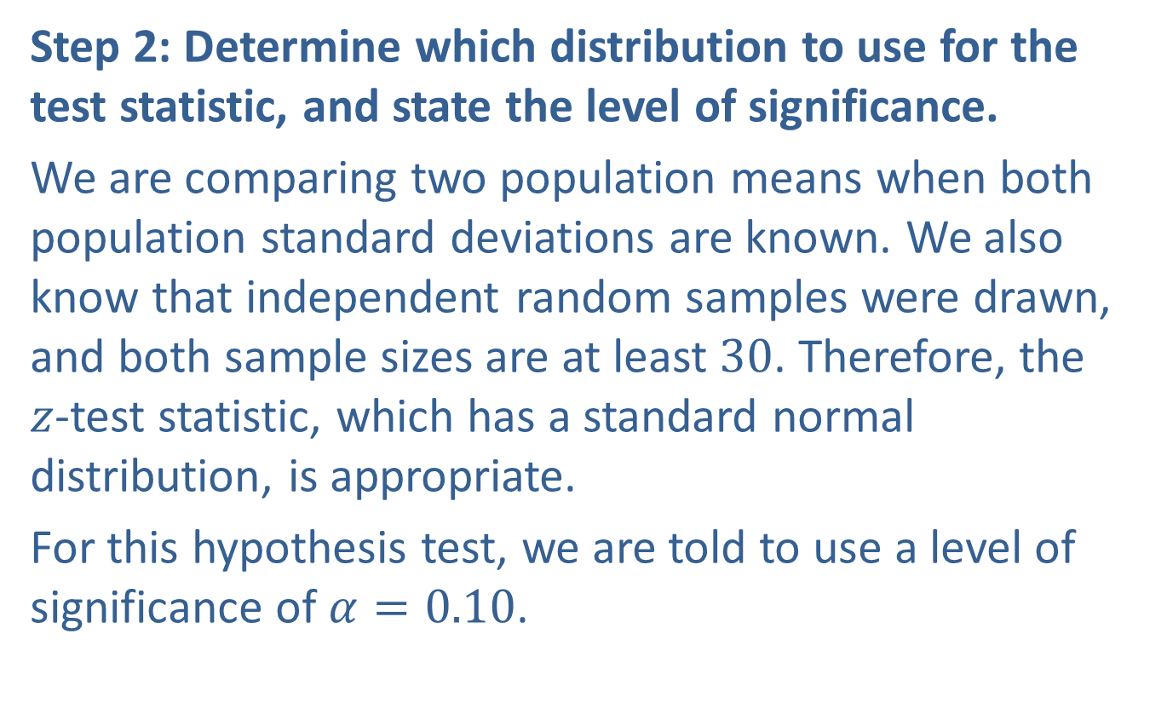
Example 11.1.1: Hypothesis Test for Two Population Means (Left-Tailed, Independent Samples, $σ$ Known) (cont.)
Step 2: Determine which distribution to use for the test statistic, and state the level of significance.
We are comparing two population means when both population standard deviations are known. We also know that independent random samples were drawn, and both sample sizes are at least 30. Therefore, the
$z$-test statistic, which has a standard normal distribution, is appropriate.
For this hypothesis test, we are told to use a level of significance of $α=0.10$.

Slide 13
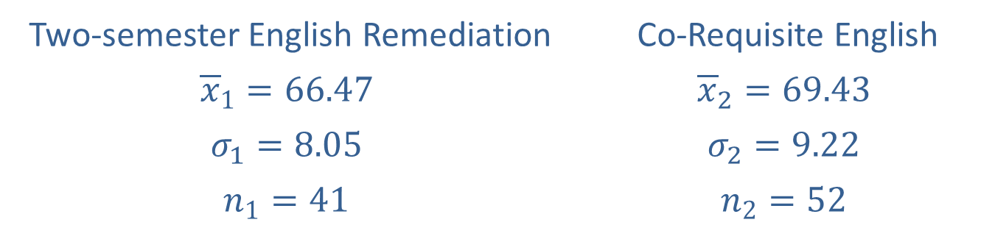
Example 11.1.1: Hypothesis Test for Two Population Means (Left-Tailed, Independent Samples, $σ$ Known) (cont.)
Step 3: Gather data and calculate the necessary sample statistics.
The following values were given in the problem.
Two-semester English Remediation | Co-Requisite English
$${\overline{x}}_{1}=66.47$$ | $${\overline{x}}_{2}=69.43$$
$$σ_{1}=8.05$$ | $$σ_{2}=9.22$$
$$n_{1}=41$$ | $$n_{2}=52$$

Slide 14
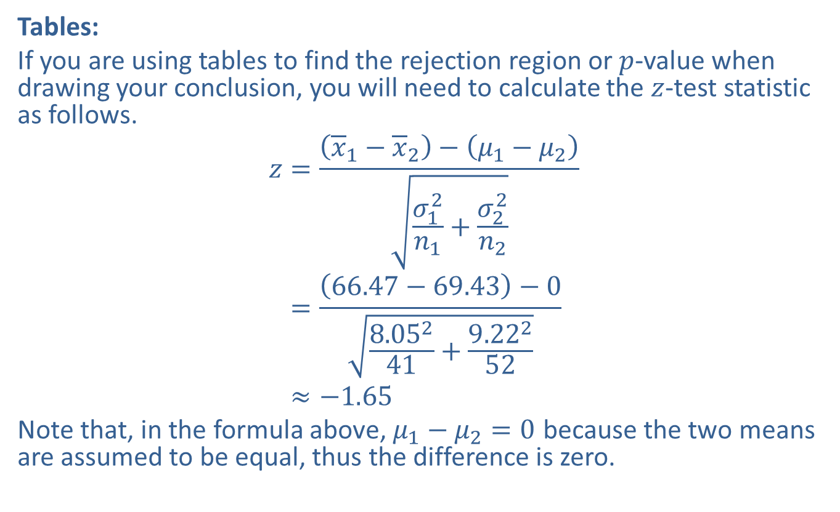
Example 11.1.1: Hypothesis Test for Two Population Means (Left-Tailed, Independent Samples, $σ$ Known) (cont.)
Tables:
If you are using tables to find the rejection region or $p$-value when drawing your conclusion, you will need to calculate the $z$-test statistic as follows.
𝑧=𝑥1−𝑥2−𝜇1−𝜇2𝜎12𝑛1+𝜎22𝑛2𝑧=66.47−69.43−08.05241+9.22252𝑧≈−1.65
Note that, in the formula above, $μ_{1}−μ_{2}=0$ because the two means are assumed to be equal, thus the difference is zero.

Slide 15
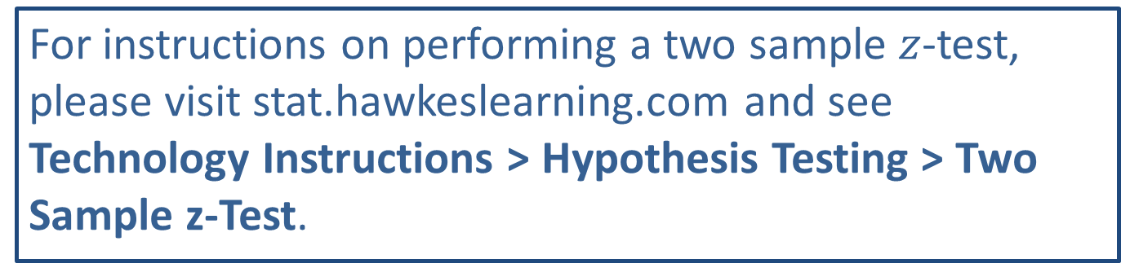
Technology
For instructions on performing a two sample $z$-test, please visit stat.hawkeslearning.com and see Technology Instructions > Hypothesis Testing > Two Sample z-Test.

Slide 16
Example 11.1.1: Hypothesis Test for Two Population Means (Left-Tailed, Independent Samples, $σ$ Known) (cont.)
TI-83/84 Plus:
Under the STATS>TESTS menu, choose 2-SampZTest. Since we know the sample statistics, choose Stats instead of Data. (Choose the Data option if listing the original data in the Lists.) After filling in the values as shown in the screenshots below, choose the type of test that the alternative hypothesis dictates, that is, a left-tailed test, <μ2.

Slide 17
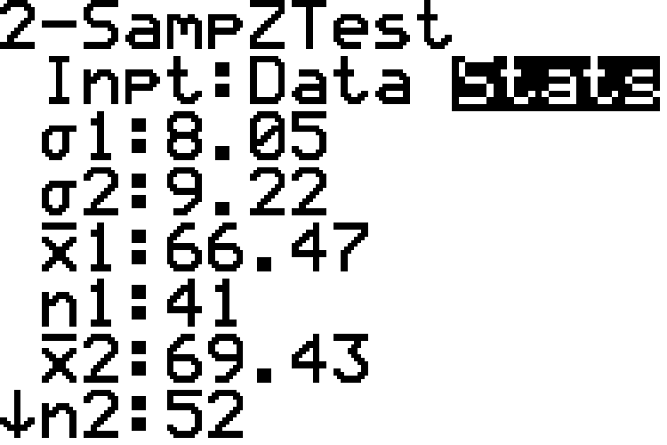
Example 11.1.1: Hypothesis Test for Two Population Means (Left-Tailed, Independent Samples, $σ$ Known) (cont.)

Slide 18
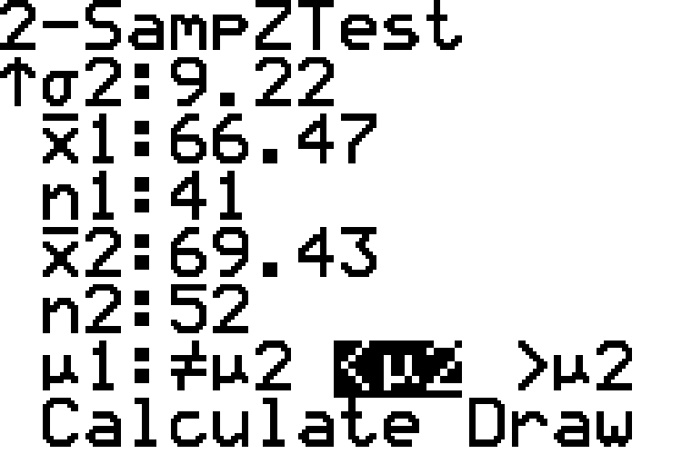
Example 11.1.1: Hypothesis Test for Two Population Means (Left-Tailed, Independent Samples, $σ$ Known) (cont.)

Slide 19
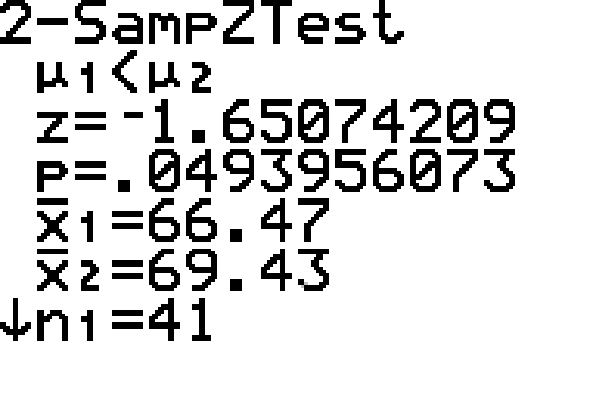
Example 11.1.1: Hypothesis Test for Two Population Means (Left-Tailed, Independent Samples, $σ$ Known) (cont.)
Choosing Calculate produces the following results.

Slide 20

Example 11.1.1: Hypothesis Test for Two Population Means (Left-Tailed, Independent Samples, $σ$ Known) (cont.)
First, note that the calculator displays the alternative hypothesis. As shown in the screenshots, the $z$-score is approximately $−1.65$. The output also shows the
$p$-value, which we will discuss shortly. The sample means and sample sizes are then repeated.

Slide 21

Example 11.1.1: Hypothesis Test for Two Population Means (Left-Tailed, Independent Samples, $σ$ Known) (cont.)
Step 4: Draw a conclusion and interpret the decision.
The alternative hypothesis tells us that we have a left-tailed test. We can use either rejection regions or
$p$-values to draw a conclusion.

Slide 22
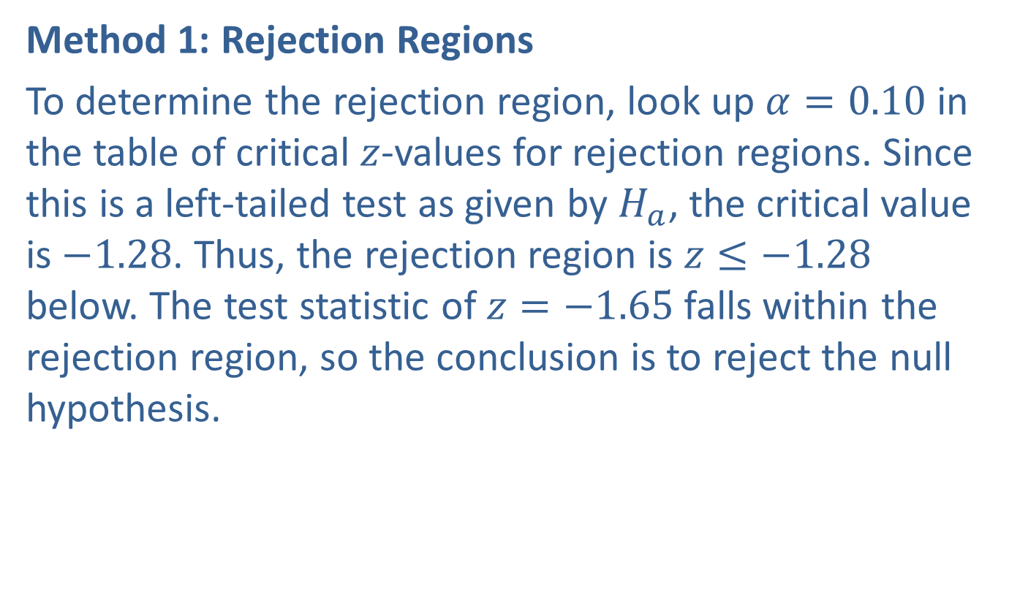
Example 11.1.1: Hypothesis Test for Two Population Means (Left-Tailed, Independent Samples, $σ$ Known) (cont.)
Method 1: Rejection Regions
To determine the rejection region, look up $α=0.10$ in the table of critical $z$-values for rejection regions. Since this is a left-tailed test as given by $H_{a}$, the critical value is $−1.28$. Thus, the rejection region is $z≤−1.28$ below. The test statistic of $z=−1.65$ falls within the rejection region, so the conclusion is to reject the null hypothesis.

Slide 23
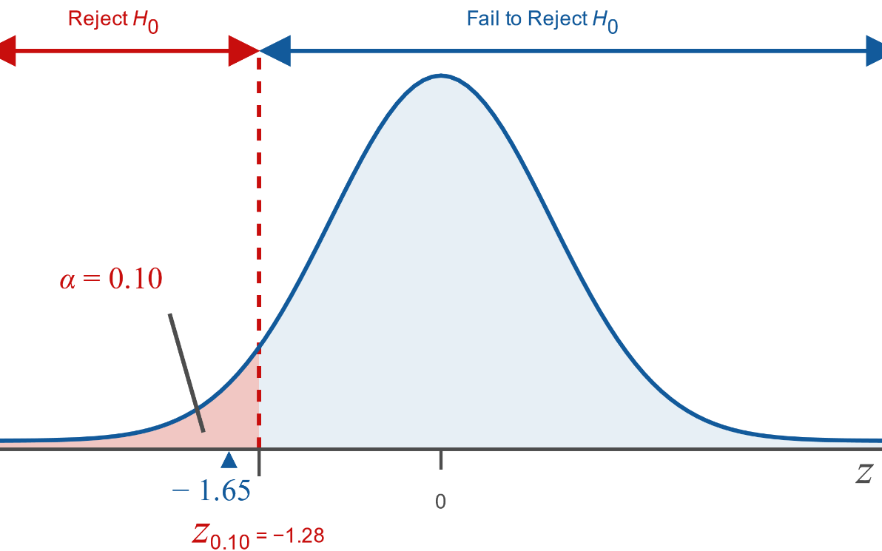
Example 11.1.1: Hypothesis Test for Two Population Means (Left-Tailed, Independent Samples, $σ$ Known) (cont.)

Slide 24
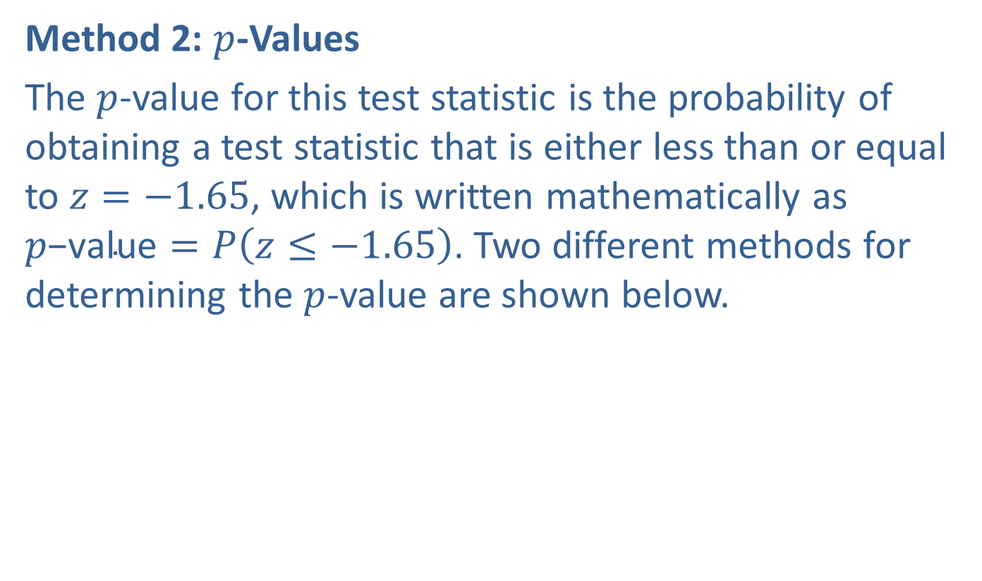
Example 11.1.1: Hypothesis Test for Two Population Means (Left-Tailed, Independent Samples, $σ$ Known) (cont.)
Method 2: $p$-Values
The $p$-value for this test statistic is the probability of obtaining a test statistic that is either less than or equal to $z=−1.65$, which is written mathematically as $p\text{−}\text{value}=P\left(z≤−1.65\right)$. Two different methods for determining the $p$-value are shown below.

Slide 25
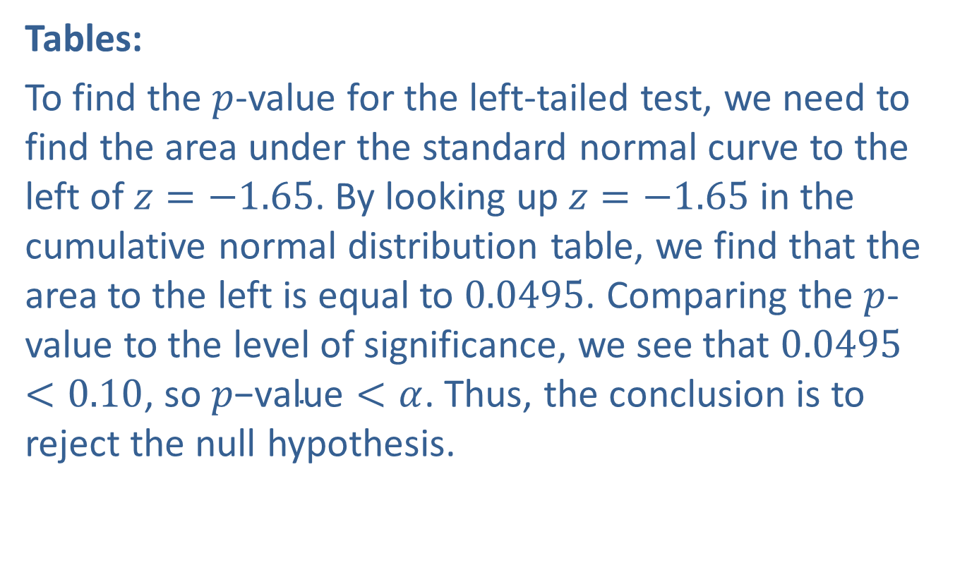
Example 11.1.1: Hypothesis Test for Two Population Means (Left-Tailed, Independent Samples, $σ$ Known) (cont.)
Tables:
To find the $p$-value for the left-tailed test, we need to find the area under the standard normal curve to the left of $z=−1.65$. By looking up $z=−1.65$ in the cumulative normal distribution table, we find that the area to the left is equal to 0.0495. Comparing the $p$-value to the level of significance, we see that $0.0495<0.10$, so $p\text{−}\text{value}<α$. Thus, the conclusion is to reject the null hypothesis.

Slide 26
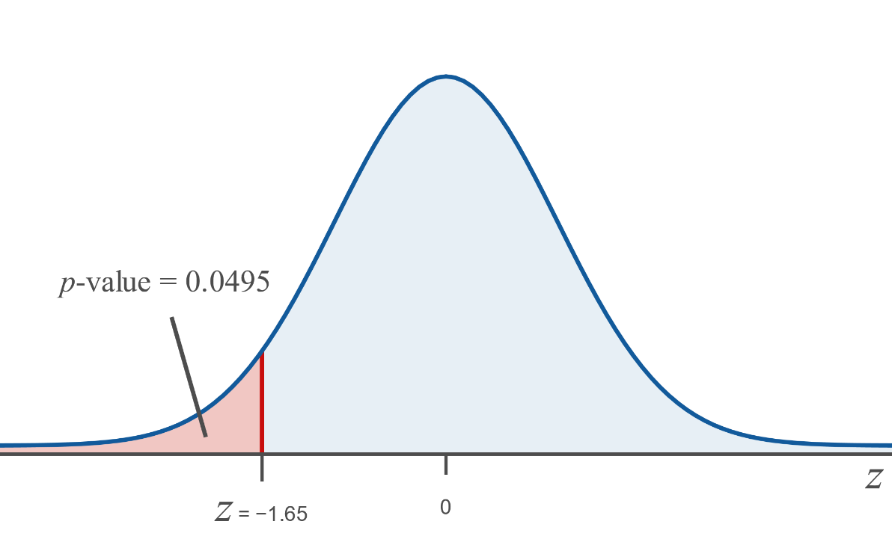
Example 11.1.1: Hypothesis Test for Two Population Means (Left-Tailed, Independent Samples, $σ$ Known) (cont.)

Slide 27
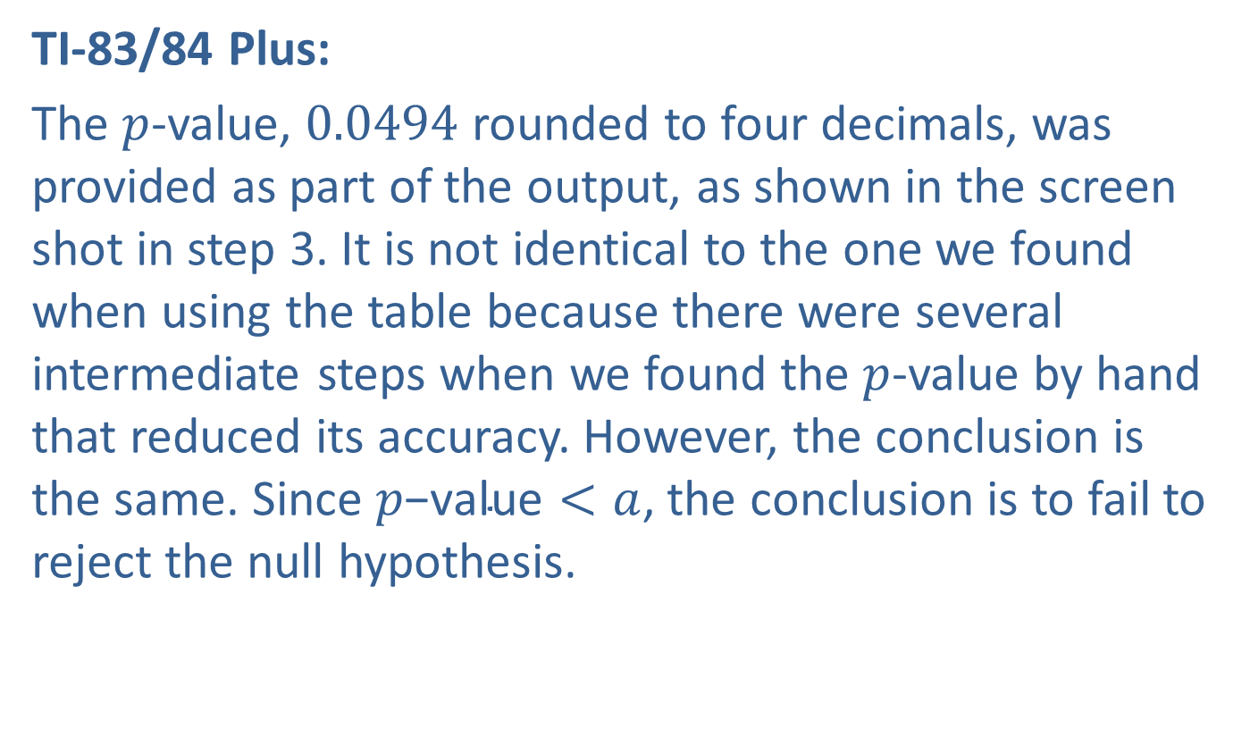
Example 11.1.1: Hypothesis Test for Two Population Means (Left-Tailed, Independent Samples, $σ$ Known) (cont.)
TI-83/84 Plus:
The $p$-value, 0.0494 rounded to four decimals, was provided as part of the output, as shown in the screen shot in step 3. It is not identical to the one we found when using the table because there were several intermediate steps when we found the $p$-value by hand that reduced its accuracy. However, the conclusion is the same. Since $p\text{−}\text{value}<a$, the conclusion is to fail to reject the null hypothesis.

Slide 28
Example 11.1.1: Hypothesis Test for Two Population Means (Left-Tailed, Independent Samples, $σ$ Known) (cont.)
Interpretation: Rejecting the null hypothesis indicates that there is sufficient evidence at the 0.10 level of significance to say that the mean final exam score for students who took the two-semester remediation English class is less than the mean score of students in the single-semester co-requisite English class.

Slide 29
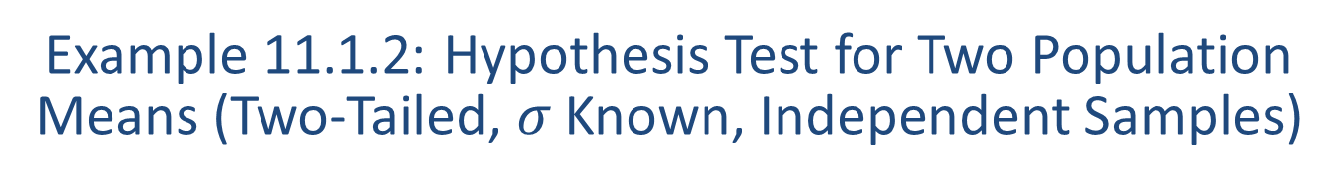
Example 11.1.2: Hypothesis Test for Two Population Means (Two-Tailed, $σ$ Known, Independent Samples)
Two universities in the same state are rivals about everything. Each university believes that its students are more physically fit than the students at the other university. To test the claim that there is a difference in the average fitness levels of students at the two universities, 36 randomly selected students at the first university were surveyed and found to exercise for a mean of 2.9 hours per week. A random sample of 38 students at the second university was also surveyed and this group was found to exercise for a mean of 2.7 hours per week. Assume that the population standard deviation for hours of exercise at the first university is known to be 1.1 hours per week and the population standard deviation for the second university is known to be 1.0 hour per week. Use a 0.90 level of confidence to perform a hypothesis test to determine if there is a difference in the average fitness levels of students at the two universities.

Slide 30
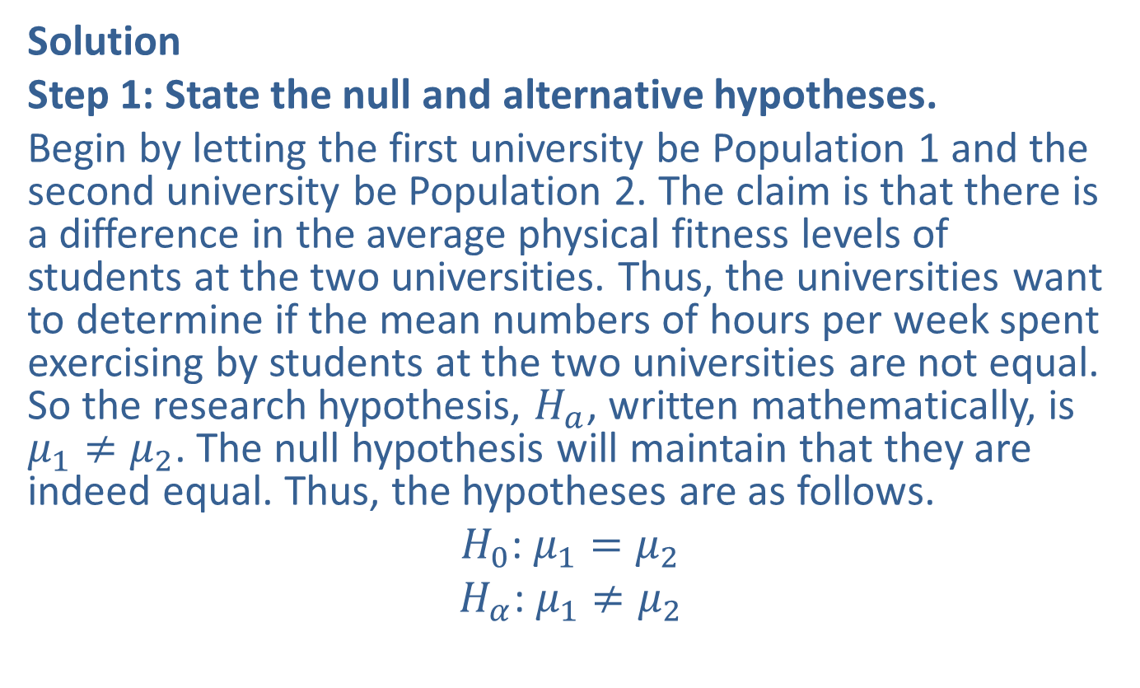
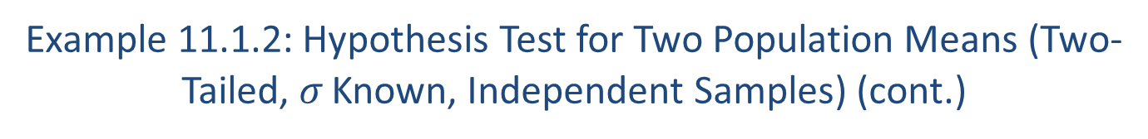
Example 11.1.2: Hypothesis Test for Two Population Means (Two-Tailed, $σ$ Known, Independent Samples) (cont.)
Solution
Step 1: State the null and alternative hypotheses.
Begin by letting the first university be Population 1 and the second university be Population 2. The claim is that there is a difference in the average physical fitness levels of students at the two universities. Thus, the universities want to determine if the mean numbers of hours per week spent exercising by students at the two universities are not equal. So the research hypothesis, $H_{a}$, written mathematically, is $μ_{1}≠μ_{2}$. The null hypothesis will maintain that they are indeed equal. Thus, the hypotheses are as follows.
$H_{0}$: $μ_{1}=μ_{2}$
$H_{α}$: $μ_{1}≠μ_{2}$

Slide 31
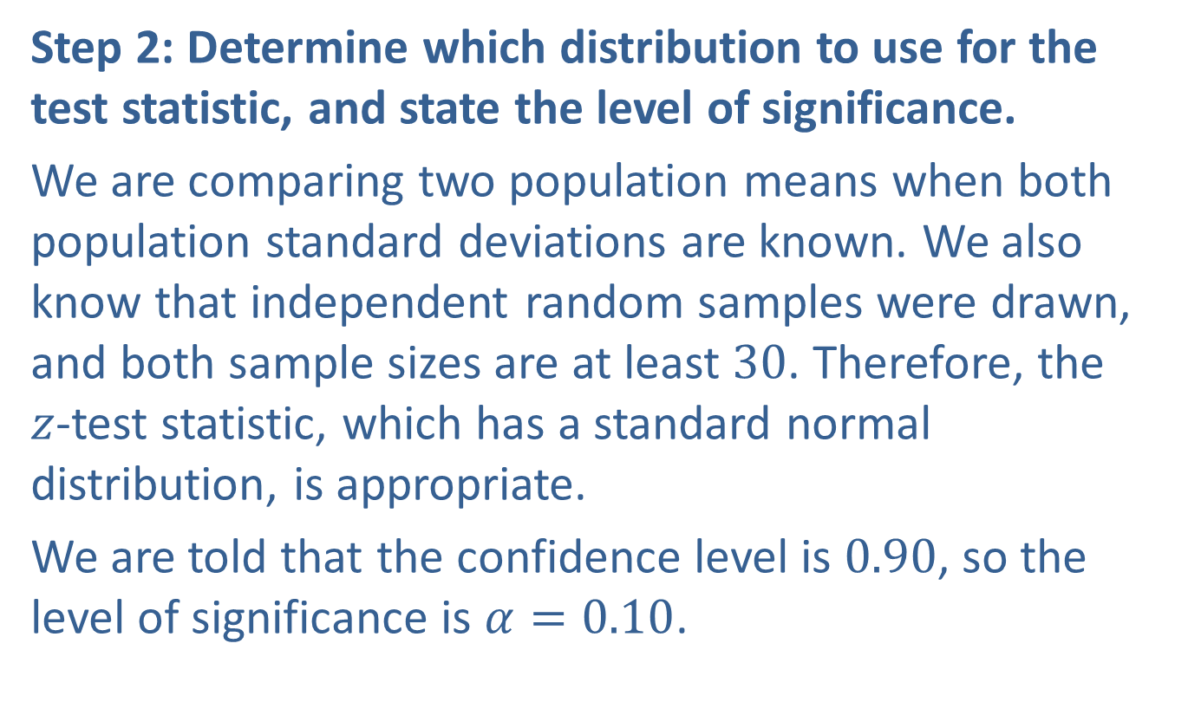
Example 11.1.2: Hypothesis Test for Two Population Means (Two-Tailed, $σ$ Known, Independent Samples) (cont.)
Step 2: Determine which distribution to use for the test statistic, and state the level of significance.
We are comparing two population means when both population standard deviations are known. We also know that independent random samples were drawn, and both sample sizes are at least 30. Therefore, the
$z$-test statistic, which has a standard normal distribution, is appropriate.
We are told that the confidence level is 0.90, so the level of significance is $α=0.10$.

Slide 32
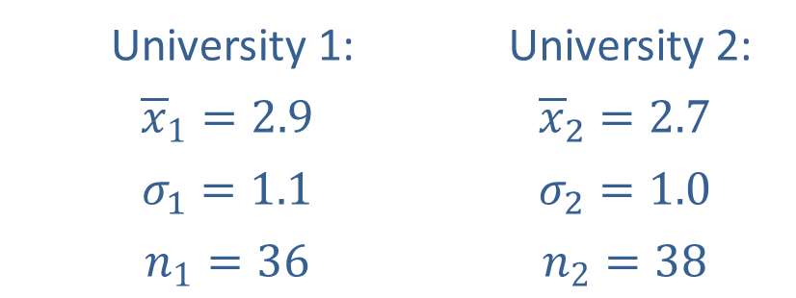
Example 11.1.2: Hypothesis Test for Two Population Means (Two-Tailed, $σ$ Known, Independent Samples) (cont.)
Step 3: Gather data and calculate the necessary sample statistics.
The following values were given in the problem.
University 1: | University 2:
$${\overline{x}}_{1}=2.9$$ | $${\overline{x}}_{2}=2.7$$
$$σ_{1}=1.1$$ | $$σ_{2}=1.0$$
$$n_{1}=36$$ | $$n_{2}=38$$

Slide 33
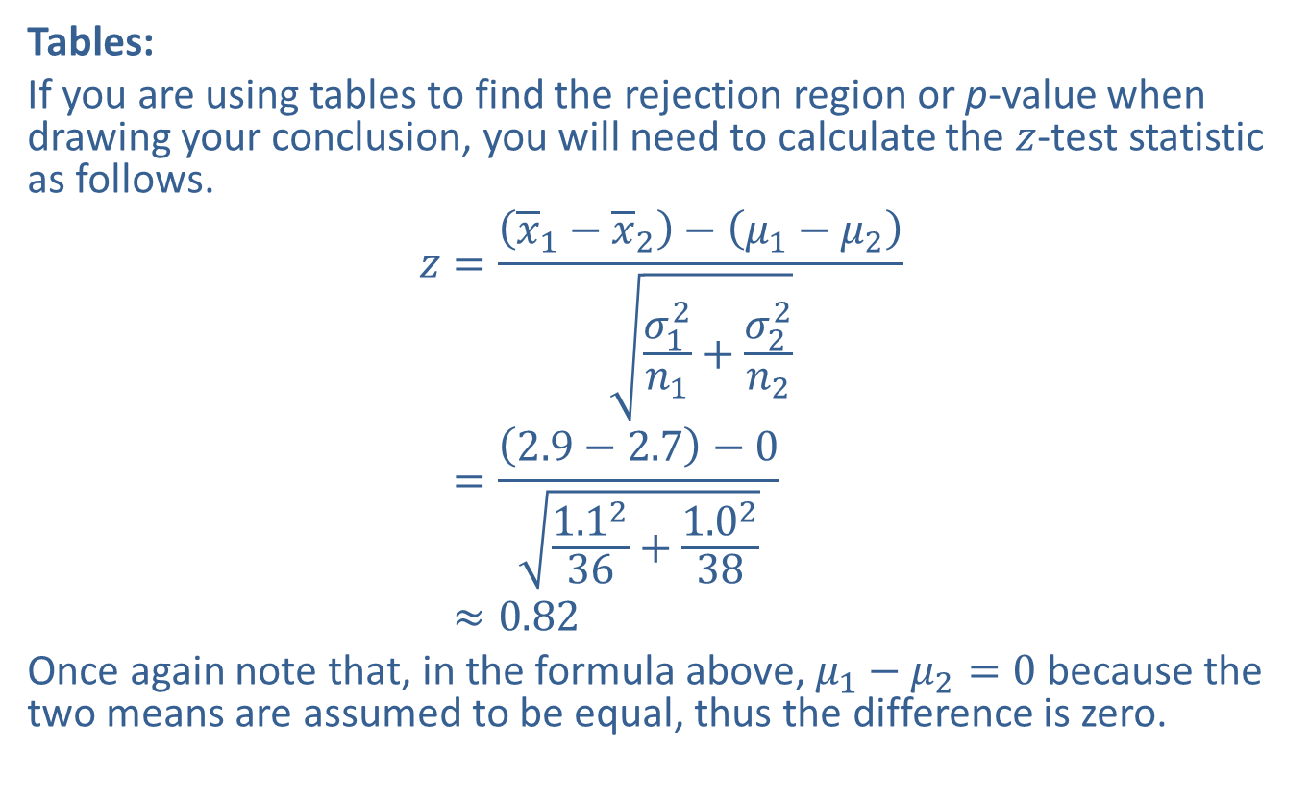
Example 11.1.2: Hypothesis Test for Two Population Means (Two-Tailed, $σ$ Known, Independent Samples) (cont.)
Tables:
If you are using tables to find the rejection region or p-value when drawing your conclusion, you will need to calculate the $z$-test statistic as follows.
𝑧=𝑥1−𝑥2−𝜇1−𝜇2𝜎12𝑛1+𝜎22𝑛2𝑧=2.9−2.7−01.1236+1.0238𝑧≈0.82
Once again note that, in the formula above, $μ_{1}−μ_{2}=0$ because the two means are assumed to be equal, thus the difference is zero.

Slide 34
Example 11.1.2: Hypothesis Test for Two Population Means (Two-Tailed, $σ$ Known, Independent Samples) (cont.)
TI-83/84 Plus
Under the STATS > TESTS menu, choose option 2-SampZTest. Since we know the sample statistics, choose Stats instead of Data. And fill in the required values, as shown in the screenshots below.

Slide 35
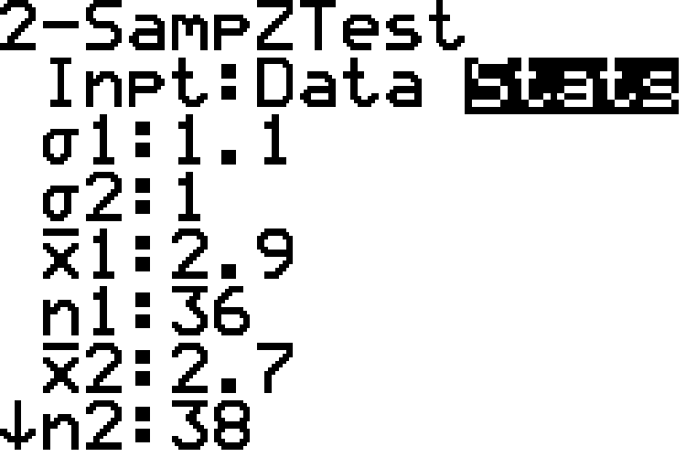
Example 11.1.2: Hypothesis Test for Two Population Means (Two-Tailed, $σ$ Known, Independent Samples) (cont.)

Slide 36
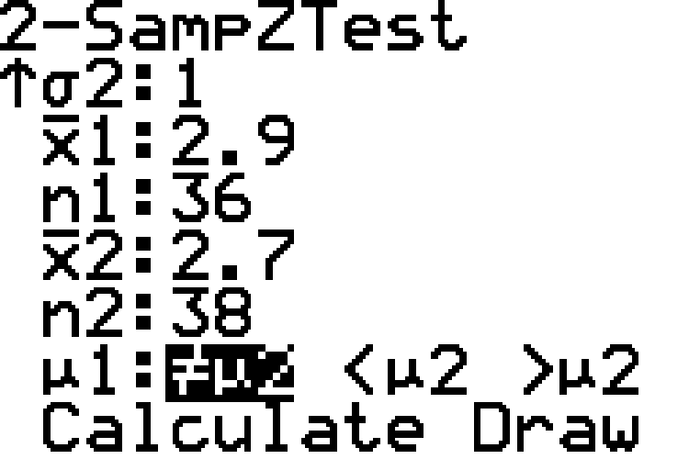
Example 11.1.2: Hypothesis Test for Two Population Means (Two-Tailed, $σ$ Known, Independent Samples) (cont.)

Slide 37
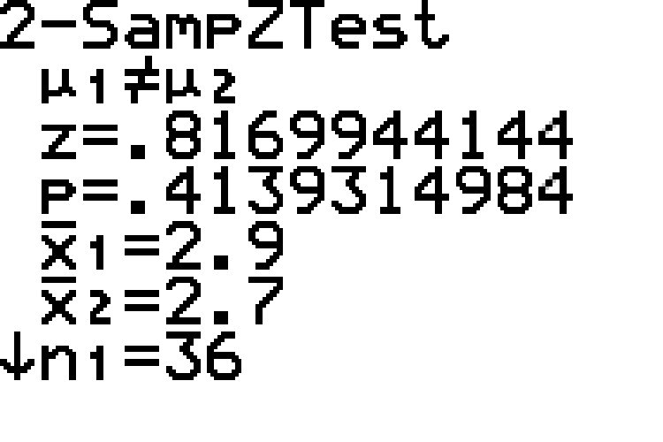
Example 11.1.2: Hypothesis Test for Two Population Means (Two-Tailed, $σ$ Known, Independent Samples) (cont.)
Choosing Calculate produces the following output screen. Again, notice that the alternate hypothesis is stated first.

Slide 38
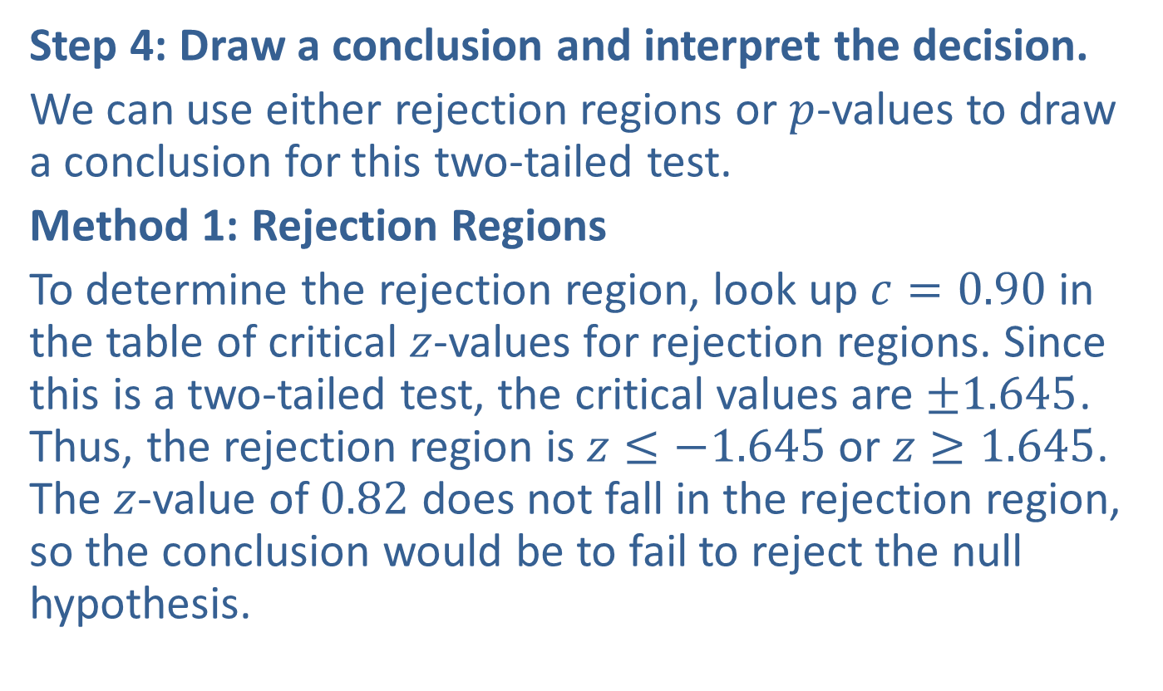
Example 11.1.2: Hypothesis Test for Two Population Means (Two-Tailed, $σ$ Known, Independent Samples) (cont.)
Step 4: Draw a conclusion and interpret the decision.
We can use either rejection regions or $p$-values to draw a conclusion for this two-tailed test.
Method 1: Rejection Regions
To determine the rejection region, look up $c=0.90$ in the table of critical $z$-values for rejection regions. Since this is a two-tailed test, the critical values are $±1.645$. Thus, the rejection region is $z≤−1.645$ or $z≥1.645$. The $z$-value of 0.82 does not fall in the rejection region, so the conclusion would be to fail to reject the null hypothesis.

Slide 39
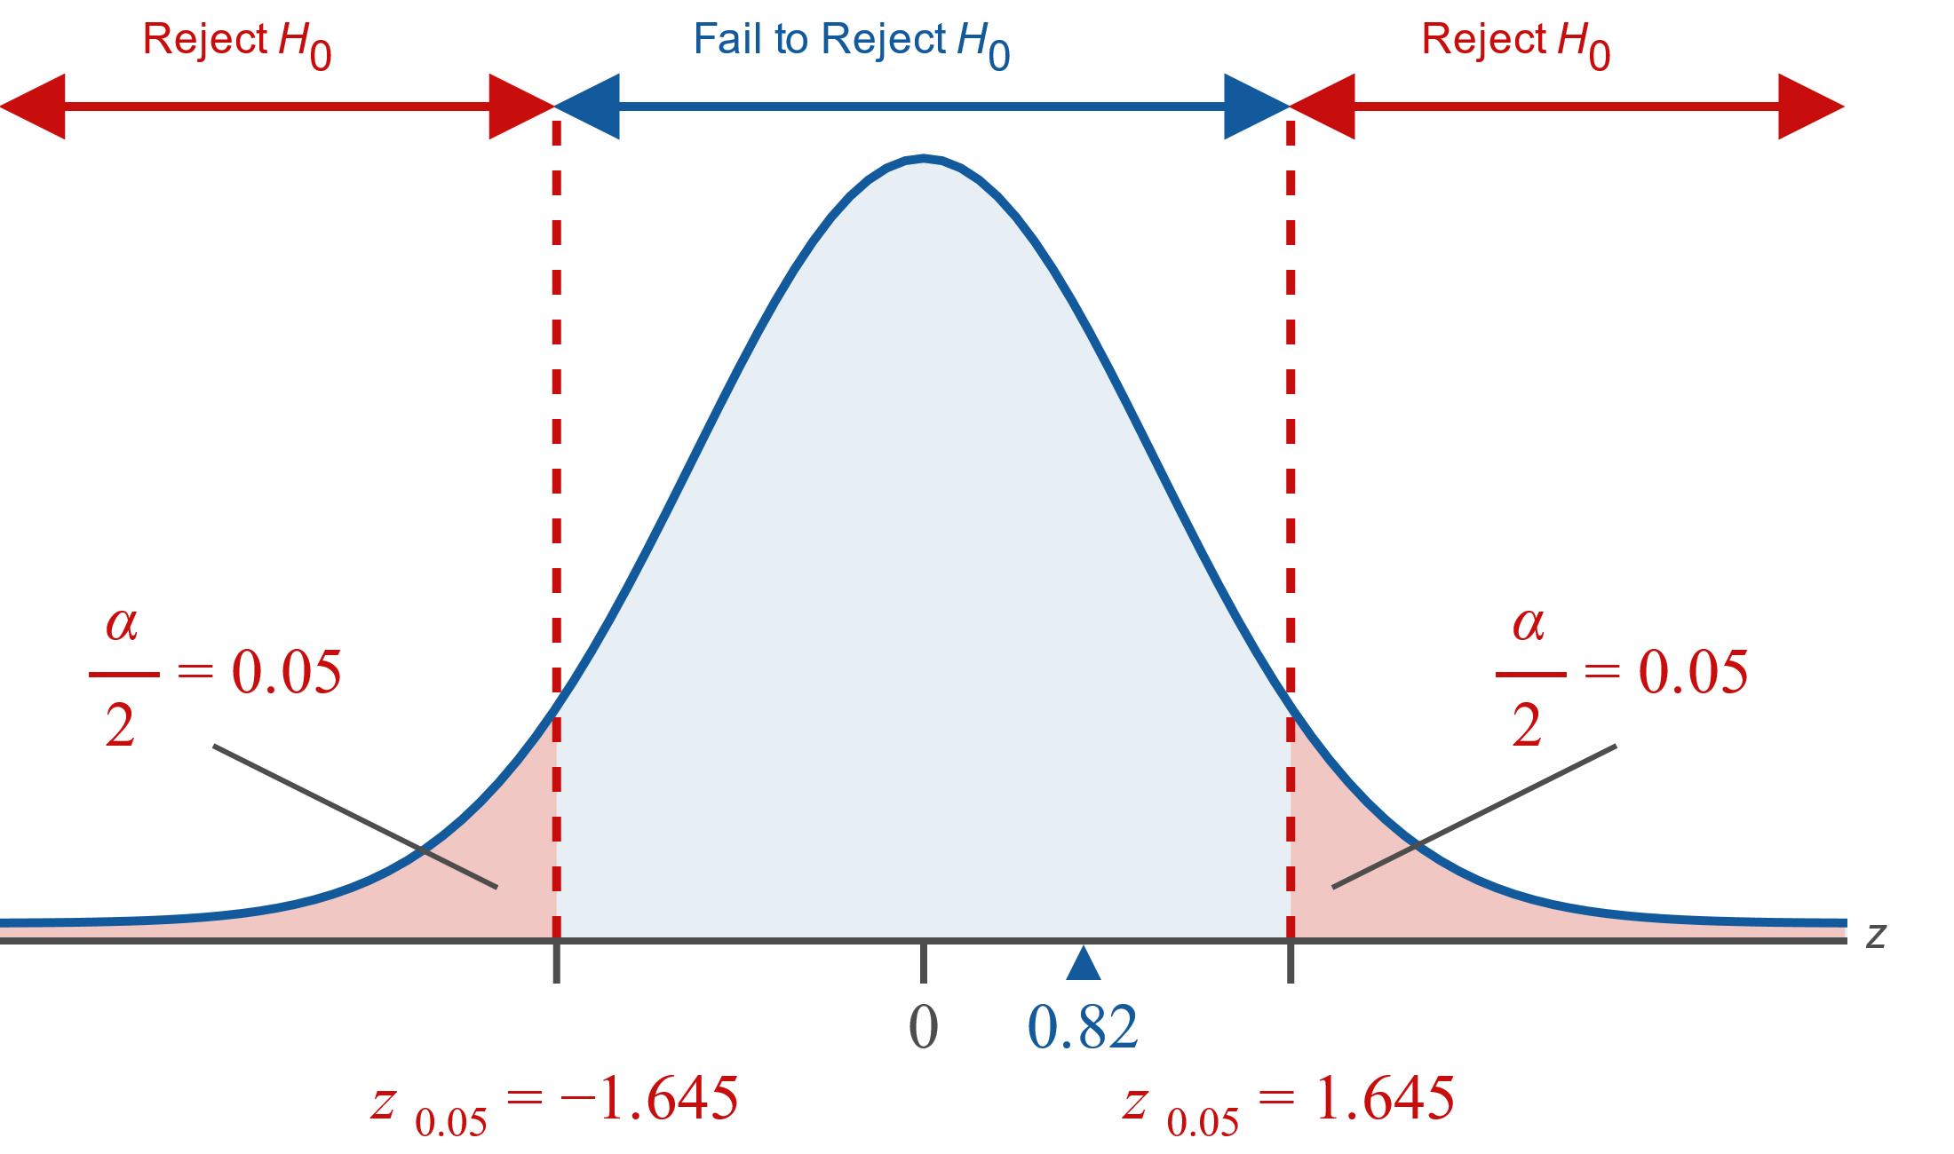
Example 11.1.2: Hypothesis Test for Two Population Means (Two-Tailed, $σ$ Known, Independent Samples) (cont.)

Slide 40
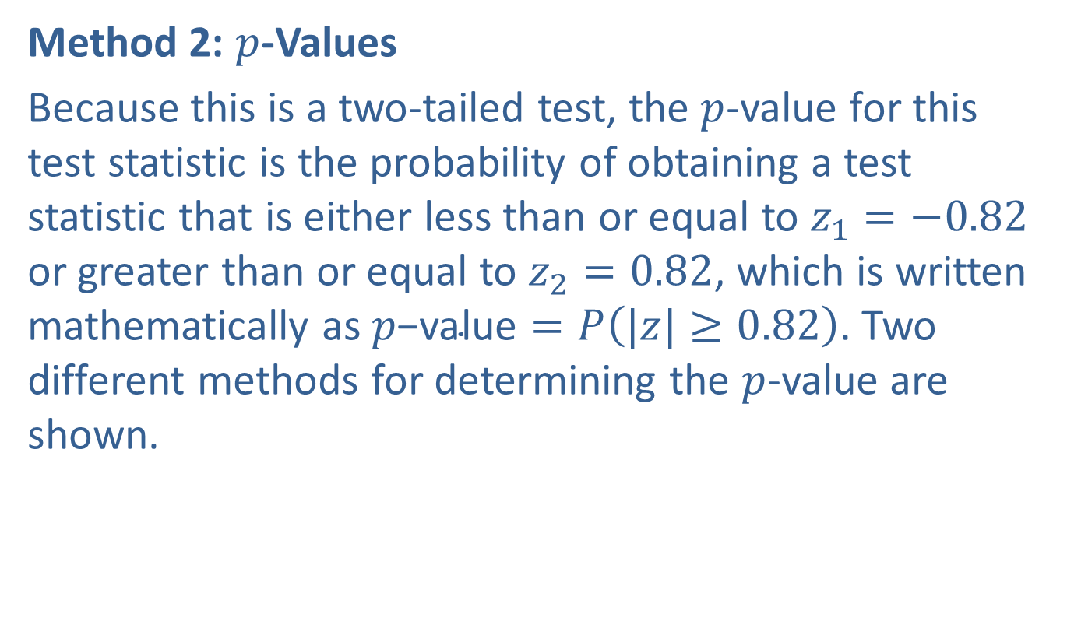
Example 11.1.2: Hypothesis Test for Two Population Means (Two-Tailed, $σ$ Known, Independent Samples) (cont.)
Method 2: $p$-Values
Because this is a two-tailed test, the $p$-value for this test statistic is the probability of obtaining a test statistic that is either less than or equal to $z_{1}=−0.82$ or greater than or equal to $z_{2}=0.82$, which is written mathematically as $p\text{−}\text{value}=P\left(|z|≥0.82\right)$. Two different methods for determining the $p$-value are shown.

Slide 41
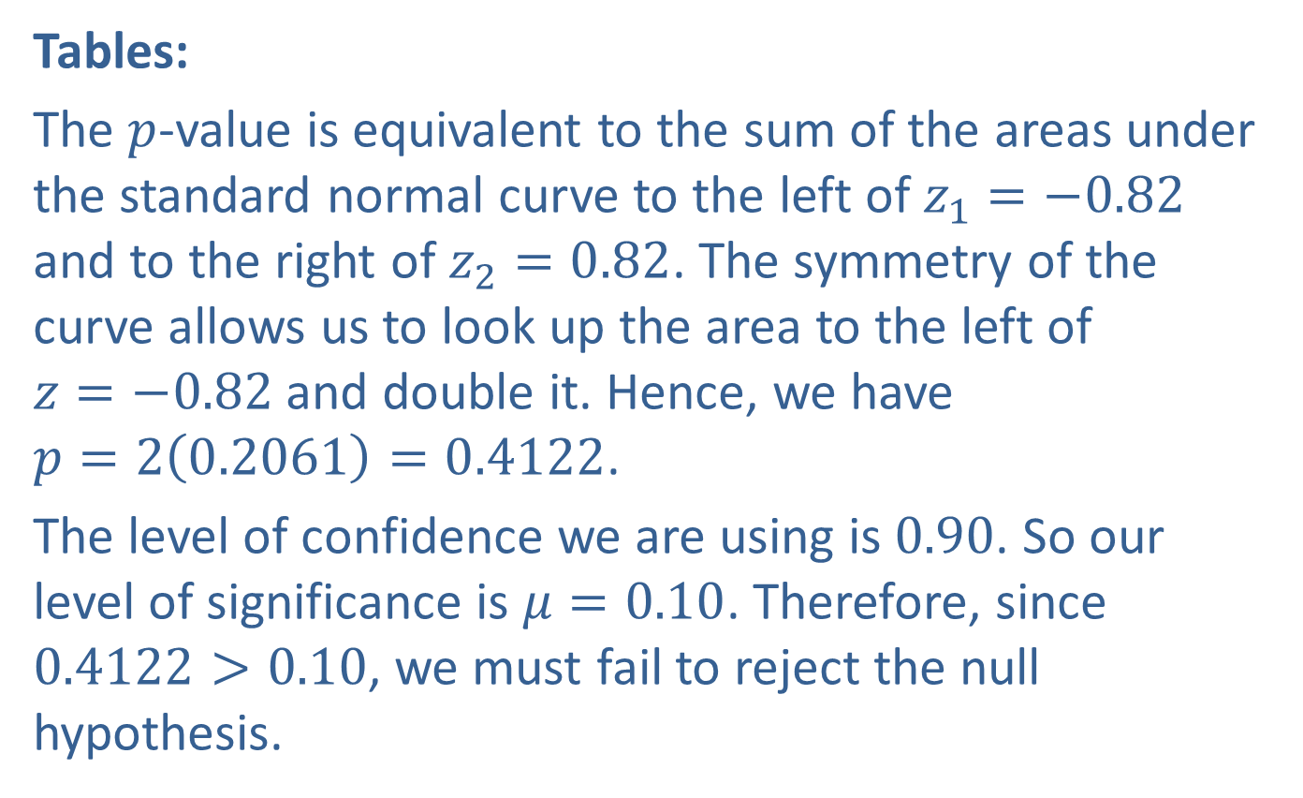
Example 11.1.2: Hypothesis Test for Two Population Means (Two-Tailed, $σ$ Known, Independent Samples) (cont.)
Tables:
The $p$-value is equivalent to the sum of the areas under the standard normal curve to the left of $z_{1}=−0.82$ and to the right of $z_{2}=0.82$. The symmetry of the curve allows us to look up the area to the left of
$z=−0.82$ and double it. Hence, we have
$p=2\left(0.2061\right)=0.4122$.
The level of confidence we are using is 0.90. So our level of significance is $μ=0.10$. Therefore, since $0.4122>0.10$, we must fail to reject the null hypothesis.

Slide 42
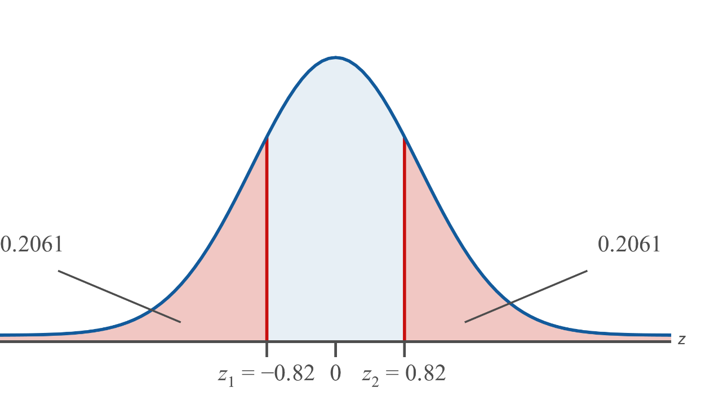
Example 11.1.2: Hypothesis Test for Two Population Means (Two-Tailed, $σ$ Known, Independent Samples) (cont.)

Slide 43

Example 11.1.2: Hypothesis Test for Two Population Means (Two-Tailed, $σ$ Known, Independent Samples) (cont.)
TI-83/84 Plus:
The $p$-value, $p=0.4139$ rounded to four decimals, was provided as part of the output, as shown Step 3. Since $0.4139>0.10$, the conclusion is to fail to reject the null hypothesis.

Slide 44
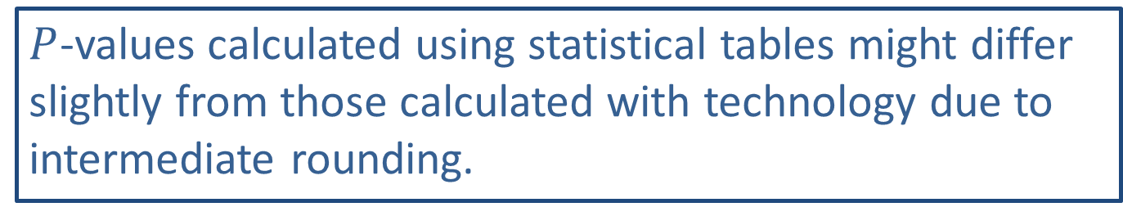
Memory Booster:
$P$-values calculated using statistical tables might differ slightly from those calculated with technology due to intermediate rounding.

Slide 45
Example 11.1.2: Hypothesis Test for Two Population Means (Two-Tailed, $σ$ Known, Independent Samples) (cont.)
Interpretation: Failing to reject the null hypothesis indicates that there is not sufficient evidence at the 0.10 level of significance to say that the mean numbers of hours per week spent exercising by students at the two universities are unequal.
Thus, we cannot conclude that there is a difference in the average fitness levels of the students at the two universities.

Slide 46
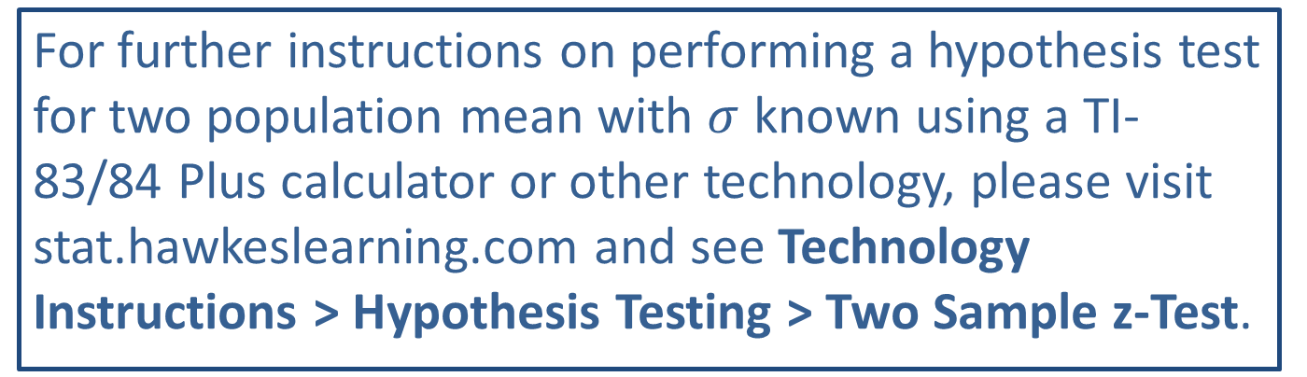
Technology
For further instructions on performing a hypothesis test for two population mean with $σ$ known using a TI-83/84 Plus calculator or other technology, please visit stat.hawkeslearning.com and see Technology Instructions > Hypothesis Testing > Two Sample z-Test.

Slide 47
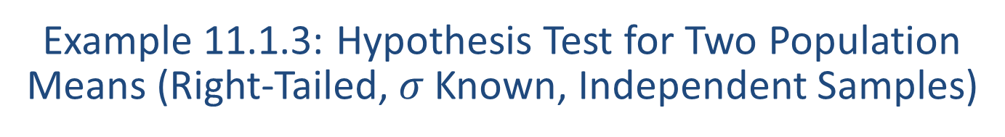
Example 11.1.3: Hypothesis Test for Two Population Means (Right-Tailed, $σ$ Known, Independent Samples)
A drug manufacturer claims that its new cholesterol drug, when used together with a healthy diet and exercise plan, lowers a patient's total cholesterol level by over 20 points more than simply changing a patient's diet and exercise regimen. To test the claim, a sample of 55 patients with high cholesterol is chosen at random from a cardiologist's list of patients to take the drug in addition to changing their diet and exercise plans. Over the course of three months, this group lowers its total cholesterol level by a mean of 44.7 points. The population standard deviation for this group is known to be 6.8 points. Another 55 patients with high cholesterol level by a mean of 23.1 points. The population standard deviation for this group is known to be 5.3 points. Test the drug manufacturer's claim using a 0.01 level of significance.

Slide 48
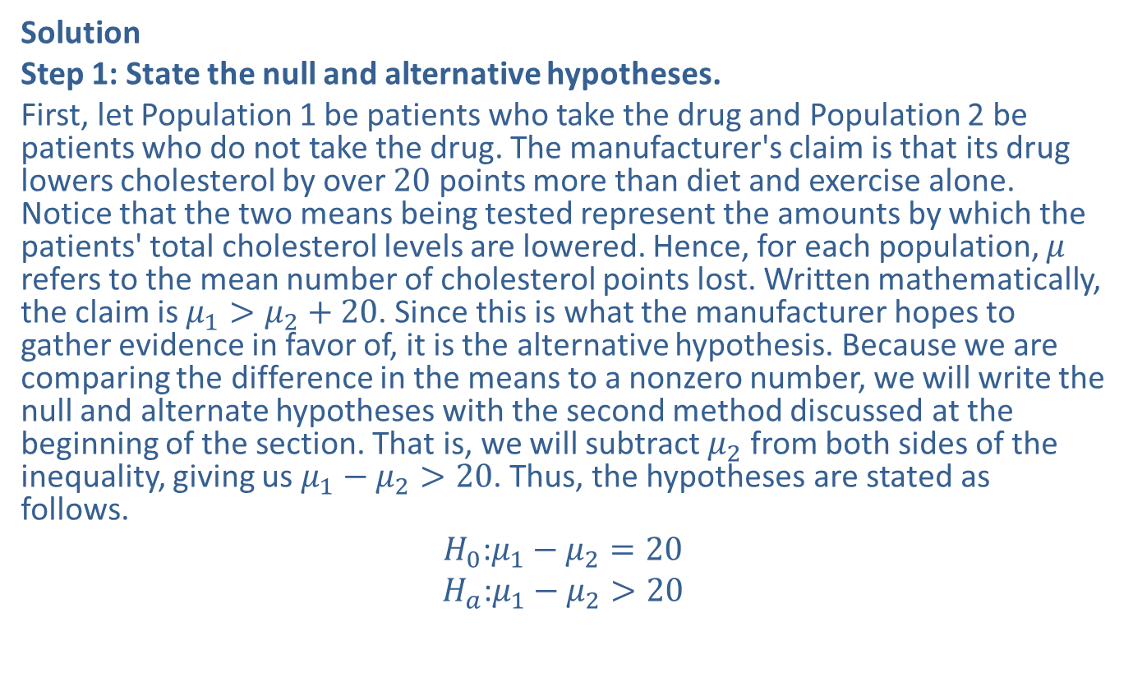
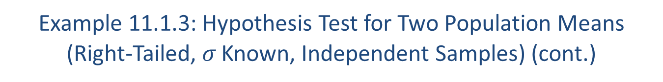
Example 11.1.3: Hypothesis Test for Two Population Means (Right-Tailed, $σ$ Known, Independent Samples) (cont.)
Solution
Step 1: State the null and alternative hypotheses.
First, let Population 1 be patients who take the drug and Population 2 be patients who do not take the drug. The manufacturer's claim is that its drug lowers cholesterol by over 20 points more than diet and exercise alone. Notice that the two means being tested represent the amounts by which the patients' total cholesterol levels are lowered. Hence, for each population, $μ$ refers to the mean number of cholesterol points lost. Written mathematically, the claim is $μ_{1}>μ_{2}+20$. Since this is what the manufacturer hopes to gather evidence in favor of, it is the alternative hypothesis. Because we are comparing the difference in the means to a nonzero number, we will write the null and alternate hypotheses with the second method discussed at the beginning of the section. That is, we will subtract $μ_{2}$ from both sides of the inequality, giving us $μ_{1}−μ_{2}>20$. Thus, the hypotheses are stated as follows.
$$H_{0}\text{:}μ_{1}−μ_{2}=20$$
$$H_{a}\text{:}μ_{1}−μ_{2}>20$$

Slide 49
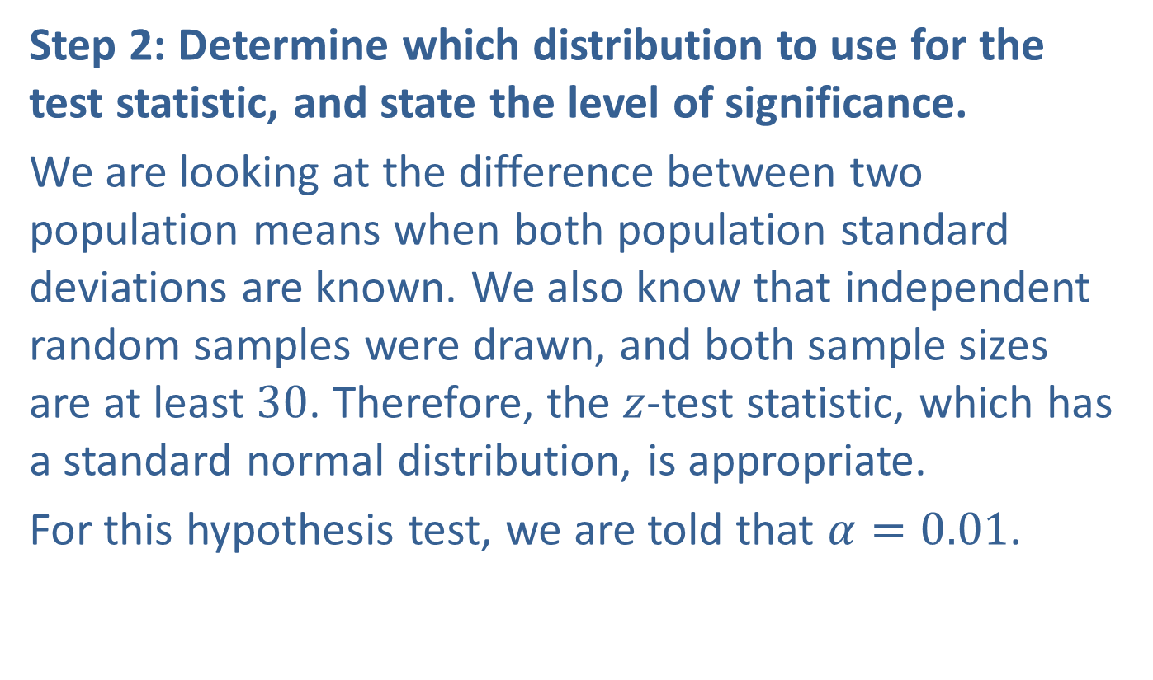
Example 11.1.3: Hypothesis Test for Two Population Means (Right-Tailed, $σ$ Known, Independent Samples) (cont.)
Step 2: Determine which distribution to use for the test statistic, and state the level of significance.
We are looking at the difference between two population means when both population standard deviations are known. We also know that independent random samples were drawn, and both sample sizes are at least 30. Therefore, the $z$-test statistic, which has a standard normal distribution, is appropriate.
For this hypothesis test, we are told that $α=0.01$.

Slide 50
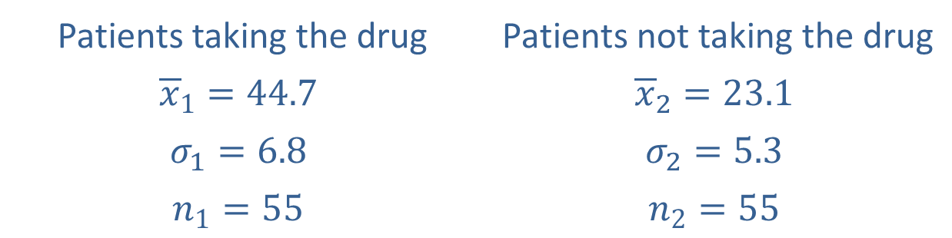
Example 11.1.3: Hypothesis Test for Two Population Means (Right-Tailed, $σ$ Known, Independent Samples) (cont.)
Step 3: Gather data and calculate the necessary sample statistics.
The following values were given in the problem.
Patients taking the drug | Patients not taking the drug
$${\overline{x}}_{1}=44.7$$ | $${\overline{x}}_{2}=23.1$$
$$σ_{1}=6.8$$ | $$σ_{2}=5.3$$
$$n_{1}=55$$ | $$n_{2}=55$$

Slide 51
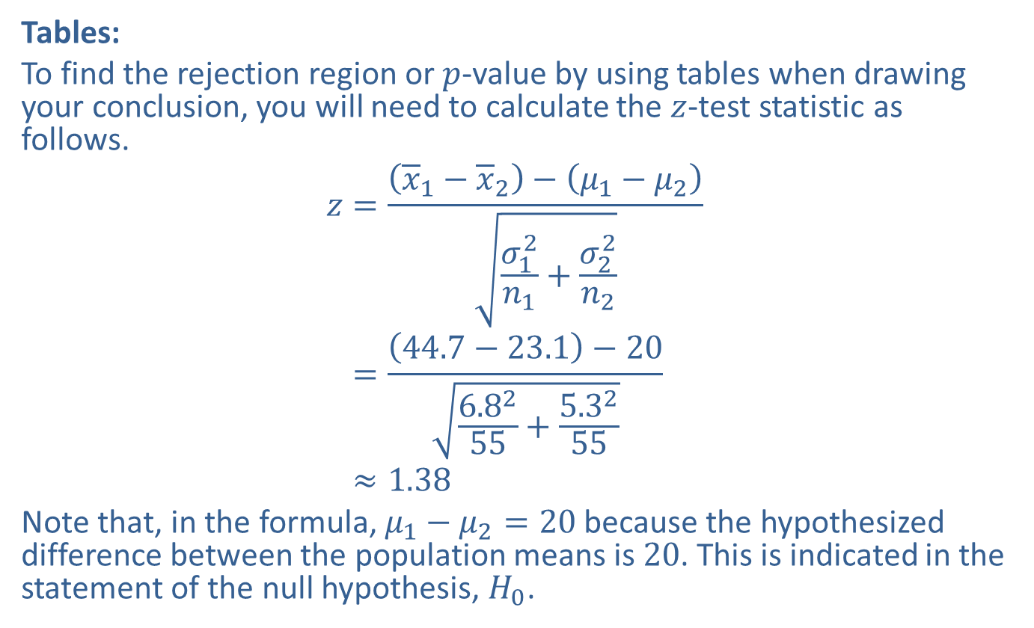
Example 11.1.3: Hypothesis Test for Two Population Means (Right-Tailed, $σ$ Known, Independent Samples) (cont.)
Tables:
To find the rejection region or $p$-value by using tables when drawing your conclusion, you will need to calculate the $z$-test statistic as follows.
𝑧=𝑥1−𝑥2−𝜇1−𝜇2𝜎12𝑛1+𝜎22𝑛2𝑧=44.7−23.1−206.8255+5.3255𝑧≈1.38
Note that, in the formula, $μ_{1}−μ_{2}=20$ because the hypothesized difference between the population means is 20. This is indicated in the statement of the null hypothesis, $H_{0}$.

Slide 52
Technology
Note that this particular test setup cannot be performed using a TI-83/84 Plus calculator because the hypothesized difference between the two population means is not zero. With Excel, it is possible to perform the test, but you must have the original data. Because we are only given the summary statistics here, we are not able to use either of these technology methods.

Slide 53

Example 11.1.3: Hypothesis Test for Two Population Means (Right-Tailed, $σ$ Known, Independent Samples) (cont.)
Step 4: Draw a conclusion and interpret the decision.
We can use either rejection regions or $p$-values to draw a conclusion for this right-tailed test.

Slide 54
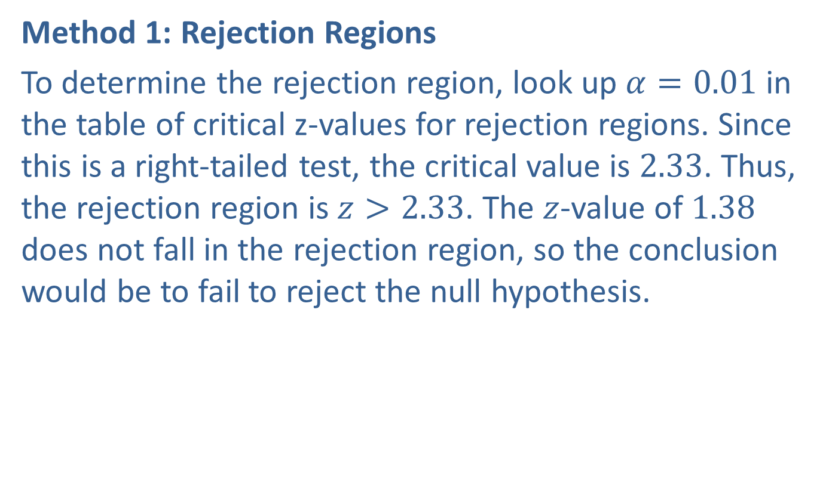
Example 11.1.3: Hypothesis Test for Two Population Means (Right-Tailed, $σ$ Known, Independent Samples) (cont.)
Method 1: Rejection Regions
To determine the rejection region, look up $α=0.01$ in the table of critical z-values for rejection regions. Since this is a right-tailed test, the critical value is 2.33. Thus, the rejection region is $z>2.33$. The $z$-value of 1.38 does not fall in the rejection region, so the conclusion would be to fail to reject the null hypothesis.

Slide 55
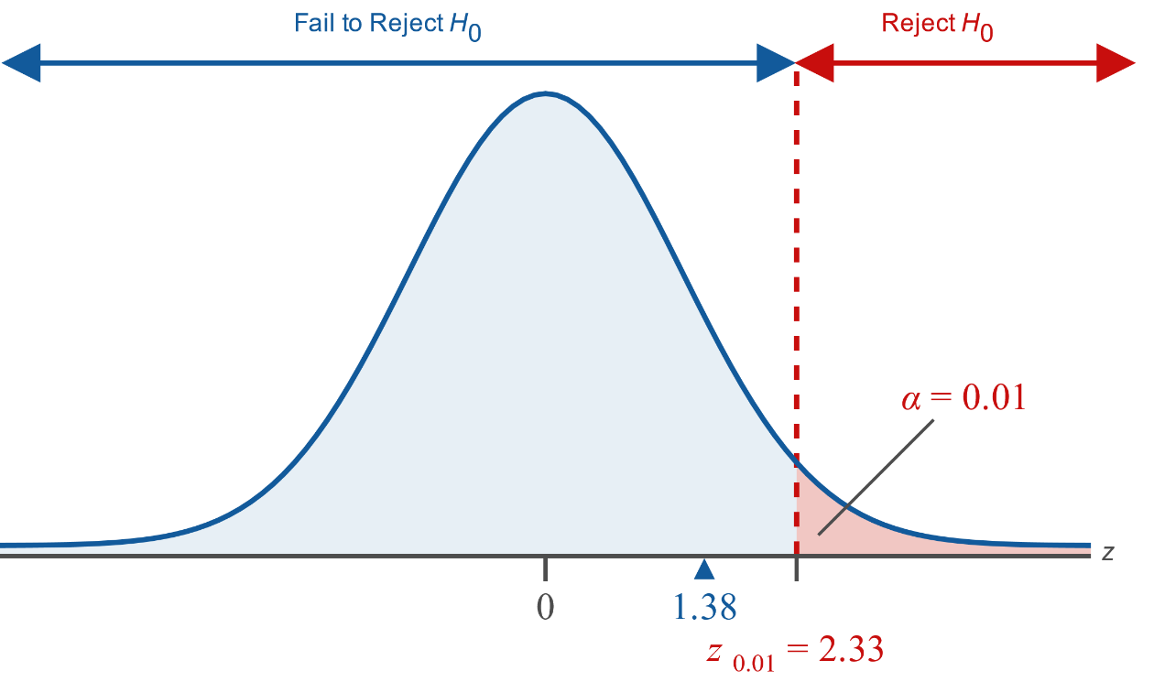
Example 11.1.3: Hypothesis Test for Two Population Means (Right-Tailed, $σ$ Known, Independent Samples) (cont.)

Slide 56
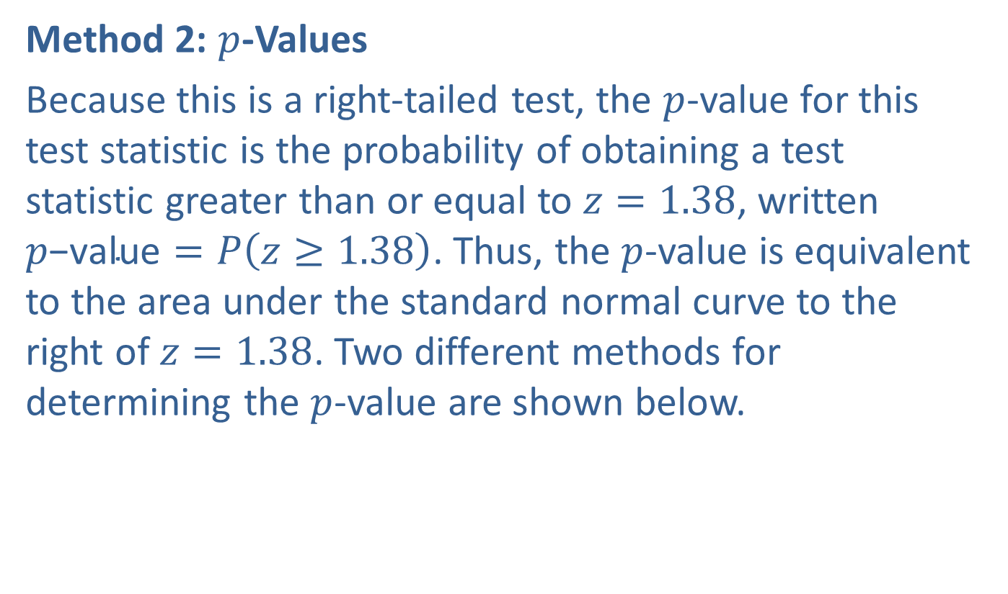
Example 11.1.3: Hypothesis Test for Two Population Means (Right-Tailed, $σ$ Known, Independent Samples) (cont.)
Method 2: $p$-Values
Because this is a right-tailed test, the $p$-value for this test statistic is the probability of obtaining a test statistic greater than or equal to $z=1.38$, written $p\text{−}\text{value}=P\left(z≥1.38\right)$. Thus, the $p$-value is equivalent to the area under the standard normal curve to the right of $z=1.38$. Two different methods for determining the $p$-value are shown below.

Slide 57


Example 11.1.3: Hypothesis Test for Two Population Means (Right-Tailed, $σ$ Known, Independent Samples) (cont.)
Tables:
We need to find the area to the right of $z=1.38$, which is 0.0838. This $p$-value is greater than $α=0.01$, which means we fail to reject the null hypothesis.

Slide 58

Example 11.1.3: Hypothesis Test for Two Population Means (Right-Tailed, $σ$ Known, Independent Samples) (cont.)
TI-83/84 Plus:
Under the DIST menu enter normalcdf(lower bound, upper bound) using the following values:
lower bound: 1.38
upper bound: 1E99
The area is approximately 0.0838 rounded to four decimal places, as shown in the screen shot. This $p$-value is greater than $α=0.01$ so we will fail to reject the null hypothesis.

Slide 59

Example 11.1.3: Hypothesis Test for Two Population Means (Right-Tailed, $σ$ Known, Independent Samples) (cont.)

Slide 60
Example 11.1.3: Hypothesis Test for Two Population Means (Right-Tailed, $σ$ Known, Independent Samples) (cont.)
Interpretation: Failing to reject the null hypothesis indicates that there is not sufficient evidence at the 0.01 level of significance to support the drug manufacturer's claim that the new drug, when used together with a healthy diet and exercise plan, lowers cholesterol by more than 20 points compared with changing diet and exercise alone.

