Slide 1
Section 11.2
Hypothesis Testing: Two Population Means (Sigma Unknown, Independent Samples)

Slide 2
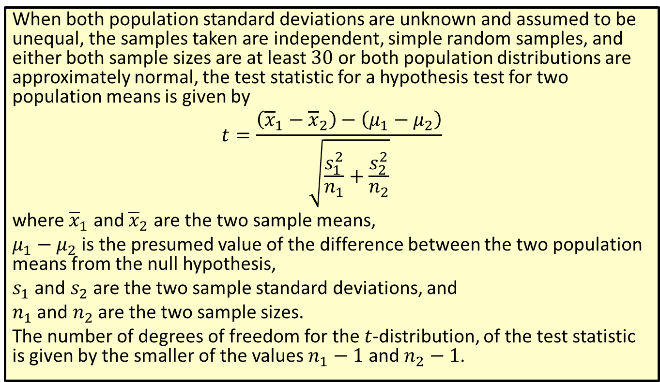

Formula: Test Statistic for a Hypothesis Test for Two Population Means with Unequal Variances ($σ$ Unknown, Independent Samples)
When both population standard deviations are unknown and assumed to be unequal, the samples taken are independent, simple random samples, and either both sample sizes are at least 30 or both population distributions are approximately normal, the test statistic for a hypothesis test for two population means is given by
$$t=\frac{\left({\overline{x}}_{1}−{\overline{x}}_{2}\right)−\left(μ_{1}−μ_{2}\right)}{\sqrt{\frac{s_{1}^{2}}{n_{1}}+\frac{s_{2}^{2}}{n_{2}}}}$$
where ${\overline{x}}_{1}$ and ${\overline{x}}_{2}$ are the two sample means,
$μ_{1}−μ_{2}$ is the presumed value of the difference between the two population means from the null hypothesis,
$s_{1}$ and $s_{2}$ are the two sample standard deviations, and
$n_{1}$ and $n_{2}$ are the two sample sizes.
The number of degrees of freedom for the $t$-distribution, of the test statistic is given by the smaller of the values $n_{1}−1$ and $n_{2}−1$.

Slide 3
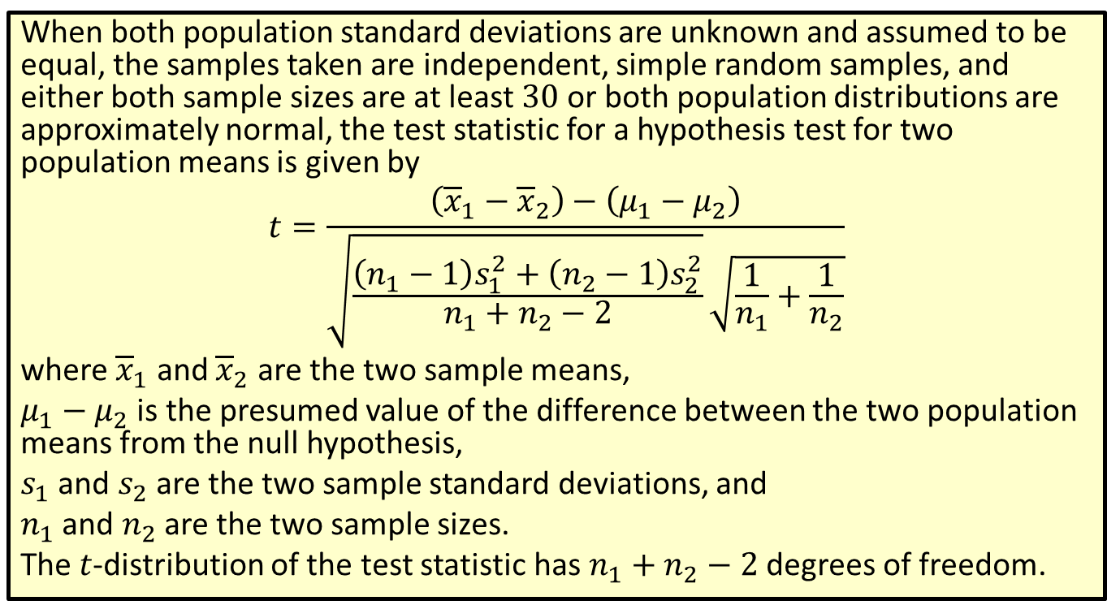
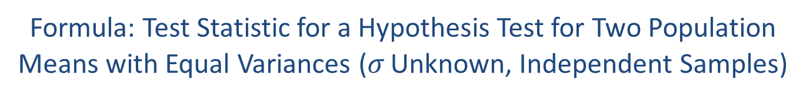
Formula: Test Statistic for a Hypothesis Test for Two Population Means with Equal Variances ($σ$ Unknown, Independent Samples)
When both population standard deviations are unknown and assumed to be equal, the samples taken are independent, simple random samples, and either both sample sizes are at least 30 or both population distributions are approximately normal, the test statistic for a hypothesis test for two population means is given by
$$t=\frac{\left({\overline{x}}_{1}−{\overline{x}}_{2}\right)−\left(μ_{1}−μ_{2}\right)}{\sqrt{\frac{\left(n_{1}−1\right)s_{1}^{2}+\left(n_{2}−1\right)s_{2}^{2}}{n_{1}+n_{2}−2}}\sqrt{\frac{1}{n_{1}}+\frac{1}{n_{2}}}}$$
where ${\overline{x}}_{1}$ and ${\overline{x}}_{2}$ are the two sample means,
$μ_{1}−μ_{2}$ is the presumed value of the difference between the two population means from the null hypothesis,
$s_{1}$ and $s_{2}$ are the two sample standard deviations, and
$n_{1}$ and $n_{2}$ are the two sample sizes.
The $t$-distribution of the test statistic has $n_{1}+n_{2}−2$ degrees of freedom.

Slide 4
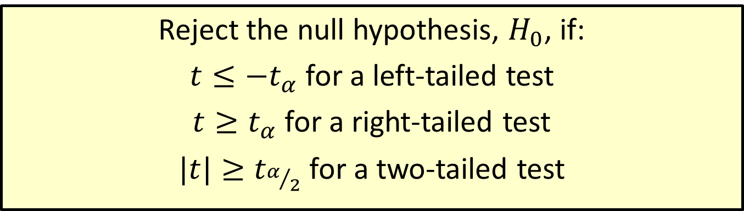

Procedure: Rejection Regions for Hypothesis Tests for Two Population Means ($σ$ Unknown)
Reject the null hypothesis, $H_{0}$, if:
$t≤−t_{α}$ for a left-tailed test
$t≥t_{α}$ for a right-tailed test
$|t|≥t_{α/2}$ for a two-tailed test

Slide 5
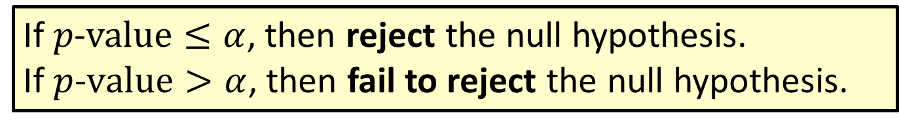

Procedure: Conclusions Using $p$-Values
If $p\text{−}value≤α$, then reject the null hypothesis. If $p$-$value>α$, then fail to reject the null hypothesis.

Slide 6
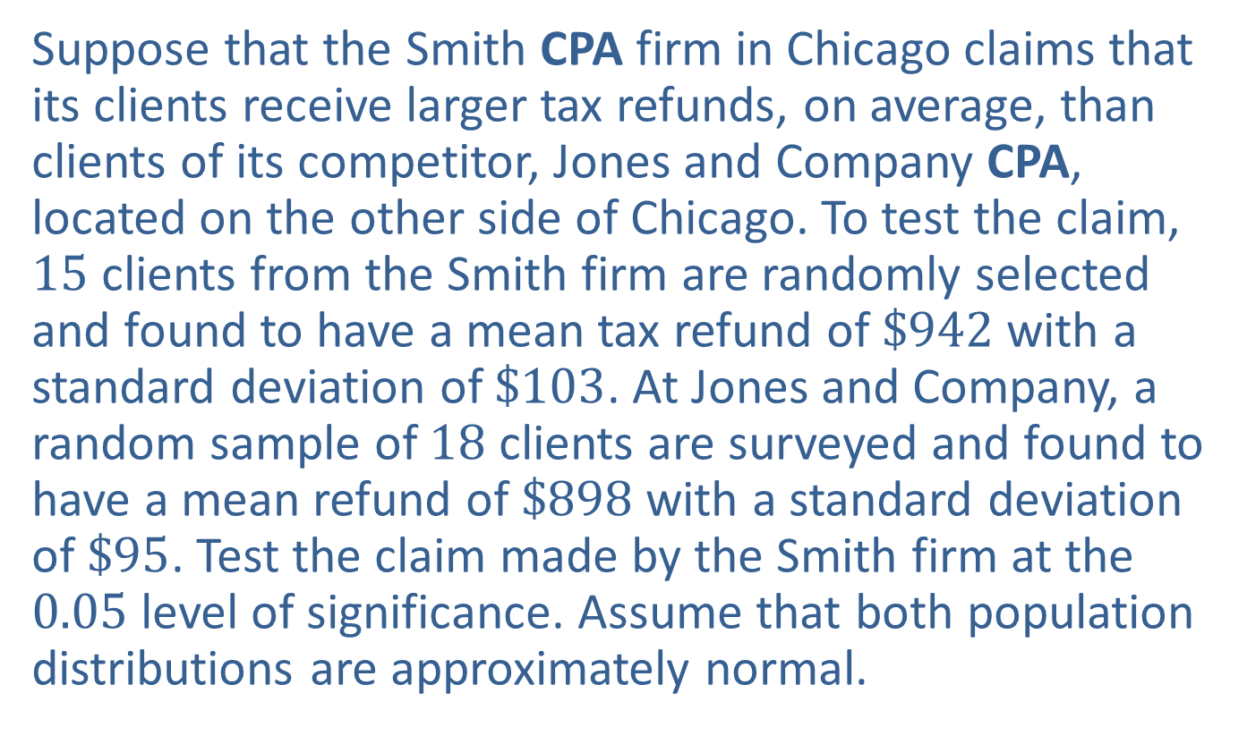

Example 11.2.1: Hypothesis Test for Two Population Means (Right-Tailed, $σ$ Unknown, Independent Samples, Unequal Variances)
Suppose that the Smith CPA firm in Chicago claims that its clients receive larger tax refunds, on average, than clients of its competitor, Jones and Company CPA, located on the other side of Chicago. To test the claim, 15 clients from the Smith firm are randomly selected and found to have a mean tax refund of $\$942$ with a standard deviation of $\$103$. At Jones and Company, a random sample of 18 clients are surveyed and found to have a mean refund of $\$898$ with a standard deviation of $\$95$. Test the claim made by the Smith firm at the 0.05 level of significance. Assume that both population distributions are approximately normal.

Slide 7
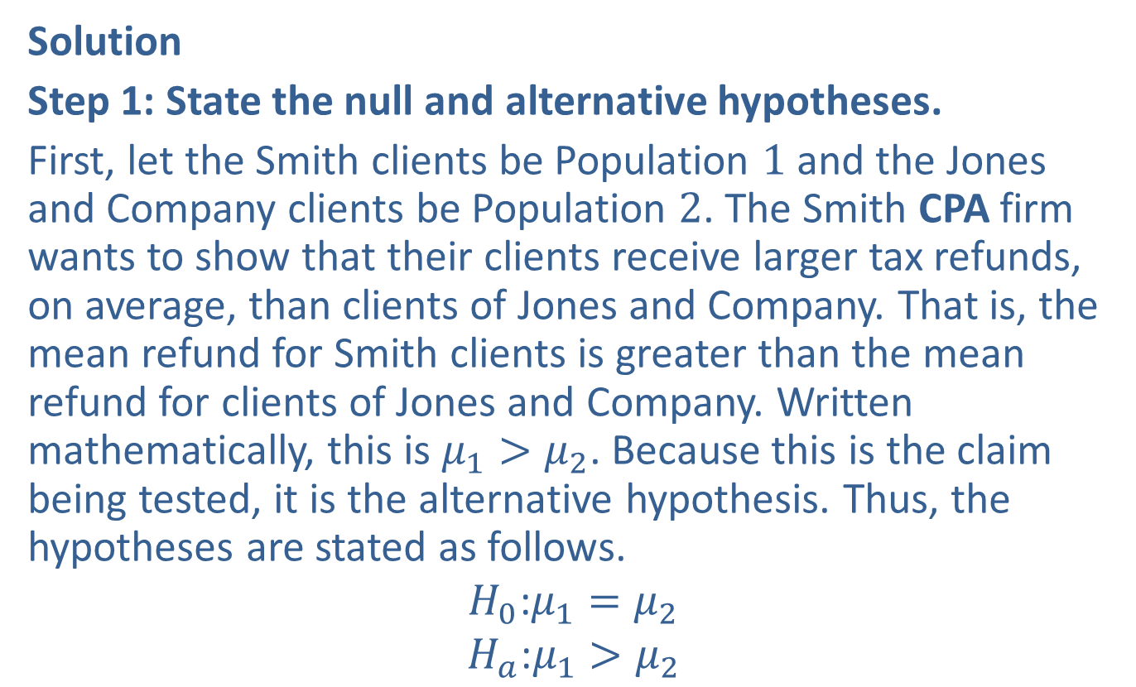
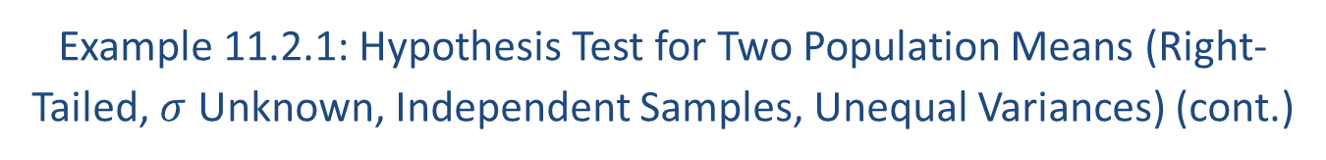
Example 11.2.1: Hypothesis Test for Two Population Means (Right-Tailed, $σ$ Unknown, Independent Samples, Unequal Variances) (cont.)
Solution
Step 1: State the null and alternative hypotheses.
First, let the Smith clients be Population 1 and the Jones and Company clients be Population 2. The Smith CPA firm wants to show that their clients receive larger tax refunds, on average, than clients of Jones and Company. That is, the mean refund for Smith clients is greater than the mean refund for clients of Jones and Company. Written mathematically, this is $μ_{1}>μ_{2}$. Because this is the claim being tested, it is the alternative hypothesis. Thus, the hypotheses are stated as follows.
$$H_{0}\text{:}μ_{1}=μ_{2}$$
$$H_{a}\text{:}μ_{1}>μ_{2}$$

Slide 8
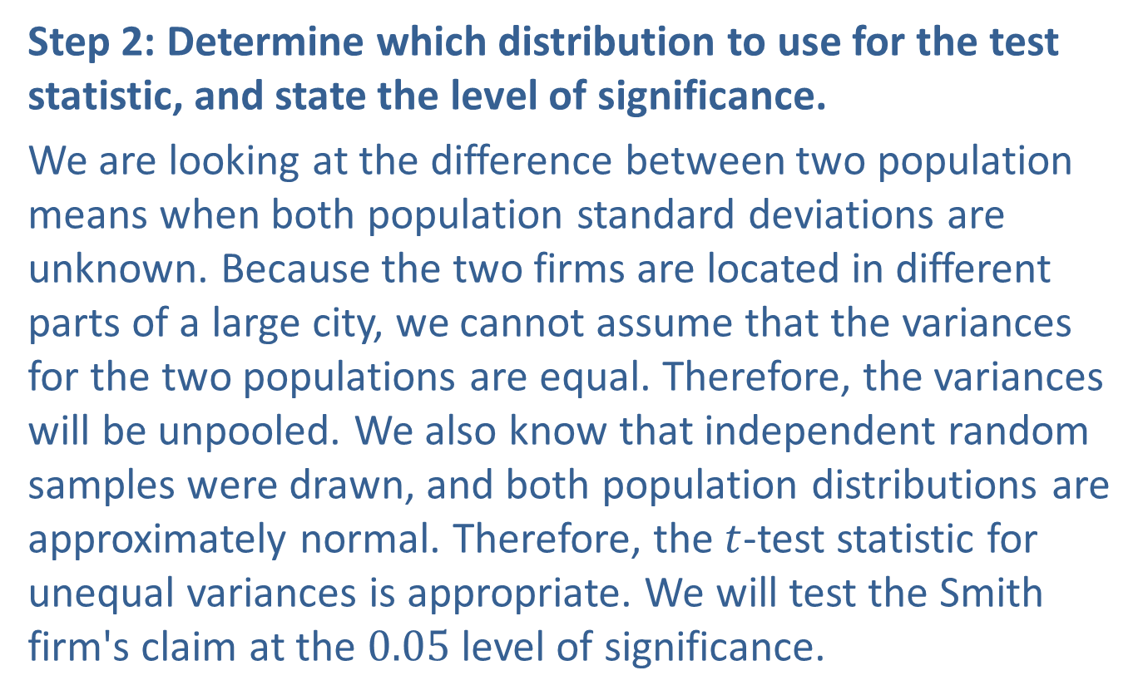
Example 11.2.1: Hypothesis Test for Two Population Means (Right-Tailed, $σ$ Unknown, Independent Samples, Unequal Variances) (cont.)
Step 2: Determine which distribution to use for the test statistic, and state the level of significance.
We are looking at the difference between two population means when both population standard deviations are unknown. Because the two firms are located in different parts of a large city, we cannot assume that the variances for the two populations are equal. Therefore, the variances will be unpooled. We also know that independent random samples were drawn, and both population distributions are approximately normal. Therefore, the $t$-test statistic for unequal variances is appropriate. We will test the Smith firm's claim at the 0.05 level of significance.

Slide 9
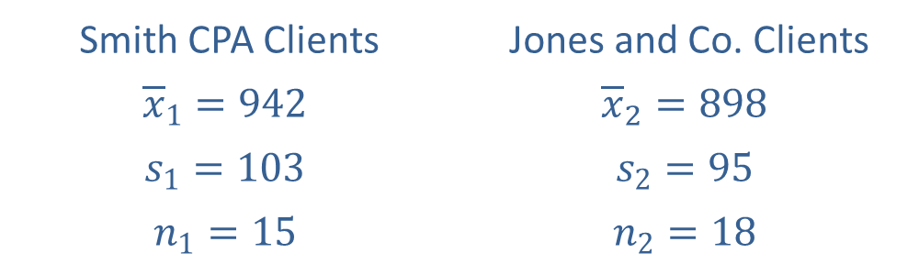

Example 11.2.1: Hypothesis Test for Two Population Means (Right-Tailed, $σ$ Unknown, Independent Samples, Unequal Variances) (cont.)
Step 3: Gather data and calculate the necessary sample statistics.
The following sample statistics were given in the problem.
We are assuming that the population variances are not equal, so we will use the test statistic for unequal variances.
Smith CPA Clients | Jones and Co. Clients
$${\overline{x}}_{1}=942$$ | $${\overline{x}}_{2}=898$$
$$s_{1}=103$$ | $$s_{2}=95$$
$$n_{1}=15$$ | $$n_{2}=18$$

Slide 10
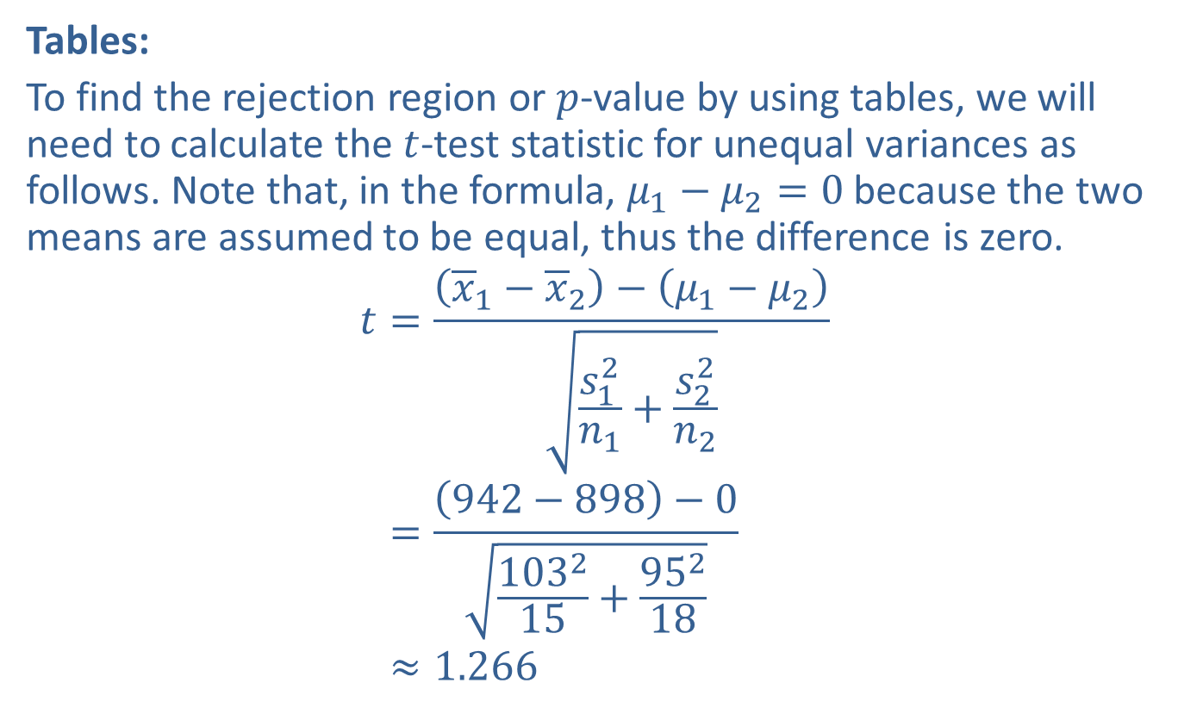
Example 11.2.1: Hypothesis Test for Two Population Means (Right-Tailed, $σ$ Unknown, Independent Samples, Unequal Variances) (cont.)
Tables:
To find the rejection region or $p$-value by using tables, we will need to calculate the $t$-test statistic for unequal variances as follows. Note that, in the formula, $μ_{1}−μ_{2}=0$ because the two means are assumed to be equal, thus the difference is zero.
𝑡=𝑥1−𝑥2−𝜇1−𝜇2𝑠12𝑛1+𝑠22𝑛2𝑡=942−898−0103215+95218𝑡≈1.266

Slide 11
Example 11.2.1: Hypothesis Test for Two Population Means (Right-Tailed, $σ$ Unknown, Independent Samples, Unequal Variances) (cont.)
TI-83/84 Plus:
Under the STATS > TESTS menu, choose 2-SampTTest. Choose the Stats input option, since we have the sample statistics, and enter the requested values. This is a right-tailed test, so choose >μ2 for the alternative hypothesis. Since the population variances are assumed to be unequal, choose No next to Pooled. The input screenshots are shown below for you.

Slide 12
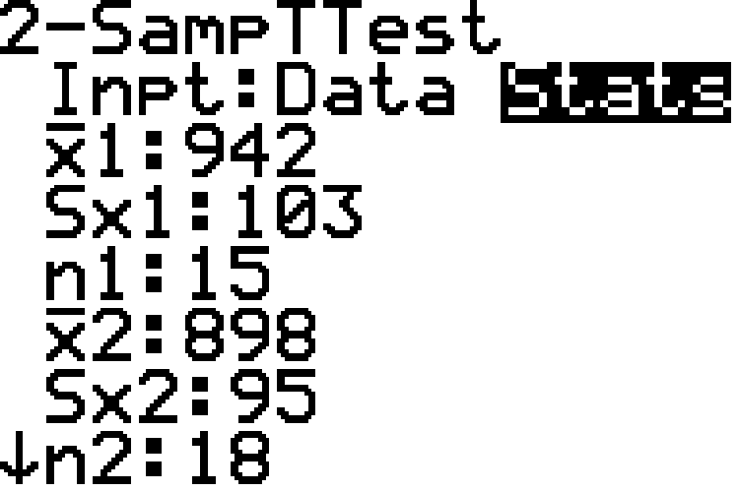
Example 11.2.1: Hypothesis Test for Two Population Means (Right-Tailed, $σ$ Unknown, Independent Samples, Unequal Variances) (cont.)

Slide 13
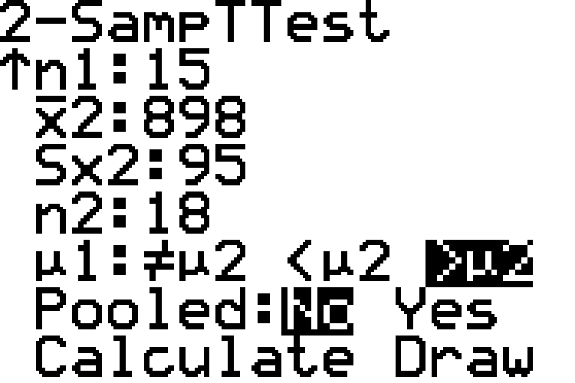
Example 11.2.1: Hypothesis Test for Two Population Means (Right-Tailed, $σ$ Unknown, Independent Samples, Unequal Variances) (cont.)

Slide 14
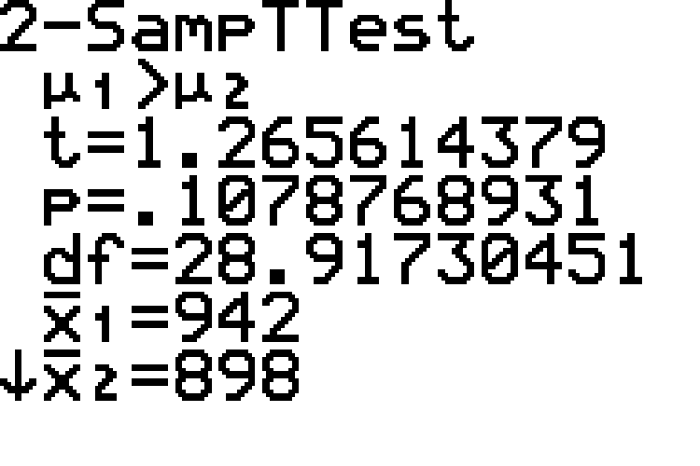
Example 11.2.1: Hypothesis Test for Two Population Means (Right-Tailed, $σ$ Unknown, Independent Samples, Unequal Variances) (cont.)
Choosing Calculate produces the following results.

Slide 15
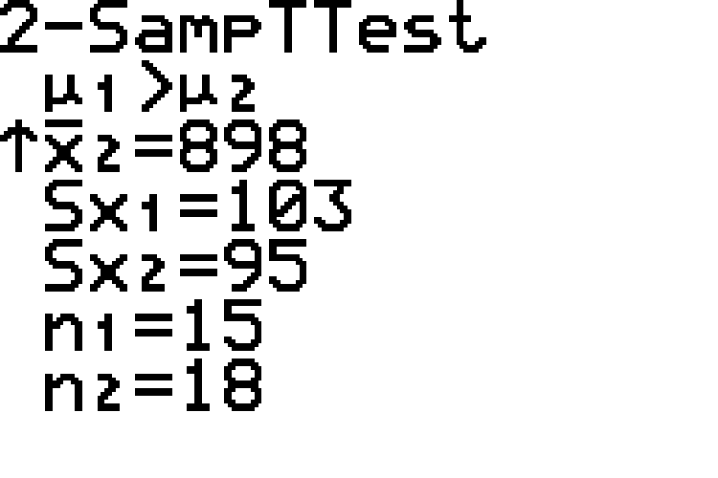
Example 11.2.1: Hypothesis Test for Two Population Means (Right-Tailed, $σ$ Unknown, Independent Samples, Unequal Variances) (cont.)

Slide 16
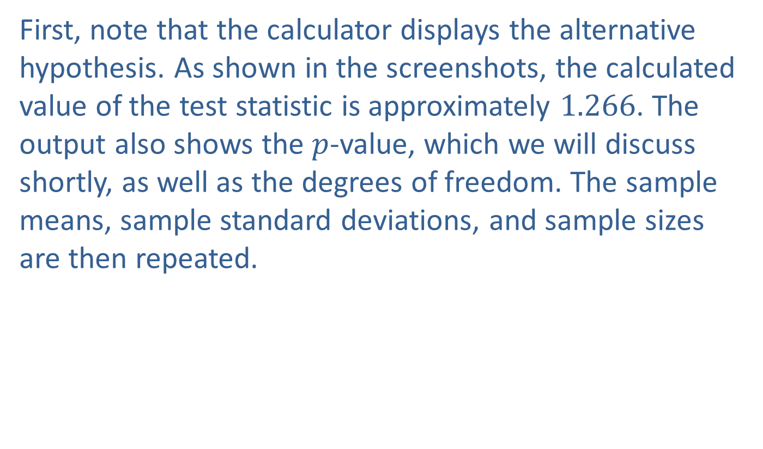
Example 11.2.1: Hypothesis Test for Two Population Means (Right-Tailed, $σ$ Unknown, Independent Samples, Unequal Variances) (cont.)
First, note that the calculator displays the alternative hypothesis. As shown in the screenshots, the calculated value of the test statistic is approximately 1.266. The output also shows the $p$-value, which we will discuss shortly, as well as the degrees of freedom. The sample means, sample standard deviations, and sample sizes are then repeated.

Slide 17

Example 11.2.1: Hypothesis Test for Two Population Means (Right-Tailed, $σ$ Unknown, Independent Samples, Unequal Variances) (cont.)
Step 4: Draw a conclusion and interpret the decision.
The alternative hypothesis tells us that we have a right-tailed test. We can use either rejection regions or $p$-values to draw a conclusion.

Slide 18
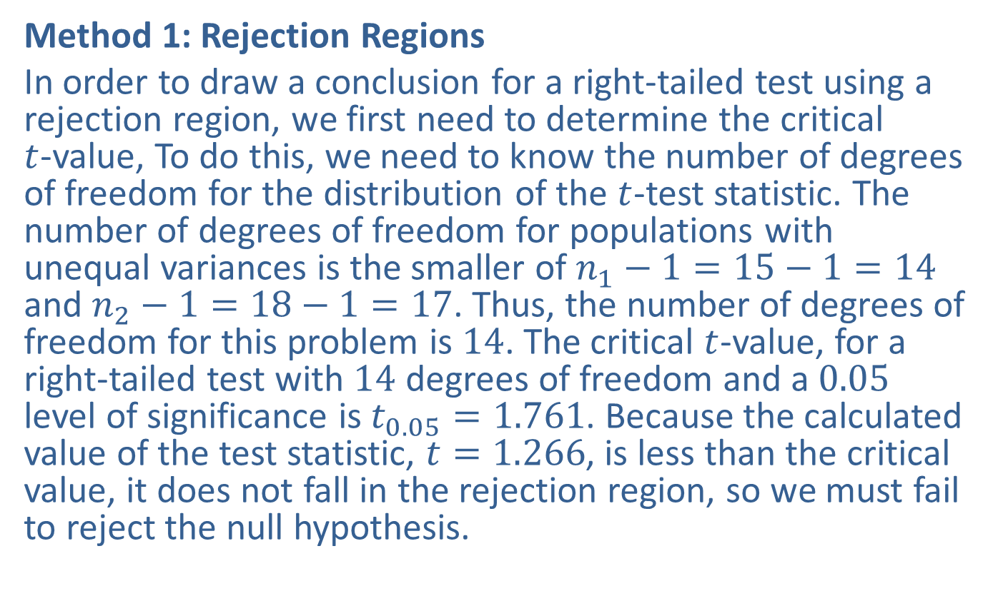
Example 11.2.1: Hypothesis Test for Two Population Means (Right-Tailed, $σ$ Unknown, Independent Samples, Unequal Variances) (cont.)
Method 1: Rejection Regions
In order to draw a conclusion for a right-tailed test using a rejection region, we first need to determine the critical $t$-value, To do this, we need to know the number of degrees of freedom for the distribution of the $t$-test statistic. The number of degrees of freedom for populations with unequal variances is the smaller of $n_{1}−1=15−1=14$ and $n_{2}−1=18−1=17$. Thus, the number of degrees of freedom for this problem is 14. The critical $t$-value, for a right-tailed test with 14 degrees of freedom and a 0.05 level of significance is $t_{0.05}=1.761$. Because the calculated value of the test statistic, $t=1.266$, is less than the critical value, it does not fall in the rejection region, so we must fail to reject the null hypothesis.

Slide 19
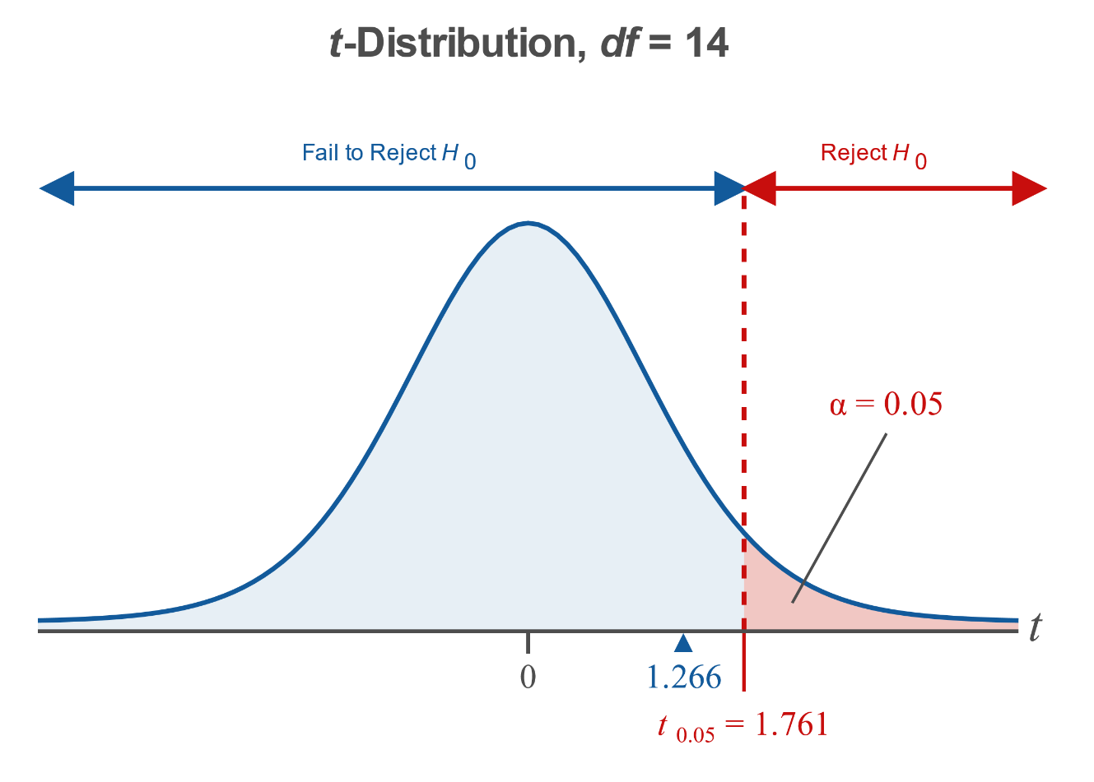
Example 11.2.1: Hypothesis Test for Two Population Means (Right-Tailed, $σ$ Unknown, Independent Samples, Unequal Variances) (cont.)

Slide 20

Example 11.2.1: Hypothesis Test for Two Population Means (Right-Tailed, $σ$ Unknown, Independent Samples, Unequal Variances) (cont.)
Method 2: $p$-Values
Since the $t$-distribution table in Appendix A cannot be used to calculate $p$-values, we will only show the 2-SampTTest option method for a TI-83/84 Plus calculator.

Slide 21
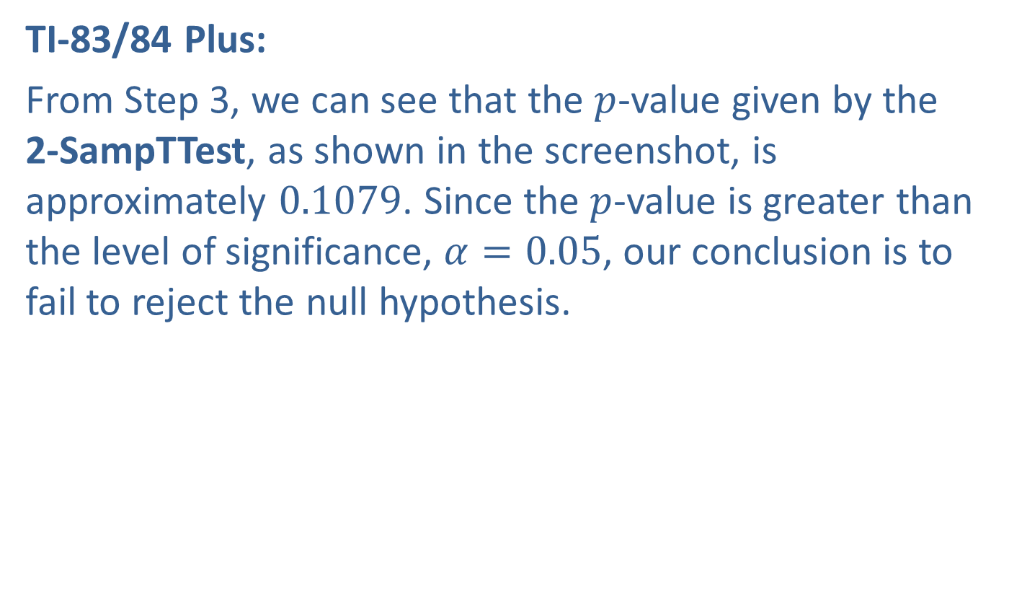
Example 11.2.1: Hypothesis Test for Two Population Means (Right-Tailed, $σ$ Unknown, Independent Samples, Unequal Variances) (cont.)
TI-83/84 Plus:
From Step 3, we can see that the $p$-value given by the 2-SampTTest, as shown in the screenshot, is approximately 0.1079. Since the $p$-value is greater than the level of significance, $α=0.05$, our conclusion is to fail to reject the null hypothesis.

Slide 22
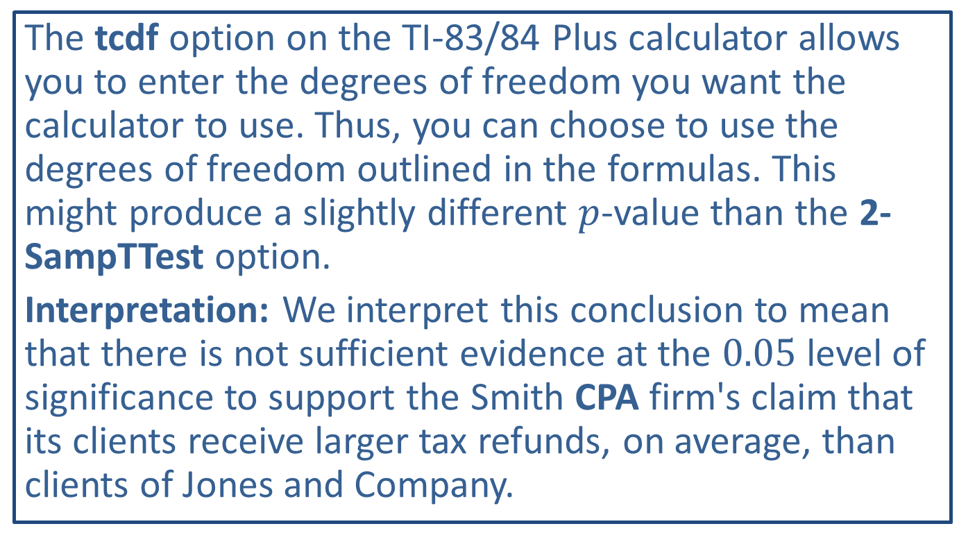
Technology
The tcdf option on the TI-83/84 Plus calculator allows you to enter the degrees of freedom you want the calculator to use. Thus, you can choose to use the degrees of freedom outlined in the formulas. This might produce a slightly different $p$-value than the 2-SampTTest option.
Interpretation: We interpret this conclusion to mean that there is not sufficient evidence at the 0.05 level of significance to support the Smith CPA firm's claim that its clients receive larger tax refunds, on average, than clients of Jones and Company.

Slide 23
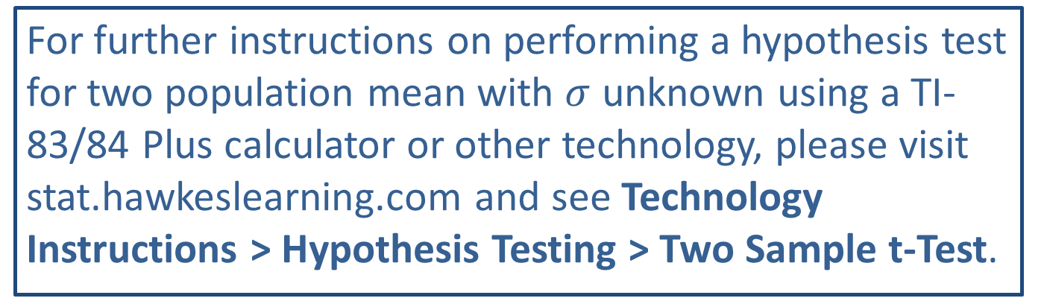
Technology
For further instructions on performing a hypothesis test for two population mean with $σ$ unknown using a TI-83/84 Plus calculator or other technology, please visit stat.hawkeslearning.com and see Technology Instructions > Hypothesis Testing > Two Sample t-Test.

Slide 24
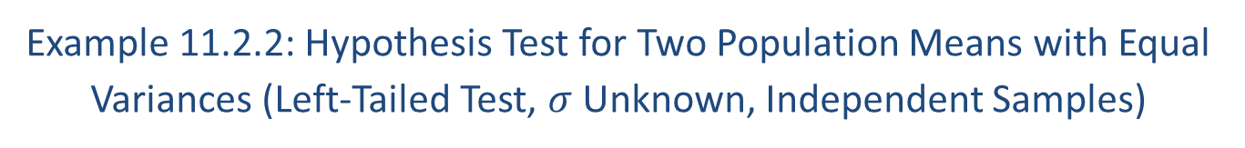
Example 11.2.2: Hypothesis Test for Two Population Means with Equal Variances (Left-Tailed Test, $σ$ Unknown, Independent Samples)
A home improvement warehouse claims that customers interested in completing their own house improvement projects can save time by attending its workshops. Specifically, the warehouse claims that amateur do-it-yourself customers who attend its tiling workshops take less time, on average, to complete comparable projects than those who do not. To test the claim, a randomly selected group of 10 customers who attended the workshops is later surveyed about the time it took to finish their tiling projects. People in this group spent a mean of 14.1 hours completing their projects with a standard deviation of 2.3 hours. Another 10 customers randomly chosen for the study from the warehouse's customer base who did not attend the workshops prior to completing their tiling projects, and they spent a mean of 15.0 hours on their projects with a standard deviation of 2.4 hours. Test the home improvement warehouse's claim at the 0.01 level of significance. Assume that the variances of the populations are unknown but assumed to be equal because the samples both came from the warehouse's customer base, and the distributions of times to complete the tiling projects are approximately normal for both populations.

Slide 25
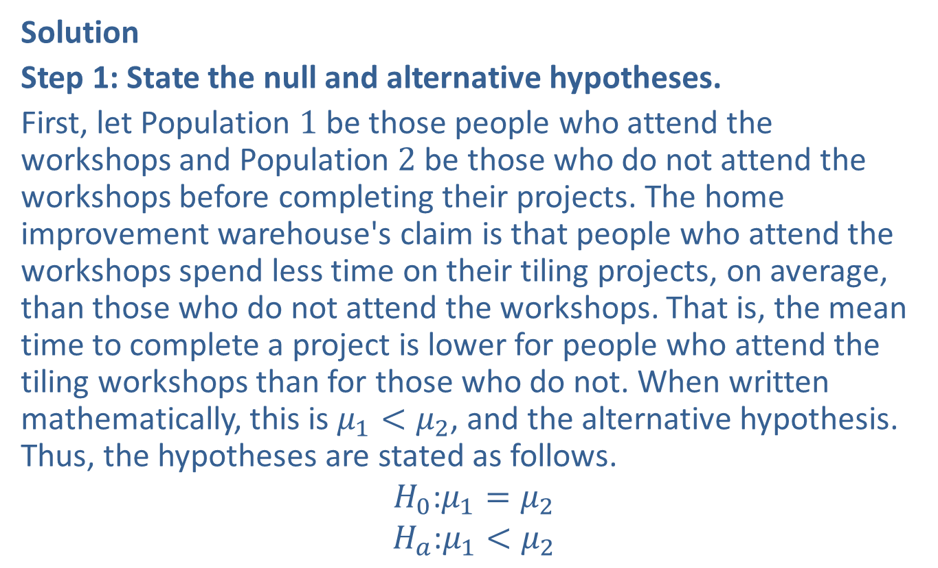
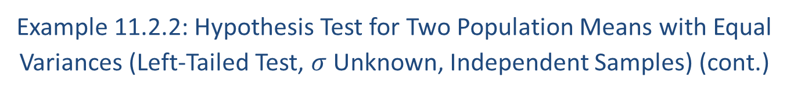
Example 11.2.2: Hypothesis Test for Two Population Means with Equal Variances (Left-Tailed Test, $σ$ Unknown, Independent Samples) (cont.)
Solution
Step 1: State the null and alternative hypotheses.
First, let Population 1 be those people who attend the workshops and Population 2 be those who do not attend the workshops before completing their projects. The home improvement warehouse's claim is that people who attend the workshops spend less time on their tiling projects, on average, than those who do not attend the workshops. That is, the mean time to complete a project is lower for people who attend the tiling workshops than for those who do not. When written mathematically, this is $μ_{1}<μ_{2}$, and the alternative hypothesis. Thus, the hypotheses are stated as follows.
$$H_{0}\text{:}μ_{1}=μ_{2}$$
$$H_{a}\text{:}μ_{1}<μ_{2}$$

Slide 26
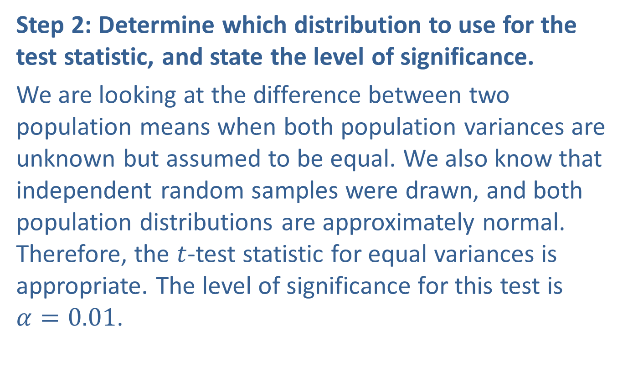
Example 11.2.2: Hypothesis Test for Two Population Means with Equal Variances (Left-Tailed Test, $σ$ Unknown, Independent Samples) (cont.)
Step 2: Determine which distribution to use for the test statistic, and state the level of significance.
We are looking at the difference between two population means when both population variances are unknown but assumed to be equal. We also know that independent random samples were drawn, and both population distributions are approximately normal. Therefore, the $t$-test statistic for equal variances is appropriate. The level of significance for this test is $α=0.01$.

Slide 27
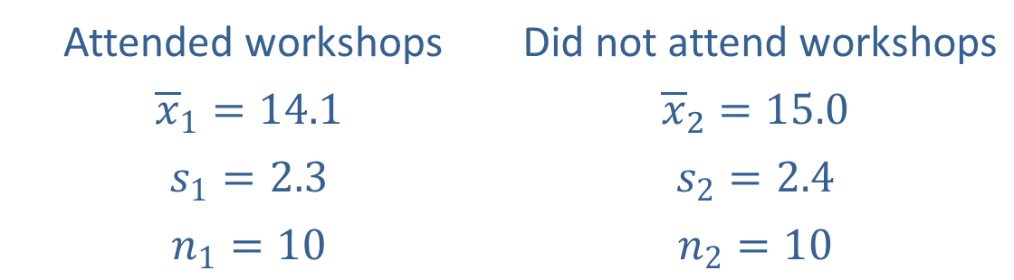
Example 11.2.2: Hypothesis Test for Two Population Means with Equal Variances (Left-Tailed Test, $σ$ Unknown, Independent Samples) (cont.)
Step 3: Gather data and calculate the necessary sample statistics.
The following sample statistics were given in the problem.
Attended workshops | Did not attend workshops
$${\overline{x}}_{1}=14.1$$ | $${\overline{x}}_{2}=15.0$$
$$s_{1}=2.3$$ | $$s_{2}=2.4$$
$$n_{1}=10$$ | $$n_{2}=10$$

Slide 28
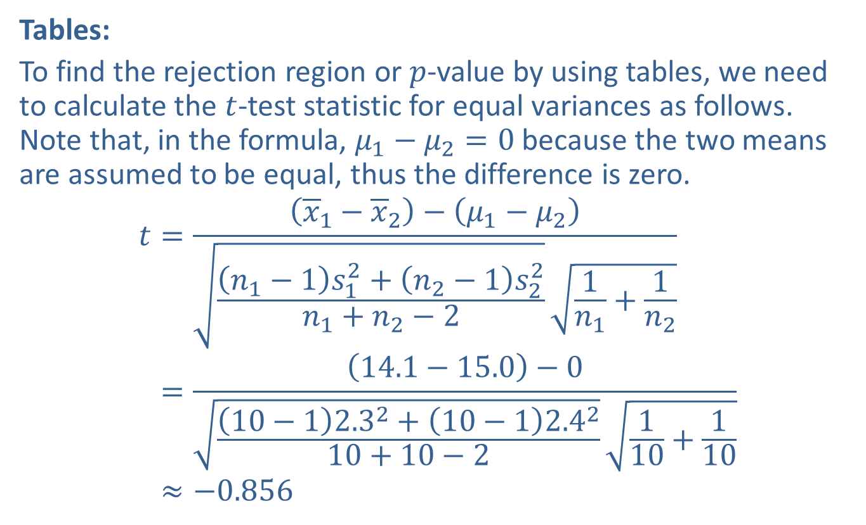
Example 11.2.2: Hypothesis Test for Two Population Means with Equal Variances (Left-Tailed Test, $σ$ Unknown, Independent Samples) (cont.)
Tables:
To find the rejection region or $p$-value by using tables, we need to calculate the $t$-test statistic for equal variances as follows. Note that, in the formula, $μ_{1}−μ_{2}=0$ because the two means are assumed to be equal, thus the difference is zero.
𝑡=𝑥1−𝑥2−𝜇1−𝜇2𝑛1−1𝑠12+𝑛2−1𝑠22𝑛1+𝑛2−21𝑛1+1𝑛2𝑡=14.1−15.0−010−12.32+10−12.4210+10−2110+110𝑡≈−0.856

Slide 29
Example 11.2.2: Hypothesis Test for Two Population Means with Equal Variances (Left-Tailed Test, $σ$ Unknown, Independent Samples) (cont.)
TI-83/84 Plus:
Under the STATS > TESTS menu, choose 2-SampTTest. Choose the Stats input option, since we have the sample statistics, and enter the requested values. This is a left-tailed test, so choose <μ2 for the alternative hypothesis. Since the population variances are assumed to be equal, choose Yes next to Pooled. The input screenshots are shown below.

Slide 30
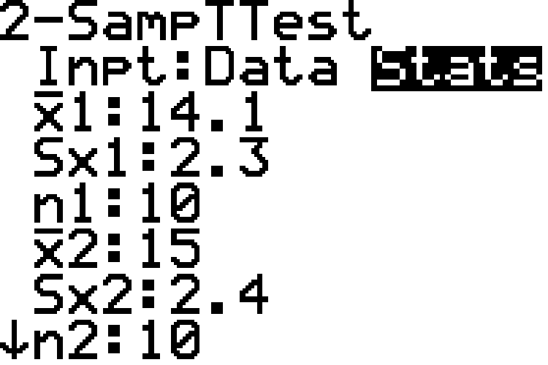
Example 11.2.2: Hypothesis Test for Two Population Means with Equal Variances (Left-Tailed Test, $σ$ Unknown, Independent Samples) (cont.)

Slide 31
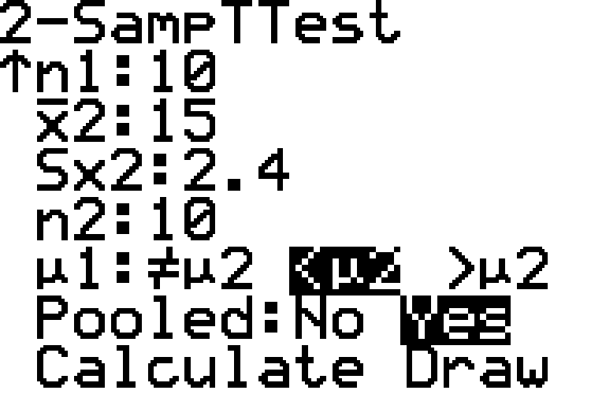
Example 11.2.2: Hypothesis Test for Two Population Means with Equal Variances (Left-Tailed Test, $σ$ Unknown, Independent Samples) (cont.)

Slide 32
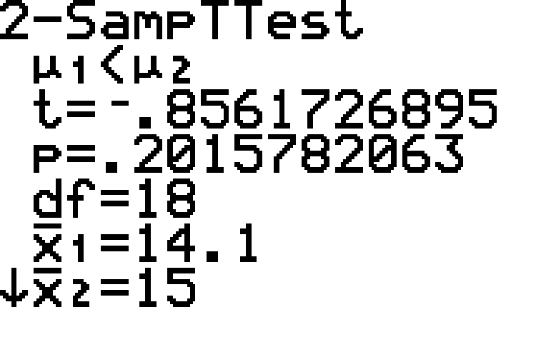
Example 11.2.2: Hypothesis Test for Two Population Means with Equal Variances (Left-Tailed Test, $σ$ Unknown, Independent Samples) (cont.)
Choosing Calculate produces the following results.

Slide 33
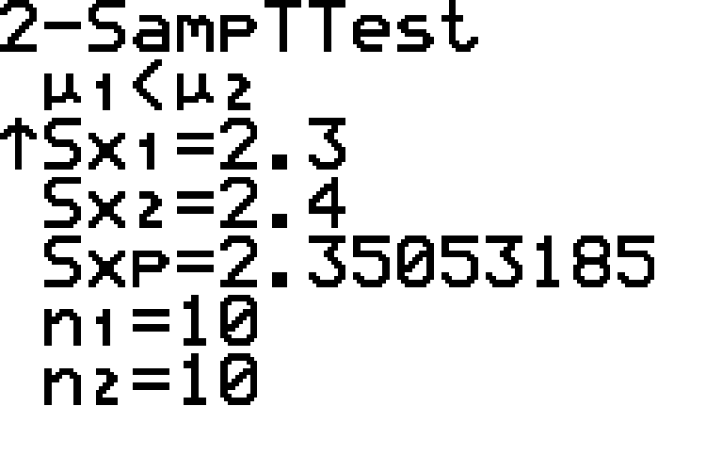
Example 11.2.2: Hypothesis Test for Two Population Means with Equal Variances (Left-Tailed Test, $σ$ Unknown, Independent Samples) (cont.)

Slide 34

Example 11.2.2: Hypothesis Test for Two Population Means with Equal Variances (Left-Tailed Test, $σ$ Unknown, Independent Samples) (cont.)
Again, notice that the calculator displays the alternative hypothesis. As shown in the screenshots, the calculated $t$-test statistic is approximately $−0.856$. Also, notice that the pooled standard deviation which is used is shown as $Sx_{p}$.

Slide 35

Example 11.2.2: Hypothesis Test for Two Population Means with Equal Variances (Left-Tailed Test, $σ$ Unknown, Independent Samples) (cont.)
Step 4: Draw a conclusion and interpret the decision.
Since the alternative hypothesis contains "<", we know that this is a left-tailed test.
We can use either rejection regions or $p$-values to draw a conclusion.

Slide 36
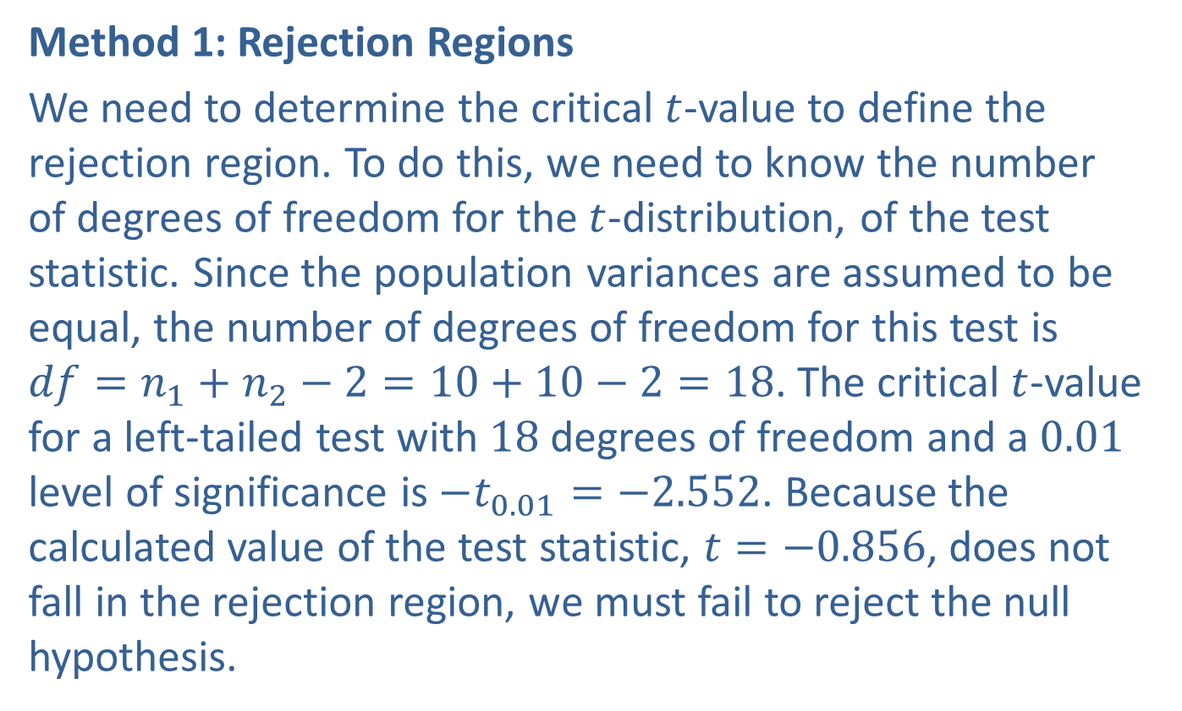
Example 11.2.2: Hypothesis Test for Two Population Means with Equal Variances (Left-Tailed Test, $σ$ Unknown, Independent Samples) (cont.)
Method 1: Rejection Regions
We need to determine the critical $t$-value to define the rejection region. To do this, we need to know the number of degrees of freedom for the $t$-distribution, of the test statistic. Since the population variances are assumed to be equal, the number of degrees of freedom for this test is $df=n_{1}+n_{2}−2=10+10−2=18$. The critical $t$-value for a left-tailed test with 18 degrees of freedom and a 0.01 level of significance is $−t_{0.01}=−2.552$. Because the calculated value of the test statistic, $t=−0.856$, does not fall in the rejection region, we must fail to reject the null hypothesis.

Slide 37
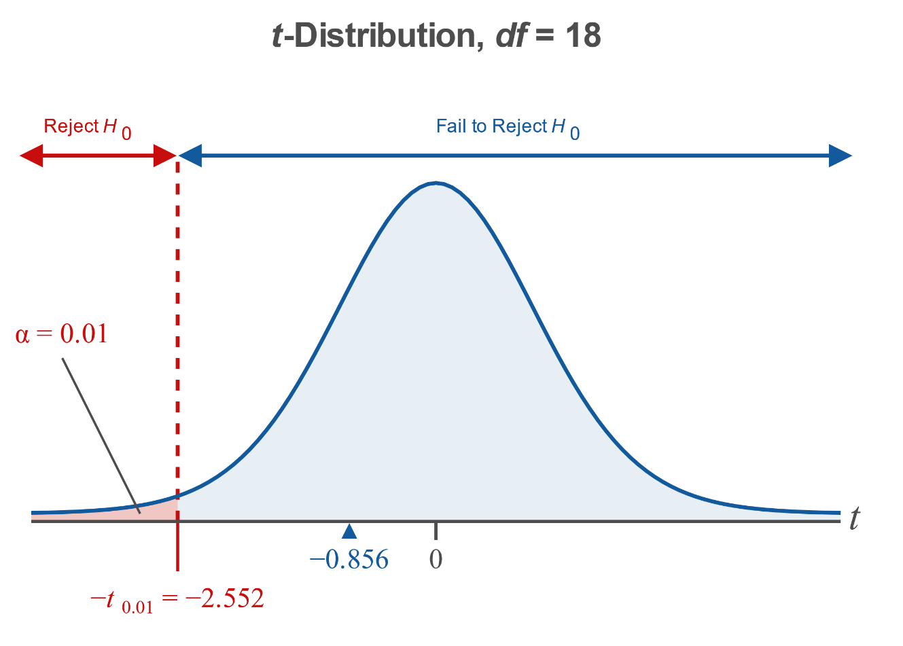
Example 11.2.2: Hypothesis Test for Two Population Means with Equal Variances (Left-Tailed Test, $σ$ Unknown, Independent Samples) (cont.)

Slide 38

Example 11.2.2: Hypothesis Test for Two Population Means with Equal Variances (Left-Tailed Test, $σ$ Unknown, Independent Samples) (cont.)
Method 2: $p$-Values
Since the $t$-distribution table in Appendix A cannot be used to calculate $p$-values, we will only show the calculator method using $p$-values.

Slide 39
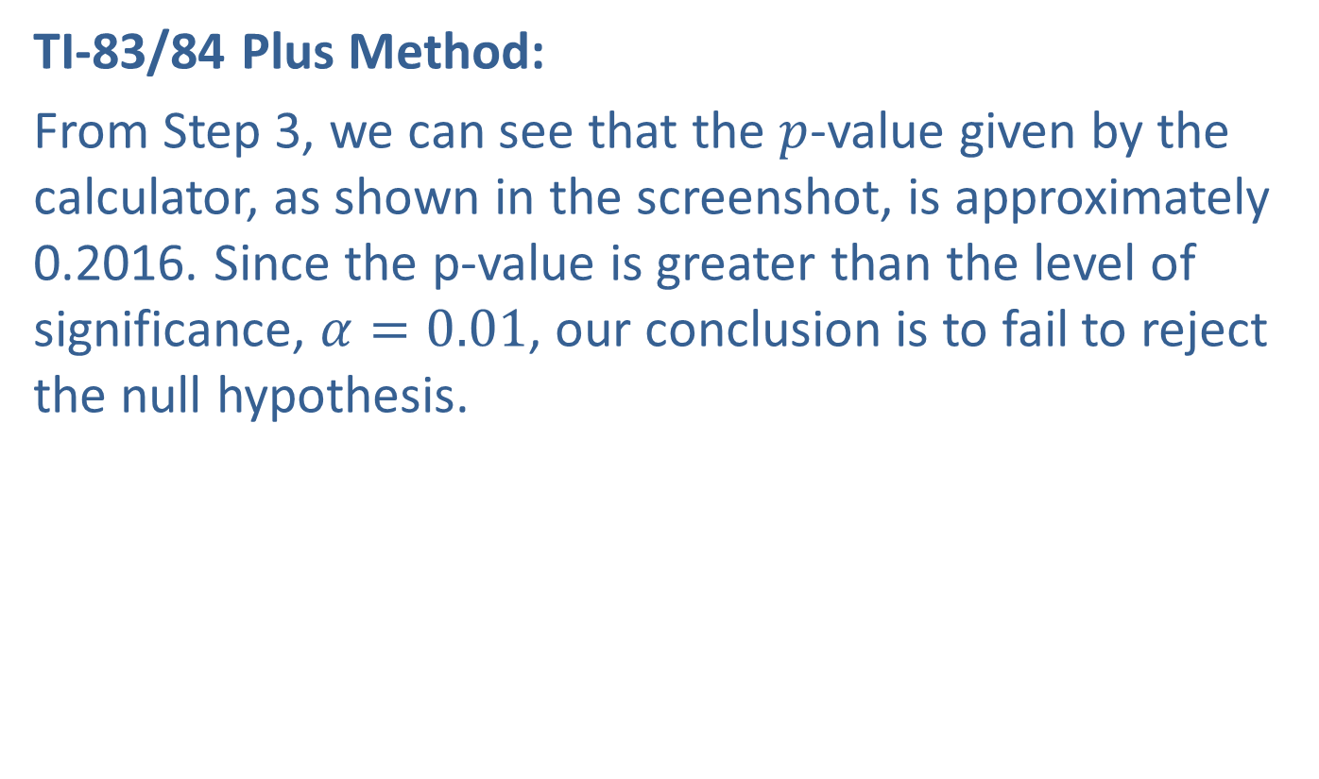
Example 11.2.2: Hypothesis Test for Two Population Means with Equal Variances (Left-Tailed Test, $σ$ Unknown, Independent Samples) (cont.)
TI-83/84 Plus Method:
From Step 3, we can see that the $p$-value given by the calculator, as shown in the screenshot, is approximately 0.2016. Since the p-value is greater than the level of significance, $α=0.01$, our conclusion is to fail to reject the null hypothesis.

Slide 40
Example 11.2.2: Hypothesis Test for Two Population Means with Equal Variances (Left-Tailed Test, $σ$ Unknown, Independent Samples) (cont.)
Interpretation: We interpret this conclusion to mean that there is not sufficient evidence at the 0.01 level to say that people who complete the tiling workshops take less time, on average, to complete their projects than those who do not attend the workshops.

