Slide 1
Section 11.3
Hypothesis Testing: Two Population Means (Sigma Unknown, Dependent Samples)

Slide 2
Memory Booster
Recall section 9.3 for more explanation on paired data.

Slide 3
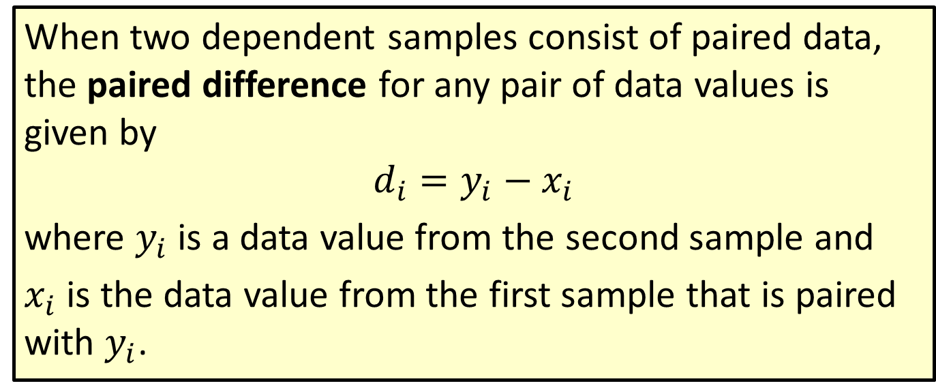
Formula: Paired Difference
When two dependent samples consist of paired data, the paired difference for any pair of data values is given by
$$d_{i}=y_{i}−x_{i}$$
where $y_{i}$ is a data value from the second sample and
$x_{i}$ is the data value from the first sample that is paired with $y_{i}$.

Slide 4
Example 11.3.1: Determining the Null and Alternative Hypotheses for a Dependent Samples
The manufacturer of a new diet pill claims that the pill helps a person lose, on average, more than 7 pounds in the first week. To test this claim, 15 people volunteer to take the diet pill for one week. Their weights are measured at the beginning and end of the week. State the null and alternative hypotheses for this hypothesis test.

Slide 5
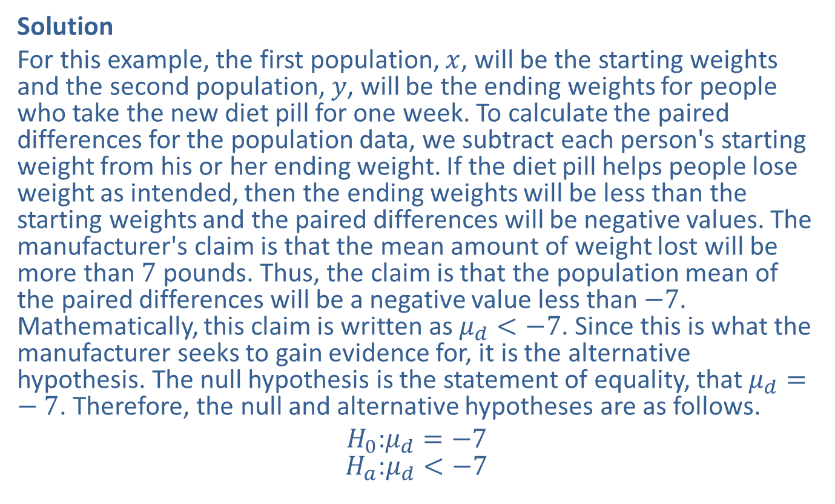
Example 11.3.1: Determining the Null and Alternative Hypotheses for a Dependent Samples (cont.)
Solution
For this example, the first population, $x$, will be the starting weights and the second population, $y$, will be the ending weights for people who take the new diet pill for one week. To calculate the paired differences for the population data, we subtract each person's starting weight from his or her ending weight. If the diet pill helps people lose weight as intended, then the ending weights will be less than the starting weights and the paired differences will be negative values. The manufacturer's claim is that the mean amount of weight lost will be more than 7 pounds. Thus, the claim is that the population mean of the paired differences will be a negative value less than $−7$. Mathematically, this claim is written as $μ_{d}<−7$. Since this is what the manufacturer seeks to gain evidence for, it is the alternative hypothesis. The null hypothesis is the statement of equality, that $μ_{d}=−7$. Therefore, the null and alternative hypotheses are as follows.
$$H_{0}\text{:}μ_{d}=−7$$
$$H_{a}\text{:}μ_{d}<−7$$

Slide 6
Memory Booster:
When subtracting the before-treatment value from the after-treatment value, a reduction in the value would result in a negative number for the difference. This means that a "reduction of more than" would correspond to < and a "reduction of less than" would correspond to > in the alternative hypothesis.

Slide 7
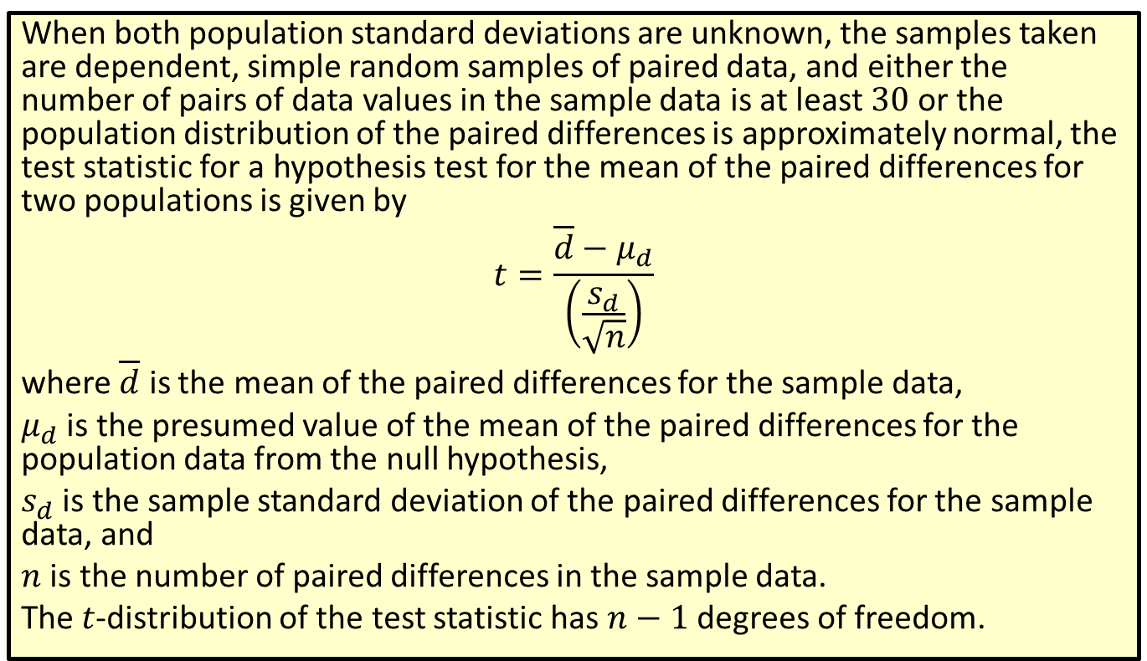
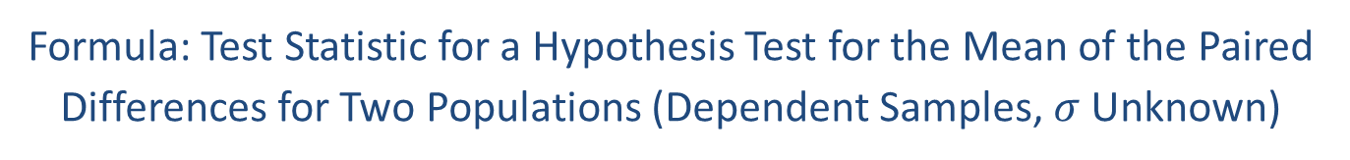
Formula: Test Statistic for a Hypothesis Test for the Mean of the Paired Differences for Two Populations (Dependent Samples, $σ$ Unknown)
When both population standard deviations are unknown, the samples taken are dependent, simple random samples of paired data, and either the number of pairs of data values in the sample data is at least 30 or the population distribution of the paired differences is approximately normal, the test statistic for a hypothesis test for the mean of the paired differences for two populations is given by
$$t=\frac{\overline{d}−μ_{d}}{\left(\frac{s_{d}}{\sqrt{n}}\right)}$$
where $\overline{d}$ is the mean of the paired differences for the sample data,
$μ_{d}$ is the presumed value of the mean of the paired differences for the population data from the null hypothesis,
$s_{d}$ is the sample standard deviation of the paired differences for the sample data, and
$n$ is the number of paired differences in the sample data.
The $t$-distribution of the test statistic has $n−1$ degrees of freedom.

Slide 8
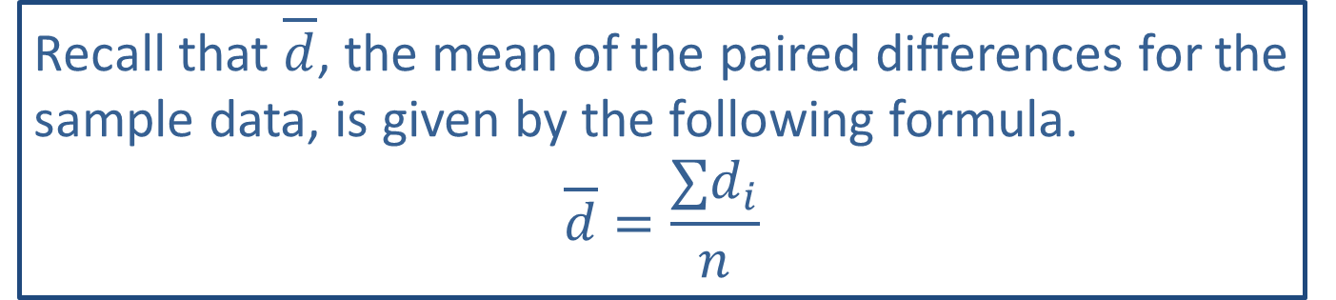
Memory Booster:
Recall that $\overline{d}$, the mean of the paired differences for the sample data, is given by the following formula.
$$\overline{d}=\frac{∑d_{i}}{n}$$

Slide 9
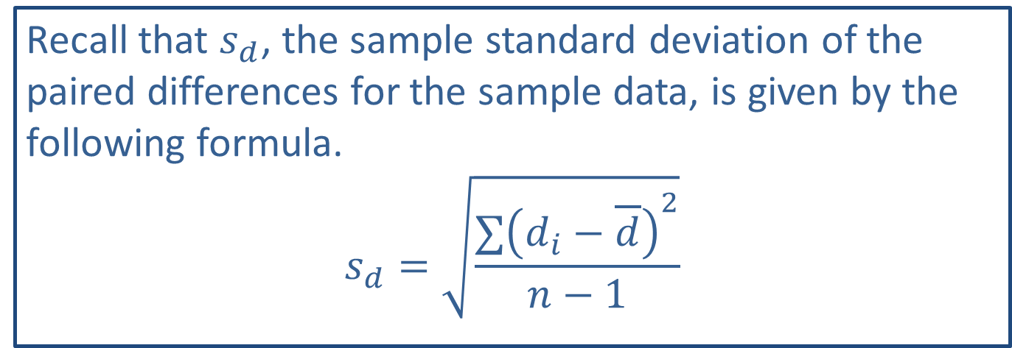
Memory Booster:
Recall that $s_{d}$, the sample standard deviation of the paired differences for the sample data, is given by the following formula.
$$s_{d}=\sqrt{\frac{∑{\left(d_{i}−\overline{d}\right)}^{2}}{n−1}}$$

Slide 10
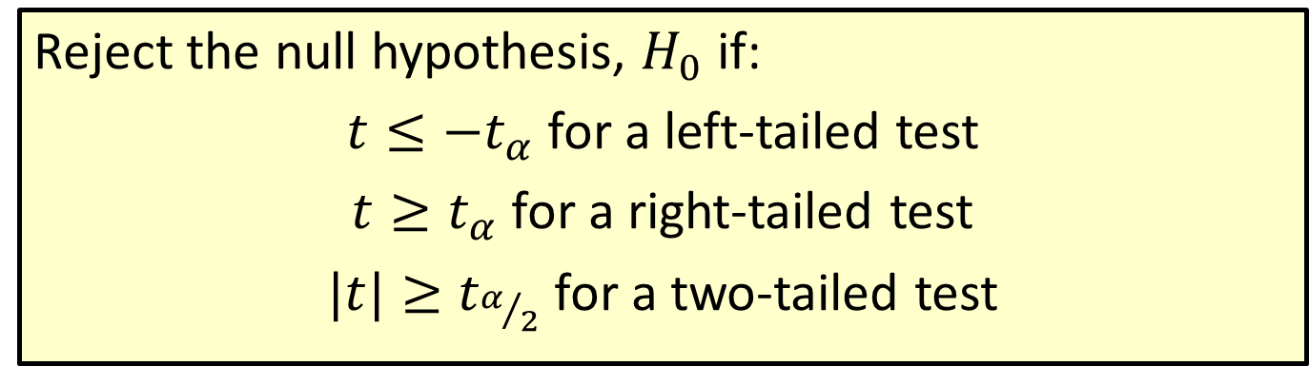

Procedure: Rejection Regions for Hypothesis Tests for the Mean of the Paired Differences for Two Populations($σ$ Unknown, Dependent Samples)
Reject the null hypothesis, $H_{0}$ if:
$t≤−t_{α}$ for a left-tailed test
$t≥t_{α}$ for a right-tailed test
$|t|≥t_{α/2}$ for a two-tailed test

Slide 11
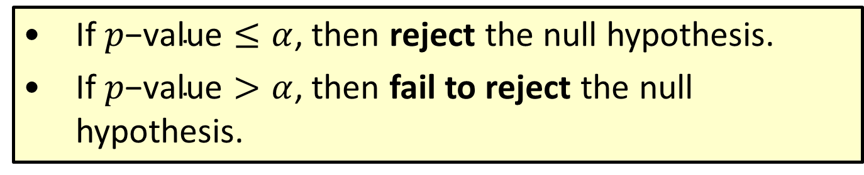

Procedure: Conclusions Using $p$-Values
​If $p\text{−}\text{value}≤α$, then reject the null hypothesis.
​If $p\text{−}\text{value}>α$, then fail to reject the null hypothesis.

Slide 12

Example 11.3.2: Hypothesis Test for the Mean of the Paired Differences for Two Populations (Right-Tailed, Dependent Samples, $σ$ Unknown)
The standard course at a local defensive-driving school includes several films depicting violent car crashes and graphic pictures of injuries sustained in these crashes. The driving school has shown these videos for many years, believing that they reduce the students' average speeds on the highway. A group of concerned citizens, who feel that these videos are very disturbing, is not convinced that the videos reduce highway speeds enough to make a significant difference in highway safety. In fact, the group claims that these videos reduce a person's speed on the highway by less than 5 miles per hour, on average. To test the claim, the citizens install electronic data recorders (EDR s) on the vehicles of 10 volunteers, who agree to drive as they would normally for two weeks while the EDR records their vehicles' speeds. After the initial driving period, each volunteer watches the videos. Then the EDR s again record their vehicles' speeds for another two weeks. The following table contains the average highway speeds for each volunteer for the two-week periods before and after watching the videos. Use these data to test the concerned citizens' claim that these videos reduce a person's speed on the highway by less than 5 miles per hour, on average. Assume that the distribution of the paired differences is approximately normal. Use a 0.05 level of significance.

Slide 13
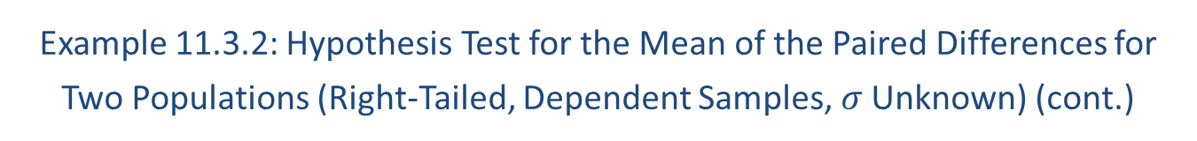
Example 11.3.2: Hypothesis Test for the Mean of the Paired Differences for Two Populations (Right-Tailed, Dependent Samples, $σ$ Unknown) (cont.)
Average Highway Speeds (in Miles per Hour)
Before | After
75.83 | 72.13
80.12 | 73.87
65.41 | 66.09
70.03 | 68.43
73.91 | 71.45
76.02 | 73.67
75.10 | 70.19
67.89 | 65.34
81.12 | 75.31
77.67 | 70.92

Slide 14
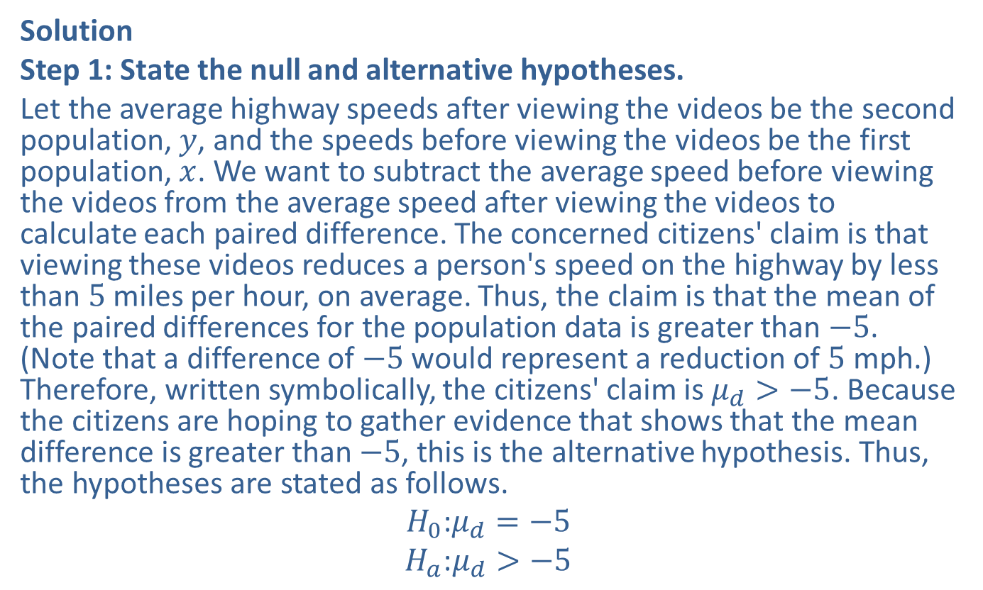
Example 11.3.2: Hypothesis Test for the Mean of the Paired Differences for Two Populations (Right-Tailed, Dependent Samples, $σ$ Unknown) (cont.)
Solution
Step 1: State the null and alternative hypotheses.
Let the average highway speeds after viewing the videos be the second population, $y$, and the speeds before viewing the videos be the first population, $x$. We want to subtract the average speed before viewing the videos from the average speed after viewing the videos to calculate each paired difference. The concerned citizens' claim is that viewing these videos reduces a person's speed on the highway by less than 5 miles per hour, on average. Thus, the claim is that the mean of the paired differences for the population data is greater than $−5$. (Note that a difference of $−5$ would represent a reduction of 5 mph.) Therefore, written symbolically, the citizens' claim is $μ_{d}>−5$. Because the citizens are hoping to gather evidence that shows that the mean difference is greater than $−5$, this is the alternative hypothesis. Thus, the hypotheses are stated as follows.
$$H_{0}\text{:}μ_{d}=−5$$
$$H_{a}\text{:}μ_{d}>−5$$

Slide 15
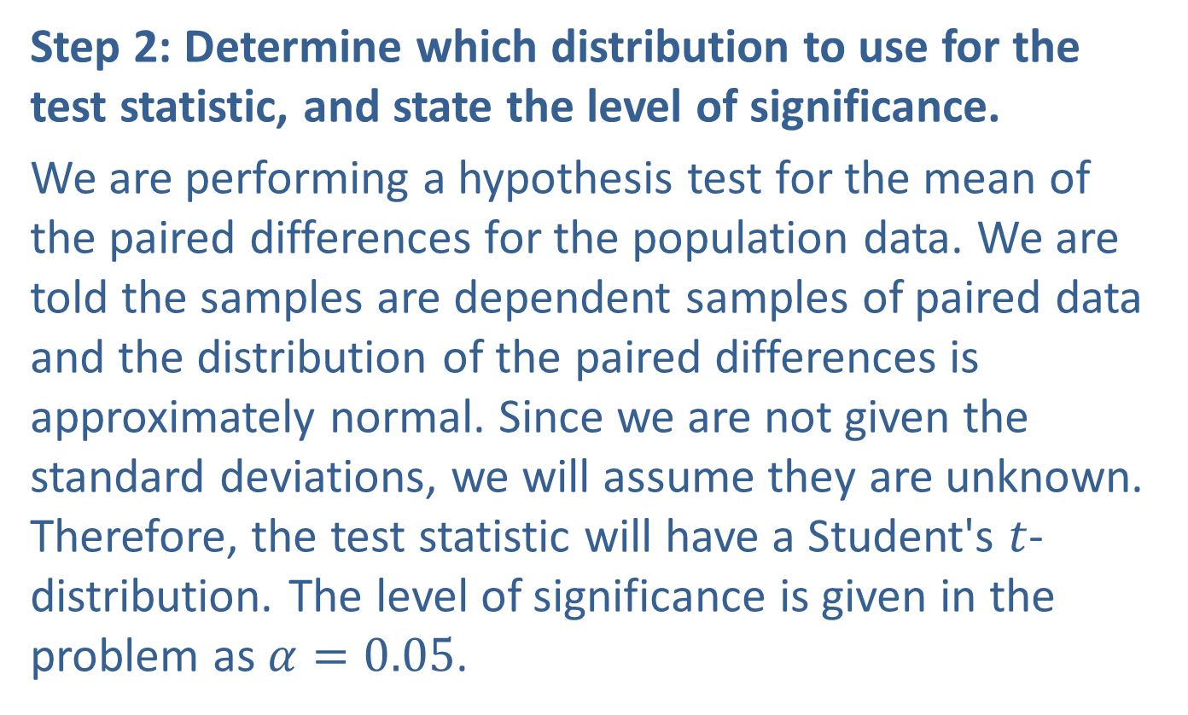
Example 11.3.2: Hypothesis Test for the Mean of the Paired Differences for Two Populations (Right-Tailed, Dependent Samples, $σ$ Unknown) (cont.)
Step 2: Determine which distribution to use for the test statistic, and state the level of significance.
We are performing a hypothesis test for the mean of the paired differences for the population data. We are told the samples are dependent samples of paired data and the distribution of the paired differences is approximately normal. Since we are not given the standard deviations, we will assume they are unknown. Therefore, the test statistic will have a Student's $t$-distribution. The level of significance is given in the problem as $α=0.05$.

Slide 16
Example 11.3.2: Hypothesis Test for the Mean of the Paired Differences for Two Populations (Right-Tailed, Dependent Samples, $σ$ Unknown) (cont.)
Step 3: Gather data and calculate the necessary sample statistics.
Since we were given raw data, we need to begin by calculating the paired differences, as well as the mean and sample standard deviation of these differences. The differences are listed in the following table.

Slide 17
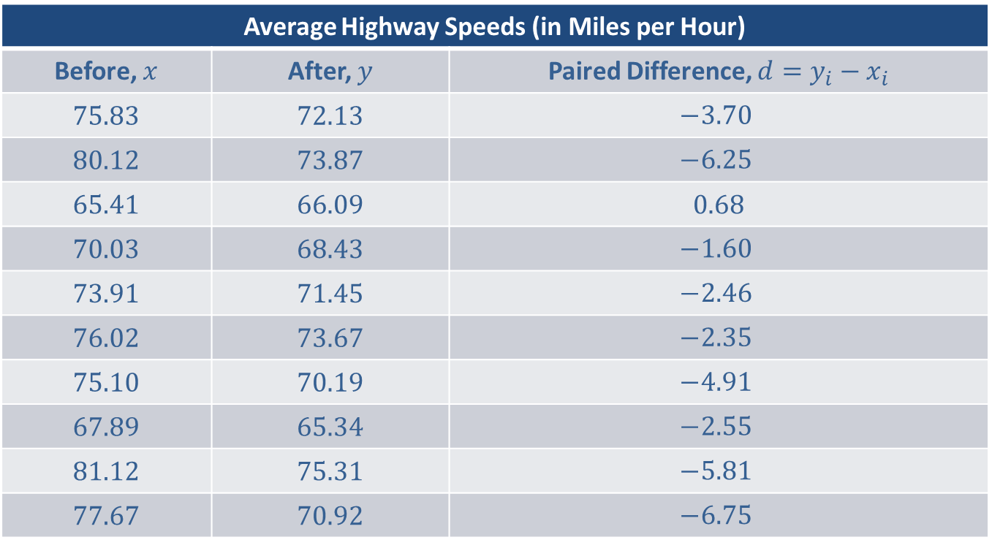
Example 11.3.2: Hypothesis Test for the Mean of the Paired Differences for Two Populations (Right-Tailed, Dependent Samples, $σ$ Unknown) (cont.)
Average Highway Speeds (in Miles per Hour)
Before, $x$ | After, $y$ | Paired Difference, $d=y_{i}−x_{i}$
75.83 | 72.13 | $$−3.70$$
80.12 | 73.87 | $$−6.25$$
65.41 | 66.09 | 0.68
70.03 | 68.43 | $$−1.60$$
73.91 | 71.45 | $$−2.46$$
76.02 | 73.67 | $$−2.35$$
75.10 | 70.19 | $$−4.91$$
67.89 | 65.34 | $$−2.55$$
81.12 | 75.31 | $$−5.81$$
77.67 | 70.92 | $$−6.75$$

Slide 18
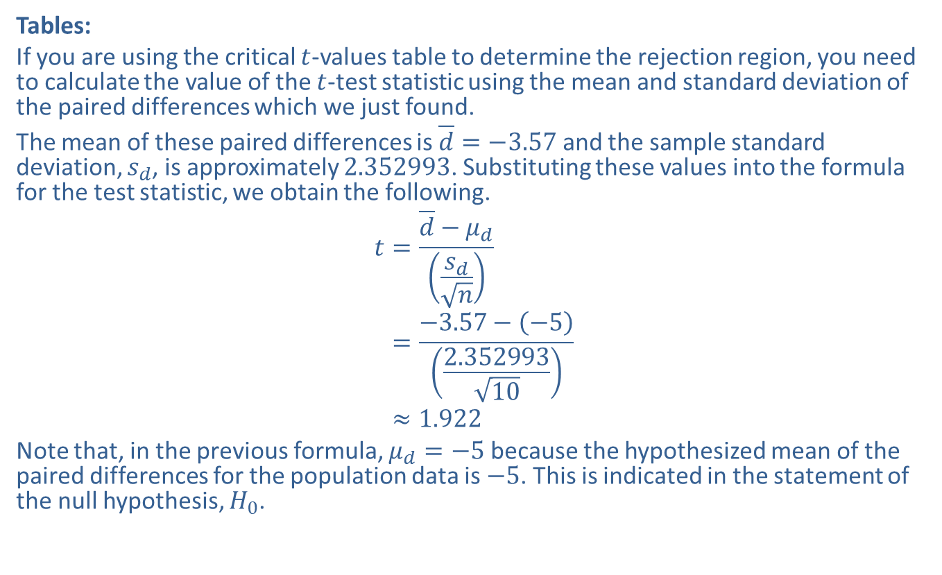
Example 11.3.2: Hypothesis Test for the Mean of the Paired Differences for Two Populations (Right-Tailed, Dependent Samples, $σ$ Unknown) (cont.)
Tables:
If you are using the critical $t$-values table to determine the rejection region, you need to calculate the value of the $t$-test statistic using the mean and standard deviation of the paired differences which we just found.
The mean of these paired differences is $\overline{d}=−3.57$ and the sample standard deviation, $s_{d}$, is approximately 2.352993. Substituting these values into the formula for the test statistic, we obtain the following.
𝑡=𝑑−𝜇𝑑𝑠𝑑𝑛𝑡=−3.57−−52.35299310𝑡≈1.922
Note that, in the previous formula, $μ_{d}=−5$ because the hypothesized mean of the paired differences for the population data is $−5$. This is indicated in the statement of the null hypothesis, $H_{0}$.

Slide 19
Technology
The hypothesis test for the differences between dependent samples can be performed on the TI-83/84 Plus calculator using the T-Test function. For instructions, please visit stat.hawkeslearning.com and navigate to Technology Instructions > Hypothesis Testing > Paired Difference.

Slide 20
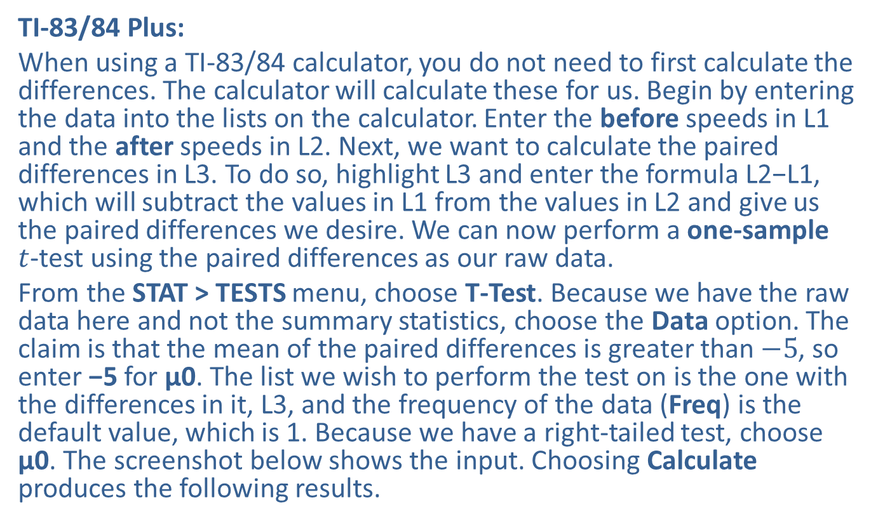
Example 11.3.2: Hypothesis Test for the Mean of the Paired Differences for Two Populations (Right-Tailed, Dependent Samples, $σ$ Unknown) (cont.)
TI-83/84 Plus:
When using a TI-83/84 calculator, you do not need to first calculate the differences. The calculator will calculate these for us. Begin by entering the data into the lists on the calculator. Enter the before speeds in L1 and the after speeds in L2. Next, we want to calculate the paired differences in L3. To do so, highlight L3 and enter the formula L2−L1, which will subtract the values in L1 from the values in L2 and give us the paired differences we desire. We can now perform a one-sample $t$-test using the paired differences as our raw data.
From the STAT > TESTS menu, choose T-Test. Because we have the raw data here and not the summary statistics, choose the Data option. The claim is that the mean of the paired differences is greater than $−5$, so enter −5 for μ0. The list we wish to perform the test on is the one with the differences in it, L3, and the frequency of the data (Freq) is the default value, which is 1. Because we have a right-tailed test, choose μ0. The screenshot below shows the input. Choosing Calculate produces the following results.

Slide 21
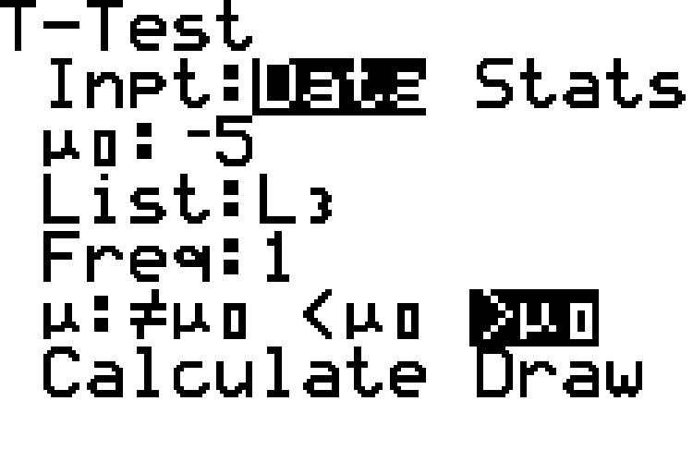
Example 11.3.2: Hypothesis Test for the Mean of the Paired Differences for Two Populations (Right-Tailed, Dependent Samples, $σ$ Unknown) (cont.)

Slide 22
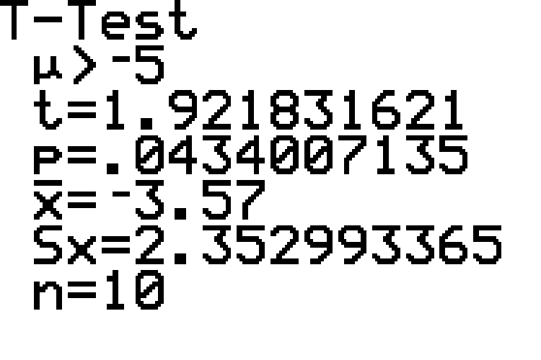
Example 11.3.2: Hypothesis Test for the Mean of the Paired Differences for Two Populations (Right-Tailed, Dependent Samples, $σ$ Unknown) (cont.)

Slide 23

Example 11.3.2: Hypothesis Test for the Mean of the Paired Differences for Two Populations (Right-Tailed, Dependent Samples, $σ$ Unknown) (cont.)
Step 4: Draw a conclusion and interpret the decision.
We can use either rejection regions or $p$-values to draw a conclusion.

Slide 24
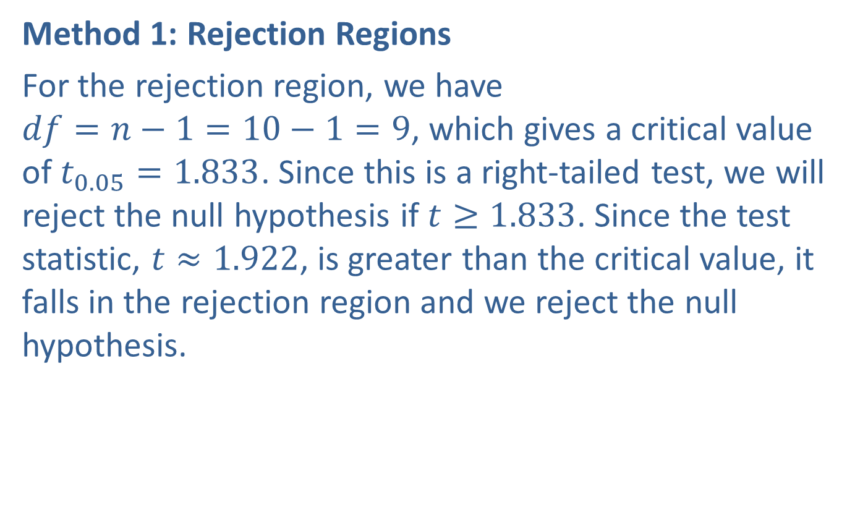
Example 11.3.2: Hypothesis Test for the Mean of the Paired Differences for Two Populations (Right-Tailed, Dependent Samples, $σ$ Unknown) (cont.)
Method 1: Rejection Regions
For the rejection region, we have $df=n−1=10−1=9$, which gives a critical value of $t_{0.05}=1.833$. Since this is a right-tailed test, we will reject the null hypothesis if $t≥1.833$. Since the test statistic, $t≈1.922$, is greater than the critical value, it falls in the rejection region and we reject the null hypothesis.

Slide 25
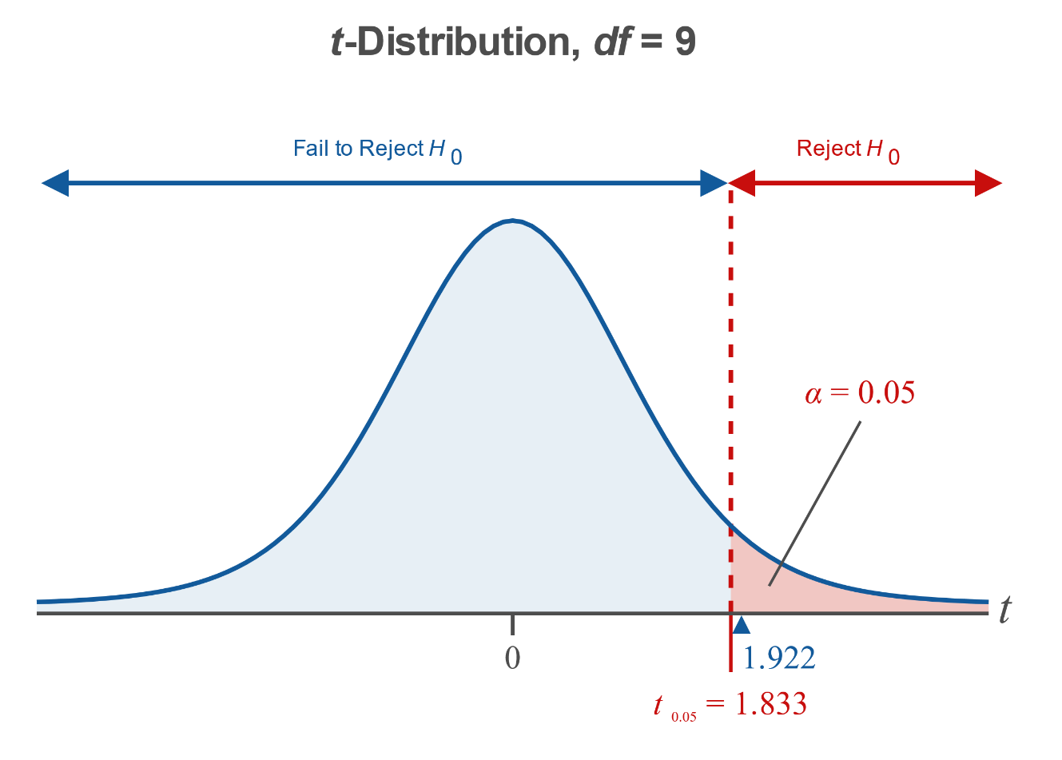
Example 11.3.2: Hypothesis Test for the Mean of the Paired Differences for Two Populations (Right-Tailed, Dependent Samples, $σ$ Unknown) (cont.)

Slide 26

Example 11.3.2: Hypothesis Test for the Mean of the Paired Differences for Two Populations (Right-Tailed, Dependent Samples, $σ$ Unknown) (cont.)
Method 2: $p$-Values
Since the $t$-distribution table in Appendix A cannot be used to calculate the $p$-values, we will only show the calculator method using $p$-values.

Slide 27
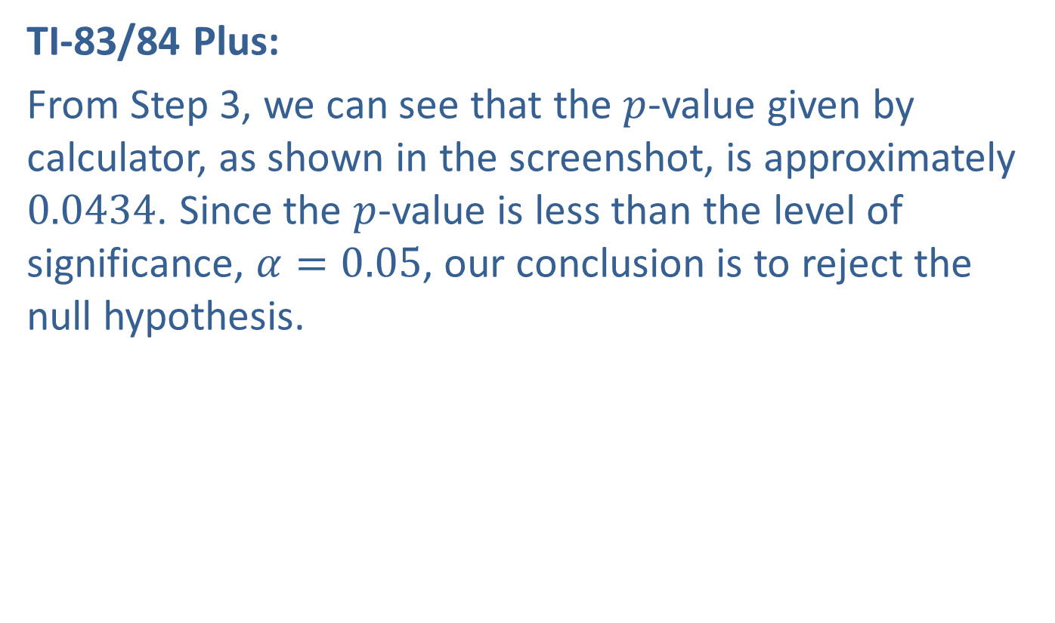
Example 11.3.2: Hypothesis Test for the Mean of the Paired Differences for Two Populations (Right-Tailed, Dependent Samples, $σ$ Unknown) (cont.)
TI-83/84 Plus:
From Step 3, we can see that the $p$-value given by calculator, as shown in the screenshot, is approximately 0.0434. Since the $p$-value is less than the level of significance, $α=0.05$, our conclusion is to reject the null hypothesis.

Slide 28
Example 11.3.2: Hypothesis Test for the Mean of the Paired Differences for Two Populations (Right-Tailed, Dependent Samples, $σ$ Unknown) (cont.)
Interpretation: Rejecting the null hypothesis indicates that there is enough evidence, at the 0.05 level of significance, to say that, after watching the videos, the mean reduction in drivers' highway speeds is less than 5 miles per hour. That is, the evidence supports the concerned citizens' claim that watching these videos reduces a person's speed on the highway by less than 5 miles per hour, on average.

Slide 29
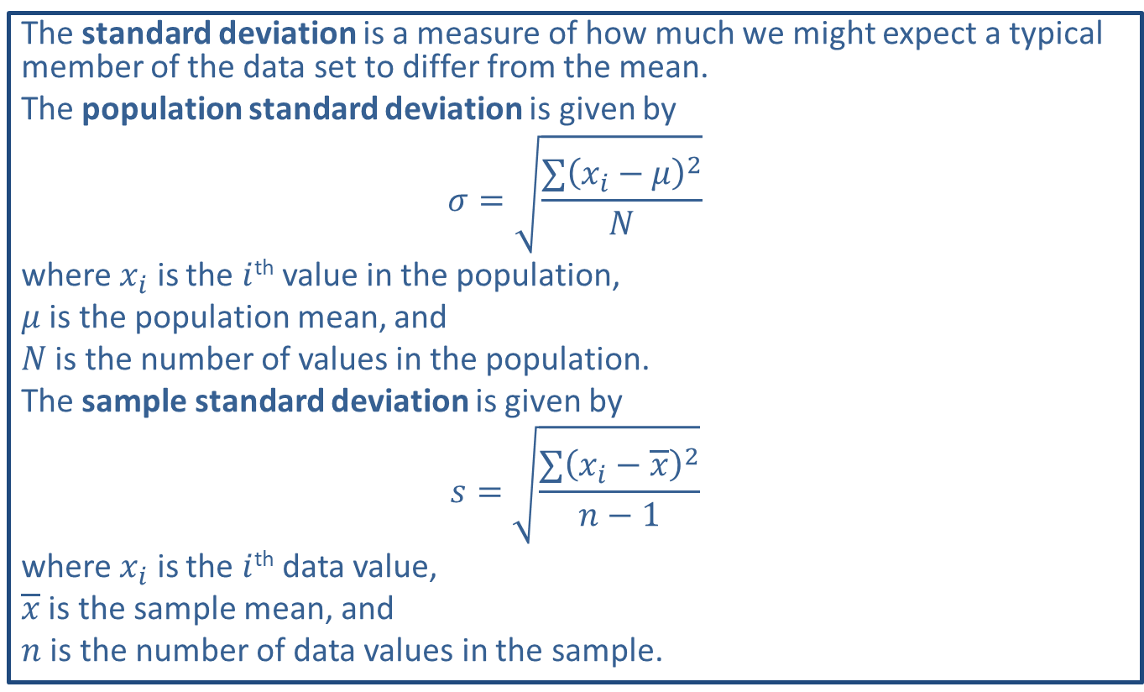
Memory Booster:
The standard deviation is a measure of how much we might expect a typical member of the data set to differ from the mean.
The population standard deviation is given by
$$σ=\sqrt{\frac{∑{\left(x_{i}−μ\right)}^{2}}{N}}$$
where $x_{i}$ is the $i$^{th} value in the population,
$μ$ is the population mean, and
$N$ is the number of values in the population.
The sample standard deviation is given by
$$s=\sqrt{\frac{∑{\left(x_{i}−\overline{x}\right)}^{2}}{n−1}}$$
where $x_{i}$ is the $i$^{th} data value,
$\overline{x}$ is the sample mean, and
$n$ is the number of data values in the sample.

Slide 30

Example 11.3.3: Hypothesis Test for the Mean of the Paired Differences for Two Populations (Two-Tailed, $σ$ Unknown, Dependent Samples)
Dr. Xiong, a clinical psychologist, wishes to test the claim that there is a significant difference in a person's adult weight if he is raised in an urban setting versus a rural setting. Dr. Xiong knows of five sets of identical twin boys who were raised separately, one twin in an urban setting and one twin in a rural setting, and who are willing to participate in a study to help her test her claim. The following table lists the results. Do these data support Dr. Xiong's claim at the 0.01 level of significance? Assume that the distribution of the paired differences is approximately normal.

Slide 31
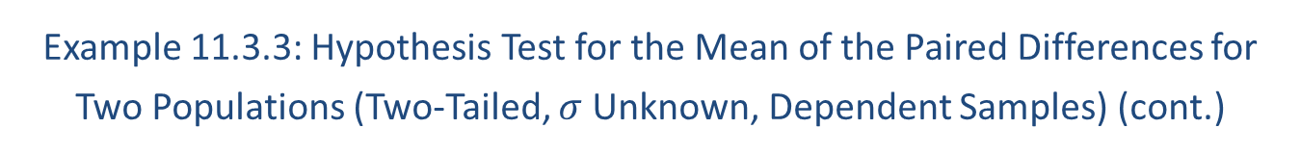
Example 11.3.3: Hypothesis Test for the Mean of the Paired Differences for Two Populations (Two-Tailed, $σ$ Unknown, Dependent Samples) (cont.)
Weights of Twins (in Pounds)
Twin Raised in an Urban Setting | 143.67 | 235.91 | 156.34 | 187.21 | 129.81
Twin Raised in a Rural Setting | 134.81 | 221.37 | 163.92 | 193.45 | 131.38

Slide 32
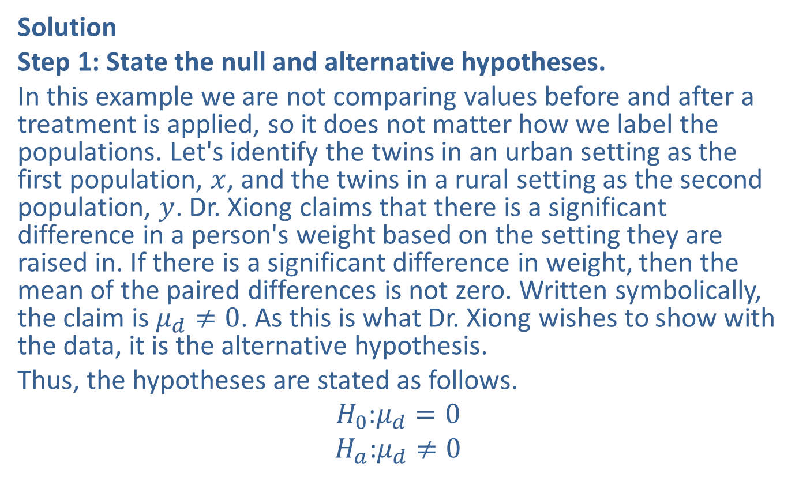
Example 11.3.3: Hypothesis Test for the Mean of the Paired Differences for Two Populations (Two-Tailed, $σ$ Unknown, Dependent Samples) (cont.)
Solution
Step 1: State the null and alternative hypotheses.
In this example we are not comparing values before and after a treatment is applied, so it does not matter how we label the populations. Let's identify the twins in an urban setting as the first population, $x$, and the twins in a rural setting as the second population, $y$. Dr. Xiong claims that there is a significant difference in a person's weight based on the setting they are raised in. If there is a significant difference in weight, then the mean of the paired differences is not zero. Written symbolically, the claim is $μ_{d}≠0$. As this is what Dr. Xiong wishes to show with the data, it is the alternative hypothesis.
Thus, the hypotheses are stated as follows.
$$H_{0}\text{:}μ_{d}=0$$
$$H_{a}\text{:}μ_{d}≠0$$

Slide 33
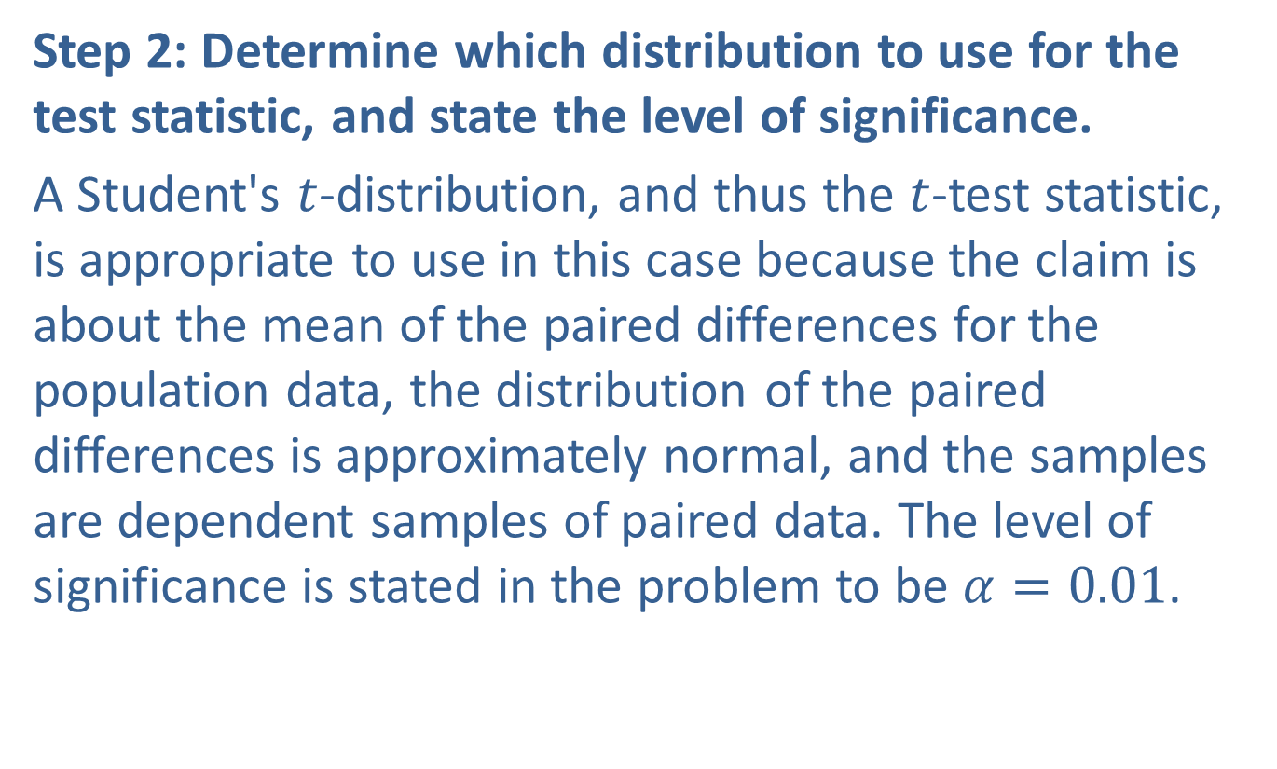
Example 11.3.3: Hypothesis Test for the Mean of the Paired Differences for Two Populations (Two-Tailed, $σ$ Unknown, Dependent Samples) (cont.)
Step 2: Determine which distribution to use for the test statistic, and state the level of significance.
A Student's $t$-distribution, and thus the $t$-test statistic, is appropriate to use in this case because the claim is about the mean of the paired differences for the population data, the distribution of the paired differences is approximately normal, and the samples are dependent samples of paired data. The level of significance is stated in the problem to be $α=0.01$.

Slide 34
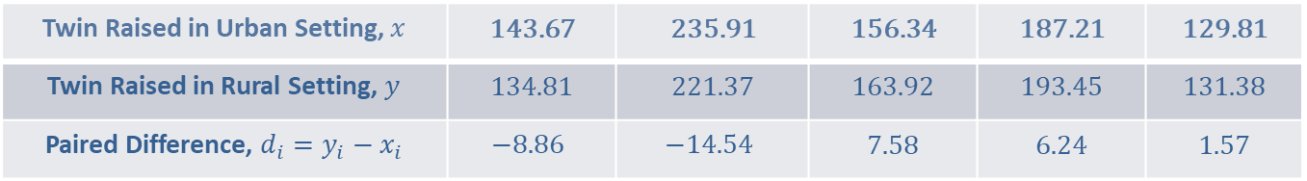
Example 11.3.3: Hypothesis Test for the Mean of the Paired Differences for Two Populations (Two-Tailed, $σ$ Unknown, Dependent Samples) (cont.)
Step 3: Gather data and calculate the necessary sample statistics.
Since we were given raw data, we need to begin by calculating the paired differences, as well as the mean and sample standard deviation of these differences. The differences are listed in the following table.
Twin Raised in Urban Setting, $x$ | 143.67 | 235.91 | 156.34 | 187.21 | 129.81
Twin Raised in Rural Setting, $y$ | 134.81 | 221.37 | 163.92 | 193.45 | 131.38
Paired Difference, $d_{i}=y_{i}−x_{i}$ | $$−8.86$$ | $$−14.54$$ | 7.58 | 6.24 | 1.57

Slide 35
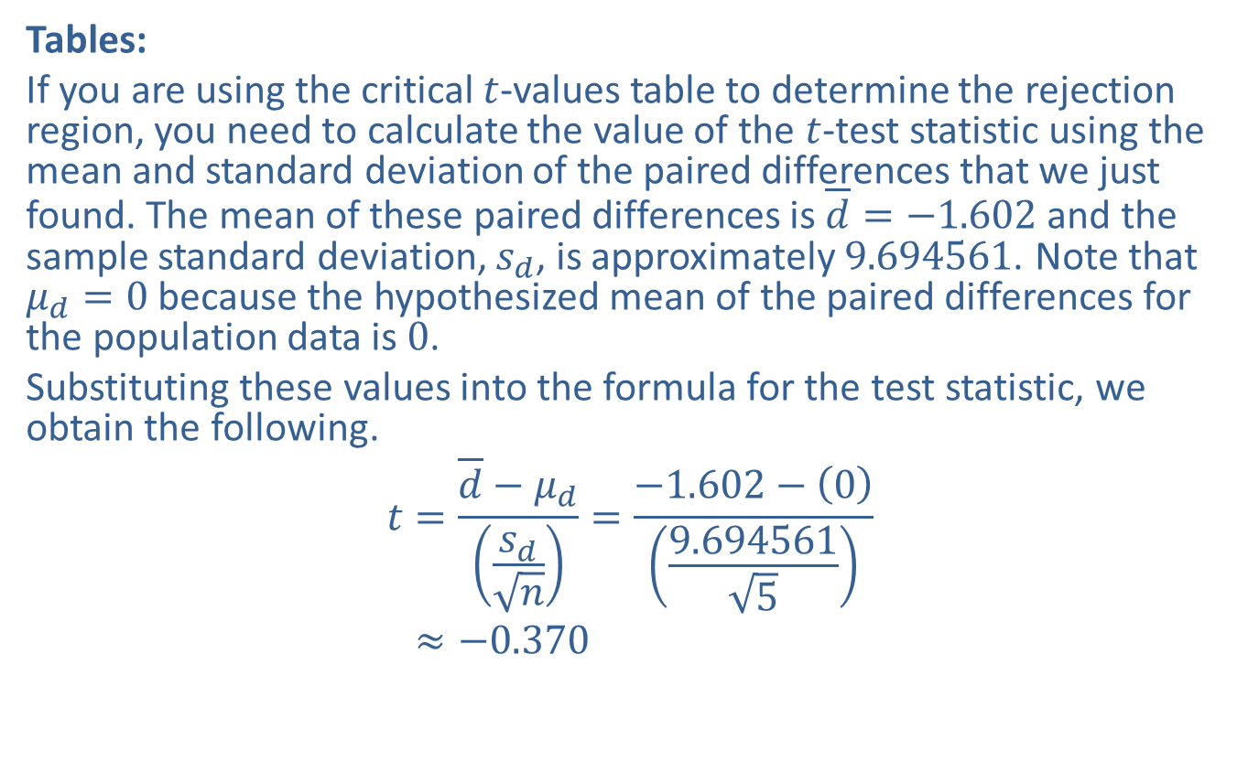
Example 11.3.3: Hypothesis Test for the Mean of the Paired Differences for Two Populations (Two-Tailed, $σ$ Unknown, Dependent Samples) (cont.)
Tables:
If you are using the critical $t$-values table to determine the rejection region, you need to calculate the value of the $t$-test statistic using the mean and standard deviation of the paired differences that we just found. The mean of these paired differences is $\overline{d}=−1.602$ and the sample standard deviation, $s_{d}$, is approximately 9.694561. Note that $μ_{d}=0$ because the hypothesized mean of the paired differences for the population data is 0.
Substituting these values into the formula for the test statistic, we obtain the following.
𝑡=𝑑−𝜇𝑑𝑠𝑑𝑛=−1.602−09.6945615𝑡≈−0.370

Slide 36
Example 11.3.3: Hypothesis Test for the Mean of the Paired Differences for Two Populations (Two-Tailed, $σ$ Unknown, Dependent Samples) (cont.)
TI-83/84 Plus
When using a TI-83/84 Plus calculator, you do not need to first calculate the differences. The calculator can calculate these for us.
Enter the weights of the twins raised in the urban setting in L1 and the weights of the twins raised in the rural setting in L2. Next, we want to calculate the paired differences in L3. To do so, highlight L3 and enter the formula to subtract the values in L1 from the values in L2, namely L2-L1.

Slide 37
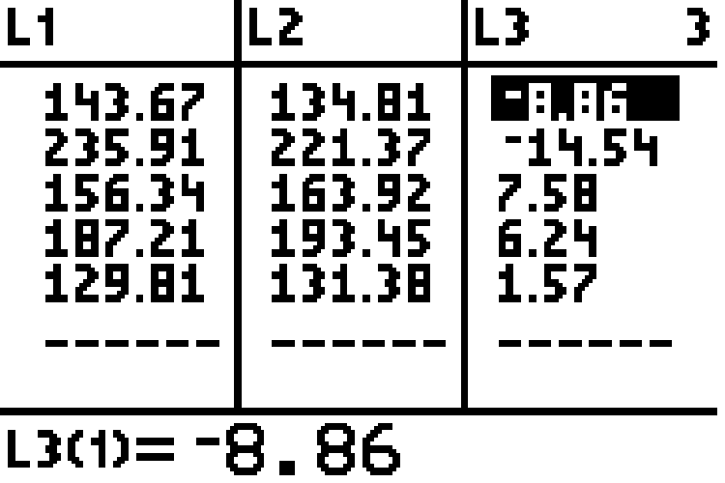
Example 11.3.3: Hypothesis Test for the Mean of the Paired Differences for Two Populations (Two-Tailed, $σ$ Unknown, Dependent Samples) (cont.)

Slide 38
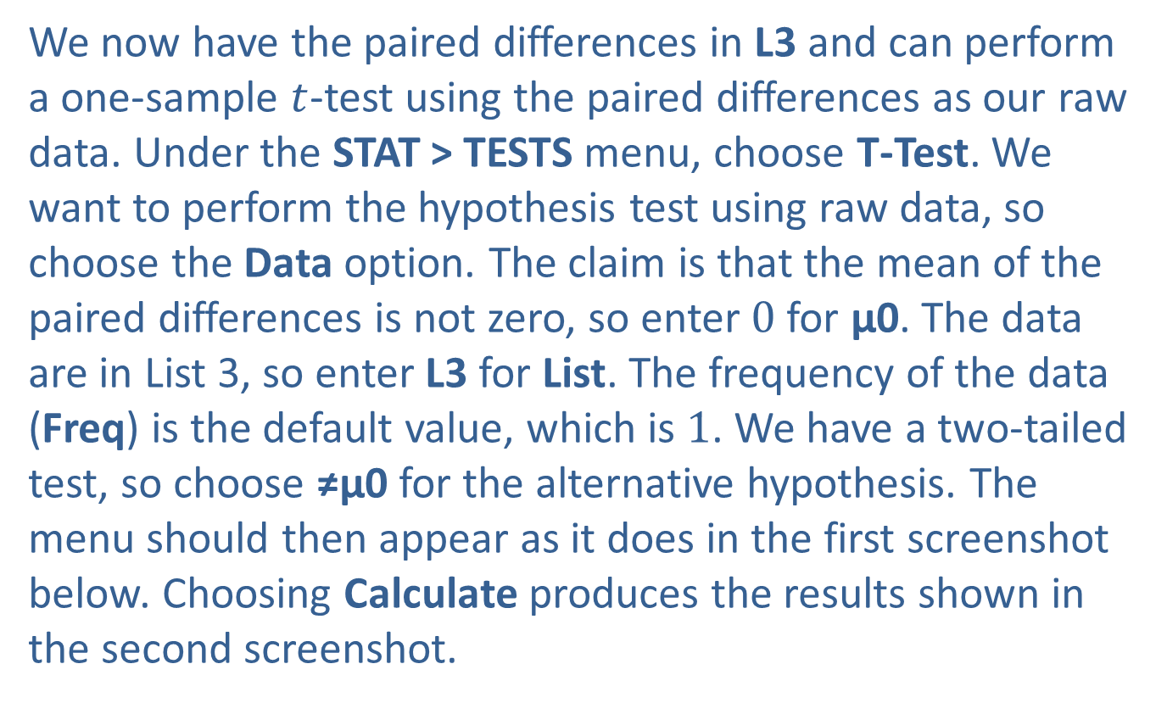
Example 11.3.3: Hypothesis Test for the Mean of the Paired Differences for Two Populations (Two-Tailed, $σ$ Unknown, Dependent Samples) (cont.)
We now have the paired differences in L3 and can perform a one-sample $t$-test using the paired differences as our raw data. Under the STAT > TESTS menu, choose T-Test. We want to perform the hypothesis test using raw data, so choose the Data option. The claim is that the mean of the paired differences is not zero, so enter 0 for μ0. The data are in List 3, so enter L3 for List. The frequency of the data (Freq) is the default value, which is 1. We have a two-tailed test, so choose ≠μ0 for the alternative hypothesis. The menu should then appear as it does in the first screenshot below. Choosing Calculate produces the results shown in the second screenshot.

Slide 39
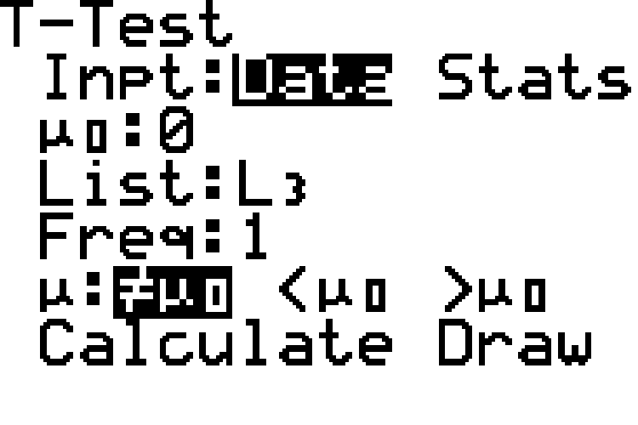
Example 11.3.3: Hypothesis Test for the Mean of the Paired Differences for Two Populations (Two-Tailed, $σ$ Unknown, Dependent Samples) (cont.)

Slide 40
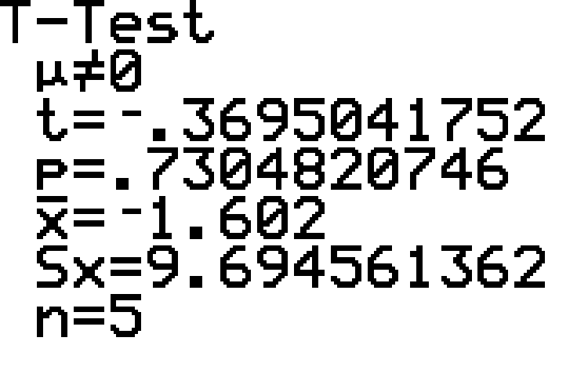
Example 11.3.3: Hypothesis Test for the Mean of the Paired Differences for Two Populations (Two-Tailed, $σ$ Unknown, Dependent Samples) (cont.)

Slide 41
Example 11.3.3: Hypothesis Test for the Mean of the Paired Differences for Two Populations (Two-Tailed, $σ$ Unknown, Dependent Samples) (cont.)
Step 4: Draw a conclusion and interpret the decision.
We can use either rejection regions or $p$-values to draw a conclusion.

Slide 42
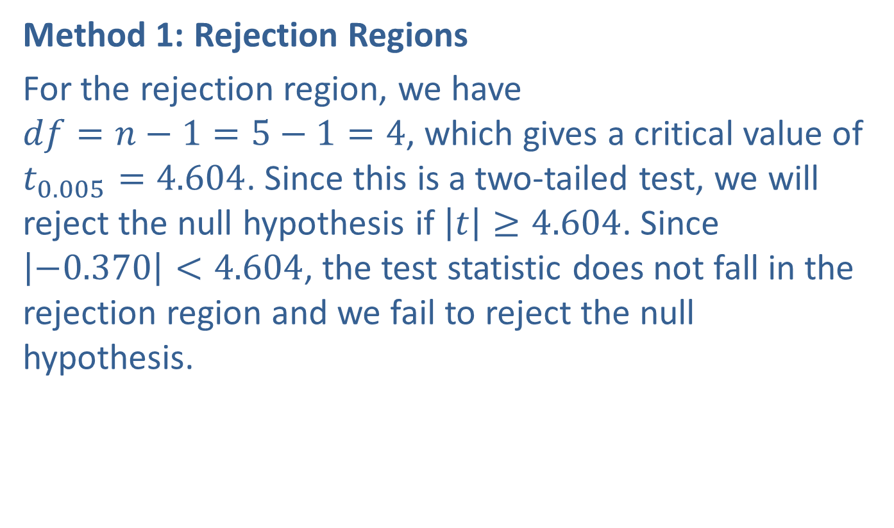
Example 11.3.3: Hypothesis Test for the Mean of the Paired Differences for Two Populations (Two-Tailed, $σ$ Unknown, Dependent Samples) (cont.)
Method 1: Rejection Regions
For the rejection region, we have $df=n−1=5−1=4$, which gives a critical value of $t_{0.005}=4.604$. Since this is a two‑tailed test, we will reject the null hypothesis if $\left|t\right|≥4.604$. Since $\left|−0.370\right|<4.604$, the test statistic does not fall in the rejection region and we fail to reject the null hypothesis.

Slide 43
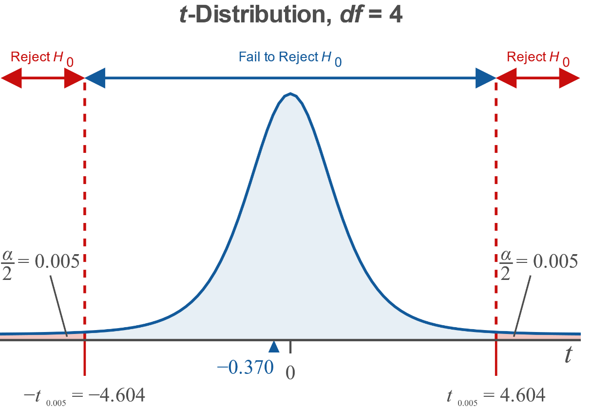
Example 11.3.3: Hypothesis Test for the Mean of the Paired Differences for Two Populations (Two-Tailed, $σ$ Unknown, Dependent Samples) (cont.)

Slide 44

Example 11.3.3: Hypothesis Test for the Mean of the Paired Differences for Two Populations (Two-Tailed, $σ$ Unknown, Dependent Samples) (cont.)
Method 2: $p$-Values
Since the $t$-distribution table in Appendix A cannot be used to calculate $p$-values, we will only show the calculator method using $p$-values.

Slide 45

Example 11.3.3: Hypothesis Test for the Mean of the Paired Differences for Two Populations (Two-Tailed, $σ$ Unknown, Dependent Samples) (cont.)
TI-83/84 Plus:
The $p$-value given by the calculator in Step 3 is approximately 0.7305. Since $0.7305>0.01$, the conclusion is to fail to reject the null hypothesis.

Slide 46
Example 11.3.3: Hypothesis Test for the Mean of the Paired Differences for Two Populations (Two-Tailed, $σ$ Unknown, Dependent Samples) (cont.)
Interpretation: Thus, there is not sufficient evidence at the 0.01 level of significance to say that the mean difference between the weights of male identical twins is not 0 for twins who are raised in different settings. That is, the evidence does not support Dr. Xiong's claim that there is a significant difference in a person's weight if he is raised in an urban setting instead of a rural setting.

