Slide 1
Section 11.4
Hypothesis Testing: Two Population Proportions

Slide 2
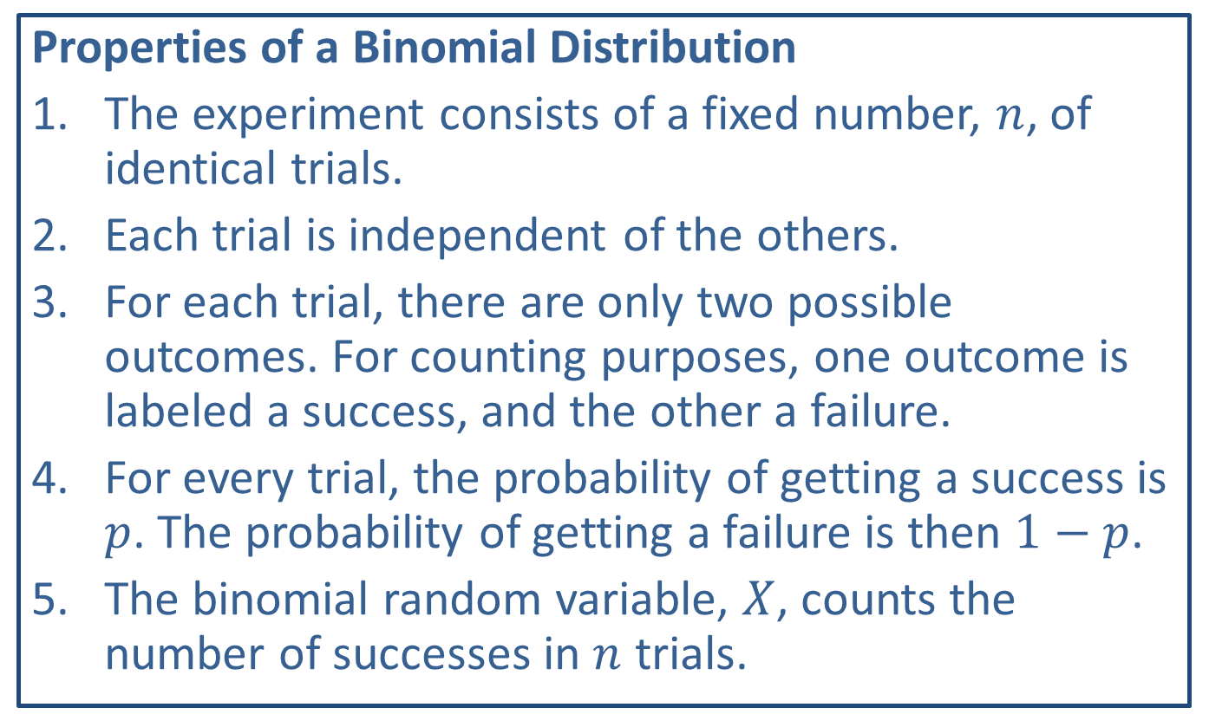
Memory Booster
Properties of a Binomial Distribution
​The experiment consists of a fixed number, $n$, of identical trials.
​Each trial is independent of the others.
​For each trial, there are only two possible outcomes. For counting purposes, one outcome is labeled a success, and the other a failure.
​For every trial, the probability of getting a success is $p$. The probability of getting a failure is then $1−p$.
​The binomial random variable, $X$, counts the number of successes in $n$ trials.

Slide 3
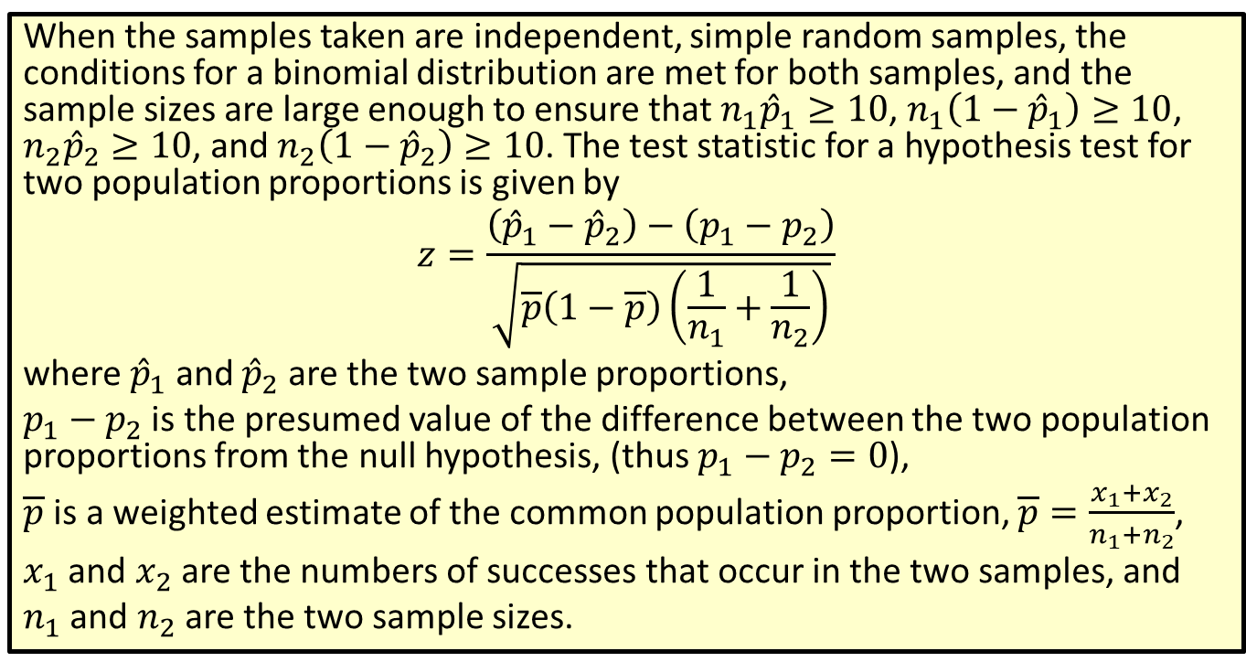
Formula: Test Statistic for a Hypothesis Test for Two Population Proportions
When the samples taken are independent, simple random samples, the conditions for a binomial distribution are met for both samples, and the sample sizes are large enough to ensure that $n_{1}{\hat{p}}_{1}≥10$, $n_{1}\left(1−{\hat{p}}_{1}\right)≥10$, $n_{2}{\hat{p}}_{2}≥10$, and $n_{2}\left(1−{\hat{p}}_{2}\right)≥10$. The test statistic for a hypothesis test for two population proportions is given by
$$z=\frac{\left({\hat{p}}_{1}−{\hat{p}}_{2}\right)−\left(p_{1}−p_{2}\right)}{\sqrt{\overline{p}\left(1−\overline{p}\right)\left(\frac{1}{n_{1}}+\frac{1}{n_{2}}\right)}}$$
where ${\hat{p}}_{1}$ and ${\hat{p}}_{2}$ are the two sample proportions,
$p_{1}−p_{2}$ is the presumed value of the difference between the two population proportions from the null hypothesis, (thus $p_{1}−p_{2}=0$),
$\overline{p}$ is a weighted estimate of the common population proportion, $\overline{p}=\frac{x_{1}+x_{2}}{n_{1}+n_{2}}$,
$x_{1}$ and $x_{2}$ are the numbers of successes that occur in the two samples, and
$n_{1}$ and $n_{2}$ are the two sample sizes.

Slide 4
Note
We will assume that the conditions for a binomial distribution are met for all examples and exercises involving hypothesis tests for population proportions.

Slide 5
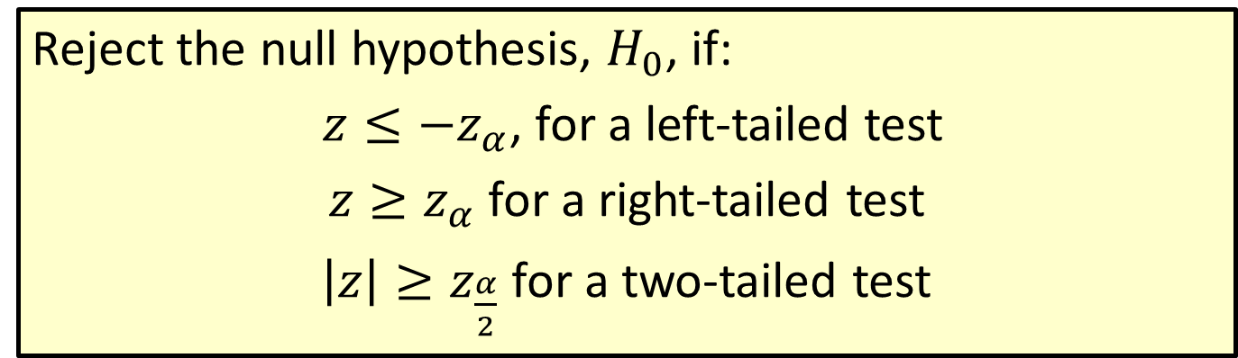
Procedure: Rejection Regions for Hypothesis Tests for Population Proportions
Reject the null hypothesis, $H_{0}$, if:
$z≤−z_{α}$, for a left-tailed test
$z≥z_{α}$ for a right-tailed test
$\left|z\right|≥z_{\frac{α}{2}}$ for a two-tailed test

Slide 6
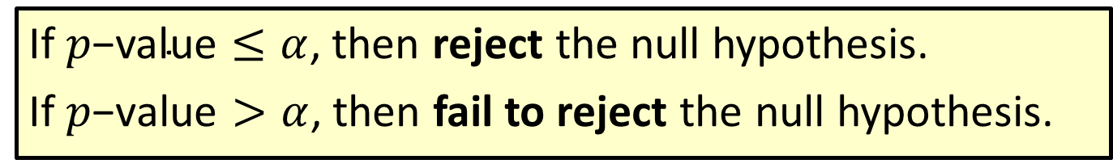

Procedure: Conclusions Using $p$-Values
If $p\text{−}\text{value}≤α$, then reject the null hypothesis.
If $p\text{−}\text{value}>α$, then fail to reject the null hypothesis.

Slide 7
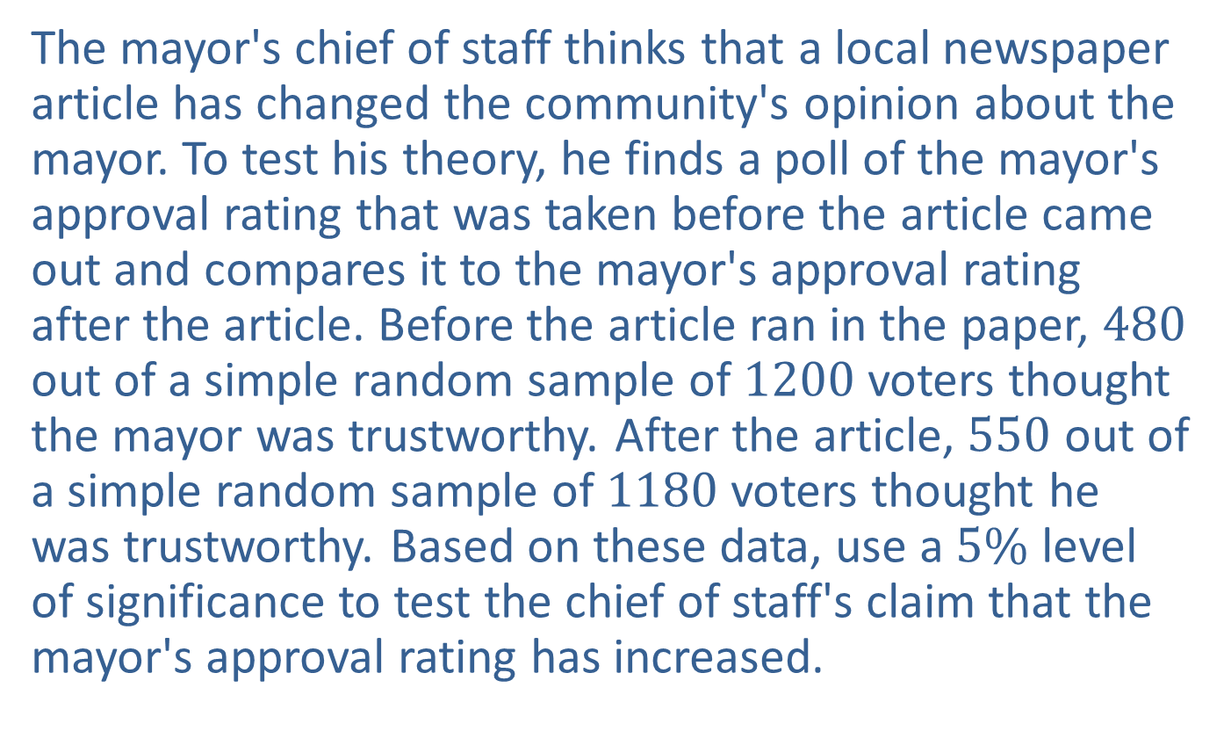
Example 11.4.1: Hypothesis Test for Two Population Proportions (Left-Tailed)
The mayor's chief of staff thinks that a local newspaper article has changed the community's opinion about the mayor. To test his theory, he finds a poll of the mayor's approval rating that was taken before the article came out and compares it to the mayor's approval rating after the article. Before the article ran in the paper, 480 out of a simple random sample of 1200 voters thought the mayor was trustworthy. After the article, 550 out of a simple random sample of 1180 voters thought he was trustworthy. Based on these data, use a $5\%$ level of significance to test the chief of staff's claim that the mayor's approval rating has increased.

Slide 8
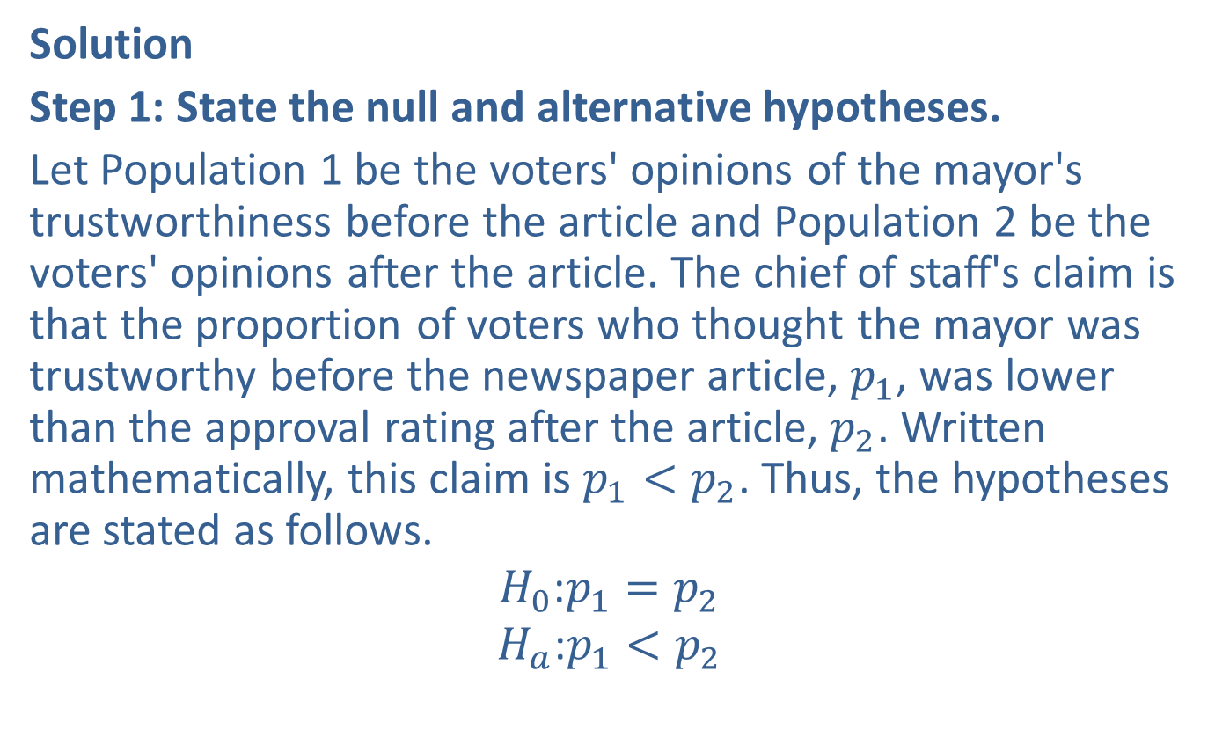
Example 11.4.1: Hypothesis Test for Two Population Proportions (Left-Tailed) (cont.)
Solution
Step 1: State the null and alternative hypotheses.
Let Population 1 be the voters' opinions of the mayor's trustworthiness before the article and Population 2 be the voters' opinions after the article. The chief of staff's claim is that the proportion of voters who thought the mayor was trustworthy before the newspaper article, $p_{1}$, was lower than the approval rating after the article, $p_{2}$. Written mathematically, this claim is $p_{1}<p_{2}$. Thus, the hypotheses are stated as follows.
$$H_{0}\text{:}p_{1}=p_{2}$$
$$H_{a}\text{:}p_{1}<p_{2}$$

Slide 9
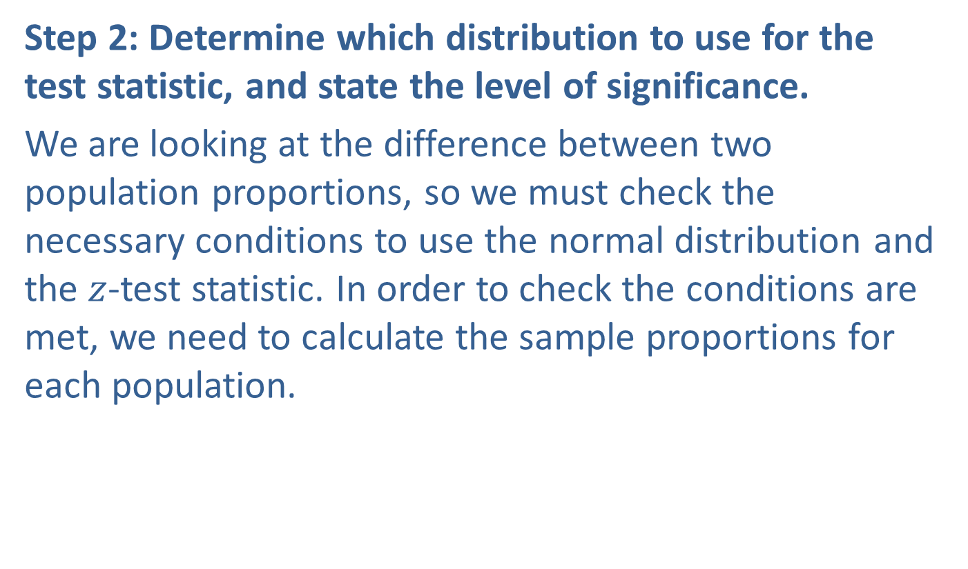
Example 11.4.1: Hypothesis Test for Two Population Proportions (Left-Tailed) (cont.)
Step 2: Determine which distribution to use for the test statistic, and state the level of significance.
We are looking at the difference between two population proportions, so we must check the necessary conditions to use the normal distribution and the $z$-test statistic. In order to check the conditions are met, we need to calculate the sample proportions for each population.

Slide 10
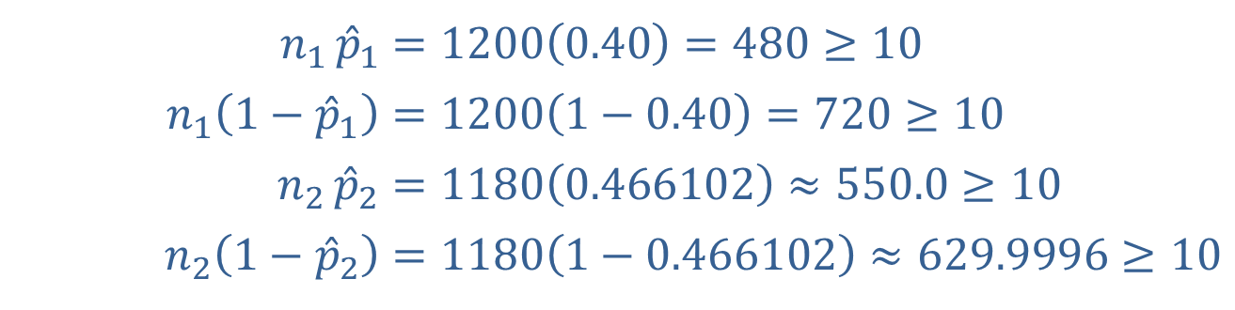

Example 11.4.1: Hypothesis Test for Two Population Proportions (Left-Tailed) (cont.)
The sample proportion for Sample 1, before the article, is ${\hat{p}}_{1}=\frac{480}{1200}=0.4$. The sample proportion for Sample 2, after the article, is ${\hat{p}}_{2}=\frac{550}{1180}≈0.466102$. Therefore, we check the conditions for the sample size as follows.
​$n_{1}{{\hat{p}}_{1}}$ | ​$=1200\left(0.40\right)=480≥10$
​$n_{1}\left(1−{\hat{p}}_{1}\right)$ | ​$=1200\left(1−0.40\right)=720≥10$
​$n_{2}{{\hat{p}}_{2}}$ | ​$=1180\left(0.466102\right)≈550.0≥10$
​$n_{2}\left(1−{\hat{p}}_{2}\right)$ | ​$=1180\left(1−0.466102\right)≈629.9996≥10$

Slide 11

Example 11.4.1: Hypothesis Test for Two Population Proportions (Left-Tailed) (cont.)
Even though the sample size is large, it is still important that the conditions are checked. Since all of the conditions are satisfied, we can use the $z$-test statistic.
For this hypothesis test, we were told to use a level of significance of $α=0.05$.

Slide 12
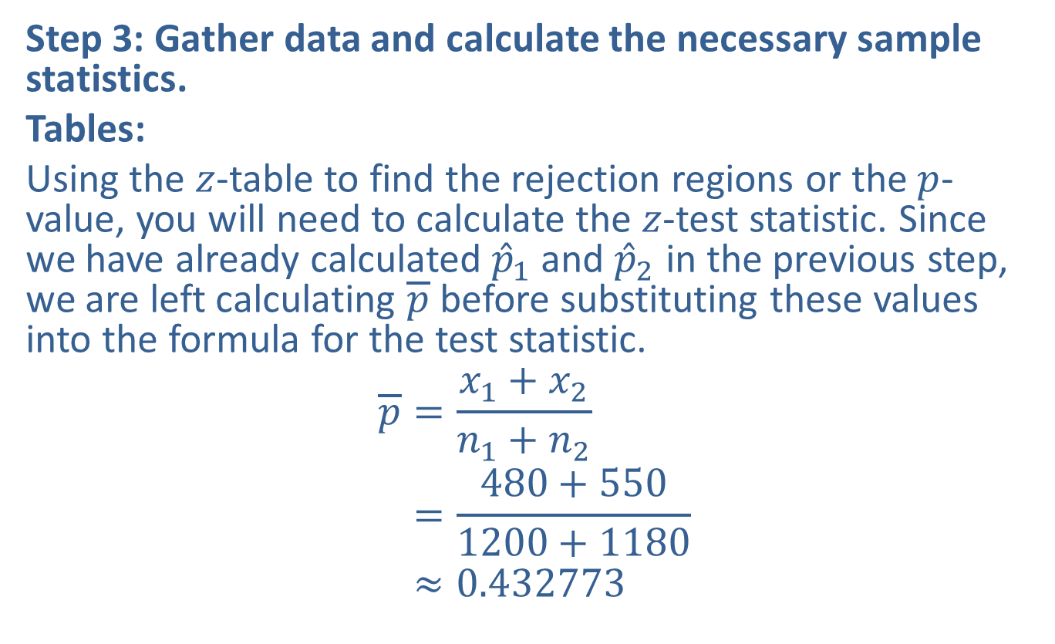
Example 11.4.1: Hypothesis Test for Two Population Proportions (Left-Tailed) (cont.)
Step 3: Gather data and calculate the necessary sample statistics.
Tables:
Using the $z$-table to find the rejection regions or the $p$-value, you will need to calculate the $z$-test statistic. Since we have already calculated ${\hat{p}}_{1}$ and ${\hat{p}}_{2}$ in the previous step, we are left calculating $\overline{p}$ before substituting these values into the formula for the test statistic.
𝑝=𝑥1+𝑥2𝑛1+𝑛2𝑝=480+5501200+1180𝑝≈0.432773

Slide 13
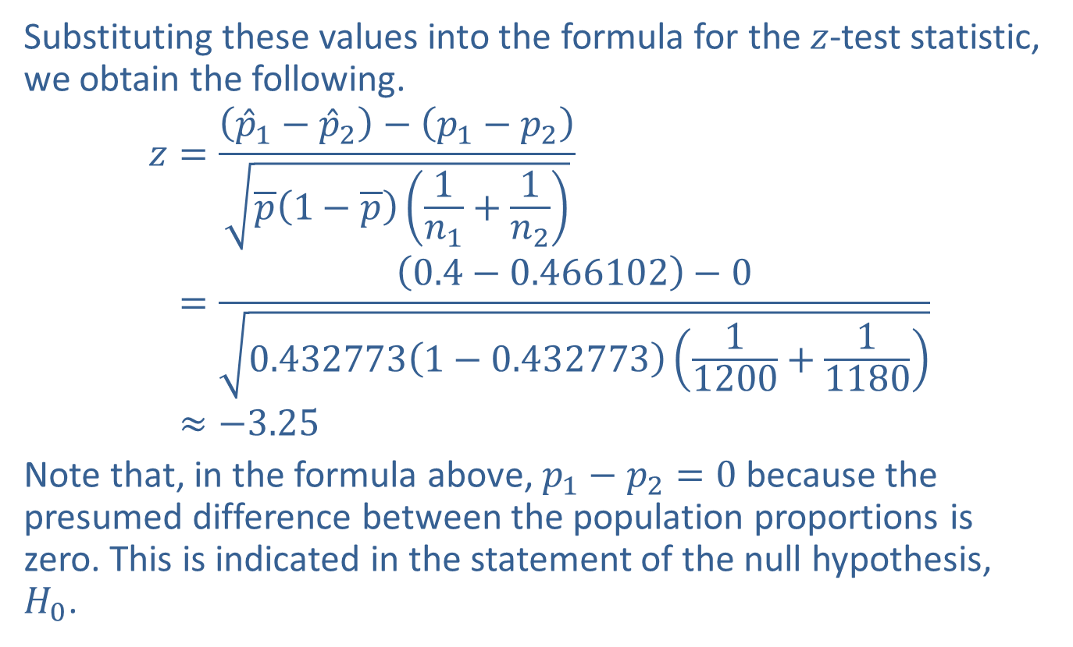
Example 11.4.1: Hypothesis Test for Two Population Proportions (Left-Tailed) (cont.)
Substituting these values into the formula for the $z$-test statistic, we obtain the following.
𝑧=𝑝1−𝑝2−𝑝1−𝑝2𝑝1−𝑝1𝑛1+1𝑛2𝑧=0.4−0.466102−00.4327731−0.43277311200+11180𝑧≈−3.25
Note that, in the formula above, $p_{1}−p_{2}=0$ because the presumed difference between the population proportions is zero. This is indicated in the statement of the null hypothesis, $H_{0}$.

Slide 14
Technology
For instructions on performing a two sample test of proportions please visit stat.hawkeslearning.com and navigate to Technology Instructions > Hypothesis Testing > Two Proportion z-Test.

Slide 15
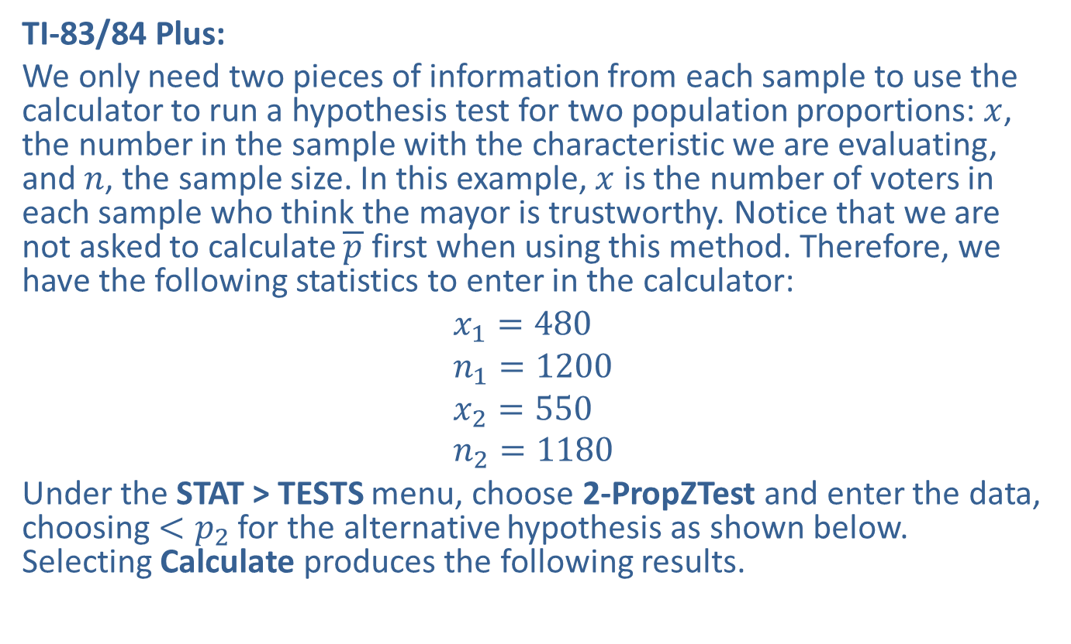
Example 11.4.1: Hypothesis Test for Two Population Proportions (Left-Tailed) (cont.)
TI-83/84 Plus:
We only need two pieces of information from each sample to use the calculator to run a hypothesis test for two population proportions: $x$, the number in the sample with the characteristic we are evaluating, and $n$, the sample size. In this example, $x$ is the number of voters in each sample who think the mayor is trustworthy. Notice that we are not asked to calculate $\overline{p}$ first when using this method. Therefore, we have the following statistics to enter in the calculator:
$$x_{1}=480 \\ n_{1}=1200 \\ x_{2}=550 \\ n_{2}=1180$$
Under the STAT > TESTS menu, choose 2-PropZTest and enter the data, choosing $<p_{2}$ for the alternative hypothesis as shown below. Selecting Calculate produces the following results.

Slide 16
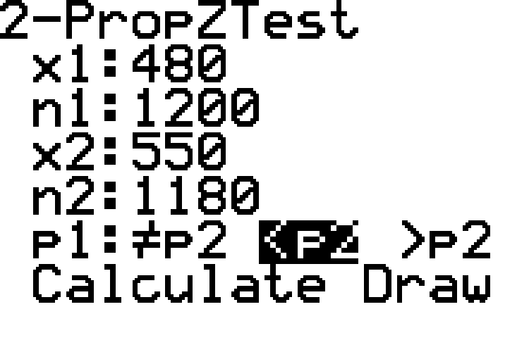
Example 11.4.1: Hypothesis Test for Two Population Proportions (Left-Tailed) (cont.)

Slide 17
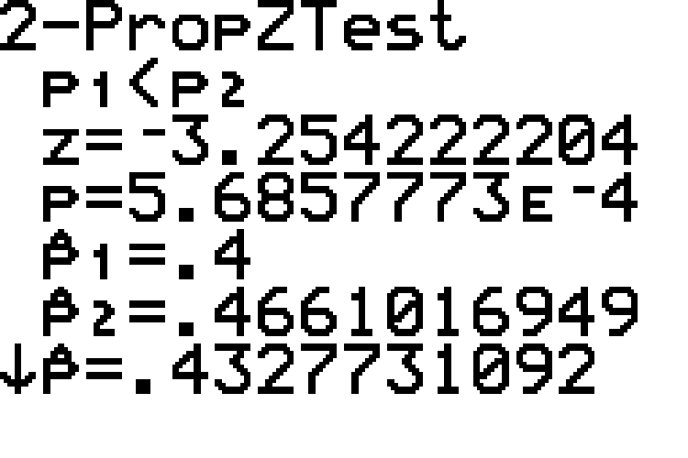
Example 11.4.1: Hypothesis Test for Two Population Proportions (Left-Tailed) (cont.)

Slide 18
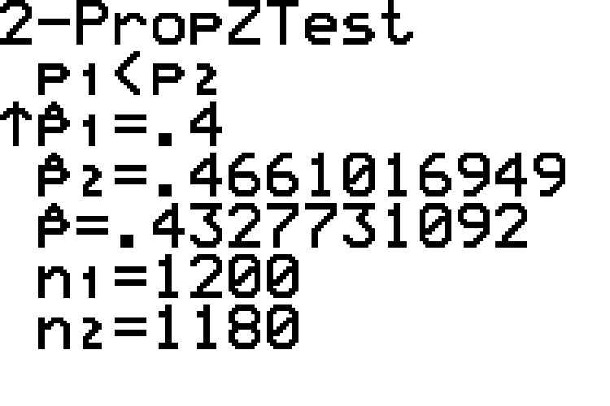
Example 11.4.1: Hypothesis Test for Two Population Proportions (Left-Tailed) (cont.)

Slide 19
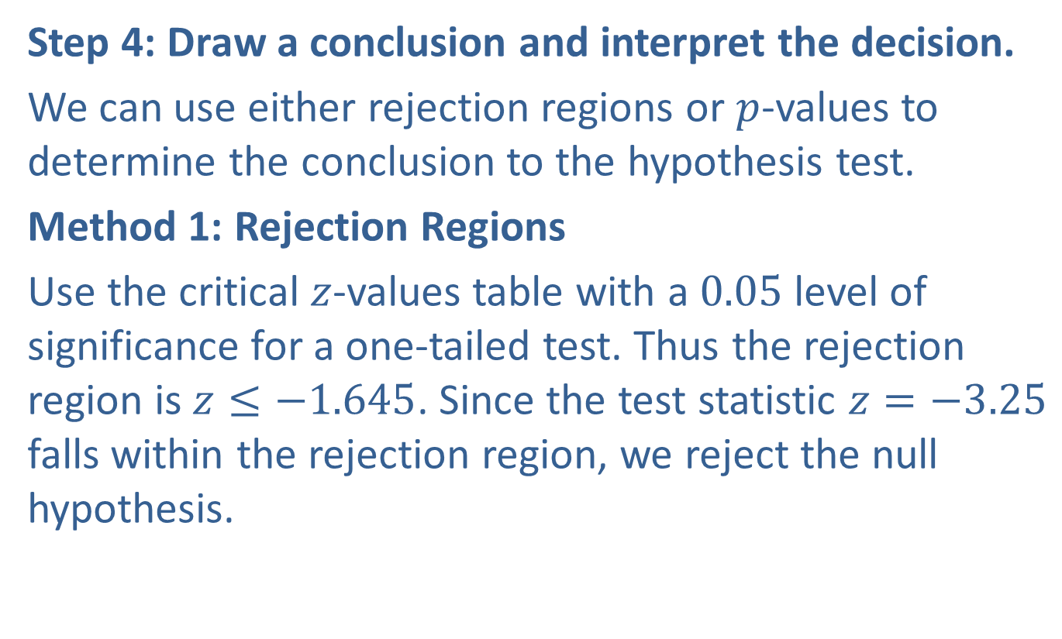
Example 11.4.1: Hypothesis Test for Two Population Proportions (Left-Tailed) (cont.)
Step 4: Draw a conclusion and interpret the decision.
We can use either rejection regions or $p$-values to determine the conclusion to the hypothesis test.
Method 1: Rejection Regions
Use the critical $z$-values table with a 0.05 level of significance for a one-tailed test. Thus the rejection region is $z≤−1.645$. Since the test statistic $z=−3.25$ falls within the rejection region, we reject the null hypothesis.

Slide 20
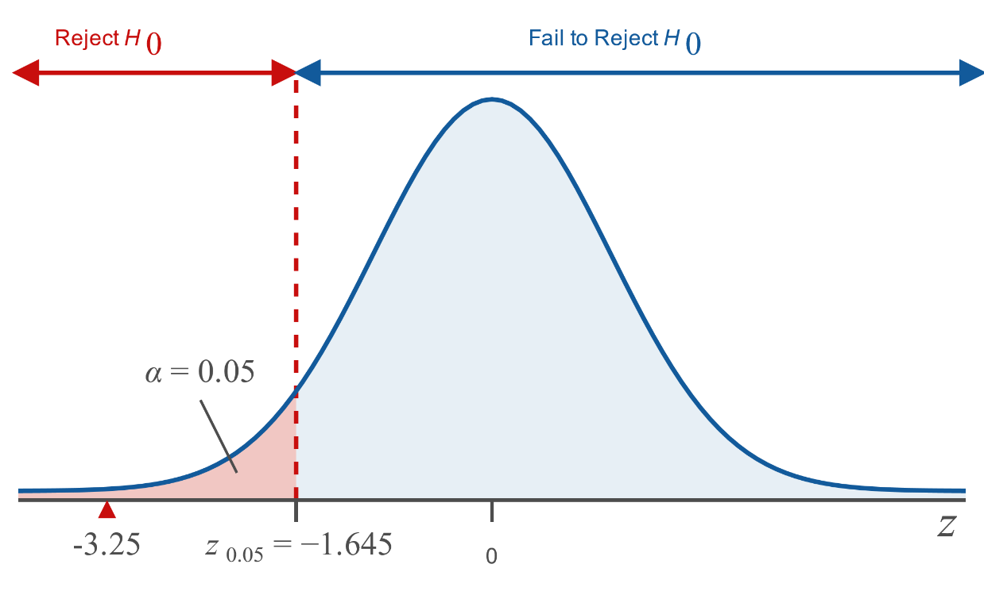
Example 11.4.1: Hypothesis Test for Two Population Proportions (Left-Tailed) (cont.)

Slide 21
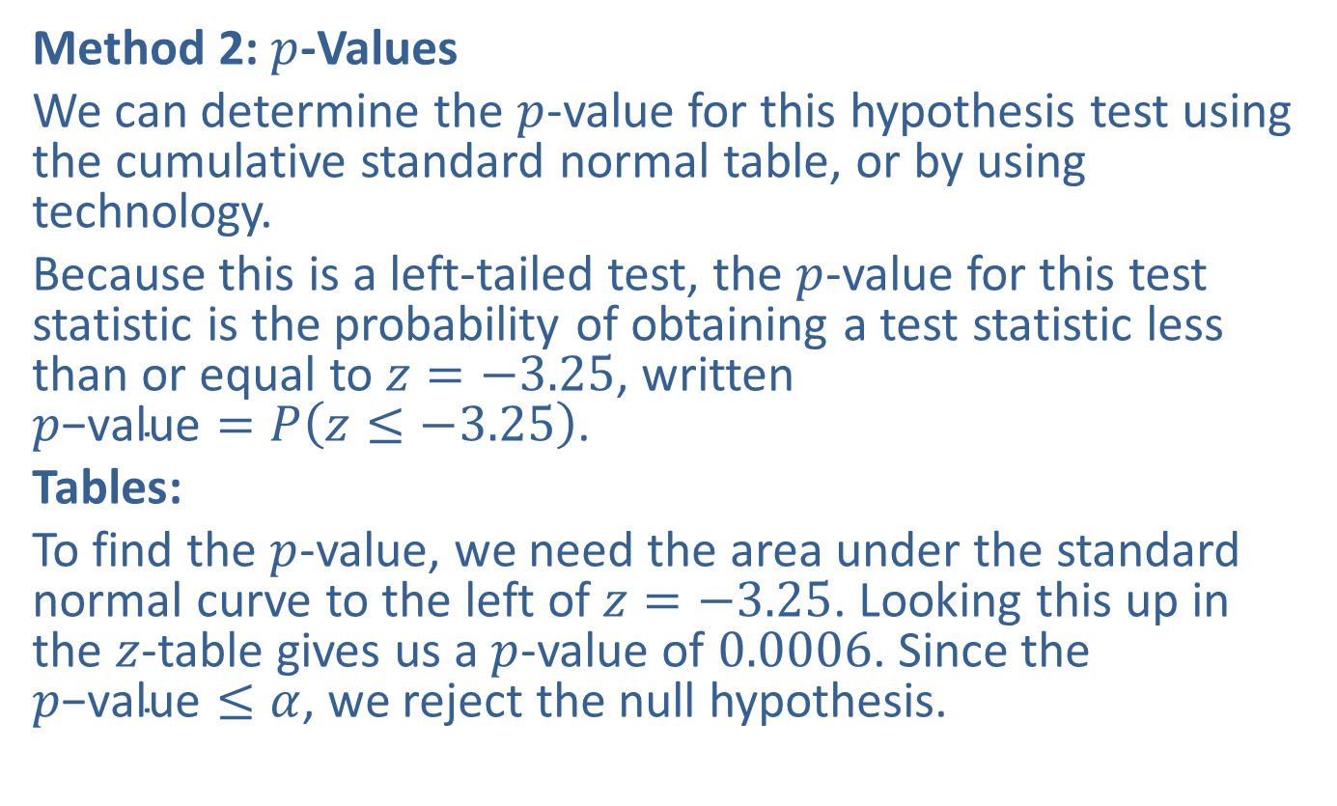
Example 11.4.1: Hypothesis Test for Two Population Proportions (Left-Tailed) (cont.)
Method 2: $p$-Values
We can determine the $p$-value for this hypothesis test using the cumulative standard normal table, or by using technology.
Because this is a left-tailed test, the $p$-value for this test statistic is the probability of obtaining a test statistic less than or equal to $z=−3.25$, written $p\text{−}\text{value}=P\left(z≤−3.25\right)$.
Tables:
To find the $p$-value, we need the area under the standard normal curve to the left of $z=−3.25$. Looking this up in the $z$-table gives us a $p$-value of 0.0006. Since the $p\text{−}\text{value}≤α$, we reject the null hypothesis.

Slide 22
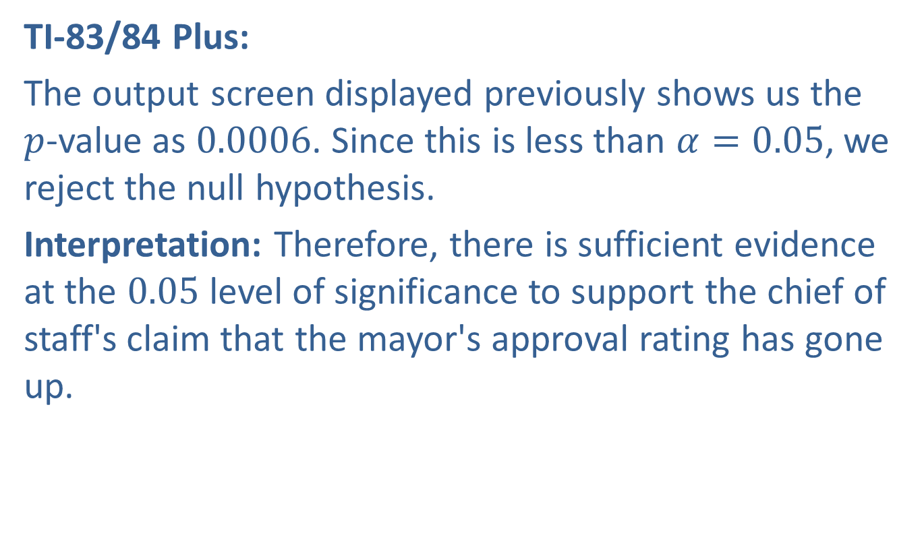
Example 11.4.1: Hypothesis Test for Two Population Proportions (Left-Tailed) (cont.)
TI-83/84 Plus:
The output screen displayed previously shows us the $p$-value as 0.0006. Since this is less than $α=0.05$, we reject the null hypothesis.
Interpretation: Therefore, there is sufficient evidence at the 0.05 level of significance to support the chief of staff's claim that the mayor's approval rating has gone up.

Slide 23
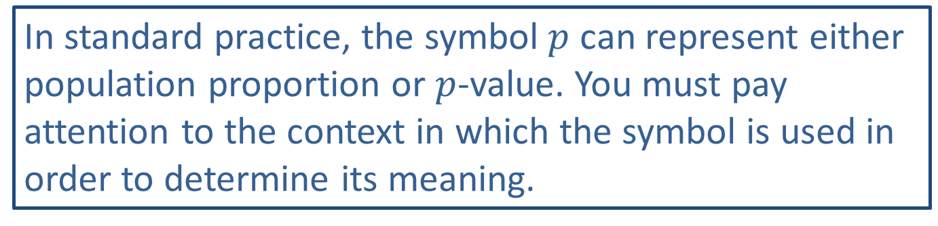
Caution
In standard practice, the symbol $p$ can represent either population proportion or $p$-value. You must pay attention to the context in which the symbol is used in order to determine its meaning.

Slide 24
Rounding Rule
When calculations involve several steps, avoid rounding intermediate calculations. If necessary, round intermediate calculations to at least six decimal places to avoid additional rounding errors in subsequent calculations.

Slide 25
Example 11.4.2: Hypothesis Test for Two Population Proportions (Two-Tailed)
In September, the annual US Surgeon General’s call to action was released. It was an initiative aimed at promoting walking and walkable communities. After a campaign push to emphasize the call to action in their area, community leaders were curious to know if the campaign worked. They hoped that the proportion of local adults who could identify walking as a way to promote healthy living was different than that of other communities. A year later, a nationwide study of 4114 adults revealed that 44.8% correctly identified the activity promoted by the US Surgeon General’s call to action the previous year. The local group found that out of 121 local adults, 65 were able to correctly identify walking as the call to action. Does the evidence support the community’s claim that the proportion of local adults who could correctly identify the Surgeon General’s call to action was different than that of the nation? Use a 0.05 level of significance.

Slide 26
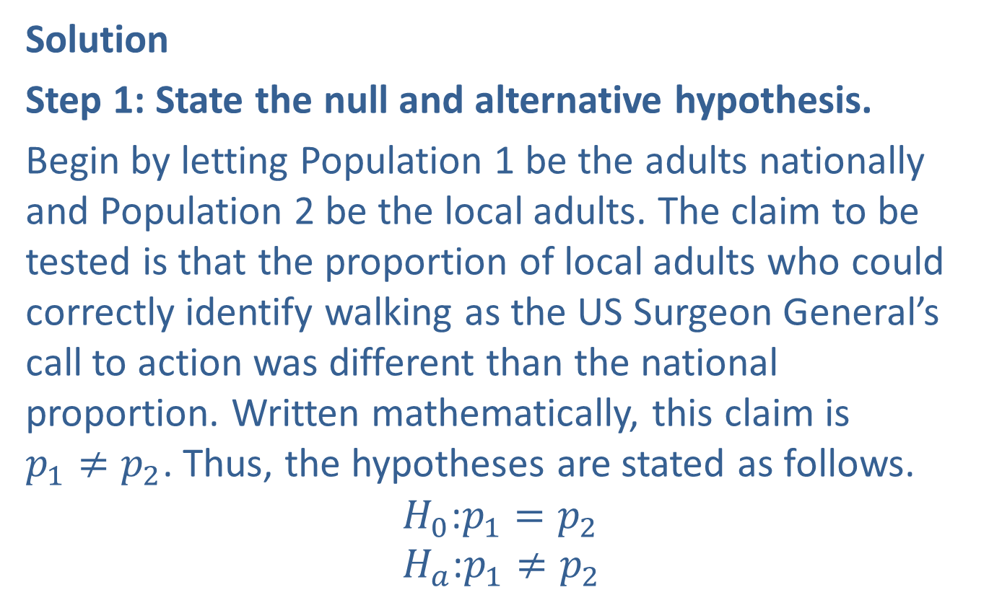
Example 11.4.2: Hypothesis Test for Two Population Proportions (Two-Tailed) (cont.)
Solution
Step 1: State the null and alternative hypothesis.
Begin by letting Population 1 be the adults nationally and Population 2 be the local adults. The claim to be tested is that the proportion of local adults who could correctly identify walking as the US Surgeon General’s call to action was different than the national proportion. Written mathematically, this claim is $p_{1}≠p_{2}$. Thus, the hypotheses are stated as follows.
$$H_{0}\text{:}p_{1}=p_{2} \\ H_{a}\text{:}p_{1}≠p_{2}$$

Slide 27
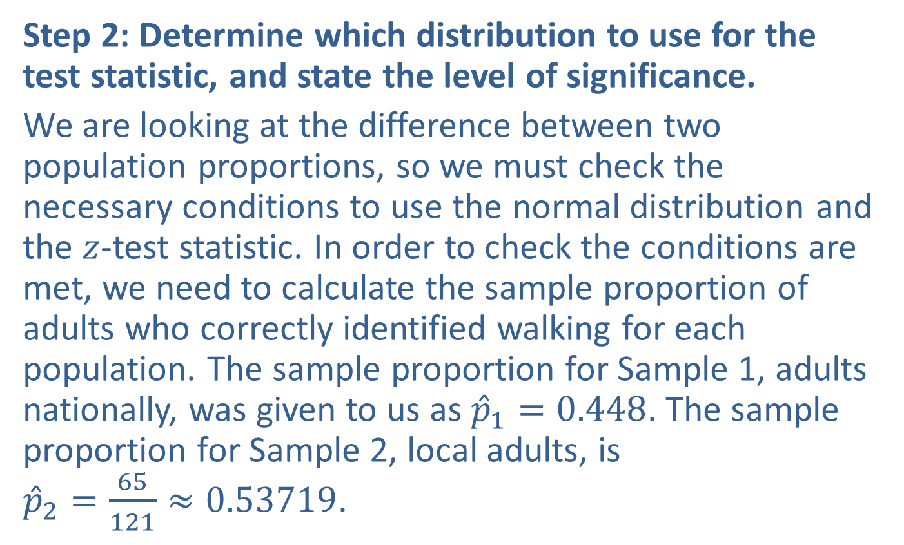
Example 11.4.2: Hypothesis Test for Two Population Proportions (Two-Tailed) (cont.)
Step 2: Determine which distribution to use for the test statistic, and state the level of significance.
We are looking at the difference between two population proportions, so we must check the necessary conditions to use the normal distribution and the $z$-test statistic. In order to check the conditions are met, we need to calculate the sample proportion of adults who correctly identified walking for each population. The sample proportion for Sample 1, adults nationally, was given to us as ${\hat{p}}_{1}=0.448$. The sample proportion for Sample 2, local adults, is ${\hat{p}}_{2}=\frac{65}{121}≈0.53719$.

Slide 28
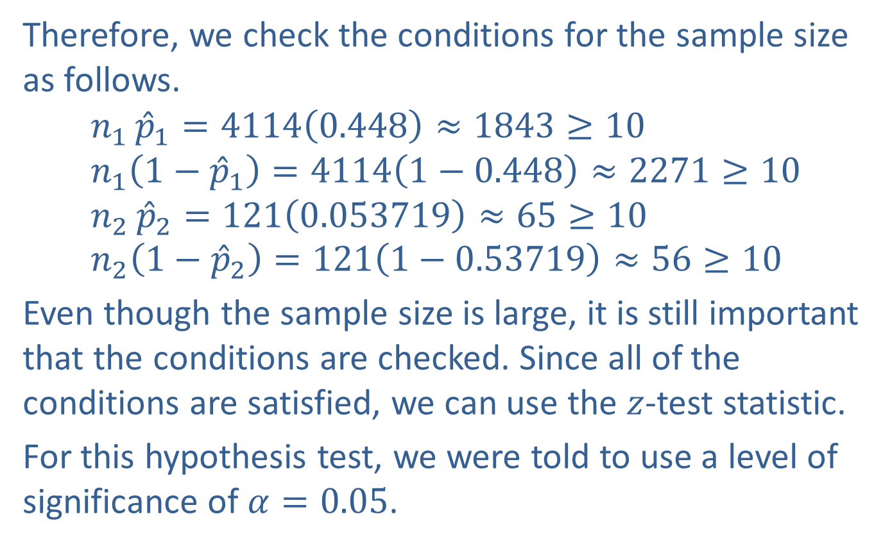
Example 11.4.2: Hypothesis Test for Two Population Proportions (Two-Tailed) (cont.)
Therefore, we check the conditions for the sample size as follows. $$n_{1}{{\hat{p}}_{1}}=4114\left(0.448\right)≈1843≥10 \\ n_{1}\left(1−{\hat{p}}_{1}\right)=4114\left(1−0.448\right)≈2271≥10 \\ n_{2}{{\hat{p}}_{2}}=121\left(0.053719\right)≈65≥10 \\ n_{2}\left(1−{\hat{p}}_{2}\right)=121\left(1−0.53719\right)≈56≥10$$
Even though the sample size is large, it is still important that the conditions are checked. Since all of the conditions are satisfied, we can use the $z$-test statistic.
For this hypothesis test, we were told to use a level of significance of $α=0.05$.

Slide 29
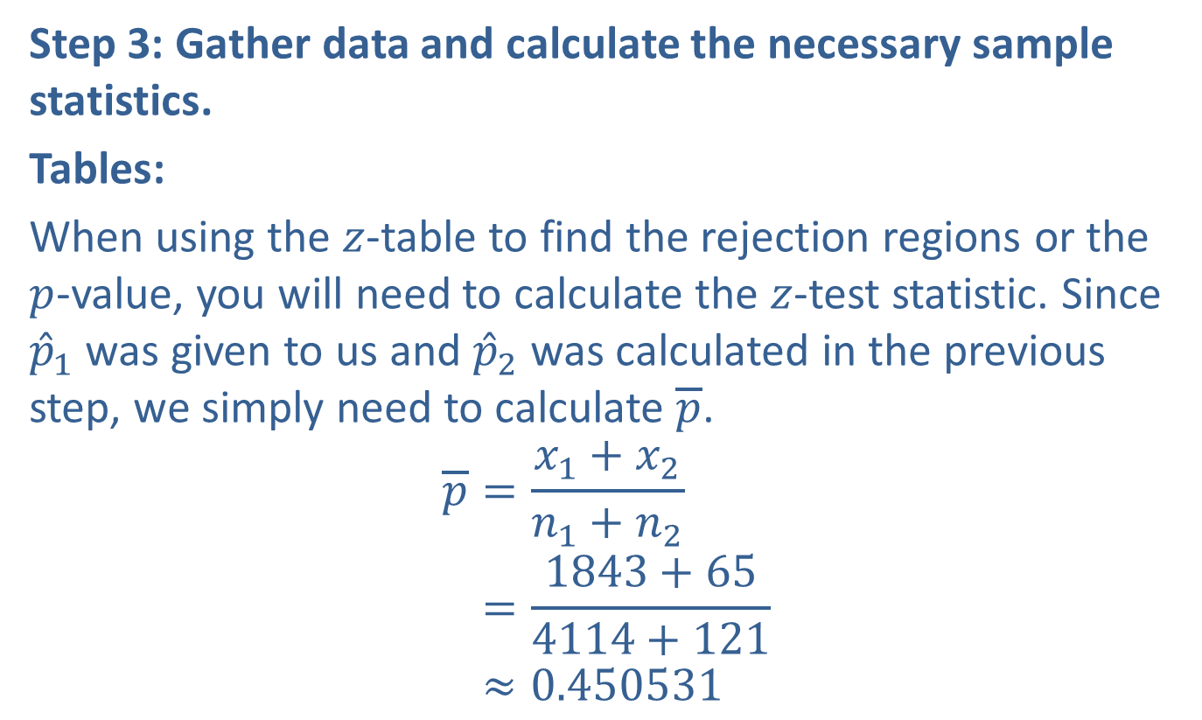
Example 11.4.2: Hypothesis Test for Two Population Proportions (Two-Tailed) (cont.)
Step 3: Gather data and calculate the necessary sample statistics.
Tables:
When using the $z$-table to find the rejection regions or the $p$-value, you will need to calculate the $z$-test statistic. Since ${\hat{p}}_{1}$ was given to us and ${\hat{p}}_{2}$ was calculated in the previous step, we simply need to calculate $\overline{p}$.
𝑝=𝑥1+𝑥2𝑛1+𝑛2𝑝=1843+654114+121𝑝≈0.450531

Slide 30
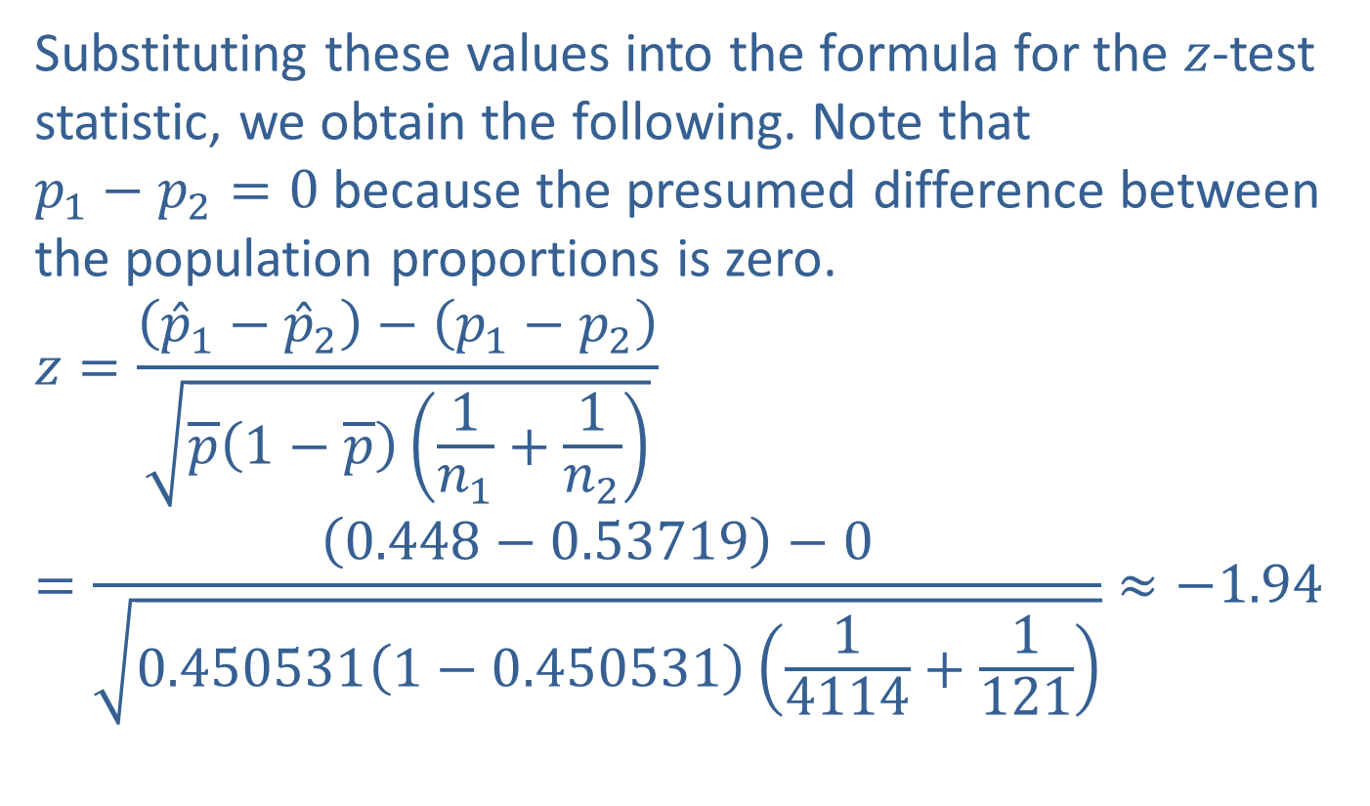
Example 11.4.2: Hypothesis Test for Two Population Proportions (Two-Tailed) (cont.)
Substituting these values into the formula for the $z$-test statistic, we obtain the following. Note that $p_{1}−p_{2}=0$ because the presumed difference between the population proportions is zero.
$$z=\frac{\left({\hat{p}}_{1}−{\hat{p}}_{2}\right)−\left(p_{1}−p_{2}\right)}{\sqrt{\overline{p}\left(1−\overline{p}\right)\left(\frac{1}{n_{1}}+\frac{1}{n_{2}}\right)}}=\frac{\left(0.448−0.53719\right)−0}{\sqrt{0.450531\left(1−0.450531\right)\left(\frac{1}{4114}+\frac{1}{121}\right)}}≈−1.94$$

Slide 31
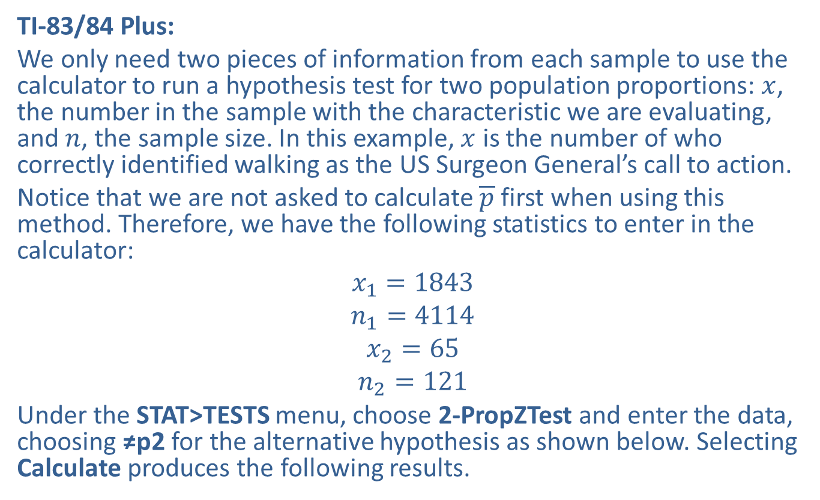
Example 11.4.2: Hypothesis Test for Two Population Proportions (Two-Tailed) (cont.)
TI-83/84 Plus:
We only need two pieces of information from each sample to use the calculator to run a hypothesis test for two population proportions: $x$, the number in the sample with the characteristic we are evaluating, and $n$, the sample size. In this example, $x$ is the number of who correctly identified walking as the US Surgeon General’s call to action.
Notice that we are not asked to calculate $\overline{p}$ first when using this method. Therefore, we have the following statistics to enter in the calculator:
$$x_{1}=1843$$
$$n_{1}=4114$$
$$x_{2}=65$$
$$n_{2}=121$$
Under the STAT>TESTS menu, choose 2-PropZTest and enter the data, choosing ≠p2 for the alternative hypothesis as shown below. Selecting Calculate produces the following results.

Slide 32
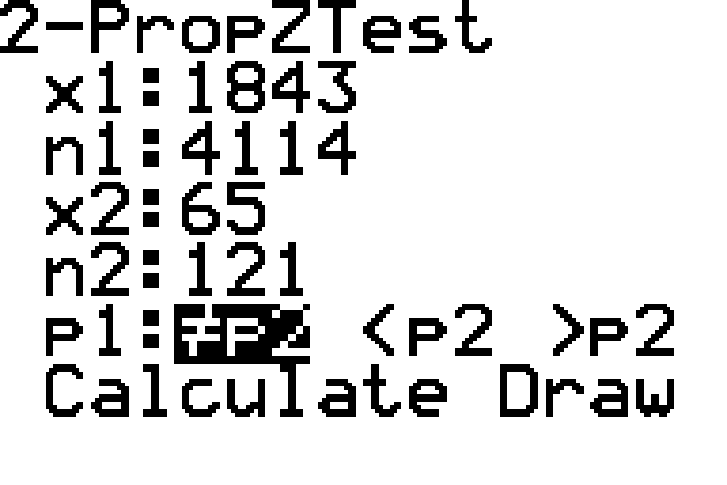
Example 11.4.2: Hypothesis Test for Two Population Proportions (Two-Tailed) (cont.)

Slide 33
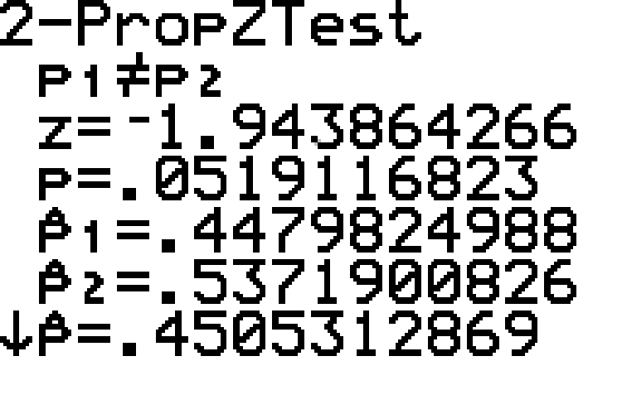
Example 11.4.2: Hypothesis Test for Two Population Proportions (Two-Tailed) (cont.)

Slide 34
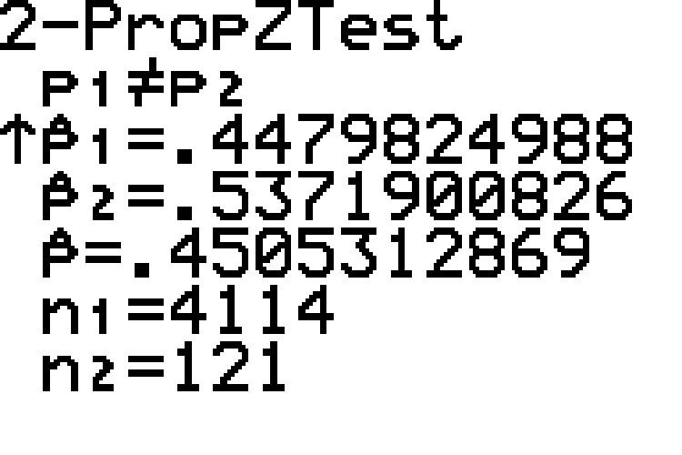
Example 11.4.2: Hypothesis Test for Two Population Proportions (Two-Tailed) (cont.)

Slide 35
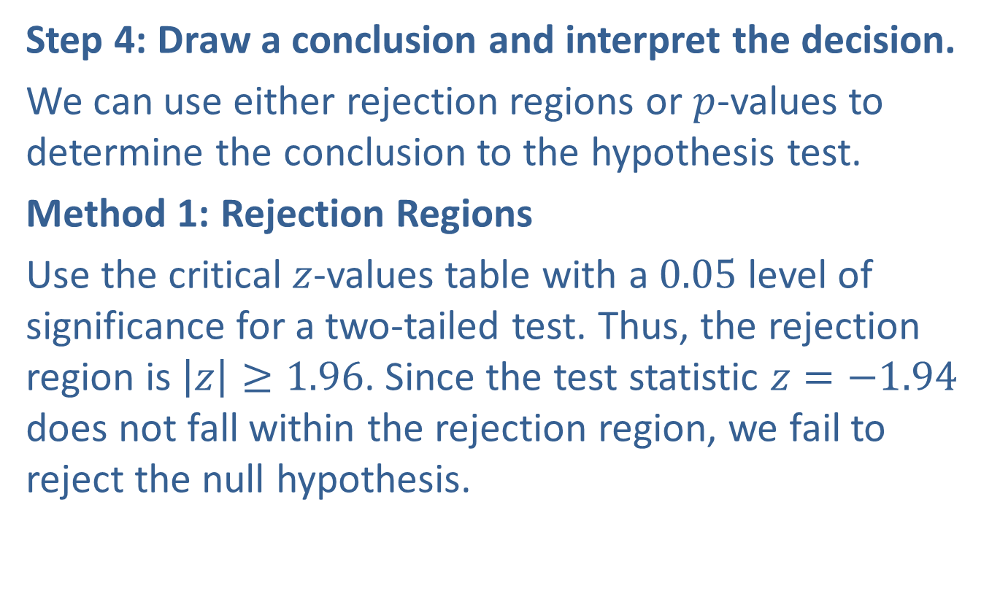
Example 11.4.2: Hypothesis Test for Two Population Proportions (Two-Tailed) (cont.)
Step 4: Draw a conclusion and interpret the decision.
We can use either rejection regions or $p$-values to determine the conclusion to the hypothesis test.
Method 1: Rejection Regions
Use the critical $z$-values table with a 0.05 level of significance for a two-tailed test. Thus, the rejection region is $\left|z\right|≥1.96$. Since the test statistic $z=−1.94$ does not fall within the rejection region, we fail to reject the null hypothesis.

Slide 36
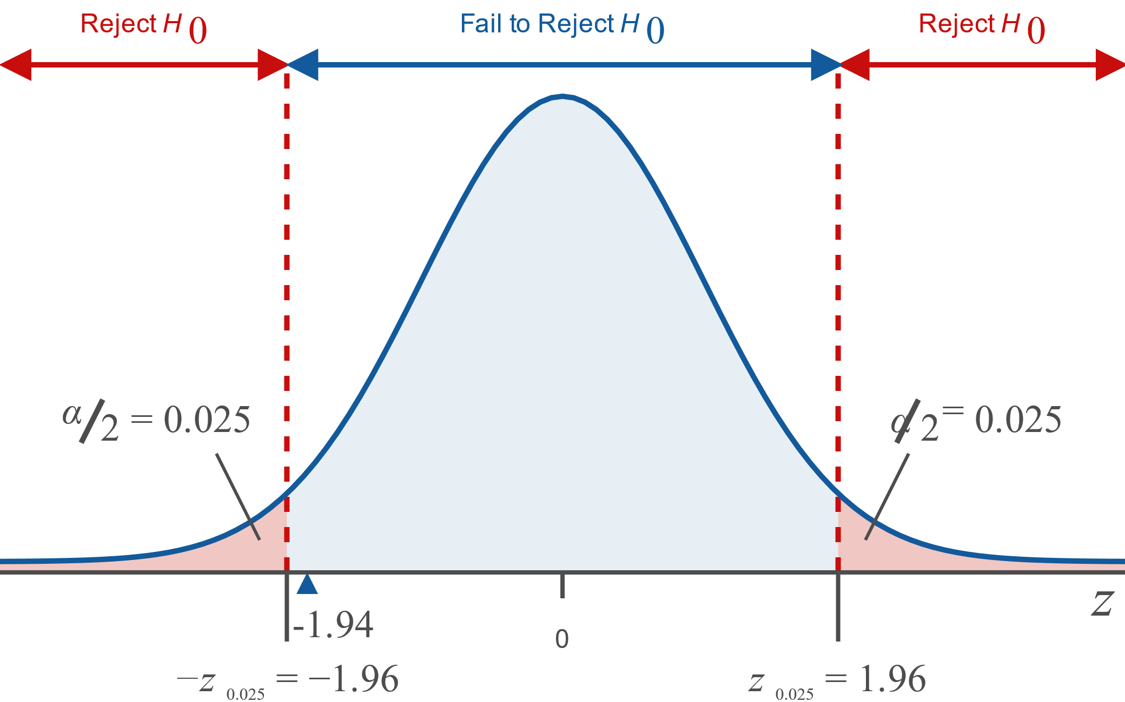
Example 11.4.2: Hypothesis Test for Two Population Proportions (Two-Tailed) (cont.)

Slide 37
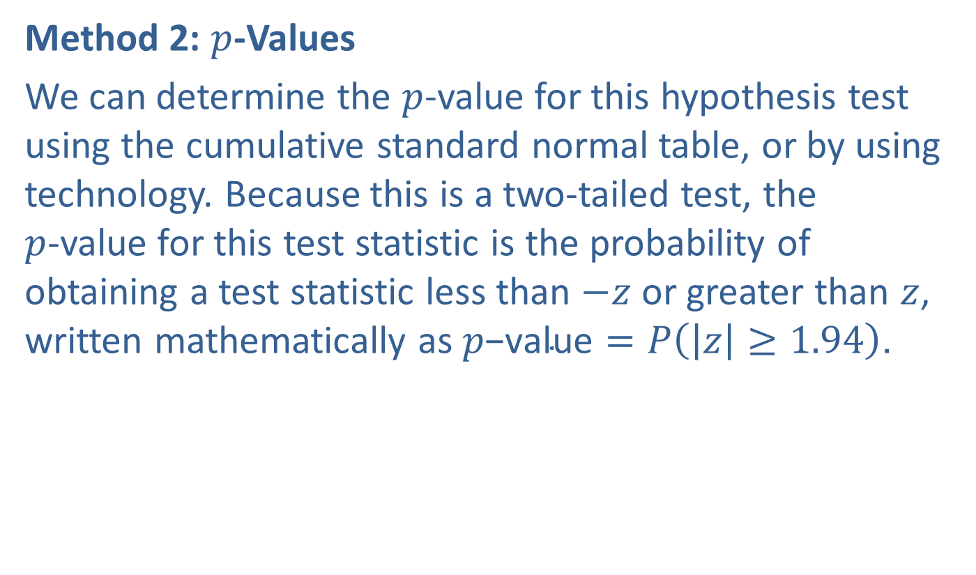
Example 11.4.2: Hypothesis Test for Two Population Proportions (Two-Tailed) (cont.)
Method 2: $p$-Values
We can determine the $p$-value for this hypothesis test using the cumulative standard normal table, or by using technology. Because this is a two-tailed test, the $p$-value for this test statistic is the probability of obtaining a test statistic less than $−z$ or greater than $z$, written mathematically as $p\text{−}\text{value}=P\left(\left|z\right|≥1.94\right)$.

Slide 38
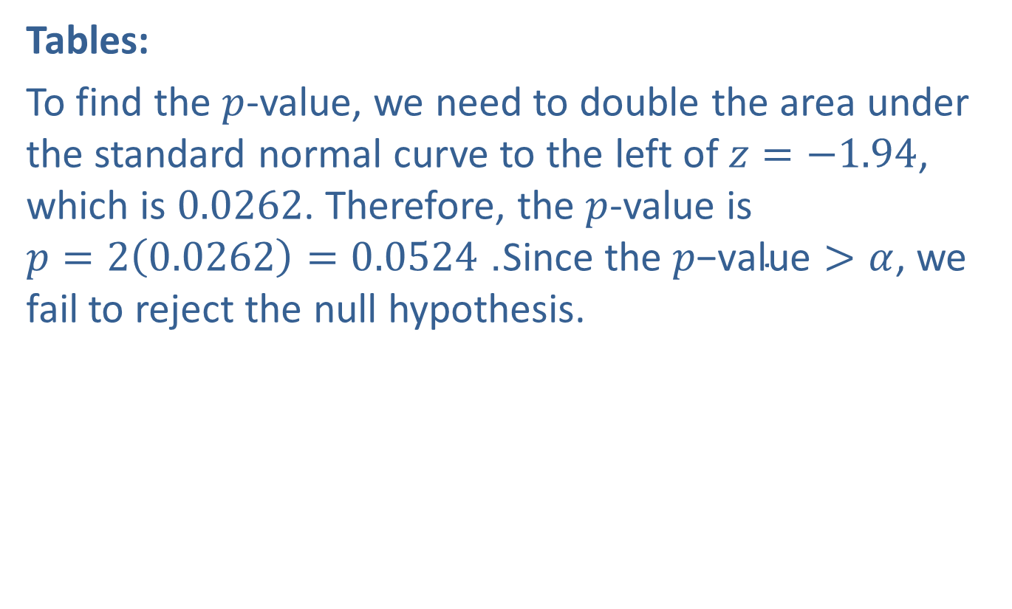
Example 11.4.2: Hypothesis Test for Two Population Proportions (Two-Tailed) (cont.)
Tables:
To find the $p$-value, we need to double the area under the standard normal curve to the left of $z=−1.94$, which is 0.0262. Therefore, the $p$-value is $p=2\left(0.0262\right)=0.0524$. Since the $p\text{−}\text{value}>α$, we fail to reject the null hypothesis.

Slide 39
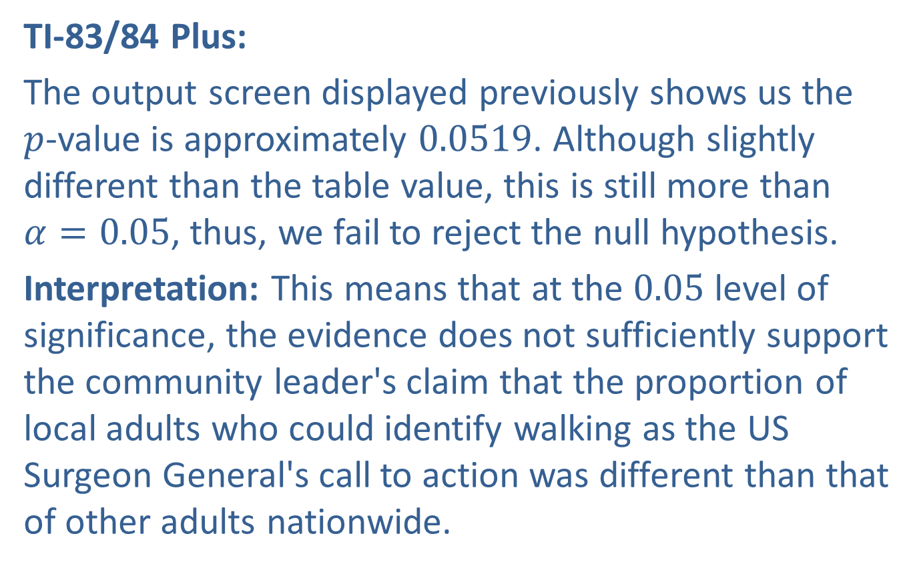
Example 11.4.2: Hypothesis Test for Two Population Proportions (Two-Tailed) (cont.)
TI-83/84 Plus:
The output screen displayed previously shows us the $p$-value is approximately 0.0519. Although slightly different than the table value, this is still more than $α=0.05$, thus, we fail to reject the null hypothesis.
Interpretation: This means that at the 0.05 level of significance, the evidence does not sufficiently support the community leader's claim that the proportion of local adults who could identify walking as the US Surgeon General's call to action was different than that of other adults nationwide.

