Slide 1
Section 11.5
Hypothesis Testing: Two Population Variances

Slide 2
Sir Ronald Fisher (1890‒1962)
In 1912 Fisher graduated from the University of Cambridge in mathematics. After leaving Cambridge he had no means of support so he worked on a farm in Canada for a few months. He returned to England and took a job as a statistician. After World War I broke out he tried to enlist but was rejected because of poor eyesight. Fisher then taught mathematics and physics at several English schools until 1919 when he took a position at the Rothamasted Agricultural Experiment Station as chief statistician. As a consequence of taking this position he worked many agricultural experiments. One of his most significant contributions to statistics is the concept of randomization and analysis of variance. Using Fisher’s methods, more than one factor can be studied in an experiment.

Slide 3
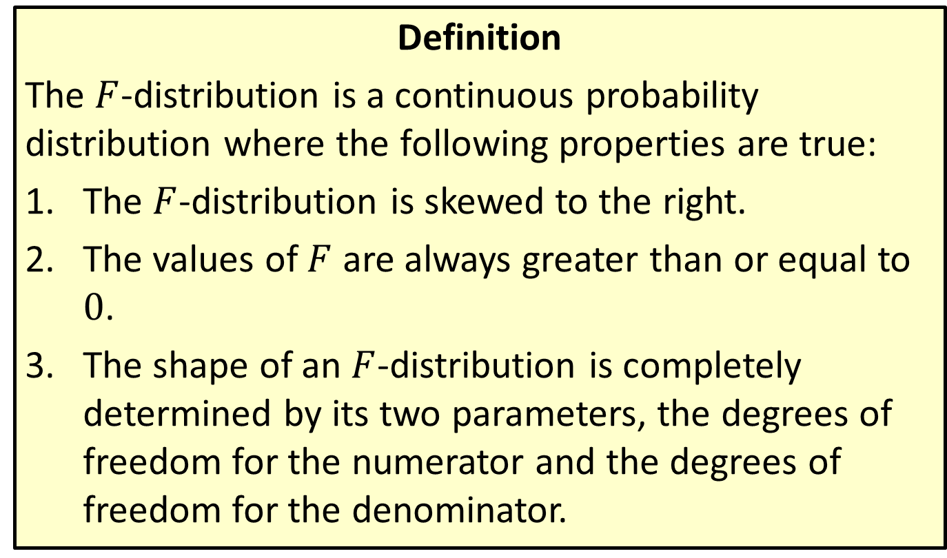

Distribution: $F$-Distribution
Definition
The $F$-distribution is a continuous probability distribution where the following properties are true:
​The $F$-distribution is skewed to the right.
​The values of $F$ are always greater than or equal to 0.
​The shape of an $F$-distribution is completely determined by its two parameters, the degrees of freedom for the numerator and the degrees of freedom for the denominator.

Slide 4
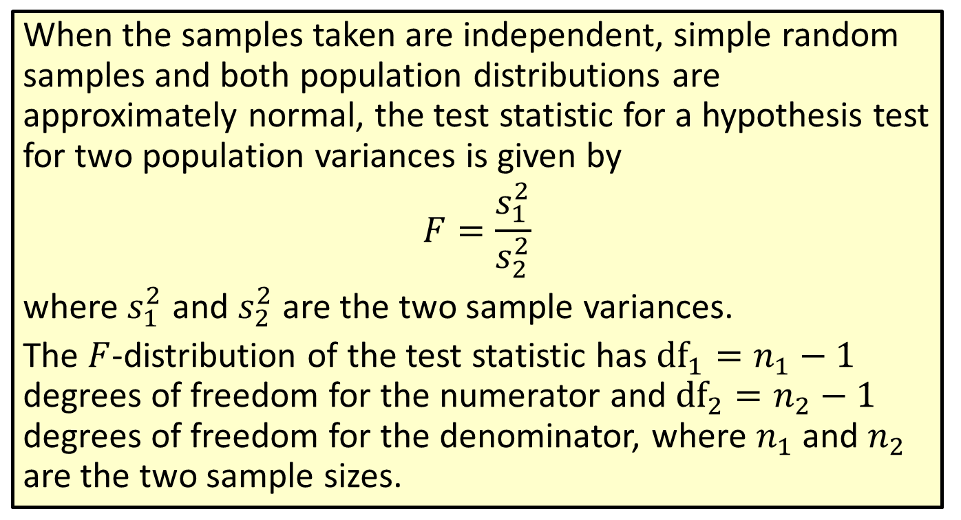
Formula: Test Statistic for a Hypothesis Test for Two Population Variances
When the samples taken are independent, simple random samples and both population distributions are approximately normal, the test statistic for a hypothesis test for two population variances is given by
$$F=\frac{s_{1}^{2}}{s_{2}^{2}}$$
where $s_{1}^{2}$ and $s_{2}^{2}$ are the two sample variances.
The $F$-distribution of the test statistic has ${df}_{1}=n_{1}−1$ degrees of freedom for the numerator and ${df}_{2}=n_{2}−1$ degrees of freedom for the denominator, where $n_{1}$ and $n_{2}$ are the two sample sizes.

Slide 5
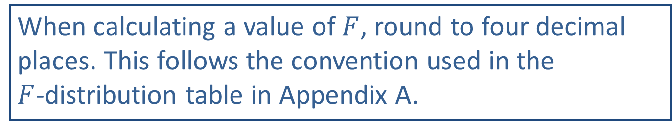
Rounding Rule
When calculating a value of $F$, round to four decimal places. This follows the convention used in the
$F$-distribution table in Appendix A.

Slide 6
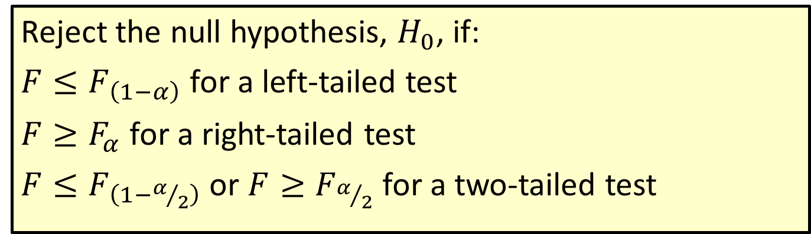
Procedure: Rejection Regions for Hypothesis Tests for Two Population Variances
Reject the null hypothesis, $H_{0}$, if:
$F≤F_{\left(1−α\right)}$ for a left-tailed test
$F≥F_{α}$ for a right-tailed test
$F≤F_{\left(1−α/2\right)}$ or $F≥F_{α/2}$ for a two-tailed test

Slide 7

Memory Booster
Refer back to Section 9.5 for more information on reading an $F$-distribution table.

Slide 8
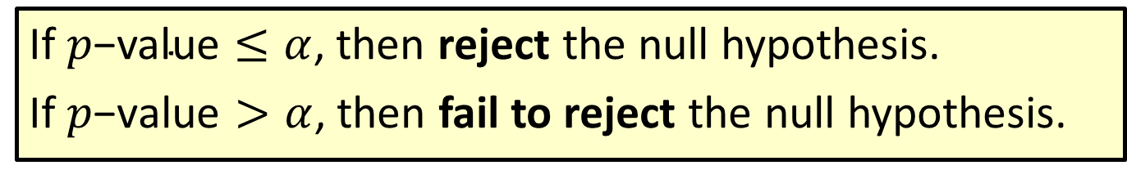

Procedure: Conclusions Using $p$-Values
If $p\text{−}\text{value}≤α$, then reject the null hypothesis.
If $p\text{−}\text{value}>α$, then fail to reject the null hypothesis.

Slide 9
Example 11.5.1: Hypothesis Test for Two Population Variances (Left-Tailed)
A graduate student walking around a large college campus notices that the values of professors' cars seem to have a much smaller variance than the values of the cars owned by students. Students, he notes, own vehicles ranging from small, broken-down trucks to Porsche convertibles, while the cars owned by faculty are more similar in style and price. To test his hypothesis that the values of professors' cars have a smaller variance than the values of students' cars, he collects data from random samples of 15 professors and 14 students on the values of their cars and calculates the variance for each sample. The sample variance of the values of the professors' cars is 34,057 and the sample variance of the values of the students' cars is 45,923. Assuming that both populations are normally distributed, conduct a hypothesis test using a 0.10 level of significance to test the graduate student's claim. Does the evidence support the student's claim?

Slide 10
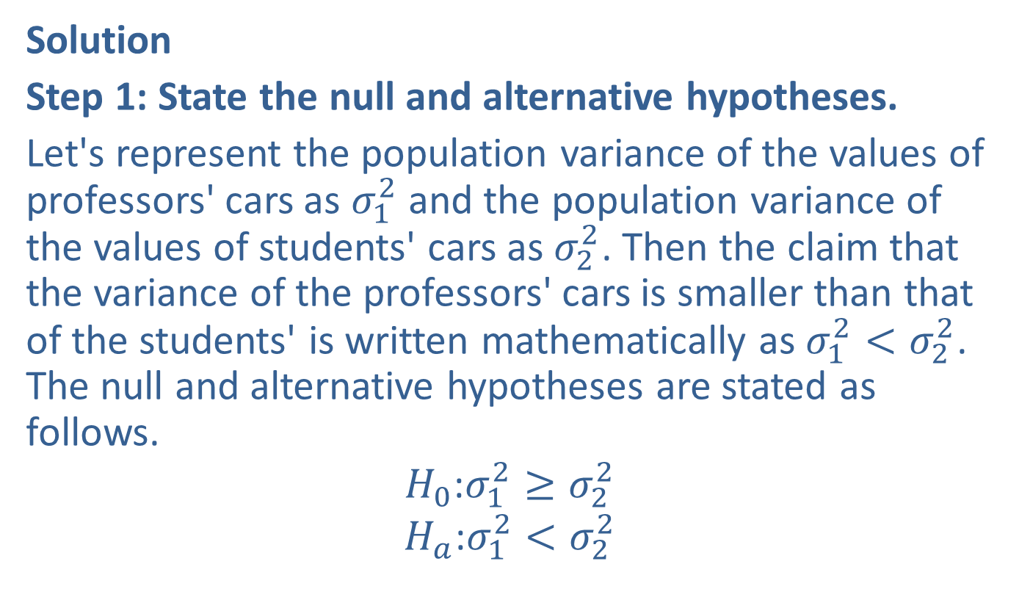
Example 11.5.1: Hypothesis Test for Two Population Variances (Left-Tailed) (cont.)
Solution
Step 1: State the null and alternative hypotheses.
Let's represent the population variance of the values of professors' cars as $σ_{1}^{2}$ and the population variance of the values of students' cars as $σ_{2}^{2}$. Then the claim that the variance of the professors' cars is smaller than that of the students' is written mathematically as $σ_{1}^{2}<σ_{2}^{2}$. The null and alternative hypotheses are stated as follows.
$$H_{0}\text{:}σ_{1}^{2}≥σ_{2}^{2}$$
$$H_{a}\text{:}σ_{1}^{2}<σ_{2}^{2}$$

Slide 11
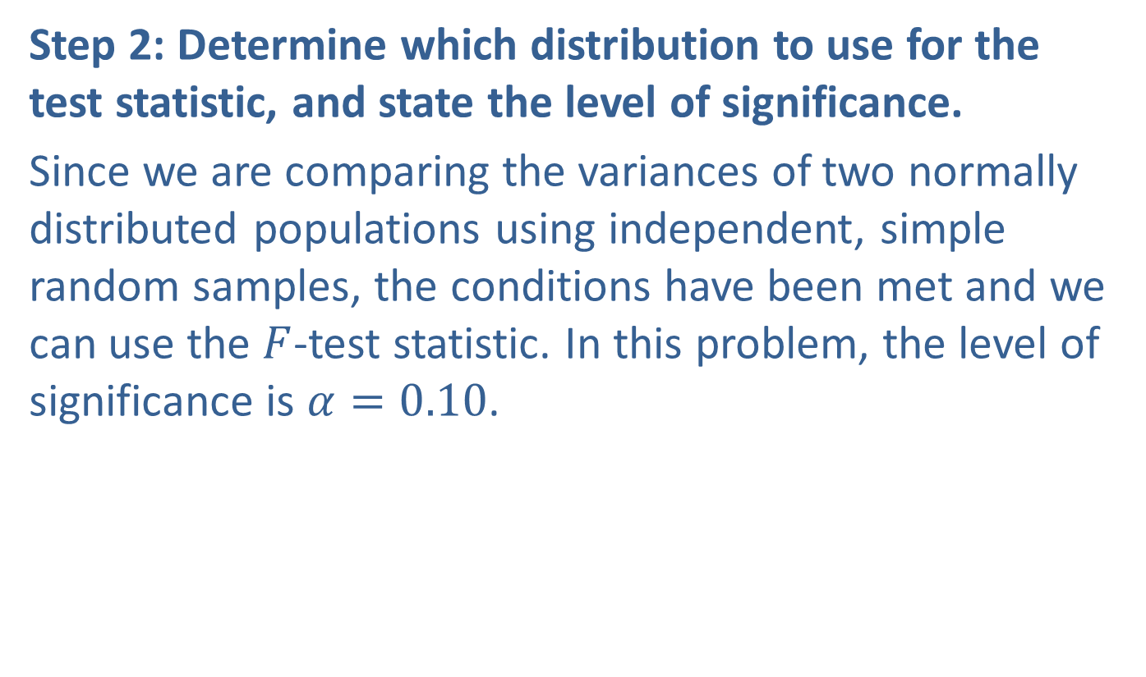
Example 11.5.1: Hypothesis Test for Two Population Variances (Left-Tailed) (cont.)
Step 2: Determine which distribution to use for the test statistic, and state the level of significance.
Since we are comparing the variances of two normally distributed populations using independent, simple random samples, the conditions have been met and we can use the $F$-test statistic. In this problem, the level of significance is $α=0.10$.

Slide 12

Example 11.5.1: Hypothesis Test for Two Population Variances (Left-Tailed) (cont.)
Step 3: Gather data and calculate the necessary sample statistics.
The following values were given in the problem.
Professors | Students
$$n_{1}=15$$ | $$n_{2}=14$$
$$s_{1}^{2}=34,057$$ | $$s_{2}^{2}=45,923$$

Slide 13
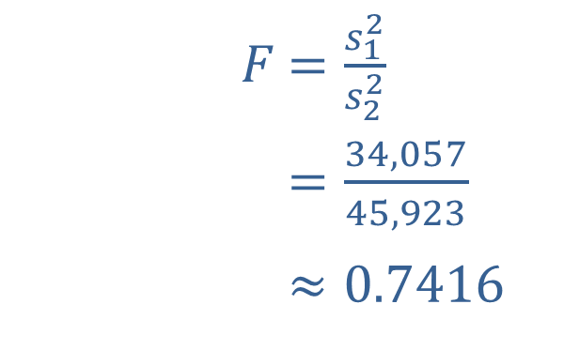

Example 11.5.1: Hypothesis Test for Two Population Variances (Left-Tailed) (cont.)
Tables:
If you are using tables to find the rejection region when drawing your conclusion, you will need to calculate the $F$-test statistic as follows.
​
​$F$ | ​$=\frac{s_{1}^{2}}{s_{2}^{2}}$
​𝐹 | ​$=\frac{34,057}{45,923}$
​𝐹 | ​$≈0.7416$

Slide 14
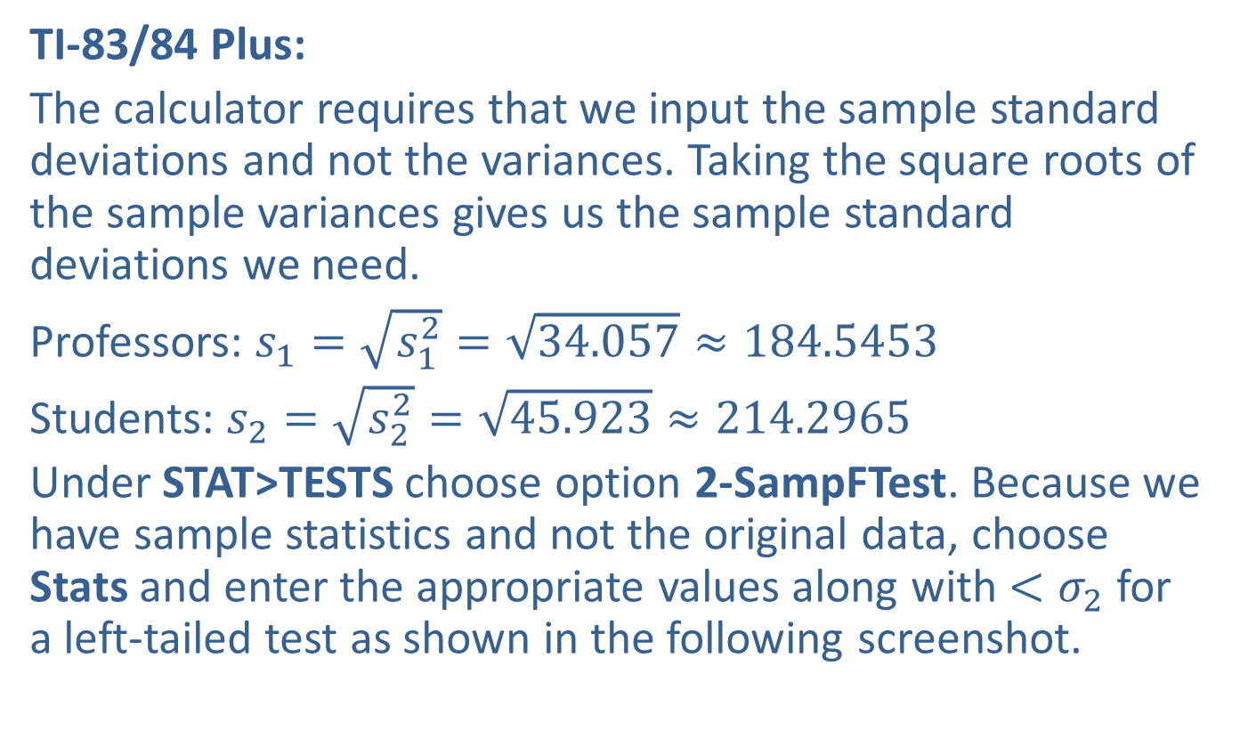
Example 11.5.1: Hypothesis Test for Two Population Variances (Left-Tailed) (cont.)
TI-83/84 Plus:
The calculator requires that we input the sample standard deviations and not the variances. Taking the square roots of the sample variances gives us the sample standard deviations we need.
Professors: $s_{1}=\sqrt{s_{1}^{2}}=\sqrt{34.057}≈184.5453$
Students: $s_{2}=\sqrt{s_{2}^{2}}=\sqrt{45.923}≈214.2965$
Under STAT>TESTS choose option 2-SampFTest. Because we have sample statistics and not the original data, choose Stats and enter the appropriate values along with $<σ_{2}$ for a left-tailed test as shown in the following screenshot.

Slide 15
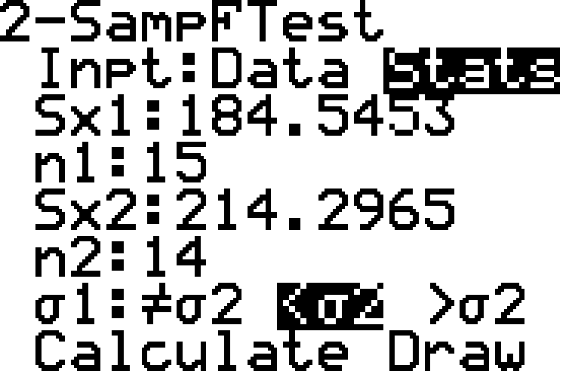
Example 11.5.1: Hypothesis Test for Two Population Variances (Left-Tailed) (cont.)

Slide 16
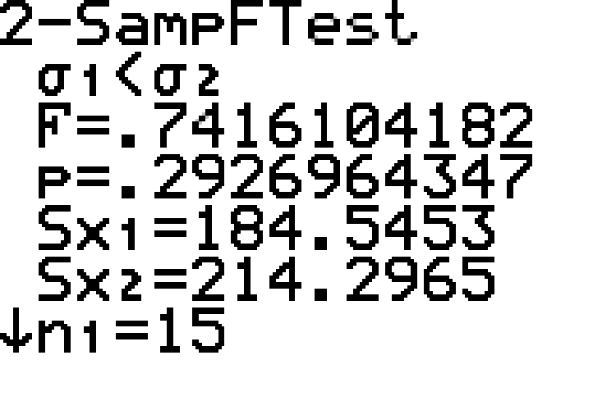

Example 11.5.1: Hypothesis Test for Two Population Variances (Left-Tailed) (cont.)
Choosing Calculate produces the following screenshot showing the alternative hypothesis, the $F$-test statistic, and the $p$-value. Notice the other lines repeat the statistics we entered.

Slide 17
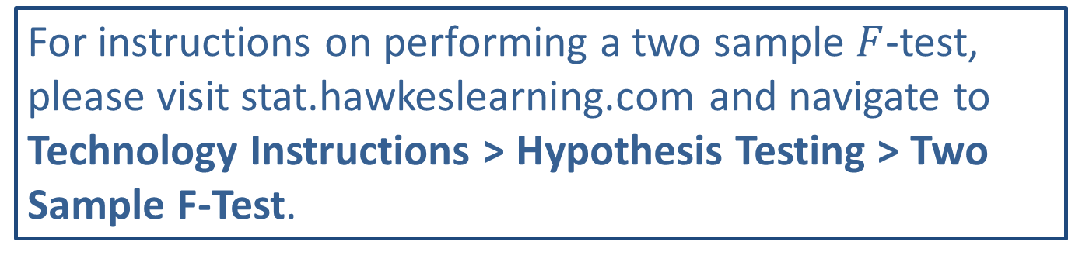
Technology
For instructions on performing a two sample $F$-test, please visit stat.hawkeslearning.com and navigate to Technology Instructions > Hypothesis Testing > Two Sample F-Test.

Slide 18
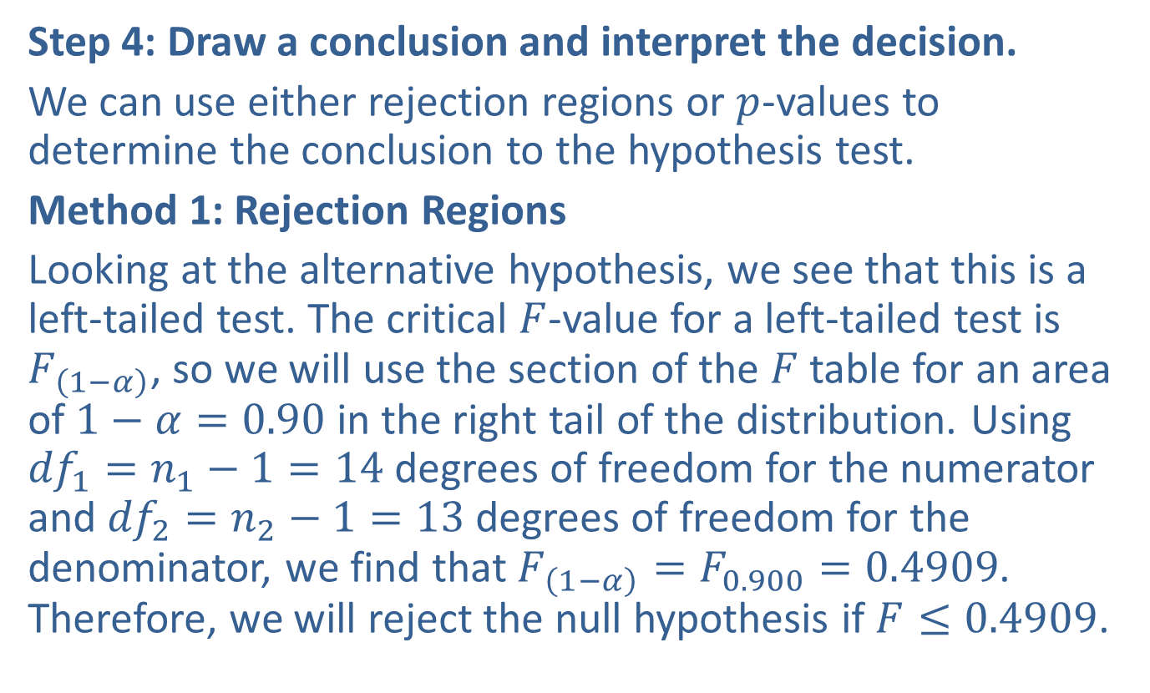
Example 11.5.1: Hypothesis Test for Two Population Variances (Left-Tailed) (cont.)
Step 4: Draw a conclusion and interpret the decision.
We can use either rejection regions or $p$-values to determine the conclusion to the hypothesis test.
Method 1: Rejection Regions
Looking at the alternative hypothesis, we see that this is a left-tailed test. The critical $F$-value for a left-tailed test is $F_{\left(1−α\right)}$, so we will use the section of the $F$ table for an area of $1−α=0.90$ in the right tail of the distribution. Using ${df}_{1}=n_{1}−1=14$ degrees of freedom for the numerator and ${df}_{2}=n_{2}−1=13$ degrees of freedom for the denominator, we find that $F_{\left(1−α\right)}=F_{0.900}=0.4909$. Therefore, we will reject the null hypothesis if $F≤0.4909$.

Slide 19
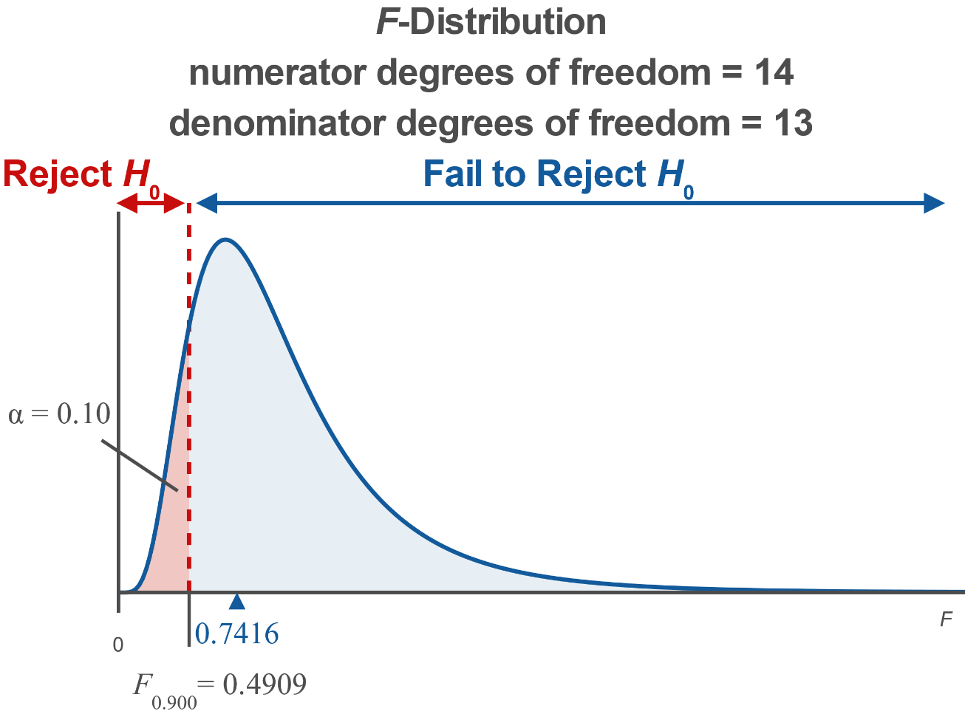
Example 11.5.1: Hypothesis Test for Two Population Variances (Left-Tailed) (cont.)

Slide 20
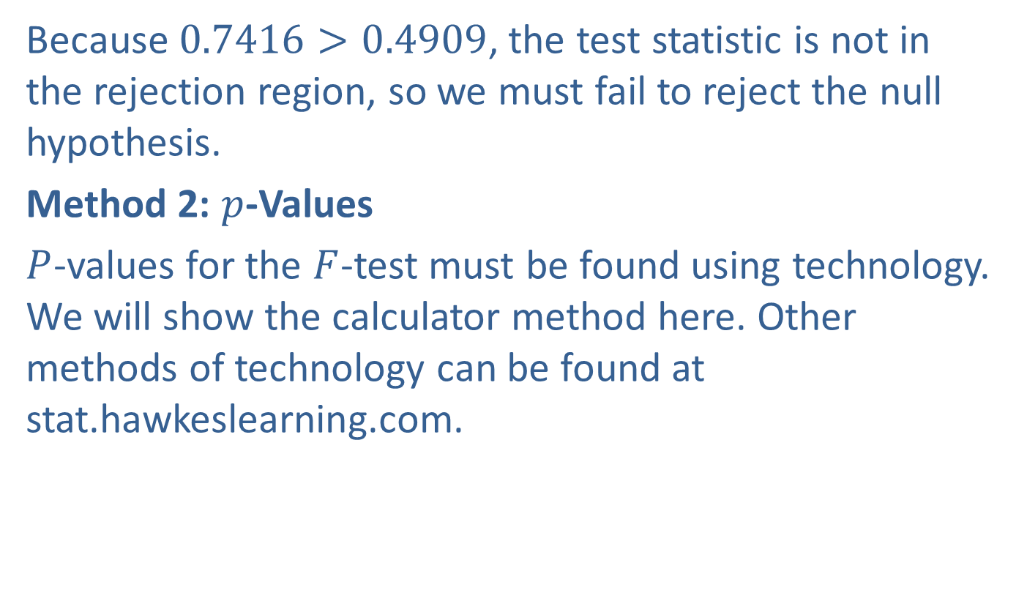
Example 11.5.1: Hypothesis Test for Two Population Variances (Left-Tailed) (cont.)
Because $0.7416>0.4909$, the test statistic is not in the rejection region, so we must fail to reject the null hypothesis.
Method 2: $p$-Values
$P$-values for the $F$-test must be found using technology. We will show the calculator method here. Other methods of technology can be found at stat.hawkeslearning.com.

Slide 21
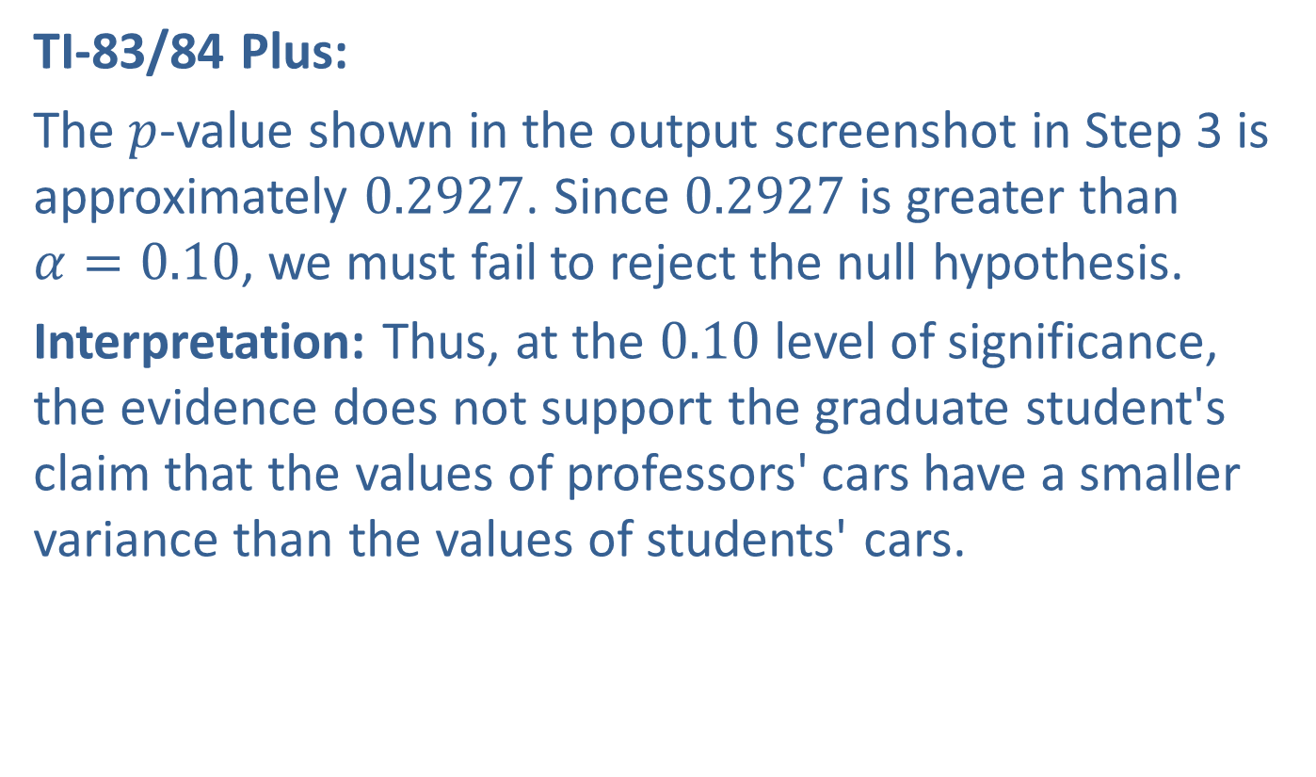
Example 11.5.1: Hypothesis Test for Two Population Variances (Left-Tailed) (cont.)
TI-83/84 Plus:
The $p$-value shown in the output screenshot in Step 3 is approximately 0.2927. Since 0.2927 is greater than $α=0.10$, we must fail to reject the null hypothesis.
Interpretation: Thus, at the 0.10 level of significance, the evidence does not support the graduate student's claim that the values of professors' cars have a smaller variance than the values of students' cars.

Slide 22
Technology
For further instructions on performing a hypothesis test for two population variances using a TI-83/84 Plus calculator or other technology, please visit stat.hawkeslearning.com and navigate to Technology Instructions > Hypothesis Testing > Two Sample F-Test.

Slide 23
Example 11.5.2: Hypothesis Test for Two Population Variances (Right-Tailed)
Suppose that a quality control inspector believes that the candy-making machines on Assembly Line A are not adjusted properly. She thinks that the variance in the sizes of the candy produced by Assembly Line A is greater than the variance in the sizes of the candy produced by Assembly Line B. A random sample of 20 pieces of candy is taken from each assembly line and measured. The sizes of the candy from Assembly Line A have a sample variance of 1.45, while the sizes of the candy from Assembly Line B have a sample variance of 0.47. Using a 0.01 level of significance, perform a hypothesis test to test the quality control inspector's claim. Assume that both populations are normally distributed.

Slide 24
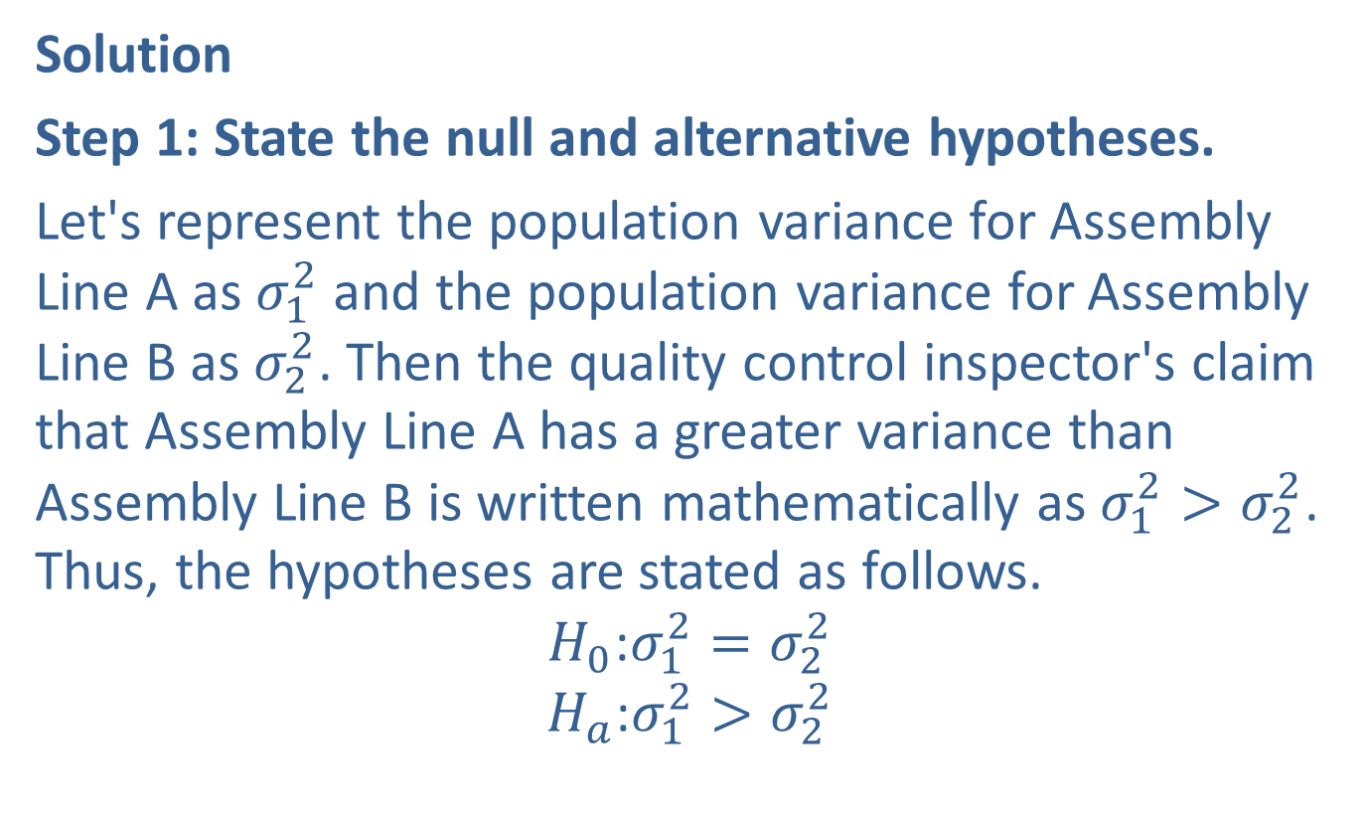
Example 11.5.2: Hypothesis Test for Two Population Variances (Right-Tailed) (cont.)
Solution
Step 1: State the null and alternative hypotheses.
Let's represent the population variance for Assembly Line A as $σ_{1}^{2}$ and the population variance for Assembly Line B as $σ_{2}^{2}$. Then the quality control inspector's claim that Assembly Line A has a greater variance than Assembly Line B is written mathematically as $σ_{1}^{2}>σ_{2}^{2}$. Thus, the hypotheses are stated as follows.
$$H_{0}\text{:}σ_{1}^{2}=σ_{2}^{2}$$
$$H_{a}\text{:}σ_{1}^{2}>σ_{2}^{2}$$

Slide 25
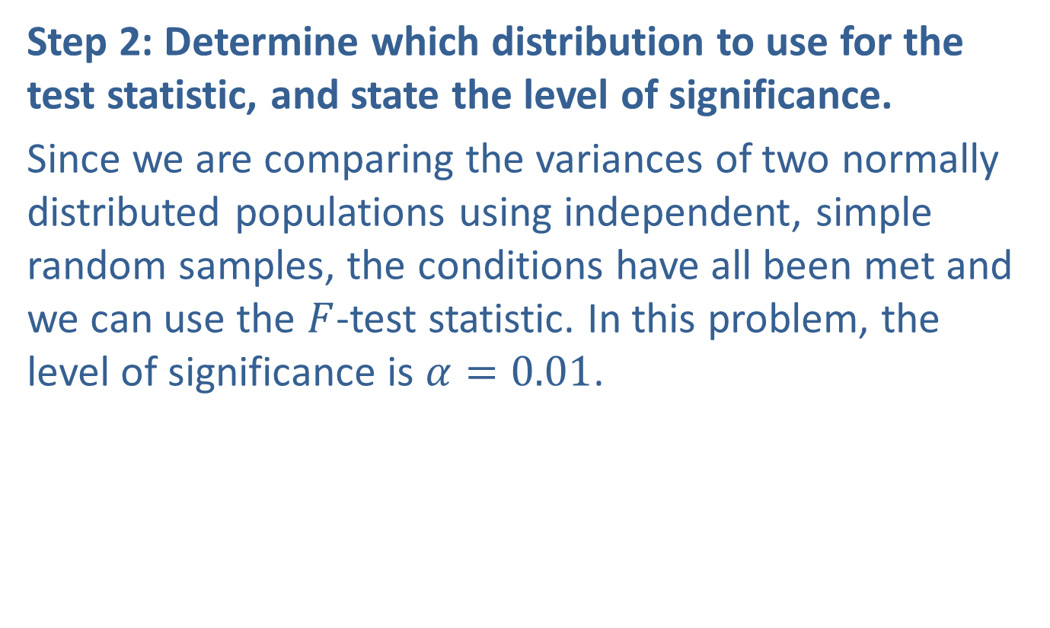
Example 11.5.2: Hypothesis Test for Two Population Variances (Right-Tailed) (cont.)
Step 2: Determine which distribution to use for the test statistic, and state the level of significance.
Since we are comparing the variances of two normally distributed populations using independent, simple random samples, the conditions have all been met and we can use the $F$-test statistic. In this problem, the level of significance is $α=0.01$.

Slide 26

Example 11.5.2: Hypothesis Test for Two Population Variances (Right-Tailed) (cont.)
Step 3: Gather data and calculate the necessary sample statistics.
The following values were given in the problem.
Assembly Line A: | Assembly Line B:
$$n_{1}=20$$ | $$n_{2}=20$$
$$s_{1}^{2}=1.45$$ | $$s_{2}^{2}=0.47$$

Slide 27
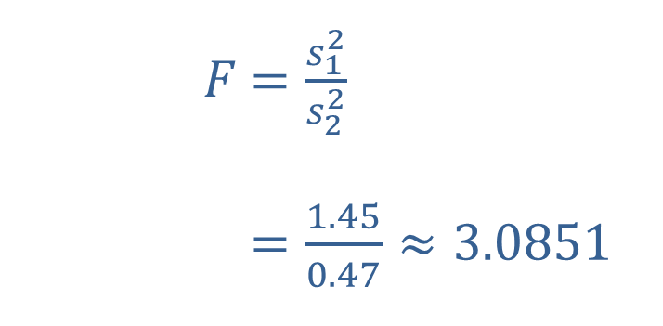
Example 11.5.2: Hypothesis Test for Two Population Variances (Right-Tailed) (cont.)
Tables:
If you are using tables to find the rejection region when drawing your conclusion, you will need to calculate the F-test statistic as follows.
​$F$ | ​$=\frac{s_{1}^{2}}{s_{2}^{2}}$
​ | ​$=\frac{1.45}{0.47}≈3.0851$

Slide 28
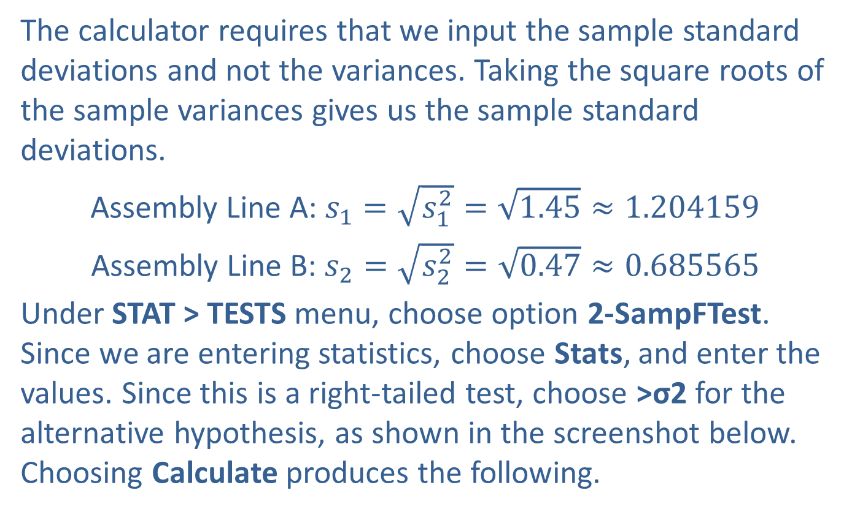
Example 11.5.2: Hypothesis Test for Two Population Variances (Right-Tailed) (cont.)
The calculator requires that we input the sample standard deviations and not the variances. Taking the square roots of the sample variances gives us the sample standard deviations.
Assembly Line A: $s_{1}=\sqrt{s_{1}^{2}}=\sqrt{1.45}≈1.204159$
Assembly Line B: $s_{2}=\sqrt{s_{2}^{2}}=\sqrt{0.47}≈0.685565$
Under STAT > TESTS menu, choose option 2-SampFTest. Since we are entering statistics, choose Stats, and enter the values. Since this is a right-tailed test, choose >σ2 for the alternative hypothesis, as shown in the screenshot below. Choosing Calculate produces the following.

Slide 29
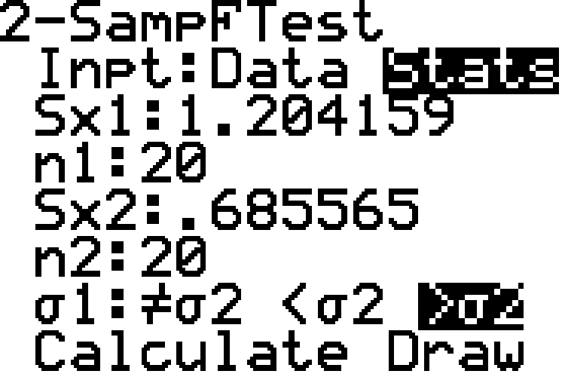
Example 11.5.2: Hypothesis Test for Two Population Variances (Right-Tailed) (cont.)

Slide 30
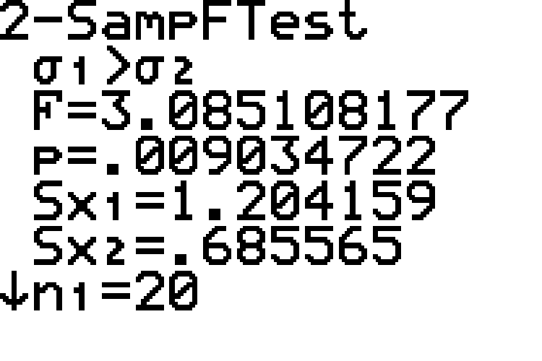
Example 11.5.2: Hypothesis Test for Two Population Variances (Right-Tailed) (cont.)

Slide 31
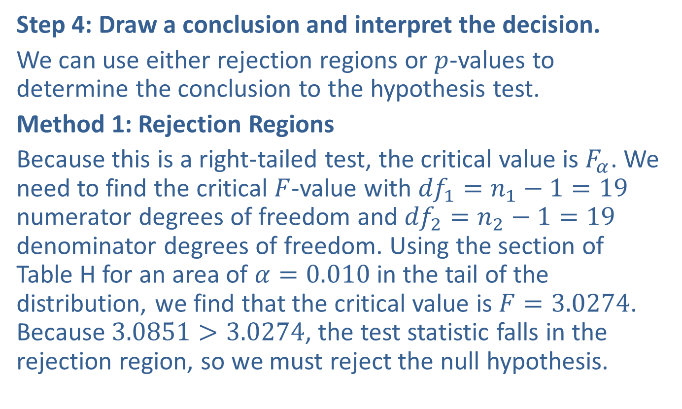
Example 11.5.2: Hypothesis Test for Two Population Variances (Right-Tailed) (cont.)
Step 4: Draw a conclusion and interpret the decision.
We can use either rejection regions or $p$-values to determine the conclusion to the hypothesis test.
Method 1: Rejection Regions
Because this is a right-tailed test, the critical value is $F_{α}$. We need to find the critical $F$-value with ${df}_{1}=n_{1}−1=19$ numerator degrees of freedom and ${df}_{2}=n_{2}−1=19$ denominator degrees of freedom. Using the section of Table H for an area of $α=0.010$ in the tail of the distribution, we find that the critical value is $F=3.0274$. Because $3.0851>3.0274$, the test statistic falls in the rejection region, so we must reject the null hypothesis.

Slide 32
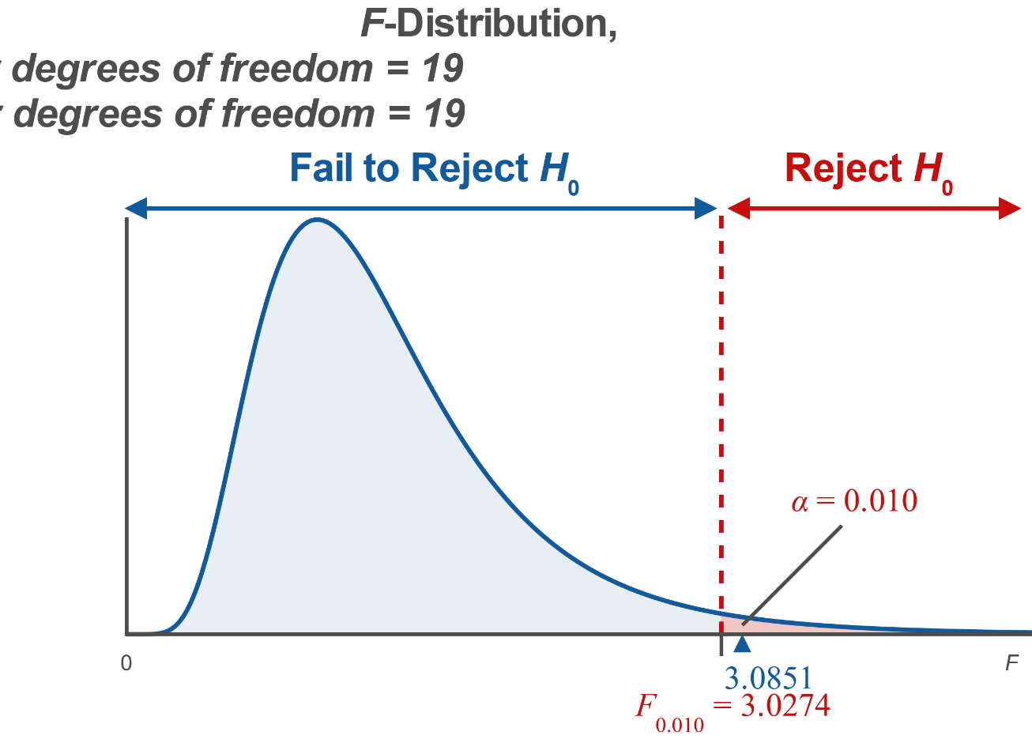
Example 11.5.2: Hypothesis Test for Two Population Variances (Right-Tailed) (cont.)

Slide 33
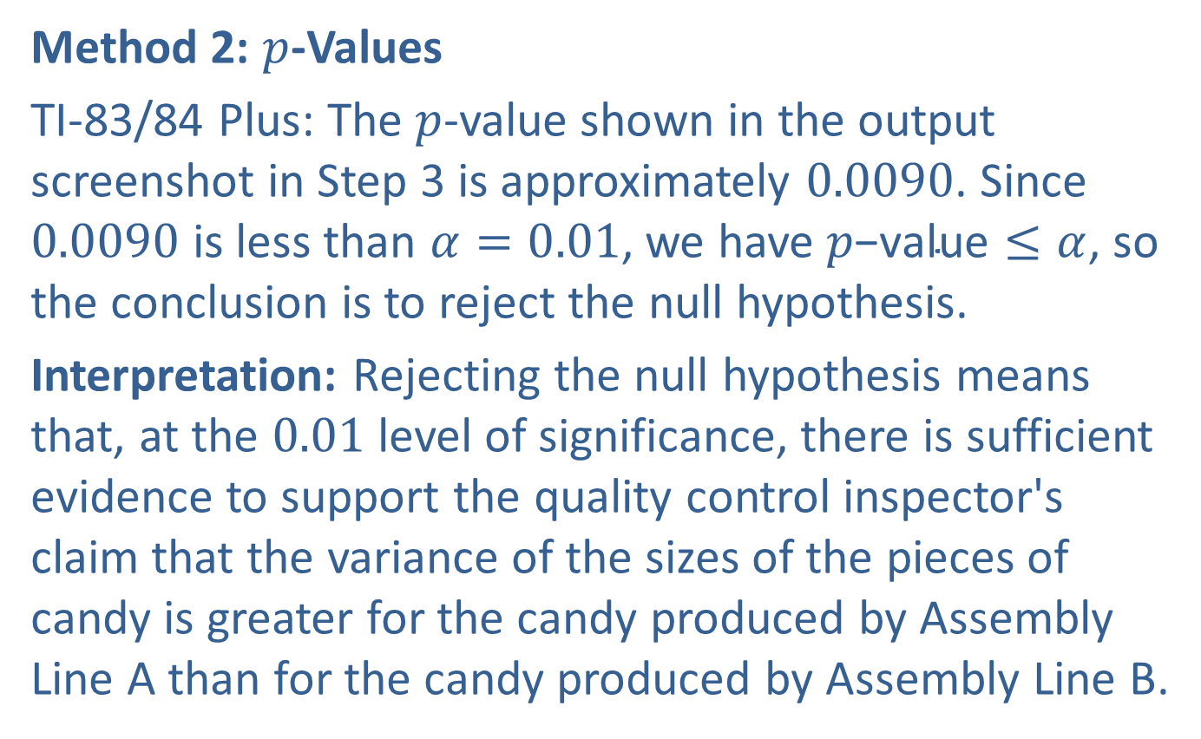
Example 11.5.2: Hypothesis Test for Two Population Variances (Right-Tailed) (cont.)
Method 2: $p$-Values
TI-83/84 Plus: The $p$-value shown in the output screenshot in Step 3 is approximately 0.0090. Since 0.0090 is less than $α=0.01$, we have $p\text{−}\text{value}≤α$, so the conclusion is to reject the null hypothesis.
Interpretation: Rejecting the null hypothesis means that, at the 0.01 level of significance, there is sufficient evidence to support the quality control inspector's claim that the variance of the sizes of the pieces of candy is greater for the candy produced by Assembly Line A than for the candy produced by Assembly Line B.

Slide 34
Example 11.5.3: Hypothesis Test for Two Population Variances (Two-Tailed)
A professor claims that the variances of the test scores on two different versions of an exam are not equal. To test his claim, he chooses a random sample of students' scores on each version. A sample of 20 scores on Version A has a sample variance of 3.8, while a sample of 20 scores on Version B has a sample variance of 3.3. Assuming that both populations of test scores are normally distributed, conduct a hypothesis test to test the professor's claim that the variances of the test scores are not equal. Use a 0.05 level of significance.

Slide 35
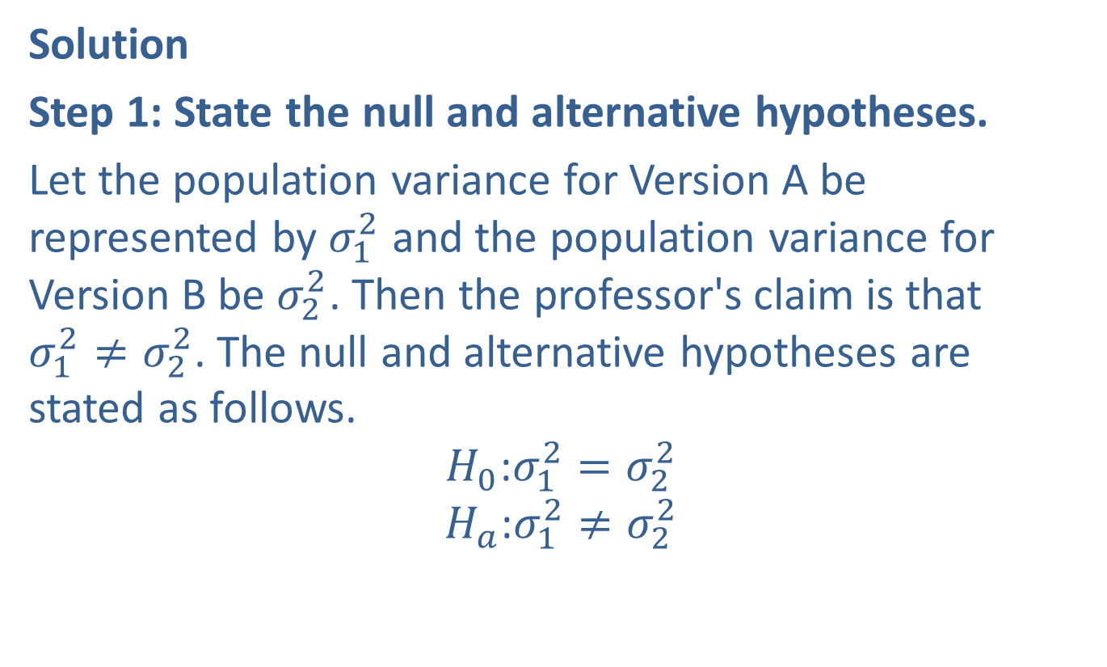
Example 11.5.3: Hypothesis Test for Two Population Variances (Two-Tailed) (cont.)
Solution
Step 1: State the null and alternative hypotheses.
Let the population variance for Version A be represented by $σ_{1}^{2}$ and the population variance for Version B be $σ_{2}^{2}$. Then the professor's claim is that
$σ_{1}^{2}≠σ_{2}^{2}$. The null and alternative hypotheses are stated as follows.
$$H_{0}\text{:}σ_{1}^{2}=σ_{2}^{2}$$
$$H_{a}\text{:}σ_{1}^{2}≠σ_{2}^{2}$$

Slide 36

Example 11.5.3: Hypothesis Test for Two Population Variances (Two-Tailed) (cont.)
Step 2: Determine which distribution to use for the test statistic, and state the level of significance.
Since we are comparing the variances of two normally distributed populations using independent, simple random samples, the conditions have been met and we can use the $F$-test statistic. In this problem, the level of significance is $α=0.05$.

Slide 37
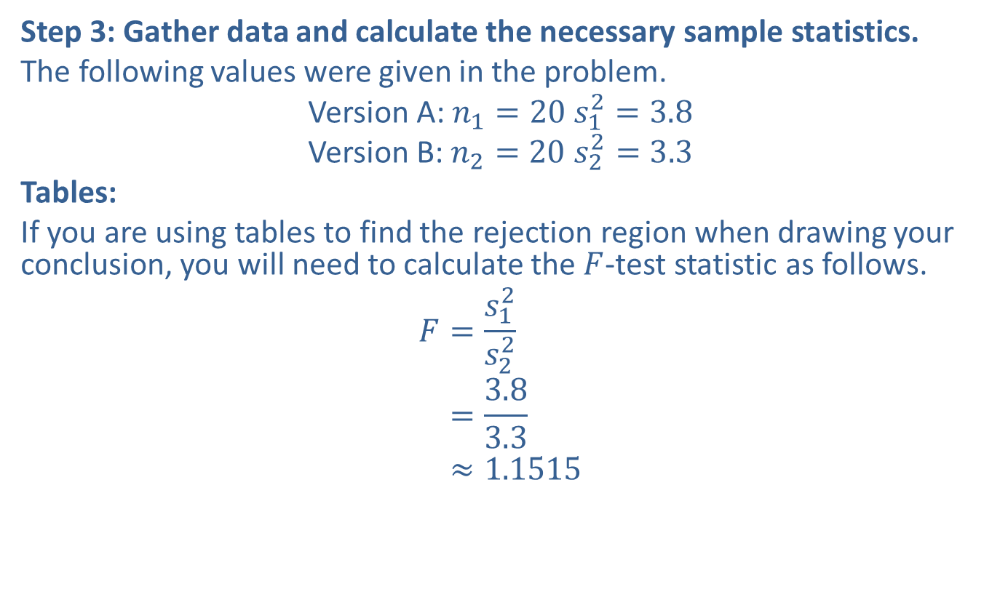
Example 11.5.3: Hypothesis Test for Two Population Variances (Two-Tailed) (cont.)
Step 3: Gather data and calculate the necessary sample statistics.
The following values were given in the problem.
Version A: $n_{1}=20$ $s_{1}^{2}=3.8$
Version B: $n_{2}=20$ $s_{2}^{2}=3.3$
Tables:
If you are using tables to find the rejection region when drawing your conclusion, you will need to calculate the $F$-test statistic as follows.
𝐹=𝑠12𝑠22𝐹=3.83.3𝐹≈1.1515

Slide 38
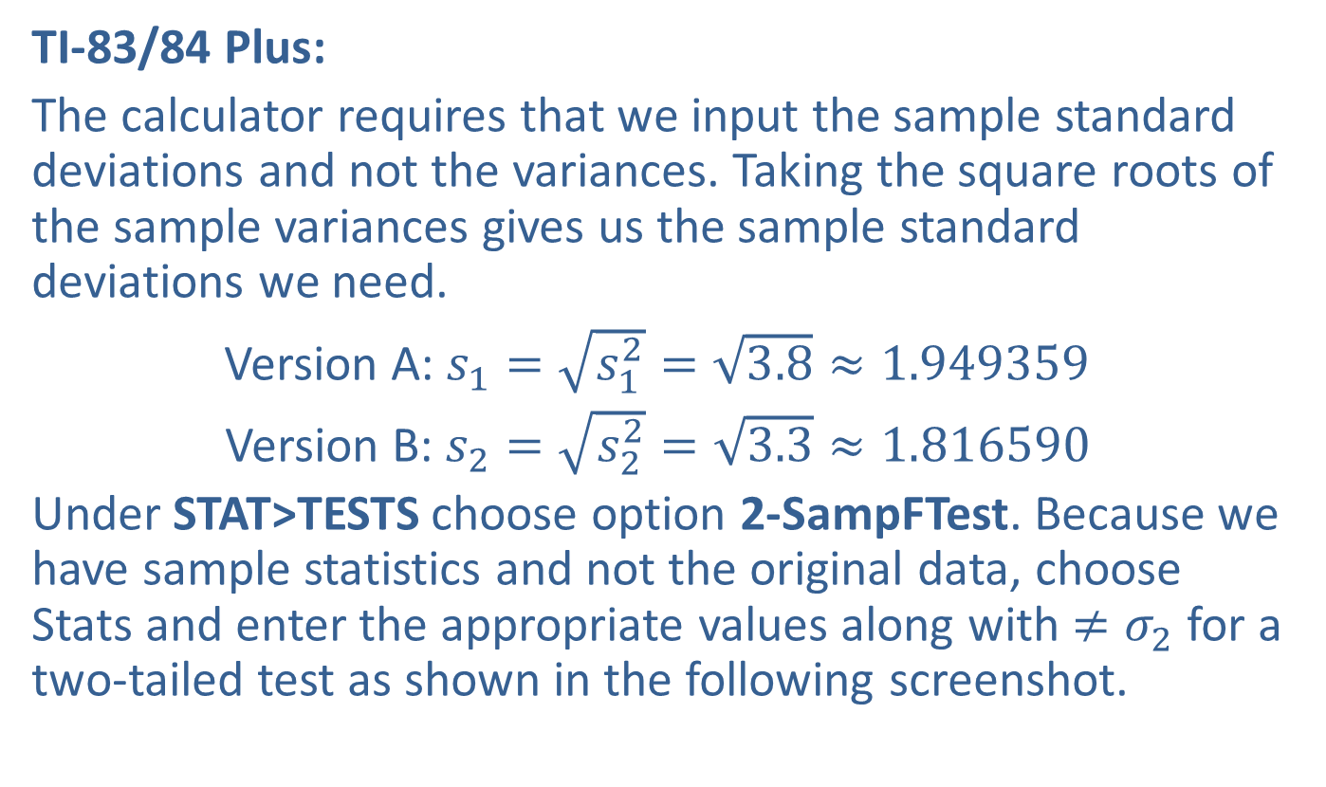
Example 11.5.3: Hypothesis Test for Two Population Variances (Two-Tailed) (cont.)
TI-83/84 Plus:
The calculator requires that we input the sample standard deviations and not the variances. Taking the square roots of the sample variances gives us the sample standard deviations we need.
Version A: $s_{1}=\sqrt{s_{1}^{2}}=\sqrt{3.8}≈1.949359$
Version B: $s_{2}=\sqrt{s_{2}^{2}}=\sqrt{3.3}≈1.816590$
Under STAT>TESTS choose option 2-SampFTest. Because we have sample statistics and not the original data, choose Stats and enter the appropriate values along with $≠σ_{2}$ for a two-tailed test as shown in the following screenshot.

Slide 39
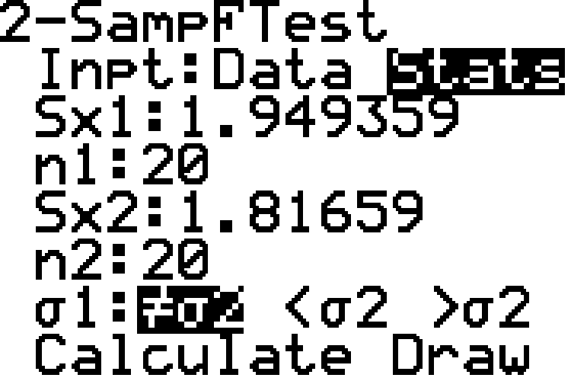
Example 11.5.3: Hypothesis Test for Two Population Variances (Two-Tailed) (cont.)

Slide 40
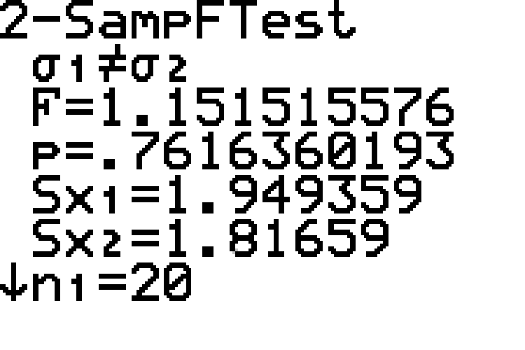
Example 11.5.3: Hypothesis Test for Two Population Variances (Two-Tailed) (cont.)
Choosing Calculate produces the following.

Slide 41

Example 11.5.3: Hypothesis Test for Two Population Variances (Two-Tailed) (cont.)
Step 4: Draw a conclusion and interpret the decision.
We can use either rejection regions or $p$-values to determine the conclusion to the hypothesis test.

Slide 42
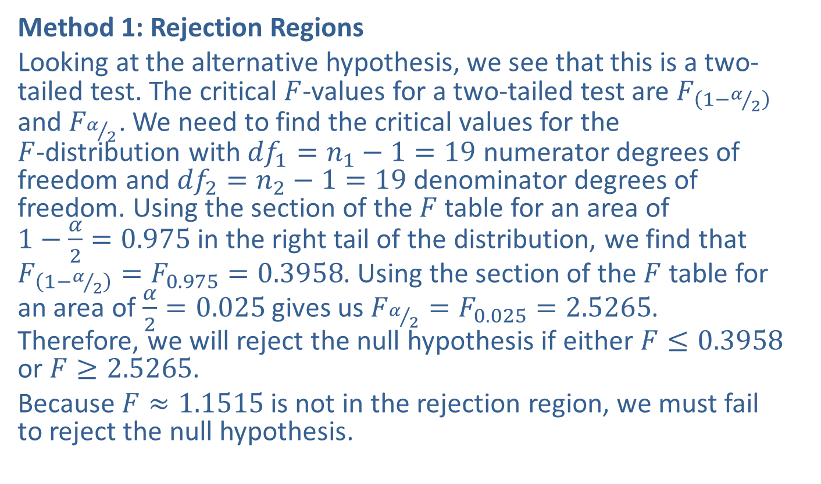
Example 11.5.3: Hypothesis Test for Two Population Variances (Two-Tailed) (cont.)
Method 1: Rejection Regions
Looking at the alternative hypothesis, we see that this is a two-tailed test. The critical $F$-values for a two-tailed test are $F_{\left(1−α/2\right)}$ and $F_{α/2}$. We need to find the critical values for the
$F$-distribution with ${df}_{1}=n_{1}−1=19$ numerator degrees of freedom and ${df}_{2}=n_{2}−1=19$ denominator degrees of freedom. Using the section of the $F$ table for an area of
$1−\frac{α}{2}=0.975$ in the right tail of the distribution, we find that $F_{\left(1−α/2\right)}=F_{0.975}=0.3958$. Using the section of the $F$ table for an area of $\frac{α}{2}=0.025$ gives us $F_{α/2}=F_{0.025}=2.5265$. Therefore, we will reject the null hypothesis if either $F≤0.3958$ or $F≥2.5265$.
Because $F≈1.1515$ is not in the rejection region, we must fail to reject the null hypothesis.

Slide 43
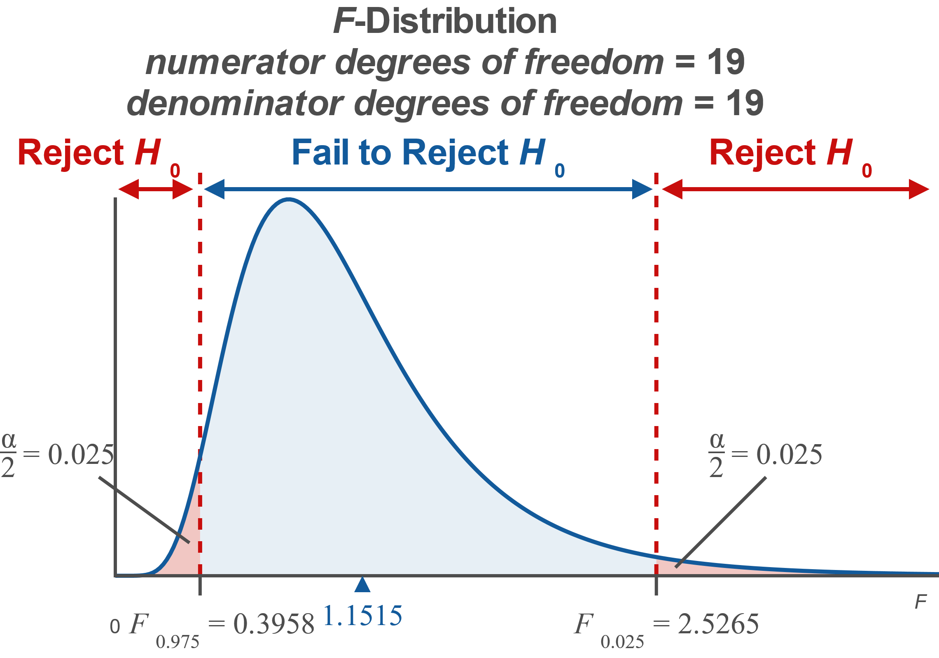
Example 11.5.3: Hypothesis Test for Two Population Variances (Two-Tailed) (cont.)

Slide 44

Example 11.5.3: Hypothesis Test for Two Population Variances (Two-Tailed) (cont.)
Method 2: $p$-Values
$P$-values for the $F$-test must be found using technology. We will show the calculator method here. Other methods of technology can be found at stat.hawkeslearning.com.

Slide 45
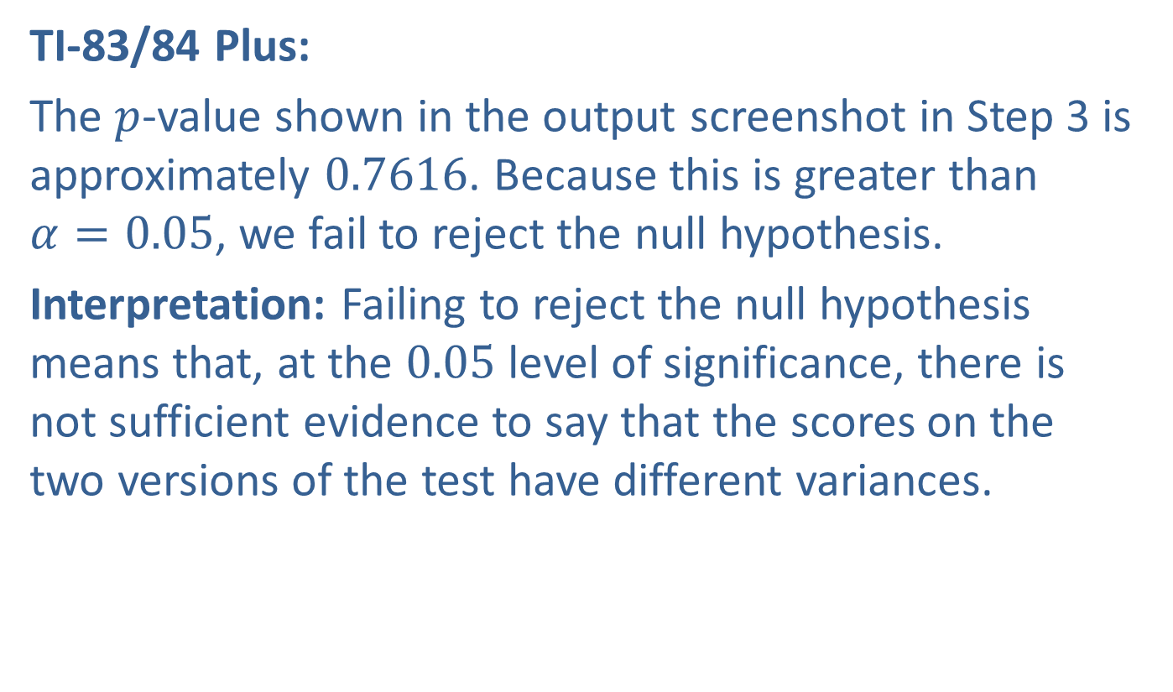
Example 11.5.3: Hypothesis Test for Two Population Variances (Two-Tailed) (cont.)
TI-83/84 Plus:
The $p$-value shown in the output screenshot in Step 3 is approximately 0.7616. Because this is greater than
$α=0.05$, we fail to reject the null hypothesis.
Interpretation: Failing to reject the null hypothesis means that, at the 0.05 level of significance, there is not sufficient evidence to say that the scores on the two versions of the test have different variances.

