Slide 1
Section 11.6
ANOVA (Analysis of Variance)

Slide 2
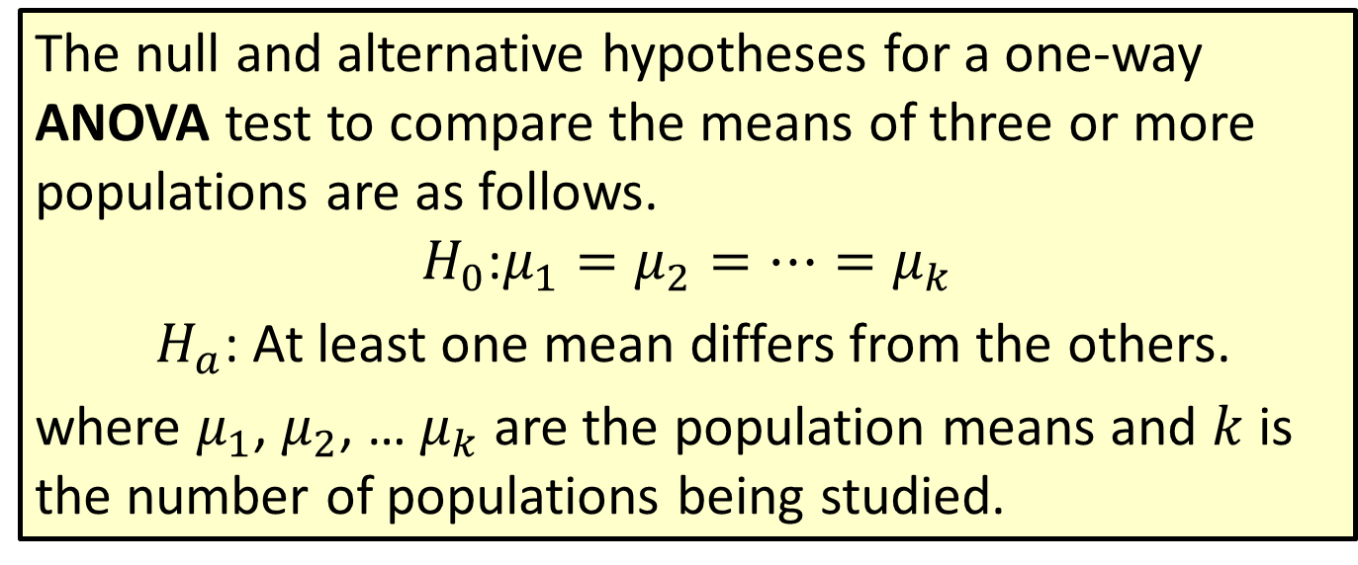
Procedure: Null and Alternative Hypotheses for a one-way ANOVA Test
The null and alternative hypotheses for a one-way ANOVA test to compare the means of three or more populations are as follows.
$$H_{0}\text{:}μ_{1}=μ_{2}=…=μ_{k}$$
$H_{a}$: At least one mean differs from the others.
where $μ_{1}$, $μ_{2}$, … $μ_{k}$ are the population means and $k$ is the number of populations being studied.

Slide 3
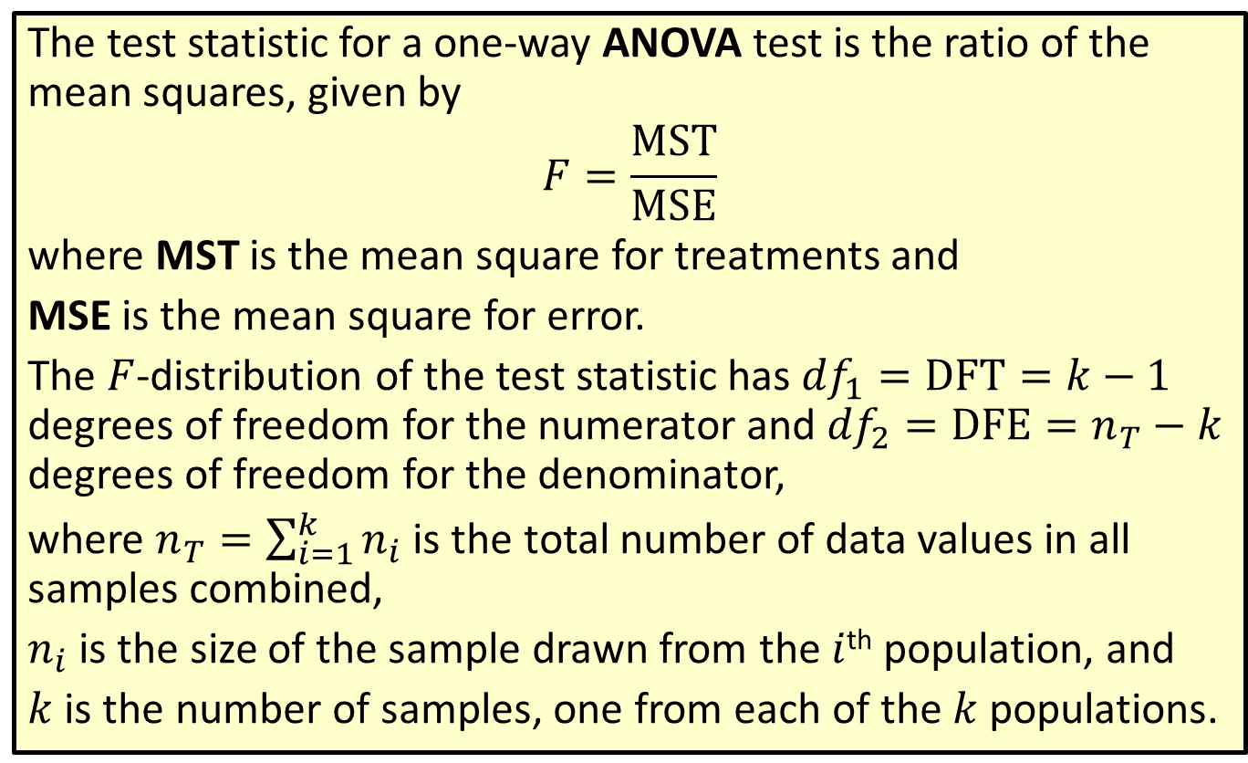
Formula: Test Statistic for a one-way ANOVA Test
The test statistic for a one-way ANOVA test is the ratio of the mean squares, given by
$$F=\frac{MST}{MSE}$$
where MST is the mean square for treatments and
MSE is the mean square for error.
The $F$-distribution of the test statistic has ${df}_{1}=DFT=k−1$ degrees of freedom for the numerator and ${df}_{2}=DFE=n_{T}−k$ degrees of freedom for the denominator,
where $n_{T}=\sum_{i=1}^{k}{n_{i}}$ is the total number of data values in all samples combined,
$n_{i}$ is the size of the sample drawn from the $i$^{th} population, and
$k$ is the number of samples, one from each of the $k$ populations.

Slide 4
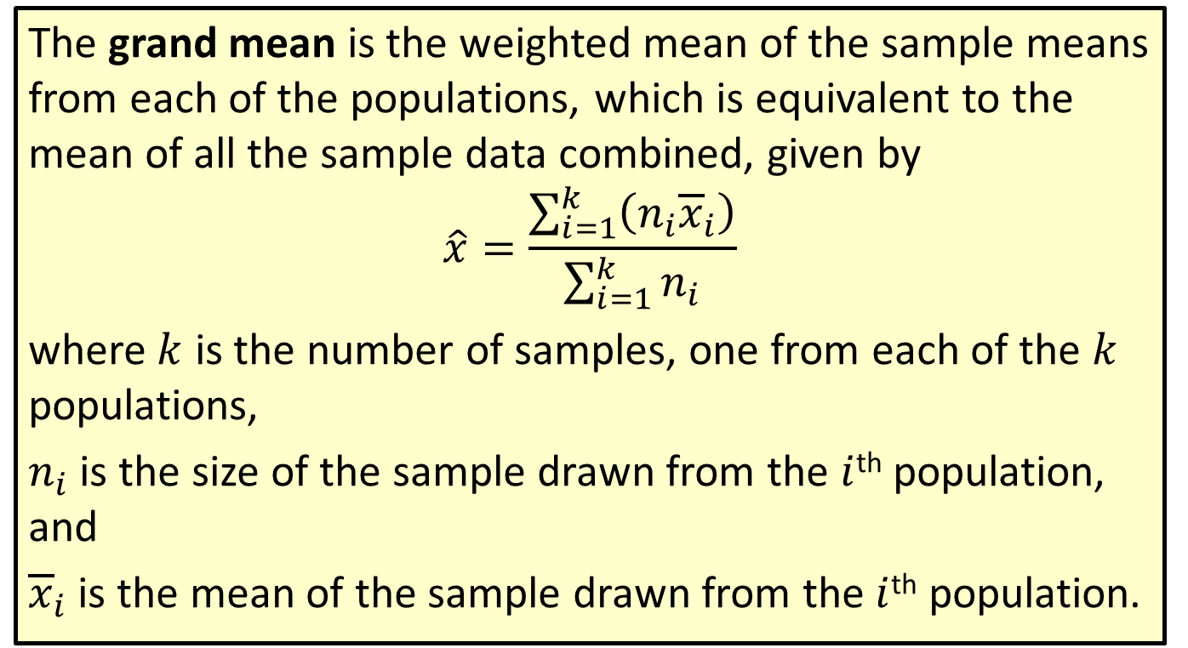
Formula: Grand Mean
The grand mean is the weighted mean of the sample means from each of the populations, which is equivalent to the mean of all the sample data combined, given by
$$\hat{x}=\frac{\sum_{i=1}^{k}{\left(n_{i}{\overline{x}}_{i}\right)}}{\sum_{i=1}^{k}{n_{i}}}$$
where $k$ is the number of samples, one from each of the $k$ populations,
$n_{i}$ is the size of the sample drawn from the $i$^{th} population, and
${\overline{x}}_{i}$ is the mean of the sample drawn from the $i$^{th} population.

Slide 5
Technology
If Data Analysis does not appear in your Excel menu under the Data tab, you can add this function using these linked instructions.

Slide 6
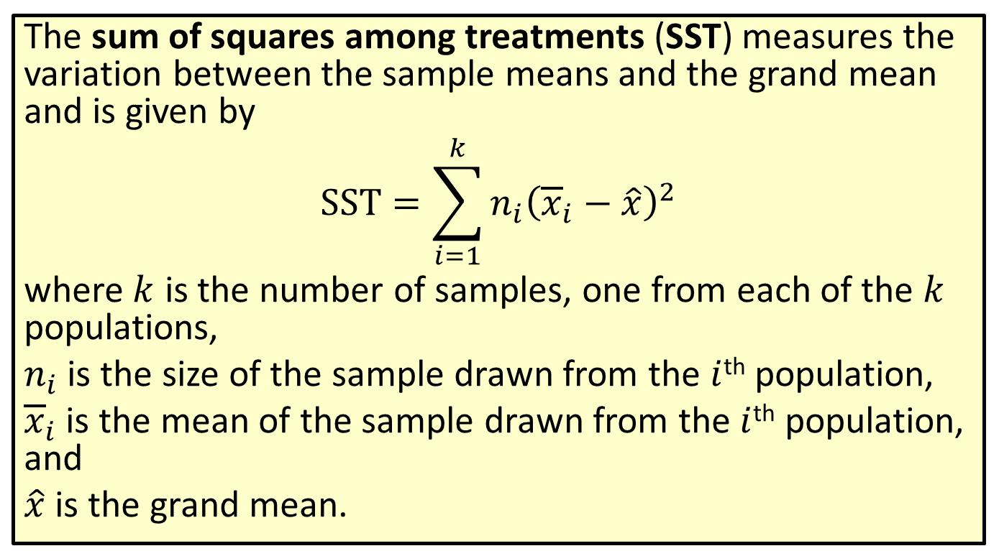
Formula: Sum of Squares among Treatments (SST)
The sum of squares among treatments (SST) measures the variation between the sample means and the grand mean and is given by
$$SST=\sum_{i=1}^{k}{n_{i}{\left({\overline{x}}_{i}−\hat{x}\right)}^{2}}$$
where $k$ is the number of samples, one from each of the $k$ populations,
$n_{i}$ is the size of the sample drawn from the $i$^{th} population,
${\overline{x}}_{i}$ is the mean of the sample drawn from the $i$^{th} population, and
$\hat{x}$ is the grand mean.

Slide 7
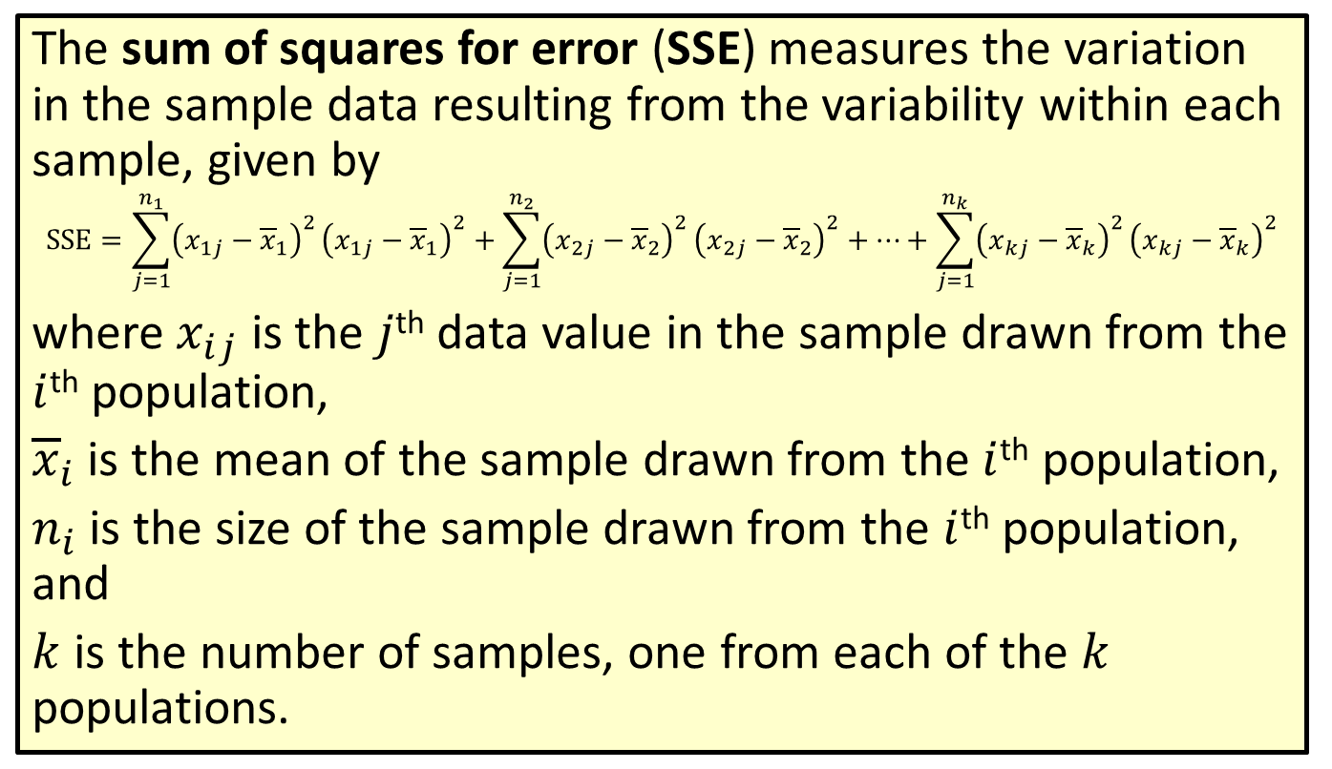
Formula: Sum of Squares for Error (SSE)
The sum of squares for error (SSE) measures the variation in the sample data resulting from the variability within each sample, given by
$$SSE=\sum_{j=1}^{n_{1}}{{\left(x_{1⁣j}−{\overline{x}}_{1}\right)}^{2}}{\left(x_{1⁣j}−{\overline{x}}_{1}\right)}^{2}+\sum_{j=1}^{n_{2}}{{\left(x_{2⁣j}−{\overline{x}}_{2}\right)}^{2}}{\left(x_{2⁣j}−{\overline{x}}_{2}\right)}^{2}+…+\sum_{j=1}^{n_{k}}{{\left(x_{k⁣j}−{\overline{x}}_{k}\right)}^{2}}{\left(x_{k⁣j}−{\overline{x}}_{k}\right)}^{2}$$
where $x_{i⁣j}$ is the $j$^{th} data value in the sample drawn from the $i$^{th} population,
${\overline{x}}_{i}$ is the mean of the sample drawn from the $i$^{th} population,
$n_{i}$ is the size of the sample drawn from the $i$^{th} population, and
$k$ is the number of samples, one from each of the $k$ populations.

Slide 8
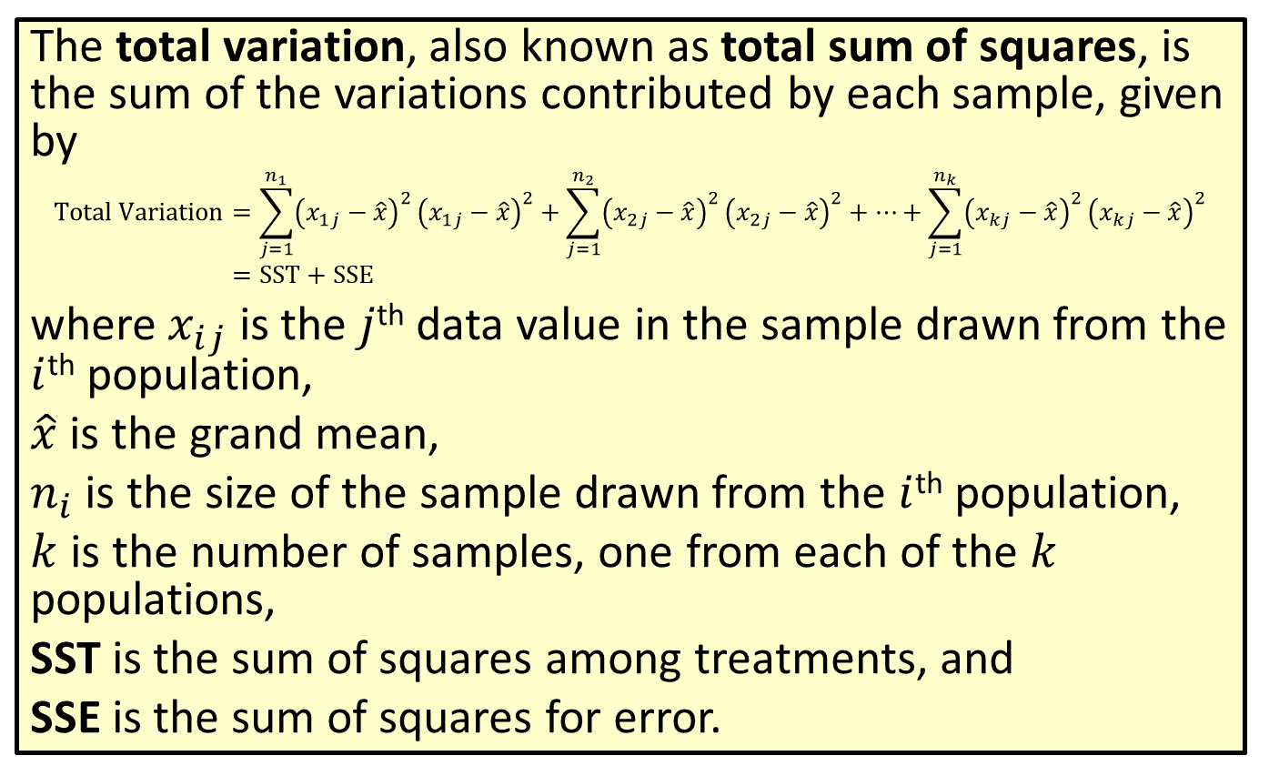
Formula: Total Variation
The total variation, also known as total sum of squares, is the sum of the variations contributed by each sample, given by
Total Variation=𝑗=1𝑛1𝑥1⁣𝑗−𝑥2𝑥1⁣𝑗−𝑥2+𝑗=1𝑛2𝑥2⁣𝑗−𝑥2𝑥2⁣𝑗−𝑥2+…+𝑗=1𝑛𝑘𝑥𝑘⁣𝑗−𝑥2𝑥𝑘⁣𝑗−𝑥2Total Variation=SST+SSE
where $x_{i⁣j}$ is the $j$^{th} data value in the sample drawn from the $i$^{th} population,
$\hat{x}$ is the grand mean,
$n_{i}$ is the size of the sample drawn from the $i$^{th} population,
$k$ is the number of samples, one from each of the $k$ populations,
SST is the sum of squares among treatments, and
SSE is the sum of squares for error.

Slide 9
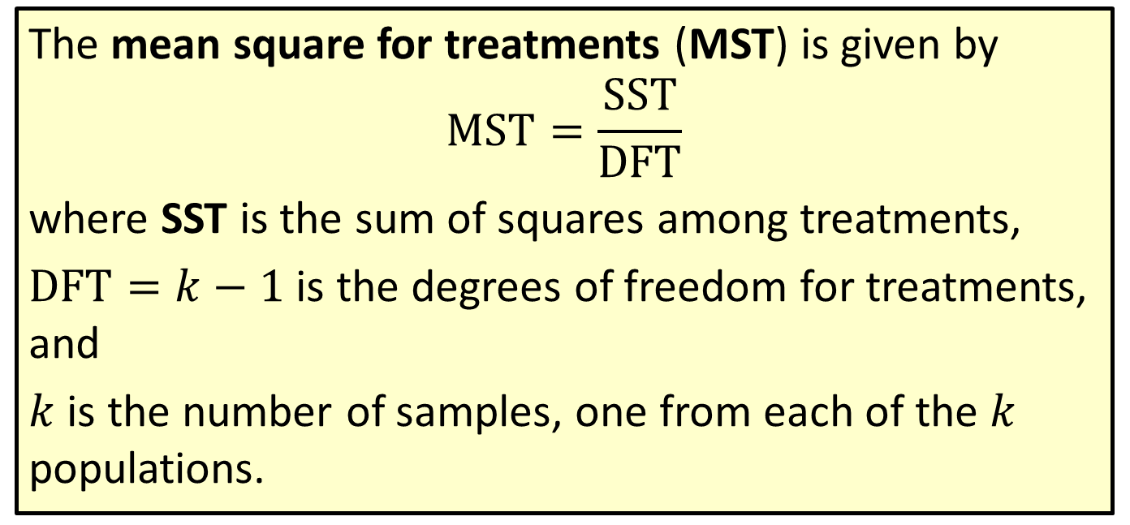
Formula: Mean Square for Treatments (MST)
The mean square for treatments (MST) is given by
$$MST=\frac{SST}{DFT}$$
where SST is the sum of squares among treatments,
$DFT=k−1$ is the degrees of freedom for treatments, and
$k$ is the number of samples, one from each of the $k$ populations.

Slide 10
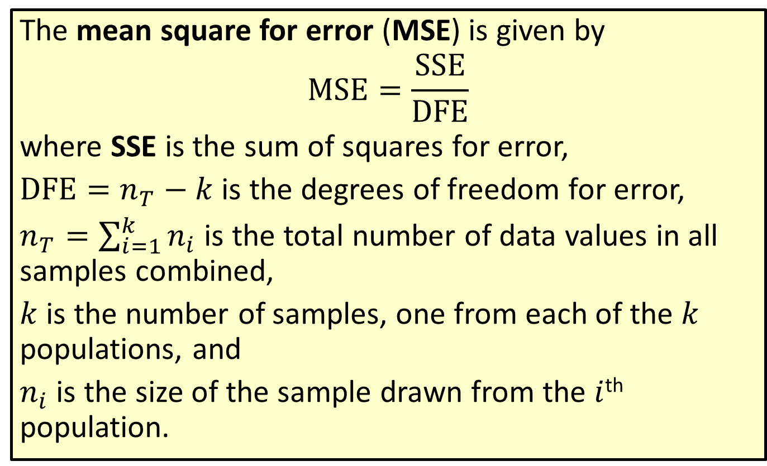
Formula: Mean Square for Error (MSE)
The mean square for error (MSE) is given by
$$MSE=\frac{SSE}{DFE}$$
where SSE is the sum of squares for error,
$DFE=n_{T}−k$ is the degrees of freedom for error,
$n_{T}=\sum_{i=1}^{k}{n_{i}}$ is the total number of data values in all samples combined,
$k$ is the number of samples, one from each of the $k$ populations, and
$n_{i}$ is the size of the sample drawn from the $i$^{th} population.

Slide 11

Procedure: Rejection Region for a One-Way ANOVA Tests
Reject the null hypothesis, $H_{0}$, if:
$$F≥F_{α}$$

Slide 12
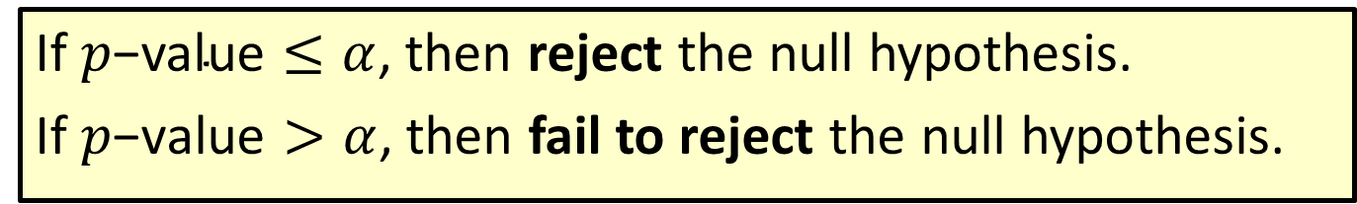

Procedure: Conclusions Using $p$-Values
If $p\text{−}\text{value}≤α$, then reject the null hypothesis.
If $p\text{−}\text{value}>α$, then fail to reject the null hypothesis.

Slide 13
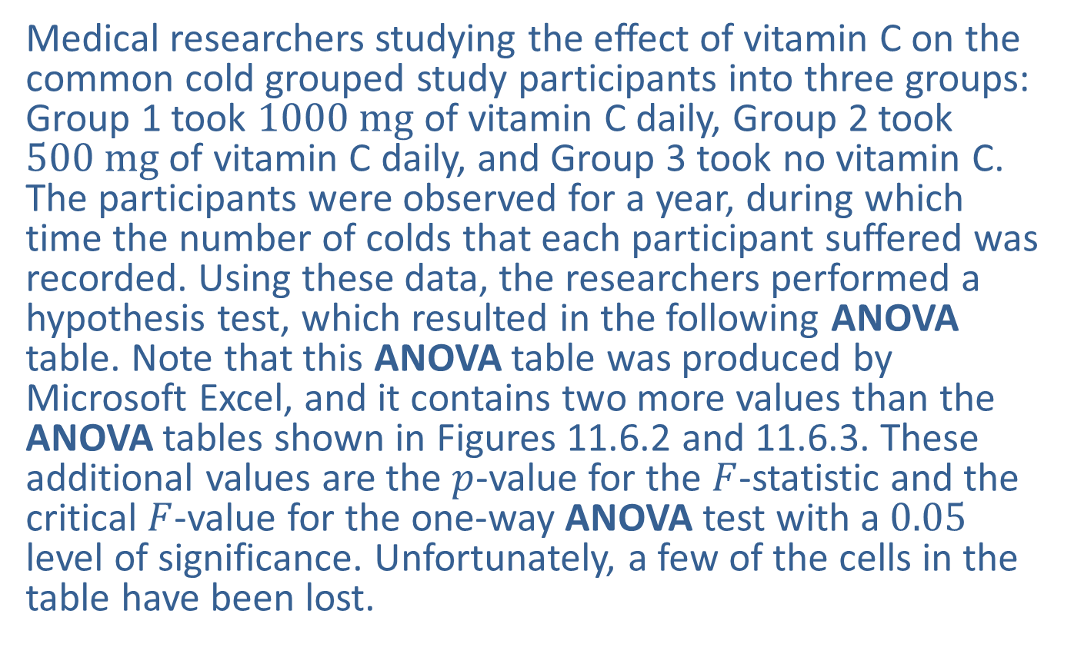
Example 11.6.1: Completing a One-Way ANOVA Table and Performing a One-Way ANOVA Test
Medical researchers studying the effect of vitamin C on the common cold grouped study participants into three groups: Group 1 took $1000 mg$ of vitamin C daily, Group 2 took $500 mg$ of vitamin C daily, and Group 3 took no vitamin C. The participants were observed for a year, during which time the number of colds that each participant suffered was recorded. Using these data, the researchers performed a hypothesis test, which resulted in the following ANOVA table. Note that this ANOVA table was produced by Microsoft Excel, and it contains two more values than the ANOVA tables shown in Figures 11.6.2 and 11.6.3. These additional values are the $p$-value for the $F$-statistic and the critical $F$-value for the one-way ANOVA test with a 0.05 level of significance. Unfortunately, a few of the cells in the table have been lost.

Slide 14
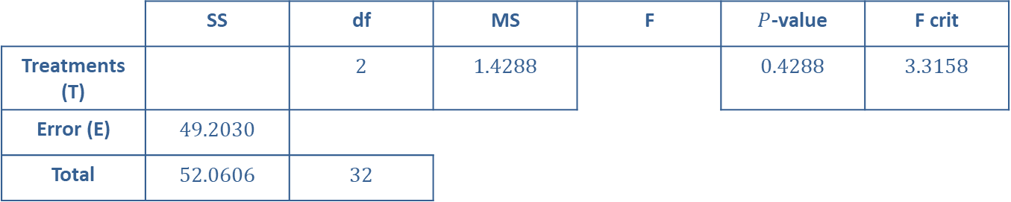
Example 11.6.1: Completing a One-Way ANOVA Table and Performing a One-Way ANOVA Test (cont.)
 | SS | df | MS | F | $P$-value | F crit
Treatments (T) |  | 2 | 1.4288 |  | 0.4288 | 3.3158
Error (E) | 49.2030
Total | 52.0606 | 32

Slide 15
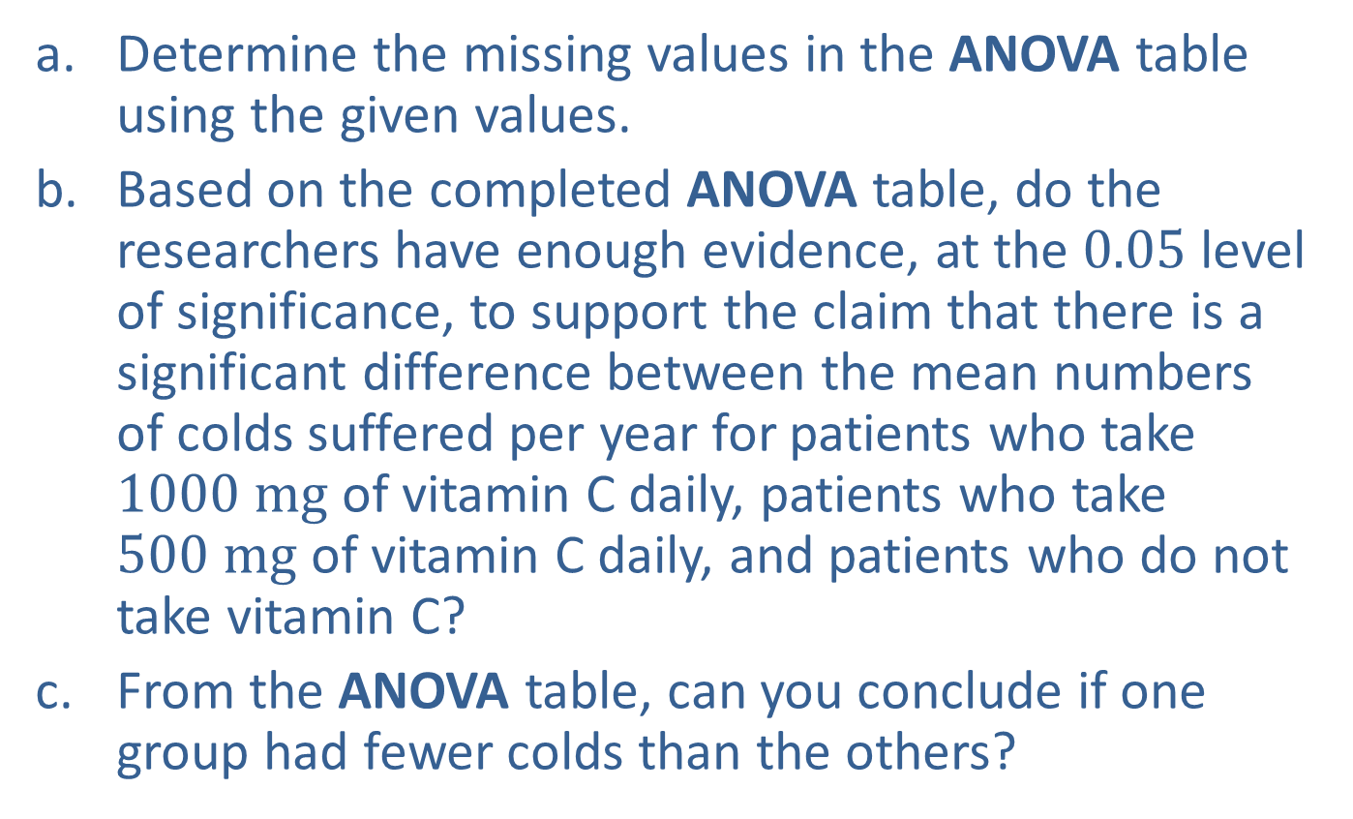
Example 11.6.1: Completing a One-Way ANOVA Table and Performing a One-Way ANOVA Test (cont.)
​Determine the missing values in the ANOVA table using the given values.
​Based on the completed ANOVA table, do the researchers have enough evidence, at the 0.05 level of significance, to support the claim that there is a significant difference between the mean numbers of colds suffered per year for patients who take $1000 mg$ of vitamin C daily, patients who take $500 mg$ of vitamin C daily, and patients who do not take vitamin C?
​From the ANOVA table, can you conclude if one group had fewer colds than the others?

Slide 16
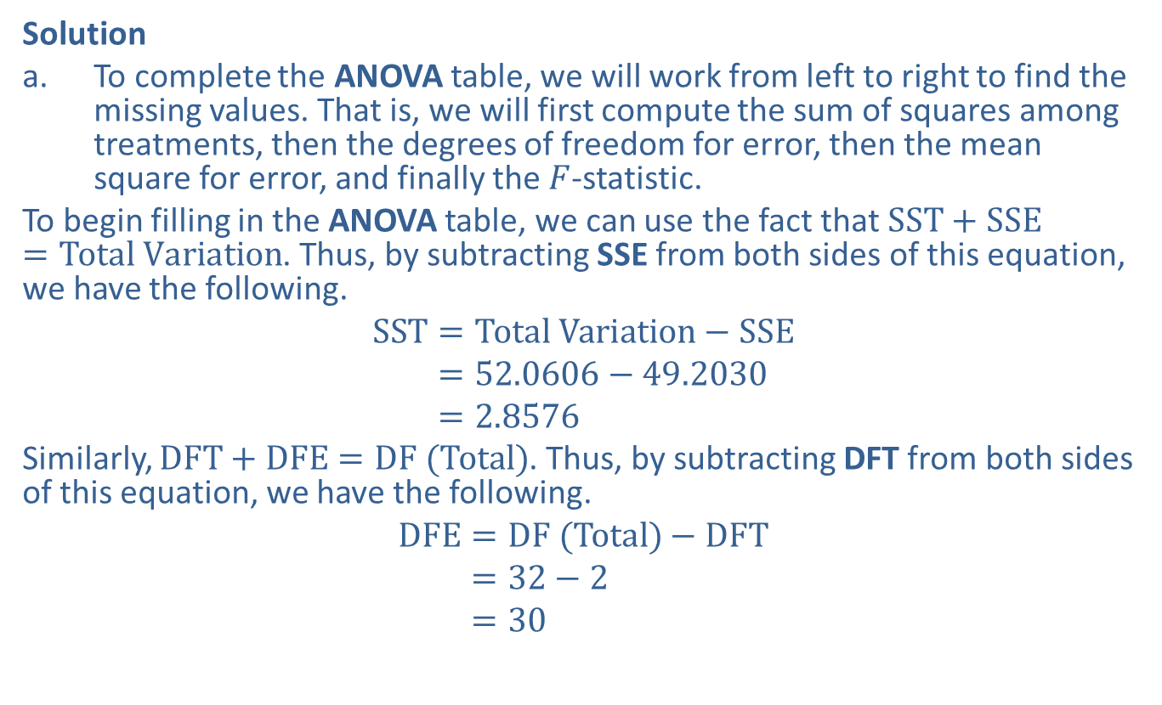
Example 11.6.1: Completing a One-Way ANOVA Table and Performing a One-Way ANOVA Test (cont.)
Solution
​To complete the ANOVA table, we will work from left to right to find the missing values. That is, we will first compute the sum of squares among treatments, then the degrees of freedom for error, then the mean square for error, and finally the $F$-statistic.
​To begin filling in the ANOVA table, we can use the fact that $SST+SSE=Total Variation$. Thus, by subtracting SSE from both sides of this equation, we have the following.
SST=Total Variation−SSESST=52.0606−49.2030SST=2.8576
​Similarly, $DFT+DFE=DF (Total)$. Thus, by subtracting DFT from both sides of this equation, we have the following.
DFE=DF (Total)−DFTDFE=32−2DFE=30

Slide 17
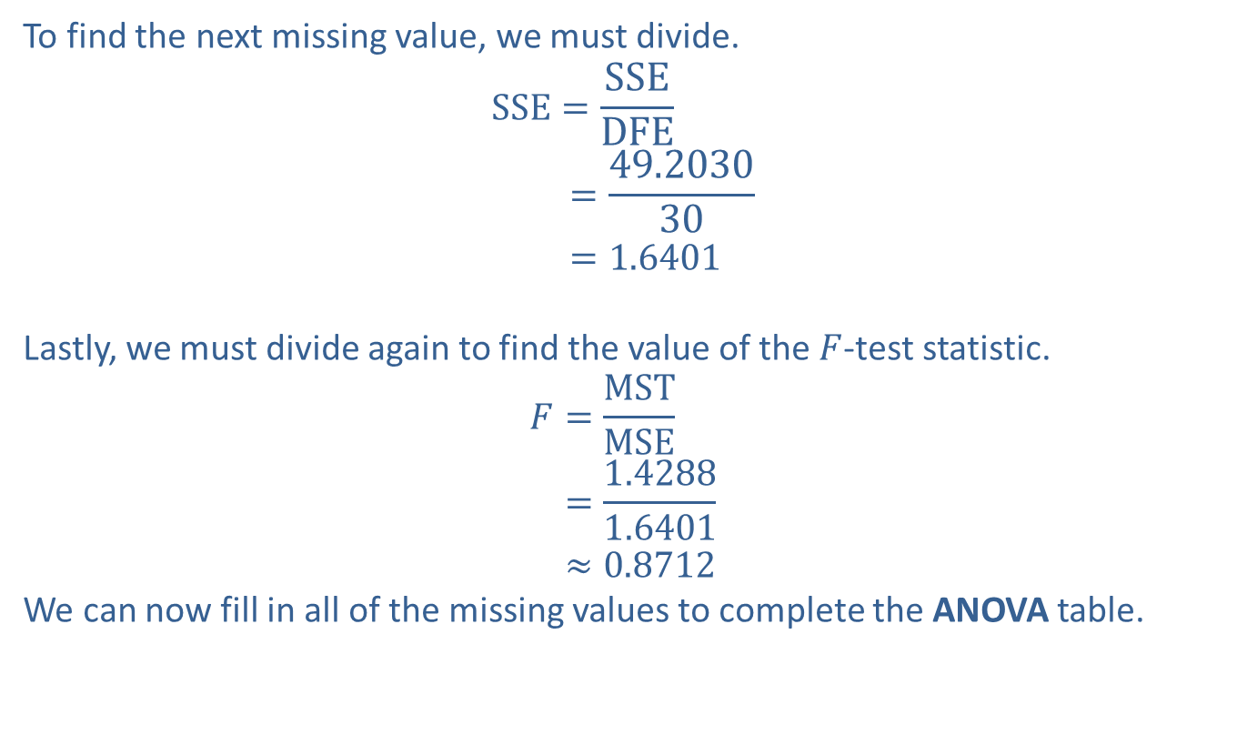
Example 11.6.1: Completing a One-Way ANOVA Table and Performing a One-Way ANOVA Test (cont.)
To find the next missing value, we must divide.
SSE=SSEDFEDFE=49.203030DFE=1.6401
​
Lastly, we must divide again to find the value of the $F$-test statistic.
𝐹=MSTMSE𝐹=1.42881.6401𝐹≈0.8712
​We can now fill in all of the missing values to complete the ANOVA table.
​

Slide 18
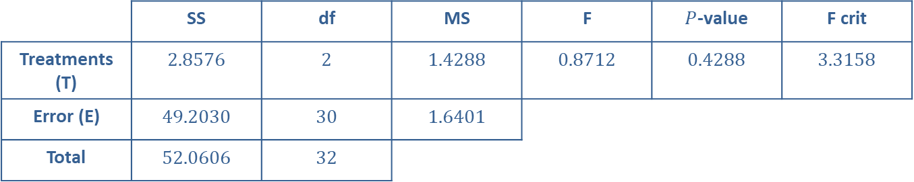
Example 11.6.1: Completing a One-Way ANOVA Table and Performing a One-Way ANOVA Test (cont.)
 | SS | df | MS | F | $P$-value | F crit
Treatments (T) | 2.8576 | 2 | 1.4288 | 0.8712 | 0.4288 | 3.3158
Error (E) | 49.2030 | 30 | 1.6401
Total | 52.0606 | 32

Slide 19
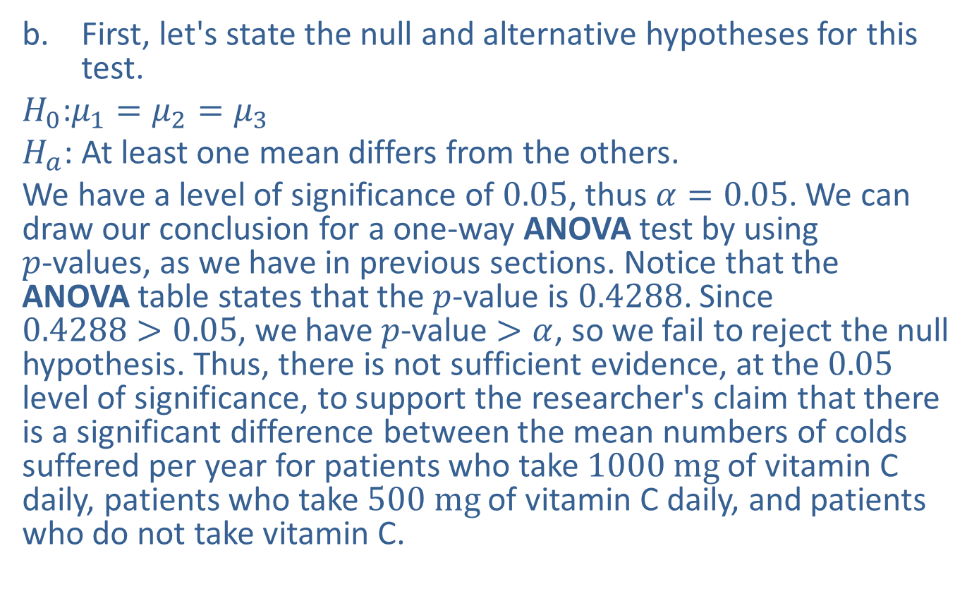
Example 11.6.1: Completing a One-Way ANOVA Table and Performing a One-Way ANOVA Test (cont.)
​First, let's state the null and alternative hypotheses for this test.
​$H_{0}\text{:}μ_{1}=μ_{2}=μ_{3}$
​$H_{a}\text{:}$ At least one mean differs from the others.
​We have a level of significance of 0.05, thus $α=0.05$. We can draw our conclusion for a one-way ANOVA test by using
$p$-values, as we have in previous sections. Notice that the ANOVA table states that the $p$-value is 0.4288. Since
$0.4288>0.05$, we have $p$-value $>α$, so we fail to reject the null hypothesis. Thus, there is not sufficient evidence, at the 0.05 level of significance, to support the researcher's claim that there is a significant difference between the mean numbers of colds suffered per year for patients who take $1000 mg$ of vitamin C daily, patients who take $500 mg$ of vitamin C daily, and patients who do not take vitamin C.

Slide 20
Example 11.6.1: Completing a One-Way ANOVA Table and Performing a One-Way ANOVA Test (cont.)
​Because we failed to reject the null hypothesis, this test did not provide support for the claim that one group had fewer (or more) colds, on average, than another group; however, even if it had, we would not be able to tell from the ANOVA table which group had fewer colds. Remember that rejecting the null hypothesis in a one-way ANOVA test supports the claim that at least one of the population means is different from the others, but it does not indicate which one differs, or by how much.

Slide 21
Example 11.6.2: Performing a One-Way ANOVA Test Using Microsoft Excel
Researchers at a drug company wish to test whether their drug is the best on the market for lowering cholesterol levels in middle-aged women. To compare the drug with other drugs on the market, 30 women with high cholesterol volunteer to take part in a six-month study. The women are divided into three groups, and each group is given a different cholesterol-lowering drug, one of which is the drug made by the company. The women's cholesterol levels are measured at the beginning of the study, and again after six months. The difference between the before-treatment and after-treatment cholesterol levels for each woman is recorded in the following table. (Note that each study participant experienced a decrease in cholesterol level over the six-month period.) Use these data to perform a one-way ANOVA test with a 0.10 level of significance. Assume that the three population distributions are all approximately normal with equal population variances. What conclusions can you draw from the test?

Slide 22
Example 11.6.2: Performing a One-Way ANOVA Test Using Microsoft Excel (cont.)
Decreases in Cholesterol Levels (in mg/dL)
Drug 1 | Drug 2 | Drug 3
18 | 18 | 21
19 | 20 | 22
20 | 16 | 17
21 | 20 | 18
22 | 21 | 22
23 | 20 | 19
18 | 18 | 21
19 | 19 | 20
20 | 17 | 18
21 | 13 | 23

Slide 23
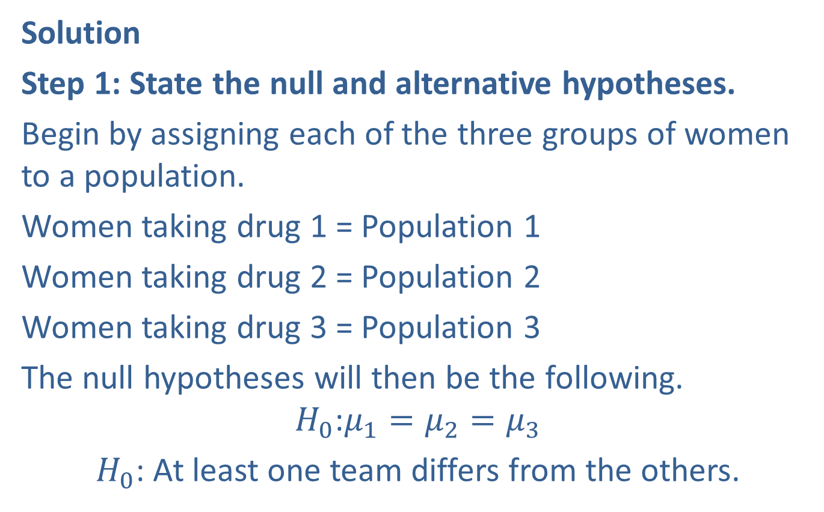
Example 11.6.2: Performing a One-Way ANOVA Test Using Microsoft Excel (cont.)
Solution
Step 1: State the null and alternative hypotheses.
Begin by assigning each of the three groups of women to a population.
Women taking drug 1 = Population 1
Women taking drug 2 = Population 2
Women taking drug 3 = Population 3
The null hypotheses will then be the following.
$$H_{0}\text{:}μ_{1}=μ_{2}=μ_{3}$$
$H_{0}$: At least one team differs from the others.

Slide 24
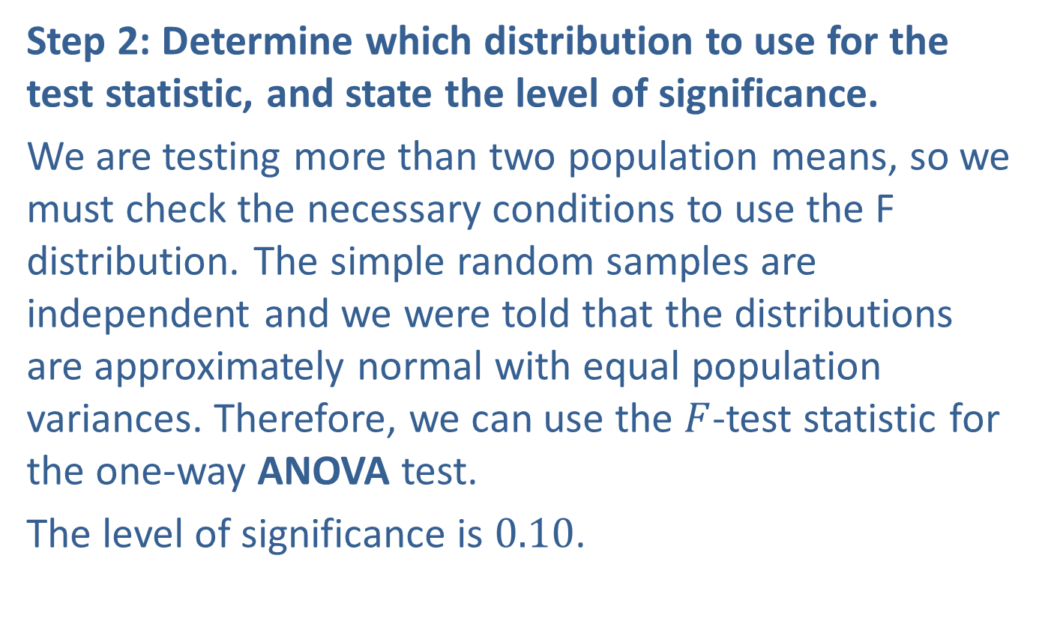
Example 11.6.2: Performing a One-Way ANOVA Test Using Microsoft Excel (cont.)
Step 2: Determine which distribution to use for the test statistic, and state the level of significance.
We are testing more than two population means, so we must check the necessary conditions to use the F distribution. The simple random samples are independent and we were told that the distributions are approximately normal with equal population variances. Therefore, we can use the $F$-test statistic for the one-way ANOVA test.
The level of significance is 0.10.

Slide 25
Example 11.6.2: Performing a One-Way ANOVA Test Using Microsoft Excel (cont.)
Step 3: Gather data and calculate the necessary sample statistics.
Microsoft Excel:
Begin by entering the data, including the column headings, into columns A, B, and C on your Excel sheet. Under the Data tab, choose Data Analysis. In the Data Analysis menu, choose Anova: Single Factor since this is a one-way ANOVA test. Next, fill out the ANOVA menu as shown in the following screenshot.

Slide 26
Technology
If Data Analysis does not appear in your Excel menu under the Data tab, you can add this function using these linked instructions.

Slide 27
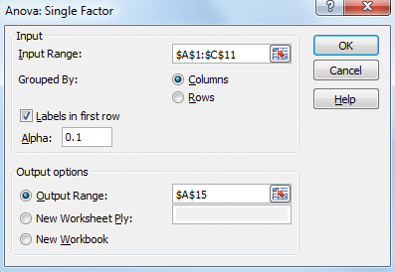
Example 11.6.2: Performing a One-Way ANOVA Test Using Microsoft Excel (cont.)

Slide 28
Example 11.6.2: Performing a One-Way ANOVA Test Using Microsoft Excel (cont.)
After clicking OK, the ANOVA table will be displayed along with a SUMMARY table, which contains the descriptive statistics for each sample.

Slide 29
Example 11.6.2: Performing a One-Way ANOVA Test Using Microsoft Excel (cont.)
Anova: Single Factor
SUMMARY
Groups | Count | Sum | Average | Variance
Drug 1 | 10 | 201 | 20.1 | 2.766667
Drug 2 | 10 | 182 | 18.2 | 5.733333
Drug 3 | 10 | 201 | 20.1 | 4.1
ANOVA
Source of Variation | SS | df | MS | F | P-value | F crit
Between Groups | 24.06667 | 2 | 12.03333 | 2.865079 | 0.074407 | 2.510609
Within Groups | 113.4 | 27 | 4.2
Total | 137.4667 | 29

Slide 30
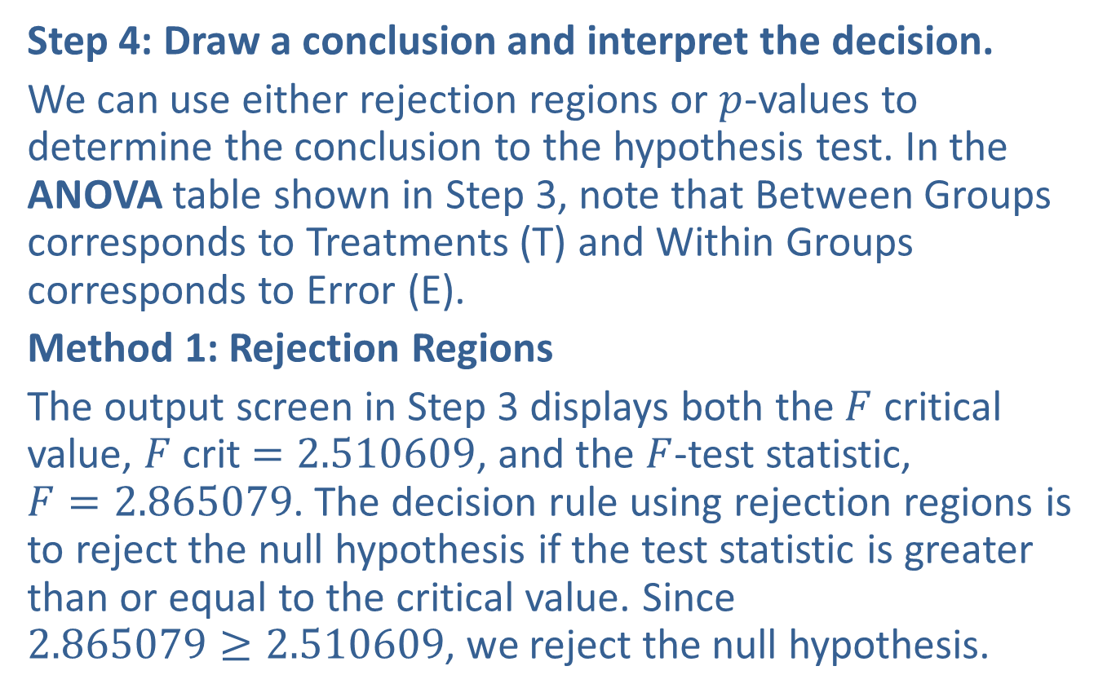
Example 11.6.2: Performing a One-Way ANOVA Test Using Microsoft Excel (cont.)
Step 4: Draw a conclusion and interpret the decision.
We can use either rejection regions or $p$-values to determine the conclusion to the hypothesis test. In the ANOVA table shown in Step 3, note that Between Groups corresponds to Treatments (T) and Within Groups corresponds to Error (E).
Method 1: Rejection Regions
The output screen in Step 3 displays both the $F$ critical value, $F$ crit $=2.510609$, and the $F$-test statistic,
$F=2.865079$. The decision rule using rejection regions is to reject the null hypothesis if the test statistic is greater than or equal to the critical value. Since
$2.865079≥2.510609$, we reject the null hypothesis.

Slide 31
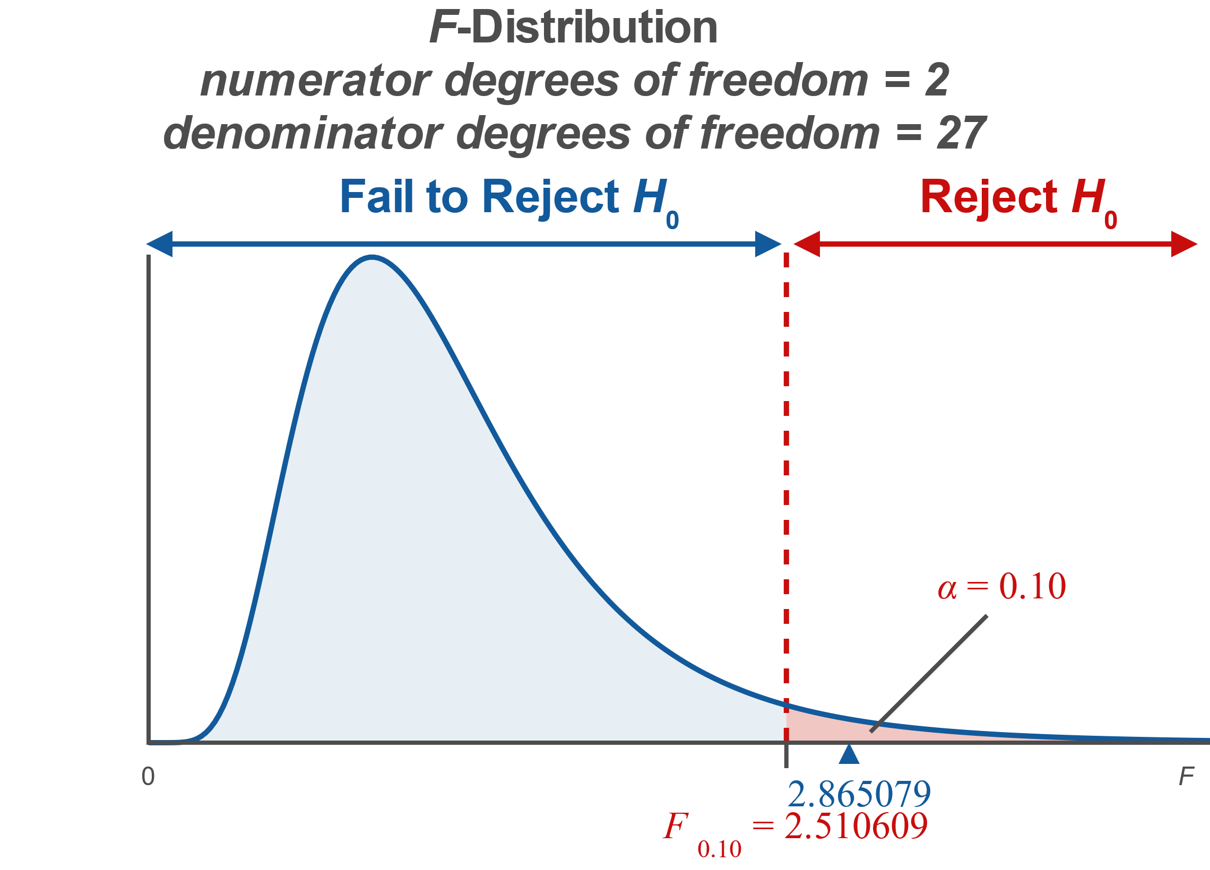
Example 11.6.2: Performing a One-Way ANOVA Test Using Microsoft Excel (cont.)

Slide 32

Example 11.6.2: Performing a One-Way ANOVA Test Using Microsoft Excel (cont.)
Method 2: $p$-values
The output screen in Step 3 displays the
$p$-value $=0.074407$. Since the $p$-value is less than our level of significance, $α=0.10$, we reject the null hypothesis.

Slide 33
Example 11.6.2: Performing a One-Way ANOVA Test Using Microsoft Excel (cont.)
Interpretation: Thus, the researchers can conclude that there is sufficient evidence, at the 0.10 level of significance, to support the claim that at least one of the population means is different. That is, the evidence suggests that the mean decrease in a woman’s cholesterol level for at least one of the drugs is different from the others. However, we cannot conclude, from the one-way ANOVA test alone, how the population means differ. Looking at the descriptive statistics for the sample data, we see that Drugs 1 and 3 lowered the women’s cholesterol levels by a mean of 20.1 points and Drug 2 lowered the women’s cholesterol levels by a mean of 18.2 points, which suggests that the population mean for Drug 2 differs from the others, but we cannot make this conclusion from the one-way ANOVA test alone.

Slide 34
Technology
For detailed instructions on performing a One-Way ANOVA test using a TI-83/84 Plus calculator or other technology, please visit stat.hawkeslearning.com and see Technology Instructions > ANOVA > One-Way.

Slide 35
Example 11.6.2: Performing a One-Way ANOVA Test Using Microsoft Excel (cont.)
Note that the one-way ANOVA test only tells us whether there exists a difference between the population means. It does not tell you which mean, or means, are different, you would use a multiple comparisons test such a Tukey, Dunnet, or an MCB test, which are beyond the scope of this book.

