Slide 1
Section 12.1
Scatter Plots and Correlation

Slide 2
Memory Booster:
Recall from Chapter 1, quantitative variables are measurements or counts.

Slide 3
Explanatory Variable & Response Variable
Definition
An explanatory variable, also known as the predictor variable or independent variable, is the variable whose fluctuation in value influences a change in the value of another variable.
A response variable, or the dependent variable, is the variable that has its value change as a result of a change in the value of the explanatory variable.

Slide 4
Example 12.1.1: Creating a Scatter Plot to Identify Trends in Data
Consider the following data collected from a sample of NFL quarterbacks during the 2018 season regarding the number of interceptions thrown and the number of times a quarterback was tackled before releasing the ball (i.e., sacked). Use the data in the table to create a scatter plot that shows the relationship between the number of interceptions thrown and the number of sacks for these quarterbacks.

Slide 5
Example 12.1.1: Creating a Scatter Plot to Identify Trends in Data (cont.)
NFL Quarterbacks (2018 Season)
Player | Team | Interceptions | Sacks
Ben Roethlisberger | PIT | 16 | 24
Patrick Mahomes | KC | 12 | 26
Matt Ryan | ATL | 7 | 42
Jared Goff | LAR | 12 | 33
Andrew Luck | IND | 15 | 18
Aaron Rodgers | GB | 2 | 49
Tom Brady | NE | 11 | 21
Philip Rivers | LAC | 12 | 32
Eli Manning | NYG | 11 | 47
Kirk Cousins | MIN | 10 | 40
Source: ESPN. “NFL Player Passing Statistics – 2018.” http://www.espn.com/nfl/statistics/player (14 Feb. 2019).

Slide 6
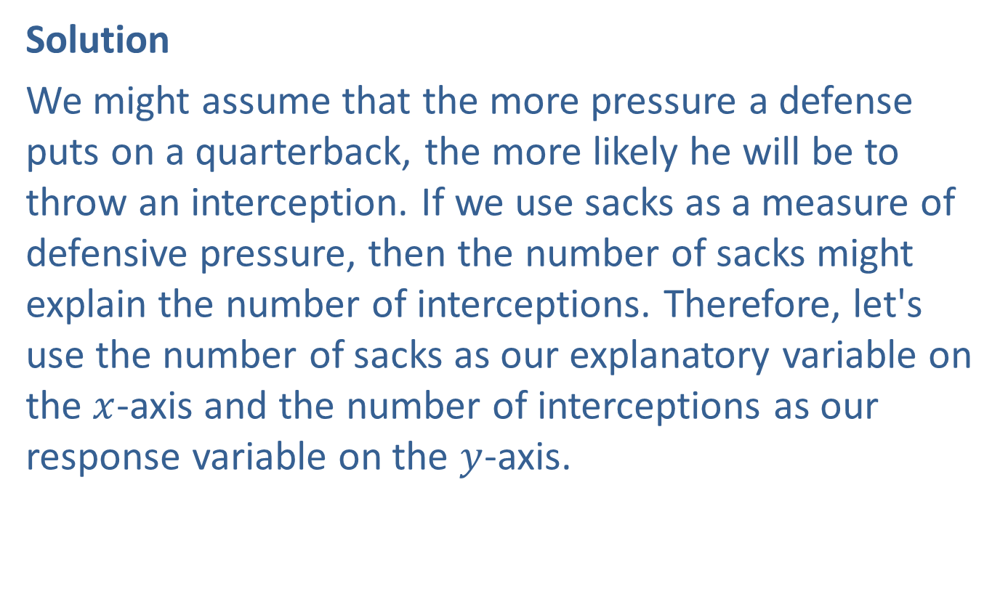
Example 12.1.1: Creating a Scatter Plot to Identify Trends in Data (cont.)
Solution
We might assume that the more pressure a defense puts on a quarterback, the more likely he will be to throw an interception. If we use sacks as a measure of defensive pressure, then the number of sacks might explain the number of interceptions. Therefore, let's use the number of sacks as our explanatory variable on the $x$-axis and the number of interceptions as our response variable on the $y$-axis.

Slide 7
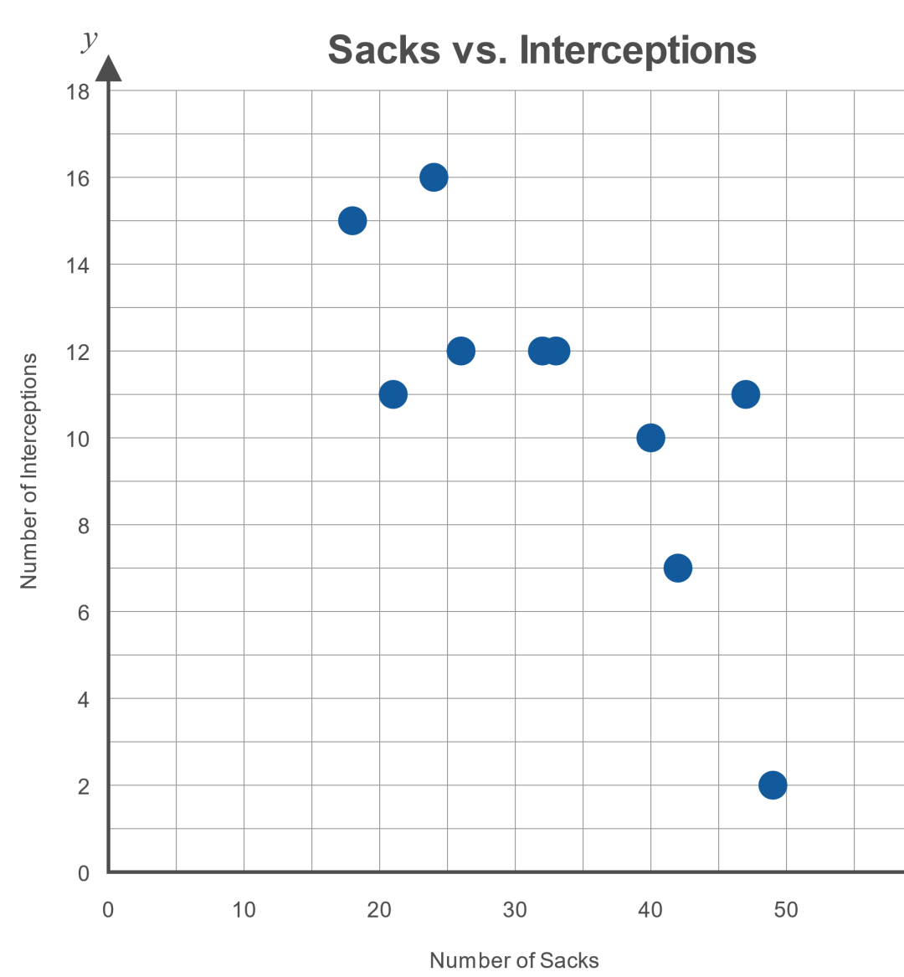
Example 12.1.1: Creating a Scatter Plot to Identify Trends in Data (cont.)

Slide 8
Example 12.1.1: Creating a Scatter Plot to Identify Trends in Data (cont.)
Notice that the points fall in a linear pattern that moves downward from left to right. This type of pattern can be described as a linear relationship with a negative slope.

Slide 9
Side Note
Statistics are used extensively in sports to describe a wide variety of aspects of the players and teams. In fact, in his article "How to predict interceptions in the NFL, backed by surprising science," Dr. Ed Feng hypothesizes that there is actually no relationship between the number of interceptions and sacks. To read more about his use of statistics to predict interceptions, and what measures actually do predict interceptions, check out his article at https://thepowerrank.com/2014/01/31/how-to-predict-interceptions-in-the-nfl-backed-by-surprising-science/.

Slide 10
Technology
For instructions on creating a scatterplot using Excel or other technologies, please visit stat.hawkeslearning.com and see
Technology Instructions > Graphs > Scatterplot.

Slide 11
Example 12.1.2: Determining Whether a Scatter Plot Would Have a Positive Slope, Negative Slope, or Not Follow a Straight-Line Pattern
Determine whether the points in a scatter plot for the two variables are likely to have a positive slope, negative slope, or not follow a straight-line pattern.
​The number of hours you study for an exam and the score you make on that exam
​The number of miles on the odometer of a used car and its price
​The pressure on a gas pedal and the speed of the car
​Shoe size and IQ for adults

Slide 12
Example 12.1.2: Determining Whether a Scatter Plot Would Have a Positive Slope, Negative Slope, or Not Follow a Straight-Line Pattern (cont.)
Solution
​As the number of hours you study for an exam increases, the score you receive on that exam is usually higher. Thus, the scatter plot would have a positive slope.
​As the number of miles on the odometer of a used car increases, the price usually decreases. Thus, the scatter plot would have a negative slope.
​The more you push on the gas pedal, the faster the car will go. Thus, the scatter plot would have a positive slope.
​Common sense suggests that there is not a relationship, linear or otherwise, between a person's IQ and his or her shoe size.

Slide 13
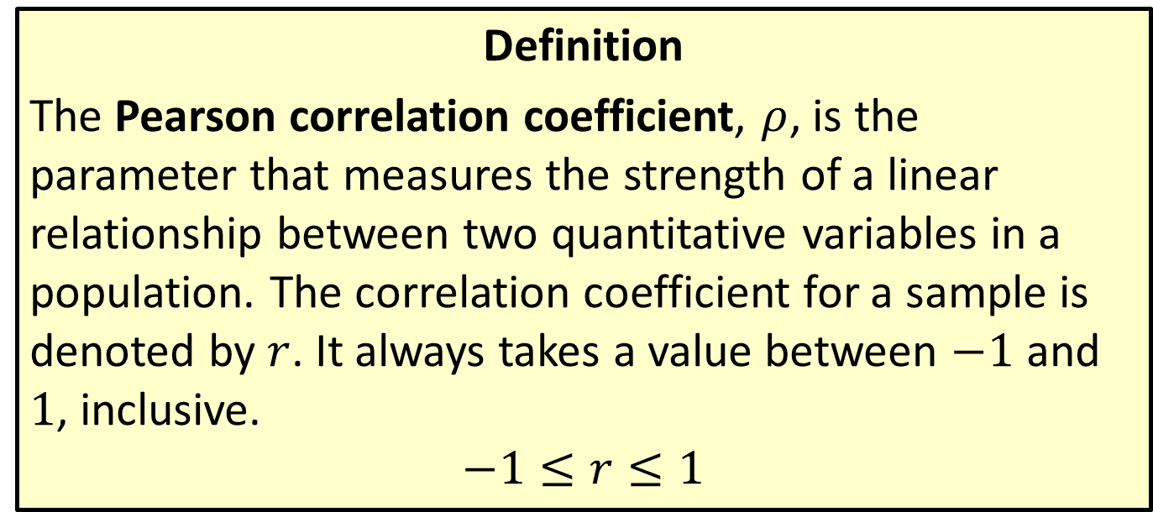
Pearson Correlation Coefficient
Definition
The Pearson correlation coefficient, $ρ$, is the parameter that measures the strength of a linear relationship between two quantitative variables in a population. The correlation coefficient for a sample is denoted by $r$. It always takes a value between $−1$ and 1, inclusive.
$$−1≤r≤1$$

Slide 14

Math Symbols
$ρ$: Pearson correlation coefficient for a population; Greek letter, rho
$r$: correlation coefficient for a sample

Slide 15
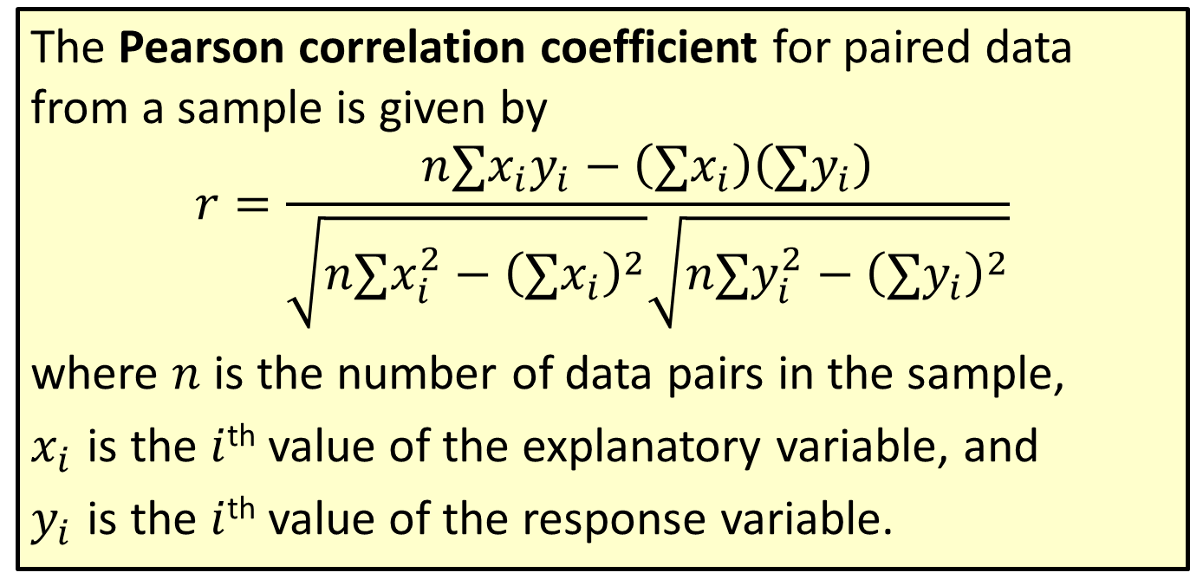
Formula: Pearson Correlation Coefficient
The Pearson correlation coefficient for paired data from a sample is given by
$$r=\frac{n∑x_{i}y_{i}−\left(∑x_{i}\right)\left(∑y_{i}\right)}{\sqrt{n∑x_{i}^{2}−{\left(∑x_{i}\right)}^{2}}\sqrt{n∑y_{i}^{2}−{\left(∑y_{i}\right)}^{2}}}$$
where $n$ is the number of data pairs in the sample,
$x_{i}$ is the $i$^{th} value of the explanatory variable, and
$y_{i}$ is the $i$^{th} value of the response variable.

Slide 16

Rounding Rule
Round the correlation coefficient, $r$, to three decimal places.

Slide 17
Example 12.1.3: Calculating the Correlation Coefficient (Using Technology)
Calculate the correlation coefficient for the data relating children's ages and heights from Table 12.1.1.

Slide 18
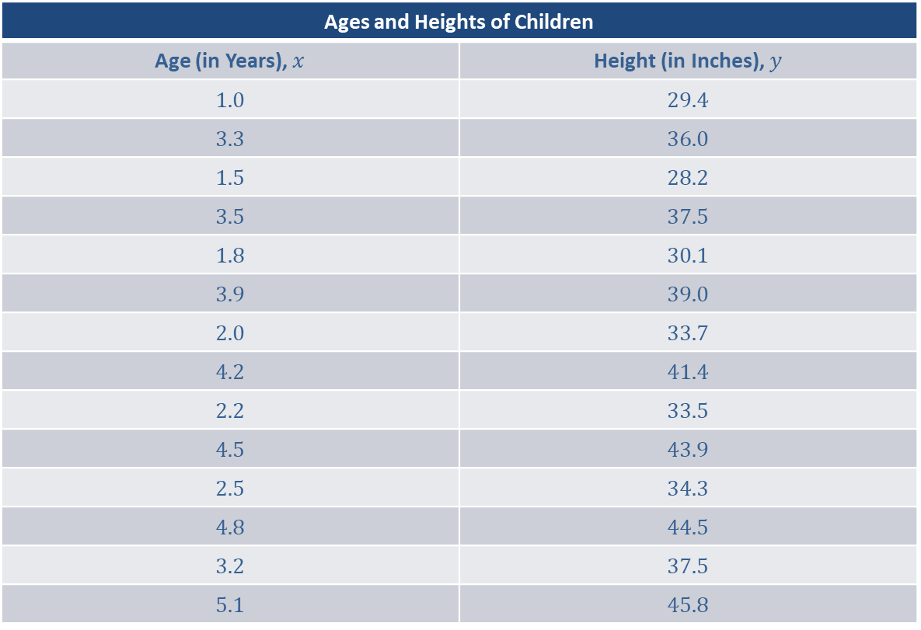
Example 12.1.3: Calculating the Correlation Coefficient (Using Technology) (cont.)
Ages and Heights of Children
Age (in Years), $x$ | Height (in Inches), $y$
1.0 | 29.4
3.3 | 36.0
1.5 | 28.2
3.5 | 37.5
1.8 | 30.1
3.9 | 39.0
2.0 | 33.7
4.2 | 41.4
2.2 | 33.5
4.5 | 43.9
2.5 | 34.3
4.8 | 44.5
3.2 | 37.5
5.1 | 45.8

Slide 19
Example 12.1.3: Calculating the Correlation Coefficient (Using Technology) (cont.)
Solution
The correlation coefficient can be calculated by hand using the formula given above, however the use of technology provides a more convenient way to perform this calculation.

Slide 20
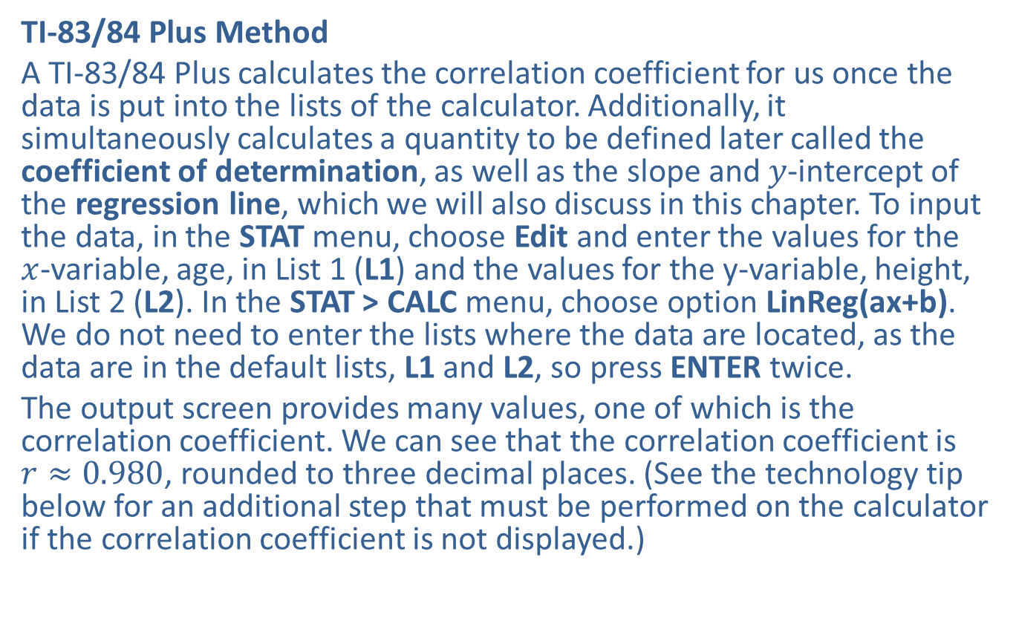
Example 12.1.3: Calculating the Correlation Coefficient (Using Technology) (cont.)
TI-83/84 Plus Method
A TI-83/84 Plus calculates the correlation coefficient for us once the data is put into the lists of the calculator. Additionally, it simultaneously calculates a quantity to be defined later called the coefficient of determination, as well as the slope and $y$-intercept of the regression line, which we will also discuss in this chapter. To input the data, in the STAT menu, choose Edit and enter the values for the $x$-variable, age, in List 1 (L1) and the values for the y-variable, height, in List 2 (L2). In the STAT > CALC menu, choose option LinReg(ax+b). We do not need to enter the lists where the data are located, as the data are in the default lists, L1 and L2, so press ENTER twice.
The output screen provides many values, one of which is the correlation coefficient. We can see that the correlation coefficient is $r≈0.980$, rounded to three decimal places. (See the technology tip below for an additional step that must be performed on the calculator if the correlation coefficient is not displayed.)

Slide 21
Technology
To ensure that the output for the function LinReg(ax+b) on a TI-83/84 Plus calculator will include the correlation coefficient and the coefficient of determination, begin by pressing 2ND and then 0, which will bring up the CATALOG. Scroll down to DiagnosticOn. Press ENTER twice. You only need to perform this step the first time that you use the function LinReg(ax+b).

Slide 22
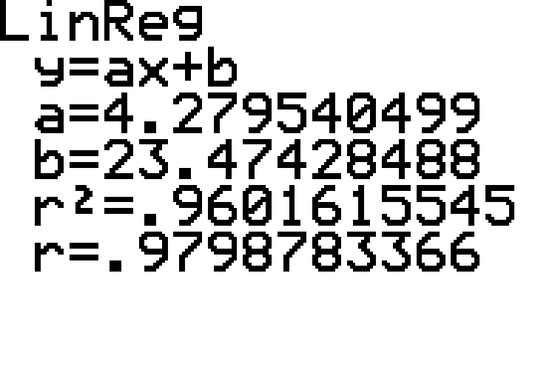
Example 12.1.3: Calculating the Correlation Coefficient (Using Technology) (cont.)

Slide 23
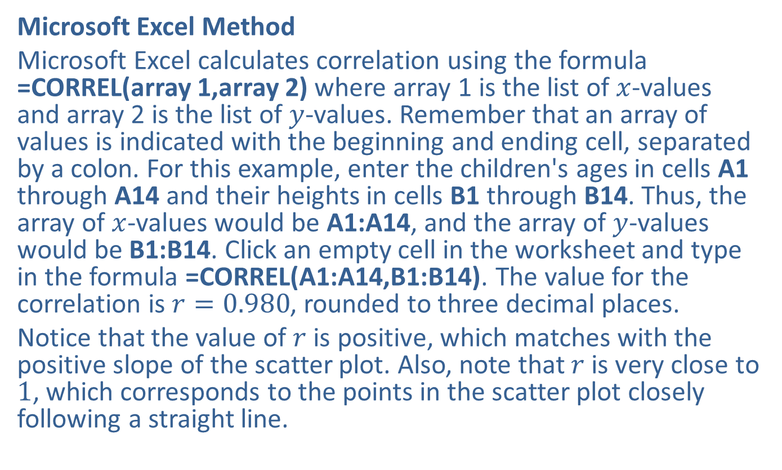
Example 12.1.3: Calculating the Correlation Coefficient (Using Technology) (cont.)
Microsoft Excel Method
Microsoft Excel calculates correlation using the formula =CORREL(array 1,array 2) where array 1 is the list of $x$-values and array 2 is the list of $y$-values. Remember that an array of values is indicated with the beginning and ending cell, separated by a colon. For this example, enter the children's ages in cells A1 through A14 and their heights in cells B1 through B14. Thus, the array of $x$-values would be A1:A14, and the array of $y$-values would be B1:B14. Click an empty cell in the worksheet and type in the formula =CORREL(A1:A14,B1:B14). The value for the correlation is $r=0.980$, rounded to three decimal places.
Notice that the value of $r$ is positive, which matches with the positive slope of the scatter plot. Also, note that $r$ is very close to 1, which corresponds to the points in the scatter plot closely following a straight line.

Slide 24
Technology
For further instructions on calculating correlation coefficients using a TI-83/84 Plus calculator or other technology, please visit stat.hawkeslearning.com and see Technology Instructions > Regression > Correlation Coefficient.

Slide 25
Example 12.1.4: Describing the Linear Relationship Between Two Variables, Graphically and Numerically
The table below provides the number of touchdown passes and the salary in millions of dollars for some of the highest-paid quarterbacks in the NFL in 2018.
​Create a scatter plot for the data regarding touchdowns and salary.
​Calculate the correlation coefficient.
​Remove the values for Patrick Mahomes and recalculate the correlation coefficient.
​How does removing this pair of values affect the value of the correlation? Why?

Slide 26
Example 12.1.4: Describing the Linear Relationship Between Two Variables, Graphically and Numerically (cont.)
NFL Quarterbacks (2018 Season)
Quarterback and Team | TD Passes | 2018 Salary (in Millions)
Patrick Mahomes, KC | 50 | 4.1064
Drew Bees, NO | 32 | 25.0000
Mitchell Trubisky, CHI | 24 | 7.2181
Ben Roethlisberger, PIT | 34 | 21.8500
Andrew Luck, IND | 39 | 24.5940
Tom Brady, NE | 29 | 15.0000
Philip Rivers, LAC | 32 | 20.8125
Jameis Winston, TB | 19 | 6.3378
Matt Ryan, ATL | 35 | 30.0000
Jared Goff, LAR | 32 | 6.9844

Slide 27
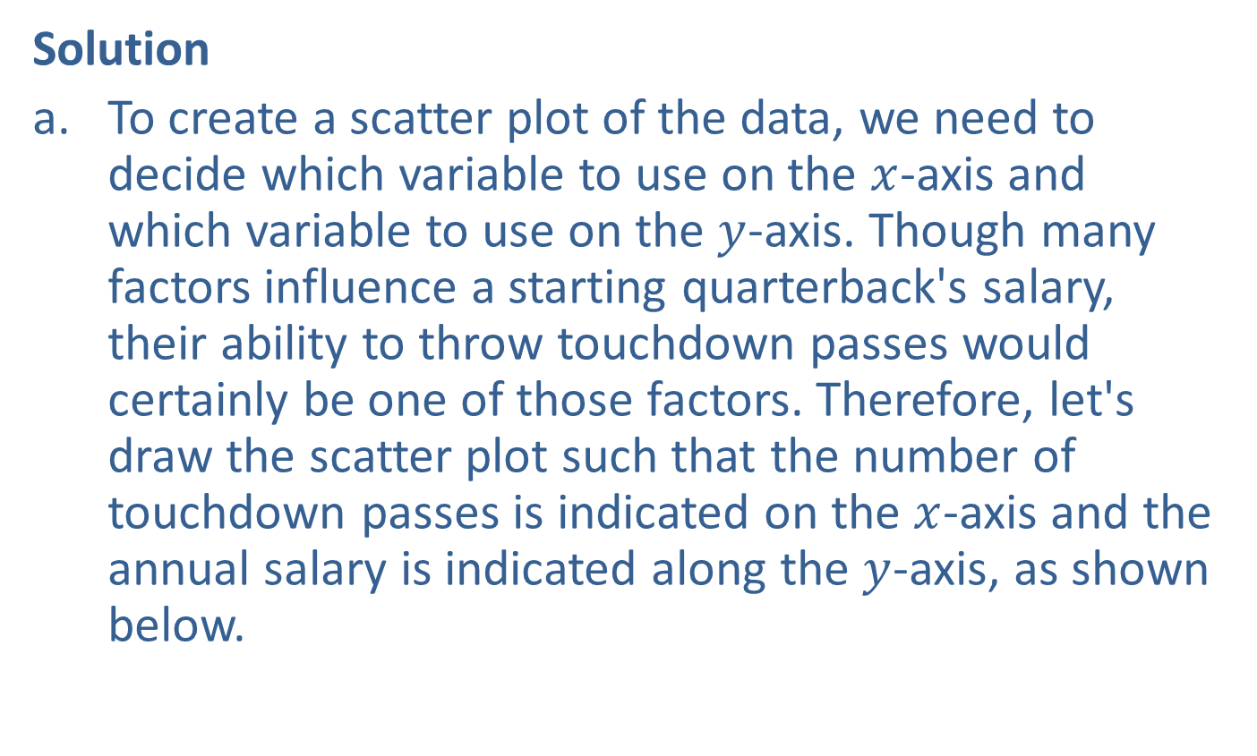
Example 12.1.4: Describing the Linear Relationship Between Two Variables, Graphically and Numerically (cont.)
Solution
​To create a scatter plot of the data, we need to decide which variable to use on the $x$-axis and which variable to use on the $y$-axis. Though many factors influence a starting quarterback's salary, their ability to throw touchdown passes would certainly be one of those factors. Therefore, let's draw the scatter plot such that the number of touchdown passes is indicated on the $x$-axis and the annual salary is indicated along the $y$-axis, as shown below.
​

Slide 28
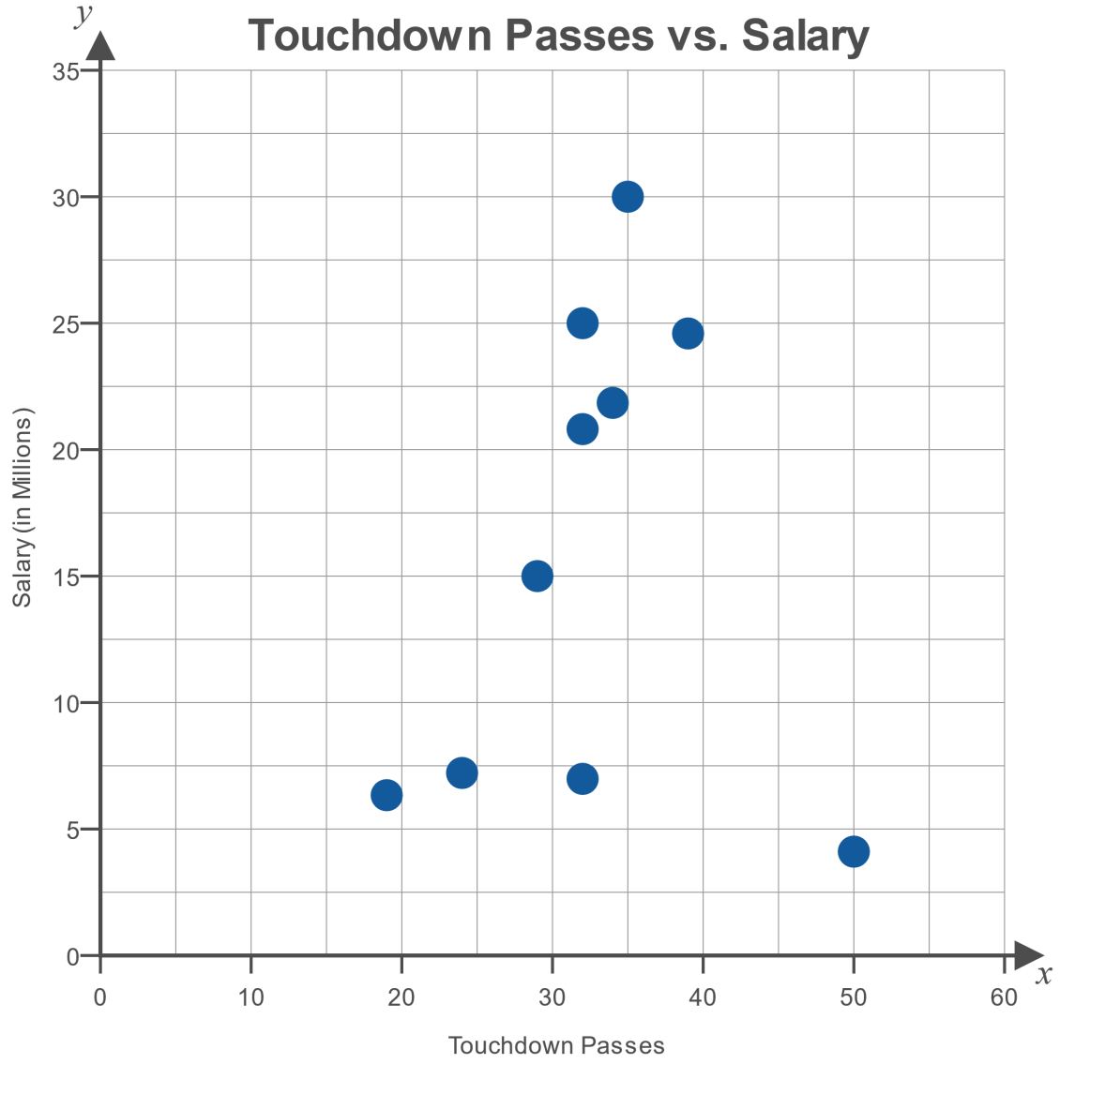
Example 12.1.4: Describing the Linear Relationship Between Two Variables, Graphically and Numerically (cont.)

Slide 29
Example 12.1.4: Describing the Linear Relationship Between Two Variables, Graphically and Numerically (cont.)
​We will use technology to calculate the correlation, as we did in the previous example.
​

Slide 30
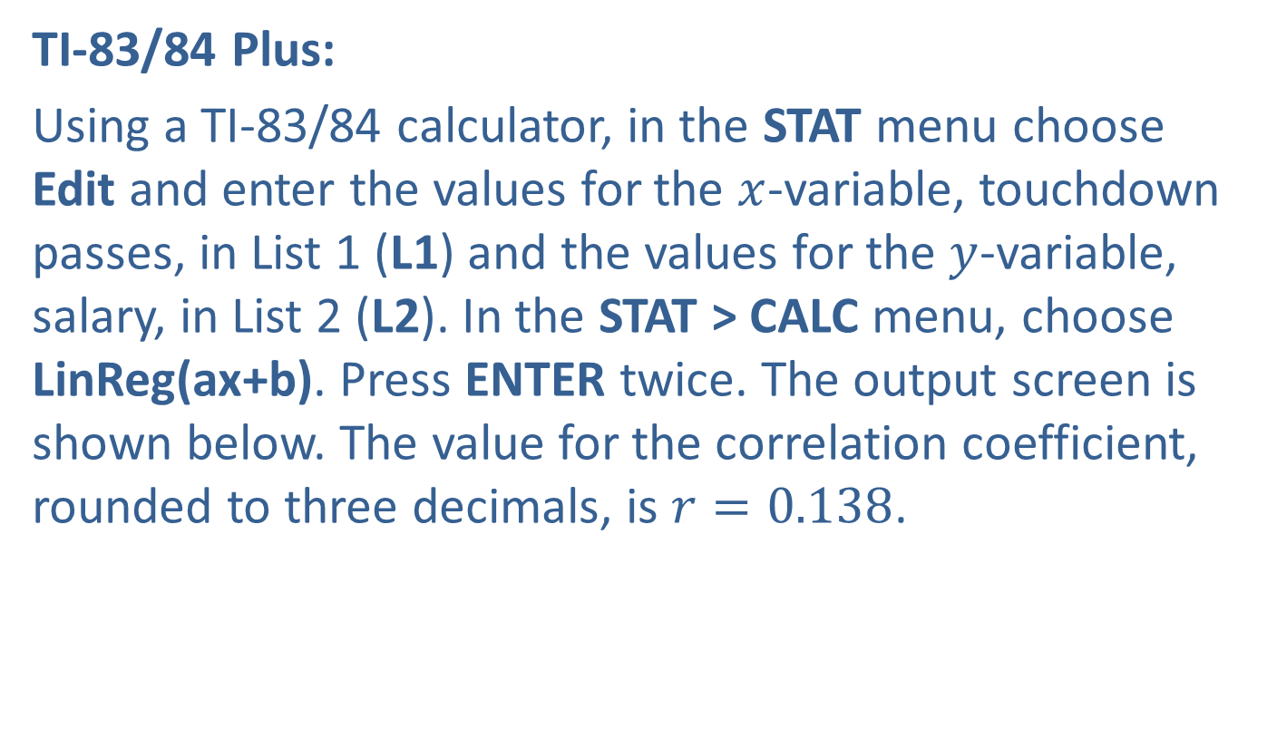
Example 12.1.4: Describing the Linear Relationship Between Two Variables, Graphically and Numerically (cont.)
​TI-83/84 Plus:
​Using a TI-83/84 calculator, in the STAT menu choose Edit and enter the values for the $x$-variable, touchdown passes, in List 1 (L1) and the values for the $y$-variable, salary, in List 2 (L2). In the STAT > CALC menu, choose LinReg(ax+b). Press ENTER twice. The output screen is shown below. The value for the correlation coefficient, rounded to three decimals, is $r=0.138$.
​

Slide 31
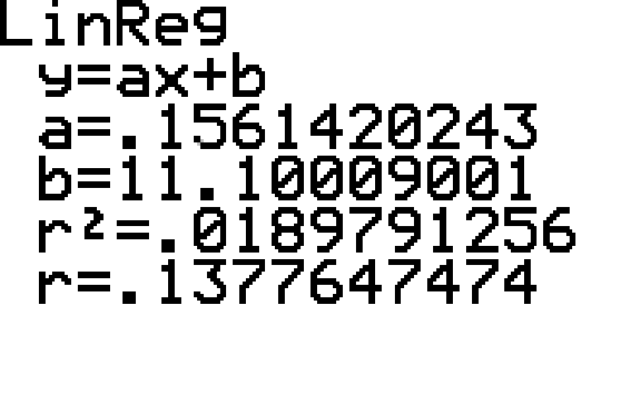
Example 12.1.4: Describing the Linear Relationship Between Two Variables, Graphically and Numerically (cont.)

Slide 32
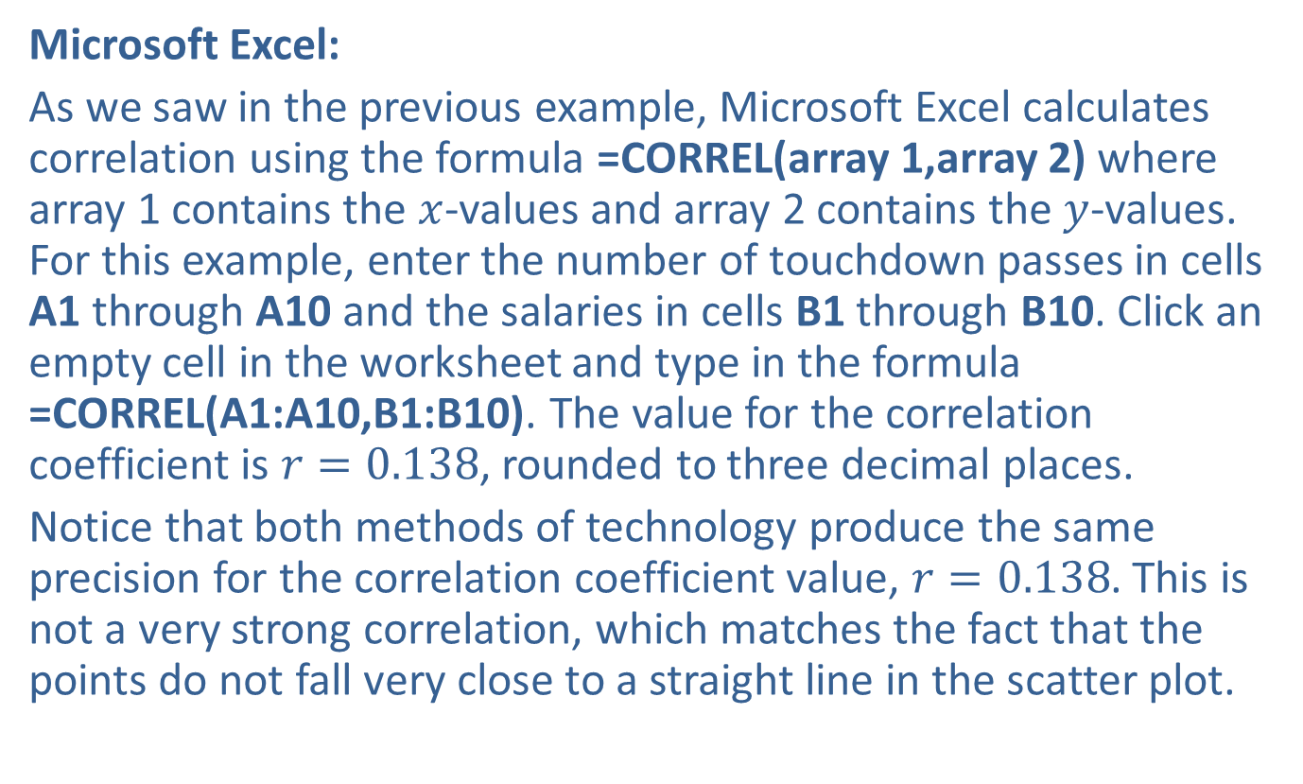
Example 12.1.4: Describing the Linear Relationship Between Two Variables, Graphically and Numerically (cont.)
​Microsoft Excel:
​As we saw in the previous example, Microsoft Excel calculates correlation using the formula =CORREL(array 1,array 2) where array 1 contains the $x$-values and array 2 contains the $y$-values. For this example, enter the number of touchdown passes in cells A1 through A10 and the salaries in cells B1 through B10. Click an empty cell in the worksheet and type in the formula =CORREL(A1:A10,B1:B10). The value for the correlation coefficient is $r=0.138$, rounded to three decimal places.
​Notice that both methods of technology produce the same precision for the correlation coefficient value, $r=0.138$. This is not a very strong correlation, which matches the fact that the points do not fall very close to a straight line in the scatter plot.

Slide 33
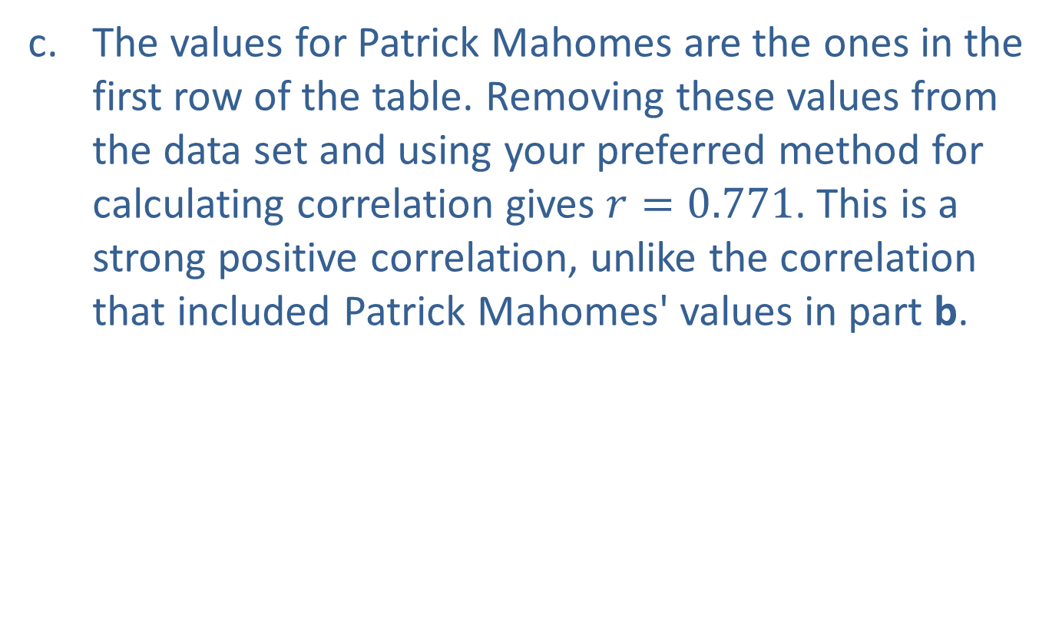
Example 12.1.4: Describing the Linear Relationship Between Two Variables, Graphically and Numerically (cont.)
​The values for Patrick Mahomes are the ones in the first row of the table. Removing these values from the data set and using your preferred method for calculating correlation gives $r=0.771$. This is a strong positive correlation, unlike the correlation that included Patrick Mahomes' values in part b.

Slide 34
Example 12.1.4: Describing the Linear Relationship Between Two Variables, Graphically and Numerically (cont.)
​By removing Patrick Mahomes' values, the correlation changes from a fairly weak positive correlation to a strong positive correlation. Why did removing one pair of data change the value of the correlation so significantly? The reason can be seen in the scatter plot. Note that Patrick Mahomes' salary is the smallest salary in the list and that he threw for more touchdowns than anyone else in the list. Thus, his pair of values can be seen in the scatter plot as the point in the bottom right of the graph. This point is an outlier in the data set, as it does not fall in line with the other points in the graph. If you look only at the other data values in the graph, you can see that they form a linear pattern that is fairly close to a straight line, and thus would have a strong correlation.

Slide 35

Determining Statistical Significance for the Pearson Correlation Coefficient
Definition
A sample correlation coefficient, $r$, is statistically significant if $|r|≥r_{α}$.

Slide 36
Example 12.1.5: Using a Table of Critical Values to Determine Significance of a Linear Relationship
Use the critical values in the Pearson Correlation Coefficient table to determine if the correlation between the number of passing touchdowns and base salary from a previous example is statistically significant using a 0.05 level of significance:
​Using the values of all 10 quarterbacks
​Excluding Patrick Mahomes' values

Slide 37

Example 12.1.5: Using a Table of Critical Values to Determine Significance of a Linear Relationship (cont.)
Solution
​Begin by finding the critical value for $α=0.05$ with $n=10$ in the Pearson Correlation Coefficient table. The critical value is found where the row for $n=10$ intersects the column for $α=0.05$.
​

Slide 38
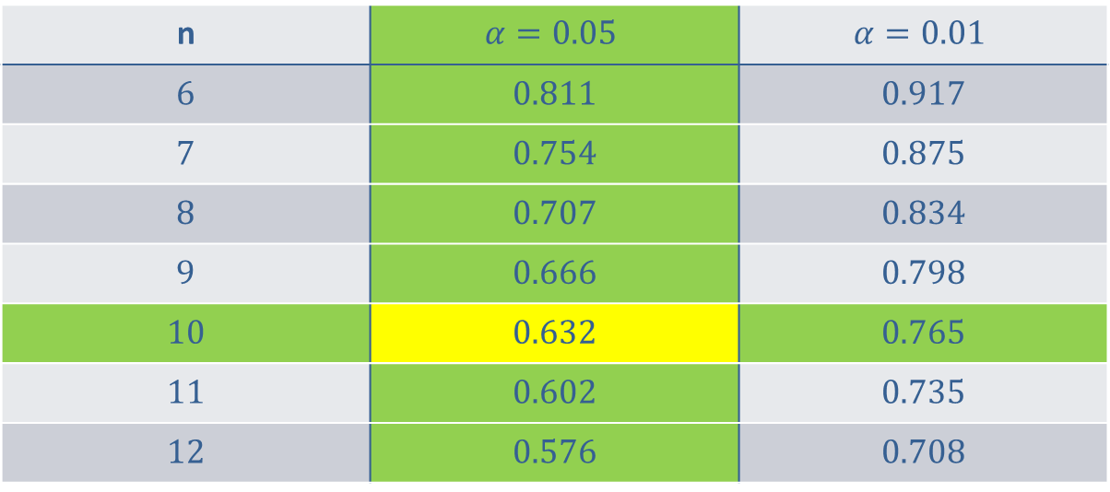
Example 12.1.5: Using a Table of Critical Values to Determine Significance of a Linear Relationship (cont.)
n | $$α=0.05$$ | $$α=0.01$$
6 | 0.811 | 0.917
7 | 0.754 | 0.875
8 | 0.707 | 0.834
9 | 0.666 | 0.798
10 | 0.632 | 0.765
11 | 0.602 | 0.735
12 | 0.576 | 0.708

Slide 39
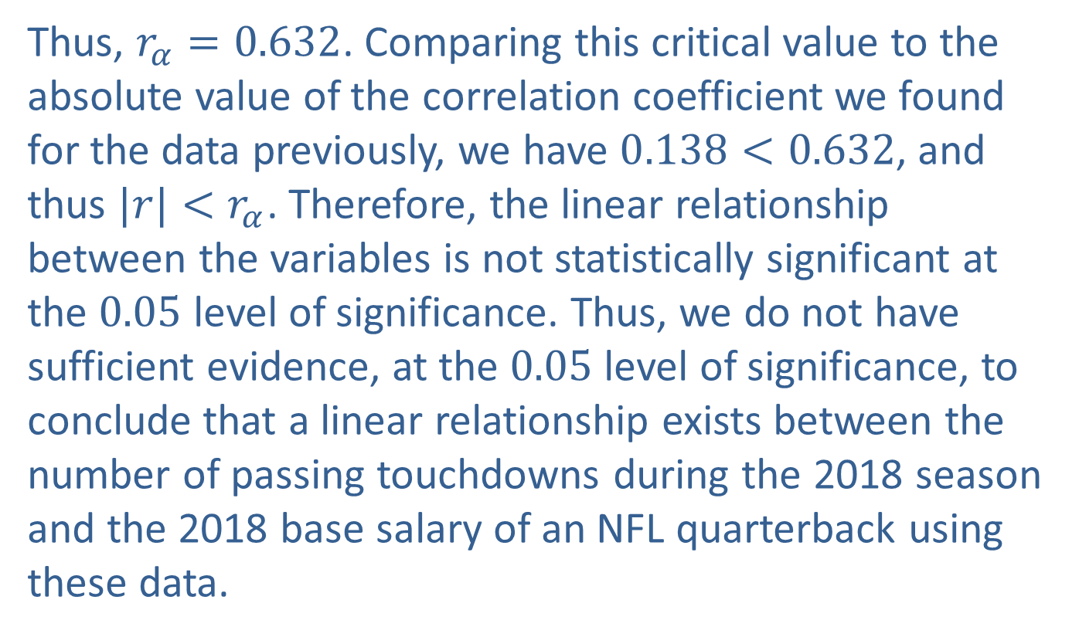
Example 12.1.5: Using a Table of Critical Values to Determine Significance of a Linear Relationship (cont.)
​Thus, $r_{α}=0.632$. Comparing this critical value to the absolute value of the correlation coefficient we found for the data previously, we have $0.138<0.632$, and thus $|r|<r_{α}$. Therefore, the linear relationship between the variables is not statistically significant at the 0.05 level of significance. Thus, we do not have sufficient evidence, at the 0.05 level of significance, to conclude that a linear relationship exists between the number of passing touchdowns during the 2018 season and the 2018 base salary of an NFL quarterback using these data.

Slide 40
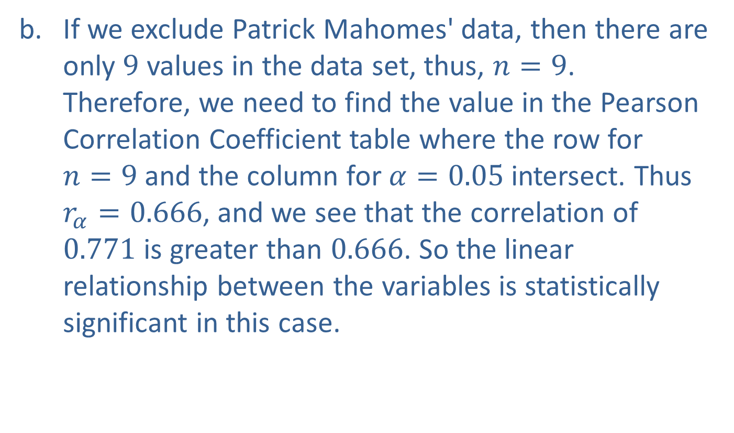
Example 12.1.5: Using a Table of Critical Values to Determine Significance of a Linear Relationship (cont.)
​If we exclude Patrick Mahomes' data, then there are only 9 values in the data set, thus, $n=9$. Therefore, we need to find the value in the Pearson Correlation Coefficient table where the row for $n=9$ and the column for $α=0.05$ intersect. Thus $r_{α}=0.666$, and we see that the correlation of 0.771 is greater than 0.666. So the linear relationship between the variables is statistically significant in this case.

Slide 41
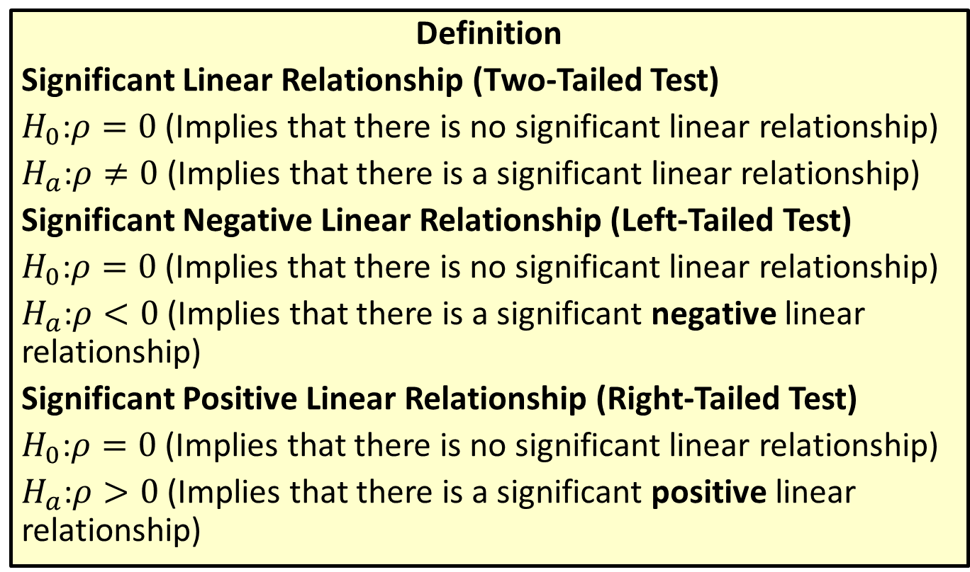
Testing Linear Relationships for Significance
Definition
Significant Linear Relationship (Two-Tailed Test)
$H_{0}\text{:}ρ=0$ (Implies that there is no significant linear relationship)
$H_{a}\text{:}ρ≠0$ (Implies that there is a significant linear relationship)
Significant Negative Linear Relationship (Left-Tailed Test)
$H_{0}\text{:}ρ=0$ (Implies that there is no significant linear relationship)
$H_{a}\text{:}ρ<0$ (Implies that there is a significant negative linear relationship)
Significant Positive Linear Relationship (Right-Tailed Test)
$H_{0}\text{:}ρ=0$ (Implies that there is no significant linear relationship)
$H_{a}\text{:}ρ>0$ (Implies that there is a significant positive linear relationship)

Slide 42
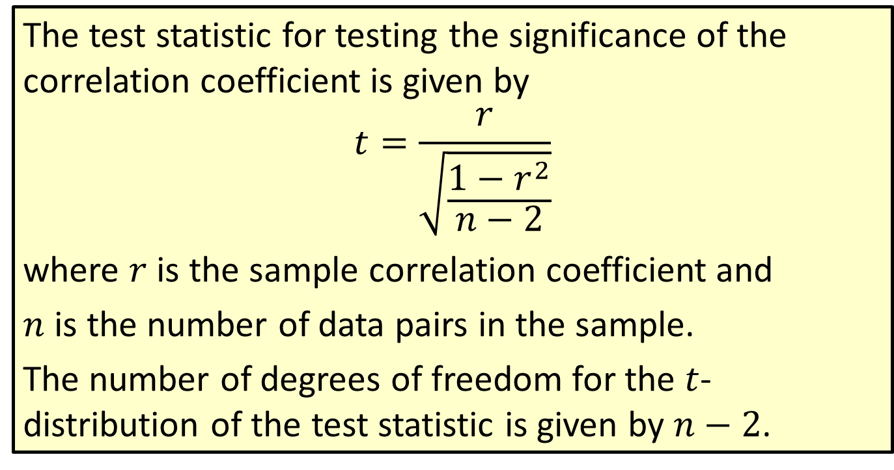
Formula: Test Statistic for a Hypothesis Test for a Correlation Coefficient
The test statistic for testing the significance of the correlation coefficient is given by
$$t=\frac{r}{\sqrt{\frac{1−r^{2}}{n−2}}}$$
where $r$ is the sample correlation coefficient and
$n$ is the number of data pairs in the sample.
The number of degrees of freedom for the $t$-distribution of the test statistic is given by $n−2$.

Slide 43
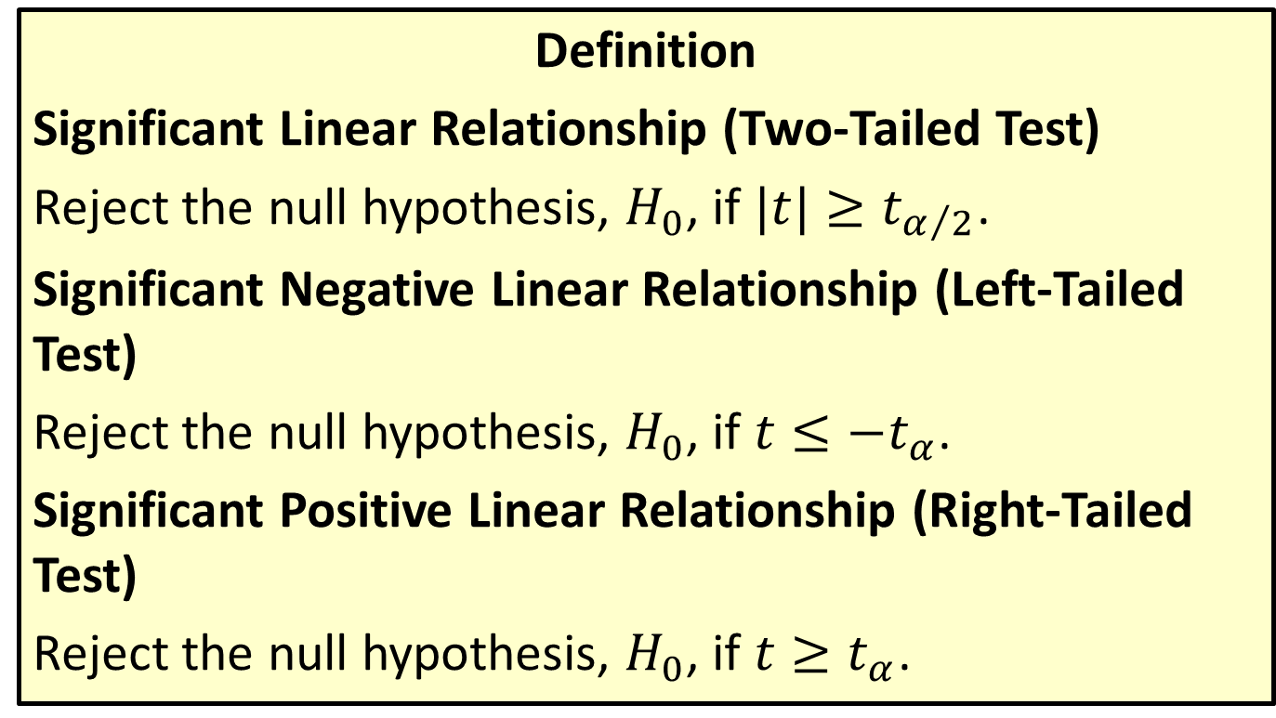
Rejection Regions for Testing Linear Relationships
Definition
Significant Linear Relationship (Two-Tailed Test)
Reject the null hypothesis, $H_{0}$, if $|t|≥t_{α/2}$.
Significant Negative Linear Relationship (Left-Tailed Test)
Reject the null hypothesis, $H_{0}$, if $t≤−t_{α}$.
Significant Positive Linear Relationship (Right-Tailed Test)
Reject the null hypothesis, $H_{0}$, if $t≥t_{α}$.

Slide 44
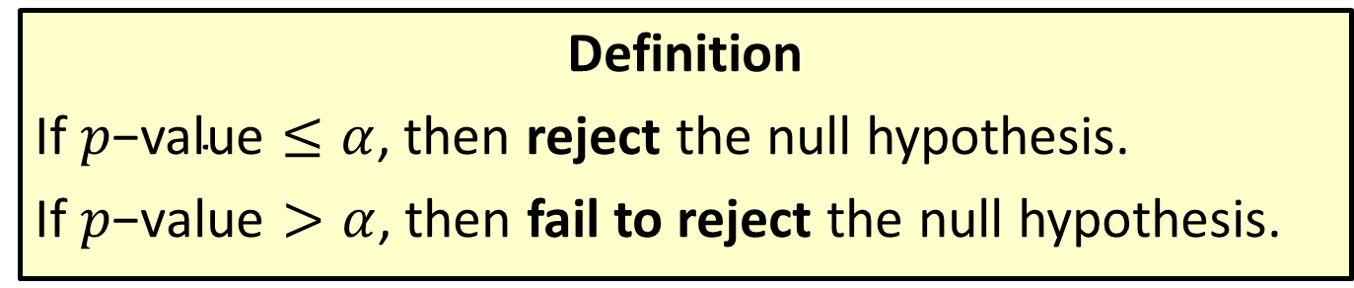

Conclusions Using $p$-Values
Definition
If $p\text{−}\text{value}≤α$, then reject the null hypothesis.
If $p\text{−}\text{value}>α$, then fail to reject the null hypothesis.

Slide 45
Example 12.1.6: Hypothesis Test to Determine if the Linear Relationship between Two Variables Is Significant
Use a hypothesis test to determine if the linear relationship between the number of parking tickets a student receives during a semester and the student's GPA during the same semester is statistically significant at the 0.05 level of significance. Refer to the data presented in the following table.

Slide 46
Example 12.1.6: Hypothesis Test to Determine if the Linear Relationship between Two Variables Is Significant (cont.)
GPA and Number of Parking Tickets
Number of Tickets | 0 | 0 | 0 | 0 | 1 | 1 | 1 | 2 | 2 | 2 | 3 | 3 | 5 | 7 | 8
GPA | 3.6 | 3.9 | 2.4 | 3.1 | 3.5 | 4.0 | 3.6 | 2.8 | 3.0 | 2.2 | 3.9 | 3.1 | 2.1 | 2.8 | 1.7

Slide 47
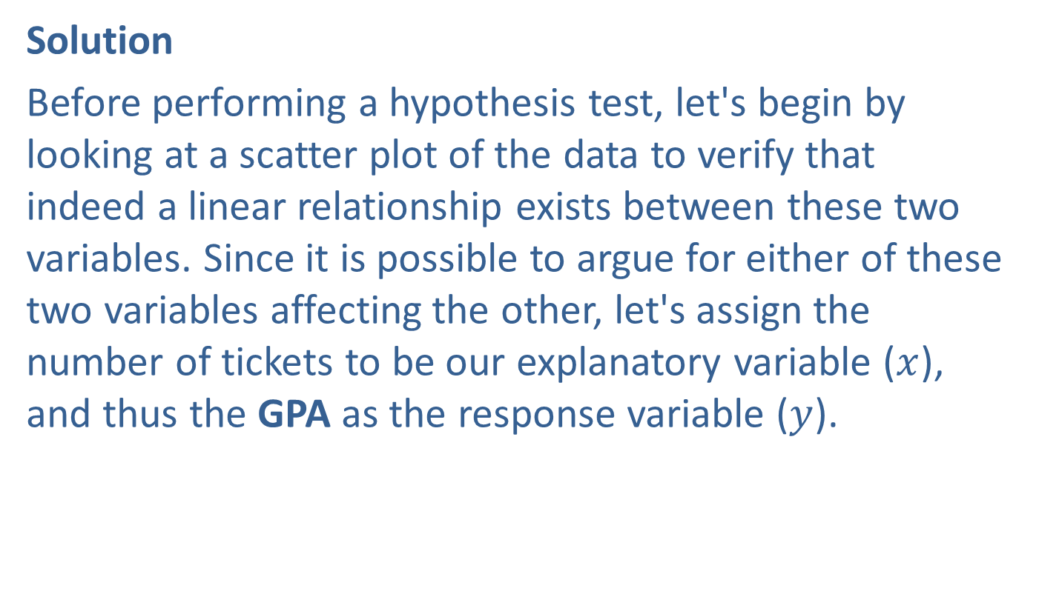
Example 12.1.6: Hypothesis Test to Determine if the Linear Relationship between Two Variables Is Significant (cont.)
Solution
Before performing a hypothesis test, let's begin by looking at a scatter plot of the data to verify that indeed a linear relationship exists between these two variables. Since it is possible to argue for either of these two variables affecting the other, let's assign the number of tickets to be our explanatory variable ($x$), and thus the GPA as the response variable ($y$).

Slide 48
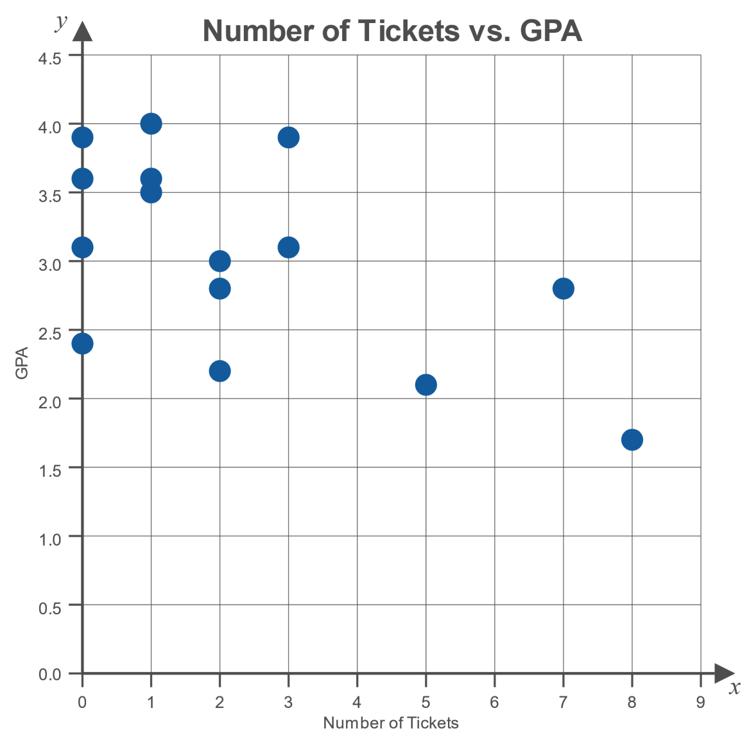
Example 12.1.6: Hypothesis Test to Determine if the Linear Relationship between Two Variables Is Significant (cont.)

Slide 49
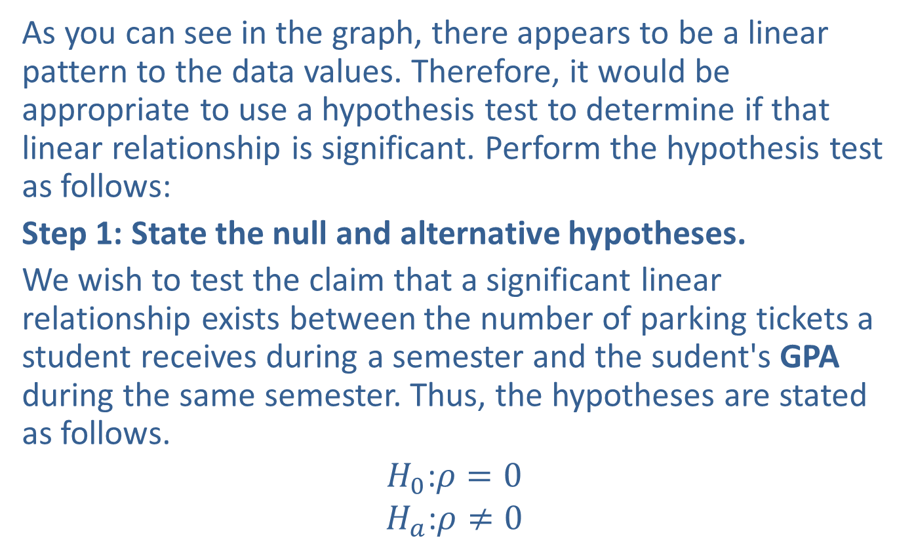
Example 12.1.6: Hypothesis Test to Determine if the Linear Relationship between Two Variables Is Significant (cont.)
As you can see in the graph, there appears to be a linear pattern to the data values. Therefore, it would be appropriate to use a hypothesis test to determine if that linear relationship is significant. Perform the hypothesis test as follows:
Step 1: State the null and alternative hypotheses.
We wish to test the claim that a significant linear relationship exists between the number of parking tickets a student receives during a semester and the sudent's GPA during the same semester. Thus, the hypotheses are stated as follows.
$$H_{0}\text{:}ρ=0$$
$$H_{a}\text{:}ρ≠0$$

Slide 50

Example 12.1.6: Hypothesis Test to Determine if the Linear Relationship between Two Variables Is Significant (cont.)
Step 2: Determine which distribution to use for the test statistic, and state the level of significance.
We will use the $t$-test statistic presented previously in this section along with a significance level of $α=0.05$ to perform this hypothesis test.

Slide 51
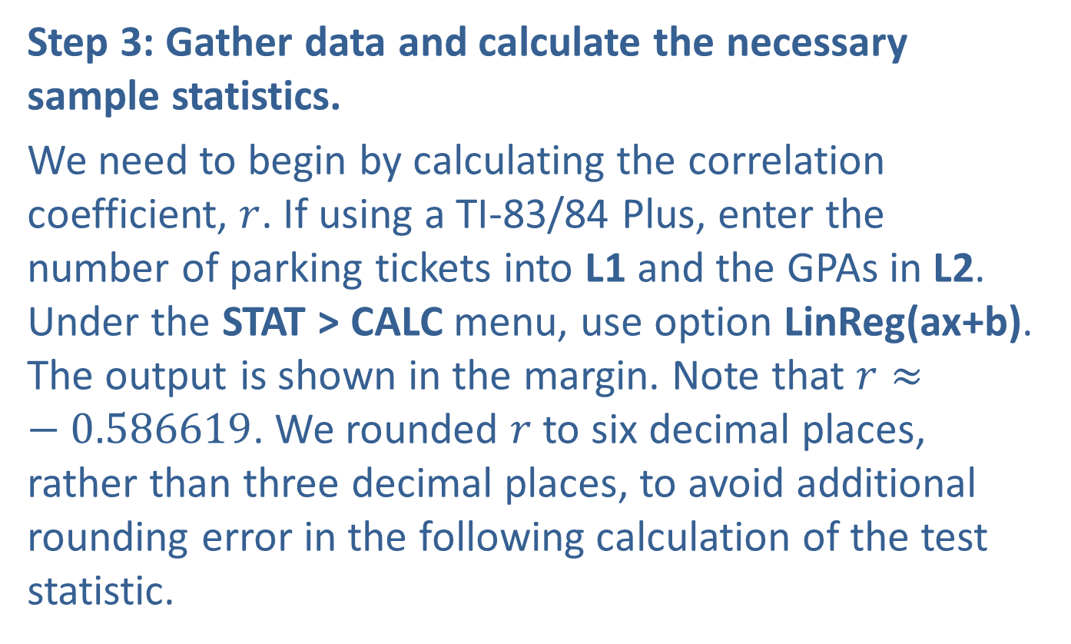
Example 12.1.6: Hypothesis Test to Determine if the Linear Relationship between Two Variables Is Significant (cont.)
Step 3: Gather data and calculate the necessary sample statistics.
We need to begin by calculating the correlation coefficient, $r$. If using a TI-83/84 Plus, enter the number of parking tickets into L1 and the GPAs in L2. Under the STAT > CALC menu, use option LinReg(ax+b). The output is shown in the margin. Note that $r≈−0.586619$. We rounded $r$ to six decimal places, rather than three decimal places, to avoid additional rounding error in the following calculation of the test statistic.

Slide 52
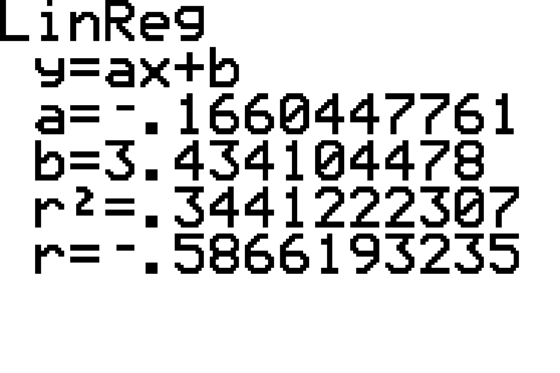
Example 12.1.6: Hypothesis Test to Determine if the Linear Relationship between Two Variables Is Significant (cont.)

Slide 53
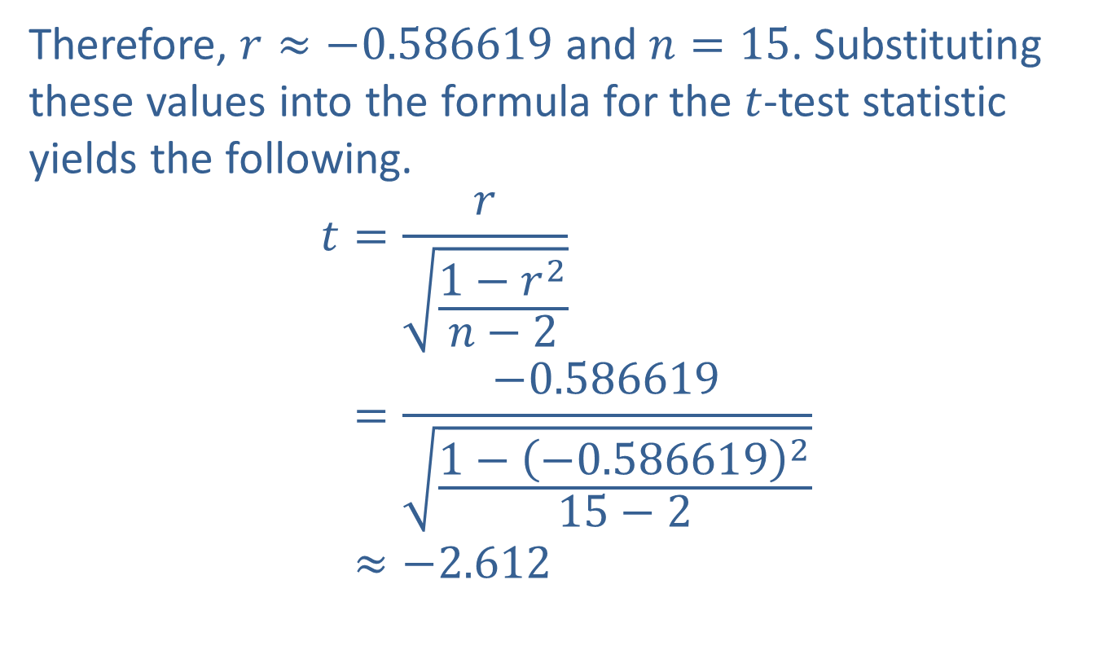
Example 12.1.6: Hypothesis Test to Determine if the Linear Relationship between Two Variables Is Significant (cont.)
Therefore, $r≈−0.586619$ and $n=15$. Substituting these values into the formula for the $t$-test statistic yields the following.
𝑡=𝑟1−𝑟2𝑛−2𝑡=−0.5866191−−0.586619215−2𝑡≈−2.612

Slide 54
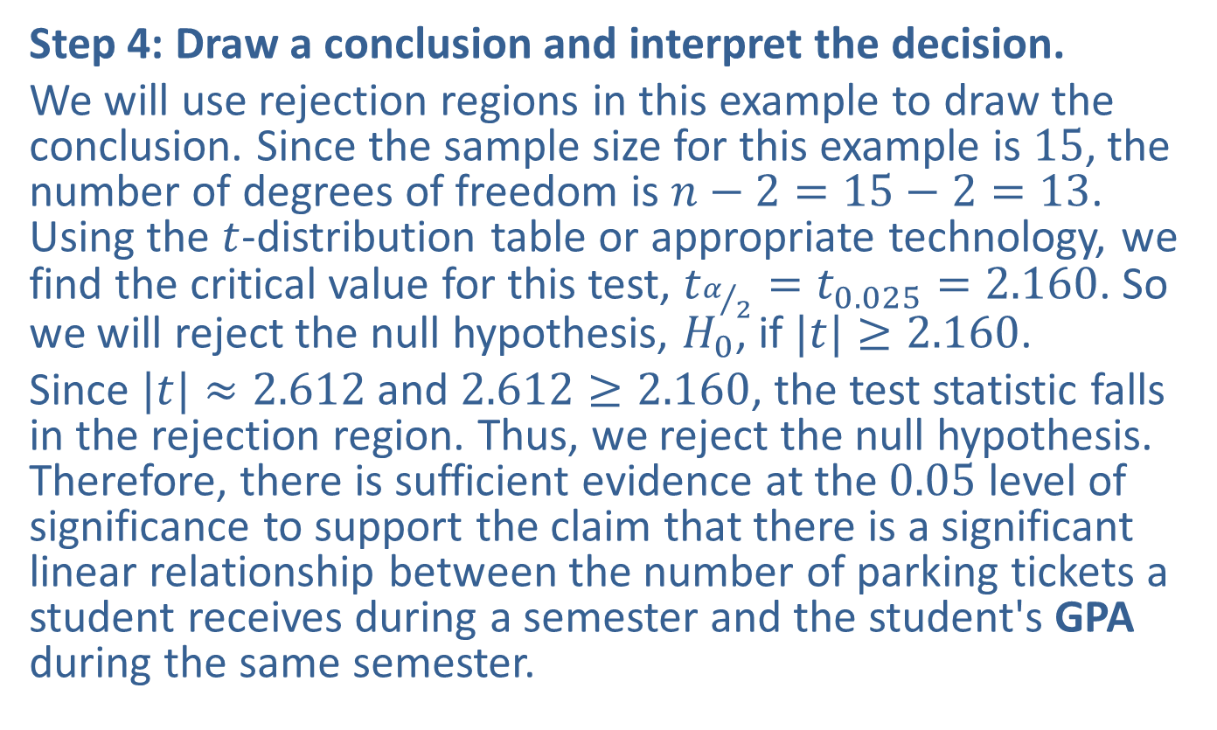
Example 12.1.6: Hypothesis Test to Determine if the Linear Relationship between Two Variables Is Significant (cont.)
Step 4: Draw a conclusion and interpret the decision.
We will use rejection regions in this example to draw the conclusion. Since the sample size for this example is 15, the number of degrees of freedom is $n−2=15−2=13$. Using the $t$-distribution table or appropriate technology, we find the critical value for this test, $t_{α/2}=t_{0.025}=2.160$. So we will reject the null hypothesis, $H_{0}$, if $|t|≥2.160$.
Since $|t|≈2.612$ and $2.612≥2.160$, the test statistic falls in the rejection region. Thus, we reject the null hypothesis. Therefore, there is sufficient evidence at the 0.05 level of significance to support the claim that there is a significant linear relationship between the number of parking tickets a student receives during a semester and the student's GPA during the same semester.

Slide 55
Note
Do you think it is always true that there is a linear relationship between a student’s GPA in a semester and the number of parking tickets the student receives in that semester? Would you ever say that a cause‑and-effect relationship exists between the variables? Is it possible that a third factor is influencing both GPA and the number of parking tickets received? Is this sample necessarily representative of the entire population? It is always important to ask questions such as these when considering whether a linear relationship between two variables is statistically significant.

Slide 56
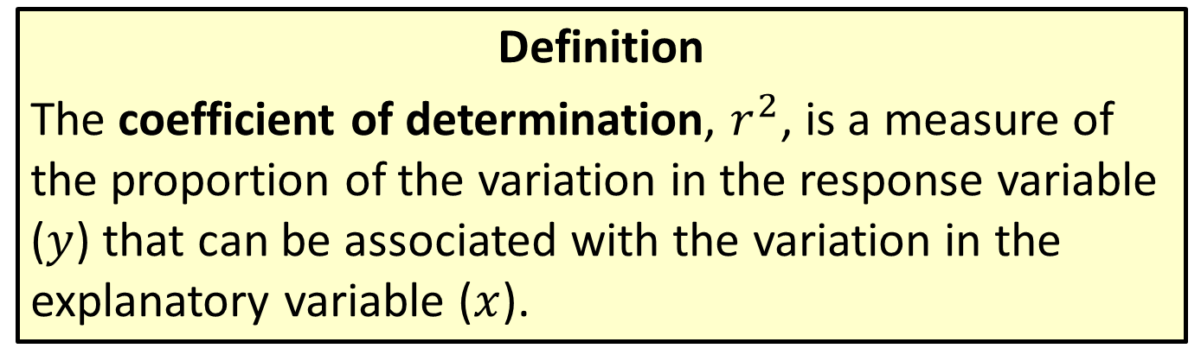
Coefficient Of Determination
Definition
The coefficient of determination, $r^{2}$, is a measure of the proportion of the variation in the response variable ($y$) that can be associated with the variation in the explanatory variable ($x$).

Slide 57
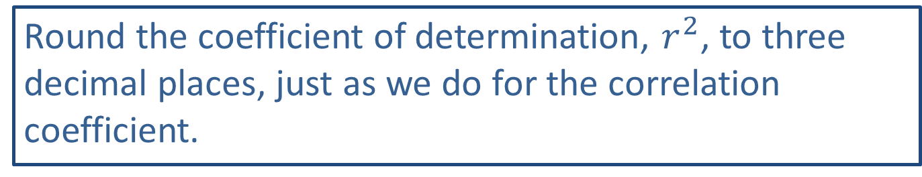
Rounding Rule
Round the coefficient of determination, $r^{2}$, to three decimal places, just as we do for the correlation coefficient.

Slide 58
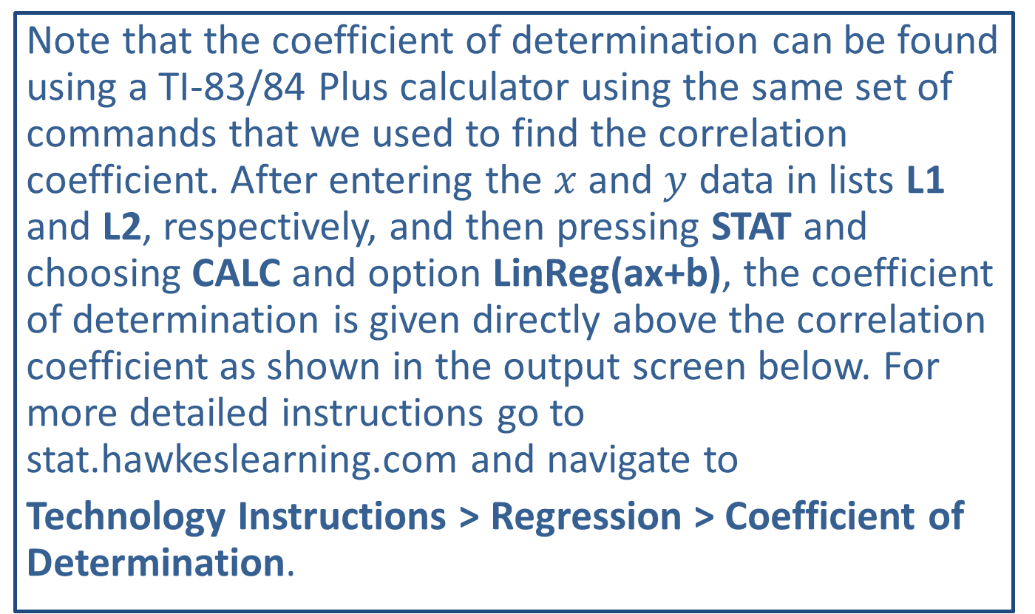
Technology
Note that the coefficient of determination can be found using a TI-83/84 Plus calculator using the same set of commands that we used to find the correlation coefficient. After entering the $x$ and $y$ data in lists L1 and L2, respectively, and then pressing STAT and choosing CALC and option LinReg(ax+b), the coefficient of determination is given directly above the correlation coefficient as shown in the output screen below. For more detailed instructions go to stat.hawkeslearning.com and navigate to
Technology Instructions > Regression > Coefficient of Determination.

Slide 59
Technology

Slide 60
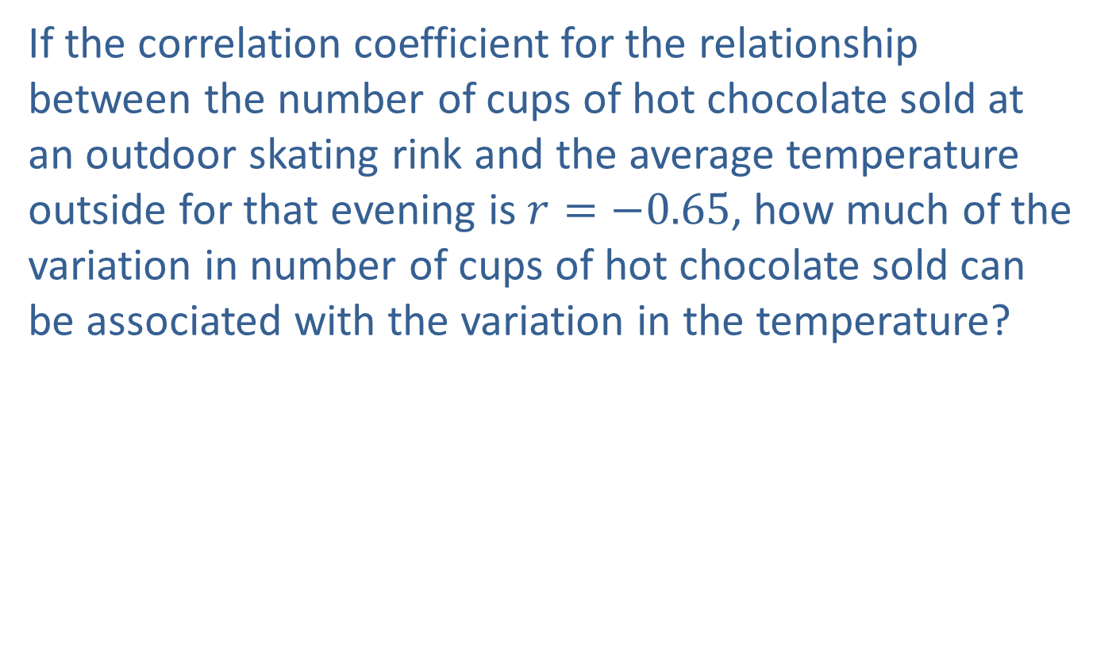
Example 12.1.7: Calculating and Interpreting the Coefficient of Determination
If the correlation coefficient for the relationship between the number of cups of hot chocolate sold at an outdoor skating rink and the average temperature outside for that evening is $r=−0.65$, how much of the variation in number of cups of hot chocolate sold can be associated with the variation in the temperature?

Slide 61
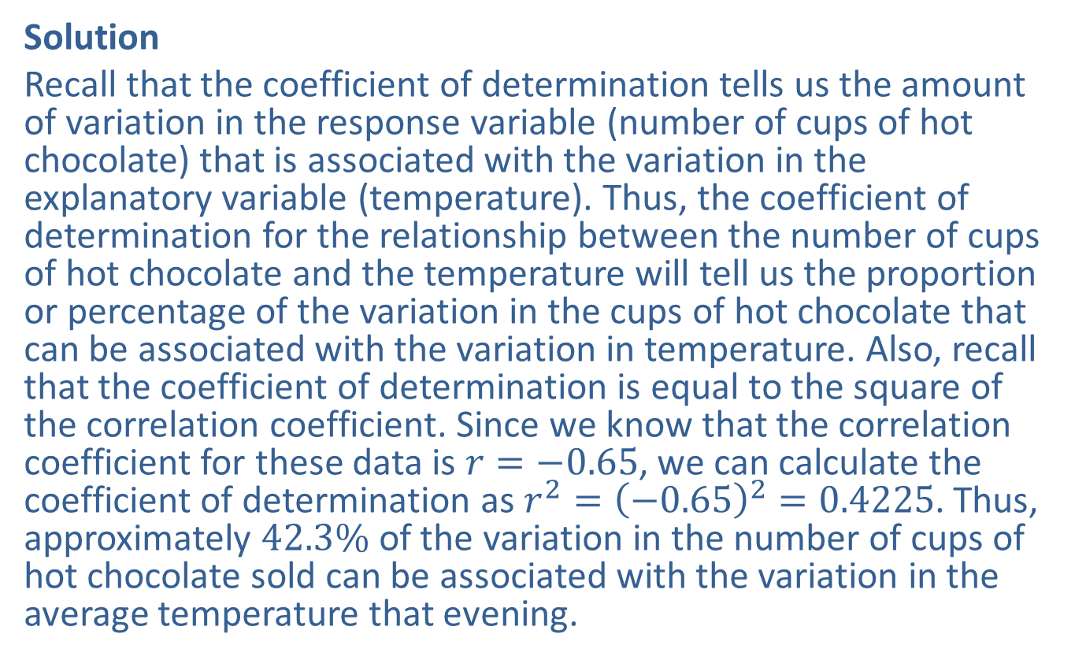
Example 12.1.7: Calculating and Interpreting the Coefficient of Determination (cont.)
Solution
Recall that the coefficient of determination tells us the amount of variation in the response variable (number of cups of hot chocolate) that is associated with the variation in the explanatory variable (temperature). Thus, the coefficient of determination for the relationship between the number of cups of hot chocolate and the temperature will tell us the proportion or percentage of the variation in the cups of hot chocolate that can be associated with the variation in temperature. Also, recall that the coefficient of determination is equal to the square of the correlation coefficient. Since we know that the correlation coefficient for these data is $r=−0.65$, we can calculate the coefficient of determination as $r^{2}={\left(−0.65\right)}^{2}=0.4225$. Thus, approximately $42.3\%$ of the variation in the number of cups of hot chocolate sold can be associated with the variation in the average temperature that evening.

