Slide 1
Section 12.2
Linear Regression

Slide 2
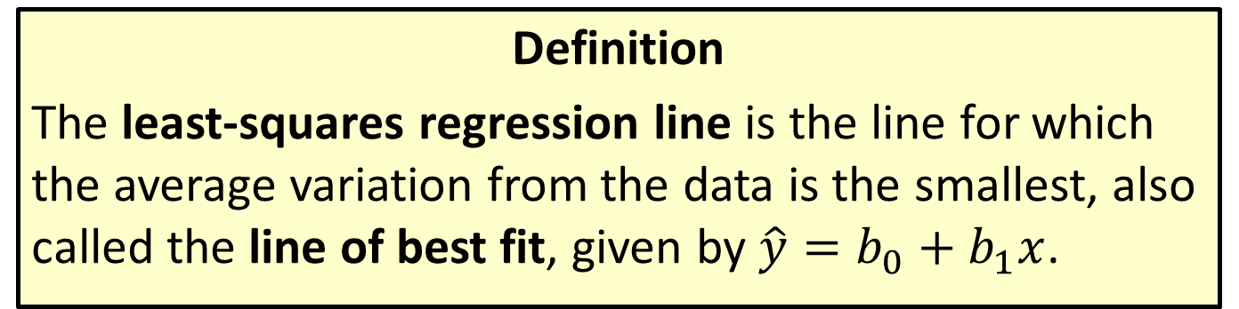
Least-Squares Regression Line
Definition
The least-squares regression line is the line for which the average variation from the data is the smallest, also called the line of best fit, given by $\hat{y}=b_{0}+b_{1}x$.

Slide 3
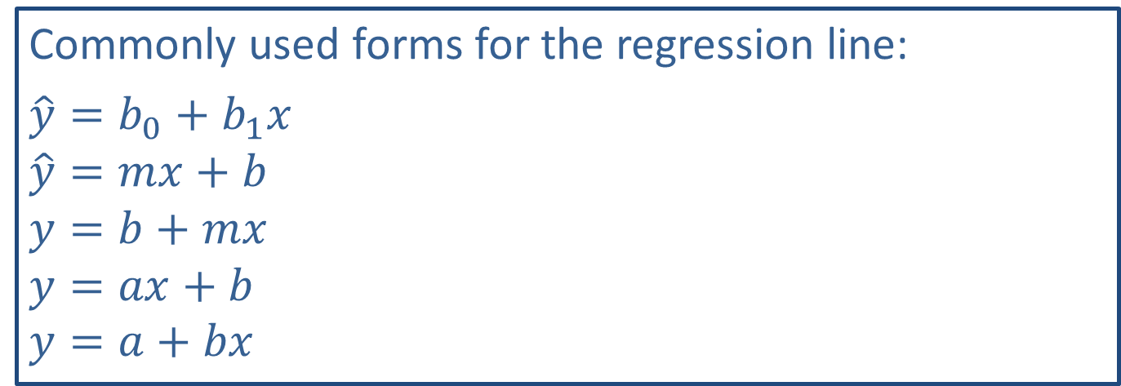
Math Symbols
Commonly used forms for the regression line:
$\hat{y}=b_{0}+b_{1}x$
$\hat{y}=mx+b$
$y=b+mx$
$y=ax+b$
$y=a+bx$

Slide 4
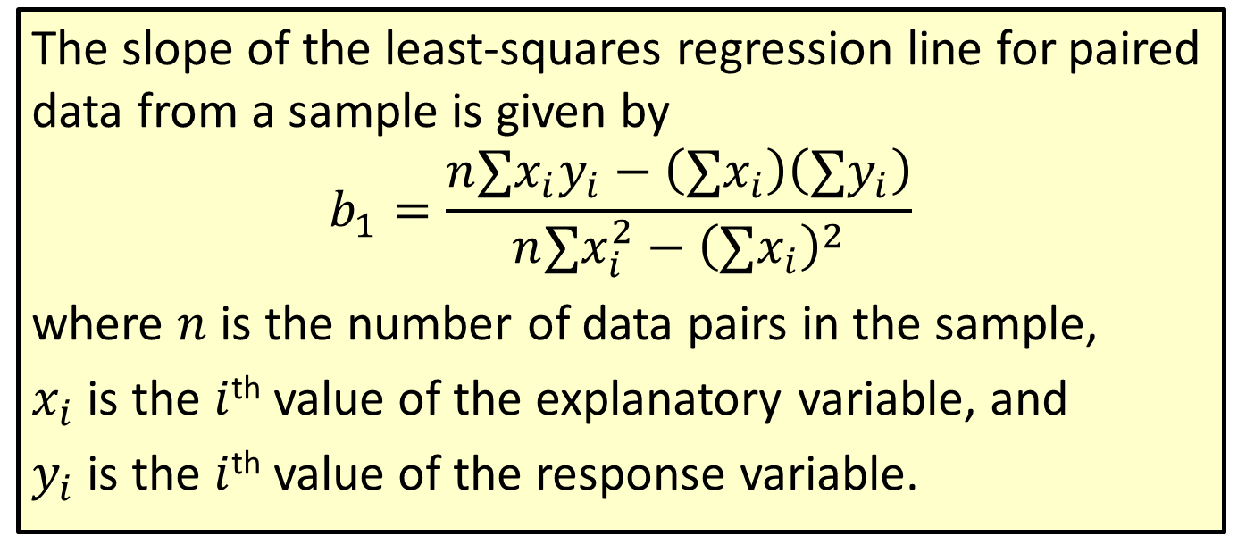
Formula: Slope of the Least-Squares Regression Line
The slope of the least-squares regression line for paired data from a sample is given by
$$b_{1}=\frac{n∑x_{i}y_{i}−\left(∑x_{i}\right)\left(∑y_{i}\right)}{n∑x_{i}^{2}−{\left(∑x_{i}\right)}^{2}}$$
where $n$ is the number of data pairs in the sample,
$x_{i}$ is the $i$^{th} value of the explanatory variable, and
$y_{i}$ is the $i$^{th} value of the response variable.

Slide 5
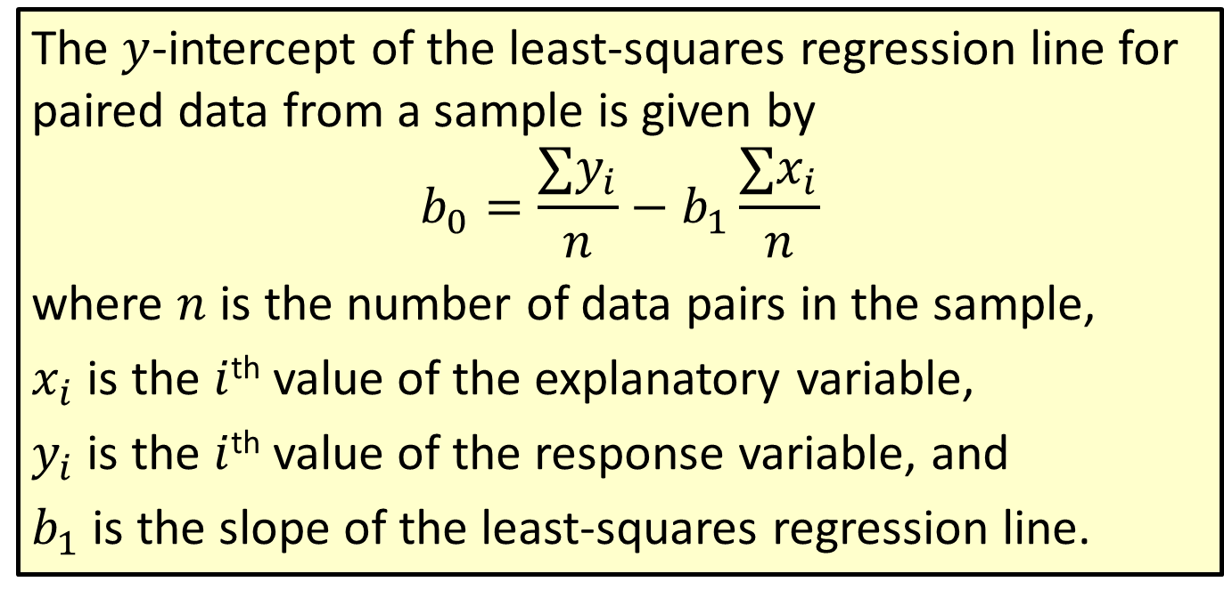

Formula: $y$-Intercept of the Least-Squares Regression Line
The $y$-intercept of the least-squares regression line for paired data from a sample is given by
$$b_{0}=\frac{∑y_{i}}{n}−b_{1}\frac{∑x_{i}}{n}$$
where $n$ is the number of data pairs in the sample,
$x_{i}$ is the $i$^{th} value of the explanatory variable,
$y_{i}$ is the $i$^{th} value of the response variable, and
$b_{1}$ is the slope of the least-squares regression line.

Slide 6

Rounding Rule
Round the slope and $y$-intercept of a regression line to three decimal places.

Slide 7
Example 12.2.1: Finding a Least-Squares Regression Line
The local school board wants to evaluate the relationship between class size and performance on the state achievement test. It decides to collect data from various schools in the district, and the data from a sample of eight classes are shown in the following table. Each pair of data represents the class size and corresponding average score on the achievement test for one class.

Slide 8
Example 12.2.1: Finding a Least-Squares Regression Line (cont.)
Class Sizes and Average Test Scores
Class Size | Average Test Score
15 | 85.3
17 | 86.2
18 | 85.0
20 | 82.7
21 | 81.9
24 | 78.8
26 | 75.3
29 | 72.1

Slide 9
Example 12.2.1: Finding a Least-Squares Regression Line (cont.)
​Determine if there is a significant linear relationship between class size and average test score at the 0.05 level of significance.
​If the relationship is significant, find the least-squares regression line for these data.

Slide 10
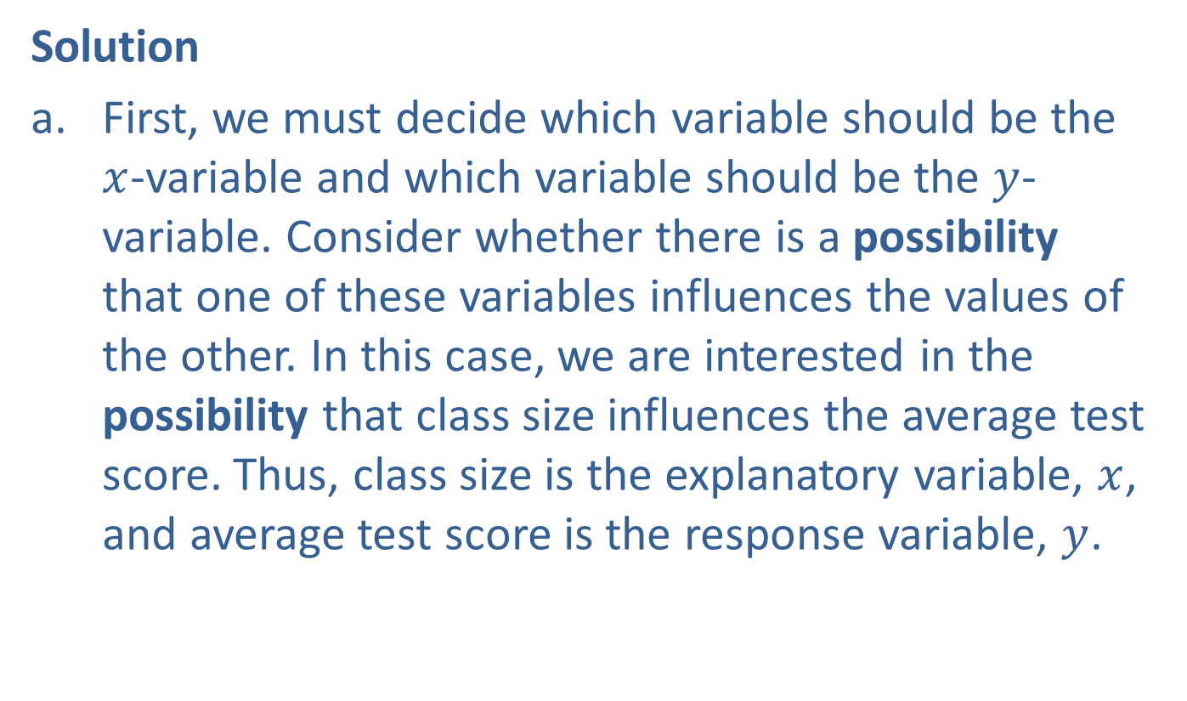
Example 12.2.1: Finding a Least-Squares Regression Line (cont.)
Solution
​First, we must decide which variable should be the $x$-variable and which variable should be the $y$-variable. Consider whether there is a possibility that one of these variables influences the values of the other. In this case, we are interested in the possibility that class size influences the average test score. Thus, class size is the explanatory variable, $x$, and average test score is the response variable, $y$.
​​

Slide 11
Example 12.2.1: Finding a Least-Squares Regression Line (cont.)
​Next, we need to make sure that the relationship between these two variables is a linear relationship that is statistically significant. A scatter plot of this data is shown in the following figure. As we see in this graph, the points do fall very close to a straight line.
​

Slide 12
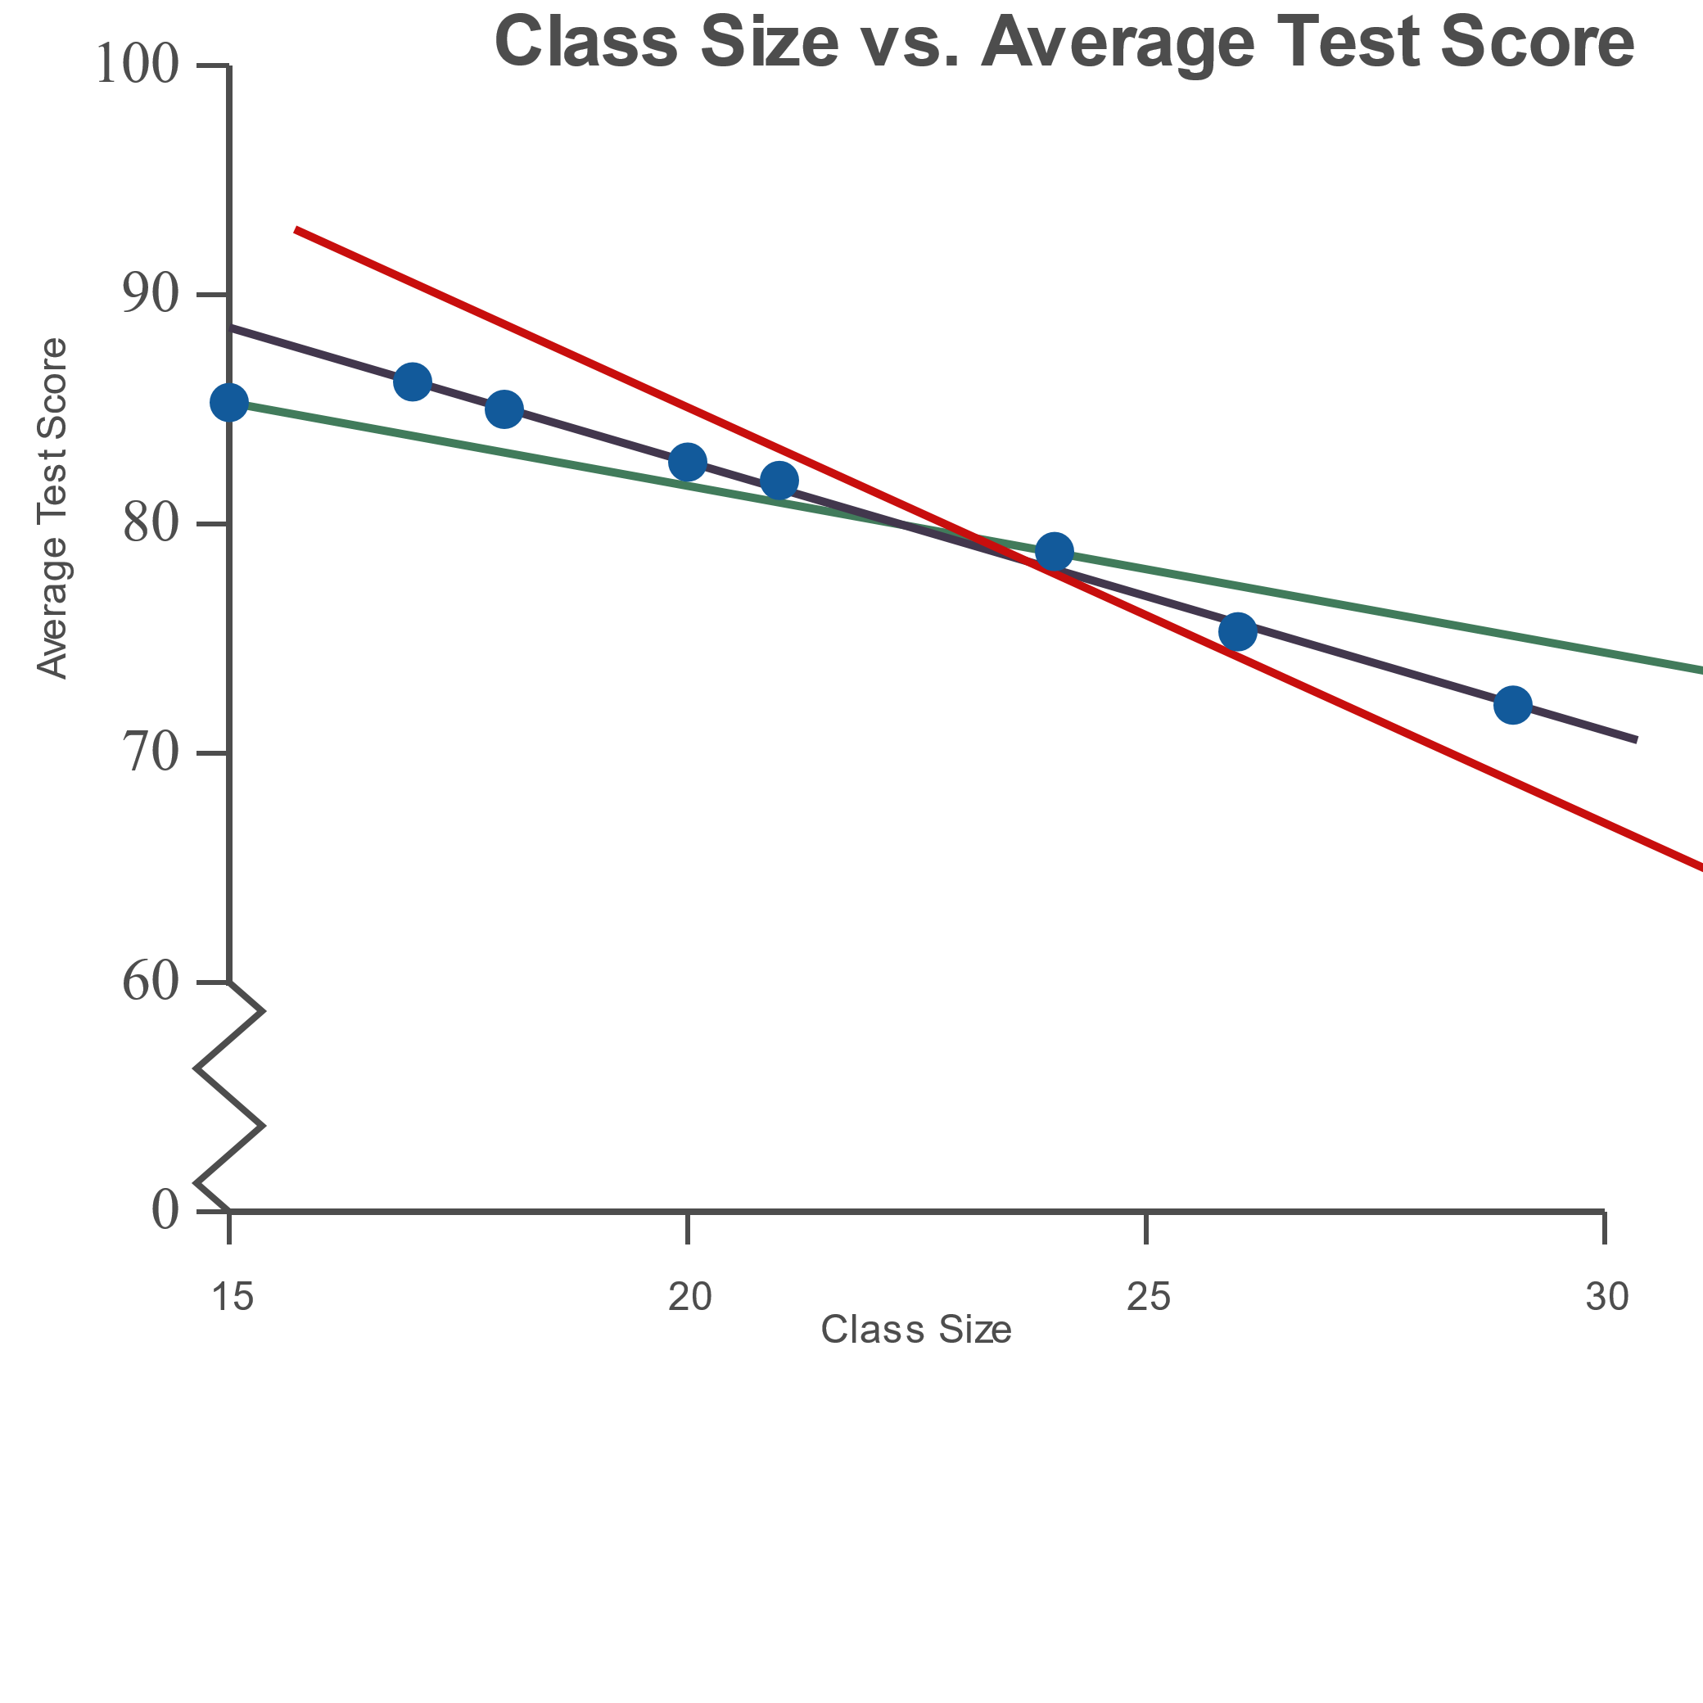
Example 12.2.1: Finding a Least-Squares Regression Line (cont.)

Slide 13

Example 12.2.1: Finding a Least-Squares Regression Line (cont.)
​To determine if this relationship is statistically significant, we must calculate the value of the correlation coefficient, $r$.
​

Slide 14
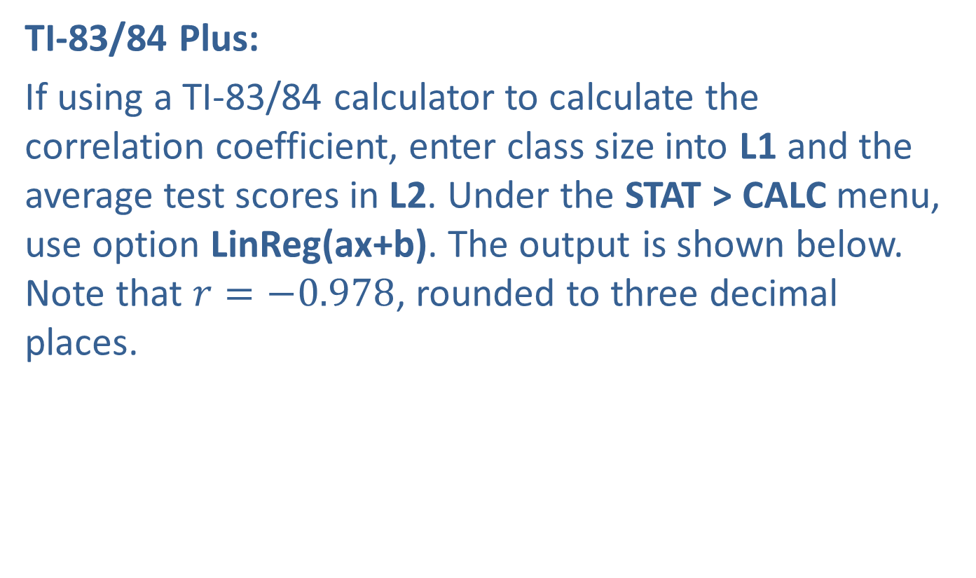
Example 12.2.1: Finding a Least-Squares Regression Line (cont.)
​TI-83/84 Plus:
​If using a TI-83/84 calculator to calculate the correlation coefficient, enter class size into L1 and the average test scores in L2. Under the STAT > CALC menu, use option LinReg(ax+b). The output is shown below. Note that $r=−0.978$, rounded to three decimal places.
​

Slide 15
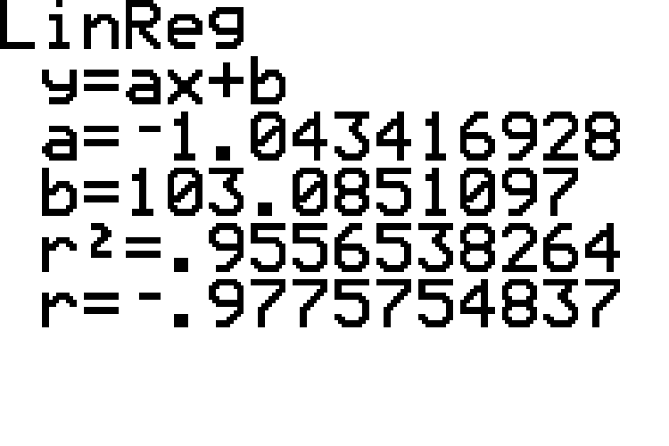
Example 12.2.1: Finding a Least-Squares Regression Line (cont.)

Slide 16
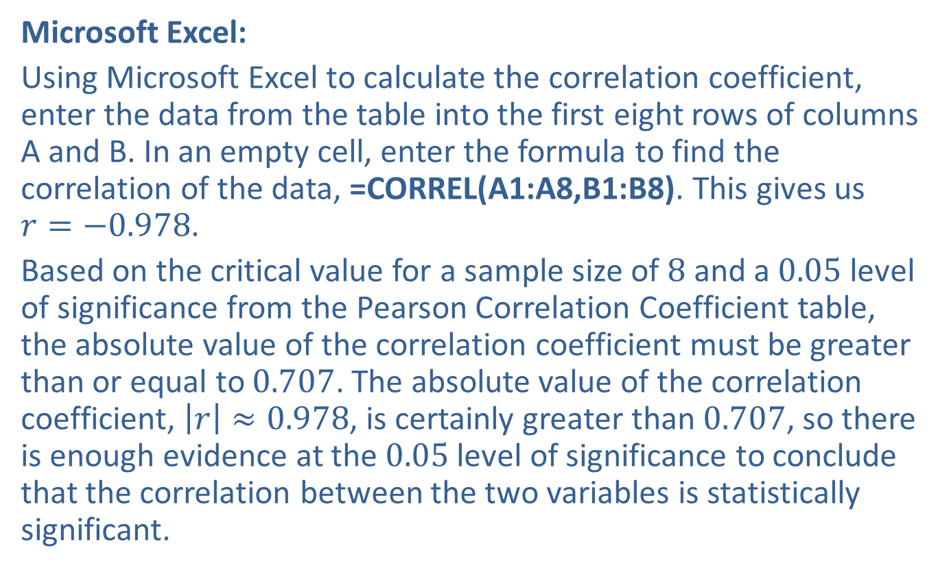
Example 12.2.1: Finding a Least-Squares Regression Line (cont.)
​Microsoft Excel:
​Using Microsoft Excel to calculate the correlation coefficient, enter the data from the table into the first eight rows of columns A and B. In an empty cell, enter the formula to find the correlation of the data, =CORREL(A1:A8,B1:B8). This gives us
$r=−0.978$.
​Based on the critical value for a sample size of 8 and a 0.05 level of significance from the Pearson Correlation Coefficient table, the absolute value of the correlation coefficient must be greater than or equal to 0.707. The absolute value of the correlation coefficient, $\left|r\right|≈0.978$, is certainly greater than 0.707, so there is enough evidence at the 0.05 level of significance to conclude that the correlation between the two variables is statistically significant.

Slide 17
Example 12.2.1: Finding a Least-Squares Regression Line (cont.)
​It is now appropriate to consider the linear regression model.
​

Slide 18
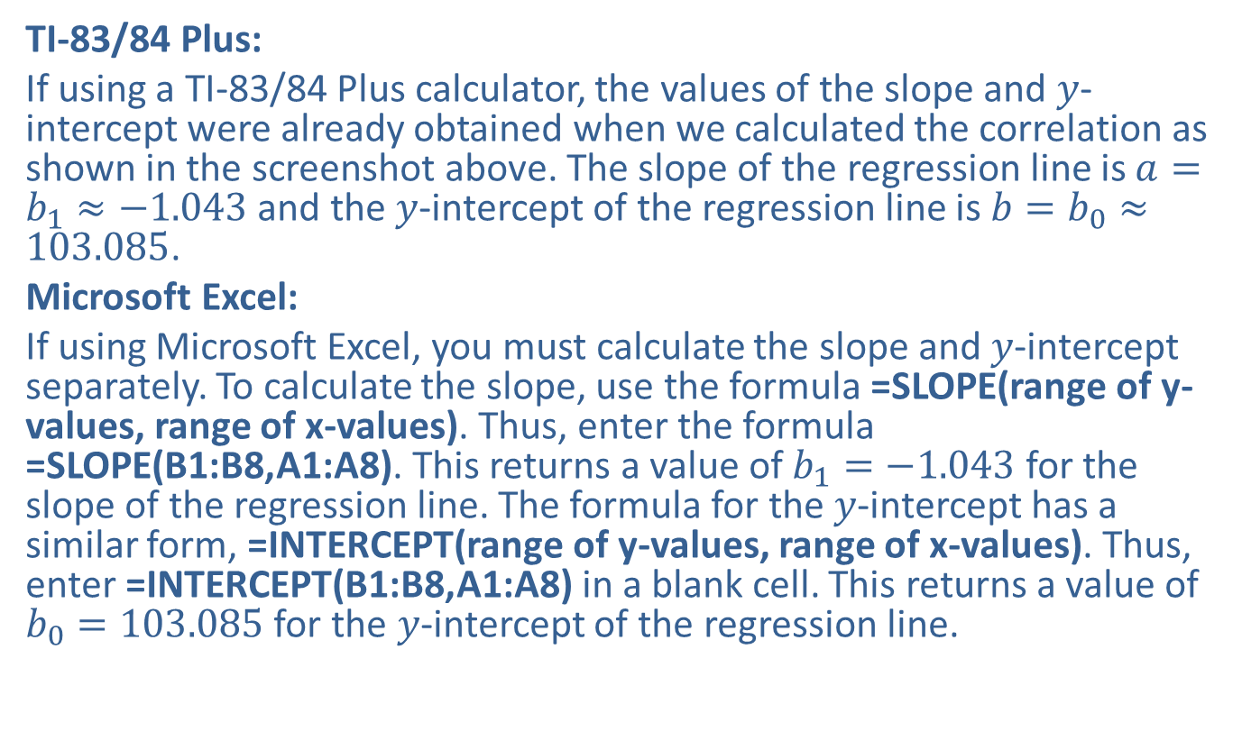
Example 12.2.1: Finding a Least-Squares Regression Line (cont.)
​TI-83/84 Plus:
​If using a TI-83/84 Plus calculator, the values of the slope and $y$-intercept were already obtained when we calculated the correlation as shown in the screenshot above. The slope of the regression line is $a=b_{1}≈−1.043$ and the $y$-intercept of the regression line is $b=b_{0}≈103.085$.
​Microsoft Excel:
​If using Microsoft Excel, you must calculate the slope and $y$-intercept separately. To calculate the slope, use the formula =SLOPE(range of y-values, range of x-values). Thus, enter the formula =SLOPE(B1:B8,A1:A8). This returns a value of $b_{1}=−1.043$ for the slope of the regression line. The formula for the $y$-intercept has a similar form, =INTERCEPT(range of y-values, range of x-values). Thus, enter =INTERCEPT(B1:B8,A1:A8) in a blank cell. This returns a value of $b_{0}=103.085$ for the $y$-intercept of the regression line.
​

Slide 19
Example 12.2.1: Finding a Least-Squares Regression Line (cont.)
 | A | B
1 | 15 | 85.30
2 | 17 | 86.20
3 | 18 | 85.00
4 | 20 | 82.70
5 | 21 | 81.90
6 | 24 | 78.80
7 | 26 | 75.30
8 | 29 | 72.10
9
10
11 | Slope | -1.043
12 | y-Intercept | 103.085

Slide 20

Example 12.2.1: Finding a Least-Squares Regression Line (cont.)
​Thus, the equation of the regression line, in the form $\hat{y}=b_{0}+b_{1}x$, is as follows.
​$\hat{y}=103.085−1.043x$
​This line of best fit is shown interposed upon the scatter plot of the data in the figure that follows.
​

Slide 21
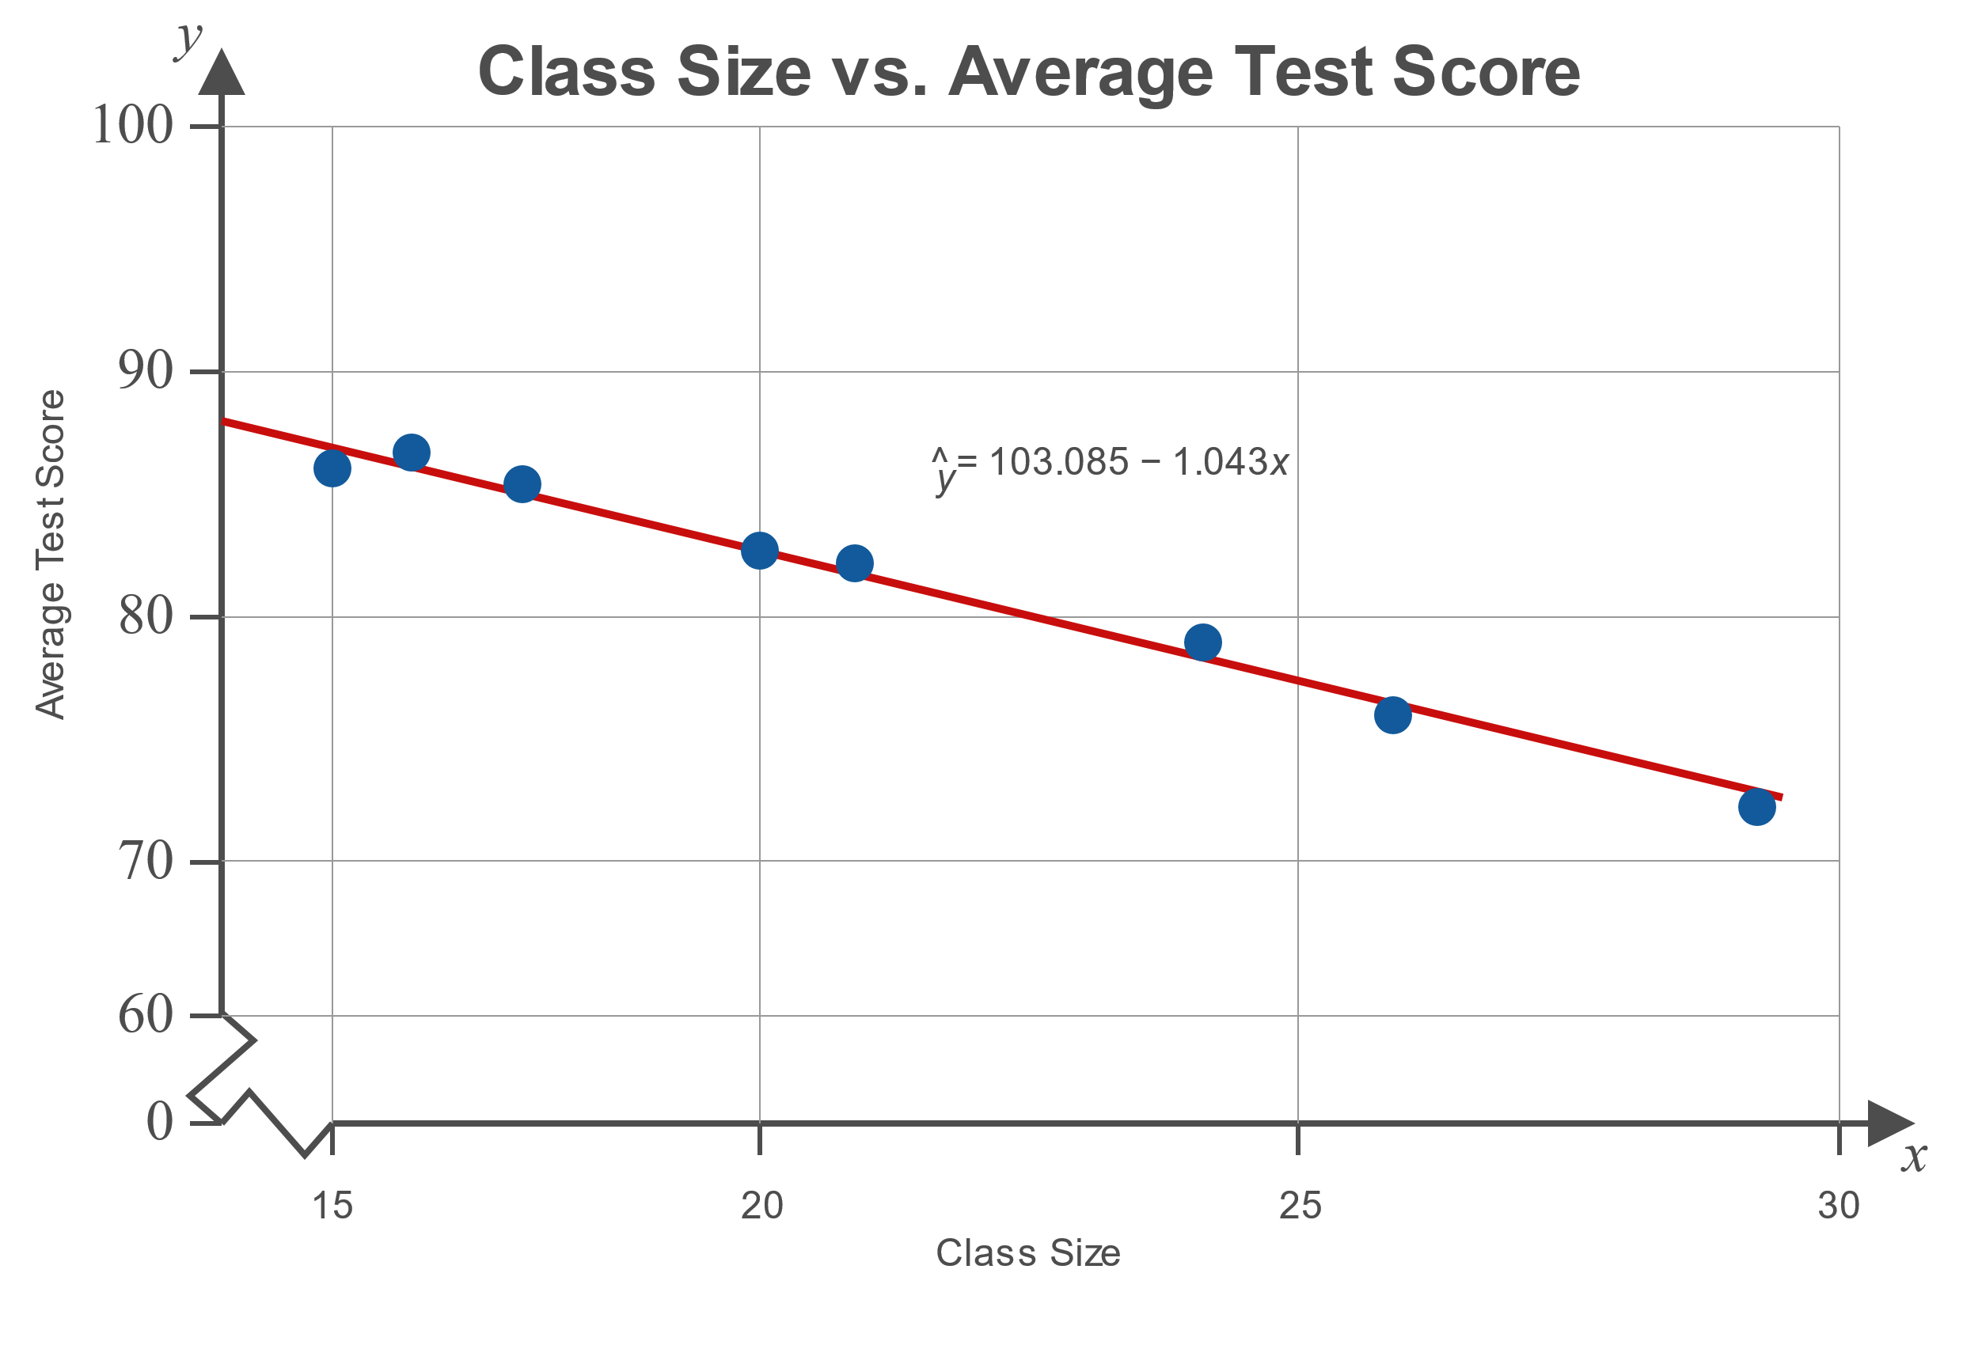
Example 12.2.1: Finding a Least-Squares Regression Line (cont.)

Slide 22
Technology
For further instructions on finding a least-squares regression line using a TI-83/84 Plus calculator, Excel, or other technology, please visit stat.hawkeslearning.com and see Technology Instructions > Regression > Simple Linear Regression.

Slide 23
A prediction should not be made with a regression model if…
Definition
​The data do not fall in a linear pattern when graphed on a scatter plot.
​The correlation coefficient is not statistically significant.
​You wish to make a prediction about a value outside the range of the sample data.
​The population is different than that from which the sample data were drawn.

Slide 24
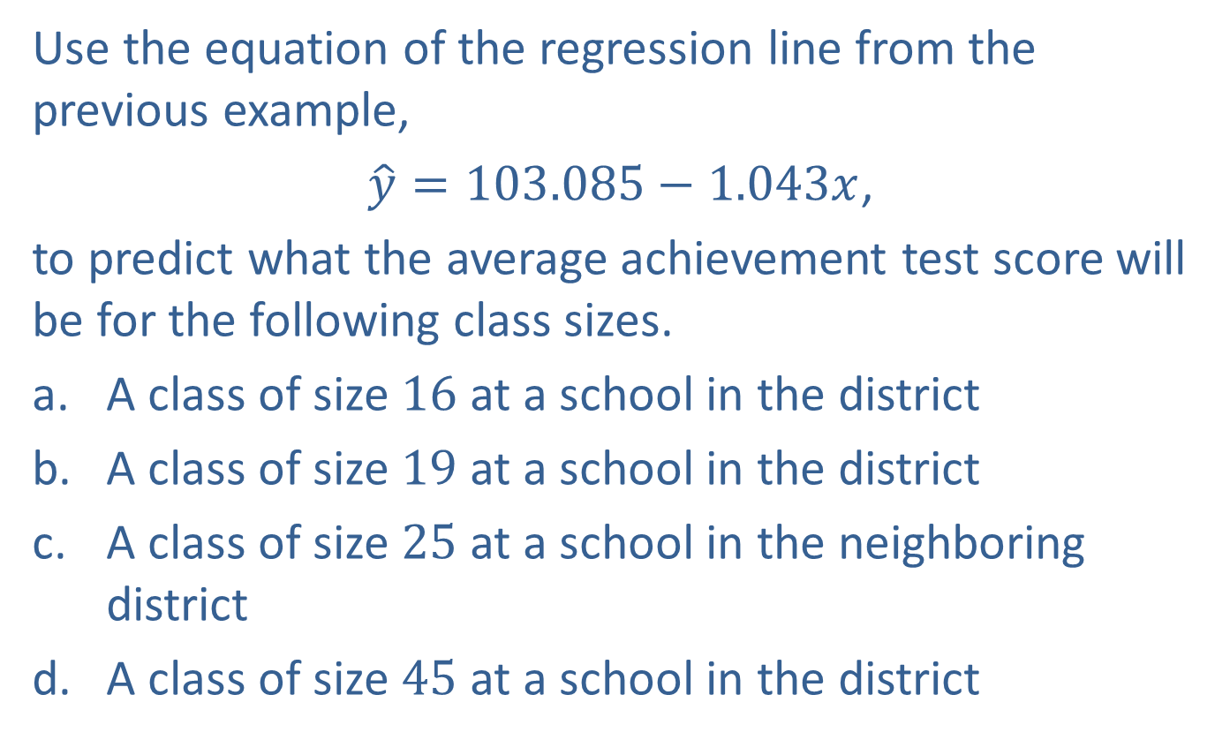
Example 12.2.2: Making Predictions Using a Least-Squares Regression Line
Use the equation of the regression line from the previous example,
$\hat{y}=103.085−1.043x$,
to predict what the average achievement test score will be for the following class sizes.
​A class of size 16 at a school in the district
​A class of size 19 at a school in the district
​A class of size 25 at a school in the neighboring district
​A class of size 45 at a school in the district

Slide 25
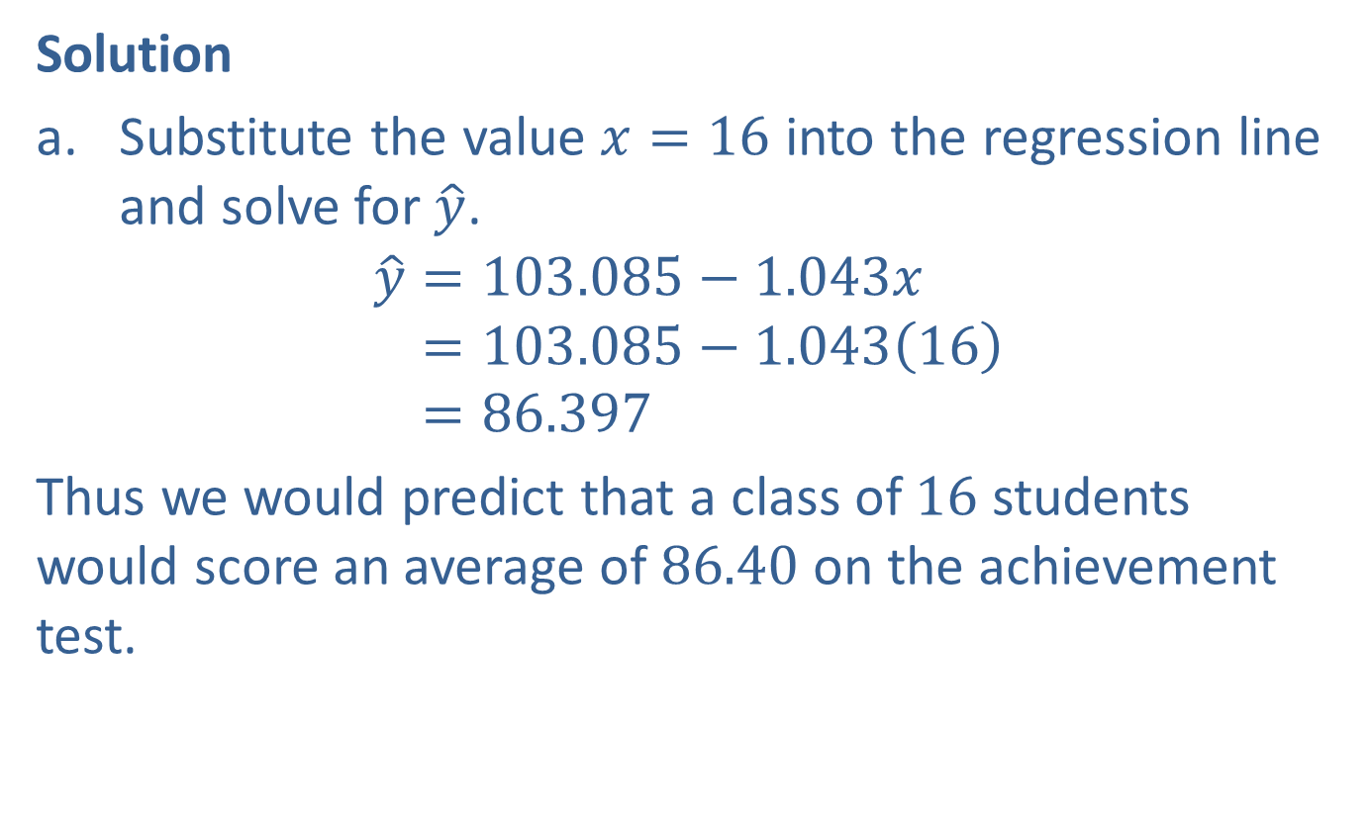
Example 12.2.2: Making Predictions Using a Least-Squares Regression Line (cont.)
Solution
​Substitute the value $x=16$ into the regression line and solve for $\hat{y}$.
𝑦=103.085−1.043𝑥𝑦=103.085−1.04316𝑦=86.397
​Thus we would predict that a class of 16 students would score an average of 86.40 on the achievement test.

Slide 26
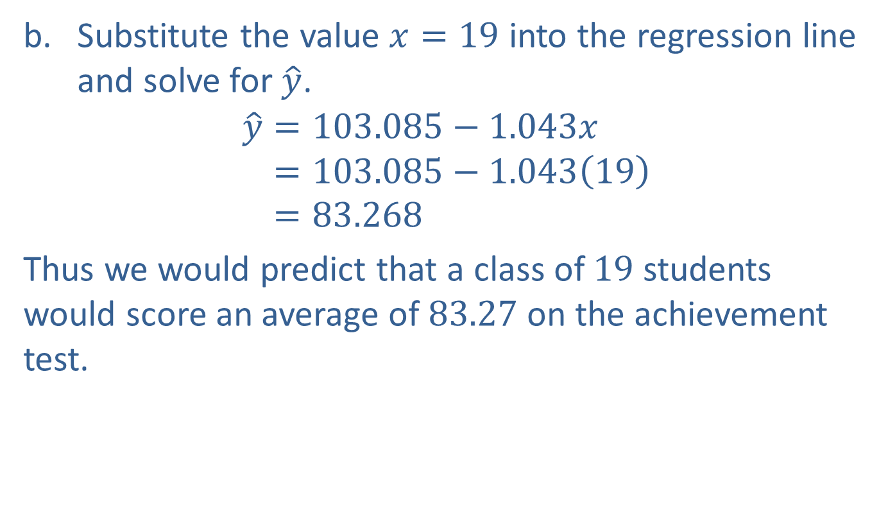
Example 12.2.2: Making Predictions Using a Least-Squares Regression Line (cont.)
​Substitute the value $x=19$ into the regression line and solve for $\hat{y}$.
𝑦=103.085−1.043𝑥𝑦=103.085−1.04319𝑦=83.268
​Thus we would predict that a class of 19 students would score an average of 83.27 on the achievement test.

Slide 27
Example 12.2.2: Making Predictions Using a Least-Squares Regression Line (cont.)
​Predictions should only be made for values from the original population. As this class was from outside of the school district, predictions should not be made.

Slide 28
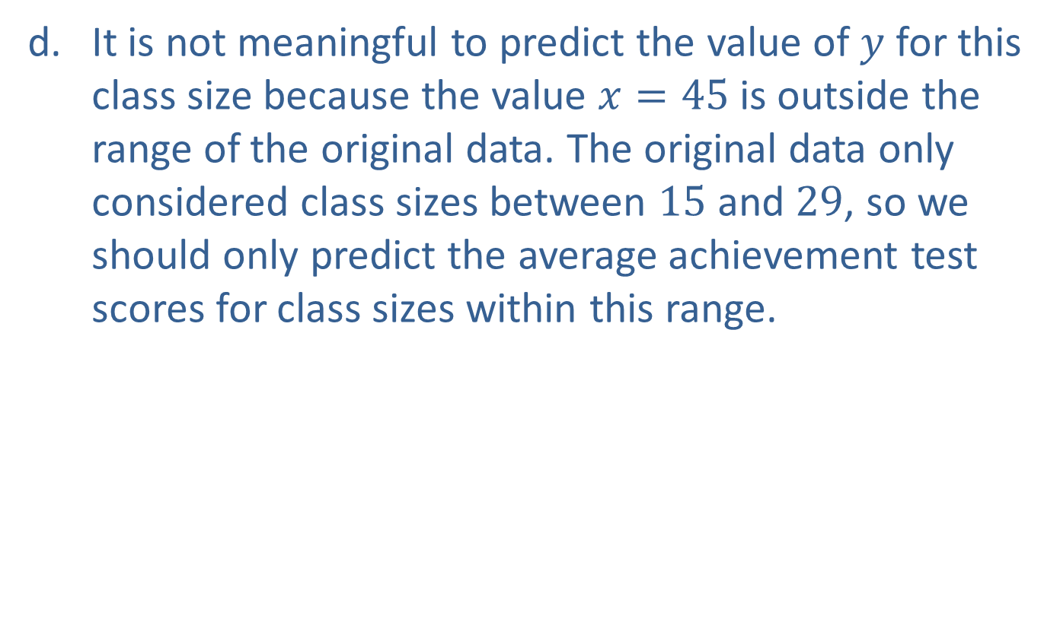
Example 12.2.2: Making Predictions Using a Least-Squares Regression Line (cont.)
​It is not meaningful to predict the value of $y$ for this class size because the value $x=45$ is outside the range of the original data. The original data only considered class sizes between 15 and 29, so we should only predict the average achievement test scores for class sizes within this range.

Slide 29
Example 12.2.3: Finding the Least-Squares Regression Line for a Given Data Set
The following data depicts the amount of forest burned in forest fires, measured in thousands of hectares, in the western U.S. and the number of days in which there was significant rainfall, called "wetting rain days," that year for the last eight years.
​Show that it is appropriate to use a linear regression model for this data. Use a 0.05 level of significance.
​Find a linear regression model for predicting the amount of forest burned based on the number of wetting rain days.
​Use the regression model to predict the number of hectares of forest that might be burned if there are 28 wetting rain days next year.

Slide 30
Example 12.2.3: Finding the Least-Squares Regression Line for a Given Data Set (cont.)
Forest Fires in the Western U.S.
Hectares Burned (in Thousands) | Number of Wetting Rain Days
85 | 31
40 | 30
475 | 18
325 | 20
450 | 22
180 | 24
95 | 26
98 | 27
Source: Holden et. al. “Decreasing fire season precipitation increased recent western US forest wildfire activity.” 23 July 2018. https://www.fs.fed.us/rm/pubs_journals/2018/rmrs_2018_holden_z001.pdf (18 Mar. 2019).

Slide 31
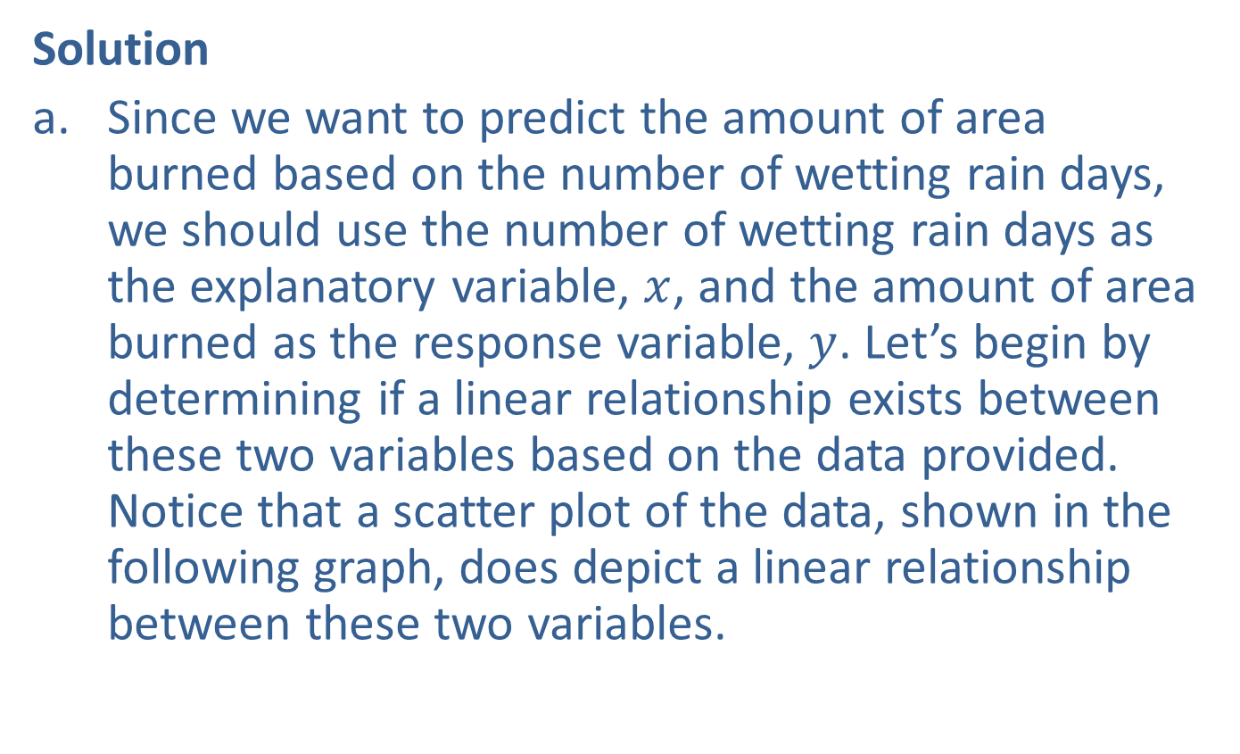
Example 12.2.3: Finding the Least-Squares Regression Line for a Given Data Set (cont.)
Solution
​Since we want to predict the amount of area burned based on the number of wetting rain days, we should use the number of wetting rain days as the explanatory variable, $x$, and the amount of area burned as the response variable, $y$. Let’s begin by determining if a linear relationship exists between these two variables based on the data provided. Notice that a scatter plot of the data, shown in the following graph, does depict a linear relationship between these two variables.
​

Slide 32
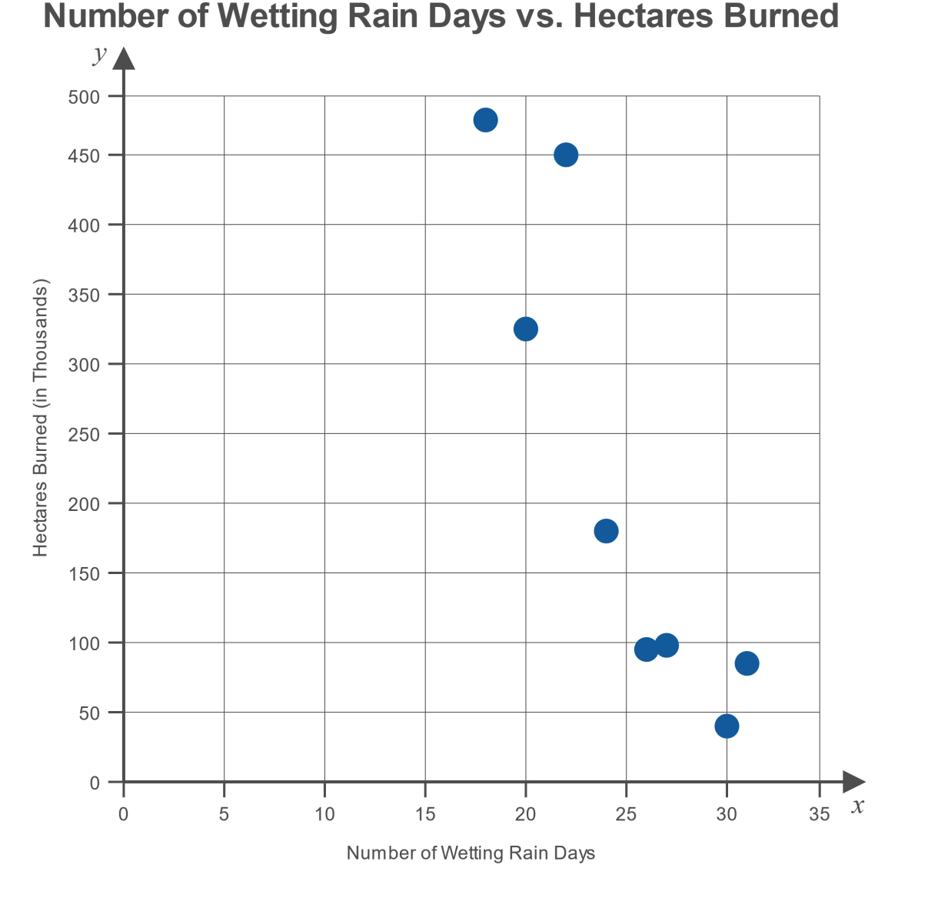
Example 12.2.3: Finding the Least-Squares Regression Line for a Given Data Set (cont.)

Slide 33

Example 12.2.3: Finding the Least-Squares Regression Line for a Given Data Set (cont.)
​Next, we need to determine if this linear relationship is statistically significant. To do that, we must calculate the value of the correlation coefficient, $r$, and compare that to the critical value for a sample size of 8 at a 0.05 level of significance.
​

Slide 34
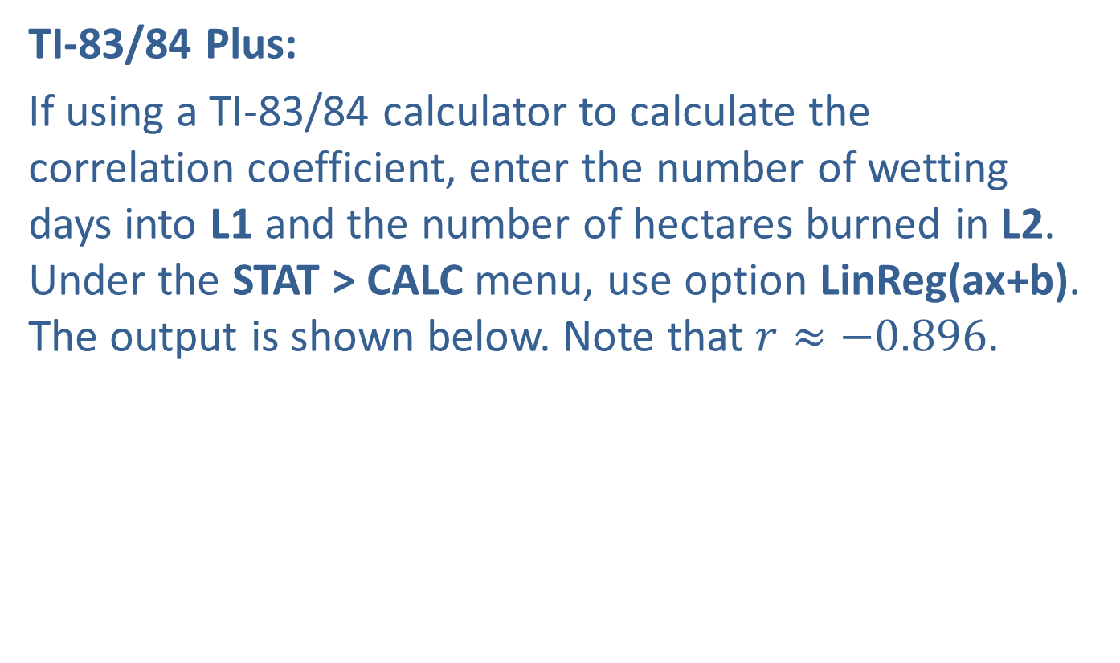
Example 12.2.3: Finding the Least-Squares Regression Line for a Given Data Set (cont.)
​TI-83/84 Plus:
​If using a TI-83/84 calculator to calculate the correlation coefficient, enter the number of wetting days into L1 and the number of hectares burned in L2. Under the STAT > CALC menu, use option LinReg(ax+b). The output is shown below. Note that $r≈−0.896$.
​

Slide 35
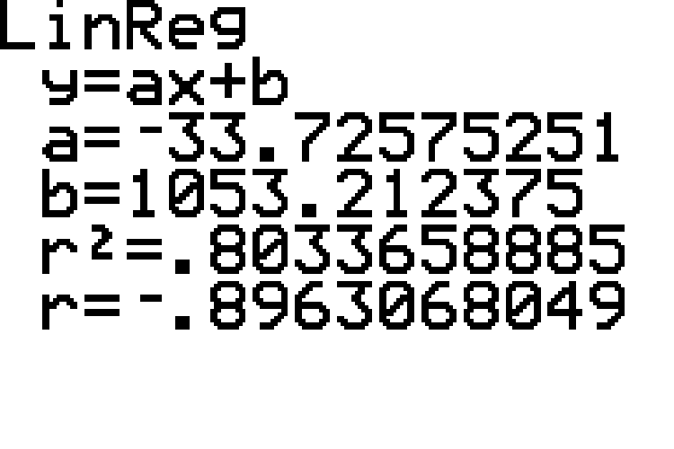
Example 12.2.3: Finding the Least-Squares Regression Line for a Given Data Set (cont.)

Slide 36
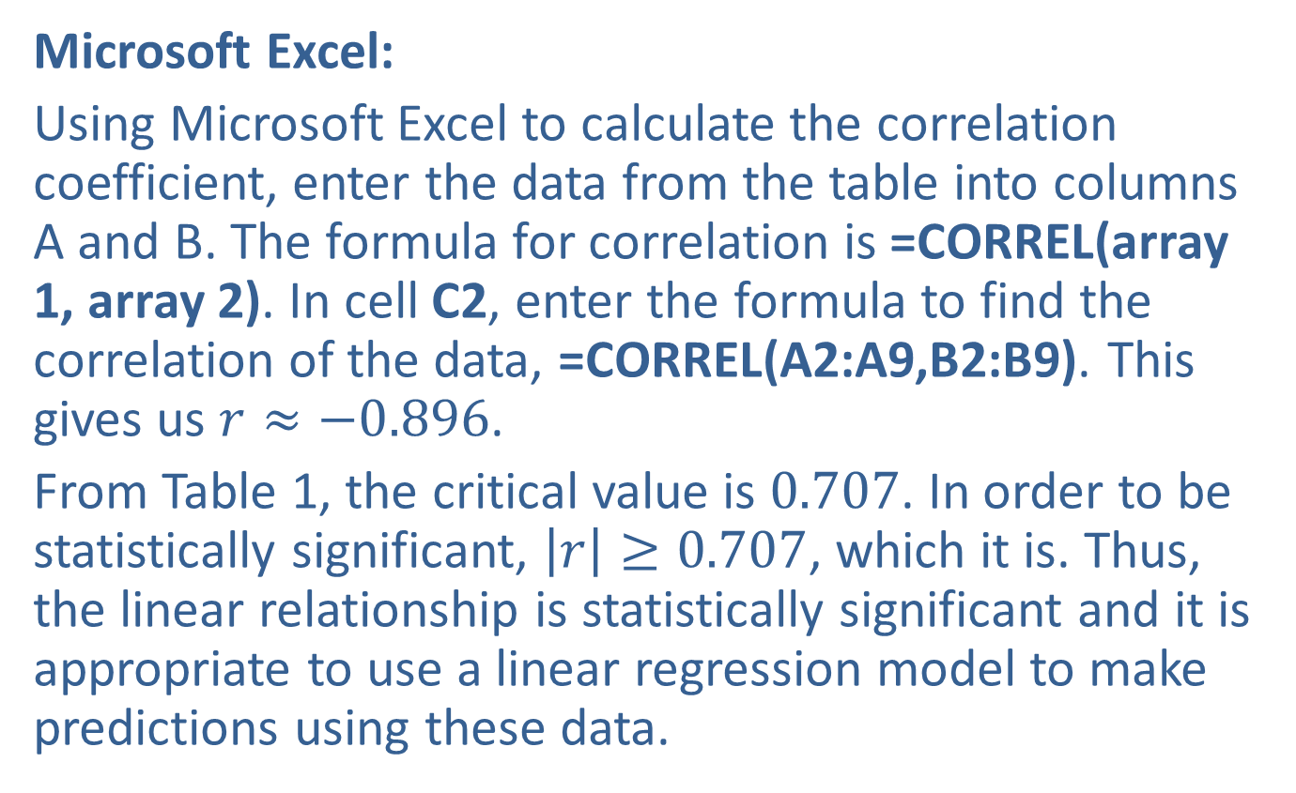
Example 12.2.3: Finding the Least-Squares Regression Line for a Given Data Set (cont.)
​Microsoft Excel:
​Using Microsoft Excel to calculate the correlation coefficient, enter the data from the table into columns A and B. The formula for correlation is =CORREL(array 1, array 2). In cell C2, enter the formula to find the correlation of the data, =CORREL(A2:A9,B2:B9). This gives us $r≈−0.896$.
​From Table 1, the critical value is 0.707. In order to be statistically significant, $\left|r\right|≥0.707$, which it is. Thus, the linear relationship is statistically significant and it is appropriate to use a linear regression model to make predictions using these data.

Slide 37

Example 12.2.3: Finding the Least-Squares Regression Line for a Given Data Set (cont.)
​To determine the equation of the regression model for these data, we need to calculate the slope and $y$-intercept of the line.
​

Slide 38
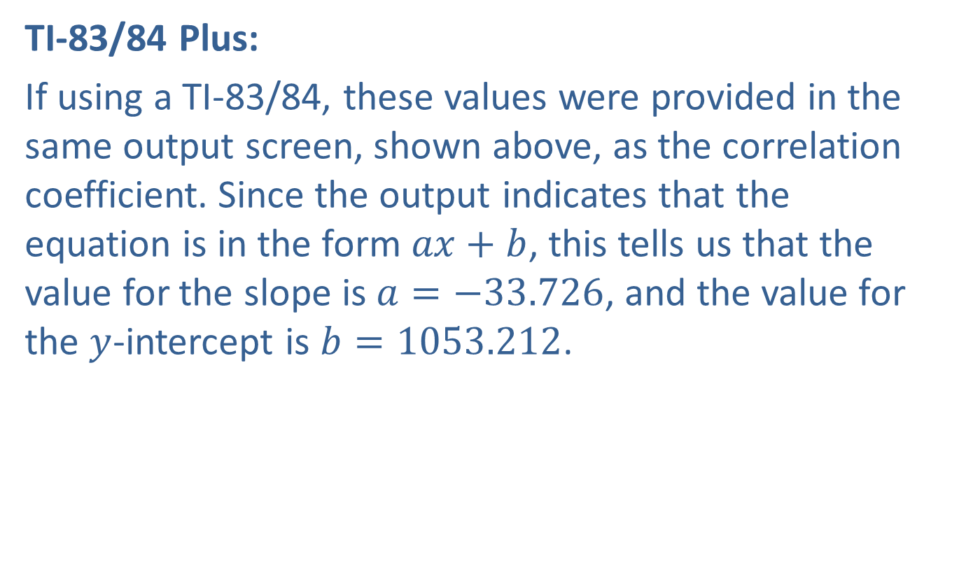
Example 12.2.3: Finding the Least-Squares Regression Line for a Given Data Set (cont.)
​TI-83/84 Plus:
​If using a TI-83/84, these values were provided in the same output screen, shown above, as the correlation coefficient. Since the output indicates that the equation is in the form $ax+b$, this tells us that the value for the slope is $a=−33.726$, and the value for the $y$-intercept is $b=1053.212$.

Slide 39
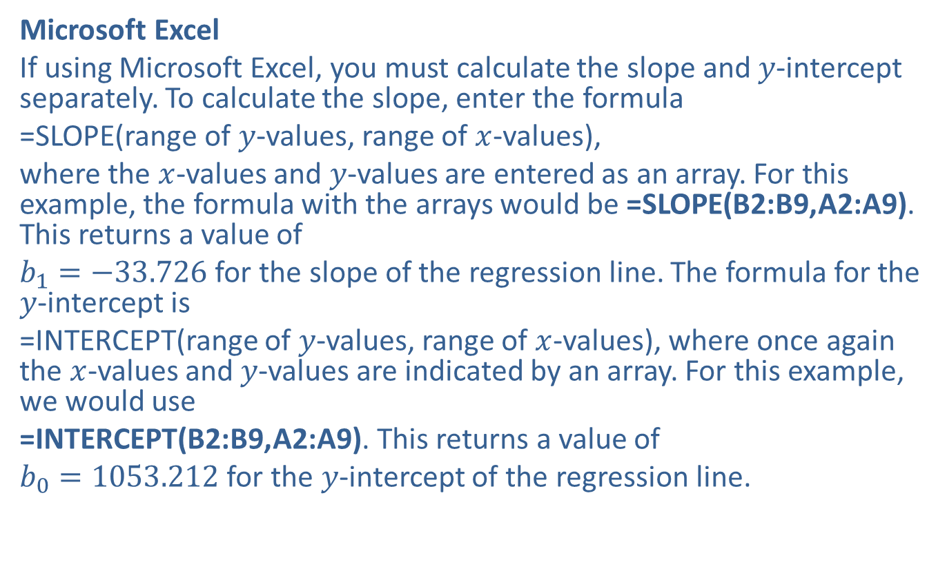
Example 12.2.3: Finding the Least-Squares Regression Line for a Given Data Set (cont.)
​Microsoft Excel
​If using Microsoft Excel, you must calculate the slope and $y$-intercept separately. To calculate the slope, enter the formula
=SLOPE(range of $y$-values, range of $x$-values),
where the $x$-values and $y$-values are entered as an array. For this example, the formula with the arrays would be =SLOPE(B2:B9,A2:A9). This returns a value of
$b_{1}=−33.726$ for the slope of the regression line. The formula for the $y$-intercept is
=INTERCEPT(range of $y$-values, range of $x$-values), where once again the $x$-values and $y$-values are indicated by an array. For this example, we would use
=INTERCEPT(B2:B9,A2:A9). This returns a value of
$b_{0}=1053.212$ for the $y$-intercept of the regression line.
​

Slide 40
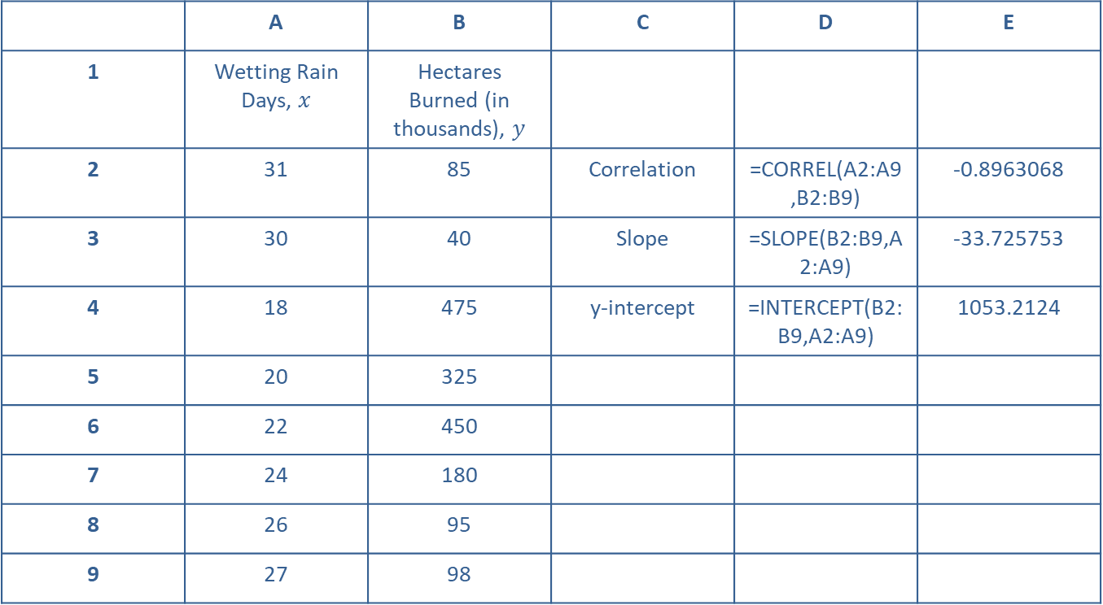
Example 12.2.3: Finding the Least-Squares Regression Line for a Given Data Set (cont.)
 | A | B | C | D | E
1 | Wetting Rain Days, $x$ | Hectares Burned (in thousands), $y$
2 | 31 | 85 | Correlation | =CORREL(A2:A9,B2:B9) | -0.8963068
3 | 30 | 40 | Slope | =SLOPE(B2:B9,A2:A9) | -33.725753
4 | 18 | 475 | y-intercept | =INTERCEPT(B2:B9,A2:A9) | 1053.2124
5 | 20 | 325
6 | 22 | 450
7 | 24 | 180
8 | 26 | 95
9 | 27 | 98

Slide 41

Example 12.2.3: Finding the Least-Squares Regression Line for a Given Data Set (cont.)
​Therefore the regression line, in the form
$\hat{y}=b_{0}+b_{1}x$, is as follows.
​$\hat{y}=1053.212−33.726x$

Slide 42
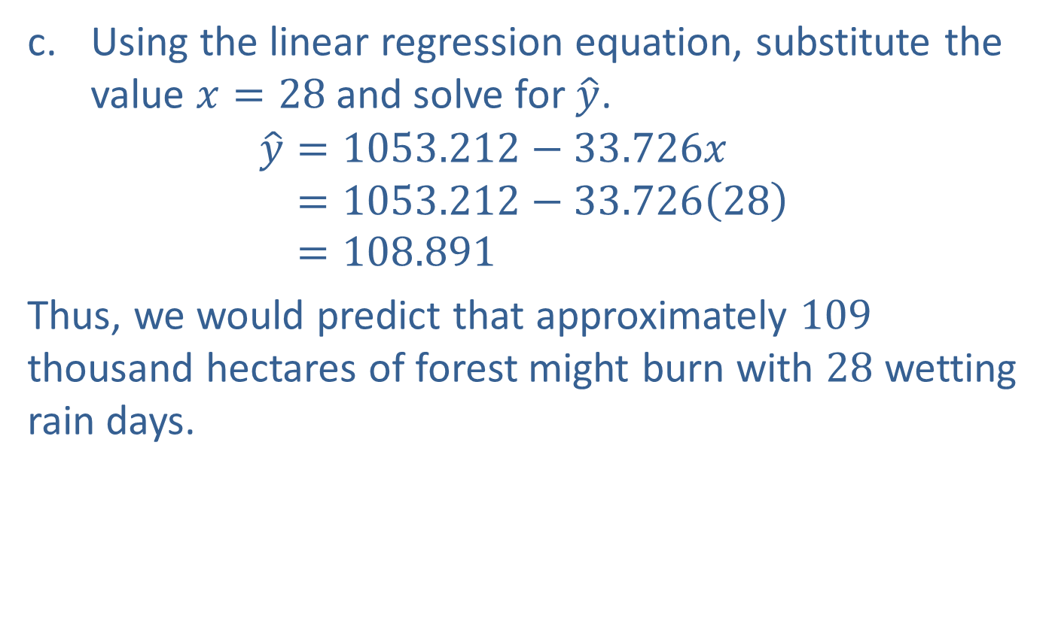
Example 12.2.3: Finding the Least-Squares Regression Line for a Given Data Set (cont.)
​Using the linear regression equation, substitute the value $x=28$ and solve for $\hat{y}$.
𝑦=1053.212−33.726𝑥𝑦=1053.212−33.72628𝑦=108.891
​Thus, we would predict that approximately 109 thousand hectares of forest might burn with 28 wetting rain days.

Slide 43
Technology
Microsoft Excel has two different methods for calculating the slope and y-intercept of a regression line. Another method uses the Regression Analysis tool, which we will discuss in detail in the next section.

Slide 44
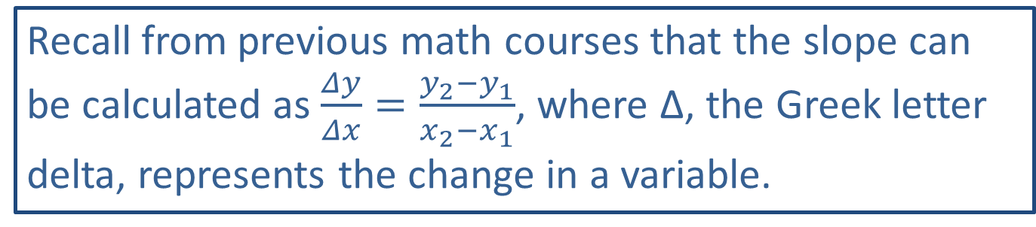
Memory Booster:
Recall from previous math courses that the slope can be calculated as $\frac{Δy}{Δx}=\frac{y_{2}−y_{1}}{x_{2}−x_{1}}$, where Δ, the Greek letter delta, represents the change in a variable.

Slide 45
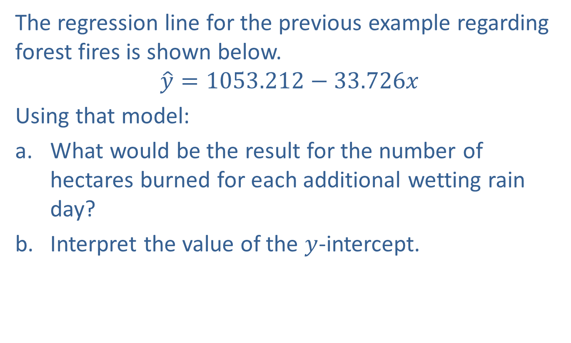

Example 12.2.4: Interpreting Slope and
$y$-Intercept of a Regression Line
The regression line for the previous example regarding forest fires is shown below.
$$\hat{y}=1053.212−33.726x$$
Using that model:
​What would be the result for the number of hectares burned for each additional wetting rain day?
​Interpret the value of the $y$-intercept.

Slide 46
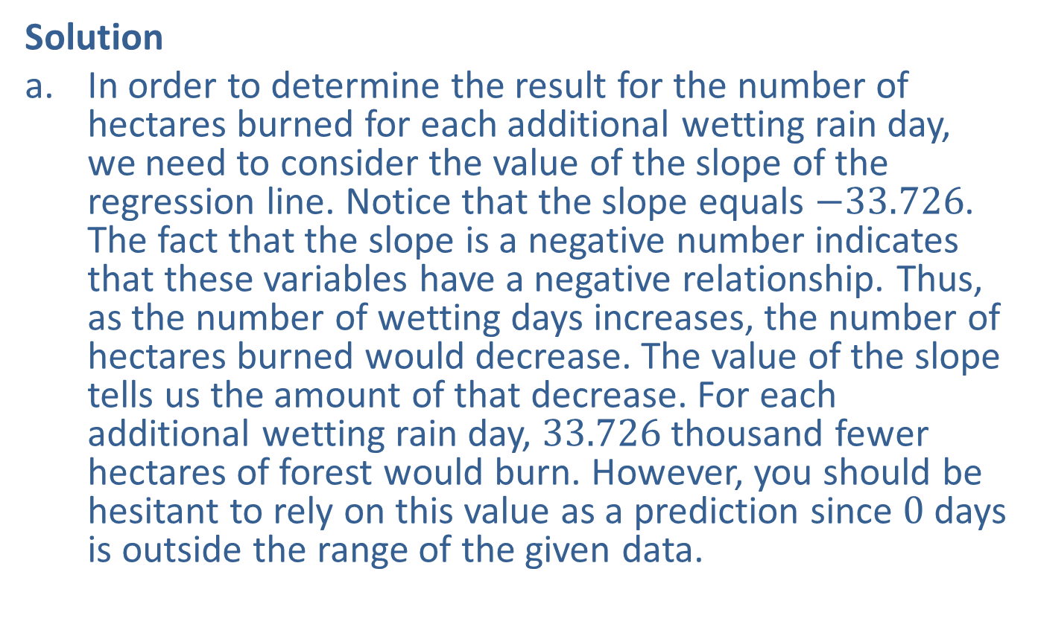
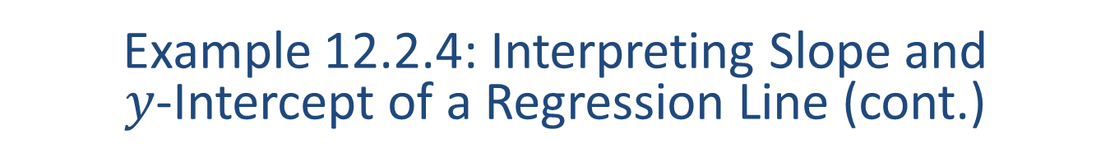
Example 12.2.4: Interpreting Slope and
$y$-Intercept of a Regression Line (cont.)
Solution
​In order to determine the result for the number of hectares burned for each additional wetting rain day, we need to consider the value of the slope of the regression line. Notice that the slope equals $−33.726$. The fact that the slope is a negative number indicates that these variables have a negative relationship. Thus, as the number of wetting days increases, the number of hectares burned would decrease. The value of the slope tells us the amount of that decrease. For each additional wetting rain day, 33.726 thousand fewer hectares of forest would burn. However, you should be hesitant to rely on this value as a prediction since 0 days is outside the range of the given data.

Slide 47
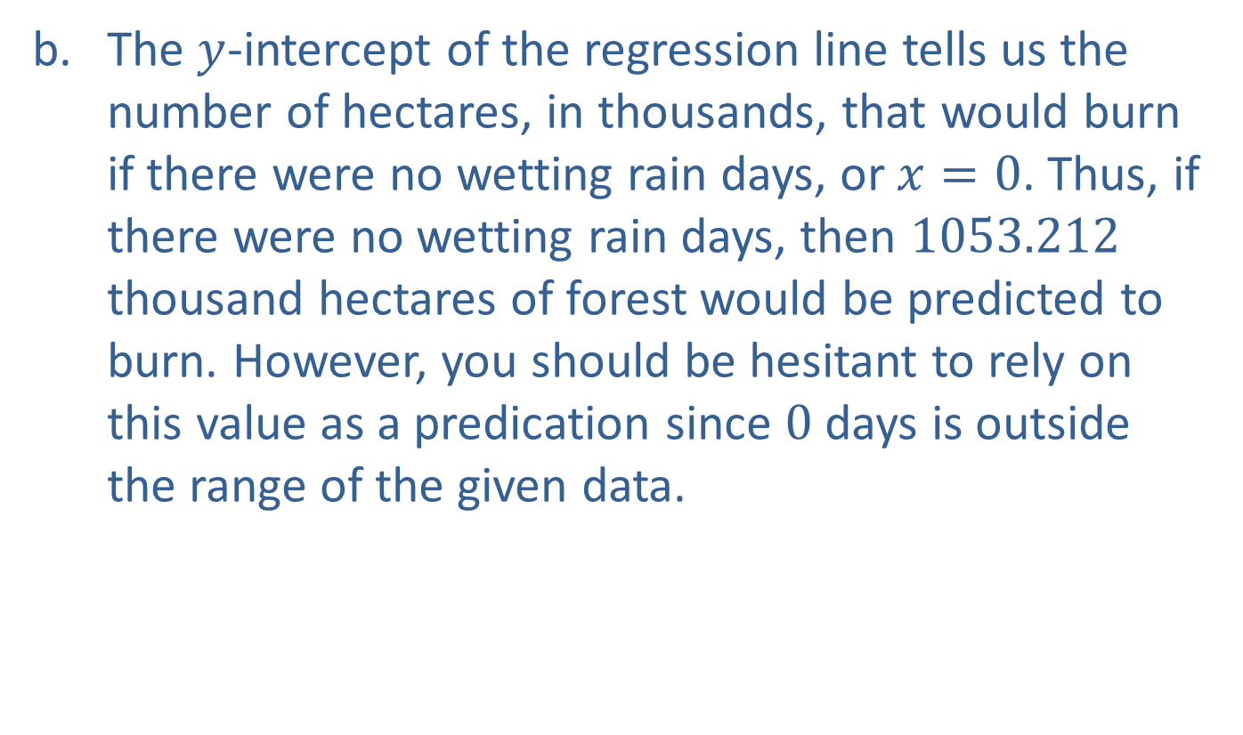
Example 12.2.4: Interpreting Slope and
$y$-Intercept of a Regression Line (cont.)
​The $y$-intercept of the regression line tells us the number of hectares, in thousands, that would burn if there were no wetting rain days, or $x=0$. Thus, if there were no wetting rain days, then 1053.212 thousand hectares of forest would be predicted to burn. However, you should be hesitant to rely on this value as a predication since 0 days is outside the range of the given data.

Slide 48
Example 12.2.5: Creating and Analyzing a Linear Regression Model
The following table gives the average monthly temperatures and corresponding monthly precipitation totals for one year in Key West, Florida.

Slide 49
Example 12.2.5: Creating and Analyzing a Linear Regression Model (cont.)
Average Temperatures and Precipitation Totals in Key West, Florida
Average Temperature in (℉) | 75 | 76 | 79 | 82 | 85 | 88 | 89 | 90 | 88 | 85 | 81 | 77
Precipitation (in Inches) | 2.22 | 1.51 | 1.86 | 2.06 | 3.48 | 4.57 | 3.27 | 5.40 | 5.45 | 4.34 | 2.64 | 2.14

Slide 50
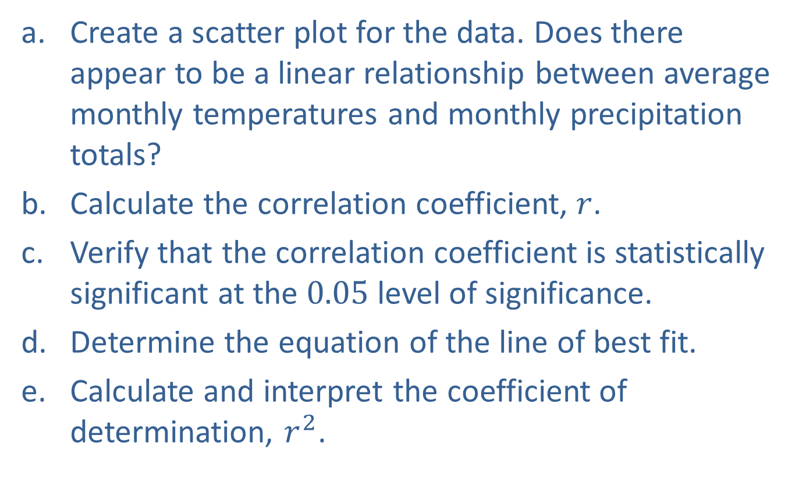
Example 12.2.5: Creating and Analyzing a Linear Regression Model (cont.)
​Create a scatter plot for the data. Does there appear to be a linear relationship between average monthly temperatures and monthly precipitation totals?
​Calculate the correlation coefficient, $r$.
​Verify that the correlation coefficient is statistically significant at the 0.05 level of significance.
​Determine the equation of the line of best fit.
​Calculate and interpret the coefficient of determination, $r^{2}$.

Slide 51
Example 12.2.5: Creating and Analyzing a Linear Regression Model (cont.)
​If appropriate, predict the monthly precipitation total in Key West for a month in which the average temperature is 80 degrees.
​If appropriate, predict the monthly precipitation in Destin, Florida, for a month in which the average temperature is 83 degrees.
​For each additional degree that the temperature rises, what is the increase in the level of precipitation?

Slide 52
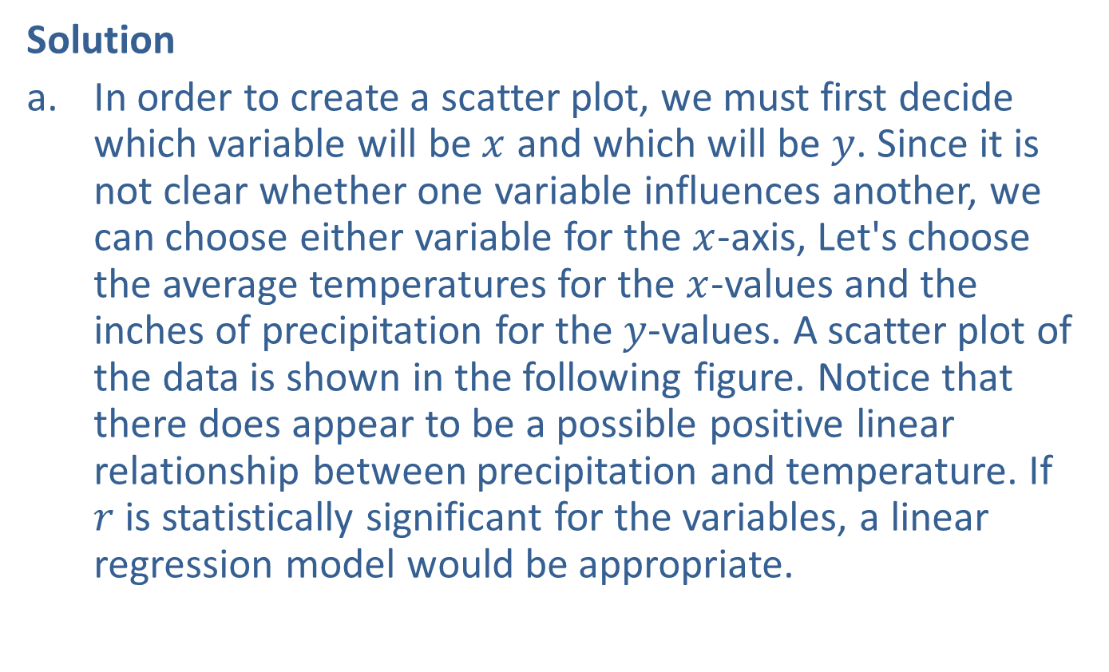
Example 12.2.5: Creating and Analyzing a Linear Regression Model (cont.)
Solution
​In order to create a scatter plot, we must first decide which variable will be $x$ and which will be $y$. Since it is not clear whether one variable influences another, we can choose either variable for the $x$-axis, Let's choose the average temperatures for the $x$-values and the inches of precipitation for the $y$-values. A scatter plot of the data is shown in the following figure. Notice that there does appear to be a possible positive linear relationship between precipitation and temperature. If $r$ is statistically significant for the variables, a linear regression model would be appropriate.
​

Slide 53
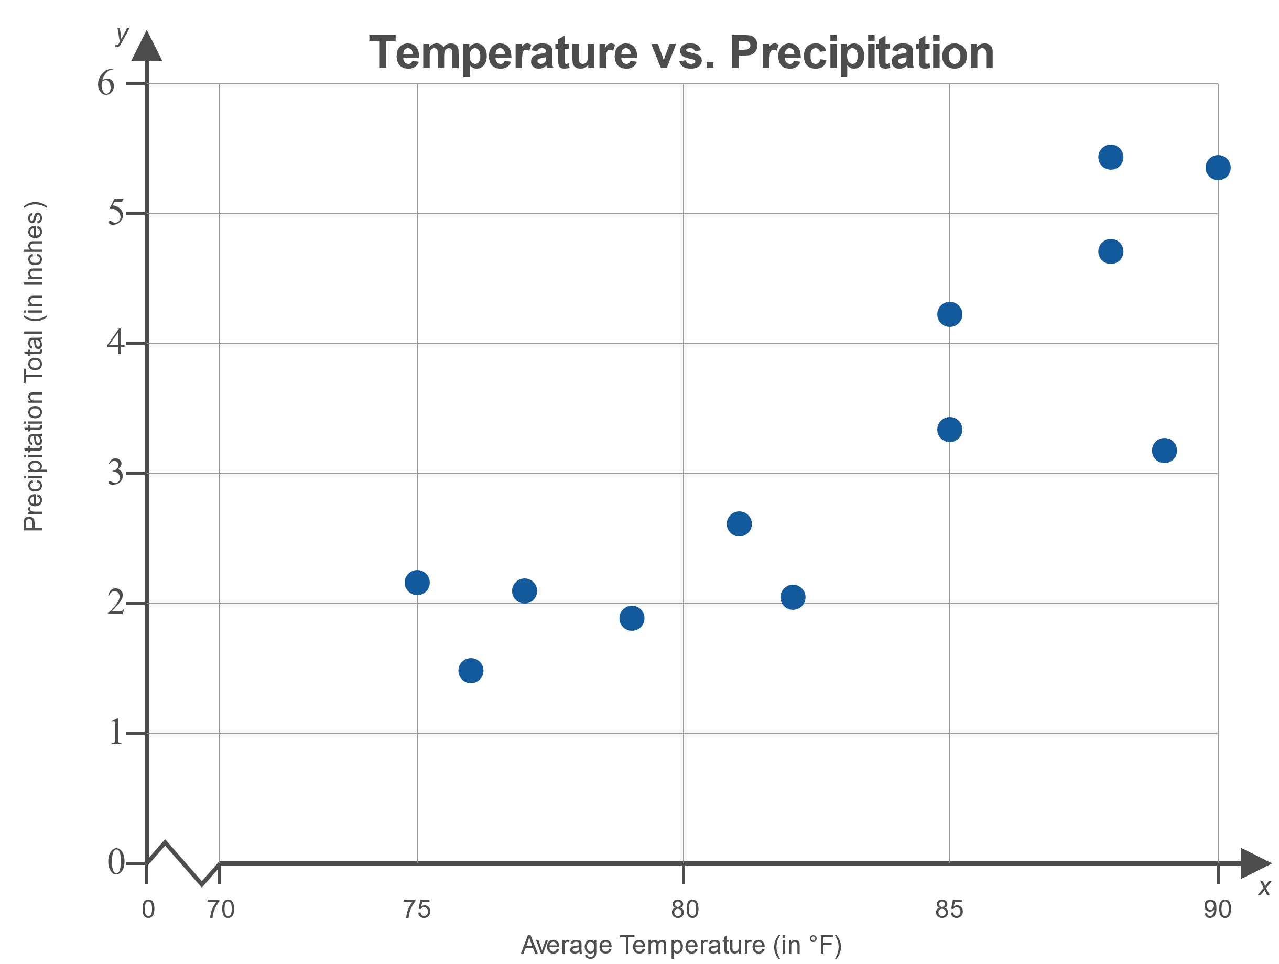
Example 12.2.5: Creating and Analyzing a Linear Regression Model (cont.)

Slide 54
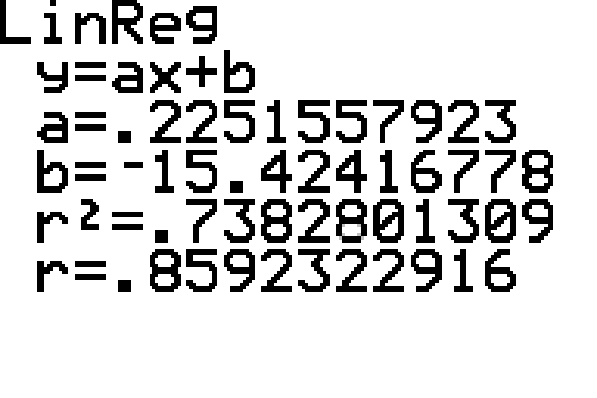

Example 12.2.5: Creating and Analyzing a Linear Regression Model (cont.)
​Using technology as we have in the previous examples, we calculate $r≈0.859$ as shown in the screenshot below.
​

Slide 55

Example 12.2.5: Creating and Analyzing a Linear Regression Model (cont.)
​Using the Pearson Correlation Coefficient table, we find that the critical value at the 0.05 level of significance for a sample of size $n=12$ is 0.576. Since $|0.859|>0.576$, we can conclude that $r$ is indeed statistically significant.

Slide 56

Example 12.2.5: Creating and Analyzing a Linear Regression Model (cont.)
​The output screen shown gives a slope of 0.225 and a $y$-intercept of $−15.424$. Using these values, the equation of the line of best fit is as follows.
​$\hat{y}=−15.424+0.225x$

Slide 57
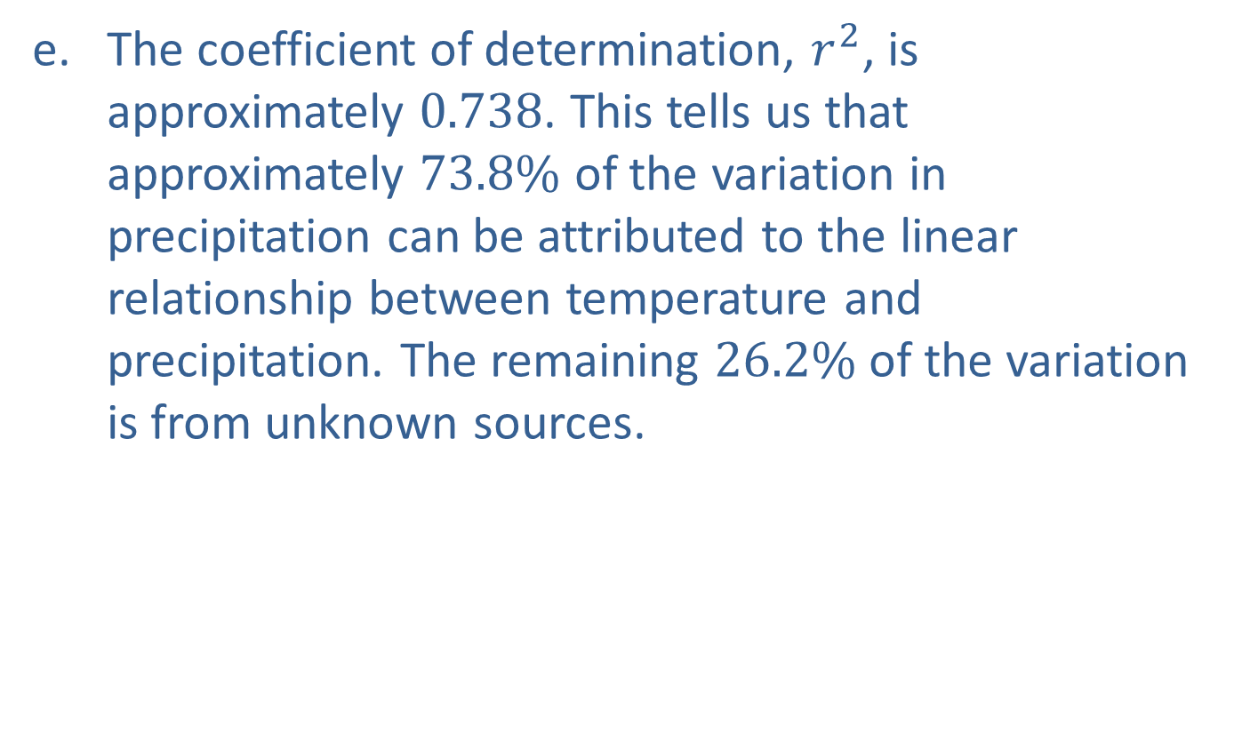
Example 12.2.5: Creating and Analyzing a Linear Regression Model (cont.)
​The coefficient of determination, $r^{2}$, is approximately 0.738. This tells us that approximately $73.8\%$ of the variation in precipitation can be attributed to the linear relationship between temperature and precipitation. The remaining $26.2\%$ of the variation is from unknown sources.

Slide 58
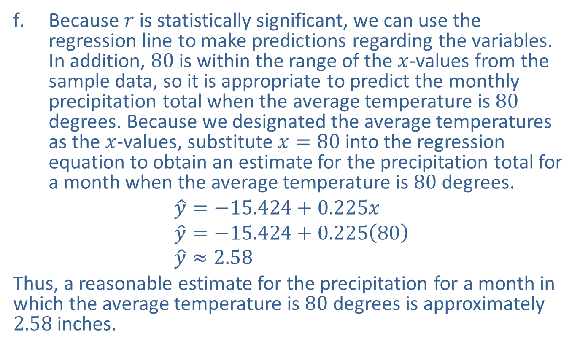
Example 12.2.5: Creating and Analyzing a Linear Regression Model (cont.)
​Because $r$ is statistically significant, we can use the regression line to make predictions regarding the variables. In addition, 80 is within the range of the $x$-values from the sample data, so it is appropriate to predict the monthly precipitation total when the average temperature is 80 degrees. Because we designated the average temperatures as the $x$-values, substitute $x=80$ into the regression equation to obtain an estimate for the precipitation total for a month when the average temperature is 80 degrees.
$$\hat{y}=−15.424+0.225x \\ \hat{y}=−15.424+0.225\left(80\right) \\ \hat{y}≈2.58$$
​Thus, a reasonable estimate for the precipitation for a month in which the average temperature is 80 degrees is approximately 2.58 inches.

Slide 59
Example 12.2.5: Creating and Analyzing a Linear Regression Model (cont.)
​The data were collected in Key West–not Destin, Florida. Therefore, it is not appropriate to use the linear regression equation to make predictions regarding the precipitation in Destin.

Slide 60
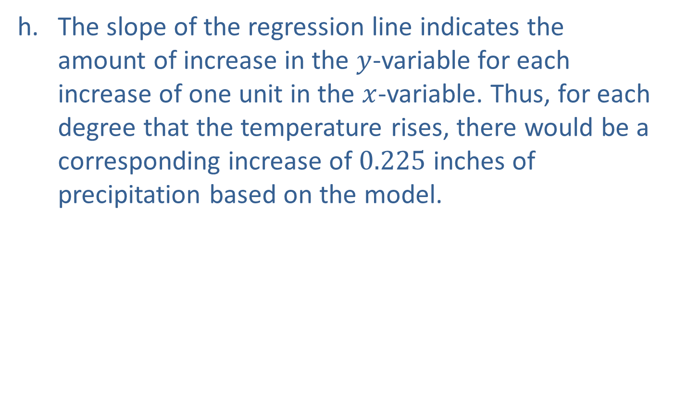
Example 12.2.5: Creating and Analyzing a Linear Regression Model (cont.)
​The slope of the regression line indicates the amount of increase in the $y$-variable for each increase of one unit in the $x$-variable. Thus, for each degree that the temperature rises, there would be a corresponding increase of 0.225 inches of precipitation based on the model.

