Slide 1
Section 12.3
Regression Analysis

Slide 2
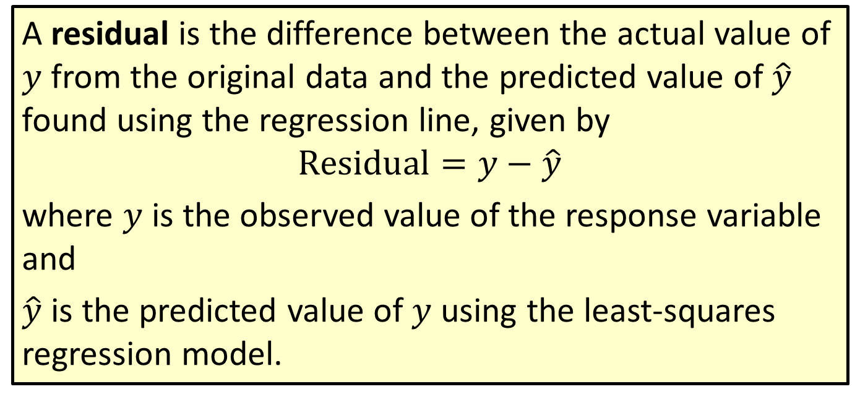
Formula: Residual
A residual is the difference between the actual value of $y$ from the original data and the predicted value of $\hat{y}$ found using the regression line, given by
$$Residual=y−\hat{y}$$
where $y$ is the observed value of the response variable and
$\hat{y}$ is the predicted value of $y$ using the least-squares regression model.

Slide 3

Example 12.3.1: Calculating Residuals Using an Estimated Regression Equation
The following table gives data from a local school district regarding children's ages ($x$) and reading levels ($y$). For these data, a reading level of 4.3 would indicate that the child's reading level is $\frac{3}{10}$ of the year through the fourth grade. The children's ages are given in years.

Slide 4
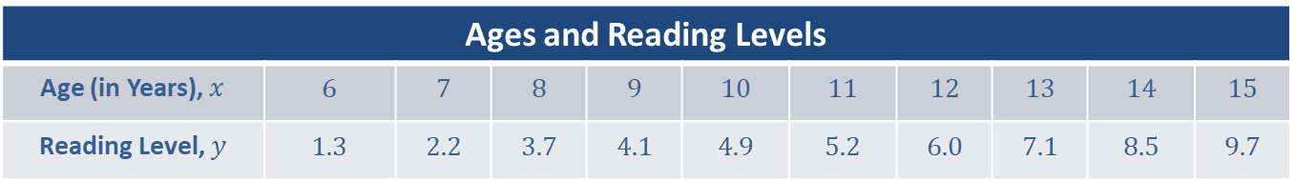
Example 12.3.1: Calculating Residuals Using an Estimated Regression Equation (cont.)
Ages and Reading Levels
Age (in Years), $x$ | 6 | 7 | 8 | 9 | 10 | 11 | 12 | 13 | 14 | 15
Reading Level, $y$ | 1.3 | 2.2 | 3.7 | 4.1 | 4.9 | 5.2 | 6.0 | 7.1 | 8.5 | 9.7

Slide 5
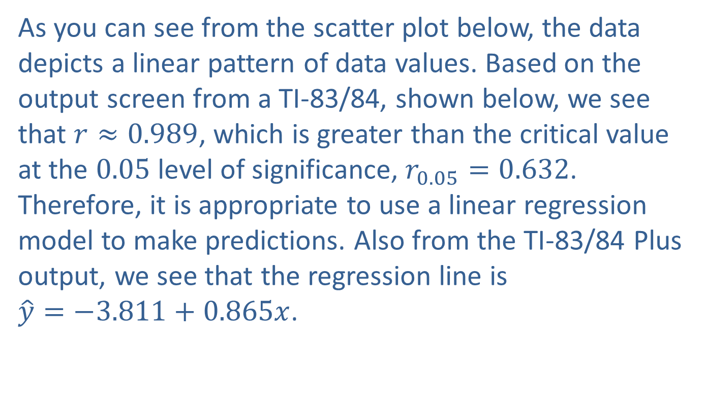
Example 12.3.1: Calculating Residuals Using an Estimated Regression Equation (cont.)
As you can see from the scatter plot below, the data depicts a linear pattern of data values. Based on the output screen from a TI-83/84, shown below, we see that $r≈0.989$, which is greater than the critical value at the 0.05 level of significance, $r_{0.05}=0.632$. Therefore, it is appropriate to use a linear regression model to make predictions. Also from the TI-83/84 Plus output, we see that the regression line is
$\hat{y}=−3.811+0.865x$.

Slide 6
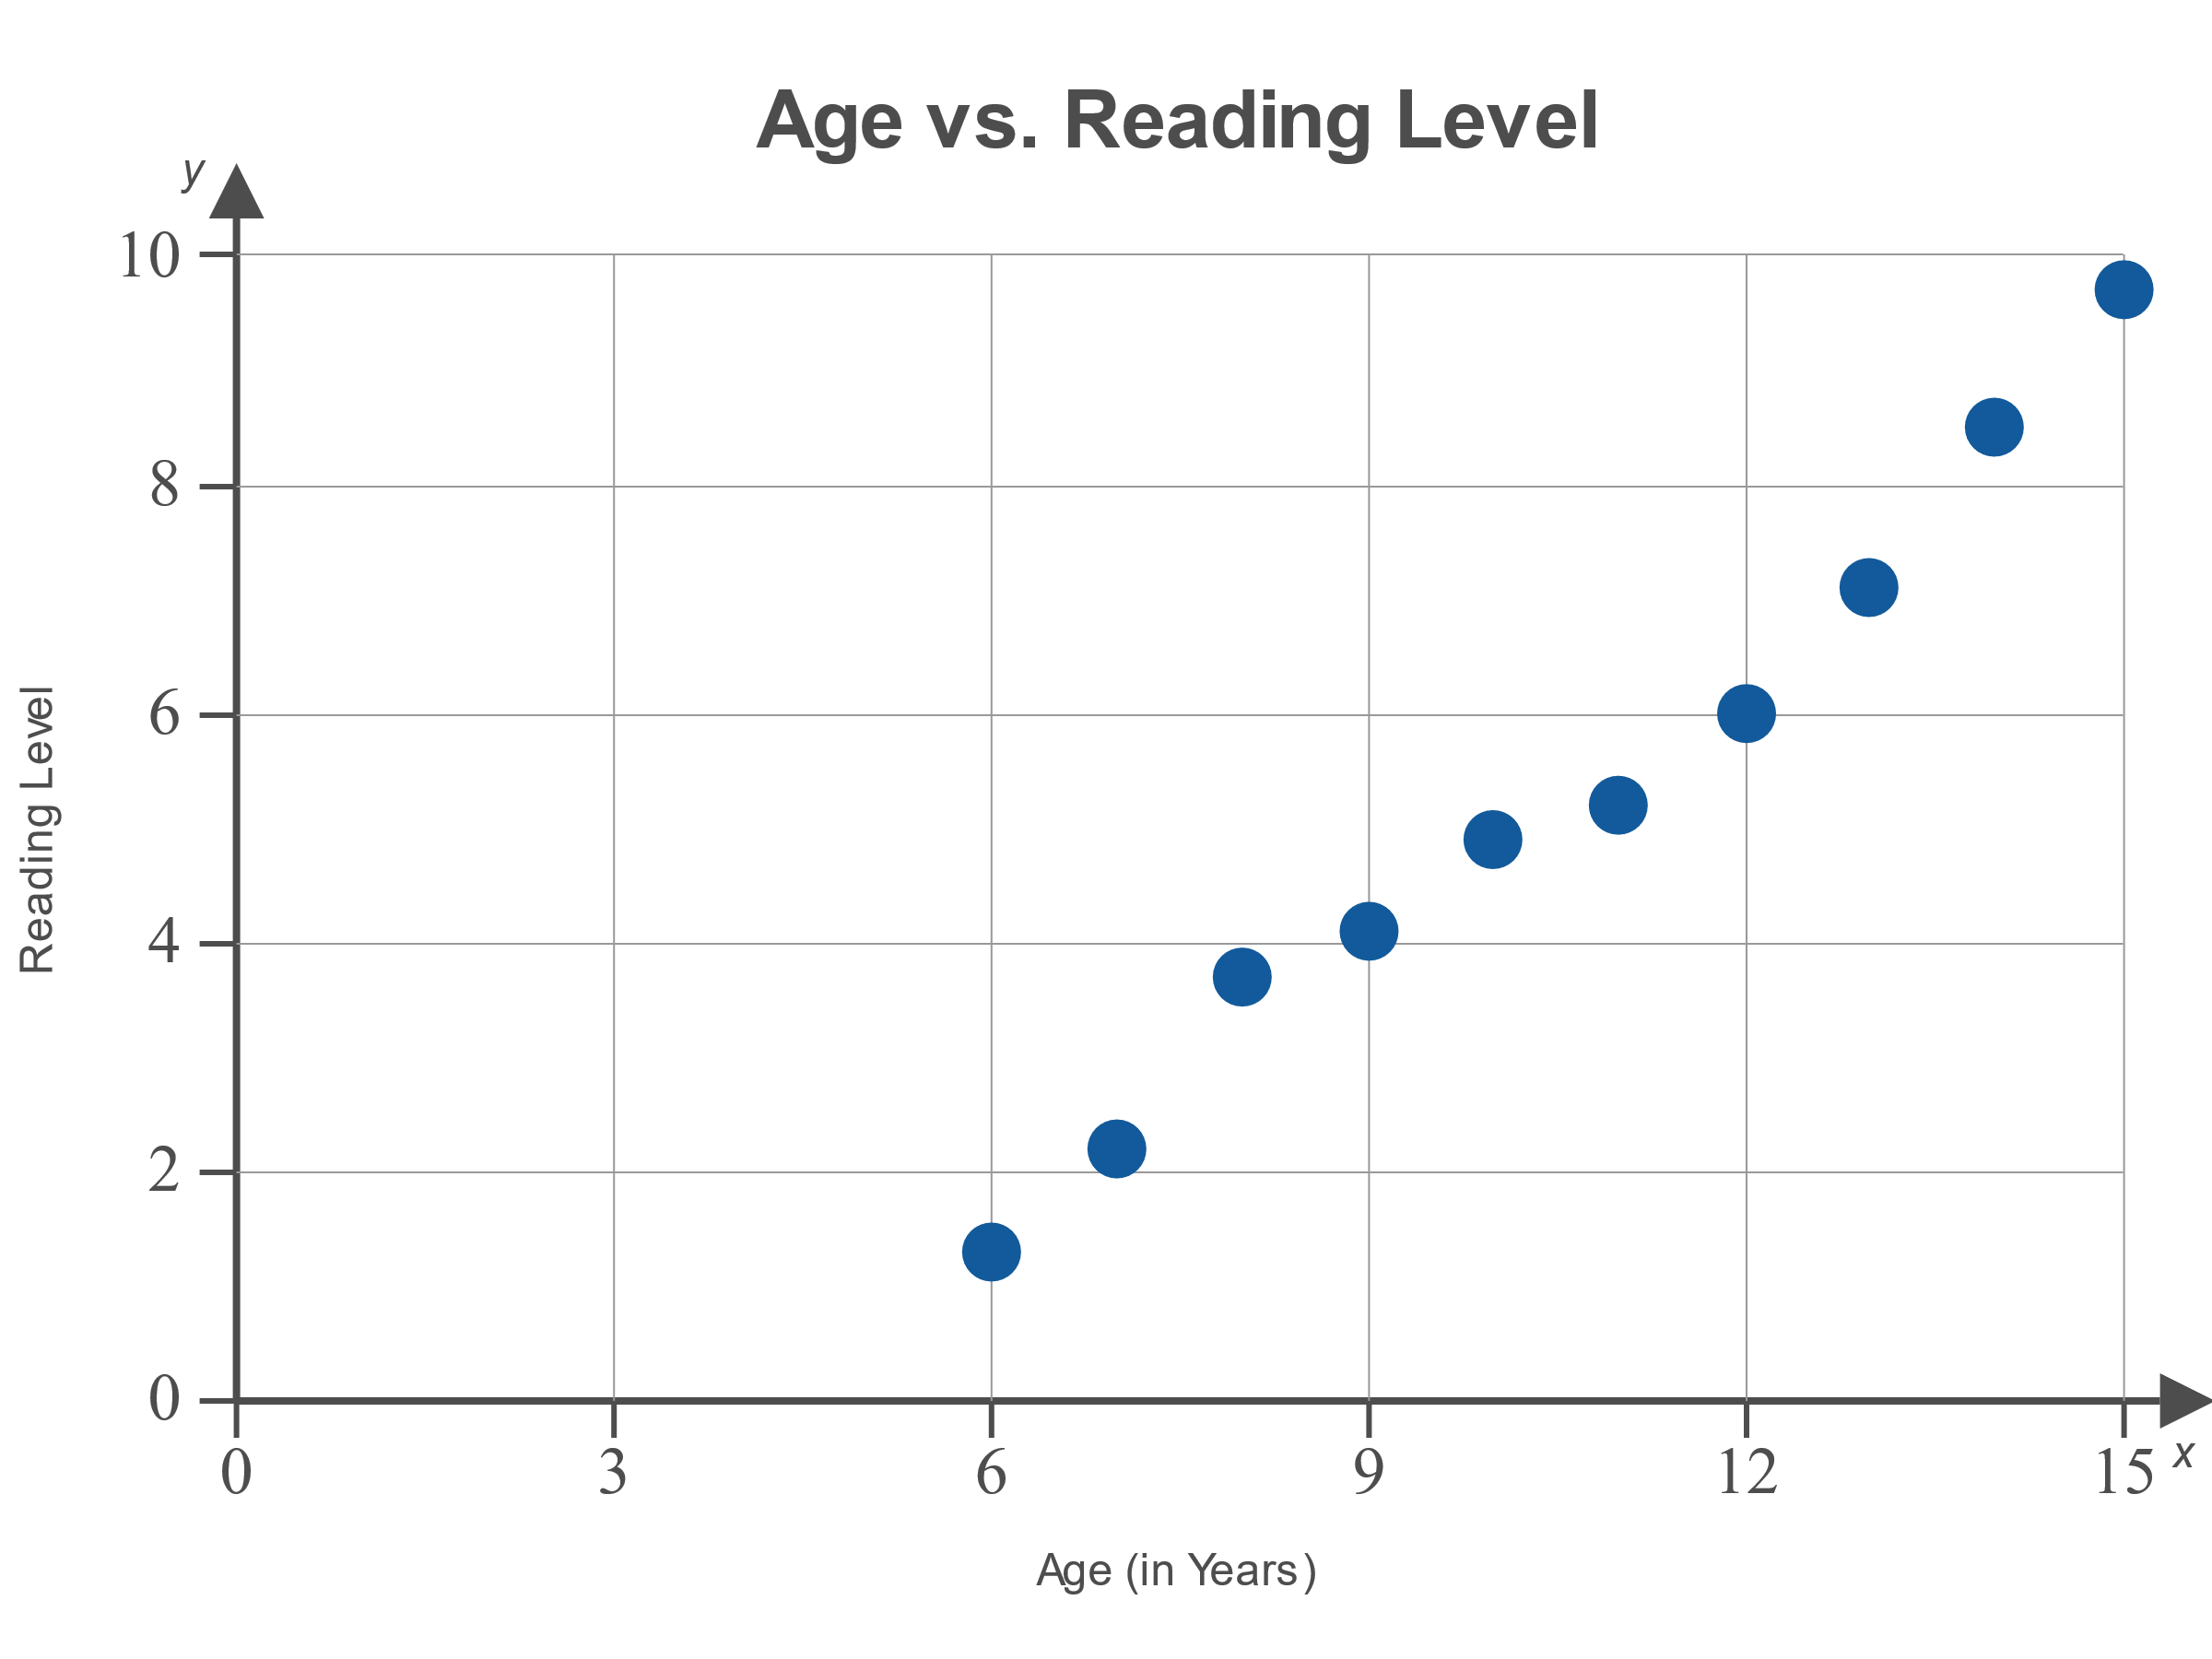
Example 12.3.1: Calculating Residuals Using an Estimated Regression Equation (cont.)

Slide 7
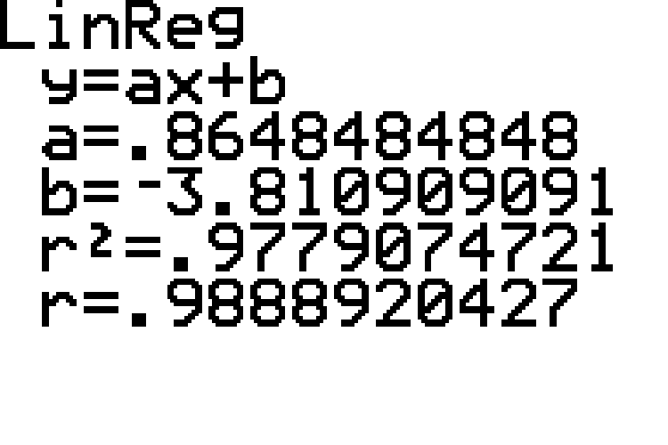
Example 12.3.1: Calculating Residuals Using an Estimated Regression Equation (cont.)

Slide 8

Example 12.3.1: Calculating Residuals Using an Estimated Regression Equation (cont.)
Use the regression equation to calculate an estimate, $\hat{y}$, for each value of $x$, and then use the estimate to calculate the residual for each value of $y$.

Slide 9
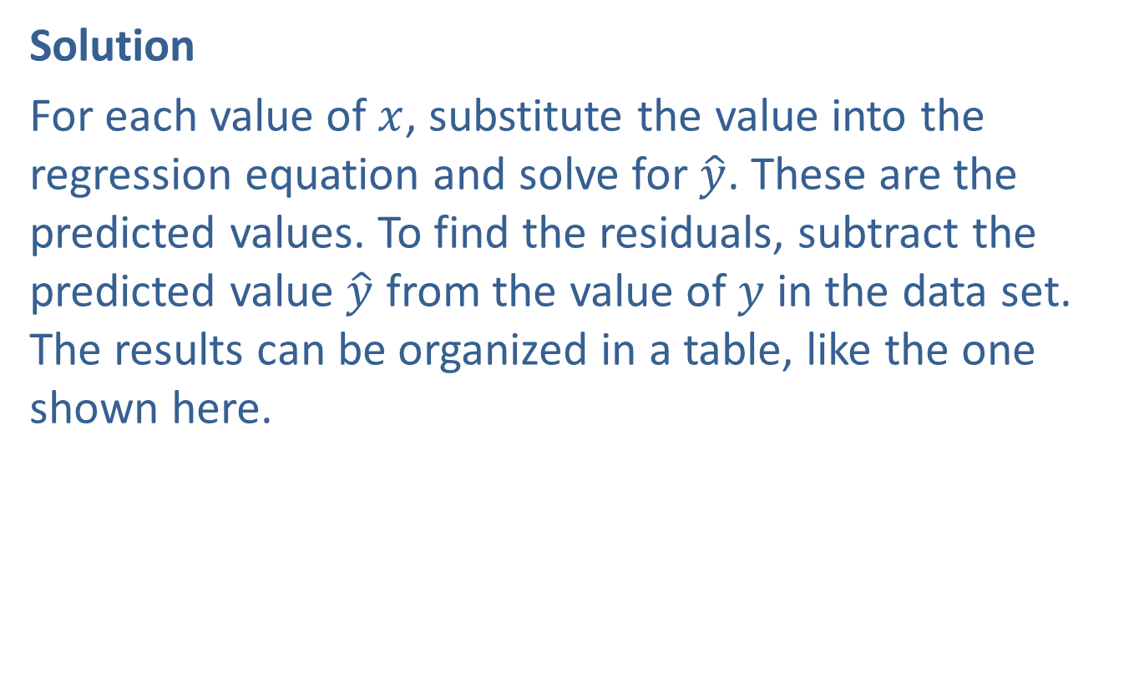
Example 12.3.1: Calculating Residuals Using an Estimated Regression Equation (cont.)
Solution
For each value of $x$, substitute the value into the regression equation and solve for $\hat{y}$. These are the predicted values. To find the residuals, subtract the predicted value $\hat{y}$ from the value of $y$ in the data set. The results can be organized in a table, like the one shown here.

Slide 10
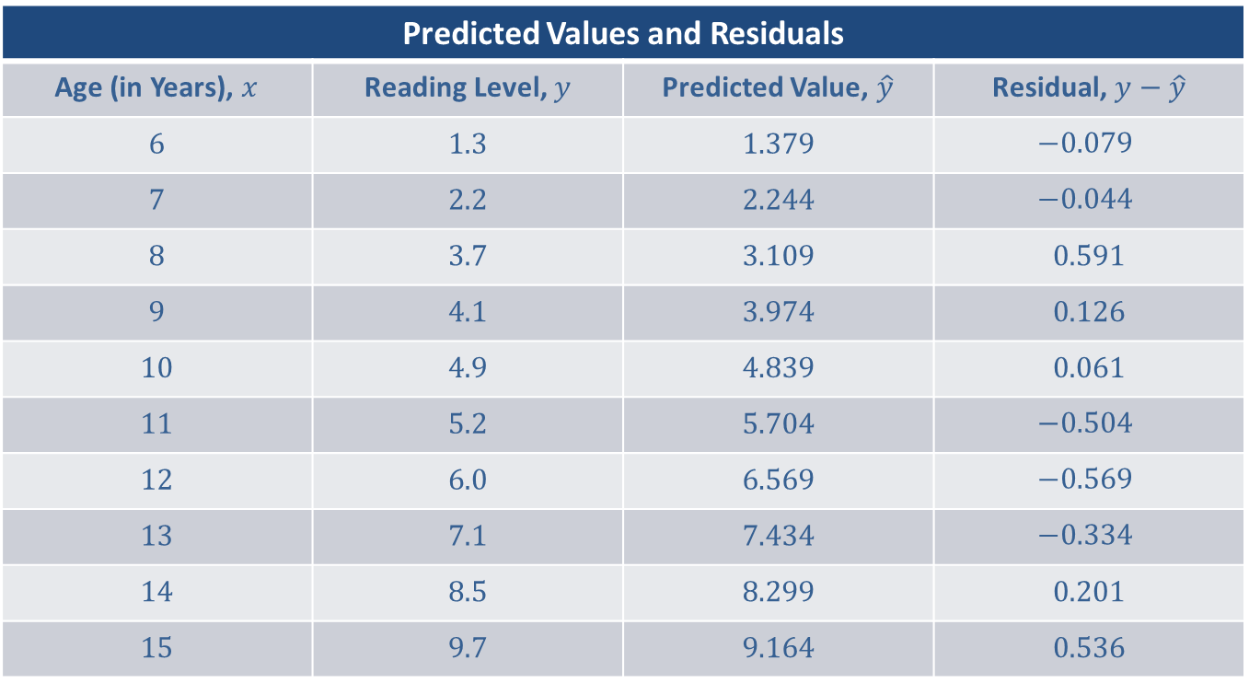
Example 12.3.1: Calculating Residuals Using an Estimated Regression Equation (cont.)
Predicted Values and Residuals
Age (in Years), $x$ | Reading Level, $y$ | Predicted Value, $\hat{y}$ | Residual, $y−\hat{y}$
6 | 1.3 | 1.379 | $$−0.079$$
7 | 2.2 | 2.244 | $$−0.044$$
8 | 3.7 | 3.109 | 0.591
9 | 4.1 | 3.974 | 0.126
10 | 4.9 | 4.839 | 0.061
11 | 5.2 | 5.704 | $$−0.504$$
12 | 6.0 | 6.569 | $$−0.569$$
13 | 7.1 | 7.434 | $$−0.334$$
14 | 8.5 | 8.299 | 0.201
15 | 9.7 | 9.164 | 0.536

Slide 11
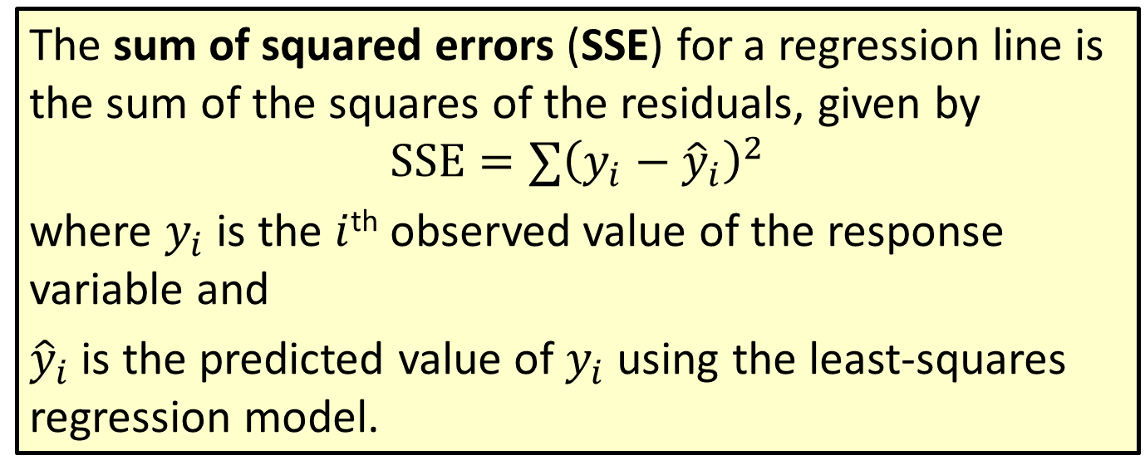
Formula: Sum of Squared Errors (SSE)
The sum of squared errors (SSE) for a regression line is the sum of the squares of the residuals, given by
$$SSE=∑{\left(y_{i}−{\hat{y}}_{i}\right)}^{2}$$
where $y_{i}$ is the $i$^{th} observed value of the response variable and
${\hat{y}}_{i}$ is the predicted value of $y_{i}$ using the least-squares regression model.

Slide 12
Example 12.3.2: Calculating the Sum of Squared Errors
Calculate the sum of squared errors, SSE, for the data regarding children's ages and reading levels from the previous example.

Slide 13
Example 12.3.2: Calculating the Sum of Squared Errors (cont.)
Solution
Using the values we calculated in the previous example, we begin by squaring each residual, or error, as shown in the following table.

Slide 14
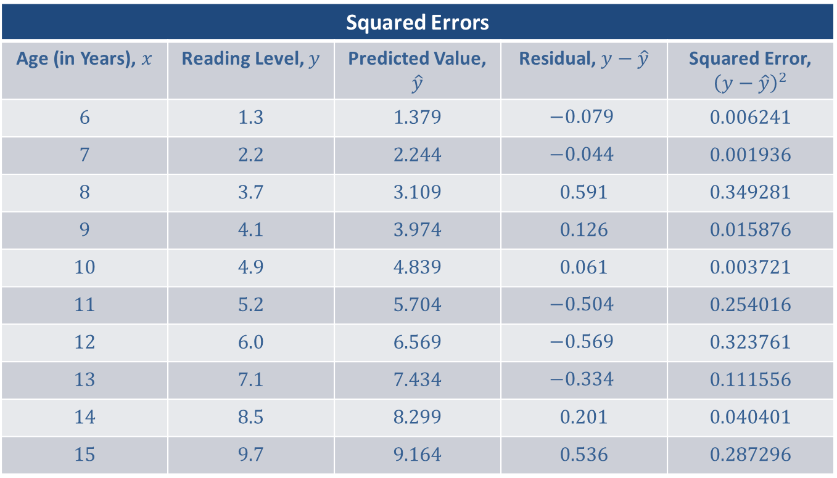
Example 12.3.2: Calculating the Sum of Squared Errors (cont.)
Squared Errors
Age (in Years), $x$ | Reading Level, $y$ | Predicted Value, $\hat{y}$ | Residual, $y−\hat{y}$ | Squared Error, ${\left(y−\hat{y}\right)}^{2}$
6 | 1.3 | 1.379 | $$−0.079$$ | 0.006241
7 | 2.2 | 2.244 | $$−0.044$$ | 0.001936
8 | 3.7 | 3.109 | 0.591 | 0.349281
9 | 4.1 | 3.974 | 0.126 | 0.015876
10 | 4.9 | 4.839 | 0.061 | 0.003721
11 | 5.2 | 5.704 | $$−0.504$$ | 0.254016
12 | 6.0 | 6.569 | $$−0.569$$ | 0.323761
13 | 7.1 | 7.434 | $$−0.334$$ | 0.111556
14 | 8.5 | 8.299 | 0.201 | 0.040401
15 | 9.7 | 9.164 | 0.536 | 0.287296

Slide 15

Example 12.3.2: Calculating the Sum of Squared Errors (cont.)
The last column lists the squares of the errors, or residual values. The sum of the squared errors is the sum of the values in this last column. Thus,
$SSE≈1.394$.

Slide 16
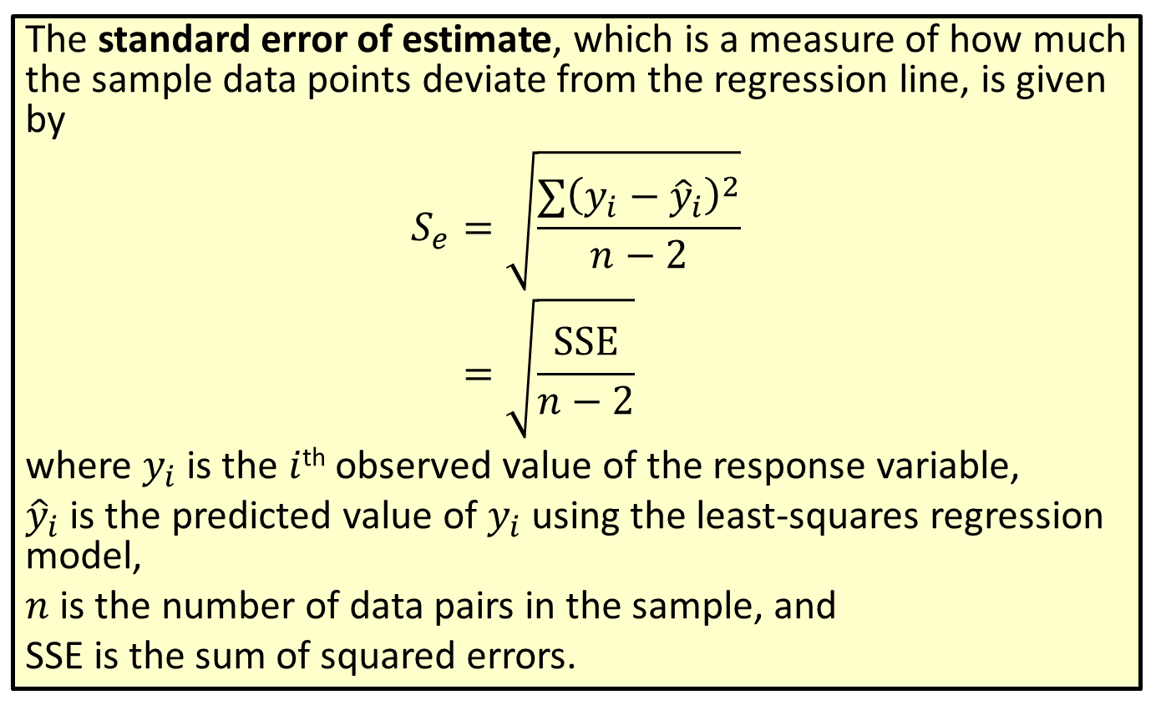
Formula: Standard Error of Estimate
The standard error of estimate, which is a measure of how much the sample data points deviate from the regression line, is given by
𝑆𝑒=∑𝑦𝑖−𝑦𝑖2𝑛−2𝑆𝑒=SSE𝑛−2
where $y_{i}$ is the $i$^{th} observed value of the response variable,
${\hat{y}}_{i}$ is the predicted value of $y_{i}$ using the least-squares regression model,
$n$ is the number of data pairs in the sample, and
SSE is the sum of squared errors.

Slide 17
Memory Booster:
The closer the standard error of value is to 0, the less the data points deviate from the regression line.

Slide 18
Example 12.3.3: Calculating the Standard Error of Estimate
Calculate the standard error of estimate for the data regarding children's ages and reading levels using the information from the previous two examples.

Slide 19
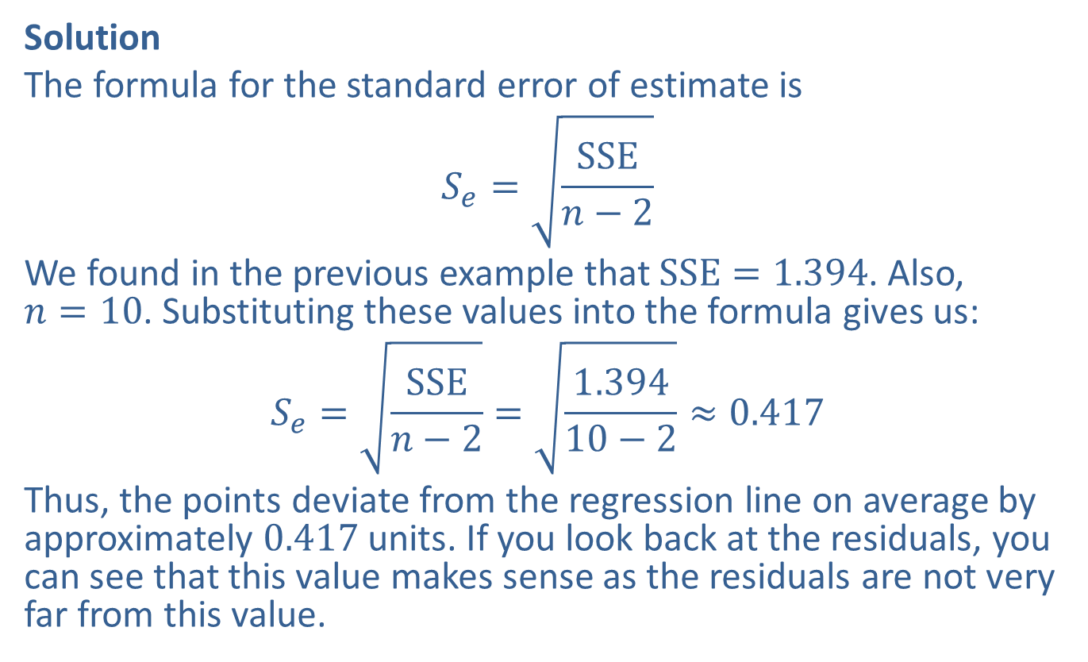
Example 12.3.3: Calculating the Standard Error of Estimate (cont.)
Solution
The formula for the standard error of estimate is
$$S_{e}=\sqrt{\frac{SSE}{n−2}}$$
We found in the previous example that $SSE=1.394$. Also,
$n=10$. Substituting these values into the formula gives us:
$$S_{e}=\sqrt{\frac{SSE}{n−2}}=\sqrt{\frac{1.394}{10−2}}≈0.417$$
Thus, the points deviate from the regression line on average by approximately 0.417 units. If you look back at the residuals, you can see that this value makes sense as the residuals are not very far from this value.

Slide 20
Example 12.3.4: Calculating the Standard Error of Estimate
Investors analyze the correlation of two stocks in a portfolio to help determine if the stocks move together or not, which can help determine the risk of the portfolio. Consider the data shown regarding the opening price of two common stocks, Apple, Inc. (AAPL) and Amazon.com (AMZN), for the first 20 days of 2019. Based on these data, these stocks have a linear relationship that is statistically significant at the 0.05 level of significance. Calculate the standard error of estimate for these data.

Slide 21
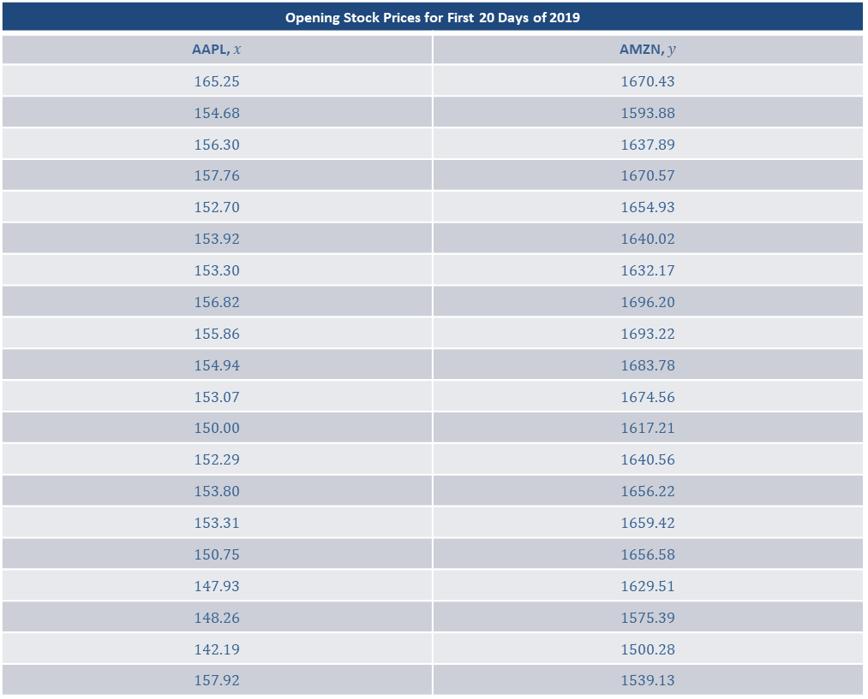
Example 12.3.4: Calculating the Standard Error of Estimate (cont.)
Opening Stock Prices for First 20 Days of 2019
AAPL, $x$ | AMZN, $y$
165.25 | 1670.43
154.68 | 1593.88
156.30 | 1637.89
157.76 | 1670.57
152.70 | 1654.93
153.92 | 1640.02
153.30 | 1632.17
156.82 | 1696.20
155.86 | 1693.22
154.94 | 1683.78
153.07 | 1674.56
150.00 | 1617.21
152.29 | 1640.56
153.80 | 1656.22
153.31 | 1659.42
150.75 | 1656.58
147.93 | 1629.51
148.26 | 1575.39
142.19 | 1500.28
157.92 | 1539.13

Slide 22
Example 12.3.4: Calculating the Standard Error of Estimate (cont.)
Source: Nasdaq. "Amazon.com, Inc. Common Stock Historical Stock Prices." 11 March 2019. https://www.nasdaq.com/symbol/amzn/historical (15 March 2019). Source: Nasdaq. "Apple Inc. Common Stock Historical Stock Prices." 11 March 2019. https://www.nasdaq.com/symbol/aapl/historical (15 March 2019).

Slide 23
Example 12.3.4: Calculating the Standard Error of Estimate (cont.)
Solution
We will use a TI-83/84 Plus calculator to find the solution for this example. Begin by entering the AAPL data into L1 and the AMZN data in L2. Under the STAT menu, choose TESTS and option LinRegTTest. Enter L1 for the Xlist and L2 for the Ylist. The value entered for the option Freq should be 1. Choose ≠0 for the alternative hypothesis to test the significance of the linear relationship. Enter the regression equation into RegEQ if you have already calculated it. If not, you may leave this blank. Choose Calculate.

Slide 24
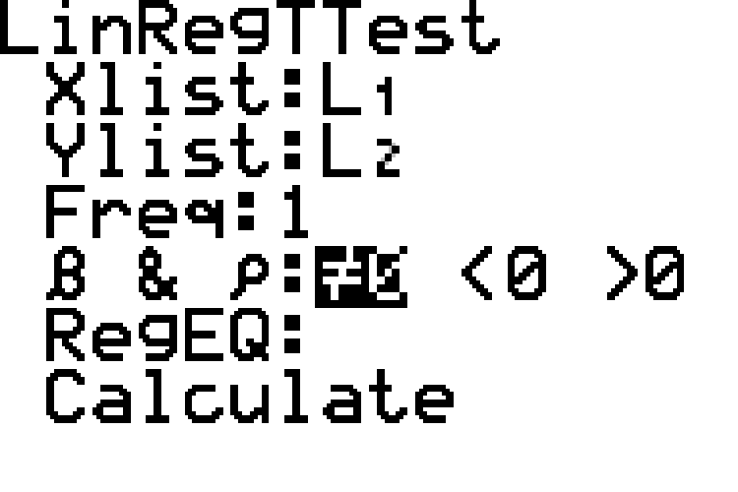
Example 12.3.4: Calculating the Standard Error of Estimate (cont.)

Slide 25
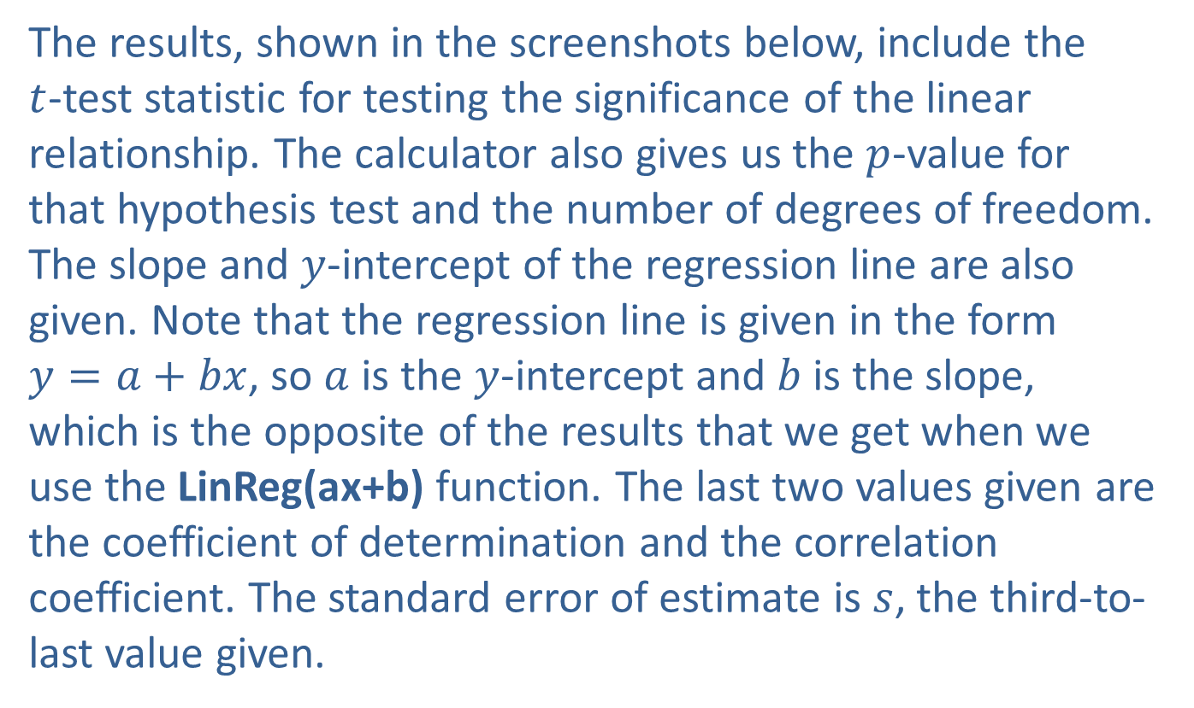
Example 12.3.4: Calculating the Standard Error of Estimate (cont.)
The results, shown in the screenshots below, include the
$t$-test statistic for testing the significance of the linear relationship. The calculator also gives us the $p$-value for that hypothesis test and the number of degrees of freedom. The slope and $y$-intercept of the regression line are also given. Note that the regression line is given in the form
$y=a+bx$, so $a$ is the $y$-intercept and $b$ is the slope, which is the opposite of the results that we get when we use the LinReg(ax+b) function. The last two values given are the coefficient of determination and the correlation coefficient. The standard error of estimate is $s$, the third-to-last value given.

Slide 26
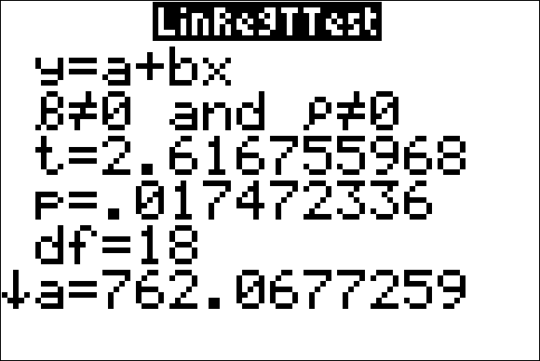
Example 12.3.4: Calculating the Standard Error of Estimate (cont.)

Slide 27
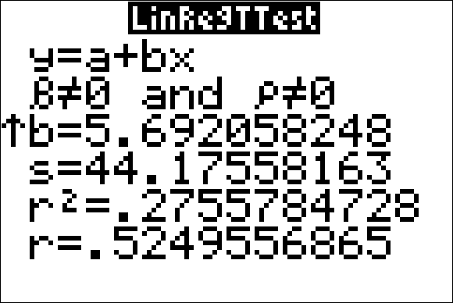
Example 12.3.4: Calculating the Standard Error of Estimate (cont.)

Slide 28
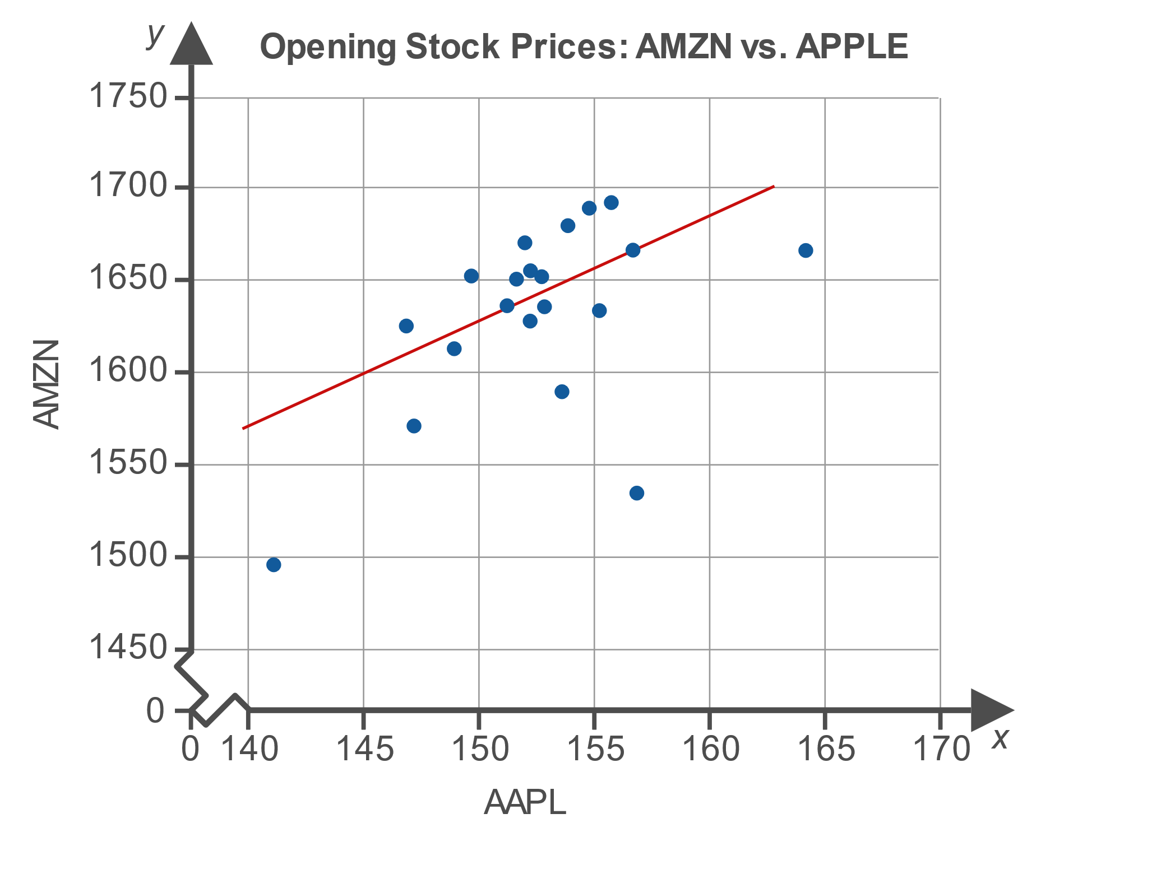
Example 12.3.4: Calculating the Standard Error of Estimate (cont.)

Slide 29
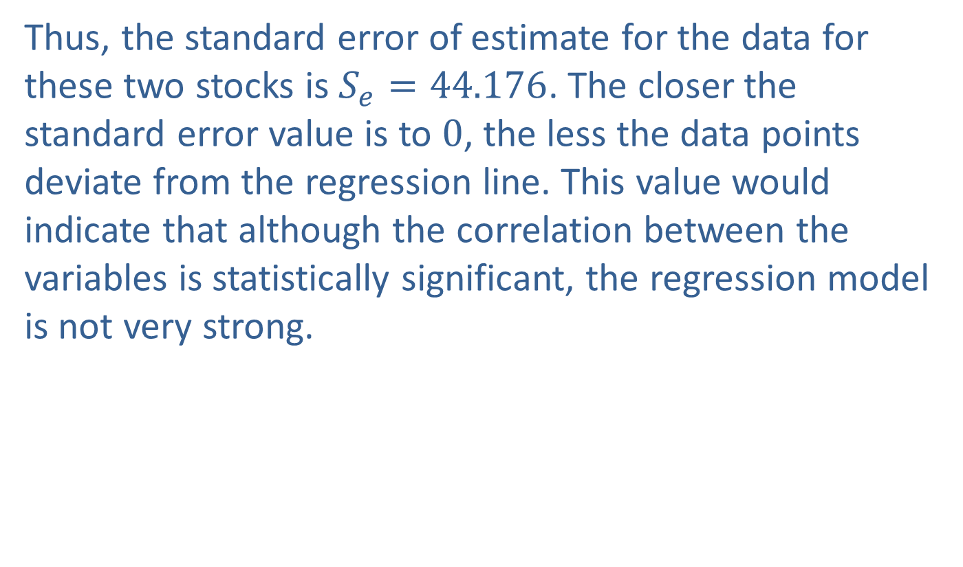
Example 12.3.4: Calculating the Standard Error of Estimate (cont.)
Thus, the standard error of estimate for the data for these two stocks is $S_{e}=44.176$. The closer the standard error value is to 0, the less the data points deviate from the regression line. This value would indicate that although the correlation between the variables is statistically significant, the regression model is not very strong.

Slide 30
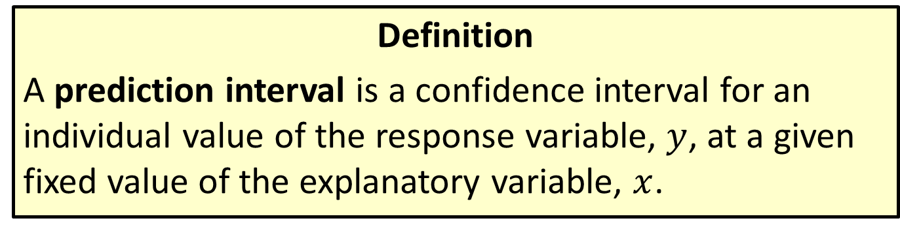
Prediction Interval
Definition
A prediction interval is a confidence interval for an individual value of the response variable, $y$, at a given fixed value of the explanatory variable, $x$.

Slide 31
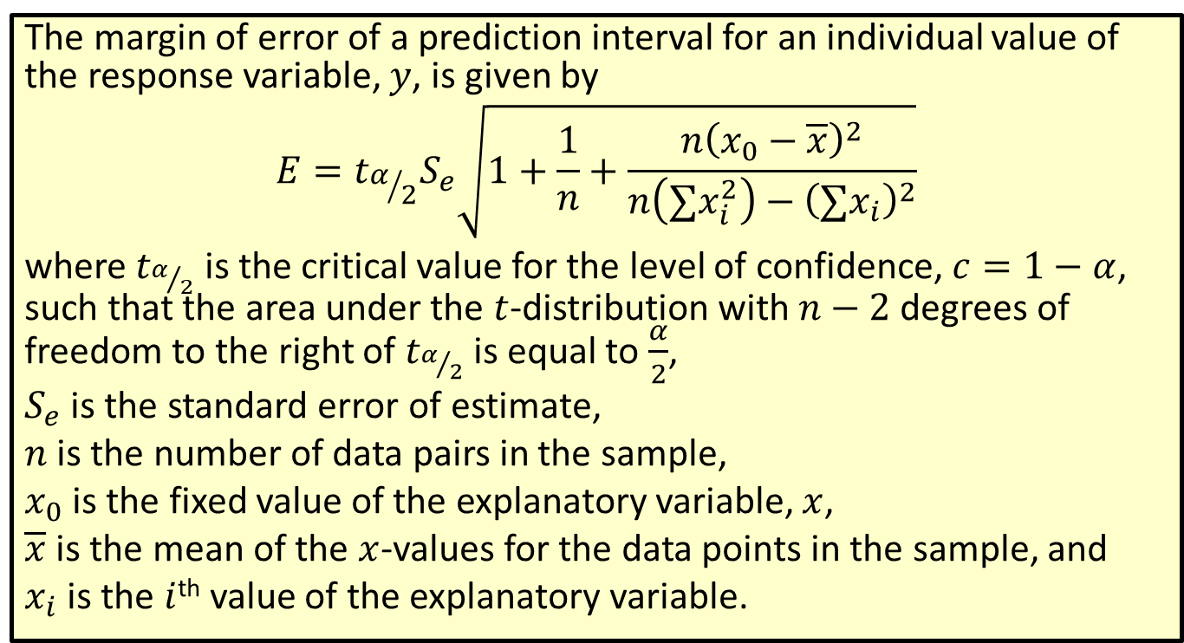

Formula: Margin of Error of a Prediction Interval for an Individual $y$-Value
The margin of error of a prediction interval for an individual value of the response variable, $y$, is given by
$$E=t_{α/2}S_{e}\sqrt{1+\frac{1}{n}+\frac{n{\left(x_{0}−\overline{x}\right)}^{2}}{n\left(∑x_{i}^{2}\right)−{\left(∑x_{i}\right)}^{2}}}$$
where $t_{α/2}$ is the critical value for the level of confidence, $c=1−α$, such that the area under the $t$-distribution with $n−2$ degrees of freedom to the right of $t_{α/2}$ is equal to $\frac{α}{2}$,
$S_{e}$ is the standard error of estimate,
$n$ is the number of data pairs in the sample,
$x_{0}$ is the fixed value of the explanatory variable, $x$,
$\overline{x}$ is the mean of the $x$-values for the data points in the sample, and
$x_{i}$ is the $i$^{th} value of the explanatory variable.

Slide 32
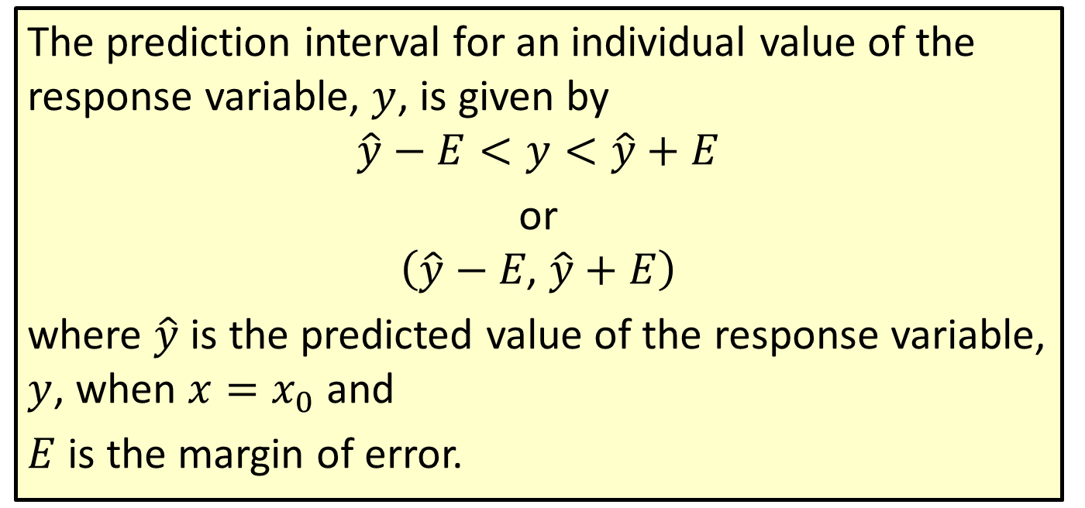

Formula: Prediction Interval for an Individual $y$-Value
The prediction interval for an individual value of the response variable, $y$, is given by
$$\hat{y}−E<y<\hat{y}+E$$
or
$$\left(\hat{y}−E\text{, }\hat{y}+E\right)$$
where $\hat{y}$ is the predicted value of the response variable, $y$, when $x=x_{0}$ and
$E$ is the margin of error.

Slide 33

Example 12.3.5: Constructing a Prediction Interval for an Individual y-Value
Using the data given in Example 12.3.4, construct a $95\%$ prediction interval for the opening price of Amazon stock corresponding to an opening price of $\$150$ for Apple, Inc. stock.

Slide 34
Example 12.3.5: Constructing a Prediction Interval for an Individual y-Value (cont.)
Solution
Neither a TI-83/84 Plus calculator nor Microsoft Excel will directly calculate a prediction interval, so we must calculate the margin of error by hand and use this value to construct the prediction interval.

Slide 35
Example 12.3.5: Constructing a Prediction Interval for an Individual y-Value (cont.)
Step 1: Find the regression equation for the sample data.
Using your choice of technology, find the regression equation from the sample data. For the purposes of this example, we are using a TI-83/84 Plus calculator. Enter the prices for the Apple, Inc. stock in L1 and for the Amazon stock in L2. From the STAT > CALC menu, choose option LinReg(ax+b).

Slide 36
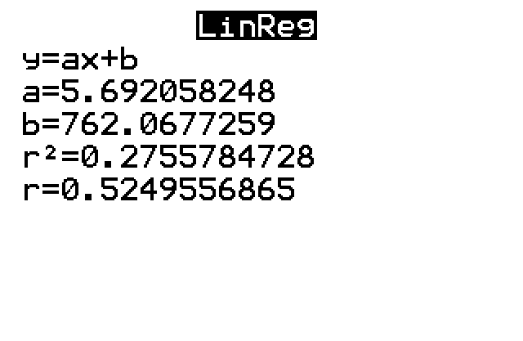
Example 12.3.5: Constructing a Prediction Interval for an Individual y-Value (cont.)

Slide 37

Example 12.3.5: Constructing a Prediction Interval for an Individual y-Value (cont.)
From the screenshot of the output, we can see that the slope is 5.692 and the $y$-intercept is 762.068. Thus, the linear regression equation is as follows:
$$\hat{y}=762.068+5.692x$$

Slide 38
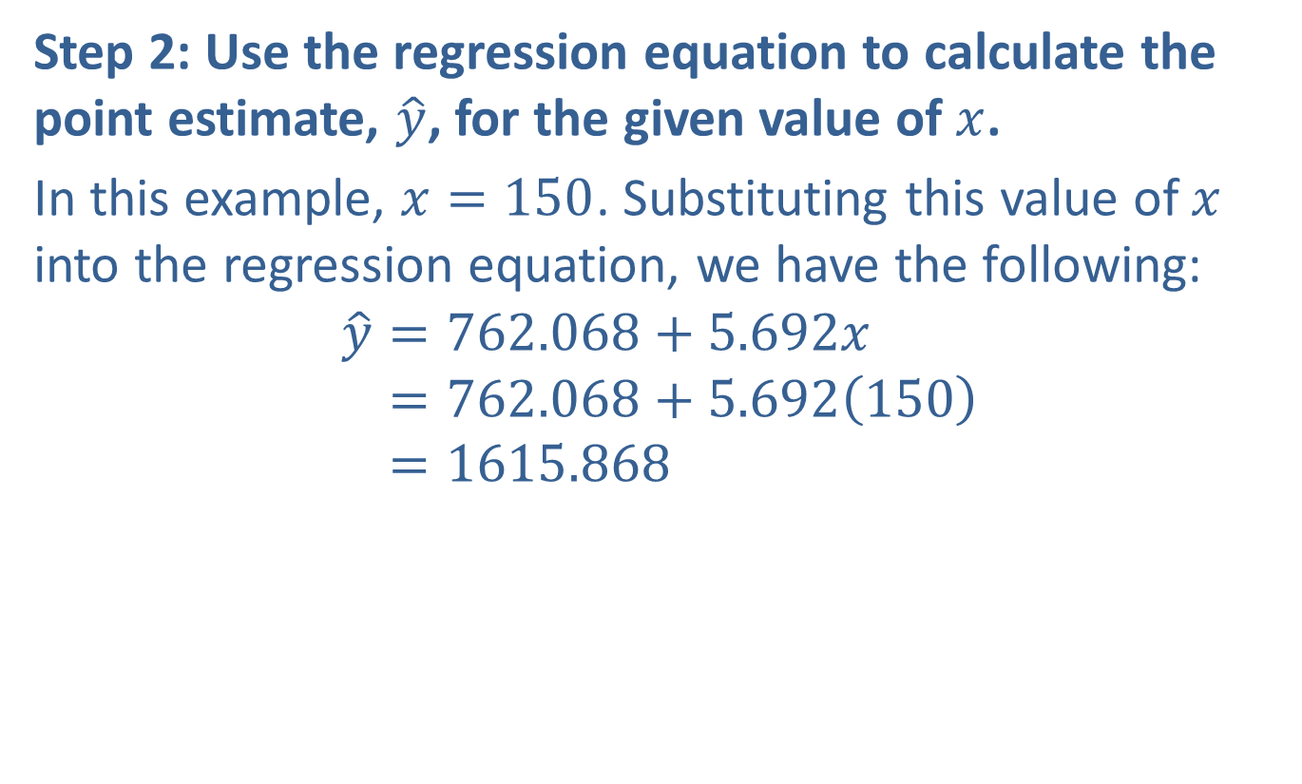
Example 12.3.5: Constructing a Prediction Interval for an Individual y-Value (cont.)
Step 2: Use the regression equation to calculate the point estimate, $\hat{y}$, for the given value of $x$.
In this example, $x=150$. Substituting this value of $x$ into the regression equation, we have the following:
𝑦=762.068+5.692𝑥𝑦=762.068+5.692150𝑦=1615.868

Slide 39
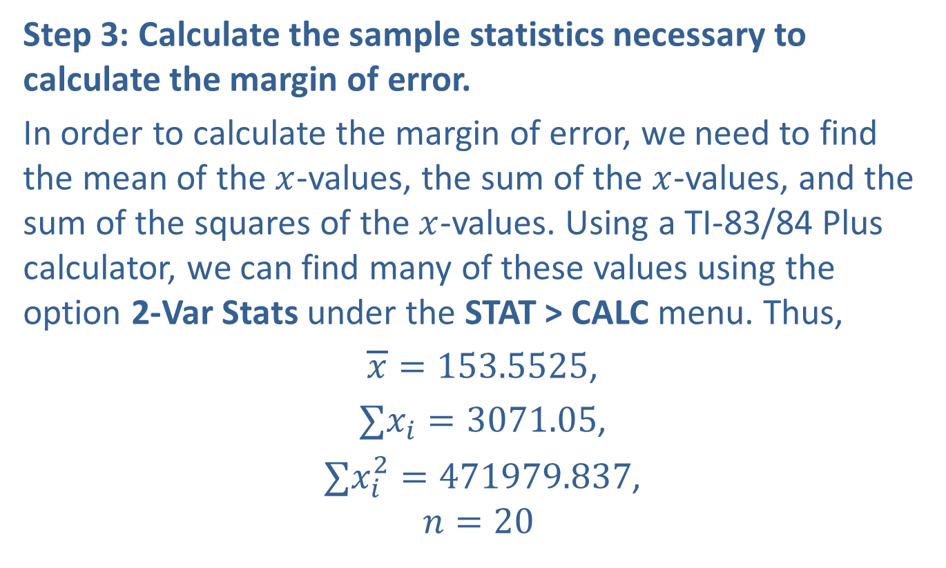
Example 12.3.5: Constructing a Prediction Interval for an Individual y-Value (cont.)
Step 3: Calculate the sample statistics necessary to calculate the margin of error.
In order to calculate the margin of error, we need to find the mean of the $x$-values, the sum of the $x$-values, and the sum of the squares of the $x$-values. Using a TI-83/84 Plus calculator, we can find many of these values using the option 2-Var Stats under the STAT > CALC menu. Thus,
$\overline{x}=153.5525$,
$∑x_{i}=3071.05$,
$∑x_{i}^{2}=471979.837$,
$$n=20$$

Slide 40
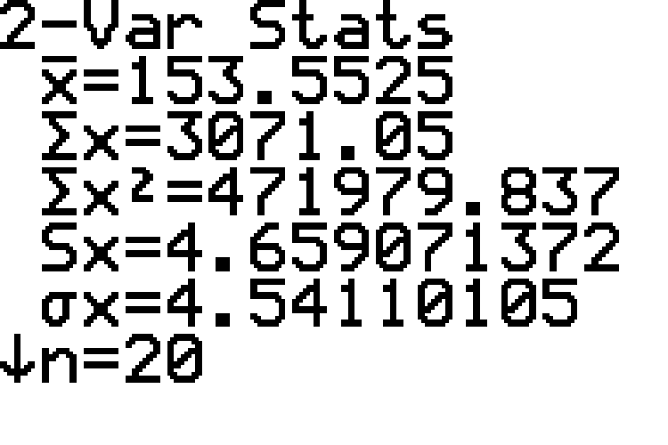
Example 12.3.5: Constructing a Prediction Interval for an Individual y-Value (cont.)

Slide 41
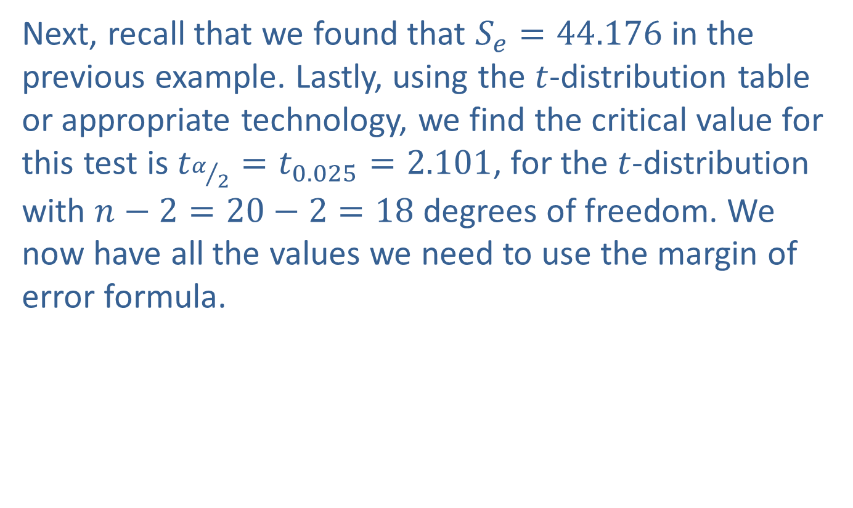
Example 12.3.5: Constructing a Prediction Interval for an Individual y-Value (cont.)
Next, recall that we found that $S_{e}=44.176$ in the previous example. Lastly, using the $t$-distribution table or appropriate technology, we find the critical value for this test is $t_{α/2}=t_{0.025}=2.101$, for the $t$-distribution with $n−2=20−2=18$ degrees of freedom. We now have all the values we need to use the margin of error formula.

Slide 42
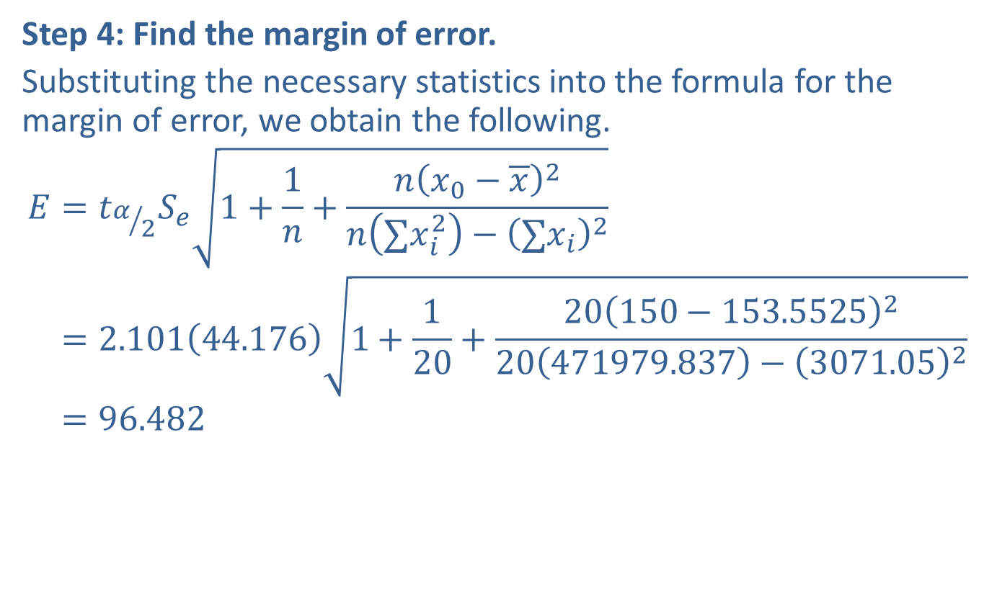
Example 12.3.5: Constructing a Prediction Interval for an Individual y-Value (cont.)
Step 4: Find the margin of error.
Substituting the necessary statistics into the formula for the margin of error, we obtain the following.
𝐸=𝑡𝛼2𝑆𝑒1+1𝑛+𝑛𝑥0−𝑥2𝑛∑𝑥𝑖2−∑𝑥𝑖2𝐸=2.10144.1761+120+20150−153.5525220471979.837−3071.052𝐸=96.482

Slide 43
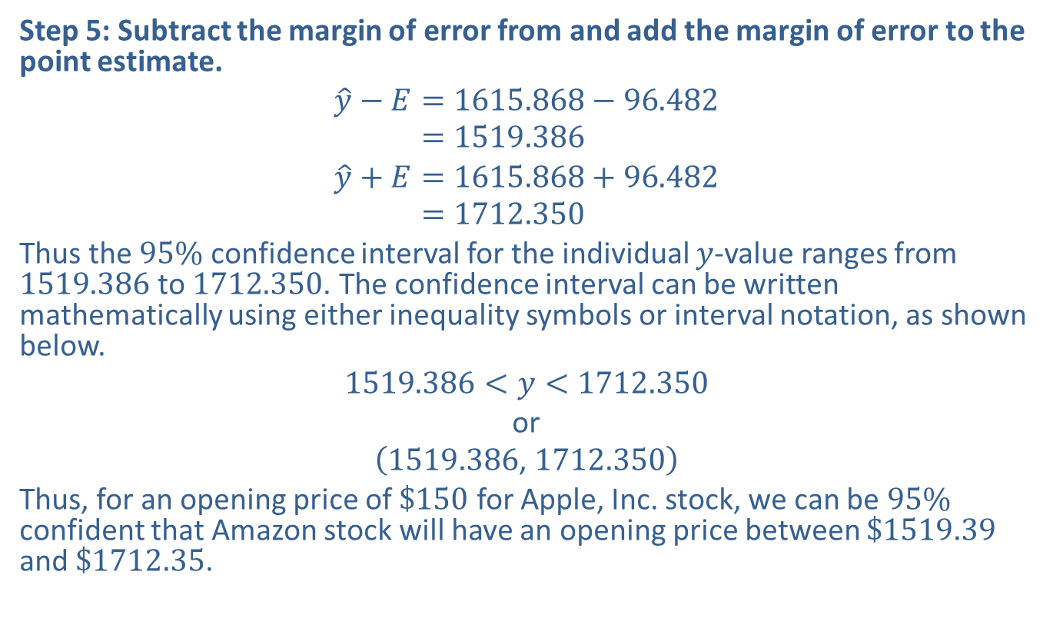
Example 12.3.5: Constructing a Prediction Interval for an Individual y-Value (cont.)
Step 5: Subtract the margin of error from and add the margin of error to the point estimate.
𝑦−𝐸=1615.868−96.482𝑦−𝐸=1519.386
𝑦+𝐸=1615.868+96.482𝑦−𝐸=1712.350
Thus the $95\%$ confidence interval for the individual $y$-value ranges from 1519.386 to 1712.350. The confidence interval can be written mathematically using either inequality symbols or interval notation, as shown below.
$$1519.386<y<1712.350$$
or
$$\left(1519.386\text{, }1712.350\right)$$
Thus, for an opening price of $\$150$ for Apple, Inc. stock, we can be $95\%$ confident that Amazon stock will have an opening price between $\$1519.39$ and $\$1712.35$.

Slide 44
Technology
For instructions on finding a prediction interval using Minitab or other technologies, please visit stat.hawkeslearning.com and see Technology Instructions > Regression > Regression Prediction Intervals.

Slide 45
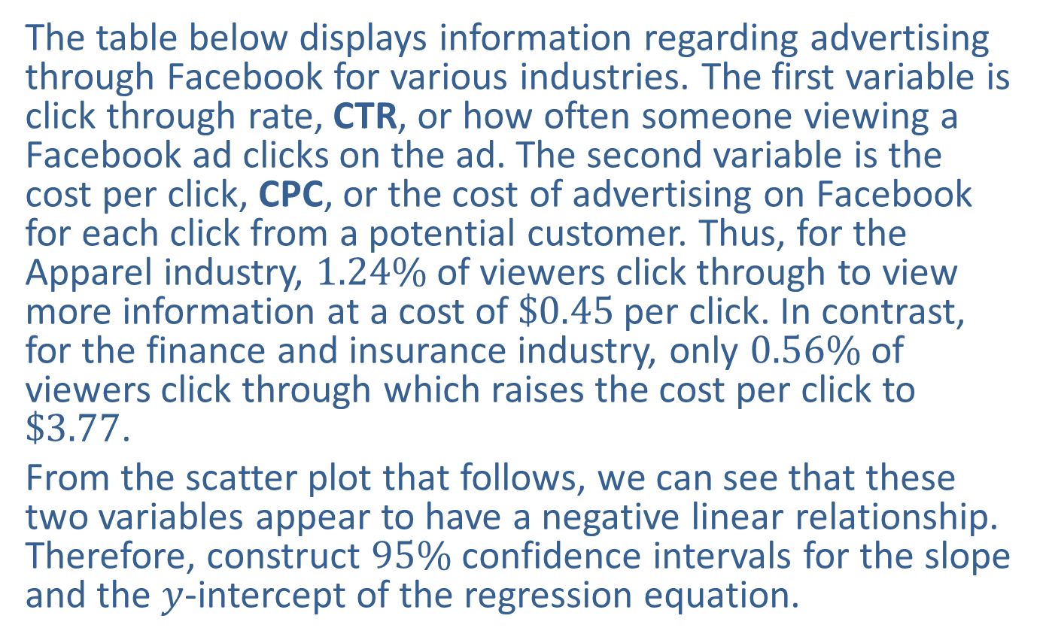

Example 12.3.6: Constructing Confidence Intervals for $β_{0}$ and $β_{1}$
The table below displays information regarding advertising through Facebook for various industries. The first variable is click through rate, CTR, or how often someone viewing a Facebook ad clicks on the ad. The second variable is the cost per click, CPC, or the cost of advertising on Facebook for each click from a potential customer. Thus, for the Apparel industry, $1.24\%$ of viewers click through to view more information at a cost of $\$0.45$ per click. In contrast, for the finance and insurance industry, only $0.56\%$ of viewers click through which raises the cost per click to $\$3.77$.
From the scatter plot that follows, we can see that these two variables appear to have a negative linear relationship. Therefore, construct $95\%$ confidence intervals for the slope and the $y$-intercept of the regression equation.

Slide 46
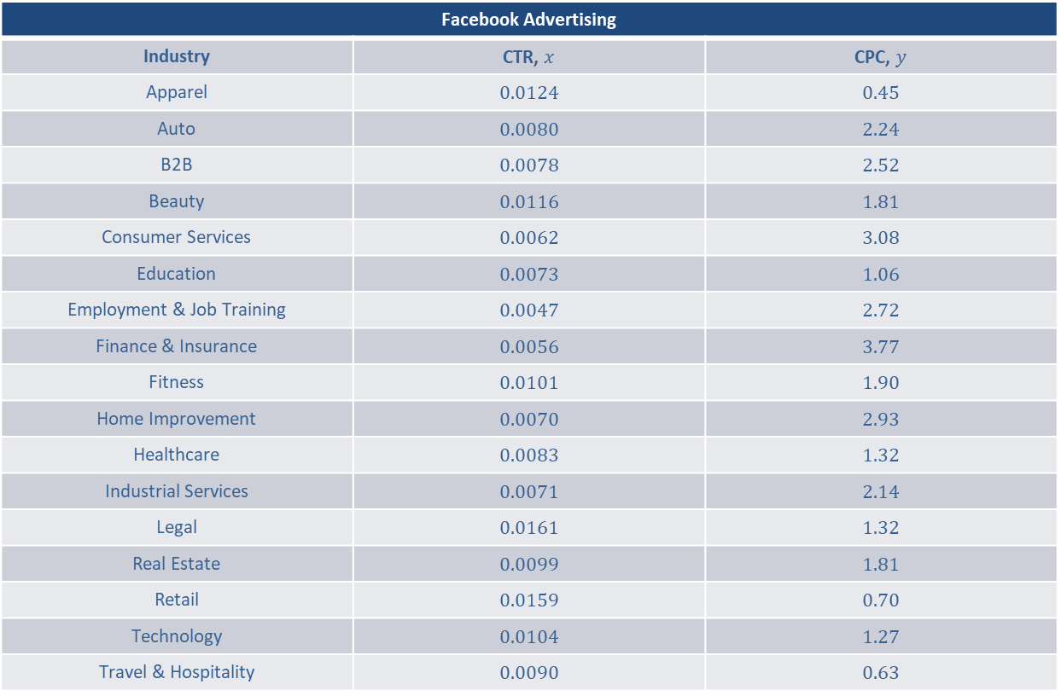

Example 12.3.6: Constructing Confidence Intervals for $β_{0}$ and $β_{1}$ (cont.)
Facebook Advertising
Industry | CTR, $x$ | CPC, $y$
Apparel | 0.0124 | 0.45
Auto | 0.0080 | 2.24
B2B | 0.0078 | 2.52
Beauty | 0.0116 | 1.81
Consumer Services | 0.0062 | 3.08
Education | 0.0073 | 1.06
Employment & Job Training | 0.0047 | 2.72
Finance & Insurance | 0.0056 | 3.77
Fitness | 0.0101 | 1.90
Home Improvement | 0.0070 | 2.93
Healthcare | 0.0083 | 1.32
Industrial Services | 0.0071 | 2.14
Legal | 0.0161 | 1.32
Real Estate | 0.0099 | 1.81
Retail | 0.0159 | 0.70
Technology | 0.0104 | 1.27
Travel & Hospitality | 0.0090 | 0.63

Slide 47
Example 12.3.6: Constructing Confidence Intervals for $β_{0}$ and $β_{1}$ (cont.)
Source: Irvine, Mark. Wordstream. "Facebook Ad Benchmarks for YOUR Industry [New Data]." 19 Feb. 2019. https://www.wordstream.com/blog/ws/2017/02/28/facebook-advertising-benchmarks (19 Feb. 2019).

Slide 48
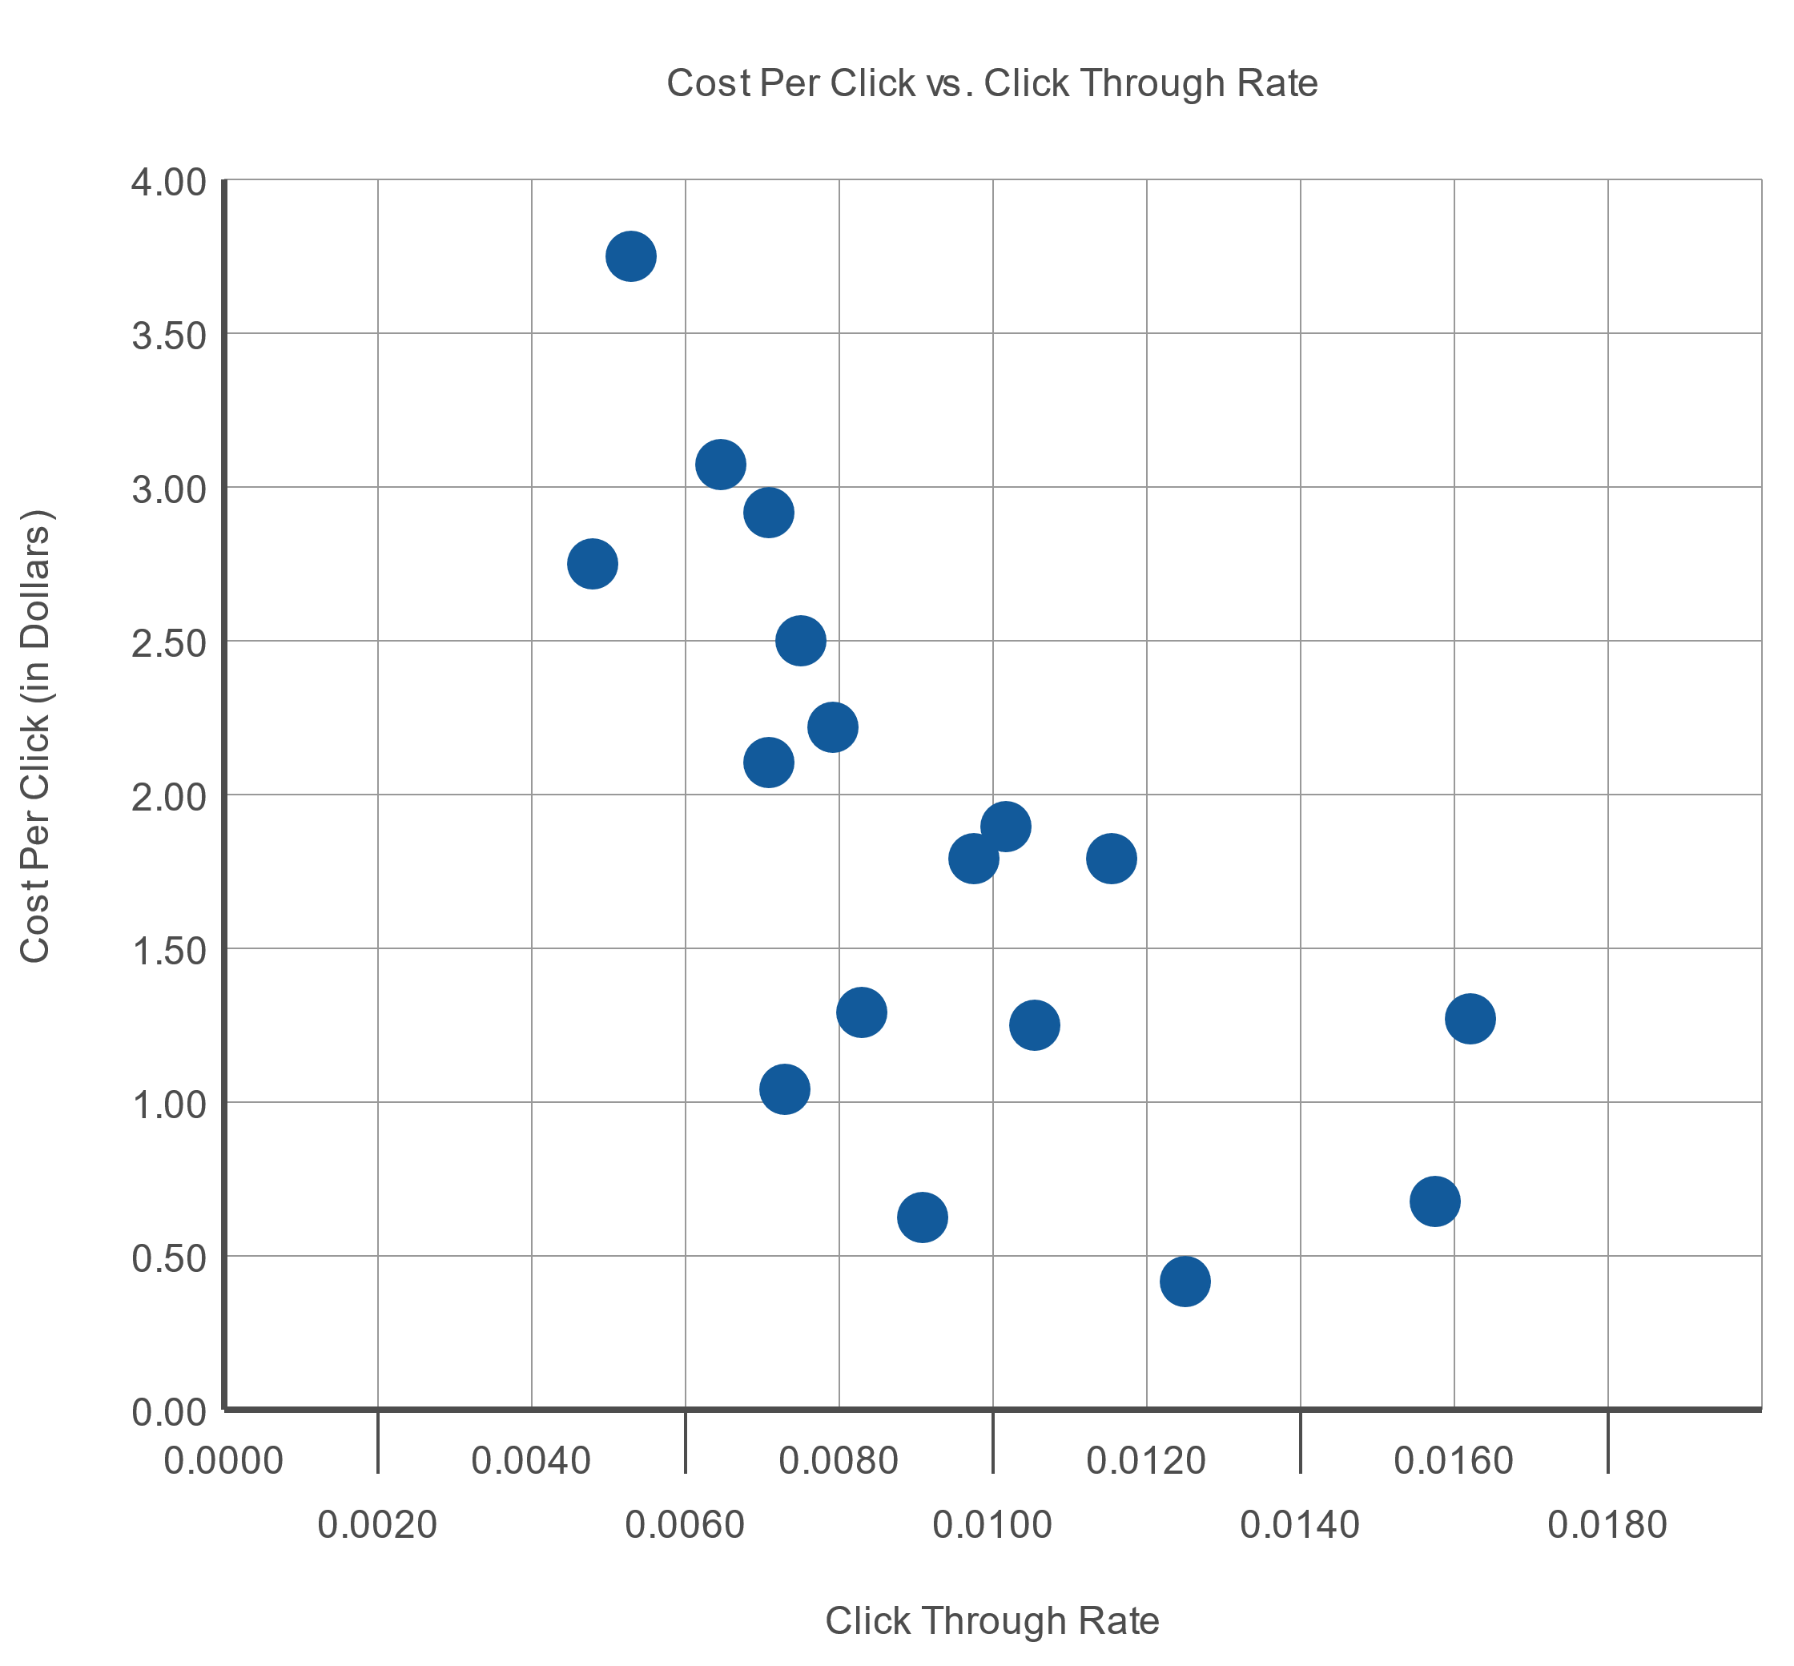
Example 12.3.6: Constructing Confidence Intervals for $β_{0}$ and $β_{1}$ (cont.)

Slide 49
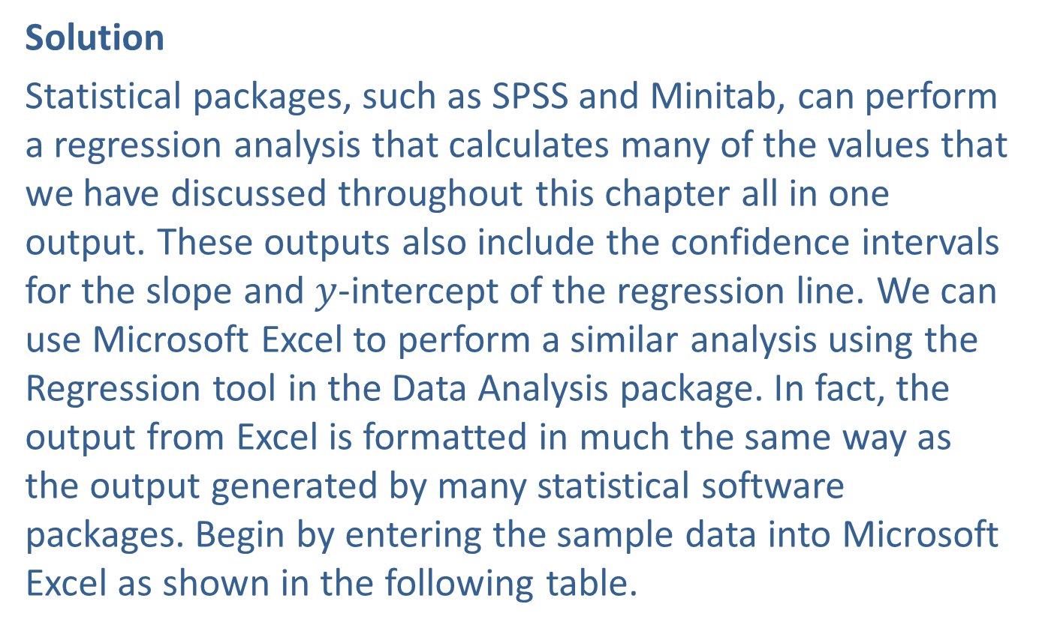
Example 12.3.6: Constructing Confidence Intervals for $β_{0}$ and $β_{1}$ (cont.)
Solution
Statistical packages, such as SPSS and Minitab, can perform a regression analysis that calculates many of the values that we have discussed throughout this chapter all in one output. These outputs also include the confidence intervals for the slope and $y$-intercept of the regression line. We can use Microsoft Excel to perform a similar analysis using the Regression tool in the Data Analysis package. In fact, the output from Excel is formatted in much the same way as the output generated by many statistical software packages. Begin by entering the sample data into Microsoft Excel as shown in the following table.

Slide 50
Example 12.3.6: Constructing Confidence Intervals for $β_{0}$ and $β_{1}$ (cont.)
 | A | B
1 | CTR | CPC
2 | 0.0124 | 0.45
3 | 0.0080 | 2.24
4 | 0.0078 | 2.52
5 | 0.0116 | 1.81
6 | 0.0062 | 3.08
7 | 0.0073 | 1.06
8 | 0.0047 | 2.72
9 | 0.0056 | 3.77
10 | 0.0101 | 1.90
11 | 0.0070 | 2.93
12 | 0.0083 | 1.32
13 | 0.0071 | 2.14
14 | 0.0161 | 1.32
15 | 0.0099 | 1.81
16 | 0.0159 | 0.70
17 | 0.0104 | 1.27
18 | 0.0090 | 0.63

Slide 51
Example 12.3.6: Constructing Confidence Intervals for $β_{0}$ and $β_{1}$ (cont.)
Under the Data tab, choose Data Analysis. Select Regression from the options listed. Enter the necessary information into the Regression menu as shown in the following screenshot. Click OK.

Slide 52
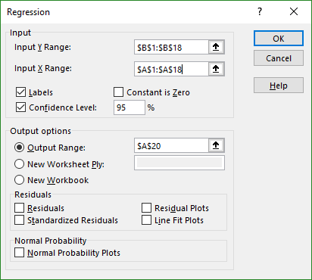
Example 12.3.6: Constructing Confidence Intervals for $β_{0}$ and $β_{1}$ (cont.)

Slide 53
Technology
If Data Analysis does not appear in your Excel menu under the Data tab, you can easily add this function. For instructions please visit stat.hawkeslearning.com and navigate to Technology Instructions > Getting Started.
The results from the regression analysis, provide an abundance of information, much of which we have discussed throughout this chapter. If you are using another technology, the output might look very similar and can be interpreted in much the same way.
As you look at the information provided in the regression model output, you might be surprised to see an ANOVA table reported as part of the results. The use of the ANOVA table in regression will be discussed more in the next section, since it is more meaningful when discussing more than one explanatory variable. However, it does contain a few of the important values we have discussed so far in this section. Let's look at where those values are found.

Slide 54
Example 12.3.6: Constructing Confidence Intervals for $β_{0}$ and $β_{1}$ (cont.)
SUMMARY OUTPUT
Regression Statistics
Multiple R | 0.67939297
R Square | 0.46
Adjusted R Square | 0.4256798
Standard Error | 0.71151556
Observations | 17
ANOVA
 | df | SS | MS | F | Significance F
Regression | 1 | 6.50993711 | 6.50993711 | 12.8590236 | 0.00270243
Residual | 15 | 7.59381583 | 0.50625439
Total | 16 | 14.1037529
 | Coefficients | Standard Error | t Stat | P-value | Lower 95% | Upper 95% | Lower 95% | Upper 95%
Intercept | 3.67211591 | 0.53321469 | 6.88674929 | 5.1753E-06 | 2.5355957 | 4.80863612 | 2.5355957 | 4.80863612
CTR | -195.400066 | 54.4904897 | -3.58594807 | 0.00270243 | -311.543795 | -79.2563374 | -311.543795 | -79.2563374

Slide 55
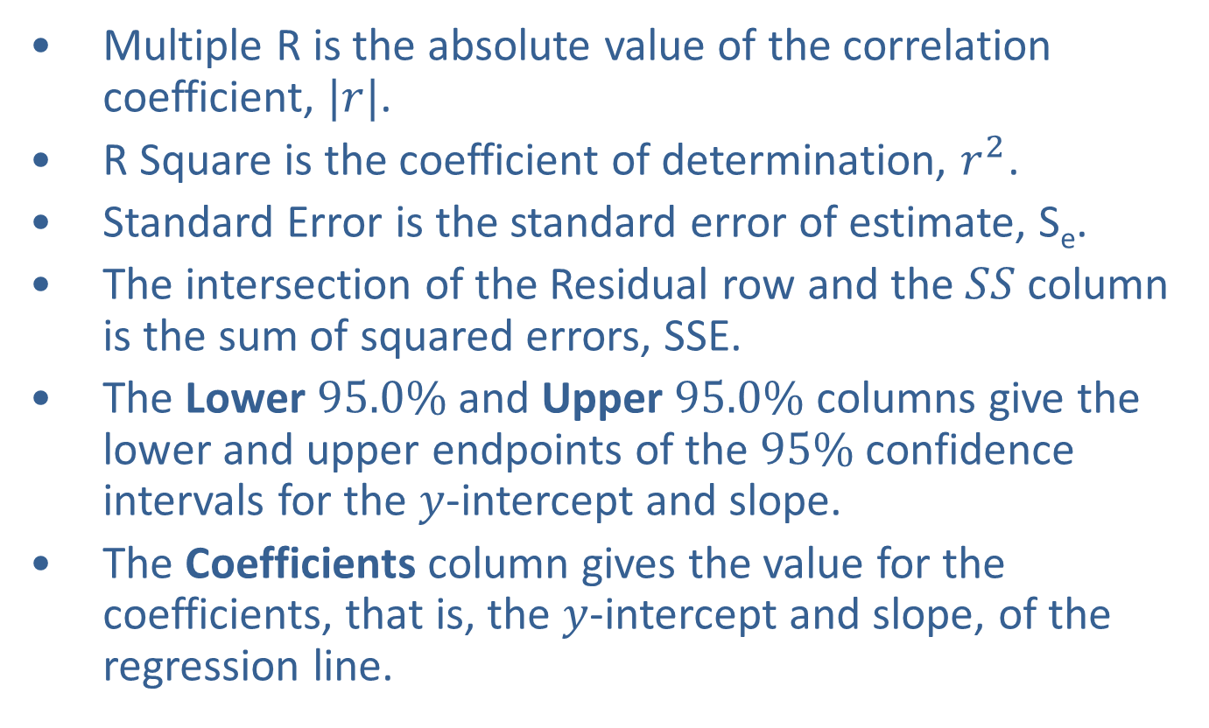
Example 12.3.6: Constructing Confidence Intervals for $β_{0}$ and $β_{1}$ (cont.)
​Multiple R is the absolute value of the correlation coefficient, $|r|$.
​R Square is the coefficient of determination, $r^{2}$.
​Standard Error is the standard error of estimate, S_{e}.
​The intersection of the Residual row and the $SS$ column is the sum of squared errors, SSE.
​The Lower $95.0\%$ and Upper $95.0\%$ columns give the lower and upper endpoints of the $95\%$ confidence intervals for the $y$-intercept and slope.
​The Coefficients column gives the value for the coefficients, that is, the $y$-intercept and slope, of the regression line.

Slide 56
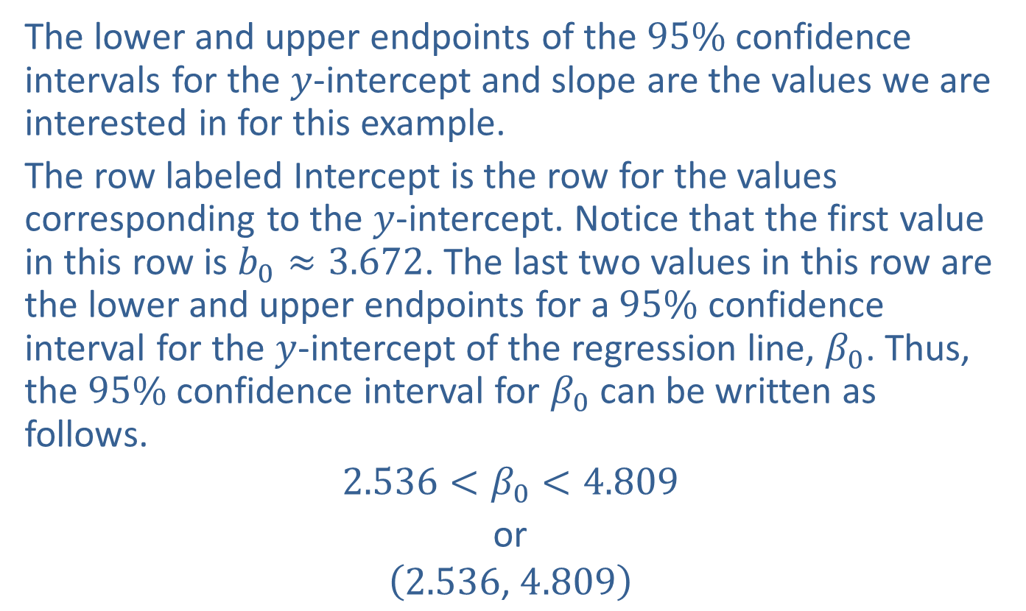
Example 12.3.6: Constructing Confidence Intervals for $β_{0}$ and $β_{1}$ (cont.)
The lower and upper endpoints of the $95\%$ confidence intervals for the $y$-intercept and slope are the values we are interested in for this example.
The row labeled Intercept is the row for the values corresponding to the $y$-intercept. Notice that the first value in this row is $b_{0}≈3.672$. The last two values in this row are the lower and upper endpoints for a $95\%$ confidence interval for the $y$-intercept of the regression line, $β_{0}$. Thus, the $95\%$ confidence interval for $β_{0}$ can be written as follows.
$$2.536<β_{0}<4.809$$
or
$$\left(2.536\text{, }4.809\right)$$

Slide 57
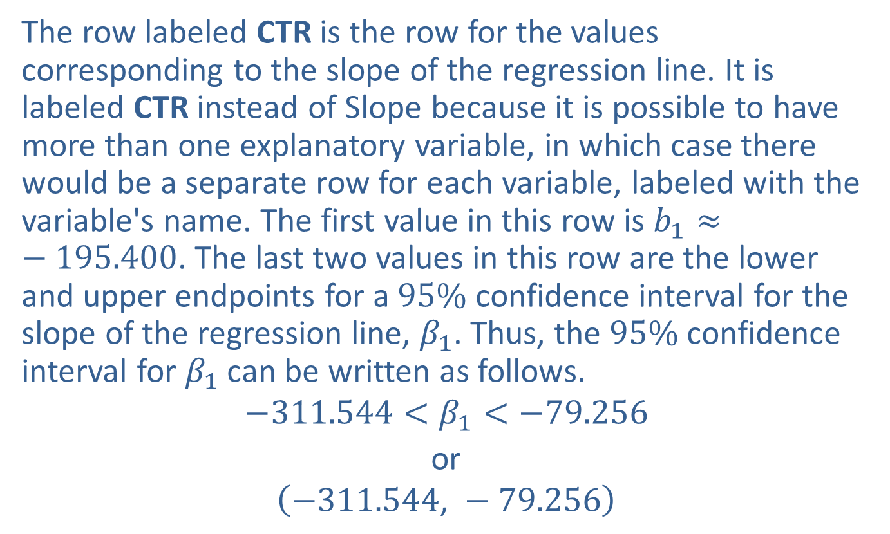
Example 12.3.6: Constructing Confidence Intervals for $β_{0}$ and $β_{1}$ (cont.)
The row labeled CTR is the row for the values corresponding to the slope of the regression line. It is labeled CTR instead of Slope because it is possible to have more than one explanatory variable, in which case there would be a separate row for each variable, labeled with the variable's name. The first value in this row is $b_{1}≈−195.400$. The last two values in this row are the lower and upper endpoints for a $95\%$ confidence interval for the slope of the regression line, $β_{1}$. Thus, the $95\%$ confidence interval for $β_{1}$ can be written as follows.
$$−311.544<β_{1}<−79.256$$
or
$$\left(−311.544\text{, }−79.256\right)$$

