Slide 1
Section 12.4
Multiple Regression

Slide 2
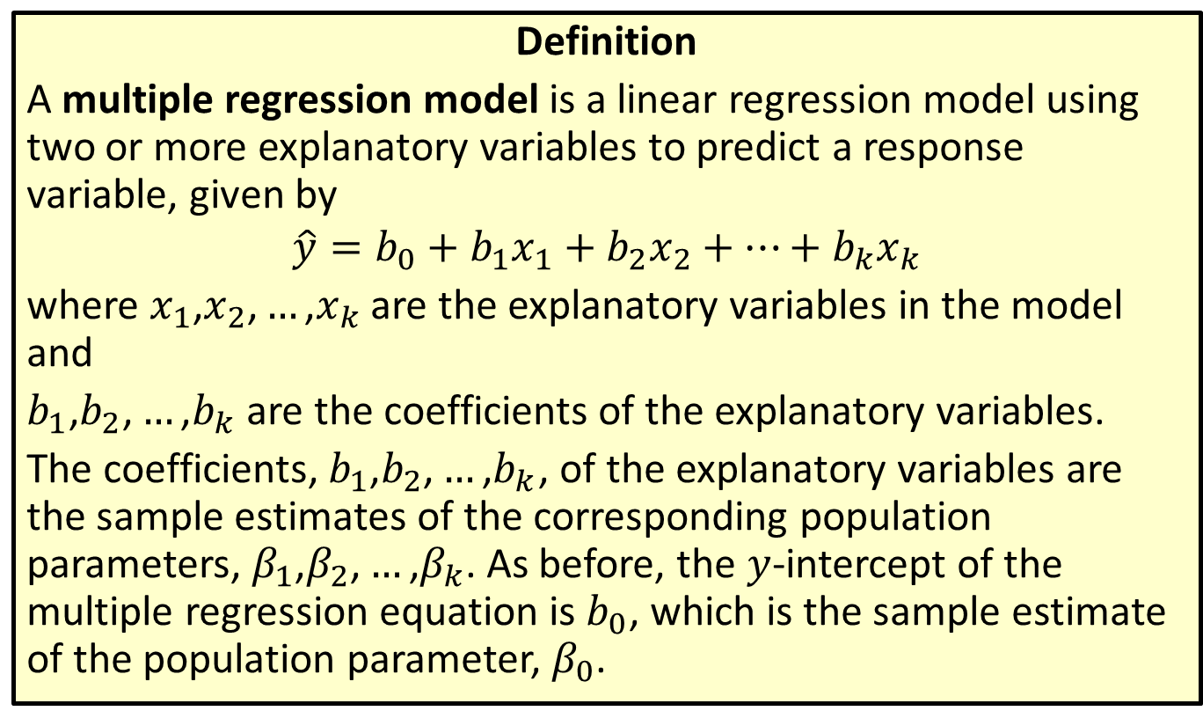
Multiple Regression Model
Definition
A multiple regression model is a linear regression model using two or more explanatory variables to predict a response variable, given by
$$\hat{y}=b_{0}+b_{1}x_{1}+b_{2}x_{2}+…+b_{k}x_{k}$$
where $x_{1}\text{,}x_{2}\text{,}…\text{,}x_{k}$ are the explanatory variables in the model and
$b_{1}\text{,}b_{2}\text{,}…\text{,}b_{k}$ are the coefficients of the explanatory variables.
The coefficients, $b_{1}\text{,}b_{2}\text{,}…\text{,}b_{k}$, of the explanatory variables are the sample estimates of the corresponding population parameters, $β_{1}\text{,}β_{2}\text{,}…\text{,}β_{k}$. As before, the $y$-intercept of the multiple regression equation is $b_{0}$, which is the sample estimate of the population parameter, $β_{0}$.

Slide 3
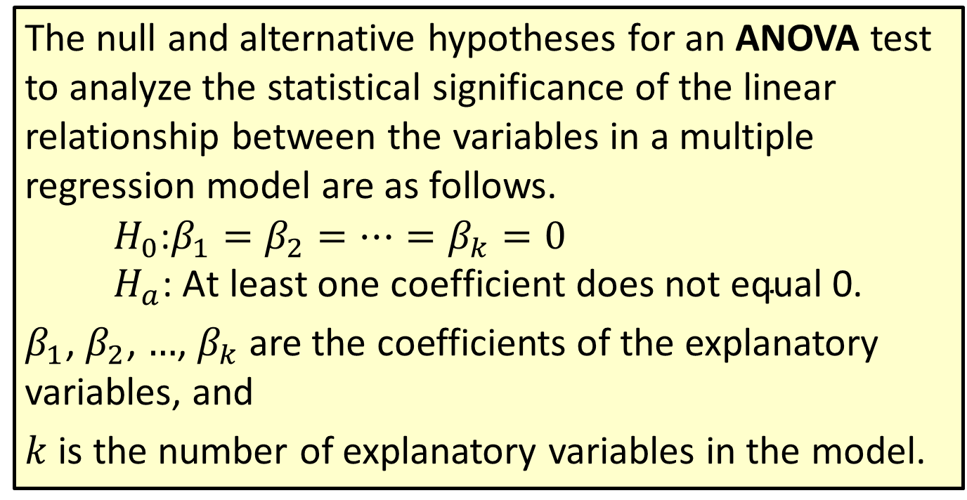
Procedure: Null and Alternative Hypotheses for an ANOVA Test
The null and alternative hypotheses for an ANOVA test to analyze the statistical significance of the linear relationship between the variables in a multiple regression model are as follows.
$$H_{0}\text{:}β_{1}=β_{2}=…=β_{k}=0 \\ H_{a}\text{: }\text{At} \text{least} \text{one} \text{coefficient} \text{does} \text{not} \text{equal}\text{ 0.}$$
$β_{1}$, $β_{2}$, $…$, $β_{k}$ are the coefficients of the explanatory variables, and
$k$ is the number of explanatory variables in the model.

Slide 4
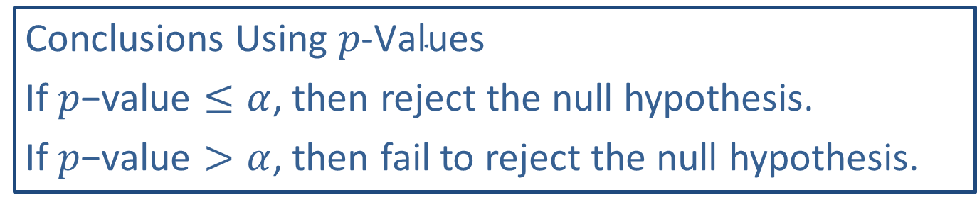
Memory Booster
Conclusions Using $p\text{‑}\text{Values}$
If $p\text{−}\text{value}≤α$, then reject the null hypothesis.
If $p\text{−}\text{value}>α$, then fail to reject the null hypothesis.

Slide 5
Example 12.4.1: Constructing and Analyzing a Multiple Regression Model
Construct and analyze a multiple regression equation for predicting a child's reading level based on the following sample data, which omits the variable of teacher's experience from the multiple regression model that we have been discussing. Use this new model to predict the reading level for a child who is 10 years old and has parents with an average of 12.7 years of education. Which of the two multiple regression models we built is better at predicting a child's reading level?

Slide 6
Example 12.4.1: Constructing and Analyzing a Multiple Regression Model (cont.)
 | A | B | C
1 | Child's Age | Parents' Education | Reading Level
2 | 6 | 13.1 | 1.3
3 | 7 | 14.5 | 2.2
4 | 8 | 16.1 | 3.7
5 | 9 | 12.5 | 4.1
6 | 10 | 11.8 | 4.9
7 | 11 | 11.1 | 5.2
8 | 12 | 10.2 | 6
9 | 13 | 12.6 | 7.1
10 | 14 | 12.1 | 8.5
11 | 15 | 14.3 | 9.7

Slide 7
Example 12.4.1: Constructing and Analyzing a Multiple Regression Model (cont.)
Solution
We will use Microsoft Excel to construct and analyze a multiple regression model for these data. Begin by entering the data as they appear in columns A, B, and C. Next, under the Data tab, choose Data Analysis. Select Regression from the options listed. Enter the necessary information into the Regression menu. Then click OK.

Slide 8
Technology
If Data Analysis does not appear in your Excel menu under the Data tab, you can easily add this function. For instructions please visit stat.hawkeslearning.com and navigate to Technology Instructions > Getting Started.
The output is shown in the following figure.

Slide 9
Example 12.4.1: Constructing and Analyzing a Multiple Regression Model (cont.)
SUMMARY OUTPUT
Regression Statistics
Multiple R | 0.996468545
R Square | 0.992949561
Adjusted R Square | 0.990935149
Standard Error | 0.252102523
Observations | 10
ANOVA
 | df | SS | MS | F | Significance F
Regression | 2 | 62.65611023 | 31.32805511 | 492.9229633 | 2.94277E−08
Residual | 7 | 0.444889774 | 0.063555682
Total | 9 | 63.101
 | Coefficients | Standard Error | t Stat | P-value | Lower 95% | Upper 95% | Lower 95.0% | Upper 95.0%
Intercept | − 6.728743363 | 0.813242326 | −8.27397093 | 7.34694E−05 | −8.651755889 | −4.805730837 | −8.651755889 | −4.805730837
Child's Age | 0.901985643 | 0.029372093 | 30.70893285 | 1.00214E−08 | 0.832531679 | 0.971439607 | 0.832531679 | 0.971439607
Parents' Education | 0.197029939 | 0.050984389 | 3.864515026 | 0.006175322 | 0.076471015 | 0.317588862 | 0.076471015 | 0.317588862

Slide 10
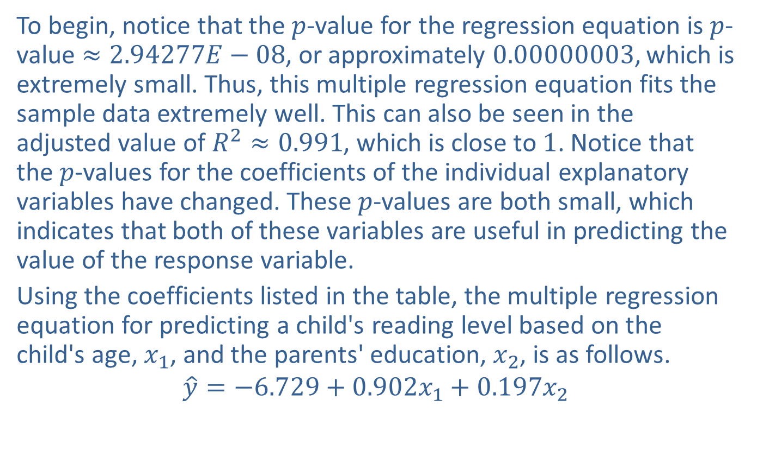
Example 12.4.1: Constructing and Analyzing a Multiple Regression Model (cont.)
To begin, notice that the $p$-value for the regression equation is $p$-value $≈2.94277E−08$, or approximately 0.00000003, which is extremely small. Thus, this multiple regression equation fits the sample data extremely well. This can also be seen in the adjusted value of $R^{2}≈0.991$, which is close to 1. Notice that the $p$-values for the coefficients of the individual explanatory variables have changed. These $p$-values are both small, which indicates that both of these variables are useful in predicting the value of the response variable.
Using the coefficients listed in the table, the multiple regression equation for predicting a child's reading level based on the child's age, $x_{1}$, and the parents' education, $x_{2}$, is as follows.
$$\hat{y}=−6.729+0.902x_{1}+0.197x_{2}$$

Slide 11
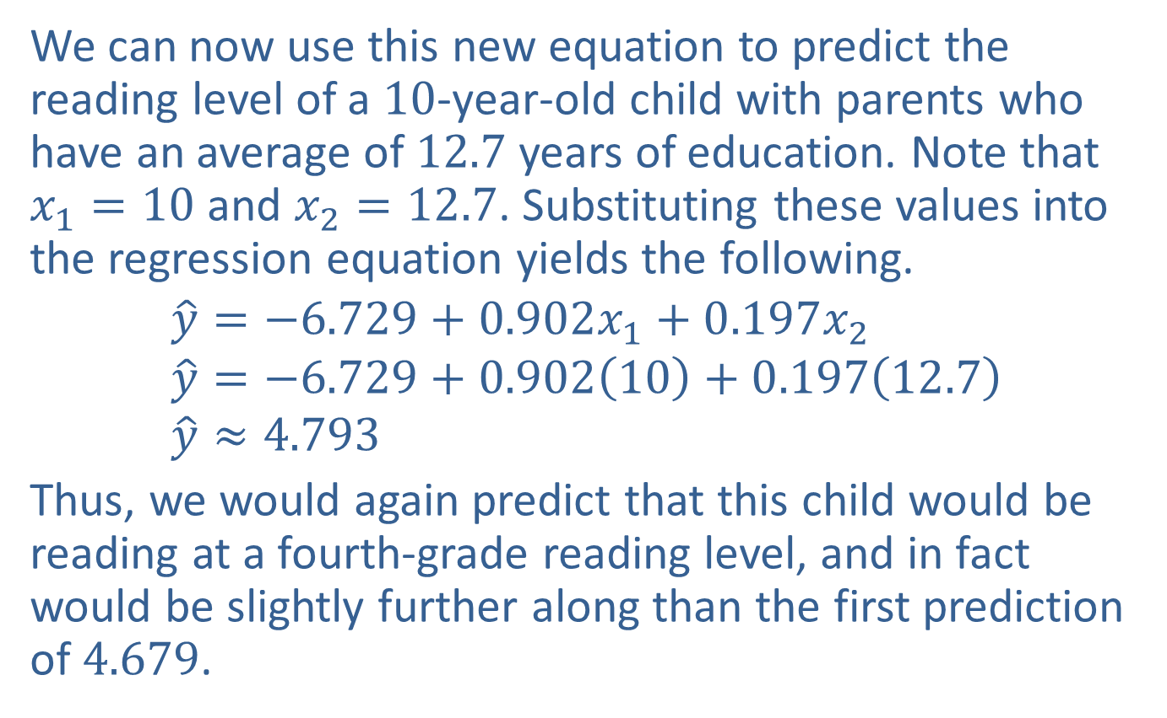
Example 12.4.1: Constructing and Analyzing a Multiple Regression Model (cont.)
We can now use this new equation to predict the reading level of a $10\text{‑}\text{year}\text{‑}\text{old}$ child with parents who have an average of 12.7 years of education. Note that $x_{1}=10$ and $x_{2}=12.7$. Substituting these values into the regression equation yields the following.
$$\hat{y}=−6.729+0.902x_{1}+0.197x_{2} \\ \hat{y}=−6.729+0.902\left(10\right)+0.197\left(12.7\right) \\ \hat{y}≈4.793$$
Thus, we would again predict that this child would be reading at a fourth-grade reading level, and in fact would be slightly further along than the first prediction of 4.679.

Slide 12
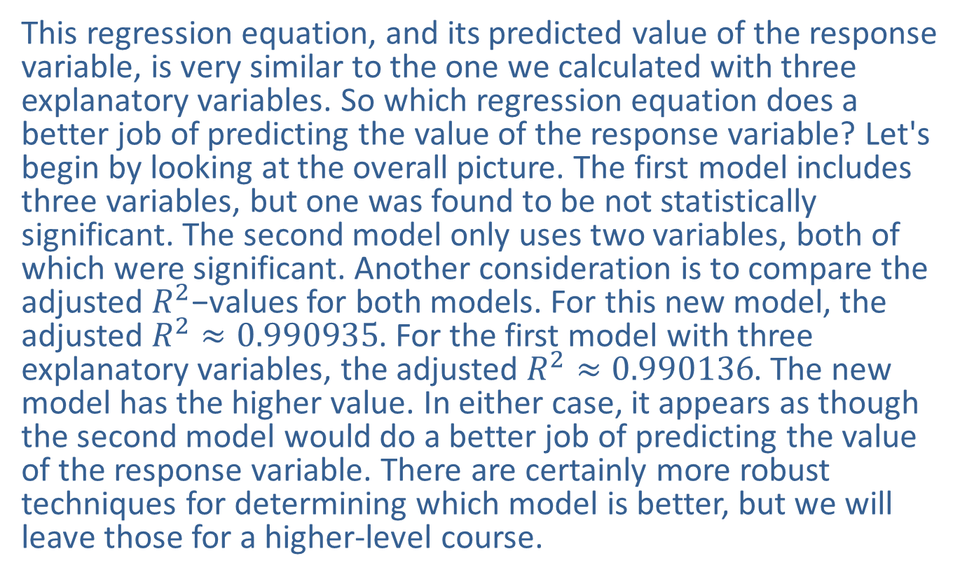
Example 12.4.1: Constructing and Analyzing a Multiple Regression Model (cont.)
This regression equation, and its predicted value of the response variable, is very similar to the one we calculated with three explanatory variables. So which regression equation does a better job of predicting the value of the response variable? Let's begin by looking at the overall picture. The first model includes three variables, but one was found to be not statistically significant. The second model only uses two variables, both of which were significant. Another consideration is to compare the adjusted $R^{2}\text{−}\text{values}$ for both models. For this new model, the adjusted $R^{2}≈0.990935$. For the first model with three explanatory variables, the adjusted $R^{2}≈0.990136$. The new model has the higher value. In either case, it appears as though the second model would do a better job of predicting the value of the response variable. There are certainly more robust techniques for determining which model is better, but we will leave those for a higher-level course.

Slide 13
Technology
For further instructions on finding a multiple regression equation using Excel, or other technology, please visit stat.hawkeslearning.com and see Technology Instructions > Regression > Multiple Regression.

