Slide 1
Section 2.1
Frequency Distributions

Slide 2
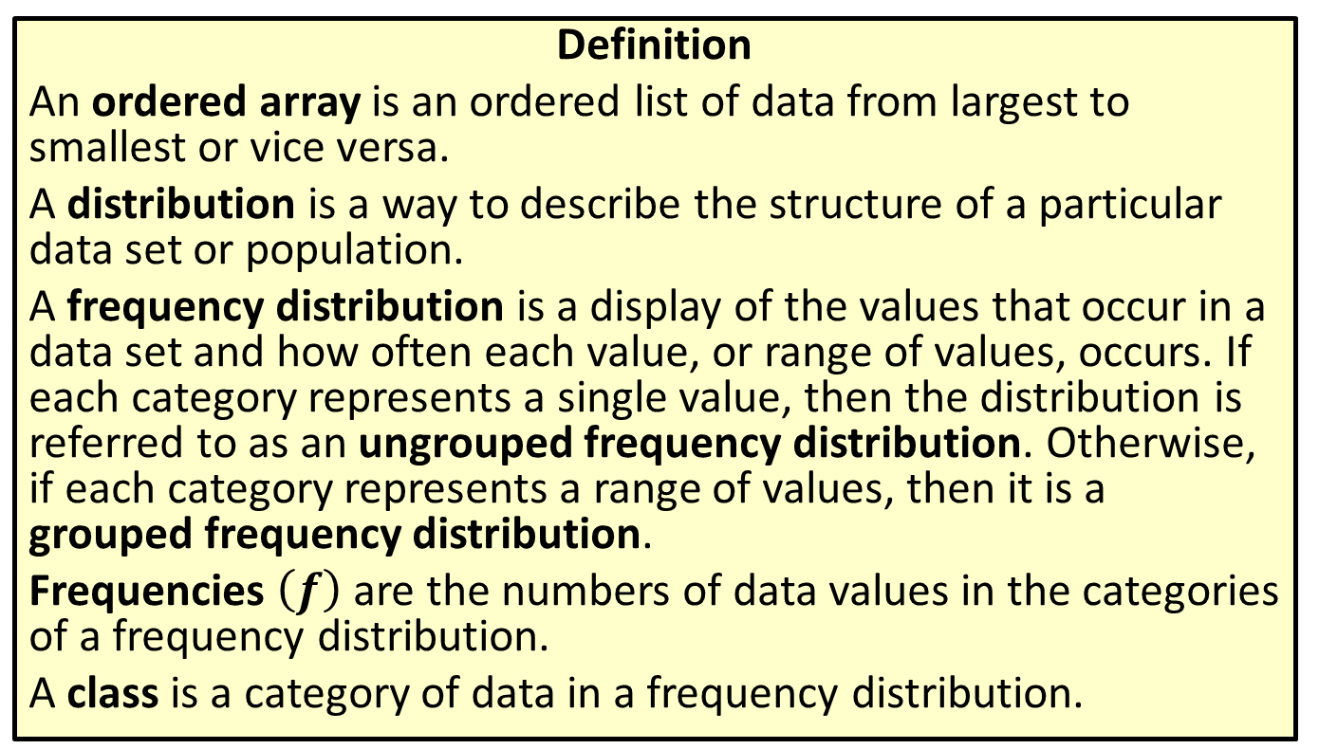
Ordered Array, Distribution, Frequency Distribution, Ungrouped Frequency Distribution, Grouped Frequency Distribution, Frequencies & Class
Definition
An ordered array is an ordered list of data from largest to smallest or vice versa.
A distribution is a way to describe the structure of a particular data set or population.
A frequency distribution is a display of the values that occur in a data set and how often each value, or range of values, occurs. If each category represents a single value, then the distribution is referred to as an ungrouped frequency distribution. Otherwise, if each category represents a range of values, then it is a grouped frequency distribution.
Frequencies $\left(f\right)$ are the numbers of data values in the categories of a frequency distribution.
A class is a category of data in a frequency distribution.

Slide 3
Procedure: Constructing a Frequency Distribution
​Decide how many classes should be in the distribution. There are typically between 5 and 20 classes in a frequency distribution. Several different methods can be used to determine the number of classes that will show the data most clearly, but in this textbook, the number of classes for a given data set will be suggested.

Slide 4
Procedure: Constructing a Frequency Distribution (cont.)
​Choose an appropriate class width. In some cases, the data set easily lends itself to natural divisions, such as decades or years. At other times, we must choose divisions for ourselves. When starting a frequency distribution from scratch, one method of finding an appropriate class width is to begin by subtracting the lowest number in the data set from the highest number in the data set and dividing the difference by the number of classes. Rounding this number up gives a good starting point from which to choose the class width. You will want to choose a width so that the classes formed present a clear representation of the data and include all members of the data set, so make a sensible choice.

Slide 5
Procedure: Constructing a Frequency Distribution (cont.)
​Find the class limits. The lower class limit is the smallest number that can belong to a particular class, and the upper class limit is the largest number that can belong to a class. Using the minimum data value, or a smaller number, as the lower limit of the first class is a good place to begin. However, judgment is required. You should choose the first lower limit so that reasonable classes will be produced, and it should have the same number of decimal places as the largest number of decimal places in the data. After choosing the lower limit of the first class, add the class width to it to find the lower limit of the second class. Continue this pattern until you have the desired number of lower class limits. The upper limit of each class is determined such that the classes do not overlap. If, after creating your classes, there are any data values that fall outside the class limits, you must adjust either the class width or the choice for the first lower class limit.

Slide 6
Procedure: Constructing a Frequency Distribution (cont.)
​Determine the frequency of each class. Make a tally mark for each data value in the appropriate class. Count the marks to find the total frequency for each class.

Slide 7
Rounding Rule
Class limits should have the same number of decimal places as the largest number of decimal places in the data.

Slide 8
Class Width, Lower Class Limit & Upper Class Limit
Definition
The class width is the difference between the lower limits or upper limits of two consecutive classes of a frequency distribution.
The lower class limit is the smallest number that can belong to a particular class.
The upper class limit is the largest number that can belong to a particular class.

Slide 9
Example 2.1.1: Constructing a Frequency Distribution
Create a frequency distribution using seven classes for the list of early-career salaries.
Highest Early-Career Salaries with a Bachelor's Degree (in an Ordered Array)
50,700 | 53,400 | 54,700 | 60,700 | 60,800
62,700 | 63,200 | 63,900 | 64,000 | 65,400
67,900 | 68,900 | 69,900 | 70,700 | 70,800
71,100 | 71,300 | 71,400 | 71,800 | 71,900
72,600 | 72,600 | 74,000 | 79,600 | 82,700

Slide 10
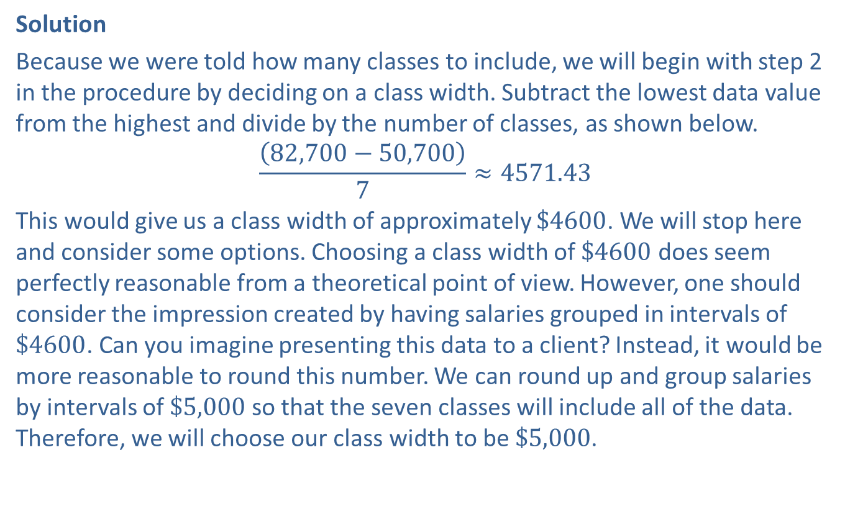
Example 2.1.1: Constructing a Frequency Distribution (cont.)
Solution
Because we were told how many classes to include, we will begin with step 2 in the procedure by deciding on a class width. Subtract the lowest data value from the highest and divide by the number of classes, as shown below.
$$\frac{\left(82,700−50,700\right)}{7}≈4571.43$$
This would give us a class width of approximately $\$4600$. We will stop here and consider some options. Choosing a class width of $\$4600$ does seem perfectly reasonable from a theoretical point of view. However, one should consider the impression created by having salaries grouped in intervals of $\$4600$. Can you imagine presenting this data to a client? Instead, it would be more reasonable to round this number. We can round up and group salaries by intervals of $\$5,000$ so that the seven classes will include all of the data. Therefore, we will choose our class width to be $\$5,000$.

Slide 11
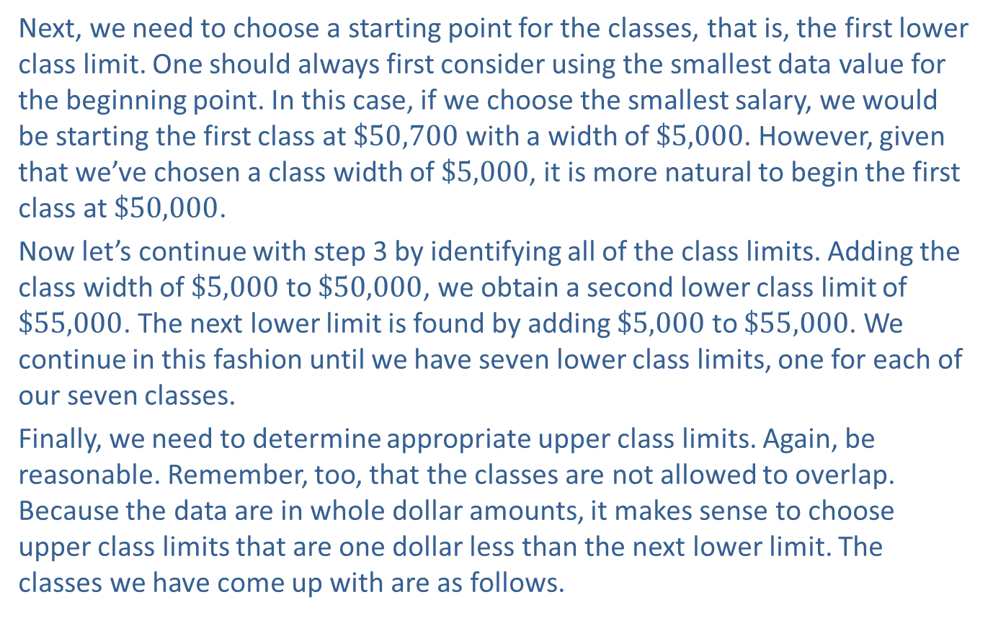
Example 2.1.1: Constructing a Frequency Distribution (cont.)
Next, we need to choose a starting point for the classes, that is, the first lower class limit. One should always first consider using the smallest data value for the beginning point. In this case, if we choose the smallest salary, we would be starting the first class at $\$50,700$ with a width of $\$5,000$. However, given that we’ve chosen a class width of $\$5,000$, it is more natural to begin the first class at $\$50,000$.
Now let’s continue with step 3 by identifying all of the class limits. Adding the class width of $\$5,000$ to $\$50,000$, we obtain a second lower class limit of $\$55,000$. The next lower limit is found by adding $\$5,000$ to $\$55,000$. We continue in this fashion until we have seven lower class limits, one for each of our seven classes.
Finally, we need to determine appropriate upper class limits. Again, be reasonable. Remember, too, that the classes are not allowed to overlap. Because the data are in whole dollar amounts, it makes sense to choose upper class limits that are one dollar less than the next lower limit. The classes we have come up with are as follows.

Slide 12
Example 2.1.1: Constructing a Frequency Distribution (cont.)
Highest Early-Career Salaries with a Bachelor’s Degree
Class | Frequency
50,000 ‐ 54,999
55,000 ‐ 59,999
60,000 ‐ 64,999
65,000 ‐ 69,999
70,000 ‐ 74,999
75,000 ‐ 79,999
80,000 ‐ 84,999

Slide 13
Example 2.1.1: Constructing a Frequency Distribution (cont.)
Step 4 is where we tabulate the number of data values that occur in each class. This produces the following frequency table.

Slide 14
Example 2.1.1: Constructing a Frequency Distribution (cont.)
Highest Early-Career Salaries with a Bachelor’s Degree
Class | Frequency
50,000 ‐ 54,999 | 3
55,000 ‐ 59,999 | 0
60,000 ‐ 64,999 | 6
65,000 ‐ 69,999 | 4
70,000 ‐ 74,999 | 10
75,000 ‐ 79,999 | 1
80,000 ‐ 84,999 | 1

Slide 15
Memory Booster
The sum of the frequency column should equal the number of data values in the set.

Slide 16
Class Boundary
Definition
A class boundary is the value that lies halfway between the upper limit of one class and the lower limit of the next class. After finding one class boundary, add (or subtract) the class width to find the next class boundary. The boundaries of a class are typically given in interval form as (lower boundary, upper boundary).

Slide 17
Example 2.1.2: Calculating Class Boundaries
Calculate the class boundaries for each class in the frequency distribution from the table below.
Highest Early-Career Salaries with a Bachelor’s Degree
Class | Frequency
50,000 ‐ 54,999 | 3
55,000 ‐ 59,999 | 0
60,000 ‐ 64,999 | 6
65,000 ‐ 69,999 | 4
70,000 ‐ 74,999 | 10
75,000 ‐ 79,999 | 1
80,000 ‐ 84,999 | 1

Slide 18
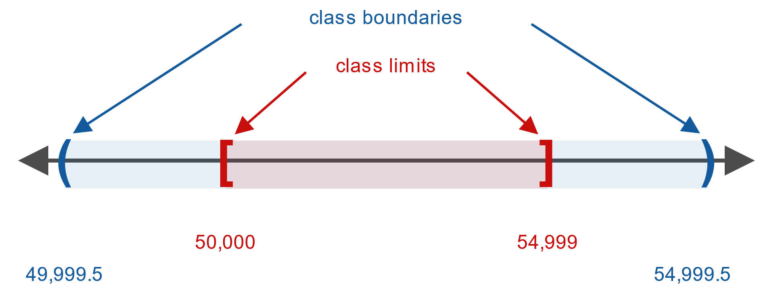
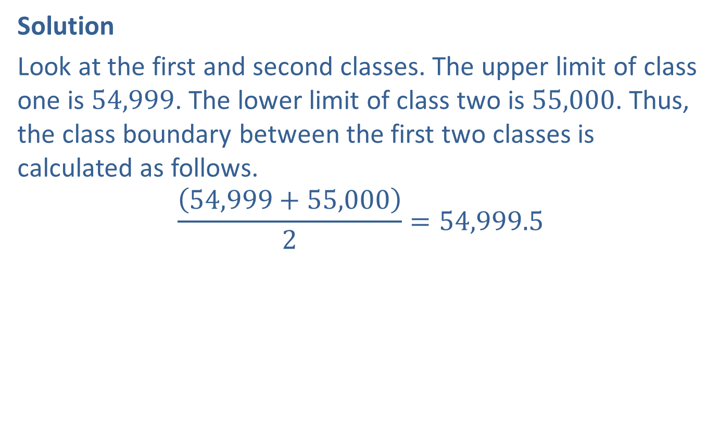
Example 2.1.2: Calculating Class Boundaries (cont.)
Solution
Look at the first and second classes. The upper limit of class one is 54,999. The lower limit of class two is 55,000. Thus, the class boundary between the first two classes is calculated as follows.
$$\frac{\left(54,999+55,000\right)}{2}=54,999.5$$

Slide 19
Example 2.1.2: Calculating Class Boundaries (cont.)
Recall that the class width is 5,000. Adding 5,000 to 54,999.5 gives the next class boundary. You can repeat this step to find the remaining class boundaries.

Slide 20
Example 2.1.2: Calculating Class Boundaries (cont.)
Highest Early-Career Salaries with a Bachelor's Degree
Class | Frequency | Class Boundaries
50,000 – 54,999 | 3 | 49,999.5 – 54,999.5
55,000 – 59,999 | 0 | 54,999.5 – 59,999.5
60,000 – 64,999 | 6 | 59,999.5 – 64,999.5
65,000 – 69,999 | 4 | 64,999.5 – 69,999.5
70,000 – 74,999 | 10 | 69,999.5 – 74,999.5
75,000 – 79,999 | 1 | 74,999.5 – 79,999.5
80,000 – 84,999 | 1 | 79,999.5 – 84,999.5

Slide 21
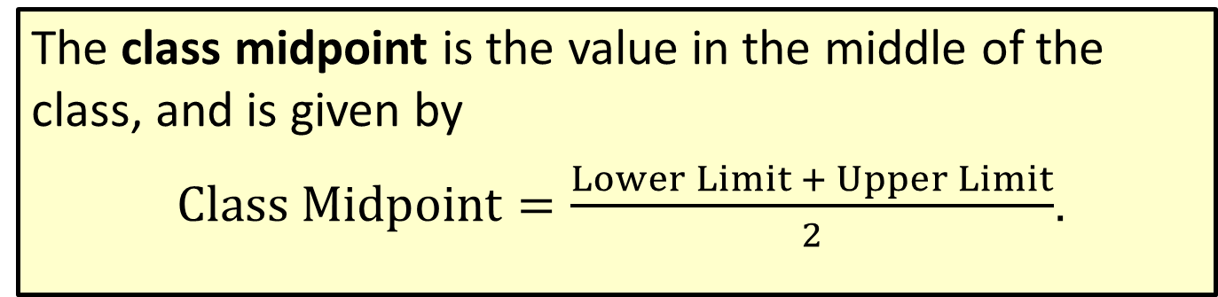
Formula: Class Midpoint
The class midpoint is the value in the middle of the class, and is given by
$Class Midpoint=\frac{Lower Limit + Upper Limit}{2}$.

Slide 22
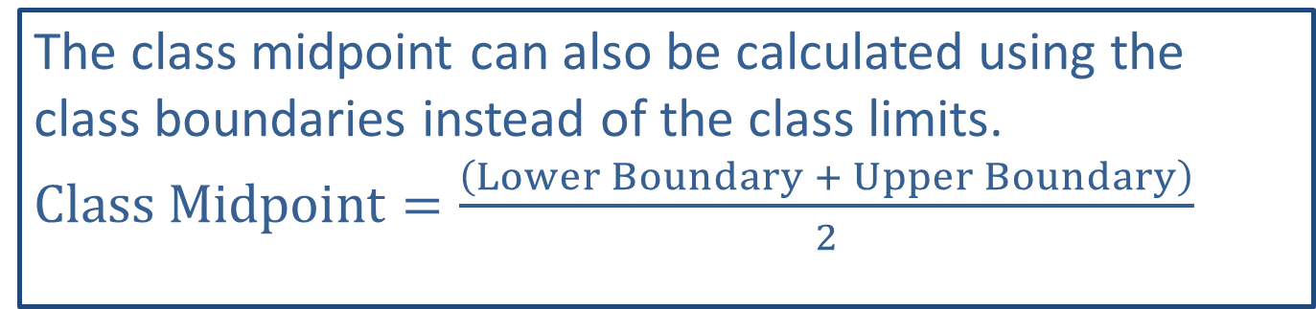
Side Note
The class midpoint can also be calculated using the class boundaries instead of the class limits. $Class Midpoint=\frac{\left(Lower Boundary + Upper Boundary\right)}{2}$

Slide 23
Example 2.1.3: Calculating Class Midpoints
Calculate the midpoint of each class in the frequency distribution from Example 2.1.1.

Slide 24
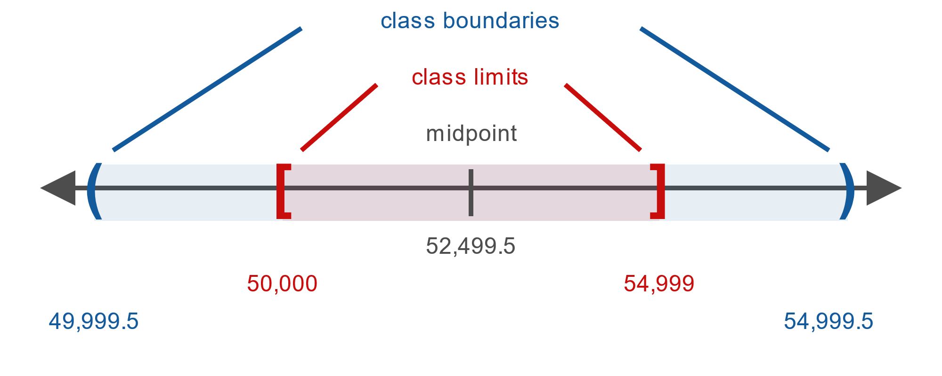
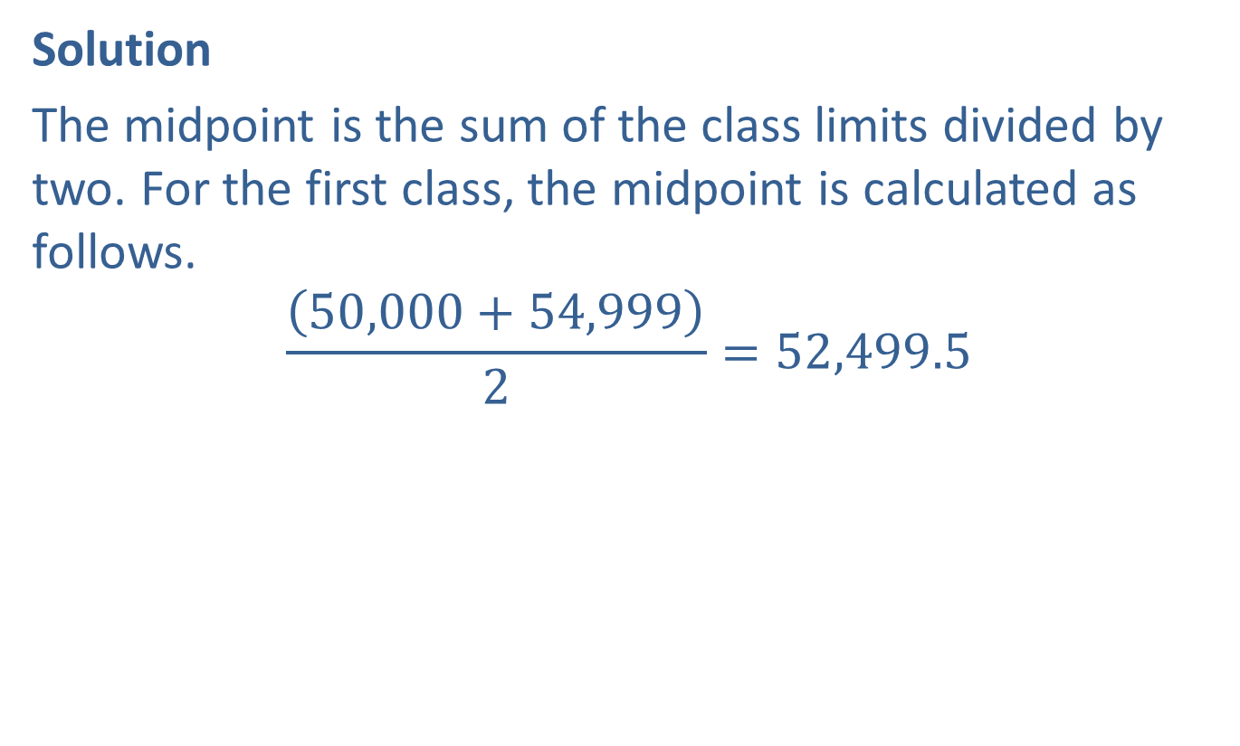
Example 2.1.3: Calculating Class Midpoints (cont.)
Solution
The midpoint is the sum of the class limits divided by two. For the first class, the midpoint is calculated as follows.
$$\frac{\left(50,000+54,999\right)}{2}=52,499.5$$

Slide 25
Example 2.1.3: Calculating Class Midpoints (cont.)
We can use this same calculation to find the midpoints of the remaining classes. Another method is to add 5,000 (the class width) to the first midpoint, as we did with class boundaries.

Slide 26
Example 2.1.3: Calculating Class Midpoints (cont.)
Highest Early-Career Salaries with a Bachelor's Degree (with Class Midpoints)
Class | Frequency | Class Midpoints
50,000 – 54,999 | 3 | 52,499.5
55,000 – 59,999 | 0 | 57,499.5
60,000 – 64,999 | 6 | 62,499.5
65,000 – 69,999 | 4 | 67,499.5
70,000 – 74,999 | 10 | 72,499.5
75,000 – 79,999 | 1 | 77,499.5
80,000 – 84,999 | 1 | 82,499.5
Notice that the class midpoints give us an estimate for the average piece of data in each class.

Slide 27
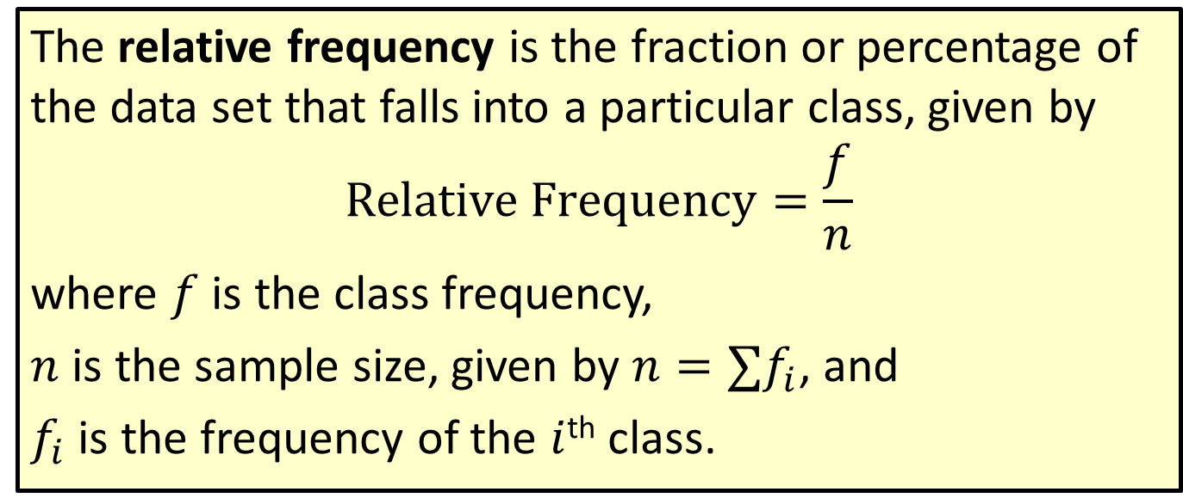
Formula: Relative Frequency
The relative frequency is the fraction or percentage of the data set that falls into a particular class, given by
$$Relative Frequency=\frac{f}{n}$$
where $f$ is the class frequency,
$n$ is the sample size, given by $n=∑f_{i}$, and
$f_{i}$ is the frequency of the $i$^{th} class.

Slide 28
Math Symbols
∑: indicates the summation of the values that follow it; uppercase Greek letter, sigma

Slide 29
Example 2.1.4: Calculating Relative Frequencies
Calculate the relative frequency for each class in the frequency distribution from Example 2.1.1.

Slide 30
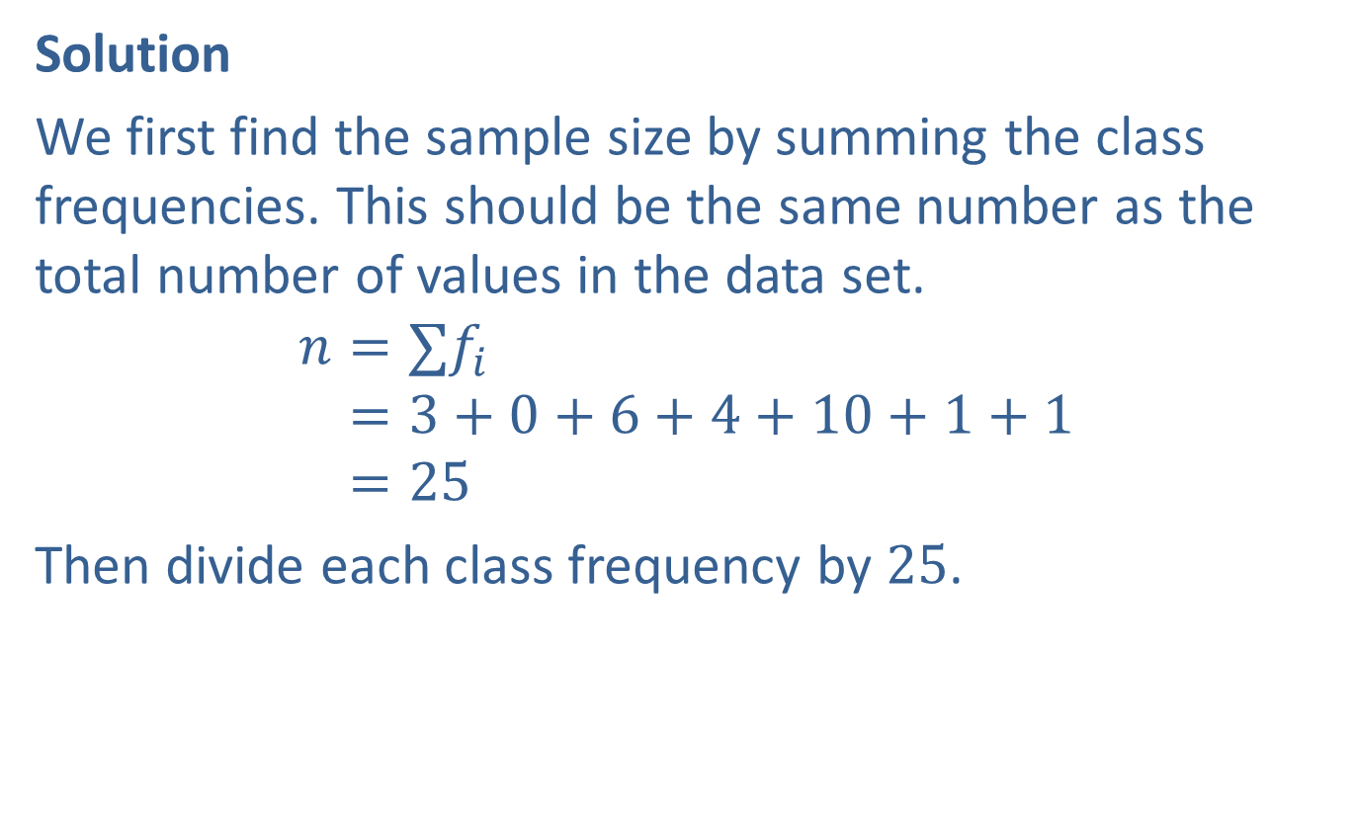
Example 2.1.4: Calculating Relative Frequencies (cont.)
Solution
We first find the sample size by summing the class frequencies. This should be the same number as the total number of values in the data set.
𝑛=∑𝑓𝑖𝑛=3+0+6+4+10+1+1𝑛=25
Then divide each class frequency by 25.

Slide 31
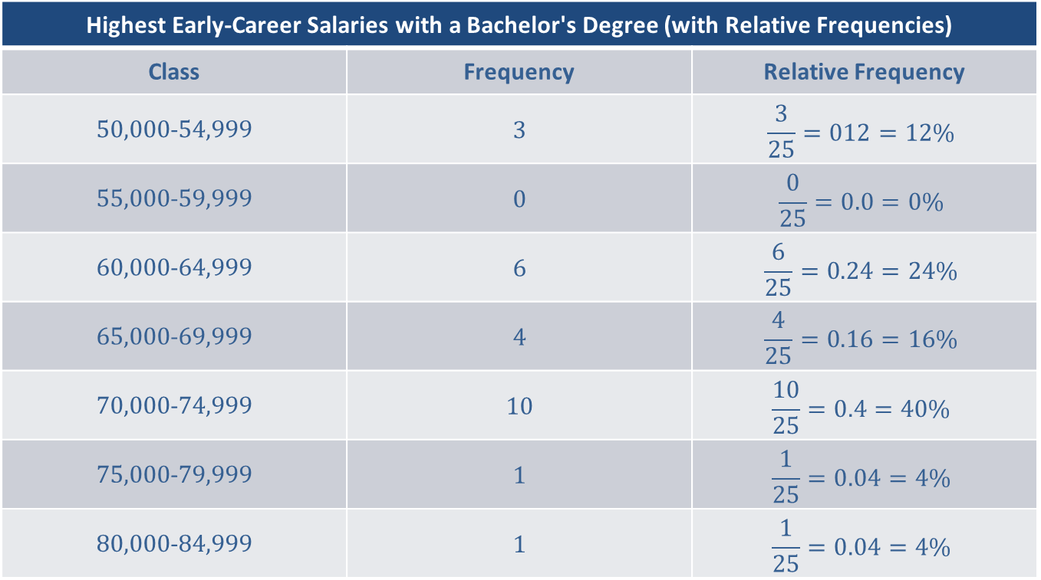
Example 2.1.4: Calculating Relative Frequencies (cont.)
Highest Early-Career Salaries with a Bachelor's Degree (with Relative Frequencies)
Class | Frequency | Relative Frequency
50,000-54,999 | 3 | $$\frac{3}{25}=012=12\%$$
55,000-59,999 | 0 | $$\frac{0}{25}=0.0=0\%$$
60,000-64,999 | 6 | $$\frac{6}{25}=0.24=24\%$$
65,000-69,999 | 4 | $$\frac{4}{25}=0.16=16\%$$
70,000-74,999 | 10 | $$\frac{10}{25}=0.4=40\%$$
75,000-79,999 | 1 | $$\frac{1}{25}=0.04=4\%$$
80,000-84,999 | 1 | $$\frac{1}{25}=0.04=4\%$$

Slide 32

Example 2.1.4: Calculating Relative Frequencies (cont.)
Notice that the relative frequencies sum to $100\%$. This should always be the case, allowing for rounding errors. Using the relative frequency, we can determine among other things that $40\%$ of the highest early-career salaries were between $\$70,000$ and $\$74,999$.

Slide 33
Cumulative Frequency
Definition
The cumulative frequency is the sum of the frequencies of a given class and all previous classes. The cumulative frequency of the last class equals the sample size.

Slide 34
Example 2.1.5: Calculating Cumulative Frequencies
Calculate the cumulative frequency for each class in the frequency distribution from Example 2.1.1.

Slide 35

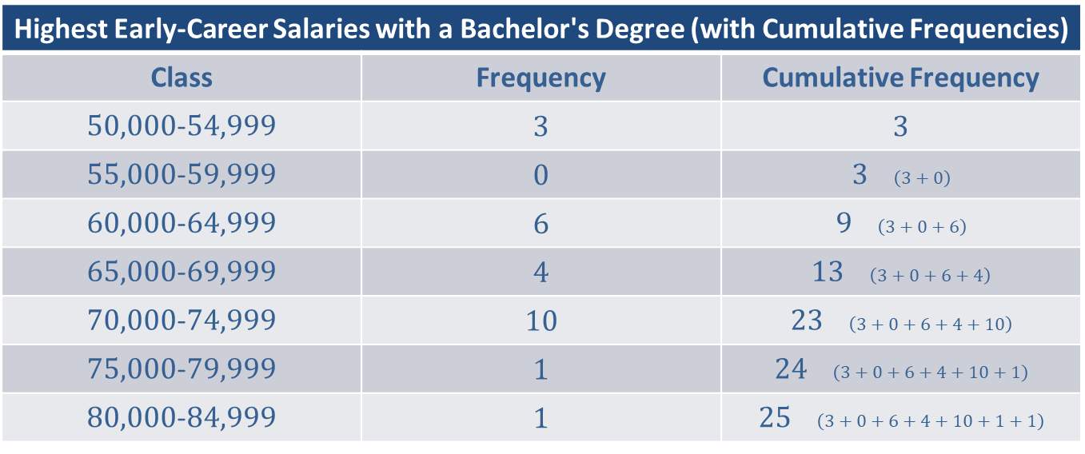
Example 2.1.5: Calculating Cumulative Frequencies (cont.)
Solution
Highest Early-Career Salaries with a Bachelor's Degree (with Cumulative Frequencies)
Class | Frequency | Cumulative Frequency
50,000-54,999 | 3 | 3
55,000-59,999 | 0 | 3 $\left(3+0\right)$
60,000-64,999 | 6 | 9 $\left(3+0+6\right)$
65,000-69,999 | 4 | 13 $\left(3+0+6+4\right)$
70,000-74,999 | 10 | 23 $\left(3+0+6+4+10\right)$
75,000-79,999 | 1 | 24 $\left(3+0+6+4+10+1\right)$
80,000-84,999 | 1 | 25 $\left(3+0+6+4+10+1+1\right)$
Using the cumulative frequency, we can determine among other things that 13 of the 25 salaries (or about half) are $\$69,999$ or less.

Slide 36
Example 2.1.6: Characteristics of a Frequency Distribution
Data collected on the numbers of miles that professors drive to work daily are listed. Use this data to create a frequency distribution that includes the class boundaries, midpoint, relative frequency, and cumulative frequency of each class. Use six classes. Be sure that your class limits have the same number of decimal places as the largest number of decimal places in the data. Note any patterns that appear in the frequency distribution.

Slide 37
Example 2.1.6: Characteristics of a Frequency Distribution (cont.)
Numbers of Miles Professors Drive to Work Each Day
3.8 | 2.7 | 9.3 | 6.5 | 5.8 | 7
10.2 | 1 | 3.7 | 9.1 | 6.2 | 11
11.9 | 5.5 | 4.8 | 7.3 | 9.1 | 1.4

Slide 38
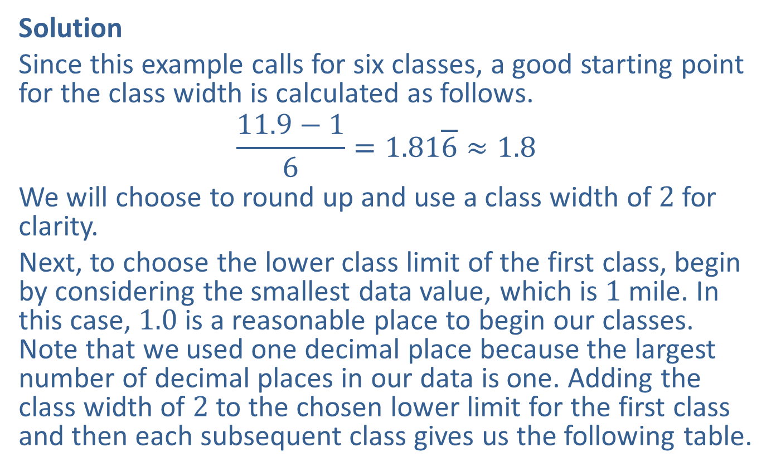
Example 2.1.6: Characteristics of a Frequency Distribution (cont.)
Solution
Since this example calls for six classes, a good starting point for the class width is calculated as follows.
$$\frac{11.9−1}{6}=1.81\overline{6}≈1.8$$
We will choose to round up and use a class width of 2 for clarity.
Next, to choose the lower class limit of the first class, begin by considering the smallest data value, which is 1 mile. In this case, 1.0 is a reasonable place to begin our classes. Note that we used one decimal place because the largest number of decimal places in our data is one. Adding the class width of 2 to the chosen lower limit for the first class and then each subsequent class gives us the following table.

Slide 39
Example 2.1.6: Characteristics of a Frequency Distribution (cont.)
Numbers of Miles Professors Drive to Work Each Day
Class | Frequency
1.0–2.9
3.0–4.9
5.0–6.9
7.0–8.9
9.0–10.9
11.0–12.9

Slide 40
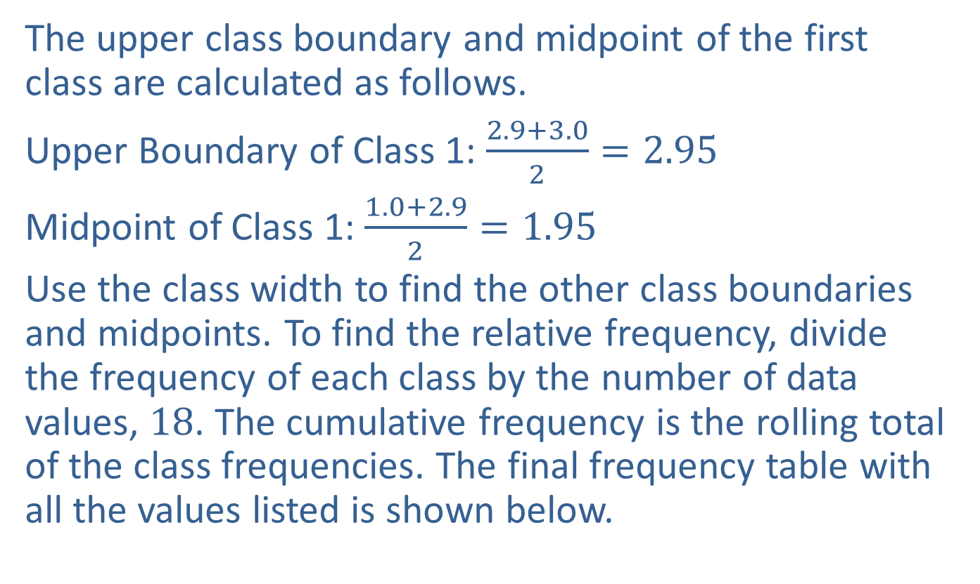
Example 2.1.6: Characteristics of a Frequency Distribution (cont.)
The upper class boundary and midpoint of the first class are calculated as follows.
Upper Boundary of Class 1: $\frac{2.9+3.0}{2}=2.95$
Midpoint of Class 1: $\frac{1.0+2.9}{2}=1.95$
Use the class width to find the other class boundaries and midpoints. To find the relative frequency, divide the frequency of each class by the number of data values, 18. The cumulative frequency is the rolling total of the class frequencies. The final frequency table with all the values listed is shown below.

Slide 41
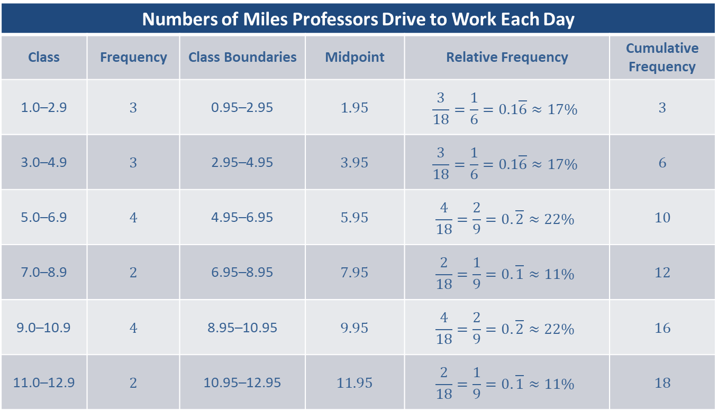
Example 2.1.6: Characteristics of a Frequency Distribution (cont.)
Numbers of Miles Professors Drive to Work Each Day
Class | Frequency | Class Boundaries | Midpoint | Relative Frequency | Cumulative Frequency
1.0–2.9 | 3 | 0.95–2.95 | 1.95 | $$\frac{3}{18}=\frac{1}{6}=0.1\overline{6}≈17\%$$ | 3
3.0–4.9 | 3 | 2.95–4.95 | 3.95 | $$\frac{3}{18}=\frac{1}{6}=0.1\overline{6}≈17\%$$ | 6
5.0–6.9 | 4 | 4.95–6.95 | 5.95 | $$\frac{4}{18}=\frac{2}{9}=0.\overline{2}≈22\%$$ | 10
7.0–8.9 | 2 | 6.95–8.95 | 7.95 | $$\frac{2}{18}=\frac{1}{9}=0.\overline{1}≈11\%$$ | 12
9.0–10.9 | 4 | 8.95–10.95 | 9.95 | $$\frac{4}{18}=\frac{2}{9}=0.\overline{2}≈22\%$$ | 16
11.0–12.9 | 2 | 10.95–12.95 | 11.95 | $$\frac{2}{18}=\frac{1}{9}=0.\overline{1}≈11\%$$ | 18

Slide 42
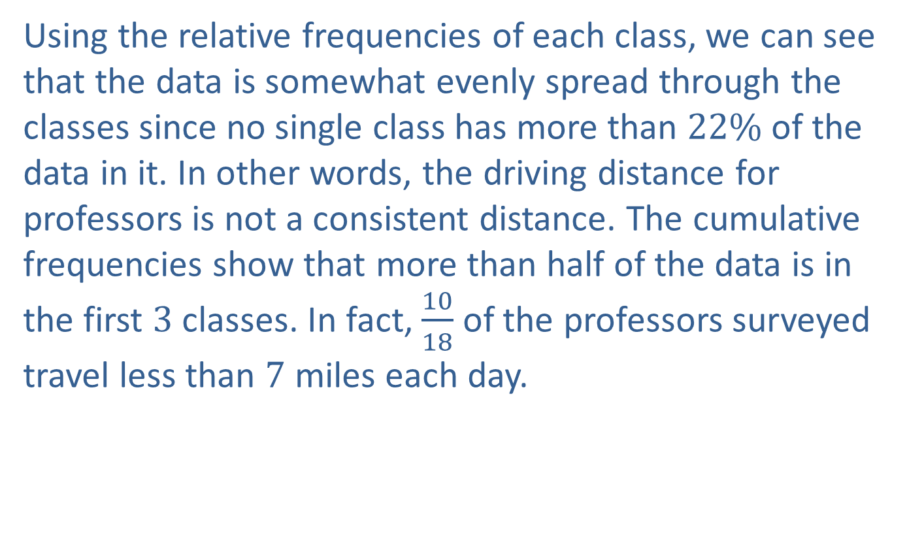
Example 2.1.6: Characteristics of a Frequency Distribution (cont.)
Using the relative frequencies of each class, we can see that the data is somewhat evenly spread through the classes since no single class has more than $22\%$ of the data in it. In other words, the driving distance for professors is not a consistent distance. The cumulative frequencies show that more than half of the data is in the first 3 classes. In fact, $\frac{10}{18}$ of the professors surveyed travel less than 7 miles each day.

Slide 43
Memory Booster
Relative frequency is a ratio that relates a class to the whole.
Cumulative frequency is a running total of the number of data values.

