Slide 1
Section 2.2
Graphical Displays of Data

Slide 2
Memory Booster
Graphs should have:
​Title
​Labels on Axes
​Source
​Data

Slide 3
Graph & Legend
Definition
A graph is a picture of the data that allows us to view patterns at a glance.
A legend is a description of how each different data category is identified in the graph.

Slide 4
Pie Chart
Definition
A pie chart is a circular graph used for qualitative data that depicts parts of a whole and shows how large each category is in relation to the whole.

Slide 5
Example 2.2.1: Creating a Pie Chart
Calculate the relative frequency, expressed as a percentage, for each housing type based on the following data. Then, create a pie chart describing the distribution of housing types for students in a statistics class.
Housing Types for Students in a Statistics Class
Type of Housing | Number of Students
Apartment | 20
Dorm | 10
House | 5
Sorority/Fraternity House | 5
Total | 40

Slide 6
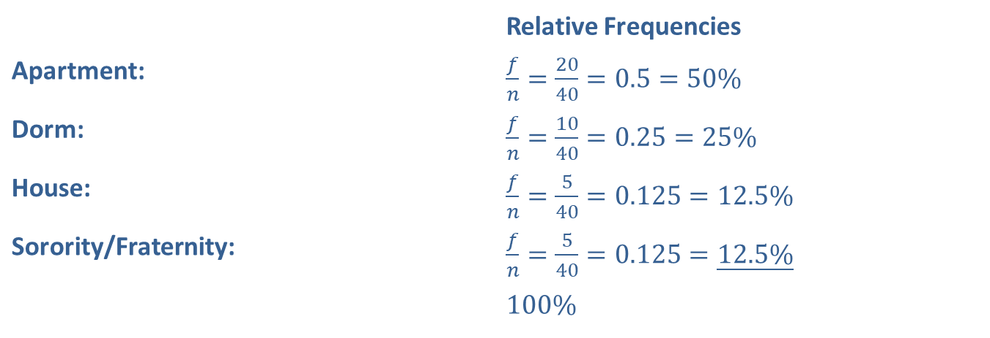
Example 2.2.1: Creating a Pie Chart (cont.)
Solution
 | Relative Frequencies
Apartment: | ​$\frac{f}{n}=\frac{20}{40}=0.5=50\%$
Dorm: | ​$\frac{f}{n}=\frac{10}{40}=0.25=25\%$
House: | ​$\frac{f}{n}=\frac{5}{40}=0.125=12.5\%$
Sorority/Fraternity: | ​$\frac{f}{n}=\frac{5}{40}=0.125=\underline{12.5\%}$
 | ​$100\%$

Slide 7
Side Note
$$"Pie" Angles=Relative Frequency×{360}^{°}$$

Slide 8
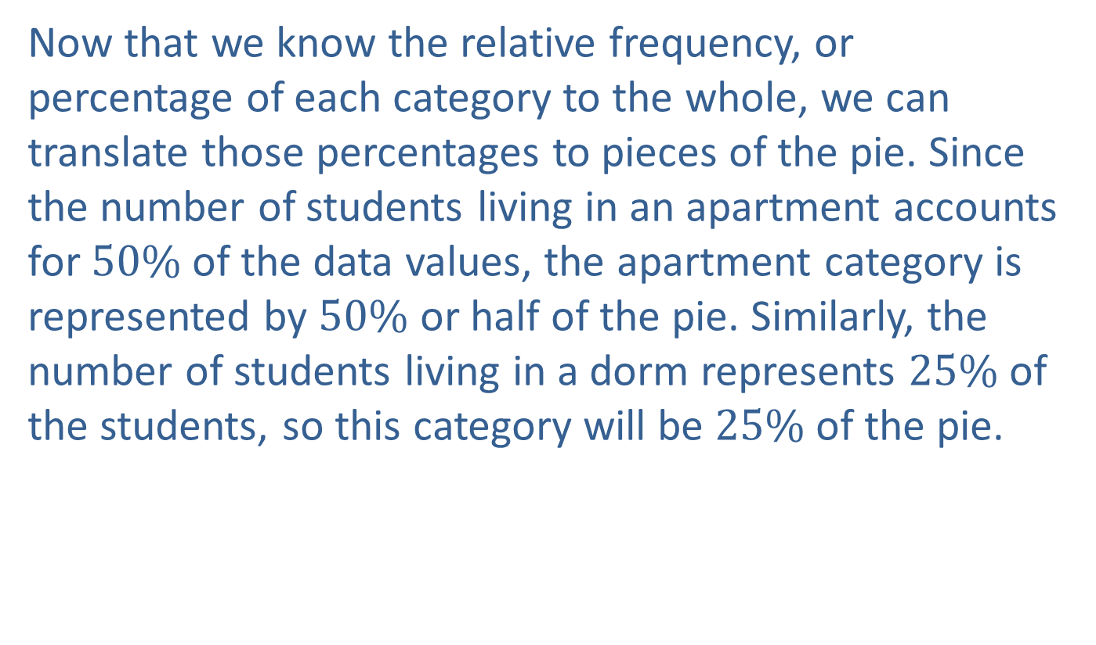
Example 2.2.1: Creating a Pie Chart (cont.)
Now that we know the relative frequency, or percentage of each category to the whole, we can translate those percentages to pieces of the pie. Since the number of students living in an apartment accounts for $50\%$ of the data values, the apartment category is represented by $50\%$ or half of the pie. Similarly, the number of students living in a dorm represents $25\%$ of the students, so this category will be $25\%$ of the pie.

Slide 9
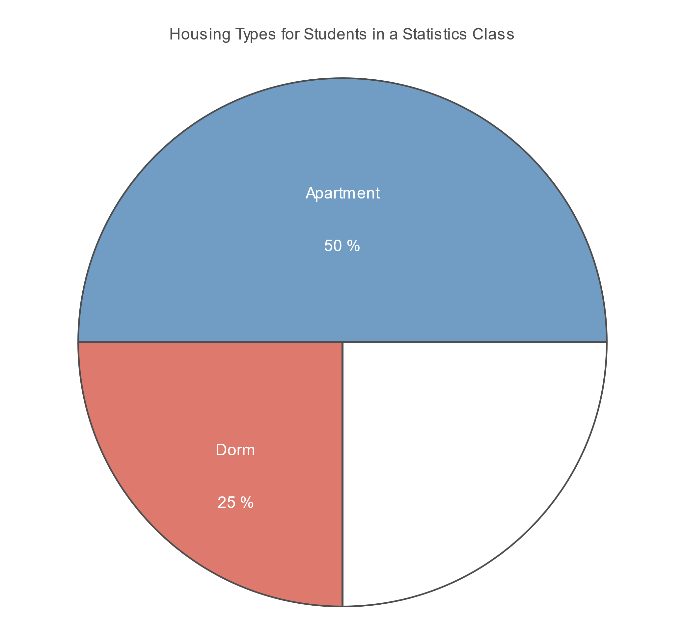
Example 2.2.1: Creating a Pie Chart (cont.)

Slide 10
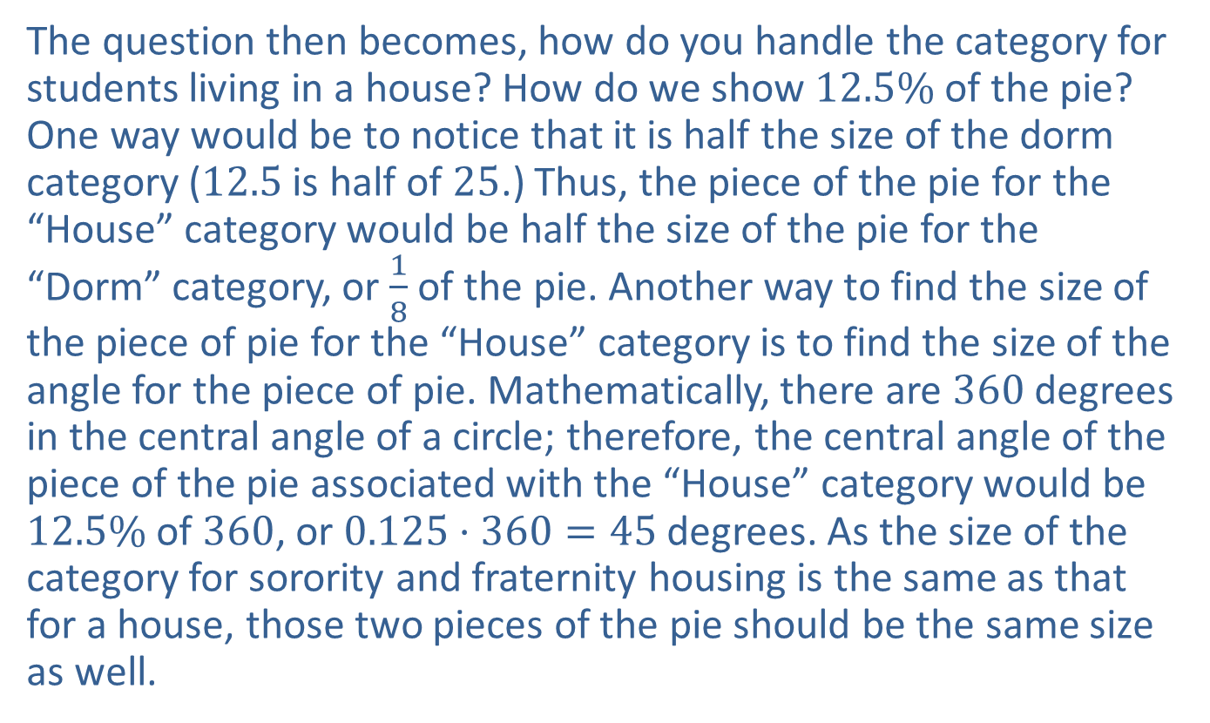
Example 2.2.1: Creating a Pie Chart (cont.)
The question then becomes, how do you handle the category for students living in a house? How do we show $12.5\%$ of the pie? One way would be to notice that it is half the size of the dorm category (12.5 is half of 25.) Thus, the piece of the pie for the “House” category would be half the size of the pie for the “Dorm” category, or $\frac{1}{8}$ of the pie. Another way to find the size of the piece of pie for the “House” category is to find the size of the angle for the piece of pie. Mathematically, there are 360 degrees in the central angle of a circle; therefore, the central angle of the piece of the pie associated with the “House” category would be $12.5\%$ of 360, or $0.125⋅360=45$ degrees. As the size of the category for sorority and fraternity housing is the same as that for a house, those two pieces of the pie should be the same size as well.

Slide 11
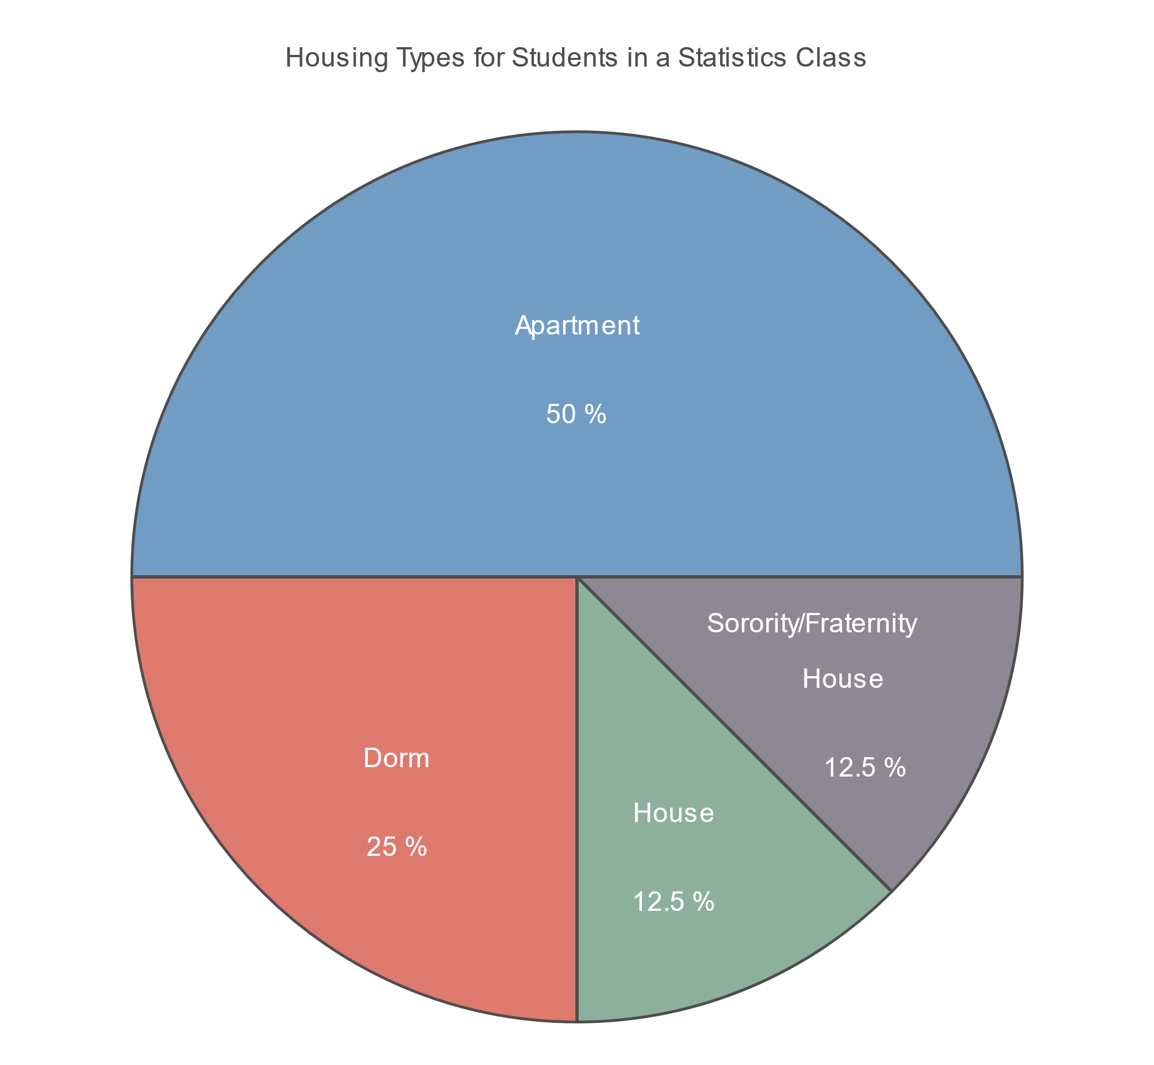
Example 2.2.1: Creating a Pie Chart (cont.)

Slide 12
Example 2.2.1: Creating a Pie Chart (cont.)
Although we have demonstrated in this example how to use arithmetic to determine the central angles of a pie chart, it is fairly unusual for someone to draw a pie chart by hand given the current availability of technology. Use of software such as Microsoft Excel allows you to create pie charts easily without angle calculations.

Slide 13
Technology
For instructions on how to create a pie chart in Excel, Minitab, or other technologies, please visit stat.hawkeslearning.com and navigate to Technology Instructions > Graphs > Pie Chart.

Slide 14
Bar Graph
Definition
A bar graph is a graph that uses bars to represent the amount of data in each category.

Slide 15
Example 2.2.2: Creating a Bar Graph
Create a bar graph of the following data describing the distribution of housing types for students in a statistics class.
Housing Types for Students in a Statistics Class
Type of Housing | Number of Students
Apartment | 20
Dorm | 10
House | 5
Sorority/Fraternity House | 5

Slide 16
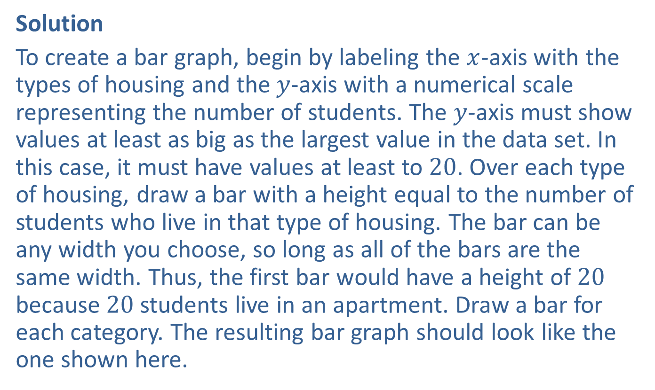
Example 2.2.2: Creating a Bar Graph (cont.)
Solution
To create a bar graph, begin by labeling the $x$-axis with the types of housing and the $y$-axis with a numerical scale representing the number of students. The $y$-axis must show values at least as big as the largest value in the data set. In this case, it must have values at least to 20. Over each type of housing, draw a bar with a height equal to the number of students who live in that type of housing. The bar can be any width you choose, so long as all of the bars are the same width. Thus, the first bar would have a height of 20 because 20 students live in an apartment. Draw a bar for each category. The resulting bar graph should look like the one shown here.

Slide 17
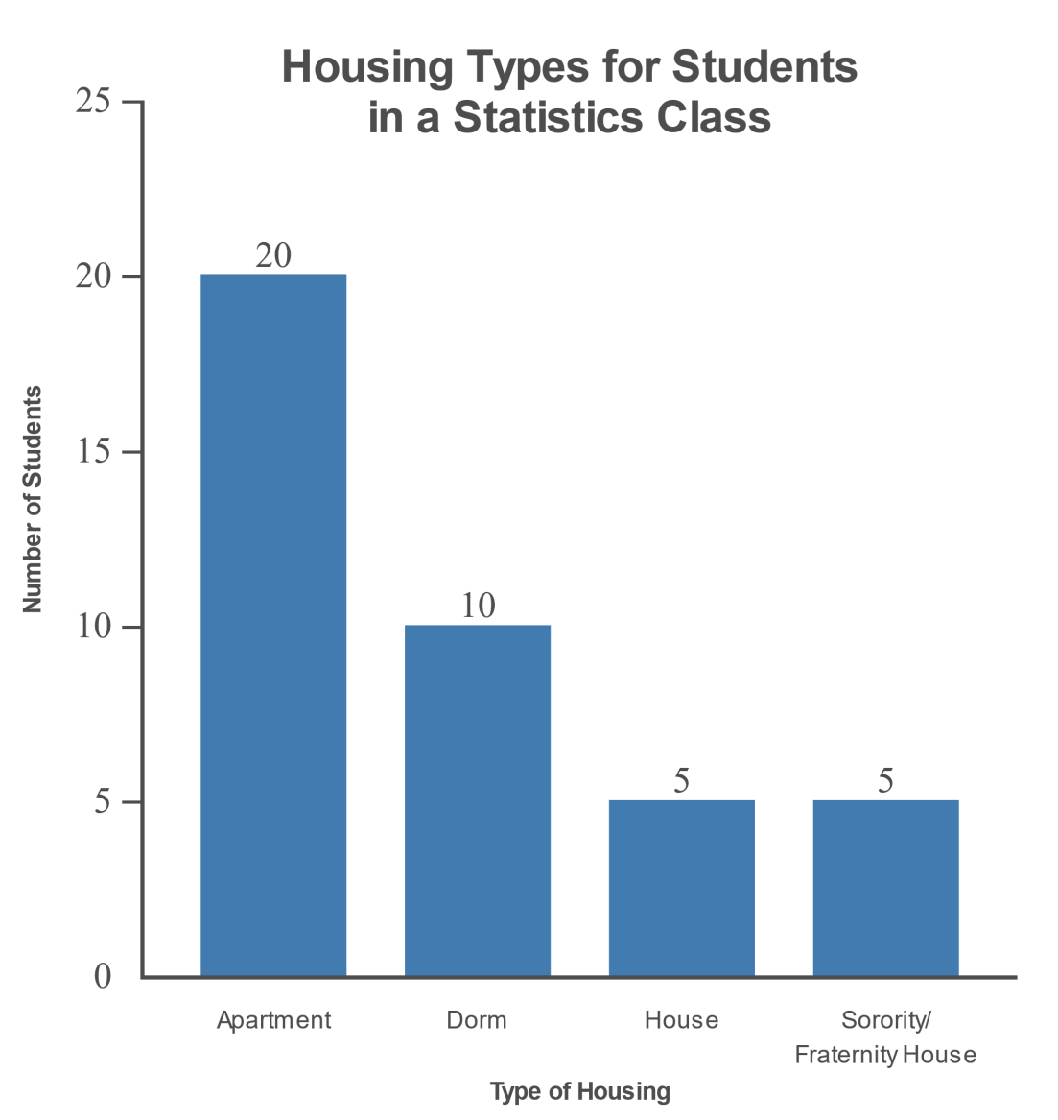
Example 2.2.2: Creating a Bar Graph (cont.)

Slide 18
Technology
For instructions on how to create a bar graph in Excel, Minitab, or other technologies, please visit stat.hawkeslearning.com and navigate to Technology Instructions > Graphs > Bar Chart.

Slide 19
Pareto Chart
Definition
A Pareto chart is a type of bar graph with the bars in descending order. It should be used for nominal data only.

Slide 20
Example 2.2.3: Creating a Pareto Chart
Create a Pareto chart, if appropriate, for the following data.
Fundraising Results
Class | Number of Fundraiser Items Sold
Ms. Boyd's class | 200
Ms. Willard's class | 157
Mr. Smith's class | 176
Mr. Carter's class | 181
Ms. Meredith's class | 143

Slide 21
Example 2.2.3: Creating a Pareto Chart (cont.)
Solution
The data are nominal; therefore, it would be appropriate to create a Pareto chart from these data. Begin by rearranging the data from the largest frequency to the smallest frequency.

Slide 22
Example 2.2.3: Creating a Pareto Chart (cont.)
Ordered Fundraising Results
Class | Number of Fundraiser Items Sold
Ms. Boyd's class | 200
Mr. Carter's class | 181
Mr. Smith's class | 176
Ms. Willard's class | 157
Ms. Meredith's class | 143

Slide 23
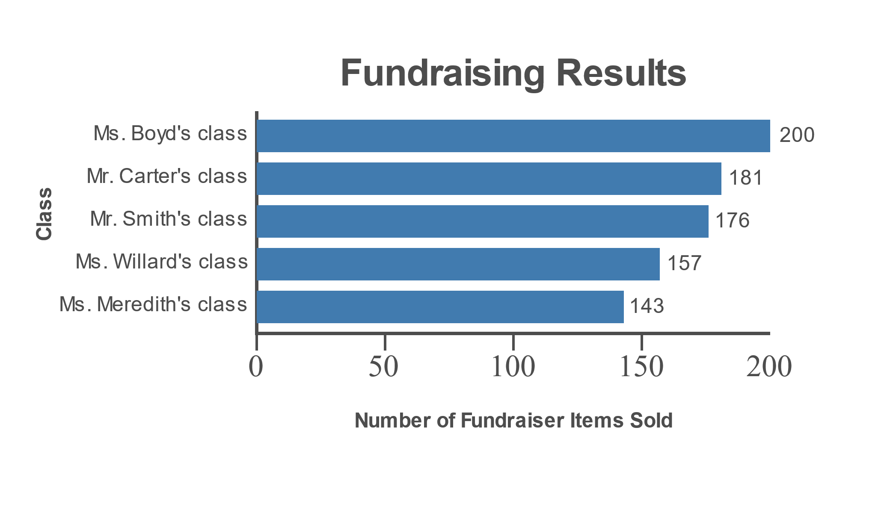
Example 2.2.3: Creating a Pareto Chart (cont.)
Next, create a bar graph of the ordered data. The resulting Pareto chart is shown.

Slide 24
Technology
For instructions on how to create a Pareto chart in Excel, Minitab, or other technologies, please visit stat.hawkeslearning.com and navigate to Technology Instructions > Graphs > Pareto Chart.

Slide 25
Example 2.2.4: Creating a Side-by-Side Bar Graph
Create a side-by-side bar graph of the following data describing the distribution of housing types for two different samples of students. Based on the graph, what can you conclude about the differences in housing choices between freshmen and sophomores at this college?
Housing Types for Two Samples of Students
Type of Housing | Number of Students Freshmen | Number of Students Sophomores
Apartment | 13 | 20
Dorm | 24 | 15
House | 6 | 9
Sorority/Fraternity House | 7 | 5

Slide 26
Example 2.2.4: Creating a Side-by-Side Bar Graph (cont.)
Solution
A side-by-side bar graph is created in the same way as we created the bar graphs before. However, instead of there being only one bar drawn over each category, there are two bars — one for each sample of students. Let's color the bars representing freshmen green and the bars representing sophomores blue, as noted in the legend.

Slide 27
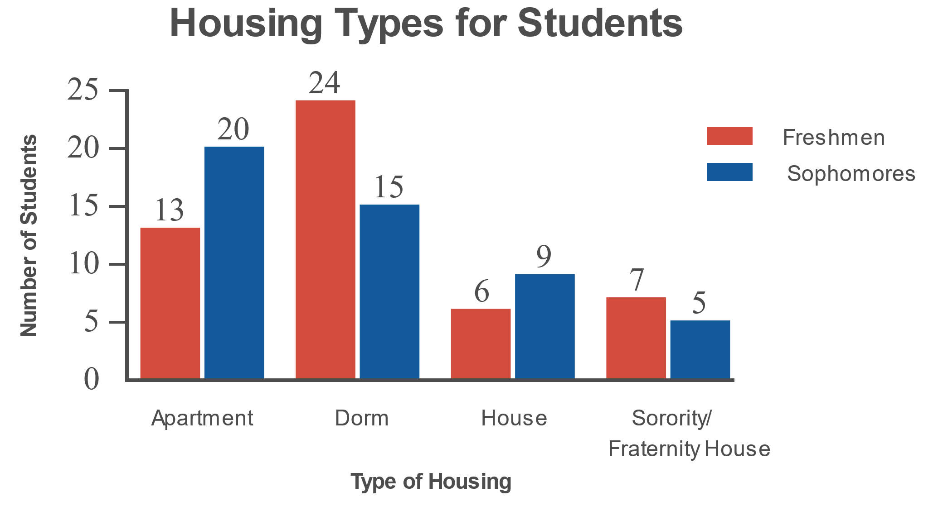
Example 2.2.4: Creating a Side-by-Side Bar Graph (cont.)

Slide 28
Example 2.2.4: Creating a Side-by-Side Bar Graph (cont.)
There is not a single right conclusion about the difference in housing choices, however, it is possible to correctly interpret a graph and to incorrectly interpret a graph. One possible response based on this graph of housing characteristics would be that more freshmen live in the dorm than sophomores. Did you make any other conclusions?

Slide 29
Side-By-Side Bar Graph & Stacked Bar Graph
Definition
A side-by-side bar graph is a type of bar graph in which multiple samples of data are displayed side-by-side for each category within the same graph.
A stacked bar graph is a type of bar graph in which multiple samples of data are displayed stacked on top of each other for each category within the same graph.
Note: A legend is essential for these types of bar graphs

Slide 30
Example 2.2.5: Creating a Stacked Bar Graph
Create a stacked bar graph for the data in the table below. What can you see from this graph that was not as obvious in the graph from the previous example?
Housing Types for Two Samples of Students
Type of Housing | Number of Freshmen | Number of Sophomores
Apartment | 13 | 20
Dorm | 24 | 15
House | 6 | 9
Sorority/Fraternity House | 7 | 5

Slide 31
Example 2.2.5: Creating a Stacked Bar Graph (cont.)
Solution
Creating a stacked bar graph begins by creating a traditional bar graph for one of the samples. In this case, create a bar graph for the freshmen, coloring each bar red. Next, extend the bar above each category by the number of sophomores in that category. Thus, the bar for the apartment category would be increased by 20, from 13 to 33. Color the extended bar blue for sophomores. Your stacked bar graph should resemble the one shown.

Slide 32
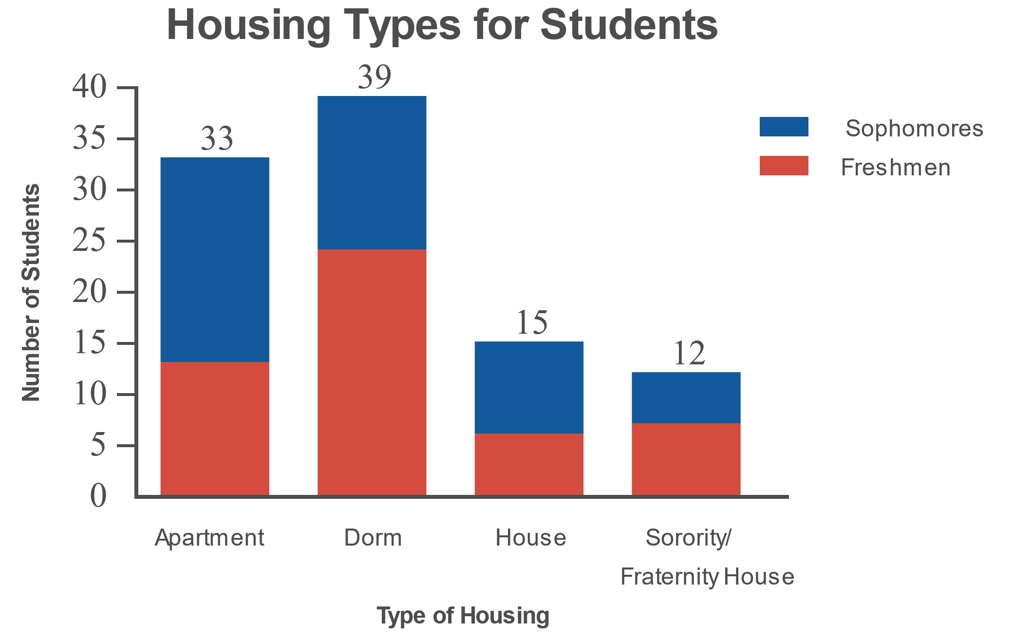
Example 2.2.5: Creating a Stacked Bar Graph (cont.)

Slide 33
Example 2.2.5: Creating a Stacked Bar Graph (cont.)
With the stacked bar graph, it is easier to see that more students overall live in the dorms than in apartments.

Slide 34
Example 2.2.6: Constructing a Histogram
Construct a histogram of the early-career salaries from the previous section. The frequency distribution of the data is restated for your convenience.

Slide 35
Example 2.2.6: Constructing a Histogram (cont.)
Highest Early-Career Salaries with a Bachelor's Degree (with Class Boundaries)
Class | Frequency | Class Midpoints | Class Boundaries
50,000 – 54,999 | 3 | 52,499.5 | 49,999.5 – 54,999.5
55,000 – 59,999 | 0 | 57,499.5 | 54,999.5 – 59,999.5
60,000 – 64,999 | 6 | 62,499.5 | 59,999.5 – 64,999.5
65,000 – 69,999 | 4 | 67,499.5 | 64,999.5 – 69,999.5
70,000 – 74,999 | 10 | 72,499.5 | 69,999.5 – 74,999.5
75,000 – 79,999 | 1 | 77,499.5 | 74,999.5 – 79,999.5
80,000 – 84,999 | 1 | 82,499.5 | 79999.5 – 84999.5

Slide 36
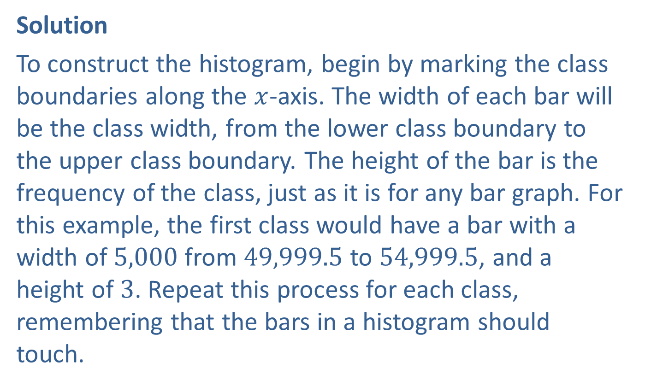
Example 2.2.6: Constructing a Histogram (cont.)
Solution
To construct the histogram, begin by marking the class boundaries along the $x$-axis. The width of each bar will be the class width, from the lower class boundary to the upper class boundary. The height of the bar is the frequency of the class, just as it is for any bar graph. For this example, the first class would have a bar with a width of 5,000 from 49,999.5 to 54,999.5, and a height of 3. Repeat this process for each class, remembering that the bars in a histogram should touch.

Slide 37
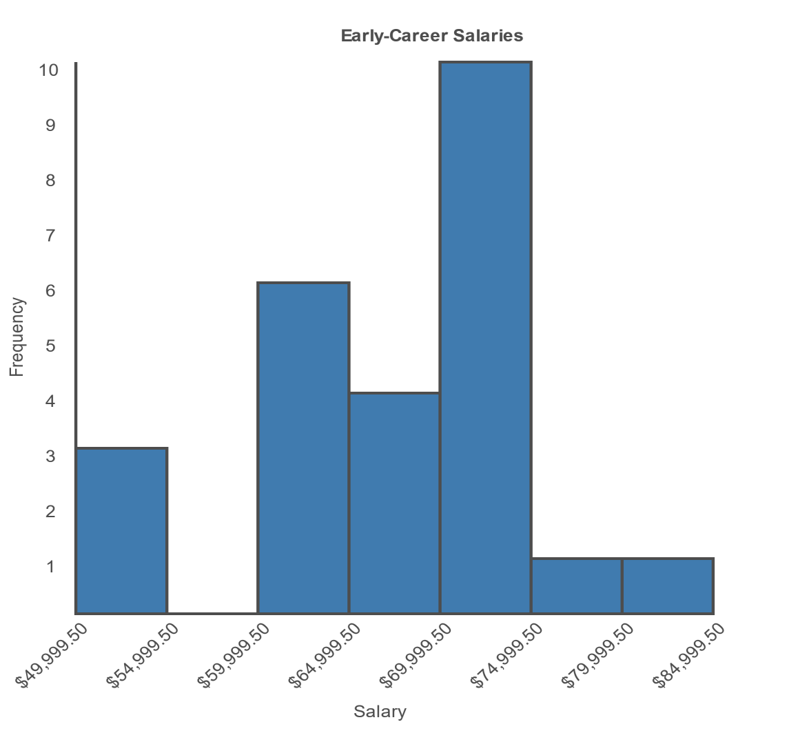
Example 2.2.6: Constructing a Histogram (cont.)
With Class Boundaries

Slide 38
Technology
For instructions on how to create a using a TI-83/84 Plus calculator, Excel, Minitab, or other technologies, please visit stat.hawkeslearning.com and navigate to Technology Instructions > Graphs > Histogram.

Slide 39
Histogram, Frequency Histogram & Relative Frequency Histogram
Definition
A histogram is a bar graph displaying a frequency distribution of quantitative data; the horizontal axis is a number line.
A frequency histogram is a histogram in which the heights of the bars represent the frequencies of each class.
A relative frequency histogram is a histogram in which the heights of the bars represent the relative frequencies of each class.

Slide 40
Example 2.2.7: Constructing a Relative Frequency Histogram
Construct a relative frequency histogram of the early-career salaries. The frequency distribution of the data is shown in the table.

Slide 41
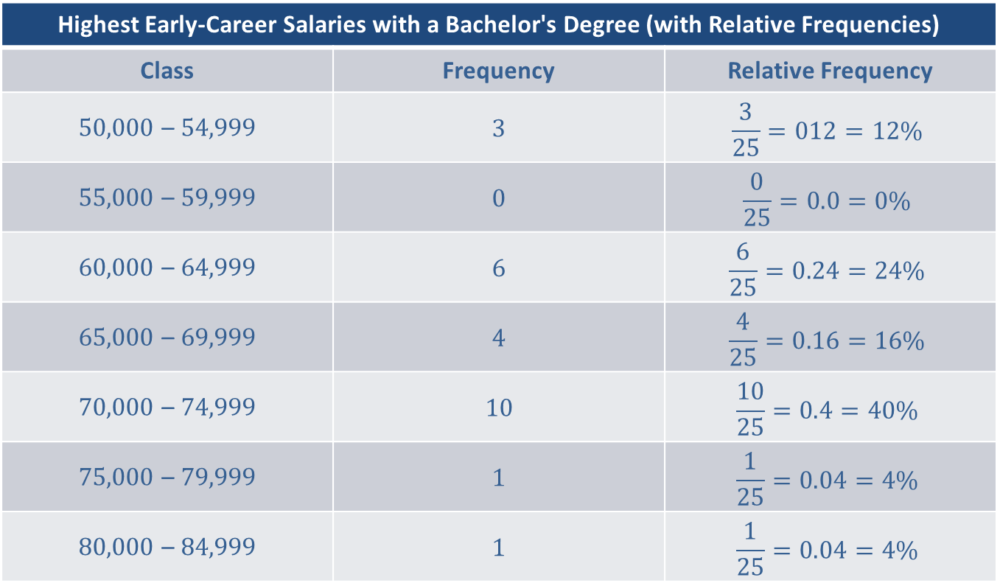
Example 2.2.7: Constructing a Relative Frequency Histogram (cont.)
Highest Early-Career Salaries with a Bachelor's Degree (with Relative Frequencies)
Class | Frequency | Relative Frequency
50,000 – 54,999 | 3 | $$\frac{3}{25}=012=12\%$$
55,000 – 59,999 | 0 | $$\frac{0}{25}=0.0=0\%$$
60,000 – 64,999 | 6 | $$\frac{6}{25}=0.24=24\%$$
65,000 – 69,999 | 4 | $$\frac{4}{25}=0.16=16\%$$
70,000 – 74,999 | 10 | $$\frac{10}{25}=0.4=40\%$$
75,000 – 79,999 | 1 | $$\frac{1}{25}=0.04=4\%$$
80,000 – 84,999 | 1 | $$\frac{1}{25}=0.04=4\%$$

Slide 42
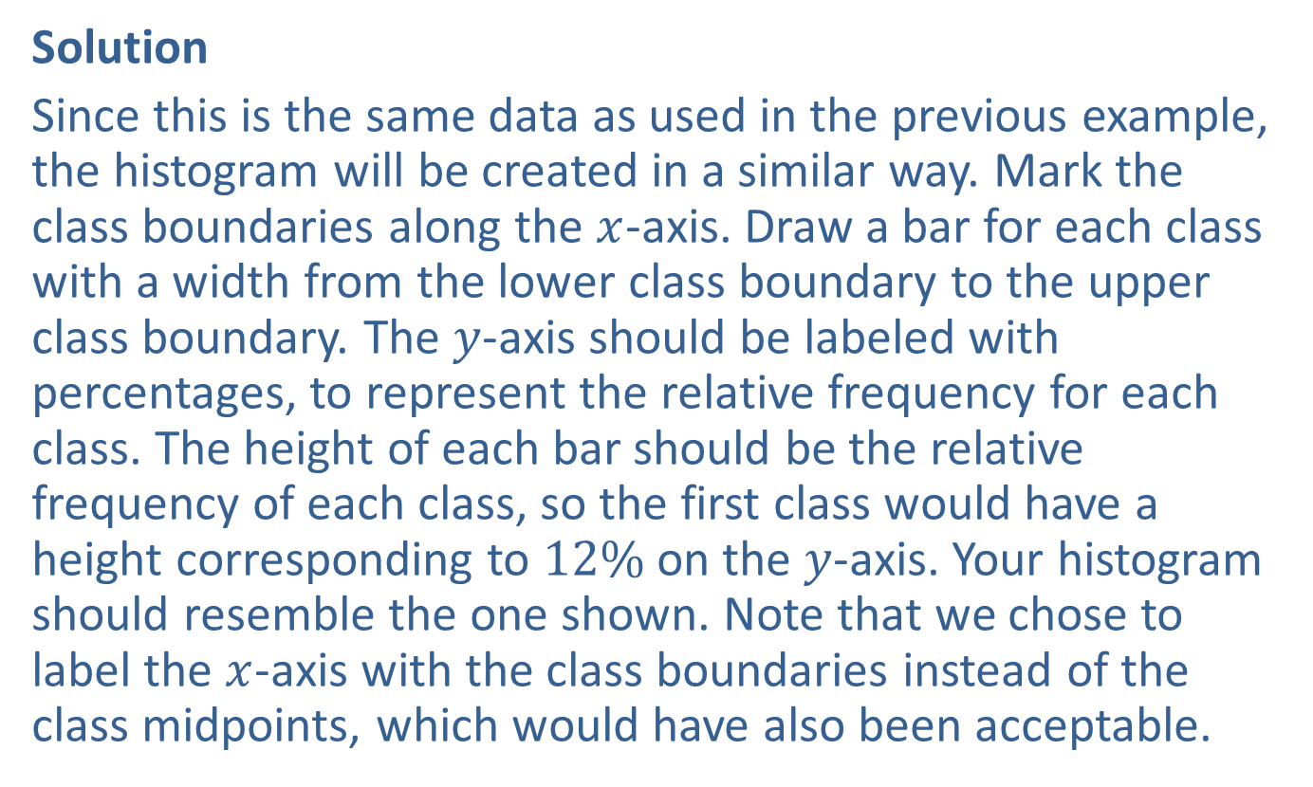
Example 2.2.7: Constructing a Relative Frequency Histogram (cont.)
Solution
Since this is the same data as used in the previous example, the histogram will be created in a similar way. Mark the class boundaries along the $x$-axis. Draw a bar for each class with a width from the lower class boundary to the upper class boundary. The $y$-axis should be labeled with percentages, to represent the relative frequency for each class. The height of each bar should be the relative frequency of each class, so the first class would have a height corresponding to $12\%$ on the $y$-axis. Your histogram should resemble the one shown. Note that we chose to label the $x$-axis with the class boundaries instead of the class midpoints, which would have also been acceptable.

Slide 43
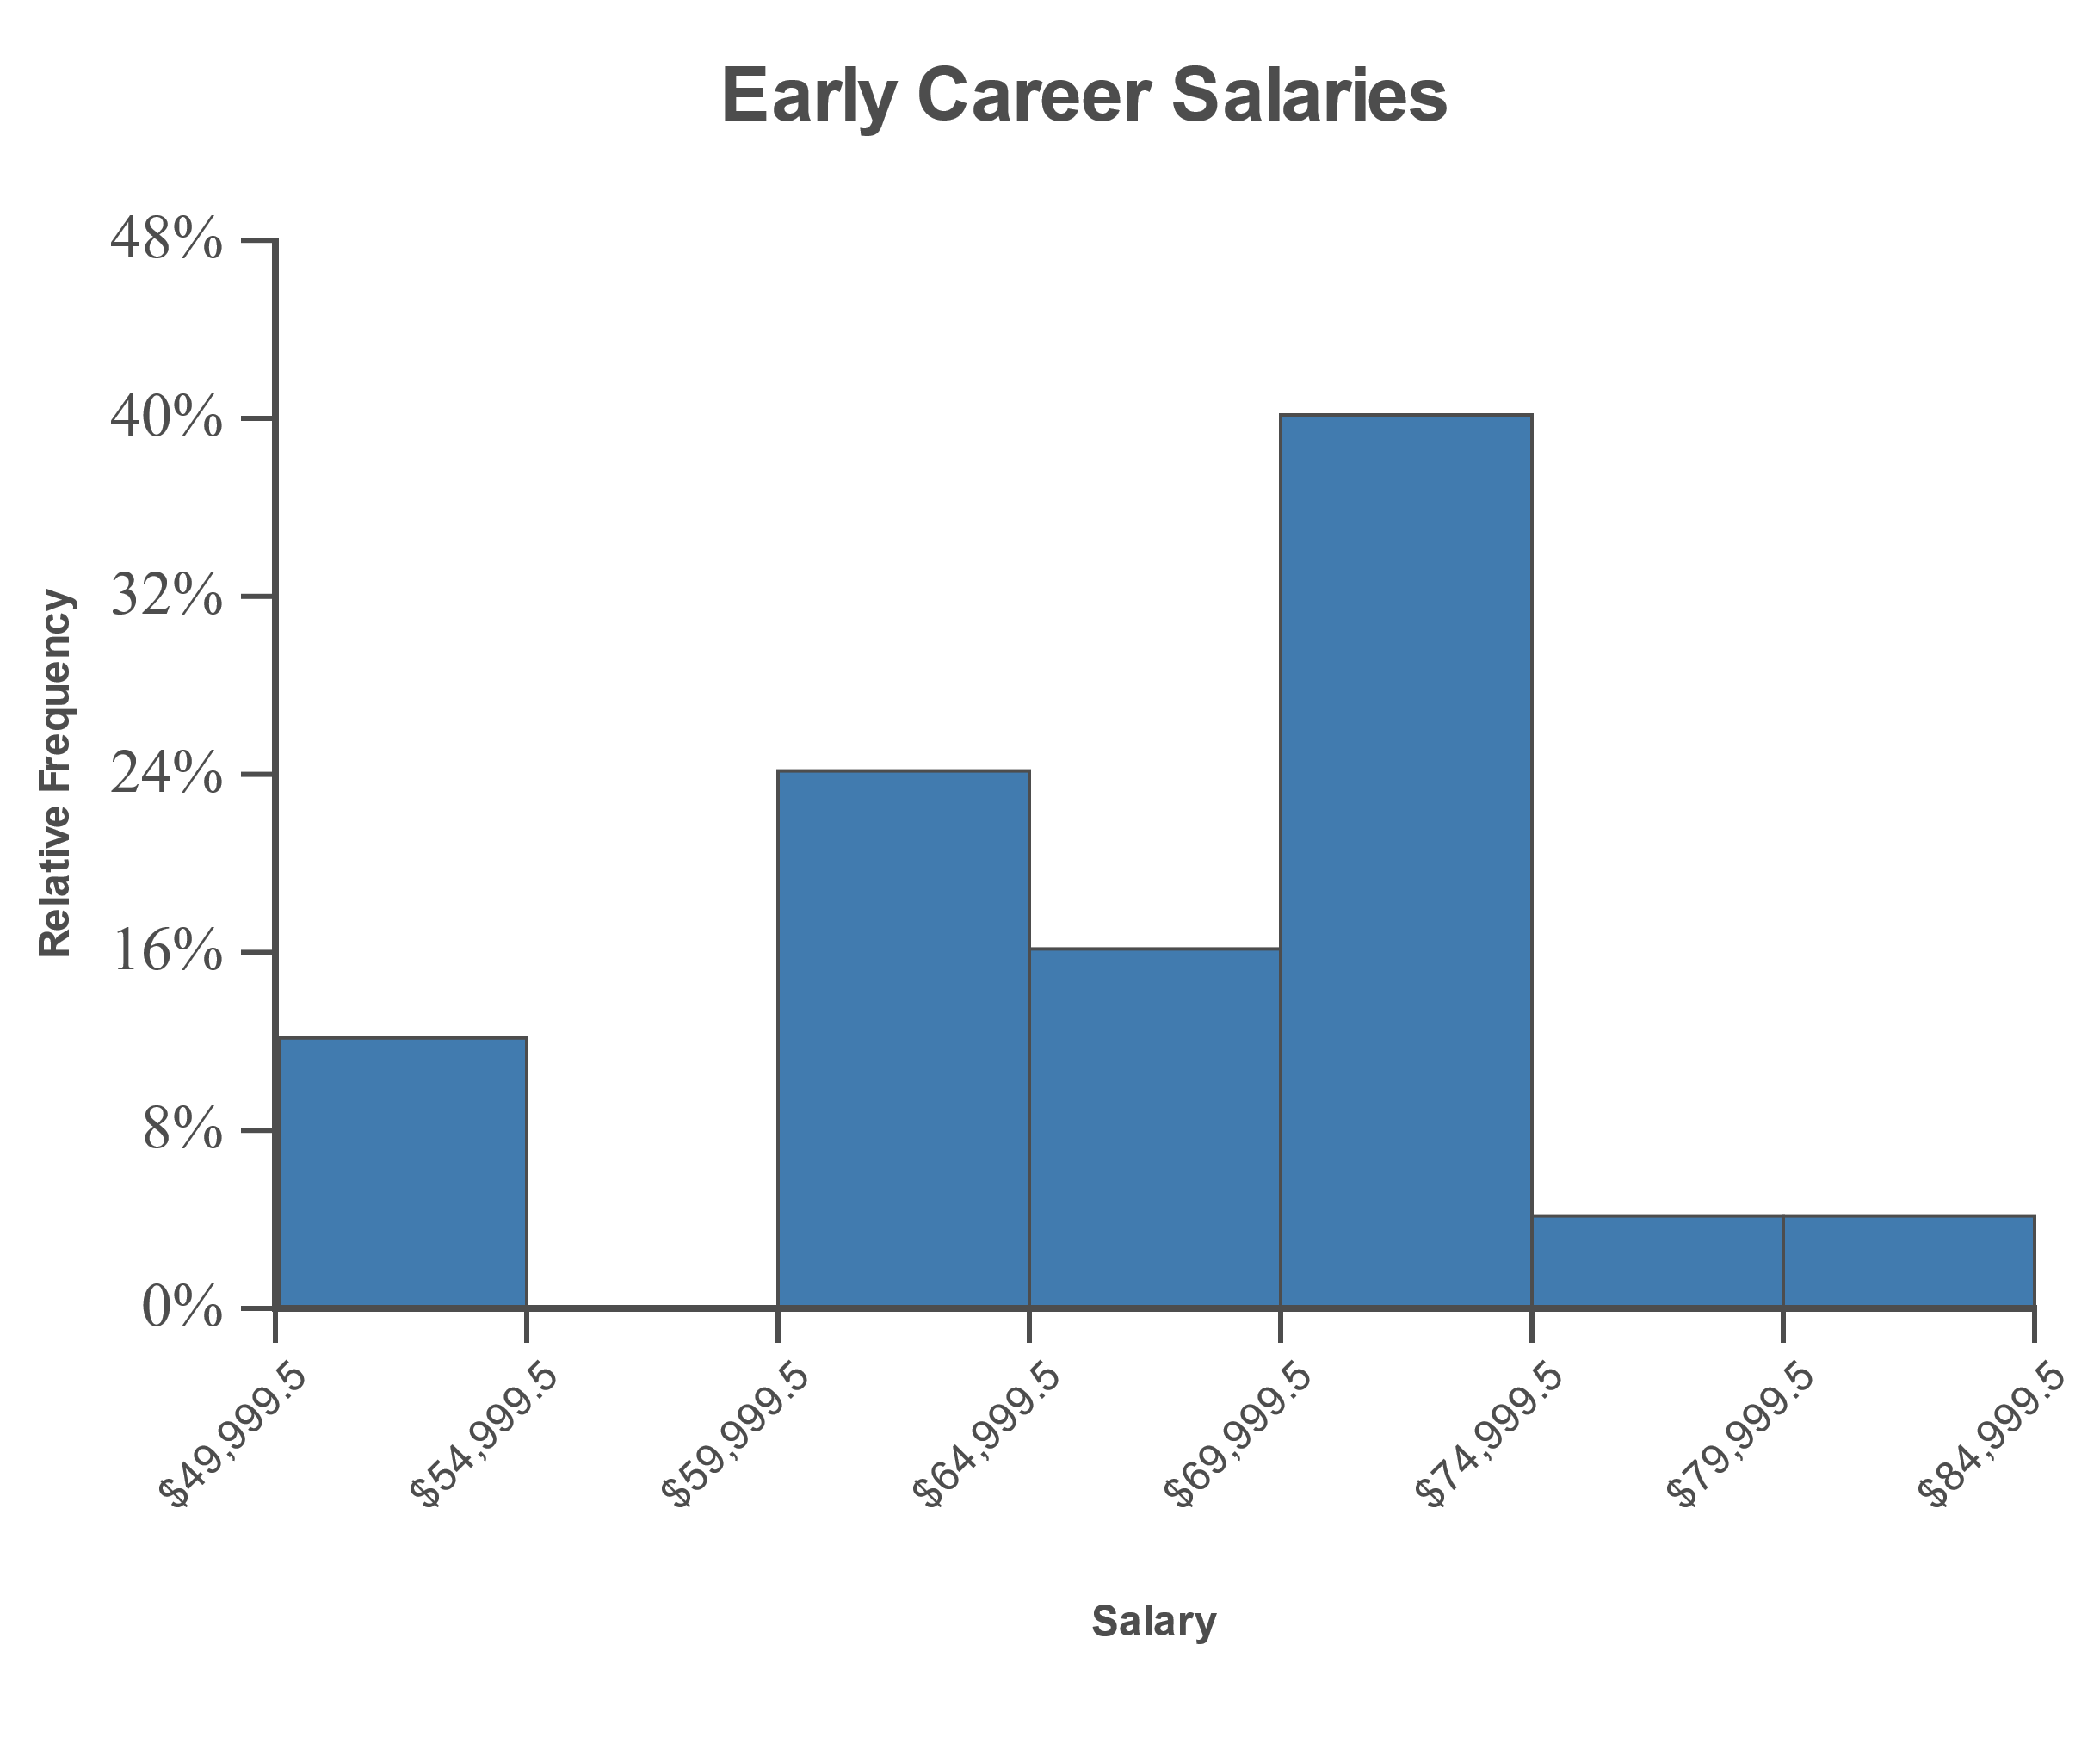
Example 2.2.7: Constructing a Relative Frequency Histogram (cont.)

Slide 44
Stem-And-Leaf Plot, Ordered Stem-And-Leaf Plot & Key
Definition
A stem-and-leaf plot is a graph of quantitative data in which each data value is split into 2 pieces: a leaf and a stem. Typically, the last significant digit in each data value is the "leaf" and the remaining digits are the "stem".
An ordered stem-and-leaf plot is a stem-and-leaf plot in which the leaves are arranged in numerical order.
The legend for a stem-and-leaf plot is often referred to as a key.

Slide 45
Procedure: Constructing a Stem-and-Leaf Plot
​Create two columns, one on the left for stems and one on the right for leaves.
​List each stem that occurs in the data set in numerical order. Each stem is normally listed only once; however, the stems are sometimes listed two or more times if splitting the leaves would make the data set's features clearer.

Slide 46
Procedure: Constructing a Stem-and-Leaf Plot (cont.)
​List each leaf next to its stem. Each leaf will be listed as many times as it occurs in the original data set. There should be as many leaves as there are data values. Be sure to line up the leaves in straight columns so that the table is visually accurate.
​Create a key to guide interpretation of the stem-and-leaf plot.
​If desired, put the leaves in numerical order to create an ordered stem-and-leaf plot.

Slide 47
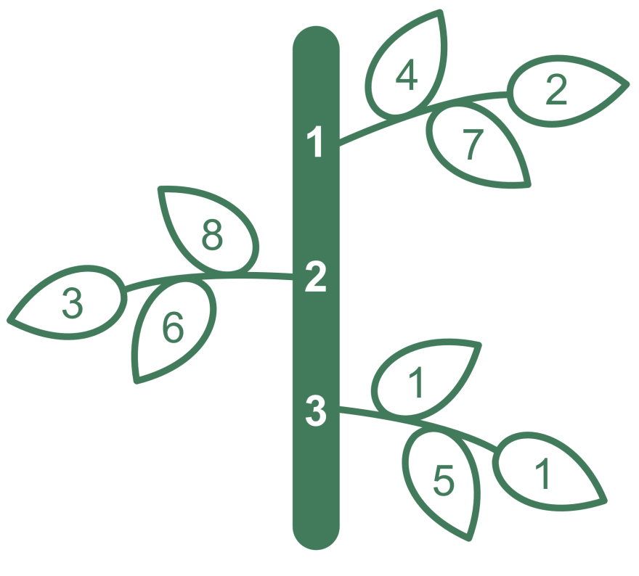
Memory Booster
Although this is not a correct way to draw a stem-and-leaf plot, this figure will help you remember the concepts associated with a stem-and-leaf plot.

Slide 48
Example 2.2.8: Creating a Stem-and-Leaf Plot
Create a stem-and-leaf plot of the following ACT scores from a group of college freshmen.
ACT Scores
18 | 23 | 24 | 31 | 19
27 | 26 | 22 | 32 | 18
35 | 27 | 29 | 24 | 20
18 | 17 | 21 | 25 | 26

Slide 49
Example 2.2.8: Creating a Stem-and-Leaf Plot (cont.)
Solution
Since all the data are 2-digit numbers, the stem column will consist of the different digits in the tens place. The leaves will contain all of the digits in the ones place. The data only has values in the 10s, 20s and 30s, so the stems will be 1, 2 and 3. Write those stems vertically in numerical order. Beginning with the first data value, 18, write its leaf of 8 next to its stem of 1. Continue to do this for each piece of data in the data set until your stem-and-left plot looks like the one shown. Indicate with a key that the stem of 1 and a leaf of 8 equals 18.

Slide 50
Example 2.2.8: Creating a Stem-and-Leaf Plot (cont.)
ACT Scores
Stem |  | Leaves
1 |  | 8 9 8 8 7
2 |  | 3 4 7 6 2 7 9 4 0 1 5 6
3 |  | 1 2 5
Key: | 1 | 8 | =18

Slide 51
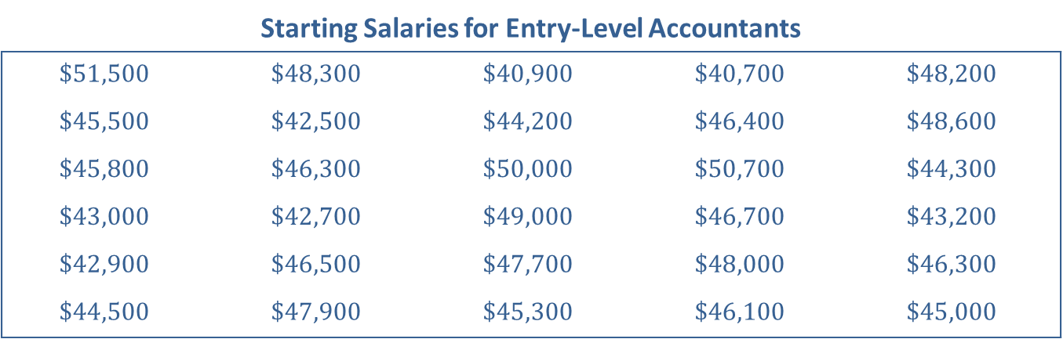
Example 2.2.9: Creating and Interpreting a Stem-and-Leaf Plot
Create a stem-and-leaf plot for the following starting salaries for entry-level accountants at public accounting firms. Use the stem-and-leaf plot that you create to answer the following questions.
Starting Salaries for Entry-Level Accountants
$$\$51,500$$ | $$\$48,300$$ | $$\$40,900$$ | $$\$40,700$$ | $$\$48,200$$
$$\$45,500$$ | $$\$42,500$$ | $$\$44,200$$ | $$\$46,400$$ | $$\$48,600$$
$$\$45,800$$ | $$\$46,300$$ | $$\$50,000$$ | $$\$50,700$$ | $$\$44,300$$
$$\$43,000$$ | $$\$42,700$$ | $$\$49,000$$ | $$\$46,700$$ | $$\$43,200$$
$$\$42,900$$ | $$\$46,500$$ | $$\$47,700$$ | $$\$48,000$$ | $$\$46,300$$
$$\$44,500$$ | $$\$47,900$$ | $$\$45,300$$ | $$\$46,100$$ | $$\$45,000$$

Slide 52
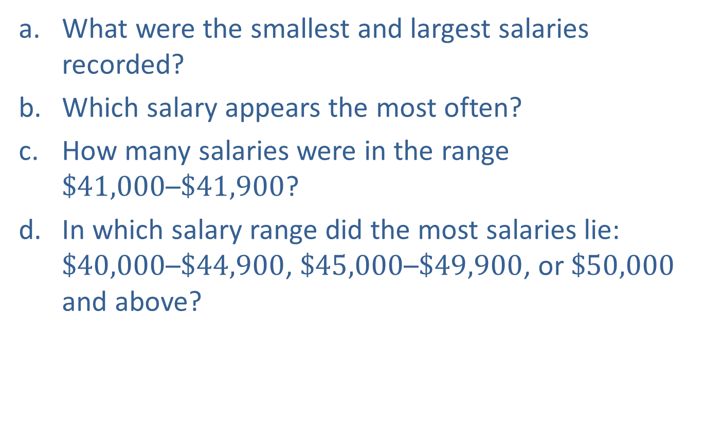
Example 2.2.9: Creating and Interpreting a Stem-and-Leaf Plot (cont.)
​What were the smallest and largest salaries recorded?
​Which salary appears the most often?
​How many salaries were in the range $\$41,000\text{–}\$41,900$?
​In which salary range did the most salaries lie: $\$40,000\text{–}\$44,900$, $\$45,000\text{–}\$49,900$, or $\$50,000$ and above?

Slide 53
Example 2.2.9: Creating and Interpreting a Stem-and-Leaf Plot (cont.)
Solution
This example is different than Example 2.2.8 in that the data have more than two digits and every data value ends in two zeros. It is important to choose the stems of the numbers so that the last significant digit in each data point will be the leaf in the chart. Listing the zeros as the leaves for each different stem would be of little use to anyone interpreting the stem-and-leaf plot. Instead, the key will denote that the salaries listed are in hundreds. Using the first two digits of each salary as a stem, we have the following plot. (Note: It is helpful to first list the salaries in numerical order.)

Slide 54
Example 2.2.9: Creating and Interpreting a Stem-and-Leaf Plot (cont.)
Starting Salaries for Entry-Level Accountants
Stem |  | Leaves
40 |  | 7 9
41
42 |  | 5 7 9
43 |  | 0 2
44 |  | 2 3 5
45 |  | 0 3 5 8
46 |  | 1 3 3 4 5 7
47 |  | 7 9
48 |  | 0 2 3 6
49 |  | 0
50 |  | 0 7
51 |  | 5
Key: | 40 | 7 | =$40,700

Slide 55
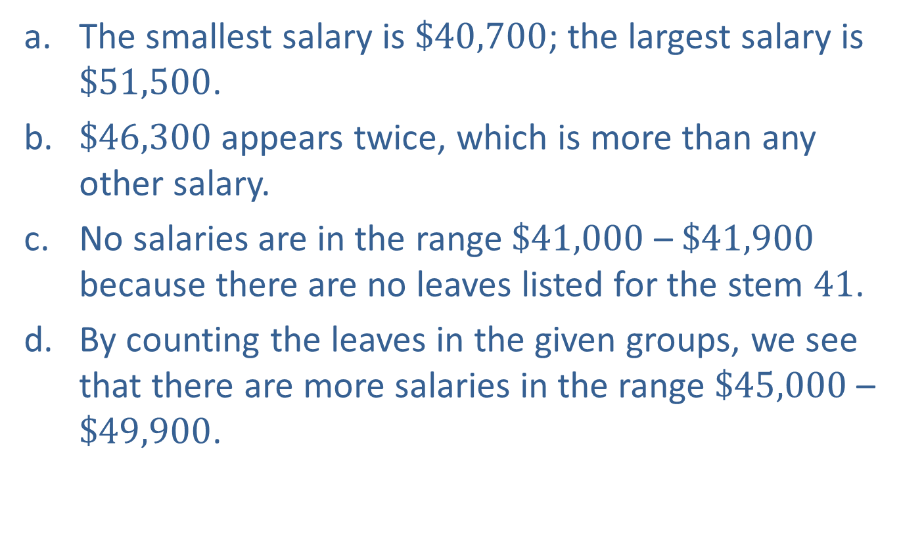
Example 2.2.9: Creating and Interpreting a Stem-and-Leaf Plot (cont.)
​The smallest salary is $\$40,700$; the largest salary is $\$51,500$.
​$\$46,300$ appears twice, which is more than any other salary.
​No salaries are in the range $\$41,000$ – $\$41,900$ because there are no leaves listed for the stem 41.
​By counting the leaves in the given groups, we see that there are more salaries in the range $\$45,000$ – $\$49,900$.

Slide 56
Example 2.2.10: Interpreting a Heat Map
The following map shows the percentage of the population who are under 5 years old. Based on this map, if you wanted to start a children’s clothing boutique, what area of the country might be the best option, and why?

Slide 57
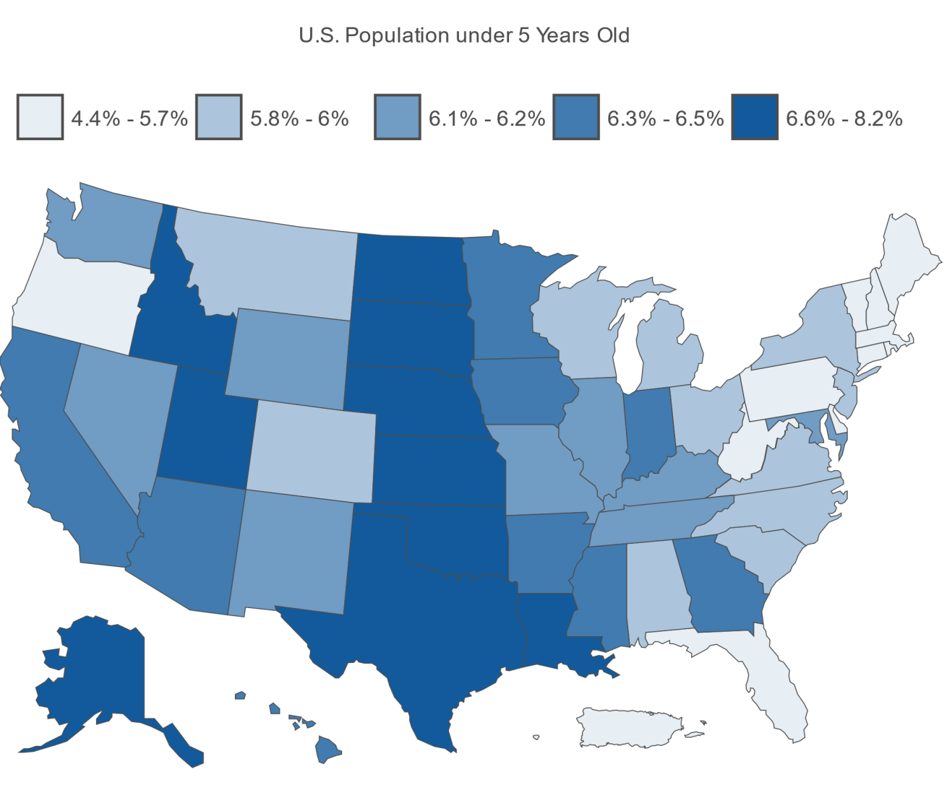
Example 2.2.10: Interpreting a Heat Map (cont.)
Source: US Census Bureau. "QuickFacts United States." 01 Jan. 2018. https://www.census.gov/quickfacts/fact/map/US/AGE135217 (30 Jan. 2019).

Slide 58
Example 2.2.10: Interpreting a Heat Map (cont.)
Solution
Since darker colored states of the country indicate areas where there are a higher percentage of children under 5 years old, it might make sense to consider opening somewhere in the middle of the United States, such as in Texas, Oklahoma, or Nebraska. However, the information in the map would be too general to determine a specific location that might be a best fit. A better option might be to look at economic data on the sales per capita for that particular industry.

Slide 59
Dot Plot, Heat Map & Line Graph
Definition
A dot plot is a graphical depiction of a data set in which each data value is represented by a dot above the appropriate value on a number line.
A heat map is any graph that depicts data in such a way as to use color to indicate the value of the category or area.
A line graph is a graph that uses points to represent data values at a particular time in history and then joins the points with line segments. It displays changes in a quantitative variable over time.

Slide 60
Example 2.2.11: Constructing a Line Graph
The Consumer Price Index (CPI) is a measure of the average change in value over time for a market basket of goods and services. It is an index calculated by the US Bureau of Labor and Statistics. The following table shows the values of the CPI from several years. Construct a line graph of these data.

Slide 61
Example 2.2.11: Constructing a Line Graph (cont.)
Consumer Price Index in January
Year | CPI
1970 | 37.8
1975 | 52.1
1980 | 77.8
1985 | 105.5
1990 | 127.4
1995 | 150.3
2000 | 168.8
2005 | 190.7
2010 | 216.7
2015 | 233.7
Source: US Bureau of Labor Statistics. "Historical Consumer Price Index for All Urban Consumers." 01 Jan. 2018. https://www.bls.gov/cpi/tables/historical-cpi-u-201712.pdf (30 Jan. 2019).

Slide 62
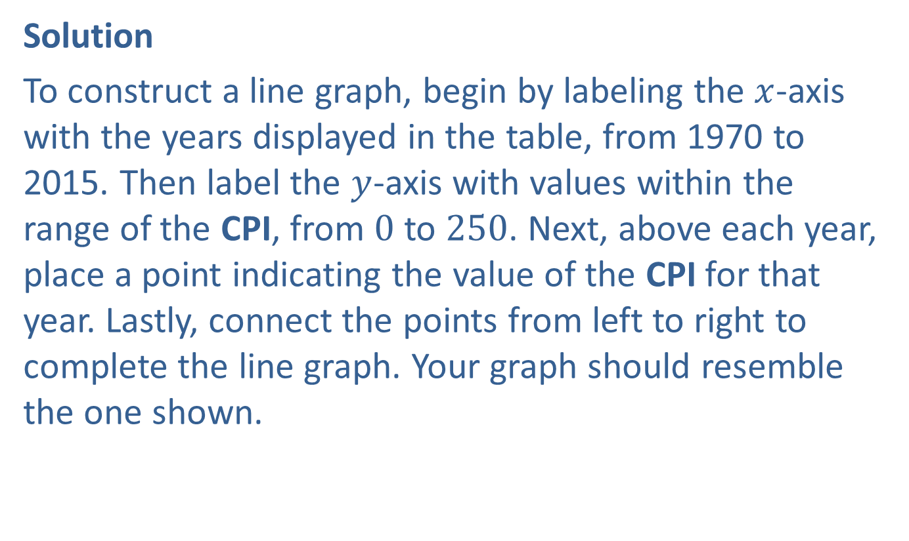
Example 2.2.11: Constructing a Line Graph (cont.)
Solution
To construct a line graph, begin by labeling the $x$-axis with the years displayed in the table, from 1970 to 2015. Then label the $y$-axis with values within the range of the CPI, from 0 to 250. Next, above each year, place a point indicating the value of the CPI for that year. Lastly, connect the points from left to right to complete the line graph. Your graph should resemble the one shown.

Slide 63
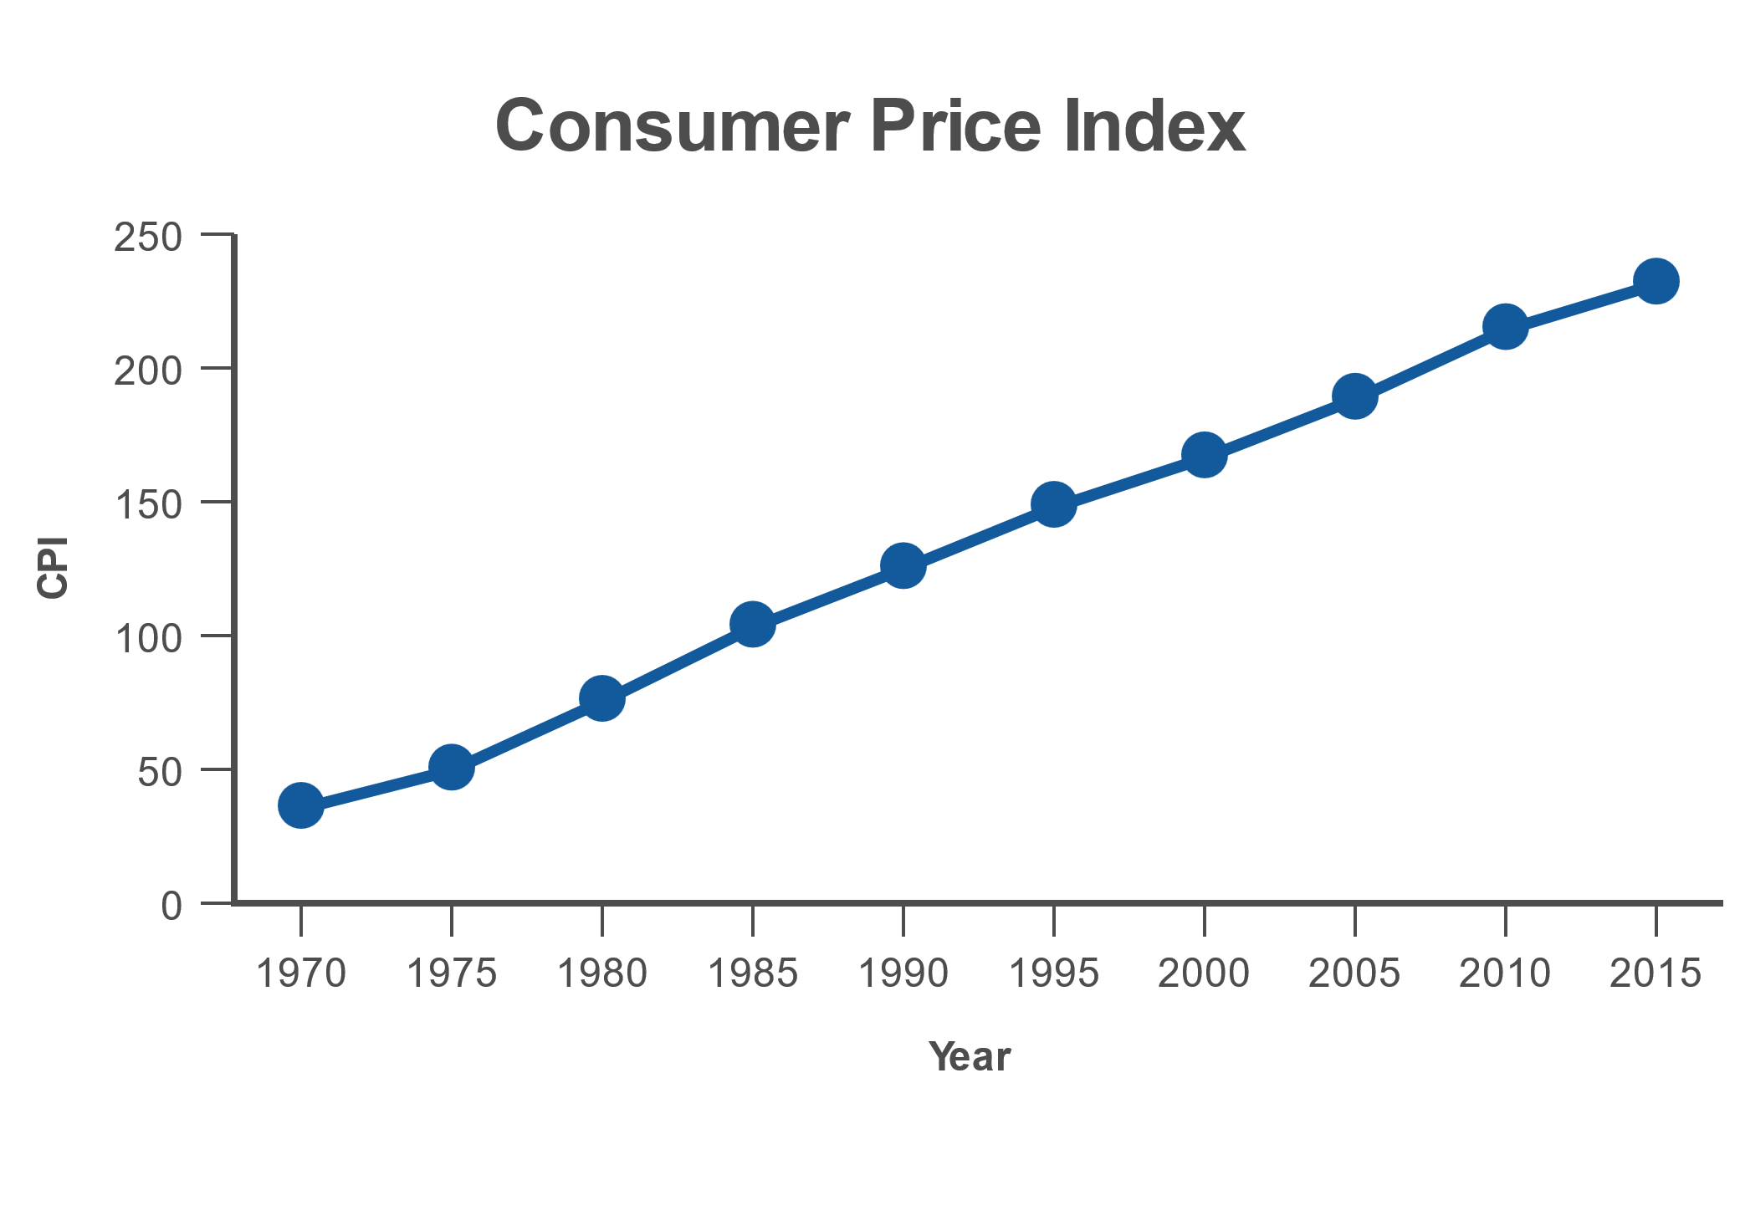
Example 2.2.11: Constructing a Line Graph (cont.)

Slide 64
Technology
For instructions on how to create a line graph using a TI-83/84 Plus calculator, Excel, Minitab, or other technologies, please visit stat.hawkeslearning.com and navigate to Technology Instructions > Graphs > Line Graph.

