Slide 1
Section 2.3
Analyzing Graphs

Slide 2
Memory Booster
Graphs should have:
​Title
​Labels on Axes
​Source
​Data

Slide 3
Time-Series Graph & Cross-Sectional Graph
Definition
A time-series graph is a line graph that is used to display a variable whose values change over time.
A cross-sectional graph displays information collected at only one point in time.

Slide 4
Pictograph
Definition
A pictograph is a bar graph that uses picture of objects instead of bars.

Slide 5
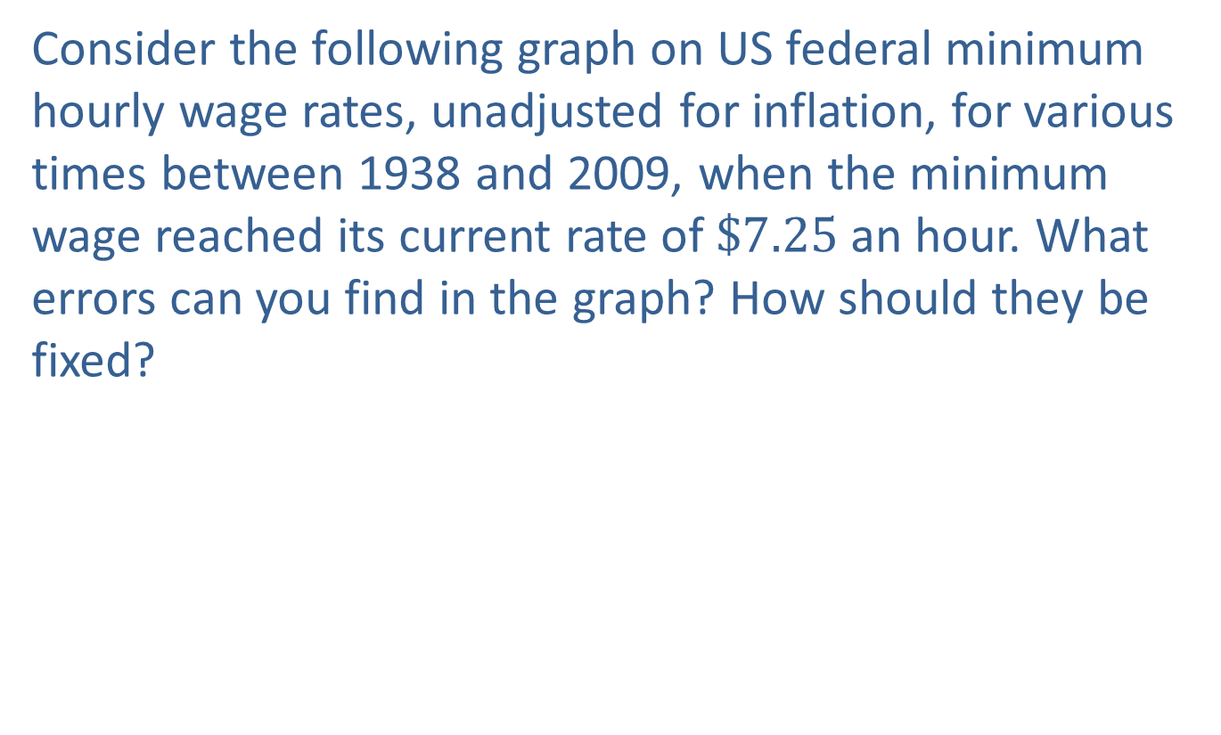
Example 2.3.1: Scaling of Graphs
Consider the following graph on US federal minimum hourly wage rates, unadjusted for inflation, for various times between 1938 and 2009, when the minimum wage reached its current rate of $\$7.25$ an hour. What errors can you find in the graph? How should they be fixed?

Slide 6
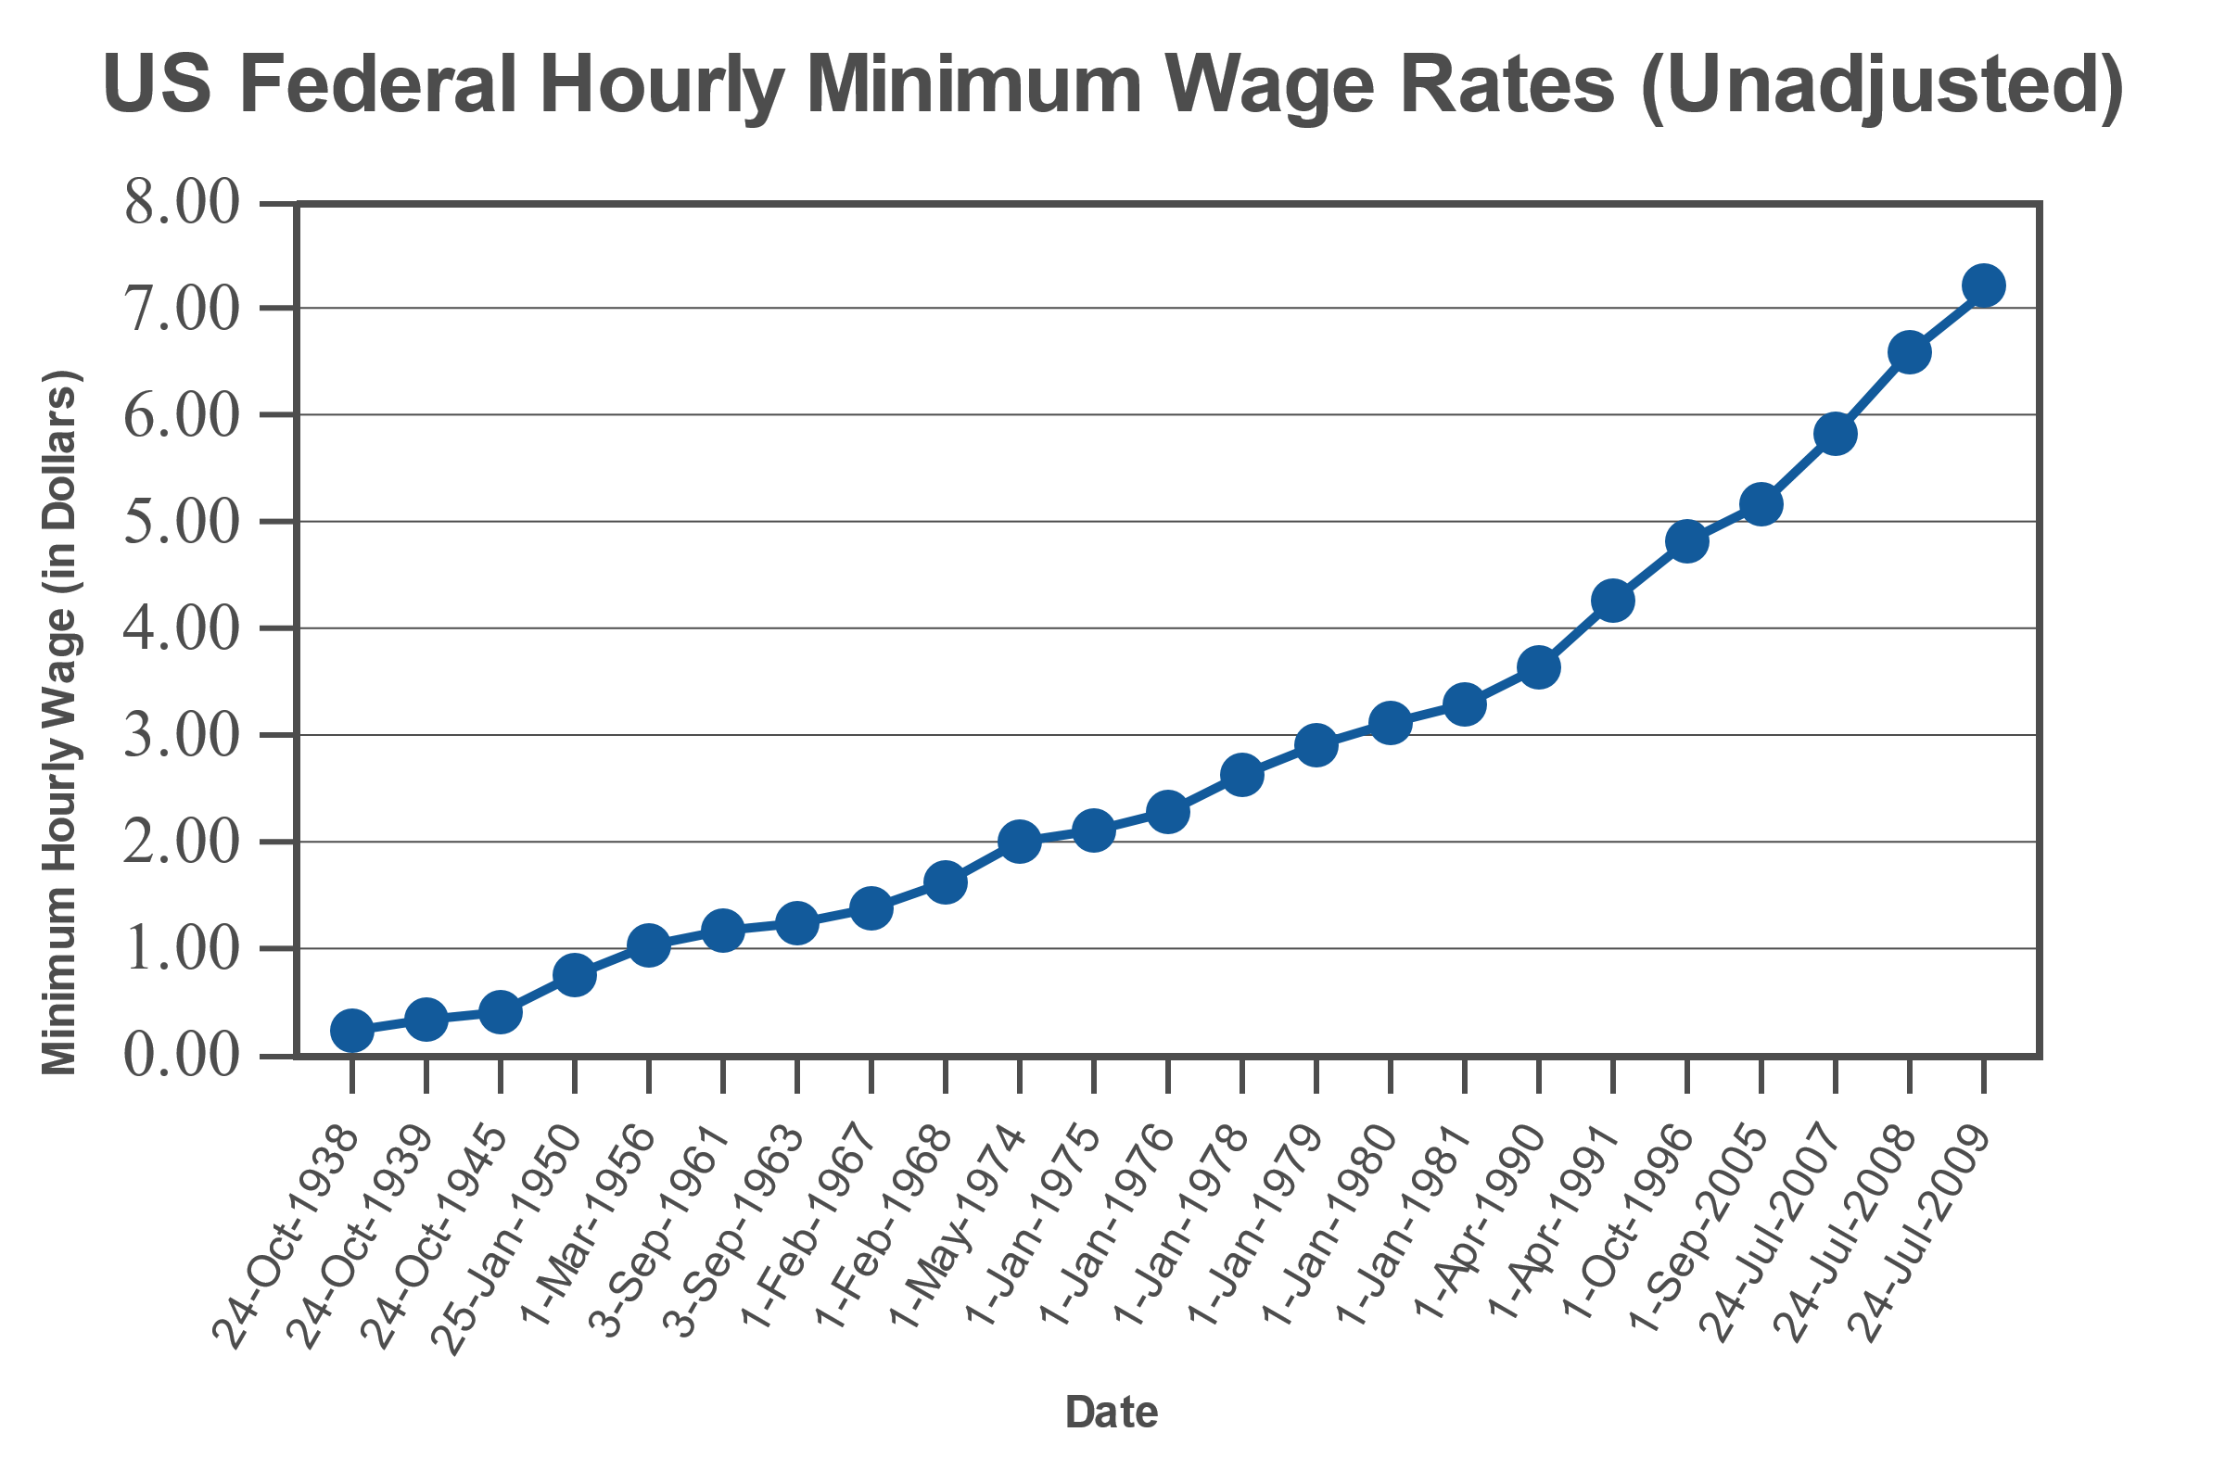
Example 2.3.1: Scaling of Graphs (cont.)
Source: US Department of Labor, Wage and Hour Division (WHD). "History of Federal Minimum Wage Rates Under the Fair Labor Standards Act, 1938-2009." http://www.dol.gov/whd/minwage/chart.htm (24 Jan. 2012).

Slide 7
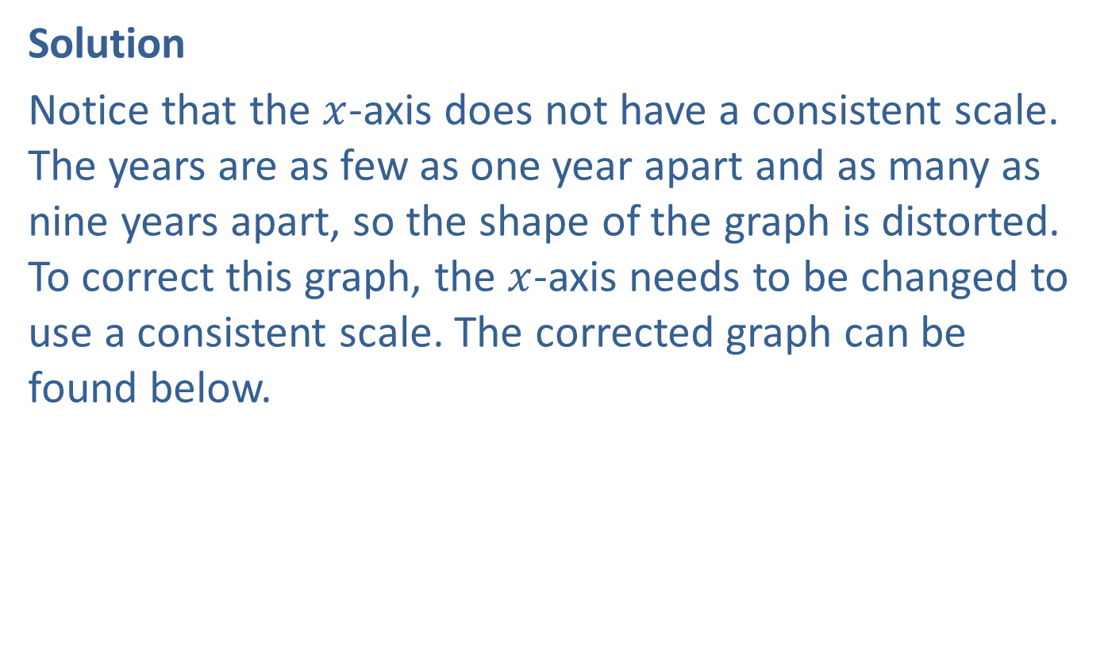
Example 2.3.1: Scaling of Graphs (cont.)
Solution
Notice that the $x$-axis does not have a consistent scale. The years are as few as one year apart and as many as nine years apart, so the shape of the graph is distorted. To correct this graph, the $x$-axis needs to be changed to use a consistent scale. The corrected graph can be found below.

Slide 8
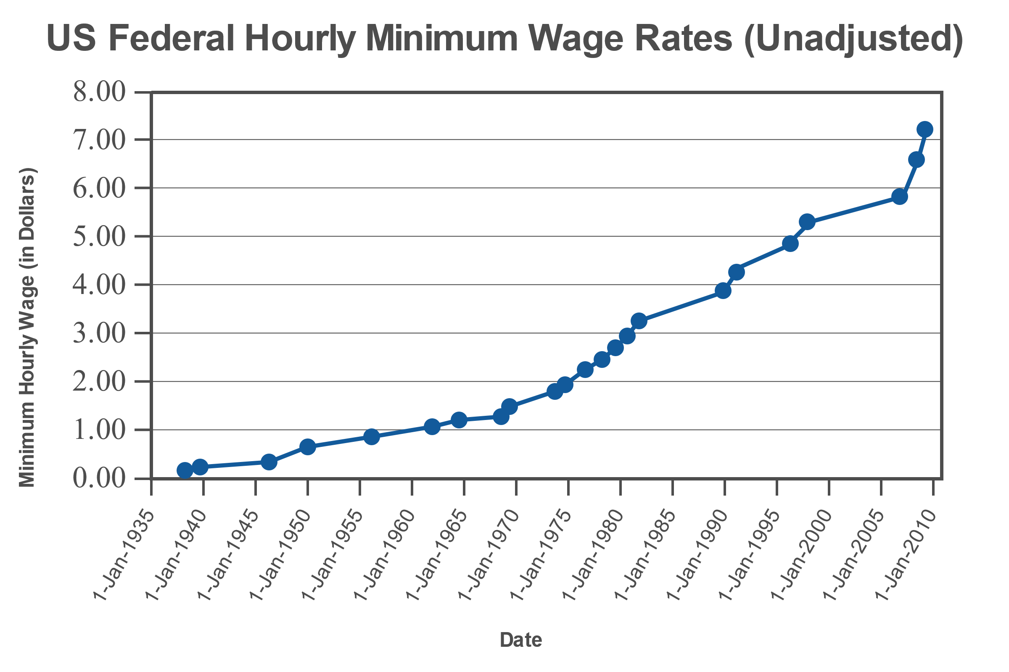
Example 2.3.1: Scaling of Graphs (cont.)

Slide 9
Uniform, Symmetric, Skewed To The Right, Skewed To The Left & Outlier
Definition
A graph's shape is uniform if the frequency of each class is relatively the same.
A graph's shape is symmetric if a vertical line drawn through the center of the graph would give mirror images of the data on either side.
A graph's shape is skewed to the right when the majority of the data fall on the left side of the distribution.
A graph's shape is skewed to the left when the majority of the data fall on the right side of the distribution.
An outlier is a data value that falls outside the shape of the distribution.

Slide 10
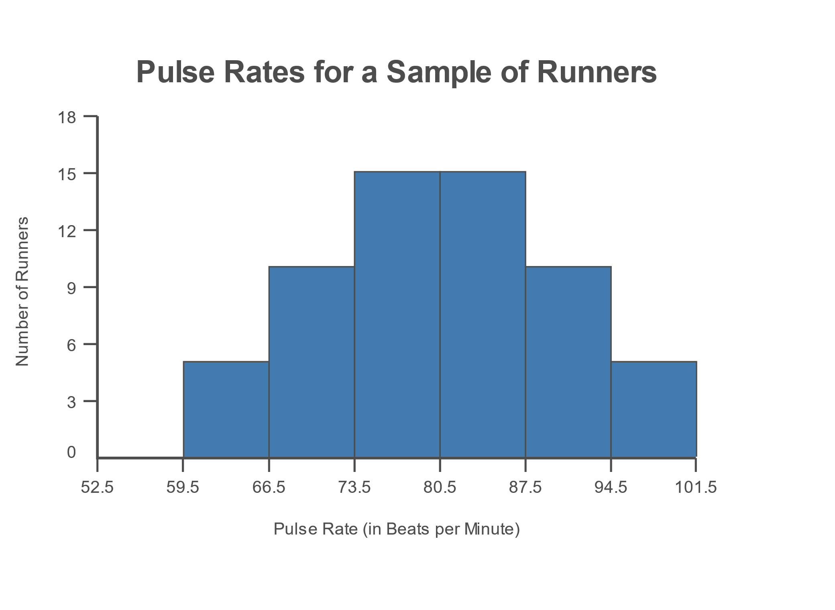
Example 2.3.2: Shapes of Graphs
Describe the overall shape of the following distribution.

Slide 11
Example 2.3.2: Shapes of Graphs (cont.)
Solution
Notice that if we draw a smooth curve skimming the top of the histogram, we begin to see a curve similar to the shape of the symmetric curve. To be symmetric, the left and right sides of the graph should be close to mirror images. Drawing a line down the center of the graph, we can see that both sides of the graph are indeed mirror images of each other.

Slide 12
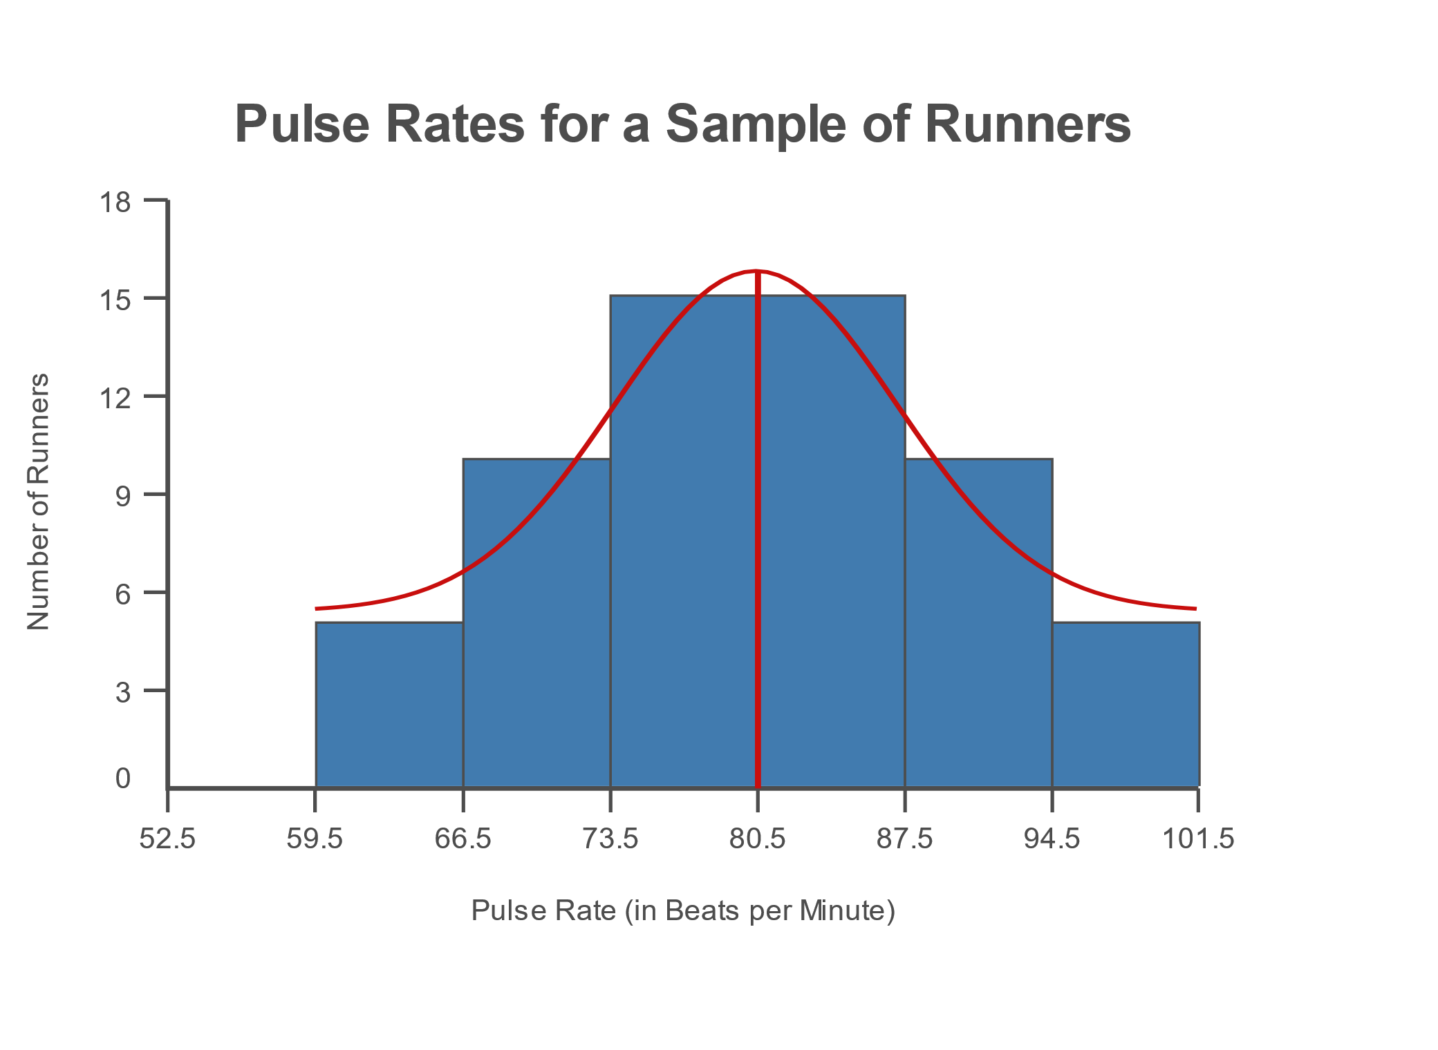
Example 2.3.2: Shapes of Graphs (cont.)
Thus, this histogram has a symmetric shape.

