Slide 1
Section 3.1
Measures of Center

Slide 2
Memory Booster
Quantitative data are counts and measurements.

Slide 3
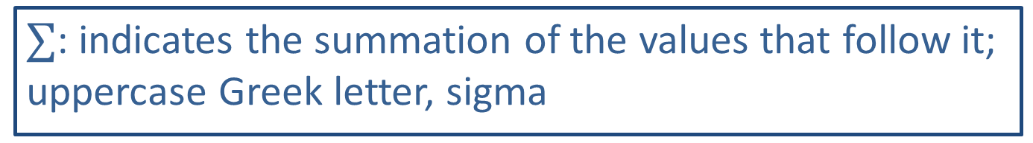
Math Symbols
$∑$: indicates the summation of the values that follow it; uppercase Greek letter, sigma

Slide 4
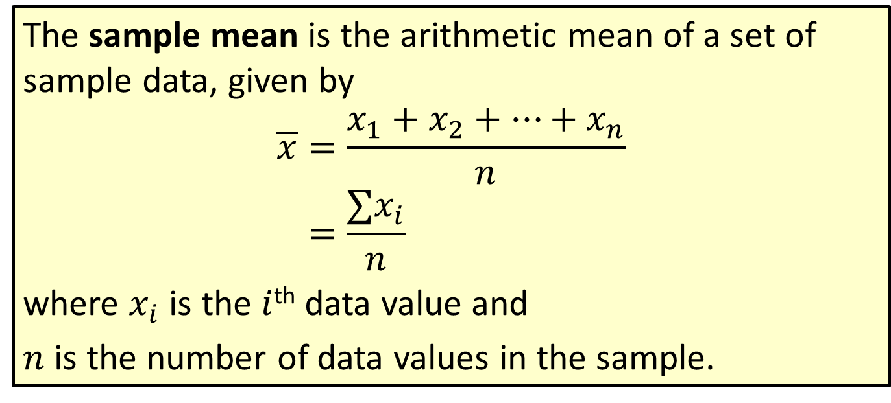
Formula: Sample Mean
The sample mean is the arithmetic mean of a set of sample data, given by
𝑥=𝑥1+𝑥2+…+𝑥𝑛𝑛𝑥=∑𝑥𝑖𝑛
where $x_{i}$ is the $i$^{th} data value and
$n$ is the number of data values in the sample.

Slide 5
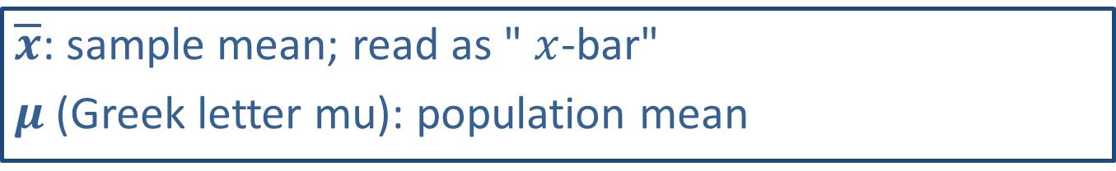
Math Symbols
$\overline{x}$: sample mean; read as " $x$-bar"
$μ$ (Greek letter mu): population mean

Slide 6
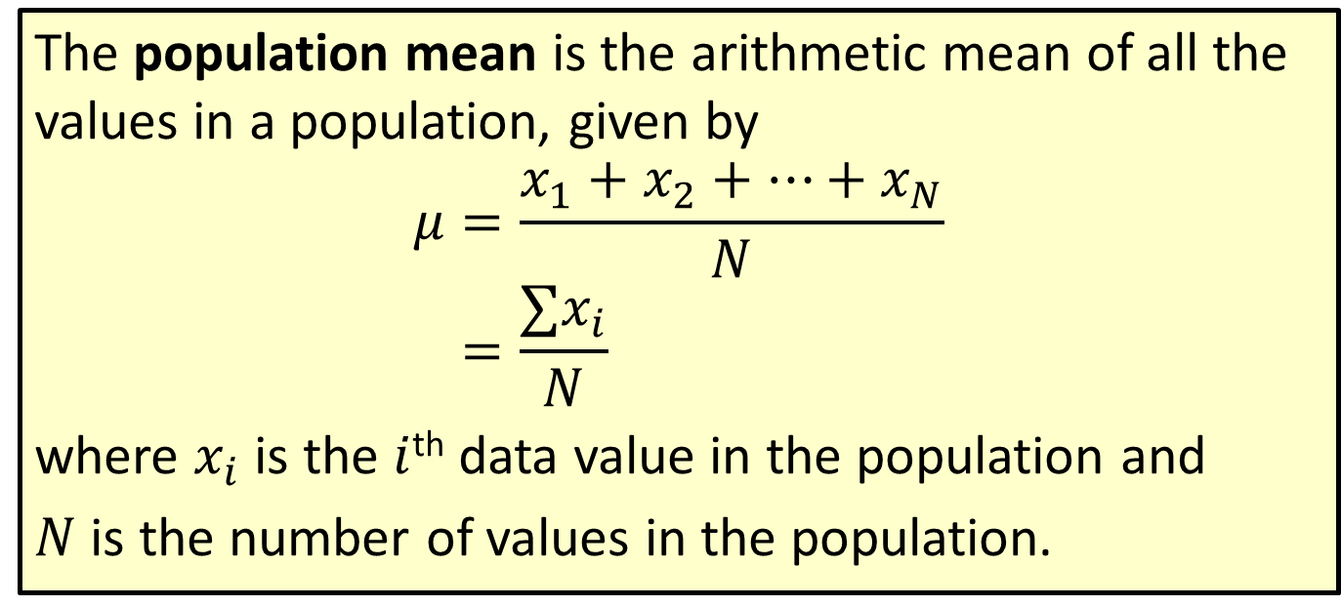
Formula: Population Mean
The population mean is the arithmetic mean of all the values in a population, given by
𝜇=𝑥1+𝑥2+…+𝑥𝑁𝑁𝜇=∑𝑥𝑖𝑁
where $x_{i}$ is the $i$^{th} data value in the population and
$N$ is the number of values in the population.

Slide 7
Rounding Rule
When calculating the mean, round to one more decimal place than the largest number of decimal places given in the data. Occasional exceptions to this rule can be made when the type of data lends itself to a more natural rounding scheme, such as rounding values of currency to two decimal places.

Slide 8
Example 3.1.1: Calculating the Sample Mean
Students were surveyed to find out the number of hours they sleep per night during the semester. Here is a sample of their self-reported responses. Calculate the mean.
5, 6, 8, 10, 4, 6, 9

Slide 9
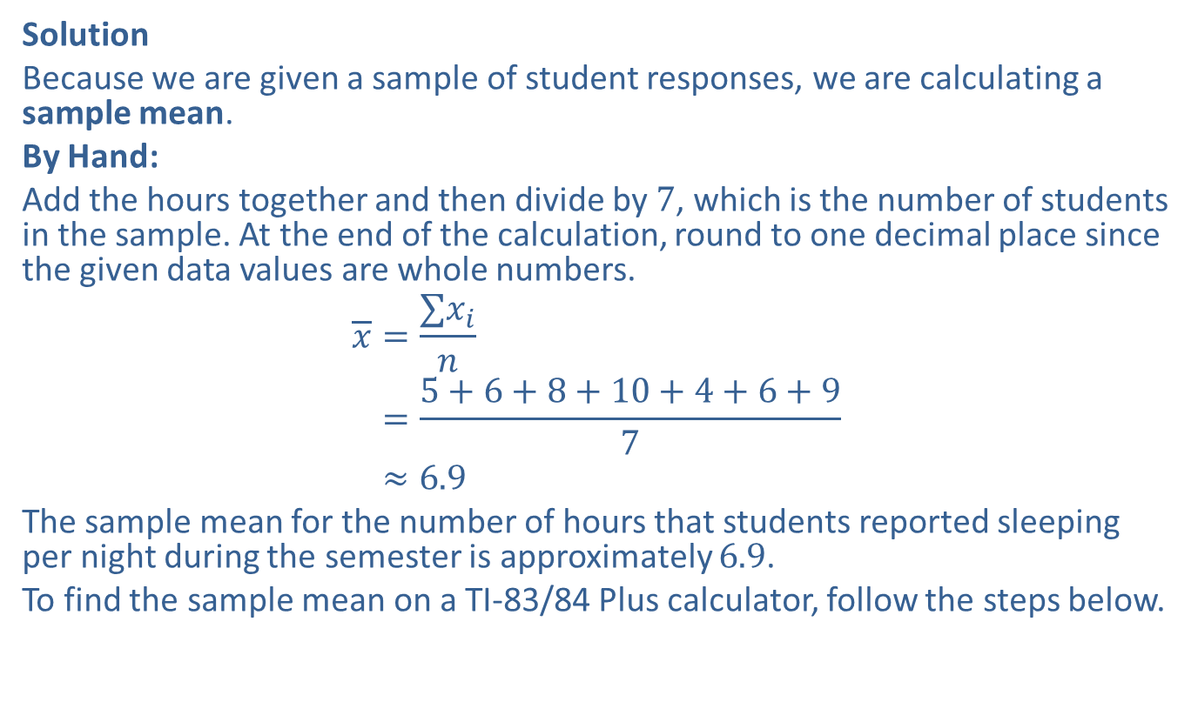
Example 3.1.1: Calculating the Sample Mean (cont.)
Solution
Because we are given a sample of student responses, we are calculating a sample mean.
By Hand:
Add the hours together and then divide by 7, which is the number of students in the sample. At the end of the calculation, round to one decimal place since the given data values are whole numbers.
𝑥=∑𝑥𝑖𝑛𝑥=5+6+8+10+4+6+97𝑥≈6.9
The sample mean for the number of hours that students reported sleeping per night during the semester is approximately 6.9.
To find the sample mean on a TI-83/84 Plus calculator, follow the steps below.

Slide 10
Example 3.1.1: Calculating the Sample Mean (cont.)
TI-83/84 Plus:
To calculate the mean, you will first need to input the data into the list function of the calculator. To do this, go to STAT > EDIT. Enter the values into L1 as shown on the top screenshot below. (Make sure any old data has been deleted first.) Next, press STAT > CALC and choose 1-Var Stats. Press Enter to obtain the results in the bottom screenshot below.

Slide 11
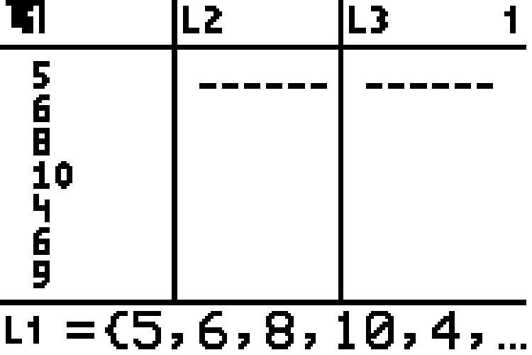
Example 3.1.1: Calculating the Sample Mean (cont.)

Slide 12
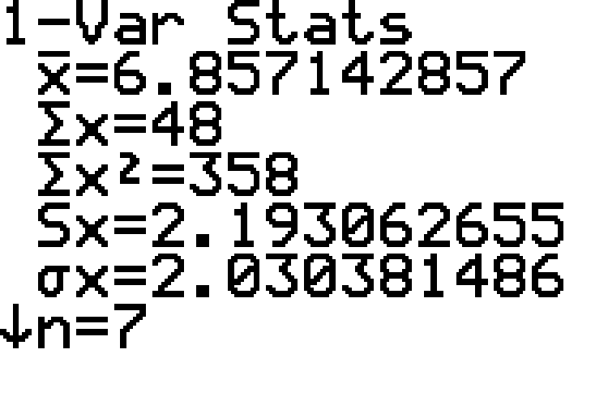
Example 3.1.1: Calculating the Sample Mean (cont.)

Slide 13
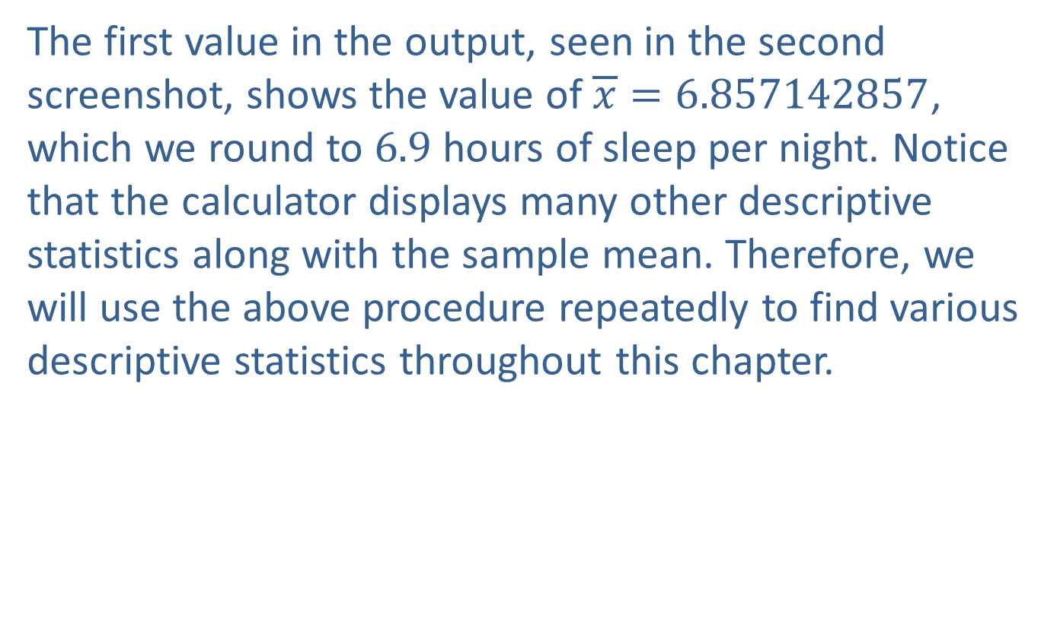
Example 3.1.1: Calculating the Sample Mean (cont.)
The first value in the output, seen in the second screenshot, shows the value of $\overline{x}=6.857142857$, which we round to 6.9 hours of sleep per night. Notice that the calculator displays many other descriptive statistics along with the sample mean. Therefore, we will use the above procedure repeatedly to find various descriptive statistics throughout this chapter.

Slide 14

Example 3.1.2: Using the Mean to Find a Data Value
Rutherford downloaded five new songs from Apple Music. He knows that on average the songs cost $\$1.23$. If four of the songs cost $\$1.29$ each, what was the price of the fifth song he downloaded?

Slide 15

Example 3.1.2: Using the Mean to Find a Data Value (cont.)
Solution
Since we are given the value of the population mean, μ, we can use algebra on the formula to find the missing value. Substituting all the values we are given into the formula for the mean, we have the following.
$$\begin{matrix}μ & =\frac{x_{1}+x_{2}+x_{3}+x_{4}+x_{5}}{N} \\ \$1.23 & =\frac{\$1.29+\$1.29+\$1.29+\$1.29+x_{5}}{5} \\ 5⋅\$1.23 & =\frac{\$5.16+x_{5}}{5}⋅5 \\ \$6.15 & =\$5.16+x_{5} \\ \$6.15−\$5.16 & =\$5.16+x_{5}−\$5.16 \\ \$0.99 & =x_{5}\end{matrix}$$
So the cost of Rutherford's fifth song was $\$0.99$.

Slide 16
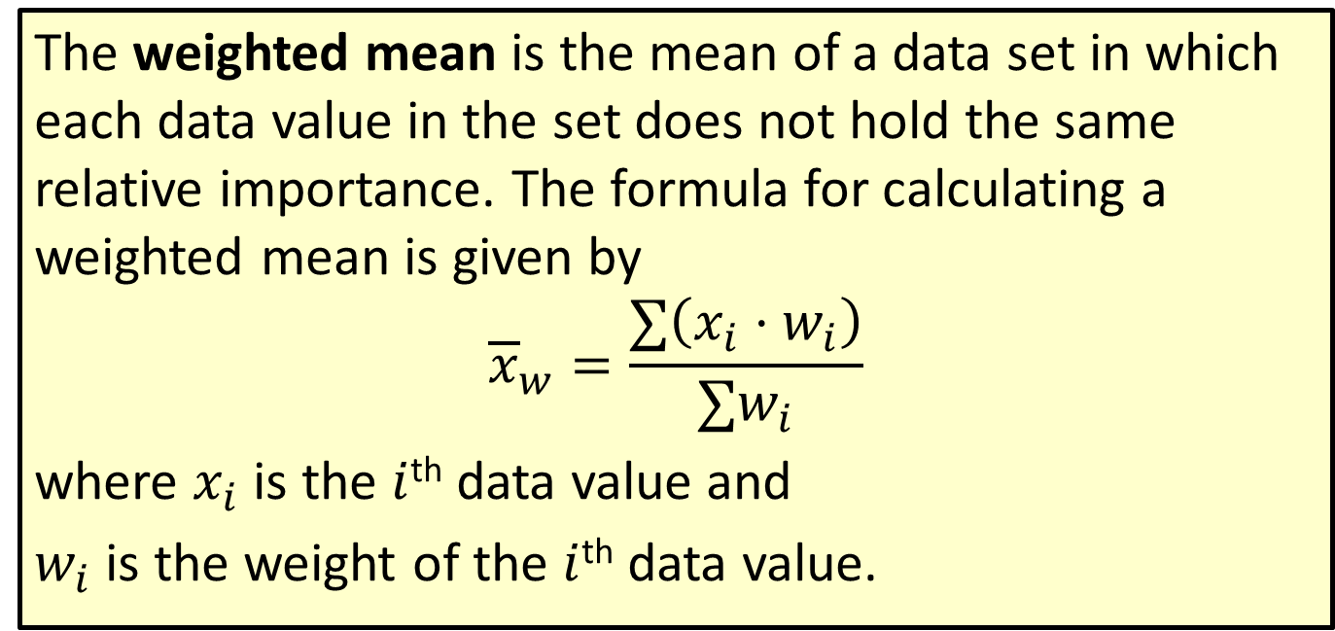
Formula: Weighted Mean
The weighted mean is the mean of a data set in which each data value in the set does not hold the same relative importance. The formula for calculating a weighted mean is given by
$${\overline{x}}_{w}=\frac{∑\left(x_{i}⋅w_{i}\right)}{∑w_{i}}$$
where $x_{i}$ is the $i$^{th} data value and
$w_{i}$ is the weight of the $i$^{th} data value.

Slide 17
A Knower of the Secret of the Dice
Oftentimes, it is easy for us to take simple mathematical concepts, such as the mean, for granted. However, imagine living in a time when these concepts were not so formally defined. The people with the ability to perform these seemingly basic functions were hailed as the magicians of their time.
An ancient Indian story recounts how King Rtuparna, known to be a frequent gambler, estimated the number of leaves and fruit on two large branches of a tree by using the leaves and fruit of a single twig as the average. He then multiplied the number of leaves and fruit on the single twig by the estimated number of twigs on each branch, and his estimation turned out to be very close to the actual value. When asked how he was able to do this, he replied, "Know that I am a knower of the secret of the dice, and therefore adept in the art of enumeration."
The invention and practice of estimation and measurement are arguably some of the most important milestones in human history, and it might come as a surprise that many of the concepts we use today stemmed from gambling scenarios. Technology, car tography, healthcare, and many other facets of our modern lives are almost entirely supported by our ability to estimate the parameters of a population by using descriptive and inferential statistics.

Slide 18
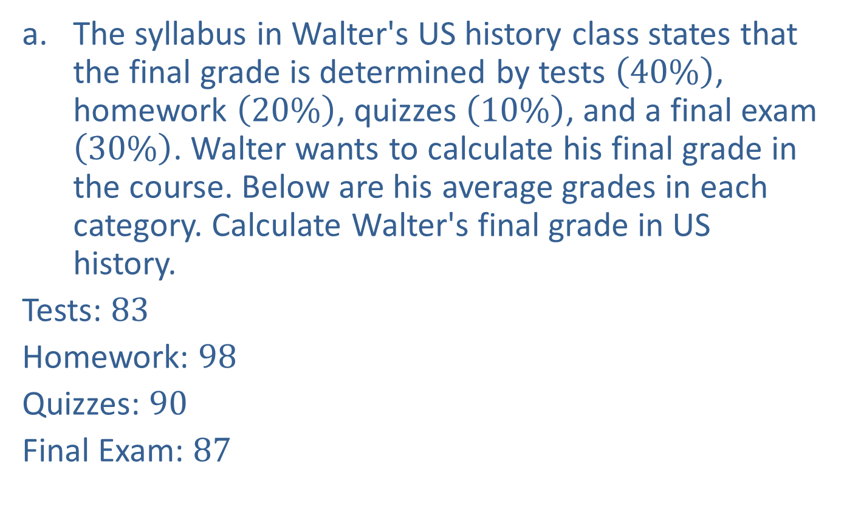
Example 3.1.3: Calculating a Weighted Mean
​The syllabus in Walter's US history class states that the final grade is determined by tests $\left(40\%\right)$, homework $\left(20\%\right)$, quizzes $\left(10\%\right)$, and a final exam $\left(30\%\right)$. Walter wants to calculate his final grade in the course. Below are his average grades in each category. Calculate Walter's final grade in US history.
​Tests: 83
​Homework: 98
​Quizzes: 90
​Final Exam: 87

Slide 19
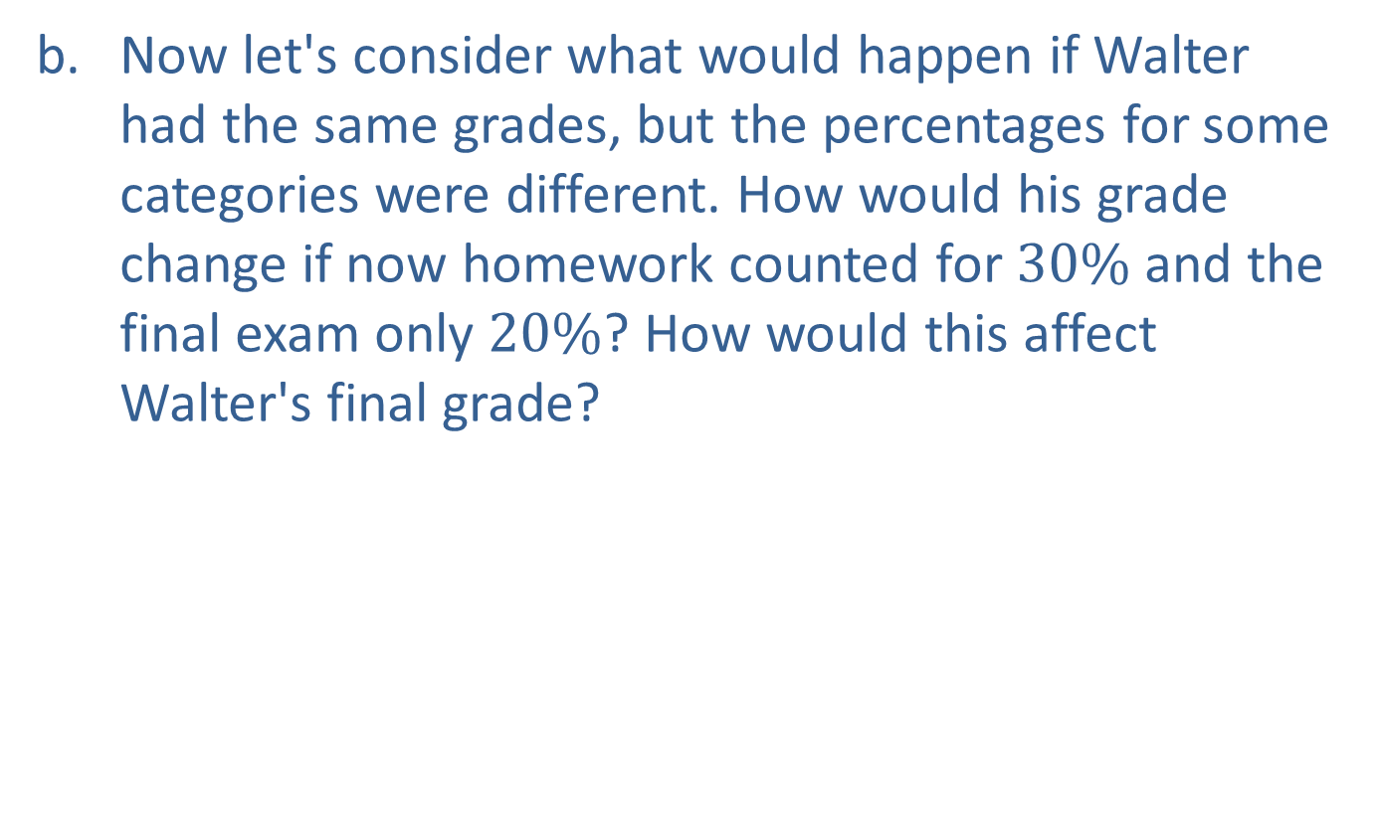
Example 3.1.3: Calculating a Weighted Mean (cont.)
​Now let's consider what would happen if Walter had the same grades, but the percentages for some categories were different. How would his grade change if now homework counted for $30\%$ and the final exam only $20\%$? How would this affect Walter's final grade?

Slide 20
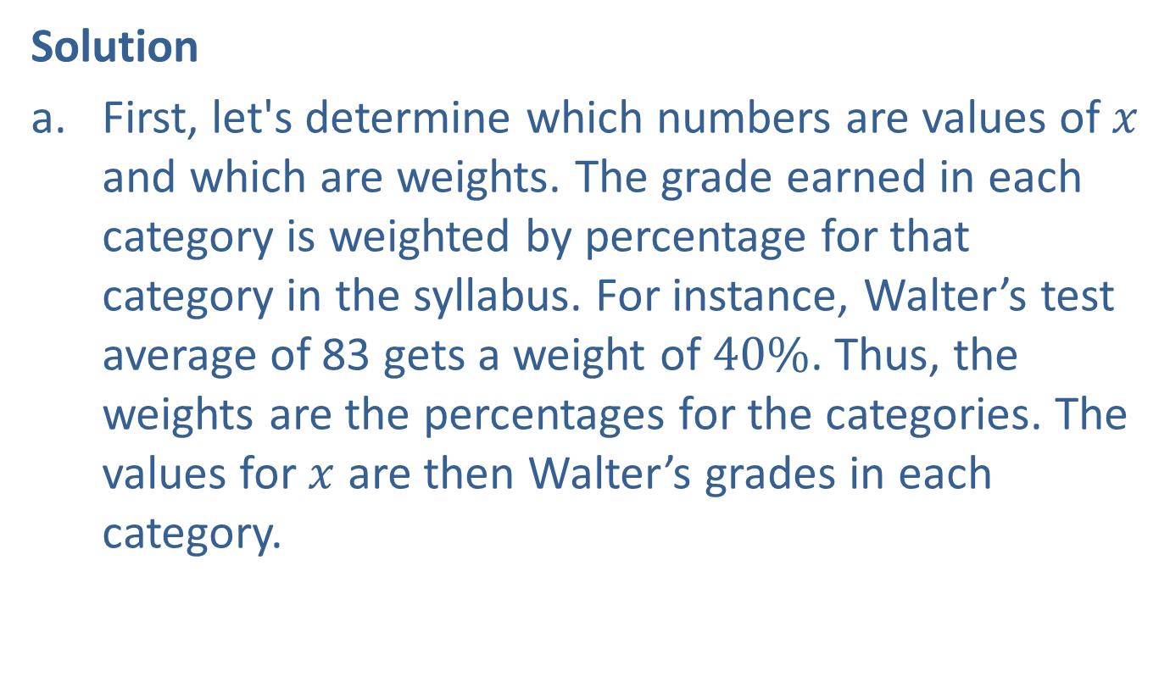
Example 3.1.3: Calculating a Weighted Mean (cont.)
Solution
​First, let's determine which numbers are values of $x$ and which are weights. The grade earned in each category is weighted by percentage for that category in the syllabus. For instance, Walter’s test average of 83 gets a weight of $40\%$. Thus, the weights are the percentages for the categories. The values for $x$ are then Walter’s grades in each category.
​​

Slide 21
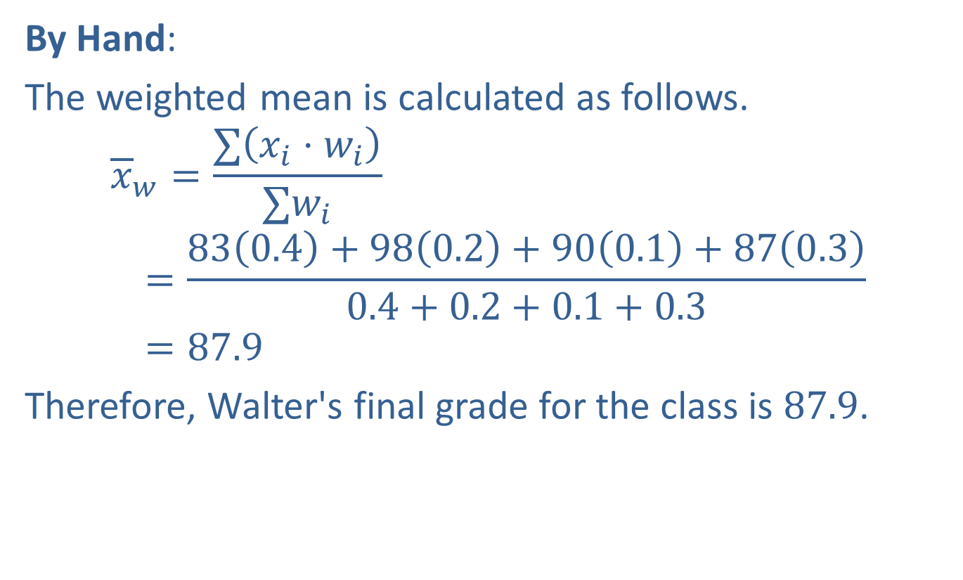
Example 3.1.3: Calculating a Weighted Mean (cont.)
​By Hand:
​The weighted mean is calculated as follows.
𝑥𝑤=∑𝑥𝑖⋅𝑤𝑖∑𝑤𝑖𝑥=830.4+980.2+900.1+870.30.4+0.2+0.1+0.3𝑥=87.9
​Therefore, Walter's final grade for the class is 87.9.
​

Slide 22
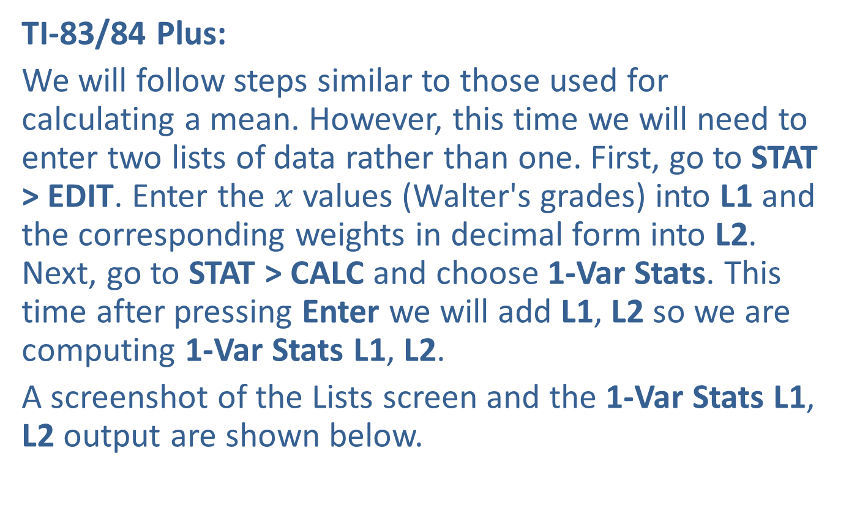
Example 3.1.3: Calculating a Weighted Mean (cont.)
​TI-83/84 Plus:
​We will follow steps similar to those used for calculating a mean. However, this time we will need to enter two lists of data rather than one. First, go to STAT > EDIT. Enter the $x$ values (Walter's grades) into L1 and the corresponding weights in decimal form into L2. Next, go to STAT > CALC and choose 1-Var Stats. This time after pressing Enter we will add L1, L2 so we are computing 1-Var Stats L1, L2.
​A screenshot of the Lists screen and the 1-Var Stats L1, L2 output are shown below.
​

Slide 23
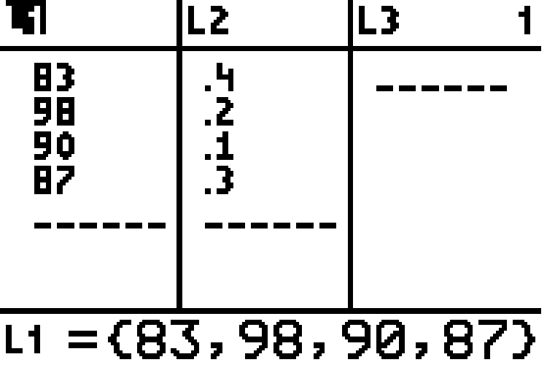
Example 3.1.3: Calculating a Weighted Mean (cont.)

Slide 24
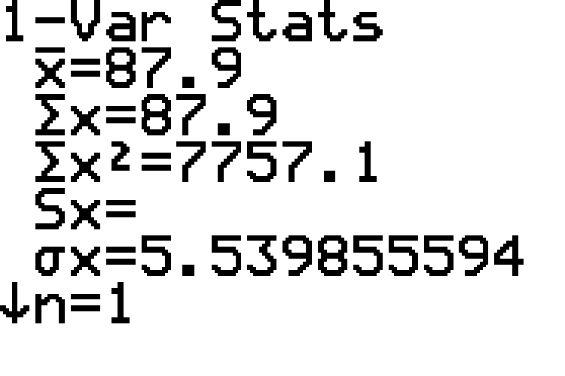
Example 3.1.3: Calculating a Weighted Mean (cont.)

Slide 25

Example 3.1.3: Calculating a Weighted Mean (cont.)
​The output screen shows the value of $\overline{x}=87.9$, along with the other descriptive statistics for this data set. Hence, Walter's final grade in US history is 87.9.

Slide 26
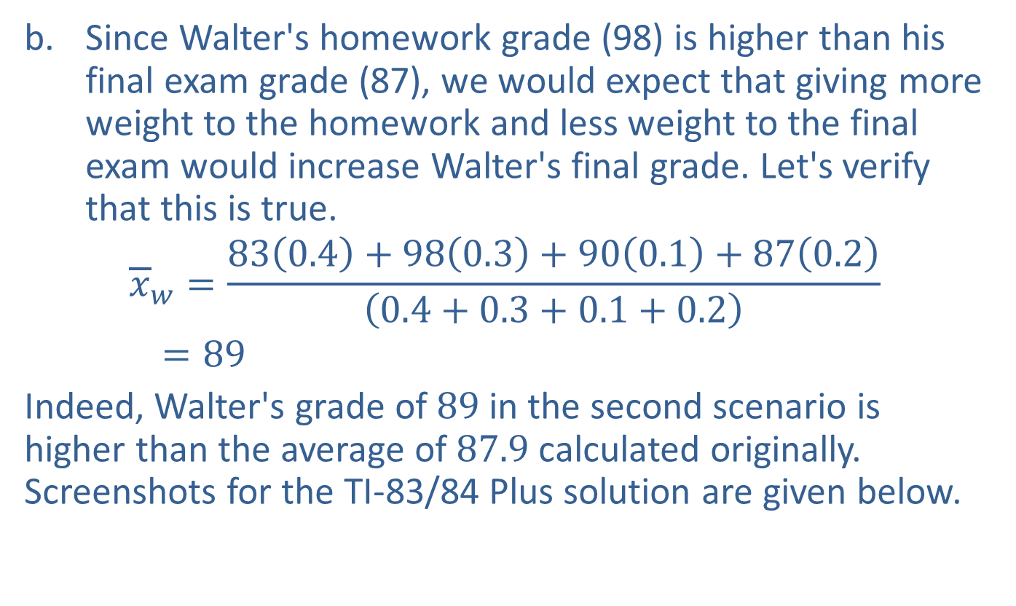
Example 3.1.3: Calculating a Weighted Mean (cont.)
​Since Walter's homework grade (98) is higher than his final exam grade (87), we would expect that giving more weight to the homework and less weight to the final exam would increase Walter's final grade. Let's verify that this is true.
𝑥𝑤=830.4+980.3+900.1+870.20.4+0.3+0.1+0.2𝑥=89
​Indeed, Walter's grade of 89 in the second scenario is higher than the average of 87.9 calculated originally. Screenshots for the TI-83/84 Plus solution are given below.
​

Slide 27

Example 3.1.3: Calculating a Weighted Mean (cont.)

Slide 28
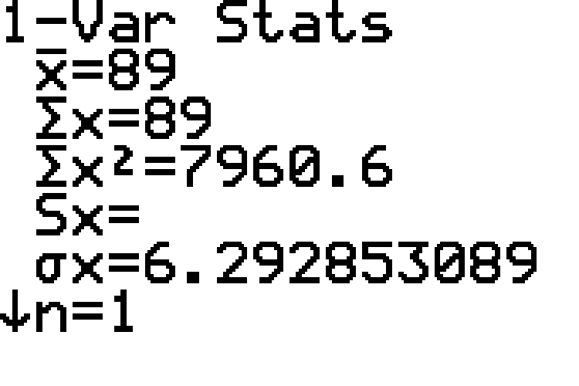
Example 3.1.3: Calculating a Weighted Mean (cont.)

Slide 29
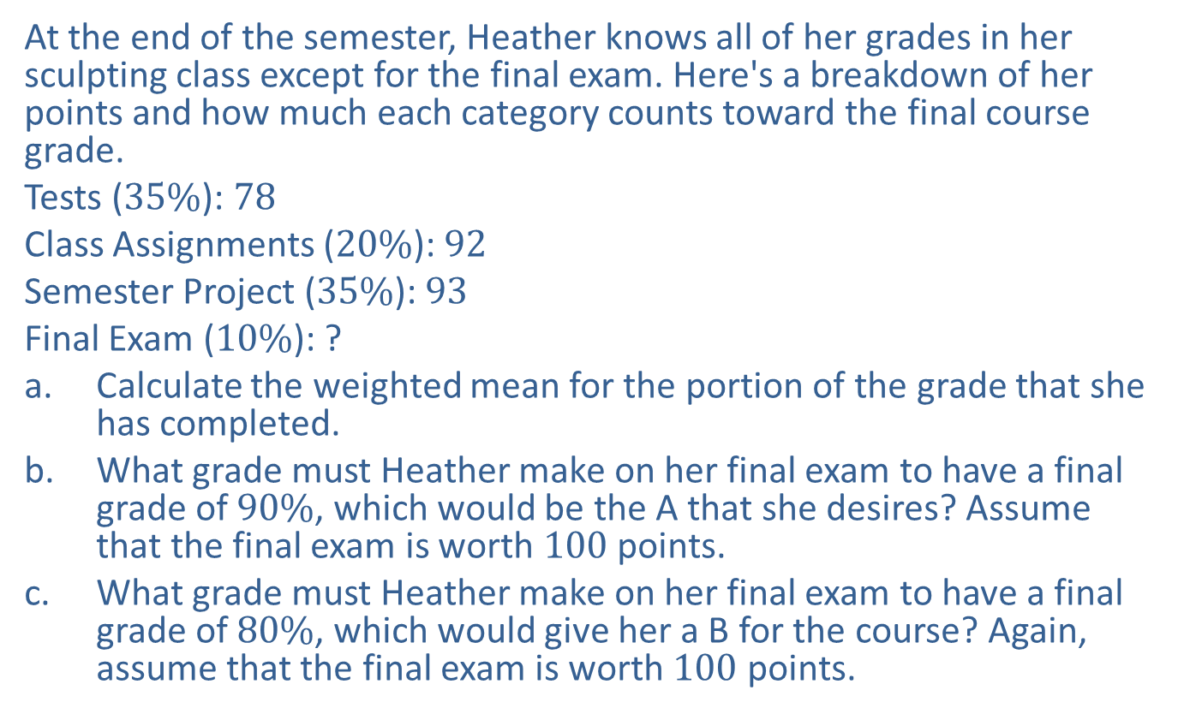
Example 3.1.4: Calculating a Weighted Mean
At the end of the semester, Heather knows all of her grades in her sculpting class except for the final exam. Here's a breakdown of her points and how much each category counts toward the final course grade.
Tests ($35\%$): 78
Class Assignments ($20\%$): 92
Semester Project ($35\%$): 93
Final Exam ($10\%$): ?
​Calculate the weighted mean for the portion of the grade that she has completed.
​What grade must Heather make on her final exam to have a final grade of $90\%$, which would be the A that she desires? Assume that the final exam is worth 100 points.
​What grade must Heather make on her final exam to have a final grade of $80\%$, which would give her a B for the course? Again, assume that the final exam is worth 100 points.

Slide 30
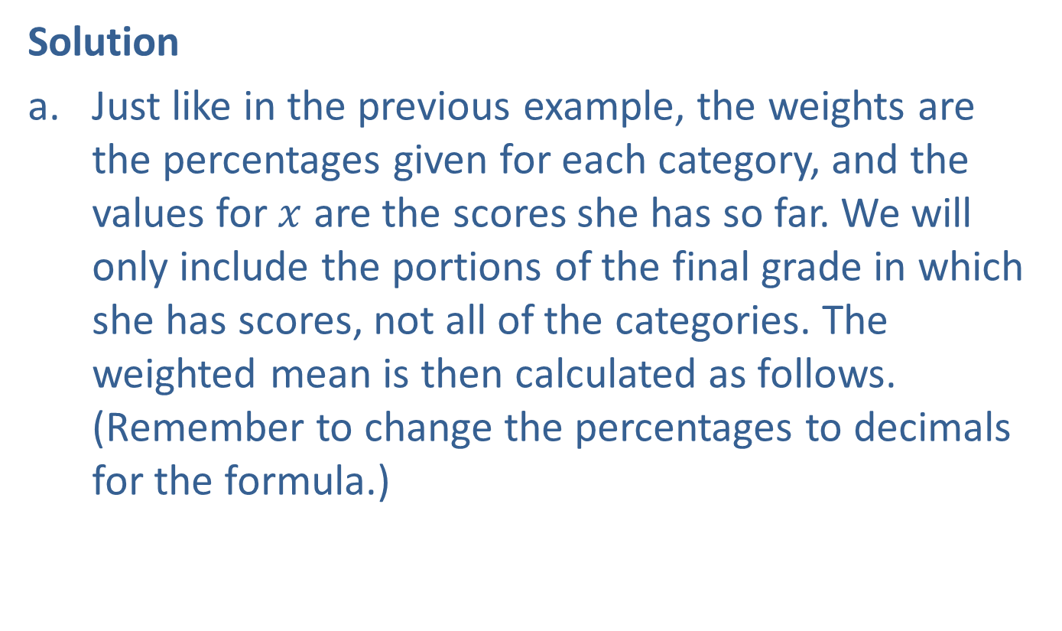
Example 3.1.4: Calculating a Weighted Mean (cont.)
Solution
​Just like in the previous example, the weights are the percentages given for each category, and the values for $x$ are the scores she has so far. We will only include the portions of the final grade in which she has scores, not all of the categories. The weighted mean is then calculated as follows. (Remember to change the percentages to decimals for the formula.)
​

Slide 31
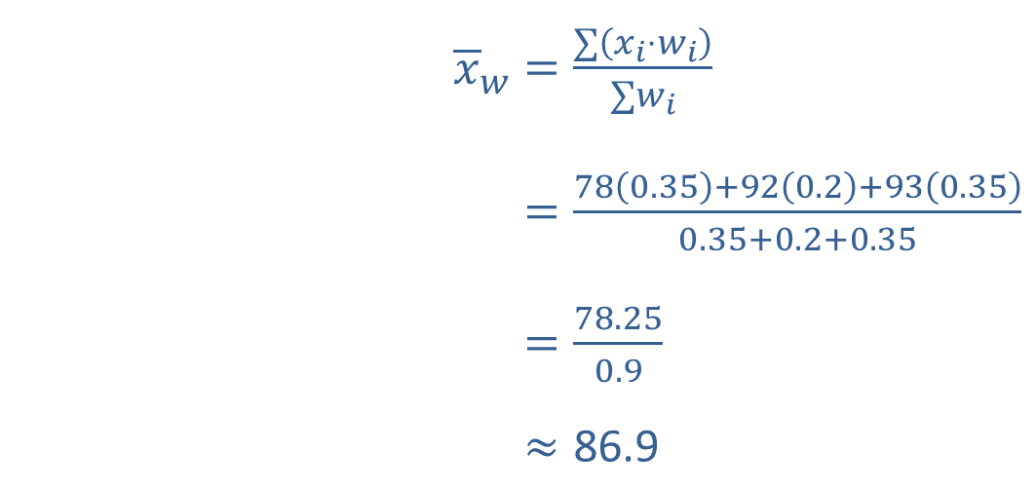
Example 3.1.4: Calculating a Weighted Mean (cont.)
Solution
​
​So, Heather has 86.9 for her sculpting grade so far without the final exam.
​${\overline{x}}_{w}$ | ​$=\frac{∑\left(x_{i}⋅w_{i}\right)}{∑w_{i}}$
 | ​$=\frac{78\left(0.35\right)+92\left(0.2\right)+93\left(0.35\right)}{0.35+0.2+0.35}$
​ | ​$=\frac{78.25}{0.9}$
 | $$≈\text{86}\text{.}\text{9}$$

Slide 32
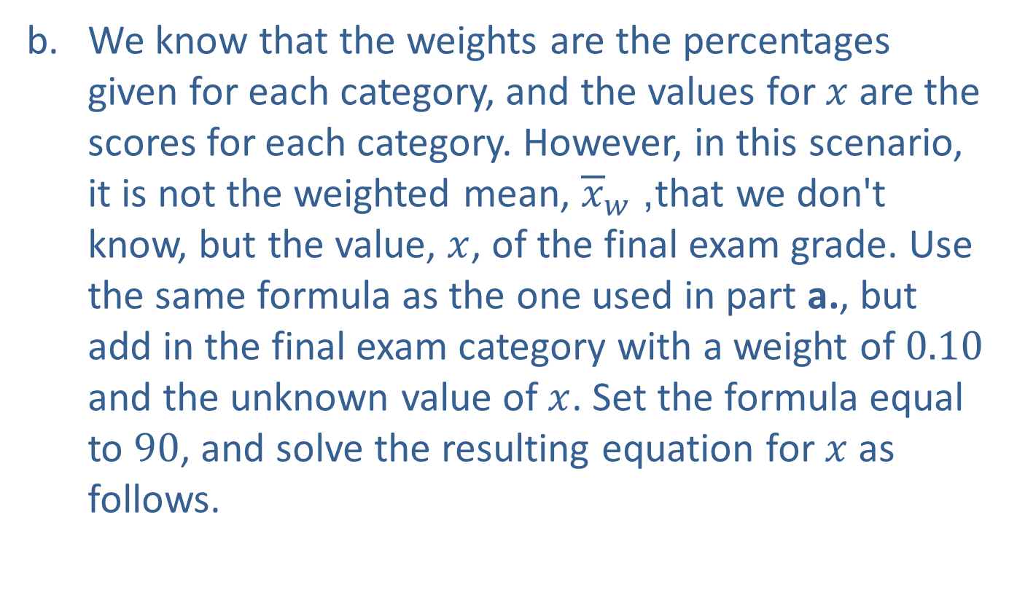
Example 3.1.4: Calculating a Weighted Mean (cont.)
We know that the weights are the percentages given for each category, and the values for $x$ are the scores for each category. However, in this scenario, it is not the weighted mean, ${\overline{x}}_{w}$, that we don't know, but the value, $x$, of the final exam grade. Use the same formula as the one used in part a., but add in the final exam category with a weight of 0.10 and the unknown value of $x$. Set the formula equal to 90, and solve the resulting equation for $x$ as follows.
​

Slide 33
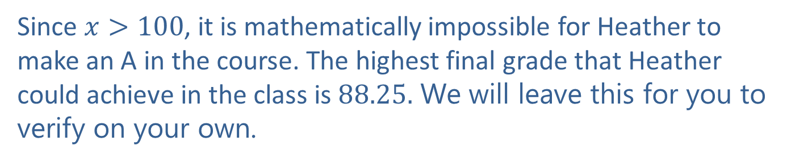
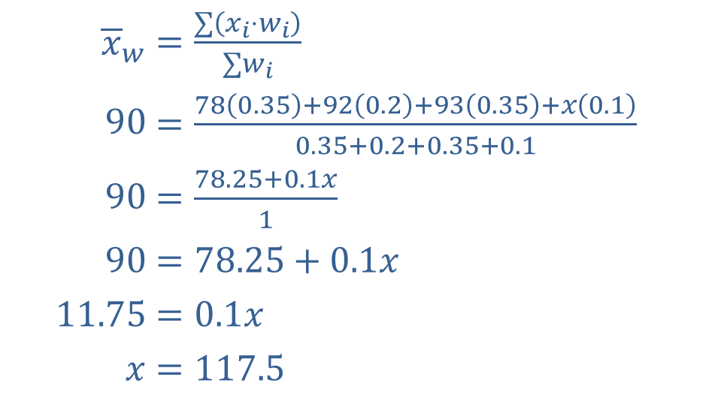
Example 3.1.4: Calculating a Weighted Mean (cont.)
​
​${\overline{x}}_{w}$ | ​$=\frac{∑\left(x_{i}⋅w_{i}\right)}{∑w_{i}}$
​$90$ | ​$=\frac{78\left(0.35\right)+92\left(0.2\right)+93\left(0.35\right)+x\left(0.1\right)}{0.35+0.2+0.35+0.1}$
​$90$ | ​$=\frac{78.25+0.1x}{1}$
​$90$ | ​$=78.25+0.1x$
​$11.75$ | ​$=0.1x$
​$x$ | ​$=117.5$
Since $x>100$, it is mathematically impossible for Heather to make an A in the course. The highest final grade that Heather could achieve in the class is 88.25. We will leave this for you to verify on your own.

Slide 34
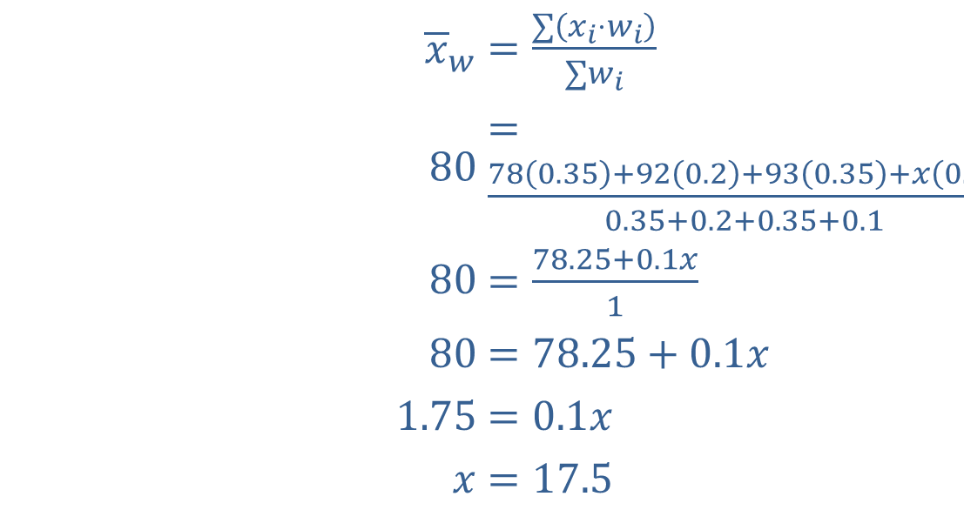
Example 3.1.4: Calculating a Weighted Mean (cont.)
​Hence, we see that although an A is not possible, Heather must score only 17.5 or higher on the final exam to secure a B in the course.
​${\overline{x}}_{w}$ | ​$=\frac{∑\left(x_{i}⋅w_{i}\right)}{∑w_{i}}$
​$80$ | ​$=\frac{78\left(0.35\right)+92\left(0.2\right)+93\left(0.35\right)+x\left(0.1\right)}{0.35+0.2+0.35+0.1}$
​$80$ | ​$=\frac{78.25+0.1x}{1}$
​$80$ | ​$=78.25+0.1x$
​$1.75$ | ​$=0.1x$
​$x$ | ​$=17.5$

Slide 35

Example 3.1.4: Calculating a Weighted Mean (cont.)
To find this solution, we will set up the problem using the same strategy as in part b., except now we will set the formula equal to 80 rather than 90. We will again solve for $x$, which represents the unknown final exam score. We then have the following.

Slide 36
Procedure: Finding the Median of a Data Set
​List the data in ascending (or descending) order, making an ordered array.
​If the data set contains an ODD number of values, the median is the middle value in the ordered array.
​If the data set contains an EVEN number of values, the median is the arithmetic mean of the two middle values in the ordered array. Note that this implies that the median may not be a value in the data set.

Slide 37
Example 3.1.5: Finding the Median
Given the number of absences for two samples of students, find the median for each sample.
​3, 4, 6, 7, 2, 8, 9
​5, 7, 8, 1, 4, 9, 8, 9

Slide 38
Example 3.1.5: Finding the Median (cont.)
Solution
​By Hand:
​First, put the data in order: 2, 3, 4, 6, 7, 8, 9. Since there are an odd number of values, the median is the number in the middle: 2, 3, 4, 6, 7, 8, 9.
​

Slide 39
Example 3.1.5: Finding the Median (cont.)
​TI-83/84 Plus:
​Begin by going to STAT > EDIT and entering the data into L1. Next, go to STAT > CALC and choose 1-Var Stats. Press Enter to obtain a list of descriptive statistics. Scroll down to find the median, which will be labeled Med = 6.
​

Slide 40
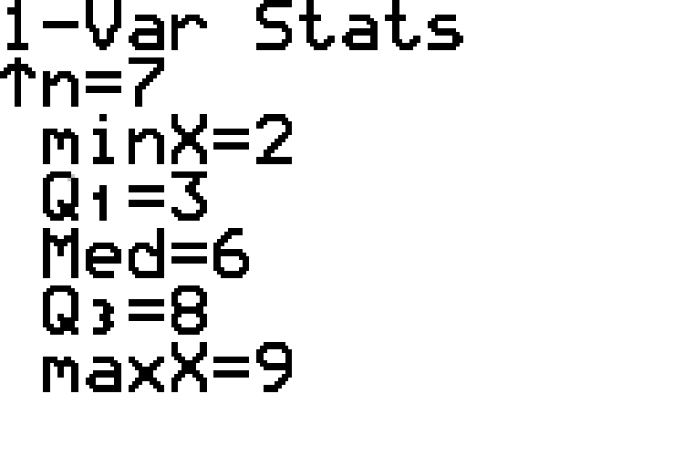
Example 3.1.5: Finding the Median (cont.)

Slide 41
Example 3.1.5: Finding the Median (cont.)
​Hence the median number of absences for the sample is 6.

Slide 42
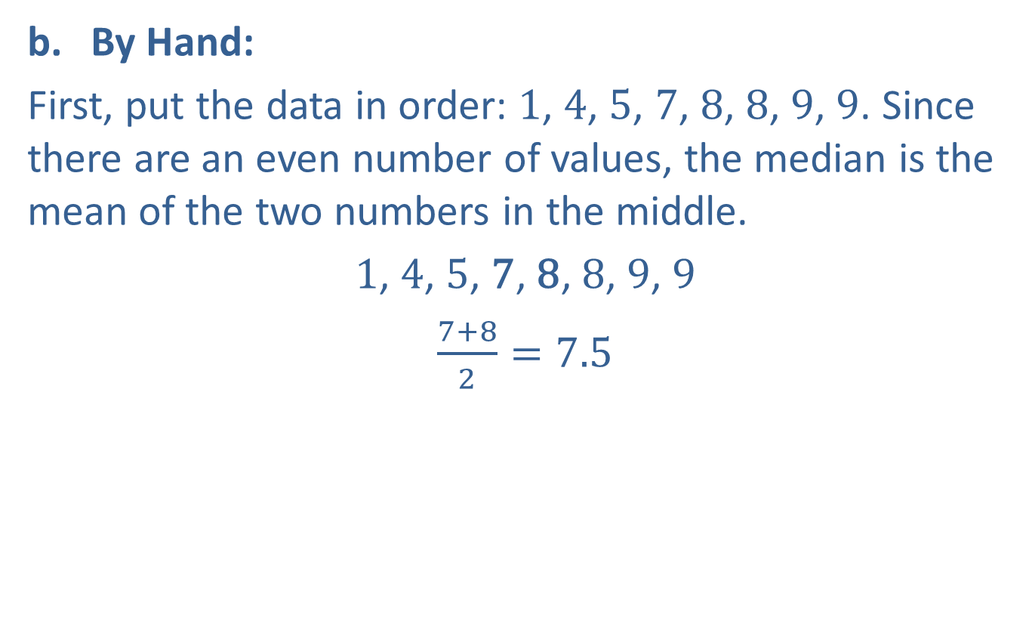
Example 3.1.5: Finding the Median (cont.)
​By Hand:
​First, put the data in order: 1, 4, 5, 7, 8, 8, 9, 9. Since there are an even number of values, the median is the mean of the two numbers in the middle.
​1, 4, 5, 7, 8, 8, 9, 9
​$\frac{7+8}{2}=7.5$
​

Slide 43

Example 3.1.5: Finding the Median (cont.)
​TI-83/84 Plus:
​The calculator steps are the same as given in part a. Note that the calculator performs the division for us when necessary. The calculator output for 1-Var Stats is shown in the margin and gives $Med=7.5$.
​

Slide 44
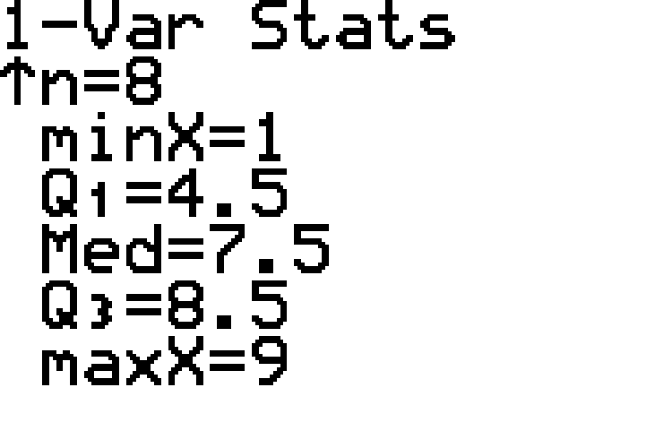
Example 3.1.5: Finding the Median (cont.)

Slide 45
Example 3.1.5: Finding the Median (cont.)
​Hence the median number of absences for the sample is 7.5.

Slide 46
Example 3.1.6: Finding the Mode
Given the number of phone calls received each hour during business hours for four different companies, find the mode of each, and state if the data set is unimodal, bimodal, multimodal, or no mode.
​6, 4, 6, 1, 7, 8, 7, 2, 5, 7
​3, 4, 7, 8, 1, 6, 9
​2, 5, 7, 2, 8, 7, 9, 3
​2, 2, 3, 3, 4, 4, 5, 5

Slide 47
Example 3.1.6: Finding the Mode (cont.)
Solution
​To make it easier to see which value(s) occur most often, begin by putting the data in numerical order. The ordered data set is: 1, 2, 4, 5, 6, 6, 7, 7, 7, 8. The number 7 occurs more than any other value, so the mode is 7. This data set is unimodal.
​Begin by sorting the data as follows: 1, 3, 4, 6, 7, 8, 9. The values all occur only once, so there is no mode.

Slide 48
Example 3.1.6: Finding the Mode (cont.)
​As before, sort the data: 2, 2, 3, 5, 7, 7, 8, 9. The values 2 and 7 both occur twice, which is more frequently than the other values; thus they are both modes. This data set is bimodal.
​Note that this data set is already sorted for us. All of the data values occur the same number of times, so there is no mode.

Slide 49
Technology Tip
Note that, although some statistical software packages will identify the mode of a data set, the mode is not one of the descriptive statistics listed by a TI-83/84 Plus calculator.

Slide 50
Example 3.1.7: Calculating Measures of Center—Mean, Median, and Mode
Given the recent economy and increasing life expectancy, many people choose to take on another job after retiring from one. Below is a sample of ages at which people truly retired; that is, they stopped working for pay.
84, 80, 82, 77, 78, 80, 79, 42
​Calculate the mean, median, and mode of the data.
​Plot the mean, median, and mode using a dot plot. Compare these measures of center to the outlier value of 42.

Slide 51
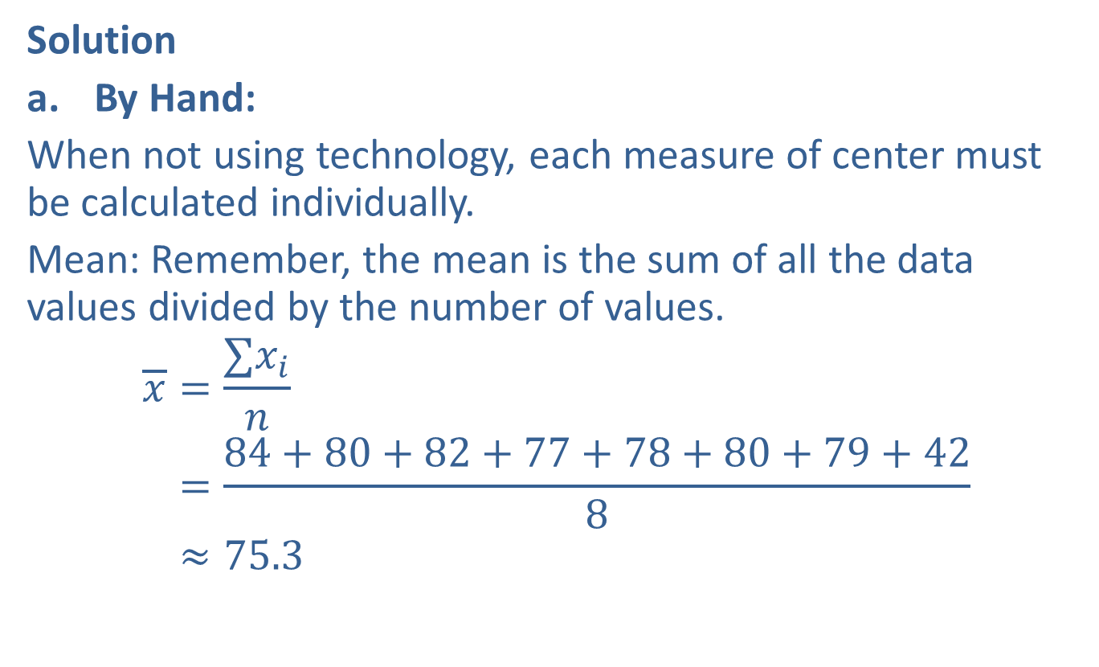
Example 3.1.7: Calculating Measures of Center—Mean, Median, and Mode (cont.)
Solution
​By Hand:
​When not using technology, each measure of center must be calculated individually.
​Mean: Remember, the mean is the sum of all the data values divided by the number of values.
𝑥=∑𝑥𝑖𝑛𝑥=84+80+82+77+78+80+79+428𝑥≈75.3
​

Slide 52
Technology Tip:
For instructions on how to find the mean, median, and mode using other technologies, go to stat.hawkeslearning.com and navigate to Technology Instructions > Descriptive Statistics > One Variable.

Slide 53
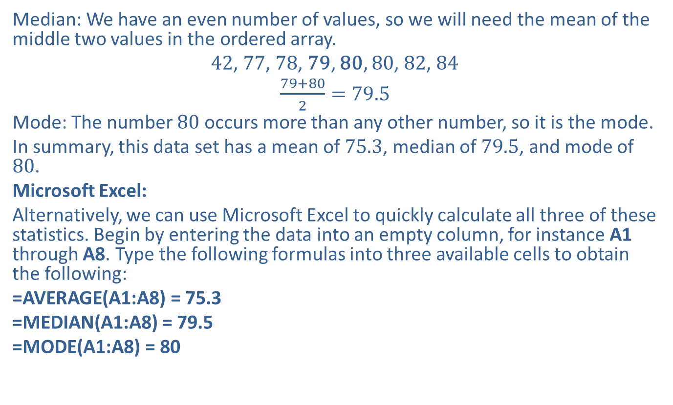
Example 3.1.7: Calculating Measures of Center—Mean, Median, and Mode (cont.)
​Median: We have an even number of values, so we will need the mean of the middle two values in the ordered array.
​42, 77, 78, 79, 80, 80, 82, 84
​$\frac{79+80}{2}=79.5$
​Mode: The number 80 occurs more than any other number, so it is the mode.
​In summary, this data set has a mean of 75.3, median of 79.5, and mode of 80.
​Microsoft Excel:
​Alternatively, we can use Microsoft Excel to quickly calculate all three of these statistics. Begin by entering the data into an empty column, for instance A1 through A8. Type the following formulas into three available cells to obtain the following:
​=AVERAGE(A1:A8) = 75.3
​=MEDIAN(A1:A8) = 79.5
​=MODE(A1:A8) = 80
​

Slide 54
Technology Tip:
The general formulas for calculating mean, median, and mode in Microsoft Excel are as follows:
=AVERAGE(cell range)
=MEDIAN(cell range)
=MODE(cell range)

Slide 55
Example 3.1.7: Calculating Measures of Center—Mean, Median, and Mode (cont.)
​In summary, this data set has a mean of 75.3, median of 79.5, and mode of 80.

Slide 56
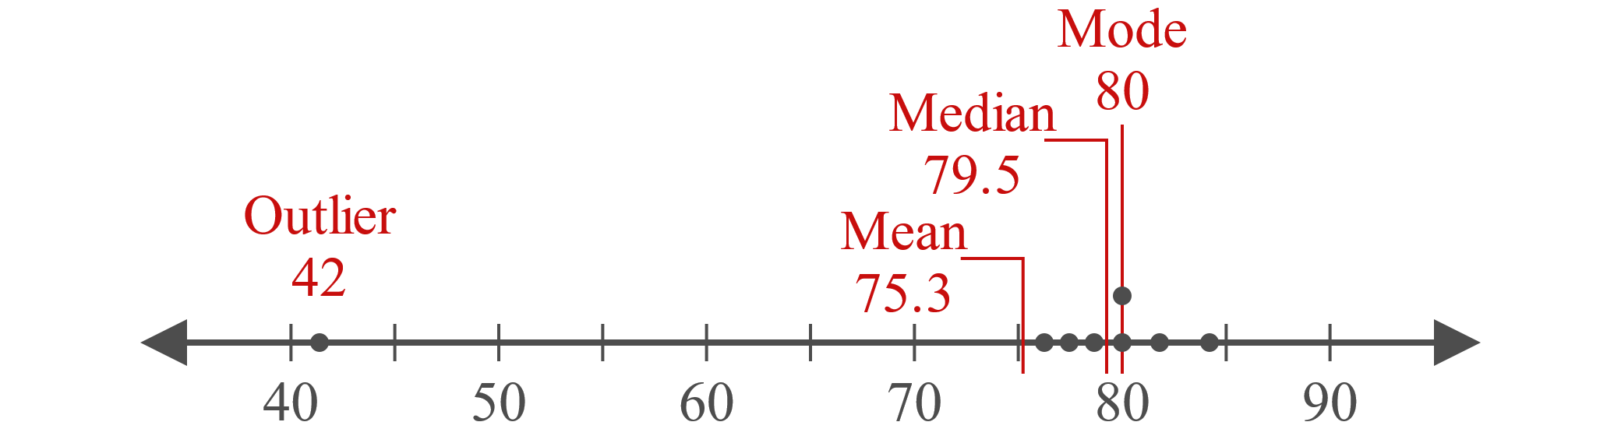
Example 3.1.7: Calculating Measures of Center—Mean, Median, and Mode (cont.)
​
​The mean, median, and mode are all shown on the dot plot above, along with the outlier value of 42. As you can see in the figure, of the three measures of center, the mean is closest to the outlier while the median and mode are more similar in value and are not affected by the outlier.

Slide 57
Procedure: Determining the Most Appropriate Measure of Center
​For qualitative data, the mode should be used.
​For quantitative data, the mean should be used, unless the data set contains outliers or is skewed.
​For quantitative data sets that are skewed or contain outliers, the median should be used.

Slide 58
Example 3.1.8: Choosing the Most Appropriate Measure of Center
Choose the best measure of center for the following data sets.
​Sizes (S, M, L, XL) of English Premier League soccer jerseys
​Salaries for a professional team of baseball players
​Prices of homes in a subdivision of similar homes
​Professor rankings from student evaluations on a scale of excellent, average, and below average

Slide 59
Example 3.1.8: Choosing the Most Appropriate Measure of Center (cont.)
Solution
​Jersey sizes are ordinal data; since they are qualitative, the mode is the best measure of center.
​The players' salaries are quantitative data with outliers since the superstars on the team make substantially more than the typical players. Therefore, the median is the best choice.
​The home prices are quantitative data with no outliers since the homes are similar. Therefore, the mean is the best choice.
​The rankings are ordinal data; since they are qualitative, it's best to use the mode as a measure of center.

Slide 60
Side Note:
Inappropriate Average
In the late 1980s, the University of North Carolina reported an unusually high average starting salary for graduates of their geography program. What could have been the reason for UNC 's superior average? Were UNC instructors better qualified? Did the program attract higher quality students? Or was there some other reason for this exceptional mean?
It turns out that the source of this inflated mean was the inclusion of one famous graduate of UNC 's geography program: Michael Jordan. Though he earned his salary from playing professional basketball rather than from the field of geography, by keeping his multimillion-dollar salary in the mix the value of the mean was significantly increased. Needless to say, Michael Jordan's salary would be considered an outlier. In this case, the median salary would more accurately represent the true center of the data.

Slide 61
Properties: Graphs and Measures of Center
​The mode is the data value at which a distribution has its highest peak.
​The median is the number that divides the area of the distribution in half.
​The mean of a distribution will be pulled toward any outliers.

Slide 62
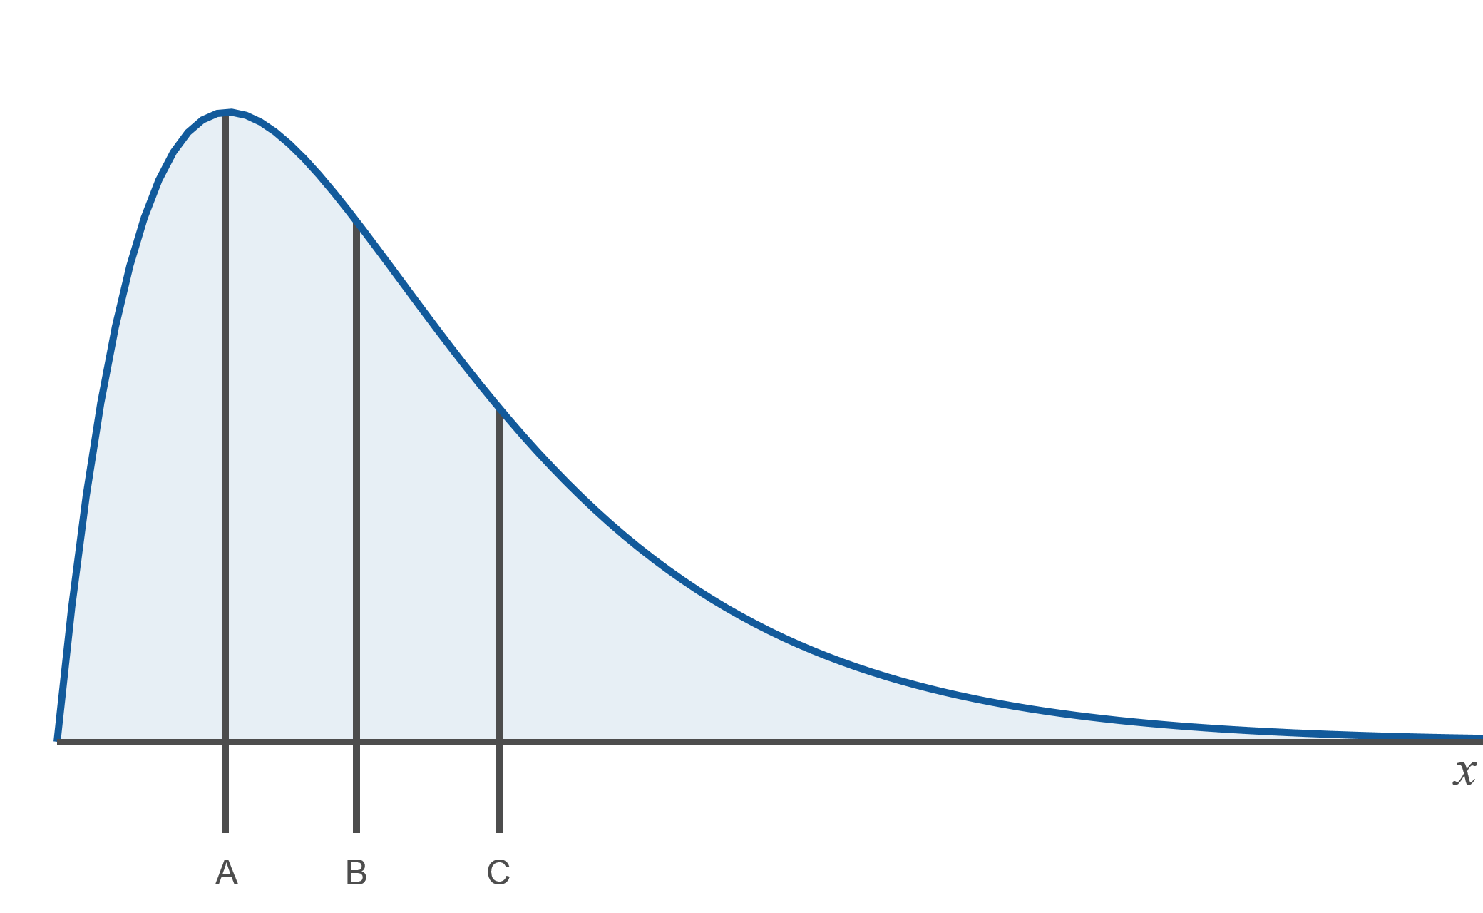
Example 3.1.9: Determining Mean, Median, and Mode from a Graph
Determine which letter represents the mean, the median, and the mode in the graph below.

Slide 63
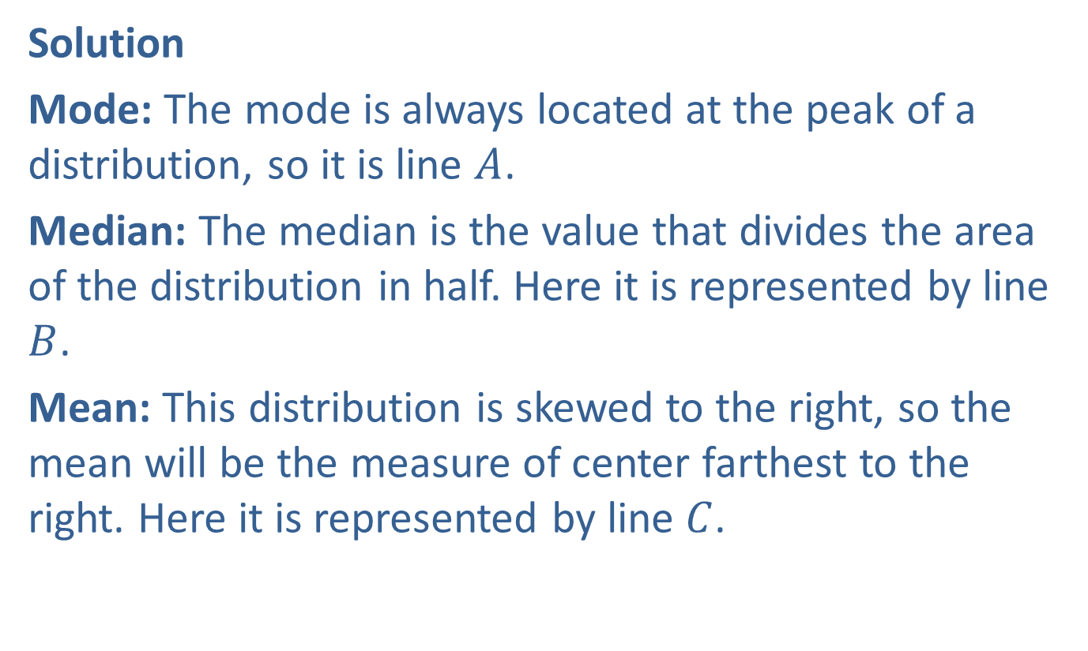
Example 3.1.9: Determining Mean, Median, and Mode from a Graph (cont.)
Solution
Mode: The mode is always located at the peak of a distribution, so it is line $A$.
Median: The median is the value that divides the area of the distribution in half. Here it is represented by line $B$.
Mean: This distribution is skewed to the right, so the mean will be the measure of center farthest to the right. Here it is represented by line $C$.

