Slide 1
Section 3.2
Measures of Dispersion

Slide 2
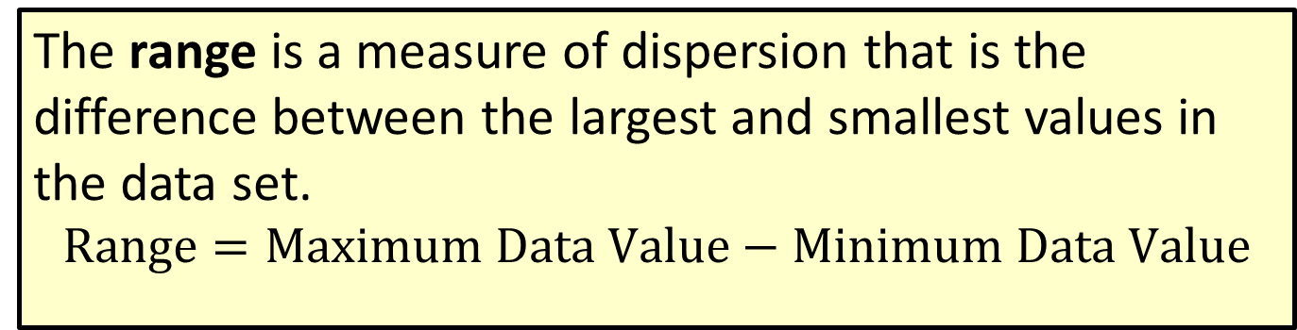
Formula: Range
The range is a measure of dispersion that is the difference between the largest and smallest values in the data set.
$$Range=Maximum Data Value−Minimum Data Value$$

Slide 3
Example 3.2.1: Calculating the Range
The following data were collected from samples of call lengths (in minutes) observed for two different mobile phone users. Calculate the range of each data set.
​2, 25, 31, 44, 29, 14, 22, 11, 40
​2, 2, 44, 2, 2, 2, 2, 2

Slide 4
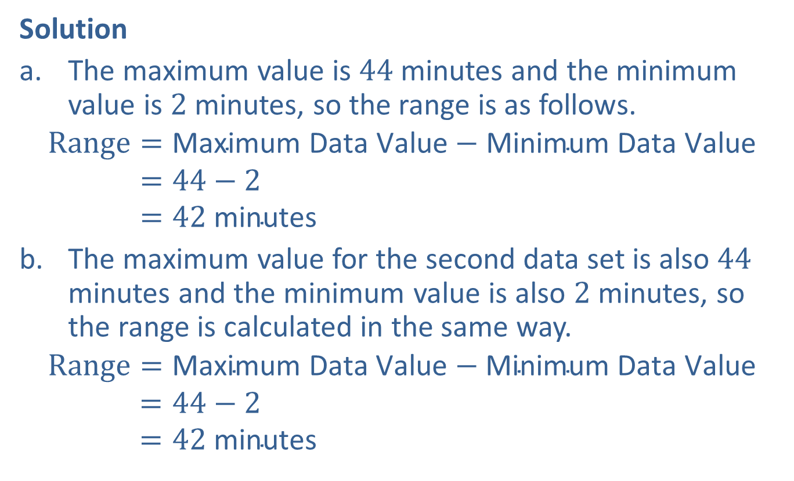
Example 3.2.1: Calculating the Range (cont.)
Solution
​The maximum value is 44 minutes and the minimum value is 2 minutes, so the range is as follows.
Range=Maximum Data Value−Minimum Data ValueRange=44−2Range=42 minutes
​The maximum value for the second data set is also 44 minutes and the minimum value is also 2 minutes, so the range is calculated in the same way.
Range=Maximum Data Value−Minimum Data ValueRange=44−2Range=42 minutes

Slide 5
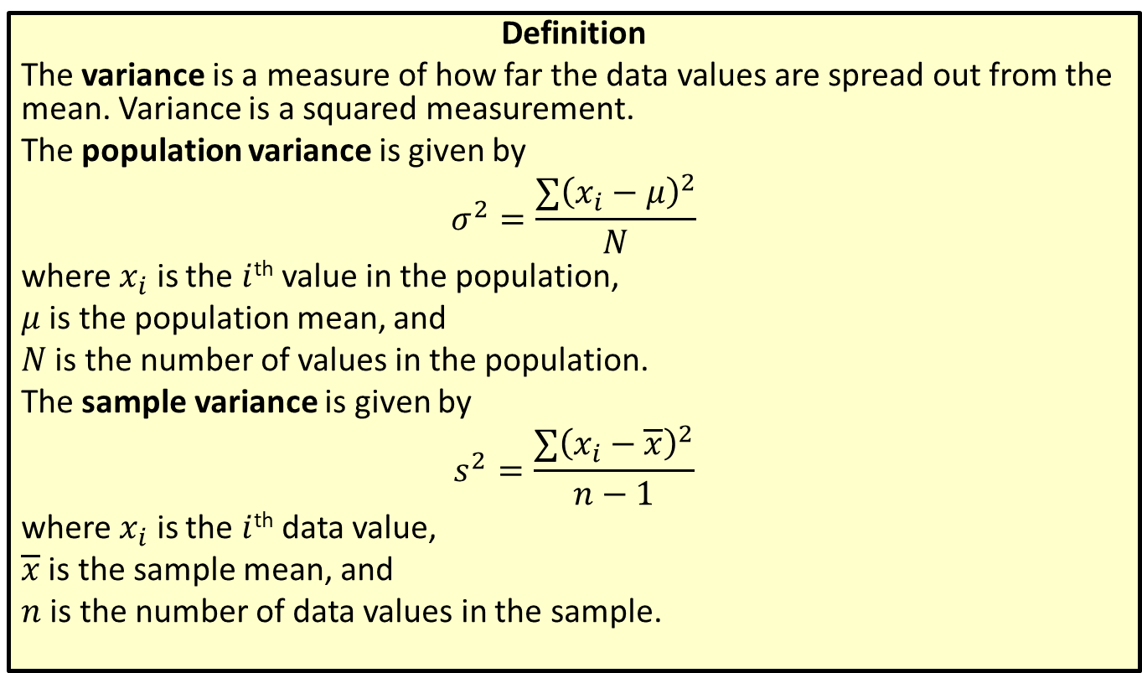
Variance
Definition
The variance is a measure of how far the data values are spread out from the mean. Variance is a squared measurement.
The population variance is given by
$$σ^{2}=\frac{∑{\left(x_{i}−μ\right)}^{2}}{N}$$
where $x_{i}$ is the $i$^{th} value in the population,
$μ$ is the population mean, and
$N$ is the number of values in the population.
The sample variance is given by
$$s^{2}=\frac{∑{\left(x_{i}−\overline{x}\right)}^{2}}{n−1}$$
where $x_{i}$ is the $i$^{th} data value,
$\overline{x}$ is the sample mean, and
$n$ is the number of data values in the sample.

Slide 6
Rounding Rule
When calculating the variance, round to one more decimal place than the largest number of decimal places given in the data. Occasional exceptions to this rule can be made when the type of data lends itself to a more natural rounding scheme, such as rounding values of currency to two decimal places.

Slide 7
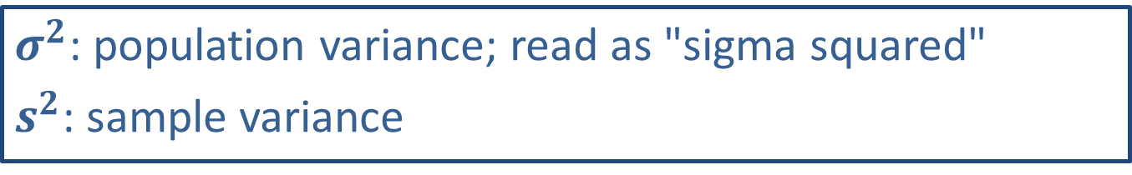
Math Symbols
$σ^{2}$: population variance; read as "sigma squared"
$s^{2}$: sample variance

Slide 8
Example 3.2.2: Calculating Variance
Jesmyn has just started driving for Uber. The number of rides she has given each day for a sample of 5 consecutive days is listed below. Find the variance for the number of rides Jesmyn has given.
3, 2, 5, 6, 4

Slide 9
Technology Tip
The general formula for calculating sample variance in Excel is =VARS.S(range).
The general formula for calculating population variance in Excel is =VARS.P(range).

Slide 10
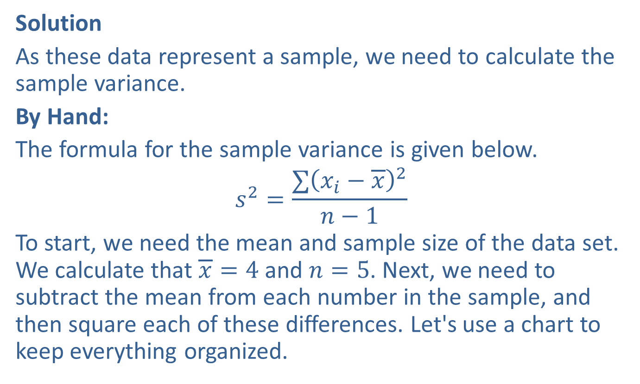
Example 3.2.2: Calculating Variance (cont.)
Solution
As these data represent a sample, we need to calculate the sample variance.
By Hand:
The formula for the sample variance is given below.
$$s^{2}=\frac{∑{\left(x_{i}−\overline{x}\right)}^{2}}{n−1}$$
To start, we need the mean and sample size of the data set. We calculate that $\overline{x}=4$ and $n=5$. Next, we need to subtract the mean from each number in the sample, and then square each of these differences. Let's use a chart to keep everything organized.

Slide 11
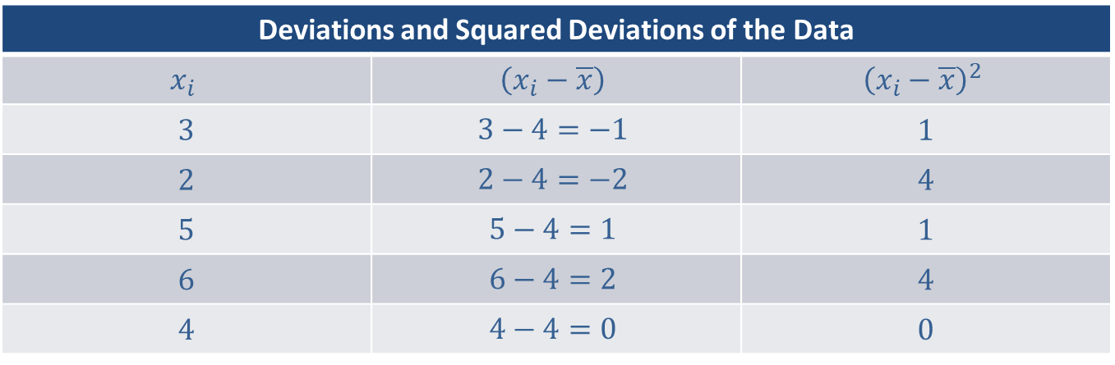
Example 3.2.2: Calculating Variance (cont.)
Deviations and Squared Deviations of the Data
$$x_{i}$$ | $$\left(x_{i}−\overline{x}\right)$$ | $${\left(x_{i}−\overline{x}\right)}^{2}$$
3 | $$3−4=−1$$ | 1
2 | $$2−4=−2$$ | 4
5 | $$5−4=1$$ | 1
6 | $$6−4=2$$ | 4
4 | $$4−4=0$$ | 0

Slide 12
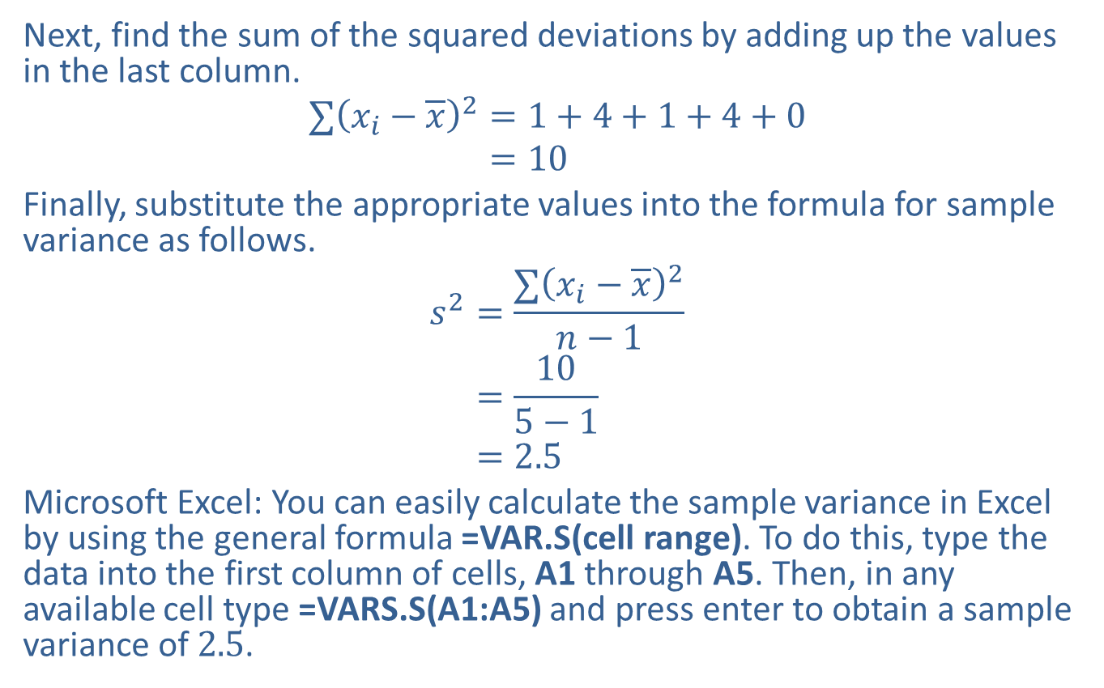
Example 3.2.2: Calculating Variance (cont.)
Next, find the sum of the squared deviations by adding up the values in the last column.
∑𝑥𝑖−𝑥2=1+4+1+4+0∑𝑥𝑖−𝑥2=10
Finally, substitute the appropriate values into the formula for sample variance as follows.
𝑠2=∑𝑥𝑖−𝑥2𝑛−1𝑠2=105−1𝑠2=2.5
Microsoft Excel: You can easily calculate the sample variance in Excel by using the general formula =VAR.S(cell range). To do this, type the data into the first column of cells, A1 through A5. Then, in any available cell type =VARS.S(A1:A5) and press enter to obtain a sample variance of 2.5.

Slide 13
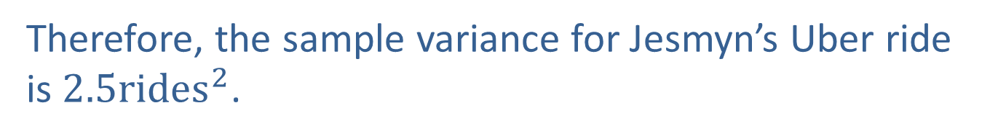
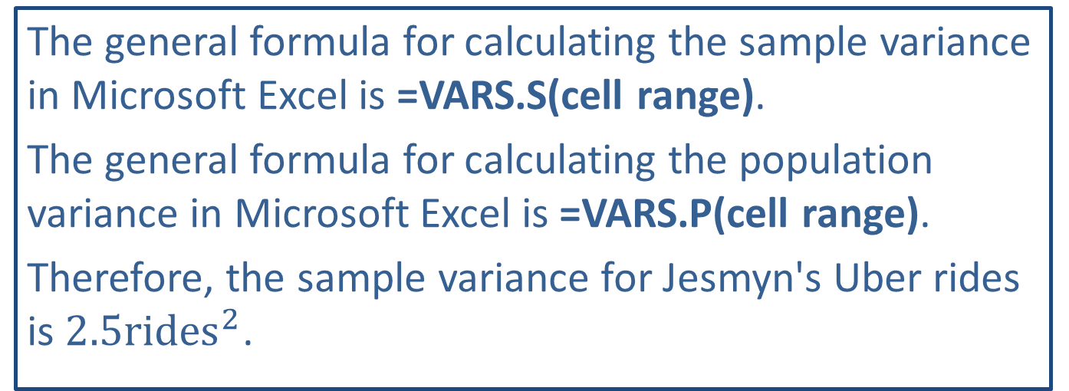
Technology Tip:
The general formula for calculating the sample variance in Microsoft Excel is =VARS.S(cell range).
The general formula for calculating the population variance in Microsoft Excel is =VARS.P(cell range).
Therefore, the sample variance for Jesmyn's Uber rides is $2.5{rides}^{2}$.
Therefore, the sample variance for Jesmyn’s Uber ride is $2.5rides^{2}$.

Slide 14
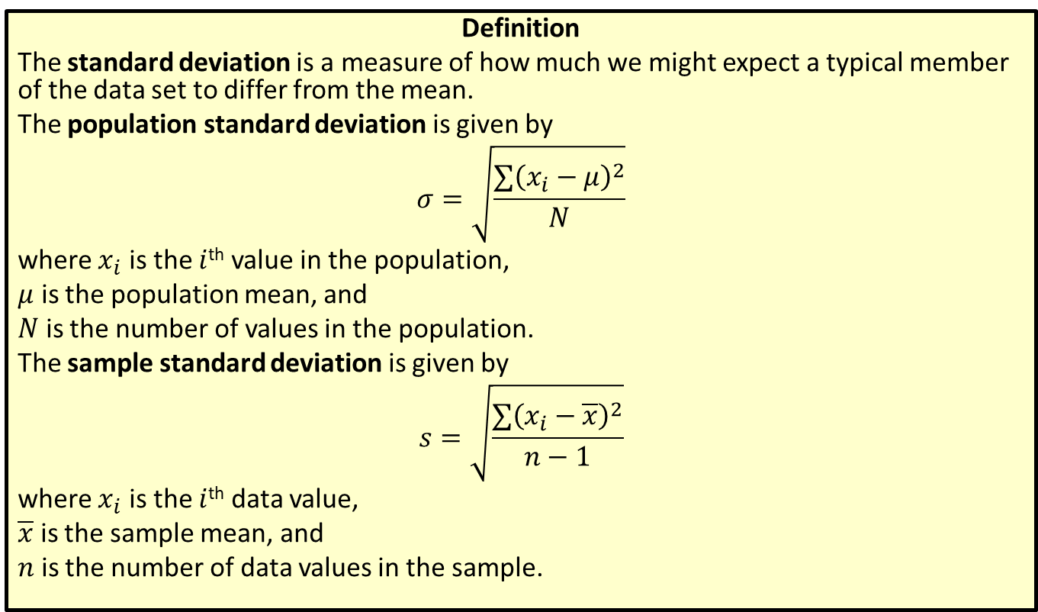
Standard Deviation
Definition
The standard deviation is a measure of how much we might expect a typical member of the data set to differ from the mean.
The population standard deviation is given by
$$σ=\sqrt{\frac{∑{\left(x_{i}−μ\right)}^{2}}{N}}$$
where $x_{i}$ is the $i$^{th} value in the population,
$μ$ is the population mean, and
$N$ is the number of values in the population.
The sample standard deviation is given by
$$s=\sqrt{\frac{∑{\left(x_{i}−\overline{x}\right)}^{2}}{n−1}}$$
where $x_{i}$ is the $i$^{th} data value,
$\overline{x}$ is the sample mean, and
$n$ is the number of data values in the sample.

Slide 15
Rounding Rule
When calculating the standard deviation, round to one more decimal place than the largest number of decimal places given in the data. Occasional exceptions to this rule can be made when the type of the data lends itself to a more natural rounding scheme, such as rounding values of currency to two decimal places.

Slide 16
Math Symbols
σ: population standard deviation; Greek letter, sigma
s: sample standard deviation

Slide 17
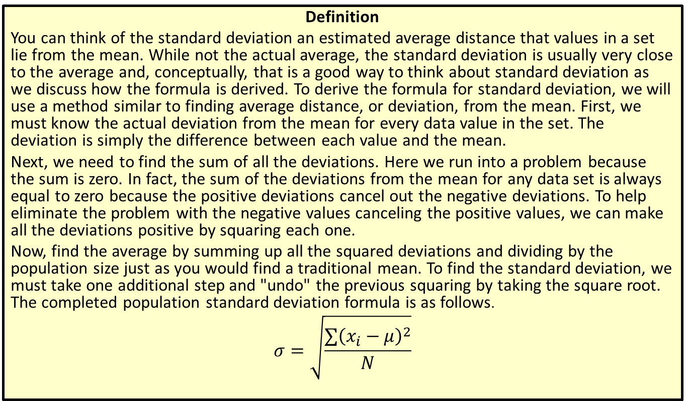
Origins of the Standard Deviation Formula
Definition
You can think of the standard deviation an estimated average distance that values in a set lie from the mean. While not the actual average, the standard deviation is usually very close to the average and, conceptually, that is a good way to think about standard deviation as we discuss how the formula is derived. To derive the formula for standard deviation, we will use a method similar to finding average distance, or deviation, from the mean. First, we must know the actual deviation from the mean for every data value in the set. The deviation is simply the difference between each value and the mean.
Next, we need to find the sum of all the deviations. Here we run into a problem because the sum is zero. In fact, the sum of the deviations from the mean for any data set is always equal to zero because the positive deviations cancel out the negative deviations. To help eliminate the problem with the negative values canceling the positive values, we can make all the deviations positive by squaring each one.
Now, find the average by summing up all the squared deviations and dividing by the population size just as you would find a traditional mean. To find the standard deviation, we must take one additional step and "undo" the previous squaring by taking the square root. The completed population standard deviation formula is as follows.
$$σ=\sqrt{\frac{∑{\left(x_{i}−μ\right)}^{2}}{N}}$$

Slide 18
Example 3.2.3: Calculating Standard Deviation
The following data set contains the ages (in years) of every patient seen by Dr. Dabbs at his urgent care clinic one afternoon. Calculate the standard deviation of the ages of his patients that afternoon.
11, 18, 25, 51, 44, 29, 30, 17, 29, 47, 52, 60

Slide 19
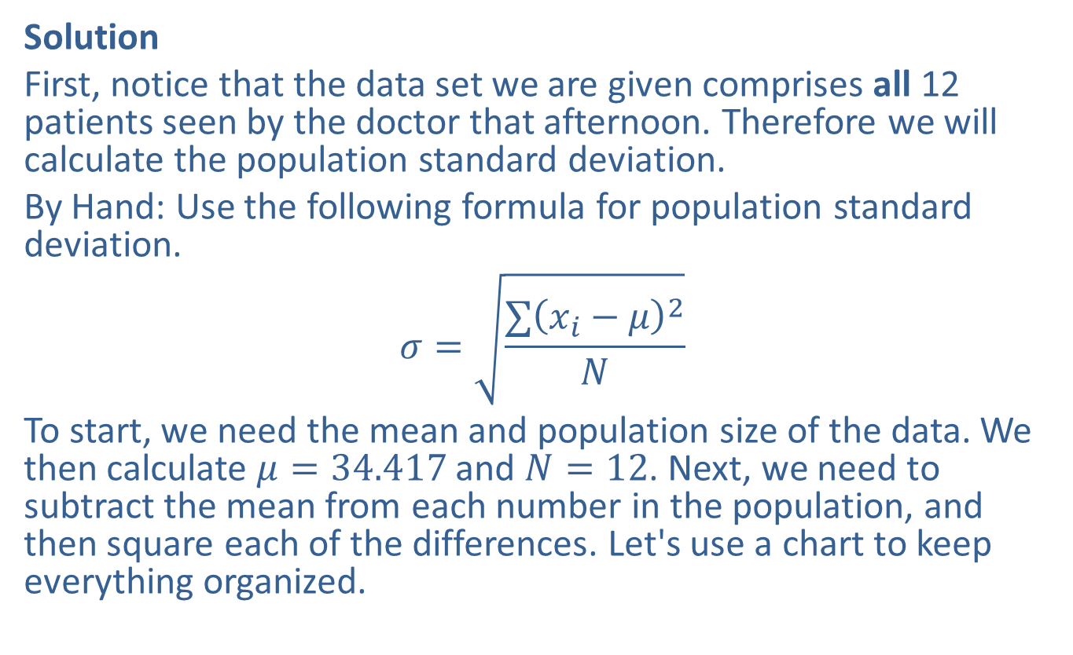
Example 3.2.3: Calculating Standard Deviation (cont.)
Solution
First, notice that the data set we are given comprises all 12 patients seen by the doctor that afternoon. Therefore we will calculate the population standard deviation.
By Hand: Use the following formula for population standard deviation.
$$σ=\sqrt{\frac{∑{\left(x_{i}−μ\right)}^{2}}{N}}$$
To start, we need the mean and population size of the data. We then calculate $μ=34.417$ and $N=12$. Next, we need to subtract the mean from each number in the population, and then square each of the differences. Let's use a chart to keep everything organized.

Slide 20
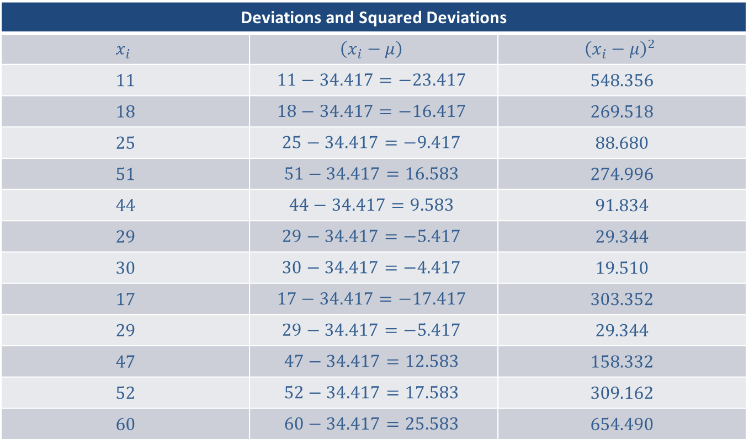
Example 3.2.3: Calculating Standard Deviation (cont.)
Deviations and Squared Deviations
$$x_{i}$$ | $$\left(x_{i}−μ\right)$$ | $${\left(x_{i}−μ\right)}^{2}$$
11 | $$11−34.417=−23.417$$ | 548.356
18 | $$18−34.417=−16.417$$ | 269.518
25 | $$25−34.417=−9.417$$ | 88.680
51 | $$51−34.417=16.583$$ | 274.996
44 | $$44−34.417=9.583$$ | 91.834
29 | $$29−34.417=−5.417$$ | 29.344
30 | $$30−34.417=−4.417$$ | 19.510
17 | $$17−34.417=−17.417$$ | 303.352
29 | $$29−34.417=−5.417$$ | 29.344
47 | $$47−34.417=12.583$$ | 158.332
52 | $$52−34.417=17.583$$ | 309.162
60 | $$60−34.417=25.583$$ | 654.490

Slide 21
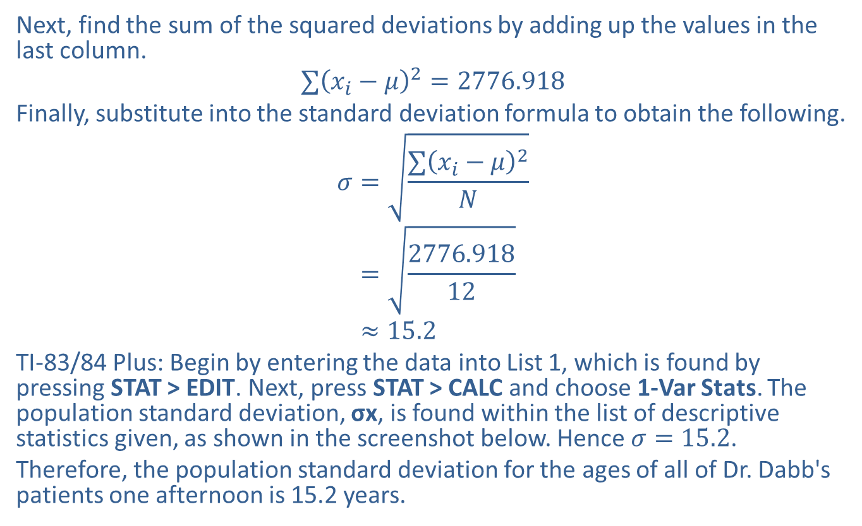
Example 3.2.3: Calculating Standard Deviation (cont.)
Next, find the sum of the squared deviations by adding up the values in the last column.
$$∑{\left(x_{i}−μ\right)}^{2}=2776.918$$
Finally, substitute into the standard deviation formula to obtain the following.
𝜎=∑𝑥𝑖−𝜇2𝑁𝜎=2776.91812𝜎≈15.2
TI-83/84 Plus: Begin by entering the data into List 1, which is found by pressing STAT > EDIT. Next, press STAT > CALC and choose 1-Var Stats. The population standard deviation, σx, is found within the list of descriptive statistics given, as shown in the screenshot below. Hence $σ=15.2$.
Therefore, the population standard deviation for the ages of all of Dr. Dabb's patients one afternoon is 15.2 years.

Slide 22
Technology Tip:
For a TI-83/84 Plus calculator, the sample standard deviation will be listed under 1-Var Stats as Sx. The population standard deviation will be listed as σx.

Slide 23
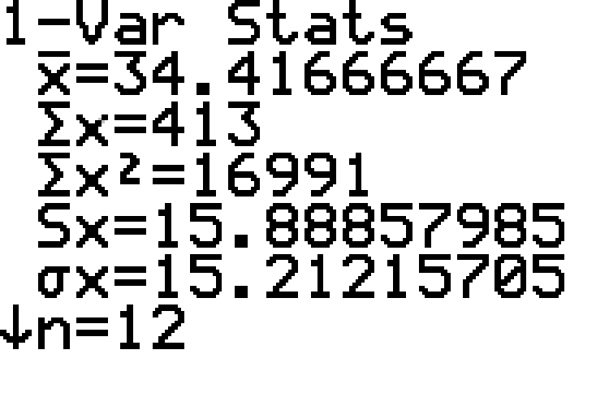
Example 3.2.3: Calculating Standard Deviation (cont.)

Slide 24
Technology Tip:
Many inexpensive calculators can easily compute standard deviation. For example, to calculate standard deviation on the TI-30XS, go to DATA and input the data values into L1. Next, go to STAT and choose 1-Var Stats. Using the settings Data:L1 and FRQ: ONE, scroll down to CALC and press Enter. You will then see a list of descriptive statistics, of which Sx is the sample standard deviation and σx is the population standard deviation.

Slide 25
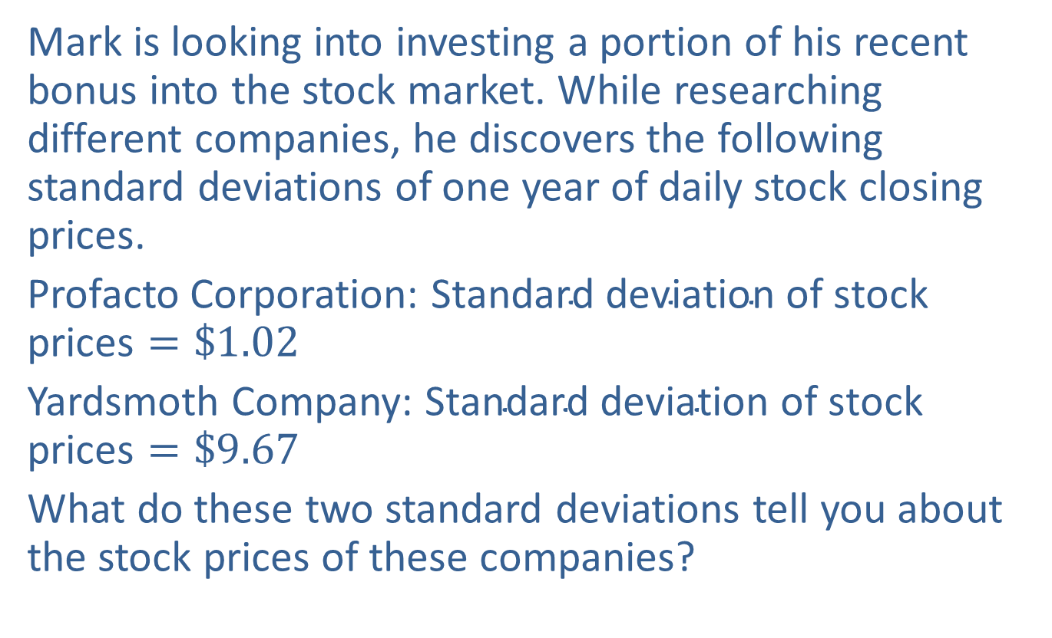
Example 3.2.4: Interpreting Standard Deviations
Mark is looking into investing a portion of his recent bonus into the stock market. While researching different companies, he discovers the following standard deviations of one year of daily stock closing prices.
Profacto Corporation: $\text{Standard} \text{deviation} \text{of} \text{stock} \text{prices}=\$1.02$
Yardsmoth Company: $\text{Standard} \text{deviation} \text{of} \text{stock} \text{prices}=\$9.67$
What do these two standard deviations tell you about the stock prices of these companies?

Slide 26
Example 3.2.4: Interpreting Standard Deviations (cont.)
Solution
A smaller standard deviation indicates that the data values are closer together, while a larger standard deviation indicates that the data values are more spread out. In this example, the standard deviation of stock prices for the Profacto Corporation is considerably smaller than that of the Yardsmoth Company. Hence, there is less variability in the daily closing prices of the Profacto stock than in the Yardsmoth stock prices. If Mark wants a stable long-term investment, then Profacto appears to be the better choice. If, however, Mark is looking to make a quick profit and is willing to take the risk, then the Yardsmoth stock would seem to better suit his purposes. Note that looking at the standard deviations is just one component of evaluating market prices.

Slide 27
Technology Tip:
For further instructions on calculating standard deviation and variance using a TI-83/84 Plus calculator or other technology, please visit stat.hawkeslearning.com and see Technology Instructions > Descriptive Statistics > One Variable.

Slide 28
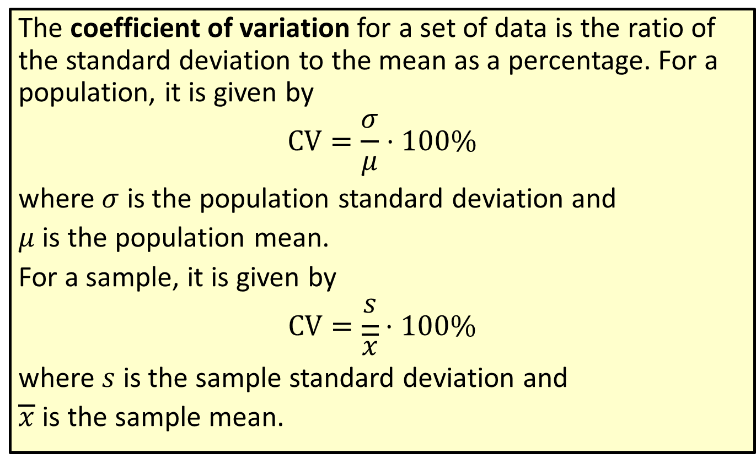
Formula: Coefficient of Variation
The coefficient of variation for a set of data is the ratio of the standard deviation to the mean as a percentage. For a population, it is given by
$$CV=\frac{σ}{μ}⋅100\%$$
where $σ$ is the population standard deviation and
$μ$ is the population mean.
For a sample, it is given by
$$CV=\frac{s}{\overline{x}}⋅100\%$$
where $s$ is the sample standard deviation and
$\overline{x}$ is the sample mean.

Slide 29
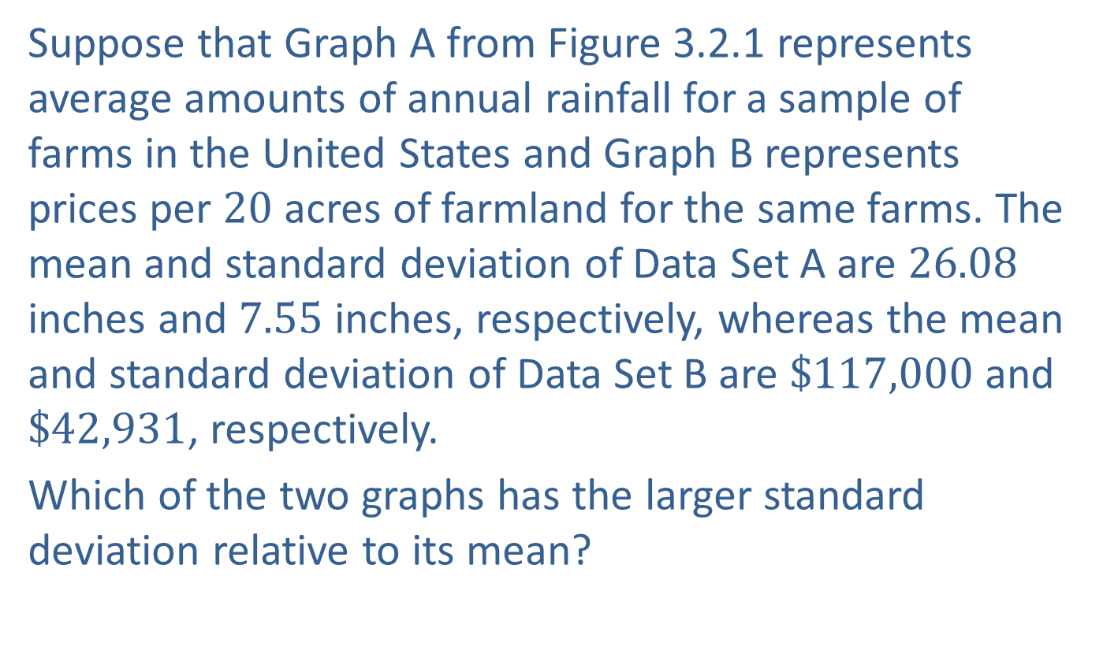
Example 3.2.5: Calculating and Interpreting Coefficient of Variation
Suppose that Graph A from Figure 3.2.1 represents average amounts of annual rainfall for a sample of farms in the United States and Graph B represents prices per 20 acres of farmland for the same farms. The mean and standard deviation of Data Set A are 26.08 inches and 7.55 inches, respectively, whereas the mean and standard deviation of Data Set B are $\$117,000$ and $\$42,931$, respectively.
Which of the two graphs has the larger standard deviation relative to its mean?

Slide 30
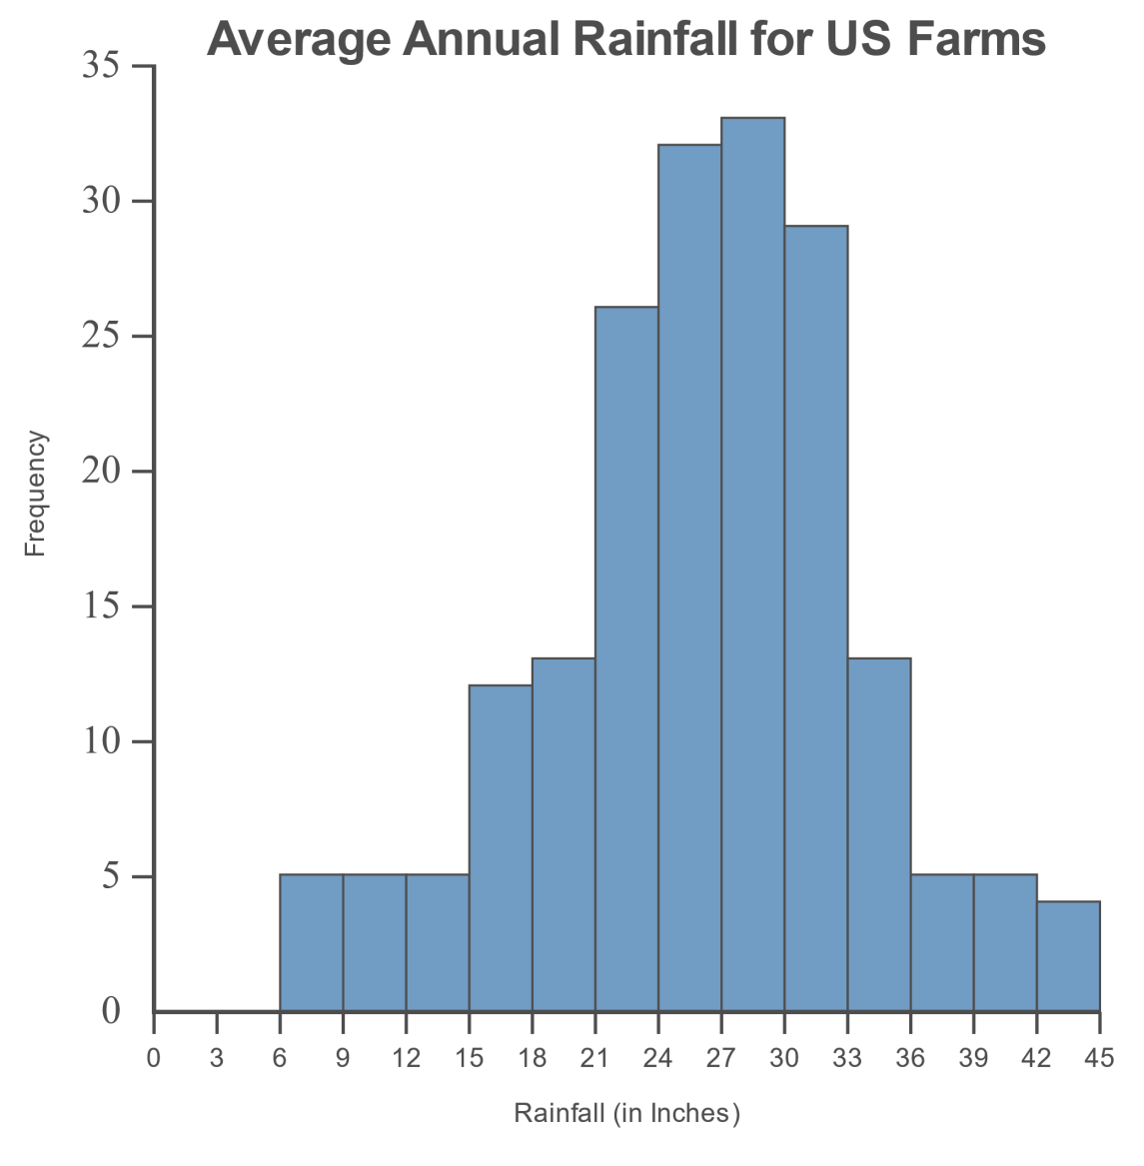
Example 3.2.5: Calculating and Interpreting Coefficient of Variation (cont.)
A

Slide 31
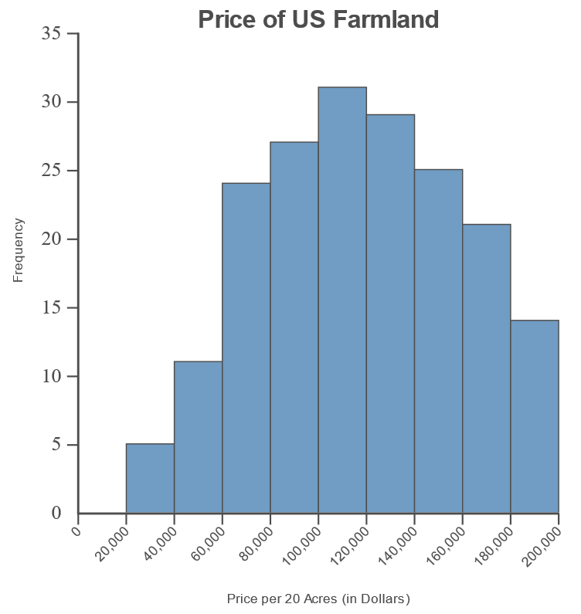
Example 3.2.5: Calculating and Interpreting Coefficient of Variation (cont.)
B

Slide 32
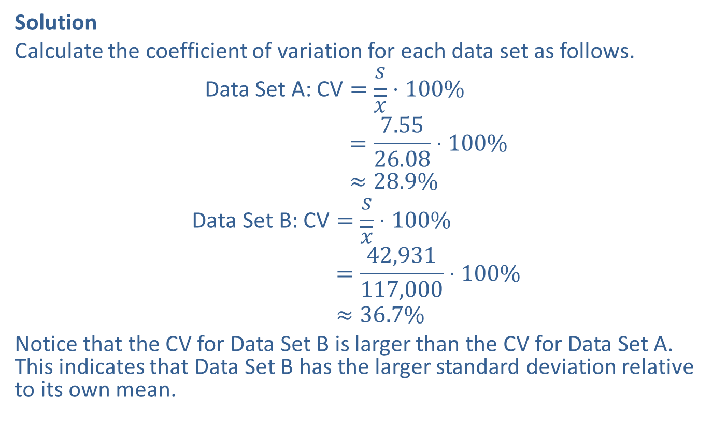
Example 3.2.5: Calculating and Interpreting Coefficient of Variation (cont.)
Solution
Calculate the coefficient of variation for each data set as follows.
Data Set A: CV=𝑠𝑥⋅100%Data Set A: CV=7.5526.08⋅100%Data Set A: CV≈28.9%
Data Set B: CV=𝑠𝑥⋅100%Data Set B: CV=42,931117,000⋅100%Data Set B: CV≈36.7%
Notice that the CV for Data Set B is larger than the CV for Data Set A. This indicates that Data Set B has the larger standard deviation relative to its own mean.

Slide 33
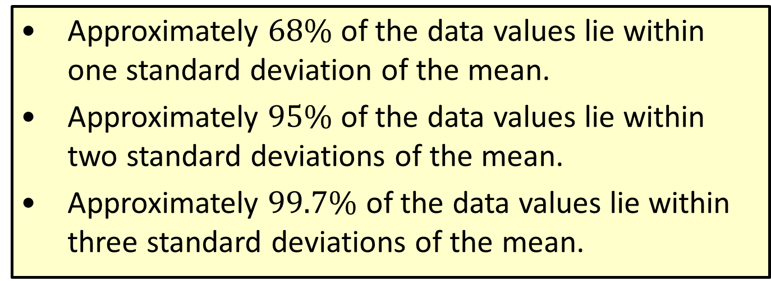
Theorem: Empirical Rule for Bell-Shaped Distributions
​Approximately $68\%$ of the data values lie within one standard deviation of the mean.
​Approximately $95\%$ of the data values lie within two standard deviations of the mean.
​Approximately $99.7\%$ of the data values lie within three standard deviations of the mean.

Slide 34
Who is King of the Hill?
In 1961, Wilt Chamberlain, won the National Basketball Association (NBA) rebounding title with 27 rebounds per game. In 1992, the colorful Dennis Rodman won the same title with 18.7 rebounds per game. Common sense suggests that professional basketball in the 1990’s is played at a much higher level than in the 1960’s. So why have the rebounding leader’s number fallen? Is it another case of “less is more”?
Researchers investigating this interesting puzzle used two other variables: Number of rebounding opportunities available (this had gone down since the field goal percent has increased historically) and the average number of minutes played per game, which has also fallen. Thus, when we adjust the actual rebounds obtained by the rebounding leaders to the number of minutes played and the total number of rebounds available, we see a completely different picture.
The adjusted rebound numbers for Chamberlain and Rodman are 35.42 and 51.06, respectively.
Chatterjee, S., Brooks, G. and Yilmaz, M. R. (1997). Who is the Greatest Rebounder of All Time? Chance, 10, 1, 22-25.

Slide 35
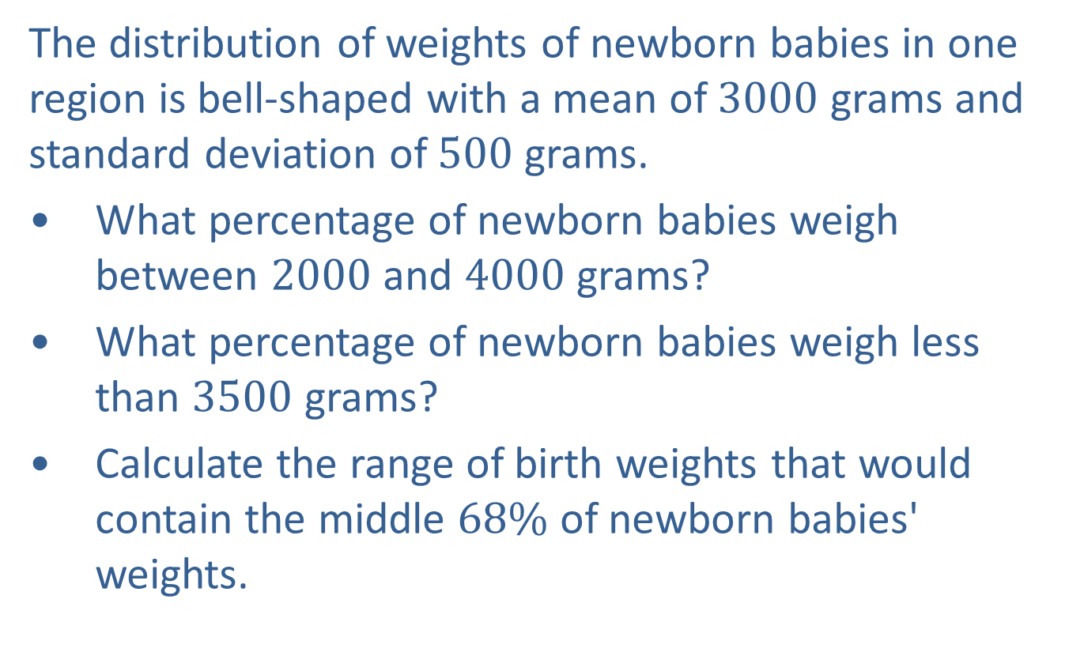
Example 3.2.6: Applying the Empirical Rule for Bell-Shaped Distributions
The distribution of weights of newborn babies in one region is bell-shaped with a mean of 3000 grams and standard deviation of 500 grams.
​What percentage of newborn babies weigh between 2000 and 4000 grams?
​What percentage of newborn babies weigh less than 3500 grams?
​Calculate the range of birth weights that would contain the middle $68\%$ of newborn babies' weights.

Slide 36
Example 3.2.6: Applying the Empirical Rule for Bell-Shaped Distributions (cont.)
Solution
​Since we know that the distribution of the data is bell-shaped, we can apply the Empirical Rule. We need to know how many standard deviations 2000 grams and 4000 grams are from the mean. By subtracting, we can find how far each of these figures is from the mean. Then, dividing by the standard deviation, we can convert these differences into numbers of standard deviations. Here are the calculations.

Slide 37
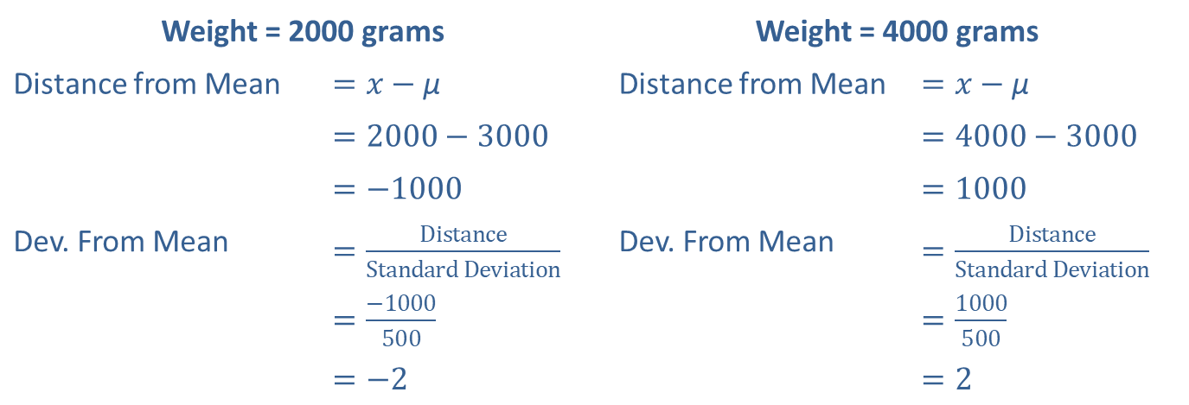
Example 3.2.6: Applying the Empirical Rule for Bell-Shaped Distributions (cont.)
Weight = 2000 grams |  | Weight = 4000 grams
Distance from Mean | $=x−\text{μ}$ | Distance from Mean | $=x−\text{μ}$
 | $=2000−3000$ |  | $=4000−3000$
 | $=−1000$ |  | $=1000$
Dev. From Mean | $=\frac{Distance}{Standard Deviation}$ | Dev. From Mean | $=\frac{Distance}{Standard Deviation}$
 | $=\frac{−1000}{500}$ |  | $=\frac{1000}{500}$
 | $=−2$ |  | $=2$

Slide 38
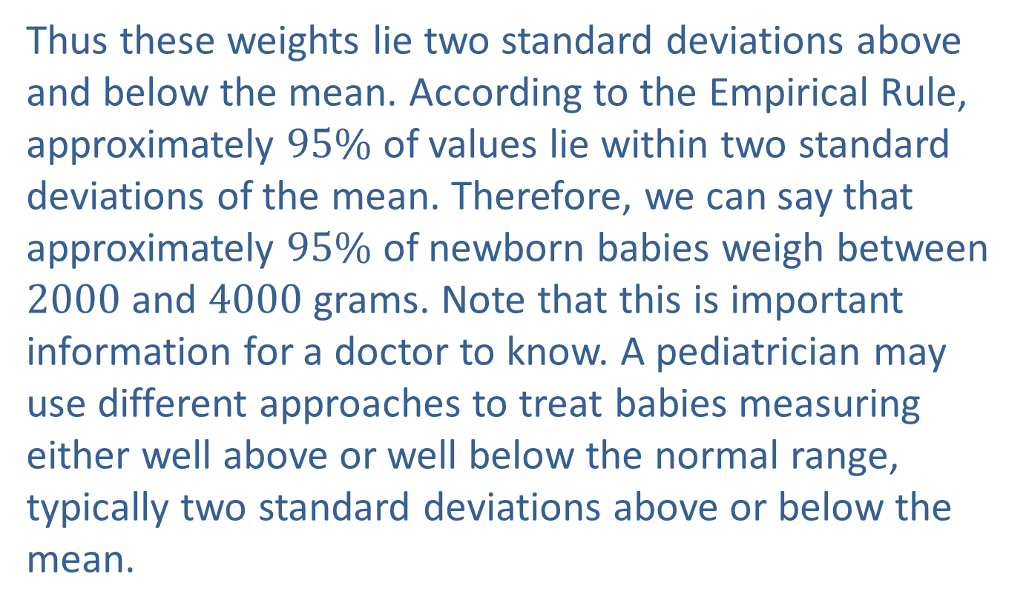
Example 3.2.6: Applying the Empirical Rule for Bell-Shaped Distributions (cont.)
​Thus these weights lie two standard deviations above and below the mean. According to the Empirical Rule, approximately $95\%$ of values lie within two standard deviations of the mean. Therefore, we can say that approximately $95\%$ of newborn babies weigh between 2000 and 4000 grams. Note that this is important information for a doctor to know. A pediatrician may use different approaches to treat babies measuring either well above or well below the normal range, typically two standard deviations above or below the mean.

Slide 39
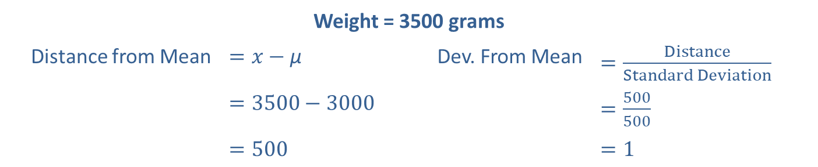
Example 3.2.6: Applying the Empirical Rule for Bell-Shaped Distributions (cont.)
​To begin, let's find out how many standard deviations a weight of 3500 grams lies from the mean by performing the same calculation as before.
​​
Weight = 3500 grams
Distance from Mean | $=x−\text{μ}$ | Dev. From Mean | $=\frac{Distance}{Standard Deviation}$
 | $=3500−3000$ |  | $=\frac{500}{500}$
 | $=500$ |  | $=1$

Slide 40
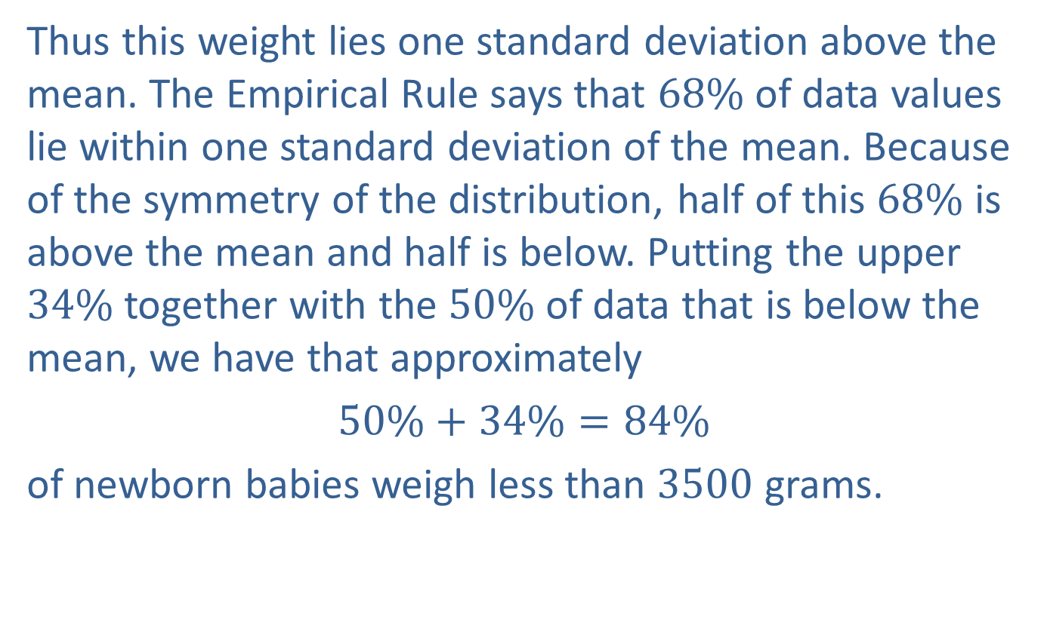
Example 3.2.6: Applying the Empirical Rule for Bell-Shaped Distributions (cont.)
​Thus this weight lies one standard deviation above the mean. The Empirical Rule says that $68\%$ of data values lie within one standard deviation of the mean. Because of the symmetry of the distribution, half of this $68\%$ is above the mean and half is below. Putting the upper $34\%$ together with the $50\%$ of data that is below the mean, we have that approximately
​$50\%+34\%=84\%$
​of newborn babies weigh less than 3500 grams.
​

Slide 41
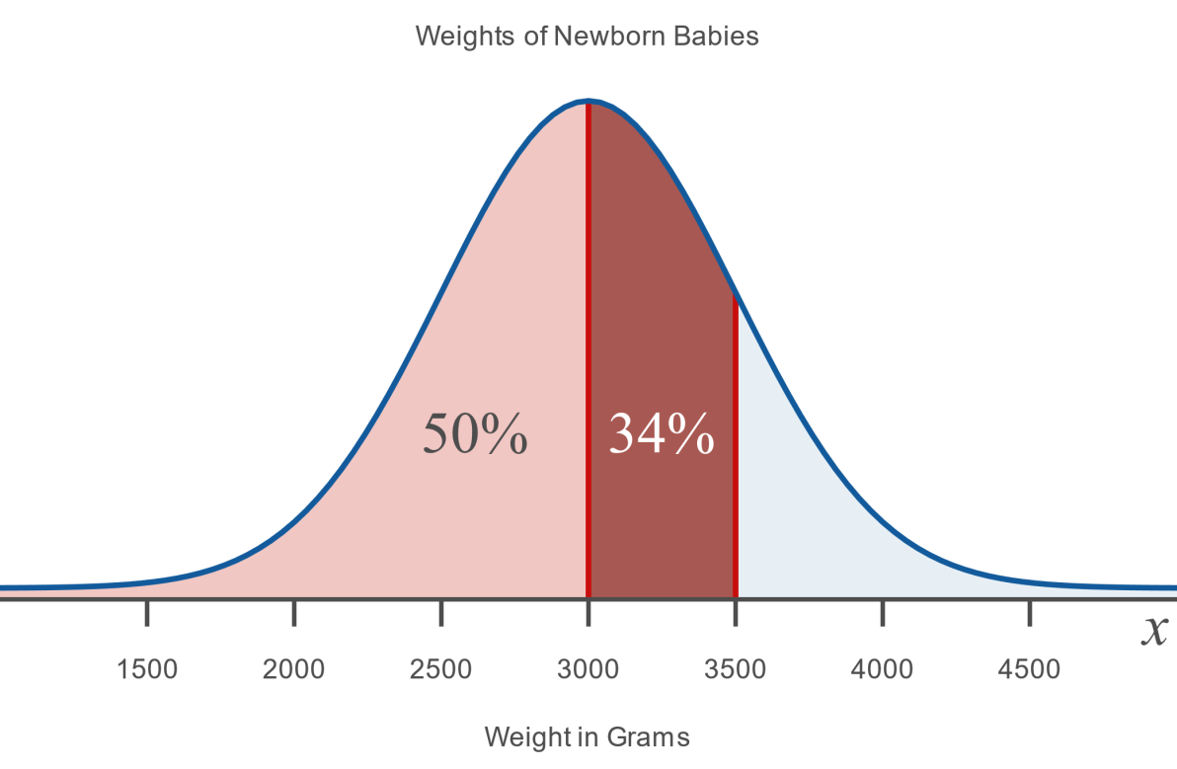
Example 3.2.6: Applying the Empirical Rule for Bell-Shaped Distributions (cont.)

Slide 42
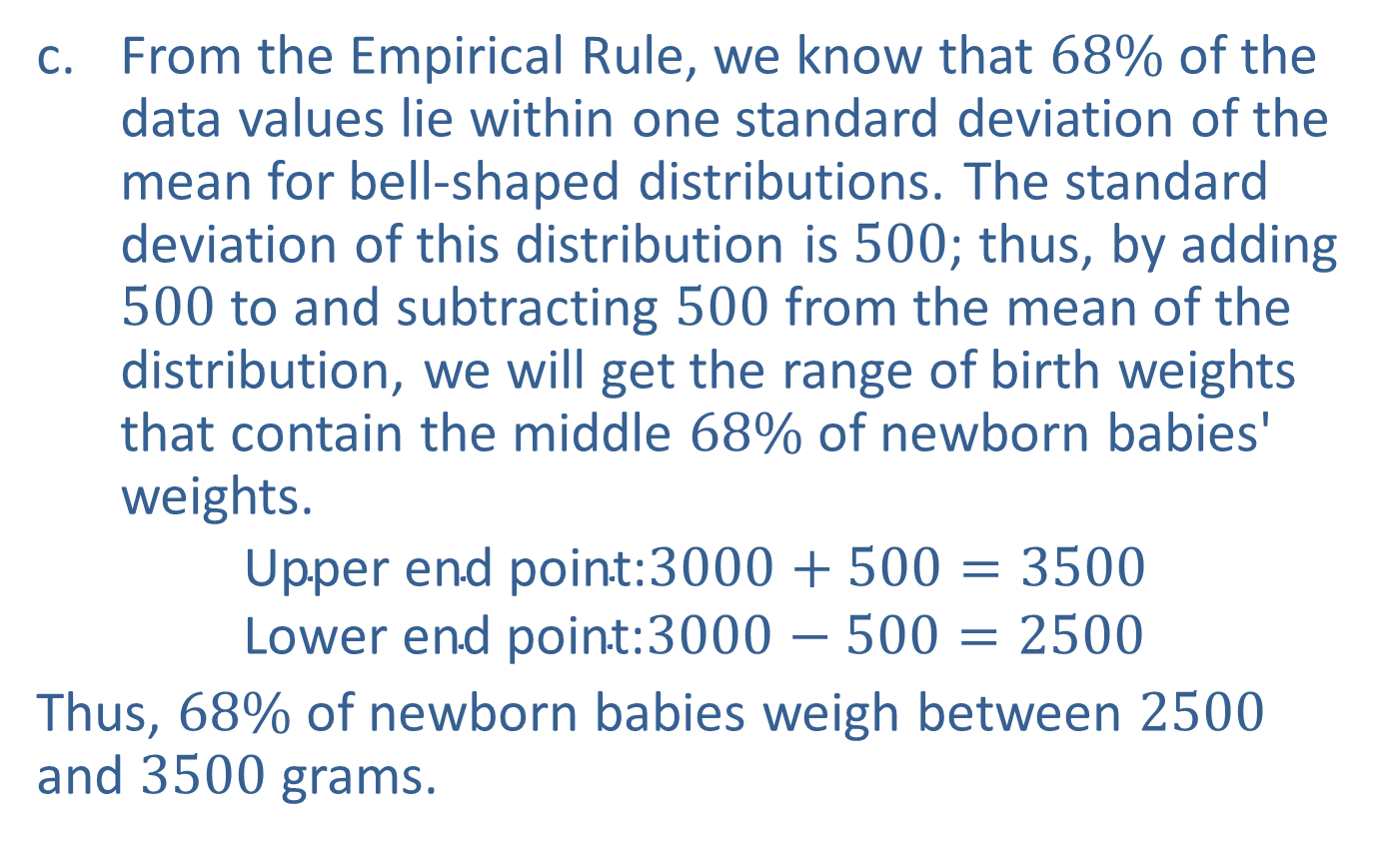
Example 3.2.6: Applying the Empirical Rule for Bell-Shaped Distributions (cont.)
​From the Empirical Rule, we know that $68\%$ of the data values lie within one standard deviation of the mean for bell-shaped distributions. The standard deviation of this distribution is 500; thus, by adding 500 to and subtracting 500 from the mean of the distribution, we will get the range of birth weights that contain the middle $68\%$ of newborn babies' weights.
$$\text{Upper} \text{end} \text{point}\text{:}3000+500=3500 \\ \text{Lower} \text{end} \text{point}\text{:}3000−500=2500$$
​Thus, $68\%$ of newborn babies weigh between 2500 and 3500 grams.

Slide 43
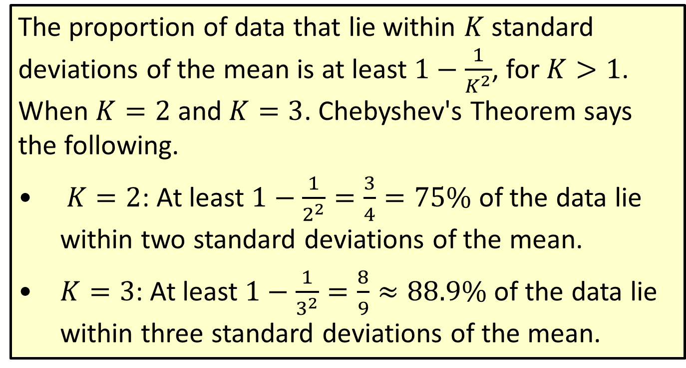
Theorem: Chebyshev's Theorem
The proportion of data that lie within $K$ standard deviations of the mean is at least $1−\frac{1}{K^{2}}$, for $K>1$. When $K=2$ and $K=3$. Chebyshev's Theorem says the following.
​ $K=2$: At least $1−\frac{1}{2^{2}}=\frac{3}{4}=75\%$ of the data lie within two standard deviations of the mean.
​$K=3$: At least $1−\frac{1}{3^{2}}=\frac{8}{9}≈88.9\%$ of the data lie within three standard deviations of the mean.

Slide 44
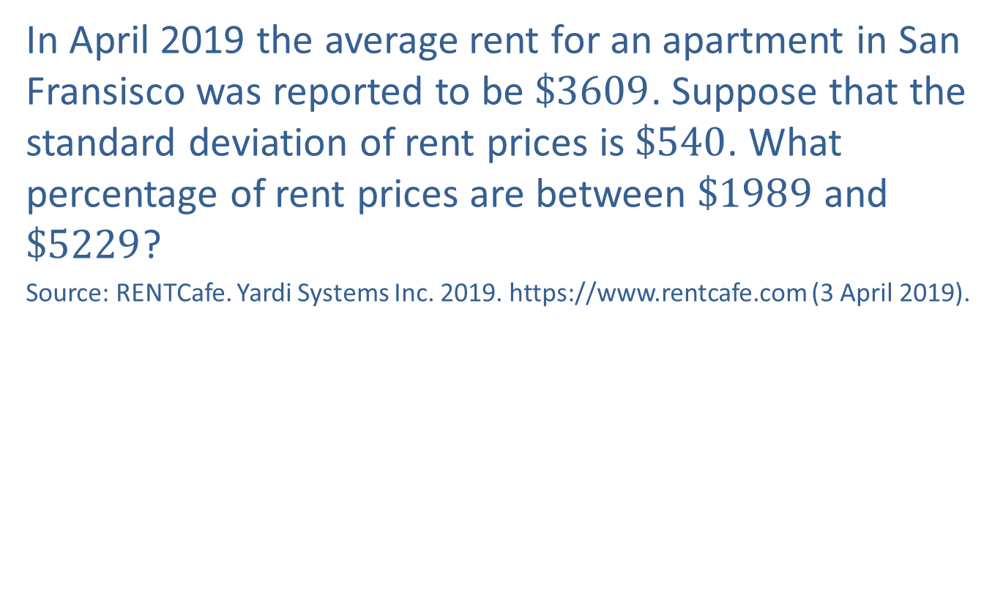
Example 3.2.7: Applying Chebyshev's Theorem
In April 2019 the average rent for an apartment in San Fransisco was reported to be $\$3609$. Suppose that the standard deviation of rent prices is $\$540$. What percentage of rent prices are between $\$1989$ and $\$5229$?
Source: RENTCafe. Yardi Systems Inc. 2019. https://www.rentcafe.com (3 April 2019).

Slide 45
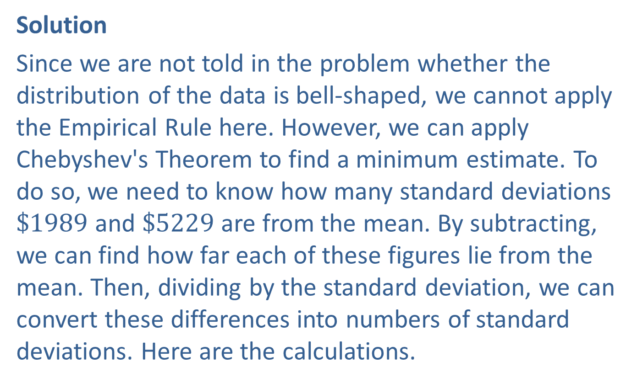
Example 3.2.7: Applying Chebyshev's Theorem (cont.)
Solution
Since we are not told in the problem whether the distribution of the data is bell-shaped, we cannot apply the Empirical Rule here. However, we can apply Chebyshev's Theorem to find a minimum estimate. To do so, we need to know how many standard deviations $\$1989$ and $\$5229$ are from the mean. By subtracting, we can find how far each of these figures lie from the mean. Then, dividing by the standard deviation, we can convert these differences into numbers of standard deviations. Here are the calculations.

Slide 46
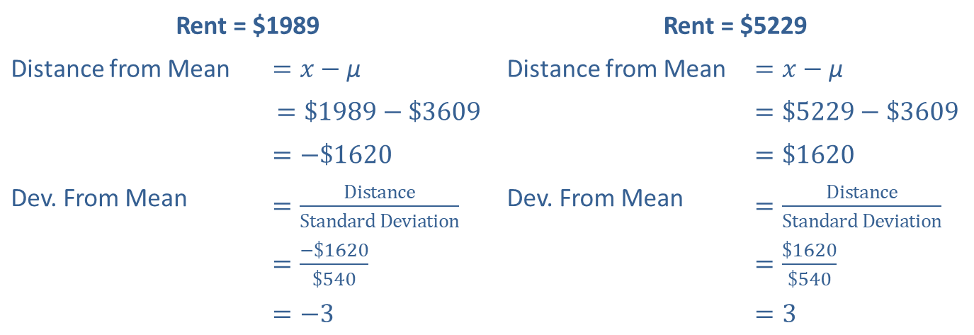
Example 3.2.7: Applying Chebyshev's Theorem (cont.)
Rent = $1989 |  | Rent = $5229
Distance from Mean | $=x−\text{μ}$ | Distance from Mean | $=x−\text{μ}$
 | $$=\$1989−\$3609$$ |  | $=\$5229−\$3609$
 | $=−\$1620$ |  | $=\$1620$
Dev. From Mean | $=\frac{Distance}{Standard Deviation}$ | Dev. From Mean | $=\frac{Distance}{Standard Deviation}$
 | $=\frac{−\$1620}{\$540}$ |  | $=\frac{\$1620}{\$540}$
 | $=−3$ |  | $=3$

Slide 47
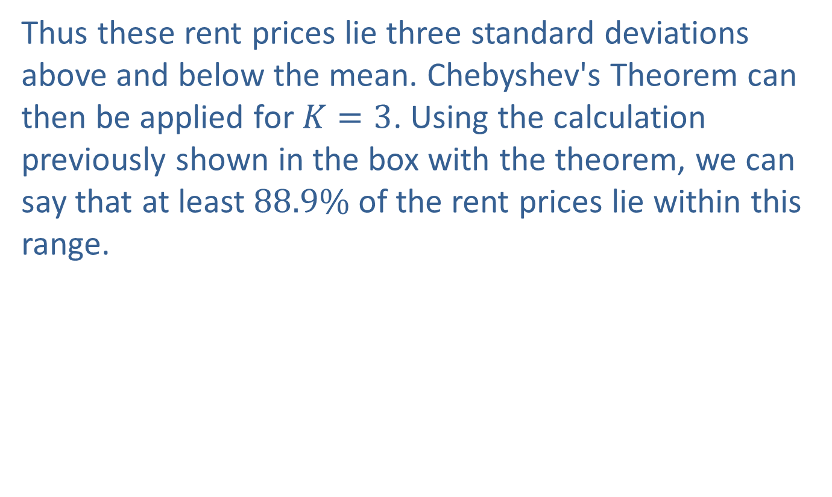
Example 3.2.7: Applying Chebyshev's Theorem (cont.)
Thus these rent prices lie three standard deviations above and below the mean. Chebyshev's Theorem can then be applied for $K=3$. Using the calculation previously shown in the box with the theorem, we can say that at least $88.9\%$ of the rent prices lie within this range.

Slide 48
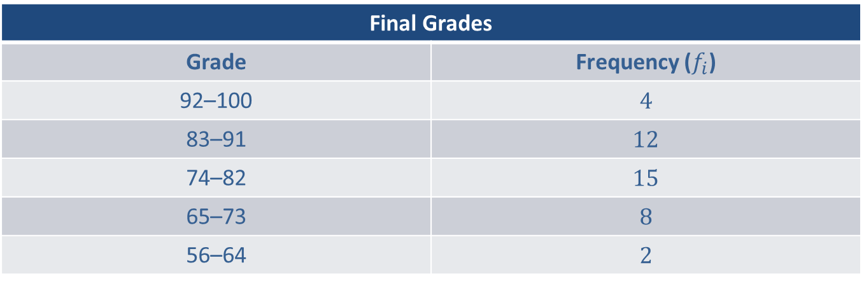
Example 3.2.8: Standard Deviation of Grouped Data
Calculate the standard deviation for the frequency distribution of final grades in the table below.
Final Grades
Grade | Frequency ($f_{i}$)
92–100 | 4
83–91 | 12
74–82 | 15
65–73 | 8
56–64 | 2

Slide 49
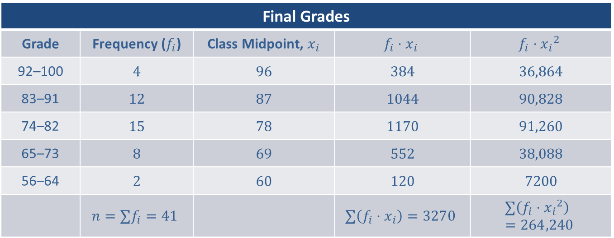
Example 3.2.8: Standard Deviation of Grouped Data (cont.)
Solution
Final Grades
Grade | Frequency ($f_{i}$) | Class Midpoint, $x_{i}$ | $$f_{i}⋅x_{i}$$ | $$f_{i}⋅{x_{i}}^{2}$$
92–100 | 4 | 96 | 384 | 36,864
83–91 | 12 | 87 | 1044 | 90,828
74–82 | 15 | 78 | 1170 | 91,260
65–73 | 8 | 69 | 552 | 38,088
56–64 | 2 | 60 | 120 | 7200
 | $$n=∑f_{i}=41$$ |  | $$∑\left(f_{i}⋅x_{i}\right)=3270$$ | $$∑\left(f_{i}⋅{x_{i}}^{2}\right)=264,240$$

Slide 50
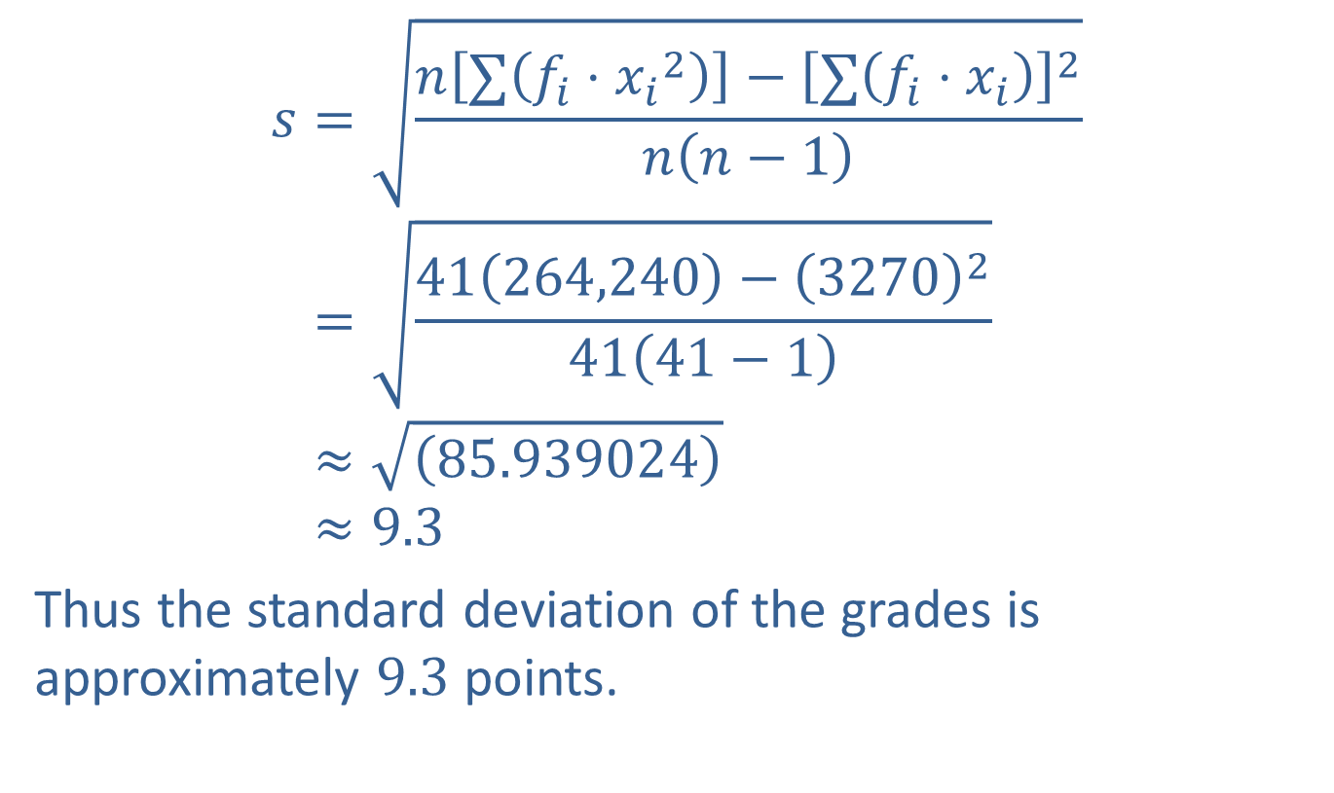
Example 3.2.8: Standard Deviation of Grouped Data (cont.)
𝑠=𝑛∑𝑓𝑖⋅𝑥𝑖2−∑𝑓𝑖⋅𝑥𝑖2𝑛𝑛−1𝑠=41264,240−327024141−1𝑠≈85.939024𝑠≈9.3
Thus the standard deviation of the grades is approximately 9.3 points.

Slide 51
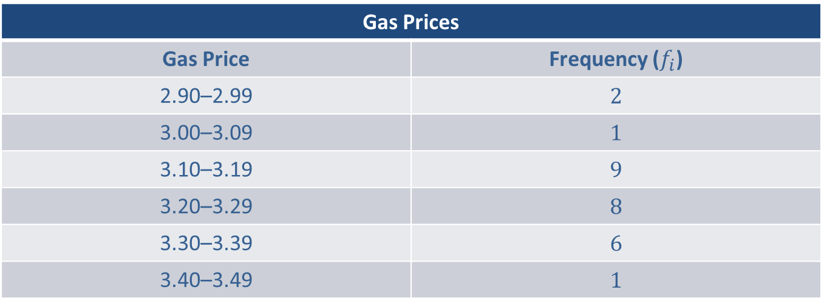
Example 3.2.9: Standard Deviation of Grouped Data
Calculate the sample standard deviation and variance for the following distribution of gas prices at the stations in a certain city.
Gas Prices
Gas Price | Frequency ($f_{i}$)
2.90–2.99 | 2
3.00–3.09 | 1
3.10–3.19 | 9
3.20–3.29 | 8
3.30–3.39 | 6
3.40–3.49 | 1

Slide 52
Example 3.2.9: Standard Deviation of Grouped Data (cont.)
Solution
Begin by extending the frequency table to include columns for the midpoint, the frequency multiplied by the midpoint, and the frequency multiplied by the midpoint squared. Next calculate the values for each cell in the table and total the columns.

Slide 53
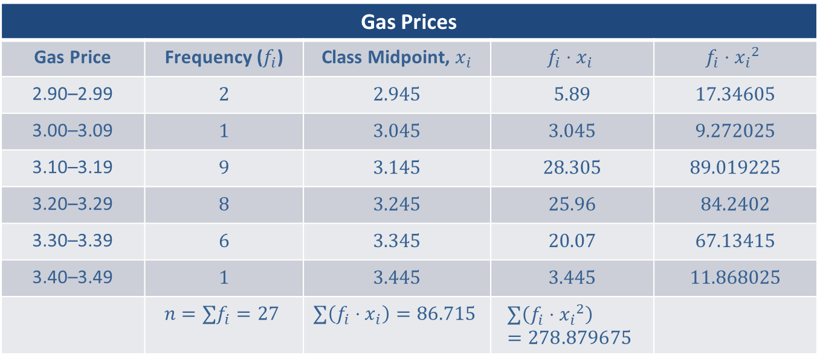
Example 3.2.9: Standard Deviation of Grouped Data (cont.)
Gas Prices
Gas Price | Frequency ($f_{i}$) | Class Midpoint, $x_{i}$ | $$f_{i}⋅x_{i}$$ | $$f_{i}⋅{x_{i}}^{2}$$
2.90–2.99 | 2 | 2.945 | 5.89 | 17.34605
3.00–3.09 | 1 | 3.045 | 3.045 | 9.272025
3.10–3.19 | 9 | 3.145 | 28.305 | 89.019225
3.20–3.29 | 8 | 3.245 | 25.96 | 84.2402
3.30–3.39 | 6 | 3.345 | 20.07 | 67.13415
3.40–3.49 | 1 | 3.445 | 3.445 | 11.868025
 | $$n=∑f_{i}=27$$ | $$∑\left(f_{i}⋅x_{i}\right)=86.715$$ | $$∑\left(f_{i}⋅{x_{i}}^{2}\right)=278.879675$$

Slide 54
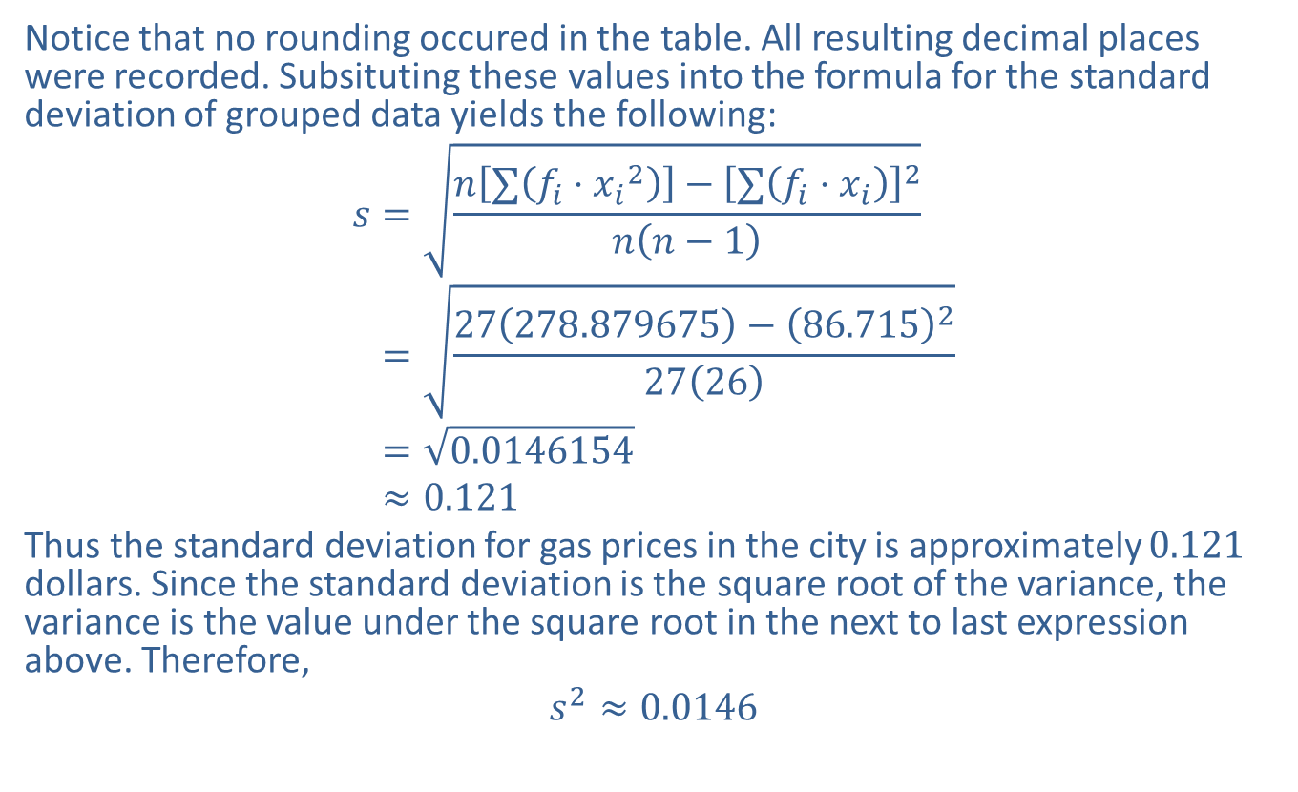
Example 3.2.9: Standard Deviation of Grouped Data (cont.)
Notice that no rounding occured in the table. All resulting decimal places were recorded. Subsituting these values into the formula for the standard deviation of grouped data yields the following:
𝑠=𝑛∑𝑓𝑖⋅𝑥𝑖2−∑𝑓𝑖⋅𝑥𝑖2𝑛𝑛−1𝑠=27278.879675−86.71522726𝑠=0.0146154𝑠≈0.121
Thus the standard deviation for gas prices in the city is approximately 0.121 dollars. Since the standard deviation is the square root of the variance, the variance is the value under the square root in the next to last expression above. Therefore,
$$s^{2}≈0.0146$$

