Slide 1
Section 3.3
Measures of Relative Position

Slide 2
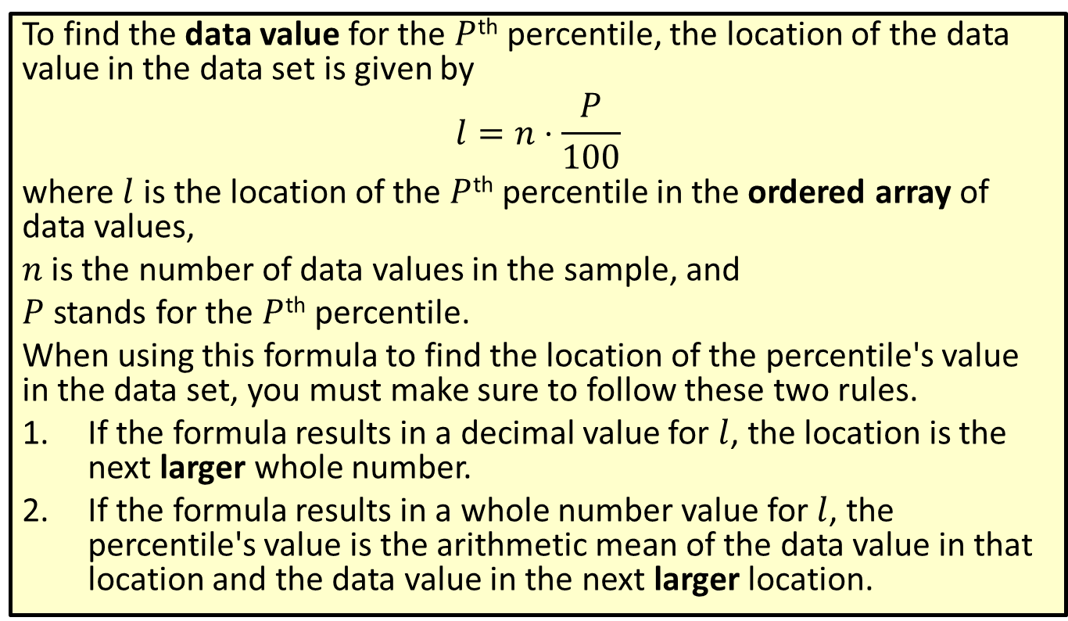

Formula: Location of Data Value for the $P$th Percentile
To find the data value for the $P$^{th} percentile, the location of the data value in the data set is given by
$$l=n⋅\frac{P}{100}$$
where $l$ is the location of the $P$^{th} percentile in the ordered array of data values,
$n$ is the number of data values in the sample, and
$P$ stands for the $P$^{th} percentile.
When using this formula to find the location of the percentile's value in the data set, you must make sure to follow these two rules.
​If the formula results in a decimal value for $l$, the location is the next larger whole number.
​If the formula results in a whole number value for $l$, the percentile's value is the arithmetic mean of the data value in that location and the data value in the next larger location.

Slide 3
Example 3.3.1: Finding Data Values Given the Percentiles
A car manufacturer is studying the highway miles per gallon (mpg) for a wide range of makes and models of vehicles. The following stem-and-leaf plot contains the average highway mpg for each of the 135 different vehicles the manufacturer tested.

Slide 4
Example 3.3.1: Finding Data Values Given the Percentiles (cont.)
Highway Gas Mileage for Various Vehicles
Stem | Leaves
12 | 1
13 | 3
14 | 1
15 | 5 6
16 | 1 1 7 8
17 | 0 0 1 2 3 4 4 5 6 9
18 | 2 3 4 5
19 | 1 2 2 2 3 3 4 6 6 7 8 9
20 | 1 2 3 3 3 4 5 6 6 7 8
21 | 0 1 1 2 3 5 7 8 9
22 | 2 3 4 7 8 9

Slide 5
Example 3.3.1: Finding Data Values Given the Percentiles (cont.)
Highway Gas Mileage for Various Vehicles
Stem | Leaves
23 | 1 1 1 4 4 5 6 6 6 6 7 8 9 9
24 | 0 1 2 3 4 4 4 5 5 5 5 6 7 8 8 8 9 9
25 | 0 0 1 1 1 2 3 3 3 3 4 4 5 6 6 7 8 9
26 | 0 0 0 1 2 5 5 6 7 9
27 | 1 4 7
28 | 3 5
29 | 2 4 9
30 | 0 7
31 | 3
32 | 7
33

Slide 6
Example 3.3.1: Finding Data Values Given the Percentiles (cont.)
Highway Gas Mileage for Various Vehicles
Stem |  | Leaves
34 |  | 5
35 |  | 9
Key: | 12 | 1 | = 12.1 mpg

Slide 7
Example 3.3.1: Finding Data Values Given the Percentiles (cont.)
​Find the value of the 10th percentile.
​Find the value of the 20th percentile.

Slide 8
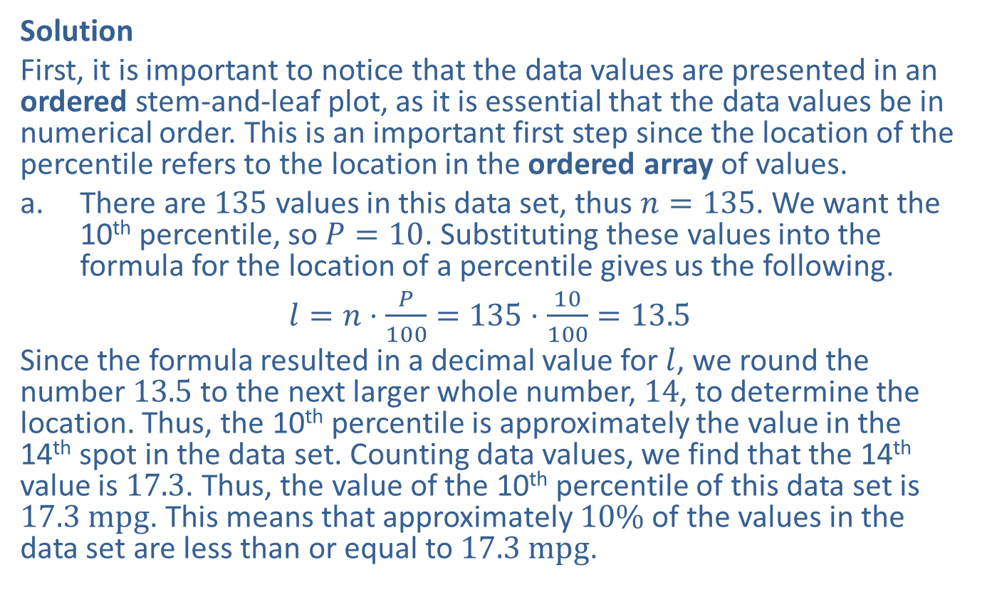
Example 3.3.1: Finding Data Values Given the Percentiles (cont.)
Solution
First, it is important to notice that the data values are presented in an ordered stem-and-leaf plot, as it is essential that the data values be in numerical order. This is an important first step since the location of the percentile refers to the location in the ordered array of values.
​There are 135 values in this data set, thus $n=135$. We want the 10th percentile, so $P=10$. Substituting these values into the formula for the location of a percentile gives us the following.
​$l=n⋅\frac{P}{100}=135⋅\frac{10}{100}=13.5$
​Since the formula resulted in a decimal value for $l$, we round the number 13.5 to the next larger whole number, 14, to determine the location. Thus, the 10th percentile is approximately the value in the 14th spot in the data set. Counting data values, we find that the 14th value is 17.3. Thus, the value of the 10th percentile of this data set is $17.3 mpg$. This means that approximately $10\%$ of the values in the data set are less than or equal to $17.3 mpg$.

Slide 9
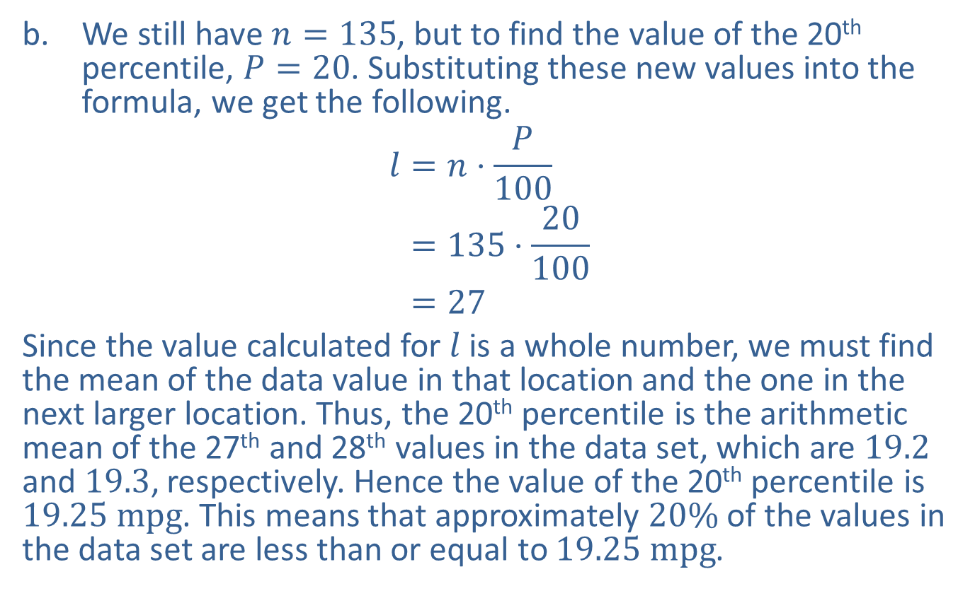
Example 3.3.1: Finding Data Values Given the Percentiles (cont.)
​We still have $n=135$, but to find the value of the 20th percentile, $P=20$. Substituting these new values into the formula, we get the following.
𝑙=𝑛⋅𝑃100𝑙=135⋅20100𝑙=27
​Since the value calculated for $l$ is a whole number, we must find the mean of the data value in that location and the one in the next larger location. Thus, the 20th percentile is the arithmetic mean of the 27th and 28th values in the data set, which are 19.2 and 19.3, respectively. Hence the value of the 20th percentile is $19.25 mpg$. This means that approximately $20\%$ of the values in the data set are less than or equal to $19.25 mpg$.

Slide 10
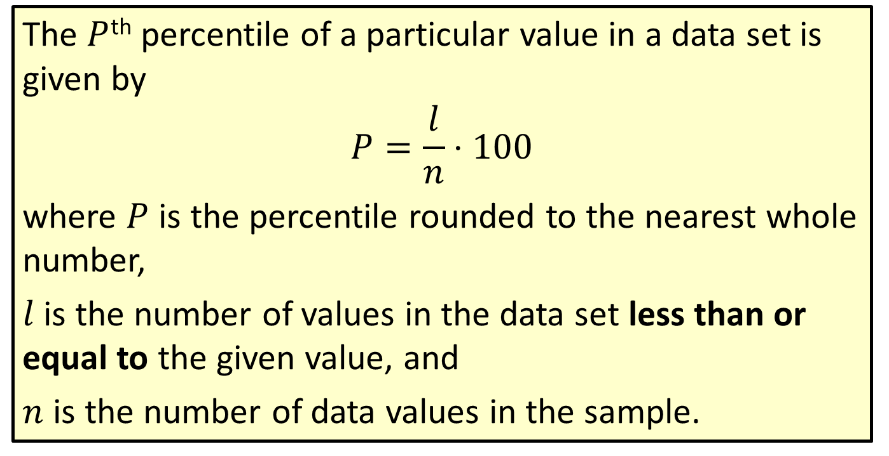

Formula: $P$th Percentile of a Data Value
The $P$^{th} percentile of a particular value in a data set is given by
$$P=\frac{l}{n}⋅100$$
where $P$ is the percentile rounded to the nearest whole number,
$l$ is the number of values in the data set less than or equal to the given value, and
$n$ is the number of data values in the sample.

Slide 11
Rounding Rule
When calculating the percentile of a data value, round to the nearest whole number.

Slide 12

Example 3.3.2: Finding the Percentile of a Given Data Value
In the data set from the previous example, the Nissan Xterra averaged $21.1 mpg$. In what percentile is this value?

Slide 13
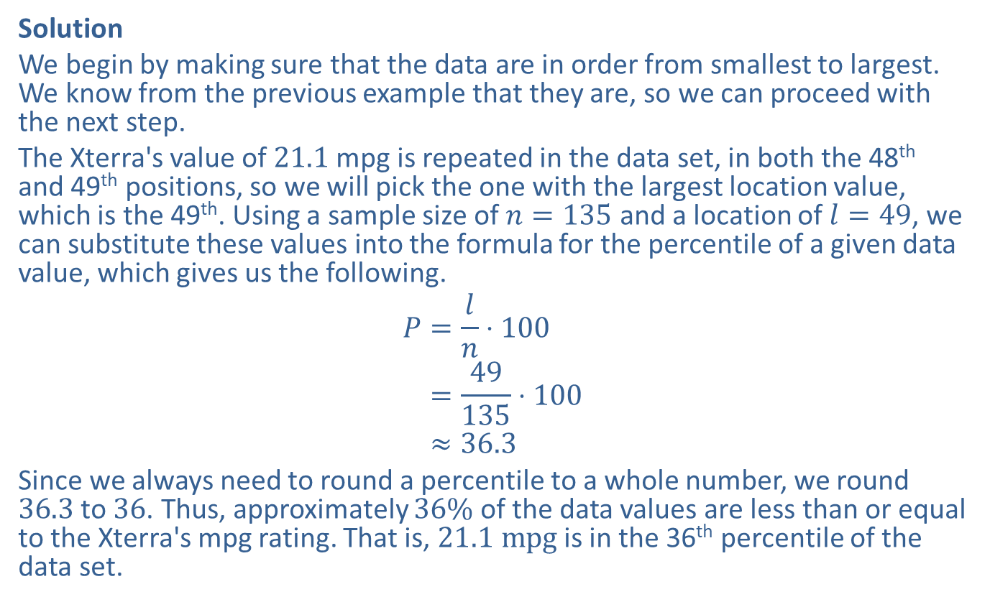
Example 3.3.2: Finding the Percentile of a Given Data Value (cont.)
Solution
We begin by making sure that the data are in order from smallest to largest. We know from the previous example that they are, so we can proceed with the next step.
The Xterra's value of 21.1 mpg is repeated in the data set, in both the 48th and 49th positions, so we will pick the one with the largest location value, which is the 49th. Using a sample size of $n=135$ and a location of $l=49$, we can substitute these values into the formula for the percentile of a given data value, which gives us the following.
𝑃=𝑙𝑛⋅100𝑃=49135⋅100𝑃≈36.3
Since we always need to round a percentile to a whole number, we round 36.3 to 36. Thus, approximately $36\%$ of the data values are less than or equal to the Xterra's mpg rating. That is, $21.1 mpg$ is in the 36th percentile of the data set.

Slide 14
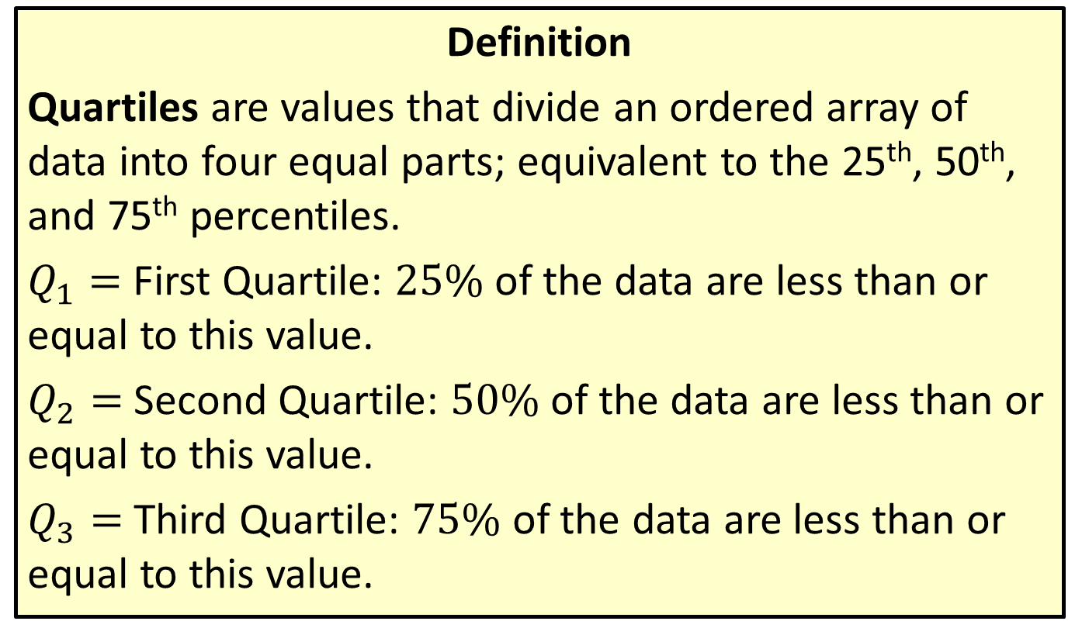
Quartiles
Definition
Quartiles are values that divide an ordered array of data into four equal parts; equivalent to the 25th, 50th, and 75th percentiles.
$Q_{1}=$ First Quartile: $25\%$ of the data are less than or equal to this value.
$Q_{2}=$ Second Quartile: $50\%$ of the data are less than or equal to this value.
$Q_{3}=$ Third Quartile: $75\%$ of the data are less than or equal to this value.

Slide 15
Side Note:
Hinges vs. Quartiles
If you do not include the median when you are approximating the first and third quartiles, you are actually calculating a completely different value, created by statistician John Tukey, called a hinge. The lower hinge is a rough approximation of the first quartile, and the upper hinge is a rough approximation of the third quartile. To complicate matters further, some textbooks (and the TI-83/84 Plus calculator) do not differentiate between quartiles and hinges. The solutions given in this textbook will actually be hinges, so as to match the values given by the TI-83/84 Plus calculator.

Slide 16
Example 3.3.3: Finding the Quartiles of a Given Data Set
Find the quartiles for the mpg data used in the previous examples. The stem and leaf plot for this data is repeated below for convenience.

Slide 17
Example 3.3.3: Finding the Quartiles of a Given Data Set (cont.)
Highway Gas Mileage for Various Vehicles
Stem | Leaves
12 | 1
13 | 3
14 | 1
15 | 5 6
16 | 1 1 7 8
17 | 0 0 1 2 3 4 4 5 6 9
18 | 2 3 4 5
19 | 1 2 2 2 3 3 4 6 6 7 8 9
20 | 1 2 3 3 3 4 5 6 6 7 8
21 | 0 1 1 2 3 5 7 8 9
22 | 2 3 4 7 8 9

Slide 18
Example 3.3.3: Finding the Quartiles of a Given Data Set (cont.)
Highway Gas Mileage for Various Vehicles
Stem | Leaves
23 | 1 1 1 4 4 5 6 6 6 6 7 8 9 9
24 | 0 1 2 3 4 4 4 5 5 5 5 6 7 8 8 8 9 9
25 | 0 0 1 1 1 2 3 3 3 3 4 4 5 6 6 7 8 9
26 | 0 0 0 1 2 5 5 6 7 9
27 | 1 4 7
28 | 3 5
29 | 2 4 9
30 | 0 7
31 | 3
32 | 7
33

Slide 19
Example 3.3.3: Finding the Quartiles of a Given Data Set (cont.)
Highway Gas Mileage for Various Vehicles
Stem |  | Leaves
34 |  | 5
35 |  | 9
Key: | 12 | 1 | = 12.1 mpg

Slide 20
Example 3.3.3: Finding the Quartiles of a Given Data Set (cont.)
​Use the percentile method to find the quartiles.
​Use the approximation method to find the quartiles.
​How do these values compare?

Slide 21
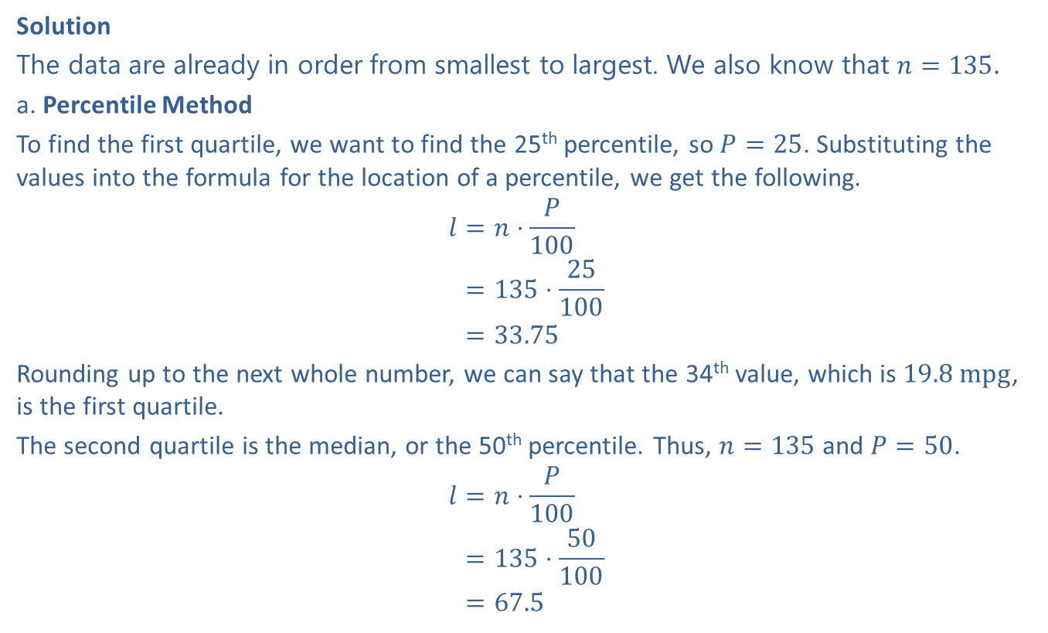
Example 3.3.3: Finding the Quartiles of a Given Data Set (cont.)
Solution
The data are already in order from smallest to largest. We also know that $n=135.$
a. ​Percentile Method
​To find the first quartile, we want to find the 25th percentile, so $P=25$. Substituting the values into the formula for the location of a percentile, we get the following.
𝑙=𝑛⋅𝑃100𝑙=135⋅25100𝑙=33.75
​Rounding up to the next whole number, we can say that the 34th value, which is $19.8 mpg$, is the first quartile.
​The second quartile is the median, or the 50th percentile. Thus, $n=135$ and $P=50$.
𝑙=𝑛⋅𝑃100𝑙=135⋅50100𝑙=67.5

Slide 22
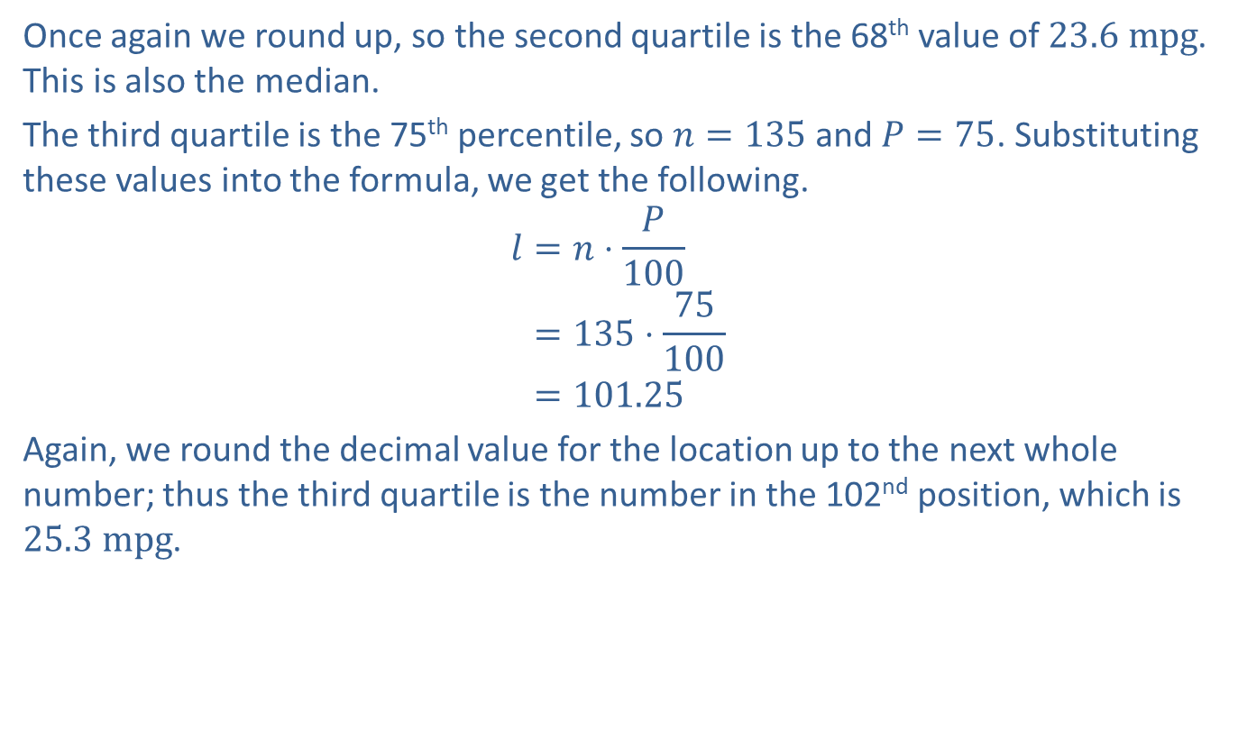
Example 3.3.3: Finding the Quartiles of a Given Data Set (cont.)
​Once again we round up, so the second quartile is the 68th value of $23.6 mpg$. This is also the median.
​The third quartile is the 75th percentile, so $n=135$ and $P=75$. Substituting these values into the formula, we get the following.
𝑙=𝑛⋅𝑃100𝑙=135⋅75100𝑙=101.25
​Again, we round the decimal value for the location up to the next whole number; thus the third quartile is the number in the 102nd position, which is $25.3 mpg$.

Slide 23
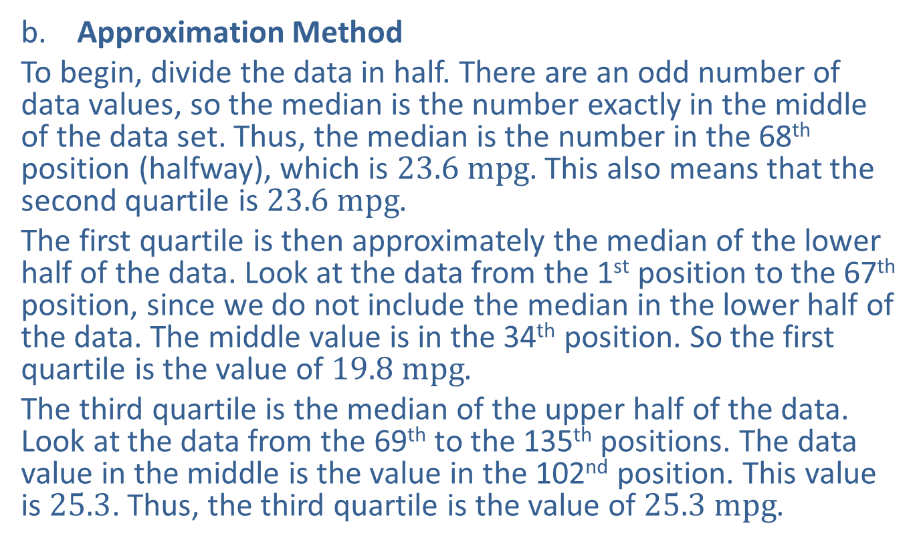
Example 3.3.3: Finding the Quartiles of a Given Data Set (cont.)
​Approximation Method
​To begin, divide the data in half. There are an odd number of data values, so the median is the number exactly in the middle of the data set. Thus, the median is the number in the 68th position (halfway), which is $23.6 mpg$. This also means that the second quartile is $23.6 mpg$.
​The first quartile is then approximately the median of the lower half of the data. Look at the data from the 1st position to the 67th position, since we do not include the median in the lower half of the data. The middle value is in the 34th position. So the first quartile is the value of $19.8 mpg$.
​The third quartile is the median of the upper half of the data. Look at the data from the 69th to the 135th positions. The data value in the middle is the value in the 102nd position. This value is 25.3. Thus, the third quartile is the value of $25.3 mpg$.

Slide 24
Example 3.3.3: Finding the Quartiles of a Given Data Set (cont.)
​These two methods result in the same values, which are also the values given by a TI-83/84 Plus calculator, as shown below.

Slide 25
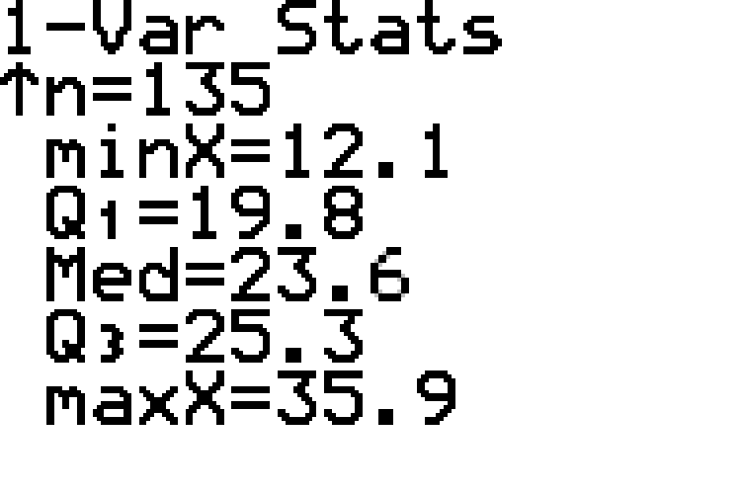
Example 3.3.3: Finding the Quartiles of a Given Data Set (cont.)

Slide 26
Example 3.3.4: Finding the Quartiles of a Given Data Set
The following speeds of motorists (in mph) were obtained by a Highway Patrol officer on duty one weekend. Determine the quartiles of each data set using the approximation method.
​60, 62, 63, 65, 65, 67, 70, 71, 71, 75, 78, 79, 80, 81
​59, 66, 67, 67, 72, 74, 75, 75, 75, 76, 78, 79, 80, 81, 85

Slide 27
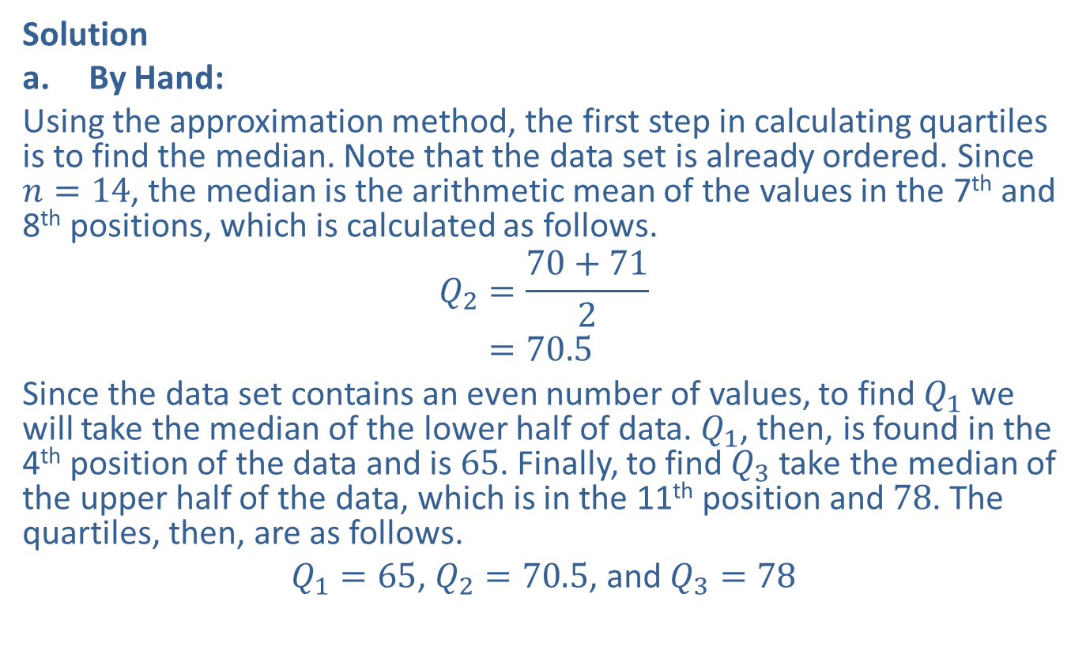
Example 3.3.4: Finding the Quartiles of a Given Data Set (cont.)
Solution
​By Hand:
​Using the approximation method, the first step in calculating quartiles is to find the median. Note that the data set is already ordered. Since $n=14$, the median is the arithmetic mean of the values in the 7th and 8th positions, which is calculated as follows.
𝑄2=70+712𝑄2=70.5
​Since the data set contains an even number of values, to find $Q_{1}$ we will take the median of the lower half of data. $Q_{1}$, then, is found in the 4th position of the data and is 65. Finally, to find $Q_{3}$ take the median of the upper half of the data, which is in the 11th position and 78. The quartiles, then, are as follows.
​$Q_{1}=65$, $Q_{2}=70.5$, and $Q_{3}=78$
​

Slide 28
Example 3.3.4: Finding the Quartiles of a Given Data Set (cont.)
​TI-83/84 Plus:
​Begin by going to STAT > EDIT and entering the data into L1. Then, go to STAT > CALC and choose 1-Var Stats to obtain the list of descriptive statistics. The results are shown below.
​

Slide 29
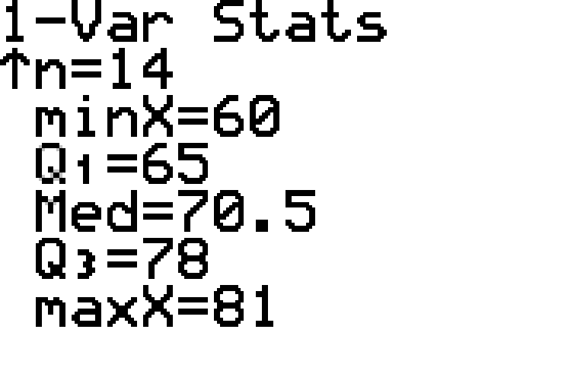
Example 3.3.4: Finding the Quartiles of a Given Data Set (cont.)

Slide 30

Example 3.3.4: Finding the Quartiles of a Given Data Set (cont.)
​ $Q_{1}=65$, Med $Q_{2}=70.5$, $Q_{3}=78$

Slide 31
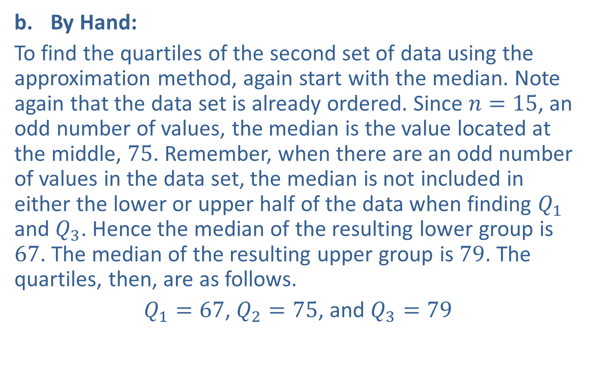
Example 3.3.4: Finding the Quartiles of a Given Data Set (cont.)
​By Hand:
​To find the quartiles of the second set of data using the approximation method, again start with the median. Note again that the data set is already ordered. Since $n=15$, an odd number of values, the median is the value located at the middle, 75. Remember, when there are an odd number of values in the data set, the median is not included in either the lower or upper half of the data when finding $Q_{1}$ and $Q_{3}$. Hence the median of the resulting lower group is 67. The median of the resulting upper group is 79. The quartiles, then, are as follows.
​$Q_{1}=67$, $Q_{2}=75$, and $Q_{3}=79$
​

Slide 32
Example 3.3.4: Finding the Quartiles of a Given Data Set (cont.)
​TI-83/84 Plus:
​Begin by choosing STAT > EDIT and entering the data into L1. Then, go to STAT > CALC and choose 1-Var Stats to obtain the list of descriptive statistics. The results are shown below.
​

Slide 33
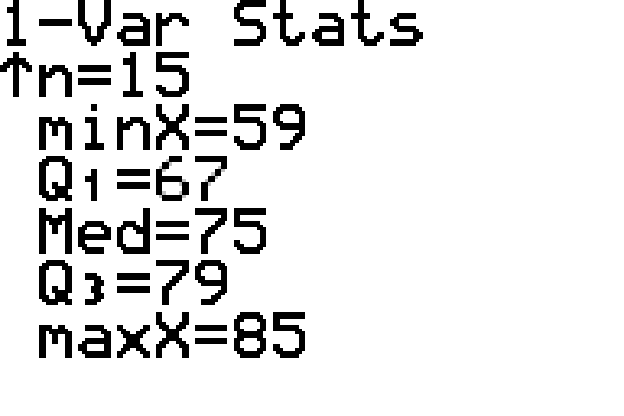

Example 3.3.4: Finding the Quartiles of a Given Data Set (cont.)
​ $Q_{1}=67$, Med $Q_{2}=75$, $Q_{3}=79$

Slide 34
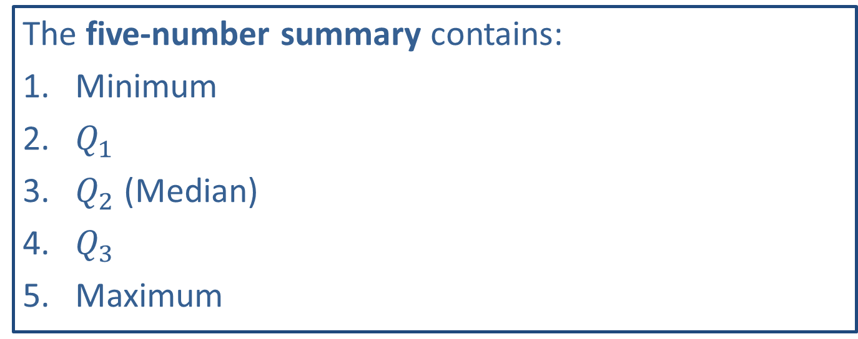
Memory Booster
The five-number summary contains:
​Minimum
​$Q_{1}$
​$Q_{2}$ (Median)
​$Q_{3}$
​Maximum

Slide 35
Example 3.3.5: Writing the Five-Number Summary of a Given Data Set
Write the five-number summary for the data from Example 3.3.3.

Slide 36
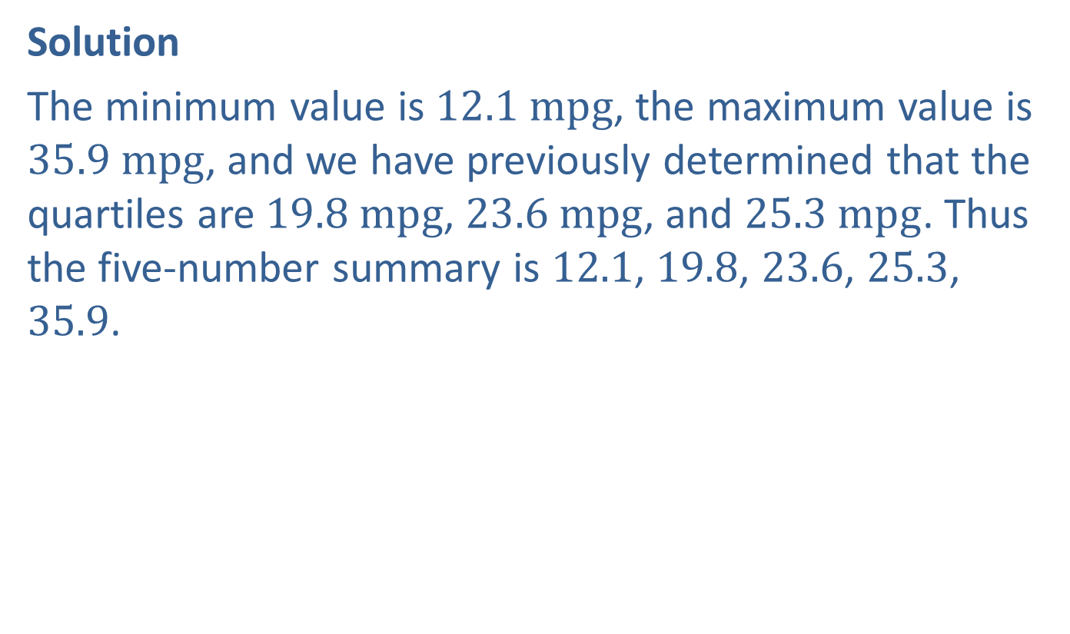
Example 3.3.5: Writing the Five-Number Summary of a Given Data Set (cont.)
Solution
The minimum value is $12.1 mpg$, the maximum value is $35.9 mpg$, and we have previously determined that the quartiles are $19.8 mpg$, $23.6 mpg$, and $25.3 mpg$. Thus the five-number summary is 12.1, 19.8, 23.6, 25.3, 35.9.

Slide 37
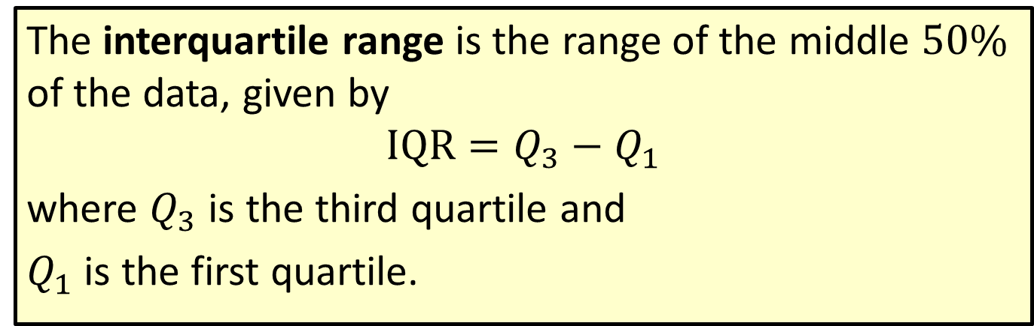
Formula: Interquartile Range (IQR)
The interquartile range is the range of the middle $50\%$ of the data, given by
$$IQR=Q_{3}−Q_{1}$$
where $Q_{3}$ is the third quartile and
$Q_{1}$ is the first quartile.

Slide 38
Procedure: Creating a Box Plot
​Begin with a horizontal (or vertical) number line that contains the five-number summary.
​Draw a small line segment above (or next to) the number line to represent each of the numbers in the five-number summary.
​Connect the line segment that represents the first quartile to the line segment representing the third quartile, forming a box with the median's line segment in between.
​Connect the "box" to the line segments representing the minimum and maximum values to form the "whiskers."

Slide 39
Example 3.3.6: Creating a Box Plot
A random sample of 100 followers was taken from one popular celebrity account on Instagram. Create a box plot to display the ages of these followers using the following 5-number summary: 9, 15.8, 19.5, 23.6, 42.

Slide 40
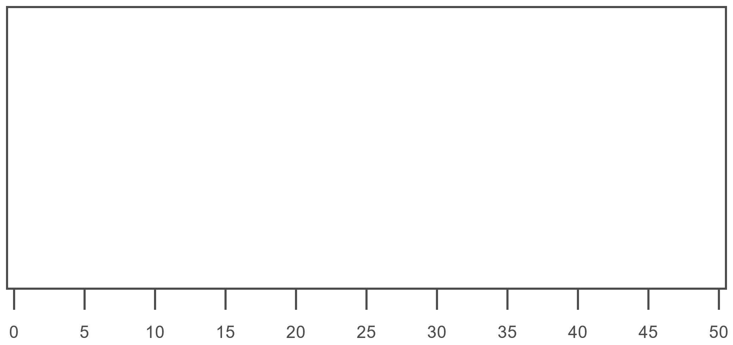
Example 3.3.6: Creating a Box Plot (cont.)
Solution
Step 1: Label the horizontal axis at even intervals.

Slide 41
Technology Tip:
Microsoft Excel is capable of creating a multitude of charts. For instructions on how to create a box plot using Excel or other technologies, please visit stat.hawkeslearning.com and navigate to Technology Instructions > Graphs > Box Plot.

Slide 42
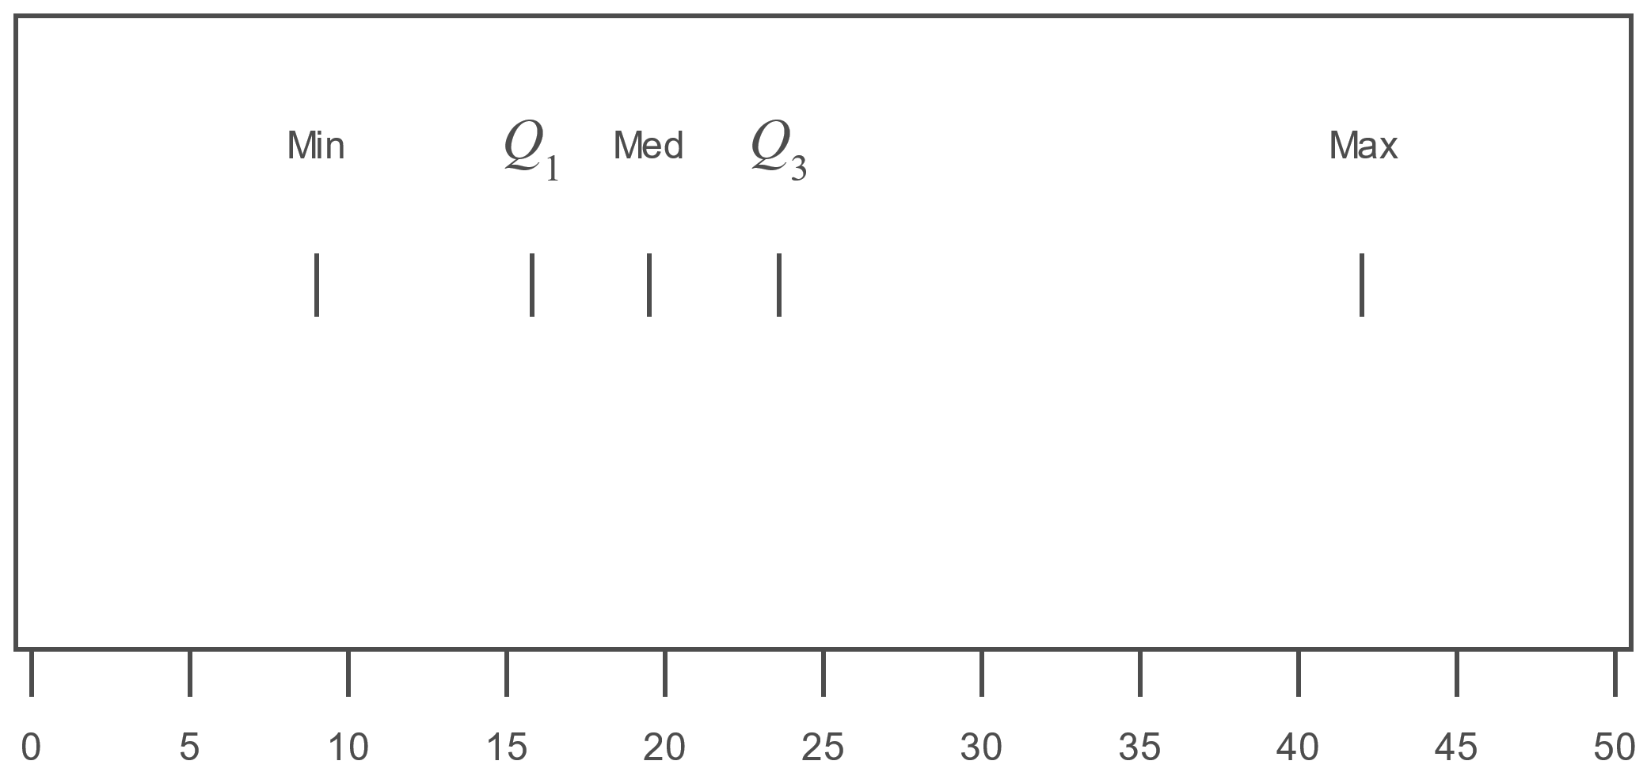
Example 3.3.6: Creating a Box Plot (cont.)
Step 2: Place a small line segment above each of the numbers in the five-number summary.

Slide 43
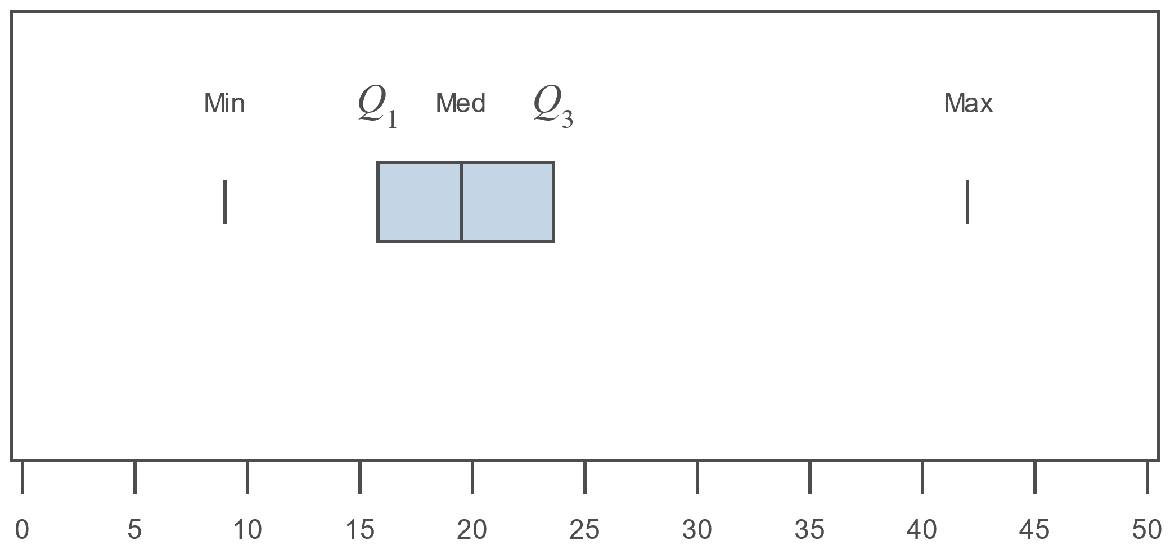

Example 3.3.6: Creating a Box Plot (cont.)
Step 3: Connect the line segment that represents $Q_{1}$ to the line segment that represents $Q_{3}$, forming a box with the median’s line segment in between.

Slide 44
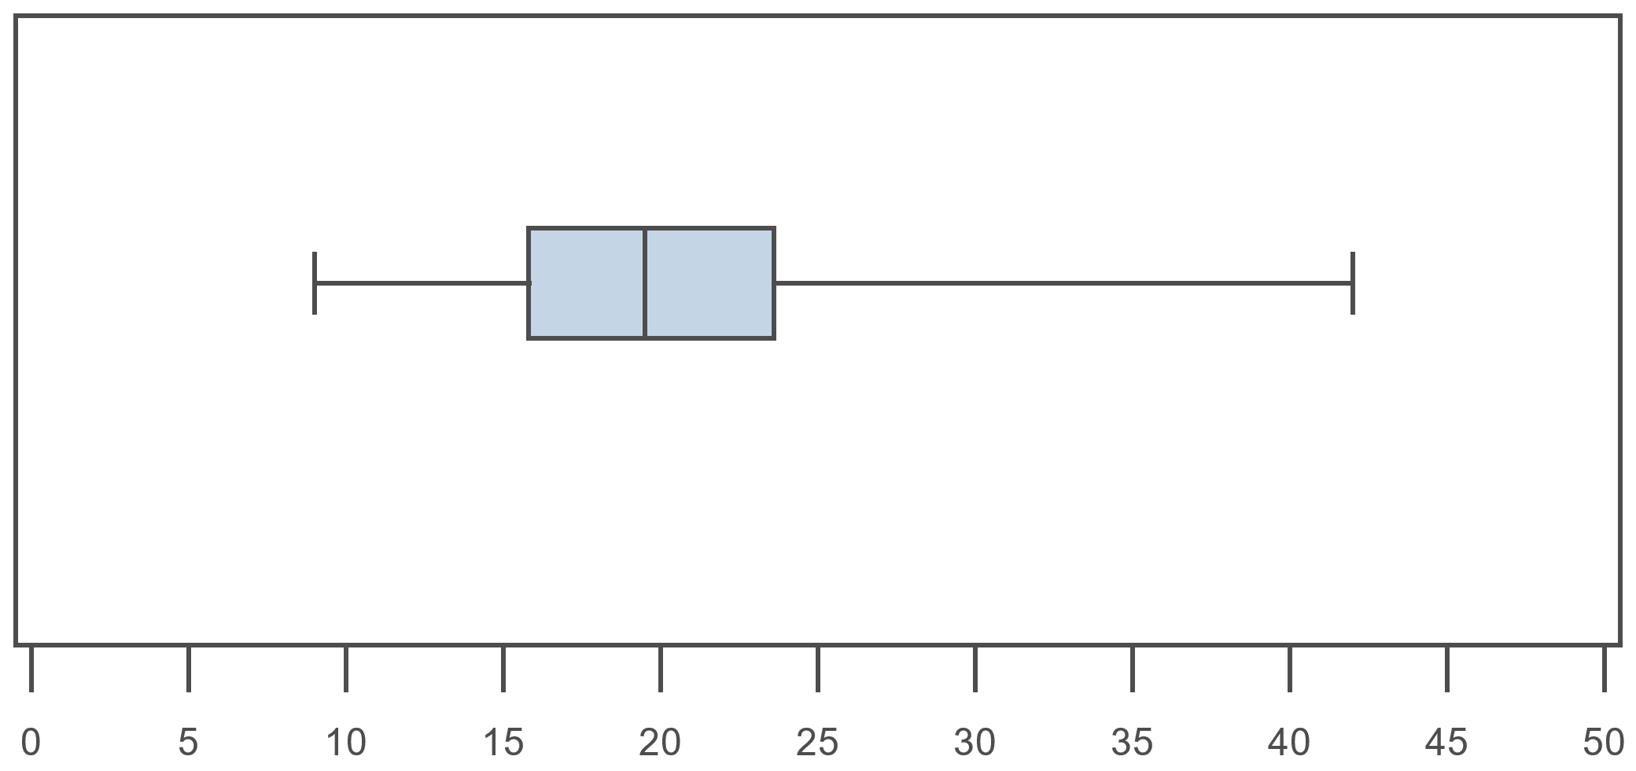
Example 3.3.6: Creating a Box Plot (cont.)
Step 4: Connect the “box” to the line segments representing the minimum and maximum to form the “whiskers.”

Slide 45
Example 3.3.7: Interpreting Box Plots
The following box plots are from the US Geological Survey website. Use them to answer the following questions.

Slide 46
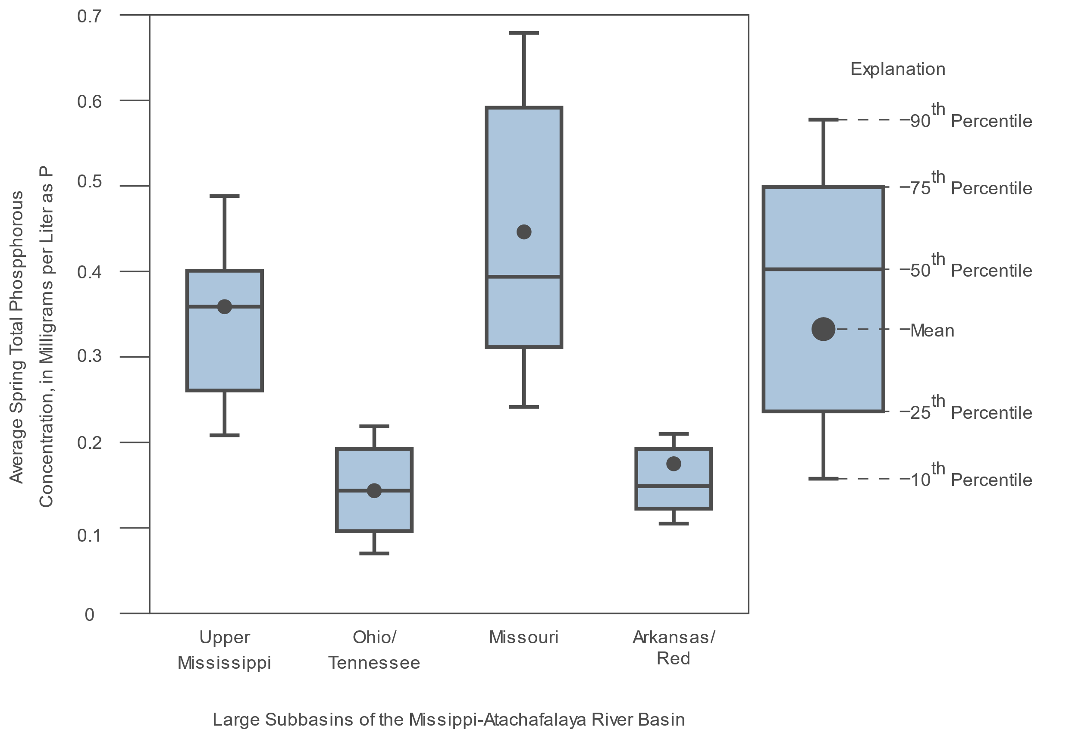
Example 3.3.7: Interpreting Box Plots (cont.)

Slide 47
Example 3.3.7: Interpreting Box Plots (cont.)
Note: Box plots showing the distribution of average Spring (April and May) total phosphorus concentrations, for the years 1979 to 2008, for four of the five large subbasins that comprise the Mississippi-Atchafalaya River Basin. (The Lower Mississippi River subbasin was excluded due to the large errors in estimating the average concentrations.)
Source: US Geological Survey. "2009 Preliminary Mississippi-Atchafalaya River Basin Flux Estimate." US Department of the Interior. 2009. http://toxics.usgs.gov/hypoxia/mississippi/oct_jun/images/figure9.png (9 Aug. 2010).
​What do the top and bottom bars represent in these box plots according to the key?
​Which subbasin had the highest median average spring total phosphorus concentration?
​Which subbasin had the lowest mean average spring total phosphorus concentration?
​Which subbasin had the largest interquartile range?

Slide 48
Example 3.3.7: Interpreting Box Plots (cont.)
Solution
​In each box plot, the top bar represents the 90th percentile of average spring total phosphorus concentration, and the bottom bar represents the 10th percentile.
​The subbasin with the highest median average spring total phosphorus concentration was the Missouri.
​The subbasin with the lowest mean average spring total phosphorus concentration was the Arkansas/Red.
​The subbasin with the largest interquartile range was the Missouri.

Slide 49
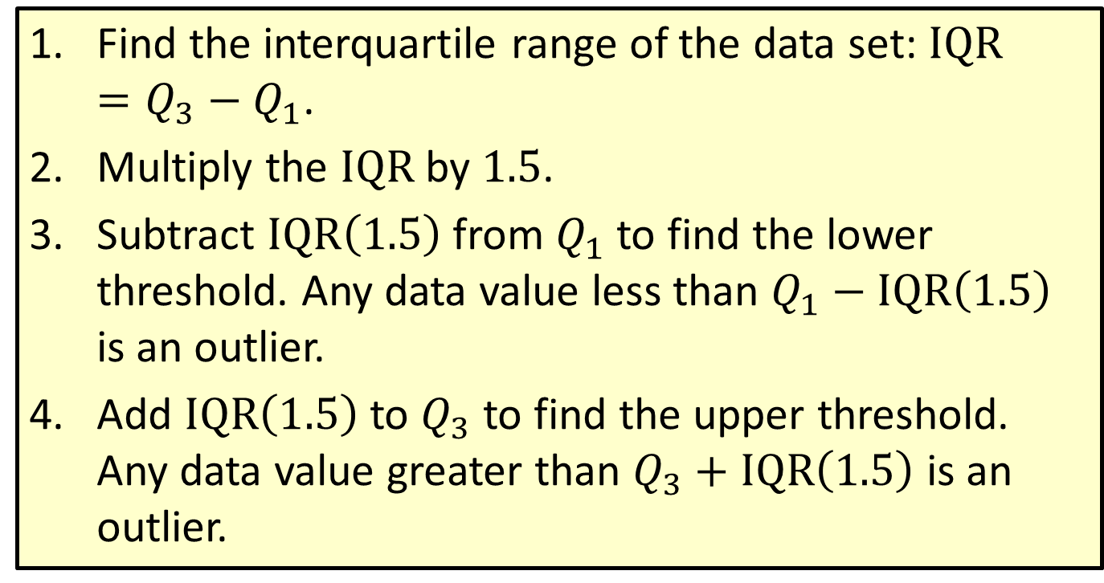
Procedure: Using the interquartile Range to Identify Outliers
​Find the interquartile range of the data set: $IQR=Q_{3}−Q_{1}$.
​Multiply the $IQR$ by 1.5.
​Subtract $IQR\left(1.5\right)$ from $Q_{1}$ to find the lower threshold. Any data value less than $Q_{1}−IQR\left(1.5\right)$ is an outlier.
​Add $IQR\left(1.5\right)$ to $Q_{3}$ to find the upper threshold. Any data value greater than $Q_{3}+IQR\left(1.5\right)$ is an outlier.

Slide 50
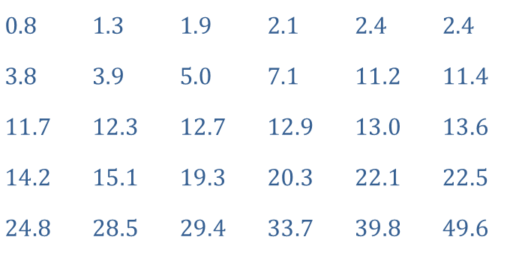
Example 3.3.8: Identifying Outliers Using the IQR
The following data represents commuting distances (in miles) for a sample of 30 summer interns.
​
​Find the interquartile range.
​Use the IQR to identify any outliers in the data set.
​$0.8$ | ​$1.3$ | ​$1.9$ | ​$2.1$ | ​$2.4$ | ​$2.4$
​$3.8$ | ​$3.9$ | ​$5.0$ | ​$7.1$ | ​$11.2$ | ​$11.4$
​$11.7$ | ​$12.3$ | ​$12.7$ | ​$12.9$ | ​$13.0$ | ​$13.6$
​$14.2$ | ​$15.1$ | ​$19.3$ | ​$20.3$ | ​$22.1$ | ​$22.5$
​$24.8$ | ​$28.5$ | ​$29.4$ | ​$33.7$ | ​$39.8$ | ​$49.6$

Slide 51

Example 3.3.8: Identifying Outliers Using the IQR (cont.)
Solution:
​Since the data is already listed as an ordered array, we can quickly identify
​$Q_{1}=3.9$ and $Q_{3}=22.1$. We than have
​ $IQR=Q_{3}−Q_{1}=22.1−3.9=18.2$.

Slide 52
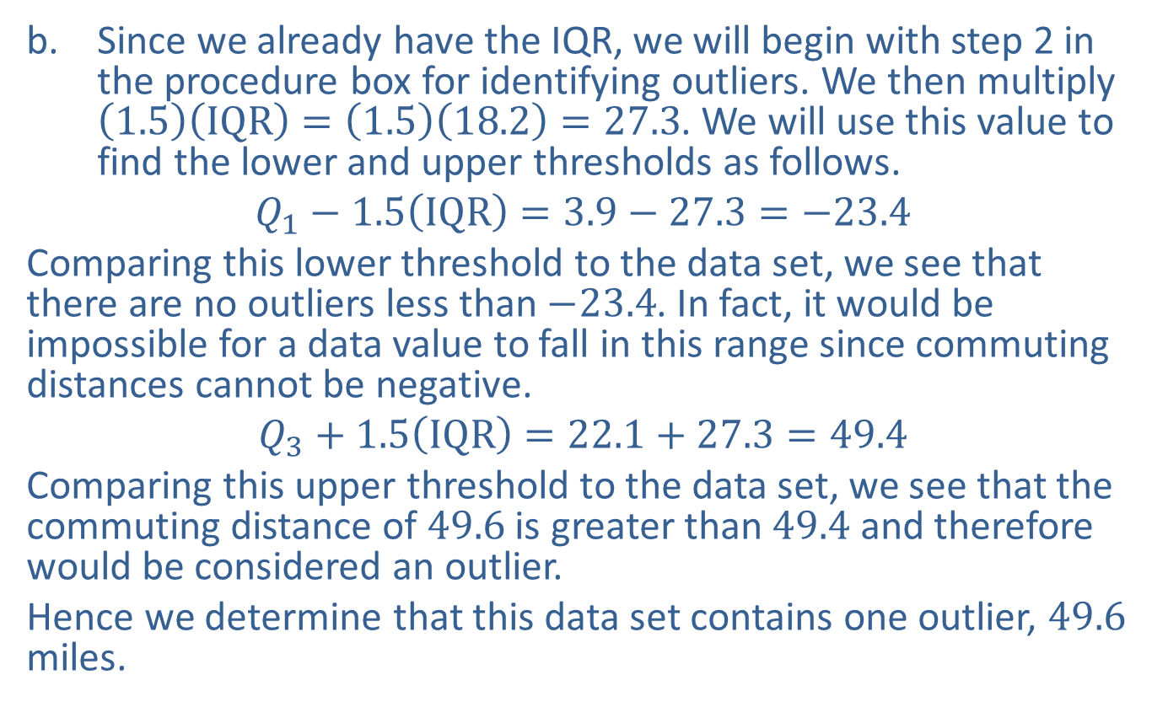
Example 3.3.8: Identifying Outliers Using the IQR (cont.)
​Since we already have the IQR, we will begin with step 2 in the procedure box for identifying outliers. We then multiply $\left(1.5\right)\left(IQR\right)=\left(1.5\right)\left(18.2\right)=27.3$. We will use this value to find the lower and upper thresholds as follows.
​$Q_{1}−1.5\left(IQR\right)=3.9−27.3=−23.4$
​Comparing this lower threshold to the data set, we see that there are no outliers less than $−23.4$. In fact, it would be impossible for a data value to fall in this range since commuting distances cannot be negative.
​$Q_{3}+1.5\left(IQR\right)=22.1+27.3=49.4$
​Comparing this upper threshold to the data set, we see that the commuting distance of 49.6 is greater than 49.4 and therefore would be considered an outlier.
​Hence we determine that this data set contains one outlier, 49.6 miles.

Slide 53
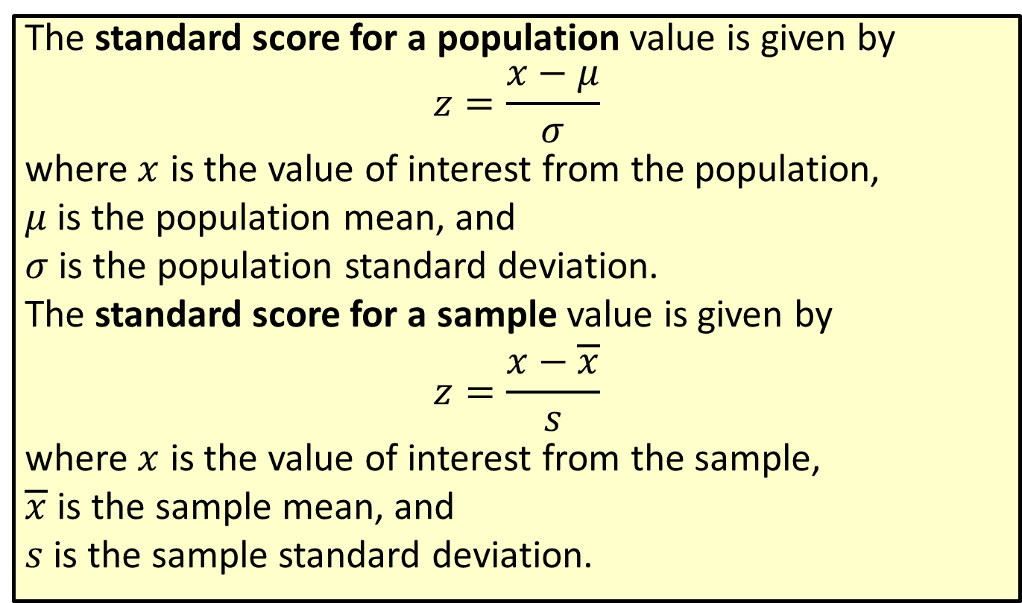
Formula: Standard Score
The standard score for a population value is given by
$$z=\frac{x−μ}{σ}$$
where $x$ is the value of interest from the population,
$μ$ is the population mean, and
$σ$ is the population standard deviation.
The standard score for a sample value is given by
$$z=\frac{x−\overline{x}}{s}$$
where $x$ is the value of interest from the sample,
$\overline{x}$ is the sample mean, and
$s$ is the sample standard deviation.

Slide 54

Rounding Rule
When calculating a $z$-score, round to two decimal places.

Slide 55
Example 3.3.9: Calculating a Standard Score
If the mean score on the math section of the SAT is 500 with a standard deviation of 100 points, what is the standard score for a student who scored a 630?

Slide 56
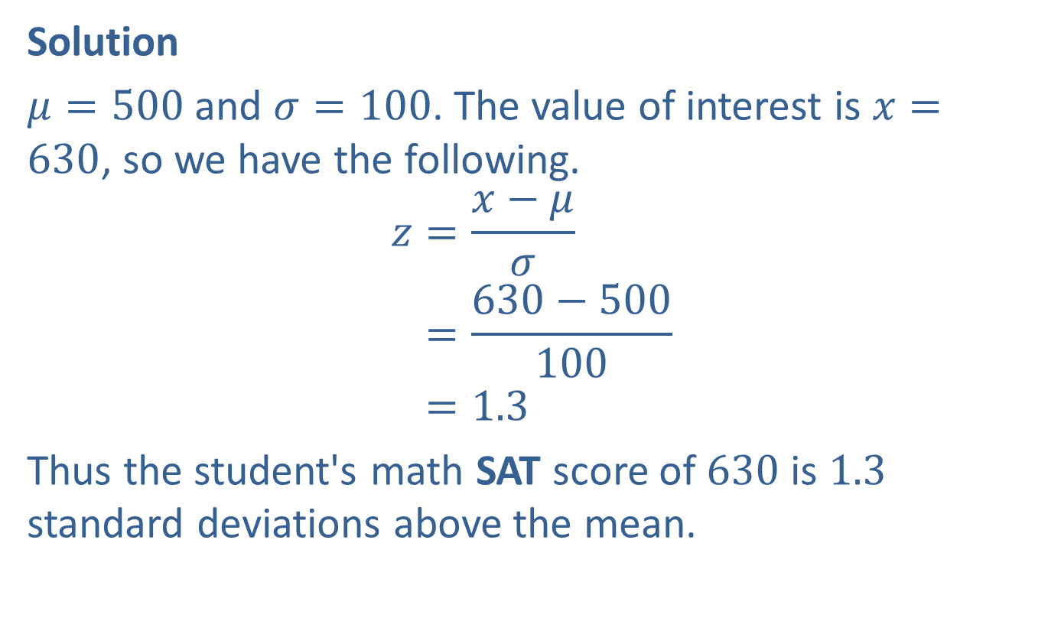
Example 3.3.9: Calculating a Standard Score (cont.)
Solution
$μ=500$ and $σ=100$. The value of interest is $x=630$, so we have the following.
𝑧=𝑥−𝜇𝜎𝑧=630−500100𝑧=1.3
Thus the student's math SAT score of 630 is 1.3 standard deviations above the mean.

Slide 57
Example 3.3.10: Comparing Standard Scores
Jodi scored an 87 on her calculus test and was bragging to her best friend about how well she had done. She said that her class had a mean of 80 with a standard deviation of 5; therefore, she had done better than the class average. Her best friend, Ashley, was disappointed. She had scored only an 82 on her calculus test. The mean for her class was 73 with a standard deviation of 6.
Who really did better on her test, compared to the rest of her class, Jodi or Ashley?

Slide 58
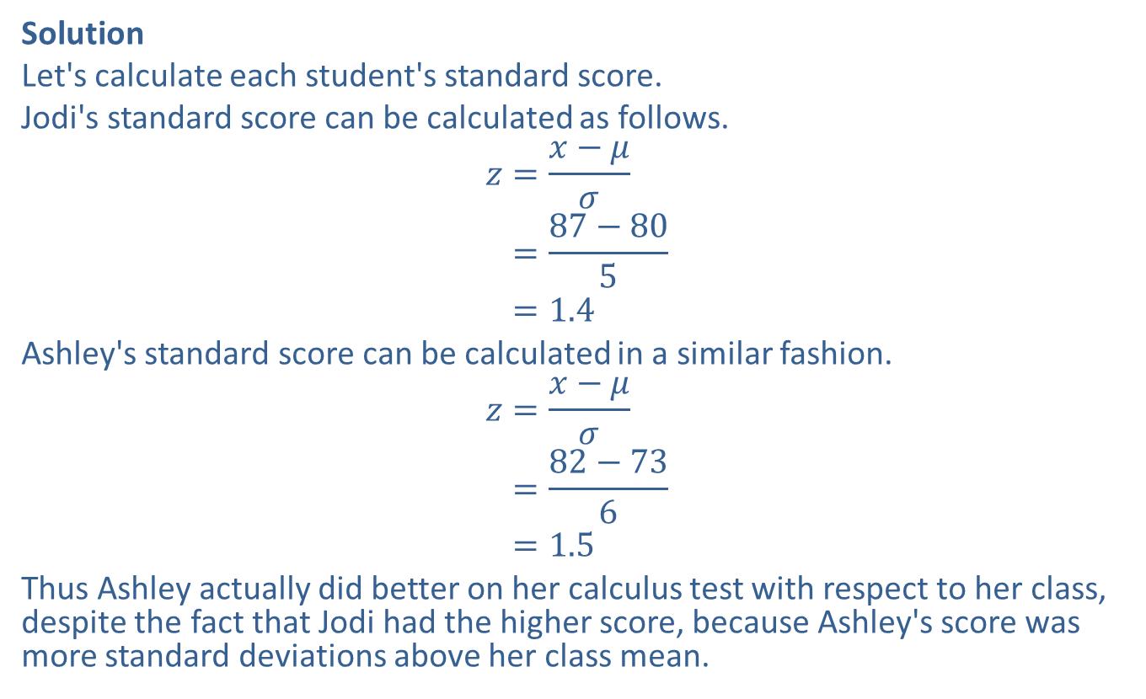
Example 3.3.10: Comparing Standard Scores (cont.)
Solution
Let's calculate each student's standard score.
Jodi's standard score can be calculated as follows.
𝑧=𝑥−𝜇𝜎𝑧=87−805𝑧=1.4
Ashley's standard score can be calculated in a similar fashion.
𝑧=𝑥−𝜇𝜎𝑧=82−736𝑧=1.5
Thus Ashley actually did better on her calculus test with respect to her class, despite the fact that Jodi had the higher score, because Ashley's score was more standard deviations above her class mean.

